Slide 1
UV/VUV Lasing Capabilities at Jefferson Lab*
Stephen Benson
For the FEL Team
May 20, 2011
* This work was supported by U.S. DOE Contract No. DE-AC05-84-ER40150, the Air Force Office of Scientific Research, DOE Basic Energy Sciences, the Office of Naval Research, and the Joint Technology Office.

Slide 2
Outline
Initial specifications and simulations
Design and construction
  Accelerator
  FEL optical cavity
Results
  Accelerator performance
  FEL performance
    700nm
    400nm
  Comparison with simulation
Setup for 3rd harmonic (~ 10eV) photon detection
VUV measurements
Future plans

Slide 3
INITIAL UV FEL SPECIFICATIONS
  Specification (from UV Demo proposal)
  Average Power > 1000 W
  Wavelength range 1–0.25 μm
  Micropulse energy ~25 μJ
  Pulse length ~0.1-1 ps FWHM nominal
  PRF 74.85, 37.425, 18.7, 9.36, 4.68 MHz
  Bandwidth ~ 0.2–1.5 %
  Timing jitter < 1 ps
  Amplitude jitter < 2 % p-p
  Wavelength jitter 0.02% RMS
  Polarization linear, > 100:1
  Transverse mode quality < 2x diffraction limit
  Beam diameter at lab 2 - 3 cm

Slide 4
Electron Beam and Optical Requirements
Short wavelengths require higher electron beam energies. The higher the better. For 250 nm we need 150 MeV. For 120 nm we need 250 MeV.
The transverse emittance and energy spread should be lower by ~ 2X compared to the IR Upgrade.
  Achieve this by operating at ½ the IR Upgrade FEL charge/bunch.
UHV vacuum is required for stable, long-term operation.
Manufacturing mirrors with λ/10 figure in the UV is challenge.
  Must also have metrology capable of verifying specs.
  Must mount without inducing aberrations.
The OC mirror will absorb ~ 1/3 of the incident THz power. The absorbed power limit is proportional to the wavelength so we can’t afford much absorbed power.
UV coatings are more lossy than those in the visible, although exact numbers are hard to pin down. They may be only a few 100 ppm

Slide 5
Estimates of FEL performance
Both pulse propagation and one-dimensional spreadsheet models are first used to estimate the gain and power.
Note: Both models assume perfect mirrors with a 93 cm Rayleigh range and 10% transmissive output coupling.

Slide 6
Three Dimensional Simulations

Slide 7
Expected Power Output with Room Temperature Mirrors
Absorbed Thz And Fundamental Power Set The Power Limit
For Initial Operation With Water Cooled Mirrors. We analyzed this in August 2008:
At half the charge, but twice the rep rate, the THz power generated will be about half that in the IR Upgrade before the THz chicane was installed.
  That value was measured as 15W absorbed per mA of beam current.
So, for this machine we would expect 7.5W launched/mA, but 1/3 is absorbed, yielding 2.5W /mA
  At 0.56mA (9.36 MHz), assuming 15% OC a mirror heating model shows an output of ~ 120W (assumes perfect mirrors)
  Assuming 0.1% absorption, we have a total absorbed power of 2.2W, comparable to the limit of ~ 3W absorbed.
  So, we can expect, at least initially, ~ 100W at 400nm.

Slide 8
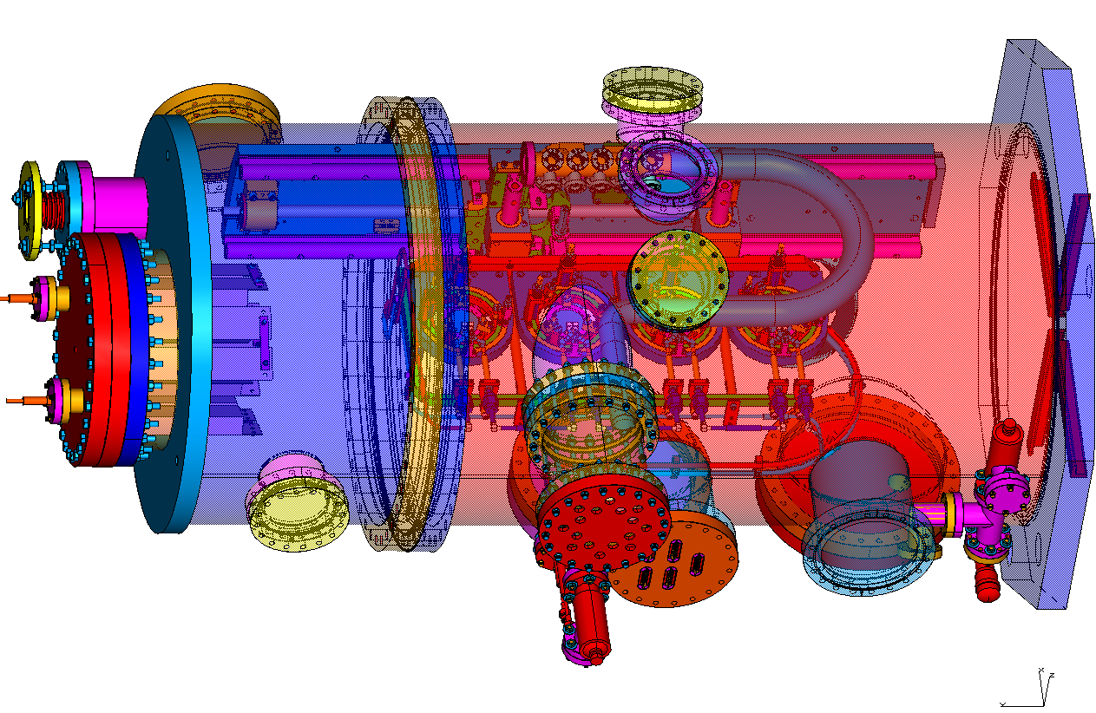
The UV FEL cavity has evolved from the IR Upgrade
Gimbaled mirrors have high first resonance (> 200 Hz)
Angular control using piezos
NEG strips for higher pumping speed
Majority of wiring contained in a separate vacuum enclosure to lower out-gassing.
Designed for cryo-cooling with well-separated cooling lines and Macor thermal isolators.

Slide 9
Initial Implementation
Funding limitations led to some compromises to lower costs.
The high pump rate afforded by the NEG pumps was deferred
  Might have faster degradation due to carbon build up on mirrors
The cryocooling was deferred.
  Limits power due to thermal aberration from power loading.
The deformable mirrors were deferred.
  We cannot optimize the Rayleigh range for VUV production.
  Also limits power due to thermal aberrations.
The THz chicane was not installed, leading to higher absorbed power from the downstream dipole.

Slide 10
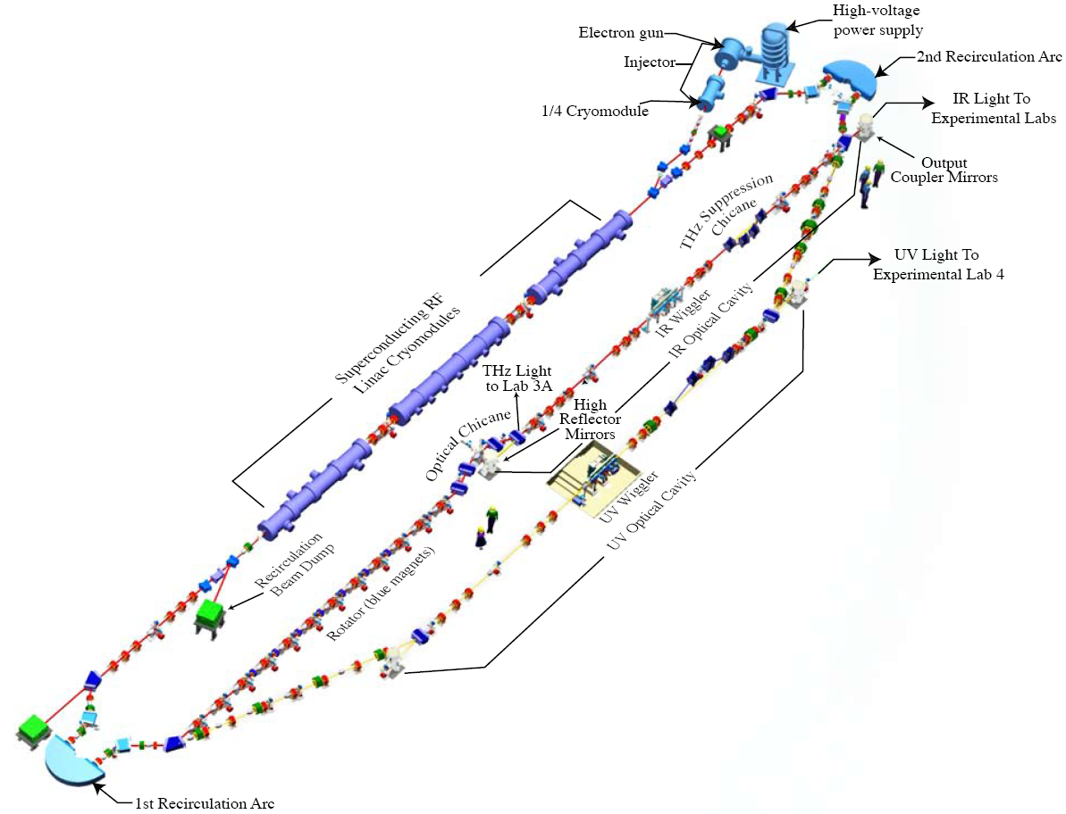
UV Demo Beamline Layout
E = 135 MeV
67 pC pulses @ 4.68 MHz
(>20 μJ/pulse in 250–700 nm UV-VIS)
(UV beamline and commissioning funded by AFOSR and BES. Wiggler on loan from Cornell U.

Slide 11
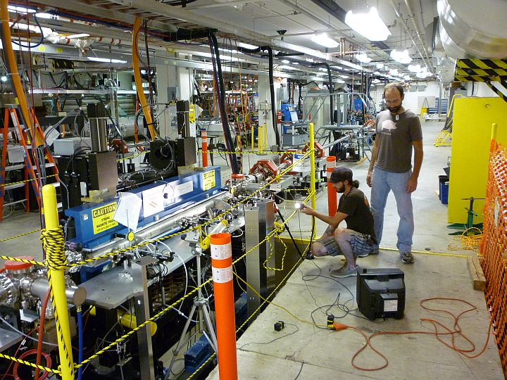
Cornell Undulator A Prototype

Slide 12
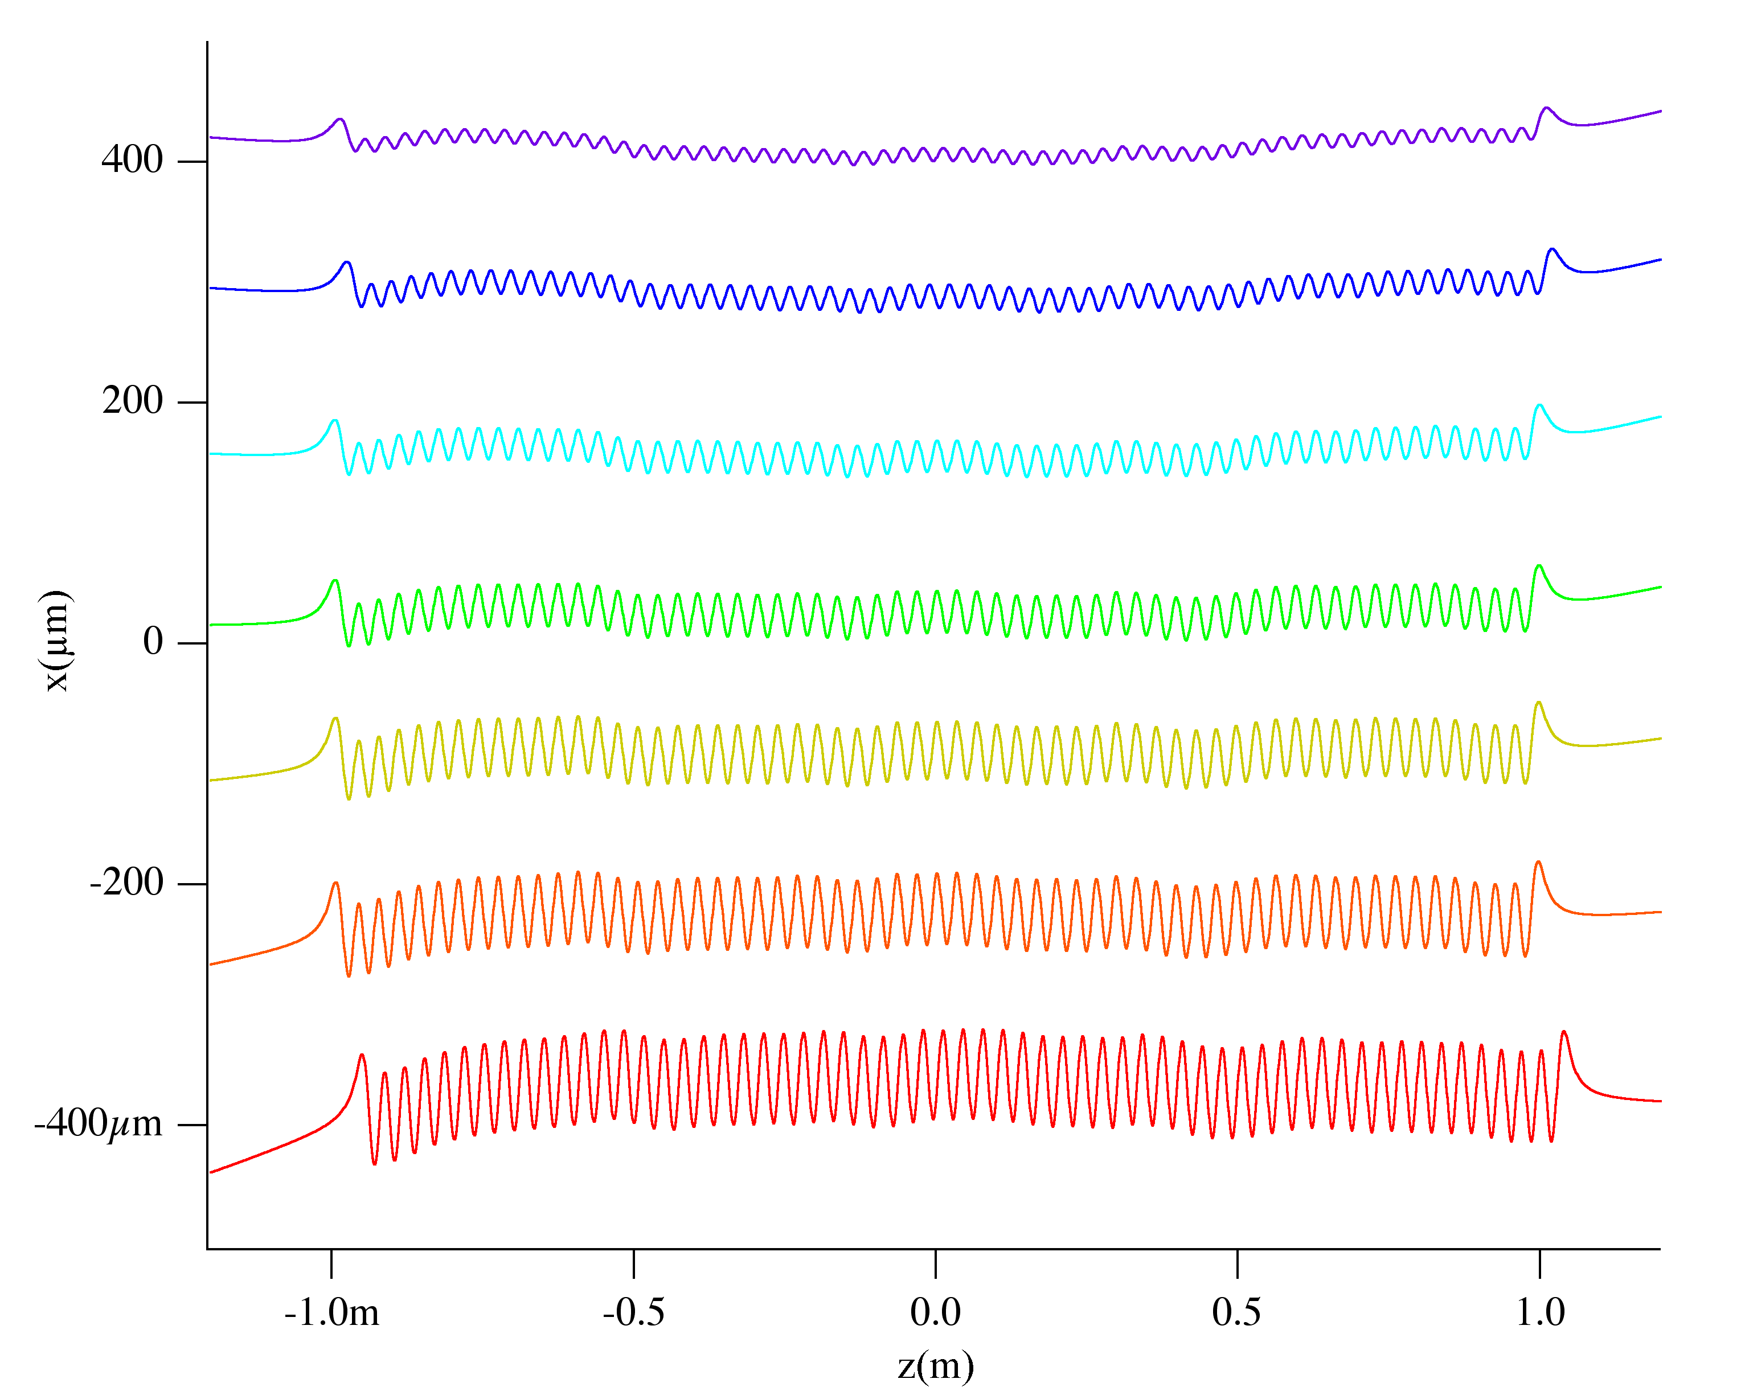
UV Wiggler trajectories in Cornell Wiggler

Slide 13
Accelerator performance
Parameter IR Upgrade performance UV line performance
Energy 115 MeV 135 MeV
Charge 135 pC 60 pC
Pulse length 150 fsec rms 100–140 fsec rms
Energy spread 0.5% rms 0.3–0.4% rms
Emittance 7-8 mm-mrad 5-6 mm-mrad
Note: Energy spread and emittance are macropulse averages.

Slide 14
UV Demo Commissioning Timeline
January 2006 - Install and commission Cornell wiggler with new gap mechanism.
Spring and Summer 2009 – Install beamline components except for optical cavity and wiggler chamber.
Fall 2009 – CW beam through UV beamline.
Spring 2010 – Install new zone 3 module and commission.
June 2010 – Lase at 630 nm, 67 pC in IR laser with 135 MeV beam.
July 2010 – Recirculate laser quality 1 mA CW beam through wiggler sized aperture.
August 17, 2010 – First electron beam through wiggler.
August 19, 2010 – First lasing, 150 W CW at 700 nm.
August 31, 2010 – First lasing in UV, 140 W @400 nm, 68 W @372 nm
December 9, 2010 – First measurement of 124 nm light
Notes:
14

Slide 15
FEL performance at 700nm
Gain at low power is ~100%, detuning curve is 12.5 µm in length

Slide 16
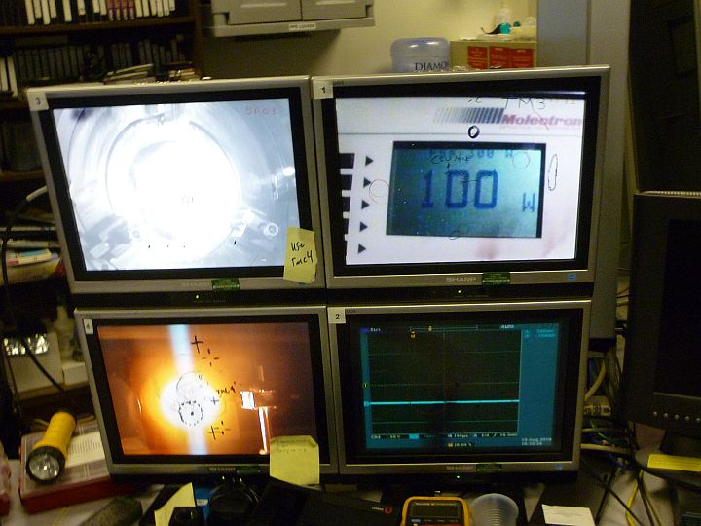
Images while lasing at 100W
Light scattered from HR mirror
Power meter
Light scattered from power probe
Time dependent diagnostics

Slide 17
FEL performance at 400nm
We had to run with the OC mirror de-centered, as the metallization technique created a damage spot at the mirror center.

Slide 18
Comparison with experiment
Besides the aforementioned spreadsheet and 1-D pulse propagation codes, we have 3D & 4D codes that better model the FEL interaction.
  These codes are Genesis and Medusa.
In conjunction with a resonator simulation code we can also model the effects of aberrations (from thermal absorption, off-axis tilts, etc) and the mode shape within or outside the optical cavity.
  This is the Optical Propagation Code (OPC).
Performance of the UVFEL has greatly exceeded the predictions of simulations.
Parameter Simulations Experiment
  Turn-on time 8.6 µsec. 5 µsec.
  Gain ~100% ~180%
  Detuning curve 4.5 µm >7 µm
  Efficiency 0.5-0.7% 0.8%

Slide 19
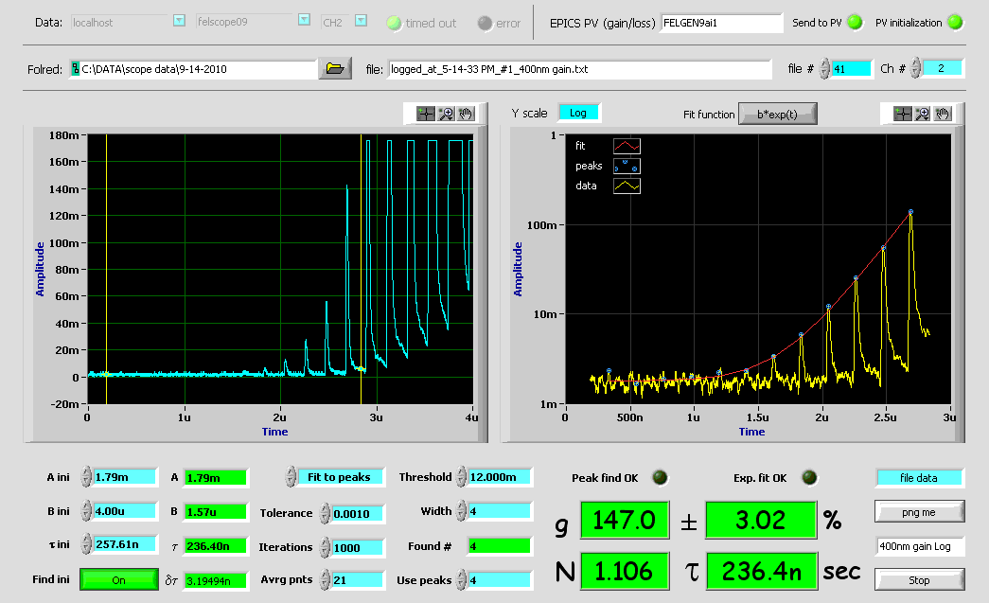
Very High Gain Seen at 400 nm

Slide 20
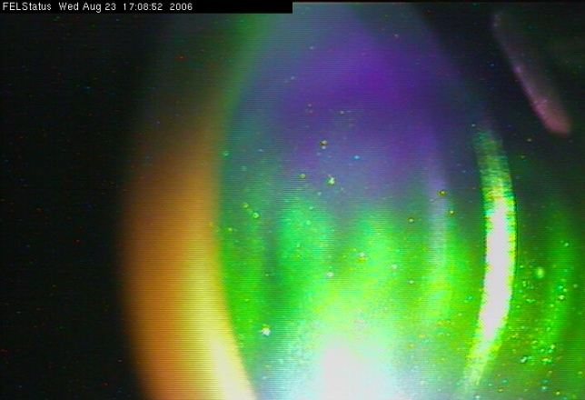
We can generate coherent harmonics at useful levels
Harmonics are produced through the electron bunching process that creates gain at the fundamental.
This bunching has Fourier components at harmonics of the fundamental frequency and in our case extends into the vacuum ultraviolet.
First few harmonics can be many 10’s of watts.
We performed measurements in the IR Demo
  “Coherent Harmonics in the Super-Radiant Regime from an FEL”, S.V. Benson, J.F. Gubeli, and M.D. Shinn, Proc. PAC 2001
Performed preliminary measurement in late August 2005
  Ratio of 3rd-7th harmonics to the fundamental
Harmonics on OC Mirror
while lasing at 1.6 micron
4th harmonic
3rd harmonic

Slide 21
IR Demo harmonic power measurements
Third harmonic power is down by about a factor of 1000. We get about 50 W at 372 nm so we expect about 50 mW of VUV light.

Slide 22
We can transmit the odd harmonics through a hole in the outcoupler
Since the odd harmonics are peaked on-axis, we can transmit them through an appropriately sized hole in the downstream mirror’s center.
The even harmonics have no power on axis and the majority of the power is in two lobes some distance away from center.
The harmonics source is the electron beam size, so if one knows that, one can calculate the mode size on the mirror, and hence, the size the hole should be.

Slide 23
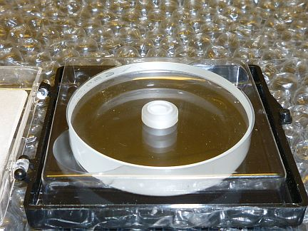
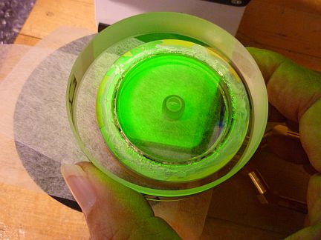
Implementation
Hole was drilled in an already fabricated sapphire substrate
  This is nontrivial – a larger hole was mechanically drilled through the plano (back) side to within 1mm of the front surface. Front was drilled with an ultrashort-pulsed laser.
It was then coated for max R at 372nm, then metallized and brazed into a cooled mirror holder and installed.

Slide 24
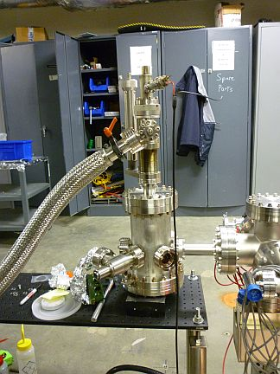
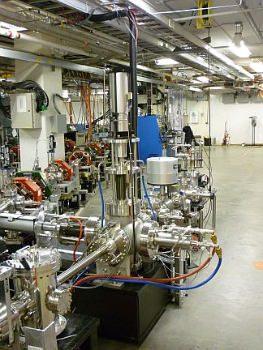
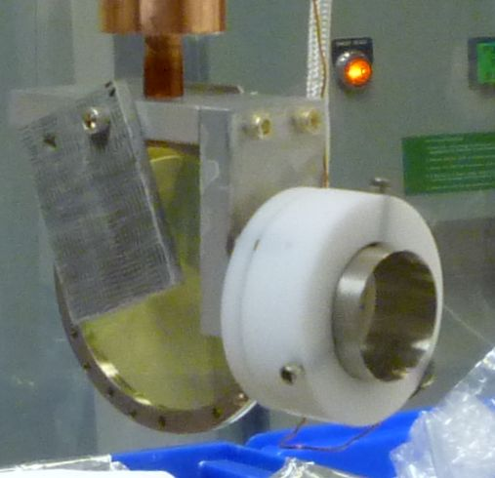
Initial Characterization of 10eV photons
Bob Legg had built a chamber for the SRC at Univ. Wisconsin that we adapted for our purposes:
VUV Chamber
10eV viewer
VUV photodiode
Ce:YAG viewer
Viewport

Slide 25
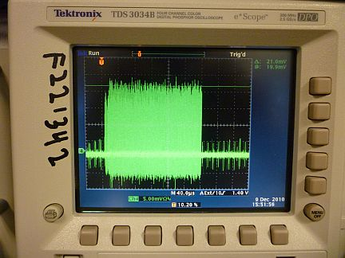
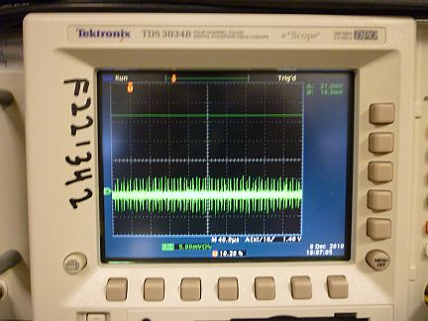
We detected the higher harmonics on 12/09
The output through the hole was dominated by the fundamental and 3rd harmonic
  The 5th harmonic is approximately 10² weaker.
  By closing a windowed vacuum valve, we effectively inserted a longpass filter – blocking the 10eV but not the fundamental, and proving the detector only responded to the higher energy photons.
Windowed valve open
Windowed valve closed

Slide 26
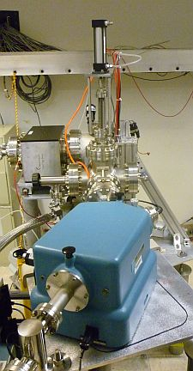
Monochromator Experiment in User Lab 1

Slide 27
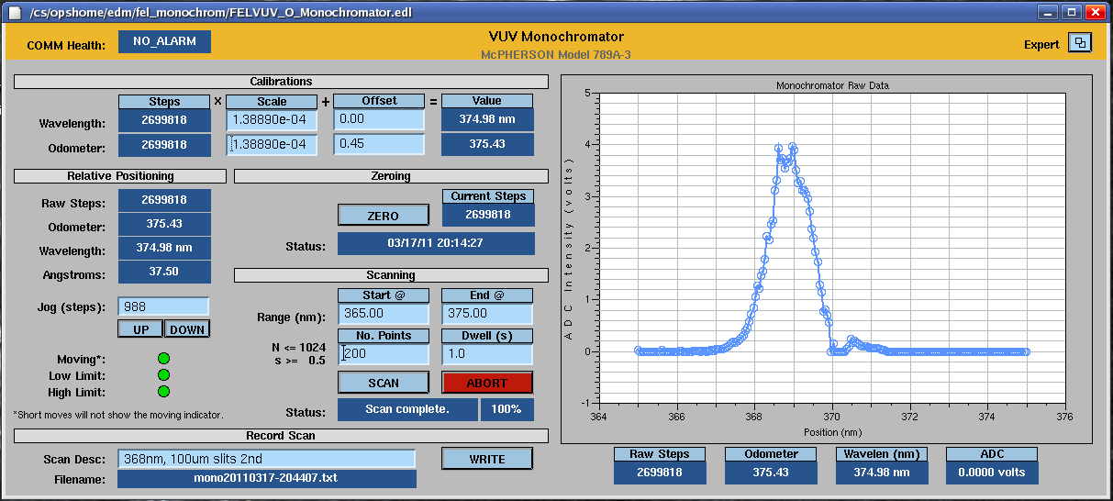
Spectrum of UV in User Lab 1

Slide 28
10 eV measurements
We measured a maximum photocurrent of 0.46 μA for a train of 240 μs pulses at 60 Hz (1.4% duty factor)
  The amplitude fluctuations were small, of order ± 3%
This corresponds to 4.8 x 10¹² ph during the macropulse.
If the efficiency were unchanged when going cw, this is ~ 2 x 10¹⁶ ph/sec
We still need to measure the bandwidth of the 3rd harmonic to make an accurate comparison to storage rings. Crude estimate is 1.2% FWHM.
In User Lab 1 we measured a conversion efficiency of 3x10⁻⁴. This was not optimized.

Slide 29
Plans for the future
Add radius of control to the HR cavity mirror to optimize the FEL output as well as the production of harmonics.
Install mirrors optimized for harmonic production.
  This uses silicon rather than sapphire substrates.
Upgrade optical transport to better separate UV and VUV photons.
Install cryogenic mirrors to allow lasing at the 1 kW level.
Install THz chicane.
Raise energy to push to shorter wavelengths.

Slide 30
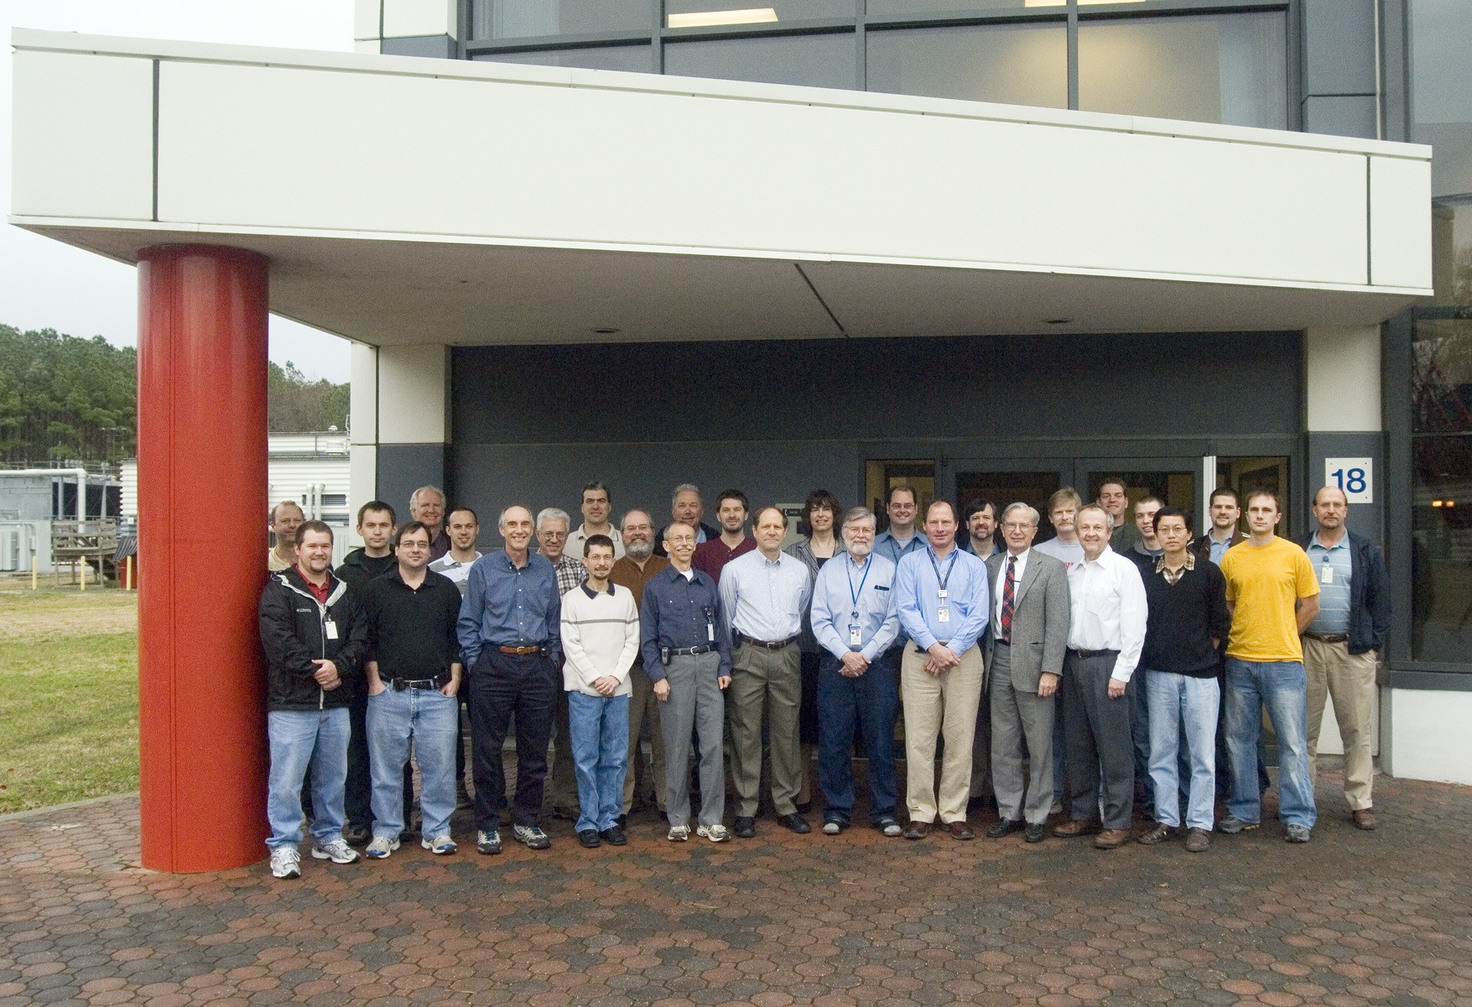
Some of the JLab Team
Photo taken Jan 16, 2007
This work supported by the Office of Naval Research, the Joint Technology Office, the Commonwealth of Virginia, the Air Force Research Laboratory, The US Army Night Vision Lab, and by DOE under contract DE-AC05-060R23177.

