Slide 1
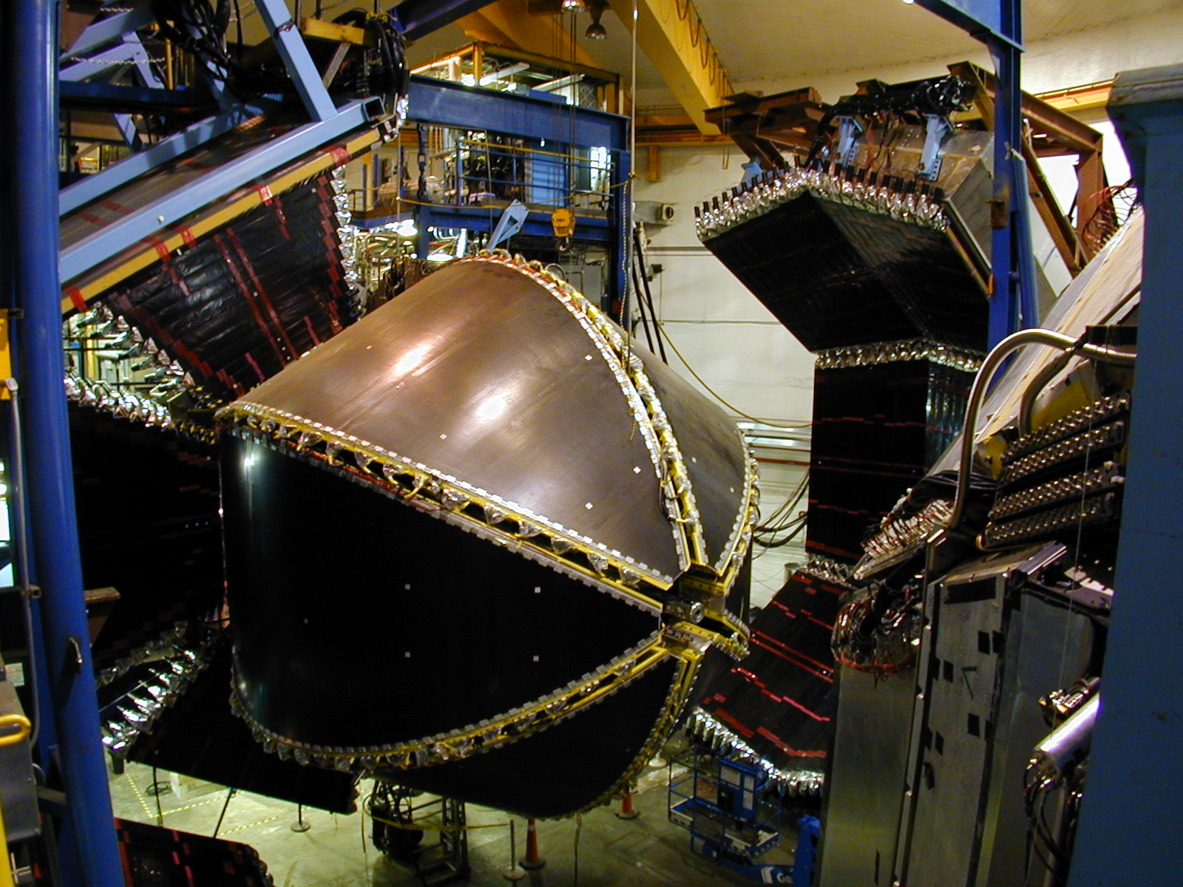
Meson production and baryon resonances with CLAS
Volker D. Burkert
Jefferson Lab
3rd Conference on Nuclear and Particle Physics, Dubrovnik, 10/3-8, 2010

Slide 2
Outline
Why do we study baryon excitations?
Searching for new states in meson photoproduction
Meson electroproduction and resonance transition form factors
Transition charge and magnetization densities on the LF
Prospects at 12 GeV
Summary

Slide 3
Why do we study excited nucleons?
“Nucleons are the stuff of which our world is made....they must be at the center of any discussion of why the world …. has the character it does” Nathan Isgur, NStar2000
The N* spectrum reflects the underlying degrees of freedom of the nucleon, our knowledge is incomplete
Two main components of the experimental N* program with CLAS
Search for new excited states
Study the underlying d.o.f. vs the distance scale
Nucleon-meson
system

Slide 4
Baryon spectrum in LQCD and dynamical coupling
LQCD – Nucleon spectrum with dynamical quarks
Dynamics of P₁₁-states:
The bare state at ~1740 MeV through coupling to inelastic channels generates 2 poles below 1400 MeV. They may be identified with the “Roper” resonance.
P₁₁(1440)
D₁₅(1675)
D₁₃(1700)
quark mass
D₁₃(1520)
Dynamical
coupling
S₁₁(1650)
S₁₁(1535)
J.M. Bulava, et al. , Phys.Rev.D79:034505,2009.
N. Suzuki et al. (JLab/EBAC), Phys.Rev.Lett.104:042302,2010

Slide 5
Search for undiscovered baryon states.
Search primarily in photo-production processes
Cross sections alone lead to ambiguous solutions => polarization observables.
Aim for large kinematical coverage and “completeness” in γp→πN, ηp, KY, .., γn→πN, K⁰Y⁰, ..
Measure more complex reactions, e.g. γp → ωp, π⁺π⁻p, K*Y, .. as well
Theory support from the JLab Excited Baryon Analysis Center (EBAC), and groups around the world, e.g. Yerevan, Bonn-Gatchina, Giessen, ..
Notes:
In the first part of my talk I will discuss studies related to the search for undiscovered states. We know that the analysis of cross section data only results in ambiguous solutions. The search aims at high statistics data sets with complete or nearly complete measurements of a number of final states, both on protons and neutrons.

Slide 6
Complete experiments in KΛ and KΣ production
Process described by 4 complex, parity conserving amplitudes
8 well-chosen measurements are needed to determine amplitude.
16 observables will be measured in CLAS ➠ allows many cross checks.
Λ weak decay has large analyzing power
Notes:
What is the status of this program?

Slide 7
Status of the N* program on protons: ✔ - published, ✔ - acquired
 | σ | Σ | T | P | E | F | G | H | T_{x} | T_{z} | L_{x} | L_{z} | O_{x} | O_{z} | C_{x} | C_{z}
pπ⁰ | ✔ | ✓ | ✓ |  | ✓ | ✓ | ✓ | ✓
nπ⁺ | ✔ | ✓ | ✓ |  | ✓ | ✓ | ✓ | ✓
pη | ✔ | ✓ | ✓ |  | ✓ | ✓ | ✓ | ✓
pη’ | ✔ | ✓ | ✓ |  | ✓ | ✓ | ✓ | ✓
pω | ✔ | ✓ | ✓ |  | ✓ | ✓ | ✓ | ✓
K⁺Λ | ✔ | ✓ | ✓ | ✔ | ✓ | ✓ | ✓ | ✓ | ✓ | ✓ | ✓ | ✓ | ✓ | ✓ | ✔ | ✔
K⁺Σ⁰ | ✔ | ✓ | ✓ | ✔ | ✓ | ✓ | ✓ | ✓ | ✓ | ✓ | ✓ | ✓ | ✓ | ✓ | ✔ | ✔
K^{0*}Σ⁺ | ✔ | ✓ |  |  |  |  |  |  |  |  | ✓ | ✓
pπ⁻ | ✔ | ✓ | ✓ |  | ✓ | ✓ | ✓ | ✓
pρ⁻ | ✓ | ✓ | ✓ |  | ✓ | ✓ | ✓ | ✓
K⁻Σ⁺ | ✓ | ✓ | ✓ |  | ✓ | ✓ | ✓ | ✓
K⁰Λ | ✓ | ✓ | ✓ | ✓ | ✓ | ✓ | ✓ | ✓ | ✓ | ✓ | ✓ | ✓ | ✓ | ✓ | ✓ | ✓
K⁰Σ⁰ | ✓ | ✓ | ✓ | ✓ | ✓ | ✓ | ✓ | ✓ | ✓ | ✓ | ✓ | ✓ | ✓ | ✓ | ✓ | ✓
K^{0*}Σ⁰ | ✓ | ✓
Proton targets
Neutron targets
Notes:
I will show the example of omega production where the omega polarization information is also measured in addition that allows a single channel analysis, followed by results from hyperon production.

Slide 8
Differential cross section of γp→K⁺Λ
Bonn-Gatchina Coupled Channel Analysis, arXiv:1009.4803
M. Mc Cracken et al. (CLAS), Phys. Rev. C 81, 025201, 2010
Notes:
In the following slides I show measurements of high statistics hyperon production cross section and polarization observables. These data have crucial in coupled channel analysis of the Bonn-Gatchina group.

Slide 9
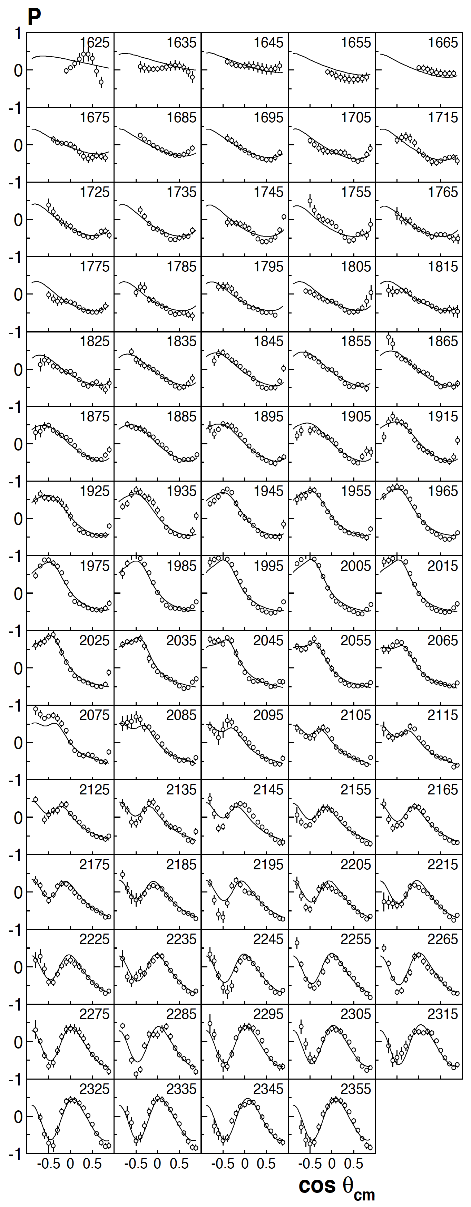
Recoil polarization P_{Λ} for γp→K⁺Λ → K⁺pπ⁻
Bonn-Gatchina Coupled Channel Analysis, arXiv:1009.4803
M. Mc Cracken et al. (CLAS), Phys. Rev. C 81, 025201, 2010
Notes:
By analyzing the Lambda decay the hyperon polarization is determined. Polarization observables carry information on the amplitude phases and are sensitive to interference of resonances and background terms.

Slide 10
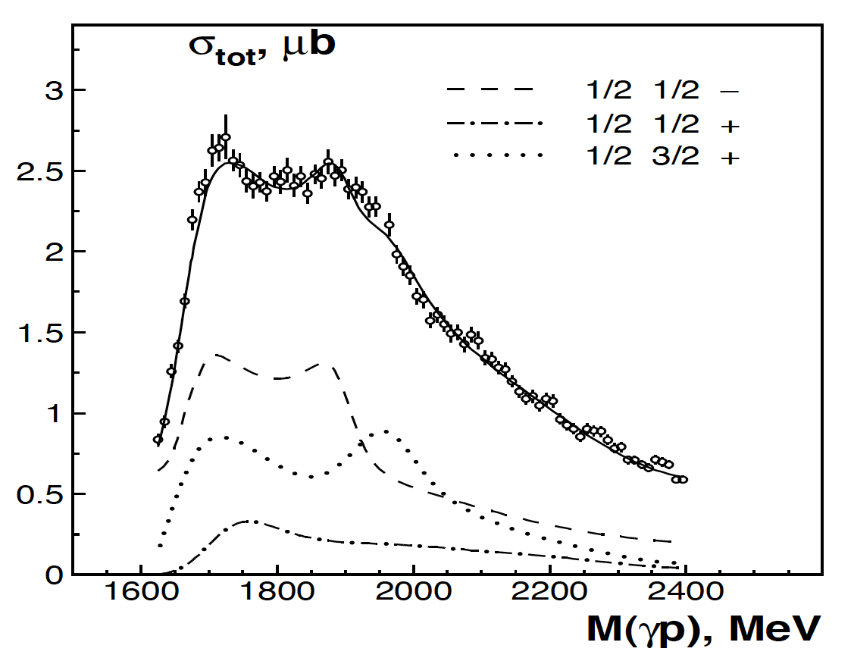
Polarization transfer γp K⁺Λ => C_{x}, C_{z}
Fit: BnGa Model
CLAS
Inclusion of the full set of CLAS data on K⁺Λ photoproduction in BnGa PWA fit resulted in evidence for several states:
N(1710)P₁₁ (***, dismissed in GWU analysis),
N(1900)P₁₃ (**)
N(1886)S₁₁ (new)
Existence of N(1900)P₁₃ would be strong evidence against quark-diquark model with tightly bound diquark.
Notes:
Finally I show the example of a polarization transfer measurement. From the photon to the Lambda.

Slide 11
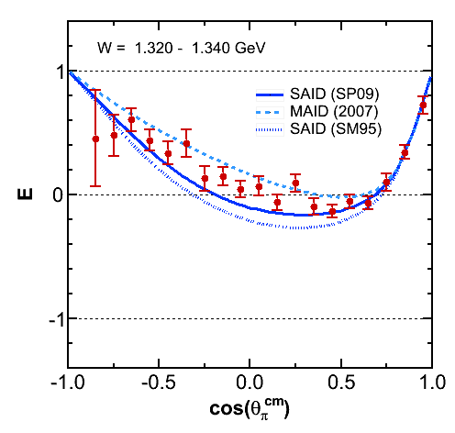
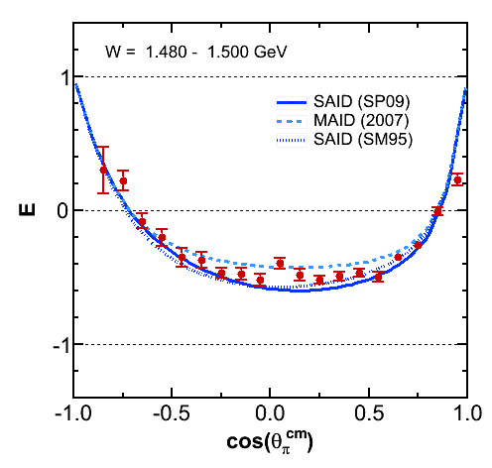
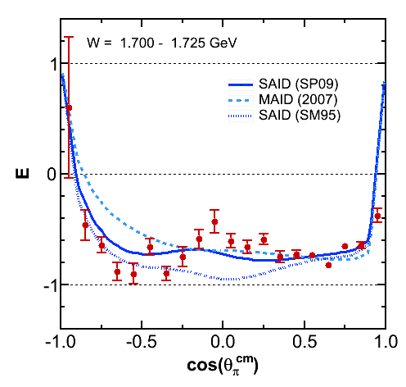
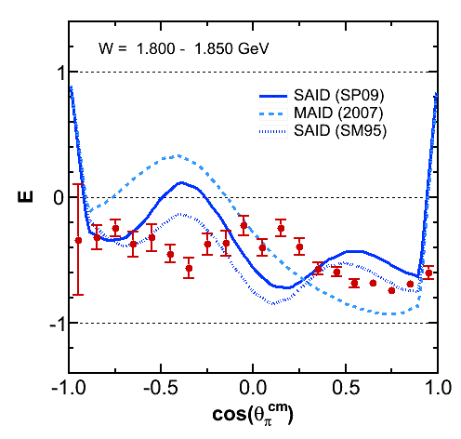
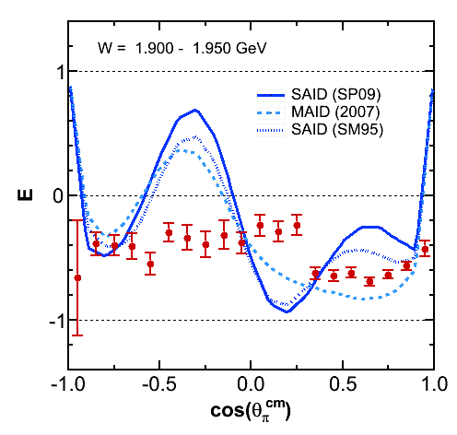
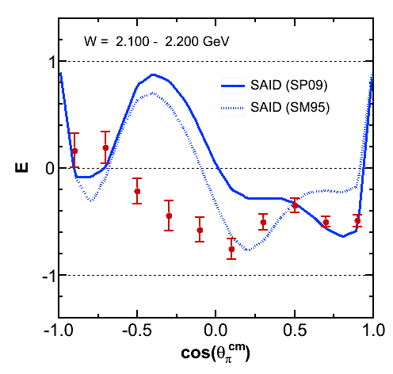
Double spin asymmetry E with FROST
FROST
→
→
E=(σ_{1/2}-σ_{3/2})/2σ
γp→nπ⁺
(preliminary)
FROST I run with longitudinal target polarization completed in 2008.
At W> 1.8 GeV, much strength is missing in parameterizations, leaving ample room for new excited states.
FROST run II w/ transverse polarization completed data taking in August 2010.
This completes the CLAS resonance search program on proton targets.

Slide 12
Status of single meson production on protons & neutrons ✔ - published, ✔ - acquired, ✔ - in preparation
 | σ | Σ | T | P | E | F | G | H | T_{x} | T_{z} | L_{x} | L_{z} | O_{x} | O_{z} | C_{x} | C_{z}
pπ⁰ | ✔ | ✓ | ✓ |  | ✓ | ✓ | ✓ | ✓
nπ⁺ | ✔ | ✓ | ✓ |  | ✓ | ✓ | ✓ | ✓
pη | ✔ | ✓ | ✓ |  | ✓ | ✓ | ✓ | ✓
pη’ | ✔ | ✓ | ✓ |  | ✓ | ✓ | ✓ | ✓
pω | ✔ | ✓ | ✓ |  | ✓ | ✓ | ✓ | ✓
K⁺Λ | ✔ | ✓ | ✓ | ✔ | ✓ | ✓ | ✓ | ✓ | ✓ | ✓ | ✓ | ✓ | ✓ | ✓ | ✔ | ✔
K⁺Σ⁰ | ✔ | ✓ | ✓ | ✔ | ✓ | ✓ | ✓ | ✓ | ✓ | ✓ | ✓ | ✓ | ✓ | ✓ | ✔ | ✔
K^{0*}Σ⁺ | ✔ | ✓ |  |  |  |  |  |  |  |  | ✓ | ✓
pπ⁻ | ✔ | ✓ | ✓ |  | ✓ | ✓ | ✓ | ✓
pρ⁻ | ✓ | ✓ | ✓ |  | ✓ | ✓ | ✓ | ✓
K⁻Σ⁺ | ✓ | ✓ | ✓ |  | ✓ | ✓ | ✓ | ✓
K⁰Λ | ✓ | ✓ | ✓ | ✓ | ✓ | ✓ | ✓ | ✓ | ✓ | ✓ | ✓ | ✓ | ✓ | ✓ | ✓ | ✓
K⁰Σ⁰ | ✓ | ✓ | ✓ | ✓ | ✓ | ✓ | ✓ | ✓ | ✓ | ✓ | ✓ | ✓ | ✓ | ✓ | ✓ | ✓
K^{0*}Σ⁰ | ✓ | ✓
Proton targets
Neutron targets
Notes:
Electromagnetic interaction not isospin conserving => need neutron target measurements. Program is less advanced, but data without polarized target have been taken. Polarized target measurements are planned for 2011/2012

Slide 13
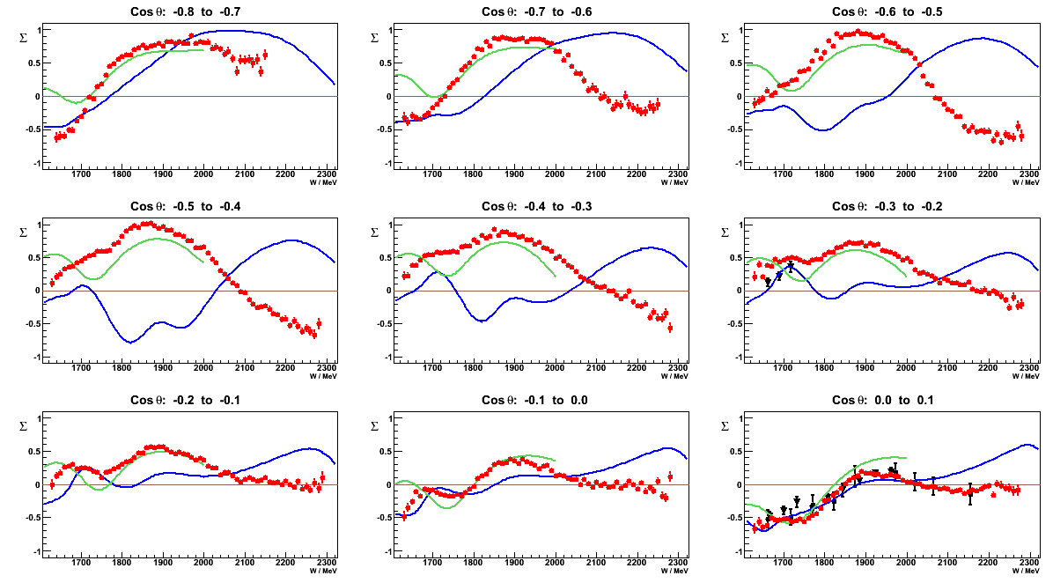
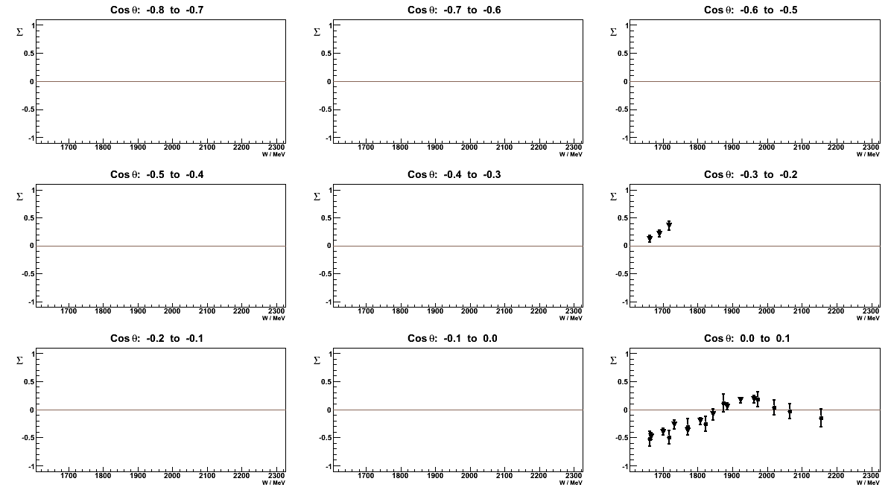
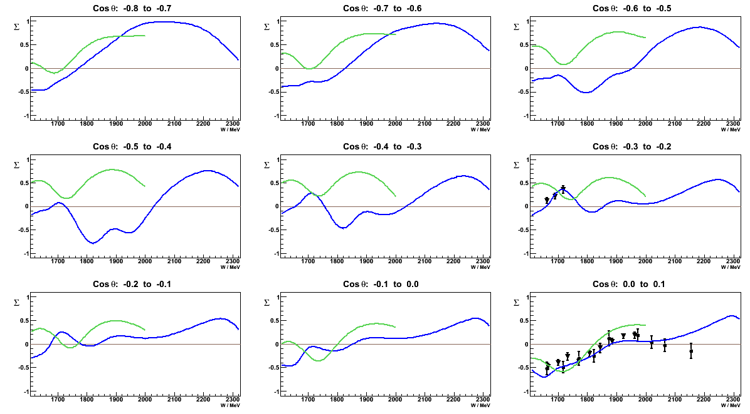
Beam asymmetry Σ for γn➙pπ⁻
Electromagnetic interaction not iso-spin conserving => need equivalent measurements on neutrons.
Samples of beam asymmetry
➪ Data expected to put strong constraints on PWA
Notes:
Here I show preliminary results of beam asymmetries

Slide 14
Electroexcitation of lowest S=0 baryon states
Effective degrees of freedom vs distance scale
Nature of excited state
2
N(1720)P₁₃
N(1680)F₁₅
SU(6)xO(3)
L_{3q}
Analyses based on 120,000 cross sections, and beam, target, and
double spin asymmetries.
e’
N(1520)D₁₃
N(1535)S₁₁
Δ(1700)D₃₃
γ_{v}
π, η, ππ
1
e
N*,△*
N
N’
A_{1/2}, A_{3/2}, S_{1/2}
M, E, S multipoles
0
Δ(1232P₃₃
N(940)P₁₁
N(1440)P₁₁
0
1
N [ħω]
2

Slide 15
1st through 3rd nucleon resonance regions
State | β_{Nπ} | β_{Nη} | β_{Nππ}
Δ(1232)P₃₃ | 0.995
N(1440)P₁₁ | 0.55-0.75 |  | 0.3-0.4
N(1520)D₁₃ | 0.55-0.65 |  | 0.4-0.5
N(1535)S₁₁ | 0.35-0.55 | 0.45-0.60
Δ(1700)D₃₃ | 0.1-0.2 |  | 0.8-0.9
N(1720)P₁₃ | 0.1-0.2 |  | > 0.7
Analysis codes for single and double pseudo-scalar meson production:
Unitary isobar model (UIM) for Nπ and Nη,
Fixed-t dispersion relations (DR) for Nπ and Nη
Reaction model for pπ⁺π⁻ (JM09)

Slide 16
Legendre Moments for ep→eNπ
Q²=0.4 GeV²
25
pπ⁰
D₀ ^{L+T}
D₀ ^{LT’}
μb/sr
D₂ ^{L+T}
DR
UIM
15
D₀ ^{L+T}
D₀ ^{LT’}
nπ⁺
μb/sr
UIM and DR give consistent fits.
D₂ ^{L+T}
1.25
1.5
1.25
1.5
W(GeV)
1.25
1.5

Slide 17
NΔ Transition form factor & multipoles
Magnetic Dipole Form Factor
Quadrupole Ratios
CLAS
Hall A
Hall C
MAMI
Pion
cloud
R_{EM}
QM
Pascalutsa,
Vanderhaeghen
CLAS
Hall A
Hall C
MAMI
R_{SM}
Sato, Lee
0.2
No sign for onset of asymptotic behavior, R_{EM}→+100%, R_{SM}→ const.
R_{EM} remains negative and small, R_{SM} increases in magnitude with Q².
Large meson-baryon contributions needed to describe multipole amplitudes

Slide 18
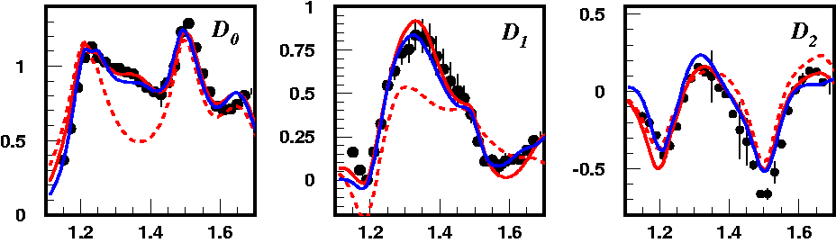
Emergence of the “Roper” N(1440)P₁₁
At small Q², the Roper is subdominant resonance
nπ⁺
Q² = 2.05 GeV²
~ const.
~cosθ
~(1 + bcos²θ)
DR w/o P₁₁(1440)
W(GeV)
DR UIM
total cross section shows strong signal from Roper
sensitive to Roper resonance in s-p interference
little sensitivity to Roper resonance

Slide 19
Helicity amplitudes for the “Roper”
Nπ
Nππ (prel.)
Nπ, Nππ
sign change
LCQM
Q³G
A_{1/2} sign change in both channels
Magnitudes of A_{1/2} and S_{1/2} consistent in the two channels.
High-Q² behavior consistent with dominant radial excitation of nucleon.
Rules out that state is dominantly a gluonic excitation Q³G (hybrid baryon).

Slide 20
Transition charge density of the “Roper”
Tiator, Vanderhaeghen, PLB672, 344,2009
γp→N⁺(1440)P₁₁ in LF helicity +1/2→ +1/2 are induced dominantly by up quarks in central region of radius ~0.4 fm, and by down quarks in an outer band which extends up to ~1fm.
Light (dark) regions: positive (negative) charge densities

Slide 21
Helicity amplitudes for γpN(1520)D₁₃
First data set that enabled the determination of S_{1/2}(Q²)
Clear evidence of helicity switch from λ=3/2
dominance at Q²=0 to λ=1/2 dominance at high Q²
=> Stringent prediction of the CQM.
(A_{1/2})²- (A_{3/2})²
A_{hel}=
(A_{1/2})²+(A_{3/2})²

Slide 22
Transition charge density of γpN⁺(1520)D₁₃
ρ₀
ρ_{T}
P
b_{y} (fm)
b_{y} (fm)
b_{x} (fm)
b_{x} (fm)
γp→N⁺(1520)D₁₃ in LF helicity +1/2→ +1/2 transition:
dominated by negative density in the center and by positive density in the outer region.
Quadrupole pattern extending to large radius.
Proton and N(1520)D₁₃ polarized along x-axis with -1/2→+1/2 spin projections:
Nearly full separation of charges in transverse space.
Short distance density uncertain due to extrapolation to large Q².

Slide 23
Helicity amplitudes for γpN(1535)S₁₁
CLAS pη
LC SR
CLAS nπ+
LCQM
HallC pη
Analysis of pη channel assumes S_{1/2}=0
Branching ratios: β_{Nη}/β_{Nπ} = 0.95±0.03
A_{1/2} (Q²) from Nπ and pη are consistent
First extraction of S_{1/2}(Q²) amplitude in Nπ channel.

Slide 24
N* resonance studies in ep epπ⁺π⁻
Developed energy-independent interaction model (JM09) to analyze sets of nine 1-dim. cross sections at fixed Q² and W.
Q² (GeV²)
0.65
0.95
1.30
2.30
2.70
3.30
D₃₃, P₁₃
3.90
4.60
D₁₃
Resonance structures become more prominent with increasing Q².
Notes:
Many higher mass states couple dominantly to the 2-pion channel and can be best analyzed in this channel. One has 9 independent cross sections available that constrain analysis. The different curves show contributions from various isobars.

Slide 25
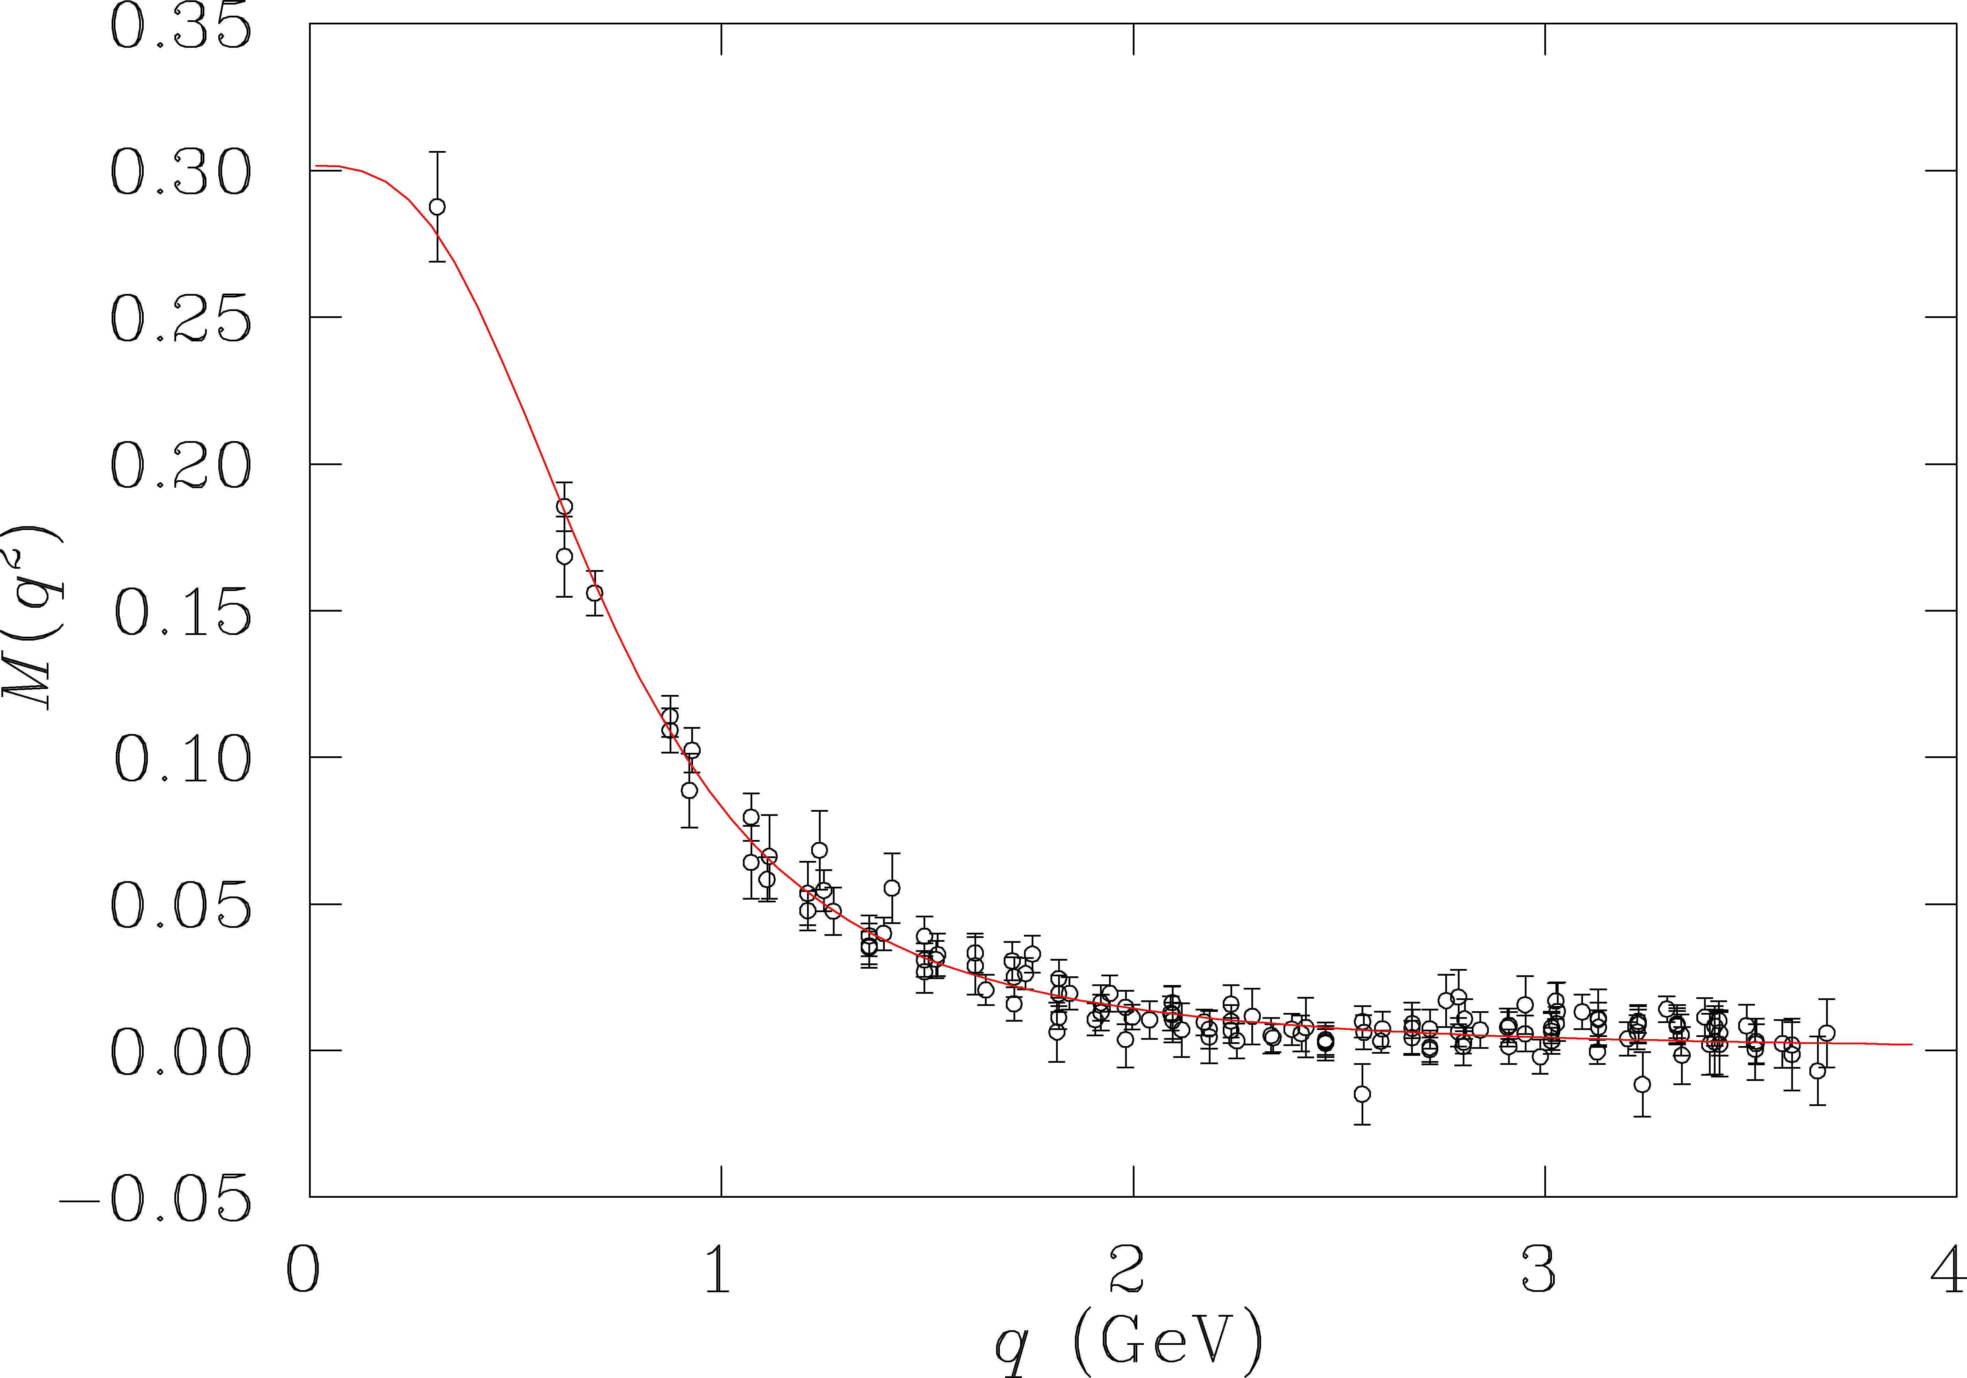
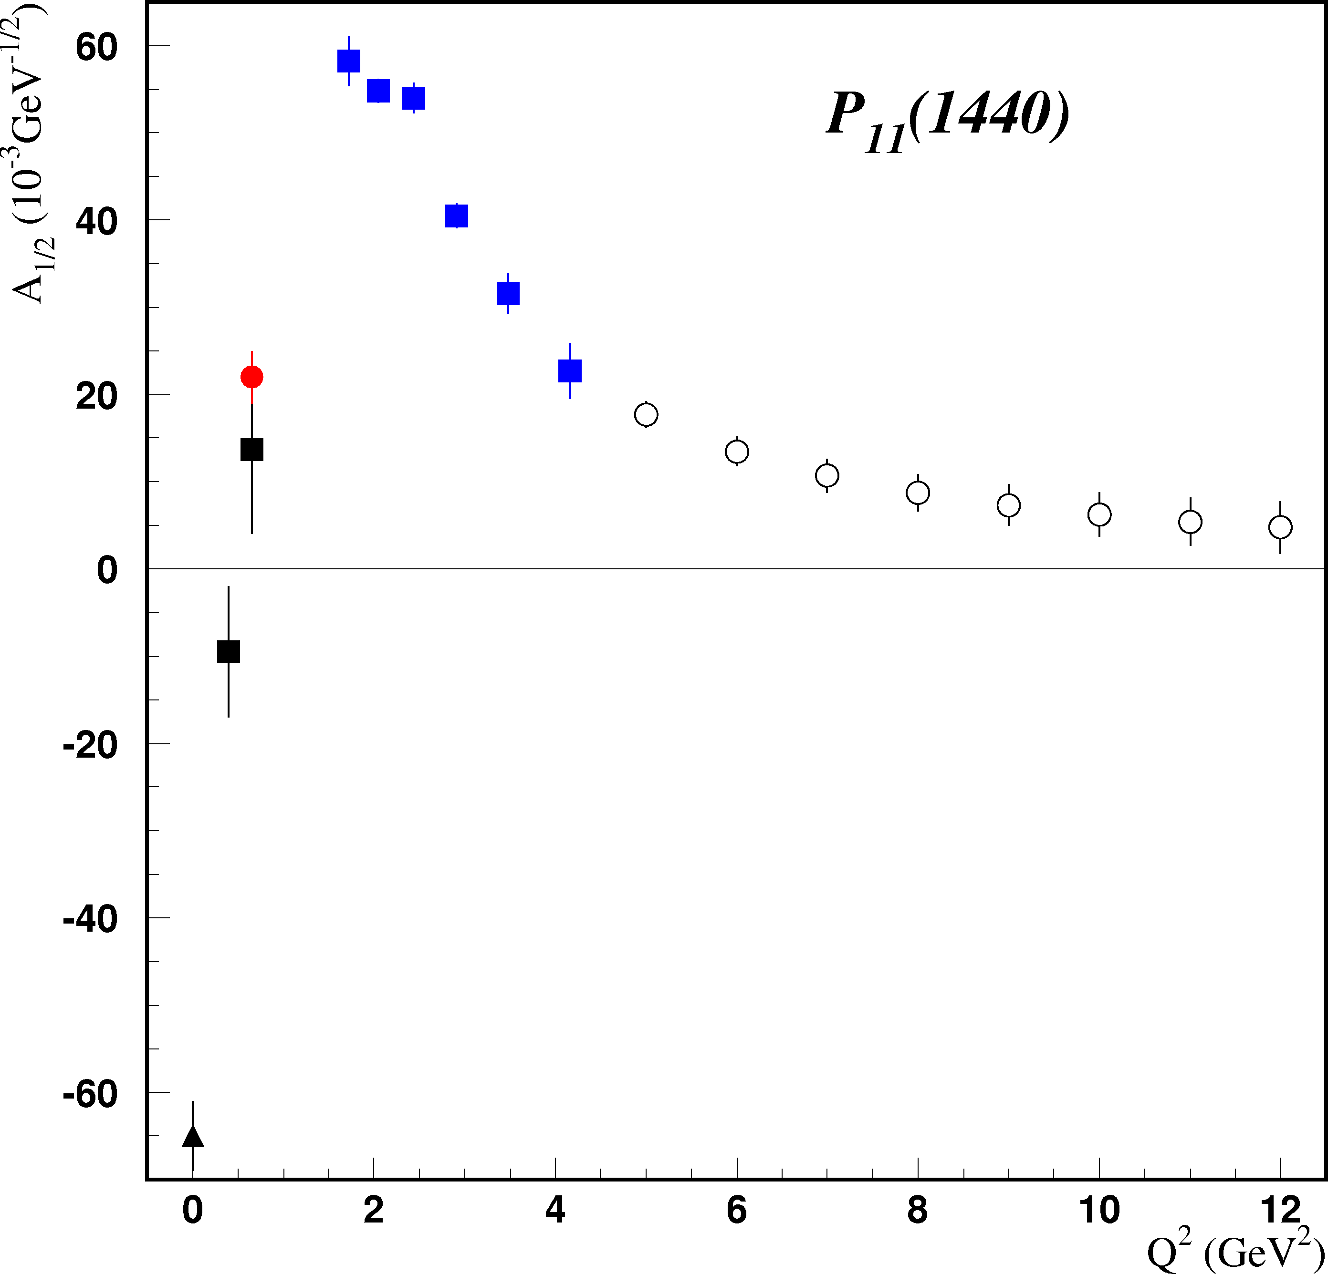
Resonance Transitions at 12 GeV
Experiment E12-09-003 will extend access to transition FF for many prominent states in the range to Q²=12GeV².
Electromagnetic form factors are sensitive to the effective quark mass.
accessible
at 6 GeV
quark mass (GeV)
accessible
at 12 GeV
CLAS12 projected
At 12 GeV we probe the transition from “dressed quarks” to elementary quarks.

Slide 26
Summary
The N* program on proton targets has reached the goal of “complete” measurements in some channels.
Partial wave analysis and coupled channel analyses find evidence for “missing” or new states
On track to complete the program on neutrons with polarized neutron target.
Transition amplitudes for lower mass states reveal information about the transverse charge and current distribution for these transitions.
CLAS12 will probe the N* FF in the transition from dressed quarks to elementary quark at high Q².
Plans to study hadron spectroscopy at the 12 GeV upgrade.

