Slide 1
Transverse Momentum Dependent Distributions
Exploring the transverse structure of the nucleon (not only spin)
3rd international workshop on nucleon structure @ Large Bjorken x
Jefferson Lab, Newport News, VA
Friday 15 October 2010
Kawtar Hafidi

Slide 2

Beyond the collinear picture of the nucleon: new degrees of freedom in QCD
TMDs
Parton density
GPDs
Parton longitudinal momentum
distributions is a function of
the parton Longitudinal
momentum fraction x
Transverse Momentum Dependent
distribution functions (TMDs)
Impact parameter dependent PDFs.
They are Fourier transform of the
t-dependence of GPDs
?
Notes:
IPD for ksi=0 because Heisenberg uncertainty principle forbids a simultaneous exact measurements of x and the longitudinal position of quarks. IPDs provide information of the position space of quarks carrying a certain momentum fraction x.

Slide 3
TMDs: The nucleon @Twist-2
Boer-Mulders
Helicity
Kotzinian-Mulders
(Worm-gear)
Pretzelosity
Sivers
Worm-gear
Transversity
All transverse-momentum dependences even for f₁ are interesting and largely unknown
Uncolored TMDs survive integration over transverse momentum
All colored TMDs vanish if there is no OAM
There is a strong indirect connection with OAM. So far any statement about OAM is model dependent

Slide 4
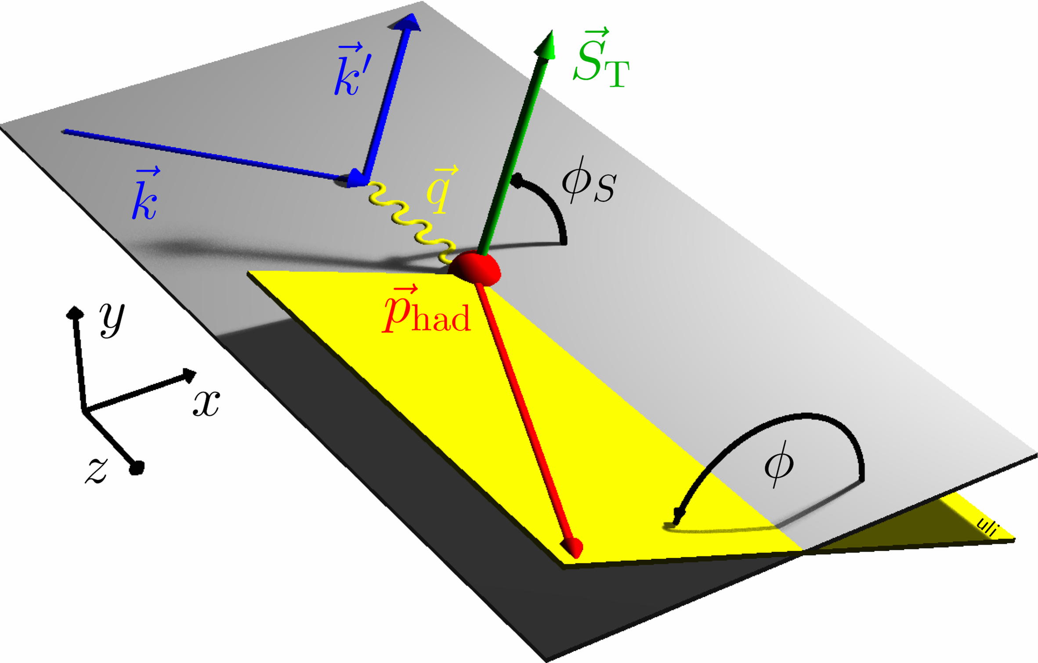
SIDIS Land
Sivers
Boer-Mulders

Slide 5
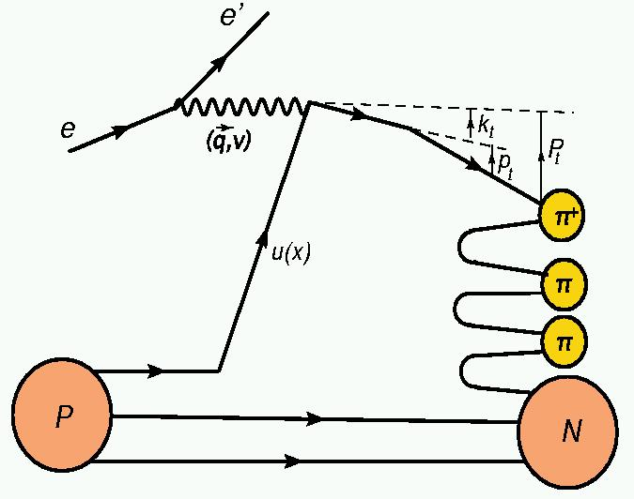
Parton intrinsic motion and azimuthal asymmetries
Collins
effect
Sivers effect
Boer-Mulders effect

Slide 6
Double spin asymmetry- longitudinally polarized target – A₁ P_{T} dependence
Projected results
For Exp. E05-113
CLAS results
Data shows slight preference for R < 1
Collected data with 10 times more statistics will allow the study of the P_{T} dependence for
different quark helicities and flavor and for several x bins

Slide 7
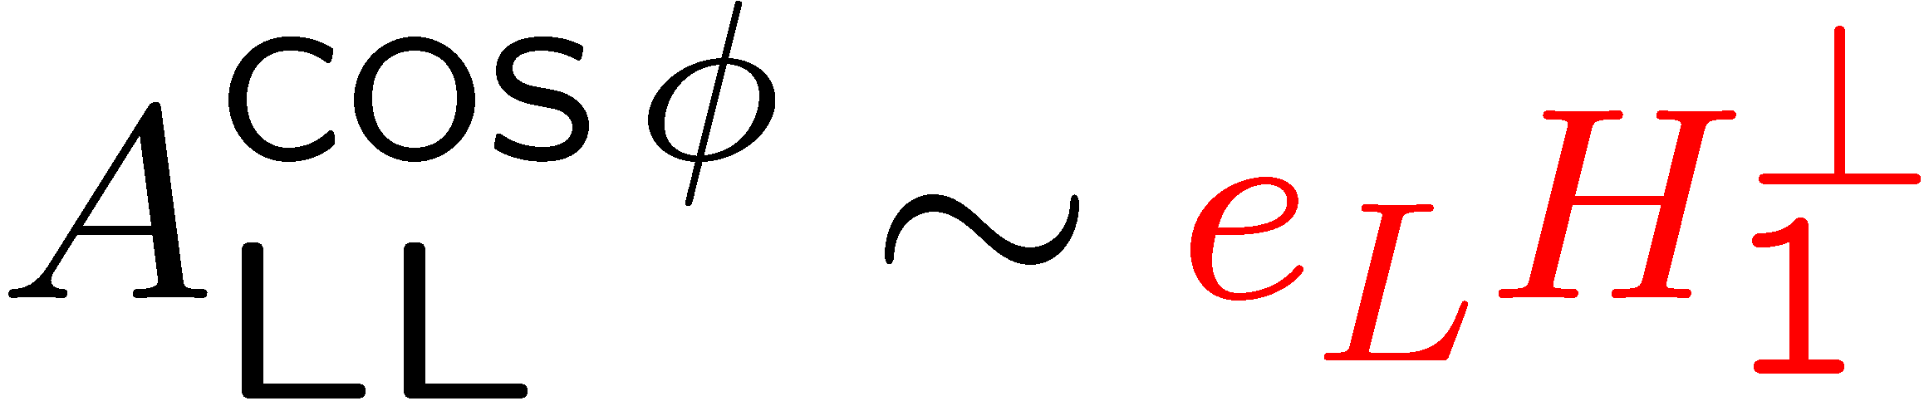
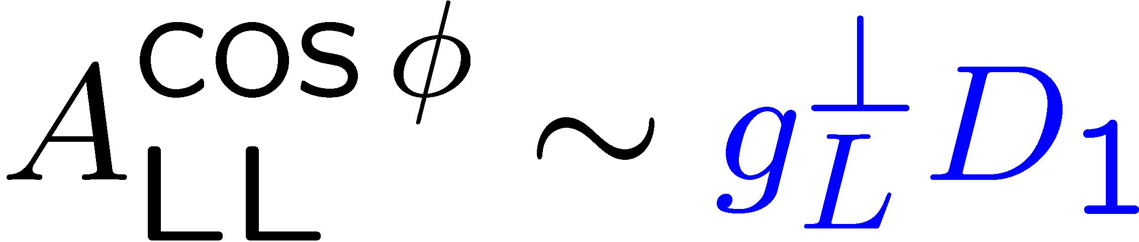
cosφ moment in A_{LL}-P_{T}-dependence
Projected results
For Exp. E05-113
hep-ph/0608048
μ₀²=0.25GeV²
μ_{D}²=0.2GeV²
CLAS PRELIMINARY
P_{T}-dependence of cosφ moment of double spin asymmetry is most sensitive to k_{T}-distributions of quarks with spin orientations along and opposite to the proton spin
7

Slide 8
Sivers amplitude for pions
HERMES PRL 103 (2009) 152002
Courtesy of G. Schnell
The amplitude is large and positive for π⁺
π⁺ is dominated by u-quark scattering
➔ u-quark Sivers DF < 0
Slightly positive
π⁻ amplitude is consistent with zero
d-quark Sivers DF > 0 maybe
large ?
Cancellation effects for π⁻ are needed to explain the results
Result is consistent with zero Sivers effect measured for deuterium by COMPASS
FSI attractive (confining color force) & u-quark dominance for π⁺ ➔ Positive contribution of u-quark to the nucleon OAM
M. Burkardt PRD66 (2002) 014005
Notes:
The Sivers effect provides evidence for the orbital motion of quarks inside a transversely polarized nucleon: the quark’s angular motion generates a left-right density difference, causing the u-quarks to favor “left” and the d-quarks “right”.

Slide 9
Transverse SSA for pion cross-section difference - HERMES
Should be flat
Access of Sivers
u-valence distribution

Slide 10
Kaon Sivers amplitude - HERMES

Slide 11
What is going on with kaons?
Non trivial role of sea quarks
Fragmentation functions do not cancel
in the ratio
Higher twist effects?

Slide 12
Q² dependence
Hint of Q² dependence for kaons

Slide 13
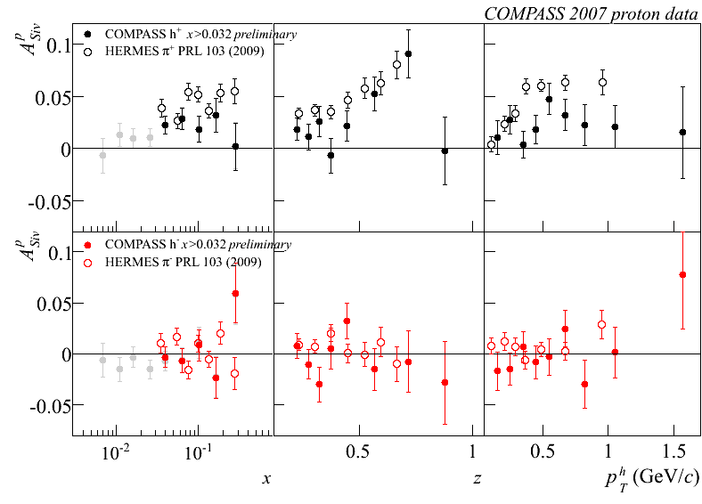
COMPASS-HERMES Proton Sivers
Courtesy of Anna Martin
new
new
HERMES and COMPASS have the same sign
BUT COMPASS is a factor of two smaller than HERMES for positive hadrons

Slide 14
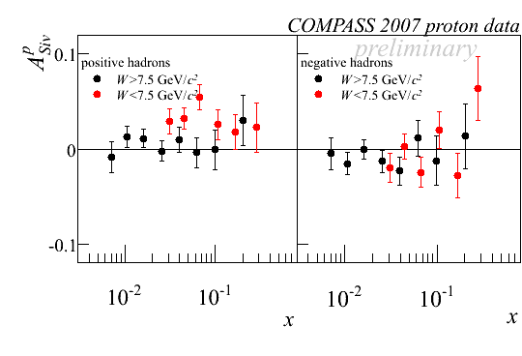
Possible W dependence of Sivers ?
Courtesy of Anna Martin

Slide 15
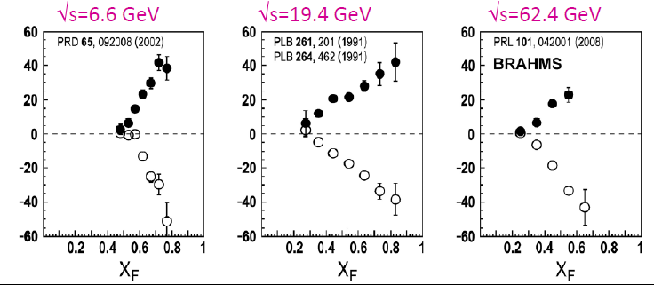
Transverse SSA in pp scattering
All available models
predict A_{N} goes
to zero at high
P_{T} values
A_{N}(%)
Hard scale is given
by P_{T}
BNL
FNAL
RHIC

Slide 16
Comparing ep and pp scattering
Courtesy of A. Lopez Ruiz
A_{N} in pp scattering is larger than ep scattering
u-quark dominance in ep scattering might
explain the small π⁻ asymmetry

Slide 17
Comparing inclusive to SIDIS
Courtesy of A. Lopez Ruiz
A_{N} resembles Sivers effect

Slide 18
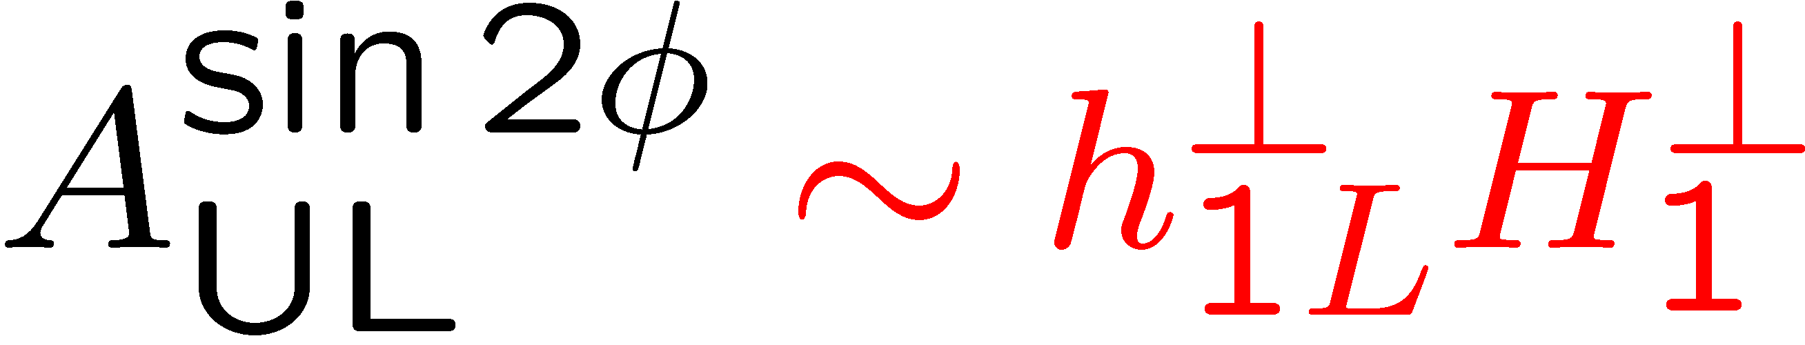
Longitudinal Target SSA measurements at CLAS
Kotzinian-Mulders asymmetry
(Worm gear)
CLAS-2009 (E05-113)
HERMES
No indication of Collins effect for π⁰
Non-zero negative asymmetry for charged pions
18
18

Slide 19
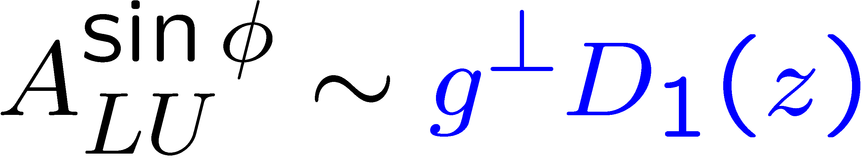
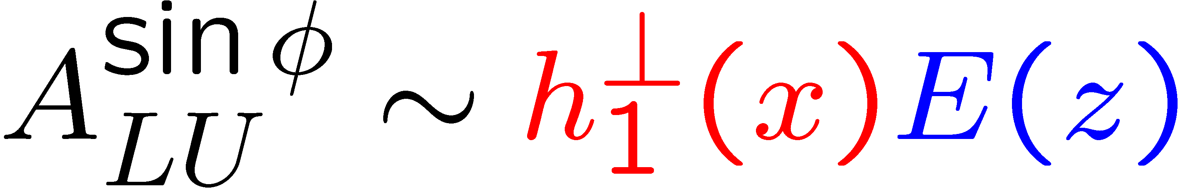
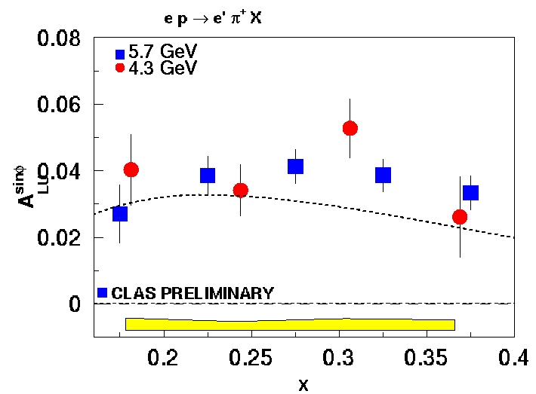
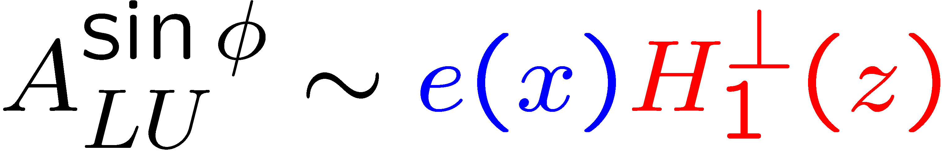
Beam SSA: A_{LU} from CLAS @ JLab
Photon Sivers Effect Afanasev & Carlson, Metz & Schlegel
Beam SSA from initial distribution (Boer-Mulders TMD) F.Yuan using h₁┴ from MIT bag model
0.5<z<0.8
Beam SSA from hadronization (Collins effect) by Schweitzer et al.
Comparable π⁰ and π⁺ BSA indicate small Collins type contributions for π⁺

Slide 20
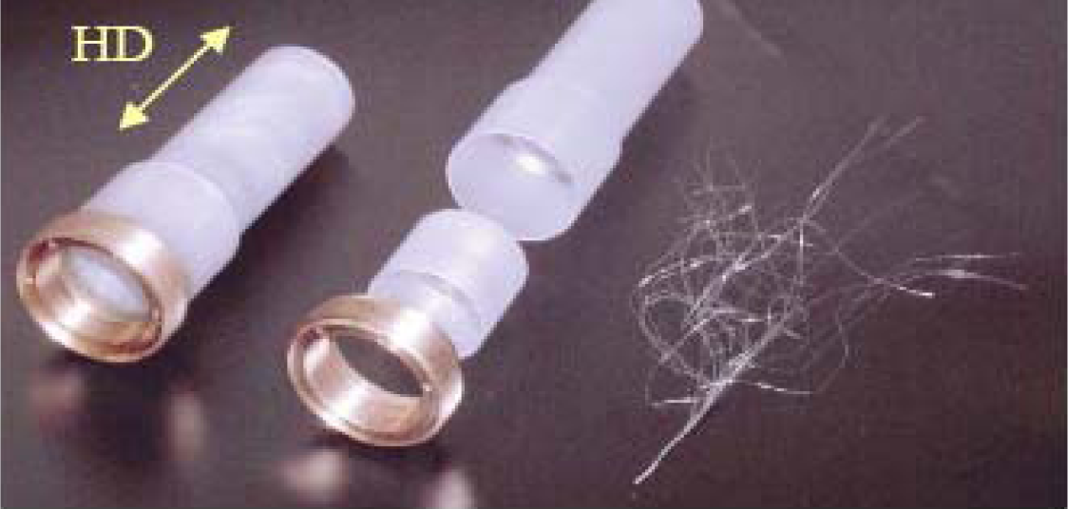
CLAS transversely polarized HD-Ice target
HD-Ice target vs std nuclear targets
  Small field (∫Bdl~0.005-0.05Tm)
  Small dilution (fraction of events from polarized material)
  Less radiation length
  Less nuclear background (no nuclear attenuation)
  Wider acceptance
20

Slide 21
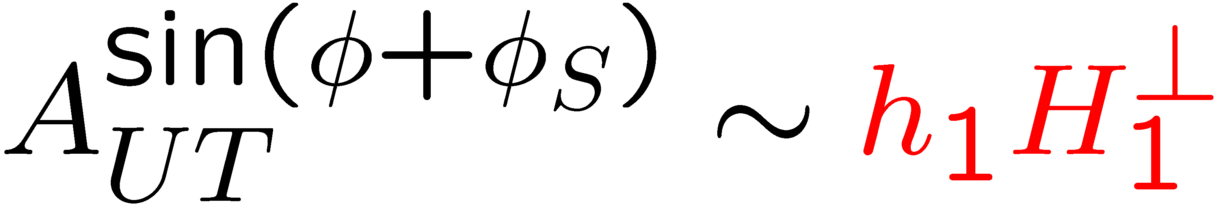
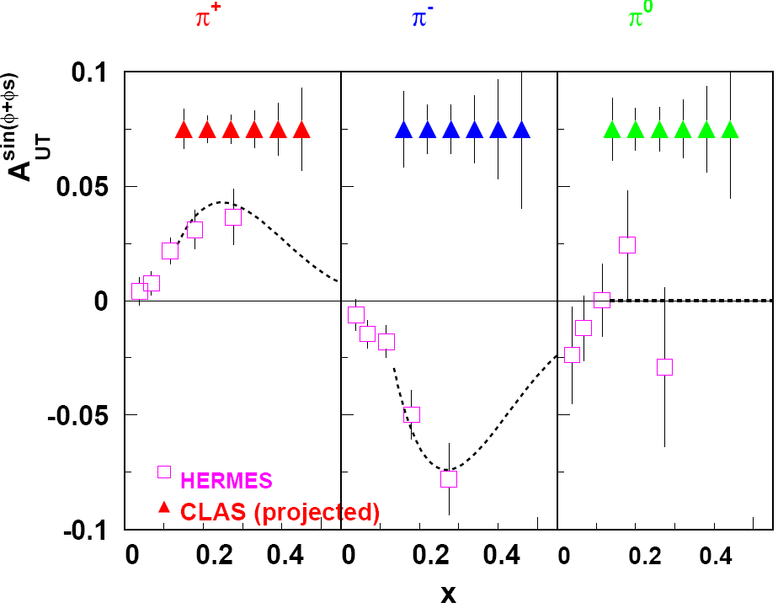
Collins Single Spin Asymmetries : E-08-015 projections
Anselmino et al (2007)
CLAS with a transversely polarized target will allow measurements of transverse spin distributions and constrain Collins fragmentation function

Slide 22
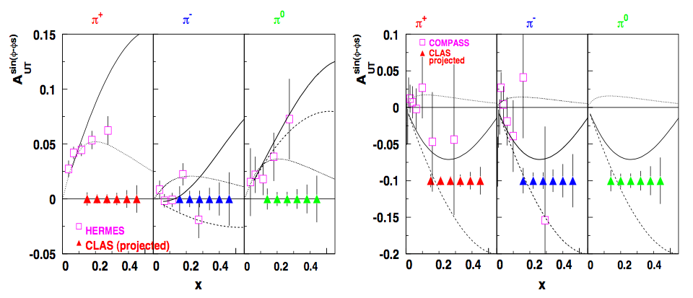
Measurements of Sivers function: CLAS E08-015
Proton
Curves by Yuan
Efremov and
Collins
CLAS will provide a measurements of Sivers asymmetry at large x, where the effect is large and models unconstrained by previous measurements.

Slide 23
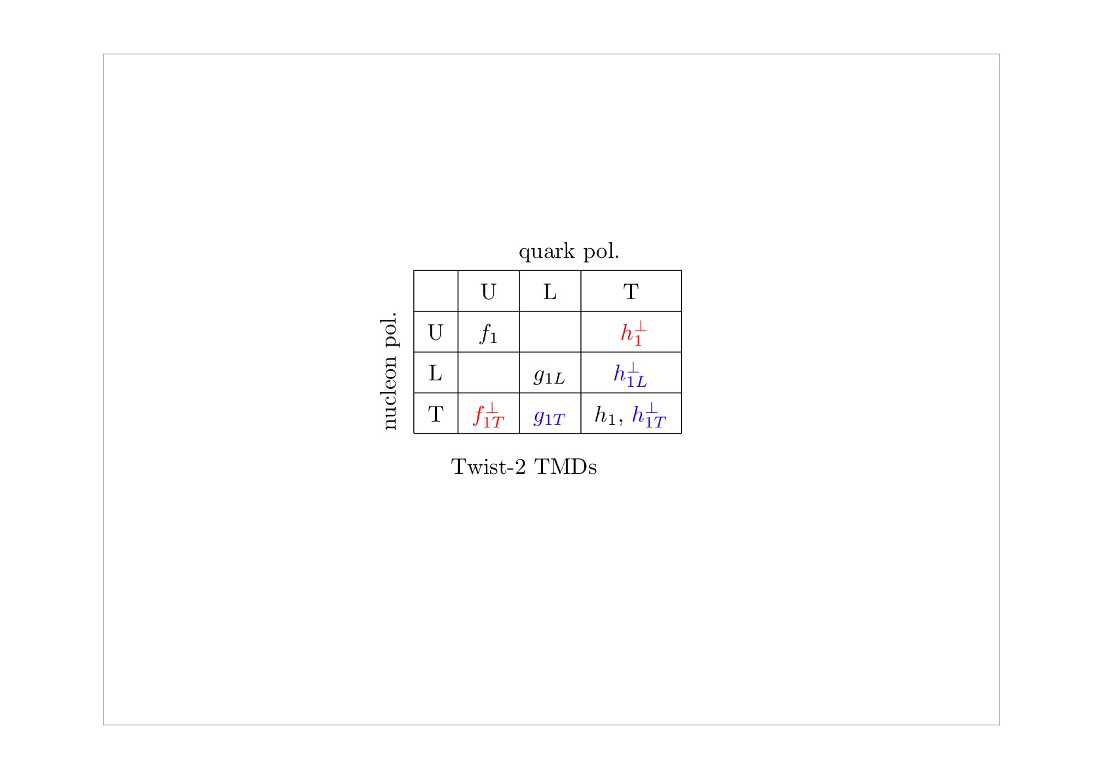
TMDs program @ 12 GeV in Hall B
PAC approved experiments & LoI
q
N
E12-06-112: Pion SIDIS
E12-09-008: Kaon SIDIS
U
E12-07-107: Pion SIDIS
E12-09-009: Kaon SIDIS
L
LOI12-06-108: Pion SIDIS
LOI12-09-004: Kaon SIDIS
T
Complete program of TMDs studies for pions and kaons
Kaon measurements crucial for a better understanding of the TMDs “kaon puzzle”
Kaon SIDIS program requires an upgrade of the CLAS12 detector PID
⇒ RICH detector to replace LTCC - Project under development

Slide 24
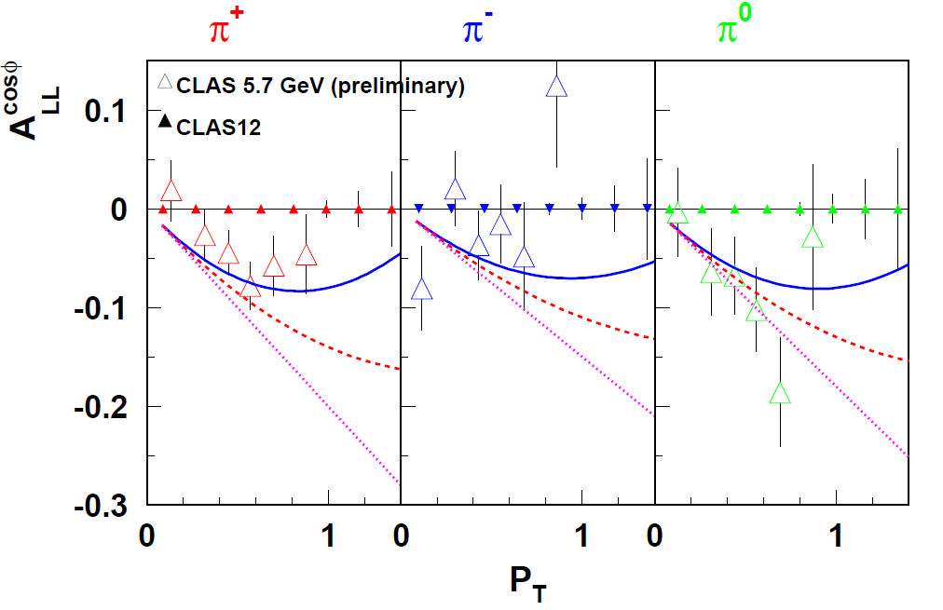
Longitudinally polarized target: Double spin asymmetries

Slide 25
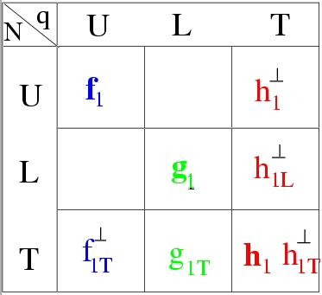
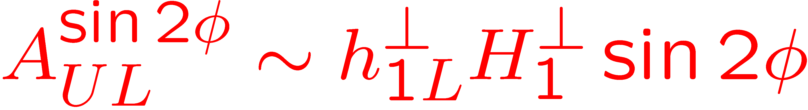

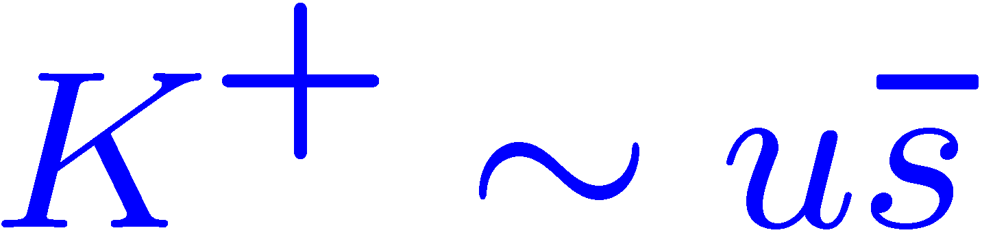
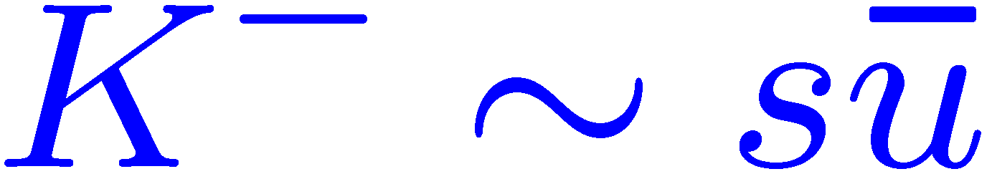
Collins fragmentation: Longitudinally polarized target
Kotzinian-Mulders Asymmetry
deuteron
proton
Pasquini et al.
Notes:
This SSA which appears as a sin2\phi moment in the cross section, was first SSA measured in electroproducion and first measurement at HERMES,
Shows no effect.
The theory calculations came later which were consistent with that measurement indicating that asymmetry is large
Only in the valence region at large x. preliminary CLAS data indeed indicate that the asymmetry may be large at large x.

Slide 26
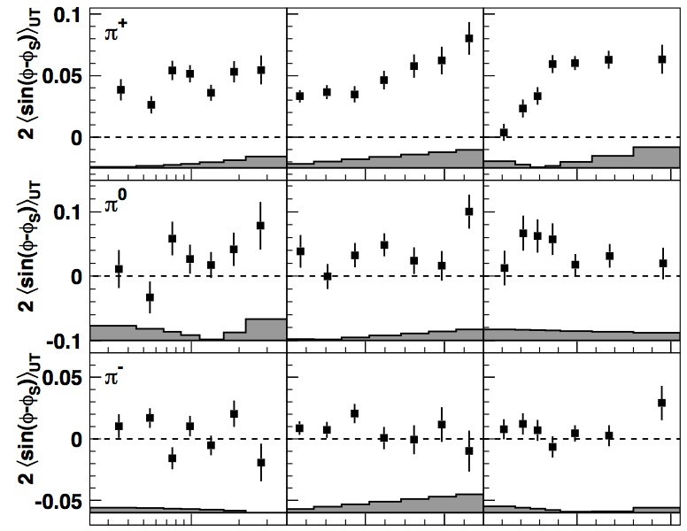
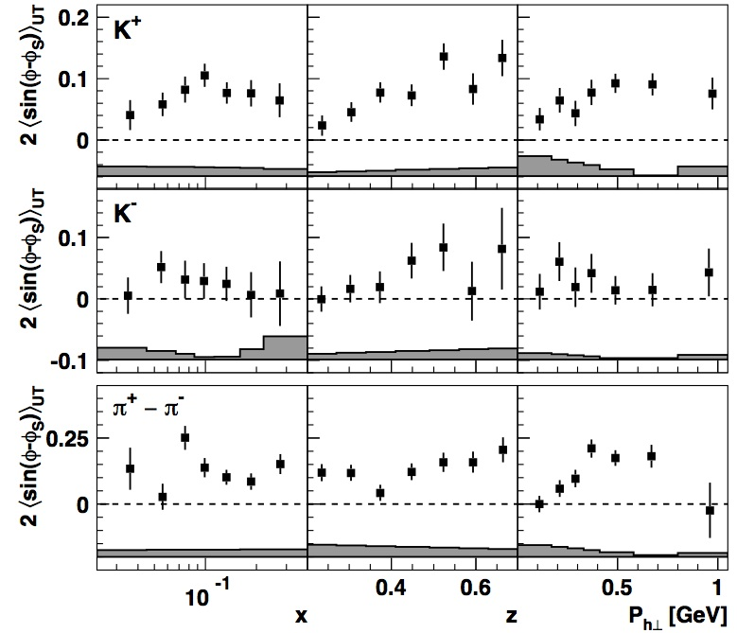
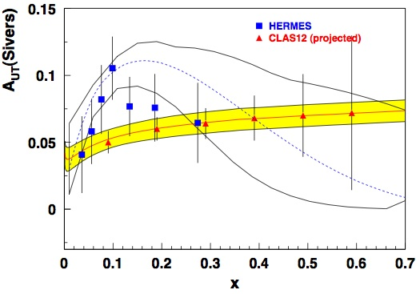

Kaon TMDs program @ 12 GeV in Hall B
π⁺
K⁺
π⁻
K⁻
HERMES coll. PRL 103 (2009)
ep→e’K⁺X
K⁺ ampl. > π⁺ ampl.
Unexpected from u-quark dominance!
How large can the effect of s quarks be?
π/K measurement @ CLAS12 will provide a more detailed knowledge of Sivers effect
S.Arnold et al.
0805.2137
M. Anselmino et al.
0805.2677

Slide 27
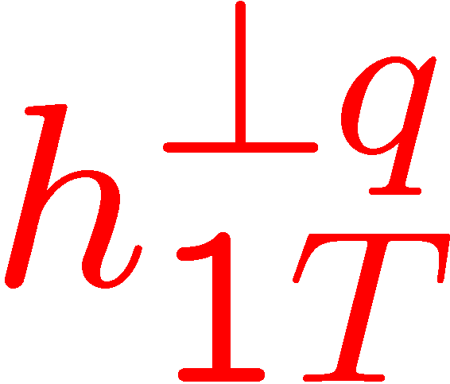
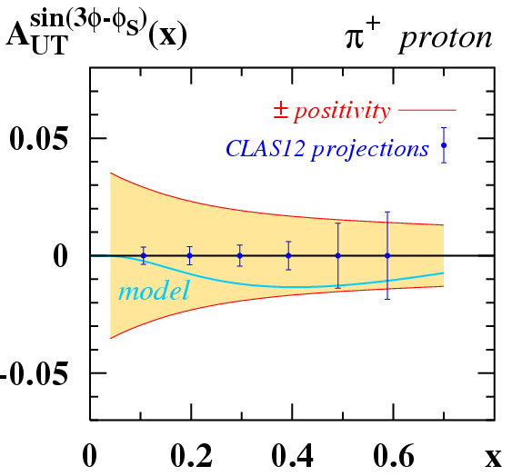
Pretzelosity @ CLAS12
Exciting relation:
(in bag & spectator model)
helicity - transversity = ‘measure’ of relativistic effects
CLAS12 will provide pretzelosity measurement in the valence region for Kaons and pions.
B. Pasquini et al. arXiv:0806.2298

Slide 28
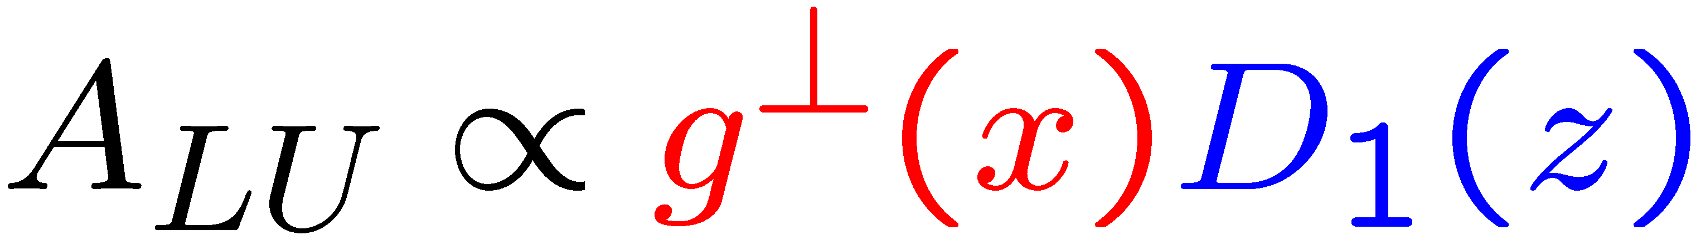
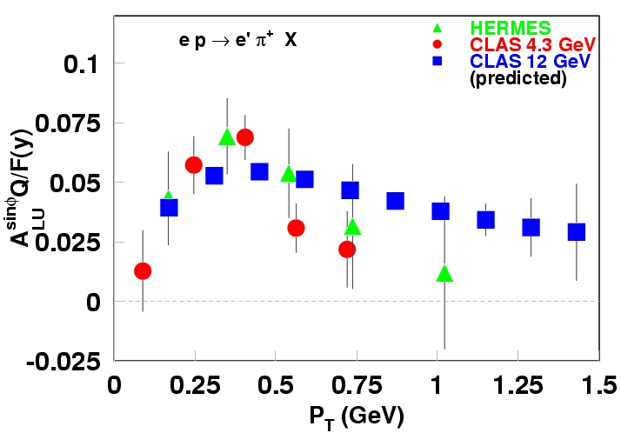
P_{T}-dependence of beam SSA
σ^{sinφ}_{LU(UL)} ~F_{LU(UL)}~ 1/Q (Twist-3)
1/P_{T}
1/Q
Nonperturbative TMD
Perturbative region
Check of the higher twist nature of observed SSA
Critical SSA test transition from non-perturbative to perturbative region

Slide 29
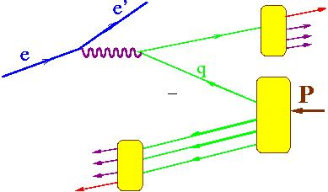
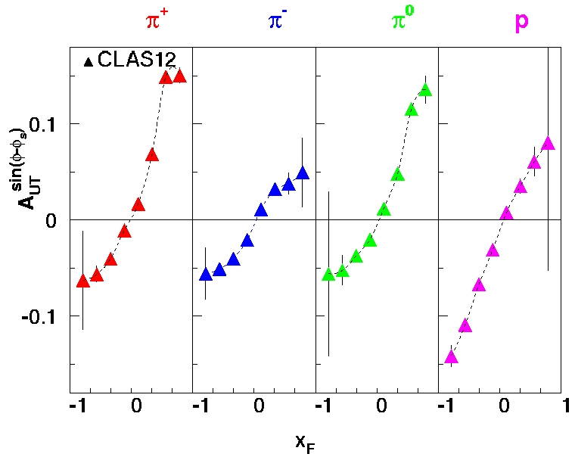
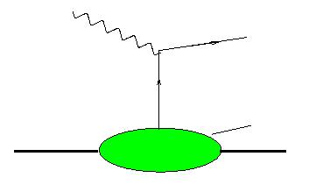
Sivers effect in the target fragmentation
x_{F}>0 (current fragmentation)
A.Kotzinian
x_{F}<0 (target fragmentation)
h
M
Fracture Functions
High statistics of CLAS12 will allow studies of kinematic dependences of the Sivers effect in target fragmentation region
Notes:
Significant effect predicted in the target fragmentation region, in particular for baryons (target remnant also asymmetric)
The same data set was used to produce projections for the target fragmentation.

Slide 30
Summary and Outlook
Great progress has been made by HERMES and COMPASS in the studies of TMDs
CLAS longitudinally polarized NH₃ and ND₃ target data provides superior sample of events allowing detailed studies of single and double spin asymmetries using multidimensional bins
Measurements of spin and azimuthal asymmetries with unpolarized, longitudinally and transversely polarized targets in semi-inclusive processes at Hall-A/B :
  Measure TMDs of partons in the valence region
  Provide detailed info on partonic spin-orbit correlations
  Study quark-gluon correlations (HT)
JLab12 will significantly increase the luminosity, kinematical coverage and particle identification capabilities of Hall-A/B

Slide 31
Inclusive Hadron Production kinematics

