Slide 1
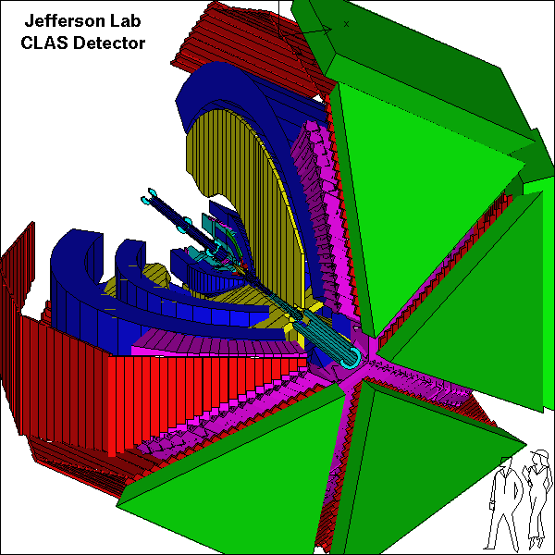
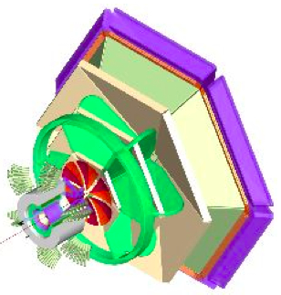

Deeply Virtual Exclusive Reactions with CLAS
Valery Kubarovsky
Jefferson Lab
ICHEP
July 22 , 2010, Paris, France
Notes:
I will talk about the experimental results from the dedicated DVCS experiment with CLAS at Jefferson Lab.

Slide 2
Outline
Physics Motivation
DVCS results
  Pseudoscaler mesons (π⁰,η) electroproduction
Vector mesons (ρ⁺, ρ⁰, ω, φ) electroproduction
Jlab 12 GeV upgrade
Summary

Slide 3



How are the proton’s charge densities related to its quark momentum distribution?
D. Mueller, X. Ji, A. Radyushkin, …1994 -1997
M. Burkardt, A. Belitsky… Interpretation in impact parameter space
?
Proton form factors, transverse charge & current densities
Structure functions,
quark longitudinal
momentum & spin
distributions
Correlated quark momentum
and helicity distributions in
transverse space - GPDs
Notes:
It was realized in past decade that the concept of Generalized Parton Distributions is powerful tool describing the nucleon structure. The GPDs contain the correlations between the transverse position and longitudinal momentum distributions of the partons in the nucleon, they allow to derive the orbital angular momentum contribution of partons to the nucleon's spin

Slide 4
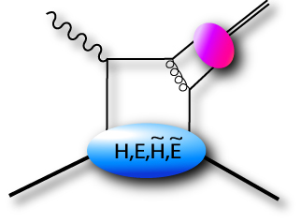
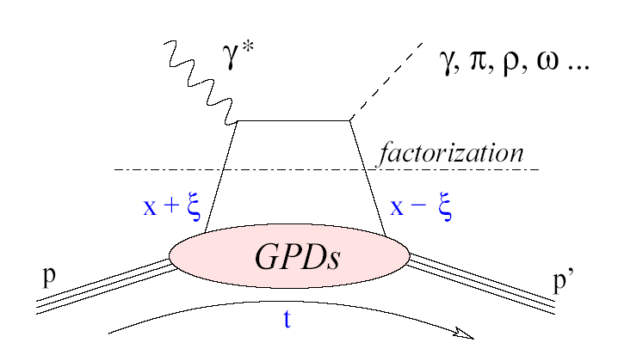
Basic Process – Handbag Mechanism
Deeply Virtual Compton Scattering (DVCS)
Deeply Virtual Meson Production (DVMP)
−2ξ
π⁰, η, ρ, ω, φ...
x – longitudinal quark
momentum fraction
γ∗_{L}
z
Φ(z)
x-ξ
2ξ – longitudinal
momentum transfer
x+ξ
p
–t – Fourier conjugate
to transverse impact
parameter
p’
ξ
x_{B}
DVMP: Factorization theorem proven ONLY for σ_{L}
One more unknown meson distribution amplitude Φ(z)
=
GPDs depend on 3 variables, e.g. H(x, ξ, t). They probe
the quark structure at the amplitude level.
2-x_{B}
Notes:
The basic process in accessing the proton structure through exclusive processes is the “handbag” mechanism. The important aspect is that we have hard scattering vertices here and here and the soft part is described by the GPDs. The upper and lower part factorize which allow us to probe GPDs in hard scattering processes with photons. There are 4 GPDs which depend on 3 kinematics quantities: the quark longitudinal momentum fraction x, the longitudinal momentum transfer to the quark xi and the 4-momentum transfer to the proton. What is the physical content of the GPDs ?

Slide 5
Measuring GPDs through polarization
σ⁺ − σ⁻
σ⁺ + σ⁻
Δσ
2σ
A =
=
ξ ~ x_{B}/(2-x_{B})
~
k = t/4M²
Polarized beam, unpolarized target:
~
H(ξ,t)
Δσ_{LU} ~ sinφ{F₁H + ξ(F₁+F₂)H +…}dφ
Kinematically suppressed
Unpolarized beam, longitudinal target:
~
~
Δσ_{UL} ~ sinφ{F₁H+ξ(F₁+F₂)H -.. }dφ
H(ξ,t)
Kinematically suppressed
Unpolarized beam, transverse target:
Δσ_{UT} ~ cosφ{k(F₂H – F₁E) + ….. }dφ
H(ξ,t), E(ξ,t)
Notes:
The most direct way of accessing GPDs is through polarization measurements. Using polarized electron beams we can measure the cross section difference for opposite electron helicities. The cross section difference depends on the 3 GPDs H, H-tilde, and E. The kinematical factors suppress the contributions of H-tilde and of E so that the beam spin asymmetry is dominated by GPD H. For longitudinally polarized target the asymmetry is dominated by H-tilde as H and E are kinematically suppressed at not too large xi giving access to H-tilde. With a transversely polarized target one has access to a combination of H and E. With these 3 measurements we are able to disentangle 3 GPDs H, E, H-tilde.

Slide 6
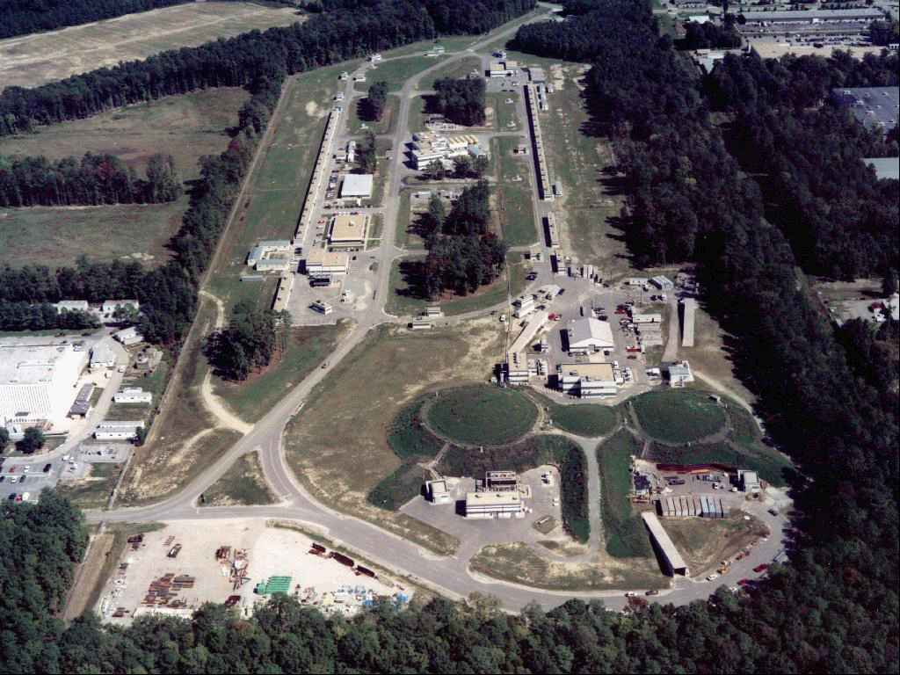
JLab Site: The 6 GeV Electron Accelerator
CLAS
3 independent beams with energies up to 6 GeV
Dynamic range in beam current: 10⁶
Notes:
Much of the activity to determine GPDs is taking place at Jefferson Lab. This shows the site with the dual linac racetrack re-circulating electron accelerator. Here is the injector area and the two parallel linear accelerators with recirculating arcs. After 5 recirculations a maximum beam energy of up to 6 GeV is achieved. The 3 endstations can have independent beams with multiples of the linac energies. The electrons are polarized at up to 85% . Beam current can be from 100 pico amperes to 100 micro amperes thus resulting at a dynamic range of 10^6. Experiment trying to access GPDs are currently concentrated in Hall A and in Hall B. In the following I will mostly discuss the broad GPD program in Hall B that uses the CLAS detector.

Slide 7
CEBAF Large Acceptance Spectrometer CLAS
Operating Luminosity 2 10³⁴ cm⁻² s⁻¹
Integrated Luminosity ~45 fb⁻¹
Beam Polarization ~85%
Almost 4π acceptance
H₂ and longitudinally polarized targets
Notes:
CLAS is a large acceptance spectrometer with a superconducting toroidal magnet at its core. Six symmetrically arranged coils form six identical sectors. Each sector is equipped with tracking chambers with a total of 35,000 drift cells, plastic scintillators for timing measurements, Gas Cerenkov counters for electron identification and electromagnetic calorimeters for photons and neutron detection. The detector is typically operated at luminosities of 10^34cm-2s-1.

Slide 8
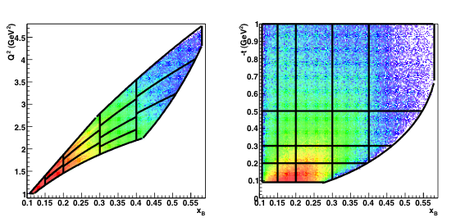
DVCS kinematics
Θ_{e}<45⁰
W>2GeV
t>t_{min}
x_{B}
x_{B}
θ_{e}>21⁰
 | Min | Max
Q² | 1 GeV² | 5 GeV²
_{xB} | 0.1 | 0.6
-t | tmin | 1 GeV²
W | 2 GeV | 3 GeV
Notes:
The physics lies in the various kinematical dependencies. The right graphs show the events broken up into Q2 and xB bins, still integrated over t. We see that for the low x_b and higher Q2 the asymmetry is dominated by sin-phi. Significant deviations are observed only at high x_{B} and low Q². The inset shows one of 65 bins in Q2, x_B, t.

Slide 9
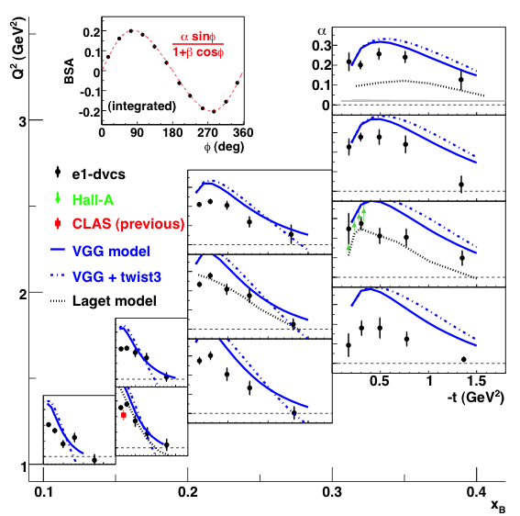
DVCS BSA A_{LU}
σ⁺ − σ⁻
σ⁺ + σ⁻
Δσ
2σ
A_{LU} =
=
Fit: A_{LU} = αsinφ/(1 + βcosφ)
Δσ_{LU} ~ sinφ{F₁H + ξ(F₁+F₂)H +…}dφ
VGG parameterization reproduces –t > 0.5GeV² behavior, and overshoots asymmetry at small t.
Regge model (J-M Laget) is in fair agreement in some kinematic bins with our results.
Phys.Rev.Lett 100:162002, 2008
Notes:
This graph shows the t-dependences of alpha at fixed Q2 and x_B. We see that alpha has a maximum at small t and drops to zero. The comparison of the leading sinΦ (twist-2) component with the standard VGG GPD parameterization shows qualitative even quantitative agreement at large t but the VGG asymmetry exceeds the data at small t. This could mean that at these t values the denominator in the asymmetry does not fully account for all contributions to the DVCS cross section.

Slide 10
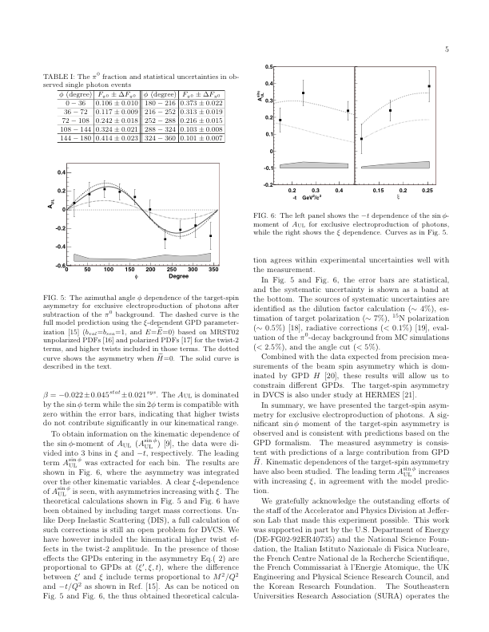
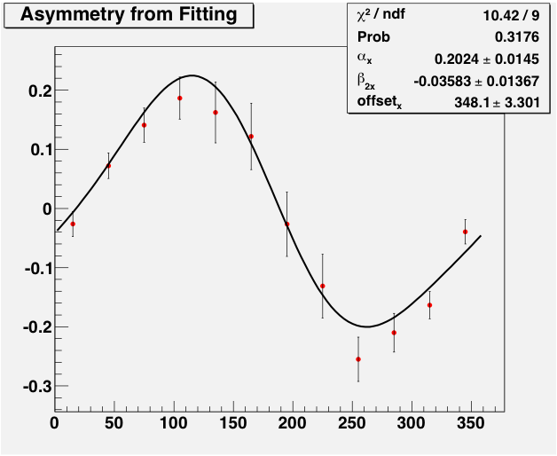
Target Spin Asymmetry A_{UL}
(new data taken @2010)
Phys.Rev.Lett 97:072002, 2006
eg1-dvcs (2010), not full statistics

Slide 11
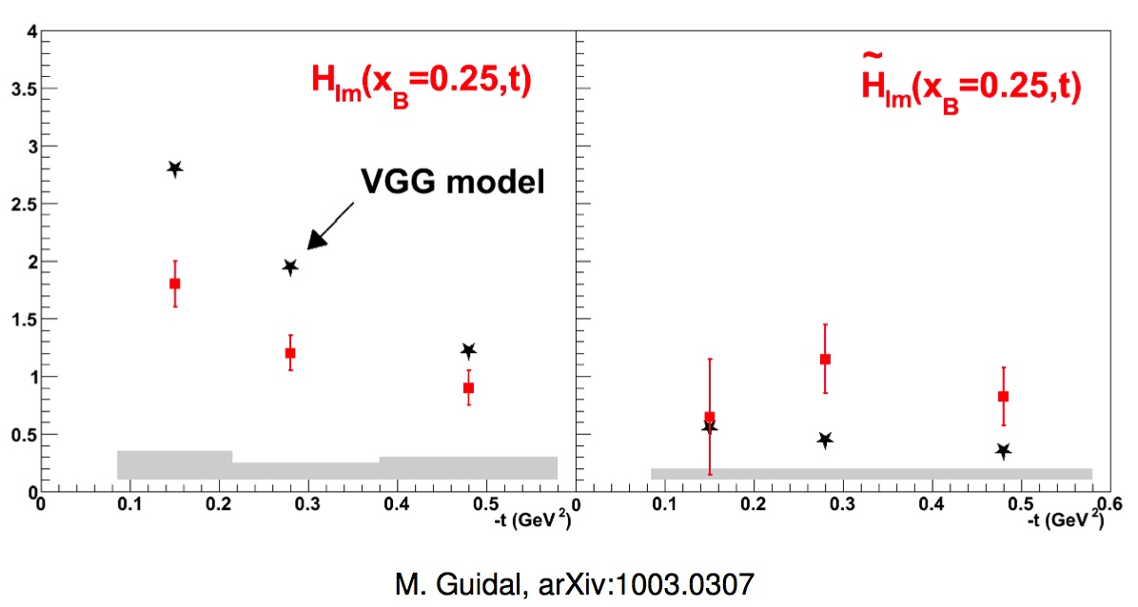
Extraction of Compton Form Factors from CLAS DVCS data
A_{LU} and A_{UL} CLAS results only
Im H(t) more flat than Im H(t)
~

Slide 12
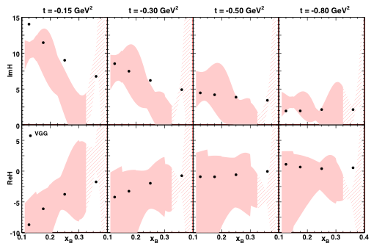
Global Analysis of the Compton FF (Jlab data)
The points are VGG model prediction
The shadow is the Real and Imaginary parts of the CFF extracted from the experimental data
H. Moutarde, PR D79 (2009) 094021

Slide 13
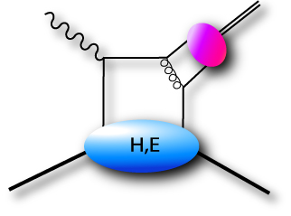
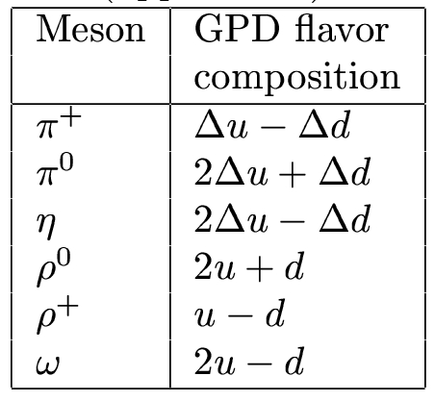
Deeply Virtual Meson production
CLAS results
Flavor separation
Access to polarized GPDs
Notes:
Now let me switch to the meson electroproduction. I will show you new unpublished results on the pi0 and eta electroproduction and the ratio of these cross sections. This is our kinematic coverage. We have 4-dimentional grid in Q2, xB,t, phi. We restrict our data to the limit W>2geV to go away from the resonance region.

Slide 14
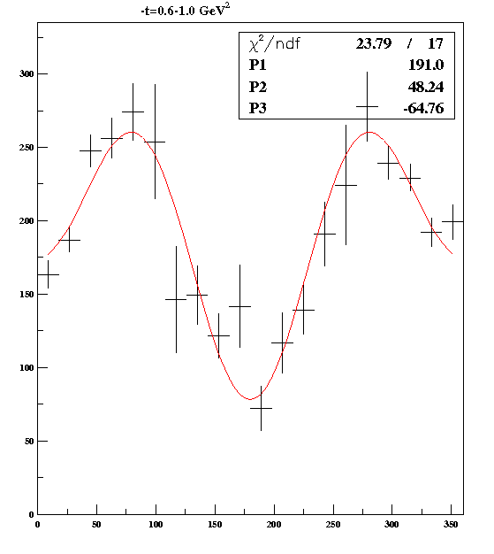
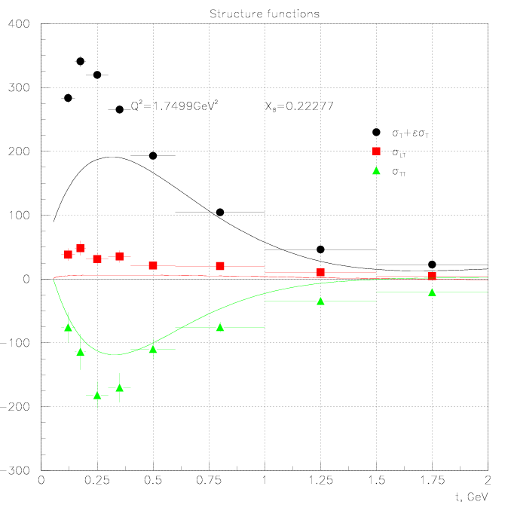
Structure Functions σ_{T}+εσ_{L} σ_{TT} σ_{LT}
-t
φ distribution
GM Laget Regge model
Notes:
The general description of the reduced cross sections in terms of the sigma_L,T,TT,LT is presented by this famouse formala.
The integrated over Q2 and t variables distribution is shown in this picture. We fit it with 3 parameter and get 3 cross section in unpolarized electron beam.
As you see we don’t separate sigma_L and sigma_T. We will do it in our future experiments with 12 GeV beam.

Slide 15
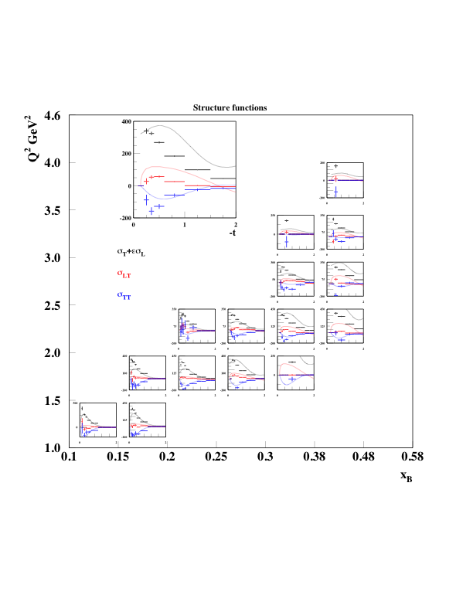
Comparison with J.M. Laget Regge model
Extracted reduced cross sections were compared with predictions of J.M. Laget Regge Model
The model is describing our data reasonably well

Slide 16
t - distribution
Notes:
We analyzed the t-distribution and extracted the slope parameter B. In general this slope parameter depends on both xB and Q2

Slide 17
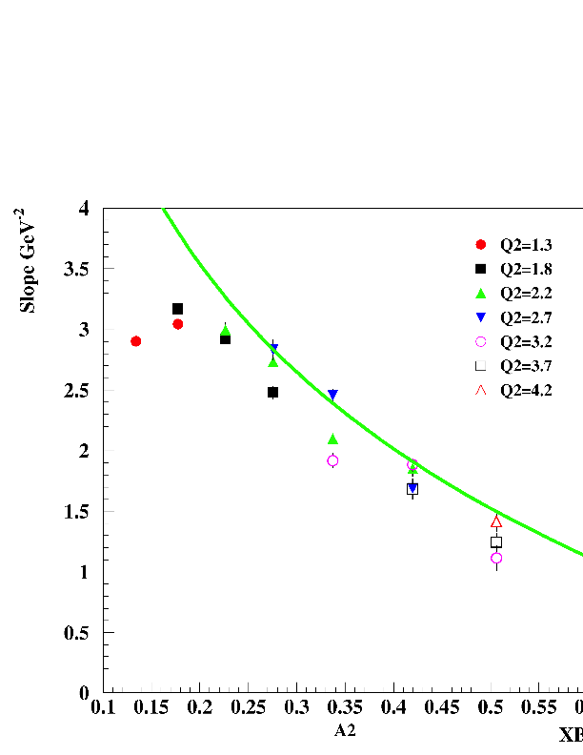
t-Slope Parameter as a Function of x_{B} and Q²
B(x_{B} ,Q²)
B(x_{B} , Q²) is almost independent of Q²
B(x_{B}) is decreasing with increasing x_{B}
This behavior suggests that the perp width of the partons goes to zero with x_{B}→1 what is in agreement with 3D image of the nucleon
This is not fit of data.
This is GPD predictions
with Regge inspired
t-dependence x^{αt}
x_{B}
Notes:
The plot shows the slope parameter s a function of x_B for different bins in Q2. What we actually see, the dependence on Q2 is very weak. In the first approximation the slope parameter depends only on x_B. More over it is decreasing with increasing x_B. As we remember the t- distribution is closevely connected with the impact parameter distribution thru Fourier transform. Looking to this picture we can say that the perp width of the partons with x→1 goes to zero. It is interesting observation.

Slide 18
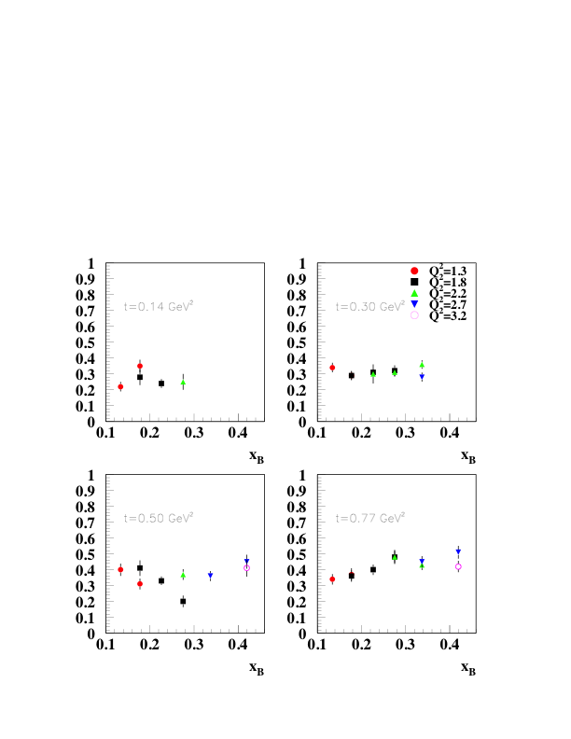
η/π⁰ Ratio
Preliminary data on the ratio
η/π⁰ as a function of x_{B} for
different bins in t.
The dependence on the x_{B} and
Q² is very weak.
η/π⁰ in the photoproduction
is near 0.2-0.3 (very close to what
we have at our smallest Q²).
Notes:
Very preliminary data in the ratio of the eta/pi0 cross section as a function od x_B for different bins in t: 0.14,0.3, 0.5. and 0.77.
What we can say? The dependence on x_B is very weak. Probably we have small positive slope. The dependence on Q2 is weak as well. The ratio is at the level of 0.3-0.4. The first bin (or may be second as well) may be affected by tmin. The GPD models predict the ratio of the order of one, but for sigma_L only. if this prediction is correct we can conclude that sigma_T dominates at least for pi0 electroproduction. It is the same conclusion that we made on the basis of the angular distributions.

Slide 19
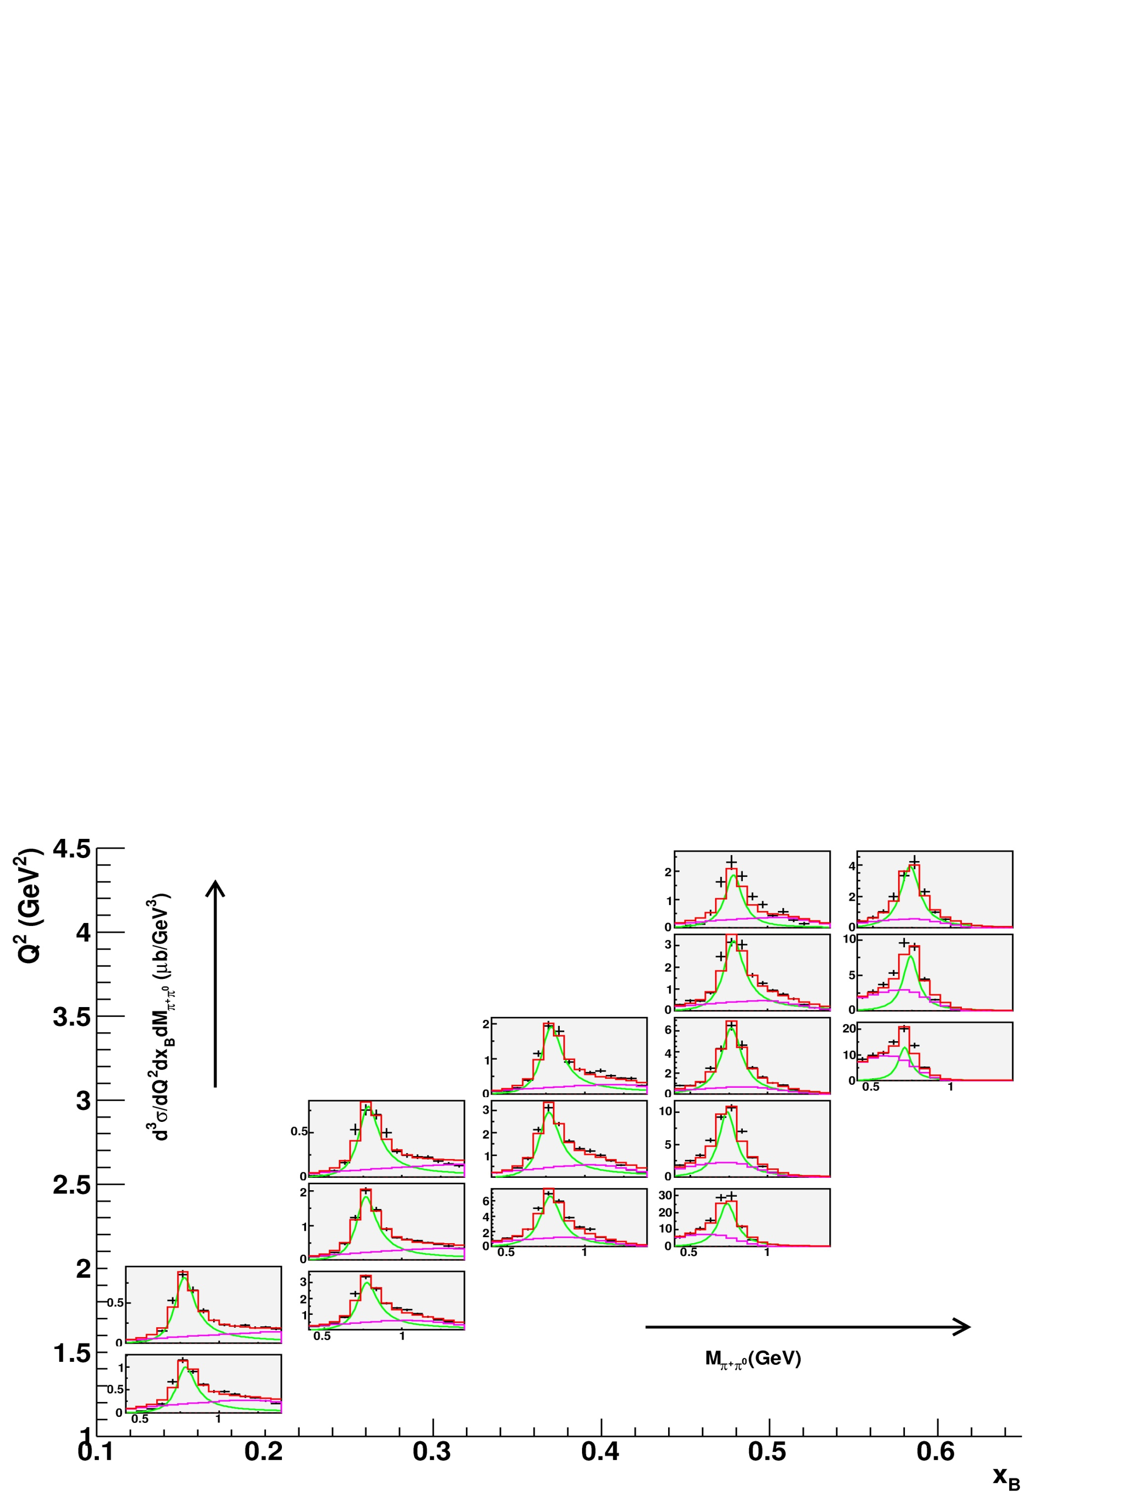
World’s first-ever measurement

Slide 20
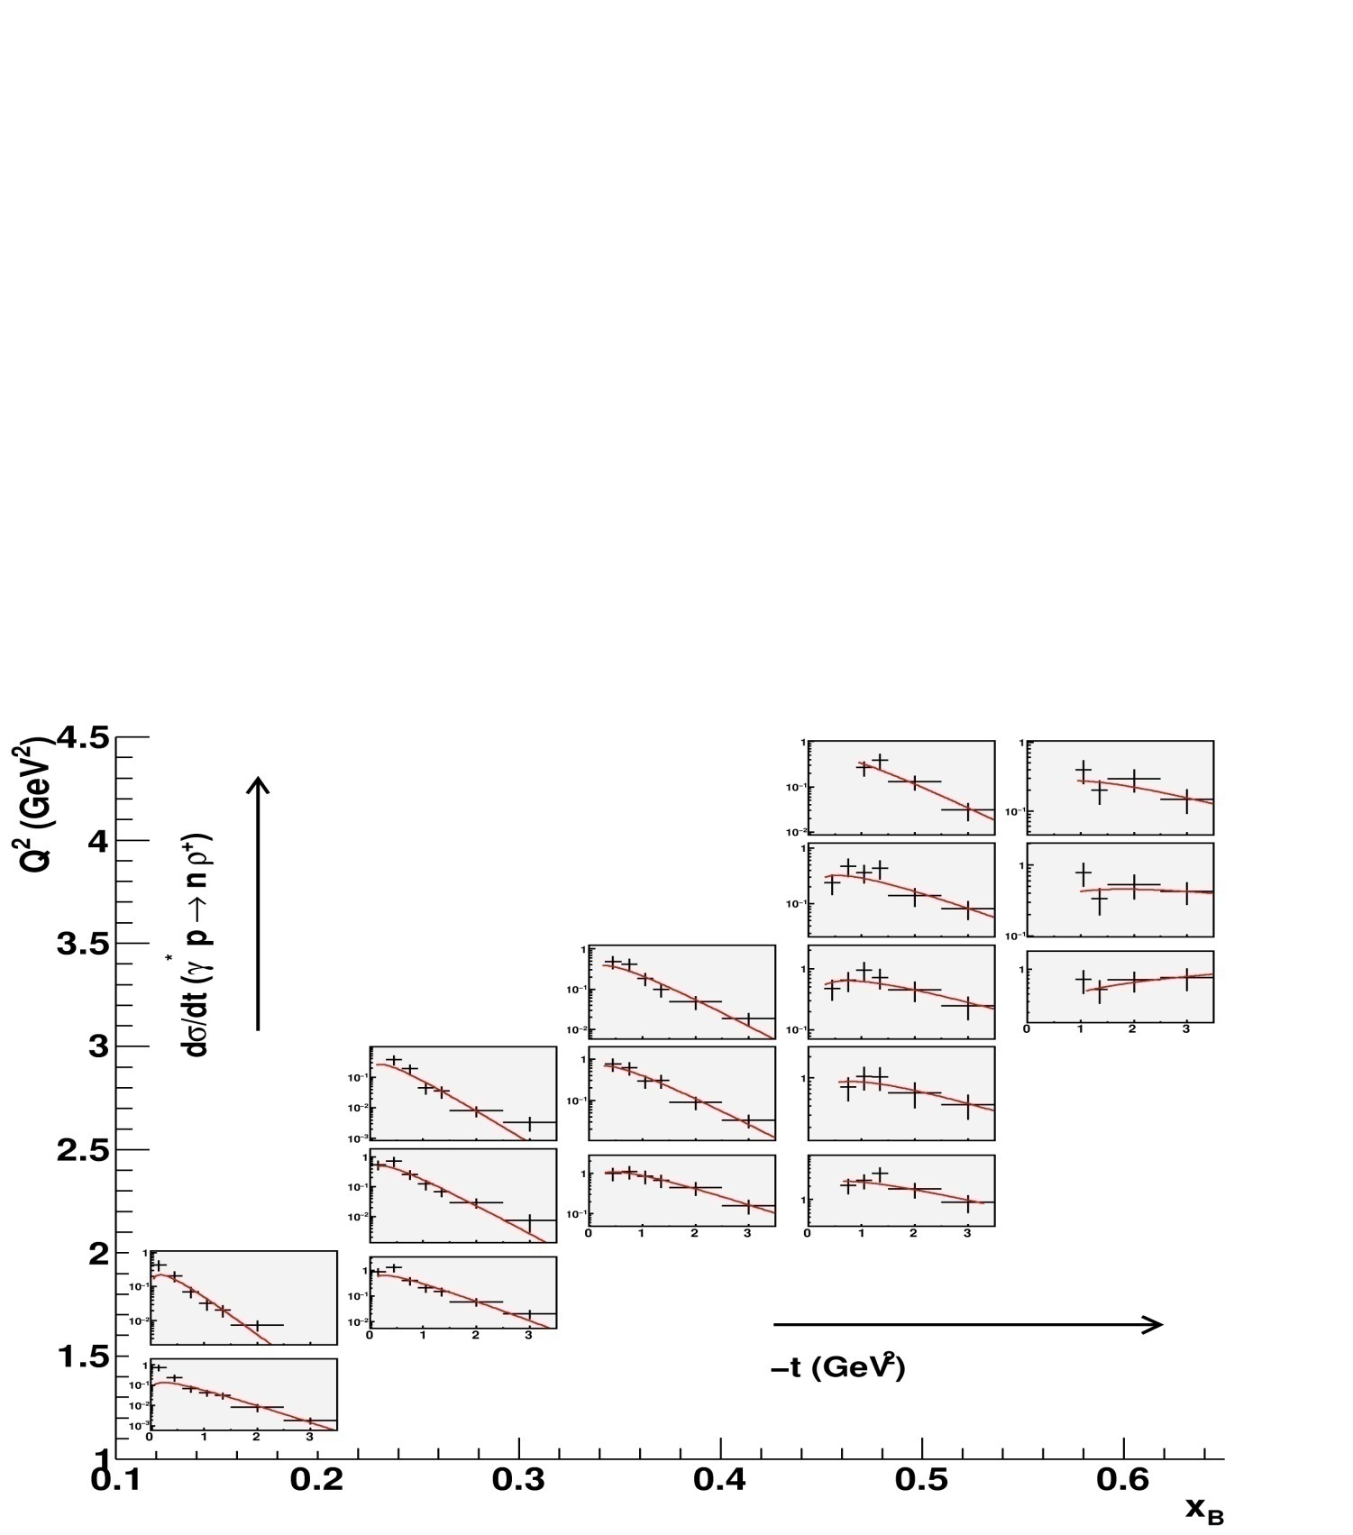
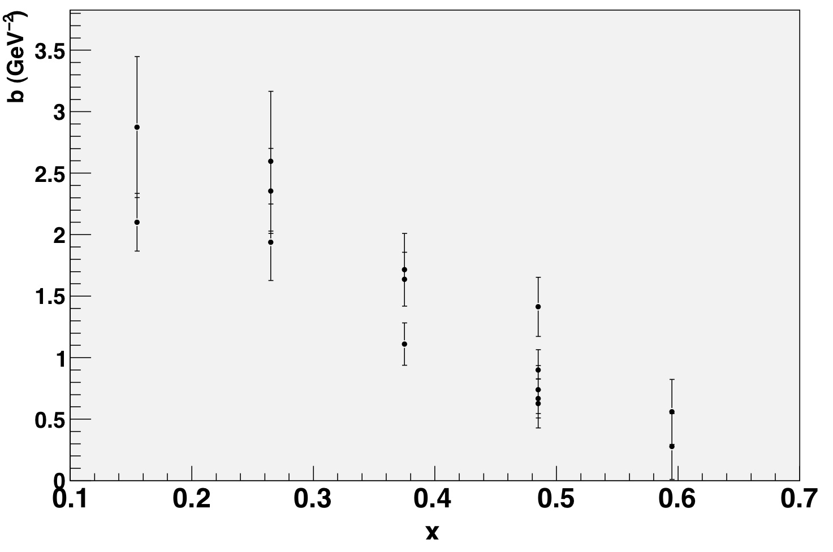
Slope parameter is decreasing with x_{B}
Similar to the π⁰

Slide 21
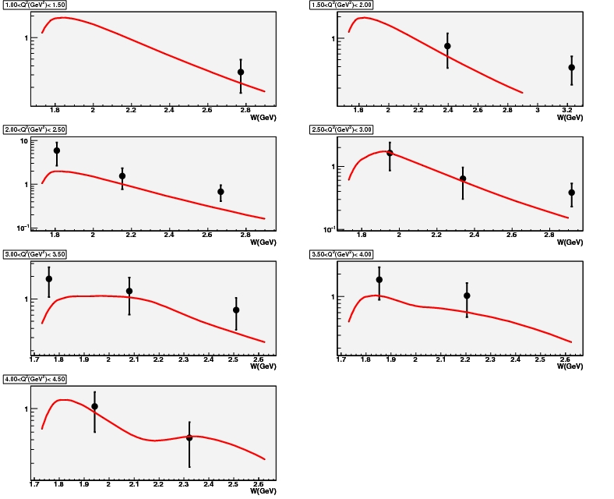
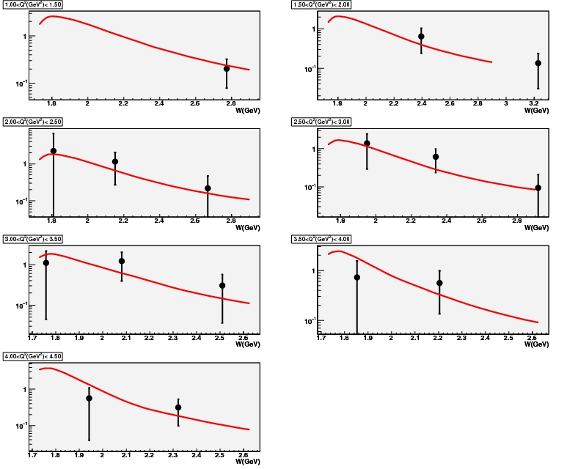
σ_{L} σ_{Τ} separation
SCHC S-channel helicity conservation
σ_{L}
σ_{Τ}
W
W
Red lines (Regge model) :Laget, Phys. Rev. D 65, 074022 (2002)

Slide 22
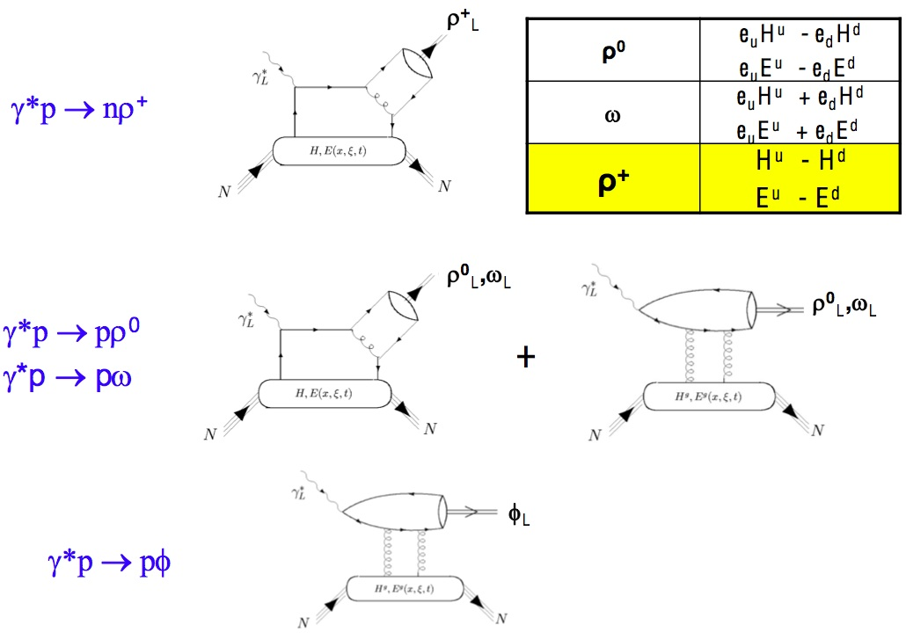
Partonic approach

Slide 23
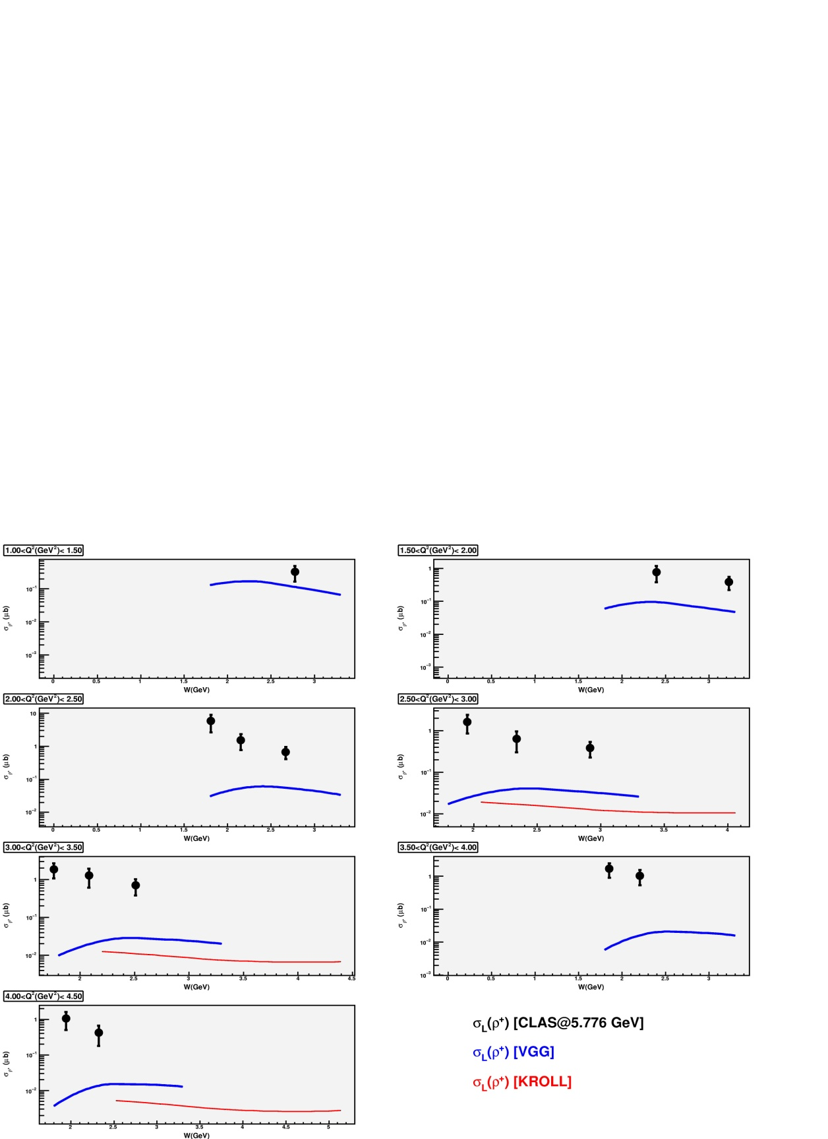
CLAS data
σ_{L}
GPD fails to describe data by more than order of magnitude

Slide 24
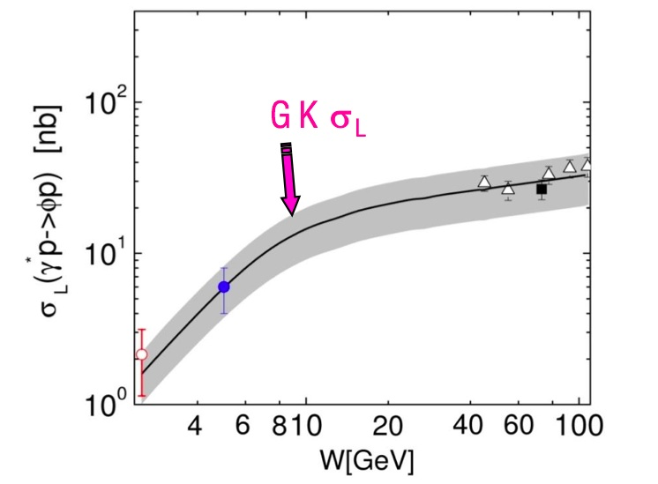
Gluons GPD are dominant for φ mesons
GPD approach describes well data for W>5 GeV
for ρ⁰ and ω channels: handbag for sea quarks and/or gluons is dominant.

Slide 25
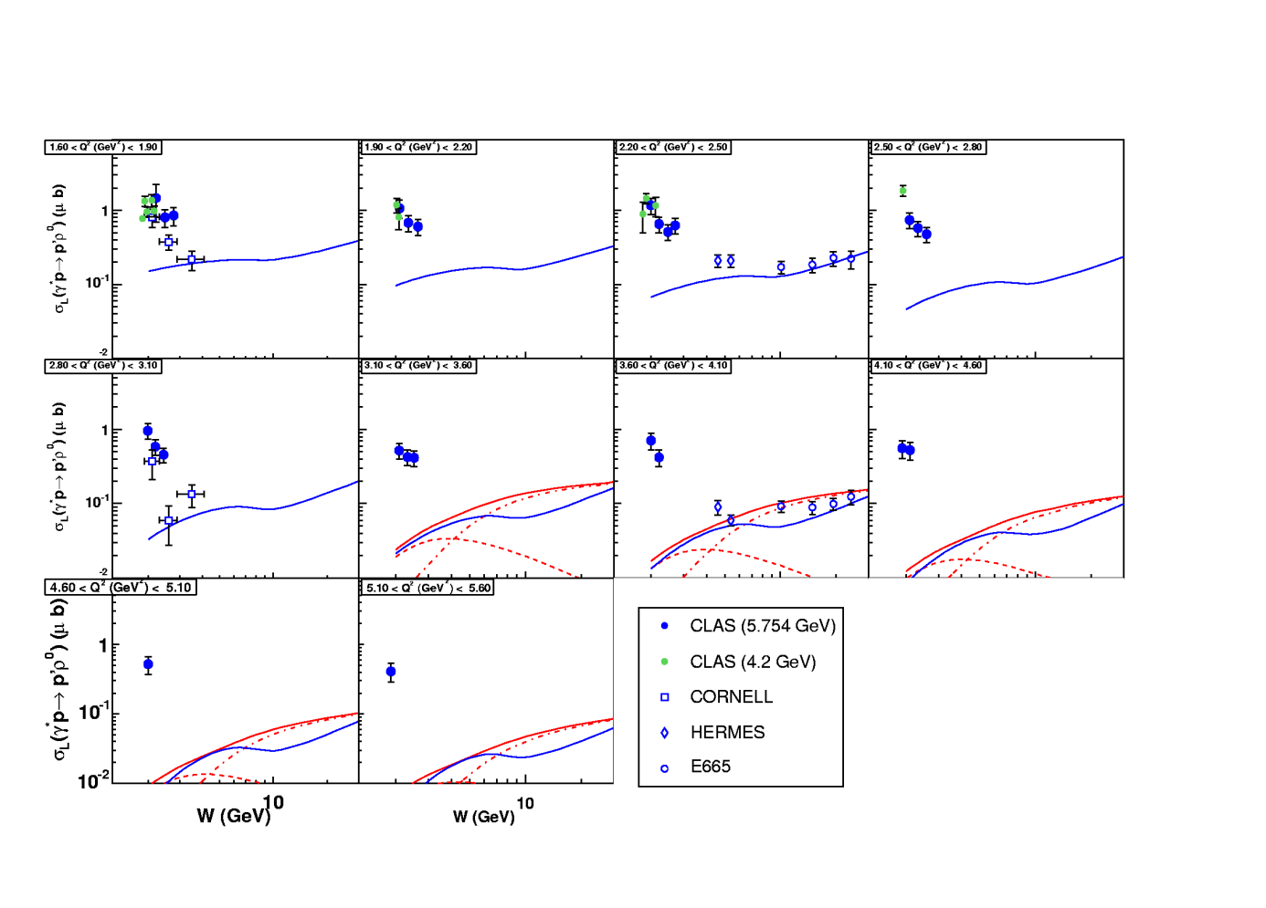
Fails to describe data W<5 GeV
Describes well for W>5 GeV
VGG model
GK model

Slide 26
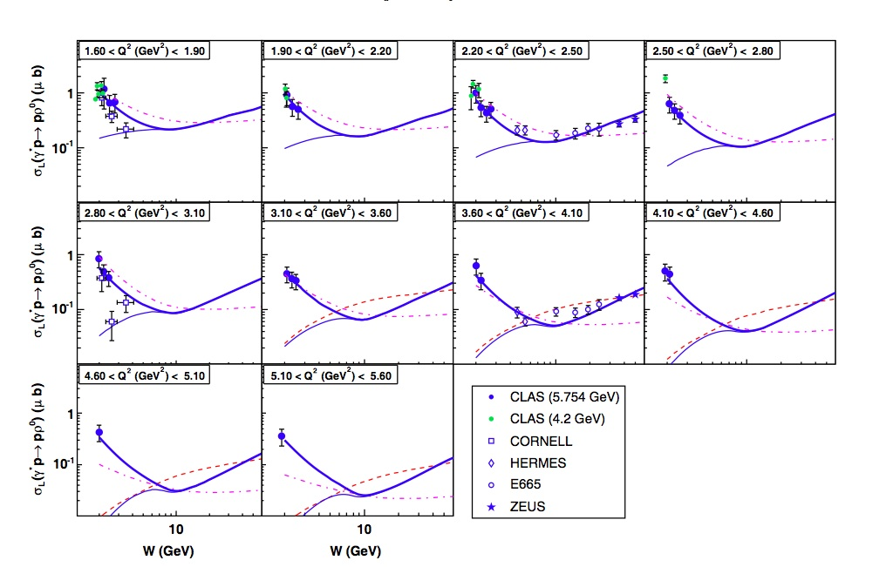
VGG "meson-like contribution"
Popular GK and VGG models can not provide the right W-dependence of
the cross-section
This does not mean that we can’t access GPD in vector meson
electroproduction
For example, adding the so called generalized D-term together with standard
VGG model successfully describes data

Slide 27
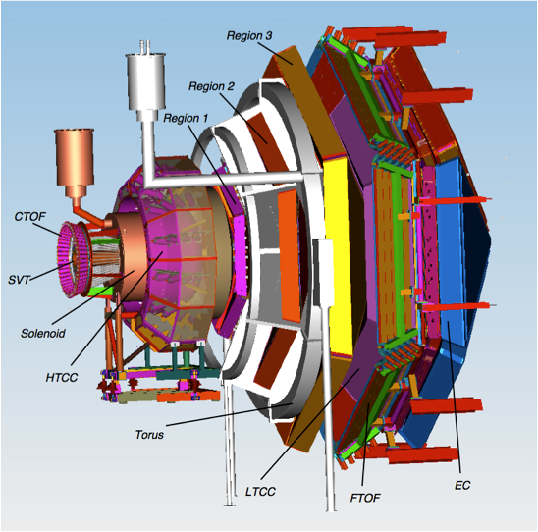
JLab 12 GeV Upgrade
CLAS12
High luminosity
Large acceptance
Wide kinematic coverage
High precision

Slide 28
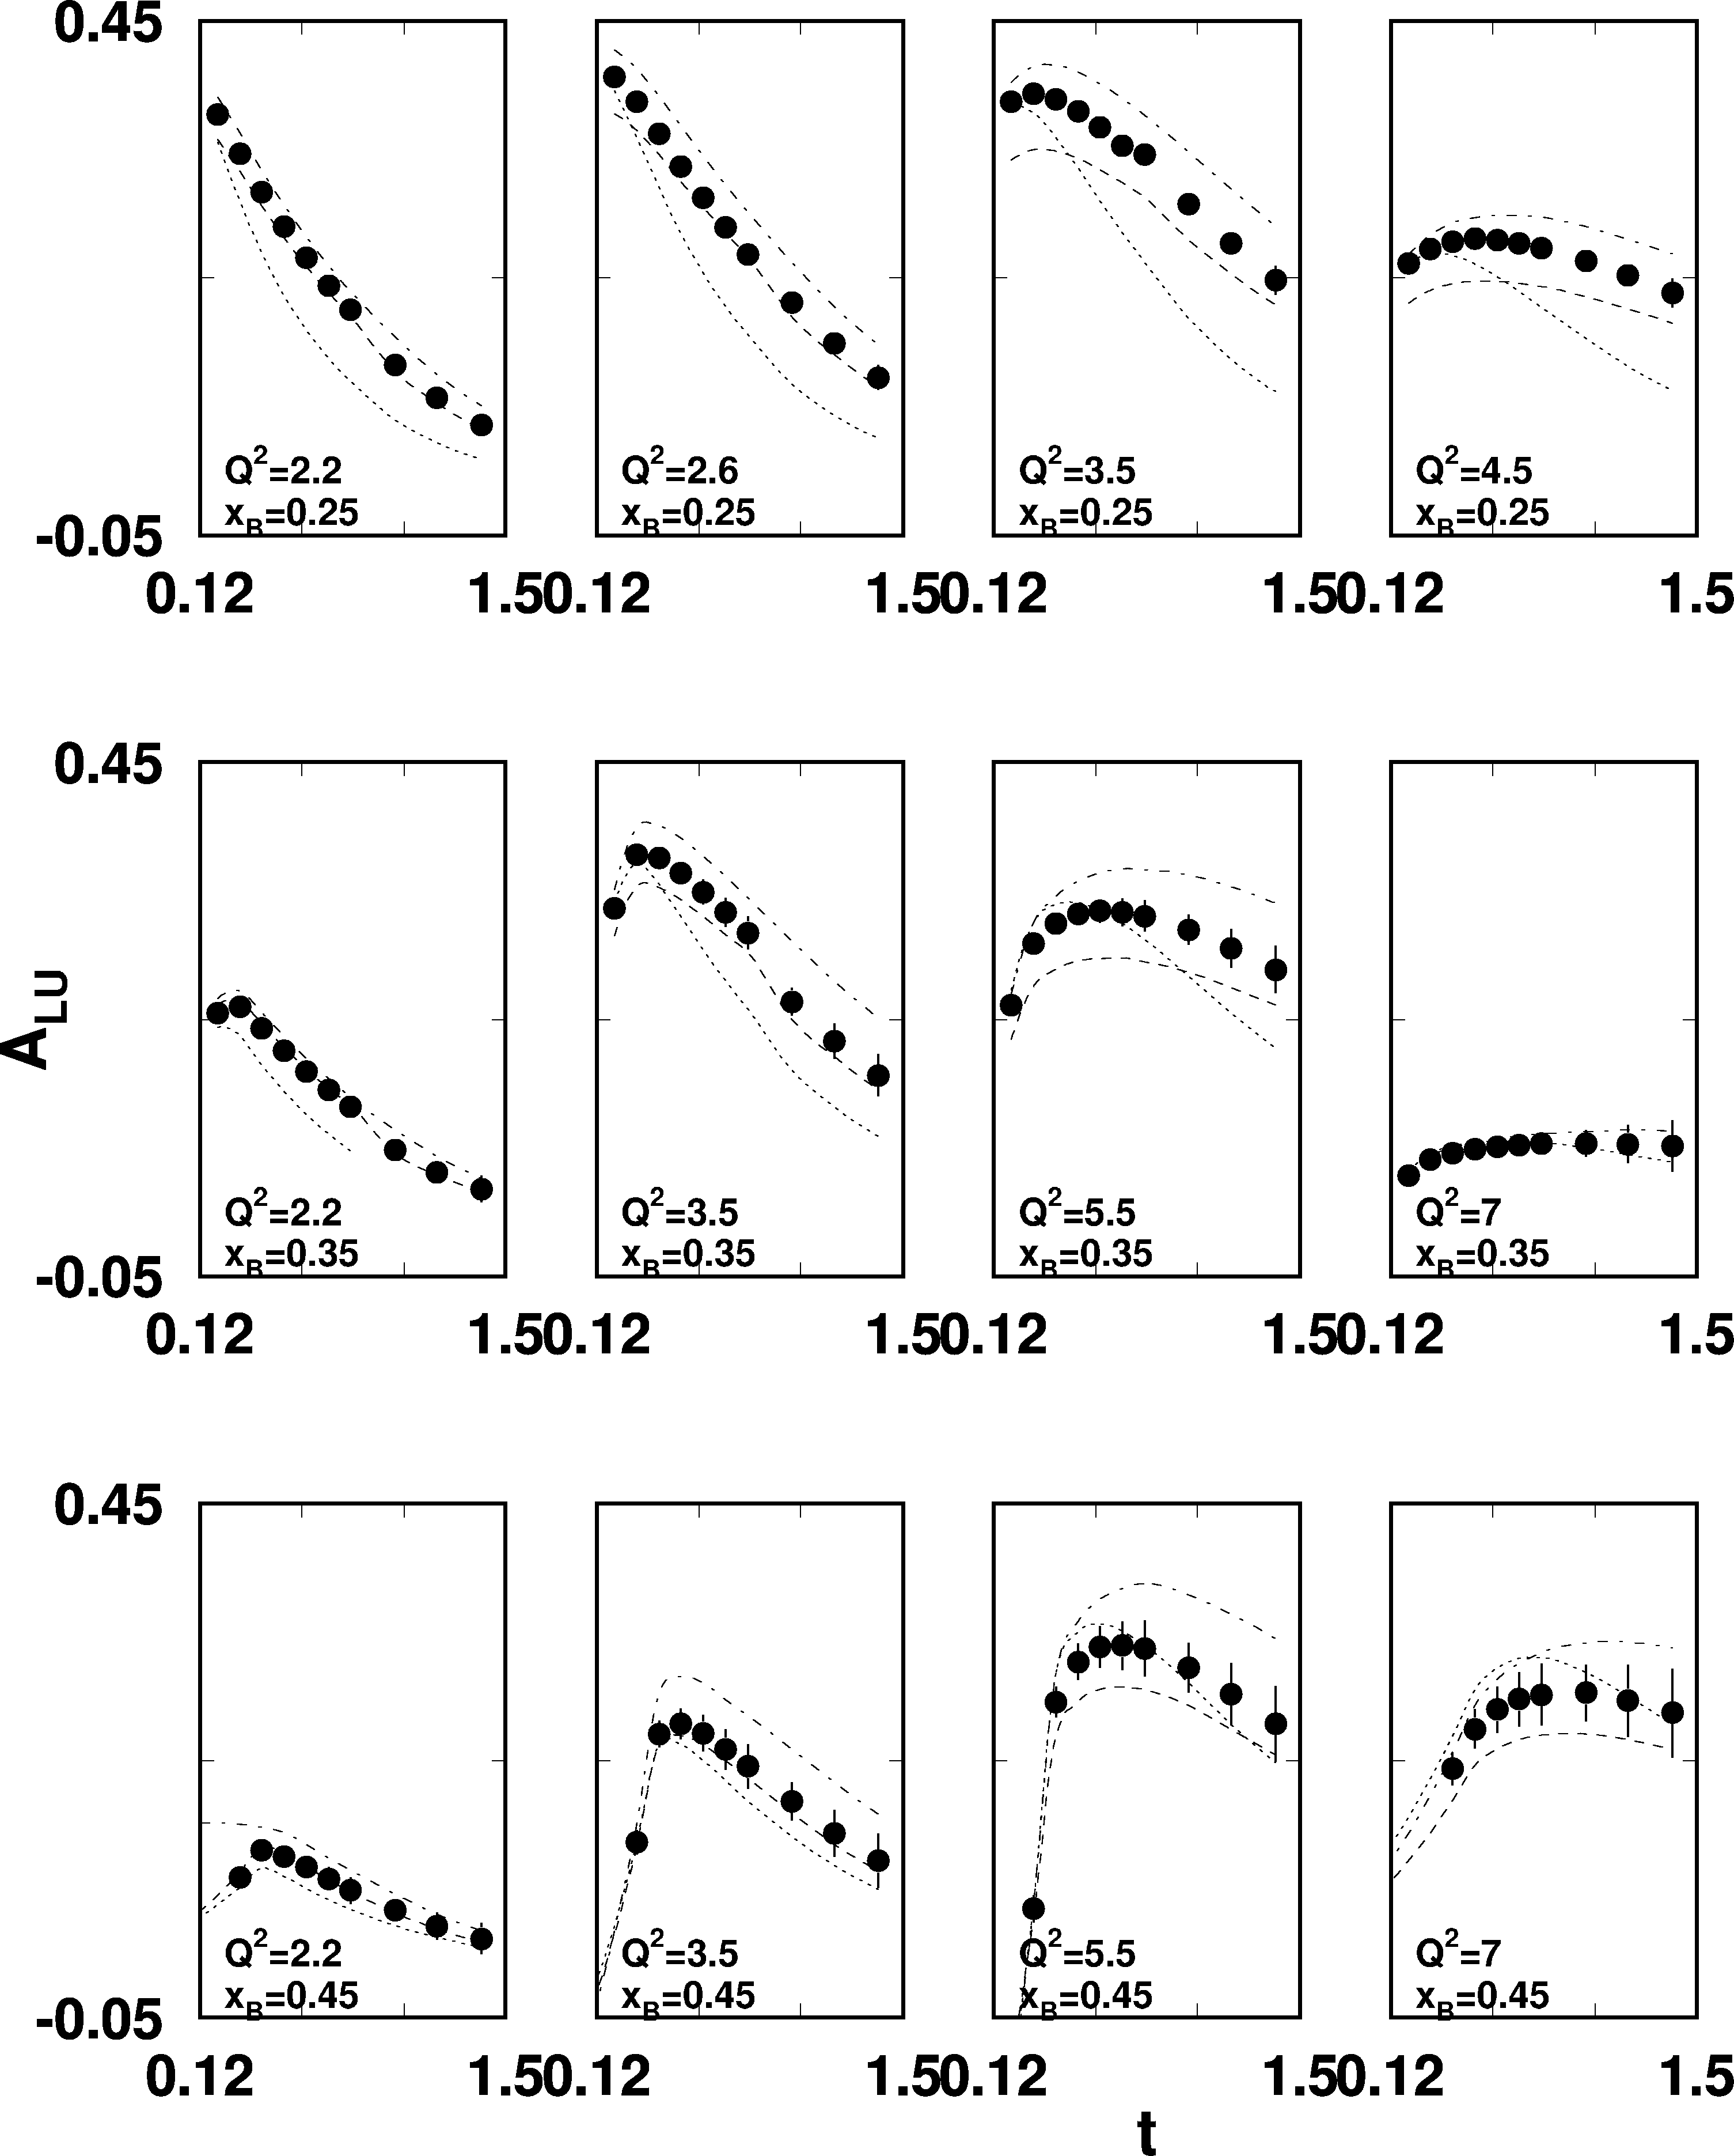
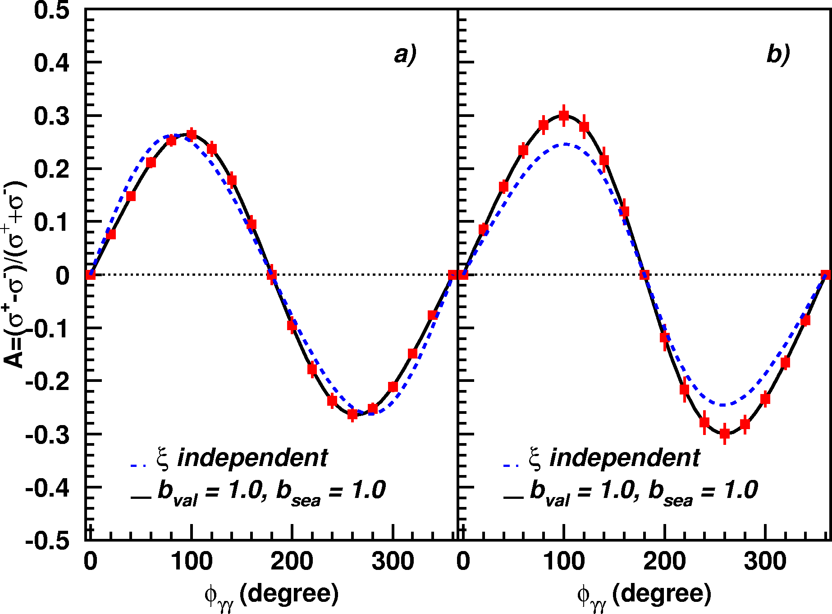
DVCS beam asymmetry at 12 GeV
Q²=5.5GeV²
x_{B} = 0.35
-t = 0.25 GeV²
0.3
0.2
0.1
0
-0.1
-0.2
-0.3
Luminosity = 720fb⁻¹
Kinematics coverage,
Q² < 8 GeV²,
x_{B} < 0.65,
t < 1.5GeV²
Notes:
With CLAS12 spectrometer we will have the possibility to map BSA for example in a broad phase space with extremely high precision.

Slide 29
Summary
CLAS DVCS results were used for the GPD extraction. This is the first step in 3-D imaging of the nucleon
More data coming with H₂ and polarized targets.
The most extensive data set of π⁰, η, ρ⁺,ρ⁰,ω, and φ electroproduction to date has been obtained with the CLAS spectrometer
Cross sections and beam-spin asymmetries were extracted in the valence quark region
The detailed comparison with the Regge model predictions was done. The model describes the data reasonably well
The popular GPD models fail to describe the experimentally measured meson cross sections. The present data provide important input to improve our understanding of these fundamental QCD issues
CLAS12 will continue the GPD study with broader kinematics at 12 GeV machine
2015

