Slide 1


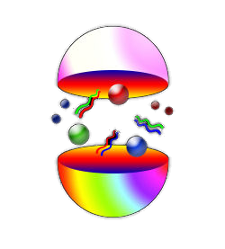
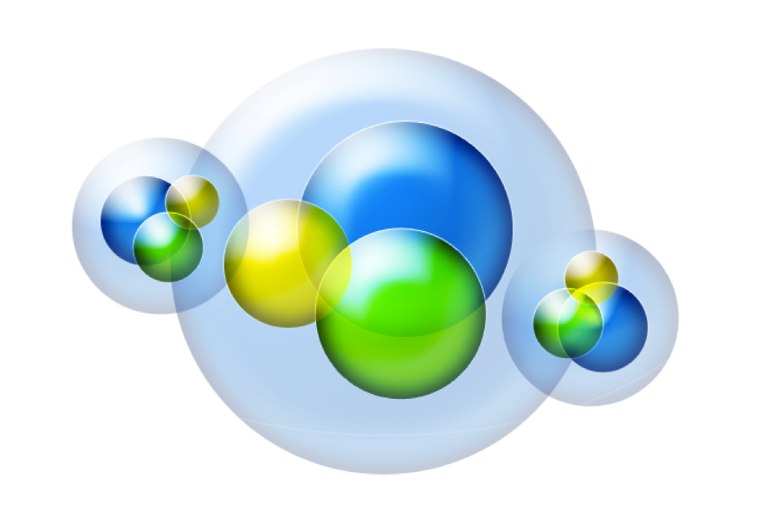





Hadron Spectroscopy with CLAS
Quark Confinement and the Hadron Spectrum IX
Universidad Complutense de Madrid
August 30th – September 3rd, 2010
Eugene Pasyuk

Slide 2
Outline
Why Hall-B at Jefferson Lab is very special place
Hadron spectroscopy status
CLAS12

Slide 3
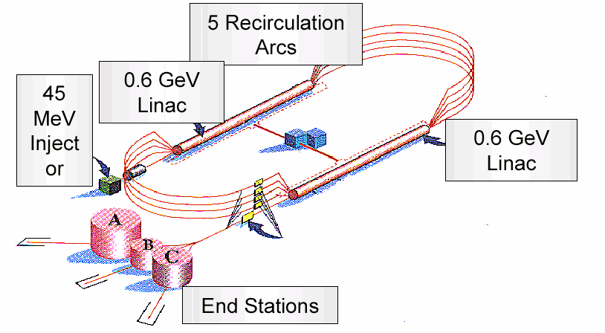
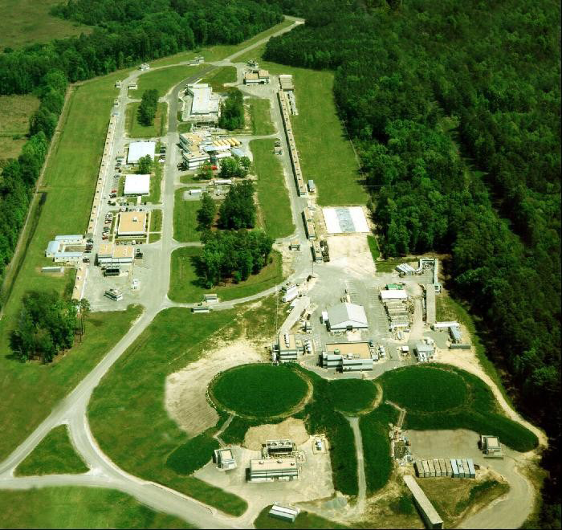
CEBAF
Emax ~ 6 GeV
Imax ~ 200 A
Duty Factor ~ 100%
E/E ~ 2.5 10⁻⁵
Beam P ≥ 85%
E ~ 0.5-5.8 GeV tagged
Hall-B

Slide 4
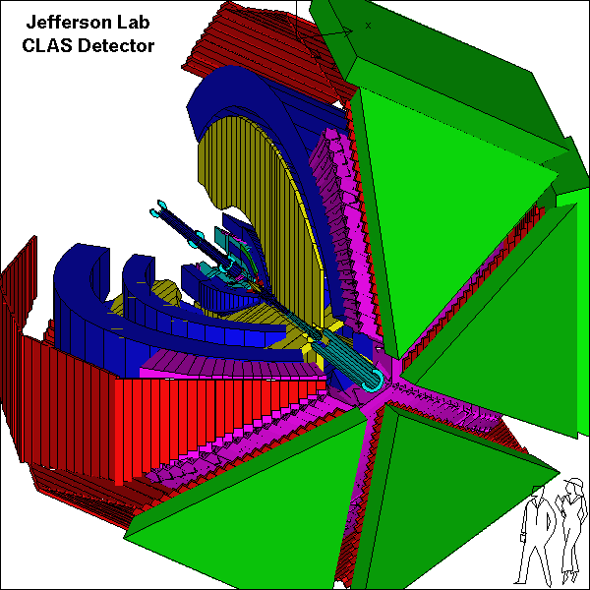
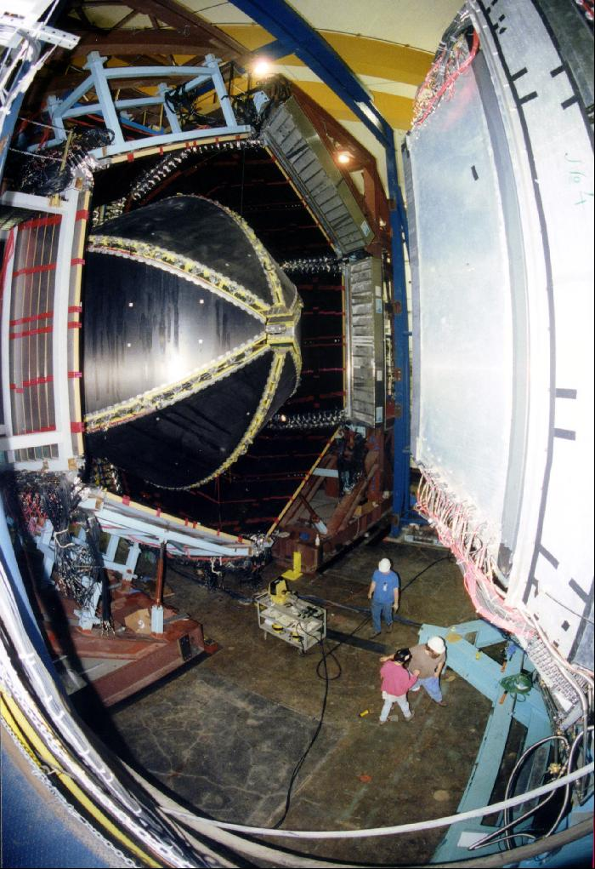
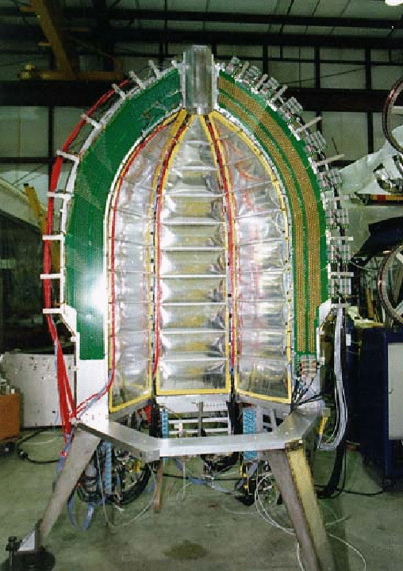
CEBAF Large Acceptance Spectrometer
Torus magnet
6 superconducting coils
Electromagnetic calorimeters
Lead/scintillator, 1296 photomultipliers
target + start counter
Drift chambers
35,000 cells
Time-of-flight counters
plastic scintillators, 684 photomultipliers
Gas Cherenkov counters
e/π separation, 256 PMTs

Slide 5
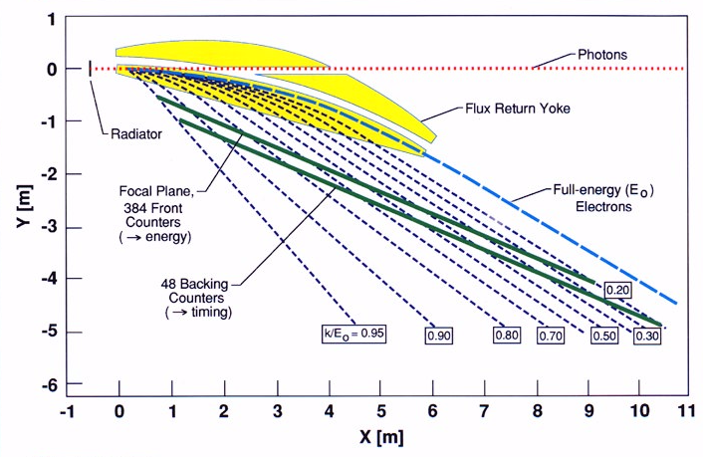
Hall B Photon Tagger
61 backing counters
E_{γ} = 20-95% of E₀
E_{γ} up to ~5.8 GeV
dE/E ~10⁻³ of E₀

Slide 6
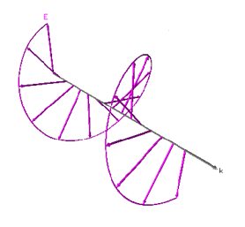
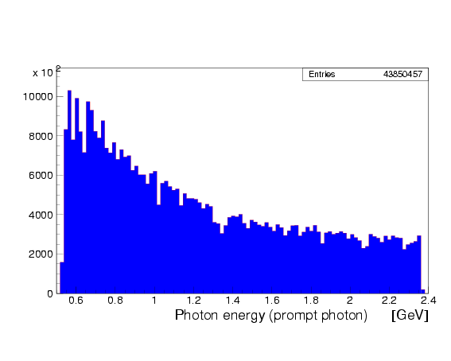
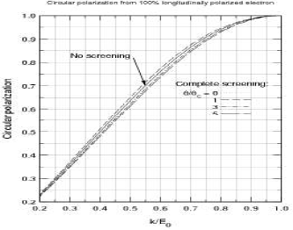
Circularly polarized photons
Circularly polarized beam produced by longitudinally polarized electrons
CEBAF electron beam polarization >85%
tagged flux ~ 50 - 100MHz for k>0.5 E₀
Circular polarization from 100% polarized electron beam
Circular polarization

Slide 7
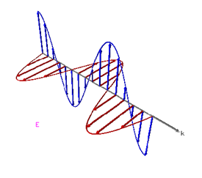
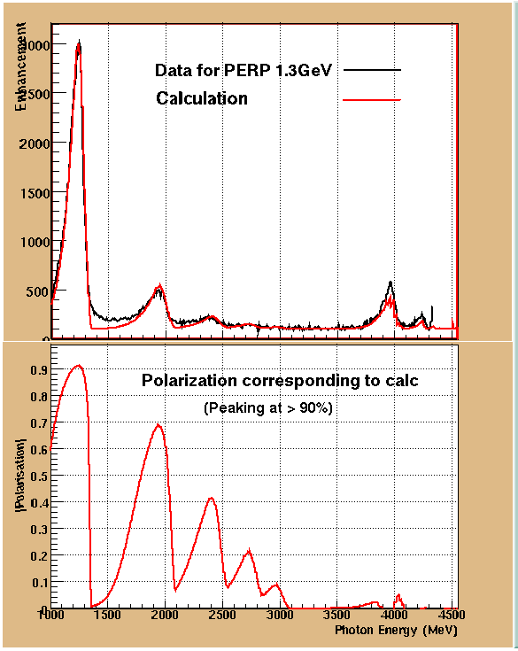
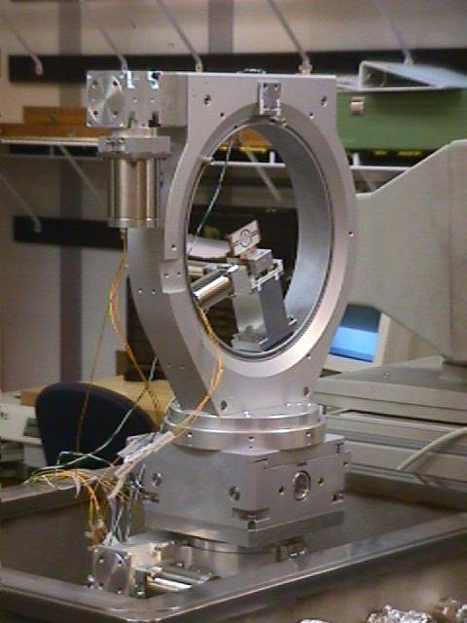
Linearly polarized photons
Linearly polarized photons: coherent bremsstrahlung on oriented diamond crystal

Slide 8
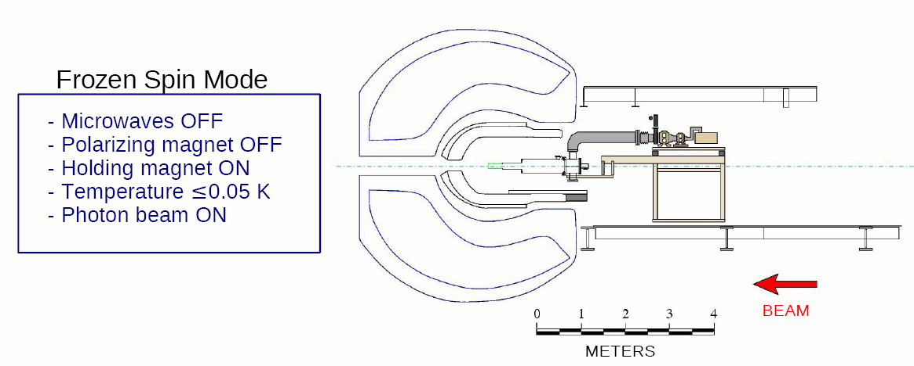
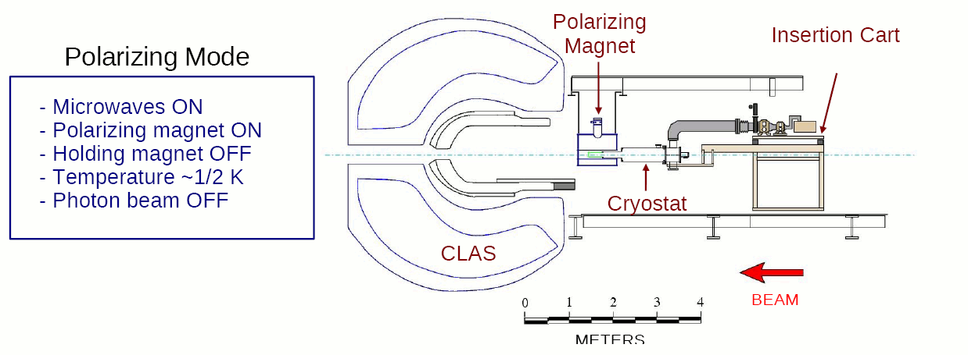
FROzen Spin Target

Slide 9
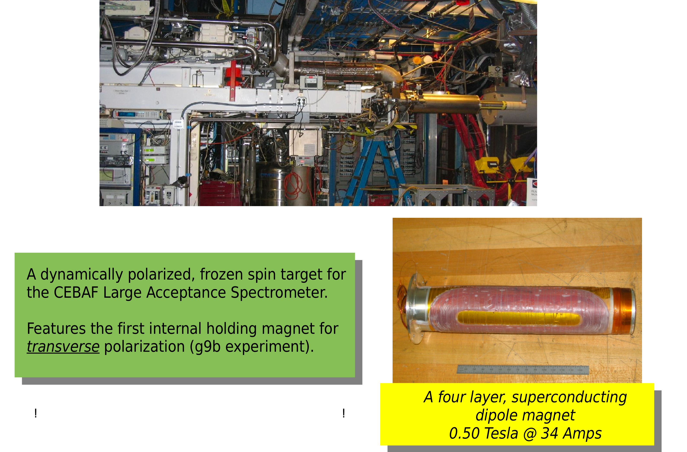
FROST during g9 experiments

Slide 10
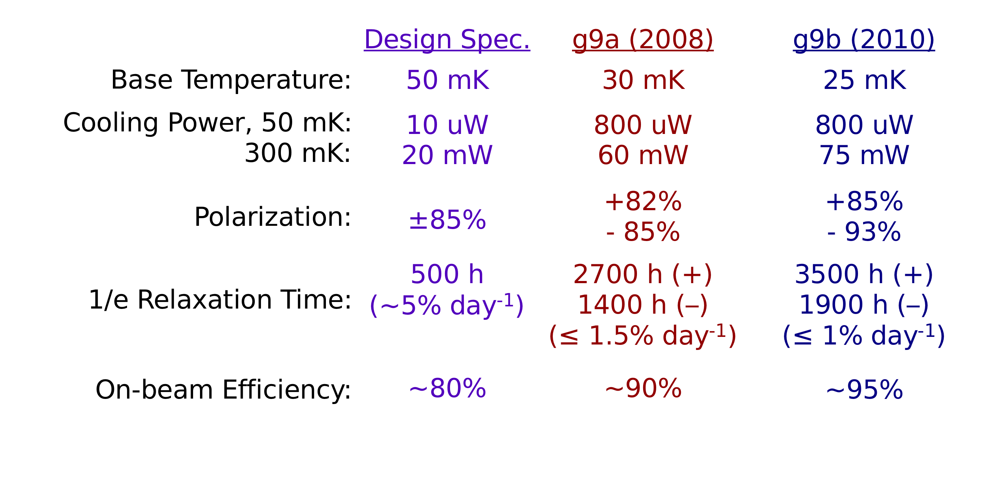
Performance of FROST during g9 experiment
longitudinal
transverse

Slide 11
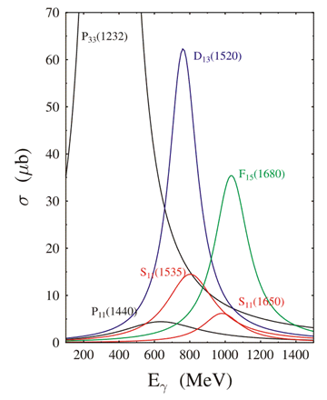
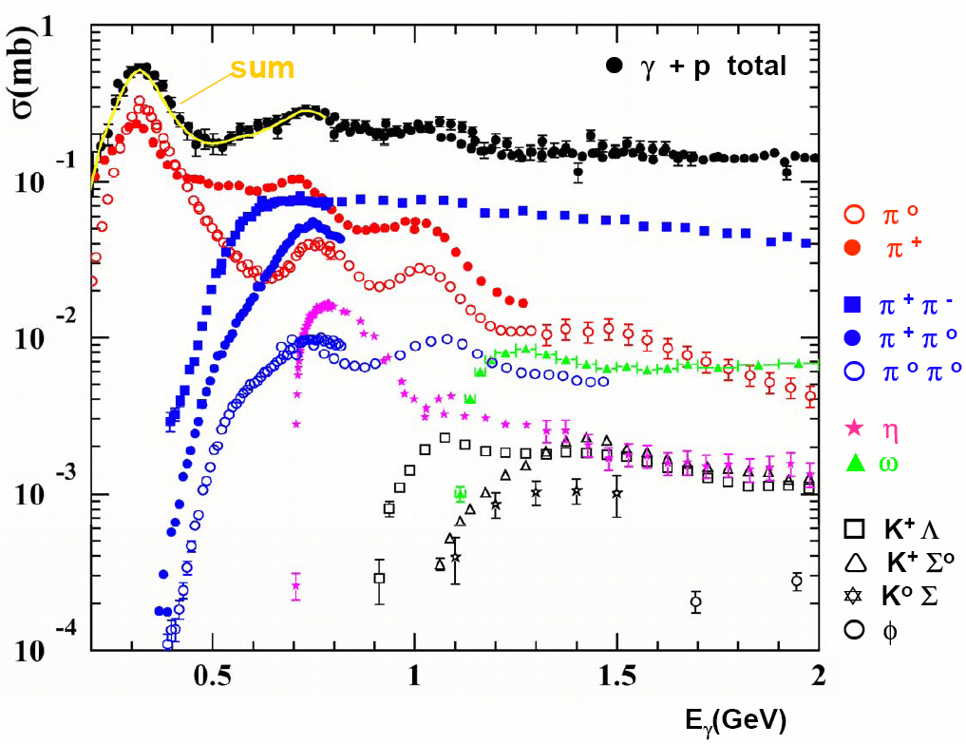
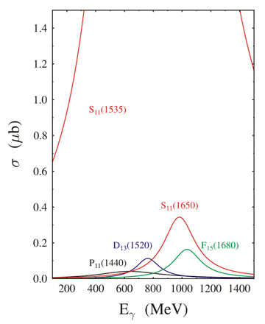
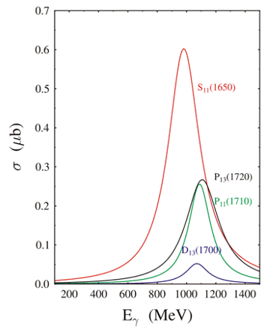
Photonuclear cross sections

Slide 12
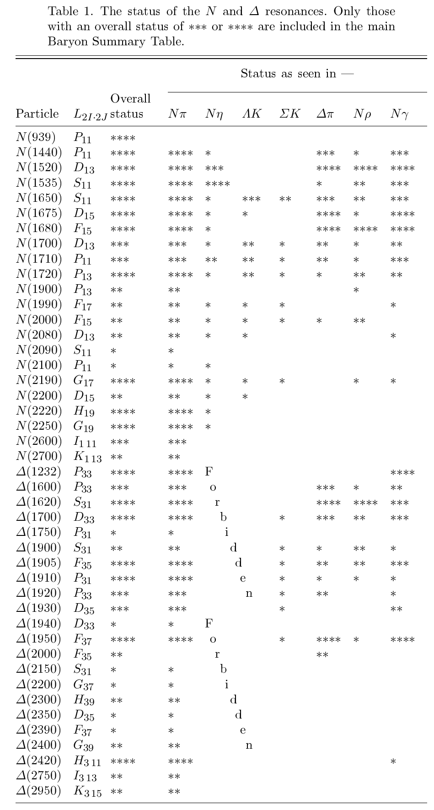
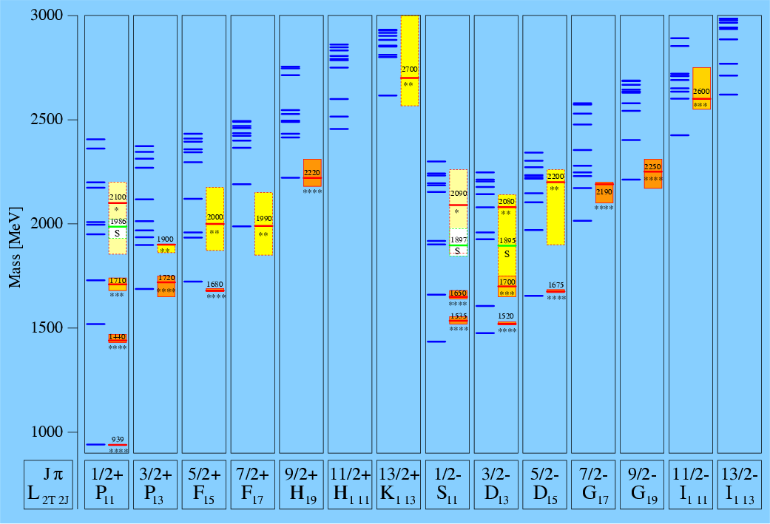
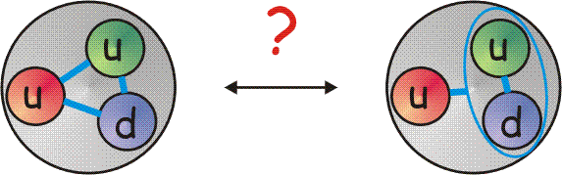
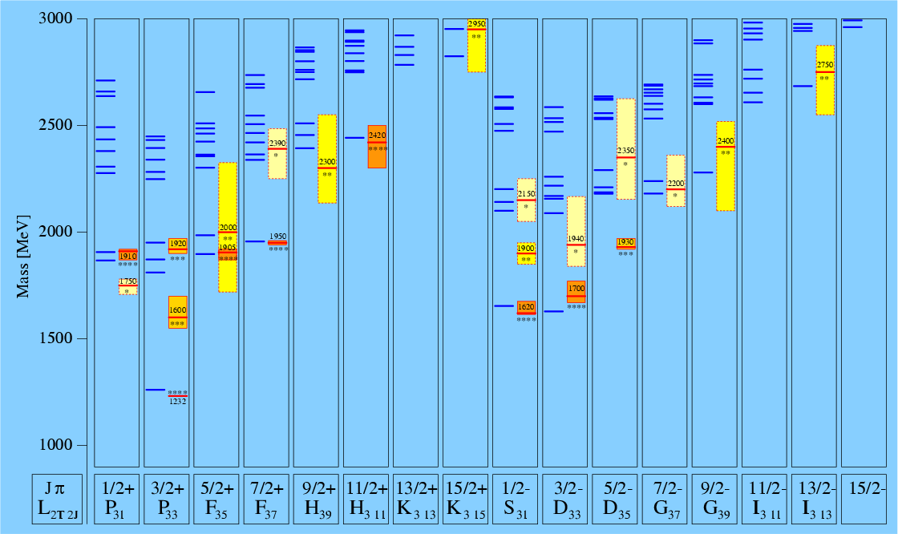
Baryon Resonance Spectrum
N*
Δ

Slide 13
From the Experiment to Theory
Experiment
cross section,
spin observables
σ,dσ/dΩ,Σ,P,T
(beam-target) E,F,G,H,
(beam-recoil) C_{x},C_{z},O_{x},O_{z},
(target-recoil) L_{x},L_{z}, T_{x},T_{z},
Amplitude analysis
→multipole amplitudes
→phase shifts
Reaction Theory
dynamical frameworks
Theory
LQCD,
quark models,
QCD sum rules,
…
Coupled channels:
resonance parameter
extraction

Slide 14
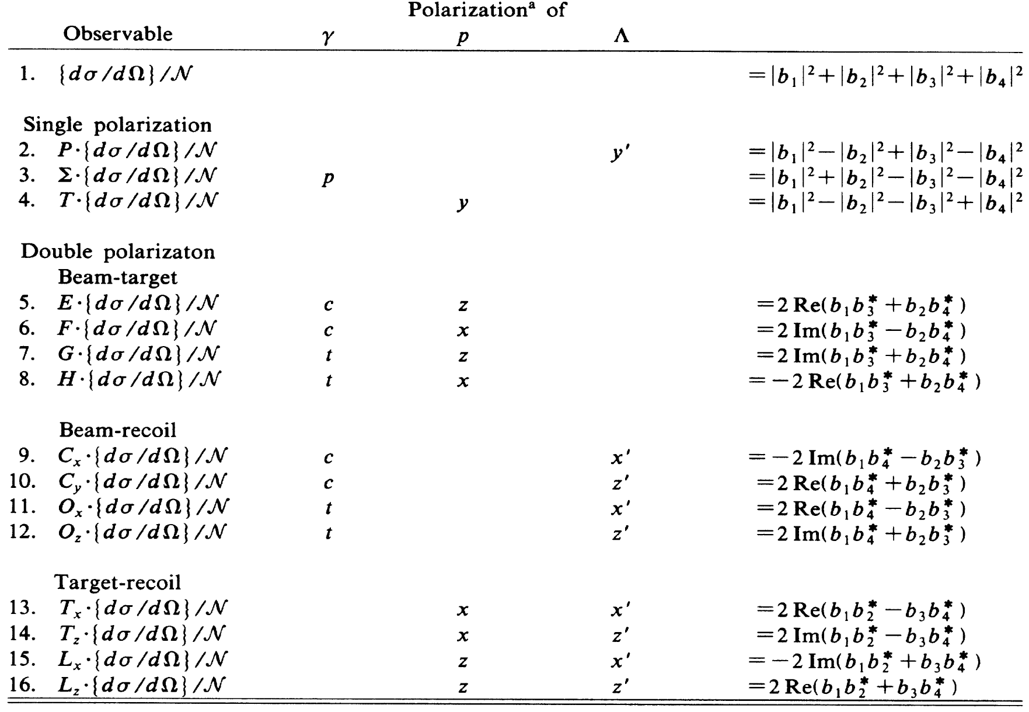
Polarization observables in pseudoscalar meson production
4 Complex amplitudes - 16 real polarization observables.
A complete measurement from 8 carefully chosen observables.
I. S. Barker, A. Donnachie, J. K. Storrow, Nucl. Phys. B95, 347 (1975).

Slide 15
What we measure with CLAS
γp→π⁰p, π⁺n
γp→ηp
γp→η’p
γp→KY (K⁺Λ, K⁺Σ⁰, K⁰Σ⁺)
γp→π⁺π⁻p ωp, ρp, ϕp
γnπ⁻p
γn→π⁺π⁻n
γnΣ⁻K⁺ , ΛK⁰ …..

Slide 16
η’ photoproduction
1968: 11 events from the ABBHHM bubble chamber experiment
1976: 7 events from the AHHM streamer chamber experiment
1998: 250 events from the SAPHIR collaboration (first differential cross sections)
2006: over 2×10⁵ events from the CLAS collaboration
2009: another few orders of magnitude from CLAS g11 data set

Slide 17
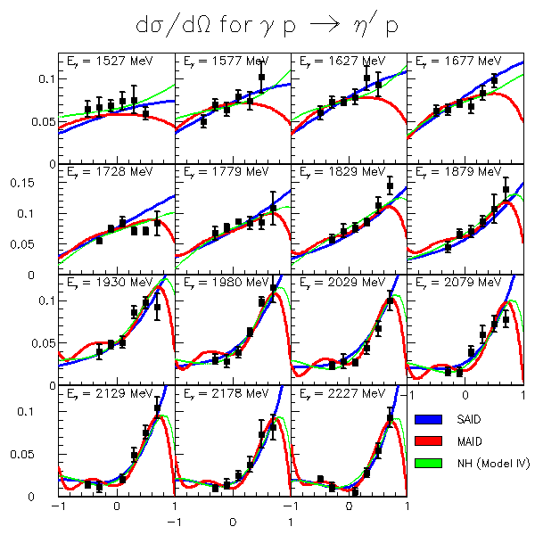
γp→η′p
SAID
MAID
NH (K. Nakayama and H. Haberzettl)
M. Dagger et al. PRL 96, 062001 (2006)

Slide 18
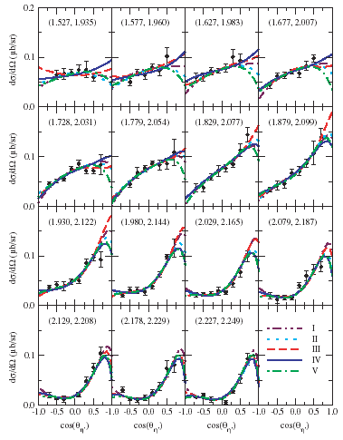
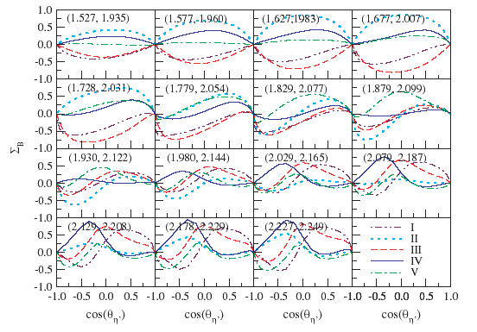
γp→η′p
K. Nakayama and H. Haberzettl, Phys. Rev. C 73, 045211 (2006).
Different versions of the model yield similar results for cross section, but quite different predictions for beam asymmetry
Predictions for beam asymmetry are quite different
M. Dugger et al. PRL 96, 062001 (2006)

Slide 19
Variants of model
I
II
III
IV
V
S₁₁(2090)
P₁₁(2100)
P₁₃(1900)
D₁₃(1700)
g_{η´NN} = 0.43
S₁₁(2090)
P₁₁(2100)
P₁₃(1900)
D₁₃(1700)
D₁₃(2080)
g_{η´NN} = 0.25
S₁₁(1535)
S₁₁(1650)
S₁₁(2090)
P₁₁(1710)
P₁₁(2100)
P₁₁(2400)
P₁₃(1900)
D₁₃(1700)
D₁₃(2080)
g_{η´NN} = 1.33
S₁₁(1535)
S₁₁(2090)
P₁₁(1710)
P₁₁(2100)
D₁₃(1700)
D₁₃(2080)
g_{η´NN} = 0.002
S₁₁(1535)
S₁₁(1650)
S₁₁(2090)
P₁₁(1710)
P₁₁(2100)
P₁₃(1720)
P₁₃(1900)
D₁₃(1520)
D₁₃(1700)
D₁₃(2080)
g_{η´NN} = 1.91

Slide 20
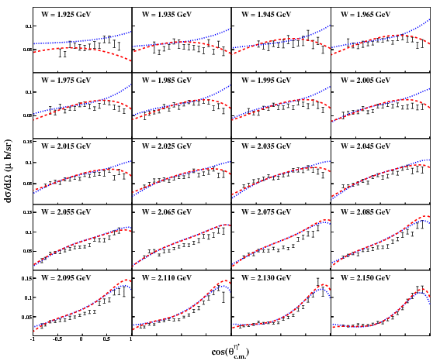
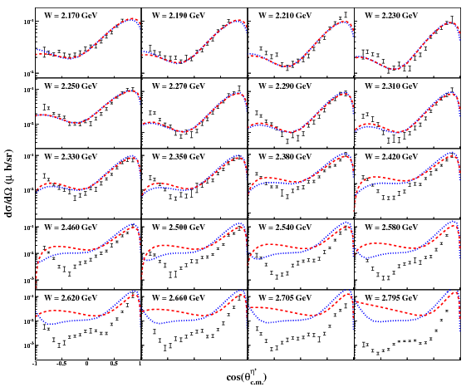
γp→η′p
M. Williams et al. PRC 80, 045213 (2009)

Slide 21
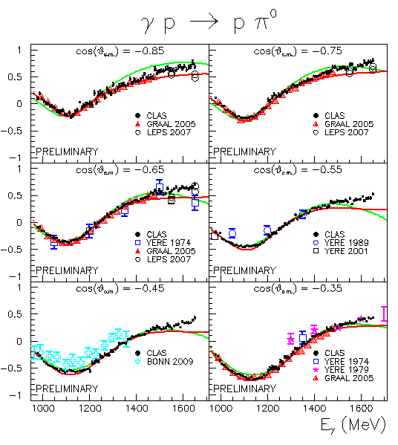
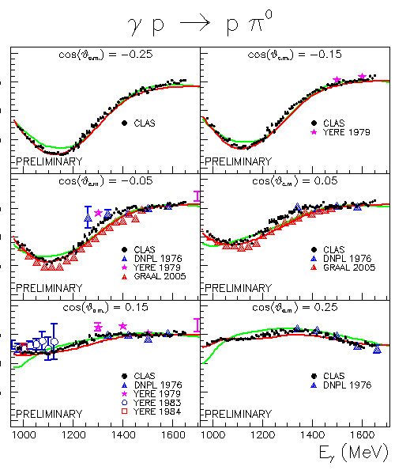
γp→π⁰p Photon asymmetry Σ
M. Dugger MENU210

Slide 22
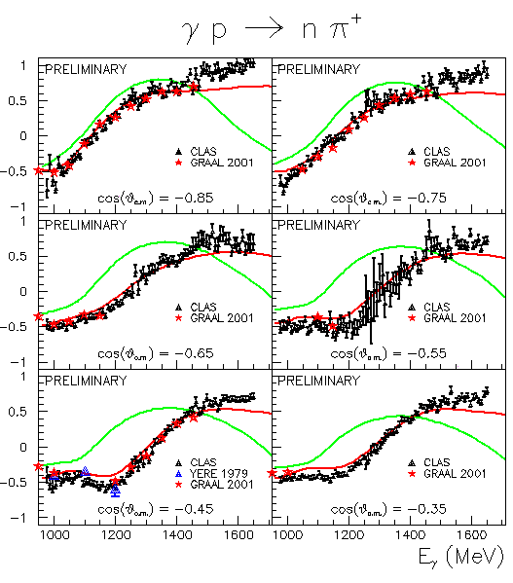
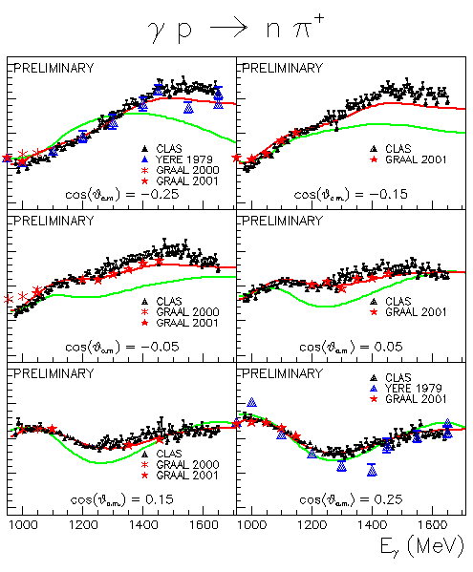
γp→π⁺n Photon asymmetry Σ
M. Dugger MENU210

Slide 23
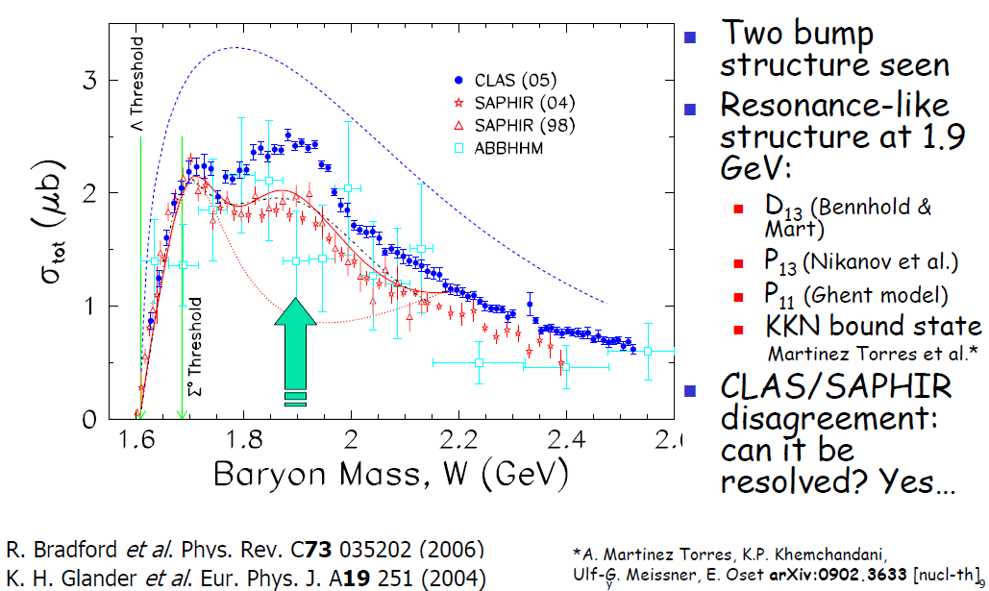
γp→K⁺Λ Cross Sections
R. Schumacher

Slide 24
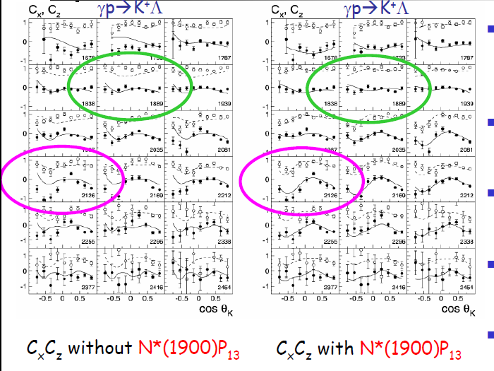
γp→K⁺Λ: Cx/Cz
Nikanov et al’.’s refit of Bonn-Gachina multi-coupled-channel isobar model
mix includes: S11 wave, P13(1720), P13(1900), P11(1840)
K⁺Σ⁰cross sections also better described with P13(1900)
Promote this “missing”resonance from ** to **** status.
P13(1900) is found in qqq quark models, but not in quark-diquark models
Bradford et al.

Slide 25
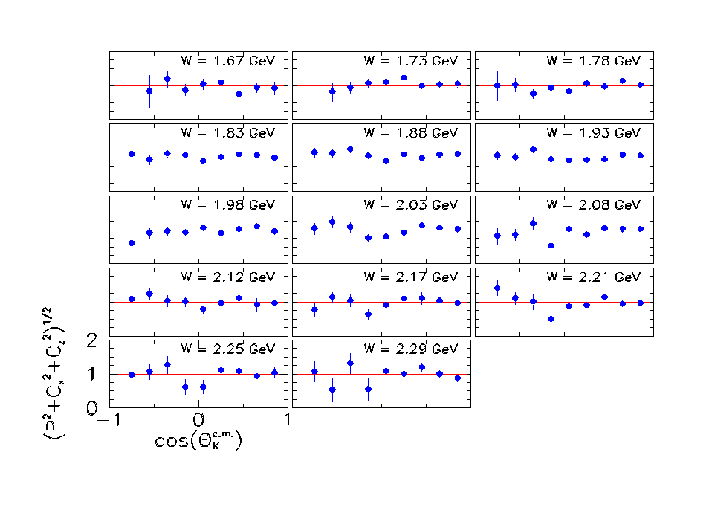
R Values for the ☹
The Λ appears 100% polarized when created with a fully polarized beam.

Slide 26
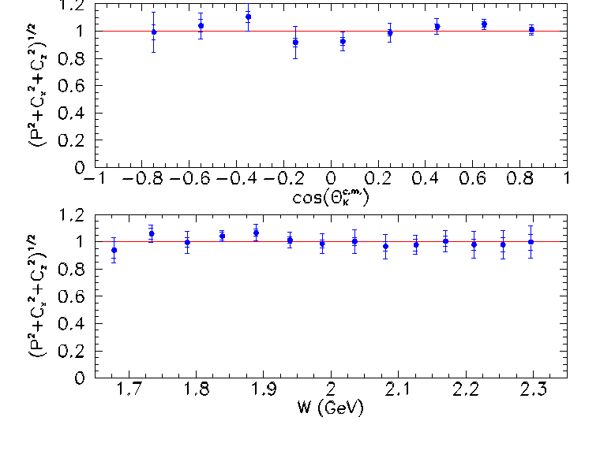
Average R values
Energy and angle averages are consistent with unity.
No such effect for Σ⁰
No model predicted this CLAS result.

Slide 27
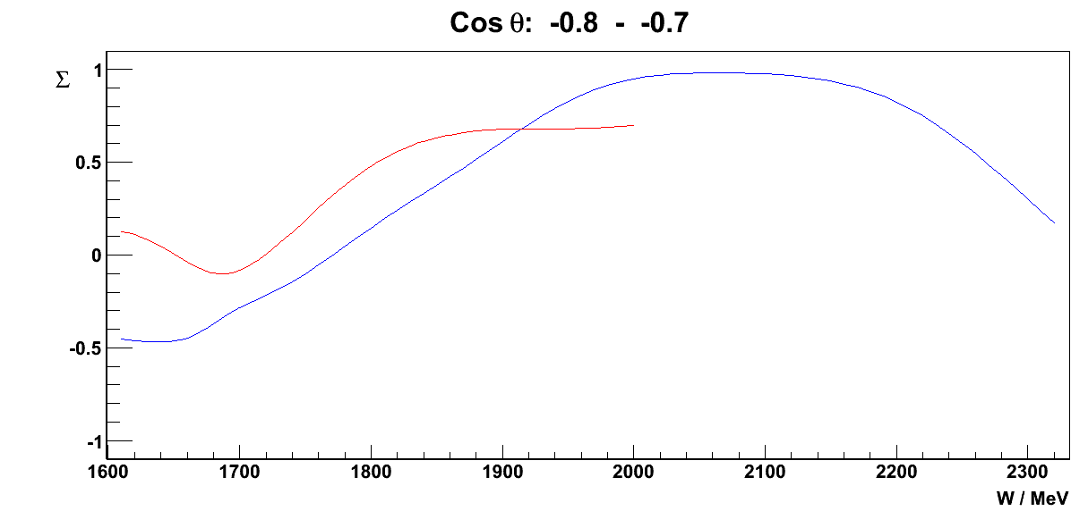
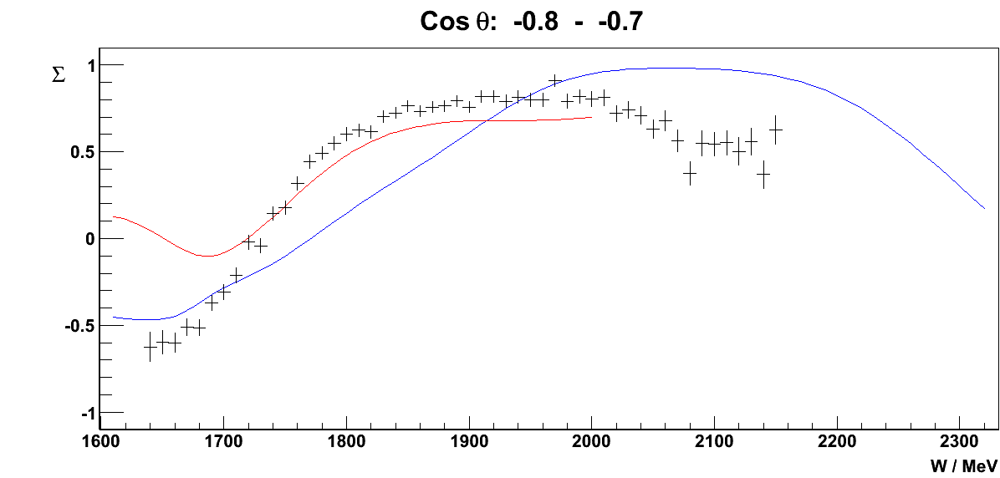
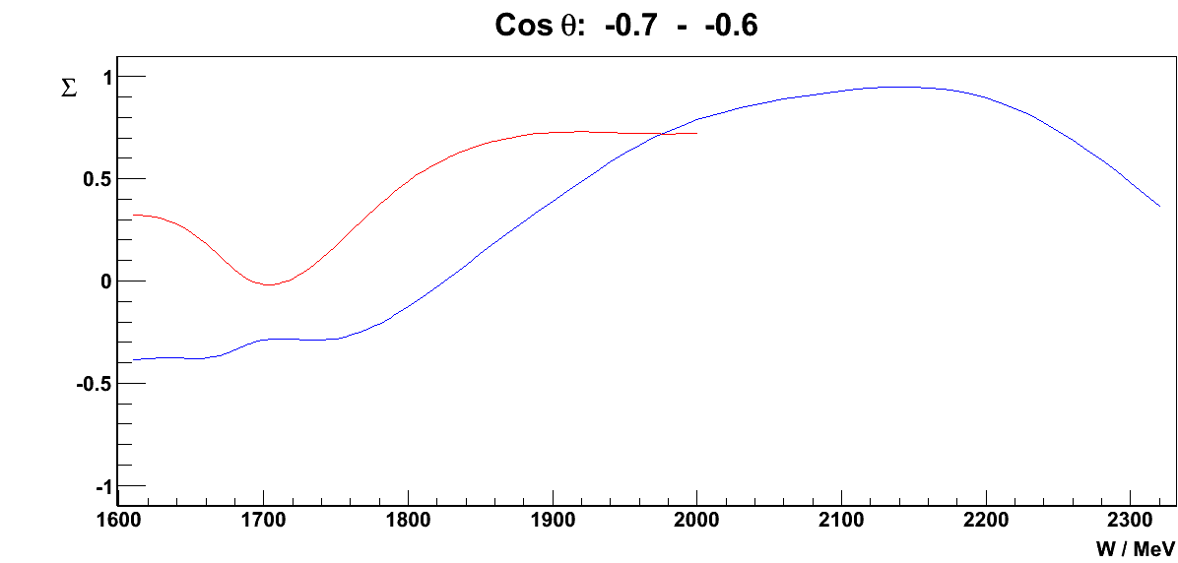
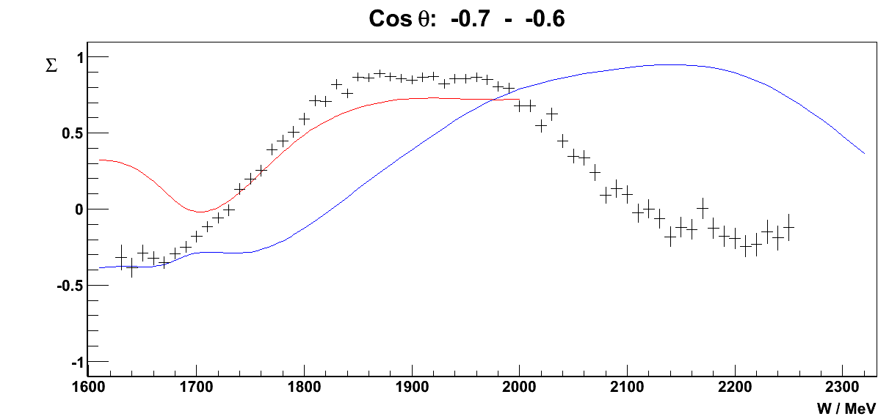
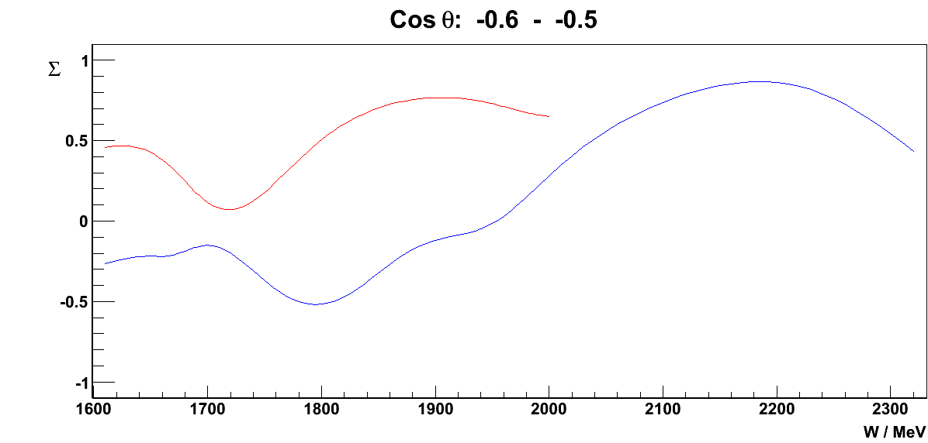
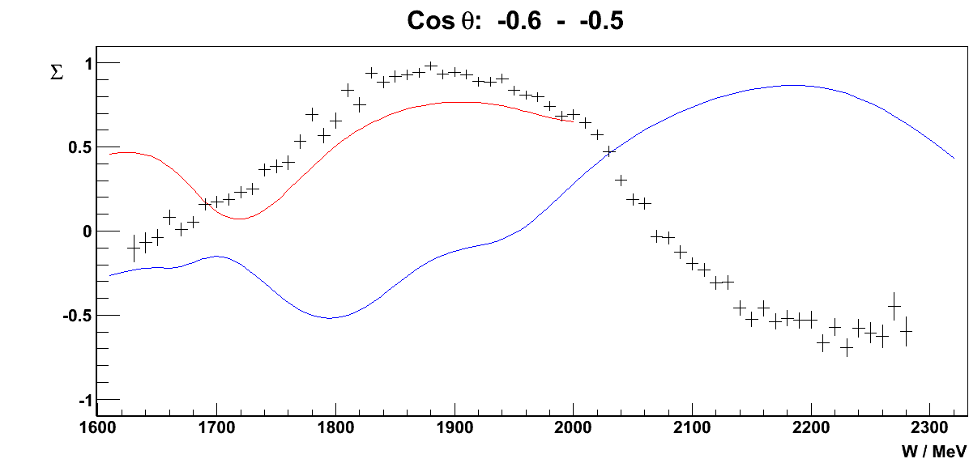
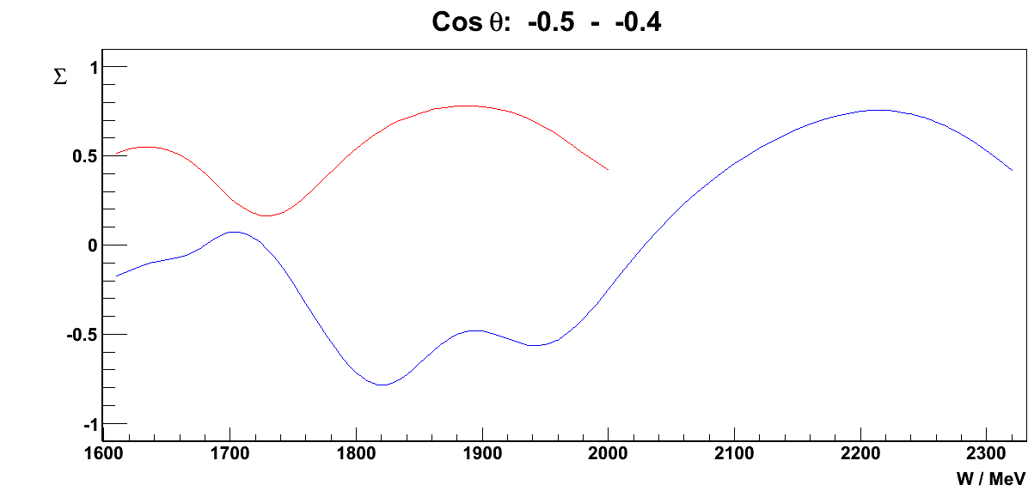
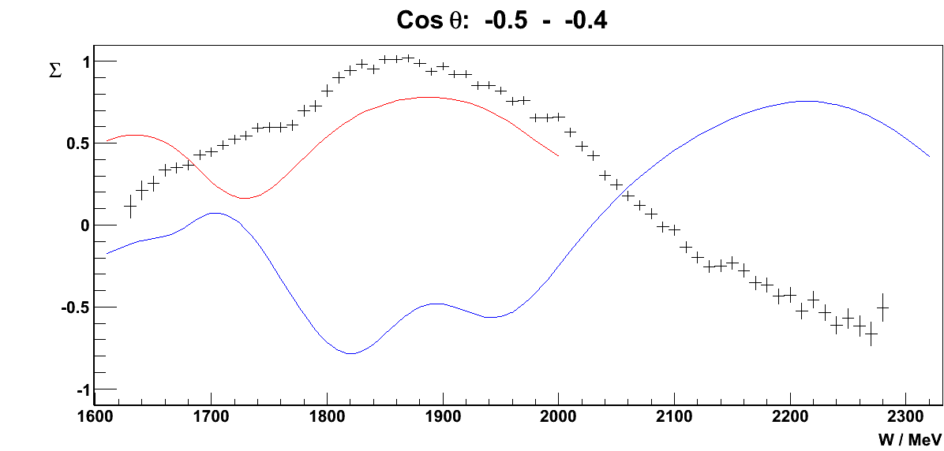
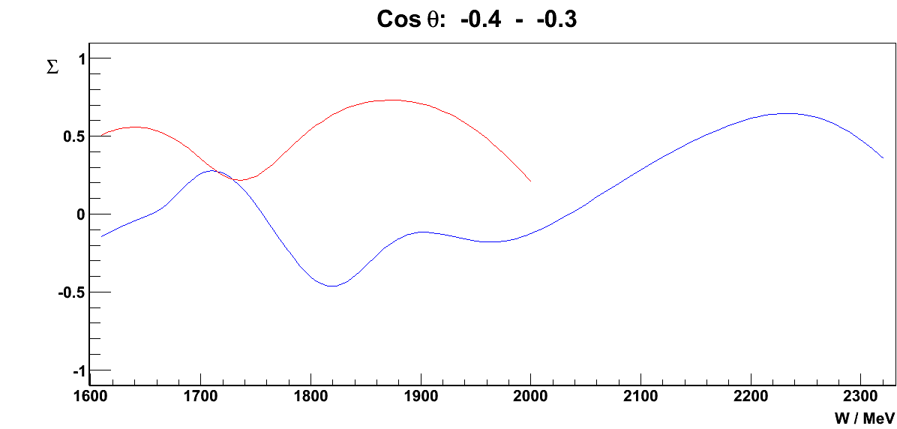
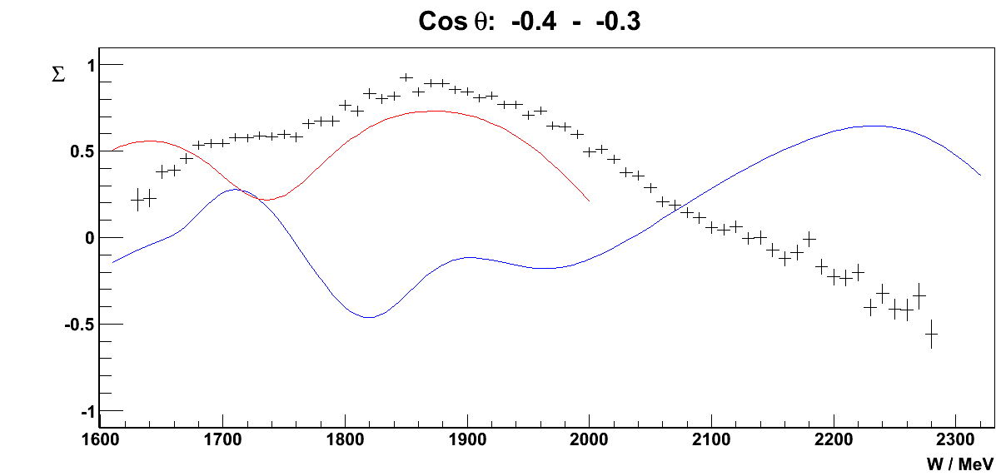








Photon asymmetry Σ γn→π⁻p
PRELIMINARY
MAID 07
SAID 09
Daria Sokhan
Previous data (Alspector, PRL 28, 1403 (‘72), Abrahamian,SJNP 32, 69 (‘80), Adamyan, JPG 15, 1797 (‘89)).

Slide 28


















Photon asymmetry γn→π⁻p
PRELIMINARY
MAID 07
SAID 09
Daria Sokhan
Previous data (Alspector, PRL 28, 1403 (‘72), Abrahamian,SJNP 32, 69 (‘80), Adamyan, JPG 15, 1797 (‘89)).

Slide 29

γp→π⁺n Helicity asymmetry E
circularly pplarized beam – longitudinally polarized target (g9a-FROST)
preliminary
S. Strauch

Slide 30
Status of meson photoproduction
 | σ | Σ | T | P | E | F | G | H | T_{x} | T_{z} | L_{x} | L_{z} | O_{x} | O_{z} | C_{x} | C_{z}
Proton target
pπ⁰ | ✔ | ✓ | ✓ |  | ✓ | ✓ | ✓ | ✓
nπ⁺ | ✔ | ✓ | ✓ |  | ✓ | ✓ | ✓ | ✓
pη | ✔ | ✓ | ✓ |  | ✓ | ✓ | ✓ | ✓
pη’ | ✔ | ✓ | ✓ |  | ✓ | ✓ | ✓ | ✓
pω | ✔ | ✓ | ✓ |  | ✓ | ✓ | ✓ | ✓
K⁺Λ | ✔ | ✓ | ✓ | ✔ | ✓ | ✓ | ✓ | ✓ | ✓ | ✓ | ✓ | ✓ | ✓ | ✓ | ✔ | ✔
K⁺Σ⁰ | ✔ | ✓ | ✓ | ✔ | ✓ | ✓ | ✓ | ✓ | ✓ | ✓ | ✓ | ✓ | ✓ | ✓ | ✔ | ✔
K^{0*}Σ⁺ | ✔ | ✓ |  |  |  |  |  |  |  |  | ✓ | ✓
Neutron target
pπ⁻ | ✔ | ✓ | ✓ |  | ✓ | ✓ | ✓ | ✓
pρ⁻ | ✓ | ✓ | ✓ |  | ✓ | ✓ | ✓ | ✓
K⁻Σ⁺ | ✓ | ✓ | ✓ |  | ✓ | ✓ | ✓ | ✓
K⁰Λ | ✓ | ✓ | ✓ | ✓ | ✓ | ✓ | ✓ | ✓ | ✓ | ✓ | ✓ | ✓ | ✓ | ✓ | ✓ | ✓
K⁰Σ⁰ | ✓ | ✓ | ✓ | ✓ | ✓ | ✓ | ✓ | ✓ | ✓ | ✓ | ✓ | ✓ | ✓ | ✓ | ✓ | ✓
K^{0*}Σ⁰ | ✓ | ✓
✔ - published, ✔ - acquired, ✔ - planned

Slide 31
What was not shown
Baryon spectroscopy
  Electroproduction, N* transition formfactors
  Excited hyperons Λ(1405), Λ(1520), Σ(1385)…
  Phtoproduction of cascades
Meson spectroscopy:
  resonances in 2π, 3π, ηπ…
  Search for exotics
  …..
        talk by Marco Battaglieri

Slide 32
CLAS12

Slide 33
A Program at the Forefront of Hadron Physics
3D Picture of the Nucleon Structure - the new Frontier in Hadron Physics
Nucleon GPDs and TMDs – exclusive and semi-inclusive processes with high precision
Precision measurements of structure functions and forward parton distributions
Elastic & Transition Form Factors up to Q²~12 GeV²
Hadronization and Color Transparency
Hadron Spectroscopy – heavy baryons (Ξ, Ω⁻), hybrid mesons
Notes:
Some of the topics to be addressed are – the 3D structure of the nucleon which is a new frontier of hadron physics. This requires measurements of GPDs and TMDs in deeply exclusive and semi-inclusive processes.

Slide 34

CLAS12
Forward Detector:
- TORUS magnet
- Forward SVT tracker
HT Cherenkov Counter
Drift chamber system
LT Cherenkov Counter
Forward ToF System
Preshower calorimeter
E.M. calorimeter (EC)
Central Detector:
-SOLENOID magnet
Barrel Silicon Tracker
Central Time-of-Flight
Proposed upgrades:
Micromegas (CD)
Neutron detector (CD)
RICH detector (FD)
Forward Tagger (FD)

Slide 35


Central detector
Superconducting 5 T Solenoid 78 cm ø warm bore
CTOF Barrel, σ_{TOF} < 60 ps
Central Vertex Tracker
Neutron Counter

Slide 36

CLAS12 – Design Parameters
Forward Central
Detector Detector
Angular range
Tracks 5⁰ – 40⁰ 35⁰ – 125⁰
Photons 2.5⁰ – 40⁰ ---
Resolution
δp/p (%) < 1 @ 5 GeV/c < 5 @ 1.5 GeV/c
δθ (mr) < 1 < 10 - 20
Δφ (mr) < 3 < 5
Photon detection
Energy (MeV) >150 ---
δθ (mr) 4 @ 1 GeV ---
Neutron detection
N_{eff} < 0.7 (EC+PCAL) under development
Particle ID
e/π Full range ---
π/p < 5 GeV/c < 1.25 GeV/c
π/K < 2.5 GeV/c < 0.65 GeV/c
K/p < 4 GeV/c < 1.0 GeV/c
π⁰→γγ Full range ---
η→γγ Full range ---
L=10³⁵cm⁻²s⁻¹

Slide 37


Forward tagger

Slide 38
Summary
For the first time it became possible to perform “compete experiment” in pseudoscalar photoproduction
Data collection with proton target is complete
This dataset should allow reconstruction of reaction amplitude without assumptions
With 12 GeV upgrade the spectroscopy program will extend to strange baryons

