Slide 1
Exclusive π⁰ electroproduction in the resonance region at high Q².
Maurizio Ungaro, Kyungseon Joo
University of Connecticut
Jefferson Laboratory
for the CLAS collaboration

Slide 2
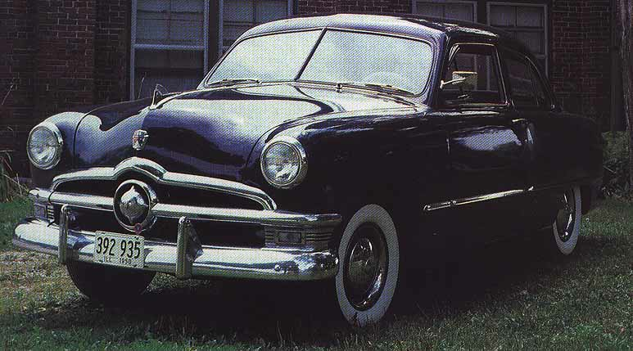
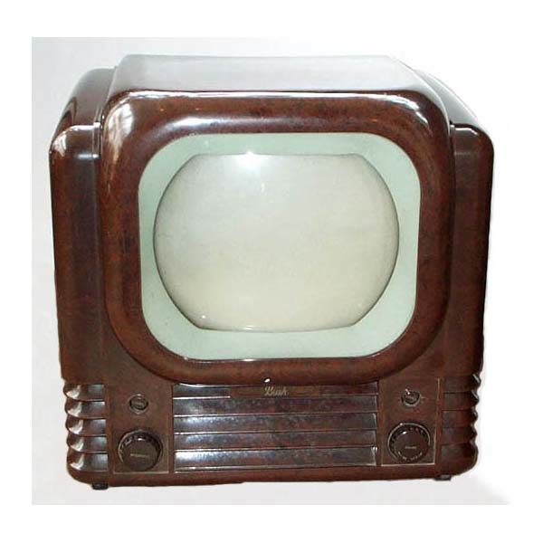
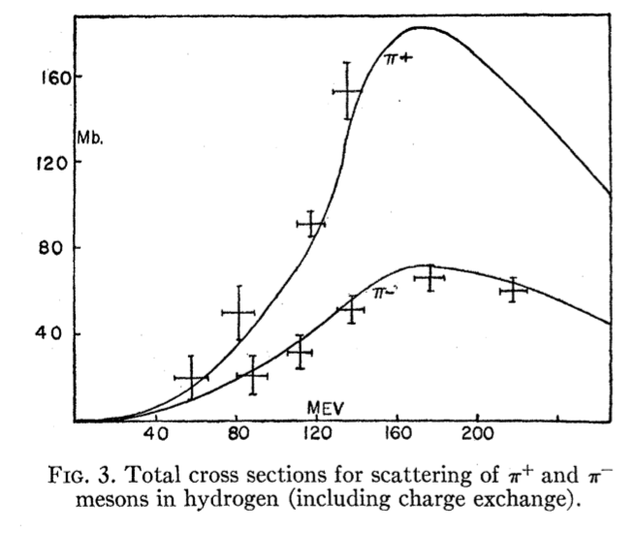
Resonance Discovery
π⁺ + P → π⁺ + P
π⁻ + P → π⁻ + P
π⁻ + P → π⁰ + N
$1750
$200
σ₊₊:σ₋₋:σ₋₀ = 9:1:2
Notes:
A car, like this Ford 1950, costs $1750.
This British BW tv, “Bush Model” had only one channel, “the bbc”. Price: 70 pounds ($200)
The Chicago Cyclotrone construction started in 1947. It would take 4 years and 2.5 million dollars to complete. It started collecting data on pi-meson on protons. In 1951, a structure was observed in pi meson scattering experiments off protons, at ~160 MeV n the c.m system.
Brueckner interpreted as a isospin 3/2, spin 3/2 resonance. A few month later Fermi, with pi- and pi+ scattering off protons, confirmed it.
What Brueckner measured was the ratio of the pi+P pi-P cross section – and the reason simple:
if you decompose the initial state into states with I=3/2 and I=1/2, using clebsch gordan coefficients,
one obtains that these processes are proportional to the amplitudes A3/2 and A1/2 like this.
Now, if you assume that there is an intermediate state, or resonance, it has to have A=3/2 (cant be ½ because of the first reaction).
If that’s the case, the ratio of pi+P to pi-P cross sections should be
9: (2+1) = 3:1. Fermi measurements seems to confirm that.
Fermi was impressed: “it’s like scattering gold from uranium”: meaning: it’s like we’re scattering from something, that has structure
“This was the first indication of structure [within the proton]” – as our director Hugh Montgomery, who worked with at fermilab in the 80’s, said in an interview.
As regarding the spin, the angular distribution in the center of mass suggest that this is a P-wave with spin 3/2.

Slide 3
Search for Quarks
Friday, May 19, 1967
Notes:
The scientist was University og Michigan Peter Frank, who Andrew Watson recalled calling gel mann at midnight to report on his hunt for quarks in oysters.
He had a student, D.M. Rank, whom thesis dissertation was the search of quarks in oysters, sea weeds and plankton.
Perhaps the best known free quark search in bulk matter is that of William Fairbank and his colleagues at Stanford, who in 1977 reported the discovery of a free quark.
They use millikan like experiment with niobium balls. His report at the APS conference in Washington was in front of an audience so large, that people could not fit the room.
Giacomo Morpurgo, one of the main contributors to the CQM model, I had the honor to attend his wonderful class during my Laurea at the universita’ di genova, also looked at fractional charges. He had a precision of very small fraction of charge by levitating steel balls and grains of graphite, in experiment that spanned 15 years. but never found it.
More recent experiments, still inspired by millikan drops in 1996 at SLAC, found that, if free quarks exist, they are present in quantities less than one per 2x10^20 nucleons.

Slide 4
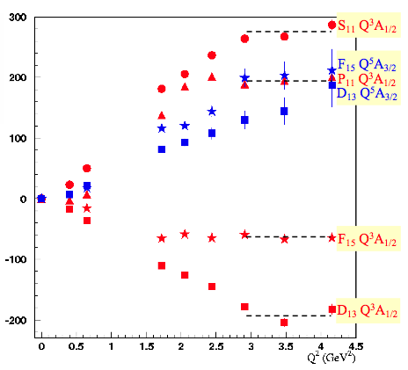
Beyond CQM
γ
g
g
Constituent Counting Rule:
Notes:
CQM is still being developed and is still useful to shade light certain mechanism.
EXAMPLE: unquenched CQM, CQM with Form factors (from clas12 N* proposal)
Nobel prizes:
1969-1970:Scaling Discovered (Nobel Prize: Friedman,Taylor, Kendall) Early 1970’s Parton model Quarks exist! Pointlike objects (Feynman,Bjorken…) 1970’s: pQCD, Assymptotic freedom. (Nobel Prize: Gross, Politzer,Wilczek)
QCD
As result of intense theoretical and experimental effort, it became increasingly clear that the structure of the nucleon and its excited states is much more complex than what could be describe in term of constituent quark only.
The structure of low-lying baryon states is well explored by electromagnetic probes. At very low momentum transferred by phenomenologically adding meson/baryon effects to the predictions of CQM. Furthermore, CQM have been refined by using relativist approach, including sea quark components, etc.
In addressing these issues one is confronted with the challenge of understanding the role of quarks and gluon in nuclei – and if you want to address and solve these issues you have to step into the domain of relativistic quantum field theory where the key phenomena can only be understood with non-perturbative methods.
Even as we speak, we need to solve the essential nature of quark confinement. This might be extracted from QCD, LQCD?
Furthermore, pQCD can’t:
produce mass in the chiral limit (I’ll expand on this in a few minutes)
can’t explain dynamics of quark-gluon interaction at low energy. What we need is QCD inspired alternatives.
Search for Quark dynamics in the nucleon: vigorous experimental program (list the labs)
Constituent Counting Rule tell us what will happen at high Q2. In CLAS, we’re starting to actually see this.

Slide 5
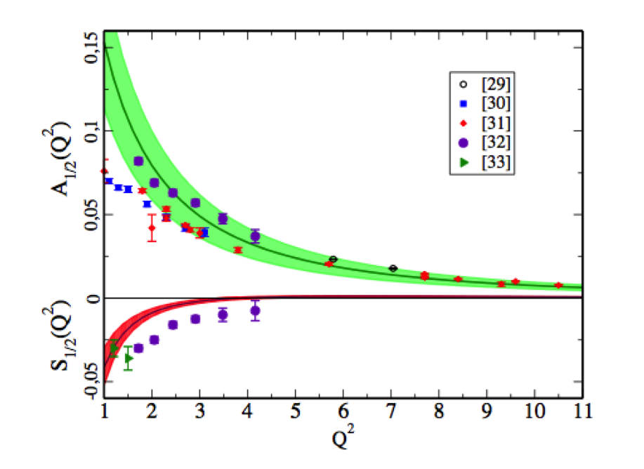
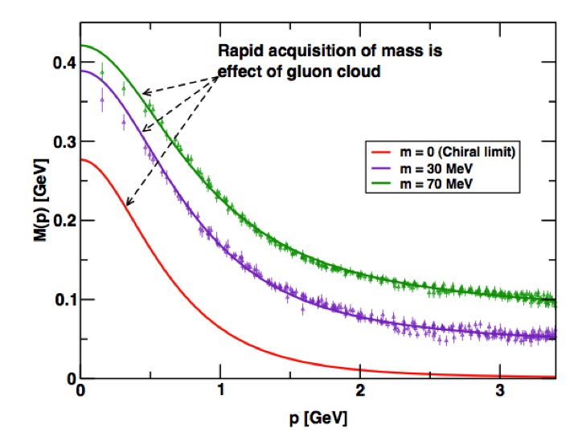
N* Program in CLAS
Map the γNN* electrocouplings as a function of photon virtuality with a combined analysis of electroproduction channels
LCSR
Dist. Amplitudes
⬆⬇
Form Factors
JLAB
Carnegie Mellon
Univ. of Maryland
Trinity College (Dublin)
DSE Framework
DCSB
Access active degrees of freedom at various distances
Explore the non-perturbative strong interactions responsible for nucleon formation and the origin of quark confinement
Investigate the origin of 98% of nucleon mass through DCSB
Notes:
At CLAS an intense program is underway with single, double meson electroproduction
Impressive results already, pi+, double meson production… this presentation regards the upcoming pi0 results.
A longstanding challenge in Hadronic Physics is to understand the spectroscopy of these resonant states, including their electromagnetic and strong decays, within a framework consistent with QCD.
If you want to take on this challenge of understanding the role of quarks and gluon in nuclei you have to step into the domain of relativistic quantum field theory where the key phenomena can only be understood with non-perturbative methods.
LQCD:
New techniques allow the calculation of baryon spectra not only in the ground state (proton, roper, S11) but also of the EXCITED states.
Data are from H.W. Lin calculations that involves for the first time radial excitations in the calculation of the form factors, and a way to extract signal to noise that help the extraction at high Q2
At low q2 the unphysical pion masses how large deviation from the experiment. This also might be due to coupling of the meson cloud with the resonances.
However at higher q2 results, given the limitation of these calculation, are promising.
DSE:
The framework of DSE is a framework that has marked success on DCSB study and hadrons observables… and these guys are just getting started.
An extensive, international study of nucleon electromagnetic form factors has been recently completed by Cloet et al (argonne). In their calculations dressed quarks are the degrees of freedom and correlations are expressed with di-quarks. The diquark current depends on their charge radius.
Here’s the key: we can use high precision measurement of nucleon-resonance transition form factor to chart the momentum evolution of the dressed-quark mass. In particular, the transition between current and constituent quark domains. This is believed to happen between 5-10 GeV2
An example of the role of transition form factor is the N->Delta. The calculation reported here, by Cloet, Bentz and Thomas. The FF lacks significant strength at 0 (its value should be 3) but qualitatively it’s very promising. This calculation is done without the running of the dress quark mass with its momentum. Following this calculation, the framework of the Faddeev equation and the dressed-quark mass variation predicted by the DSE, will be performed.
LCSR
An approach that allows quantitative descriptions of form factor using soft non perturbative contribution is the LCSR.
One of the feature of LCSR that I’d like to emphasize here is the ability of connecting the DA to the transition form factors.
The LCSR expect to converge at Q2>2… here the prediction looks to describe the data reasonably well. As the LQCD results are expected to improve, these results will have to improve – for example, include NLO radiative corrections.

Slide 6
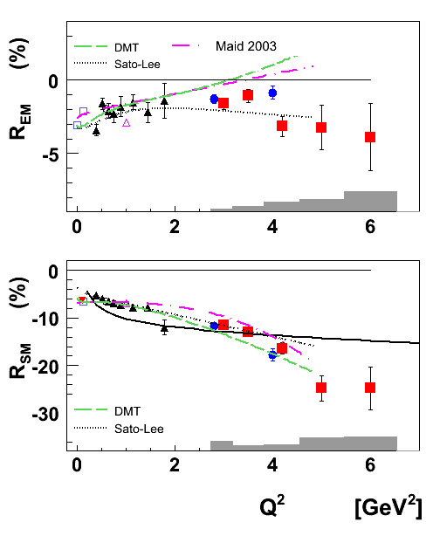
High Q² π⁰ electroproduction
Single π⁺, π⁰ production
π⁺ in the resonance region
π⁰ in the Delta
e’
Missing:
π⁰ in the resonance region
π⁺, π⁰
e
γ_{v}
N*, △*
Q²: 2.0 → 6.5 GeV²
W: 1.1 → 2.0 GeV
~75000 data points
No prior data
p
n, p’
M. Ungaro Phys.Rev.Lett.97:112003,2006
K. Park Phys.Rev.C77:015208,2008
I.G. Aznauryan Phys.Rev.C78:045209,2008
This analysis
0 ← Q² → 6
Q²: 1.6 → 5.4 GeV²
W: 1.1 → 1.8 GeV
58000 data points
Q²: 2 → 6.5 GeV²
W: 1.1 → 1.4 GeV
7200 data points
Nick Markov, UCONN
η electroproduction from the same dataset
1.1 ← W → 2.0
Notes:
A longstanding challenge in Hadronic Physics is to understand the spectroscopy of these resonant states, including their electromagnetic and strong decays, within a framework consistent with QCD.
At CLAS an intense program is underway with single, double meson electroproduction
Impressive results already, pi+, double meson production… this presentation regards the upcoming pi0, eta results.
will extract asymmetries as well
Why high Q²?
Constraints on short range behavior-correlations.
Simplifications in treating reaction mechanism.
Measurement. Cross sections, asymmetries.
Extraction of elastic and resonance form factors.
Impact physics.
eta cpuples only wth I=1/2

Slide 7
Experiment Overview
σ = σ(W,Q²,cos(θ∗))
dσ/dΩ_{π} = σ_{T} + εσ_{L} + εσ_{TT}cos2φ + √2ε(ε+)σ_{LT}cosφ + h√2ε(ε−1)σ_{LT’}sinφ
Detect:
Electron, Proton
Will Extract:
Cross sections, Structure Functions
Beam Spin Asymmetries
Helicity amplitudes and their Q² dependence
N
Notes:
We must understand the Hadrons Structure in order to
understand why the world is the way it is.
Elastic scattering and transitions to excited states are equally
fundamental and together constrain physics inputs.
They put different constraints depending on spin and parity
and structure of ground and excited states.

Slide 8
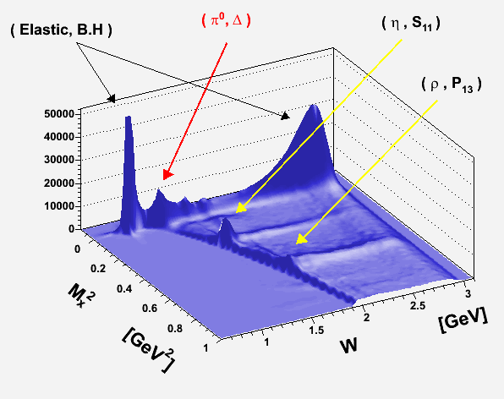
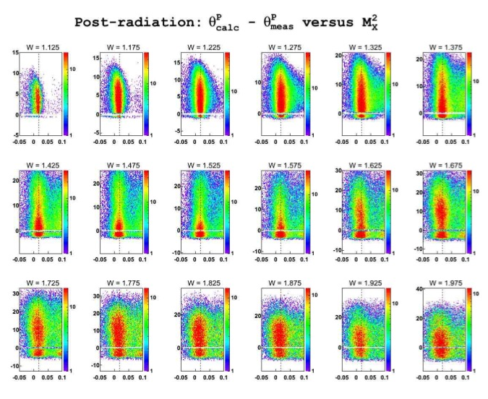
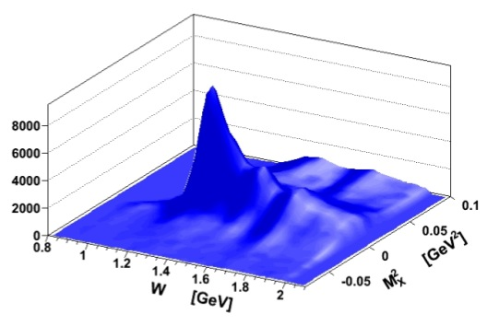
Analysis Overview
B.H. Separation:
The typical angle between the emitted photon and the electron in B.H. processes is θ ∼ m/E

Slide 9
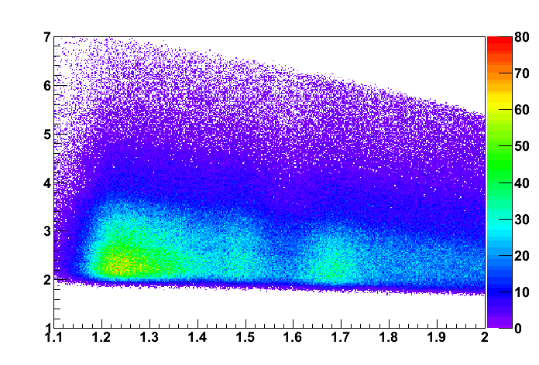
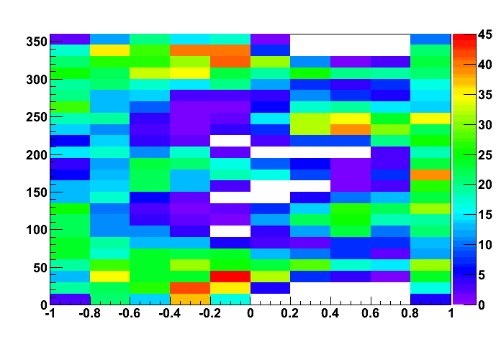
Analysis Overview
π⁰
W=1.59 Q²=3.5
Q² [GeV²]
W [GeV]
45 bins in W, ΔW=20 MeV
7 bins in Q² DQ²/Q² ~ 0.18
10 bins in cos(θ*)
24, 48, 96 bins in φ*
Total: 75600 CS points
Notes:
may asubstantially affect other channels with lower cross section (lambda k, sigma k)

Slide 10
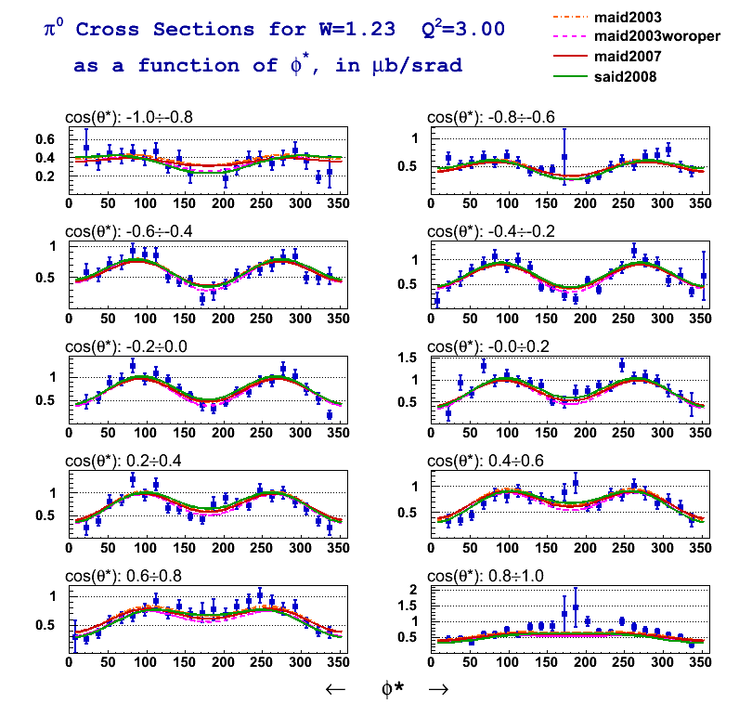
Preliminary Results
dσ/dΩ∗ = σ_{T} + εσ_{L} + εσ_{TT}cos2φ + √2ε(ε+1)σ_{LT}cosφ
CLAS Preliminary
240 points
out of 75K

Slide 11
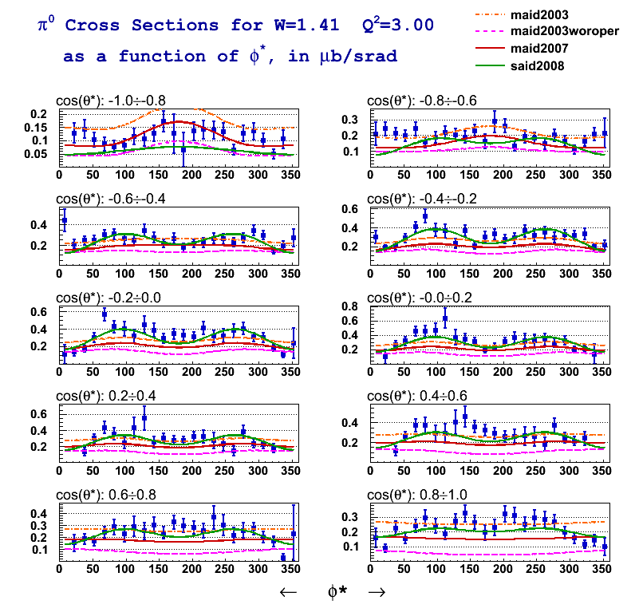
Preliminary Results
dσ/dΩ∗ = σ_{T} + εσ_{L} + εσ_{TT}cos2φ + √2ε(ε+1)σ_{LT}cosφ
CLAS Preliminary
240 points
out of 75K

Slide 12
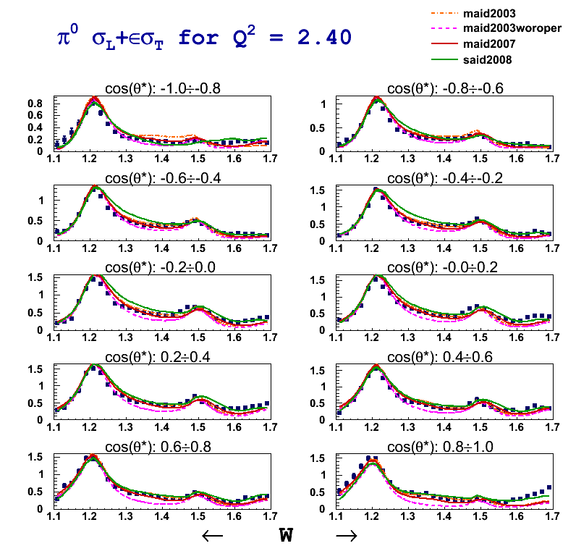
Preliminary Results
dσ/dΩ∗ = σ_{T} + εσ_{L} + εσ_{TT}cos2φ + √2ε(ε+1)σ_{LT}cosφ
CLAS Preliminary

Slide 13
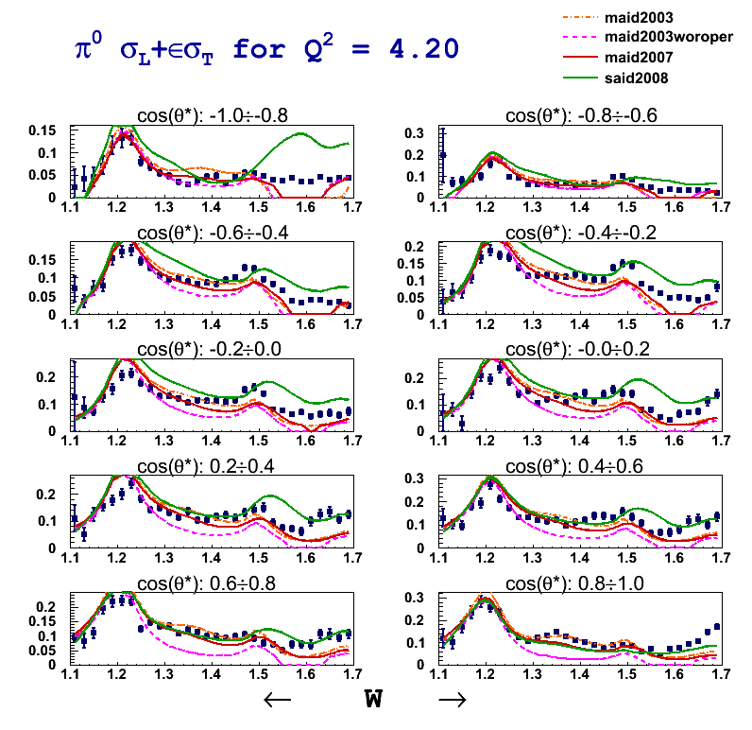
Preliminary Results
dσ/dΩ∗ = σ_{T} + εσ_{L} + εσ_{TT}cos2φ + √2ε(ε+1)σ_{LT}cosφ
CLAS Preliminary

Slide 14
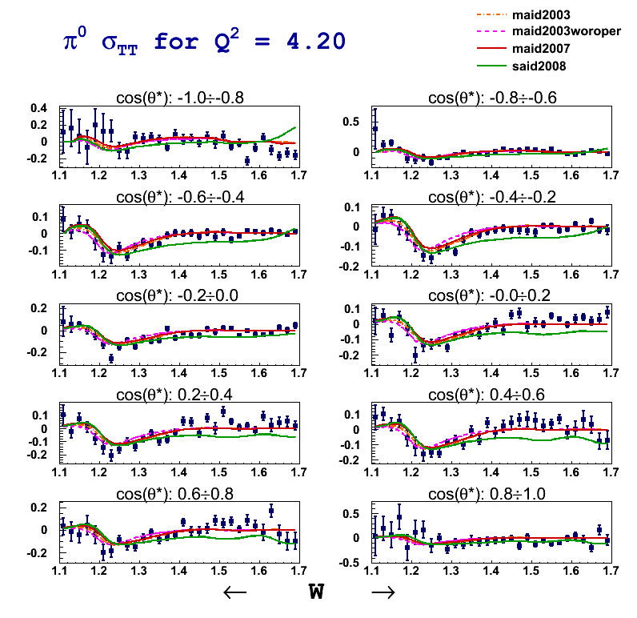
Preliminary Results
dσ/dΩ∗ = σ_{T} + εσ_{L} + εσ_{TT}cos2φ + √2ε(ε+1)σ_{LT}cosφ
CLAS Preliminary

Slide 15
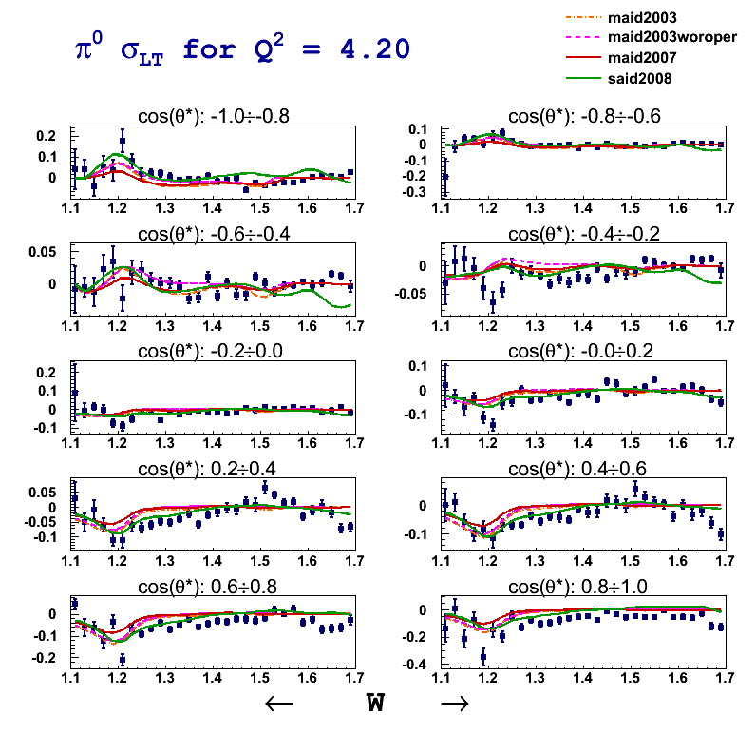
Preliminary Results
dσ/dΩ∗ = σ_{T} + εσ_{L} + εσ_{TT}cos2φ + √2ε(ε+1)σ_{LT}cosφ
CLAS Preliminary

Slide 16
Summary, Outlook
To do list:
JANR, DR (Being Done)
SAID analysis
Review:
π⁰ (by this summer)
η (by this fall/winter)
The combined analysis of single and double meson channels is key to the N* program and to provide a high definition picture of the nucleon
Explore the non-perturbative strong interactions responsible for nucleon formation and the origin of quark confinement
CLAS Preliminary

Slide 17
Backup Slides

Slide 18
Analysis Overview
Radiative Correction
exclurad
(Afanasev, Akushevich, Burkert, Joo)
Input: Exclusive cross section
No peaking approximation
No soft-hard photon discrimination
Radiation of 4 SF with angular dependence of each one (exclusive electroproduction)
W=1.29

Slide 19
Analysis Overview
Radiative Correction
exclurad
(Afanasev, Akushevich, Burkert, Joo)
Input: Exclusive cross section
No peaking approximation
No soft-hard photon discrimination
Radiation of 4 SF with angular dependence of each one (exclusive electroproduction)
W=1.63

Slide 20
Analysis Overview
S1
S2
Normalization check:
Good electron PID, fiducial cut
Good acceptance from simulation
Vertex Correction, Cuts
Kinematic Corrections
Elastic Scattering
Inclusive scattering
W [GeV]
W [GeV]
S3
S4
W [GeV]
W [GeV]
S5
S6
Data
Keppel
Brasse
W [GeV]
W [GeV]

Slide 21
Analysis Overview
Data:
Electron ID
Proton ID
Vertex Correction, Selections
Electron Fiducial Cut
Proton Fiducial Cut
Electron Momentum Correction
Proton Momentum Correction
Normalization Check
Radiative Correction
Bin Averaging Correction
π⁰, η selection
Simulation:
Electron ID
Proton ID
Vertex Correction, Selections
Electron Fiducial Cut
Proton Fiducial Cut
Timing Resolution Match
Momentum Resolution Match
Acceptance Correction
To do list:
Finalize Systematic Errors
Collaboration Review
Amplitudes extraction (JANR, DR, SAID)
Notes:
what to be done
so, what I’ll show you are counts for each W,Q2,cost, phi bins

Slide 22
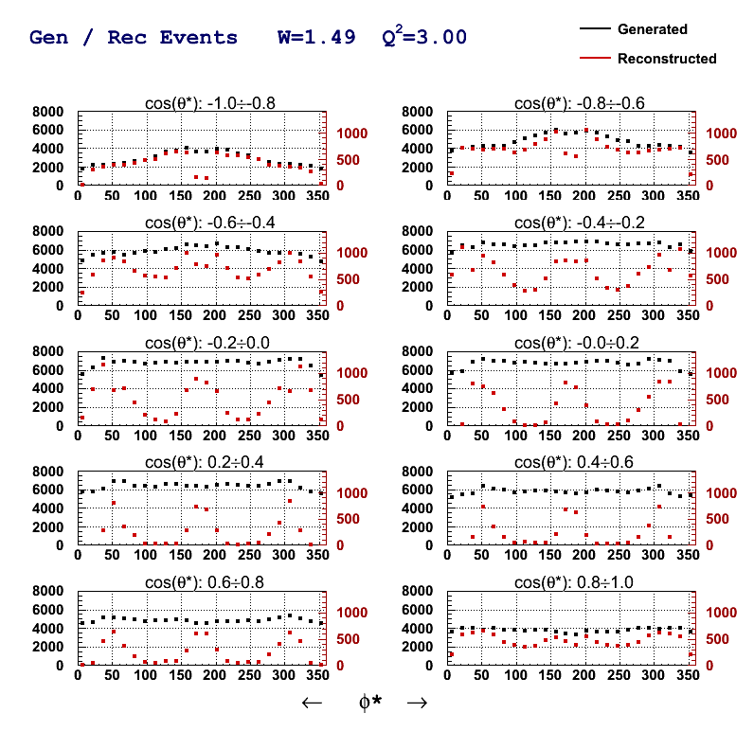
Analysis Overview
24 φ bins
200M Generated Events
MAID2007
AAO_RAD
Electron ID
Proton ID
Vertex Correction, Selections
Electron Fiducial Cut
Proton Fiducial Cut
Timing Resolution Match
Momentum Resolution Match
Drift Chamber Efficiencies
π⁰ selection

Slide 23
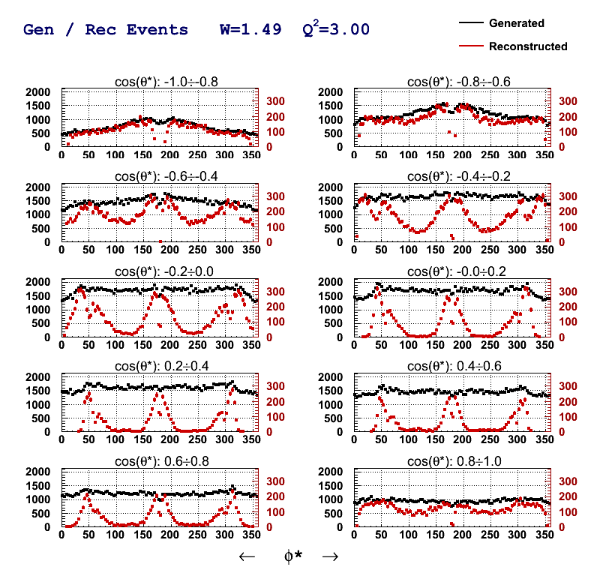
Analysis Overview
96 φ bins
200M Generated Events
MAID2007
AAO_RAD
Electron ID
Proton ID
Vertex Correction, Selections
Electron Fiducial Cut
Proton Fiducial Cut
Timing Resolution Match
Momentum Resolution Match
Drift Chamber Efficiencies
π⁰ selection

Slide 24
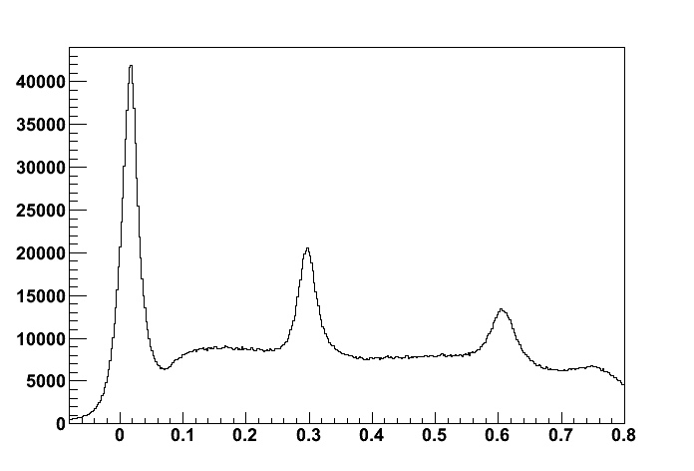
What about η?
π⁰
η
eP missing mass² [GeV²]

Slide 25
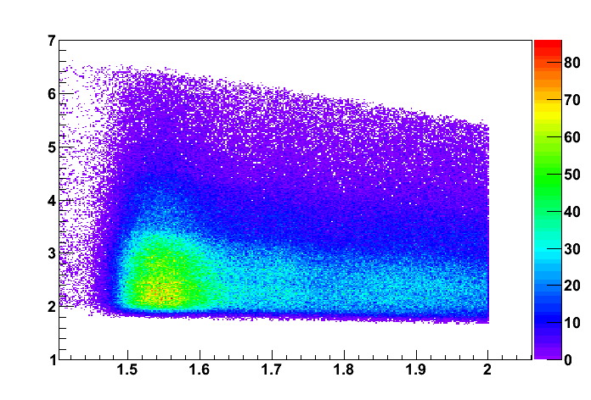
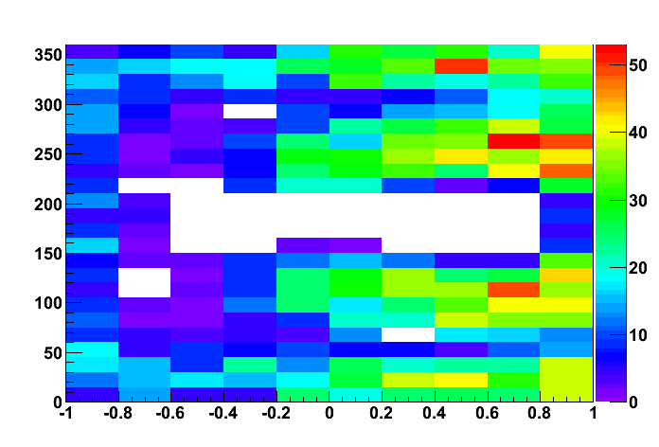
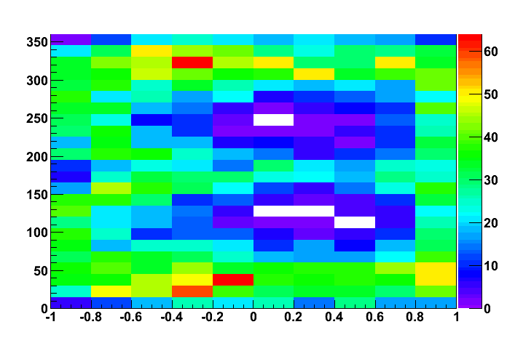
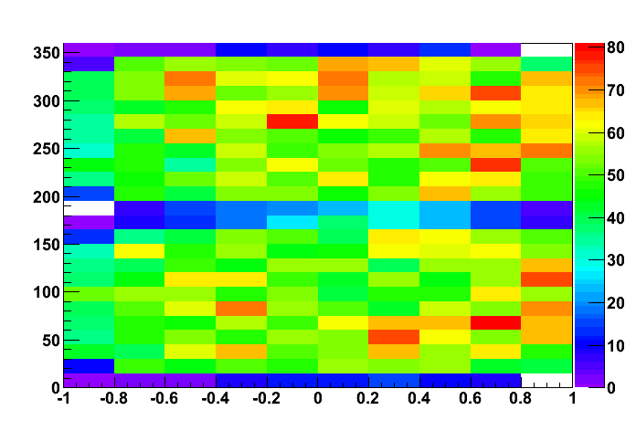
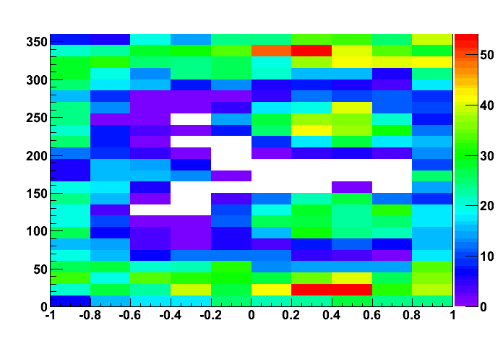
What about η?
η
W=1.95 Q²=3.0
W=1.65 Q²=3.0
W=1.53 Q²=3.0
W=1.79 Q²=3.0
Q² [GeV²]
Q² [GeV²]
Q² [GeV²]
Q² [GeV²]
W [GeV]
W [GeV]
W [GeV]
W [GeV]
25 bins in W, ΔW=20 MeV
7 bins in Q² DQ²/Q² ~ 0.18
10 bins in cos(θ*)
24 bins in φ*
Total: 43750 points

