Slide 1

Status of meson photoproduction experiments with CLAS
NSTAR 2013 Workshop
Peñiscola, Valencian Community, Spain
May 27-30, 2013
Eugene Pasyuk
Jefferson Lab
for the CLAS Collaboration

Slide 2
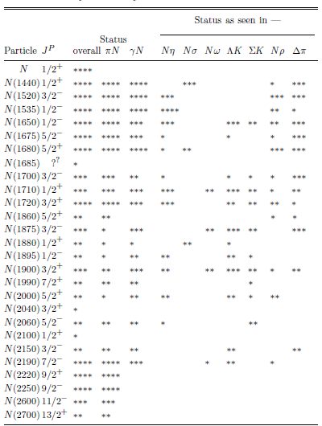
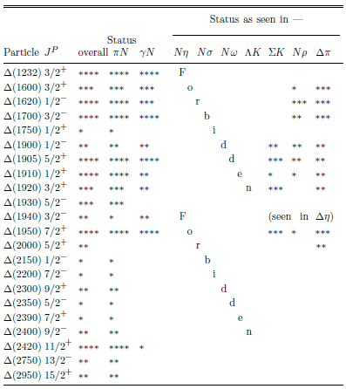
Resonance status for N* and Δ*
Nearly half the states have only fair or poor evidence!
Most states need more work to learn details
Are there missing states?

Slide 3
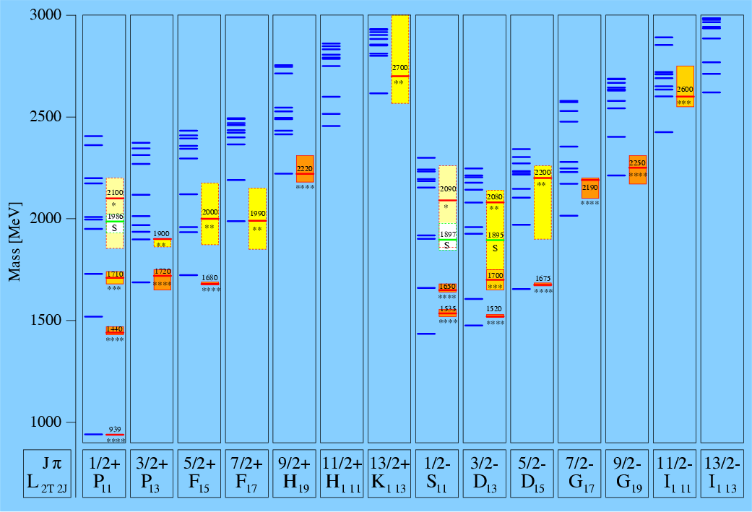
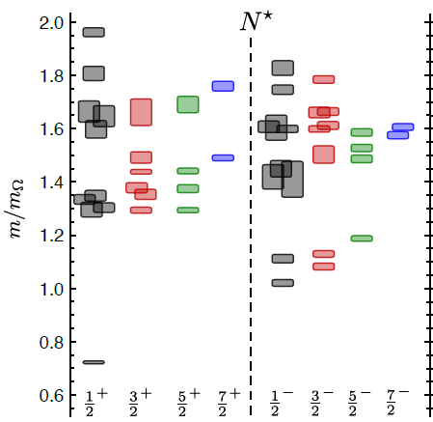
Baryon Resonance Spectrum
Lattice QCD
N*
Mass(π) = 396 MeV
S. Capstik and W. Roberts
Masses, widths, and coupling constants not well known for many resonances
Most models predict more resonance states than observed
R.G. Edwards et al. Phys. Rev. D84 074508 (2011)

Slide 4
From the Experiment to Theory
Experiment
cross section,
spin observables
(single) dσ/dΩ,Σ,P,T
(beam-target) E,F,G,H,
(beam-recoil) C_{x},C_{z},O_{x},O_{z},
(target-recoil) L_{x},L_{z}, T_{x},T_{z},
Amplitude analysis
→multipole amplitudes
→phase shifts
Reaction Theory
dynamical frameworks
Theory
LQCD,
quark models,
QCD sum rules,
…

Slide 5
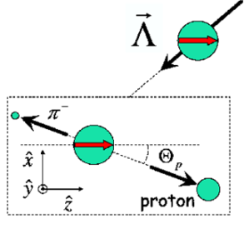
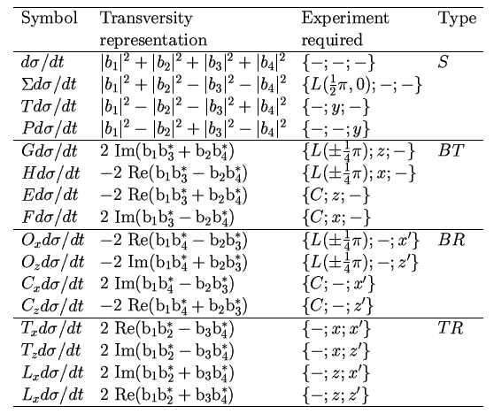
Polarization observables in pseudoscalar meson production
4 Complex amplitudes: 16 real polarization observables.
Complete measurement from 8 carefully chosen observables.
πN has large cross section but in KY recoil is self-analysing
☻
πN
KY
recoil targ γ
γ targ recoil
☻☻☻
☻☻☻
☻☻☻
☻☻☻
☻☻☻
☻☻☻
☻☻☻
☻☻☻
☻☻☻
I. S. Barker, A. Donnachie, J. K. Storrow, Nucl. Phys. B95 347 (1975).
Complete, and
over-determined
circ polarized photons
longitudinally polarized target
linearly polarized photons
transversely polarized target

Slide 6
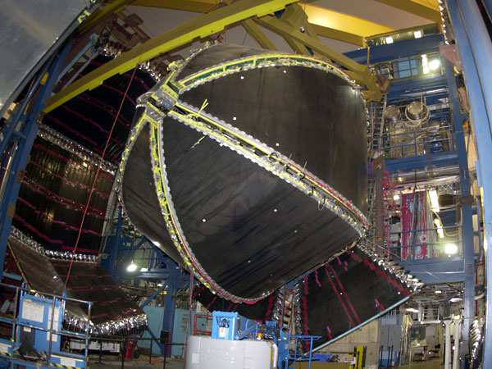
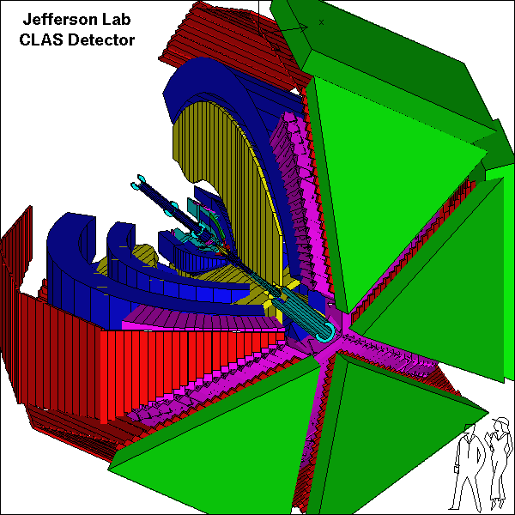
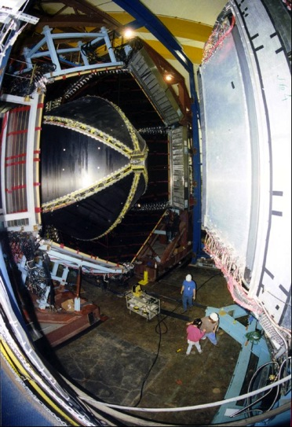
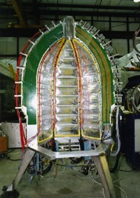


CEBAF Large Acceptance Spectrometer 1997-2012
Torus magnet
6 superconducting coils
Electromagnetic calorimeters
Lead/scintillator, 1296 photomultipliers
target + start counter
Drift chambers
35,000 cells
Time-of-flight counters
plastic scintillators, 684 photomultipliers
Gas Cherenkov counters
e/π separation, 256 PMTs

Slide 7
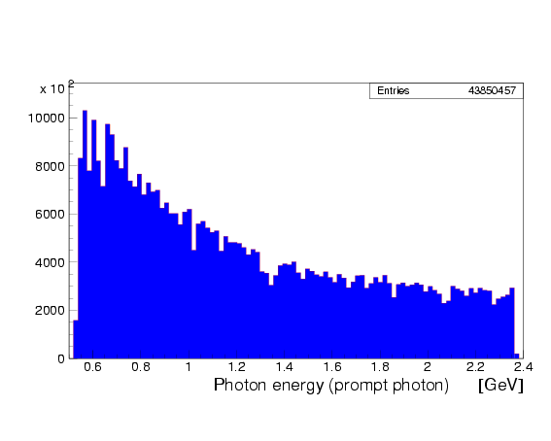
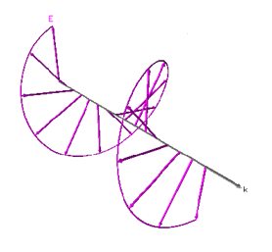
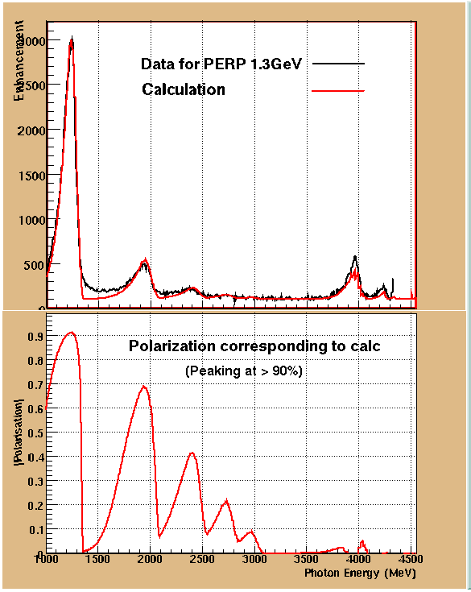
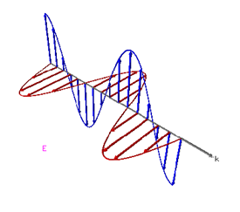
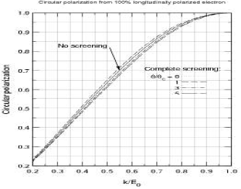
Polarized pohoton beam
Circular polarization from 100% polarized electron beam
Circular polarization
H. Olsen and L.C. Maximon, Phys. Rev. 114, 887 (1959)
Circularly polarized beam produced by longitudinally polarized electrons
Linearly polarized photons: coherent bremsstrahlung on oriented diamond crystal

Slide 8
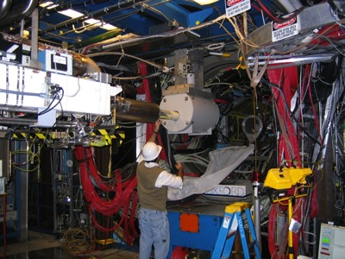
FROST

Slide 9
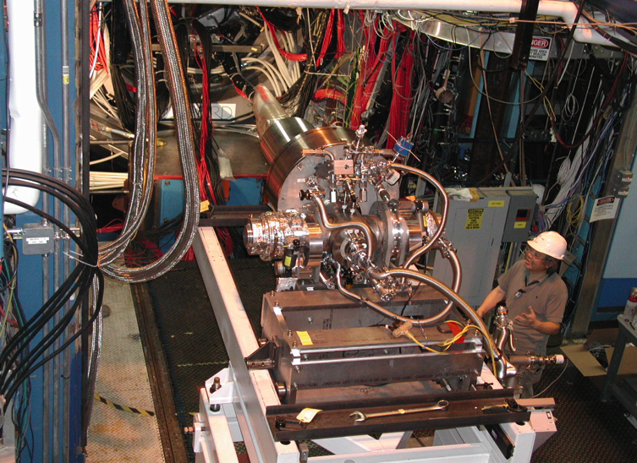
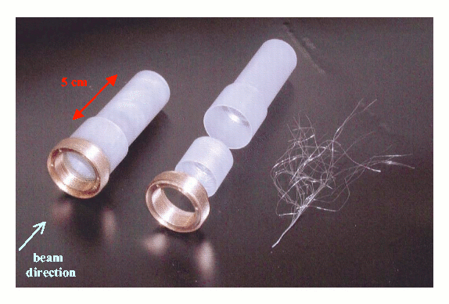
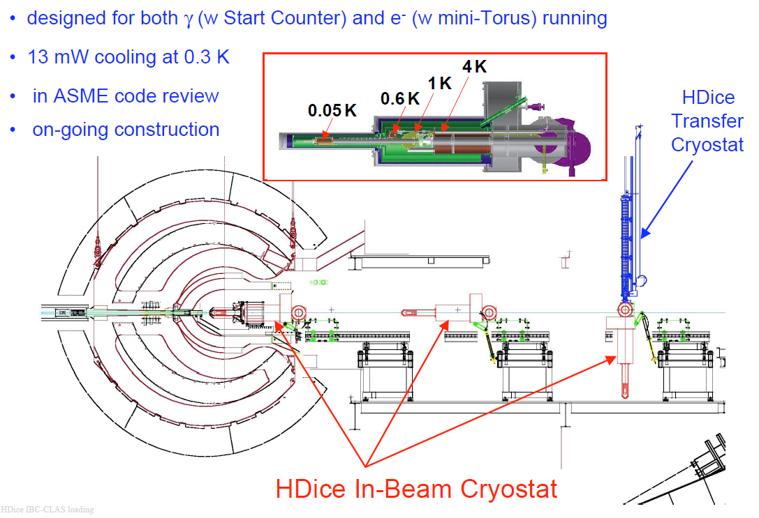
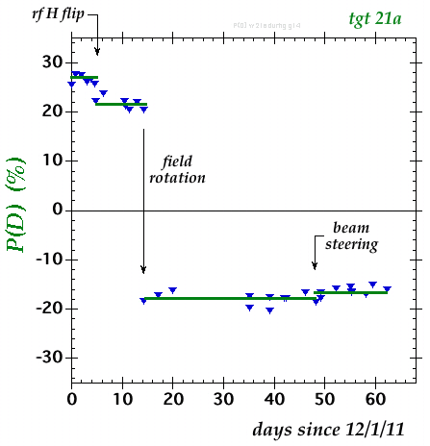
HDIce polarized target
Polarized at very high magnetic field and very low temperature
Transferred to in-beam cryostat
Spin can be moved between H and D with RF transitions
All material can be polarized with small background

Slide 10
What we measure with CLAS
γp→π⁰p, π⁺n
γp→ηp
γp→η’p
γp→KY (K⁺Λ, K⁺Σ⁰, K⁰Σ⁺)
γp→π⁺π⁻p ωp, ρp, ϕp
….
γn→π⁻p
γn→π⁺π⁻n
γn→Σ⁻K⁺ , ΛK⁰
…..
See parallel talks:
B1 – E. Phelps
B1 - B. Vernarsky
C2 – R. Tucker
C2 – T. Kagea
A4 – N. Walford
A4 - C. Taylor
A4 – P. Mattione
B4 – P. Cole
B4 - K. Park
B5 – I. Senderovich

Slide 11
Single pion production

Slide 12
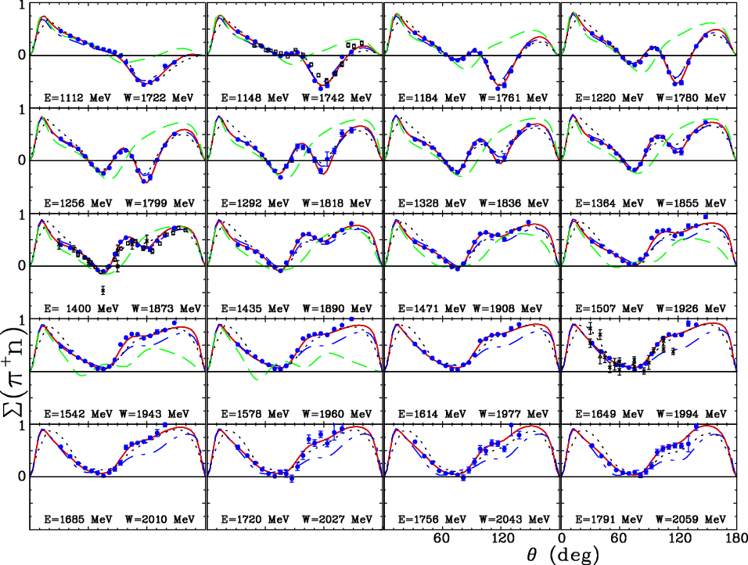

Σ for γp → nπ⁺
DU12
CM12
MAID
BbGa
0
60
120
0
60
120
M. Dugger et al.

Slide 13
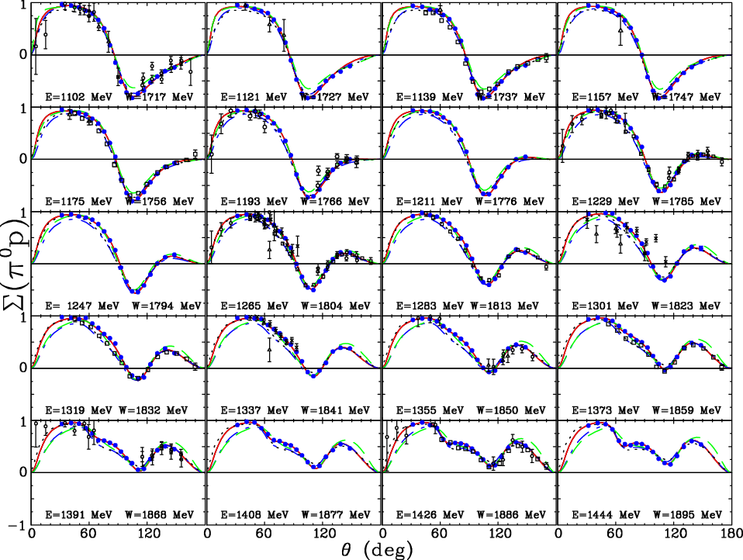
Σ for γ p → p π⁰
DU12
CM12
MAID
BbGa
M. Dugger et al.

Slide 14
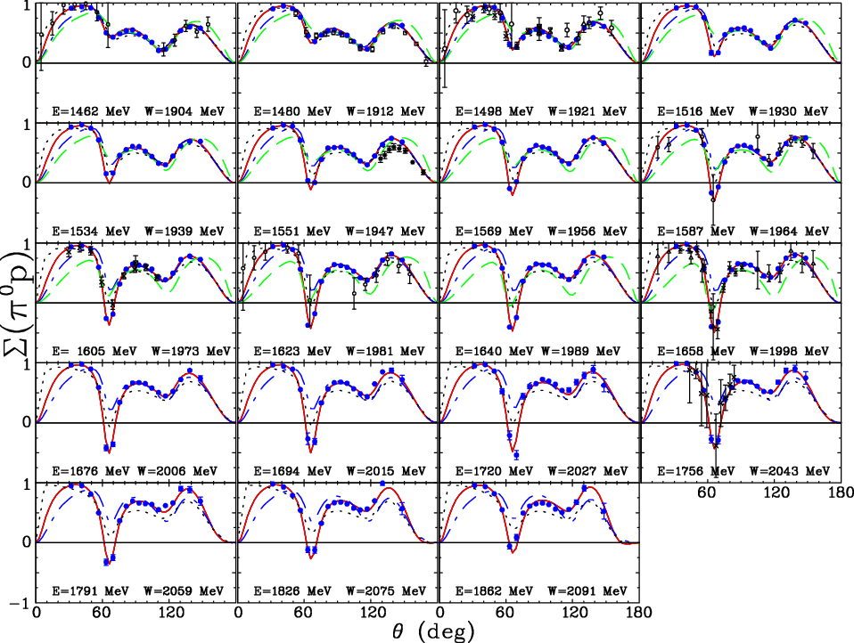
Σ for γ p → p π⁰
DU12
CM12
MAID
BbGa
M. Dugger et al.

Slide 15
Changes in couplings
 | Solution | A_{1/2} | A_{3/2}
Δ(1700)3/2⁻ | DU12 | 132 ± 5 | 108 ± 5
 | CM12 | 105 ± 5 | 92 ± 4
 | BnGa | 170 ± 20 | 170 ± 25
 | MD07 | 226 | 210
 | PDG12 | 104 ± 15 | 85 ± 22
Δ(1905)5/2⁺ | DU12 | 20 ± 2 | -49 ± 5
 | CM12 | 19 ± 2 | -38 ± 4
 | BnGa | 25 ± 5 | -49 ± 4
 | MD07 | 18 | -28
 | PDG12 | 26 ± 11 | -45 ± 20

Slide 16
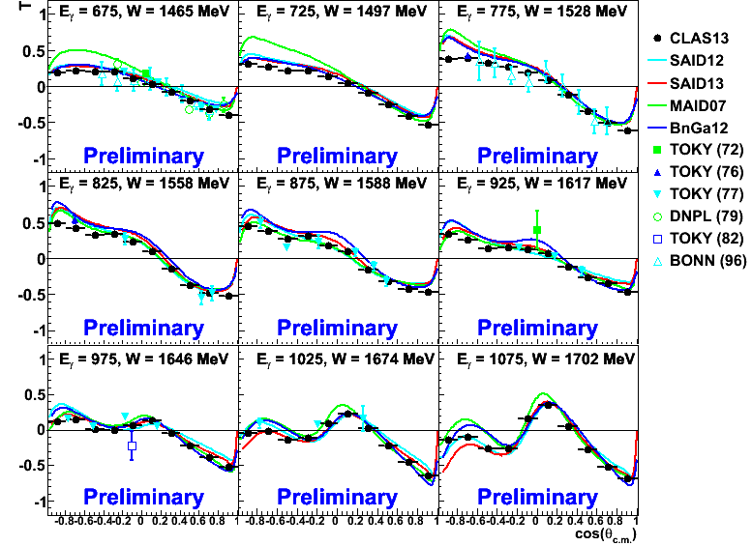
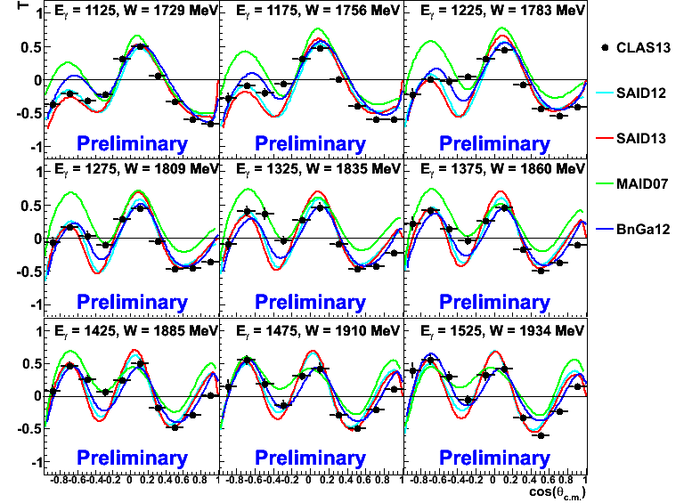
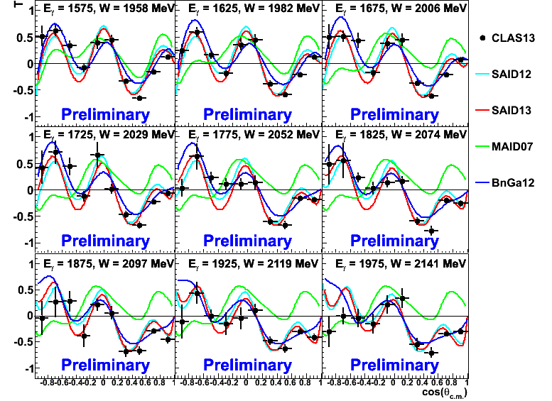
T for γ p → n π⁺
(new)
(new)
(new)
M. Dugger et al.

Slide 17
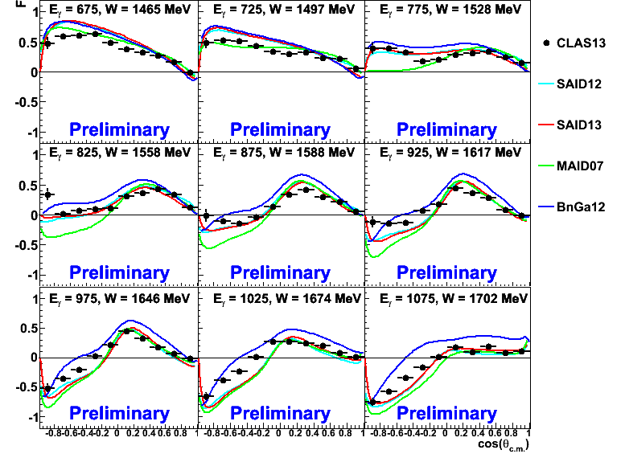
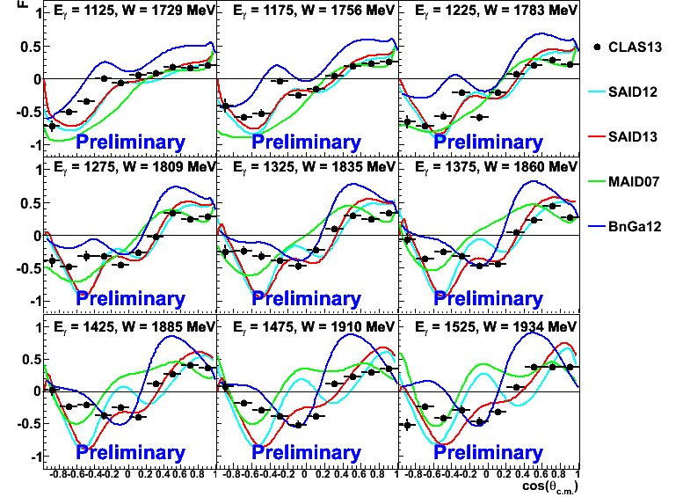
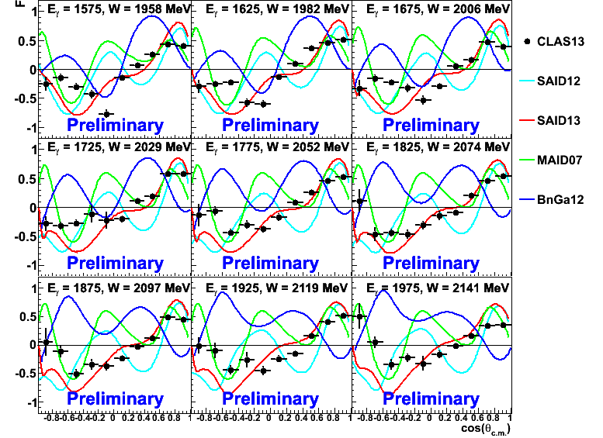
F for γ p → n π⁺
(new)
(new)
Agreement with predictions get much worse at higher energies
SAID13 are predictions based on preliminary fits to CLAS pion Σ measurements
(new)
M. Dugger et al.

Slide 18
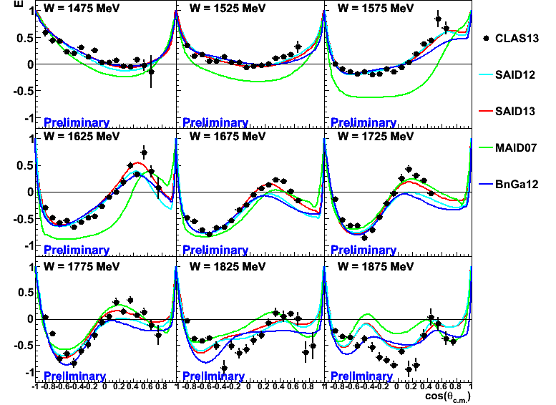
E for γ p → p π⁰
(new)
Early stage results
Predictions agree better at lower energies
M. Dugger et al.

Slide 19
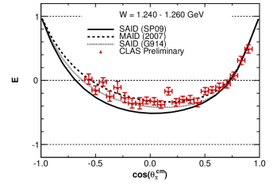
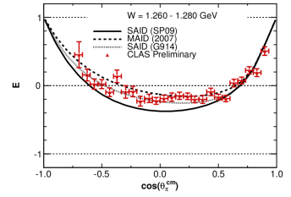
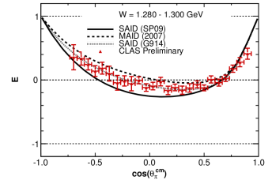
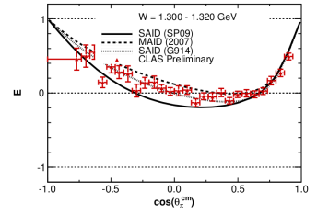
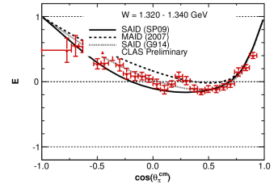
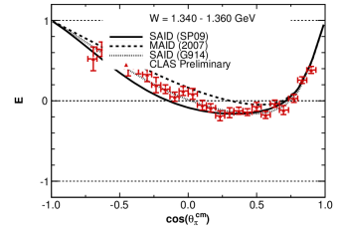
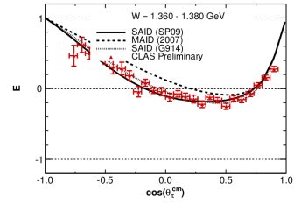
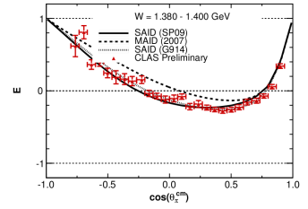
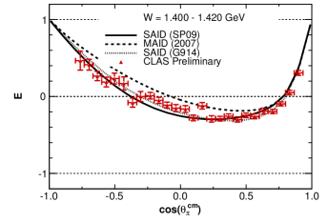
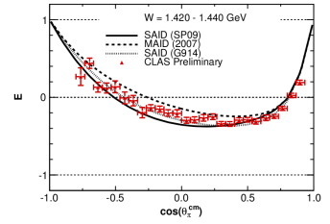
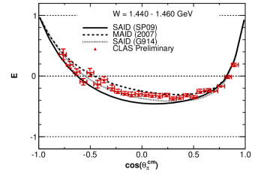
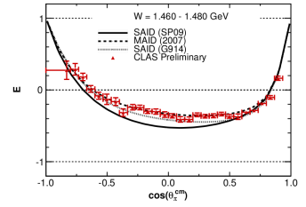
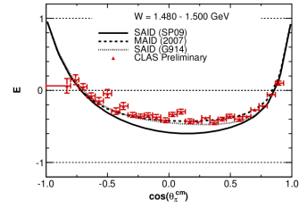
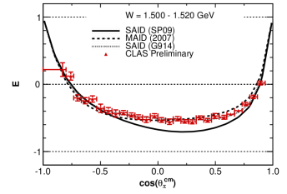
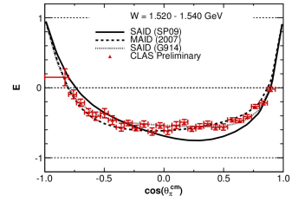
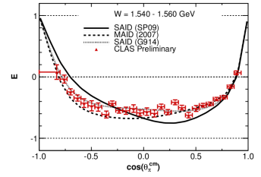
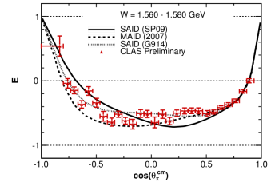
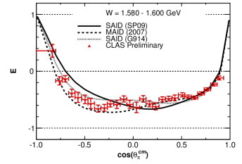
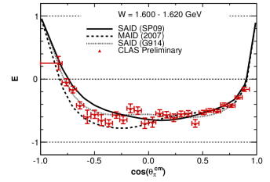
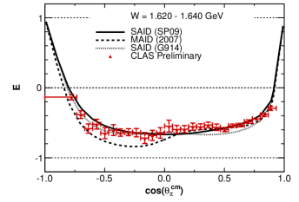
















E for γ p → n π⁺
W = 1.25 GeV
SAID
SAID (new fit)
MAID
W=1.25 GeV
W = 1.27 GeV
PRELIMINARY
W = 1.29 GeV
W = 1.31 GeV
W = 1.33 GeV
W = 1.35 GeV
PRELIMINARY
PRELIMINARY
PRELIMINARY
PRELIMINARY
PRELIMINARY
W = 1.45 GeV
W = 1.47 GeV
W = 1.37 GeV
W = 1.39 GeV
W = 1.41 GeV
W = 1.43 GeV
Predictions worse at higher energies above 1.7 GeV
PRELIMINARY
PRELIMINARY
PRELIMINARY
PRELIMINARY
PRELIMINARY
PRELIMINARY
W = 1.49 GeV
W = 1.51 GeV
W = 1.53 GeV
W = 1.55 GeV
W = 1.57 GeV
W = 1.59 GeV
PRELIMINARY
PRELIMINARY
PRELIMINARY
PRELIMINARY
PRELIMINARY
PRELIMINARY
PRELIMINARY
PRELIMINARY
PRELIMINARY
PRELIMINARY
PRELIMINARY
PRELIMINARY
W = 1.61 GeV
W = 1.63 GeV
W = 1.65 GeV
W = 1.67 GeV
W = 1.69 GeV
W = 1.71 GeV
W=1.73 GeV
W = 1.75 GeV
W = 1.77 GeV
W = 1.81 GeV
W = 1.83 GeV
W = 1.9 GeV
PRELIMINARY
W = 1.73 GeV
PRELIMINARY
PRELIMINARY
PRELIMINARY
PRELIMINARY
PRELIMINARY
W = 1.94 GeV
W = 1.98 GeV
W = 2.02 GeV
PRELIMINARY
PRELIMINARY
PRELIMINARY
PRELIMINARY
PRELIMINARY
PRELIMINARY
W = 2.07 GeV
W = 2.13 GeV
W = 2.19 GeV
Cos(θ_{π}^{c.m.})
S. Strauch

Slide 20

Σ for γ n → p π⁻
preliminary
D. Sokhan
Curve - SAID
Red GRAAL
Magenta and Blue - Erevan
9 out of 40 angular bins are shown
Bins 0.04 in cos and 20 MeV in W

Slide 21




E for γn(p) → pπ⁻(p)
➔ C2 - T. Kageya

Slide 22
η photoproduction

Slide 23








Σ for η
PRELIMINARY
PRELIMINARY
PRELIMINARY
PRELIMINARY
PRELIMINARY
PRELIMINARY
See parallel talks:
C2 – R. Tucker
B5 – I. Senderovich
PRELIMINARY
PRELIMINARY
PRELIMINARY
PRELIMINARY
PRELIMINARY
PRELIMINARY
PRELIMINARY
preliminary
PRELIMINARY
PRELIMINARY
PRELIMINARY
PRELIMINARY
PRELIMINARY
PRELIMINARY
PRELIMINARY
PRELIMINARY
PRELIMINARY
PRELIMINARY
PRELIMINARY
SAID
MAID
PRELIMINARY
PRELIMINARY
PRELIMINARY
PRELIMINARY
PRELIMINARY
PRELIMINARY
Patrick Collins

Slide 24
KY production

Slide 25





Σ , O_{x} , O_{z} for γ p → K⁺ Λ
D. G. Ireland, K. Livingston, B. McKinnon, C. A. Paterson

Slide 26




Σ , O_{x} , O_{z} for γ p → K⁺ Σ⁰
D. G. Ireland, K. Livingston, B. McKinnon, C. A. Paterson

Slide 27


T for γ p → K⁺ Λ and γ p → K⁺Σ⁰
Due to the self-analyzing nature of the , determine many observables using only a linearly polarized beam
Direct measurements of T
A4 – N. Walford
D. G. Ireland, K. Livingston, B. McKinnon, C. A. Paterson

Slide 28
π⁺π⁻ photoproduction

Slide 29

Photoproduction of π⁺π ⁻p states
Dominates photoproduction cross section for W >1.6 GeV
64 observables
28 independent relations related to helicity amplitude magnitudes
21 independent relations related to helicity amplitude phases
Results in 15 independent numbers
Could be used for search of resonances that decay into other resonances

Slide 30
Integrated cross sections for γp → p
Preliminary results: integrated cross section at W from 1.6 to 2.8 GeV
JLAB g11a
accept. corr. applied
SAPHIR(2005)&ABBHHM(1969)
JLAB g11a within CLAS acceptance
Systematic errors from accept. corr. procedure ~8-20%
E .Golovach

Slide 31
Differential cross sections for γp → p
Blues dots:
Measured cross sections within the CLAS acceptance.
Blue line:
JM model* prediction within the CLAS acceptance.
Black line:
JM model results for 100% acceptance.
Black dots:
Estimated cross sections when the contribution from inefficient area was obtained employing phase space approximation.
*Mokeev et al.
PRC 80 (2009) 045212
E .Golovach

Slide 32
Differential cross sections for γp → p
Blues dots:
Measured cross sections within the CLAS acceptance.
Black dots:
Estimated cross sections when the contribution from inefficient area was obtained employing phase space approximation.
E .Golovach

Slide 33

Cross section for γp →pπ⁺π⁻

Slide 34

I^{S} for pπ⁺π⁻
Linearly polarized photons, unpolarized target
E=1900-1950 MeV W=2120 MeV
One of 20 energy bins
Charles Hanretty

Slide 35

I for pπ⁺π⁻
S. Strauch et al., PRL. 95, 162003 (2005)
W. Roberts and T. Oed, PRC 71, 055201 (2005)
S. Park
A. Fix and H. Arenhovel, EPJA 25, 115 (2005)

Slide 36

P_{z} for pπ⁺π⁻
W. Roberts and T. Oed, PRC 71, 055201 (2005)
S. Park
A. Fix and H. Arenhovel, EPJA 25, 115 (2005)

Slide 37

P_{z} for pπ⁺π⁻
W. Roberts and T. Oed, PRC 71, 055201 (2005)
S. Park
A. Fix and H. Arenhovel, EPJA 25, 115 (2005)

Slide 38

Comparison with model: P^{c}z
preliminary
A. Fix and H. Arenhovel, EPJA 25, 115 (2005)
38
Y. Mao

Slide 39

Comparison with model: P^{s}z
preliminary
A. Fix and H. Arenhovel, EPJA 25, 115 (2005)
39
Y. Mao

Slide 40
Summary of meson photoproduction
 | σ | Σ | T | P | E | F | G | H | T_{x} | T_{z} | L_{x} | L_{z} | O_{x} | O_{z} | C_{x} | C_{z}
Proton target
pπ⁰ | ✔ | ✓ | ✓ | ✓ | ✓ | ✓ | ✓ | ✓
nπ⁺ | ✔ | ✓ | ✓ | ✓ | ✓ | ✓ | ✓ | ✓
pη | ✔ | ✓ | ✓ | ✓ | ✓ | ✓ | ✓ | ✓
pη’ | ✔ | ✓ | ✓ | ✓ | ✓ | ✓ | ✓ | ✓
K⁺Λ | ✔ | ✓ | ✓ | ✔ | ✓ | ✓ | ✓ | ✓ | ✓ | ✓ | ✓ | ✓ | ✓ | ✓ | ✔ | ✔
K⁺Σ⁰ | ✔ | ✓ | ✓ | ✔ | ✓ | ✓ | ✓ | ✓ | ✓ | ✓ | ✓ | ✓ | ✓ | ✓ | ✔ | ✔
K^{0*}Σ⁺ | ✔ | ✓ | ✓ | ✓ | ✓ | ✓ | ✓ | ✓
“Neutron” target
pπ⁻ | ✔ | ✓ | ✓ |  | ✓ | ✓ | ✓ | ✓
K⁺Σ⁻ | ✓ | ✓ | ✓ |  | ✓ | ✓ | ✓ | ✓
K⁰Λ | ✓ | ✓ | ✓ | ✓ | ✓ | ✓ | ✓ | ✓ | ✓ | ✓ | ✓ | ✓ | ✓ | ✓ | ✓ | ✓
K⁰Σ⁰ | ✓ | ✓ | ✓ | ✓ | ✓ | ✓ | ✓ | ✓ | ✓ | ✓ | ✓ | ✓ | ✓ | ✓ | ✓ | ✓
✔ - published ✔ - acquired

Slide 41

Summary
Data collection with proton and deuteron targets is complete
“compete measurement” in pseudoscalar meson photoproduction is reality
In many cases these are the first measurements.
In most cases model predictions do not agree with the data at higher energies
Phenomenological and theoretical analyses will have to deal with tenths of thousands of data points for various observables in different final states.
NSTAR Workshop

Slide 42

Extras

Slide 43


Polarization observables in pseudoscalar meson production

Slide 44


g14 – E06-101: polarized gamma beams on polarized HD
• Circular and Linear polarized photons
• flux up to 10⁸ s⁻¹ tagged (low bkg)
• Longitudinally polarized solid HD
• P(D) ~ 22%; lifetimes ~ 2 yr
• Nov/11 – May/12: 14 billion triggers

Slide 45


Slide 46

R Values for the Λ
The Λ appears 100% polarized when created with a fully polarized beam.

Slide 47

Average R values
Energy and angle averages are consistent with unity.
No model predicted this CLAS result.

Slide 48




Model of effective Lagrangian approach
Diagrams of N* for the reaction γN → ππN
Other decays:
N-Born terms
Δ-Born terms
About the model:
Calculates diff-cross section by using transition amplitudes
Amplitudes are determined by all the double-pion diagrams
The diagrams above show the decay from N* resonances.
Include resonances:
48

Slide 49
Examples of 2-fold differential γ p → p π⁺ π⁻ cross sections
2-fold cross sections within the CLAS acceptance.
Nine one-fold and 18 two-fold differential cross sections have become available for the first time in W-bins of 25 MeV width.

Slide 50
One-fold differential γ p → p π⁺ π⁻ cross sections
Blue dots: experimental data within the CLAS acceptance
Black dots: accounting for the contributions from inefficient areas employing phase space approximation
Red dots: extrapolating cross sections into inefficient areas within the framework of the JM model
Two approaches for cross section extrapolation provided close results

Slide 51
γp→K⁺Λ: cross section and P
g11: W=1.7 – 2.8 GeV
(unpolarized beam & target)
recoil polarization P
excitation function
M.E. McCracken et al., PRC 81, 025201 (2010)

Slide 52

γp→K⁺Λ: Cx/Cz
Bradford et al. PRC 75, 035205 (2007),

Slide 53
Comparison with other measurements
Experiment | Final State | W range (Gev) | Σ | P | T | Ox | Oz
CLAS g11 | KΛ | 1.62 – 2.84 | N | Y | N | N | N
 | KΣ | 1.69 – 2.84 | N | Y | N | N | N
LEPS | KΛ | 1.94 – 2.30 | Y | N | N | N | N
 | KΣ | 1.94 – 2.30 | Y | N | N | N | N
GRAAL | KΛ | 1.64 – 1.92 | Y | Y | Y | Y | Y
 | KΣ | 1.74 – 1.92 | Y | Y | N | N | N
CLAS g8 | KΛ | 1.71 – 2.19 | Y | Y | Y | Y | Y
 | KΣ | 1.75 – 2.19 | Y | Y | Y | Y | Y

Slide 54


Comparison with other measurements
LEPS
LEPS
CLAS g8
CLAS g8
GRAAL
GRAAL

Slide 55
Beam Asymmetry Comparison

Slide 56
Beam Asymmetry Comparison

Slide 57
Beam Asymmetry Comparison

Slide 58
Beam-Recoil Comparison

Slide 59
Beam Asymmetry Comparison

Slide 60

Beam Asymmetry

Slide 61
Target Asymmetry

Slide 62

Beam-Recoil, Ox

Slide 63

Beam-Recoil, Oz

Slide 64

Beam Asymmetry

Slide 65
Target Asymmetry

Slide 66
Beam-Recoil, Ox

Slide 67
Beam-Recoil, Oz

