Slide 1
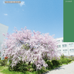
Selected Results on Hadron Spectroscopy from CLAS
K. Hicks (Ohio U.)
Hadron Physics Symposium
Nagoya, April 18, 2014

Slide 2
Selected results from CLAS
Search for scalar mesons (g12 data)
Cascade photoproduction (g12 data)
K⁰Λ photoproduction from the neutron (g10 data)
K⁰Σ⁺ photoproduction from the proton (g11 data)

Slide 3
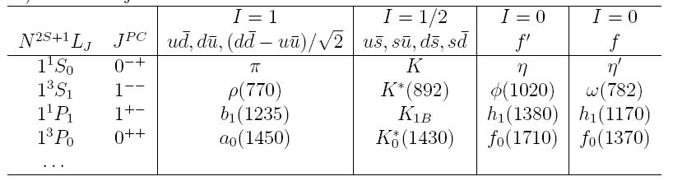
Scalar mesons: PDG assignments
There are 4 isoscalar states identified by experiment: f₀(980), f₀(1370), f₀(1500) and f₀(1710)
There are only 2 slots for the f₀ states in the quark model
The assignments of the f₀ states are still uncertain.

Slide 4

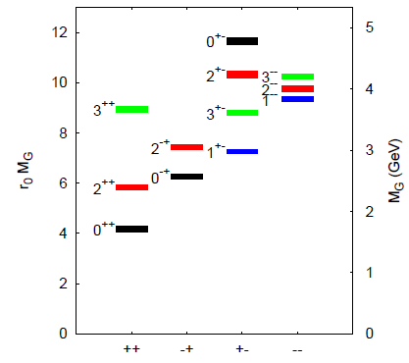
Theory calculations
Mixing scenario
LQCD calculations
Physical states f_{1,} f₂, f₃:
are a mixture of bare states
Dependence on model
Case 1: heavy glueball
f₀(1370) strong SU(3) singlet
f₀(1500) strong SU(3) octet
f₀(1710) strong glueball component
Case 2: light glueball
f₀(1370) strong SU(3) singlet
f₀(1500) strong glueball component
f₀(1710) strong SU(3) octet
Y Chen et al., PRD 73:014516 (2006)
V. Crede, C.Meyer arXiv:0812.0600

Slide 5
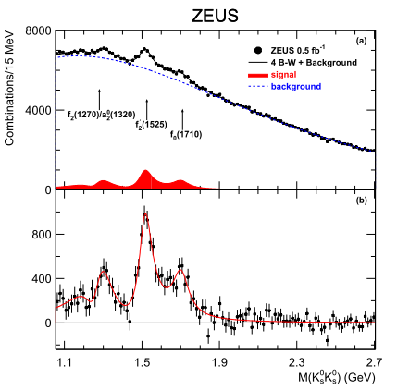
Just one of the previous searches:
Why choose strange decay?
M.Chanowitz suggests in PRL 95, 172001 (2005) that glueballs are more likely to decay to strange channels
Why choose K_{s}⁰K_{s}⁰ ?
Ensure that the final state has the same PC =++ as the lightest glueball
ZEUS Collaboration: S. Chekanov, et al, Phys.Rev.Lett.101:112003,2008,.

Slide 6
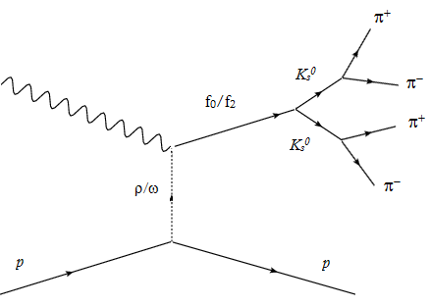
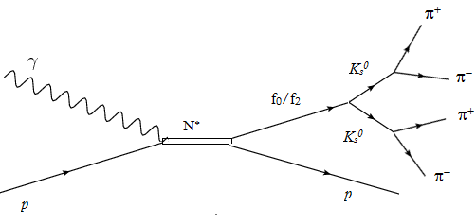
Photoproduction of scalar mesons
Photoproduction of scalar mesons via Pomeron exchange or via the hadronic component of the photon.
(Mathieu et al, arXiv:0810.4453)
s-channel
t-channel
Photoproduction is a good way to study scalar mesons. Dominant mechanism : ρ, ω
Donnachie and Kalashnikova arXiv:0806.3698

Slide 7
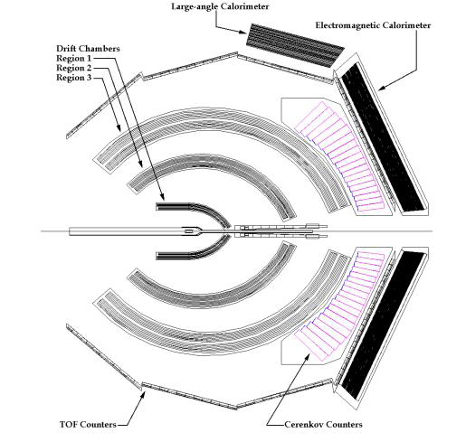
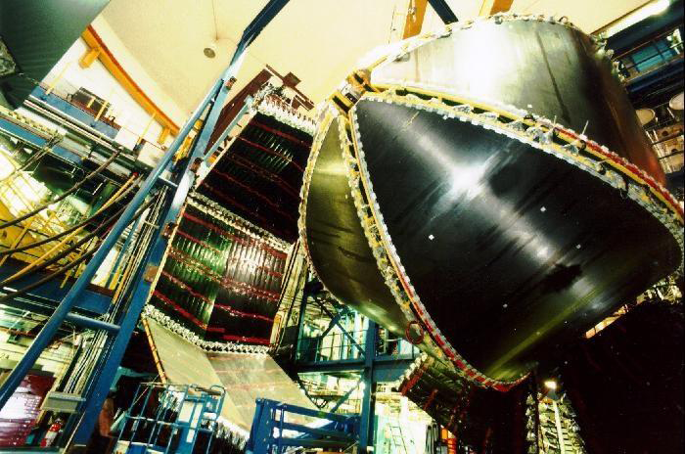
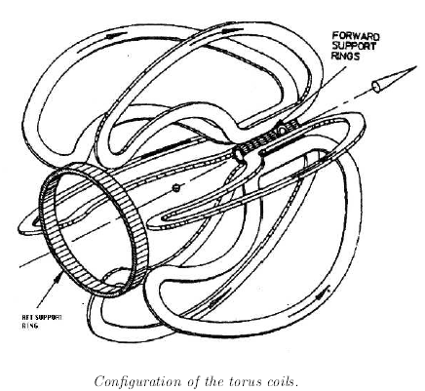
The CLAS Detector

Slide 8
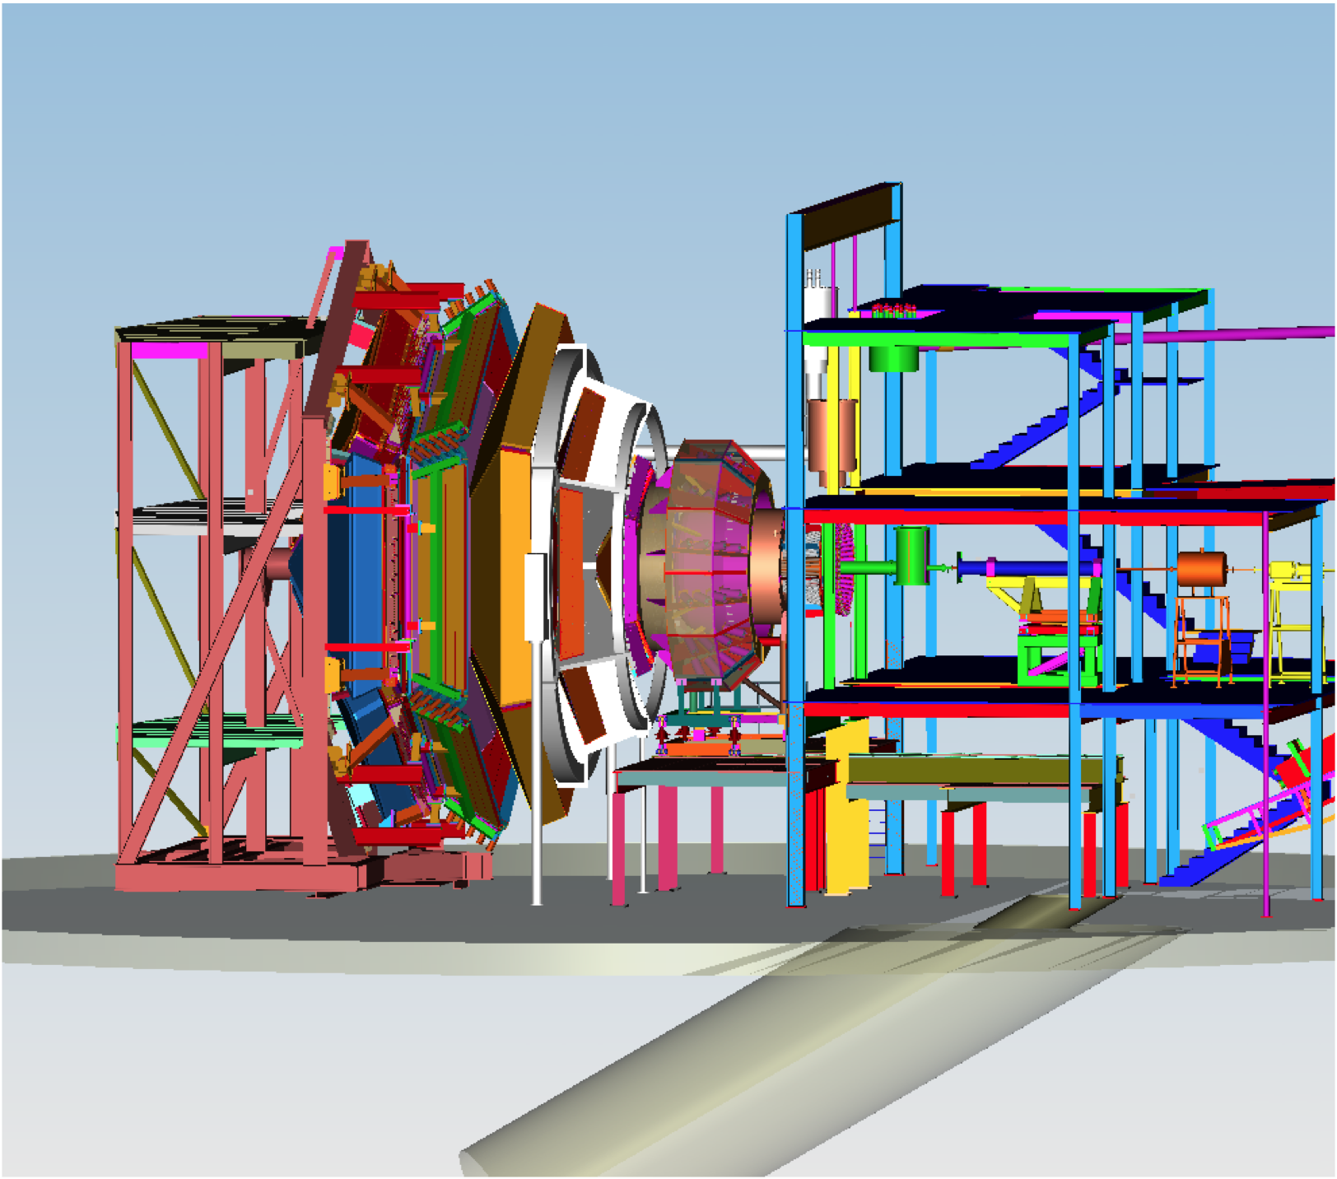
The Future: CLAS12
Hall B
CLAS12 high luminosity, large acceptance + RICH + user provided equipment

Slide 9
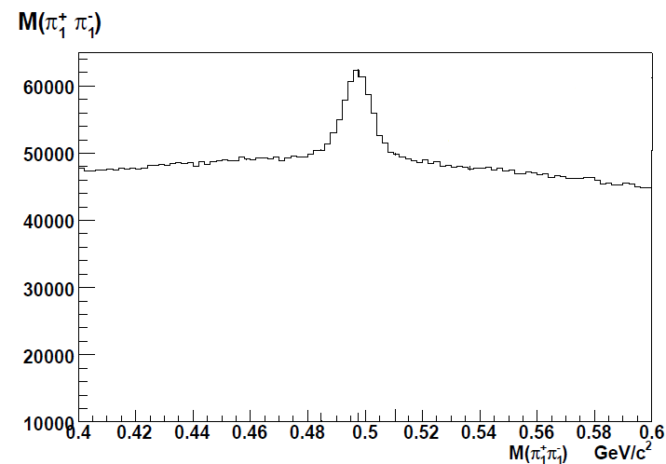
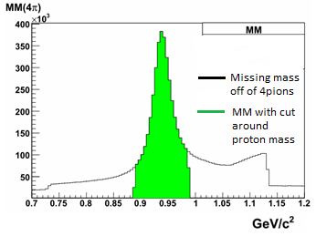
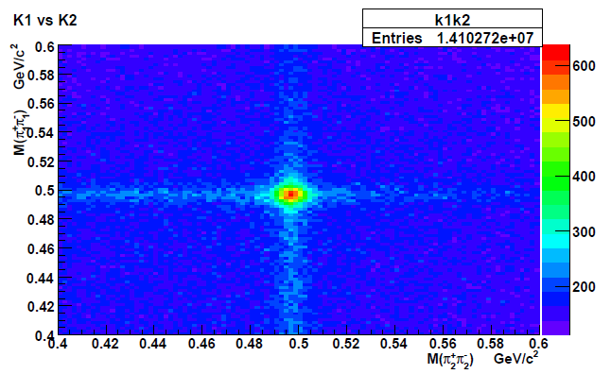
Event Selection
K⁰_{S} invariant mass
Missing mass off of 4π
The adjoining plot shows the high correlation between the two K⁰_{s}
Plots courtesy of S. Chandavar

Slide 10
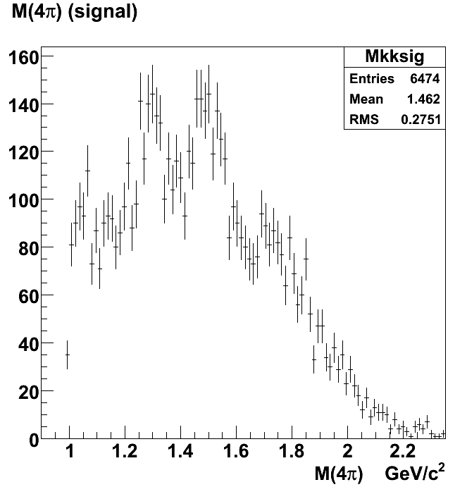

Preliminary Results (E_{G}>2.7 GeV)
f₂(1270)
f₀(1500)/
f₂’(1525)
The K_{s}⁰K_{s}⁰ invariant mass spectrum has a peak around 1270 MeV and another around 1500 MeV.
A partial wave analysis need to be performed to determine whether the peak at 1500 MeV is the f₀(1500) or the f₂’(1525)
Topic of PhD thesis: S. Chandavar

Slide 11
Selected results from CLAS
Search for scalar mesons (g12 data)
Cascade photoproduction (g12 data)
K⁰Λ photoproduction from the neutron (g10 data)
K⁰Σ⁺ photoproduction from the proton (g11 data)

Slide 12
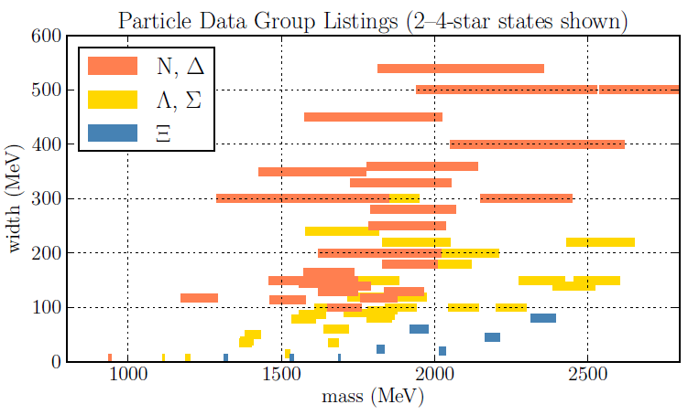
N*, Y*, and Ξ* Resonance Widths
Plot courtesy of J. Goetz

Slide 13
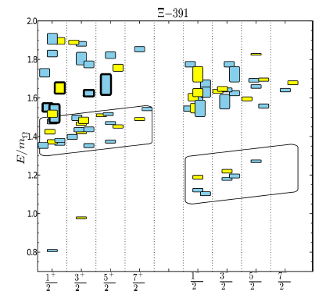
Lattice QCD Results (m_{π}=391 MeV)
R. Edwards, et al., PRD 87 (2013) 054506.
The lattice results predict many resonances at masses slightly above the first excited state.
Mass (units of Omega g.s.)
Ξ(1530)
Spin and Parity

Slide 14
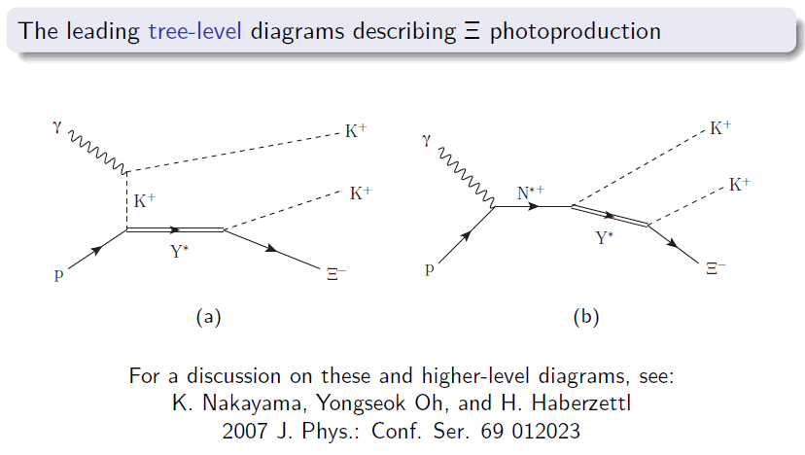
Photoproduction: two-step model

Slide 15
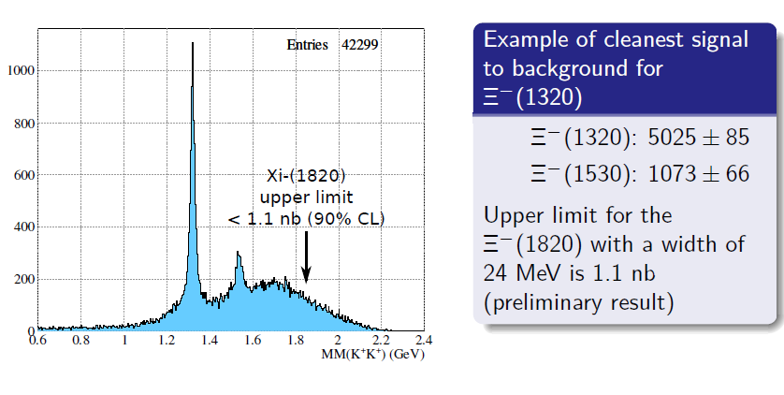
Preliminary results from g12 data
Plot courtesy of J. Goetz
Surprising result: no hint of higher-mass X resonances!

Slide 16
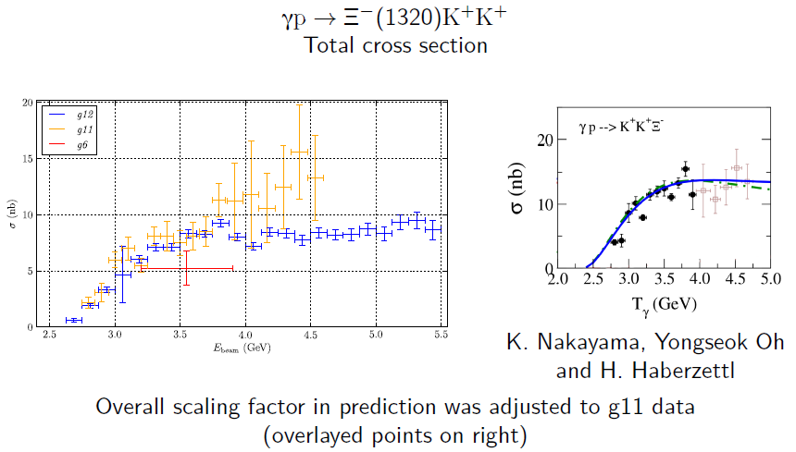
Comparison with previous data
Plots courtesy of J. Goetz
Preliminary!

Slide 17
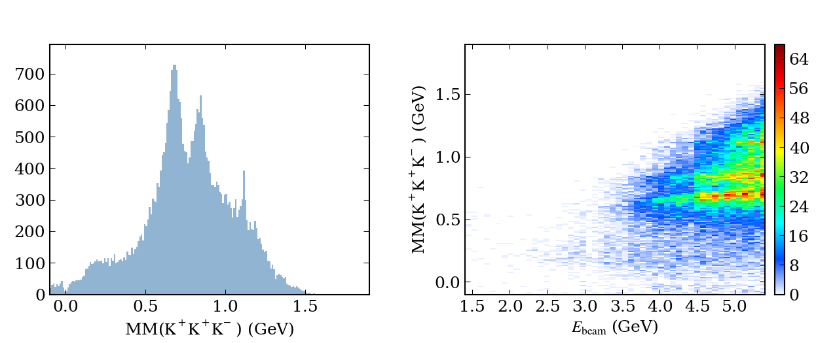
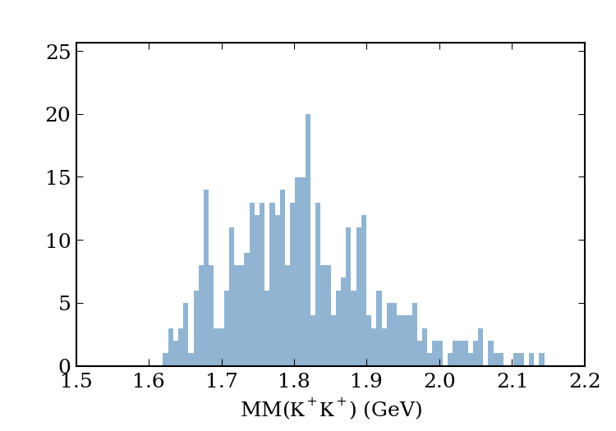
New (very preliminary!) result
Plots courtesy of J. Goetz

Slide 18
Selected results from CLAS
Search for scalar mesons (g12 data)
Cascade photoproduction (g12 data)
K⁰Λ photoproduction from the neutron (g10 data)
K⁰Σ⁺ photoproduction from the proton (g11 data)

Slide 19
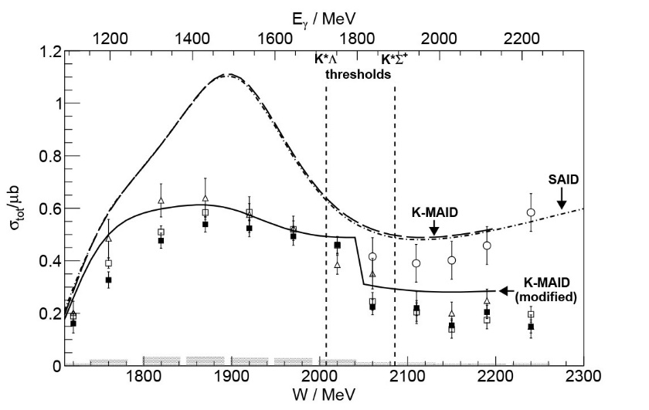
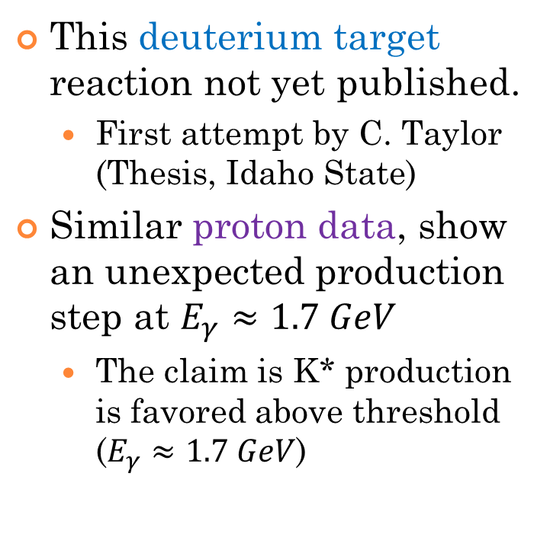

Motivation and Significance
This deuterium target reaction not yet published.
  First attempt by C. Taylor (Thesis, Idaho State)
Similar proton data, show an unexpected production step at $E_{γ}≈1.7 GeV$
  The claim is K* production is favored above threshold ($E_{γ}≈1.7 GeV$)
$$Compare: γp→K^{0}Σ^{+}$$
From:CBELSA/TAPS

Slide 20
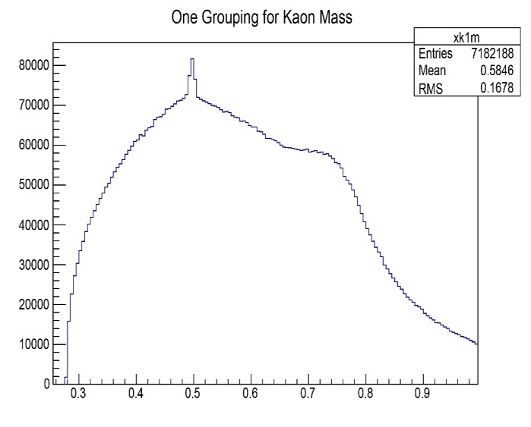
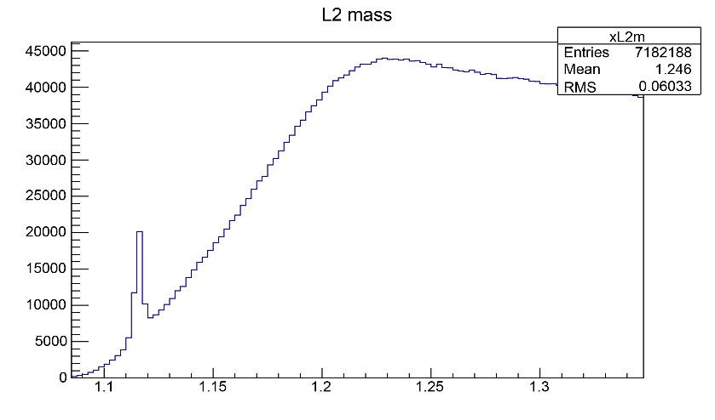
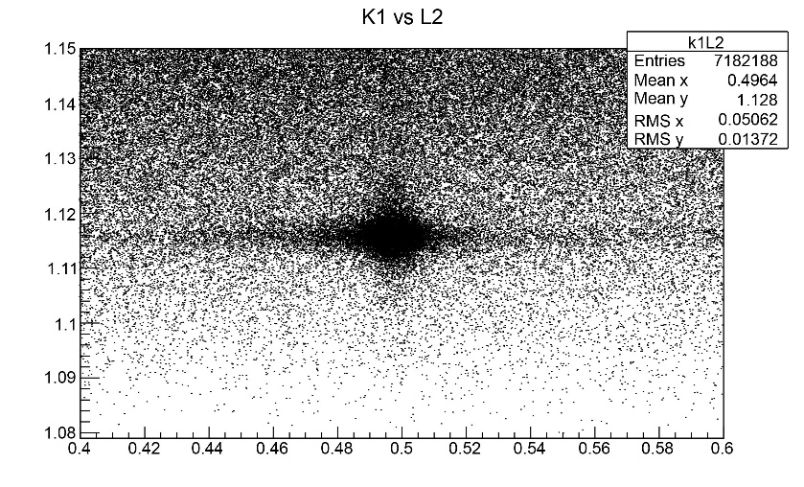

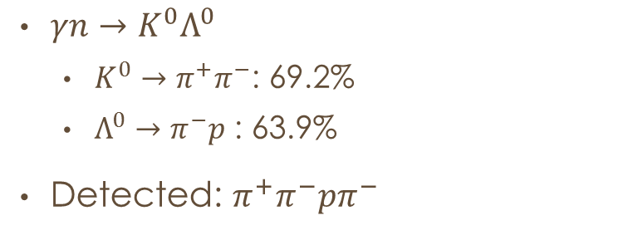



The Reaction
$γn→K^{0}Λ^{0}$
  $K^{0}→π^{+}π^{−}$: 69.2%
  $Λ^{0}→π^{−}p$ : 63.9%
Detected: $π^{+}π^{−}pπ^{−}$
Counts
M($π^{+}π^{−}$)
Counts
M($π^{−}p$)
M($π^{−}p$)
M($π^{+}π^{−}$)

Slide 21
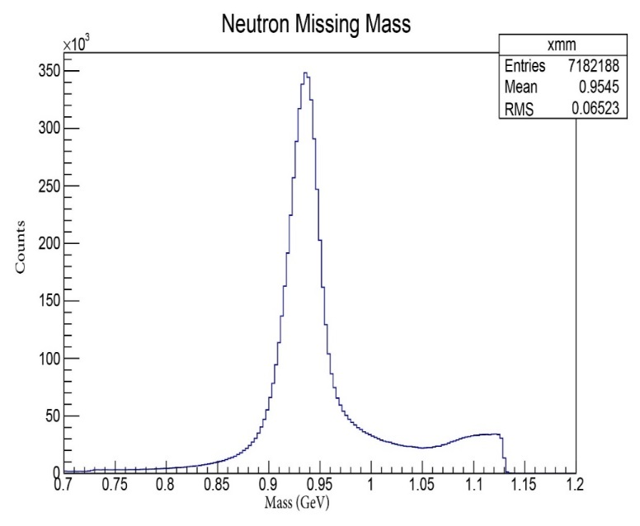
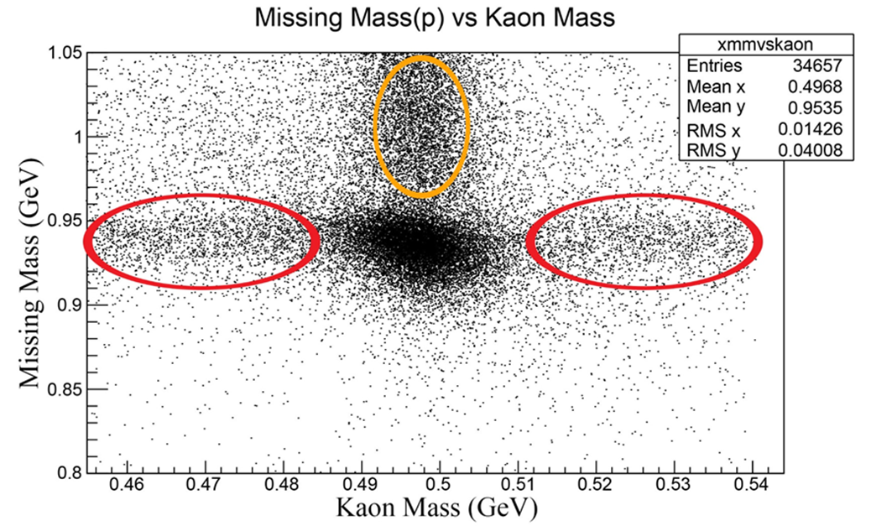
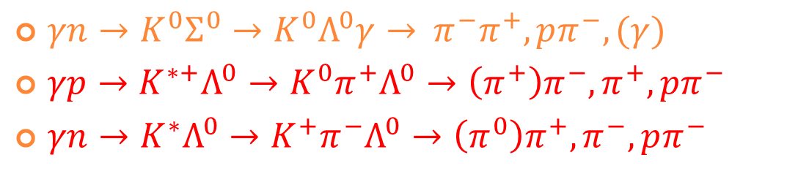
Background reactions
$γn→K^{0}Σ^{0}→K^{0}Λ^{0}γ→$ $π^{−}π^{+},pπ^{−},(γ)$
$γp→K^{∗+}Λ^{0}→K^{0}{π^{+}Λ}^{0}→\left(π^{+}\right)π^{−},π^{+},pπ^{−}$
$γn→K^{∗}Λ^{0}→K^{+}{π^{−}Λ}^{0}→\left(π^{0}\right)π^{+},π^{−},pπ^{−}$
Plots courtesy of N. Compton

Slide 22
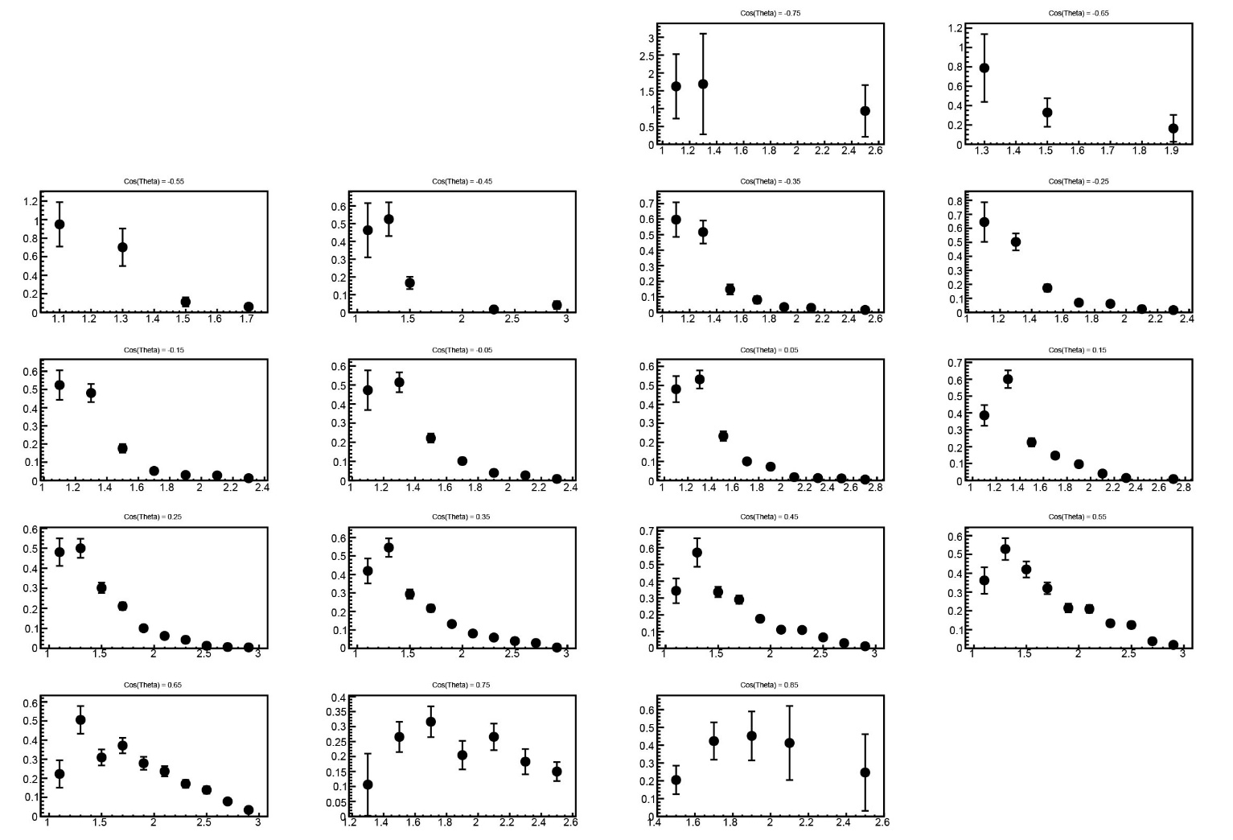
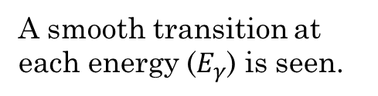
Cross Section as a Function of Energy
A smooth transition at each energy ($E_{γ}$) is seen.
Preliminary!
Plots courtesy of N. Compton

Slide 23
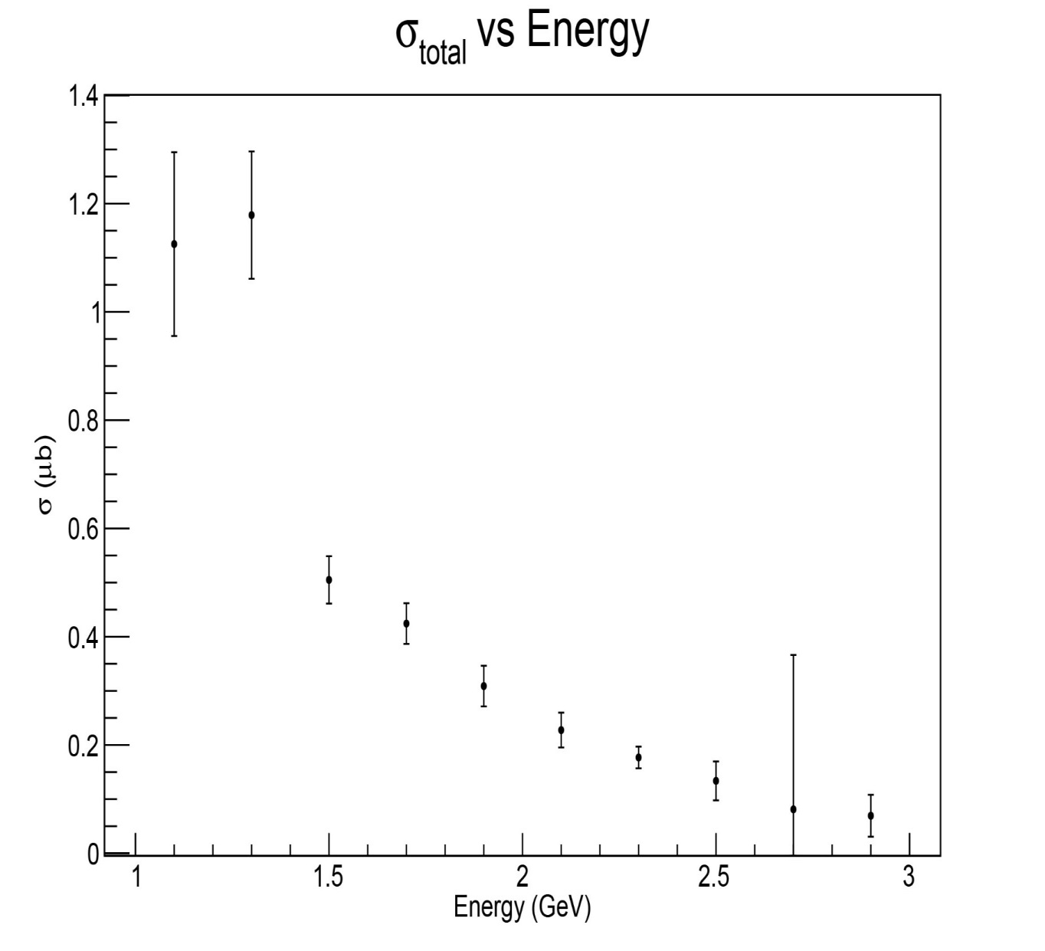
Total Cross Section: γ d → K⁰Λ (p)
The results, still preliminary, do not show any effect from the K* threshold.
Preliminary!
PhD work of N. Compton

Slide 24
Selected results from CLAS
Search for scalar mesons (g12 data)
Cascade photoproduction (g12 data)
K⁰Λ photoproduction from the neutron (g10 data)
K⁰Σ⁺ photoproduction from the proton (g11 data)

Slide 25
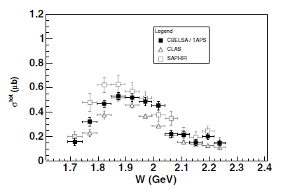
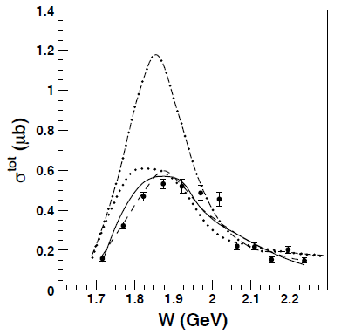
Previous results on γ p → K⁰ Σ⁺.
CBELSA/TAPS: EPJA 35 (2008) 39-45.
Theory shows smooth W-dependence.
Note the drop at W=2.05 (K* threshold).

Slide 26
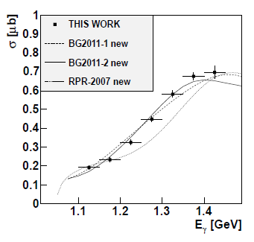
New data at lower W
Mainz data: PRC 88 (2013) 044601.
The total cross section peaks at about 0.7 mb. This is rather higher than for CBELSA/TAPS.
New (precise) data at higher W are desired.

Slide 27
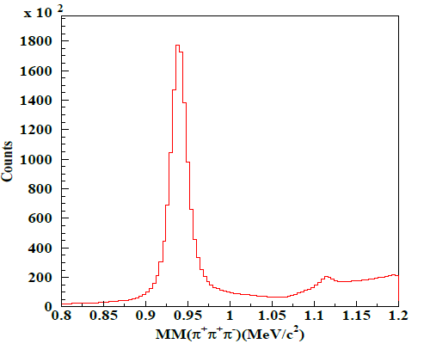
4. K⁰Σ⁺ cross section result
Similar as for K^{*+}Λ, but select the best positive charged π candid for either Kaon (method 1) or Σ (method 2)
For both method, we first cut on 3 pions missing mass(or neutron mass)
Cut on K⁰ mass and fit Σ⁺ peak (method 1) or cut on Σ⁺ mass and fit K⁰ peak (method 2) to extract the counts
Same cuts and corrections were both applied to experimental data and Monte Carlo data

Slide 28
Cross sections: two analysis methods
Method 1
Method 2
1.5 --- 2.1 GeV
2.1 --- 2.7 GeV

Slide 29
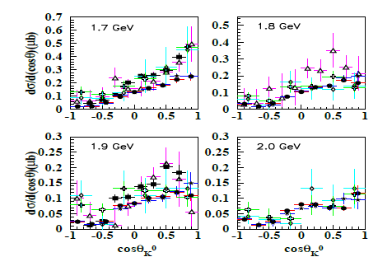
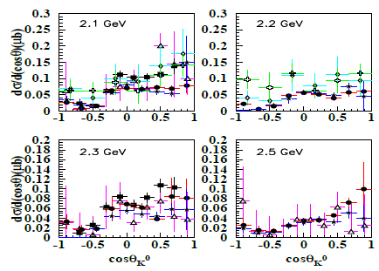
Comparison with world data
CLAS preliminary: solid black points. Other colors: previous data.
In general, the agreement is not too bad, but clearly there is disagreement among world data at various kinematics.

Slide 30
Summary
This is only a small selection of the many hadron physics analysis projects being done at CLAS.
  I have focused only on Ohio group results.
All four results presented here are nearly finished and will be submitted for publication.
Some other hadron physics being done at CLAS:
  Meson photoproduction: search for exotic mesons.
  Strangeness production: Λ(1405), Λ(1520), etc.
  Two-pion photoproduction: N(1440), ρΔ, etc.
  Complete set of spin observables for γ p → K⁺Λ.
These high-precision data are leading to new theoretical developments in hadron spectroscopy

