Slide 1


Deeply Virtual Meson Production with CLAS
Deeply pseudoscalar meson
production with CLAS
Michel Guidal (IPN Orsay)
on behalf of/with
Valery Kubarovsky (Jefferson Lab)
Valery Kubarovsky
Jefferson Lab

Slide 2
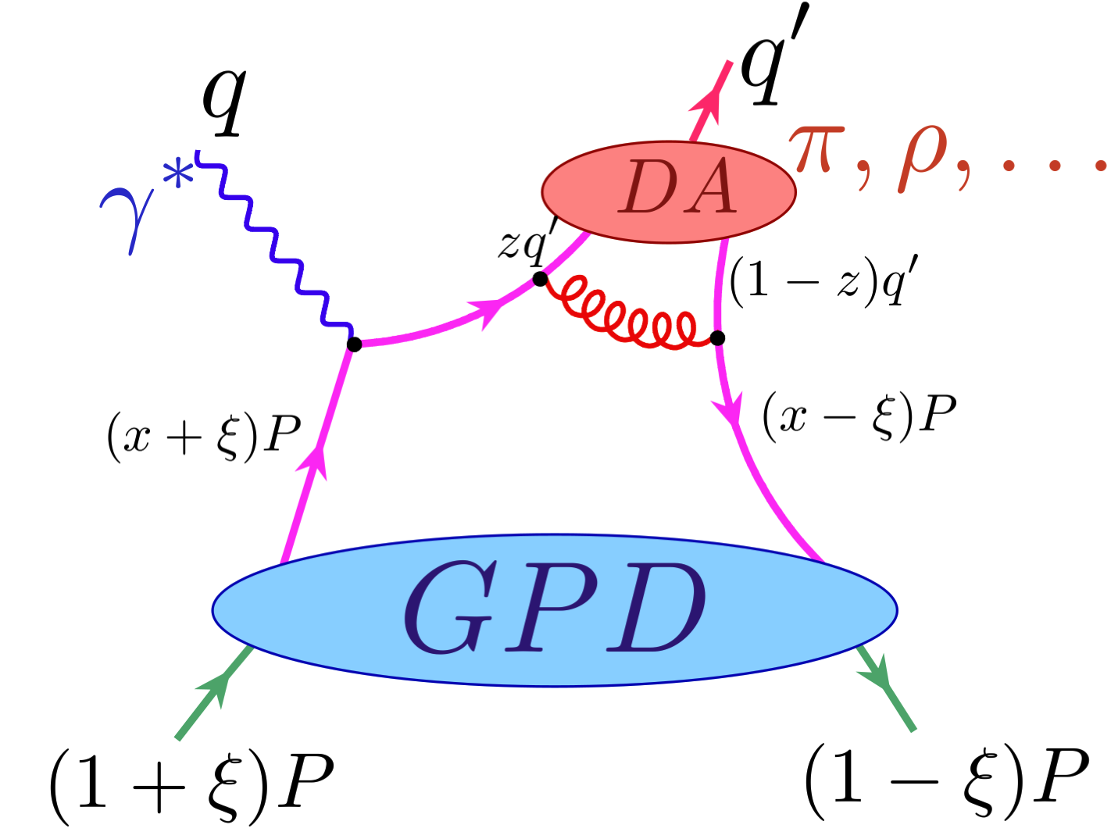
Outline
Physics motivation
Transversity GPD and structure functions
CLAS data on pseudoscalar meson electroproduction
Conclusion
Notes:
After short introduction I will show you the latest development in the field of DVCS study with polarized and unpolarized targets, vector meson elecroproduction and Jlab12 upgrade program.

Slide 3
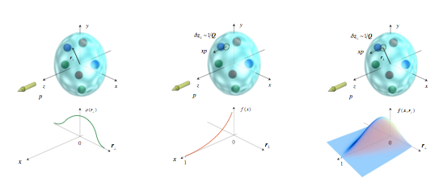
Description of hadron structure in terms of GPDs
Nucleon form factors transverse charge & current densities
Nobel prize 1961- R. Hofstadter
Structure functions
quark longitudinal
momentum (polarized and unpolarized) distributions
Nobel prize 1990 –J.Friedman,
H. Kendall, R. Taylor
GPDs
correlated quark momentum distributions (polarized and unpolarized) in transverse space
Notes:
Understanding the structure of the nucleon in terms of the QCD fundamental degrees of freedom is a major goal of the modern nuclear physics. The electromagnetic probe provides an outstanding tool to study the nucleon’s structure. Proton formfactors are closely connected with the transvers charge and current densities inside the nucleon. Deep inelastic scattering cross section can be expressed in terms of structure functions that described longitudinal momentum and spin distributions. The Generalized Parton Distributions provides a new formalism to unravel the nucleon structure that unifies form factors, parton distributions, and the angular momentum of partons. The t-dependence of the GPDs connected through the Fourier transform to the transverse spatial distributions of quarks and gluons with different momentum.

Slide 4
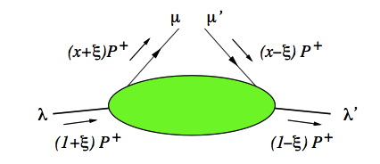
Generalized Parton
Distributions
GPDs are the functions of three kinematic variables: x, ξ and t
There are 4 chiral even GPDs where partons do not transfer helicity H, H, E, E
~
~

Slide 5
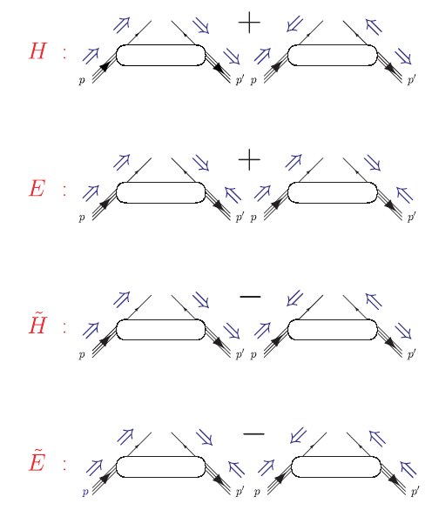

Slide 6
Generalized Parton
Distributions
GPDs are the functions of three kinematic variables: x, ξ and t
There are 4 chiral even GPDs where partons do not transfer helicity H, H, E, E
4 chiral odd GPDs flip the parton helicity
H_{T}, H_{T}, E_{T}, E_{T}
The chiral-odd GPDs are difficult to access since subprocesses with quark helicity-flip are suppressed
~
~
~
~

Slide 7


Chiral-odd GPDs
Very little known about the chiral-odd GPDs
Anomalous tensor magnetic moment
(Compare with anomalous magnetic moment)
Transversity distribution
The transversity describes the distribution of transversely polarized
quarks in a transversely polarized nucleon

Slide 8


Leading twist σ_{L}
The brackets <F> denote the convolution
of the elementary process with the GPD F
(generalized form factors)
For π⁰, suppressed by a factor coming from:
For η, no such cancellation:
For π⁺, strong pion pole contribution:

Slide 9
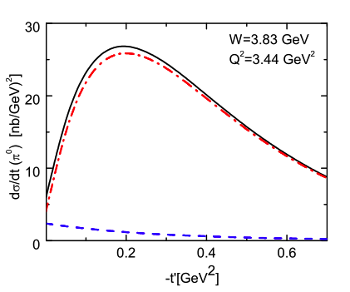
Kroll & Goloskokov
t-dependence at t=t_{min} is determined by the interplay between:
( dominant in GK)

Slide 10
Transverse Densities for u and d Quarks in the Nucleon
Strong distortions
for unpolarized
quarks in transversely
polarized nucleon
Strong distortions
for transversely
polarized quarks
in an unpolarized
nucleon
_
~
Described by E
Described by E_{T}=2H_{T}+E_{T}
Gockeler et al, hep/lat/0612032

Slide 11
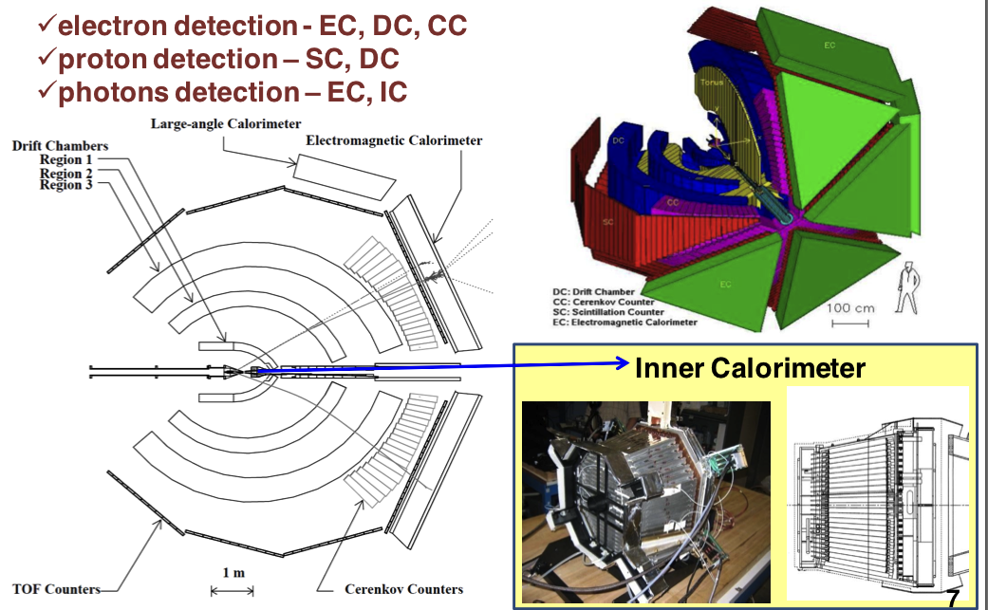
CEBAF Large Acceptance
Spectrometer CLAS
CLAS Lead Tungstate Electromagnetic Calorimeter
424 crystals, 18 RL,
Pointing geometry,
APD readout

Slide 12
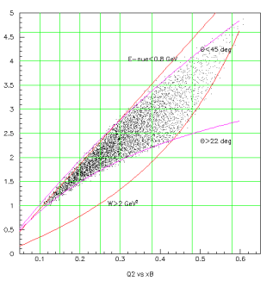
4 Dimensional Grid
E_{e}=5.75 GeV
epγγ
channel
Q²
Rectangular bins are used.
Q²- 7 bins(1.-4.5GeV²)
x_{B}- 7 bins(0.1-0.58)
t - 8 bins(0.09-2.0GeV)
φ - 20 bins(0-360°)
π⁰ data ~2000 bins
Phys.Rev.Lett. 109 (2012) 112001 ,
arXiv:1405.0988
η data ~1000 bins
(preliminary)
x_{B}

Slide 13
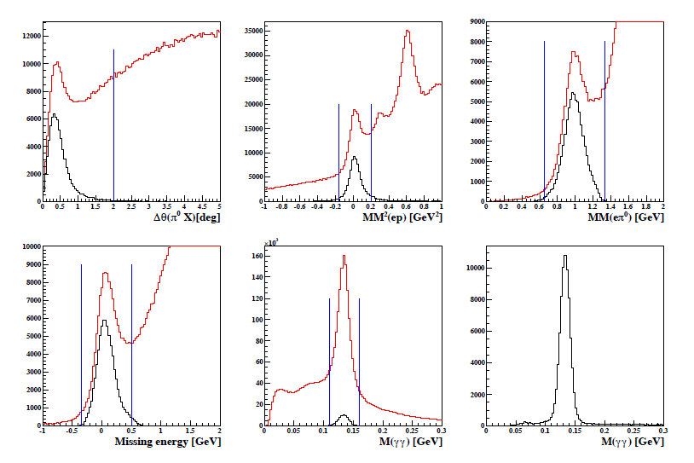
Cuts to select the exclusive final state epπ⁰

Slide 14
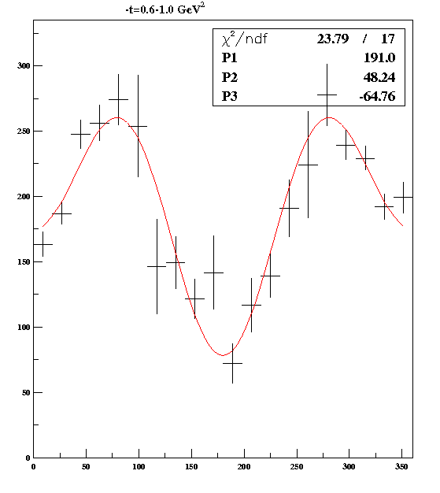
Structure Functions σ_{U}=σ_{T}+εσ_{L} σ_{TT} σ_{LT}
φ distribution
Agreement with Hall A measurement (limited phase space) at the few percent level

Slide 15
W dependence
σ_{U}~1/W^{1.5-2}

Slide 16
dσ_{U}/dt
-t
GeV²

Slide 17
t-slope parameter: x_{B} dependence
The slope parameter is decreasing with increasing x_{B}. The Q² dependence is weak.

Slide 18
CLAS data and GPD theory predictions
S. Goloskokov and P. Kroll : solid curves
S. Liuti and G. Goldstein: dashed curves
σ_{T}+εσ_{L}
σ_{TT}
σ_{TL}
Include transversity GPDs H_{T} and
Dominate in CLAS kinematics.
The model was optimized for low x_{B} and high Q². Terms of order t/Q² are omitted
The model successfully describes CLAS data even at low Q²
Pseudoscalar meson production might provide possibility to access the transversity GPDs.
( dominant in GK)
( dominant in LG)

Slide 19
GPD Flavor Decomposition
GPDs appear in the different flavor combinations for π⁰ and η
Assuming that there is no contribution from strange quarks for η –meson
The combined π⁰ and η data permit the flavor(u and d) decomposition for GPDs H_{T} and E_{T}

Slide 20
Comparison π⁰/η preliminary
π⁰
η
σ_{u}
σ_{LT}
σ_{TT}
σ_{U} drops by a factor of 2.5 for η
σ_{TT} drops by a factor of 10
The GK GPD model follows the experimental data
The statement about the transversity GPD dominance in the pseudoscalar electroproduction becomes more solid with the inclusion of η data

Slide 21
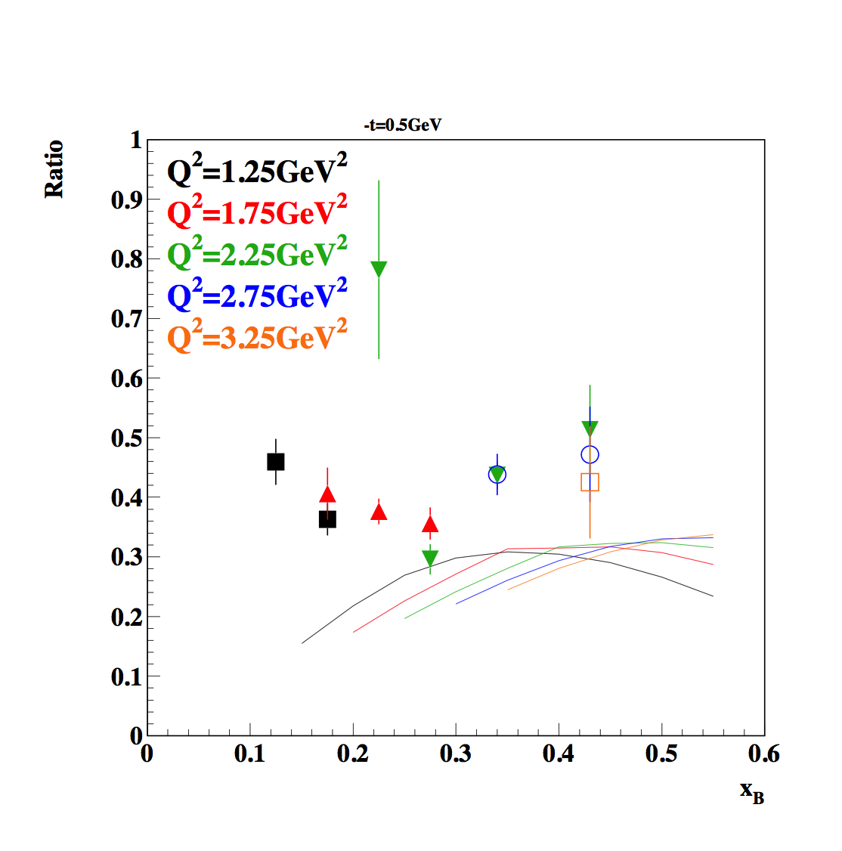
η/π⁰ ratio
The dependence on x_{B} and
Q² is very weak.
Conventional GPD models predict this ratio to be around 1 (at low –t).
GPD model with transversity predicts this ratio to be ~1/3 at CLAS kinematics

Slide 22
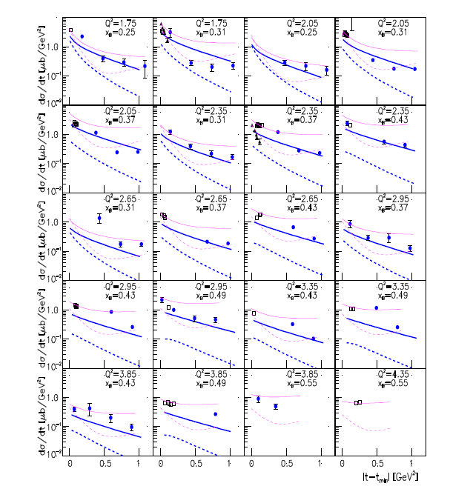

Eur.Phys.J. A49 (2013) 16
CLAS data
Hall C data
GK
σ_{T}+εσ_{L}
σ_{L}
[
]
KM
σ_{T}+εσ_{L}
σ_{L}

Slide 23
Summary
The discovery of Generalized Parton Distributions has opened up a new and exciting avenue of hadron physics that needs exploration in dedicated experiments.
Is exclusive (pseudoscalar-)meson electroproduction interpretable in terms of GPDs ?
In the GK approach, yes, provided one introduces higher-twist contributions, in particular transversity GPD contributions to account for the strong transverse cross sections.
CLAS π⁰, π⁺ and η data support this picture, in particular the dominance/importance of the transversity GPDs and .
The combined π⁺, π⁰ and η data will help for the flavor decomposition of transversity GPDs

Slide 24
END

Slide 26
Structure functions and GPDs
Leading twist σ_{L} suppressed :
The brackets <F> denote the convolution
of the elementary process with the GPD F
(generalized formfactors)
Kroll & Goloskokov

Slide 28
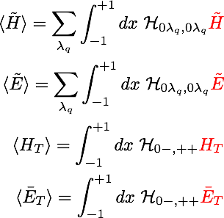

Slide 29
Structure functions and GPDs
The brackets <F> denote the convolution of the elementary process with the GPD F (generalized formfactors)

Slide 30
Transverse Densities for u and d Quarks in the Nucleon
Strong distortions
for unpolarized
quarks in transversely
polarized nucleon
Strong distortions
for transversely
polarized quarks
in an unpolarized
nucleon
_
~
Controlled by E
Controlled by E_{T}=2H_{T}+E_{T}
Gockeler et al, hep/lat/0612032

Slide 31
Structure functions and GPDs
Leading twist σ_{L} suppressed :
The dominant contributions to the cross section are coming from
The brackets <F> denote the convolution
of the elementary process with the GPD F
(generalized formfactors)
Kroll & Goloskokov

Slide 32
The transversity describes the distribution of transversely polarized
quarks in a nucleon transversely polarized with respect to
the direction of the hard probe, i.e., the virtual photon γ∗.
It is the most difficult one to measure.
The transversity distribution was first mentioned by Ralston and Soper [39],
but re- mains unmeasured until the
recent HERMES measurement [40].
The reason is that the transversity is a
chiral–odd object, which requires the combination
with another chiral– odd object in helicity
conserving process. Hence, unlike the other two,
it is inaccessible in inclusive measurement of DIS

Slide 33
E12-06-108
Hard Exclusive Electroproduction of π⁰ and η with CLAS12
Cross sections of the reactions ep ➝ epπ⁰, ep ➝epη
Extract structure functions σ_{T}+εσ_{L}, σ_{TT}, σ_{LT} σ_{LT’} vs. Q², x_{B}, t
  Fourier decomposition of the reduced cross section
  σ_{T}+εσ_{L}, σ_{TT}, σ_{LT}
  Beam-spin asymmetry σ_{LT’}
Handbag - 3D nucleon tomography
  transversity GPDs H_{T} and data.
  Backward pion production (high-t, low-u). Transition distribution amplitudes.
CLAS6 data

Slide 34
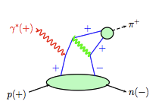
Transversity in π⁰ electroproduction
S. Goloskokov, P. Kroll, 2011
G. Goldstein, S. Liuti, 2011
Theory: Goloskokov&Kroll
Transvers cros section
domunates in this model
Data CLAS

Slide 35
Monte Carlo
Empirical model for the structure cross sections was used for the MC simulation and radiative corrections
This model is based on CLAS data
MC simulation included the radiative effects and used empirical model for the Born term.
100 M events were simulated with GSIM program.

Slide 36
Radiative Corrections
Q² = 1.15 GeV²
x_{B} = 0.13
-t = 0.1 GeV²
Radiative Corrections were calculated using Exclurad package with structure cross sections described by our empirical cross section.
π⁰
η
φ

