Slide 1

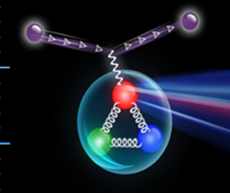
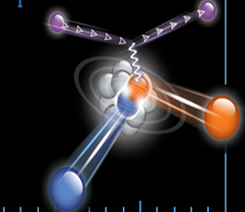
June 2015 Trento, Italy
The EMC effect and Short Range Correlation in nuclei
Eli Piasetzky
Tel Aviv University, Israel

Slide 2
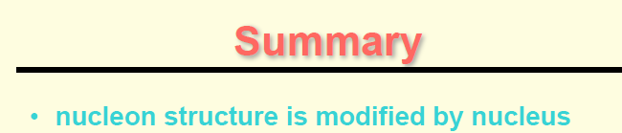
If this is true than it is mainly the high-momentum (large-virtuality ) nucleons in the nucleus.

Slide 3

The EMC Monday

Slide 4
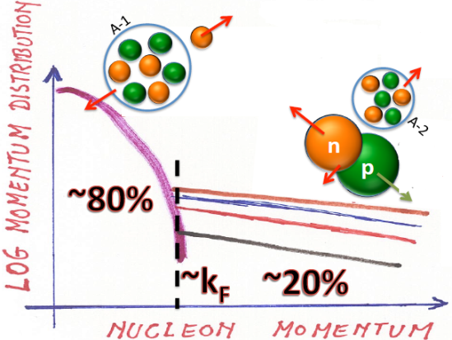
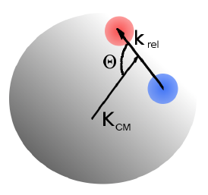

What are Short (intermediate) Range Correlations in nuclei ?
(tensor)
2N-SRC
SRC ~R_{N}
LRC ~R_{A}
~1 fm
≤1.f
1.7f
1.7f
1.7 fm
ρ_{o} = 0.16 GeV/fm³
Nucleons
In momentum space:
K ₁
A pair with large relative momentum between the nucleons and small CM momentum.
K ₁
K ₂
K ₁ > K_{F} ,
K ₂ > K_{F}
K ₂
Notes:
4

Slide 5


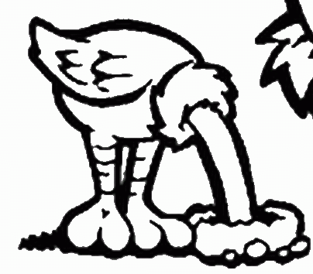
Some do not like them
Some theoreticians denied their existence

Slide 6
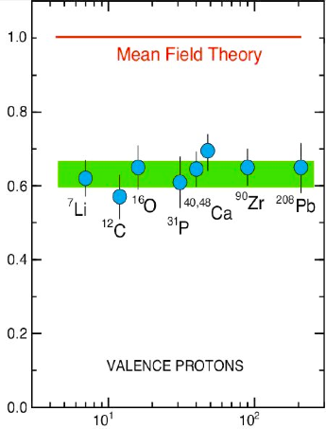
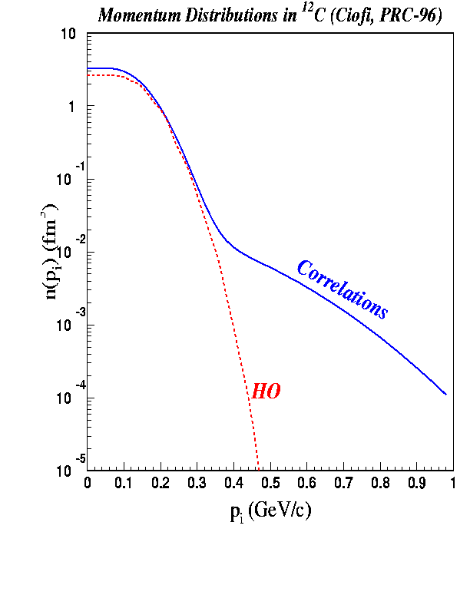
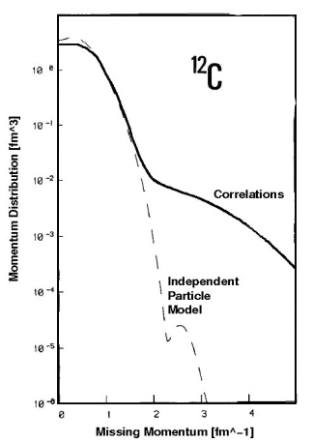
Spectroscopic
factors
for (e, e’p)
reactions
show only
60-70%
of the
expected
single-particle
strength.
L. Lapikas, Nucl. Phys. A553, 297c (1993)
Benhar et al., Phys. Lett. B 177 (1986) 135.
MISSING :
Correlations Between Nucleons
SRC and LRC
Notes:
6

Slide 7
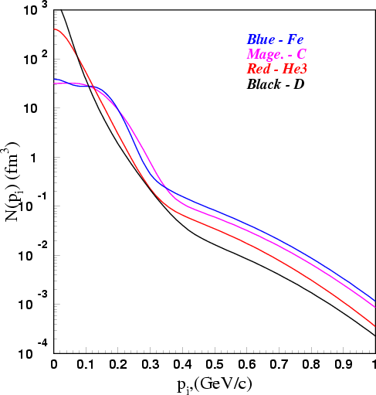
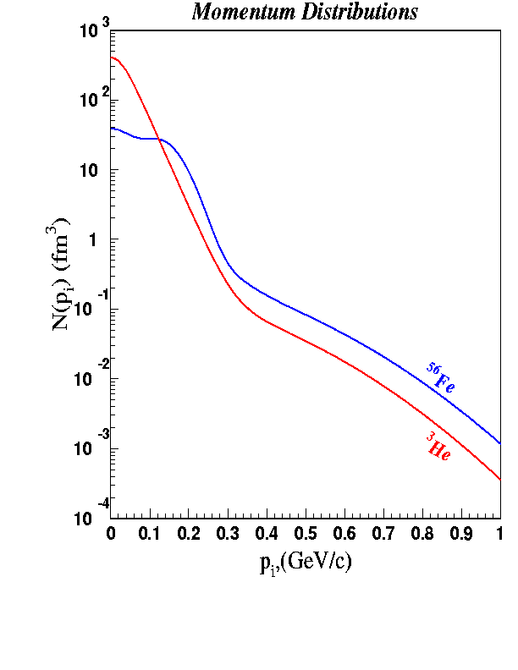
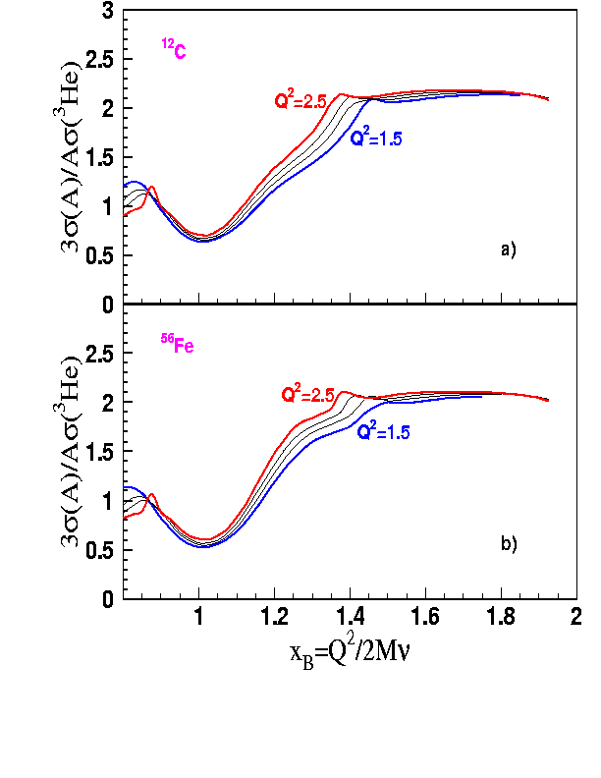
The inclusive A(e,e’) measurements
At high nucleon momentum
distributions are similar in shape for
light and heavy nuclei: SCALING.
  Can be explained by 2N-SRC dominance.
Adapted from
Ciofi degli Atti
  Within the 2N-SRC dominance picture one can get the probability of 2N-SRC in any nucleus, from the scaling factor.
In A(e,e’) the momentum of the struck proton (p_{i}) is unknown.
e
e/
p_{i}
q
But: For fixed high Q² and x_{B}>1, x_{B} determines a minimum p_{i}
Prediction by Frankfurt, Sargsian, and Strikman:

Slide 8
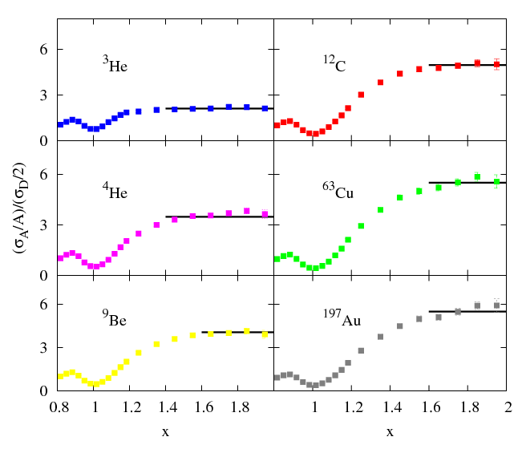
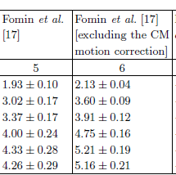
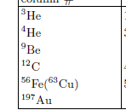
Results from JLab Hall C (E02-019)
N. Fomin et al. Phys. Rev. Lett. 108:092502, 2012.
Q²=2.5GeV²
a_{2N}(A/d)
See talk by Shalev
More r(A,d) data:
SLAC D. Day et al. PRL 59,427(1987)
Jlab /Hall B: K. Sh. Egiyan et al. PRC 68, 014313 (2003)
K. Sh. Egiyan et al. PRL. 96, 082501 (2006)

Slide 9
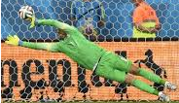
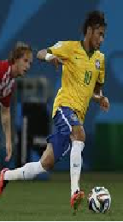
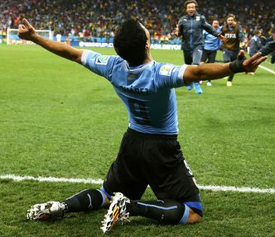
Quasi-Free scattering off a nucleon in a short range correlated pair
Hard exclusive
triple – coincidence measurements
K ₁
K ₂
Pmiss [MeV/c] | pairs | nuclei | experiment
300-600 | pp only | ¹²C | EVA/BNL
300-600 | pp and np | ¹²C | E01-015/ Jlab
400-850 | pp and np | ⁴He | E07-006/ JLab
300-700 | pp only | C, Al, Fe, Pb | CLAS/JLab

Slide 10
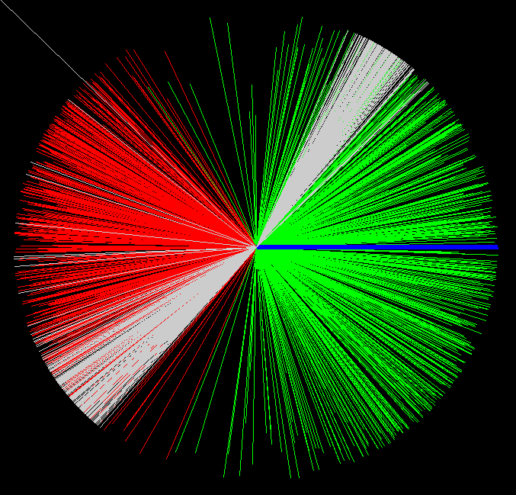
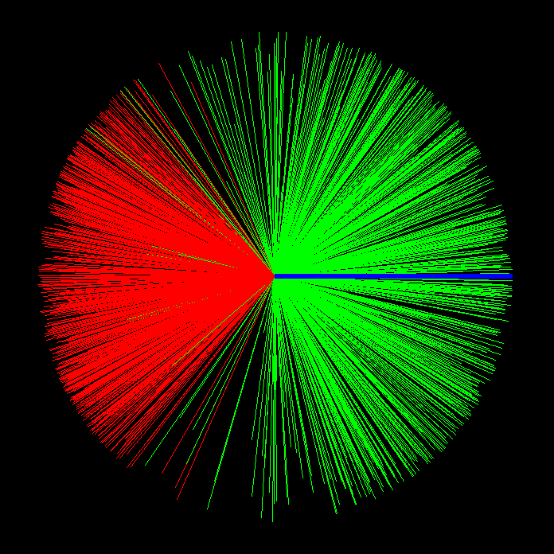
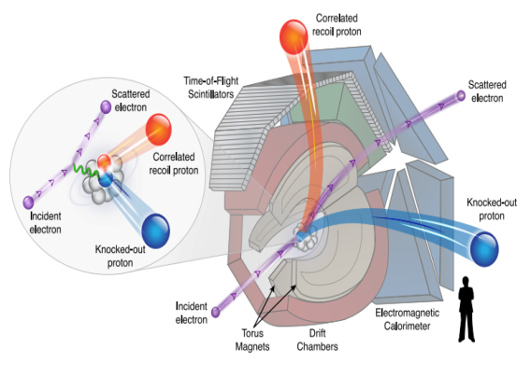
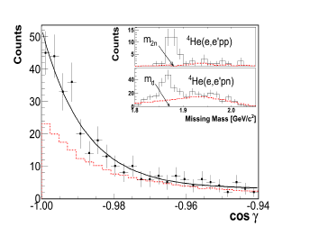
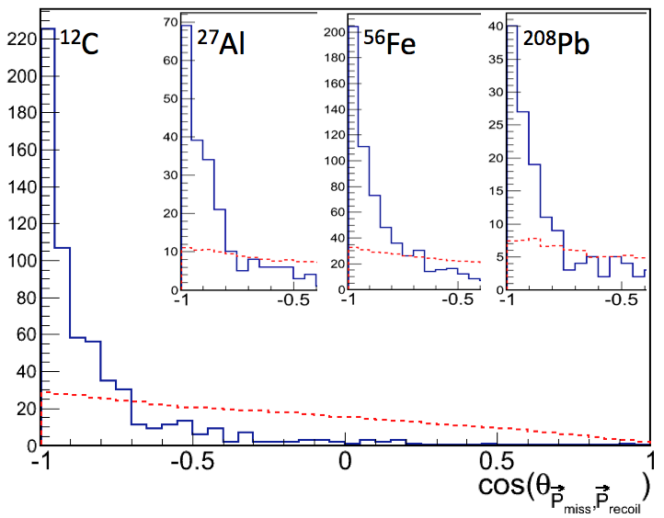
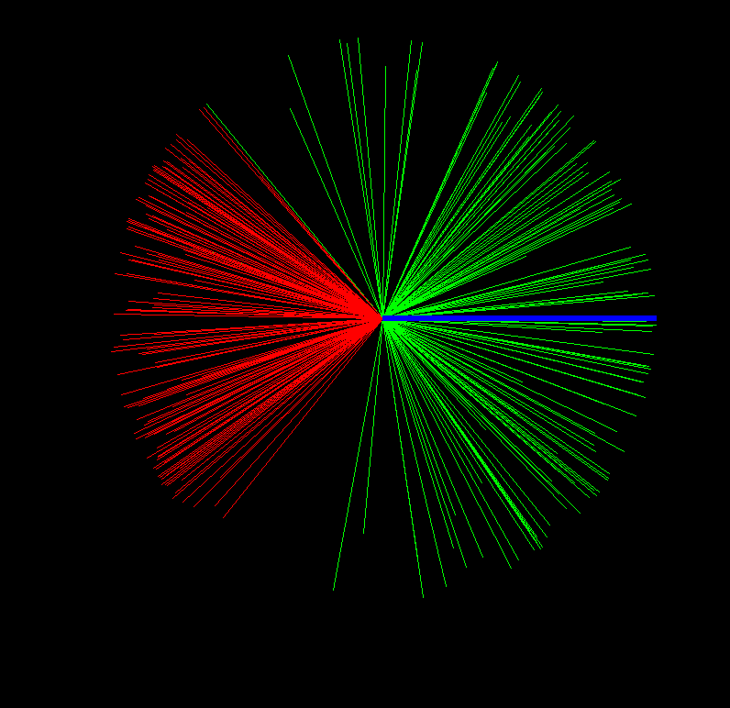
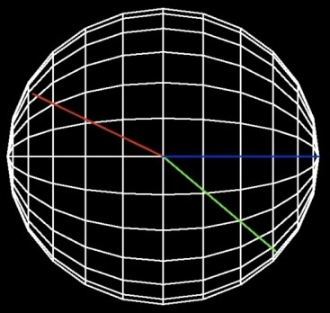
JLab / CLAS, Data Mining, EG2 data set
¹²C(e.e’pp)
P_{recoil}
⁵⁶Fe(e,e’pp)
P_{recoil}
q
q
P_{miss}
²⁰⁸Pb(e,e’pp)
pp-SRC events
q
γ
Ein =5.014 GeV
P_{miss}
Q²>1.5GeV/c²
X>1.2
JLab /Hal A Exp 07-006

Slide 11
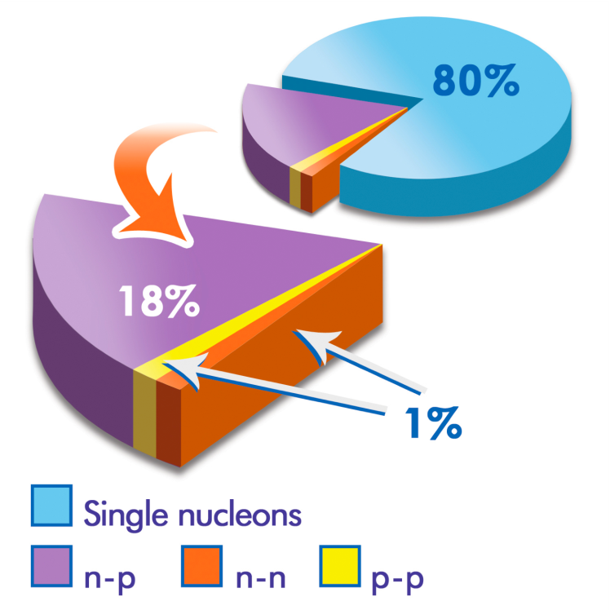
R. Subedi et al., Science 320, 1476 (2008).
¹²C
BNL / EVA
¹²C(e,e’pn) / ¹²C(e,e’p)
[¹²C(e,e’pn) / ¹²C(e,e’pp)] / 2
[¹²C(e,e’pp) / ¹²C(e,e’p)] / 2

Slide 12
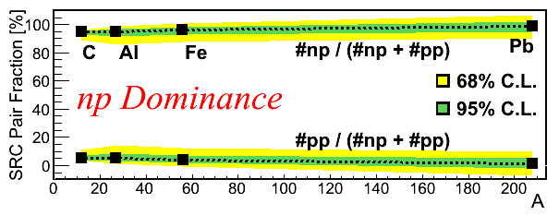
np / pp SRC pairs ratio
c
Al
Fe
Pb
O. Hen et al., Science 346, 614 (2014).

Slide 13
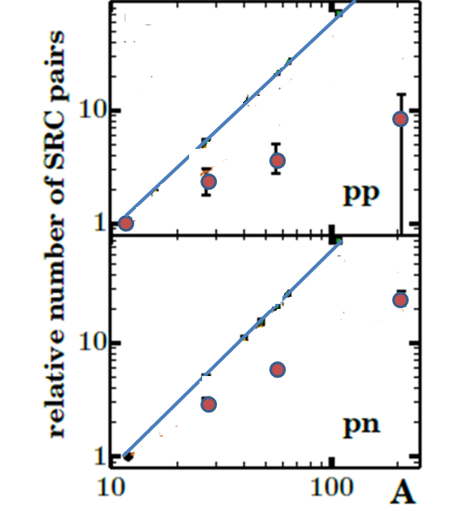
The mass dependence of the SRC pairs
CLAS JLab data see C. Colle et al.
http://arxiv.org/abs/arXiv:1503.06050

Slide 14
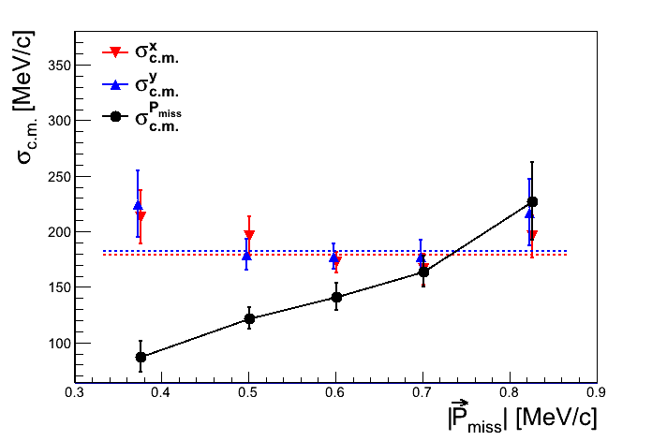
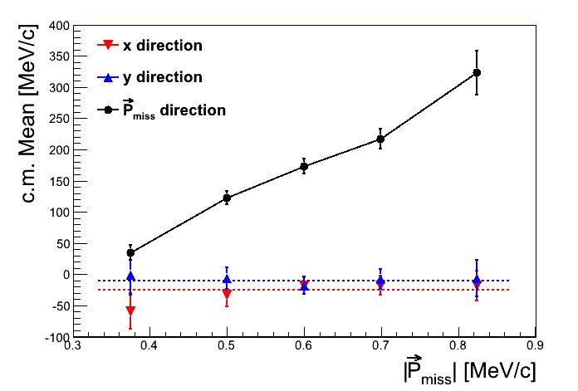
C.M. motion of the pair
⁵⁶Fe
P
σ=180±4.7 [MeV/c]
PRELIMINARY
 | σ_{x} | σ_{y}
¹²C | 169±7 | 164±6
²⁷Al | 162±10 | 180±13
⁵⁶Fe | 179±6 | 182±7
²⁰⁸Pb | 208±18 | 186±16
O. Hen E. Cohen et al., in preparation

Slide 15
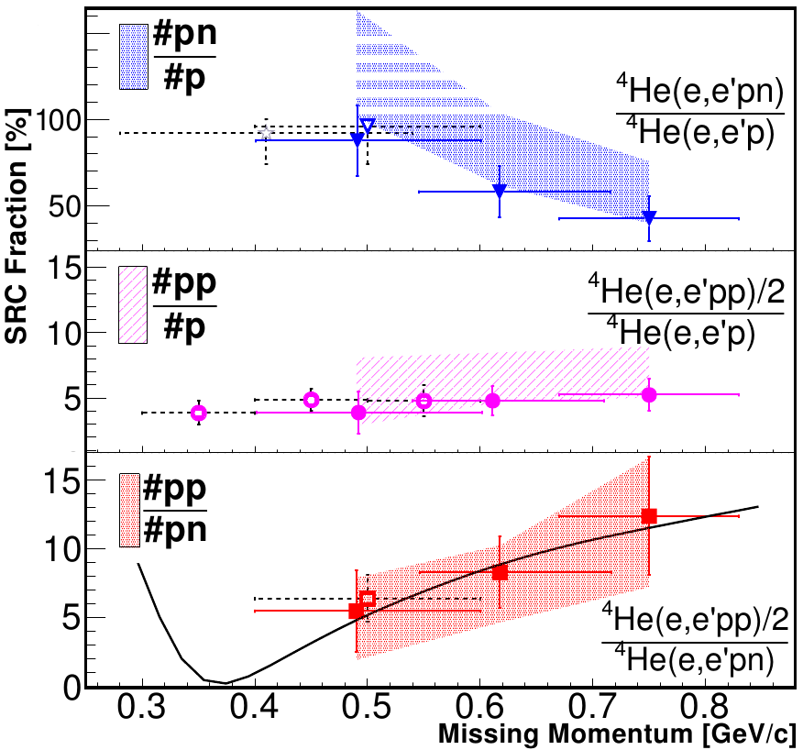
E07-006 (2011) ⁴He
I. Korover et al. Phys. Rev. Let. 113, 022501 (2014).

Slide 16
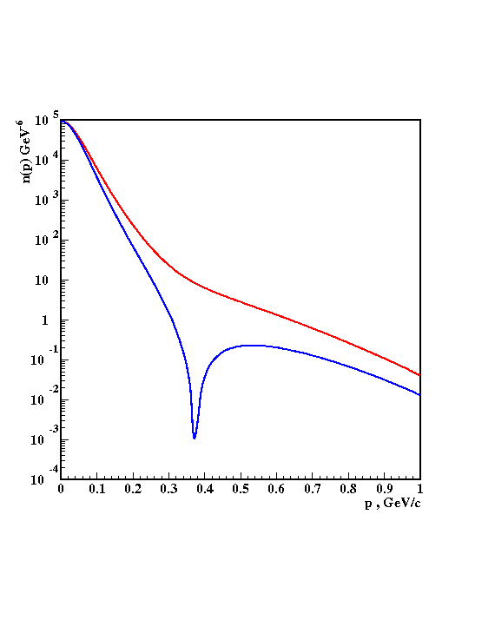
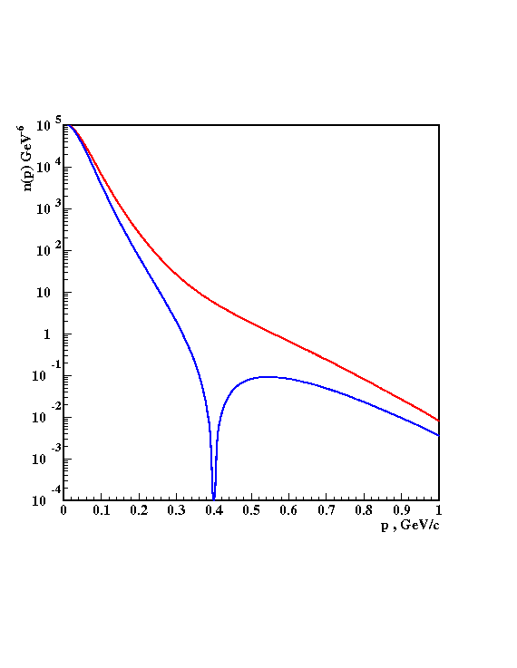
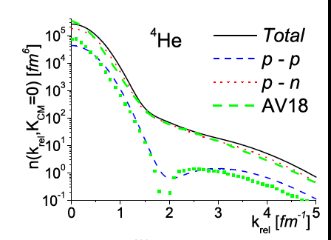
At 300-600 MeV/c there is an excess strength in the np momentum distribution due to the strong correlations induced by the tensor NN potential.
³He
³He
np
np
pn
pp
pp
pp
V18
Bonn
pp/np
Schiavilla, Wiringa, Pieper, Carson, PRL 98,132501 (2007).
³He
SRC
L = 0, 2
Ciofi and Alvioli
PRL 100, 162503 (2008).
Sargsian, Abrahamyan, Strikman, Frankfurt PR C71 044615 (2005).

Slide 17
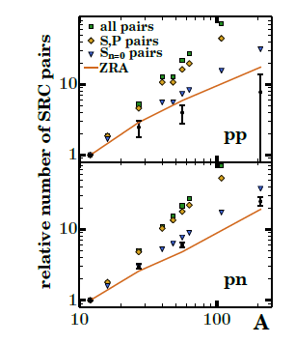

The mass dependence of the SRC pairs
N=0 (nodeless) L=o
IPM pairs
Predominantly:
L=0,2 T=0 S=1
(deuteron like) pairs
http://arxiv.org/abs/arXiv:1503.06050

Slide 18
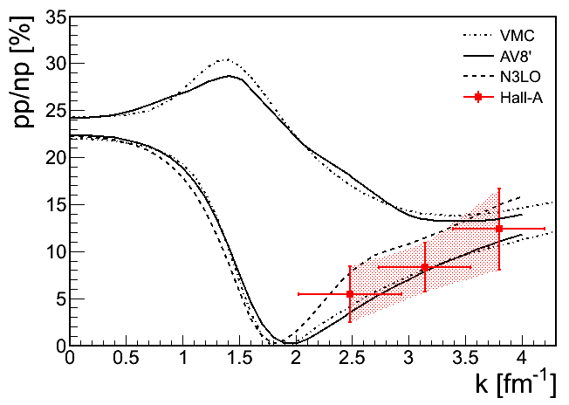
Wiringa, Schiavilla, Steven, Pieper, and Carlson, PRC 89, 024305 (2014).
Neff, Feldmeier, Horiuchi, Weber : arXiv:1503.06122
Korover et al. PRL 113, 022501 (2014).
All pairs
K_{cm}=0

Slide 19
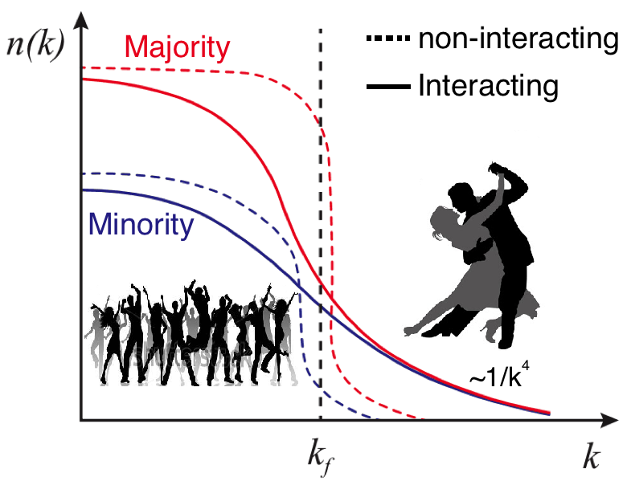
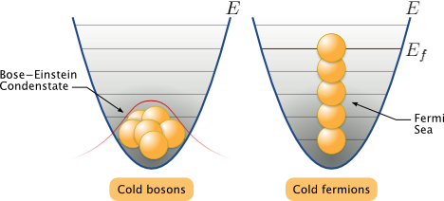
np-dominance and asymmetric neutron rich nuclei
  Pauli Principle:
neutrons
Majority
Minority
protons
proton
Universal property
A proton have a greater probability than a neutron to be above the Fermi sea
Possible inversion of the momentum sharing :
?
M. Sargsian Phys.Rev. C89 (2014) 3, 034305
O. Hen et al., Science 346, 614 (2014).

Slide 20
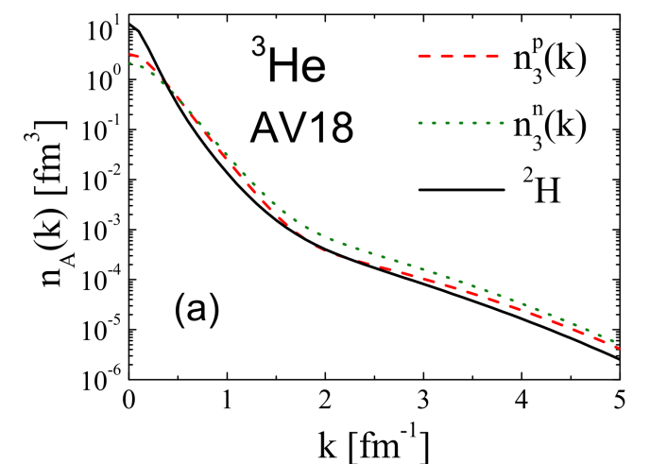
Protons move faster than neutrons in N>Z nuclei
( protons move faster than neutrons in N>Z nuclei )
<KE>
<KE>
Light nuclei A<11
p
n
p − n
Variational Monte Carlo calculations by the Argonne group
Wiringa et al.
phys. Rev. C89, 034305 (2014).
Notes:
Fix this up
Choose the n star stuff to include

Slide 21
Short distance structure of nuclei
1
The probability for a nucleon to have momentum ≥ 300 MeV / c in medium nuclei is ~25%
1
CLAS / HALL B
5
2
More than ~90% of all nucleons with momentum ≥ 300 MeV / c belong to 2N-SRC.
1
. PRL. 96, 082501 (2006)
Most of kinetic energy of nucleon in nuclei
is carried by nucleons in 2N-SRC.
2
4
3
Probability for a nucleon with momentum 300-600 MeV / c to belong to np-SRC is ~18 times larger than to belong to pp-SRC.
1
PRL 98,132501 (2007).
In light asymmetric nuclei :
2
3
2
EVA / BNL and Jlab / HALL A
3
In heavy asymmetric nuclei ?
PRL 162504(2006); Science 320, 1476 (2008).

Slide 22
Short distance structure of nuclei
4
Dominant NN force in the 2N-SRC is tensor force.
The high momentum tail (300-600 MeV/c) is dominated by
L=0,2 S=1 np –SRC pairs.
4
These pairs are produced from Sn=0 IPM pairs
Three nucleon SRC are present in nuclei. They contribute about an order of magnitude less than the 2N_SRC
6
Isospin structure ? Geometry ? Abundance ?
CLAS / HALL B
6
.

Slide 23
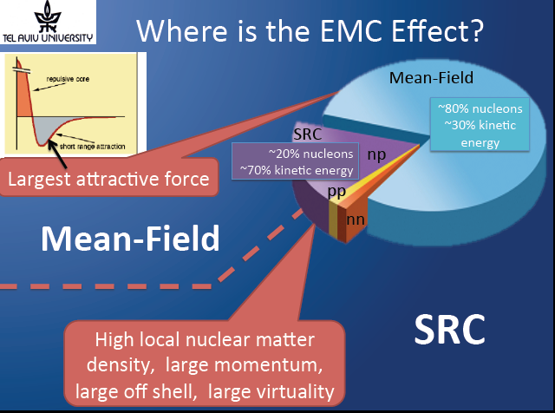

Slide 24
Inclusive electron scattering A(e,e’)
A(e,e’)

Slide 25
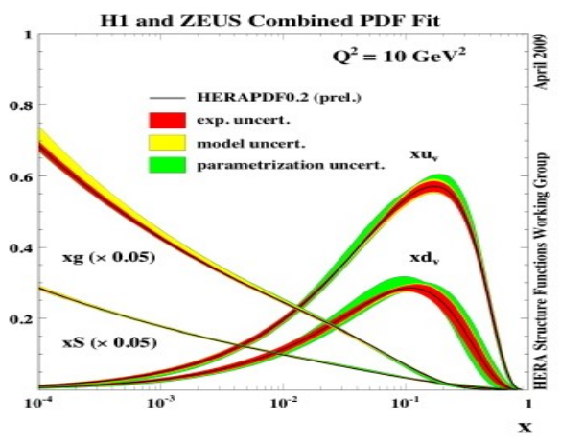
Inclusive electron scattering A(e,e’)
DIS off nucleons
DIS off nuclei
E
E`
E
E`
Incident lepton
scattered lepton
Incident lepton
scattered lepton
(ω,q)
(ω,q)
nucleon
W²
nucleus
Final state Hadrons
Nucleons
x_{B} gives the fraction of nucleon momentum carried by the struck parton
x_{B} counts the number of nucleons involved
2N-SRC
3N-SRC
--> scaling
--> Counting the number of SRC clusters in nuclei

Slide 26
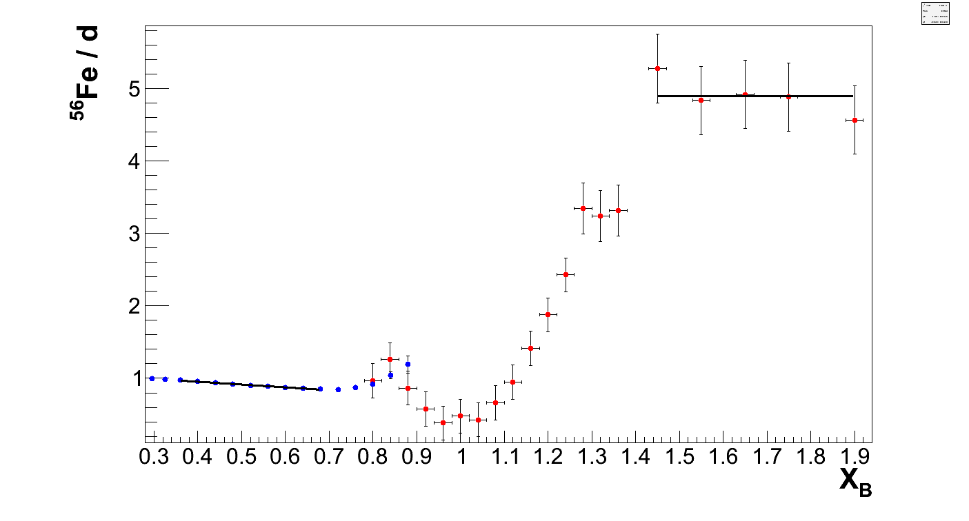
:
Comparing magnitude of EMC effect and SRC scaling factors
SRC
scaling factor
EMC
slope
SLAC data:
Frankfurt, Strikman, Day, Sargsyan,
Phys. Rev. C48 (1993) 2451.
Gomez et al., Phys. Rev. D49, 4348 (1983).
Q²=2, 5, 10, 15 GeV/c² (averaged)
Q²=2.3 GeV/c²

Slide 27
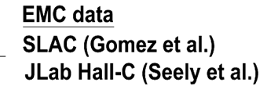
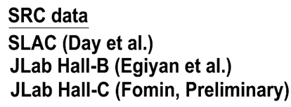
Slopes 0.35 ≤ X_{B} ≤ 0.7
Scaling factors X_{B} ≥ 1.4

Slide 28
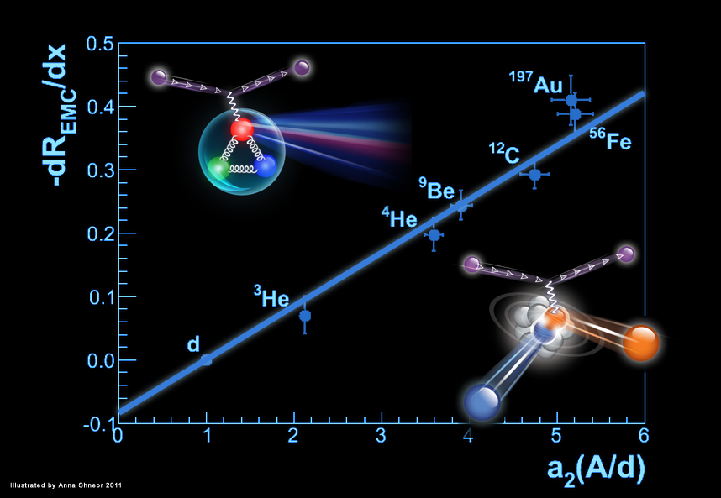
the EMC effect is associated with large virtuality ( )
EMC
SRC
PRL 106, 052301 (2011), also PRC 85 047301 (2012)

Slide 29

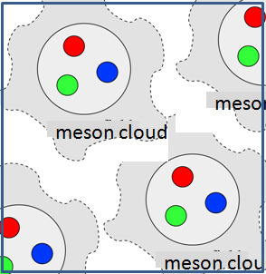
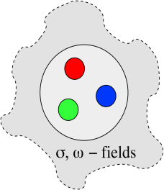

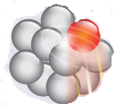
Are nucleons being modified in the nuclear medium ?
Free neutron
Bound neutron
meson cloud
Do nucleons change their quark-gluon structure in the nuclear medium ?
In-Medium vs. Free
Structure Function
Do nucleons change global properties (radius, mass ...) ?
In-Medium vs. Free
Form Factors

Slide 30
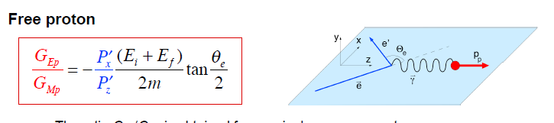
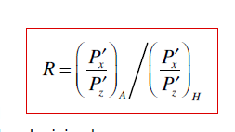

The recoil polarization of a knockout proton in quasi-elastic scattering
*G_{Ep}/G_{Mp}
obtained from a single measurement
with syst. and stat. uncertainties ~1%.
*sensitive to the properties of the nucleon (size, charge dist…
*only moderately sensitive to MEC, IC, FSI.
*Minimal affected by radiative corrections.

Slide 31


Dependent on proton virtuality:
Jlab E03-104 Data
Jlab approved proposal PR_12-11-002
Calculations by the Madrid group
Adapted from S. Strauch
S. Dieterich et al. PL B500, 47 (2001).
S. Strauch et al. PRL. 91 052301 (2003).
M. Paolone et al. PRL. 91 052301 (2003).

Slide 32


New PRELIMINARY data from MAINZ
MAMI / A1
600 MeV polarized electron beam

Slide 33


New PRELIMINARY data from MAINZ
PRELIMINARY

Slide 34




bound nucleon ≠free nucleon ?
The observable of choice to study this question:
Average nuclear density
A
The local nuclear density
The virtuality (momentum off -shellness) of the nucleon

Slide 35


Hypothesis can be checked by measuring DIS off Deuteron
tagged with high momentum recoil nucleon
large effect
EMC
0.070±0.003
0.98
SRC
A
SRC=0 free nucleons

Slide 36



12 GeV JLab approved experiment E 12-11-107
Spectator Tagging:
➔Selects DIS off high momentum
(high virtuality) nucleons
proton

Slide 37


12 GeV submitted proposal to CLAS
Spectator Tagging:
➔Selects DIS off high momentum
(high virtuality) nucleons
neutron

Slide 38



can also be study with EIC
DIS
DIS
3 GeV/c
K ₁
p_{beam}
K ₂
Study the EMC effect on SRC pair as a function of the virtiality
Tagged DIS with recoil nucleon with p> p_{beam}

Slide 39

Deuteron is not a free np pair
EMC
The slopes for
0.35 ≤ X_{B} ≤ 0.7
0.070±0.003
0.98
SRC
A
SRC=0 free nucleons

Slide 40




Slide 41


EMC ➔ IMC
EMC (ratio to deuterium) → IMC (ratio to free (unbound) pn pair)
IMC- In-Medium Correction
PRL 106, 052301 (2011)

Slide 42

The free neutron DIS cross section

Slide 43
Where is the ratio of cross sections for absorbing a longitudinal to that for a transverse photon.
See talk by Patricia Solvignon
Gessman, Saito,Thomas,Annu. Rev. Nucl. Part. Sci. 1995. 45:337

Slide 44

The free neutron structure function
For
0.35 ≤ X_{B} ≤ 0.7
SLAC Data, J. Arrington et al.
JPG 36(2009)205005.
Fermi smearing using relativistic deuteron momentum density
Extracted from this work
With medium correction
Phys. Rev. Lett. 106, 052301, 2011

Slide 45



Robustness
0.7 IMC
1.25 IMC
New data strengthen the connection between Short Range Correlations and the EMC effect.
O. Hen, E. Piasetzky, (Tel Aviv U.) , L.B. Weinstein, (Old Dominion U.) . Feb 2012.]
Phys. Rev. C85 (2012) 047301

Slide 46


The free neutron structure function
ud-SRC
Compared to CT calculations
d/u ->1
Preliminary calculation by :H. l. Lai, P. Nadolsky, J. Pumplin, .P.Yuan
SU6
d/u=1/2
Fh07b / fh02c are CT10 / CT10W like Chebyshev fits
pQCD
See talk by J.Pumplin in this conference
d/u=0.2
SLAC Data,
Scalar
qq
d/u=0

Slide 47
EMC / SRC correlation
the EMC effect is associated with large virtuality ( )
EMC
SRC
PRL 106, 052301 (2011), also PRC 85 047301 (2012)

Slide 48
New PRELIMINARY data from MAINZ
PRELIMINARY
In medium FF are also associated with large virtuality

Slide 49

the EMC effect is associated with large virtuality
Hypothesis can be verified by measuring DIS off Deuteron
tagged with high momentum recoil nucleon
EMC
12 GeV JLab/ Hall C approved experiment E 12-11-107
12 GeV JLab/ Hall B proposal
Tagged recoil neutron measure in the proton structure function
Tagged recoil proton measure neutron structure function
See details in a talk by E.Piasetzky on Thursday

Slide 50
Implications

Slide 51

IMC Effect: Agrees with BONUS
BONUS IMC measurement (d/p+n)
Preliminary
IMC Effect Slope
BONUS: -0.10(5) .
EMC/SRC: -0.09(1)
Free
np
pair
Weinstein et al. PRL 106, 052301 (2011)
O. Hen et al., Phys. Rev. C 85, 047301 (2012); K. Griffioen et al., In-Preparation (2015).

Slide 52
EMC ➔ IMC
EMC (ratio to deuterium) → IMC (ratio to free (unbound) pn pair)
IMC- In-Medium Correction
PRL 106, 052301 (2011)

Slide 53
Neutron structure function
One should not neglect the EMC effect using deuteron and proton data to extract free neutron properties
EMC/SRC →
larger d / u ratio x->1
Weinstein et al. Phys. Rev. Lett. 106, 052301, 2011

Slide 54
NuTeV anomaly
Ask Misak if he will address this implication of SC/EMC

Slide 55




Acknowledgment
I would like to thank the organizers
Raphael Dupre and Sergio Scopetta
for the invitation.
Raphael Dupre'
Collaborators:
Or Hen, Larry Weinstein, Shalev Gilad, Doug Higinbothan, Steve Wood, John Watson
Misak Sargsian, Mark Strikman, Leonid Frankfurt, Gerald Miller

Slide 56
The observable of choice:
The recoil polarization of a knockout proton in quasi-elastic scattering
*G_{Ep}/G_{Mp}
* obtained from a single measurement with syst. and stat. uncertainties ~1%.
*sensitive to the properties of the nucleon (size, charge dist…
*only moderately sensitive to MEC, IC, FSI.
*Minimal affected by radiative corrections.

Slide 57
Dependent on proton virtuality:
Jlab E03-104 Data
Jlab approved proposal PR_12-11-002
Calculations by the Madrid group
Adapted from S. Strauch
S. Dieterich et al. PL B500, 47 (2001).
S. Strauch et al. PRL. 91 052301 (2003).
M. Paolone et al. PRL. 91 052301 (2003).

Slide 58


Slide 59

The free neutron structure function
Compared to CTEQ calculations
Preliminary calculation by :H. l. Lai, P. Nadolsky, J. Pumplin, .P.Yuan
SLAC Data,
JPG 36(2009)205005.
SLAC Data,
CT10W -

Slide 60





INC constrained d/u x-->1 ratio
The IMC (at a 90% C.L.):
d/u ratio for x->1
0.23±0.09.
Nucleon Model | F₂^{n}/F₂^{p} | d/u
SU(6) | 2/3 | 1/2
Scalar diquark | 1/4 | 0
pQCD (p↑ q↑) | 3/7 | 1/5
Phys. Rev. D84 117501 (2011).

Slide 61



Robustness
0.7 IMC
1.25 IMC
New data strengthen the connection between Short Range Correlations and the EMC effect.
O. Hen, E. Piasetzky, (Tel Aviv U.) , L.B. Weinstein, (Old Dominion U.) . Feb 2012.]
Phys. Rev. C85 (2012) 047301

Slide 62





Summary
After 30 years the EMC effect is well established measured effect
with no consensus as to its origin.
SRC and EMC are linearly correlated.
We suggest that this correlation occurs because both phenomena are related to high-momentum (large virtuality) nucleons.
Can be verify by measuring DIS tagged by a high momentum recoil spectator.
An approved experiment at 12 GeV JLab. / EIC possibility
Based on the EMC/SRC correlation, we claim an ‘EMC like’ (IMC) effect
also in deuteron, which impacts extraction of free neutron SF
and proton d/u ratio at large x.

Slide 63
Acknowledgment
I would like to thank Thia, Katerina, and Pavel for the invitation.
Rolf for giving the talk with zero time for preparation
Collaborators:
Or Hen, Larry Weinstein, Shalev Gilad, Doug Higinbothan, Steve Wood, John Watson
Misak Sargsian, Mark Strikman, Leonid Frankfurt, Gerald Miller

Slide 64


Acknowledgment
Phys. Rev. Lett. 106, 052301 (2011)
Phys. Rev. D84 117501 (2011).
Phys. Rev. C85 047301 (2012).
The EMC Effect and High Momentum Nucleons in Nuclei, O. Hen, D. W. Higinbotham, G. A. Miller, E. Piasetzky, L. B. Weinstein, arXiv:1304.2813 [nucl-th]
InternatIional Journal of Modern Physics E,

Slide 65


A
The EMC Effect and High Momentum Nucleons in Nuclei, O. Hen, D. W. Higinbotham, G. A. Miller, E. Piasetzky, L. B. Weinstein, arXiv:1304.2813 [nucl-th]

Slide 66


Slide 67


Slide 68











Frankfurt and Strikman PL B183 (1987) 254.
Ciofi and Simula PRC 53 (1996) 1689.
The EMC Effect and High Momentum Nucleons in Nuclei, O. Hen, D. W. Higinbotham, G. A. Miller, E. Piasetzky, L. B. Weinstein, arXiv:1304.2813 [nucl-th]

Slide 69


Slide 70
Toy models for large x
Proton Wavefunction (Spin and Flavor Symmetric)
1
1
1
p
=
u
(
ud
)
+
u
(
ud
)
−
u
↓
(
ud
)
2
S
=
0
18
S
=
1
3
S
=
1
1
2
−
d
(
uu
)
−
d
↓
(
uu
)
3
S
=
1
3
S
=
1
Nucleon Model | F₂^{n}/F₂^{p} | d/u
SU(6) | 2/3 | 1/2
Scalar diquark | 1/4 | 0
pQCD (p↑ q↑) | 3/7 | 1/5
Adapted from J.P. Chen

Slide 71
The free neutron structure function
Compared to CT calculations
Preliminary calculation by :H. l. Lai, P. Nadolsky, J. Pumplin, .P.Yuan
SU6
Fh07b / fh02c are CT10 / CT10W like Chebyshev fits
pQCD
See talk by J.Pumplin in this conference
SLAC Data,
Scalar
qq

Slide 72

The d / u ratio
Compared to CT calculations
SLAC Data,
ud-SRC
See talk by Sargsian
SU6
pQCD
Fh07b / fh02c are CT10 / CT10W like Chebyshev fits
Scalar
qq
Preliminary calculation by :H. l. Lai, P. Nadolsky, J. Pumplin, .P.Yuan

Slide 74
Toy models for large x
Proton Wavefunction (Spin and Flavor Symmetric)
1
1
1
p
=
u
(
ud
)
+
u
(
ud
)
−
u
↓
(
ud
)
2
S
=
0
18
S
=
1
3
S
=
1
1
2
−
d
(
uu
)
−
d
↓
(
uu
)
3
S
=
1
3
S
=
1
Nucleon Model | F₂^{n}/F₂^{p} | d/u
SU(6) | 2/3 | 1/2
Scalar diquark | 1/4 | 0
pQCD (p↑ q↑) | 3/7 | 1/5
ud-SRC |  | →1
See talk by Sargsian
u/d SRC
Adapted from J.P. Chen

Slide 75



The European Muon Collaboration (EMC) effect
Question :
30 years old
A bound nucleon ≠ A free nucleon ?
Jerry’s talk:
per nucleon in nuclei ≠ per nucleon in deuteron

Slide 76

PRELIMINARY

Slide 77

PRELIMINARY

