Slide 1
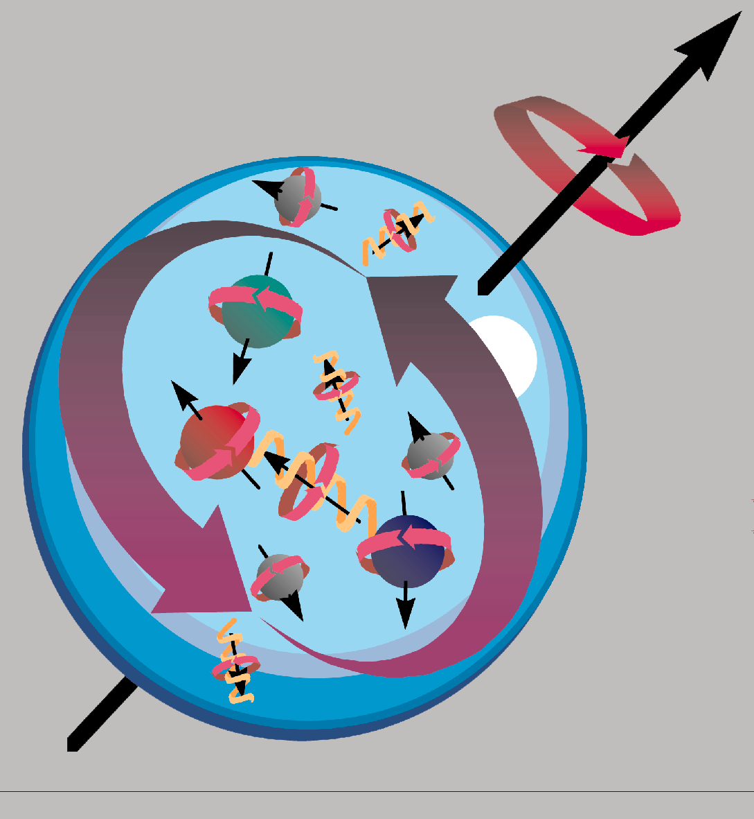
JLab DVMP workshop
ρ⁰, ω, ρ⁺ exclusive electroproduction
on the proton at CLAS
M. Guidal, IPN Orsay

Slide 2
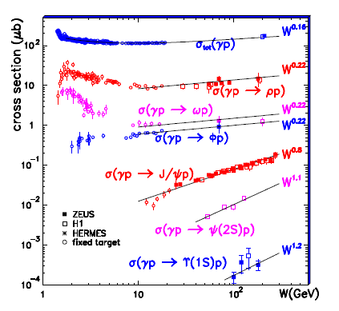

Slide 4
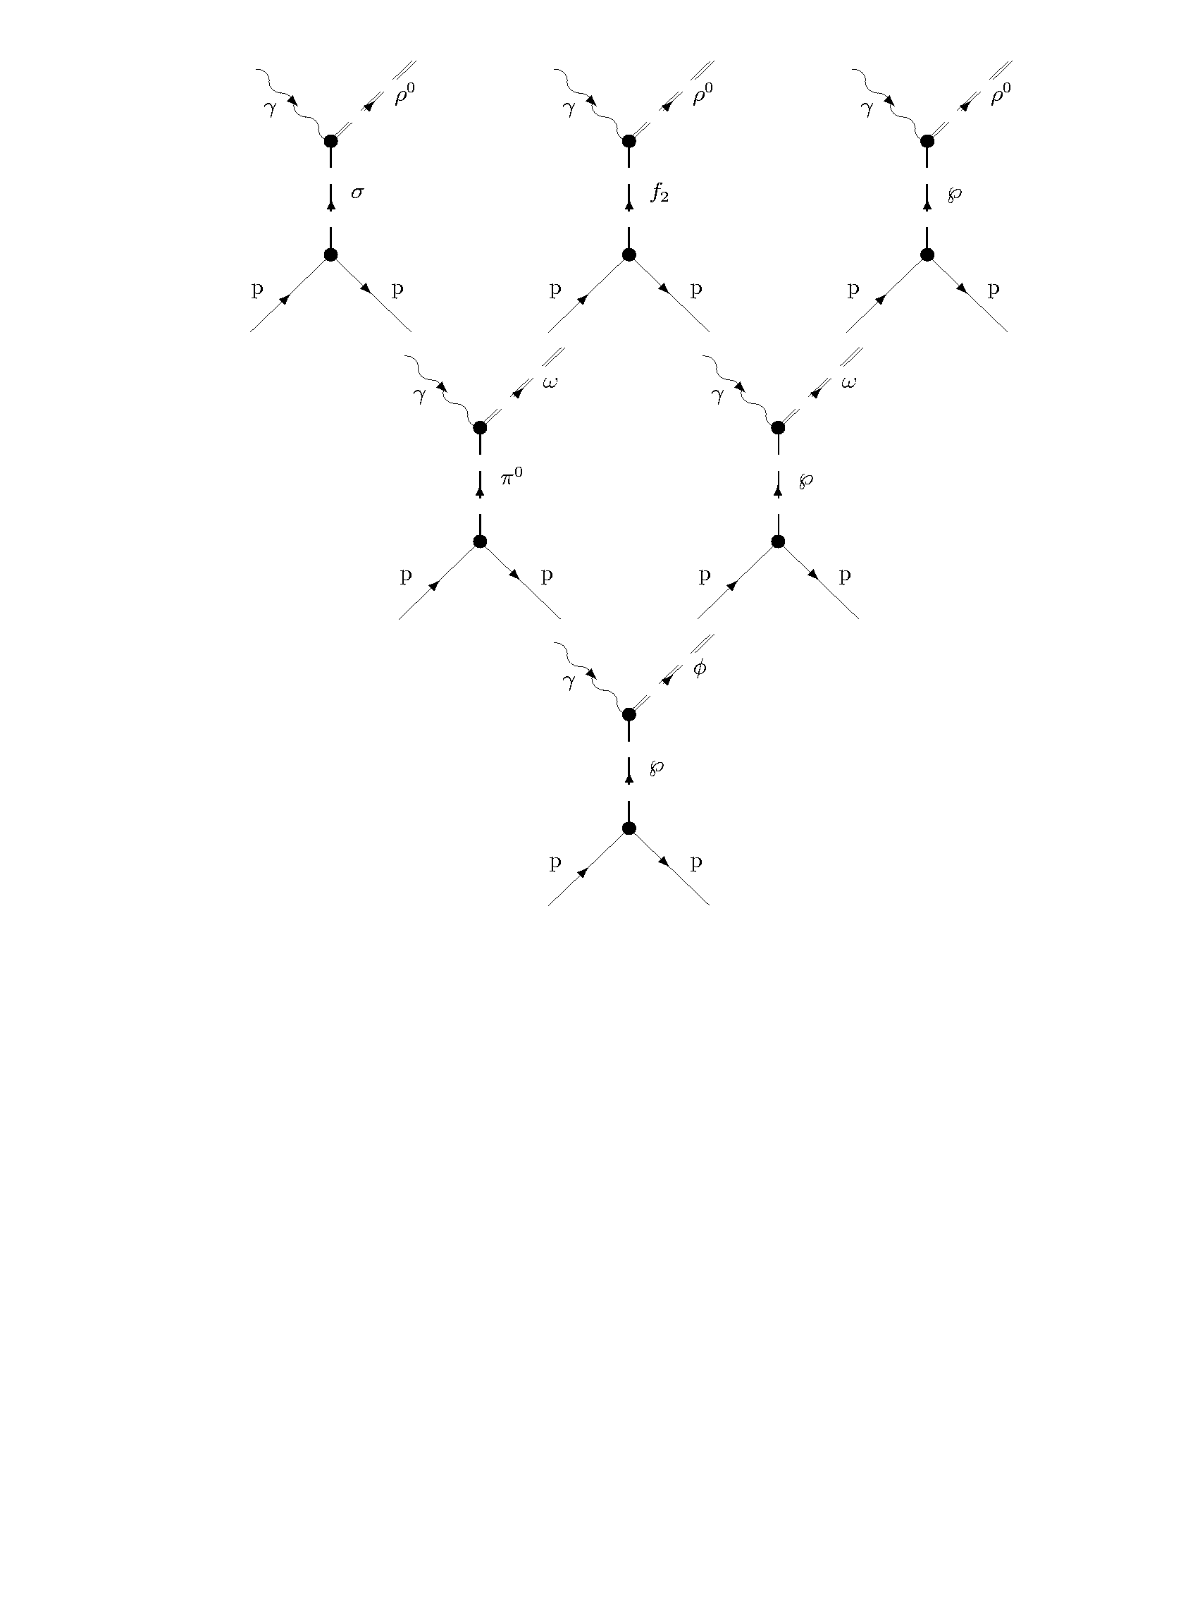
,

Slide 5
Regge theory:
Exchange of families of mesons in the t-channel

Slide 6
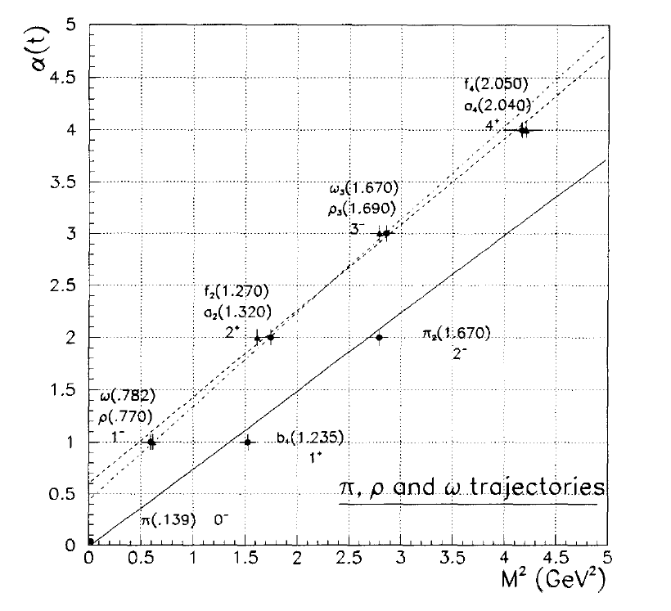

Slide 7
Regge theory:
Exchange of families of mesons in the t-channel
M(s,t) ~ s^{α(t)}
where α(t) (trajectory) is the relation between the spin and the (squared) mass of a family of particles
σ_{tot}~1/s x Im(M(s,t=0))->s^{α(0)-1}
[optical theorem]
M->s^{α(t)}
dσ/dt~1/s² x |M(s,t)|²->s^{2α(t)-2}
->[e^{α(t)lns(s)}]
σ_{tot}
dσ/dt
s
t

Slide 8
,

Slide 9
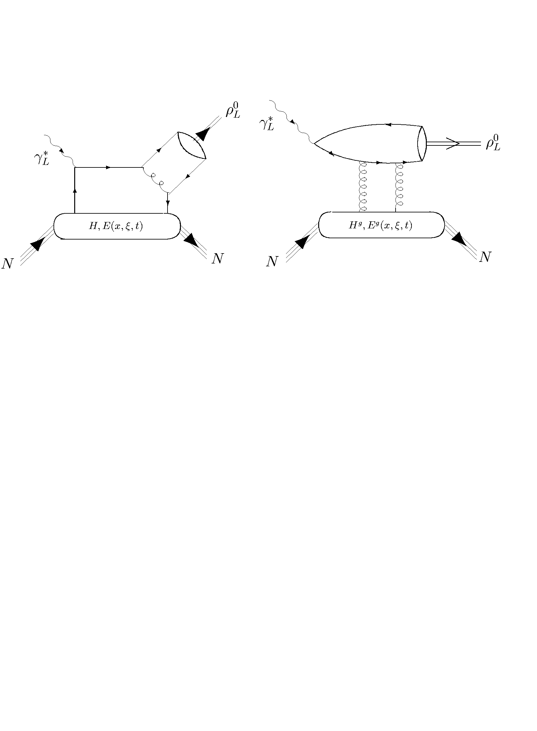
,
Q²>>

Slide 10
,
Q²>>
Q²>>

Slide 11
Some signatures of the (asymptotic) « hard » processes:
Q² dependence:
σ_{L}~1/Q⁶
σ_{T}~1/Q⁸
σ_{L}/σ_{T}~Q²
W (or x_{B}) dependence:
σ~|xG(x)|²
(for gluon handbag)
Ratio of yields:
ρ/ω/φ/(J/Ψ)~9/1/2/8
(for gluon handbag)
Saturation with hard scale of α_{P}(0), b, …
SCHC : checks with SDMEs

Slide 12
HERMES
H1,
ZEUS
H1, ZEUS
CLAS
COMPASS
,
+ « older »
data from:
E665, NMC,
Cornell,…
Q²>>
Q²>>

Slide 13
HERMES
H1,
ZEUS
H1, ZEUS
CLAS
COMPASS
,
+ « older »
data from:
E665, NMC,
Cornell,…
Q²>>
Q²>>

Slide 14
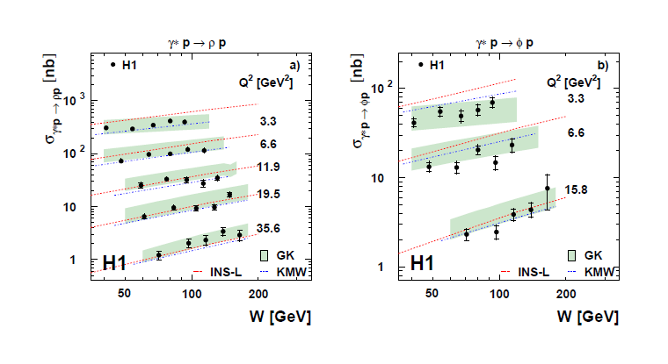
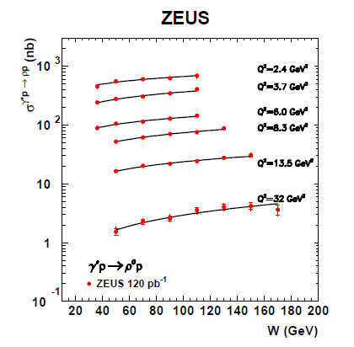

Slide 15
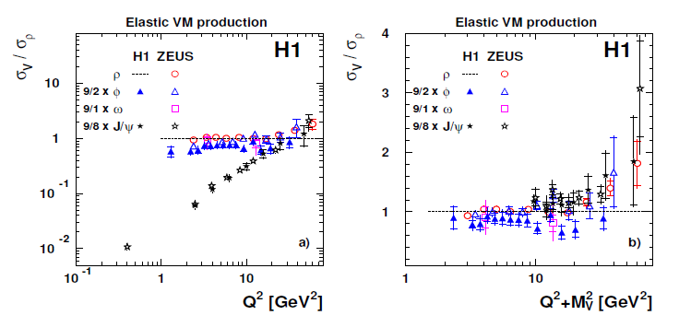
Ratios
ρ/ω/φ/(J/Ψ) ~ 9/1/2/8
|ρ⁰>=1/sqrt(2){|uu>-|dd>}
∼{2/3−(−1/3)}
Ratio ρ/ω=9
|ω>=1/sqrt(2){|uu>+|dd>}
∼{2/3+(−1/3)}

Slide 16
For W>5 GeV, good indications that the “hard”/pQCD regime
is reached/dominant for μ²=(Q²+M_{V}²)/4 ~ 3-5 GeV².
Data are relatively well described by GPD/handbag approaches
Great, one can hope to learn about the gluon (transverse)
spatial distribution in the nucleon, the gluon orbital momentum
contribution to the nucleon spin, etc…

Slide 17
HERMES
H1,
ZEUS
H1, ZEUS
CLAS
COMPASS
,
Q²>>
Q²>>

Slide 18
F.-X. Girod
Exclusive ρ⁰, ω, φ & ρ⁺ electroproduction
on the proton @ CLAS6
K. Lukashin et al., Phys.Rev.C63:065205,2001 (φ@4.2 GeV)
}
e1-b
(1999)
C. Hadjidakis et al., Phys.Lett.B605:256-264,2005 (ρ⁰@4.2 GeV)
}
L. Morand et al., Eur.Phys.J.A24:445-458,2005 (ω@5.75GeV)
J. Santoro et al., Phys.Rev.C78:025210,2008 (φ@5.75GeV)
e1-6
(2001-2002)
S. Morrow et al., Eur.Phys.J.A39:5-31,2009 (ρ⁰@5.75GeV)
}
e1-dvcs
(2005)
A. Fradi, Orsay Univ. PhD thesis (ρ⁺@5.75 GeV)

Slide 19
Exclusive ρ ⁰ electroproduction

Slide 20
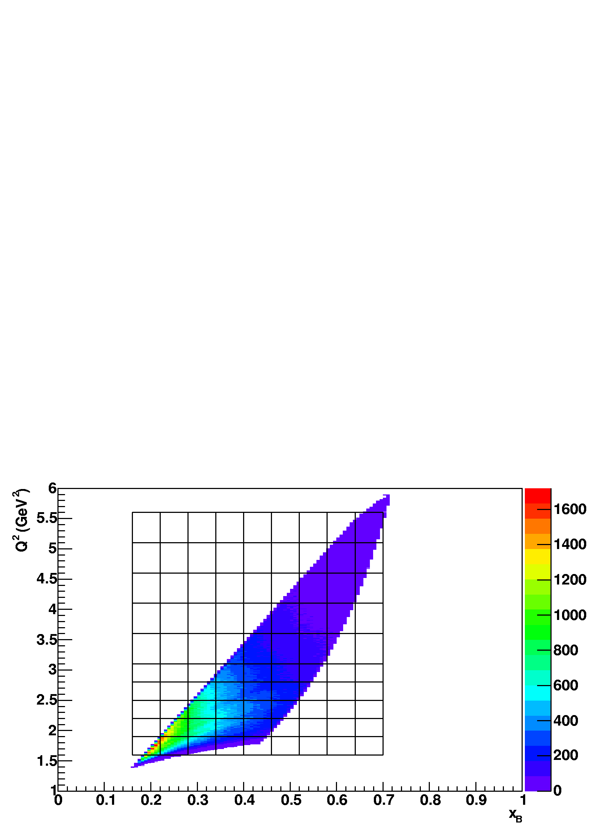
^{e1-6 experiment (E}e ^{=5.75 GeV)}
(October 2001 – January 2002)

Slide 21
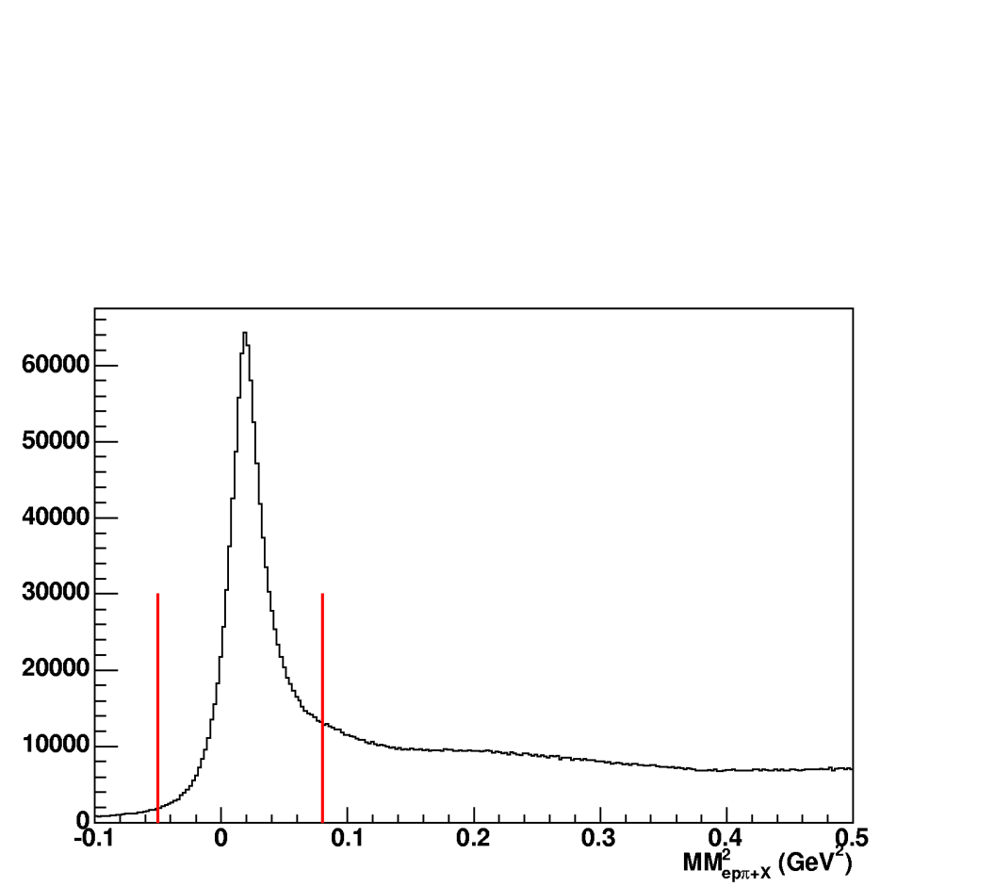
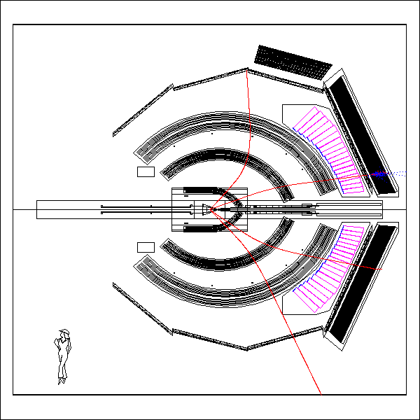
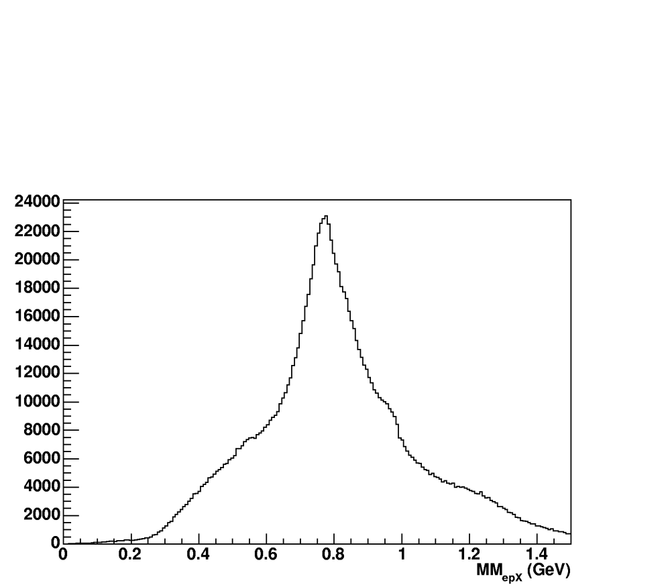
ep → ep π⁺(π⁻)
Mm(epπ⁺ X)
π⁺
e
Mm(epX)
(π⁻)
p

Slide 22
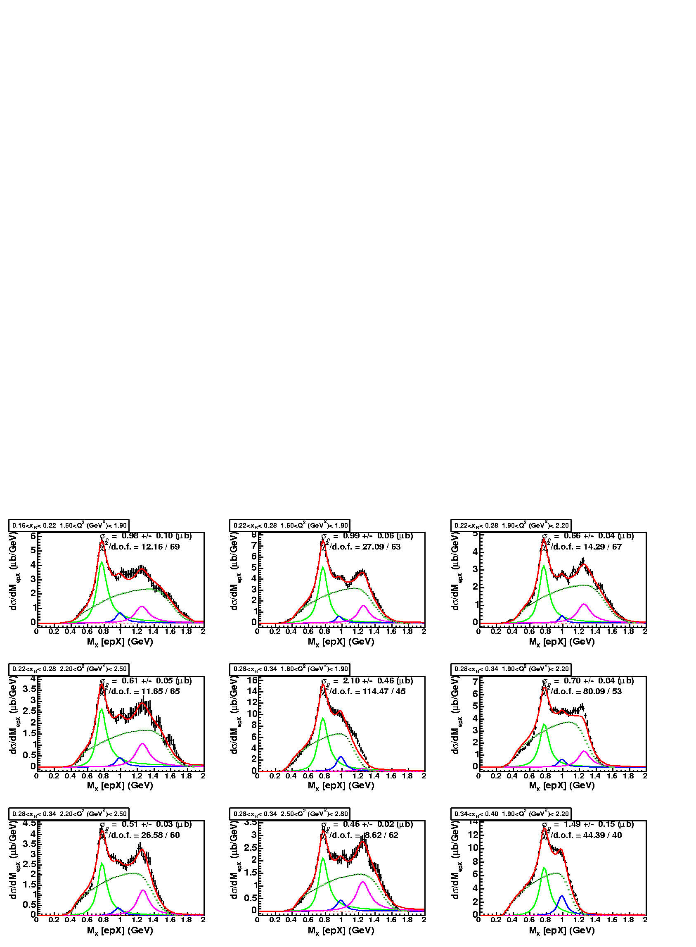
Background Subtraction
  1) Ross-Stodolsky B-W for ρ⁰(770), f₀(980) and f₂(1270)
  with variable skewedness parameter,
  2) Δ⁺⁺(1232) π⁺π⁻ inv.mass spectrum and π⁺π⁻ phase space.

Slide 23
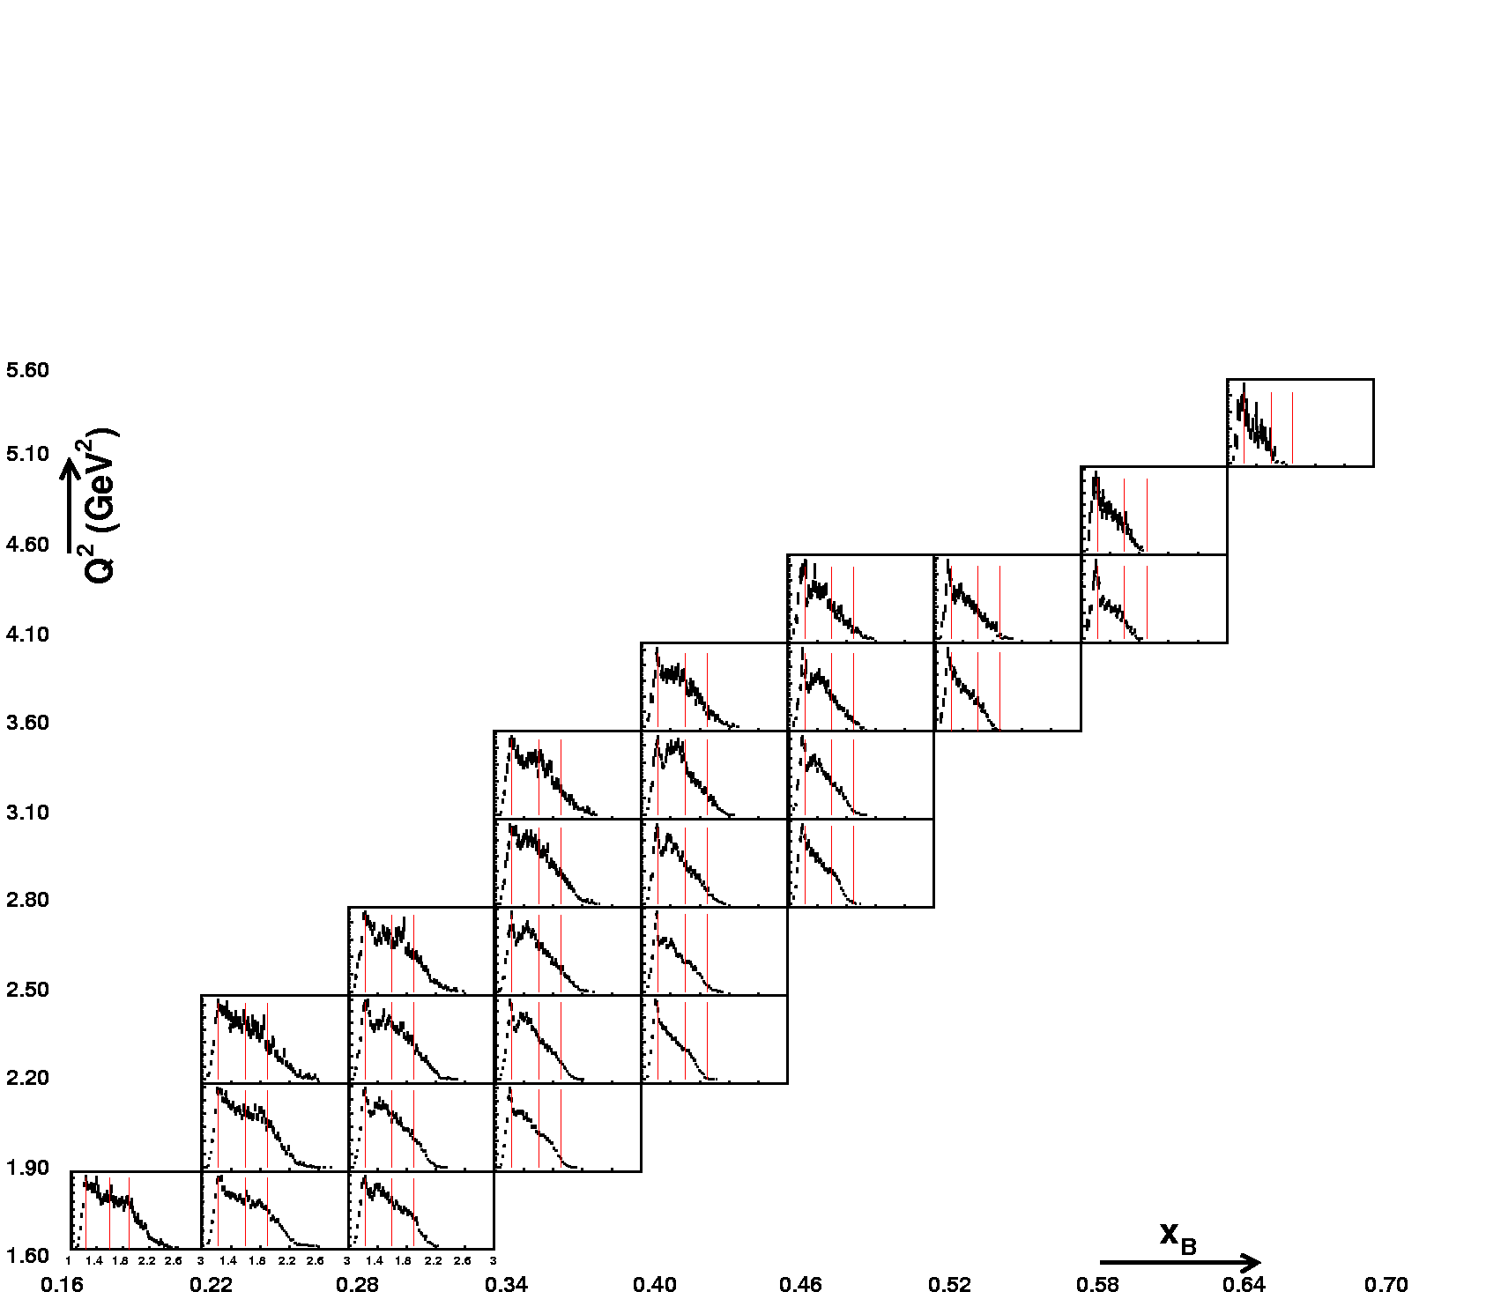
IM(pπ⁺)

Slide 24
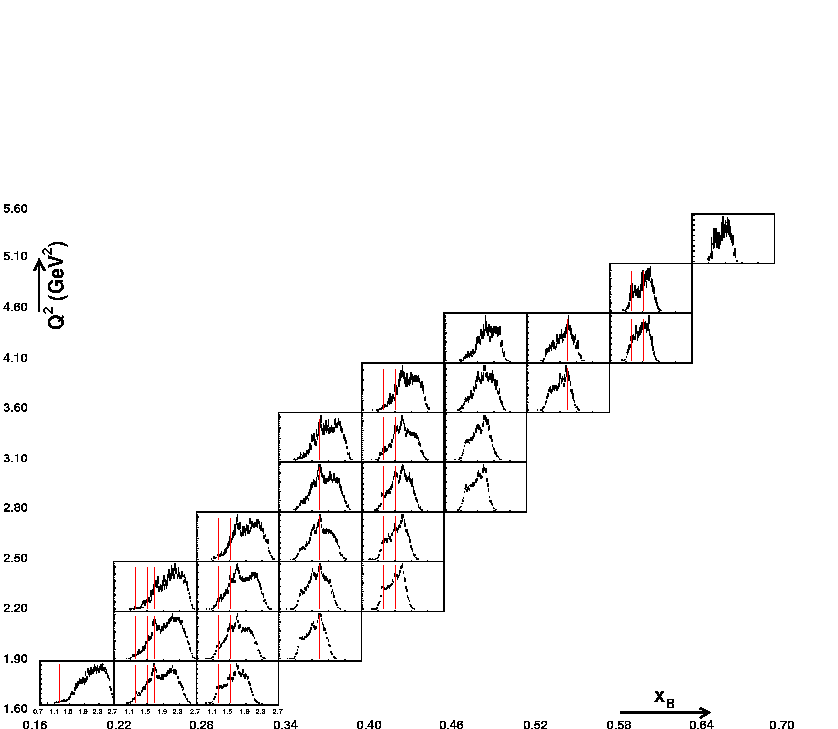
IM(pπ⁻)

Slide 25
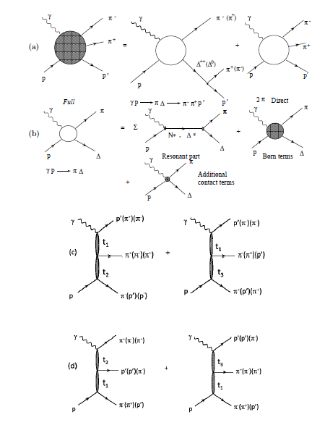
V. Mokeev
2π e-prod model
Working
up to W=1.6 GeV
up to Q²~1 GeV²

Slide 26
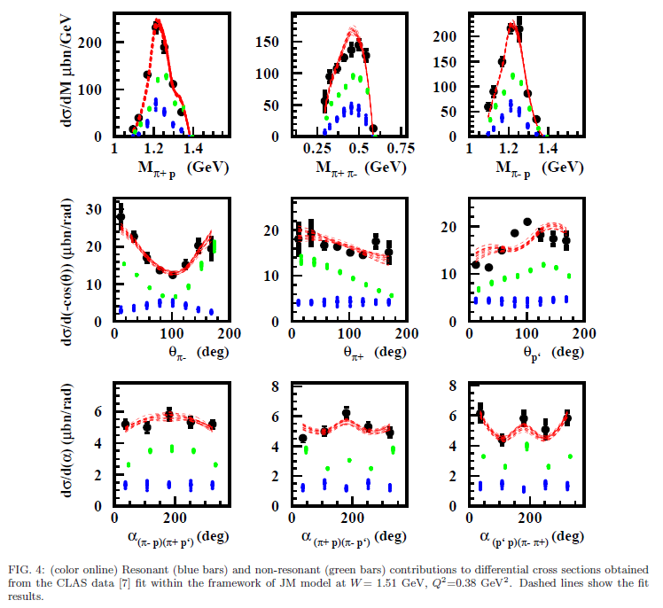

Slide 27
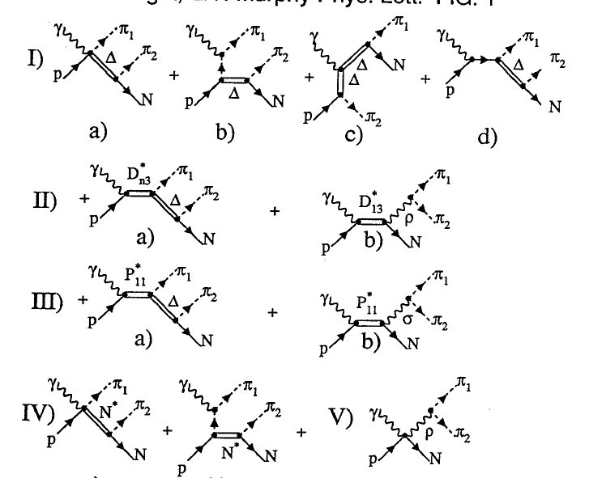
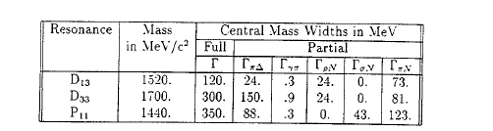
J-M. Laget
2π e-prod model
+f₀ + f₂

Slide 28
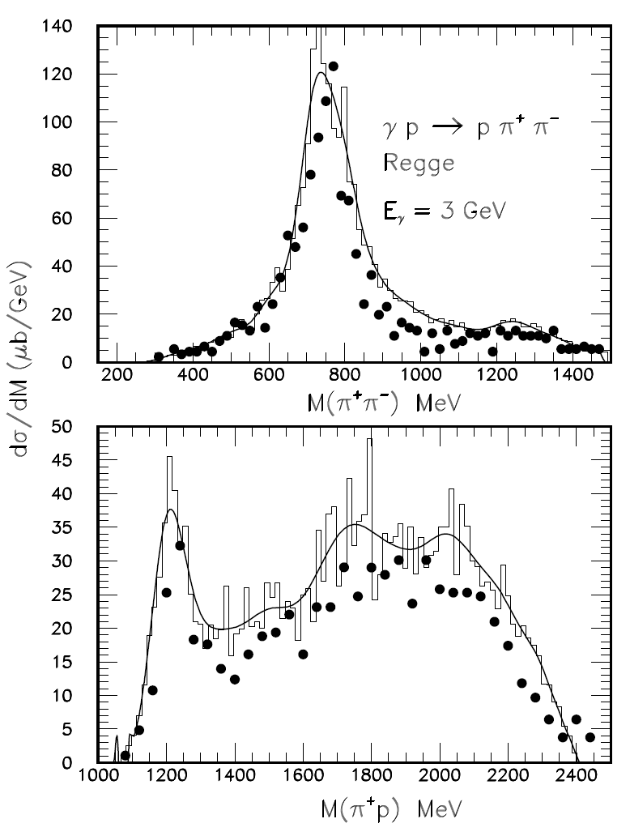
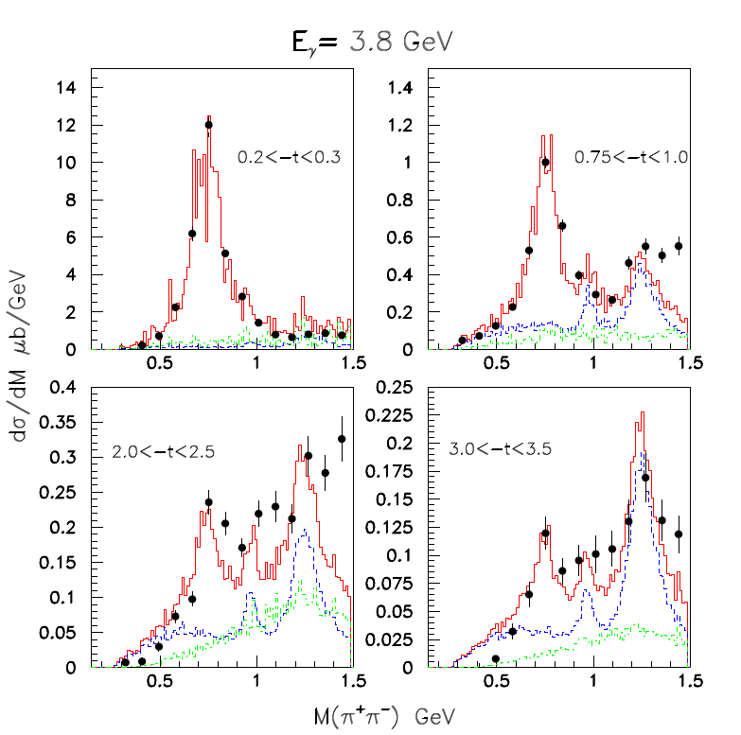
Laget model: Photoproduction
Good description of
CLAS,SLAC data
σ +f₀ + f₂
πΔ(∗)+ πΝ∗
all (incl.ρ⁰)

Slide 29
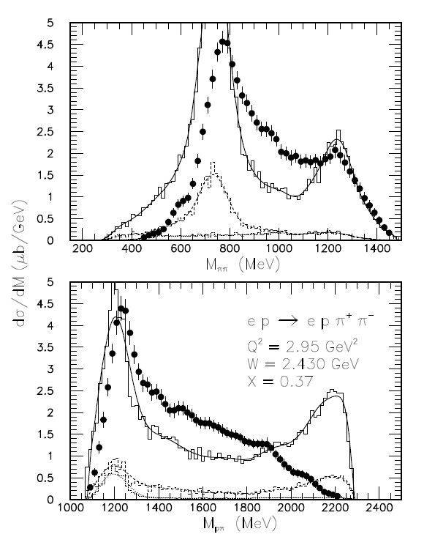
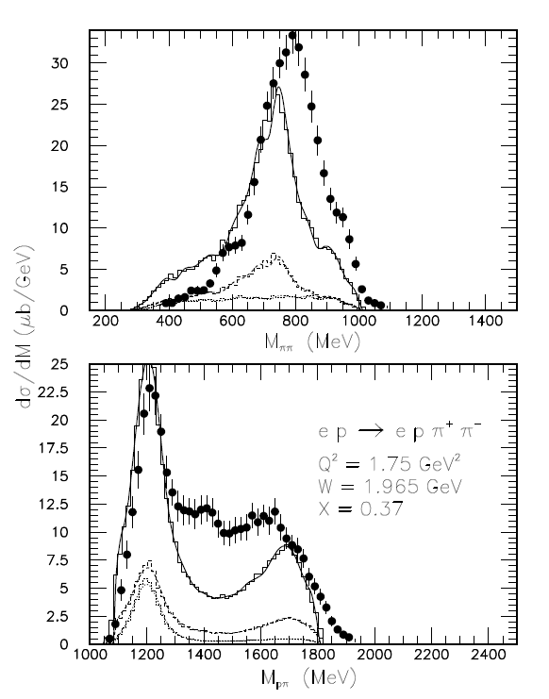
Laget model: Electroproduction
CLAS data
Laget model

Slide 30
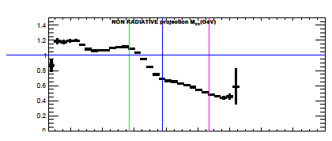
At the time of the analysis (~2008), radiative corrections were treated as averaged over M_{π+π-}, i.e. only as a function of (x_{B}, Q²)
However, current more refined re-analysis of these data
(B. Garillon, aimed at f₀ and f₂ analysis, see talk on Saturday)
show that there is a M_{π+π-}-dependence
M_{π+π-} (GeV)
ρ⁰
f₀
f₂
Relatively small effect on ρ⁰ cross sections as
the “distortion” of the M_{π+π-} spectrum was “absorbed”
in the effective π⁺π⁻ continuum background subtraction
(also ~25% syst. uncertainty was included)

Slide 31
Background Subtraction
  1) Ross-Stodolsky B-W for ρ⁰(770), f₀(980) and f₂(1270)
  with variable skewedness parameter,
  2) Δ⁺⁺(1232) π⁺π⁻ inv.mass spectrum and π⁺π⁻ phase space.

Slide 32
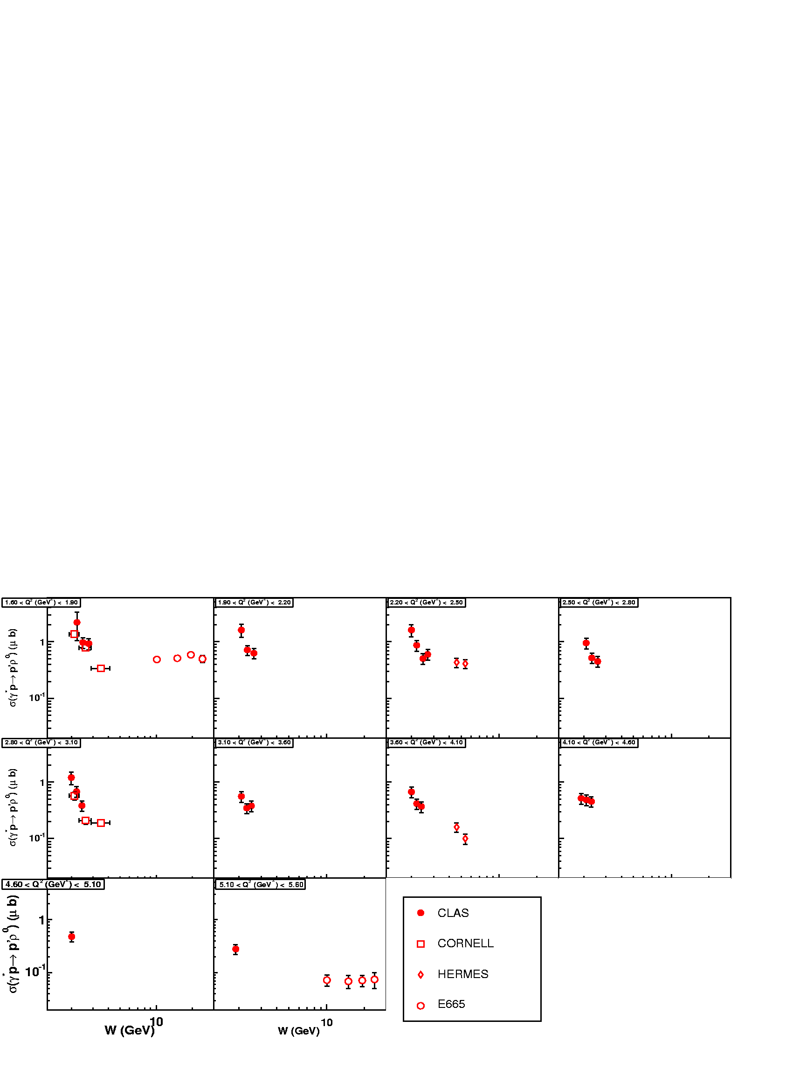
σ_{ρ} (γ*p → pρ⁰) vs W

Slide 33
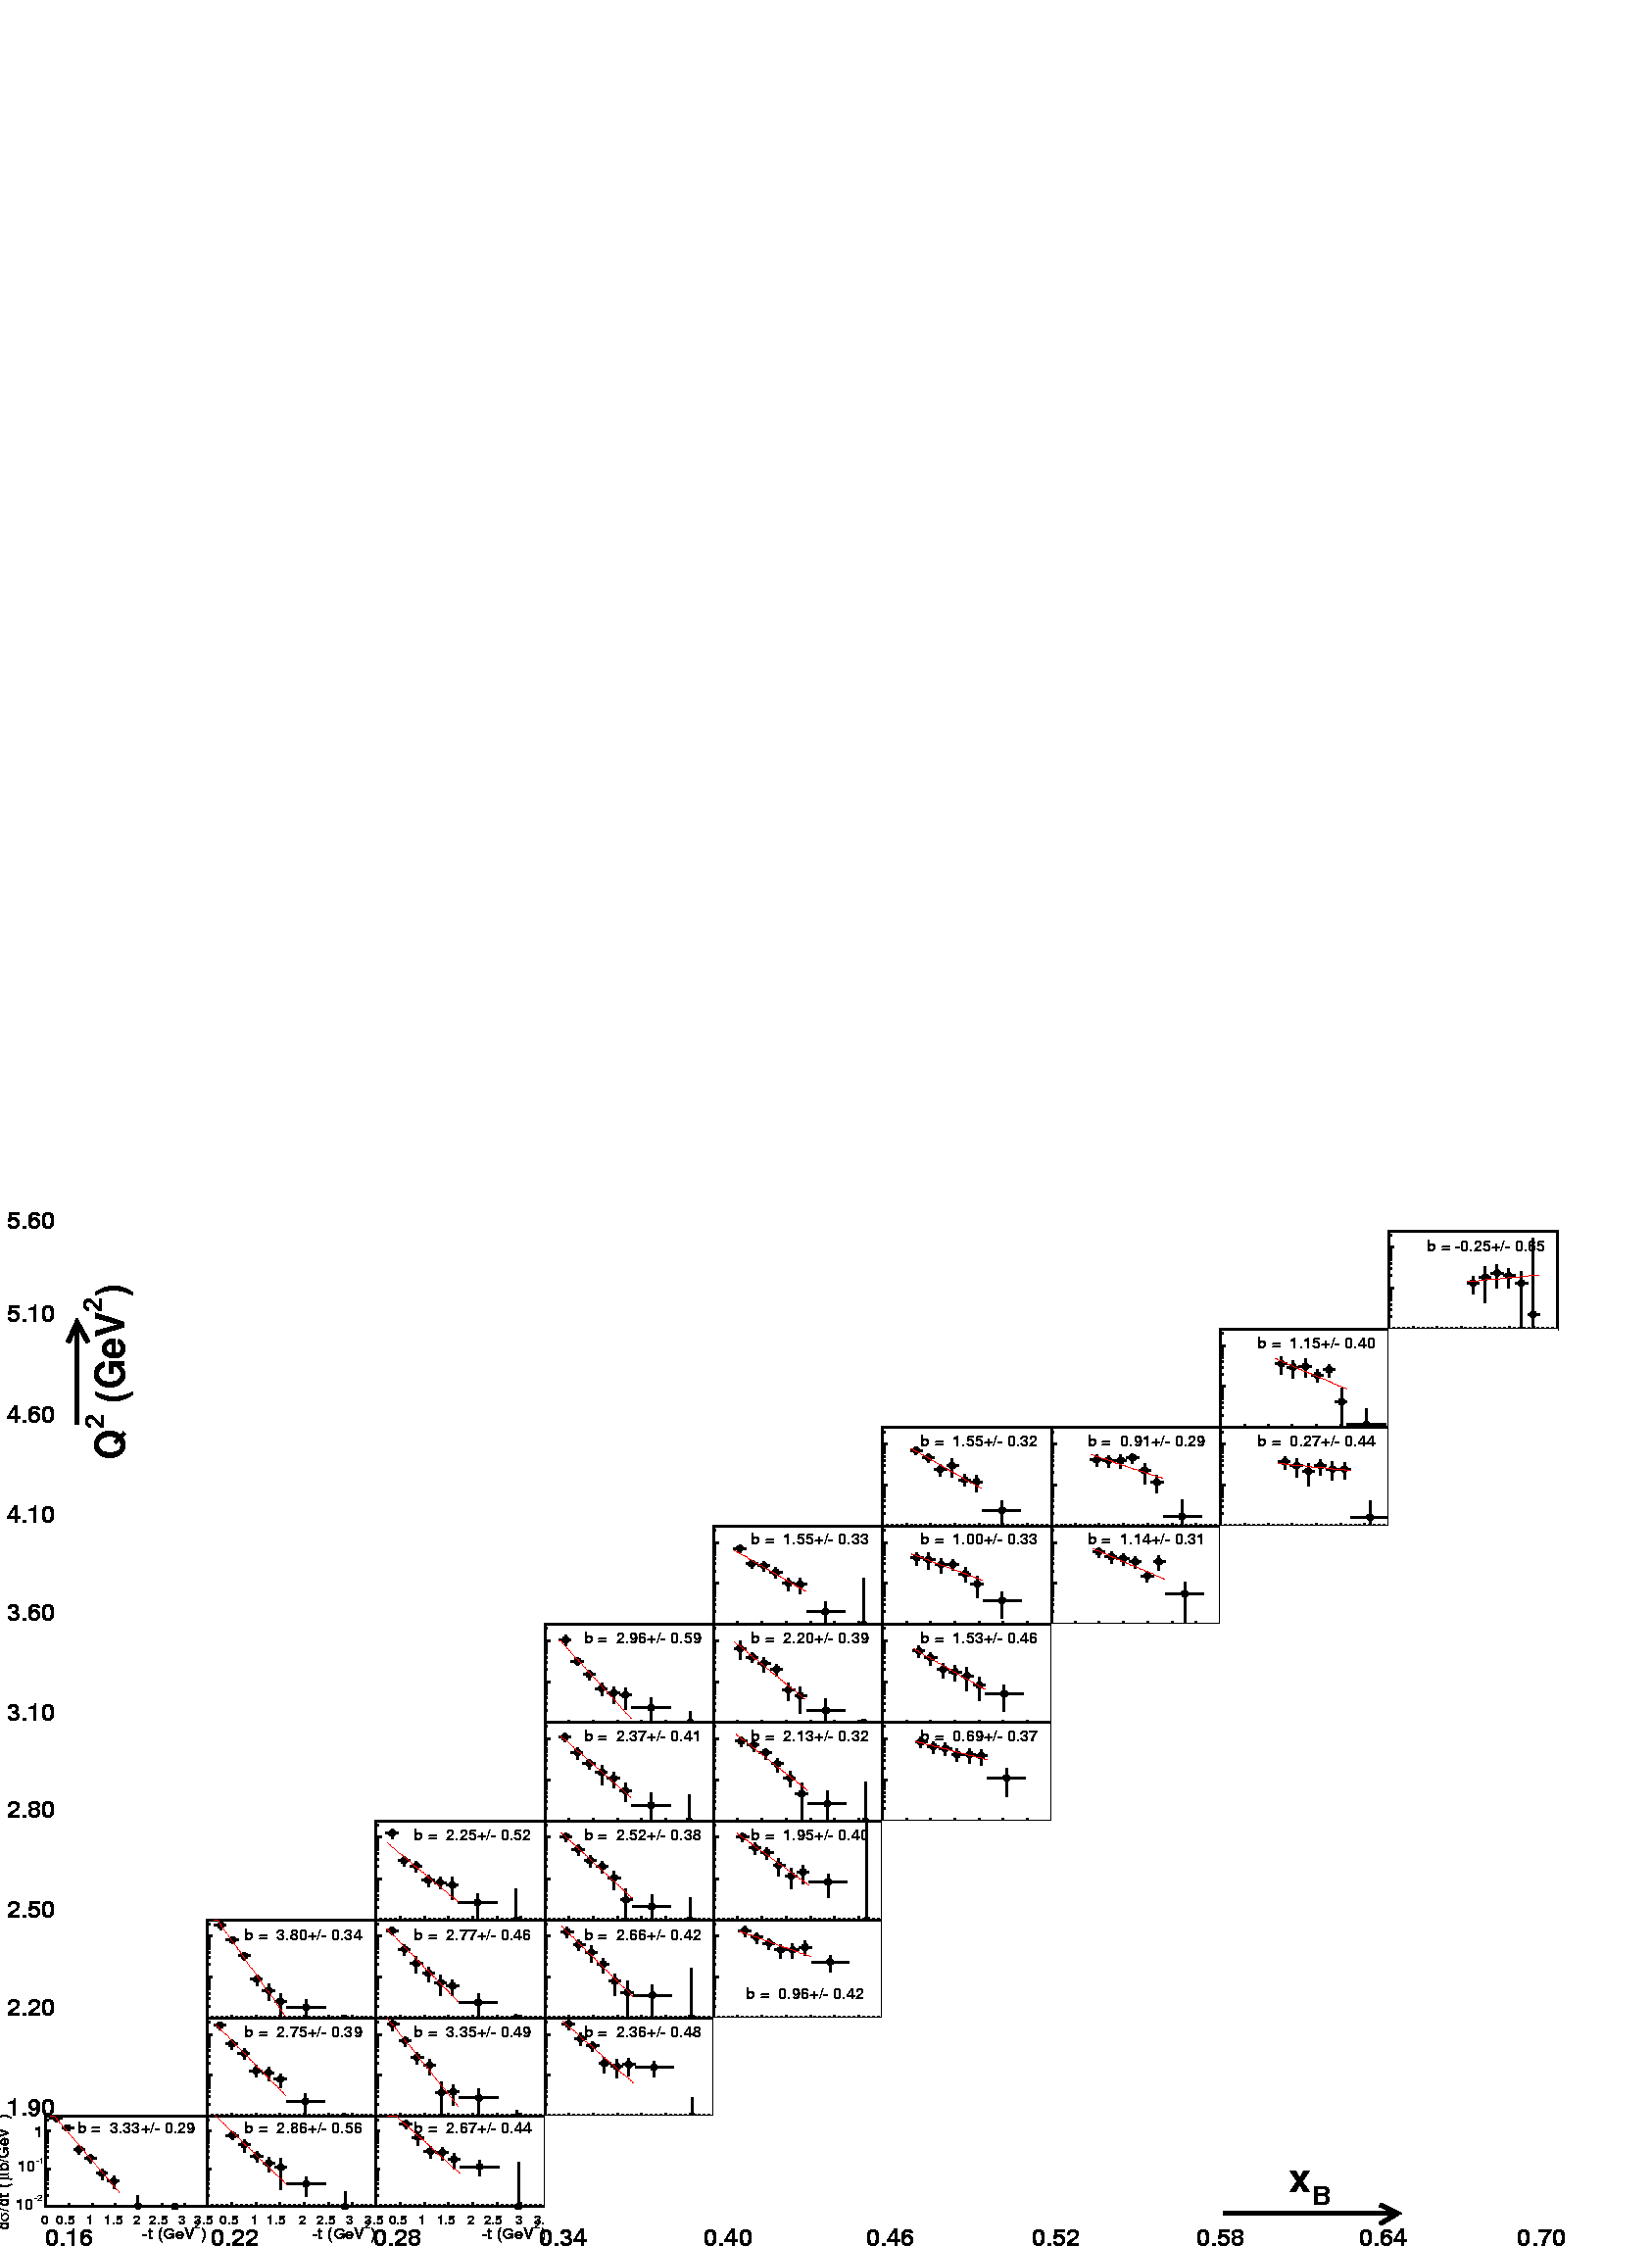
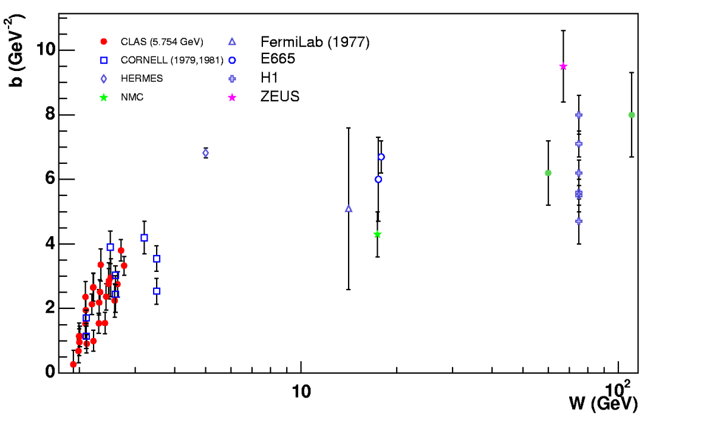
dσ/dt (γ*p → pρ⁰)
Large t_{min} ! (1.6 GeV²)
Fit by e^{bt}

Slide 34
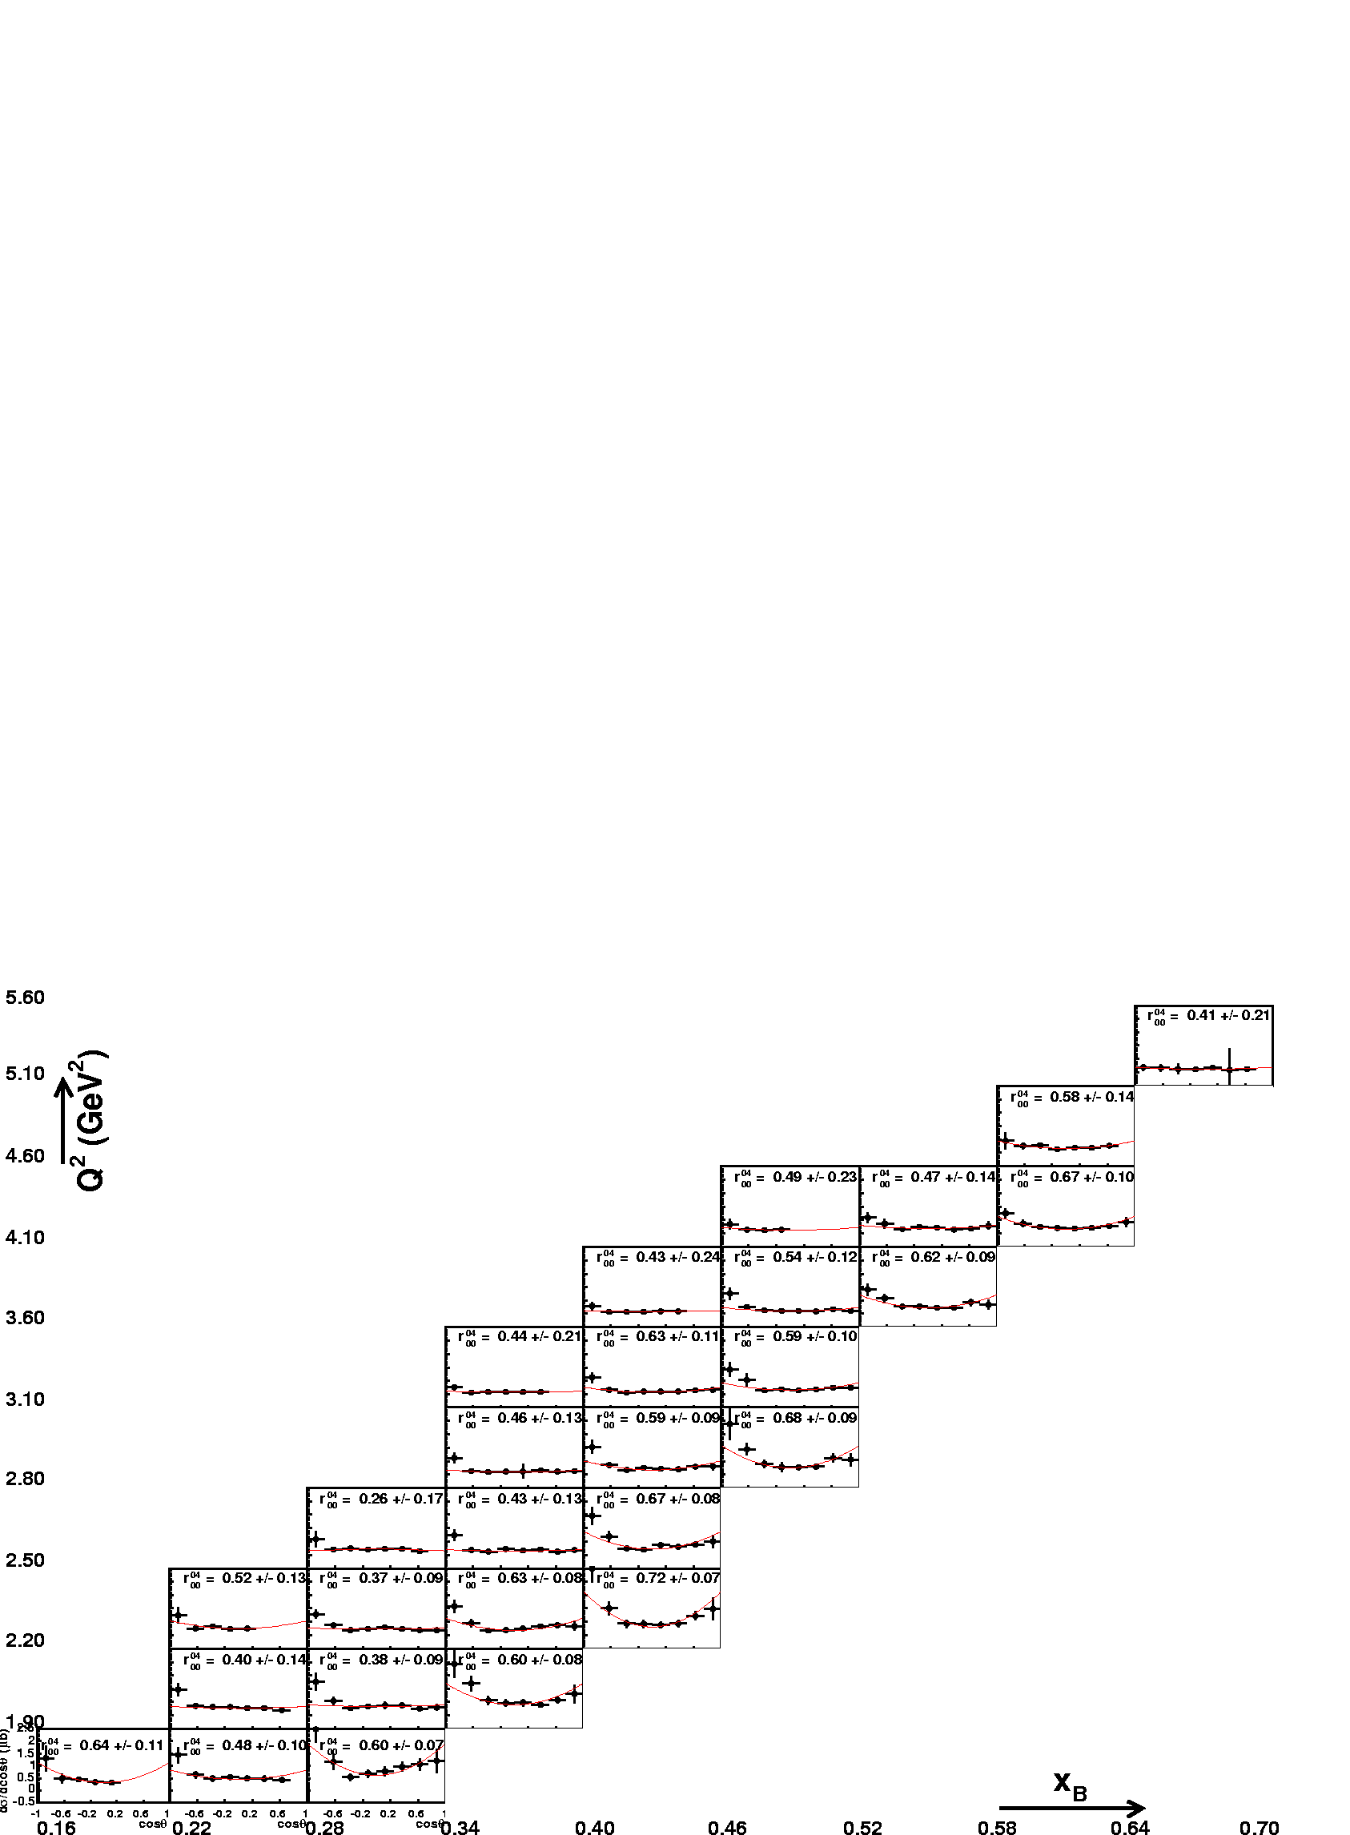
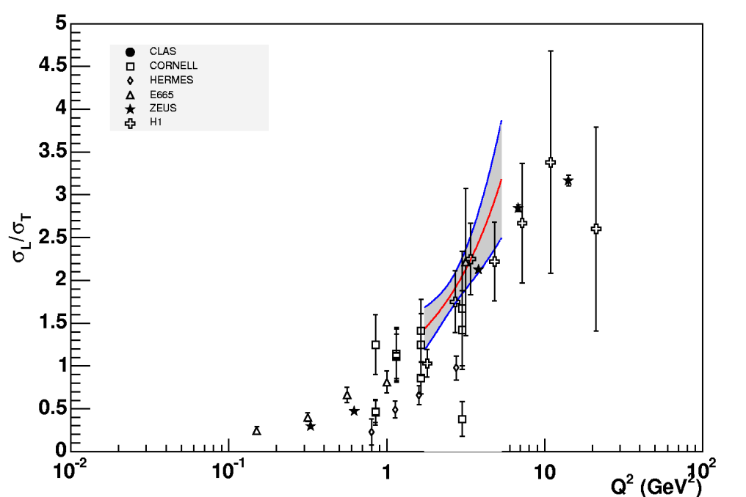
Angular distribution analysis, cos θ_{cm}
Relying on SCHC
(exp. check to the ~25% level)

Slide 35
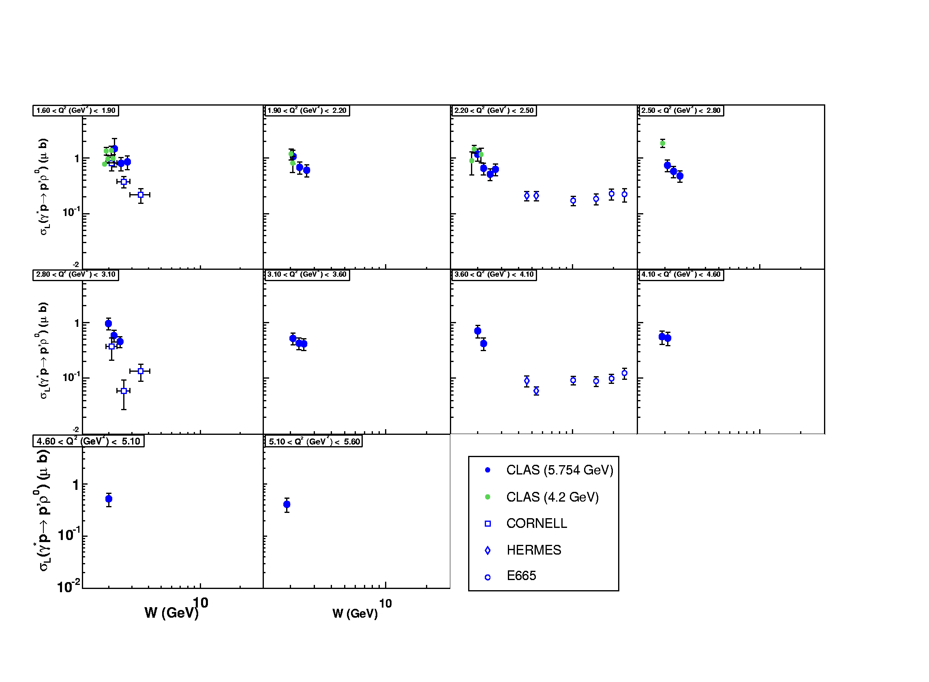
Longitudinal cross section σ_{L} (γ*_{L}p → pρ_{L}⁰)

Slide 36
Interpretation “a la Regge” : Laget model
γ*p → pρ⁰
γ*p → pω
Free parameters:
*Hadronic coupling constants: g_{MNN}
*Mass scales of EM FFs: (1+Q²/Λ²)⁻²
γ*p → pφ

Slide 37
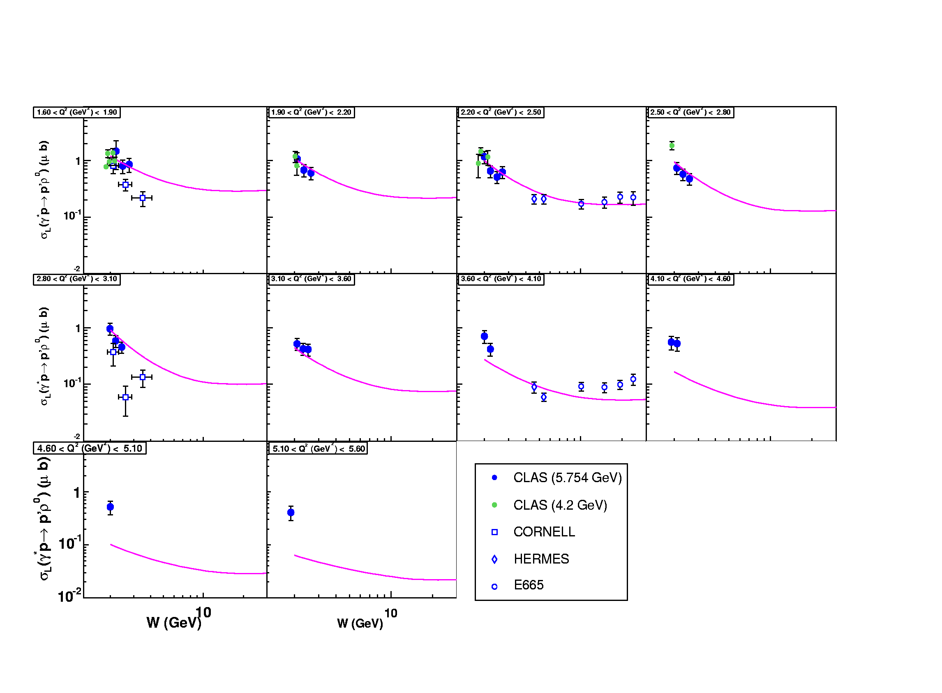
σ_{L} (γ*_{L}p → pρ_{L}⁰)
σ,f₂
Pomeron
Regge/Laget

Slide 38
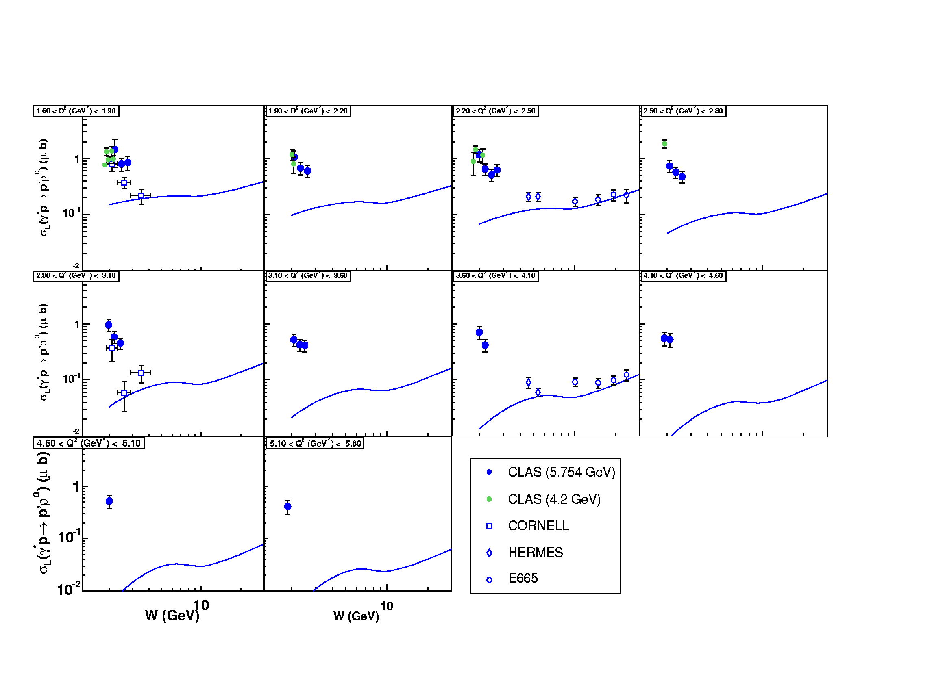
+
VGG GPD model

Slide 39
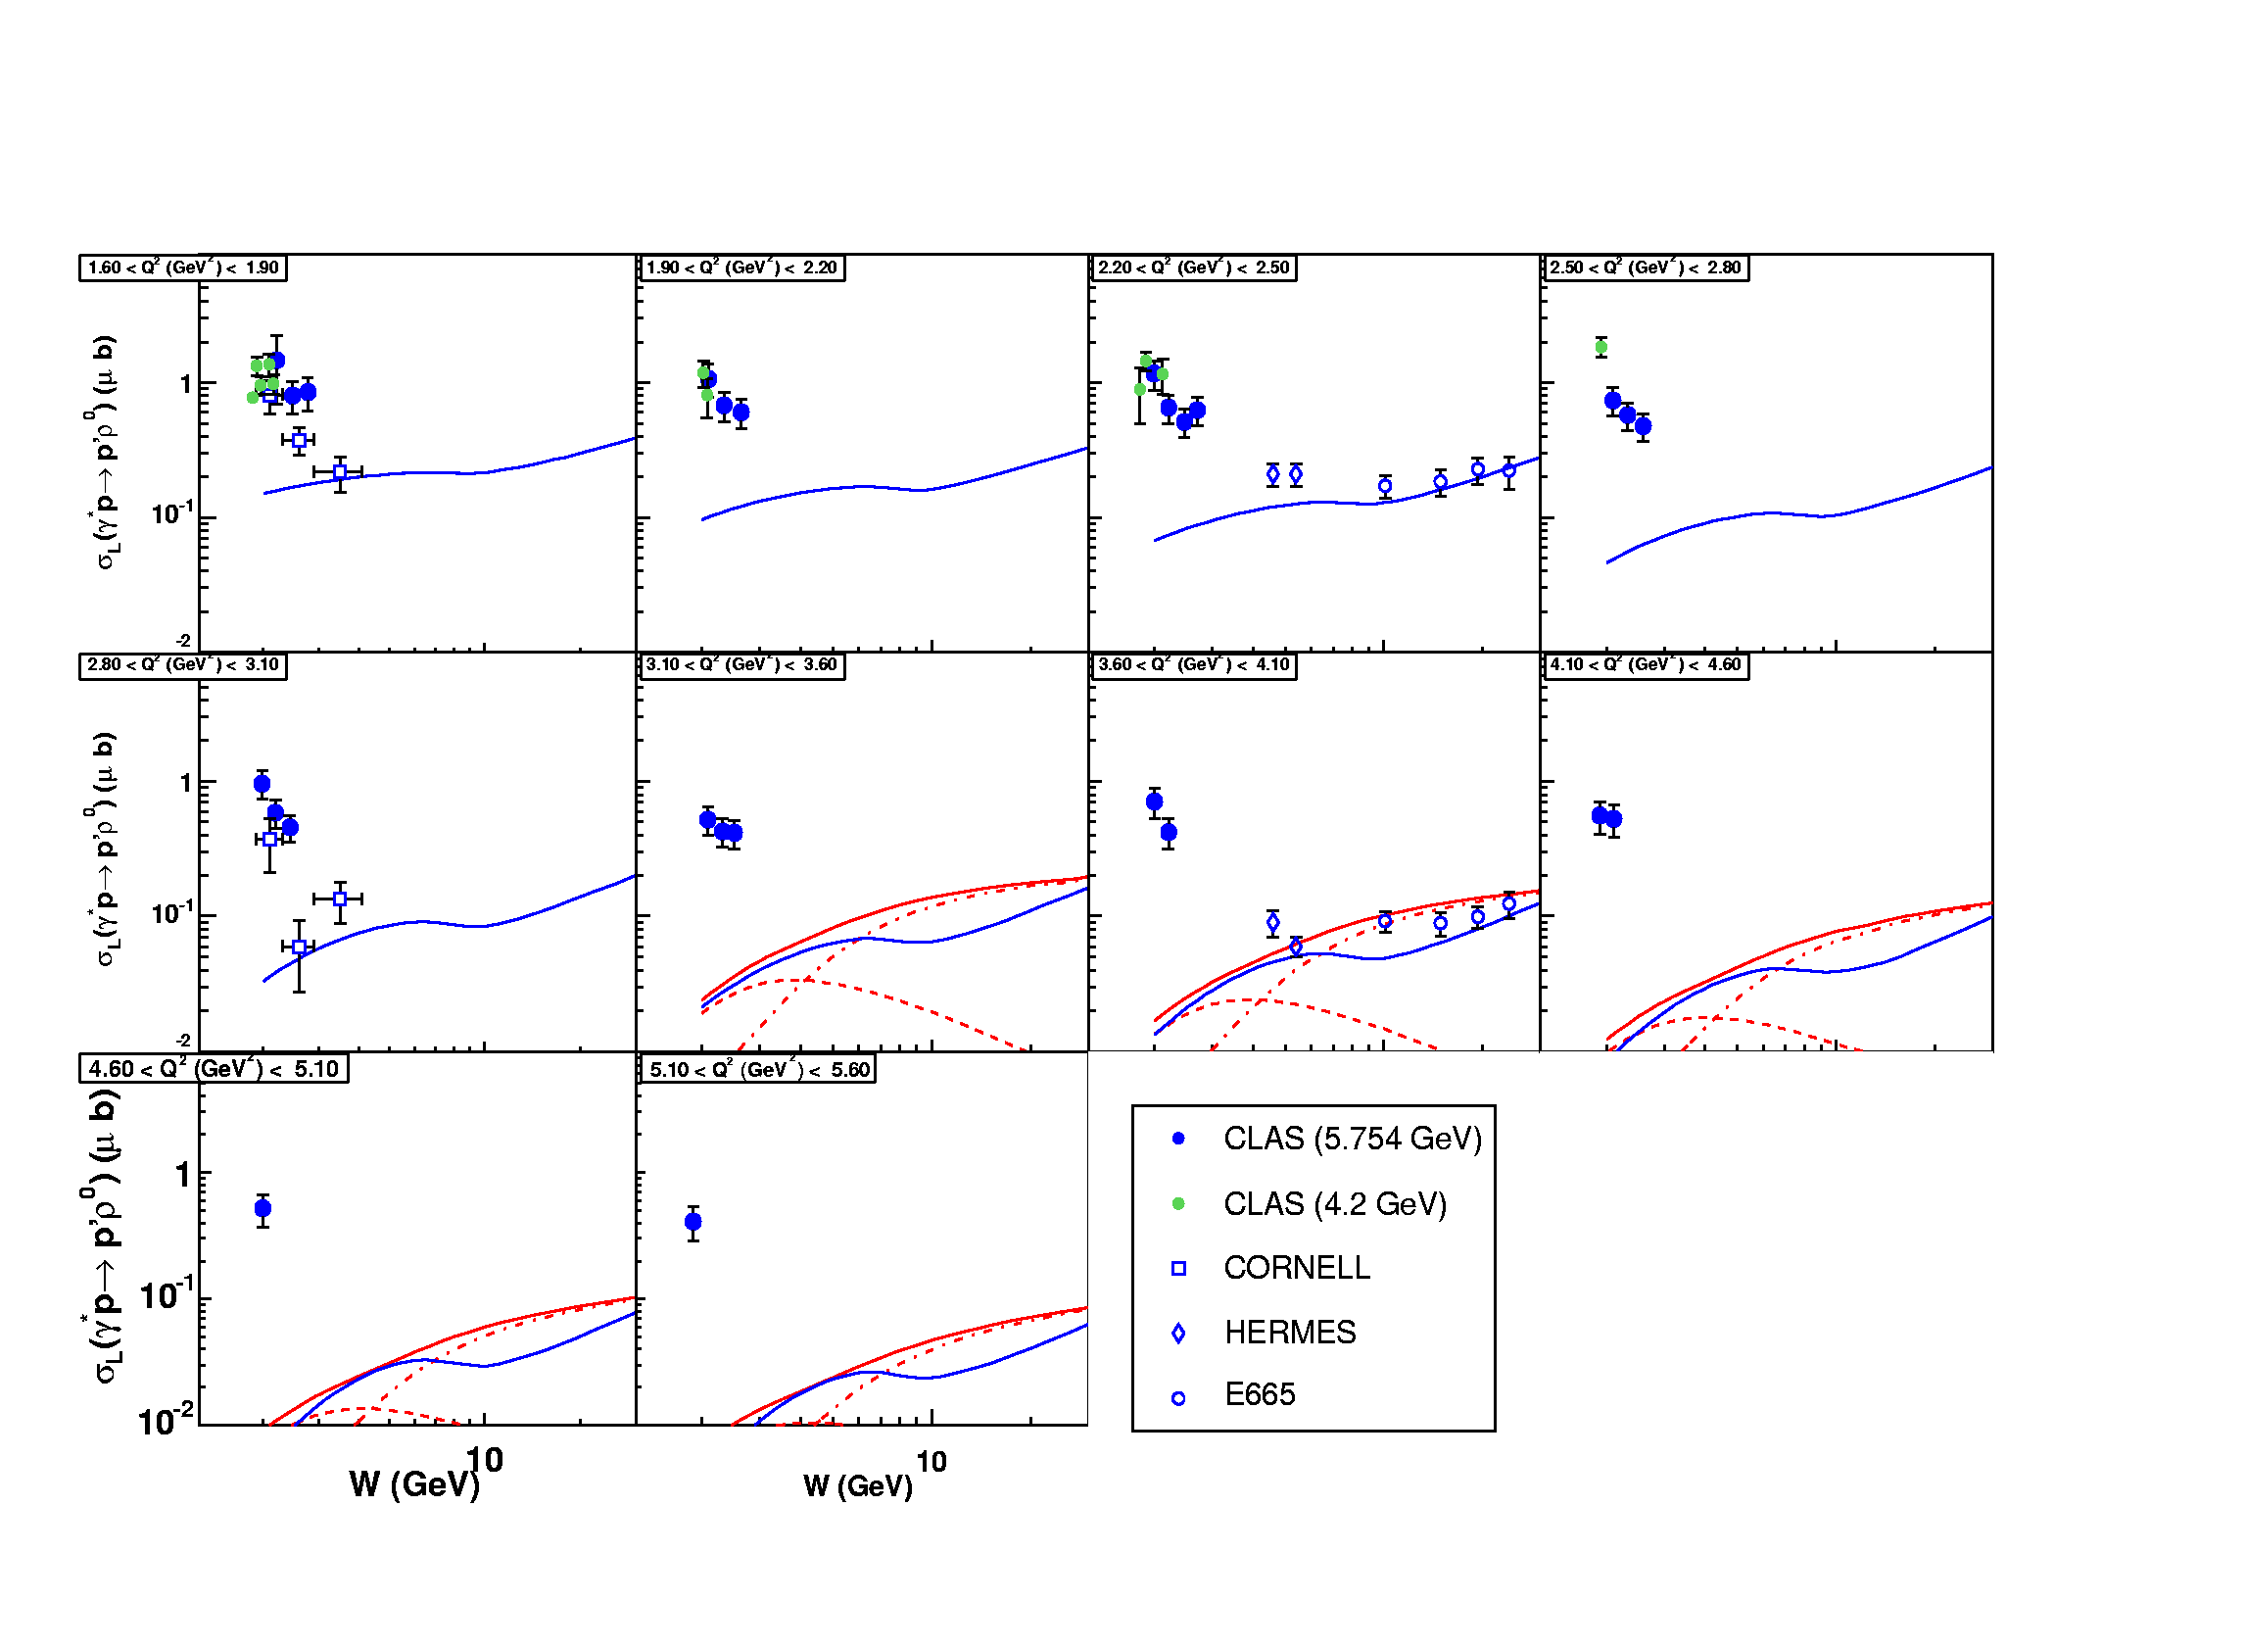
+
GK GPD model

Slide 40
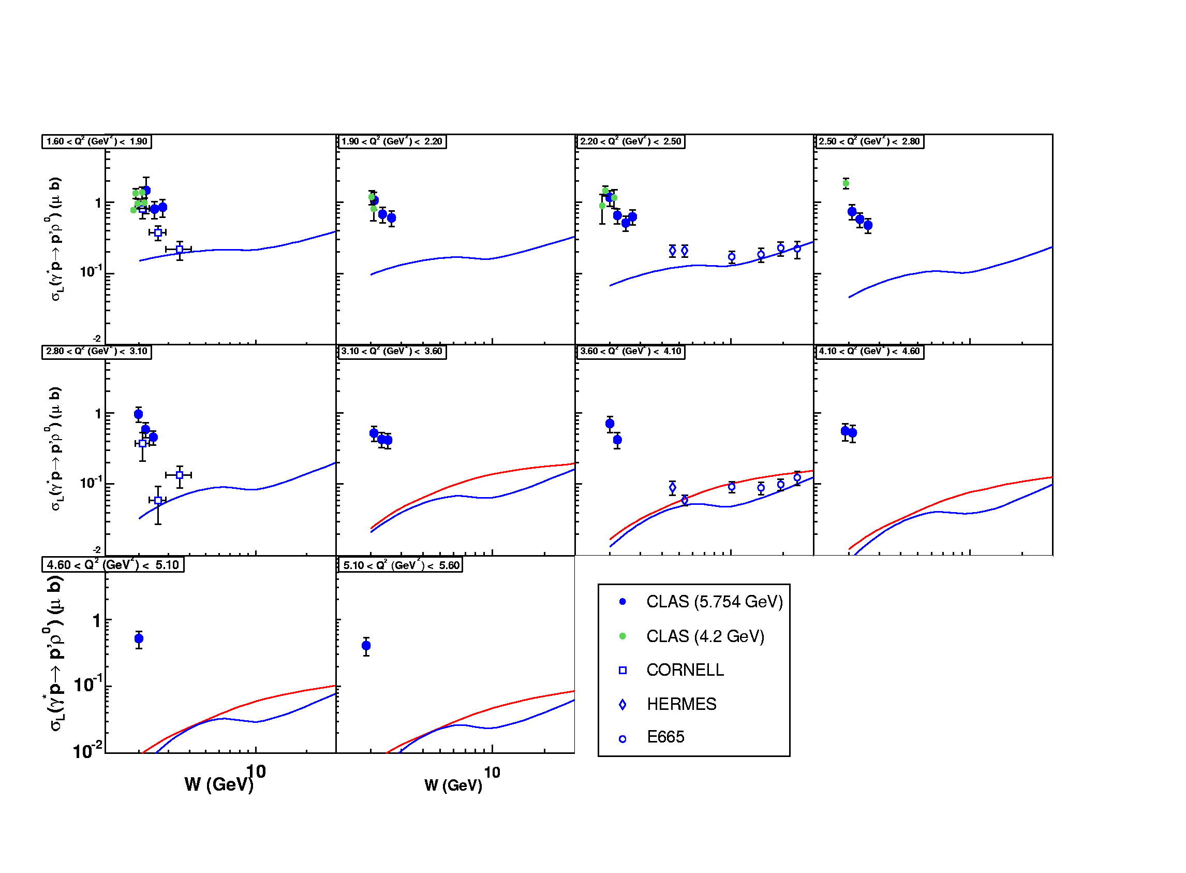
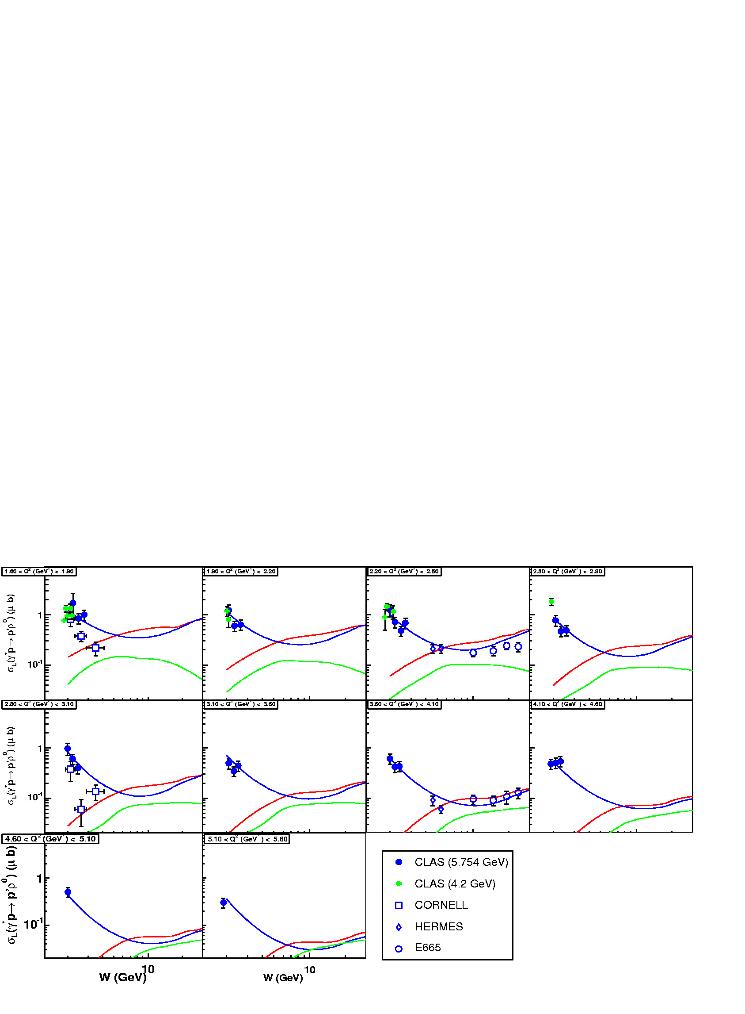
t
γ, π, ρ, ω…
-2ξ
x+ξ
x-ξ
~
~
H, H, E, E (x,ξ,t)
“ERBL” region
“DGLAP” region
x
-1
-ξ
0
ξ
+1
Antiquark
distribution
q q Distribution amplitude
Quark
distribution
ERBL
DGLAP
W~1/ξ
Notes:
Intro

Slide 41
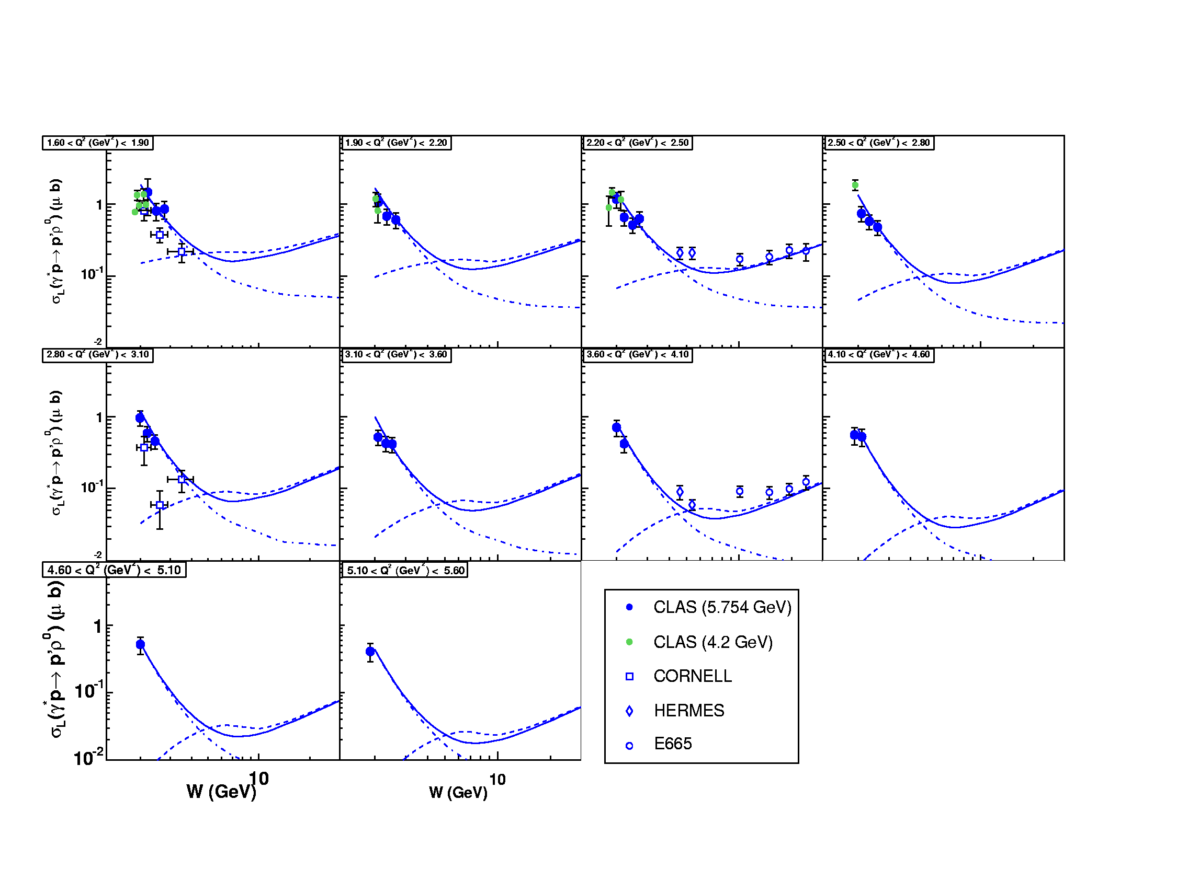
DDs
+ “(fitted) meson exchange”
DDs w/o “meson exchange” (VGG)
“(fitted) meson exchange”

Slide 42
Comparison of cross sections is model-dependent:
k_{perp} dependence ansatz, model for GPDs,…
Some signatures available for gluon handbag are not
relevant for quark handbag:
W (or x_{B}) dependence:
σ~|xG(x)|²
Ratio of yields:
ρ/ω/φ/(J/Ψ)~9/1/2/8
Model-independent features:
Q² dependence:
σ_{L}~1/Q⁶
σ_{T}~1/Q⁸
σ_{L}/σ_{T}~Q²
Saturation with hard scale of b
SCHC : checks with SDMEs

Slide 43
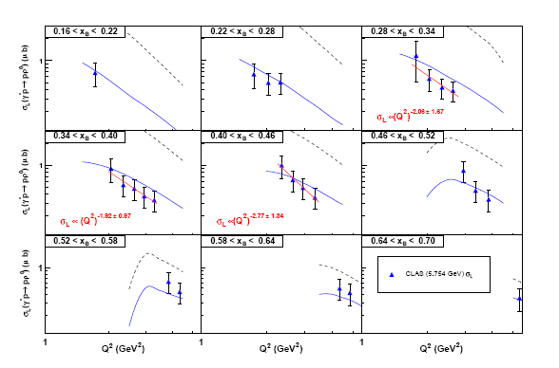
CLAS@6 GeV
S. Morrow et al., Eur.Phys.J.A39:5-31,2009 (ρ⁰@5.75GeV)

Slide 44
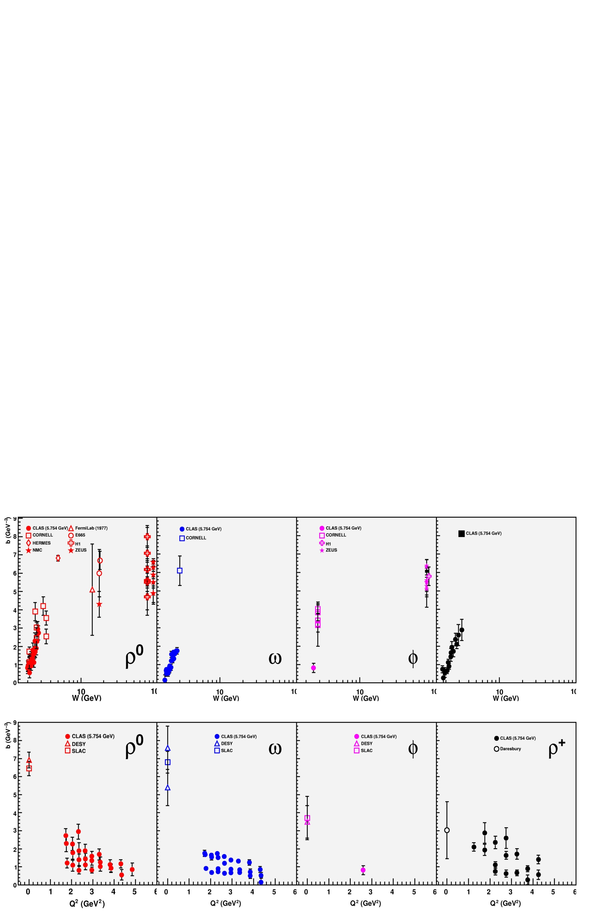
b (from e^{bt}) as a function of Q² (be careful of correlation with W)
σ_{L}/σ_{T} as a function of Q²
(be careful of correlation with W)

Slide 45
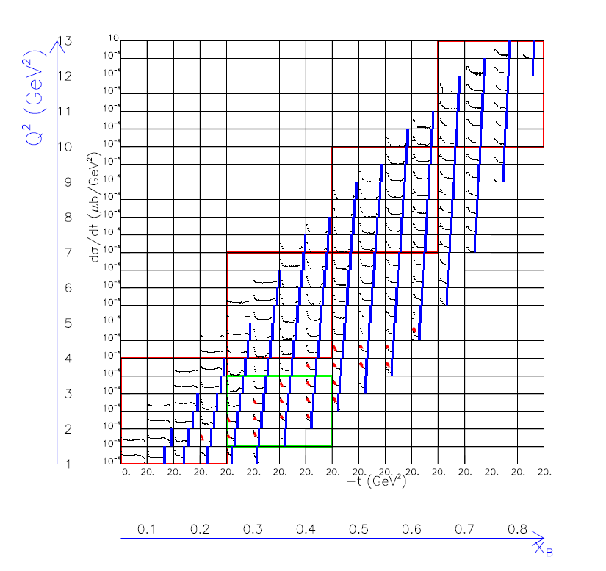
Exclusive ρ⁰ electroproduction at CLAS12
CLAS12 proposal PR12-11-103
Q² range
at 6 GeV
Q² range
at 12 GeV

Slide 46
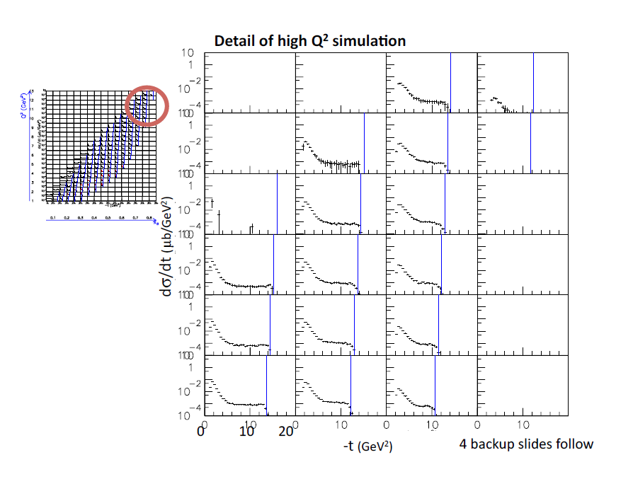

Slide 47
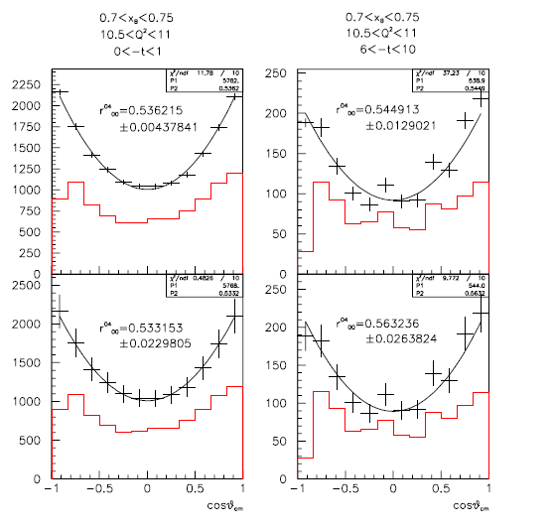
ρ⁰ decay angular distribution (polar angle θ_{cm})
CLAS12 proposal PR12-11-103
purely statistical
error bars
statistical error bars
+10% systematic

Slide 48
Exclusive ω electroproduction

Slide 49
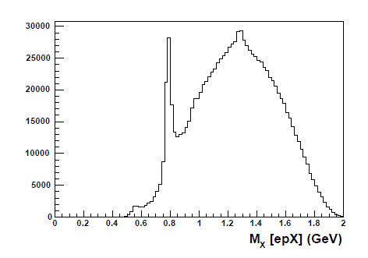
ep->epω ( π⁺π⁻[π⁰])

Slide 50
cos(θ_{cm}) distribution
φ_{cm} distribution

Slide 51
Cross section σ(γ*p → pω)
Laget Regge model
for γ*p → pω
DESY data
CORNELL data
Issue with GPD approach if
π⁰ exchange dominant :
Laget σ_{T}+εσ_{L}
~
π⁰->E
while
~
Laget εσ_{L}
VGG εσ_{L}
(H&E)
E subleading in
handbag for VM
production
(GK includes π⁰
exchange with
k_{perp} effects)

Slide 52
Cross section σ(γ*p → pω)
Comparison with GPD calculation (VGG)

Slide 53
Exclusive ρ ⁺ electroproduction
(A. Fradi’s thesis)
Slow but steady progress
towards publication !

Slide 54
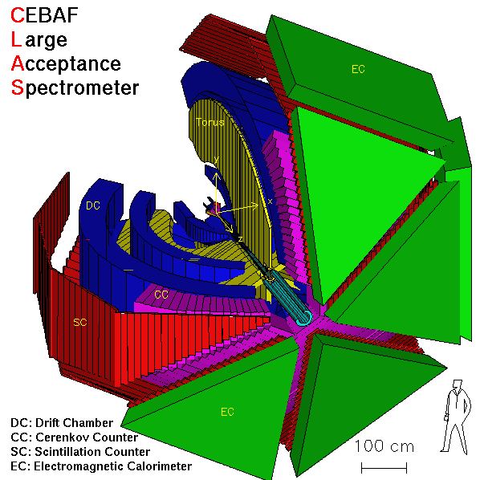
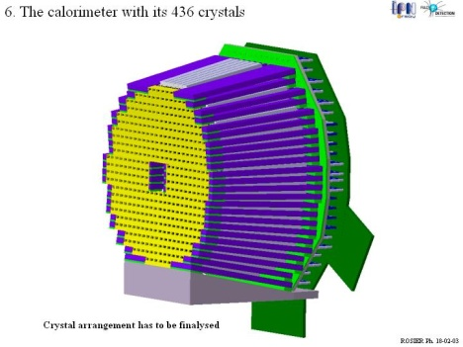
Channel selection
e p→ e’ [n] ρ⁺ → e’ [n] π⁺π⁰→ e’ [n] π⁺ γ γ
π⁺
EC
e
γ
γ
(π⁻)
(p)
One event in CLAS
IC
Notes:
54

Slide 55
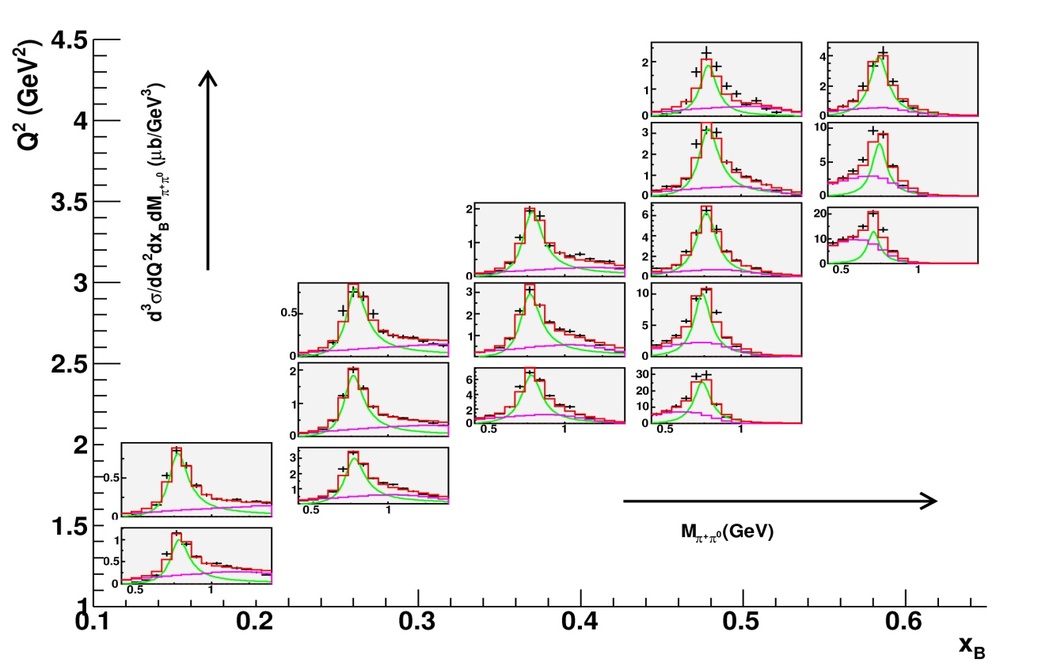
Invariant mass IM(π⁺π⁰)

Slide 56
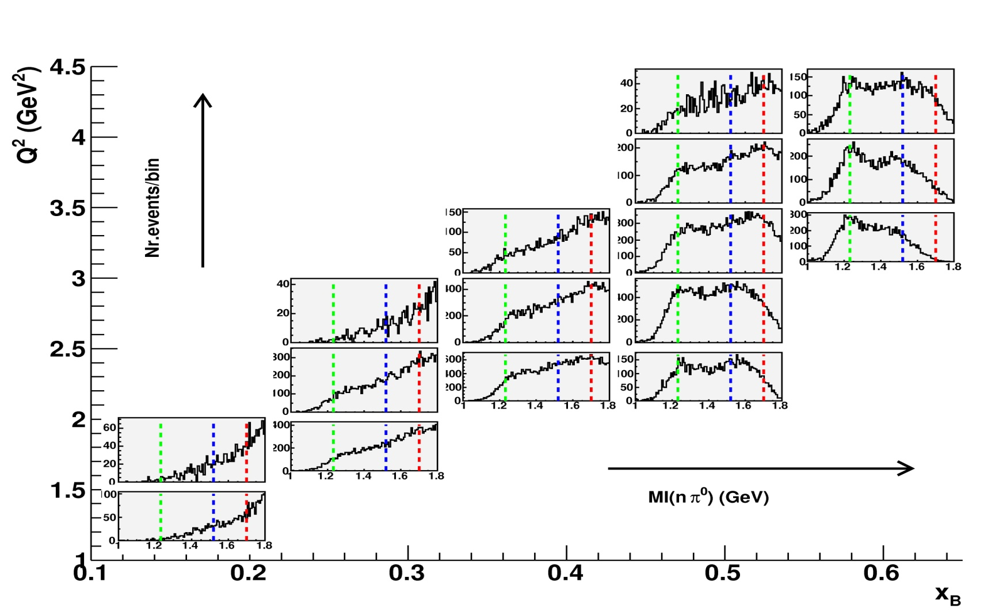
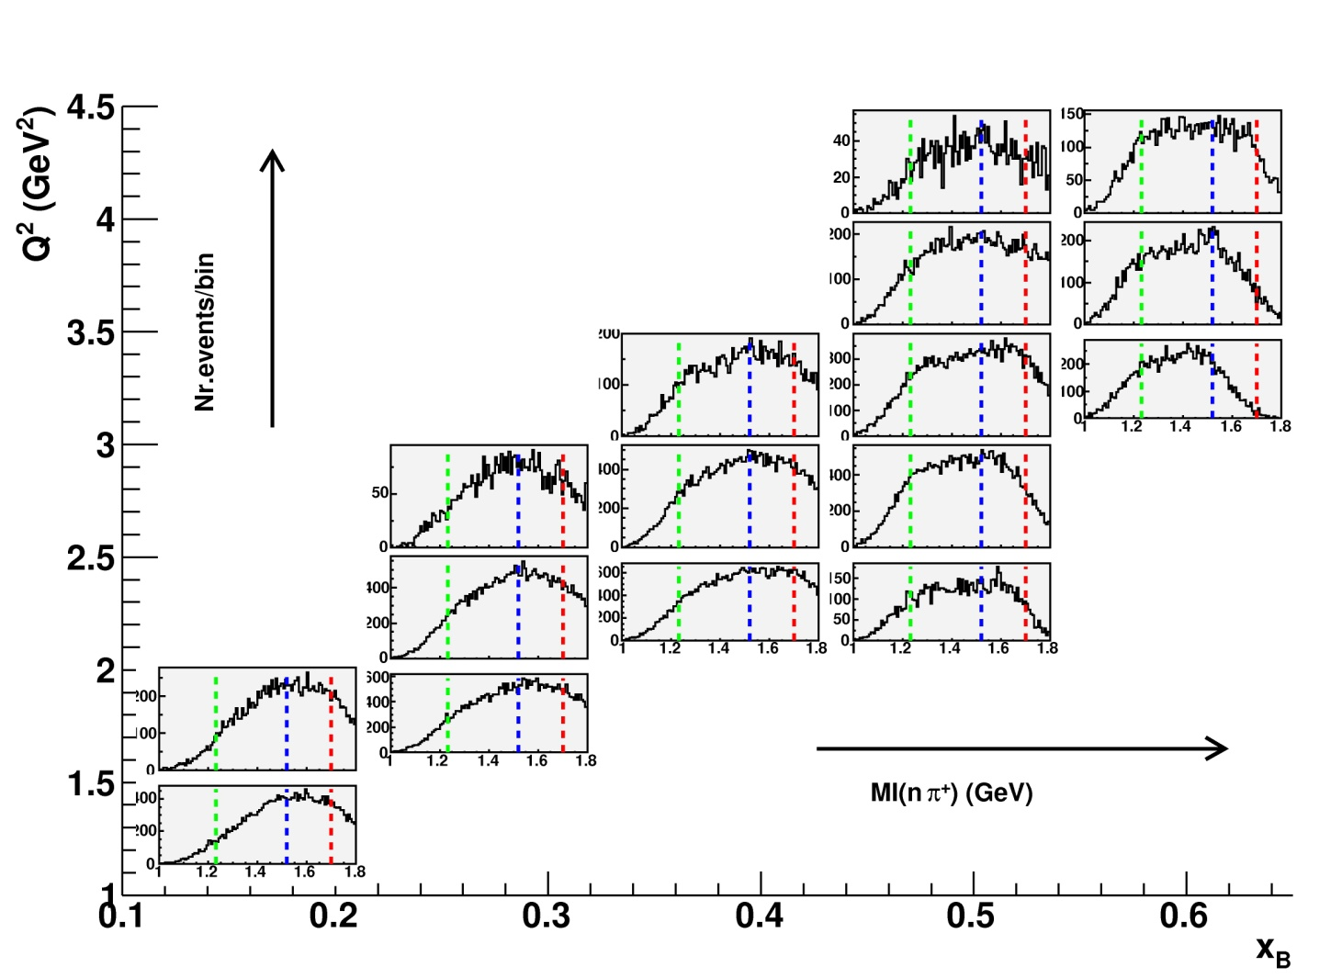
Invariant mass IM(nπ⁰)
Invariant mass IM(nπ⁺)

Slide 57
Invariant mass IM(π⁺π⁰)

Slide 58
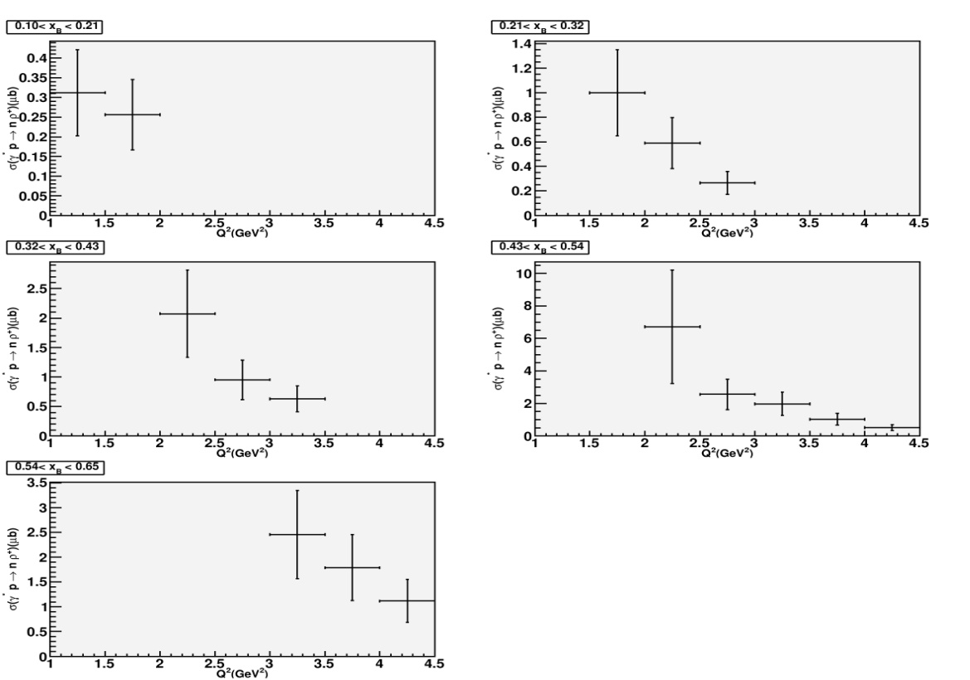
Total cross section
σ (Q²,x_{B}) ρ⁺
PRELIMINARY

Slide 59
Laget Regge “hadronic” approach
ρ⁺
ρ⁺
π⁺
+
ρ⁺
n
n
GPD “partonic” approach
H , E
ρ⁺_{L}
ρ⁰ | e_{u}H^{u} - e_{d}H^{d} e_{u}E^{u} - e_{d}E^{d}
ω | e_{u}H^{u} + e_{d}H^{d} e_{u}E^{u} + e_{d}E^{d}
ρ⁺ | H^{u} - H^{d} E^{u} - E^{d}

Slide 60
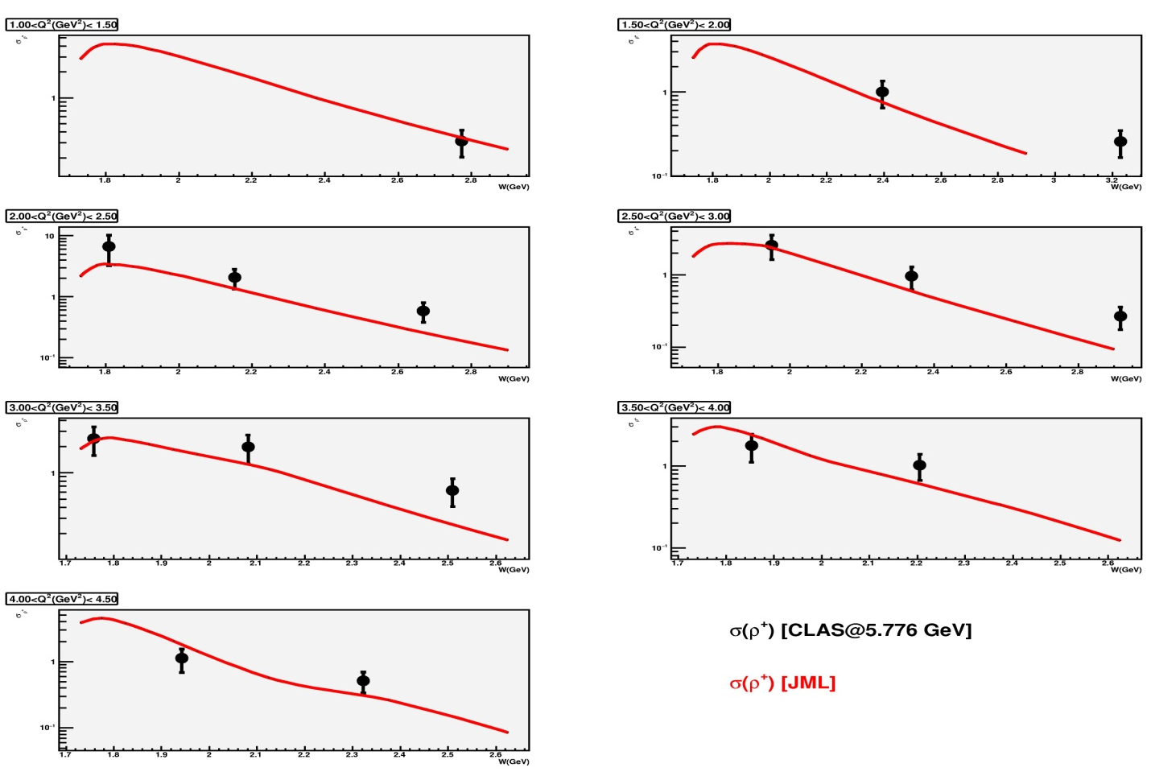

“Hadronic approach”:
Laget model
ρ⁺
ρ⁰

Slide 61
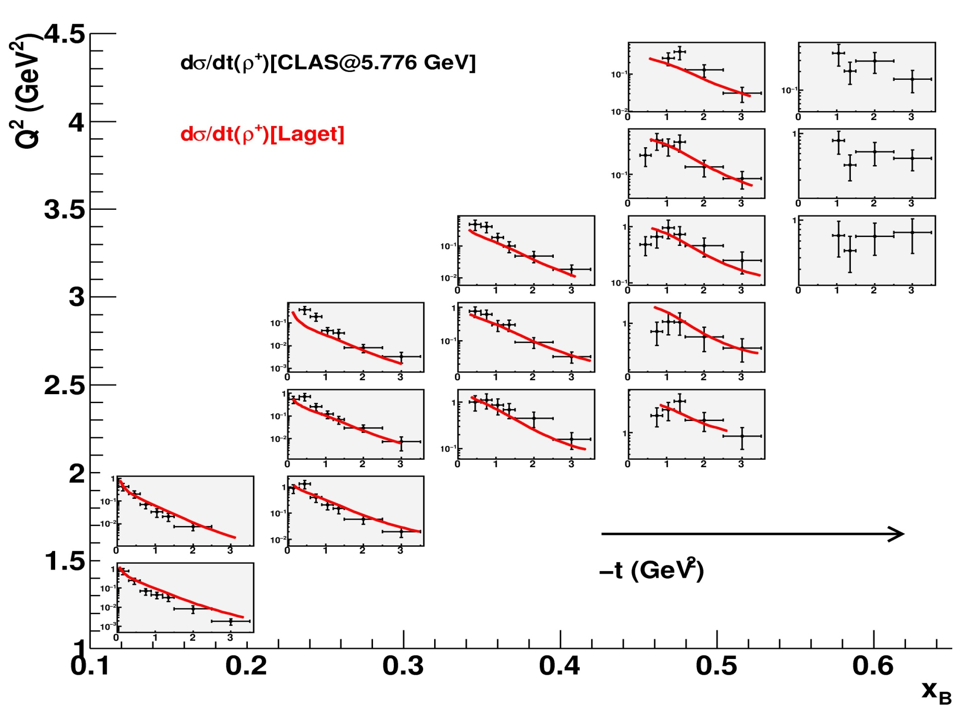
“Hadronic approach”
PRELIMINARY
Laget model does not reproduce the drop of dσ/dt for t →0
Notes:
61

Slide 62


“Partonic approach”:
GPDs
e’
ρ⁺
(*)
e
γ∗_{L}
GPDs
p
n
ρ⁺
ρ⁰
VGG GPD model
GK GPD model
Notes:
62

Slide 63

“Partonic approach”: GPDs
(*)
GPDs model agrees fairly
with the data at low x_{B} (high W)
GPDs model misses
the data at high x_{B} (low W)
Only H in this calculation
Notes:
63

Slide 64

Hint of GPD E dominance
(*)
The GPD E reproduces the drop of dσ/dt for t →0
Notes:
64

Slide 65

ρ⁺
(preliminary)
ρ⁰
ω
φ
C. Hadjidakis et al., Phys.Lett.B605:256-264,2005 (ρ⁰@4.2 GeV)
S. Morrow et al., Eur.Phys.J.A39:5-31,2009 (ρ⁰@5.75GeV)
L. Morand et al., Eur.Phys.J.A24:445-458,2005 (ω@5.75GeV)
J. Santoro et al., Phys.Rev.C78:025210,2008 (φ@5.75GeV)
K. Lukashin, Phys.Rev.C63:065205,2001 (φ@4.2 GeV)
A. Fradi, Orsay Univ. PhD thesis, 2009 (ρ⁺@5.75GeV)

Slide 66
Comparison of t-slope
for ρ⁰, ω, φ channels at 6 GeV

Slide 67
VMs (ρ⁰,ω,φ) the only exclusive process [with DVCS] measured
over a W range of 2 orders of magnitude (σ_{L,T}, dσ/dt, SDMEs,…)
At high energy (W>5 GeV), transition from “soft” to “hard”
(μ² scale) physics relatively well understood (further work
needed for precision understanding/extractions)
handbag interpretation and nucleon imaging
At low energy (W<5 GeV), success of “hard” approach for
the φ channel ( nucleon gluon imaging) but large failure
for the ρ⁰,ω, ρ⁺ channels.
This is not understood. Why the GPD/handbag approach
sould set at much larger Q² for valence quarks ?
Are the widely used GPD parametrisations in the valence region
completely wrong ?
JLab12 PR12-11-103 proposal: broader phase space, check
when Q² independence settles for a variety of observables

Slide 68
GPDs/handbag ???
GPDs/handbag
W~1/ξ

Slide 69
BACKUP
SLIDES

Slide 70
t
γ, π, ρ, ω…
-2ξ
x+ξ
x-ξ
~
~
H, H, E, E (x,ξ,t)
“ERBL” region
“DGLAP” region
x
-1
-ξ
0
ξ
+1
Antiquark
distribution
q q Distribution amplitude
Quark
distribution
ERBL
DGLAP
W~1/ξ
Notes:
Intro

Slide 71
DDs + “meson exchange”
DDs w/o “meson exchange” (VGG)
“meson exchange”

Slide 72
σ_{ρ} (γ*p → pρ⁰) vs W

Slide 73
σ_{L} (γ*_{L}p → pρ_{L}⁰)
σ,f₂
Pomeron
Regge/Laget

Slide 74
Exclusive φ electroproduction

Slide 75

ep->epφ ( Κ⁺[Κ⁻])

Slide 76



Laget σ_{T}+εσ_{L}
W=2.9 GeV
W=2.45 GeV
W=2.1 GeV
GK σ_{L}
φ_{L}

Slide 77

100% acceptance & integrated over all variables but (x_{B},Q²)
6 GeV e
fixed p target
Counting rates
for 1000 hours
at 10³⁴ cm⁻²s⁻¹
Limitation comes
from phase space

Slide 78
100% acceptance & integrated over all variables but (x_{B},Q²)
6 GeV e
fixed p target
Counting rates
for 100 hours
at 10³⁴ cm⁻²s⁻¹
Limitation comes
from phase space

Slide 79

100% acceptance & integrated over all variables but (x_{B},Q²)
11 GeV e
fixed p target
Counting rates
for 1000 hours
at 10³⁵ cm⁻²s⁻¹
Limitation comes
from phase space

Slide 80
100% acceptance & integrated over all variables but (x_{B},Q²)
11 GeV e
fixed p target
Counting rates
for 1000 hours
at 10³⁵ cm⁻²s⁻¹
Limitation comes
from phase space

Slide 81

100% acceptance & integrated over all variables but (x_{B},Q²)
11 GeV e
60 GeV p
Counting rates
for 1000 hours
at 10³⁴ cm⁻²s⁻¹
Limitation comes
from luminosity

Slide 82
100% acceptance & integrated over all variables but (x_{B},Q²)
11 GeV e
60 GeV p
Counting rates
for 1000 hours
at 10³⁴ cm⁻²s⁻¹
Limitation comes
from luminosity

Slide 83


Slide 84



6 GeV e
fixed p target
11 GeV e
fixed p target
11 GeV e
60 GeV p

Slide 85
dσ/dt (γ*p → pρ⁰)
Large t_{min} ! (1.6 GeV²)
Fit by e^{bt}

Slide 86


Longitudinal cross sections
PRELIMINARY
σ_{L}(ρ⁺)[μb]
dσ_{L}/dt (ρ⁺)[μb]

Slide 87
Increasing Q²:
?
e
−
2
2
Q ~ MeV
Q²>>
e
−
2
2
Q >>GeV

Slide 88

GPDs parametrization based
on DDs (VGG/GK model)
Strong power corrections… but seems to work at large W…

Slide 89
dσ/dt (γ*p → pρ⁰)
Large t_{min} ! (1.6 GeV²)
Fit by e^{bt}

Slide 90
W dependence
Steepening W slope as a function of Q²
indicates « hard » regime
(reflects gluon distribution in the proton)

Slide 91

W dependence
Steepening W slope as a function of Q²
indicates « hard » regime
(reflects gluon distribution in the proton)
Two ways to set a « hard » scale:
*large Q²
*mass of produced VM
Universality : ρ, φ at large Q²+M_{V}² similar to J/ψ

Slide 92

α_{P}(0) increases from “soft” (~1.1) to “hard” (~1.3)
as a function of scale μ²=(Q²+M_{V}²)/4.
Hardening of W distributions with μ²

Slide 93


Q² dependence
σ_{L}~1/Q⁶ => Fit with σ~1/(Q²+M_{V}²)^{n}
ρ:
Q² >0 GeV² => n=2+/- 0.01
J/ψ:
Q² >0 GeV² => n=2.486
+/- 0.08
+/-0.068
Q² >10 GeV² => n=2.5+/- 0.02
(S. Kananov)
Q² dependence is damped at low Q² and steepens at large Q²
Approaching handbag prediction of n=6
(Q² not asymptotic, fixed W vs fixed x_{B}, σ_{tot} vs σ_{L}, Q² evolution of G(x)…)

Slide 94



t dependence
b decreases from “soft” (~10 GeV⁻²)
to “hard” (~4-5 GeV⁻²) as a function
of scale μ²=(Q²+M_{V}²)/4

Slide 95
Ratios
ρ/ω/φ/(J/Ψ) ~ 9/1/2/8
|ρ⁰>=1/sqrt(2){|uu>-|dd>}
∼{2/3−(−1/3)}
Ratio ρ/ω=9
|ω>=1/sqrt(2){|uu>+|dd>}
∼{2/3+(−1/3)}

Slide 96

σ_{L}/σ_{T}
(almost) compatible with handbag prediction
(damping at large Q²)

Slide 97


SDMEs
HERMES
H1
(almost) no SCHC violation

Slide 98



Cornell
HERMES
CLAS

Slide 99
ep->epφ ( Κ⁺[Κ⁻])
GK σ_{L}
φ_{L}
HERA
HERMES
CLAS

Slide 100


Exclusive φ electroproduction:
gluon imaging of the proton
x<0.01: measured at H1/ZEUS
x>0.1: practically unknown: φ with CLAS12

Slide 101


Exclusive φ electroproduction:
gluon imaging of the proton
(A. Kubarovsky’s simulations)
CLAS12 proposal PR12-11-103:
Extract t–slope of dσ_{L}/dt up to Q²~7 GeV2
As a function of Q²: check when Q²-independence settles
As a function of x_{B} (or W): first 3D-gluon imaging at large x

Slide 102

C. Weiss:

Slide 103



LO (w/o kperp effect)
LO (with kperp effect)
Handbag diagram calculation
needs k_{perp} effects to account for
preasymptotic effects
Same thing for 2-gluon exchange process

