Slide 1
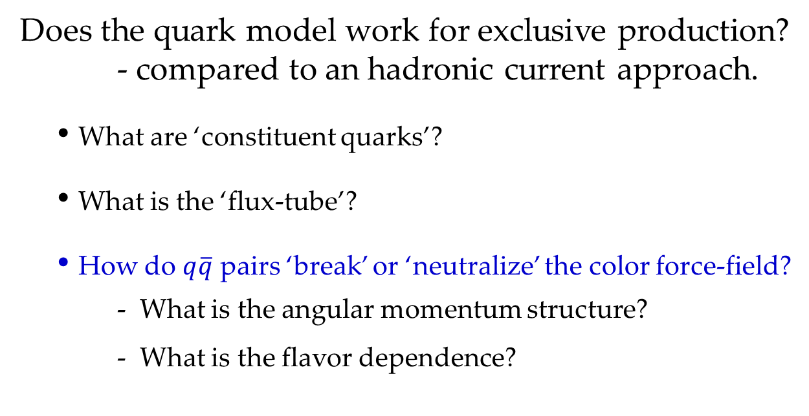
String Fragmentation in the Exclusive Limit
Mac Mestayer
Does the quark model work for exclusive production?
- compared to an hadronic current approach.
  What are ‘constituent quarks’?
  What is the ‘flux-tube’?
  How do $q\overline{q}$ pairs ‘break’ or ‘neutralize’ the color force-field?
  - What is the angular momentum structure?
  - What is the flavor dependence?
Notes:
In this talk I will discuss our recent collaboration PRL article on strangeness suppression,
but the more general motivation regards the quark model. There are a number of questions
one could ask, such as “what are constituent quarks” and “what is the flux tube”, but I will
focus on quark-anti-quark creation which happens every time a new hadron is produced.
Our recent paper was on flavor dependence, in particular, the suppression of strange quark
pairs compared to their non-strange counterparts, but I will start the talk with an earlier
result with relevance to understanding the angular momentum state of the q-qbar.

Slide 2

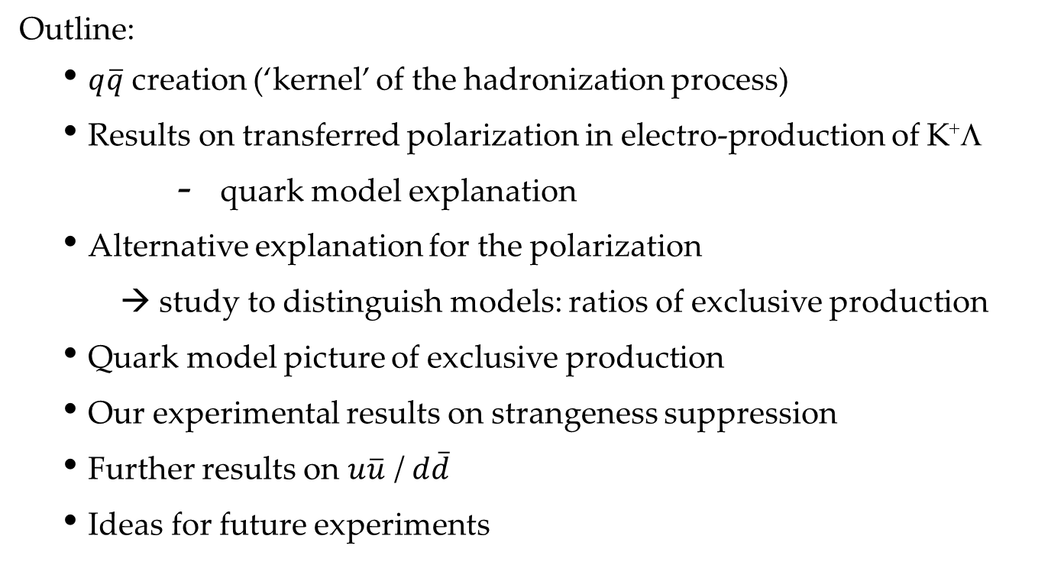
Understanding $q\overline{q}$ Creation
Outline:
  $q\overline{q}$ creation (‘kernel’ of the hadronization process)
  Results on transferred polarization in electro-production of K⁺Λ
      quark model explanation
  Alternative explanation for the polarization
    → study to distinguish models: ratios of exclusive production
  Quark model picture of exclusive production
  Our experimental results on strangeness suppression
  Further results on $u\overline{u}$ / $d\overline{d}$
  Ideas for future experiments

Slide 3
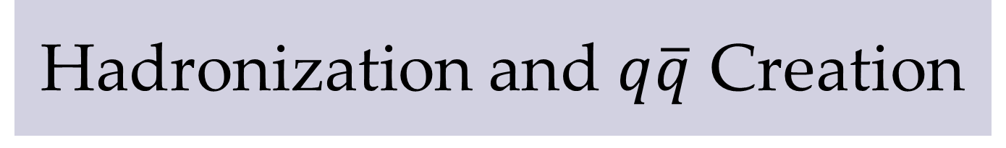




Hadronization and $q\overline{q}$ Creation
$$ud$$
e$ʹ$
flux tube
‘break’ flux-tube
$$u$$
e
$$uud$$
“the keys to a qualitative understanding of strong QCD are identifying the effective degrees of freedom …..
….. the effective degrees of freedom for strong QCD are valence constituent quarks and flux tubes.”
- Nathan Isgur, “Why N*’s are Important”, NSTAR2000 Conf.
Notes:
With the discovery of J/Psi and charmonium, it has been known that potential models
could reproduce the spectra by assuming a linear potential; that is a constant-force
linking the charm and anti-charm quarks. This can be envisioned as a physical tube
of chromo-electric energy, the “flux-tube”, with about 1 GeV of potential energy per fermi.
Nathan Isgur thought that this was the correct qualitative view of hadrons,
writing in a conference report that “ …
The picture on the right shows the basic idea of the LUND model of hadron production,
with q-qbar pairs shown as colored lines, grouping into outgoing q-qbar mesons.

Slide 4
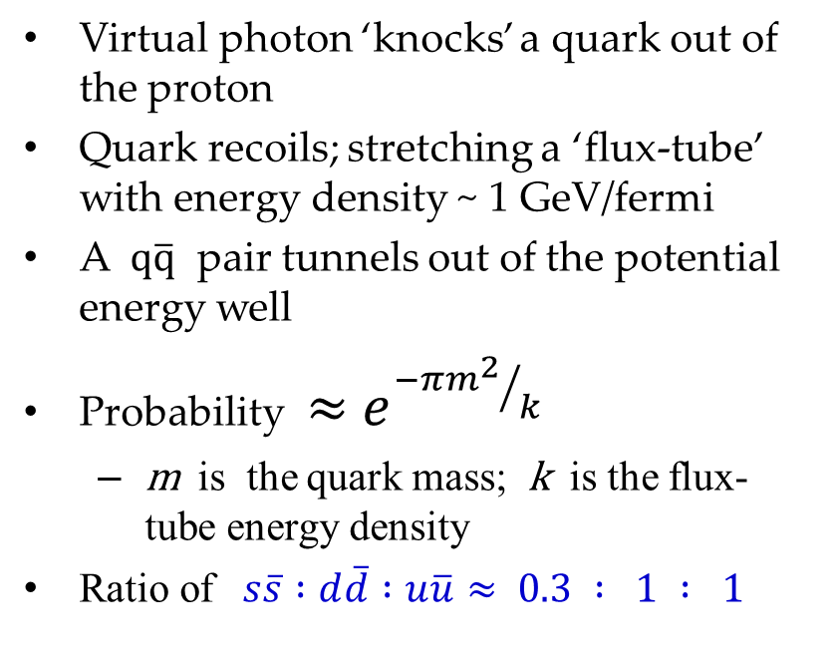
LUND Model of Hadronization
(for electro-production)
Virtual photon ‘knocks’ a quark out of the proton
Quark recoils; stretching a ‘flux-tube’ with energy density ~ 1 GeV/fermi
A $q\overline{q}$ pair tunnels out of the potential energy well
Probability $≈{ e}^{{−{πm}^{2}}/k}$
  m is the quark mass; k is the flux-tube energy density
Ratio of $s\overline{s} :d\overline{d} :u\overline{u}≈ 0.3 : 1 : 1$
Notes:
here’s a bare-bones explanation of the LUND model for electro-production,
as in Pythia, for example.

Slide 5
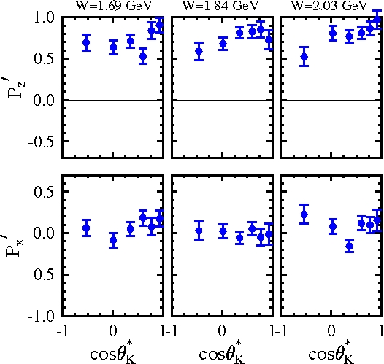
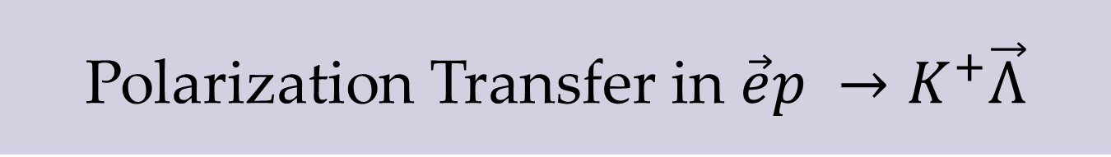
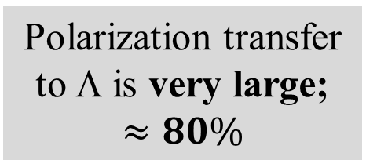
Polarization Transfer in $\vec{e}p →K^{+}\vec{Λ}$
Polarization transfer to Λ is very large;
$$≈80\%$$
Can quark spin dynamics explain this?
Phys.Rev.Lett. 90, 131804 (2003), D.S. Carman, K. Joo, mm, B.A. Raue et al., (CLAS Collab)
Notes:
Now I want to switch gears somewhat and show you the results of a CLAS
publication from 2003. Here we measured K+Lambda production from a polarized
electron beam. We found that about 80% of the polarization of the electron
(either + or – with respect to the beam direction) was transferred to the Lambda.
The connection with today’s talk is that we interpreted the results in terms of a
simple quark model.

Slide 6

Quark Spins*: Transferred Polarization
u-quark polarized
by photon’s spin:
helicity conserved
polarized
electron
g polarized
virtual photon
u
u
d
p
u
after absorption of
photon’s momentum
u
d
Λ polarization
in direction of γ
if s and s have
opposite spins !
K⁺
u
$$s\overline{s}$$
s spin selected
opposite u-quark’s
u
d
Λ
* Phys.Rev.D61, 117503,(2000), ZuoTang Liang, C.Boros

Slide 7
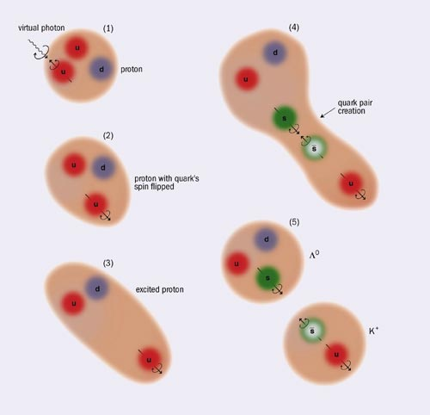
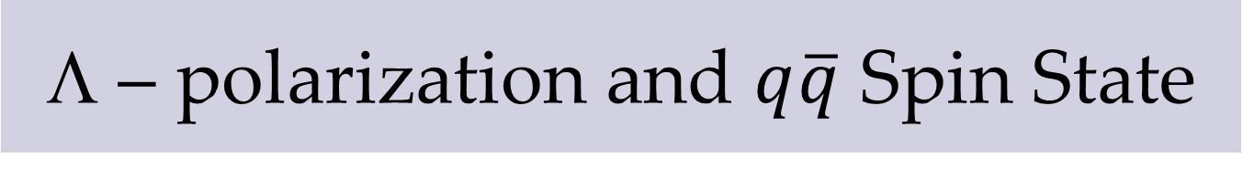
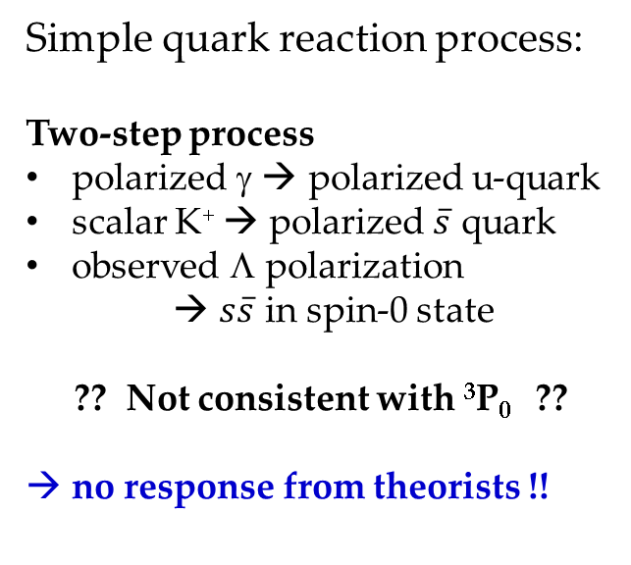
Λ – polarization and $q\overline{q}$ Spin State
Simple quark reaction process:
Two-step process
polarized γ → polarized u-quark
scalar K⁺ → polarized $\overline{s}$ quark
observed Λ polarization
→ $s\overline{s}$ in spin-0 state
?? Not consistent with ³P₀ ??
no response from theorists !!
“Jlab results put new spin on the vacuum”
CERN Courier, June, 2003
Notes:
We tried to advertise the fact that we were not consistent with 3P0, to goad
theorists into doing quark-model type calculations, but no response.
Recently I visited Bjorken and asked him why this was so –
Note that our interpretation of induced polarization leads to a
different conclusion about the spin correlation of the s and sbar, …

Slide 8
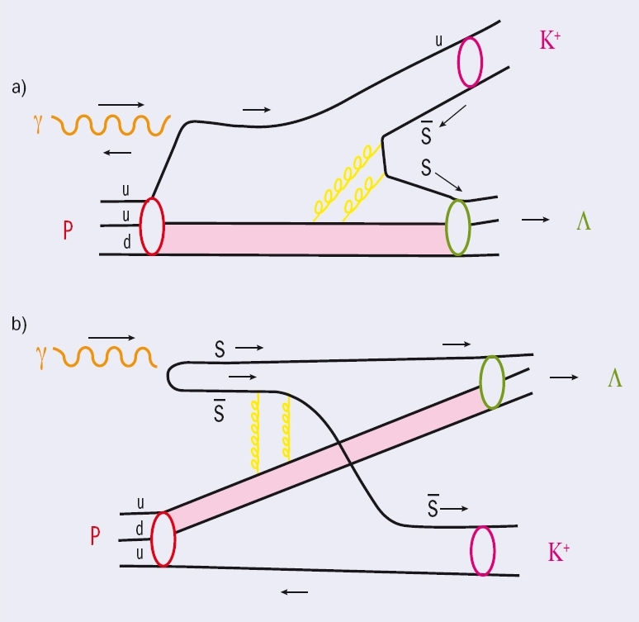
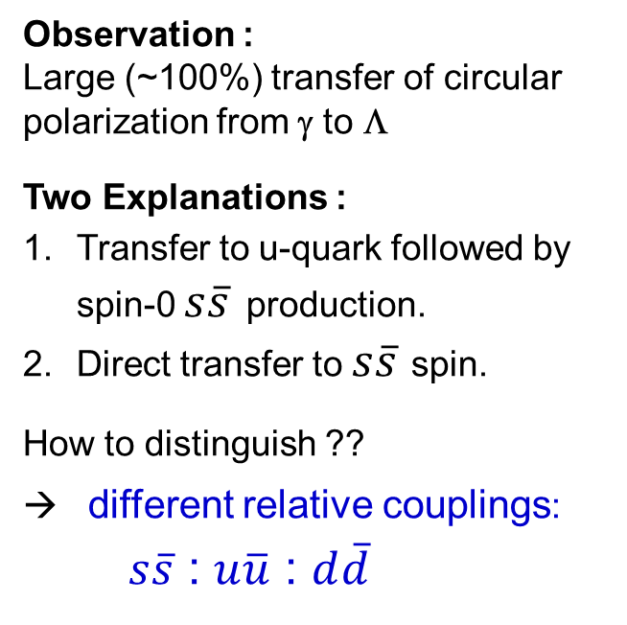
Polarization Transfer: Two Ideas*
Observation :
Large (~100%) transfer of circular polarization from γ to Λ
Two Explanations :
Transfer to u-quark followed by spin-0 $s\overline{s}$ production.
Direct transfer to $s\overline{s}$ spin.
How to distinguish ??
different relative couplings:
$s\overline{s}$ : $u\overline{u}$ : $d\overline{d}$
* “Polarized hyperons probe dynamics of quark spin”
CERN Courier, Aug. 2007- Carman, Lee, Schumacher, mm
Notes:
We kept up efforts to advertise the results; this time even enlisting
Harry Lee to help us. Dan and I advocated for our 2-step model, while
Reinhard took the view that the photon directly polarized the s and sbar.
Harry Lee didn’t take sides, but pointed out that in either case at least
two gluons were transferred.
I pondered how to distinguish our two models:
One idea was to change the meson from a scalar K+ to a vector K+*.
In mine and Dan’s model, the polarization would flip sign, but in
Reinhard’s model it would not.
We looked at the data but the combinatorial background looked too large.
It was then I noticed another difference between the two models …

Slide 9


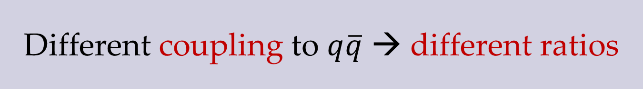










Different coupling to $q\overline{q}$ → different ratios
u
Λ
d
n
p
$$s$$
$$d$$
$$u$$
u
K⁺
$$\overline{s}$$
$$\overline{d}$$
π⁺
$$\overline{u}$$
π⁰
Photon Coupling: 0.25 0.25 1
u
Λ
n
p
d
$$d$$
$$s$$
$$u$$
$$\overline{s}$$
$$\overline{d}$$
$$\overline{u}$$
u
K⁺
π⁺
π⁰
Strong Coupling: 0.3 1 1
Notes:
… and that is that the different field coupling to the q-qbar current
would give different ratios for final states.
The key is that the photon field couples to charge-squared while
the strong coupling field couples to the effective mass (phenomenologically)

Slide 10






Exclusive Baryon Meson Production
- quark model picture
baryon
ud
$$q$$
meson
$$\overline{q}$$
$$q\overline{q}$$
Final State
eʹ
u
$$u\overline{u}$$
π⁰ p
$$d\overline{d}$$
π⁺ n
$$s\overline{s}$$
Κ⁺ Λ
e
uud
proton
Notes:
so, we planned to study the ratio of production of u-ubar, d-dbar
and s-sbar pairs. If the scattering were initiated by scattering off
a u-quark (which happens 8/9 of the time) these would result in
pi0-p, pi+ n or K+Lam if we consider only the ground-state baryon
and meson.
…. and so Kijun and I set off with high hopes …

Slide 11
Analysis in brief: (e1f data)
Detect electron and charged hadron (π⁺, p, or K⁺)
Bin each event: Q², W, cosθ, φ
Identify neutral hadron (n, π⁰ or Λ) by missing mass
  fit (sig. + bkgd.), subtract bkgd., count within cuts
Corrections to yield
  efficiency/acceptance, phase-space
Fit corrected φ distribution: ( a + b cosφ + c cos2φ )
Ratio of constant terms: K⁺Λ/π⁺n, π⁰p/π⁺n, K⁺Λ/π⁰p
Notes:
Here’s how we did the analysis

Slide 12
Fits to Κ⁺ Λ Corrected Yields
2.4
2.4
2.0
1.9
1.8
1.7
Example of φ-fits for K⁺Λ yields
Constant term used as the average
→ ratio of constant terms
W
-0.8 -0.4 0.0 0.4 0.8
cosθ
Notes:
Here’s a picture of the data showing 360 acceptance and phase-space corrected
yields of K+ Lambda. Each sub-plot (at constant W and costheta and qsq) was fit to
a + b cosphi + c cosphi**2 and we formed the ratios of the constant “a” terms

Slide 13
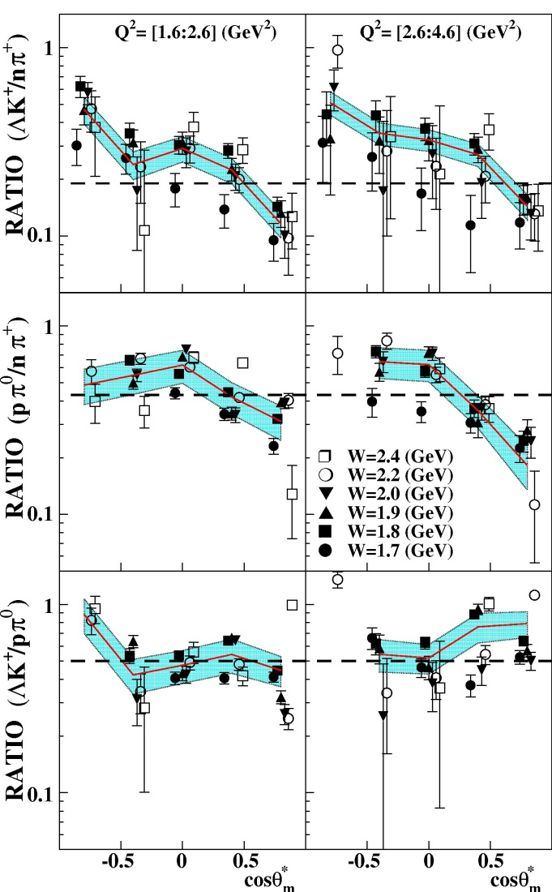
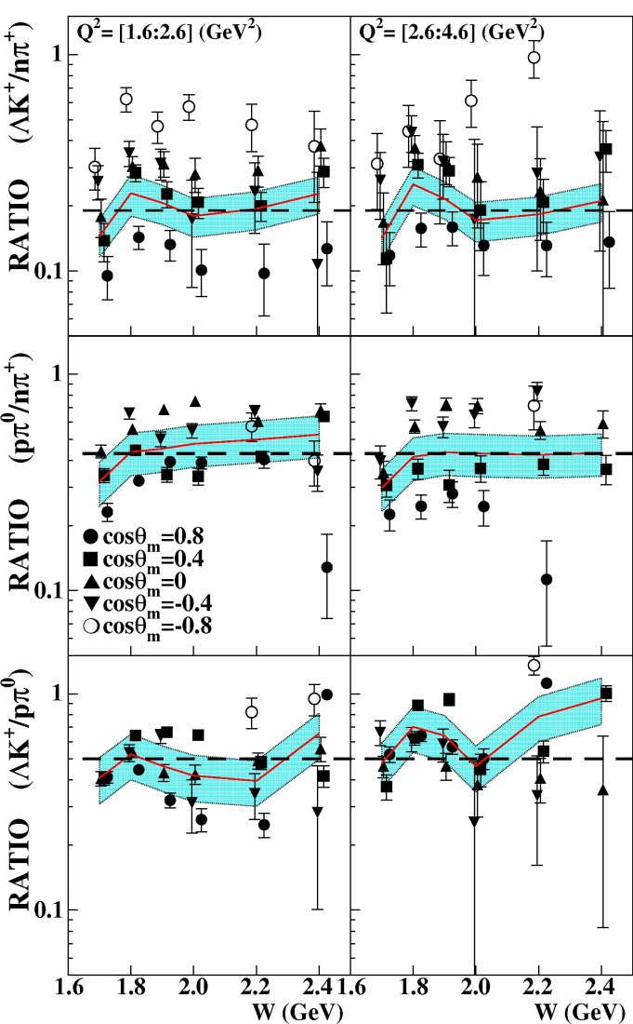
Published Cross Section Ratios
weighted
averages
K⁺Λ/π⁺n
.19
+/- .03
.43
+/- .09
π⁰p/π⁺n
K⁺Λ/π⁰p
.50 +/- .12
cosθ
W
Notes:
and here are those ratios of the corrected yields.
The left-hand plots are versus costheta, r.h. vs. W
The left-most sub-plot is low qsq, right-most high qsq
No apparent significant qsq or W dependence.
There is a noticeable costheta dependence for the
top two ratios (with denominator pi+ n).
For purposes of comparing with the single suppression
factor s-sbar/q-qbar we determined the over-all weighted average
which we show as a dotted line.

Slide 14
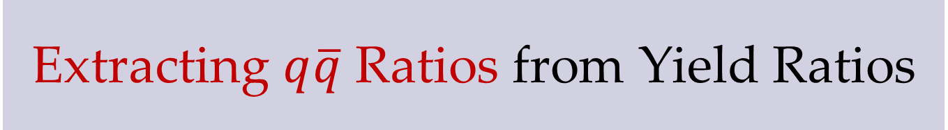
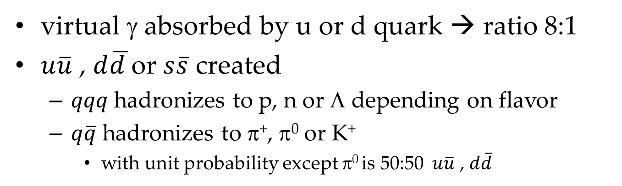
Extracting $q\overline{q}$ Ratios from Yield Ratios
virtual γ absorbed by u or d quark → ratio 8:1
$u\overline{u}$ , $d\overline{d }$or $s\overline{s}$ created
  $qqq$ hadronizes to p, n or Λ depending on flavor
  $q\overline{q}$ hadronizes to π⁺, π⁰ or K⁺
    with unit probability except π⁰ is 50:50 $u\overline{u}$ , $d\overline{d}$
strangeness suppression
Ratio | $s\overline{s} /$ $d\overline{d }$ | $u\overline{u} /$ $d\overline{d }$
K⁺Λ/π⁺n | $$0.19 ±0.03$$ | -
K⁺Λ/π⁰p “a” | $$0.22 ±0.07$$ | -
K⁺Λ/π⁰p “b” | $$0.28 ±0.07$$ | -
π⁰p/π⁺n | - | $$0.74 ±0.18$$
not photon
coupling; but
not exactly 1
$u\overline{u}/d\overline{d}$ = 0.74 for case “a” and 1.0 for case “b”
Notes:
We converted our hadronic ratios into qqbar ratios with a simple algorithm.
1- we assumed that the event started with a struck u or d quark in the ratio 8:1
2- a qqbar was created
3- the qqq state hadronizes into the lowest mass baryon with same flavor
4- the qqbar state hadronizes into the lowest mass meson with same flavor, except we
took into acccount that a pi0 wavefunction is 50:50 uubar, ddbar
our results table is shown here;
-strangeness suppression was observed at the .2 - .3 level, consistent with high energy
u-ubar/d-dbar was far from value of 4 expected from Reinhard’s model, but it was
not exactly 1 either

Slide 15
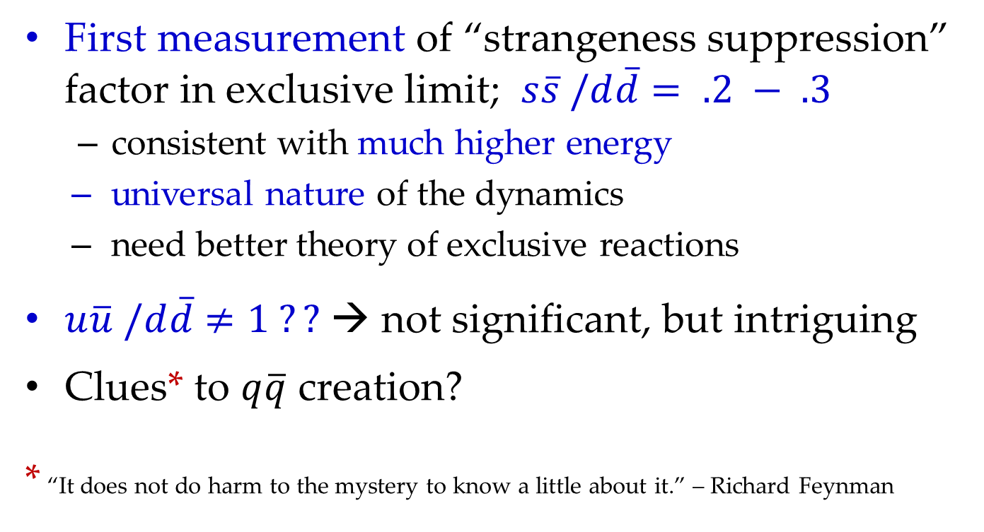
PRL Conclusions
First measurement of “strangeness suppression” factor in exclusive limit; $s\overline{s} /d\overline{d}$ $= .2 − .3$
  consistent with much higher energy
  universal nature of the dynamics
  need better theory of exclusive reactions
$u\overline{u} /d\overline{d}$ $≠1 ??$ → not significant, but intriguing
Clues* to $q\overline{q}$ creation?
* “It does not do harm to the mystery to know a little about it.” – Richard Feynman
Notes:
These were our physics conclusions …
-we observed strangeness suppression in exclusive reactions consistent
in strength with the fitted values for very high energy
we stated that this finding argued strongly for the universal nature of
qqbar creation
we pointed out the need for better theory
and, regarding the uubar/ddbar ratio, we said it was not significant, but intriguing
and still a mystery
To quote Richard Feynman, “

Slide 16
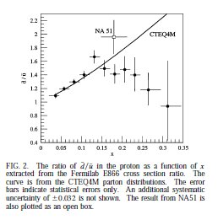
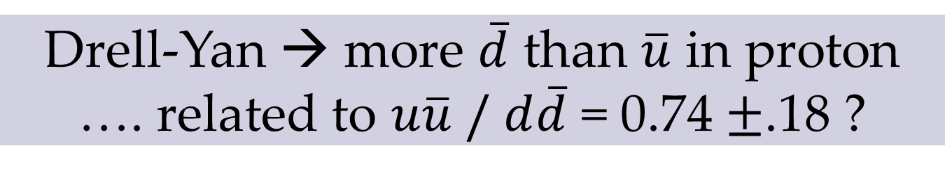
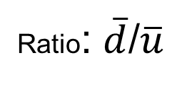
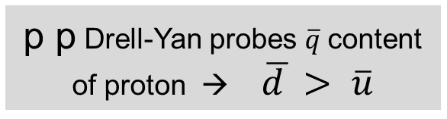
Drell-Yan → more $\overline{d}$ than $\overline{u}$ in proton
…. related to $u\overline{u} /$ $d\overline{d}$ = 0.74 $±$.18 ?
Ratio: $\overline{d}$/$\overline{u}$
p p Drell-Yan probes $\overline{q}$content of proton → $\overline{d }> \overline{u}$
X
E.A. Hawker et al., Phys. Rev. Lett. 80, 3715 (1998).
Notes:
Here are the Drell-Yan results that we said might be
related to our non-unity value for uubar/ddbar;
from a Fermilab expt. published in ‘98 where they measured more
dbars than ubars in the proton

Slide 17



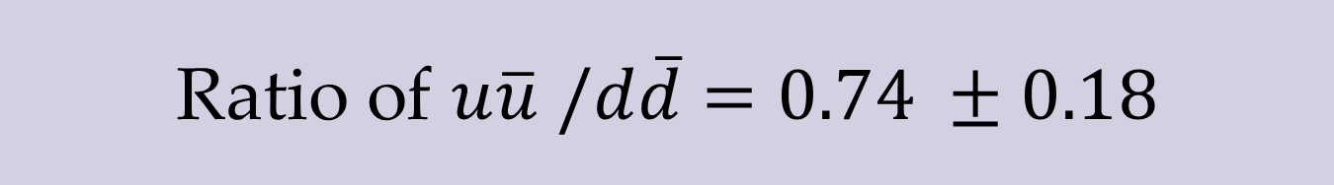





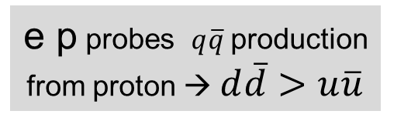





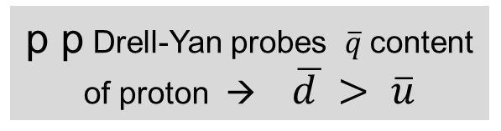



Ratio of $u\overline{u} /d\overline{d}$ $=0.74 ±0.18$
μ⁺
e’
μ⁻
e
$$u$$
$$u$$
$$u$$
$$u$$
$$u$$
$$d$$
$$d$$
$$\overline{u}$$
$$\overline{u}$$
$$u$$
$$u$$
$$u$$
$$u$$
$$u$$
$$d$$
$$d$$
p p Drell-Yan probes $\overline{q}$content of proton → $\overline{d }> \overline{u}$
related ?
e p probes $q\overline{q}$production from proton → $d\overline{d}>u\overline{u}$
Notes:
Here’s a diagram of the two processes;
although not quite strict crossing symmetry, still the similarities
are interesting. Could they be related? and could further studies
shed more light on the mystery.

Slide 18
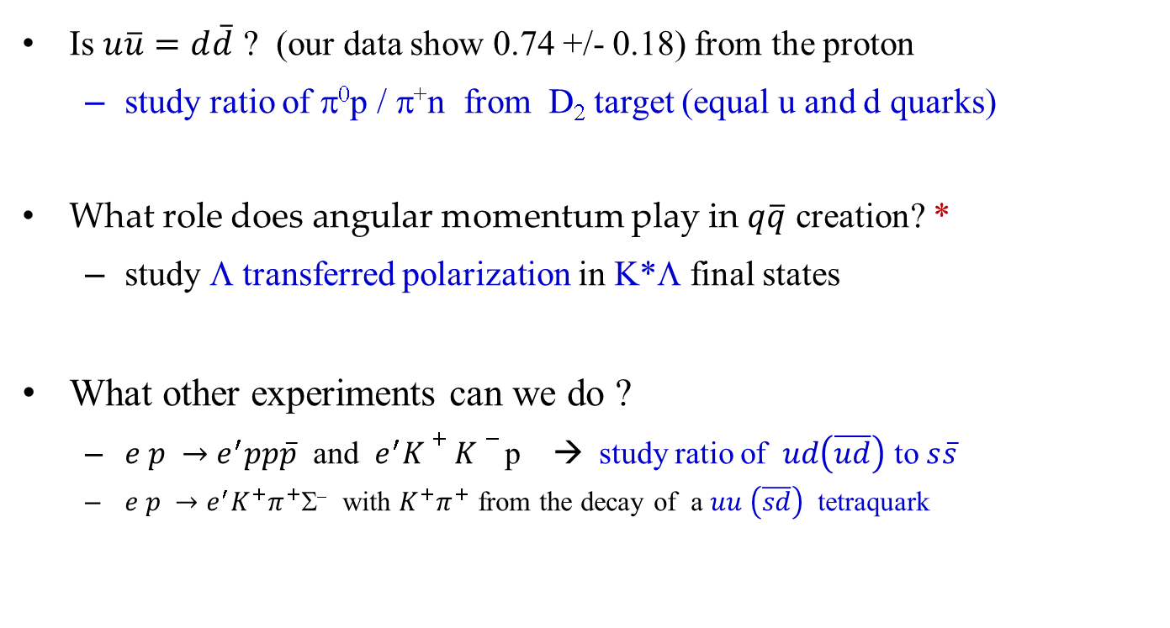
Future Studies
Is $u\overline{u}=d\overline{d}$ ? (our data show 0.74 +/- 0.18) from the proton
  study ratio of π⁰p / π⁺n from D₂ target (equal u and d quarks)
What role does angular momentum play in $q\overline{q}$ creation? *
  study Λ transferred polarization in K*Λ final states
What other experiments can we do ?
  $e p →e^{′}pp\overline{p}$ and $e^{′}K+K−$ p → study ratio of $ud\left(\overline{ud}\right)$ to $s\overline{s}$
  $e p →e^{′}K^{+}π^{+}$Σ⁻ with $K^{+}π^{+}$ from the decay of a $uu \left(\overline{sd}\right)$ tetraquark
* “On the mechanism of open-flavor strong decays”, Phys. Rev. D 54, 6811 (1996),
E. S. Ackleh, T. Barnes, E. S. Swanson

Slide 19
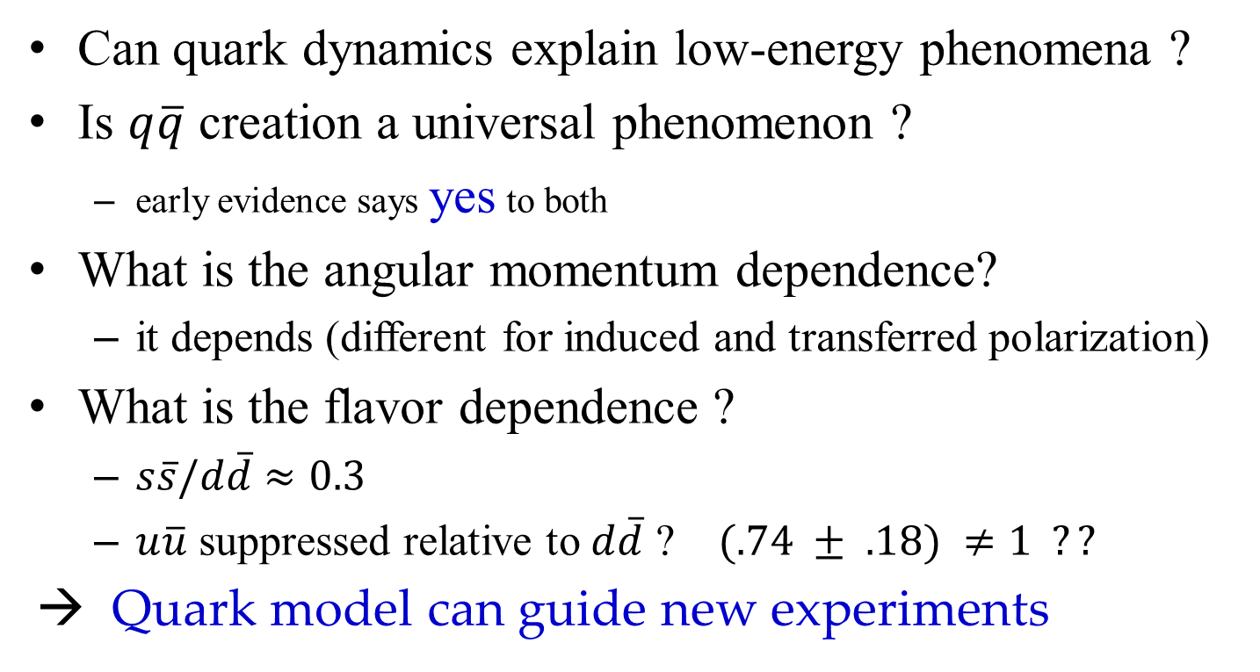
Conclusions
Can quark dynamics explain low-energy phenomena ?
Is $q\overline{q}$ creation a universal phenomenon ?
  early evidence says yes to both
What is the angular momentum dependence?
  it depends (different for induced and transferred polarization)
What is the flavor dependence ?
  $s\overline{s}/d\overline{d}$ $≈0.3$
  $u\overline{u}$ suppressed relative to $d\overline{d}$ ? $(.74 ± .18) ≠1 ??$
→ Quark model can guide new experiments
Notes:
Can quark dynamics explain low-energy phenomena?
is qqbar creation a universal phenomenon?
our evidence says yes
It is certainly true that a quark model picture can guide new
experiments and I look forward to talking to whoever might be interested
in some of the ideas that I touched upon.
Thanks for the opportunity to talk about quark-antiquark creation!

Slide 20
Back-Up Slides

Slide 21
Λ Polarization
Transfer
xyz system
  defined in electron plane
  z along γ direction
Polarization transfer
  near maximal along z
  ~ 75%
  ~0 along x direction
Models are only “ok”
  but, not tuned
  sensitive to polarization
Carman et al,
PRL90. 131804
(2003)
Simpler in quark picture ?

Slide 22
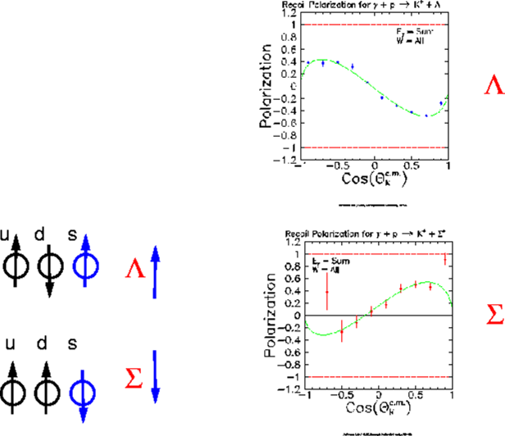
Induced Λ,Σ⁰ Polarization
averaged over W
Pol(Λ) ~ -Pol (Σ⁰)
common mechanism ?
s-quark polarization ?
u d s
Λ
Σ⁰
u d s
J.W. McNabb
thesis, CMU

Slide 23
Hyperon Induced Polarization
unpolarized
real photon
p
u
u
d
Simple Phenomenology
Λ pol. ~ -n , fwd. kaons
Λ pol. ~ +n, bck. kaons
n = q x K
for forward kaons:
  “K goes left”
  g “Λ polarized down”
  “K goes right”
  g “Λ polarized up”
K
Λ
left
Λ
right
K

Slide 24
Quark Spins in Induced Polarization
unpolarized
real photon
u-quark polarized
by spin-orbit force
“right-scatter”
g “spin-down”
u
u
d
p
after absorption of
photon’s momentum
(helicity conservation)
u
u
d
Λ polarization
“down” for K going “left”
if s and s have
same spins!
K⁺
u
s
s
s spin selected
opposite u-quark’s
u
d
Λ

Slide 25
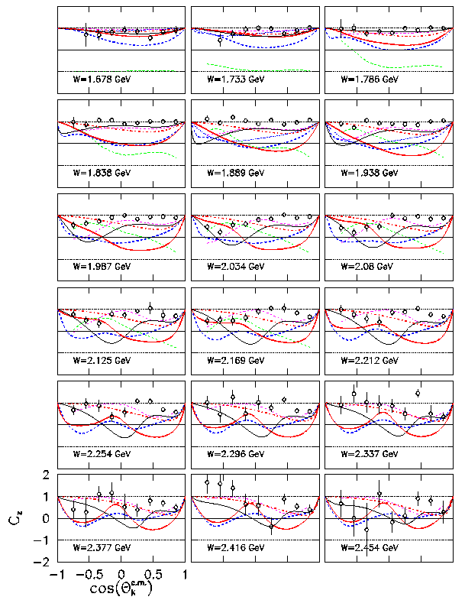
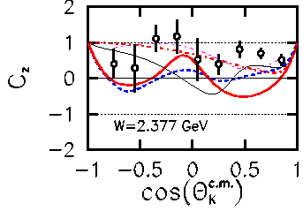
Recent results on
polarization transfer
with circularly polarized
photons:
γ p g K⁺ Λ
1
C_{z} plotted vs. cosθ
different W bins
C_{z} is large except
at highest W

Slide 26
Λ Polarization
Transfer
e’
unpolarized
p
Simple
Phenomenology
e
K⁺
Λ polarized ~ γ direction
  for all K⁺ angles
  for all W
-or-
Λ
Λ
K⁺

Slide 27
Quark model → physics conclusion
Though important, this result on its own would likely be insufficient to merit publication in Physical Review Letters, as theoretical study of the new data is needed to reach specific conclusions. However the authors have done an excellent job of highlighting a second, more qualitative result of their spin-transfer data. They have observed that the longitudinal polarization …………….This conclusion is
made in the context of the flux-tube model of the reaction and is somewhat
dependent on the details of the Lambda spin structure, but provides a persuasive explanation of the simple structure of the polarization data. I believe it is of sufficient general interest to merit publication in PRL.
The authors use a simple non-relativistic quark model to deduce that the s-sbar pair are created with spins anti-aligned, in disagreement with the standard 3P_0 operator used in most calculations. Although the model is very simple, and the authors are careful to point out that it could be in error, I believe that their results must have significant implications for quark pair production, and should provide guidance for theory.
Notes:
The PRL referees approved it for publication despite having no theory
to back up specific conclusions because we had a simple quark model
explanation that provided a persuasive explanation.

Slide 28
Lambda Polarization from other Experiments
LEP experiments (ALEPH and OPAL): Z decay
  Λ polarization = -0.3 for z>0.3
  s quark polarized in electro-weak decay
  fully accounts for Λ polarization
  a static (CQM) quark model favored
HERMES semi-inclusive Λ production
  small value of polarization (~ 0.1)
  a inconclusive
  a exclusive polarizations larger than inclusive
PP a Λ (x) (CERN R608, several FERMILAB expts.)
  polarization negative; increases with P_{T} to 1. GeV/c
  increases with X_{F}; as large as -0.40
PP a Λ K⁺ P (CERN R608)
  polarization negative; as large as -0.64
  a exclusive polarizations larger than for inclusive reactions
Phys. Lett. B
374 (1996) 319
Eur. Phys. J. C
2 (1998) 49
Phys. Rev. D
64 (2001) 11205
Phys. Lett. B
185 (1987) 209
Phys. Lett. B
283 (1992) 155

Slide 29
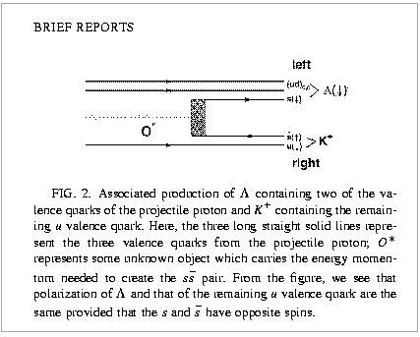
Model for Λ Polarization in Exclusive Production
p p g p Λ K⁺
(ud)₀
s (i)
Λ
p
s(h)
u(i)
K⁺
Figure and caption from Liang and Boros, Phys.Rev.D61, 117503, 2000.
Authors make three points:
u-quark is polarized “down” as it scatters “right”
  phenomenology explains single-spin asymmetry data
spin of s-quark is opposite that of u-quark to make spin-0 K⁺
spin of s-quark must be opposite that of s to predict correct Λ spin.

Slide 30
Quark Spins: Transferred Polarization
u-quark polarized
by photon’s spin:
helicity conserved
polarized
electron
g polarized
virtual photon
u
u
d
p
u
after absorption of
photon’s momentum
u
d
Λ polarization
in direction of γ
if s and s have
opposite spins !
K⁺
u
s
s
s spin selected
opposite u-quark’s
u
d
Λ

Slide 31
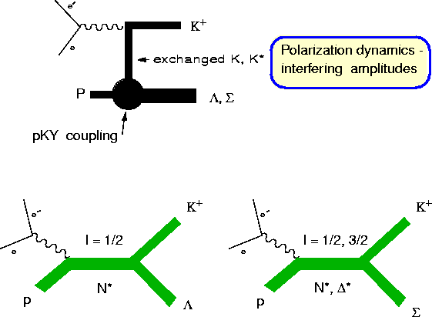
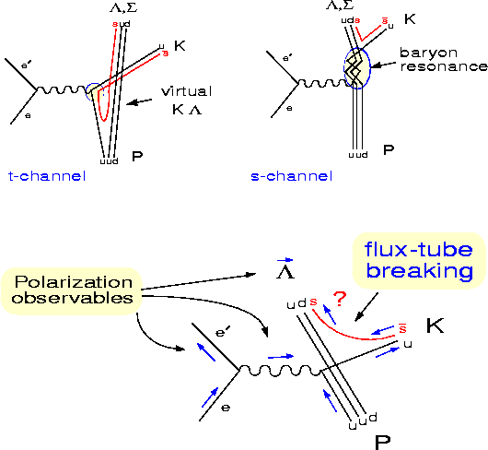
How to describe exclusive production ? hadrons or quarks ?
Currents are constituent quarks
Not “elementary” either !
Successes in meson decays; not
as much work on production
Currents are mesons, baryons
Not “elementary”
Mature field; but many parameters

Slide 32
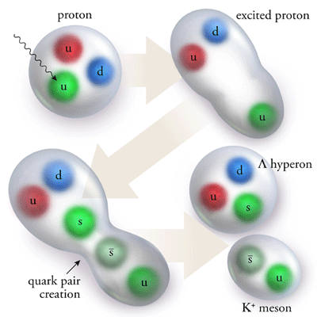
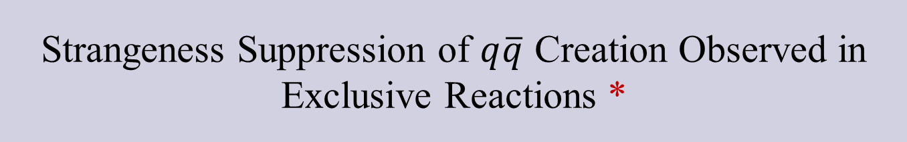
Strangeness Suppression of $q\overline{q}$ Creation Observed in Exclusive Reactions *
PRL Editors' Suggestion
“Strange quark–anti-quark pairs are less likely to be produced in hadronic collisions than their light quark counterparts, providing insight into color confinement in QCD.”
* M.D. Mestayer, K. Park et al. (CLAS Collaboration) Phys. Rev. Lett. 113, 15204 (2014). Published 10 October 2014 Illustration by Kandice Carter, Joanna Korolyshyn.
Notes:
… and so PRL published us with an editor’s suggestion indicating that it is
interesting outside of nuclear physics
I want to give thanks to Kandice Carter and Joanna Korolyshyn for the great illustration.

