Slide 1
Baryon Spectroscopy from JLab
D. G. Ireland

Slide 2
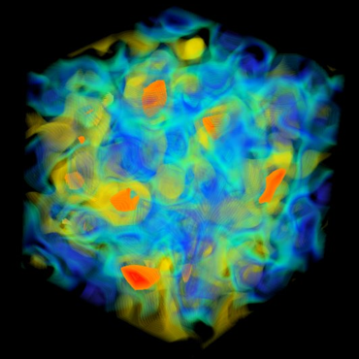

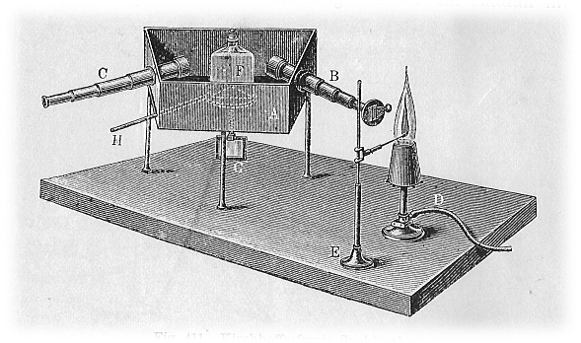
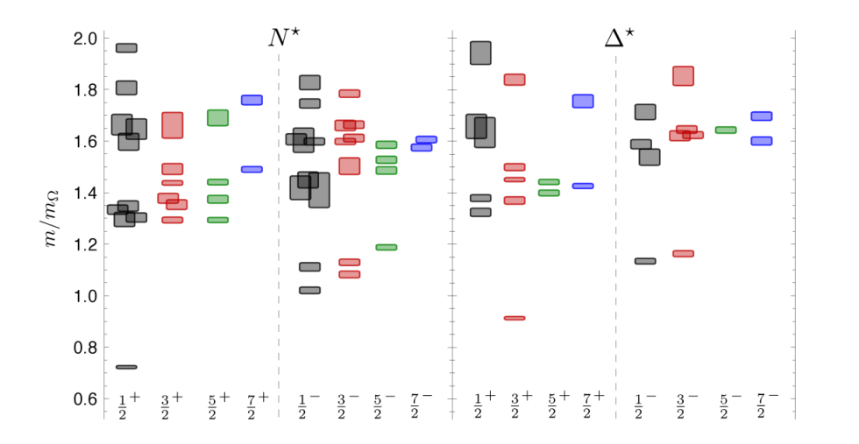
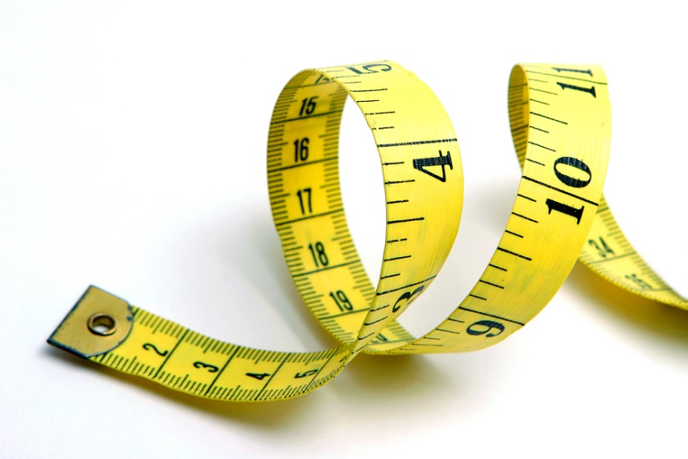
Our Task
manifests itself in
Reactions
Nature (QCD)
are accessible to
help us understand
Measurements
Theories
inspire

Slide 3
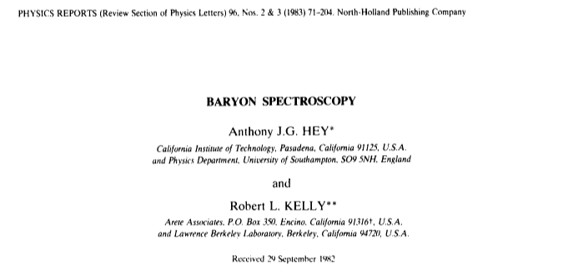
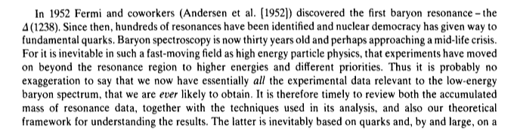

Slide 4
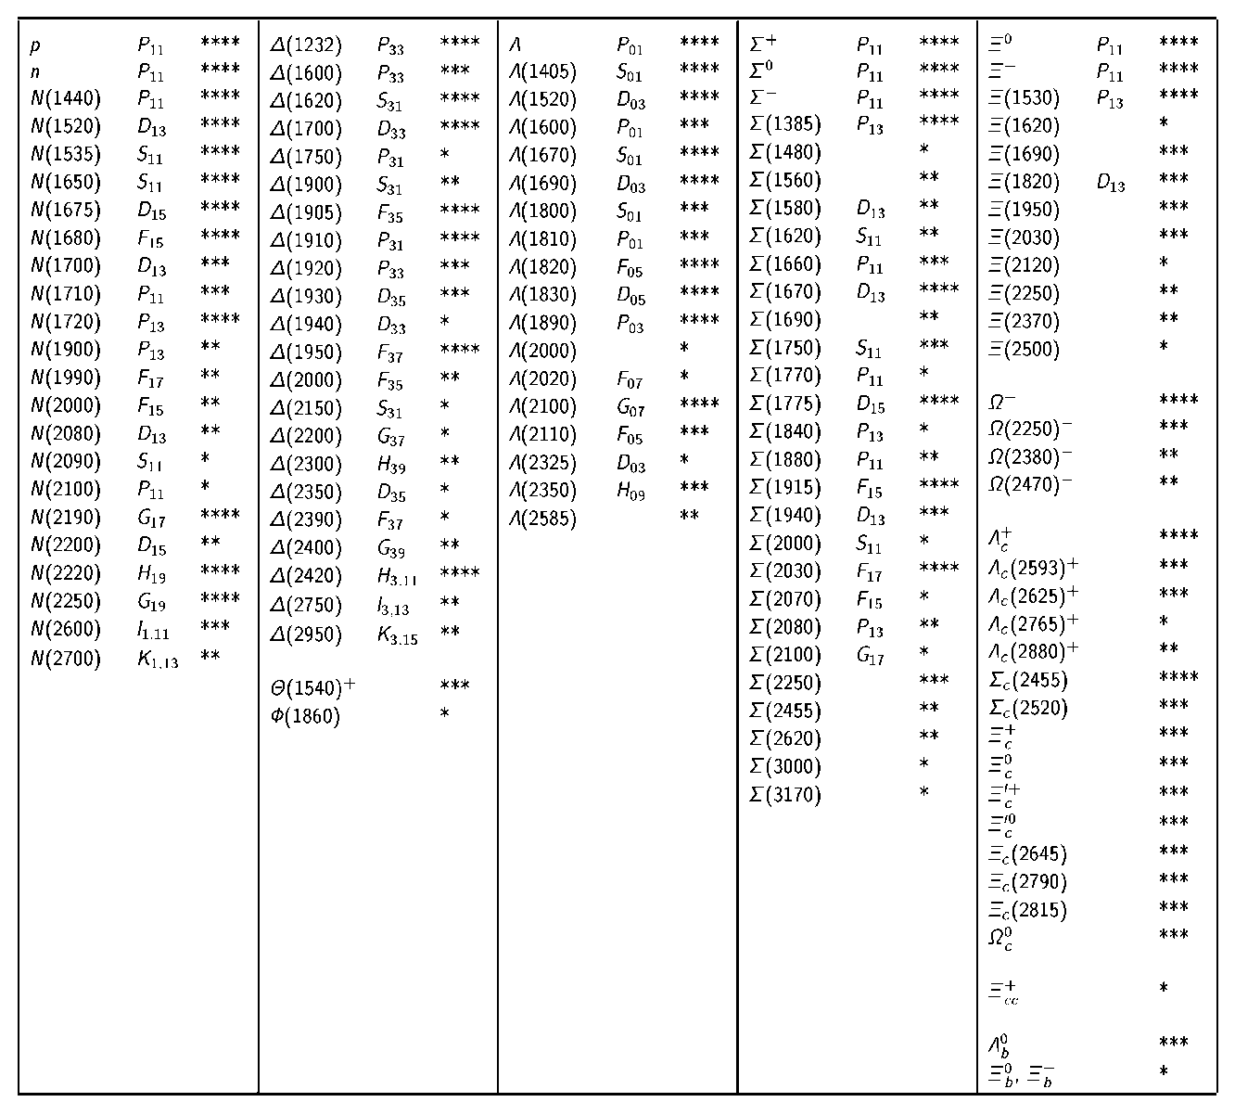
Baryon Summary Table (PDG 2004)
Number of 3- and 4-star
Resonances
Baryon | 2004
N* | 15
Δ | 10
Λ | 14
Σ | 12
Ξ | 7
Ω | 2
other | 14

Slide 5
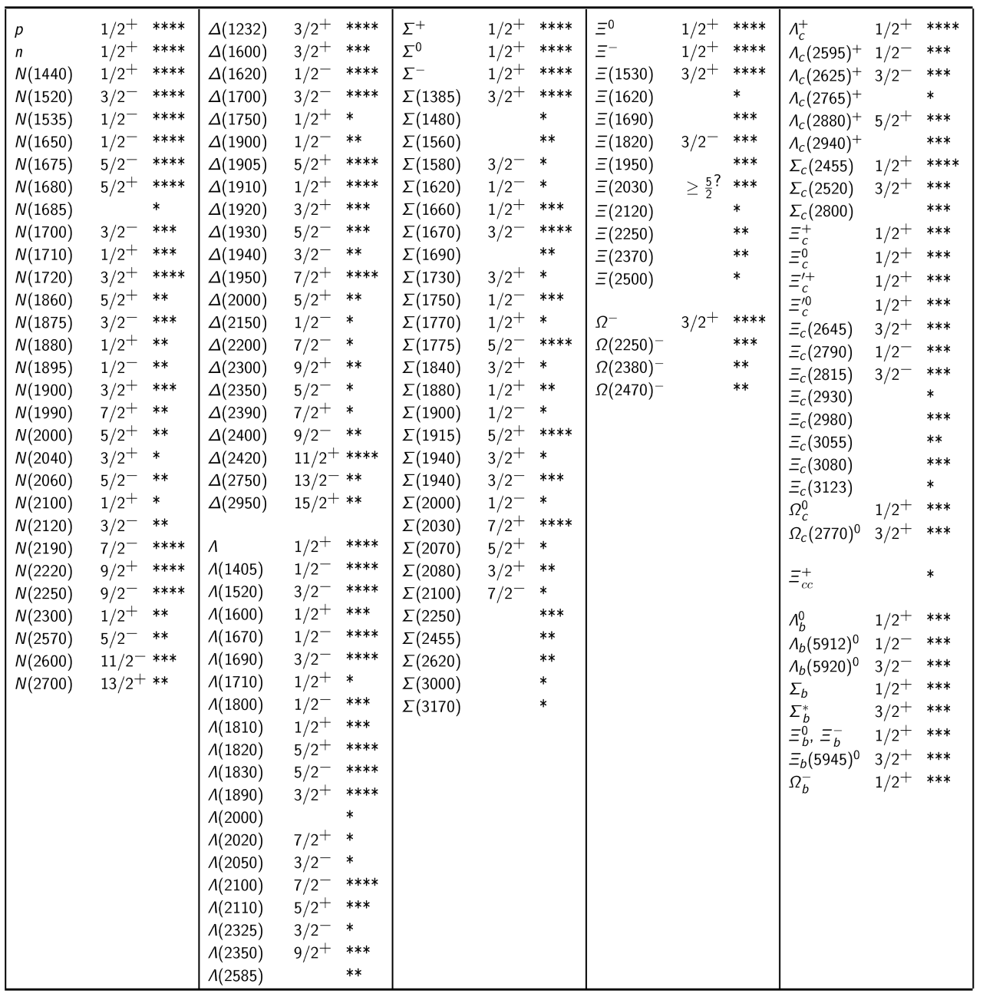
Baryon Summary Table (PDG 2014)
Number of 3- and 4-star
Resonances
Baryon | 2004 | 2014
N* | 15 | 17
Δ | 10 | 10
Λ | 14 | 14
Σ | 12 | 12
Ξ | 7 | 9
Ω | 2 | 2
other | 14 | 27

Slide 6
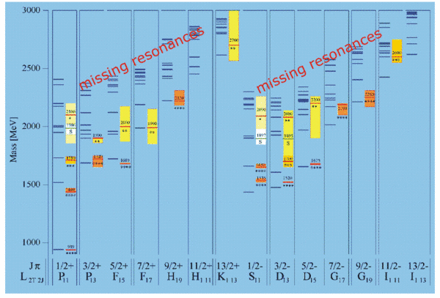
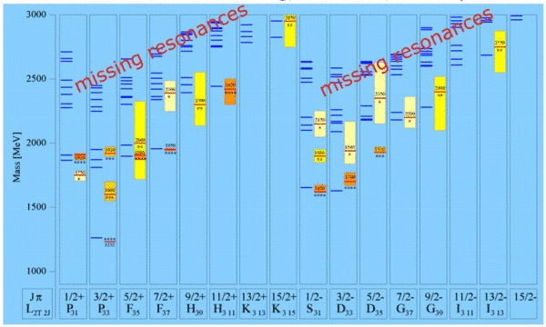

But...
Quark Model N* Resonances
Quark Model Δ* Resonances
Lattice QCD

Slide 7
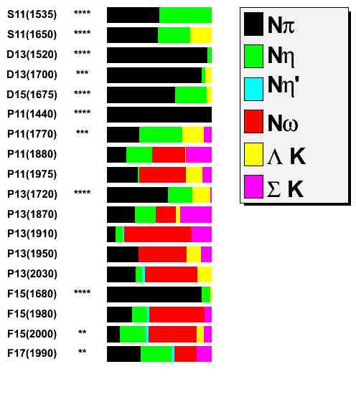
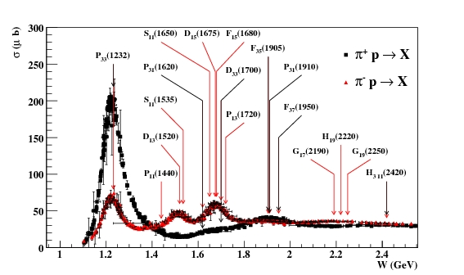
Resonance Hunting…
Total Cross-sections
+ differential cross-sections
+ Partial Wave Analysis + ...
Mostly done with πN scattering
Missing resonances may decay through other channels

Slide 8
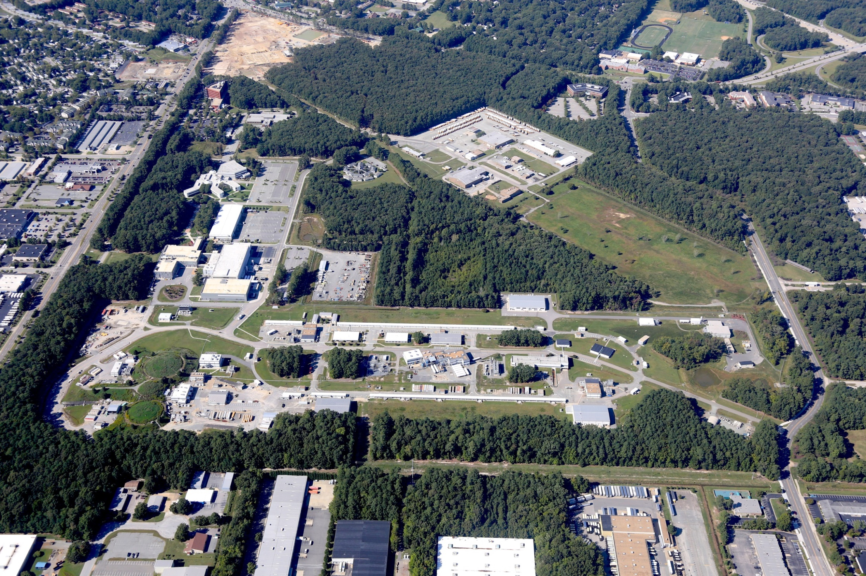

Jefferson Lab

Slide 9

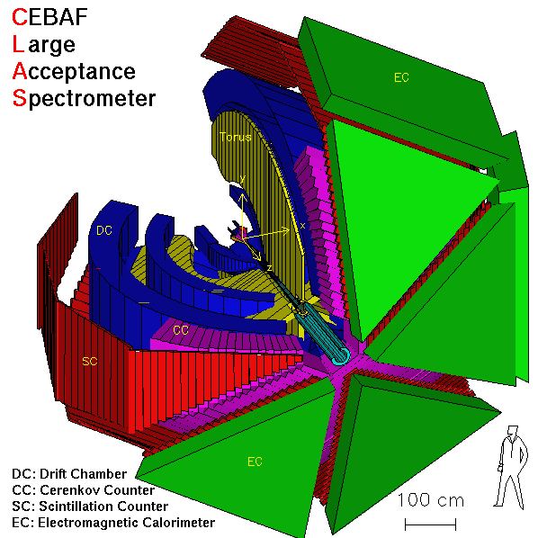

Slide 10
N* photoproduction program at CLAS
 | σ | Σ | T | P | E | F | G | H | T_{x} | T_{z} | L_{x} | L_{z} | O_{x} | O_{z} | C_{x} | C_{z}
pπ⁰ | ✔ | ✓ | ✓ |  | ✓ | ✓ | ✓ | ✓
nπ⁺ | ✔ | ✓ | ✓ |  | ✓ | ✓ | ✓ | ✓
pη | ✔ | ✓ | ✓ |  | ✓ | ✓ | ✓ | ✓
pη’ | ✔ | ✓ | ✓ |  | ✓ | ✓ | ✓ | ✓
pω/φ | ✔ | ✓ | ✓ |  | ✓ | ✓ | ✓ | ✓
Νππ | ✓ | ✓
K⁺Λ | ✔ | ✓ | ✓ | ✔ | ✓ | ✓ | ✓ | ✓ | ✓ | ✓ | ✓ | ✓ | ✓ | ✓ | ✔ | ✔
K⁺Σ⁰ | ✔ | ✓ | ✓ | ✔ | ✓ | ✓ | ✓ | ✓ | ✓ | ✓ | ✓ | ✓ | ✓ | ✓ | ✔ | ✔
K^{0*}Σ⁺ | ✔ | ✓ |  |  |  |  |  |  |  |  | ✓ | ✓
K^{+*}Σ⁰ | ✔ | ✓
pπ⁻ | ✔ | ✓ |  |  | ✓ | ✓ | ✓
pρ⁻ | ✓ | ✓ |  |  | ✓ | ✓ | ✓
K⁻Σ⁺ | ✓ | ✓ |  |  | ✓ | ✓ | ✓
K⁰Λ | ✓ | ✓ |  | ✓ | ✓ | ✓ | ✓ |  |  |  | ✓ | ✓ | ✓ | ✓ | ✓ | ✓
K⁰Σ⁰ | ✓ | ✓ |  | ✓ | ✓ | ✓ | ✓ |  |  |  | ✓ | ✓ | ✓ | ✓ | ✓ | ✓
K^{0*}Σ⁰ | ✓ | ✓
Proton targets
Data taking completed May 18, 2012
✔-published, ✔-acquired
Neutron targets

Slide 11
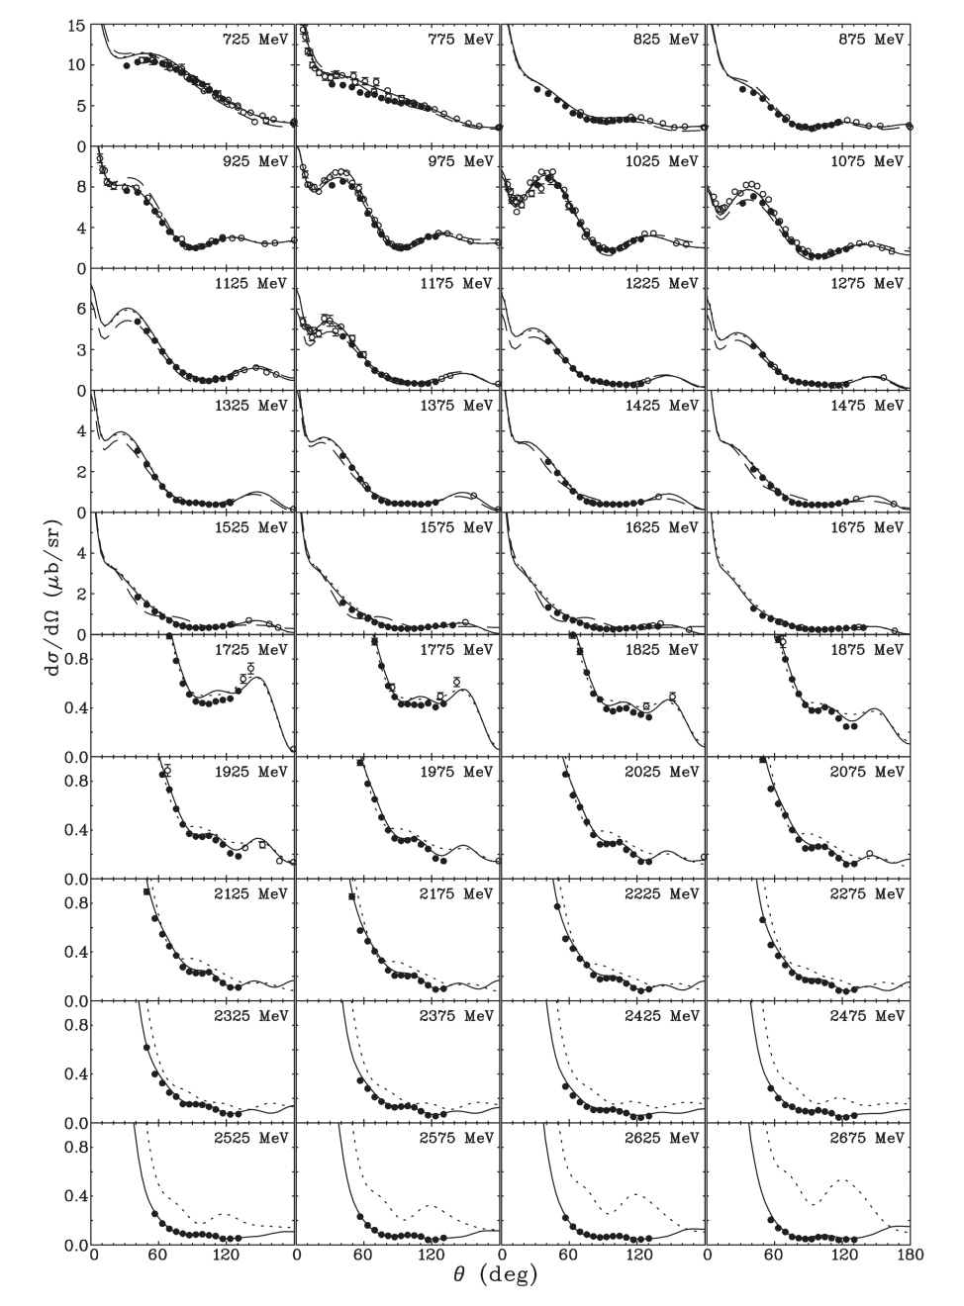
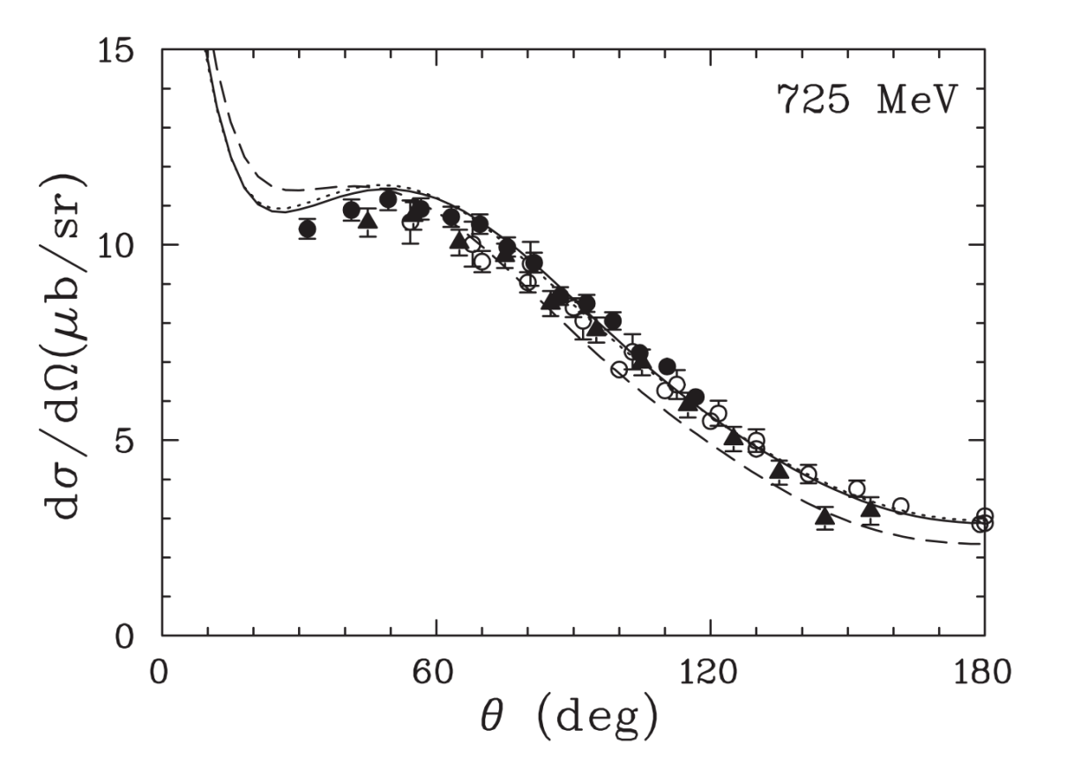
Channel: $γ+p→π^{+}+n$;Cross-section
M. Dugger et al. (CLAS), Phys. Rev. C 79, 065206, 2009

Slide 12
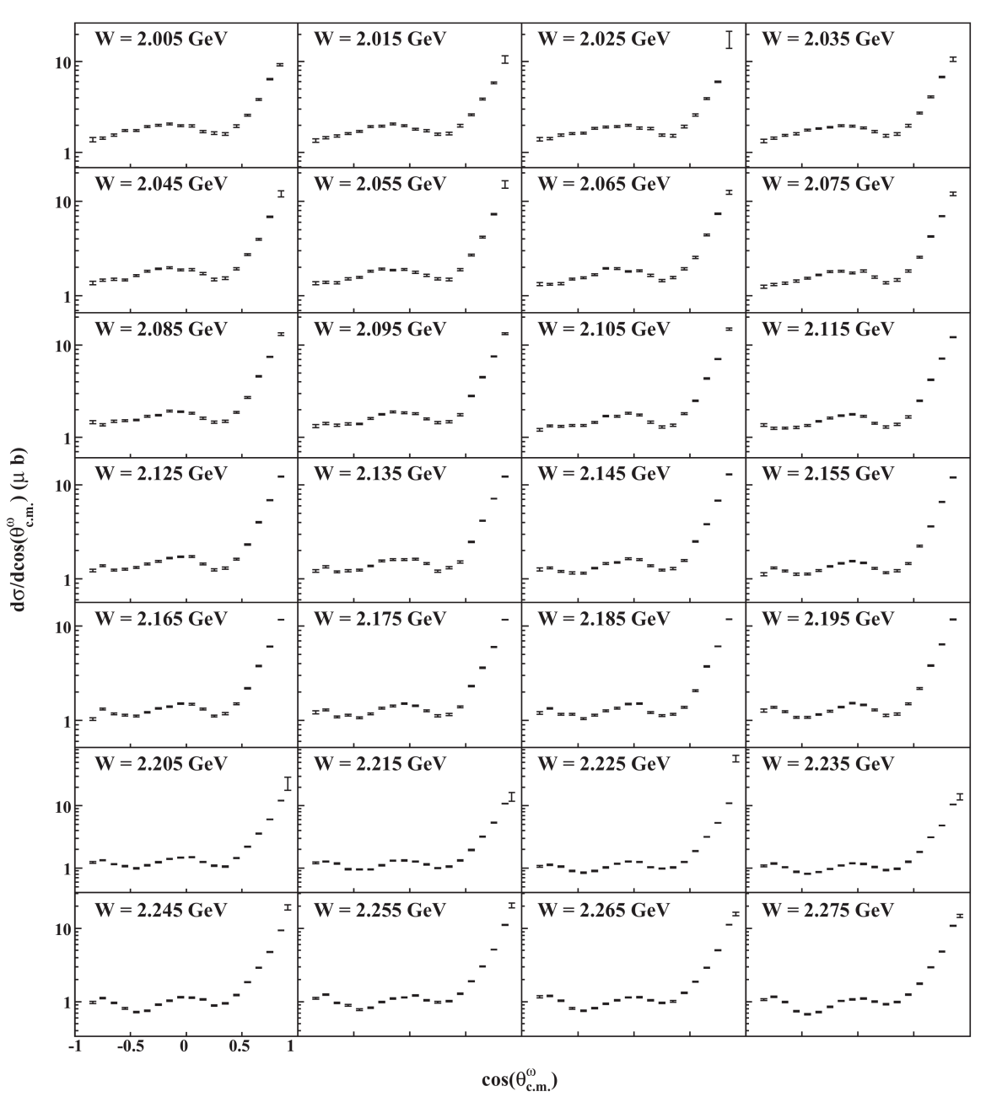
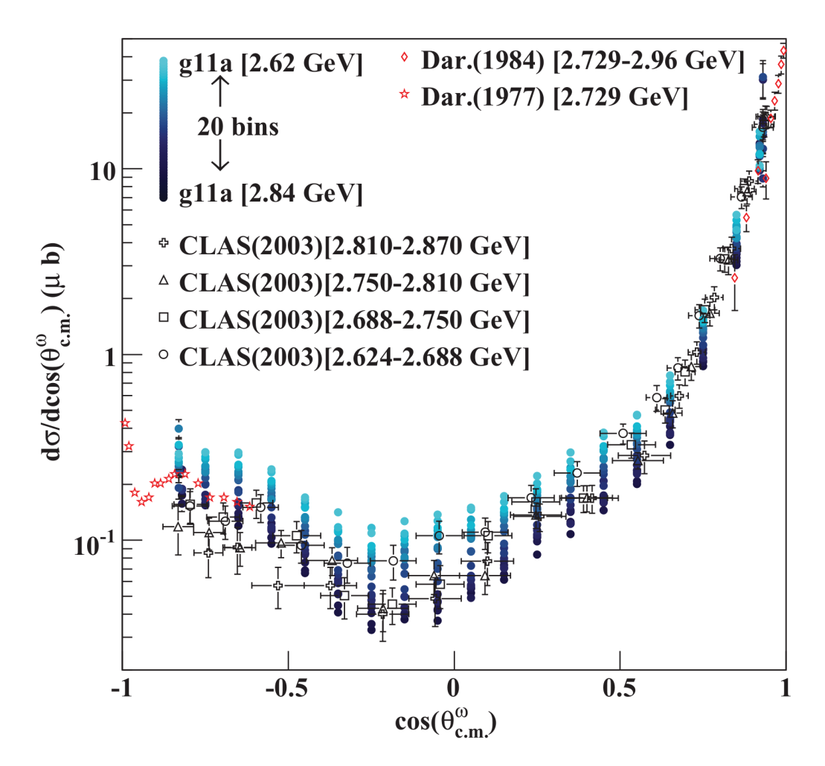
Channel: $γ+p→ω+p$;Cross-section
M. Williams et al. (CLAS), Phys. Rev. C 80, 065208, 2009

Slide 13
CLAS results γp→K⁺Λ → K⁺pπ⁻
Bonn-Gatchina Coupled Channel Analysis, A.V. Anisovich et al, EPJ A48, 15 (2012)
(Includes nearly all new photoproduction data)
M. McCracken et al. (CLAS), Phys. Rev. C 81, 025201, 2010

Slide 14
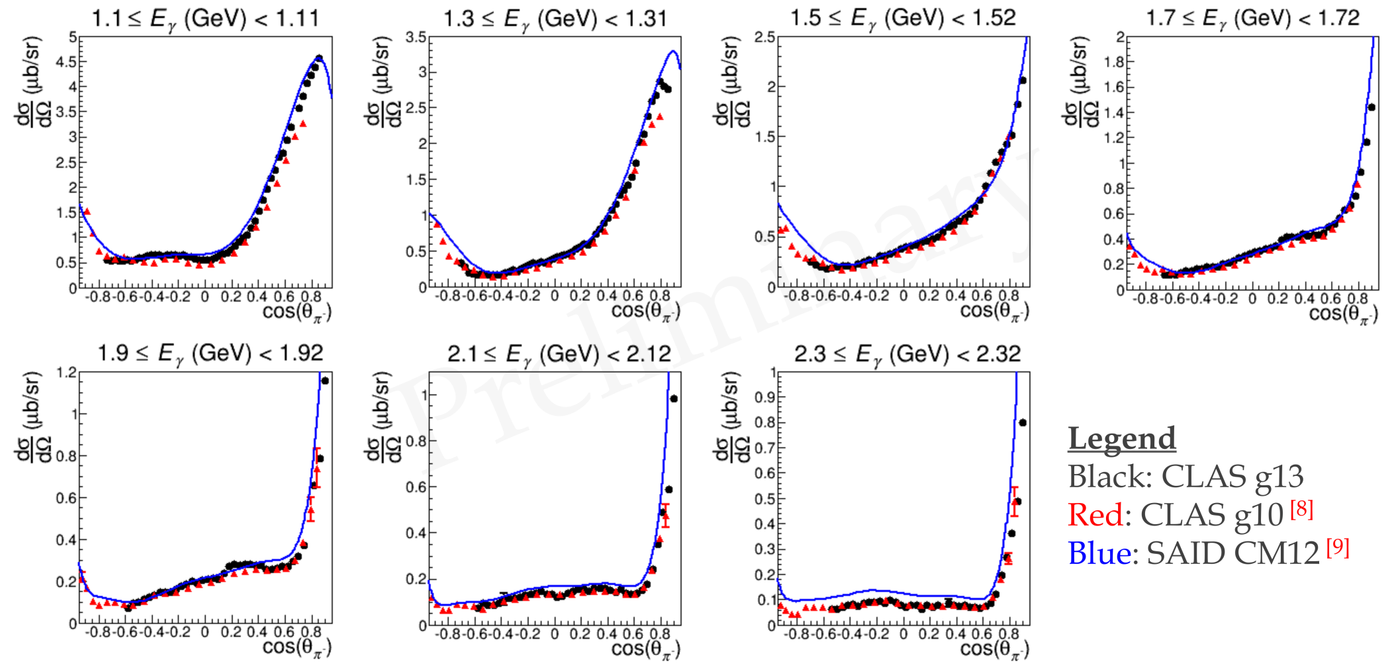
Channel: $\vec{γ}+d→π^{−}+p (n)$;Cross-section
W. Chen et al. Phys. Rev. Lett. 103, 012301 (2009)
W. Chen et al, Phys Rev C 86, 015206 (2012)
Black data points: Preliminary data (P. Mattione)

Slide 15
Two-Fold π⁺π⁻p Differential Cross Sections
π⁻Δ⁺⁺ channel,
t_{πΔ} -exchange
W=1.81 GeV
π⁺Δ⁰ channel,
t_{πΔ} -exchange
E.N. Golovach,
Moscow State Univ.
crossed cells with substan- tial contributions from the reaction phase space area of zero acceptance were taken out, but can be restored in the future physics
analysis.
ρπ channel,
t_{pp’} -exchange
First preliminary results on nine one-fold
differential and 28 two-fold differential π⁺π⁻p
photoproduction cross sections have become
available from CLAS at W from 1.6 to 2.5 GeV collected in bins of 25 MeV size over W.

Slide 16
Resonance Photocouplings
Resonance | A_{1/2}, GeV^{-1/2} *1000, JM15/RPP12 | A_{3/2}, GeV^{-1/2} *1000 JM15/RPP12
N(1650)1/2⁻ | 63±6 53±16
N(1680)5/2⁺ | -29±3 -15±6 | 133±14 133±12
N(1700)3/2⁻ | -5±4 -18±13 | 30±22 -2±24
N’(1720)3/2⁺ | 40±3 N/A | -43±8 N/A
N(1720)3/2⁺ | 89±16 97±3 (*) | -35±13 -39±3(*)
Δ(1600)3/2⁺ | -26±10 -23±20 | -19±9 -9±21
Δ(1620)1/2⁻ | 33±4 27±11
Δ(1700)3/2⁻ | 97±19 104±15 | 84±11 85±22
Δ(1905)5/2⁺ | 25±4 26±11 | -57±10 -45±20
Δ(1950)7/2⁺ | -68±16 -76±12 | -123±20 -97±10
Fit of the CLAS data within the framework of the JM15:
(*)M. Dugger et al., Phys. Rev. C76, 025211 (2007).
Consistent results on photocouplings of resonances with masses above 1.6 GeV from analyses of Nπ and π⁺π⁻p channels demonstrate reliable extraction of these fundamental quantities.

Slide 17
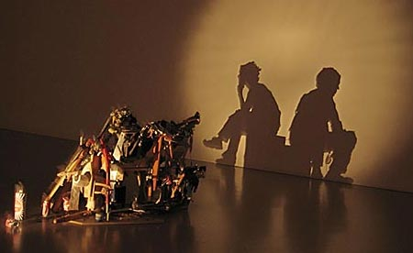
Interpreting results from one point of view

Slide 18
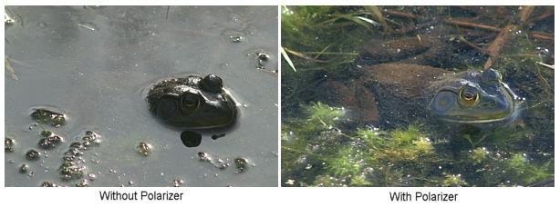
In praise of polarisation...
…you’ll see more!

Slide 19
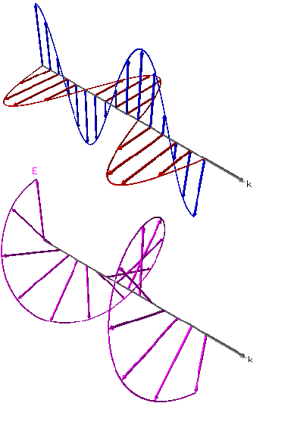



Example: Kaon Photoproduction
K+
proton
Hyperon is self-analysing
proton

Slide 20
Transversity Amplitudes
}
b₁ = < + | M | + ⊥>
}
b₂ = < − | M | − ⊥>
}
b₃ = < + | M | −‖ >
}
b₄ = < − | M | +‖>

Slide 21
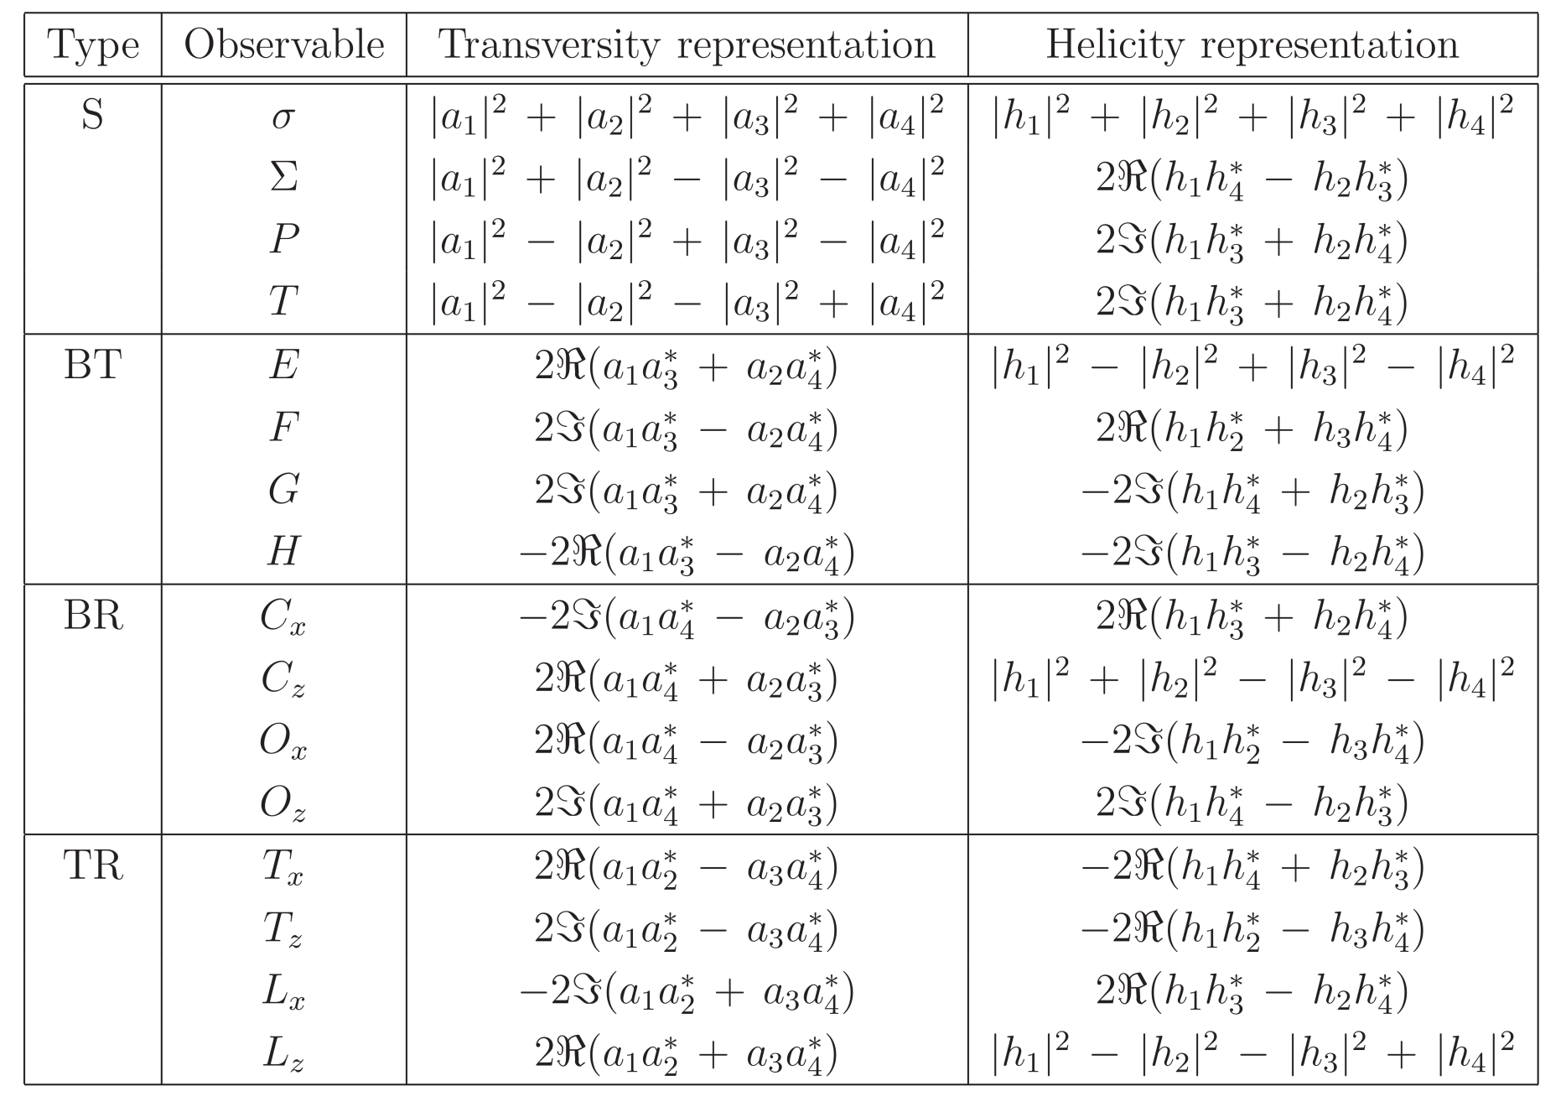
Observables and Amplitudes

Slide 22
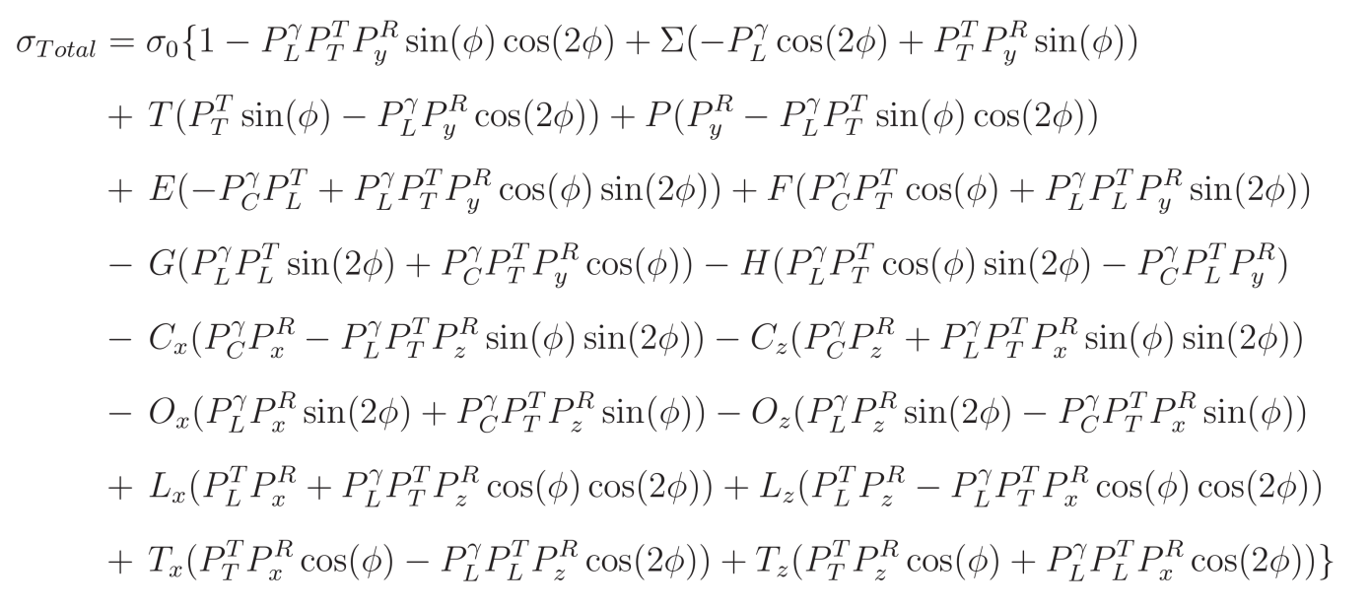
Cross-section Formula

Slide 23
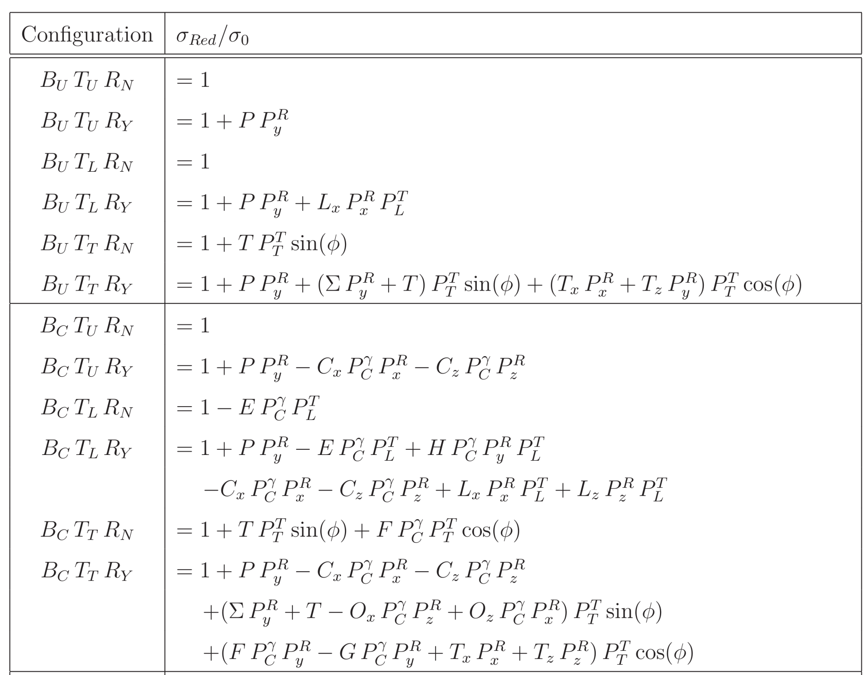
Experimental Configurations

Slide 24
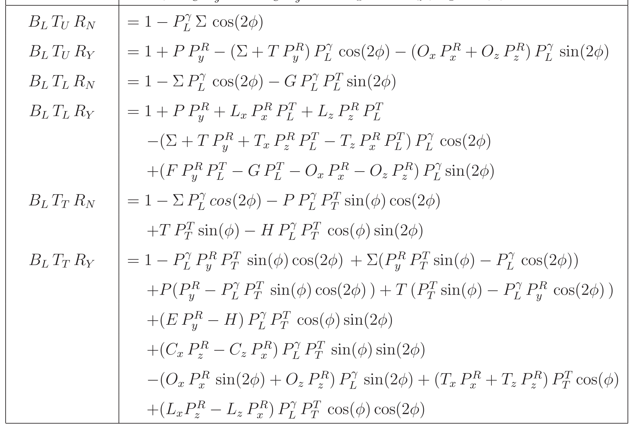
Experimental Configurations

Slide 25
Recoil Polarization

Slide 26
CLAS results γp→K⁺Λ → K⁺pπ⁻
Bonn-Gatchina Coupled Channel Analysis, A.V. Anisovich et al, EPJ A48, 15 (2012)
(Includes nearly all new photoproduction data)
M. Mc Cracken et al. (CLAS), Phys. Rev. C 81, 025201, 2010
R. Bradford et al. (CLAS), Phys.Rev. C75, 035205, 2007

Slide 27
Evidence for new N* states and couplings
State N((mass)J^{P} | PDG 2010 | PDG 2012 | KΛ | KΣ | Nγ
N(1710)1/2⁺ | *** (not seen in GW analysis) | *** | *** | ** | ***
N(1880)1/2⁺ |  | ** | ** | * | **
N(1895)1/2⁻ |  | ** | ** | * | ***
N(1900)3/2⁺ | ** | *** | *** | ** | ***
N(1875)3/2⁻ |  | *** | *** | ** | ***
N(2150)3/2⁻ |  | ** | ** |  | **
N(2000)5/2⁺ | * | *** | ** | * | **
N(2060)5/2⁻ |  | *** |  | ** | ***
Bonn-Gatchina Analysis – A.V. Anisovich et al., EPJ A48, 15 (2012)
(First coupled-channel analysis that includes nearly all new photoproduction data)

Slide 28
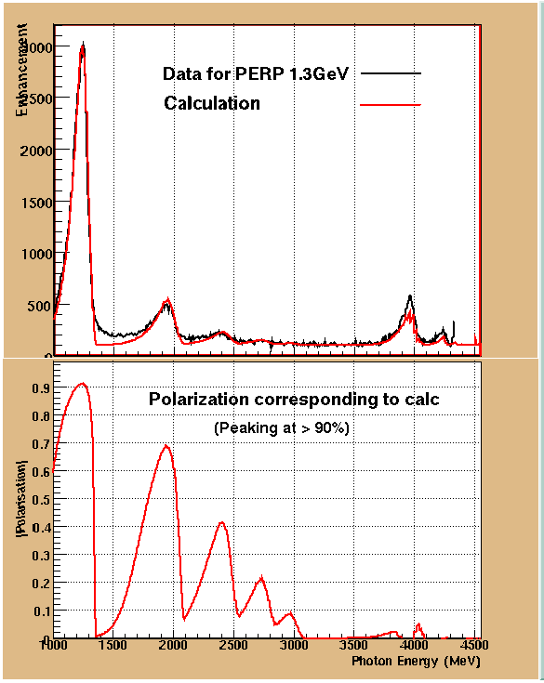
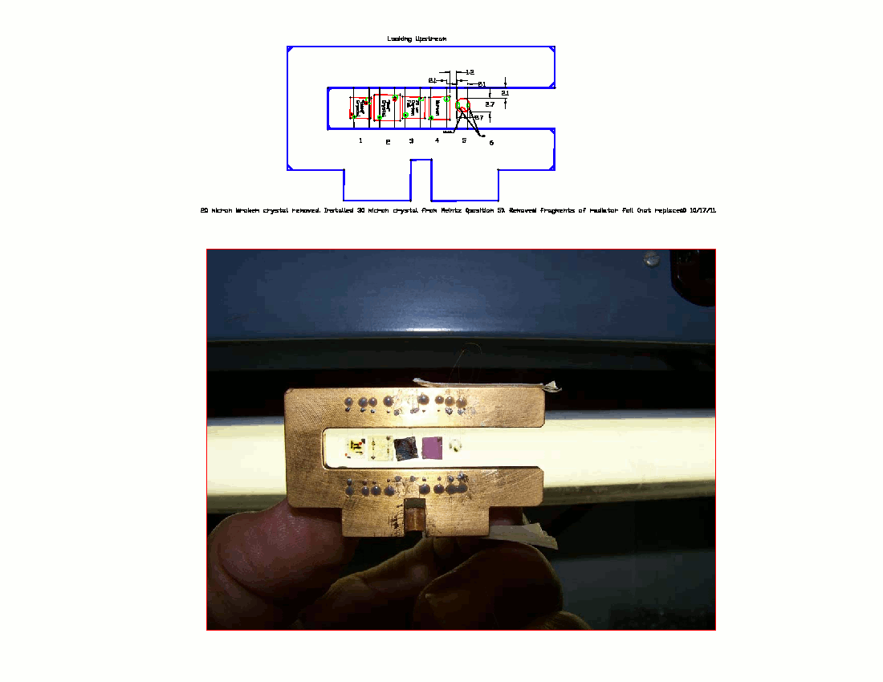
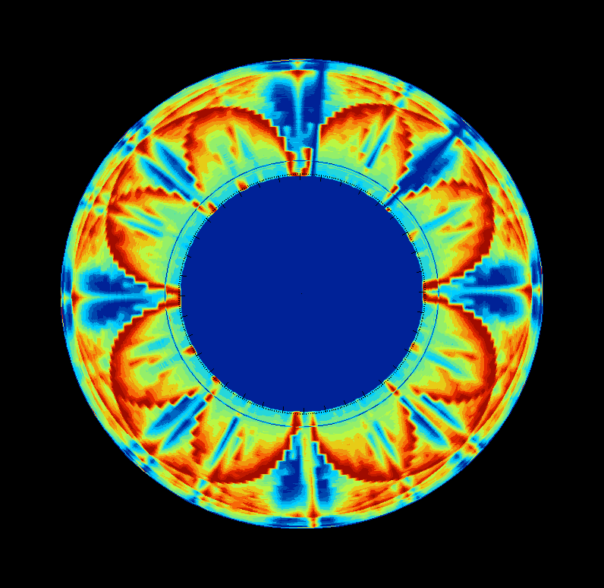
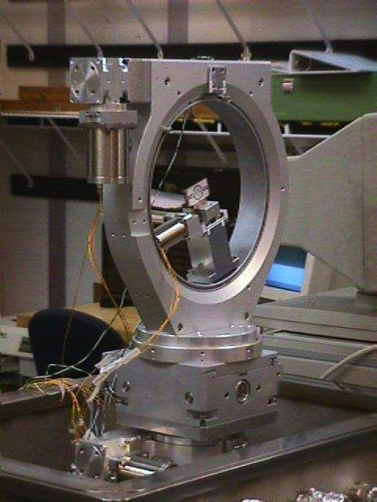
Linearly Polarized Photons
Diamond radiator mounted
on target ladder
Polarization determined by fit to coherent bremsstrahlung spectrum
Alignment checked by
observing symmetric
“Stonehenge Plot”
Radiator in goniometer
Technique also used in JLab Hall D

Slide 29
Linearly Polarized Photons

Slide 30
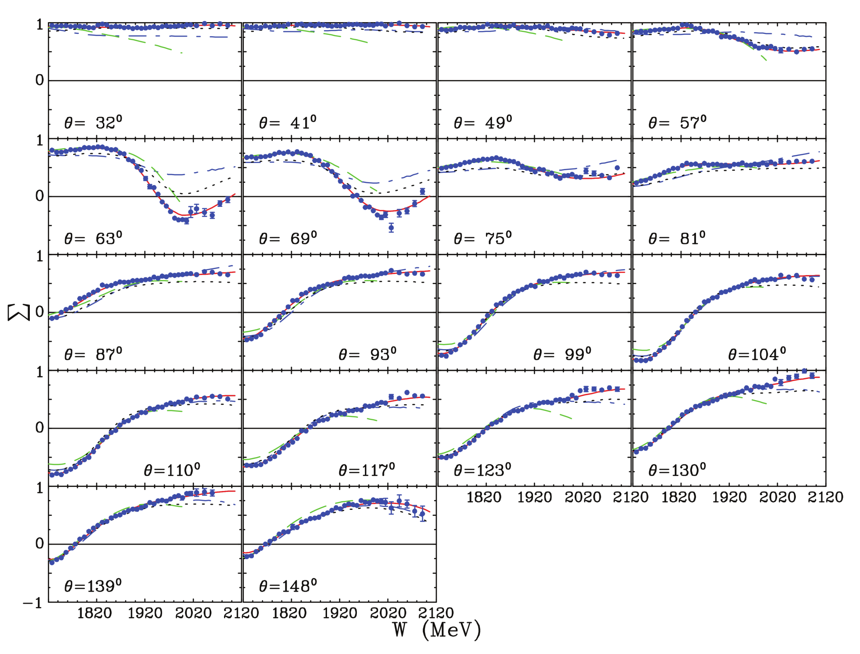
CLAS Results: Channel: $\vec{γ}+p→π^{0}+p$;Observable: Σ
M. Dugger et al. (CLAS), Phys. Rev. C 88, 065203, 2013

Slide 31
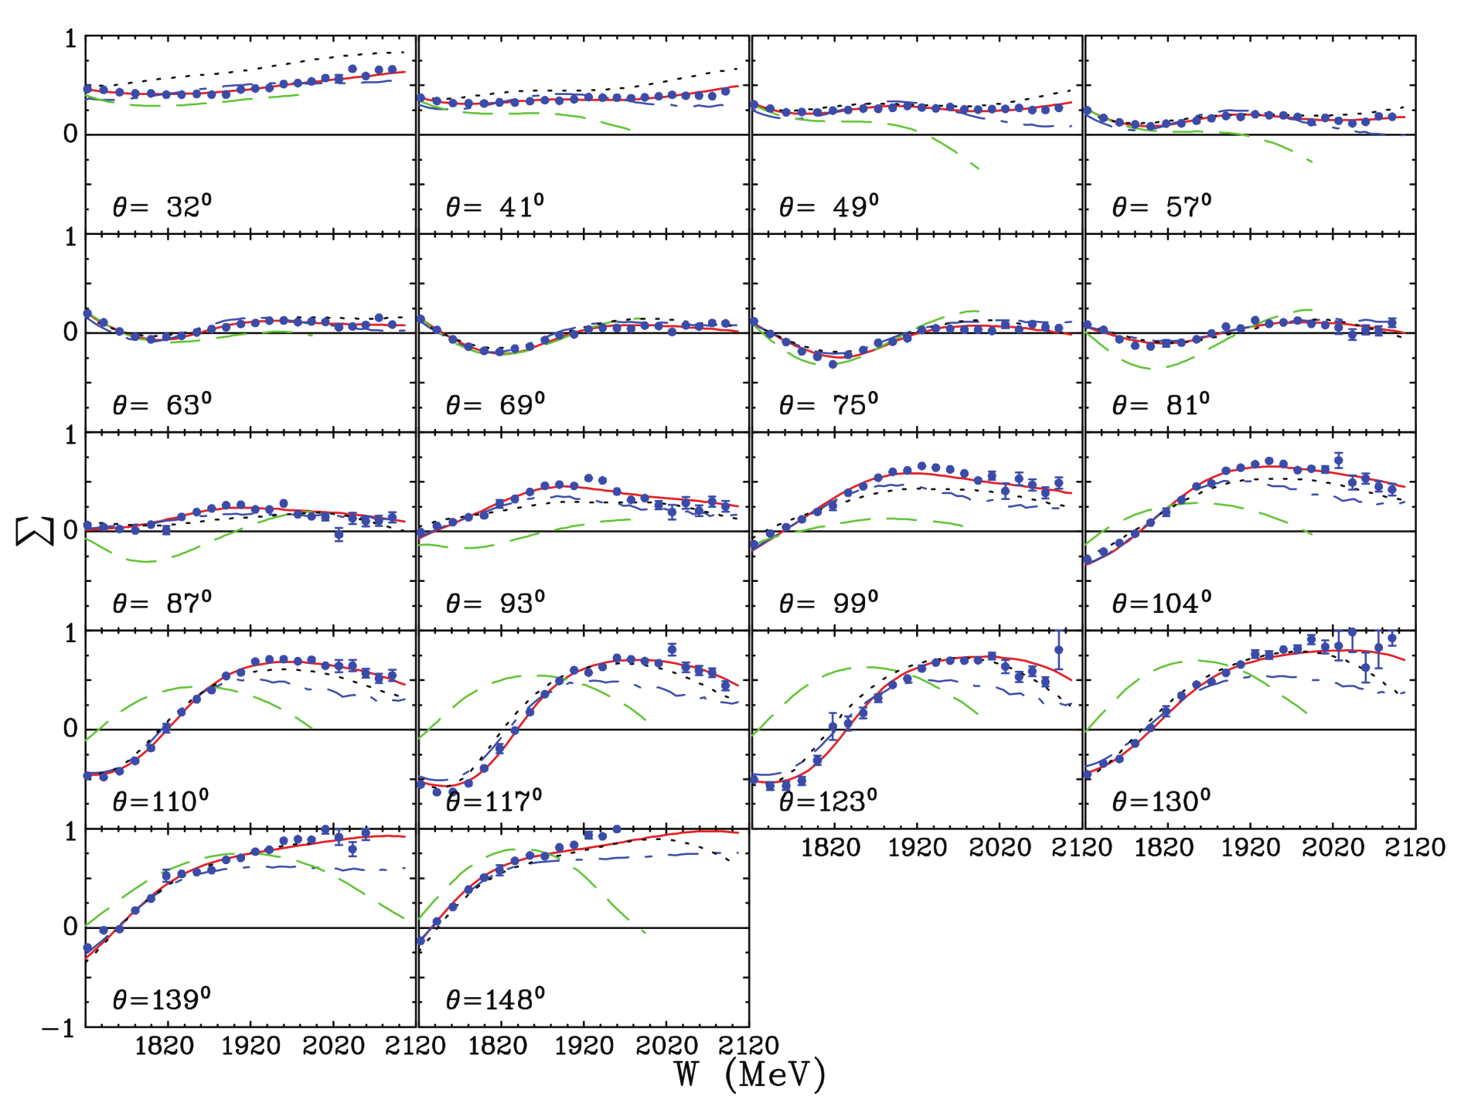
CLAS Results: Channel: $\vec{γ}+p→π^{+}+n$;Observable: Σ
M. Dugger et al. (CLAS), Phys. Rev. C 88, 065203, 2013

Slide 32
Beam-Recoil Polarization

Slide 33
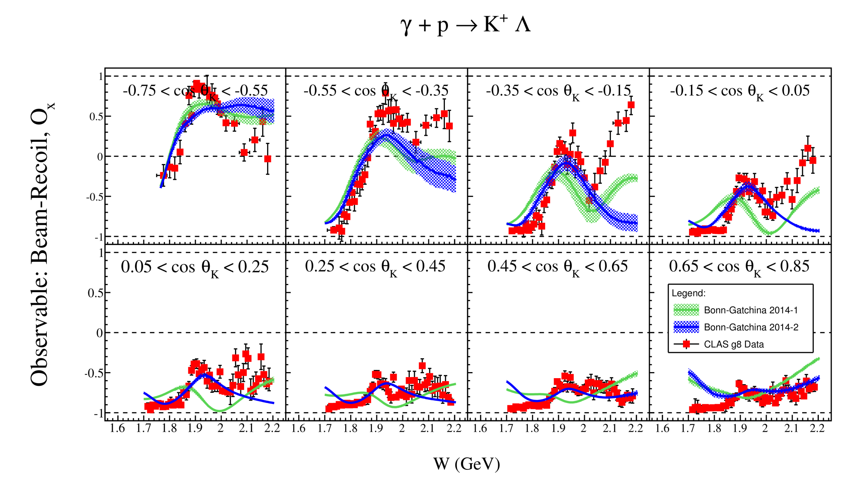
CLAS Results: Channel: $\vec{γ}+p→K^{+}+Λ$;Observable: Ox
Preliminary

Slide 34
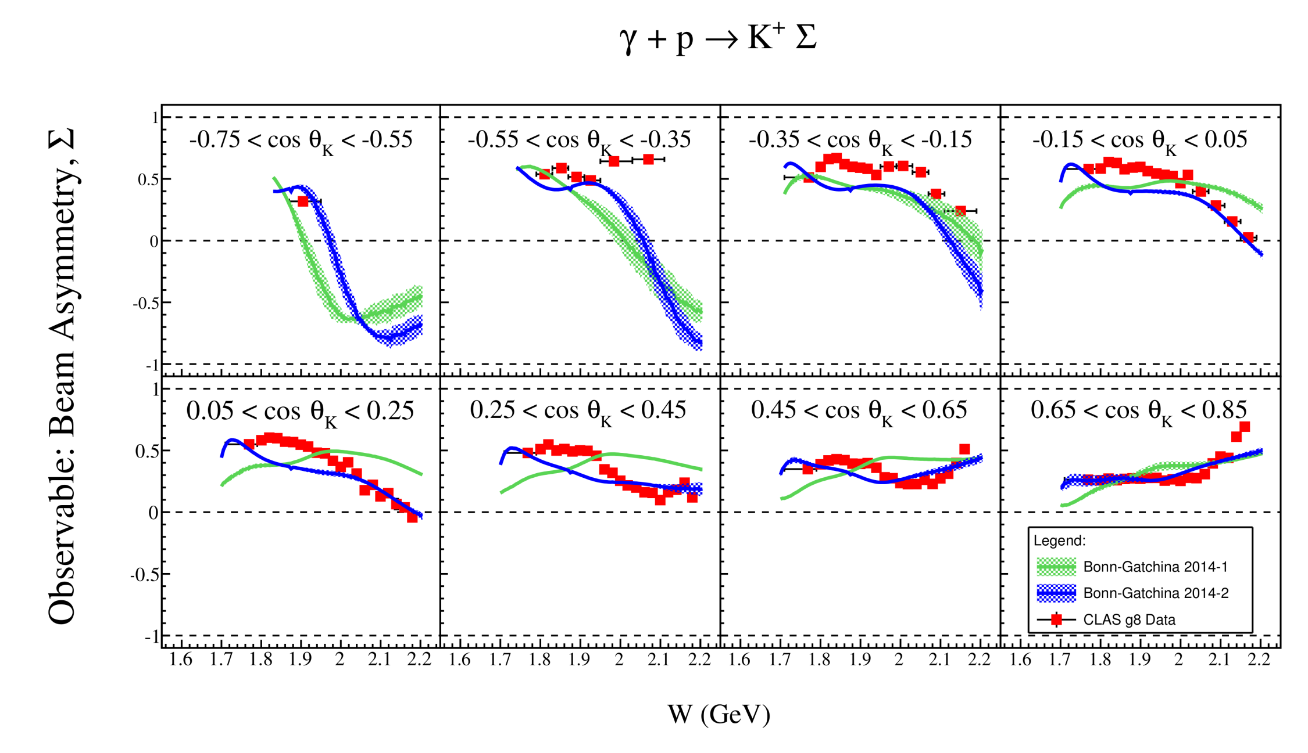
CLAS Results: Channel: $\vec{γ}+p→K^{+}+Σ^{0}$;Observable: Σ
Preliminary

Slide 35
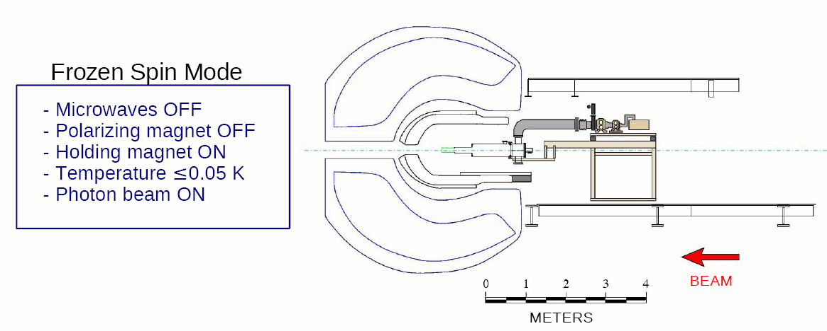
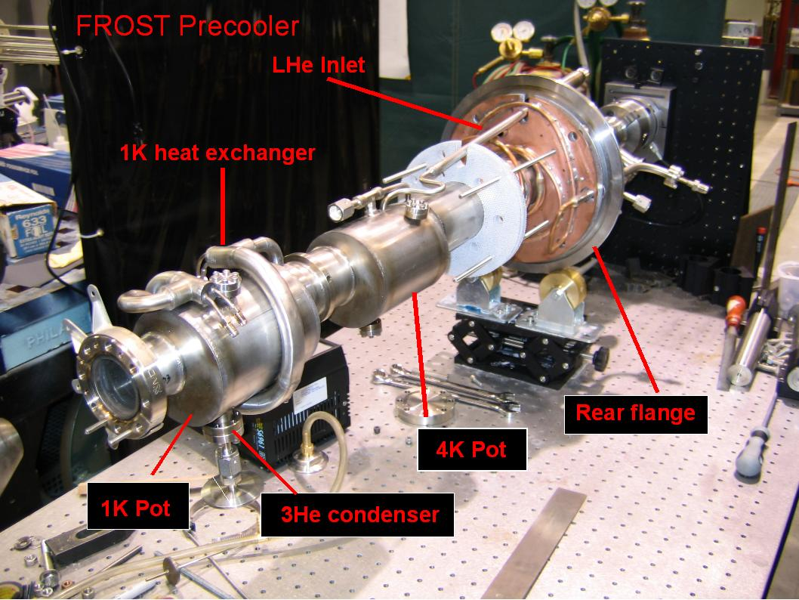
FROzen Spin Target (FROST)
Target can be longitudinally or transversely polarised

Slide 36
Target Polarization

Slide 37
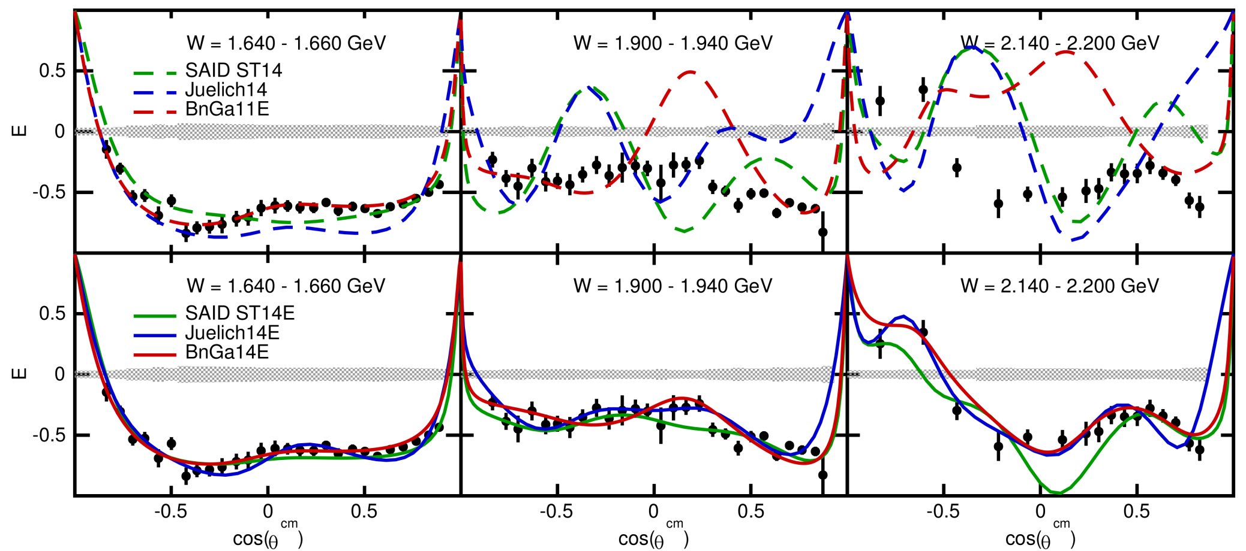
CLAS Results: Channel: $\vec{γ}+\vec{p}→π^{+}+n$;Observable: E
S. Strauch et al. (CLAS), http://arxiv.org/abs/1503.05163 , Phys. Lett. B 750, 53 (2015).

Slide 38
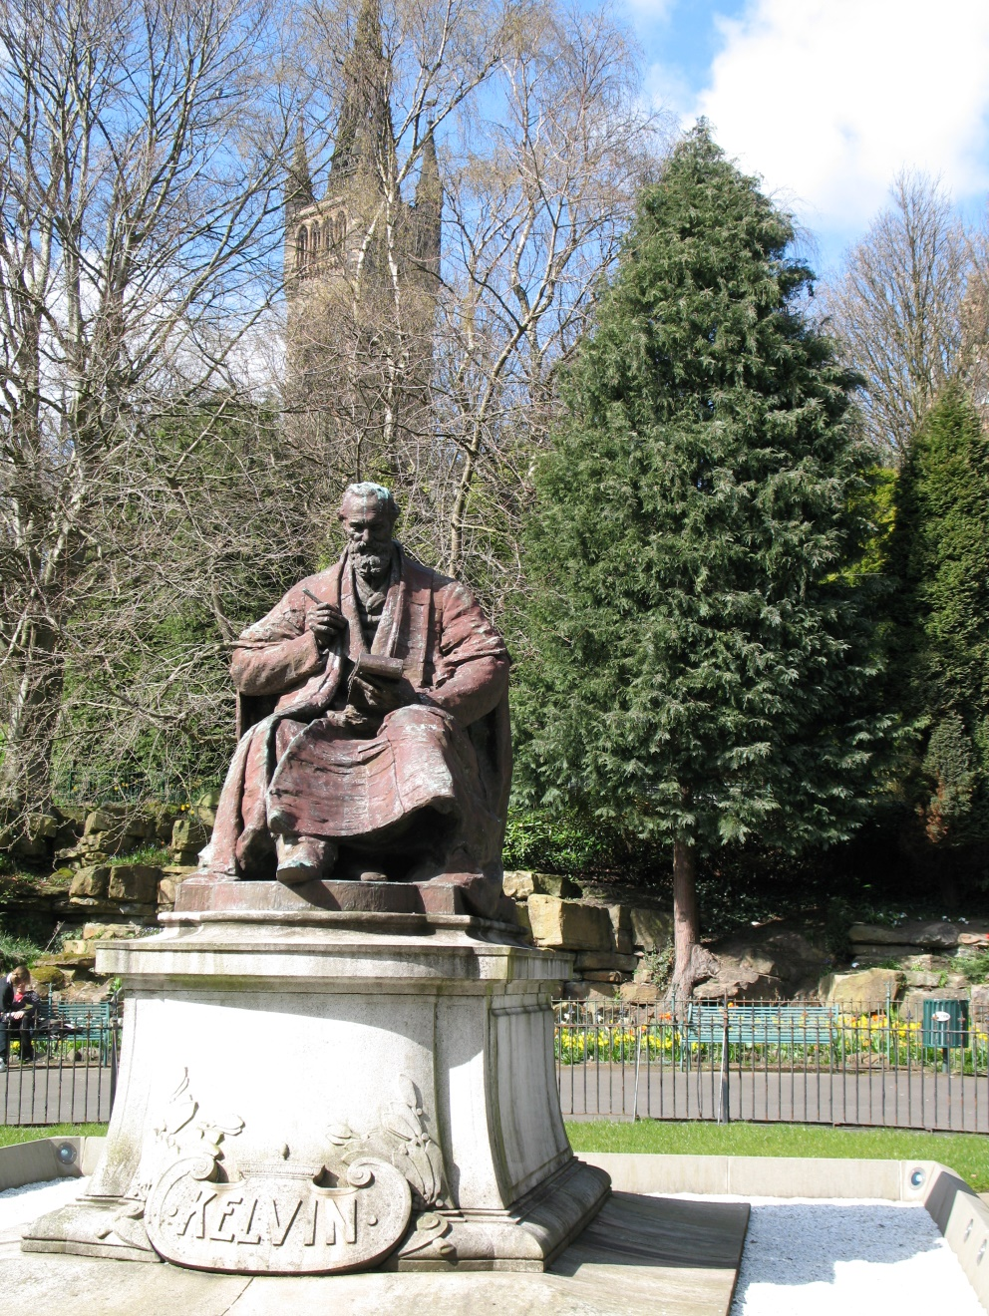
Measurement
“When you can measure what you are speaking about, and express it in numbers, you know something about it, when you cannot express it in numbers, your knowledge is of a meagre and unsatisfactory kind; it may be the beginning of knowledge, but you have scarcely, in your thoughts advanced to the stage of science.”
― William Thomson, 1st Baron Kelvin

Slide 39

But...
There is no such thing as a complete measurement!

Slide 40
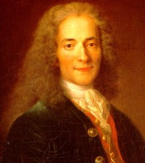

Uncertainty
“Uncertainty is an uncomfortable position. But certainty is an absurd one.”
― Voltaire

Slide 41
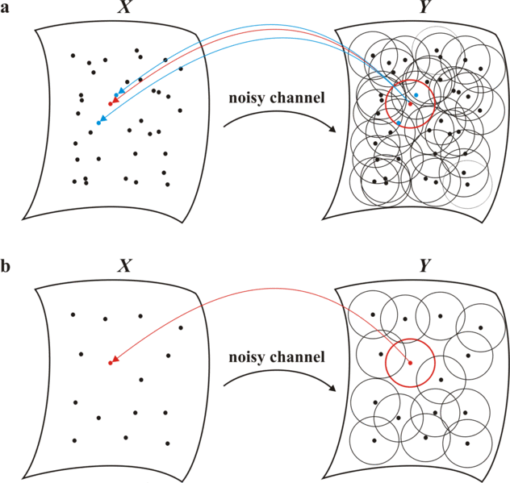
Required Accuracy
If X = Amplitudes;
Y= Observables,
What accuracy of observables are required to distinguish amplitudes?
Amplitude Space
Observable Space

Slide 42

Amplitude Analysis
Assuming “perfect” differential cross section measurement
(one bin in W, θ_{CM})
Rescale transversity amplitudes:
... which leads to the constraint...

Slide 43
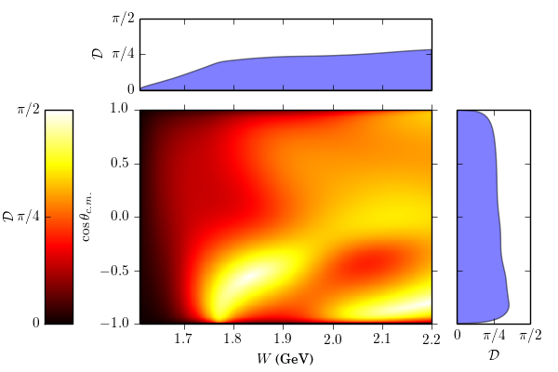
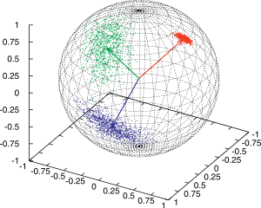
“Distance” between models
Compute geodesics in amplitude space between points given by
Kaon-MAID
RPR-2011
J. Nys, University of Gent

Slide 44
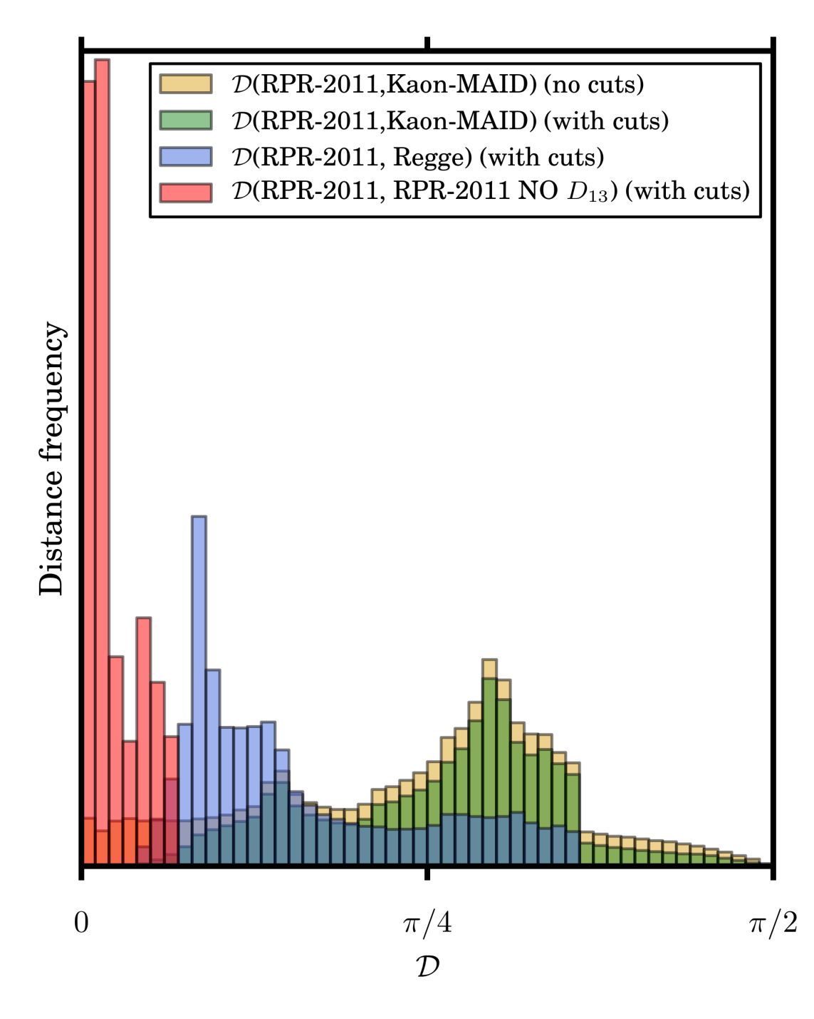

Distributions of “distances”
Statistical sample in amplitude space
Distances between different theories larger than distances within one theory
Work needed to translate measured accuracy to equivalent distance
J. Nys, University of Gent

Slide 45
Summary and Outlook
CLAS@JLab has measured many photoproduction channels in N* resonance region
Much more still to come, including:
  Two-pion photoproduction
  Finalised results from linearly polarized photon beams
  Results from deuterium target
  More results from FROST
  Results from HDIce
Electroproduction also important
Progress in N* physics needs:
  Combined analyses of all relevant channels
  Use of data from all sources (different labs)
  Analysis of experimental and theoretical uncertainty
  More hard work!

Slide 46
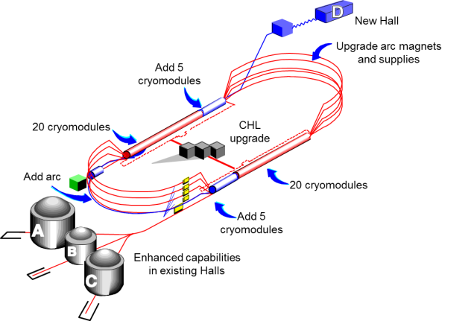
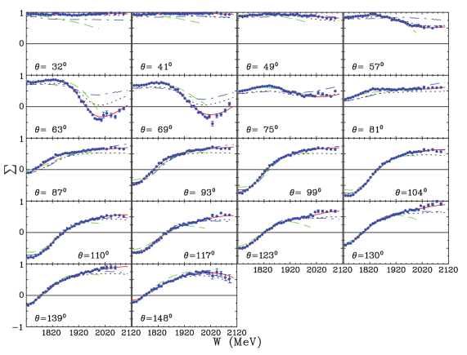
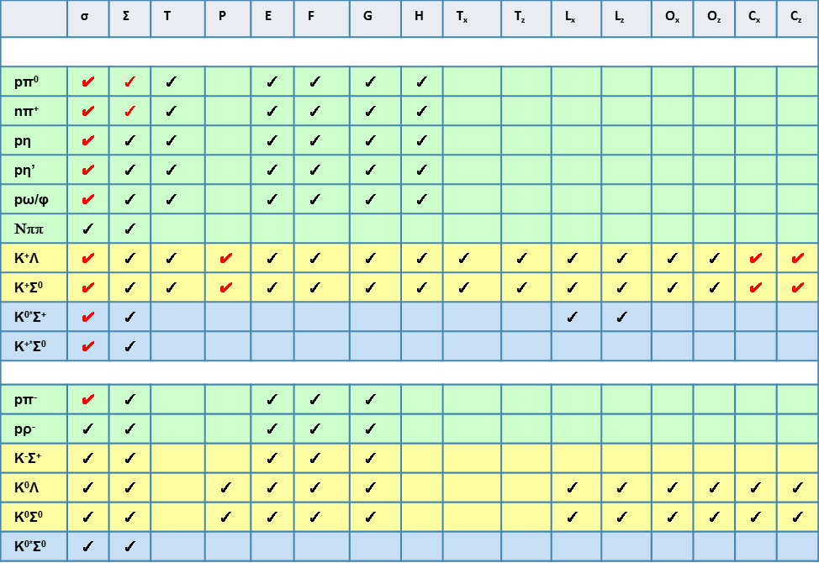




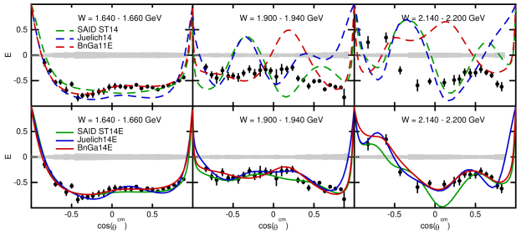
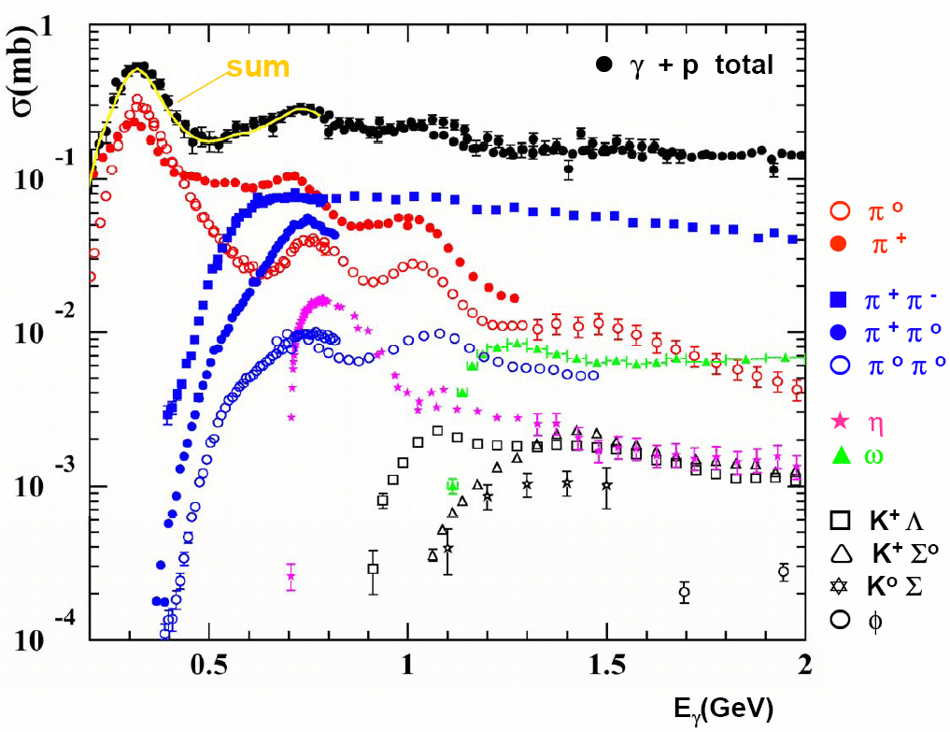


Conclusions

Slide 48
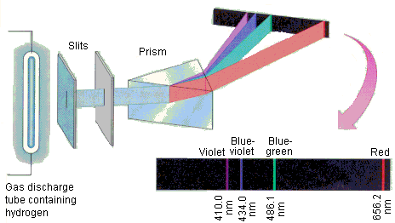
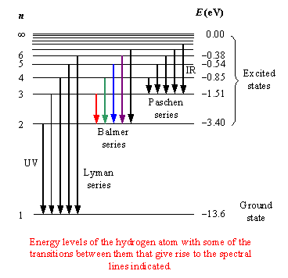


Why spectra matter...

Slide 49
Meson Photoproduction Cross Sections

Slide 50

JLab 12 GeV Upgrade

Slide 51

Pseudoscalar Meson Photoproduction
very high
momentum
transfer (pQCD)

Slide 52

Evidence for new N* states and couplings

