Slide 1
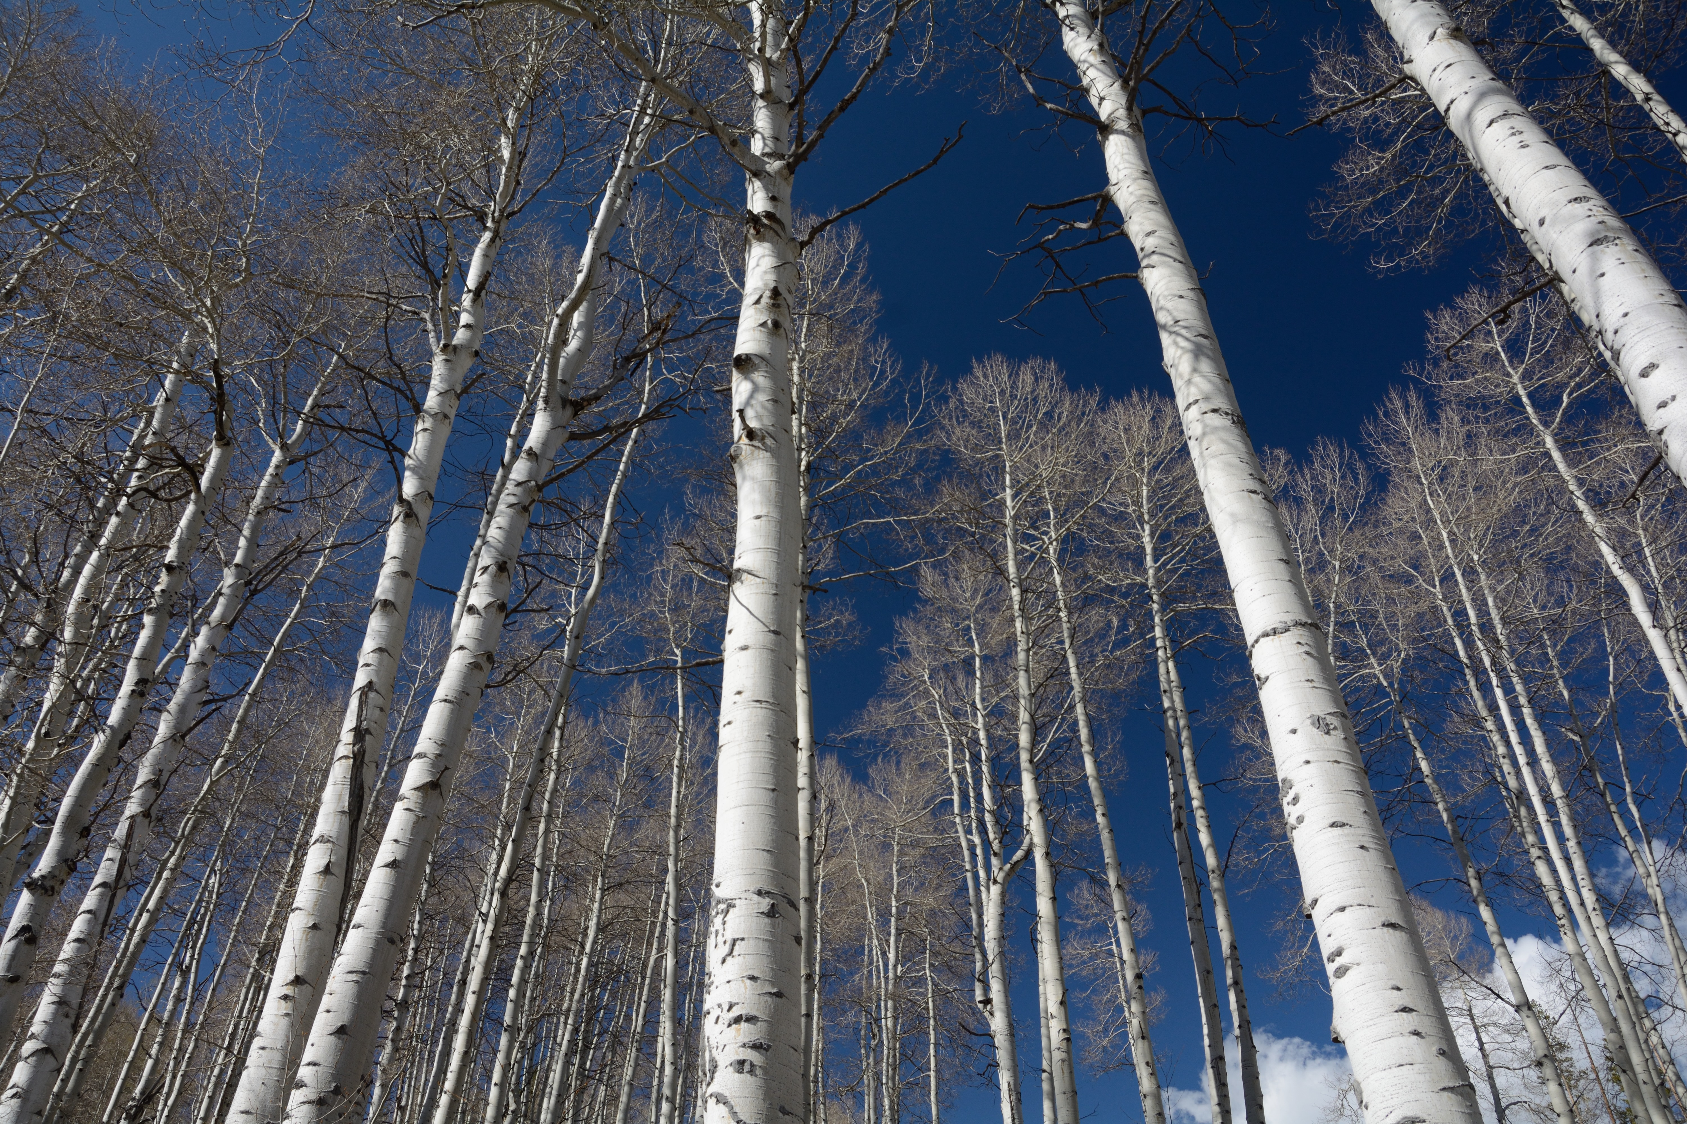
Modifications of Nucleons in Nuclei
Sebastian Kuhn
Old Dominion University
Norfolk, Virginia, USA
Notes:
TOPICS NOT DISCUSSED: gluon condensate/colored glass condensate; hadronization; color transparency, heavy ion collisions, shadowing

Slide 2
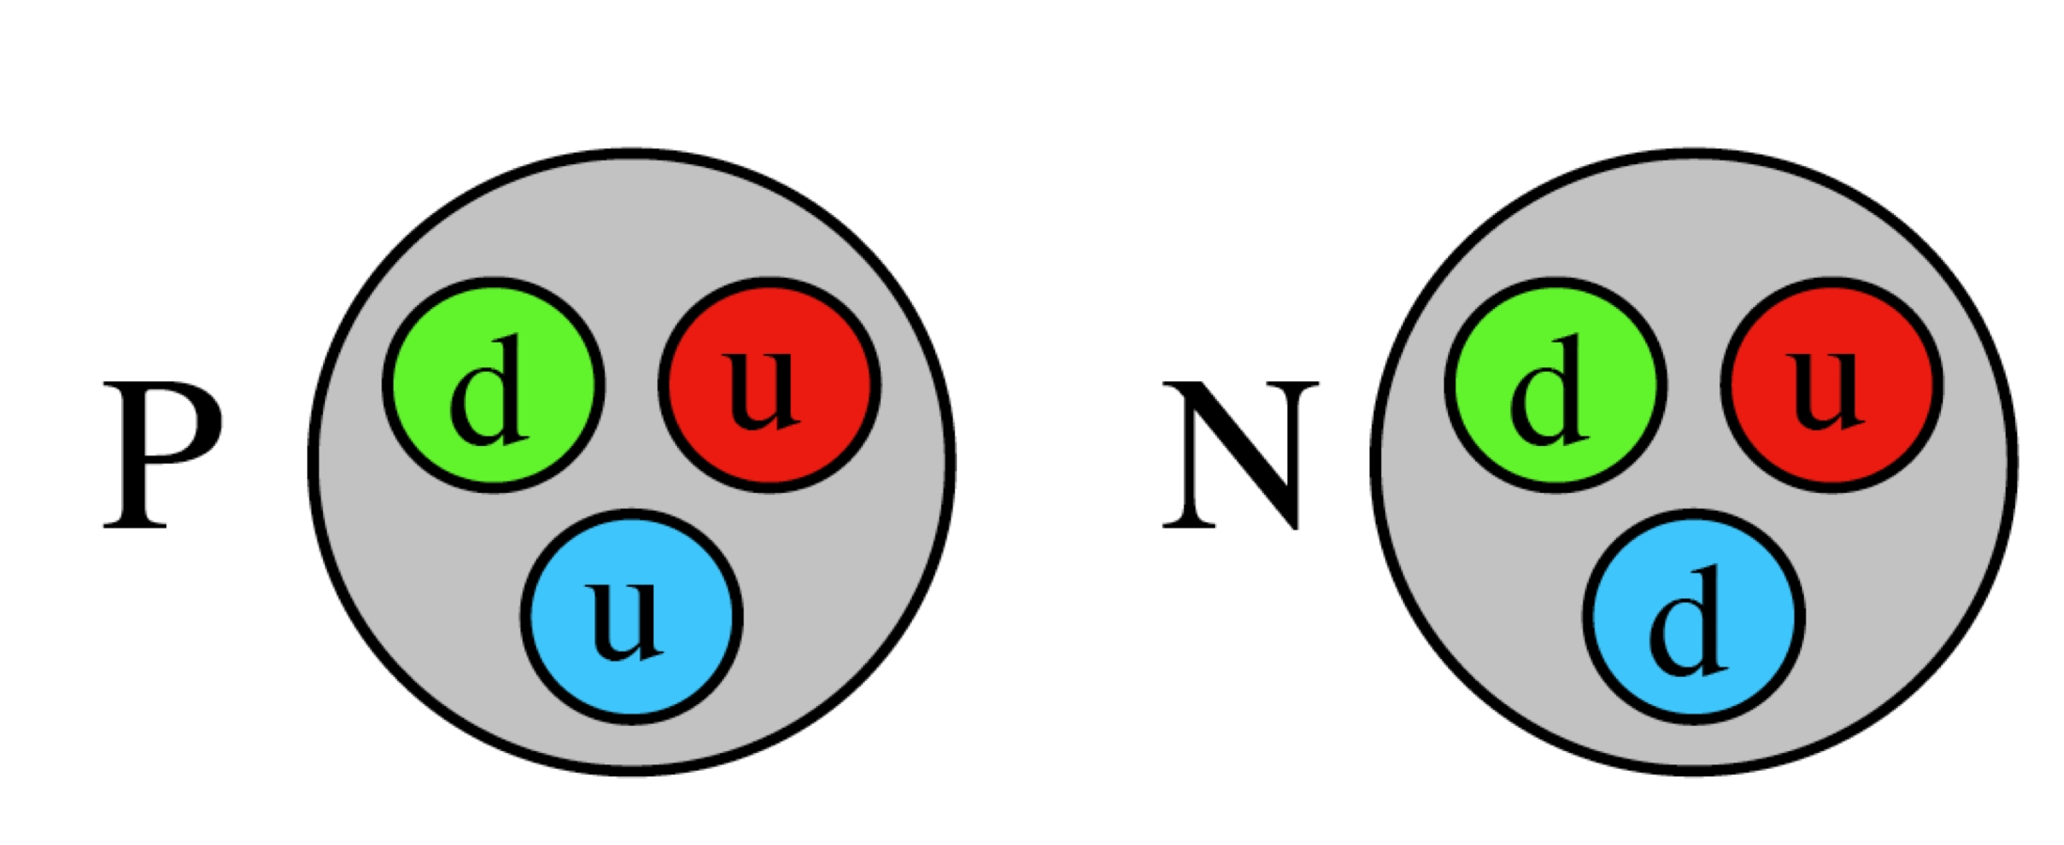
Definition of Terms:
What are Nucleons?
Stationary solutions of the QCD Lagrangian with A = 1, I = ½ ; S = B = C = T = 0 and s = ½
Bound systems of 3 light valence quarks (uud or udd) and a large number of sea quarks (qq) and gluons
Describable as a superposition of Fock states, including bare qqq, and excitations of the chiral condensate (“pion cloud”); solitons
Characterized by SFs, FFs, GPDs, WFs…
…your definition here…
Classical Nuclear Physics:
“Structure-less” hard objects
quark spin and motion
Meson
cloud
valence quarks
sea quarks, gluons
correlations
orbital angular momentum
Notes:
Begin by defining terms!

Slide 3
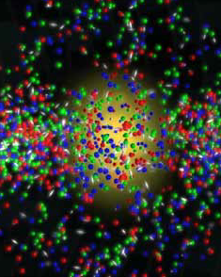
What are Nuclei?
Stationary solutions of the QCD Lagrangian with A = 2,3,… , I = 0,½,… ; S = B = C = T = 0 and s = 0, ½, 1…
Bound systems of 3A light valence quarks (u and d) and a large number of sea quarks (qq) and gluons
Describable as a superposition of Fock states, including A bare qqq clusters, and excitations of the chiral condensate (“pion cloud, sigma field…”)
…
(Structure-less) nucleons bound
together by a potential?
Notes:
Point out that only in the last case it makes even sense to ask “are nucleons modified in nuclei” – otherwise the question is “how come that nuclei look even close to being made up from nucleons?”

Slide 4
Nucleon-Nucleon Potentials
OBE
Chiral …
EFT
Ultimately: (L)QCD!
Determined by phase shifts
Example: Deuteron bound state
  Tensor correlations
  High momentum components
  Short range (S-state) properties?
(CD Bonn, Machleidt 2000)
Entem&Machleidt, 2008; Piarulli&Schiavilla 2015
CD Bonn
Argonne V18
Nijmegen I
ΔProb(p…p+Δp)
S
S-wave
D-wave
D
p [GeV]
Notes:
Point out that TC can only occur in S=1 and therefore T=0 system, coupling S to D wave. Dominates momentum strength 300-600 MeV/c. EVEN THAT IS model-dependent (V18 vs. CD-Bonn). Issues: off-shell effects, D-state not observable (and NOT an eigenstate of the Hamiltonian -> therefore it doesn’t make sense to talk about the properties of a “D-state nucleon”.), although D-state probability can be defined theoretically (just not directly measured). Deuteron atypically loosely bound – S-wave has p_RMS = 105 MeV/c , r_RMS = 4 fm. D-wave has r_RMS = 2.5 fm, p_RMS = 370 MeV/c. Clearly high-momentum, but not exactly SHORT range. Beyond that, rel. effects, super-large off-shellness, FSI, MEC, … hard to even fathom how to access this regime (also nucleons MUST loose their individuality at d < 2r, and phase shifts become unreliable above pi threshold = 365 MeV/c or 284 MeV lab energy).

Slide 5
Features of “nucleon models” for nuclei
Mean field potential ↔ “Fermi motion”
(Tensor) correlations ↔︎ High momen-
tum components
a₂
A(e,e’p)
A(e,e’)
Notes:
a2 = probability of hitting something with high momentum in A / same probability in D

Slide 6
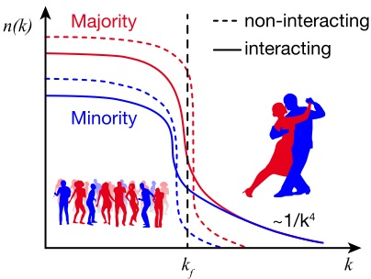
Features of “nucleon models” for nuclei
Mean field potential ↔ “Fermi motion”
(Tensor) correlations ↔︎ High momen-
tum components
Notes:
Nearly all high-momentum nucleons are balanced by back-to-back opposite nucleon (np pairs); np/nn persists even in heavy, asymmetric nuclei. See talk by Or Hen yesterday

Slide 7
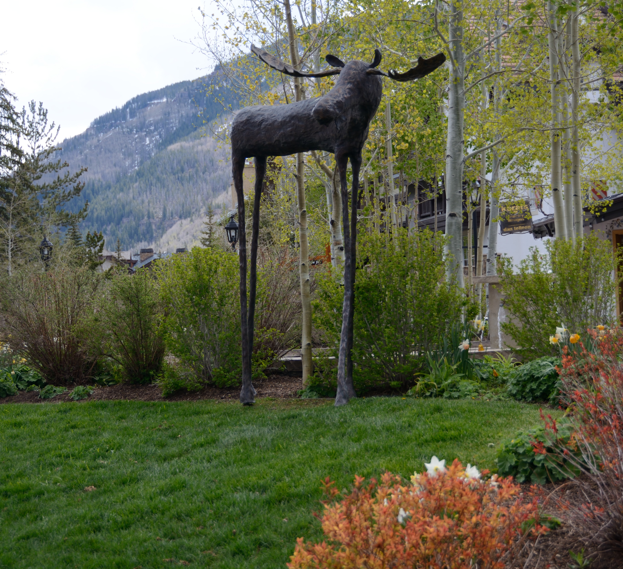
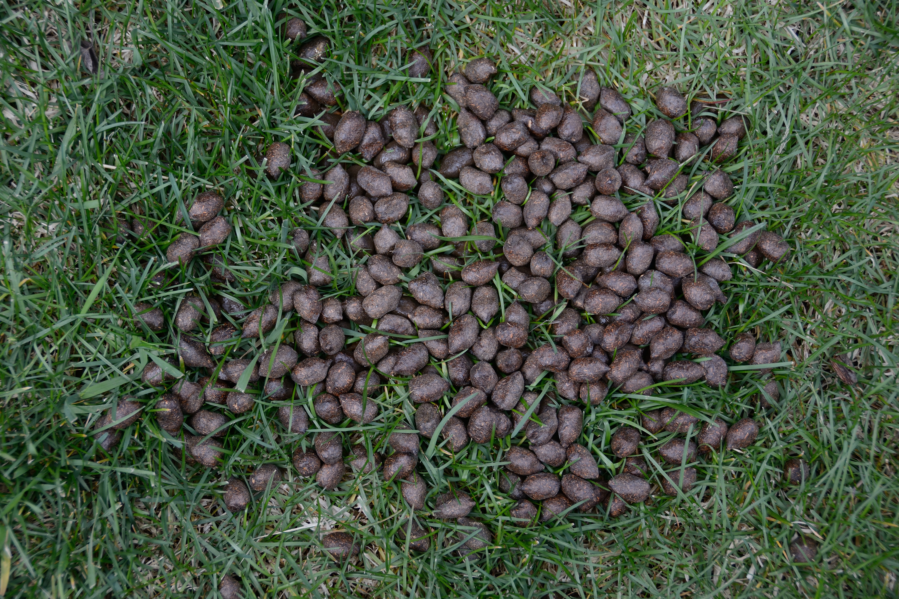



Are nucleons modified in nuclei?
Notes:
Most of you have probably heard that joke about the Mafia in Sicily too many times. So here is a new version:
Nucleon modifications in nuclei are like the moose in Vail – we know they are here in principle.
There are many theoretical papers, and some tantalizing indirect evidence. But many people want to see one with their own eyes to be convinced!

Slide 8
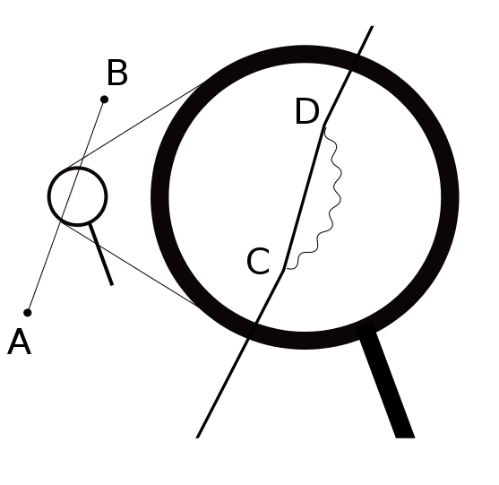
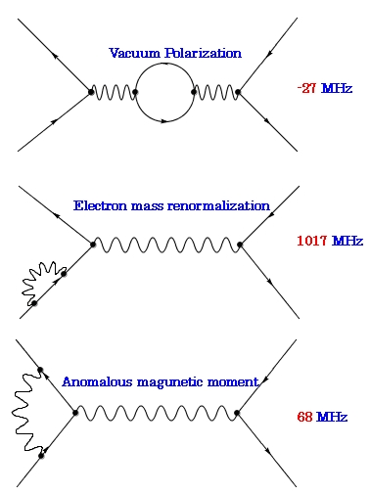
Are nucleons modified in nuclei?
Are electrons modified in atoms?
  Binding energy = ½ α² times mass – only 0.0027%
  Classical picture: Unchanged electron in electrostatic potential of nucleus – good to amazing accuracy
  But in QED: Electrons do have structure…
  …and therefore are “modified” in atoms
Notes:
Lambshift – 4.372 µeV lowering of 2p vs. 2s energy level (by 1/3 x 10-6 of binding energy) “3 Million times smaller”

Slide 9
Are nucleons modified in nuclei?
Are atoms modified in molecules?
  Obviously!
  QM picture: Atoms are deformed or even share electrons to form molecules
  Clearly, electron distributions in space and momentum space are strongly modified
  Binding energy a good fraction of atomic binding energy (H₂ binding energy ¹/₃ of electron binding in H)

Slide 10
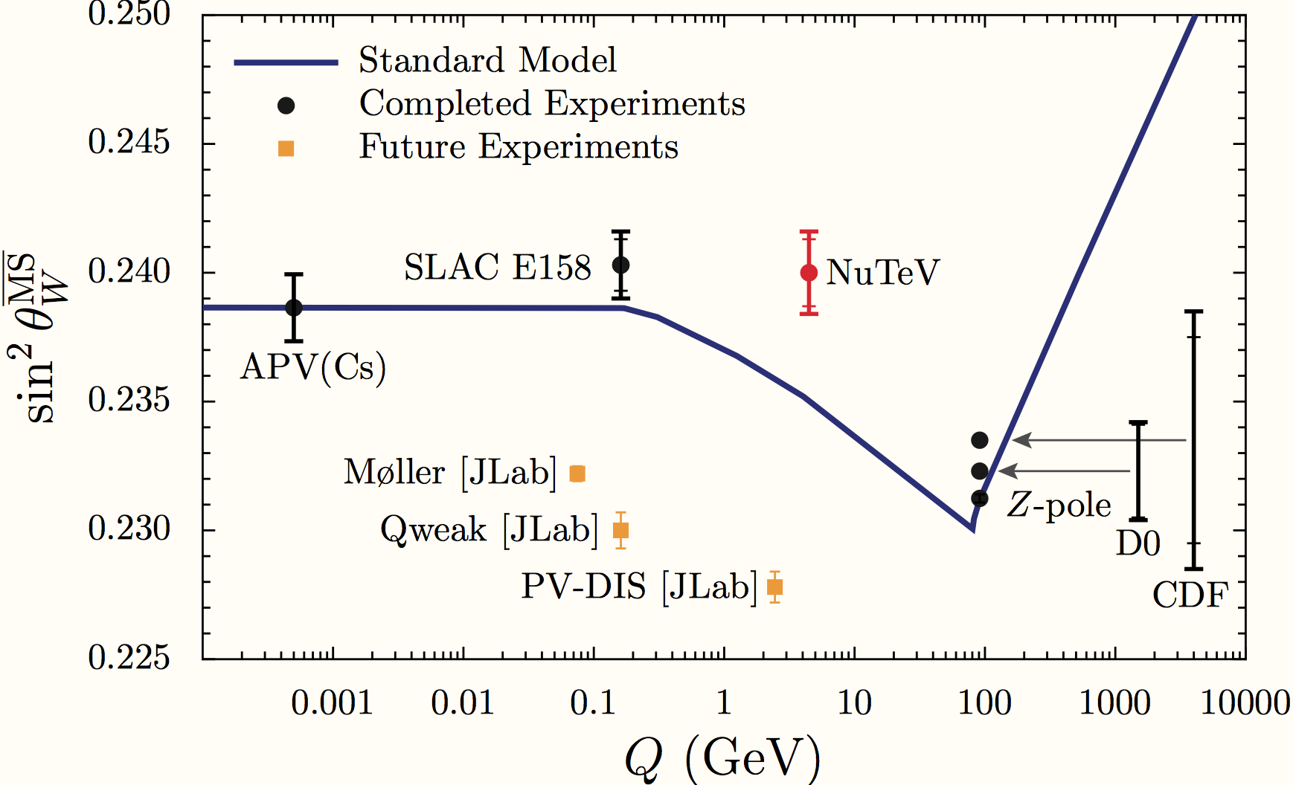
Are nucleons modified in nuclei?
Nucleons:
  bound by up to nearly 1% of their mass!
  very rich internal structure
  Therefore somewhere in between atoms and molecules?
Why do we care?
  Nuclei used as “nucleon targets” (e.g. D, ³He for n, heavier nuclei for DM detection, neutrinos -> NuTeV!)
  Consequences for nuclear structure (from nuclei to neutron stars; Equation of State) and p/d+A colliders
  Necessary ingredient for a fundamental (QCD-based) understanding of nuclear binding
Notes:
Note: EMC effect in D maybe 4% at x = 0.6, but overall nuclear uncertainty increases rapidly beyond that. F2d/F2p =R_EMC * (5 + 5 d/u) / (4 + 1 d/u) =>
d/u = (4*F2d/F2p - 5 *R_EMC)/(5*R_EMC – F2d/F2p). IFd/u = 0.2 and R_EMC = 1 => F2d/F2p = 1/0.7 = 1.4. D d/u / dR_EMC = (d/u)*(-5/(4*F2d/F2d – 5*R_EMC) -5/(5*R_EMC – F2d/F2p)) = -42/25, so even a 6% uncertainty in R_EMC at higher x translates into a 0.1 uncertainty in d/u, which is what Melnitchouk et al find.

Slide 11
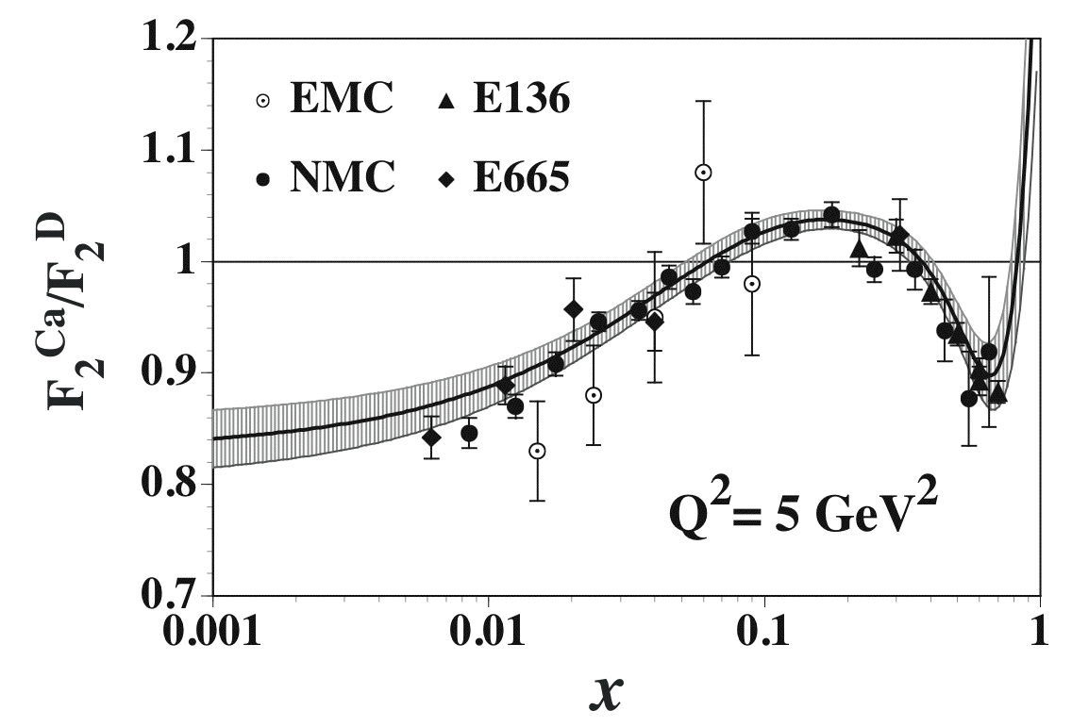
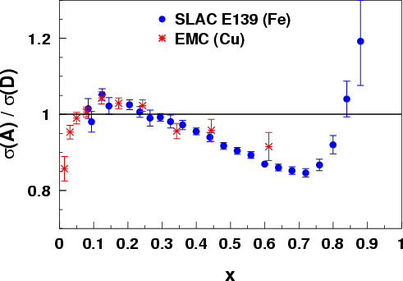
Experimental Evidence
Fermi
Motion
Anti-
shadowing
EMC
Slope
Shadowing
x
Notes:
Point out shadowing, anti-shadowing, slope region and Fermi-enhancement for SECOND slide. 32 years ago…

Slide 12
Nuclear PDF Fits
HKN: M. Hirai, S. Kumano, and
T.-H. Nagai, Phys. Rev. C 76, 065207
EPS: K. J. Eskola, H. Paukkunen
C. A. Salgado, JHEP 0904 (2009) 065
DSSZ: Daniel de Florian, Rodolfo Sassot, Pia Zurita,
Marco Stratmann, Phys. Rev. D 85, 074028
ν data
Notes:
E. Nocera talk at UTFSM: Large differences among all nuclear PDF sets, depending on the data included (Rg is left almost unconstrained by DIS and DY data)
W. Melnitchouk talk at Temple Town meeting

Slide 13
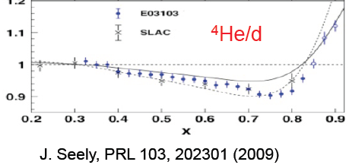
Recent Experimental Evidence
Notes:
Mention: Effect is subtle – need to properly scale x to x_max = A – contribution from photons; FSI can reduce ratio further at lower Q2 (Cosyn+Sargsian et al) Non-zero FSI effect, too. F&S claim only at truly high x > 0.6 is there a strong EMC effect.
However, this is somewhat cheating – while momentum conservation REQUIRES that the average quark z-momentum must be smaller in nuclei, that still doesn’t give you a MECHANISM to do it.

Slide 14
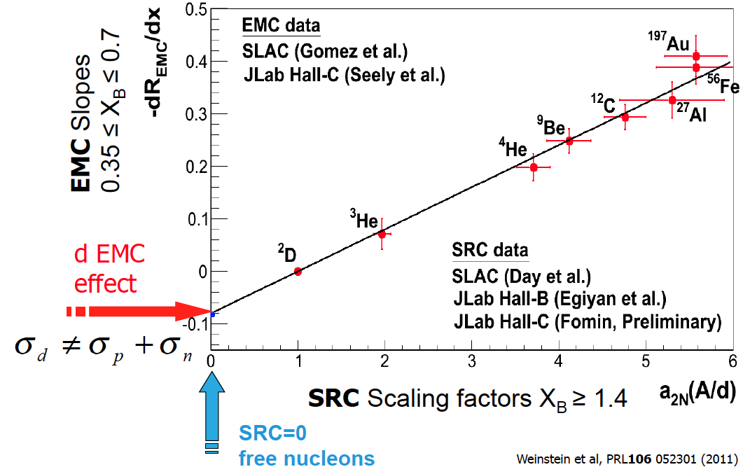
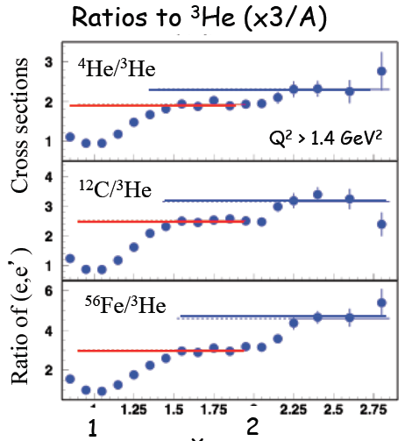
An interesting connection
EMC vs. SRC
  Both due to high local density?
  EMC effect more pronounced in high-momentum/SRC nucleons?
Probability of a nucleon inside the nucleus to be in a “short-range” (tensor) correlation (dominated by pn correlations 10:1)
Notes:
Point out the crucial 9Be point
Bottom left is updated version with BONuS result for d included, plus corrections for Isospin, Coulomb effects, x normalized to A.

Slide 15
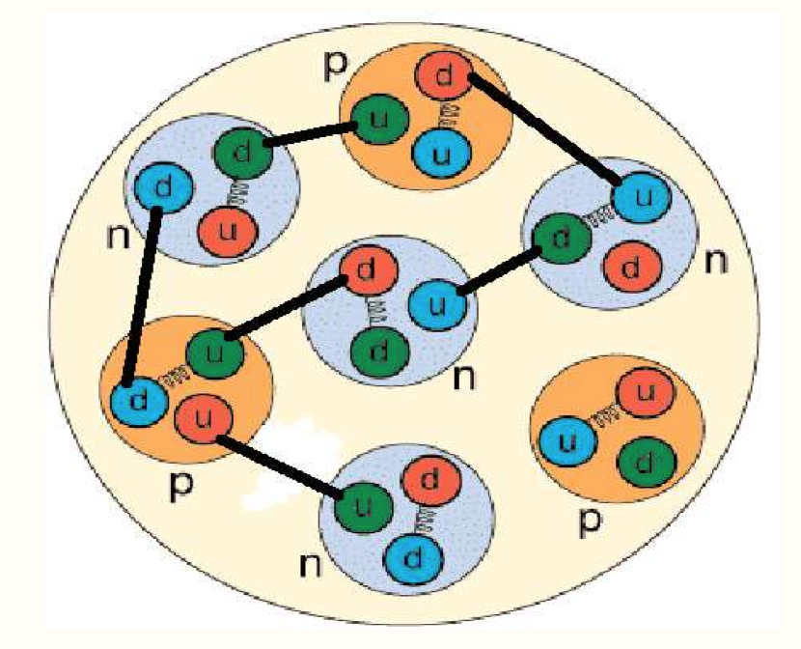
Possible Explanations
EMC ∝ A: ruled out by ⁴He
EMC ∝ average nuclear density: ruled out by ⁹Be
EMC ∝ local density. Consistent with binding models
(e.g., quark-meson coupling; quarks rearrange them-
selves inside nucleons due to scalar/vector field)
EMC ∝ virtuality of struck nucleon ^{*)} => mostly in high-momentum (SRC) nucleons.
Nucleon swelling, x rescaling, Q² rescaling, pion enhancement, suppression of point-like configurations…
^{*)}
Notes:
S. A. Kulagin and R. Petti, Phys. Rev. C 82, 054614 (2010).
L.L. Frankfurt and M.I. Strikman, Nucl.Phys. B250, 143 (1985); and Phys. Rep. 160, 235 (1988); arXive 1203.5278. It is not that nucleons are more modified in SRC; only that SRC pick out nucleons with non-minimal Fock component (less high x)

Slide 16
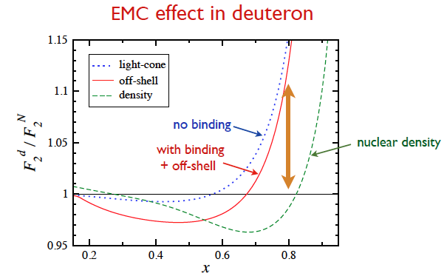
EMC-effect in the Deuteron?
…and first hints seen in BONuS experiment
(K. Griffioen, to be published)
Predicted by theory…
(W. Melnitchouk, private comm.)
PRELIMINARY
Notes:
S. A. Kulagin and R. Petti, Phys. Rev. C 82, 054614 (2010).
Note: EMC effect in D maybe 4% at x = 0.6, but overall nuclear uncertainty increases rapidly beyond that. F2d/F2p =R_EMC * (5 + 5 d/u) / (4 + 1 d/u) =>
d/u = (4*F2d/F2p - 5 *R_EMC)/(5*R_EMC – F2d/F2p). IFd/u = 0.2 and R_EMC = 1 => F2d/F2p = 1/0.7 = 1.4. D d/u / dR_EMC = (d/u)*(-5/(4*F2d/F2d – 5*R_EMC) -5/(5*R_EMC – F2d/F2p)) = -42/25, so even a 6% uncertainty in R_EMC at higher x translates into a 0.1 uncertainty in d/u, which is what Melnitchouk et al find.

Slide 17
Further Experimental Evidence
Form Factors for p in ⁴He at JLab
However, alternative explanations in standard nuclear models (incl. MEC, FSI etc.) exist
⁴He FF
∝ G_{E}/G_{M}
Proposed future measurement: E12-11-002
“One would have expected that probing few-body systems at very high Q might have revealed a new role for quark degrees-of-freedom at short distances. Except for their implicit role in determining the effective forces and currents (as well as nucleon electromagnetic form factors), the models discussed in this review do not include any such effects.” Marcucci et al., arXive 1504.05063
M. Paolone, et al., Phys. Rev. Lett. 105, 072001 (2010).
“p Virtuality”
Notes:
Mention Coulomb Sum Rule! Still an open question. On the other hand, NucleAR form factors a bit of a red herring – charge is conserved and has to be smeared out SOMEHOW through the nuclear volume.

Slide 18
List of data to come
JLab 6 GeV:
  E02-109/E04-001/E06-009: R_{A}-R_{D}, R_{D}-R_{p} (res. region)
  CLAS: data mining initiative -> tagged F_{2A}/F_{2D}
  GPDs in ⁴He (CLAS EG6)
Minerνa, Seaquest
In-medium FF experiments at Mainz (Piasetzky et al.)
JLab 12: EMC (F₂, R), SRC (³He, ³H,…), b₁, pol. EMC, tagged (several), BONuS + Marathon, FF, GPDs, superfast quarks at x>1,…
EIC: sea/gluon PDFs, shadowing, anti-shadowing, tagged EMC effect,…
Sun 09:15 - Arie Bodek
Thu 08:25 - Or Hen
Fri 08:25 MINERvA - Aaron Mislivec
Sun 08:25 SeaQuest - R. Evan McClellan
Sat 15:20 - Douglas Higinbotham
Notes:
Wed 17:05 - Inclusive quasi-real photoproduction measurements at HERMES - Edward R. Kinney, incl. Lambda polarization and BEC in nuclei
Thu 08:00 - Hadronic Physics and the Structure of Nucleons and Nuclei, incl. Eli Piasetzky and Or Hen
Fri 08:00 - Neutrino Masses and Neutrino Mixing, several talks incl. Minerva talk Friday morning
Sat 15:20 - Hadronic Physics and the Structure of Nucleons and Nuclei - Douglas Higinbotham (Jefferson Lab)
Sun 08:25 - First results from the SeaQuest experiment at Fermilab; 09:15 - Experimental investigation of the structure functions of deuterium, carbon, aluminum, iron, and copper nuclei – Arie Bodek

Slide 19
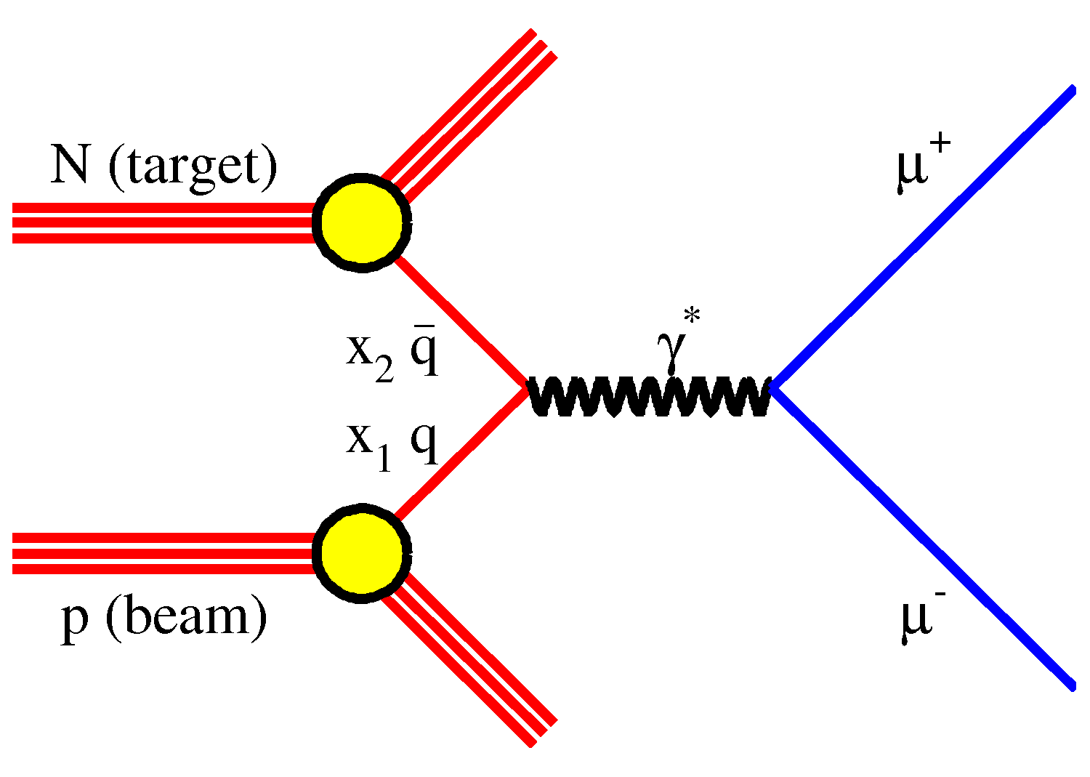
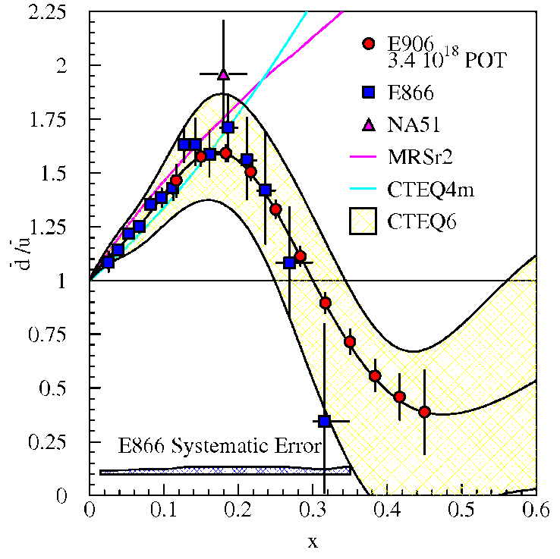
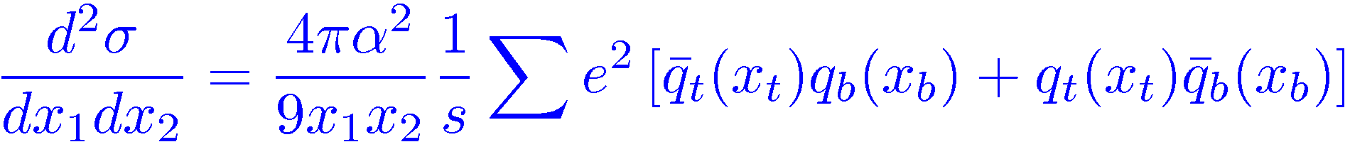
Drell-Yan measurement of anti-quark distributions
Sun 08:25 – SeaQuest - R. Evan McClellan
FNAL E906
No model predicts dbar/ubar <1.
Now underway
Notes:
Will also take data on nuclei in the EMC region above x = 0.3 Point to talk on Sunday morning

Slide 20
EMC experiments with 12 GeV
E12-14-002: Medium modifications of R and of separated structure functions
E12-10-008: ³⁻⁴He, ⁶⁻⁷Li, ¹⁰⁻¹¹B, Be, C, ⁴⁰⁻⁴⁸Ca, Cu
Notes:
Will also add to the World data set on EMC

Slide 21
Isospin-dependent EMC effect?
Notes:
Quark Meson Coupling Model (really: Nambu-Jona-Lasinio model, scalar and vector mean field (affects lower components more strongly -> spin effect). Strong enhancement in nuclear matter, partially offset by “weaker binding” of p_{3/2} proton in ⁷Li). Slide from W. Melnitchouk’s talk at Temple

Slide 22
Polarized EMC effect?
J. Smith, J. Miller Phys. Rev. C 72, 022203(R) (2005)
QMC
I. Cloët, W. Bentz, A. Thomas Phys.Lett. B642, 210 (2006)
H. Fanchiotti, et al.
arXiv:1404.3047 (2014)
Notes:
Quark Meson Coupling Model (really: Nambu-Jona-Lasinio model, scalar and vector mean field (affects lower components more strongly -> spin effect). Strong enhancement in nuclear matter, partially offset by “weaker binding” of p_{3/2} proton in ⁷Li)
Chiral Quark Soliton Model
x-rescaling+modified sea scheme (MSS) H. Fanchiotti, et al.
arXiv:1404.3047 (2014)

Slide 23
Polarized EMC effect?
Δσ Ratio
A|| Ratio
E12-14-001 with CLAS12 at JLab: Ratio of g₁ and A₁ for ⁷Li vs. free p
Notes:
50 days with 11 GeV beam + 5 days calibration. Approved by PAC42 with “B+”

Slide 24
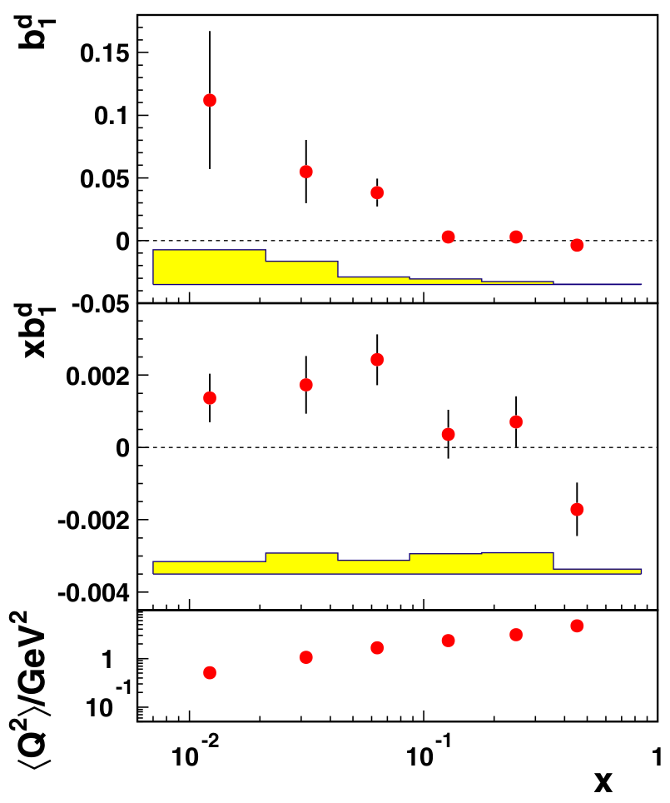
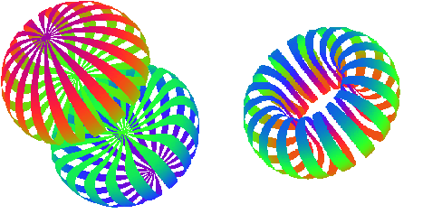
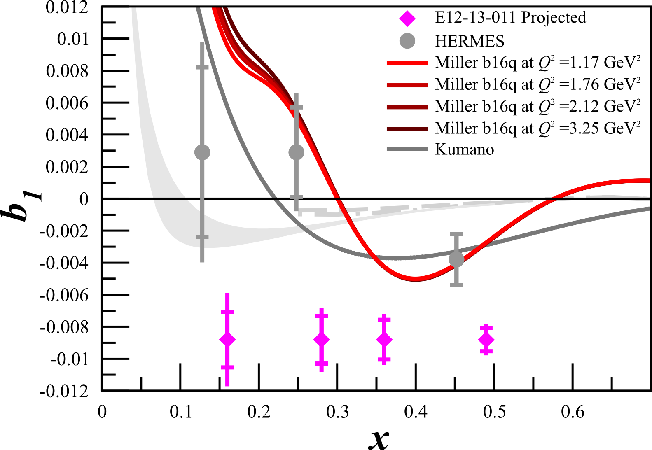

b₁ (See Fri 17:30 - Elena Long)
First Result from HERMES
Tensor $P_{zz}={(p}_{+}+p_{−})−2p_{0}$
( + )-2
Conventional Nuclear Models predict 0
C12-13-011

Slide 25
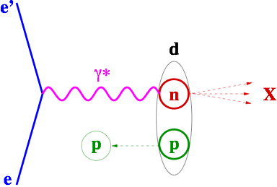
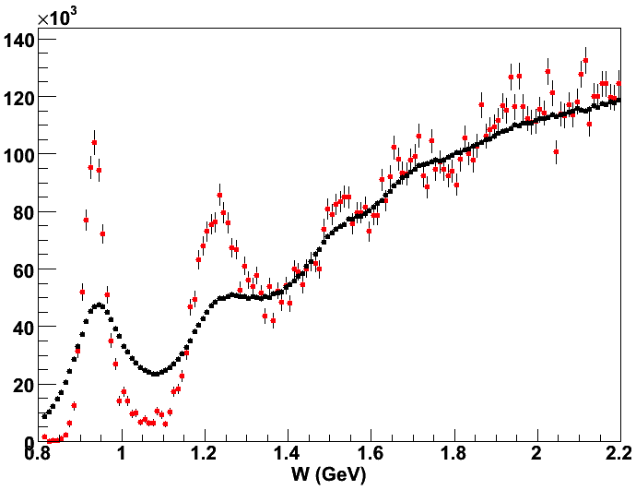
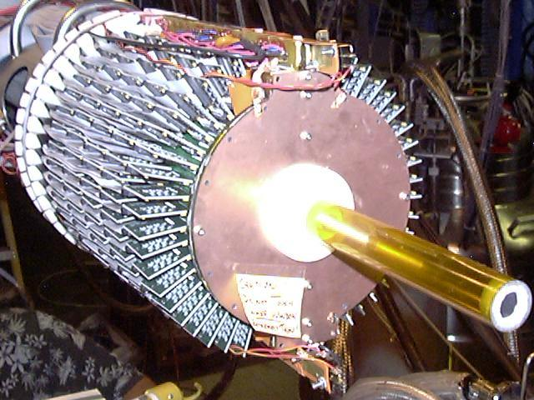
Spectator Tagging
d(e,e’ps)X
spectator
D(e,e’p_{s})X: Cts vs. W*
BONuS
D(e,e’)X: Cts vs. W
Notes:
Mention that can be used to get absolute F2n and therefore directly extract EMC effect = F2A / (Z*F2p + N*F2n), including for deuterium as shown earlier.

Slide 26
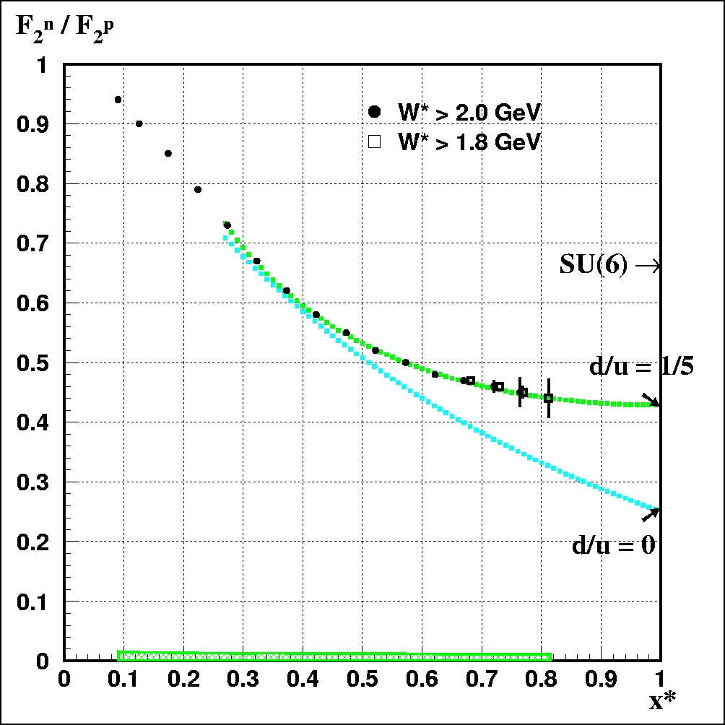
Using tagging to suppress binding effects: p_{S} < 100 MeV/c, θ_{Sq} > 110º
BoNuS 12 with CLAS12
MARATHON: ³H/³He (Hall A)
BONuS: spectator p tagging (Hall B)
PVDIS: SoLID (Hall A)
p_{s} < 100 MeV/c > 110º rel. to q
Notes:
Mention that Marathon uses a different approach: EMC-type effect largely cancels (if not strongly isospin-dependent), accesses SFs folded w/ Fermi; however, it will provide important data on isospin-dependence of EMC effect. Mention talk by Xiaochao Thursday morning.

Slide 27
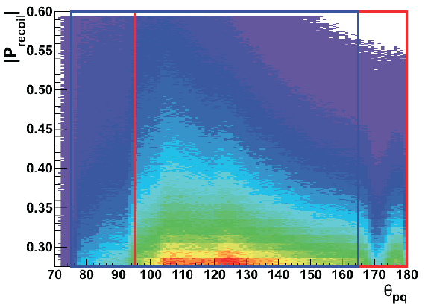
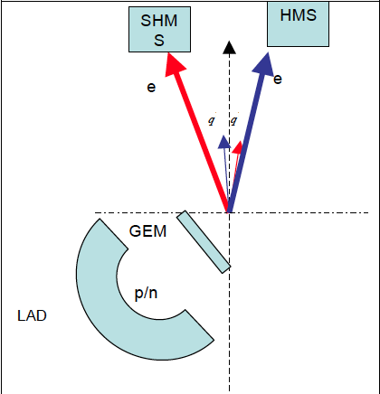
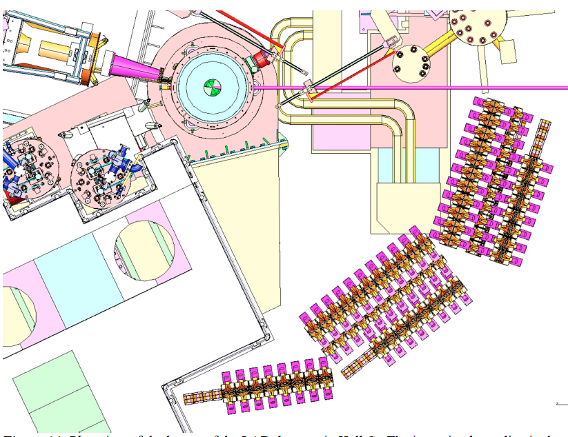
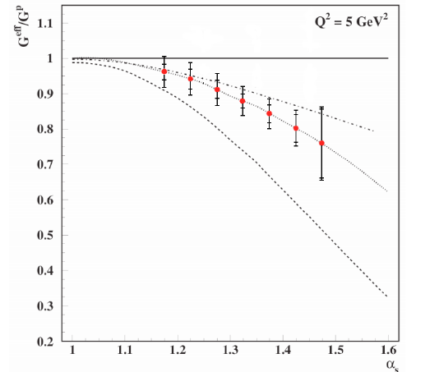
Using tagging to enhance binding effects: p_{S} > 300 MeV/c -> E12-11-107
O. Hen, L. Weinstein, S. Gilad, S. Wood
D(e,e’p_{s})X with HMS/SHMS and “LAD”
Notes:
Curves: Top = off-shell (binding), middle = Q2 rescaling, bottom = PLC suppression model; all from W. Melnitchouk, M. Sargsian, and M.I. Strikman, Z. Phys. A359 (1997) 99.
Based on Deeps (E6): Klimenko et al., PRC73 035212(2006)

Slide 28
Using tagging to enhance binding effects: n tagging -> Proposals to PAC43
O.Hen, L. Weinstein, E. Piasetzky, H. Hakobyan
D(e,e’n_{s})X with CLAS12 and “BAND”
Advantage: Very far backwards spectators; free p SF is precisely known
Notes:
Curves: Top = off-shell (binding), middle = Q2 rescaling, bottom = PLC suppression model; all from W. Melnitchouk, M. Sargsian, and M.I. Strikman, Z. Phys. A359 (1997) 99.

Slide 29
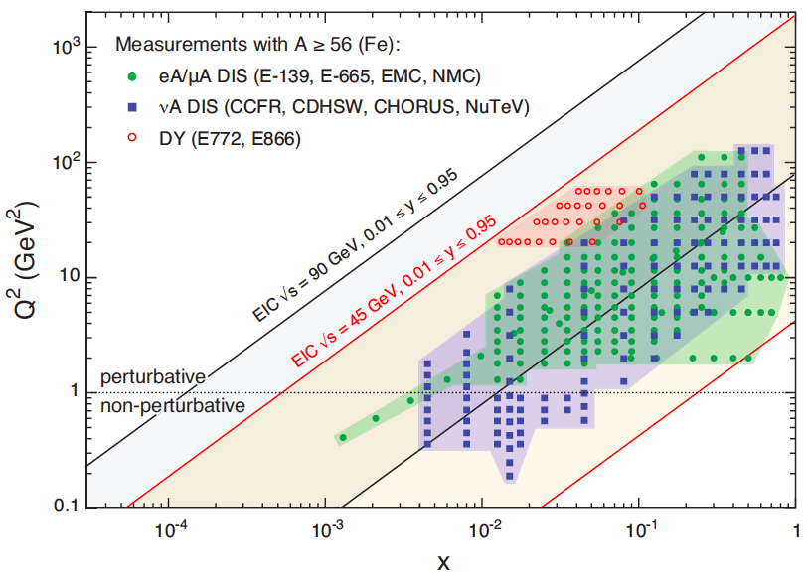
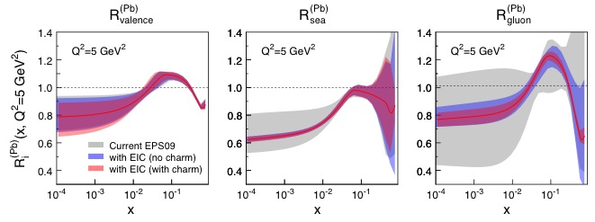
ElectronIonCollider
55 MeV off mass shell p = 220 MeV/c
Notes:
NOTE: Information on gluon shadowing will also come from LHC – ultraperipheral collisions equivalent to gamma-nuclear IA

Slide 30

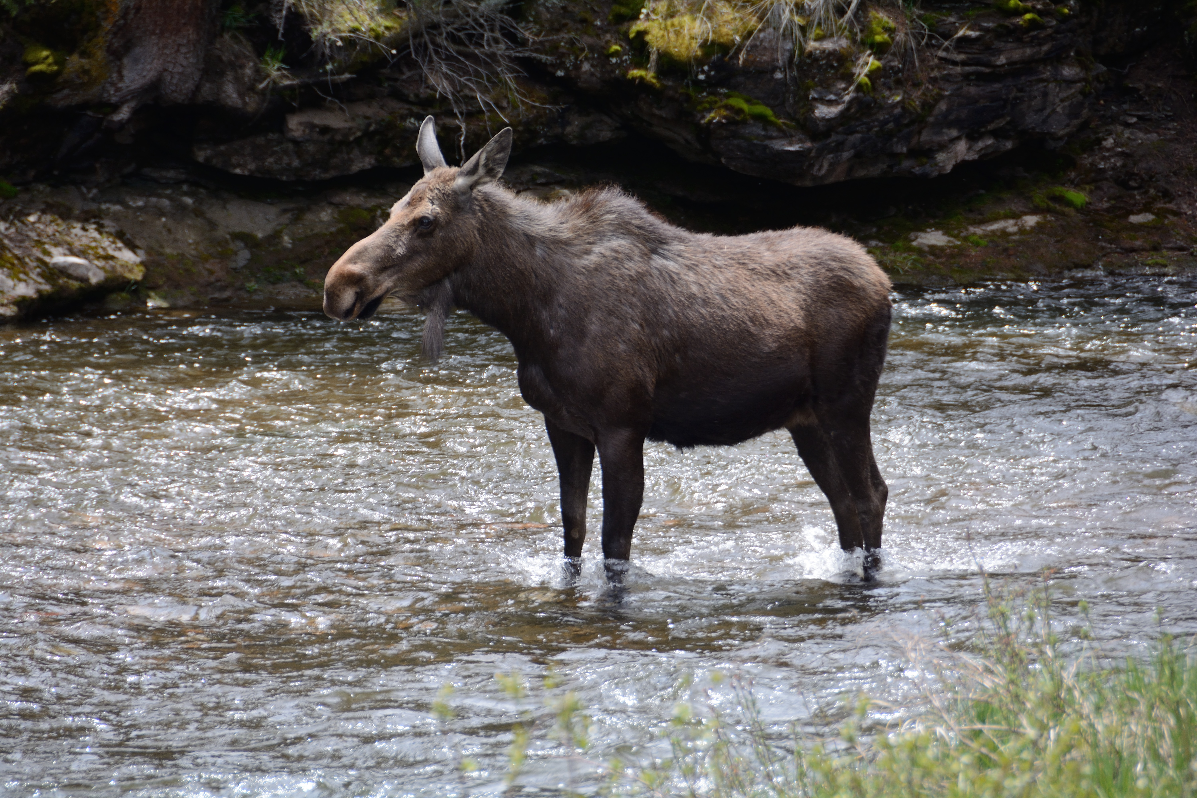
Summary and Outlook
30 years of data on the EMC effect – but no universally accepted theoretical description
Recently entered era of high precision, calculable nuclei and new probes
Rich experimental program at Jefferson Lab: Our best hope to finally figure it out
Beyond: EIC can make significant contributions
Notes:
Main issue: We need to get away from a cartoon image where either the nuclear structure is oversimplified or the QCD structure of nucleons is ignored to a realistic if more complex picture of hadrons in the nuclear medium.

Slide 31
Experimental Evidence
– a different view
12 GeV experiment to measure superfast quarks at high Q²
2%
Notes:
Point out shadowing, anti-shadowing, slope region and Fermi-enhancement

Slide 32
Shadowing in D?
Result of destructive interference among the amplitudes for the interaction with 1, 2, 3,… nucleons in the target
Expected to increase with spectator momentum in tagged SFs
Gives rise to 1% tensor asymmetry at small x
Work by V. Guzey

Slide 33
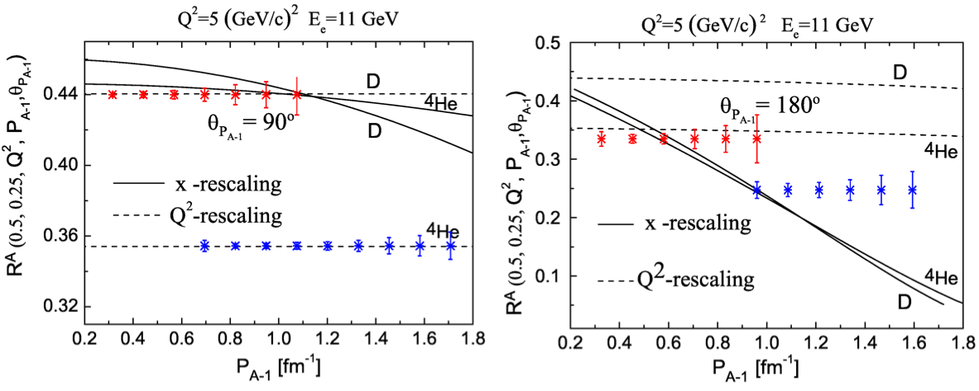
Tagged EMC Effect
Proposals to PAC44
N. Baltzel, R. Dupré, K. Hafidi, S. Stepanyan
Notes:
Advantage: Detect A-1 intact => minimize FSI, fragmentation. Direct access to “off-shell-ness” by itself; NOT sensitive to “SRC”. Also, by comparing 3He and 3H, can measure difference between bound n and p.

Slide 34

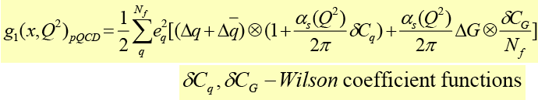
Inclusive lepton scattering
Callan-Gross
Wandzura-
Wilczek
Parton model: DIS can access
At finite Q²: pQCD evolution (q(x,Q²), Δq(x,Q²) ⇒ DGLAP equations), and gluon radiation
⇒ access to gluons.
p
SIDIS: Tag the flavor of the struck quark with the leading FS hadron ⇒ separate q_{i}(x,Q²), Δq_{i}(x,Q²)
H
Jefferson Lab kinematics: ⇒ target mass effects,
higher twist contributions and resonance excitations
Non-zero
Further Q²-dependence (power series in )
Traditional “1-D” Parton Distributions (PDFs)
(integrated over many variables)
Notes:
Spell out “SIDIS”

Slide 37
Unpolarized EMC effect in ⁷Li. The curves indexed with various numbers are the results from the same “Standard Nuclear Model” we used before, for 4 different Q² bins (in the kinematics of the proposed measurement). The dark blue curve is from the QMC model by Thomas/Cloët/Benz. The small inset is for “no offshell” (Fermi motion only).

Slide 38
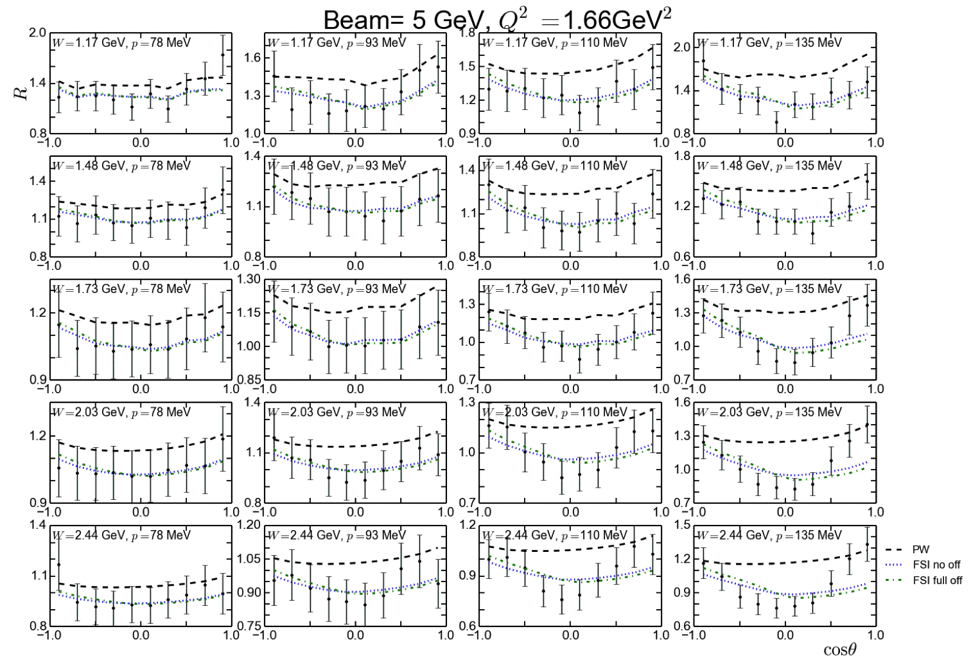
FSI (Example deuteron)
D(e,e’p_{s})X
(BONuS)
D(e,e’)X

Slide 39
Data with random variation

