Slide 1
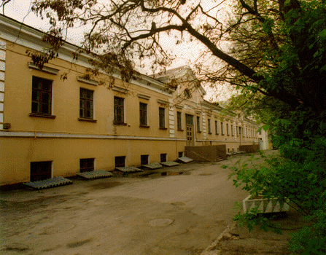

Photo-production of strange mesons with polarized photons and targets
XIV International Seminar on Electromagnetic Interactions of Nuclei,
Moscow October 5-8 2015
Eugene Pasyuk
Jefferson Lab

Slide 2
Outline
Some formalism
Experimental tools
Results
Summary

Slide 3
Bump?
SAPHIR data (1998) triggered discussionon “missing”D₁₃:
D₁₃(1890)?, P₁₁(1840)? D₁₃(1900)?... lots of other interpretations
CLAS got into the game
First CLAS measurements (g1c): dσ/dΩ, P, Cx, Cz
Confirmed bump around 1.9 GeV

Slide 4
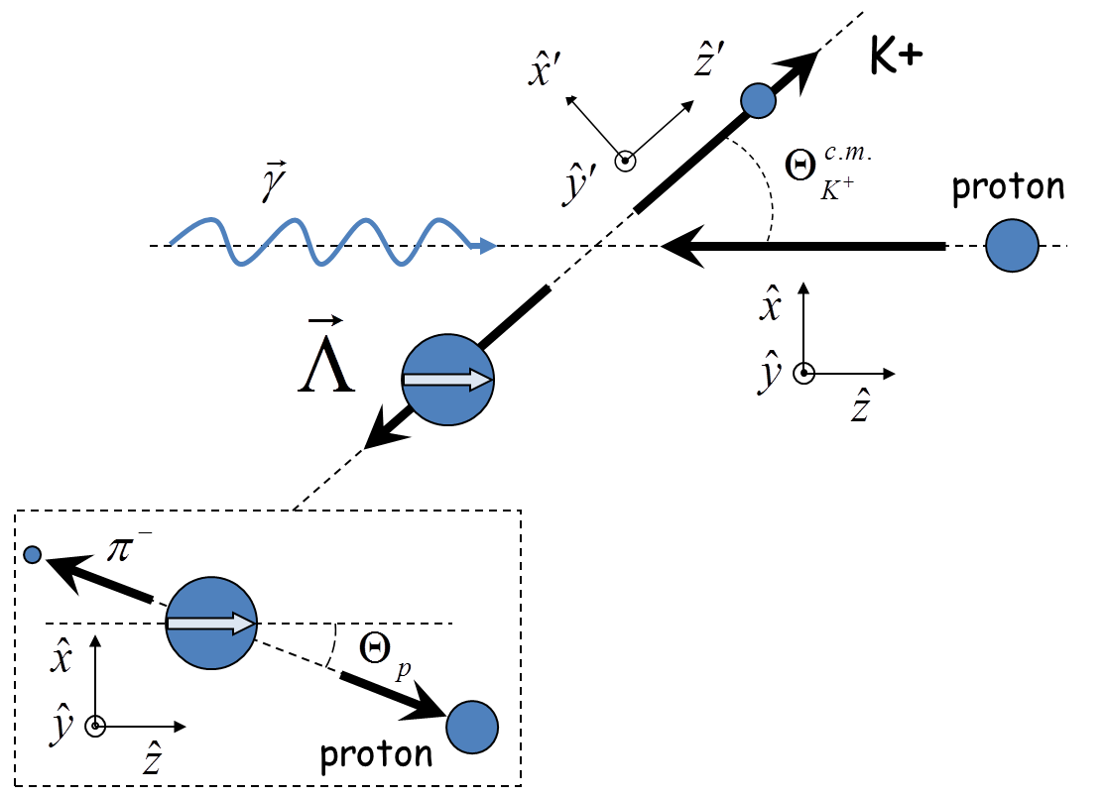
Kinematics

Slide 5
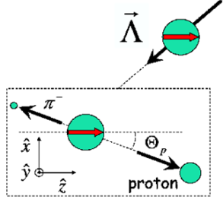
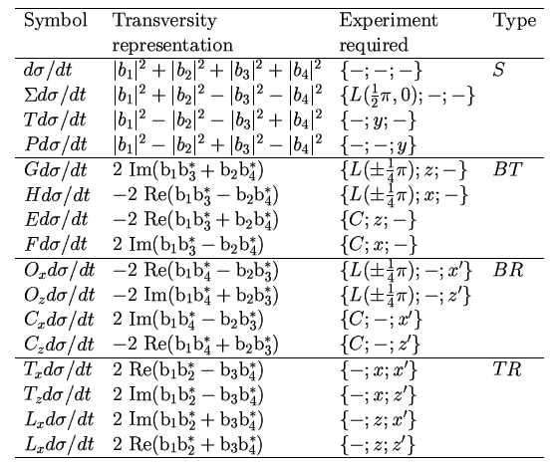
Polarization observables in pseudoscalar meson production
4 Complex amplitudes: 16 real polarization observables.
Complete measurement from 8 carefully chosen observables.
πN has large cross section but in KY recoil is self-analysing
☻
πN
KY
recoil targ γ
γ targ recoil
☻☻☻
☻☻☻
☻☻☻
☻☻☻
☻☻☻
☻☻☻
☻☻☻
☻☻☻
☻☻☻
I. S. Barker, A. Donnachie, J. K. Storrow, Nucl. Phys. B95 347 (1975).
circ polarized photons
longitudinally polarized target
linearly polarized photons
transversely polarized target

Slide 6
General cross section
single spin observables
Beam-Target
Beam-Recoil
Target-Recoil
A. M. Sandorfi, S. Hoblit, H. Kamano, T.-S. H. Lee J.Phys.G38:053001,2011

Slide 7
Oops!
There is no such thing as complete experiment!
Whatever we measure has uncertainties and they lead to ambiguities in fitting procedures.
“Uncertainty is an uncomfortable
position. But certainty is an
absurd one.”
― Voltaire

Slide 8
Fierz Identities

Slide 9
Experiments
Beam |  | Target |  |  | Recoil |  |  | Target + Recoil
 |  |  |  |  | x’ | y’ | z’ | x’ | x’ | x’ | y’ | y’ | y’ | z’ | z’ | z’
 |  | x | y | z |  |  |  | x | y | z | x | y | z | x | y | z
unpolarized | dσ₀ |  | T |  |  | P |  | T_{x’} |  | L_{x’} |  | Σ |  | T_{z’} |  | L_{z’}
P_{L}^{γ} sin(2φ_{γ}) |  | H |  | G | O_{x’} |  | O_{z’} |  | C_{z’} |  | E |  | F |  | -C_{x’}
P_{L}^{γ} cos(2φ_{γ}) | Σ |  | -P |  |  | -T |  | -L_{x’} |  | T_{z’} |  | -dσ₀ |  | L_{x’} |  | -T_{x’}
circular P_{c}^{γ} | dσ₀ | F |  | -E | C_{x’} |  | C_{z’} |  | -O_{z’} |  | G |  | -H |  | O_{x’}
Every observable can be measured in at least two different experiments.
It is important to measure both K⁺Λ and K⁺Σ⁰: Isospin filter
It is also important to do measurement on both proton and neutron target
There is no such things as redundant data!

Slide 10
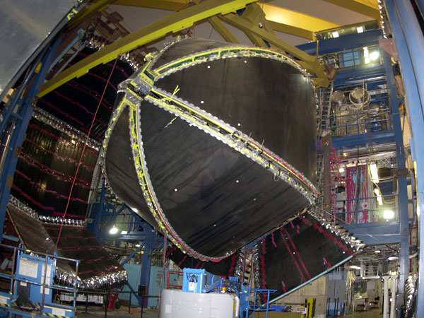
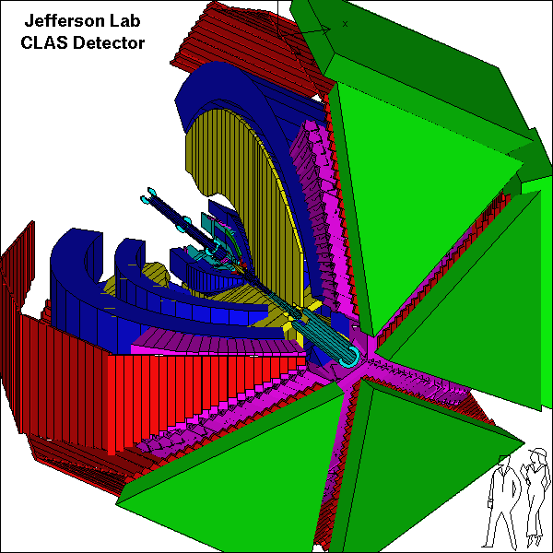
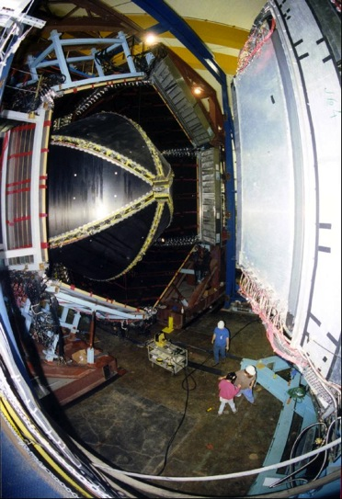
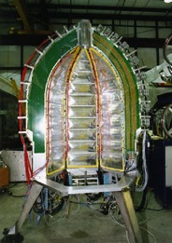
CEBAF Large Acceptance Spectrometer 1997-2012
Torus magnet
6 superconducting coils
Electromagnetic calorimeters
Lead/scintillator, 1296 photomultipliers
target + start counter
Drift chambers
35,000 cells
Time-of-flight counters
plastic scintillators, 684 photomultipliers
Gas Cherenkov counters
e/π separation, 256 PMTs

Slide 11
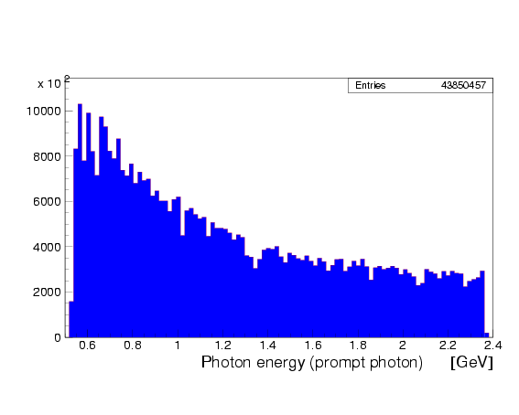
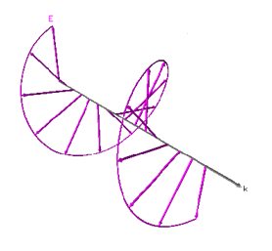
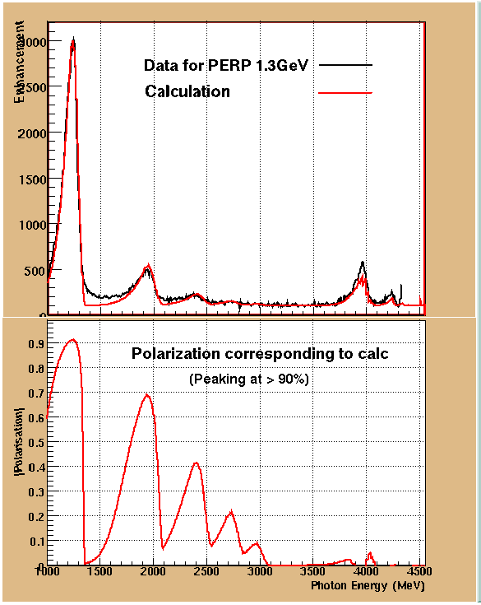
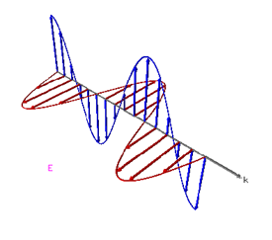
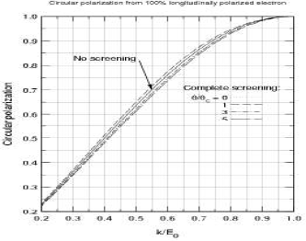
Polarized pohoton beam
Circular polarization from 100% polarized electron beam
Circular polarization
H. Olsen and L.C. Maximon, Phys. Rev. 114, 887 (1959)
Circularly polarized beam produced by longitudinally polarized electrons
Linearly polarized photons: coherent bremsstrahlung on oriented diamond crystal

Slide 12
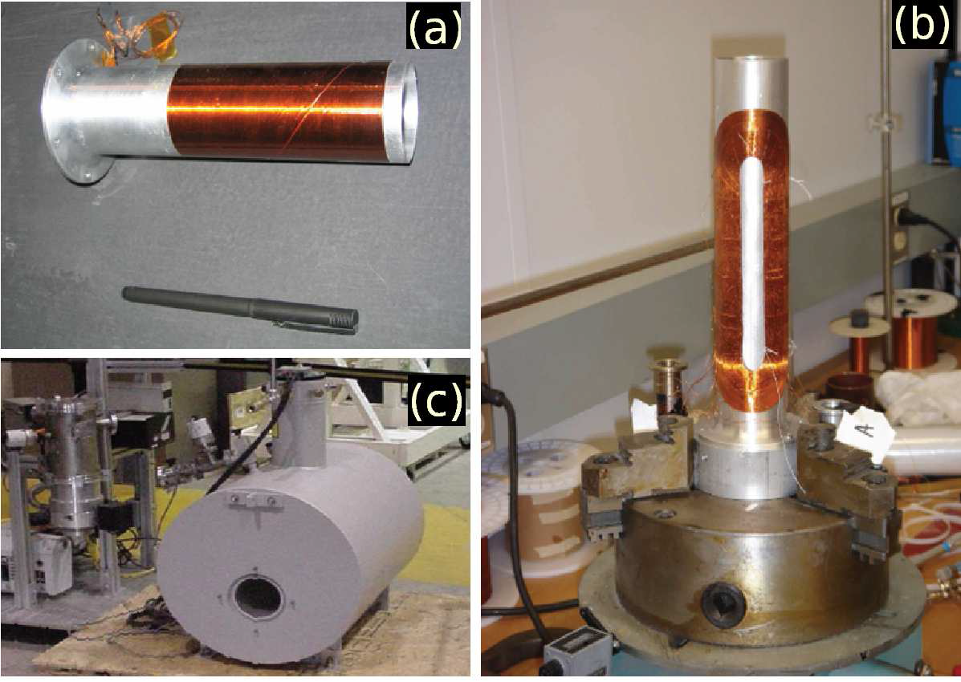
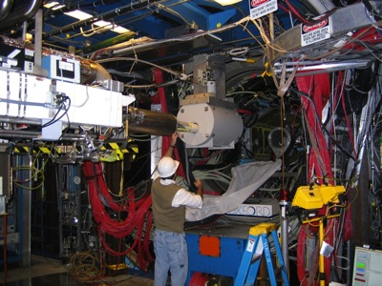
FROST

Slide 13
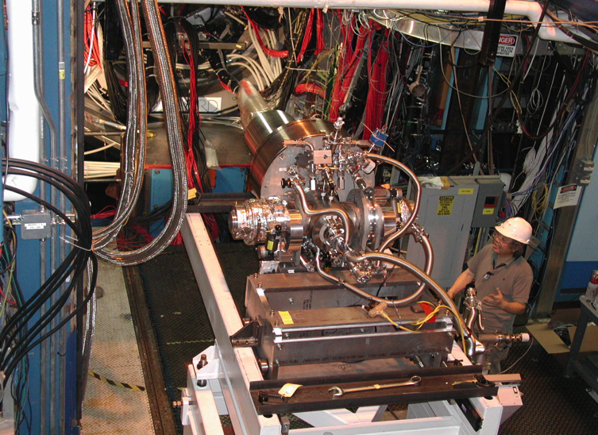
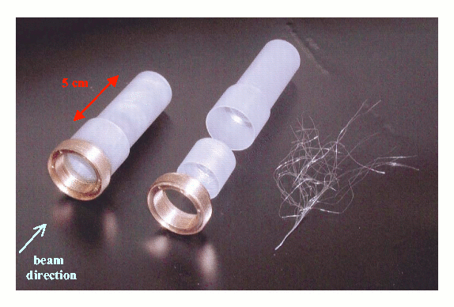
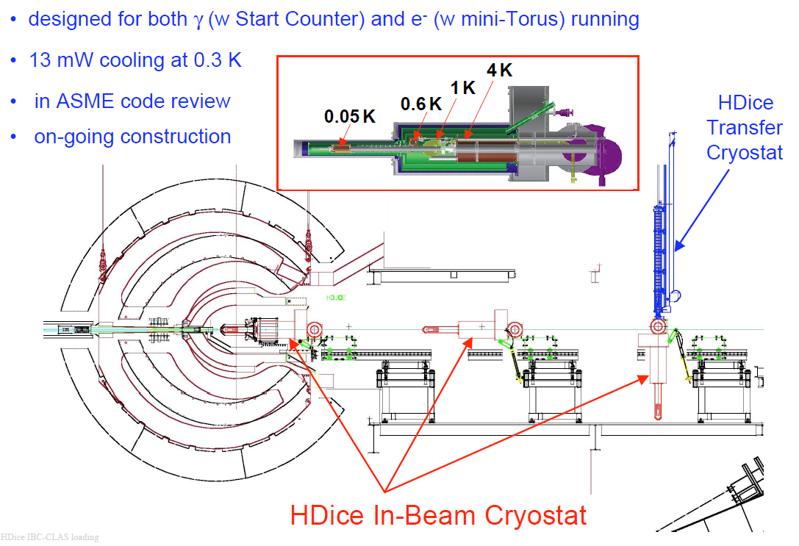
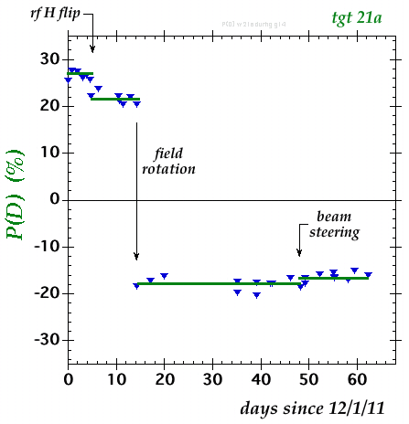
HDIce polarized target
Polarized at very high magnetic field and very low temperature
Transferred to in-beam cryostat
Spin can be moved between H and D with RF transitions
All material can be polarized with small background

Slide 14
CLAS Experiments: g1c, g11
Beam |  | Target |  |  | Recoil |  |  | Target + Recoil
 |  |  |  |  | x’ | y’ | z’ | x’ | x’ | x’ | y’ | y’ | y’ | z’ | z’ | z’
 |  | x | y | z |  |  |  | x | y | z | x | y | z | x | y | z
unpolarized | dσ₀ |  | T |  |  | P |  | T_{x’} |  | L_{x’} |  | Σ |  | T_{z’} |  | L_{z’}
P_{L}^{γ} sin(2φ_{γ}) |  | H |  | G | O_{x’} |  | O_{z’} |  | C_{z’} |  | E |  | F |  | -C_{x’}
P_{L}^{γ} cos(2φ_{γ}) | Σ |  | -P |  |  | -T |  | -L_{x’} |  | T_{z’} |  | -dσ₀ |  | L_{x’} |  | -T_{x’}
circular P_{c}^{γ} | dσ₀ | F |  | -E | C_{x’} |  | C_{z’} |  | -O_{z’} |  | G |  | -H |  | O_{x’}
unpolarized target
g1c – circularly polarized beam
g11 – unpolarized beam, high statistics

Slide 15
CLAS Experiments: g8b
Beam |  | Target |  |  | Recoil |  |  | Target + Recoil
 |  |  |  |  | x’ | y’ | z’ | x’ | x’ | x’ | y’ | y’ | y’ | z’ | z’ | z’
 |  | x | y | z |  |  |  | x | y | z | x | y | z | x | y | z
unpolarized | dσ₀ |  | T |  |  | P |  | T_{x’} |  | L_{x’} |  | Σ |  | T_{z’} |  | L_{z’}
P_{L}^{γ} sin(2φ_{γ}) |  | H |  | G | O_{x’} |  | O_{z’} |  | C_{z’} |  | E |  | F |  | -C_{x’}
P_{L}^{γ} cos(2φ_{γ}) | Σ |  | -P |  |  | -T |  | -L_{x’} |  | T_{z’} |  | -dσ₀ |  | L_{x’} |  | -T_{x’}
circular P_{c}^{γ} | dσ₀ | F |  | -E | C_{x’} |  | C_{z’} |  | -O_{z’} |  | G |  | -H |  | O_{x’}
linearly polarized beam

Slide 16
CLAS Experiments: g9a
Beam |  | Target |  |  | Recoil |  |  | Target + Recoil
 |  |  |  |  | x’ | y’ | z’ | x’ | x’ | x’ | y’ | y’ | y’ | z’ | z’ | z’
 |  | x | y | z |  |  |  | x | y | z | x | y | z | x | y | z
unpolarized | dσ₀ |  | T |  |  | P |  | T_{x’} |  | L_{x’} |  | Σ |  | T_{z’} |  | L_{z’}
P_{L}^{γ} sin(2φ_{γ}) |  | H |  | G | O_{x’} |  | O_{z’} |  | C_{z’} |  | E |  | F |  | -C_{x’}
P_{L}^{γ} cos(2φ_{γ}) | Σ |  | -P |  |  | -T |  | -L_{x’} |  | T_{z’} |  | -dσ₀ |  | L_{x’} |  | -T_{x’}
circular P_{c}^{γ} | dσ₀ | F |  | -E | C_{x’} |  | C_{z’} |  | -O_{z’} |  | G |  | -H |  | O_{x’}
Longitudinally polarized target

Slide 17
CLAS Experiments: g9b
Beam |  | Target |  |  | Recoil |  |  | Target + Recoil
 |  |  |  |  | x’ | y’ | z’ | x’ | x’ | x’ | y’ | y’ | y’ | z’ | z’ | z’
 |  | x | y | z |  |  |  | x | y | z | x | y | z | x | y | z
unpolarized | dσ₀ |  | T |  |  | P |  | T_{x’} |  | L_{x’} |  | Σ |  | T_{z’} |  | L_{z’}
P_{L}^{γ} sin(2φ_{γ}) |  | H |  | G | O_{x’} |  | O_{z’} |  | C_{z’} |  | E |  | F |  | -C_{x’}
P_{L}^{γ} cos(2φ_{γ}) | Σ |  | -P |  |  | -T |  | -L_{x’} |  | T_{z’} |  | -dσ₀ |  | L_{x’} |  | -T_{x’}
circular P_{c}^{γ} | dσ₀ | F |  | -E | C_{x’} |  | C_{z’} |  | -O_{z’} |  | G |  | -H |  | O_{x’}
transversely polarized target

Slide 18
CLAS Experiments: deuteron target
g10 unpolarized beam, unpolarized deuterium target
g13 circularly and linearly polarized beam on unpolarized deuterium target
g14 circularly and linearly polarized beam on longitudinally polarized HD target
final states with strangeness: K⁰Λ, K⁺Σ⁻

Slide 19
g11 cross sections and P
CLAS g11 data
A.V. Anisovich et al. EPJ. A (2011) 47: 27

Slide 20
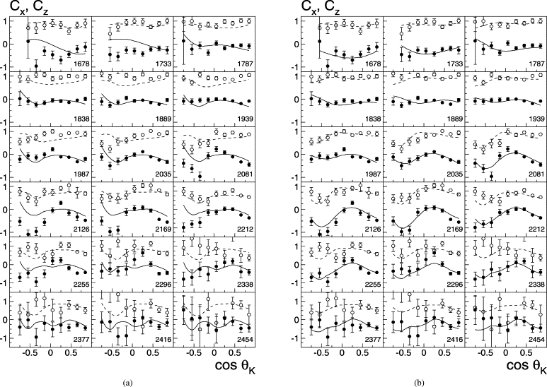
Polarization transfer Cx, Cz
without N(1900) 3/2⁺
with N(1900) 3/2⁺
Fits: BoGa-Model, V. A. Nikonov et al., Phys. Lett. B 662, 245 (2008)

Slide 21
Linearly polarized photons on unpolarized target: Comparison with other measurements
Experiment | Final State | W range (Gev) | Σ | P | T | Ox | Oz
CLAS g11 | K⁺Λ | 1.62 – 2.84 | N | Y | N | N | N
 | K⁺Σ⁰ | 1.69 – 2.84 | N | Y | N | N | N
LEPS | K⁺Λ | 1.94 – 2.30 | Y | N | N | N | N
 | K⁺Σ⁰ | 1.94 – 2.30 | Y | N | N | N | N
GRAAL | K⁺Λ | 1.64 – 1.92 | Y | Y | Y | Y | Y
 | K⁺Σ⁰ | 1.74 – 1.92 | Y | Y | N | N | N
CLAS g8 | K⁺Λ | 1.71 – 2.19 | Y | Y | Y | Y | Y
 | K⁺Σ⁰ | 1.75 – 2.19 | Y | Y | Y | Y | Y

Slide 22
Kinematical coverage comparison for Σ
CLAS g8
GRAAL
LEPS

Slide 23
Comparison with GRAAL and LEPS
CLAS g8
GRAAL
LEPS
UGlasgow

Slide 24
Comparison with CLAS g11
preliminary
UGlasgow

Slide 25
Ox/Oz
preliminary
preliminary
UGlasgow

Slide 26
Energy dependence: Σ
preliminary
preliminary
UGlasgow

Slide 27
Energy dependence: Ox
preliminary
preliminary
UGlasgow

Slide 28
Energy dependence: Oz
preliminary
preliminary
UGlasgow

Slide 29
Energy dependence: T
preliminary
preliminary
UGlasgow

Slide 30
Fierz identity check
preliminary
UGlasgow

Slide 31
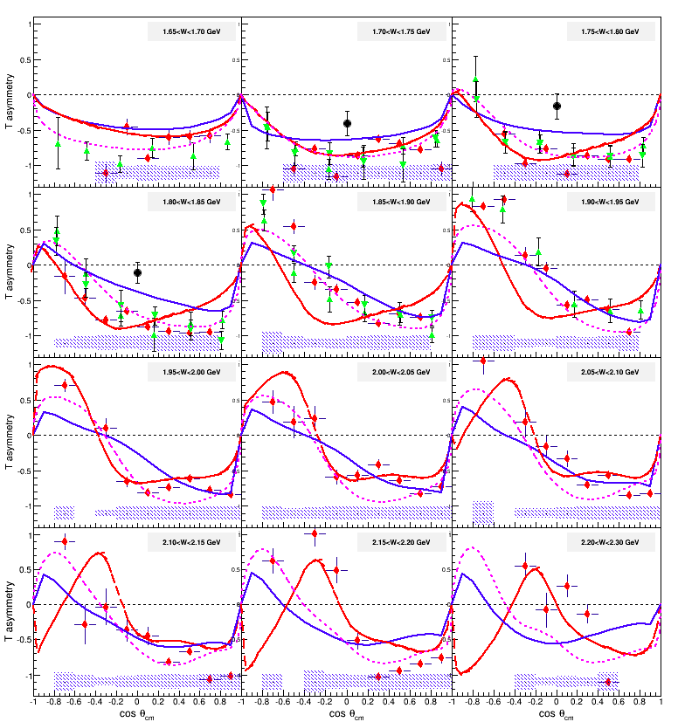
T for K⁺Λ
Data:
CLAS g9b
Bonn78
GRAAL09
Curves:
RPR-Ghent
Kaon-MAID
BOGA
preliminary

Slide 32
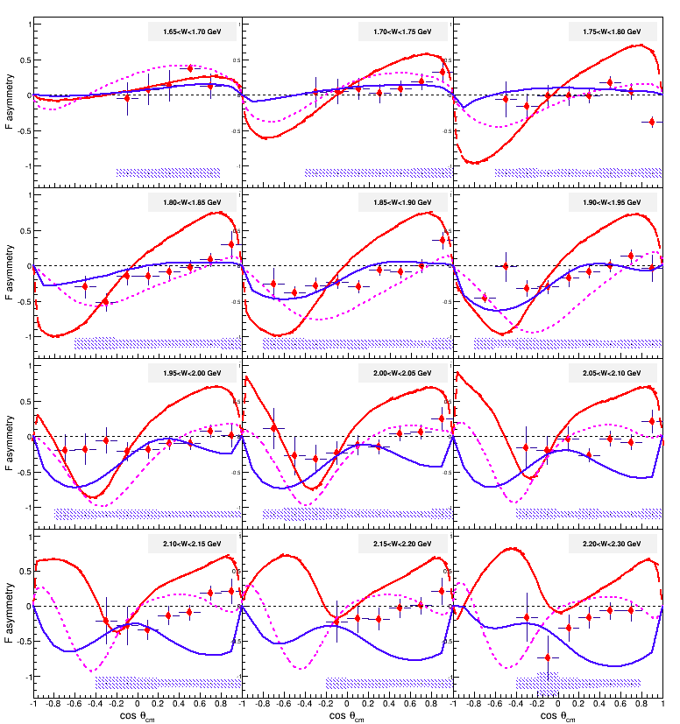
F for K⁺Λ
Data:
CLAS g9b
Curves:
RPR-Ghent
Kaon-MAID
BOGA
preliminary

Slide 33
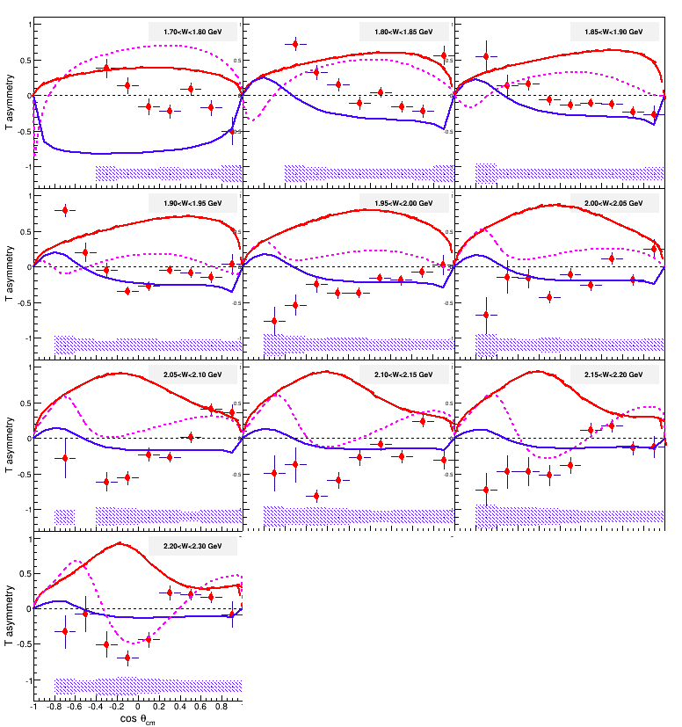
T for K⁺Σ⁰
Data:
CLAS g9b
Curves:
RPR-Ghent
Kaon-MAID
BOGA
preliminary

Slide 34
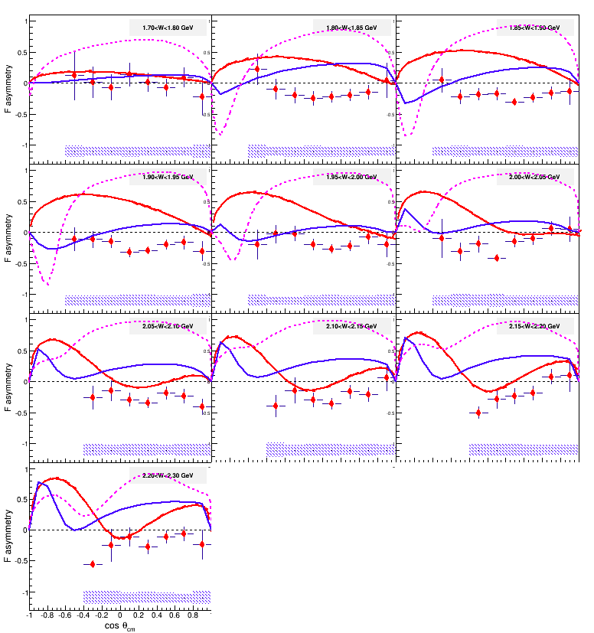
F for K⁺Σ⁰
Data:
CLAS g9b
Curves:
RPR-Ghent
Kaon-MAID
BOGA
preliminary

Slide 35
PDG
N* | J^{P}(L_{2I,2J}) | 2010 | 2012
N(1440) | 1/2⁺ (P11) | **** | ****
N(1520) | 3/2⁻ (D13) | **** | ****
N(1535) | 1/2⁻ (S11) | **** | ****
N(1650) | 1/2- (S11) | **** | ****
N(1675) | 5/2- (D15) | **** | ****
N(1680) | 5/2+ (F15) | **** | ****
N(1685) |  |  | *
N(1700) | 3/2- (D13) | *** | ***
N(1710) | 1/2+ (P11) | *** | ***
N(1720) | 3/2+ (P13) | **** | ****
N(1860) | 5/2+ |  | **
N(1875) | 3/2- |  | ***
N(1880) | 1/2+ |  | **
N(1895) | 1/2- |  | **
N(1900) | 3/2+ (P13) | ** | ***
N(1990) | 7/2+ (F17) | ** | **
N(2000) | 5/2+ (F15) | ** | **
N(2080) | D13 | **
N(2090) | S11 | *
N(2040) | 3/2+ |  | *
N(2060) | 5/2- |  | **
N(2100) | 1/2+ (P11) |  | *
N(2120) | 3/2- |  | **
N(2190) | 7/2- (G17)
N(2200) | D15 | **
N(2220) | 9/2+ (H19) | **** | ****
Major revision of the baryon table to large extent driven by new photoproducton data, particularly CLAS data.
The “bump” origin seems to be settled being attributed to N(1900) 3/2+
Other new states still require more confirmation

Slide 36
Summary
Polarization measurements in photoproduction of strangeness proved themselves to be a very important piece for understanding of the nucleon resonance spectrum.
There is no redundant data. Any data are useful.
Precision and consistency of the experimental data is of critical importance.
More interesting data are on the way for strange and non-strange meson production both on proton and deuteron targets.

Slide 37

Extras

Slide 38
Ox
preliminary

Slide 39
γp→K⁺Λ: cross section and P
g11: W=1.7 – 2.8 GeV
(unpolarized beam & target)
recoil polarization P
M.E. McCracken et al., PRC 81, 025201 (2010)

Slide 40
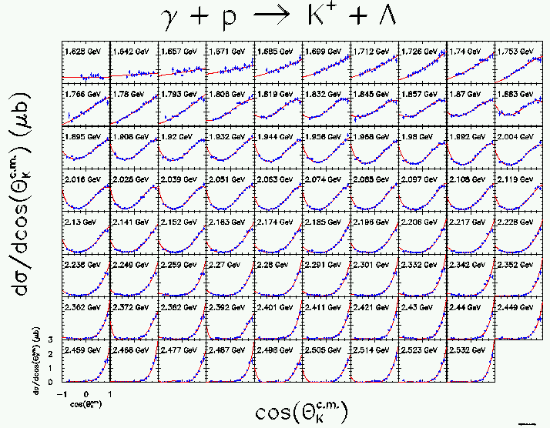
g1c xsec

Slide 41
SAPHIR data (1998) triggered discussionon “missing” D₁₃:
Mart-Bennhold: evidence for D₁₃(1890)
Saghai: bump in s due to u-channel and off-shell effects
Zhao: no need for D₁₃(~1900)
Janssen: s-p wave interference (P₁₁(1840))
SAID: no need for D₁₃(~1900)
Penner-Mosel: evidence for D₁₃(1900)
Waluyo-Bennhold: strong evidence for D₁₃(1950)
Sarantsev-Klempt: evidence for radial excitation of D₁₃(1520) at 1950 MeV
Mart: refit with multipole model: P₁₃(1900)
Torres-Meissner: KKN bound state
Nikonov: refit of Bonn-Gatchina model: P₁₃(1900)

Slide 42
Σ
preliminary

Slide 43
Oz
preliminary

Slide 44
g8 Target asymmetry T
preliminary

Slide 45
Experiments
Beam |  | Target |  |  | Recoil |  |  | Target + Recoil
 |  |  |  |  | x’ | y’ | z’ | x’ | x’ | x’ | y’ | y’ | y’ | z’ | z’ | z’
 |  | x | y | z |  |  |  | x | y | z | x | y | z | x | y | z
unpolarized | dσ₀ |  | T |  |  | P |  | T_{x’} |  | L_{x’} |  | Σ |  | T_{z’} |  | L_{z’}
P_{L}^{γ} sin(2φ_{γ}) |  | H |  | G | O_{x’} |  | O_{z’} |  | C_{z’} |  | E |  | F |  | -C_{x’}
P_{L}^{γ} cos(2φ_{γ}) | Σ |  | -P |  |  | -T |  | -L_{x’} |  | T_{z’} |  | -dσ₀ |  | L_{x’} |  | -T_{x’}
circular P_{c}^{γ} | dσ₀ | F |  | -E | C_{x’} |  | C_{z’} |  | -O_{z’} |  | G |  | -H |  | O_{x’}
Every observable can be measured in at least two different experiments
It is important to measure both K⁺Λ and K⁺Σ⁰: Isospin filter
It is also important to do measurement on both proton and neutron target

