Slide 1
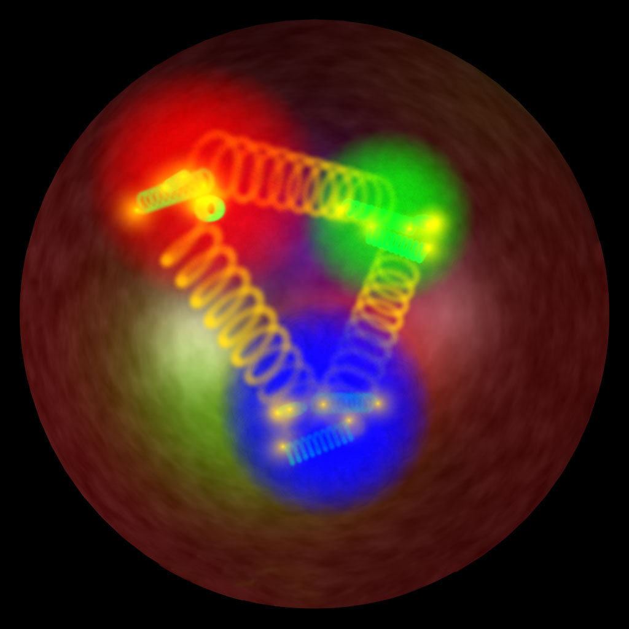
QCD2016, 05/07/2016
Generalized Parton Distributions
of the nucleon
Michel Guidal (IPN Orsay)

Slide 2
y
ep a eX
(DIS)
z
(Parton Distribution
Functions: PDF)
x

Slide 3
y
ep a eX
(DIS)
z
(Parton Distribution
Functions: PDF)
x
y
ep a ep
(elastic)
z
(Form Factors: FFs)
x

Slide 4
y
ep a eX
(DIS)
z
(Parton Distribution
Functions: PDF)
x
y
ep a ep
(elastic)
z
(Form Factors: FFs)
x
ep a epγ
(DVCS)
z
x

Slide 5
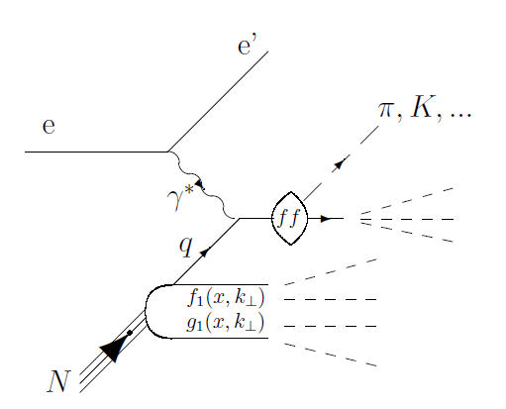
y
ep a eX
(DIS)
z
(Parton Distribution
Functions: PDF)
x
y
ep a ep
(elastic)
z
(Form Factors: FFs)
x
ep a epγ
(DVCS)
z
x
(Generalized Parton
Distributions: GPDs)
ep a eπX
(SIDIS)
z
(Transverse Momentum
Dependent PDFs: TMDs)
x

Slide 6
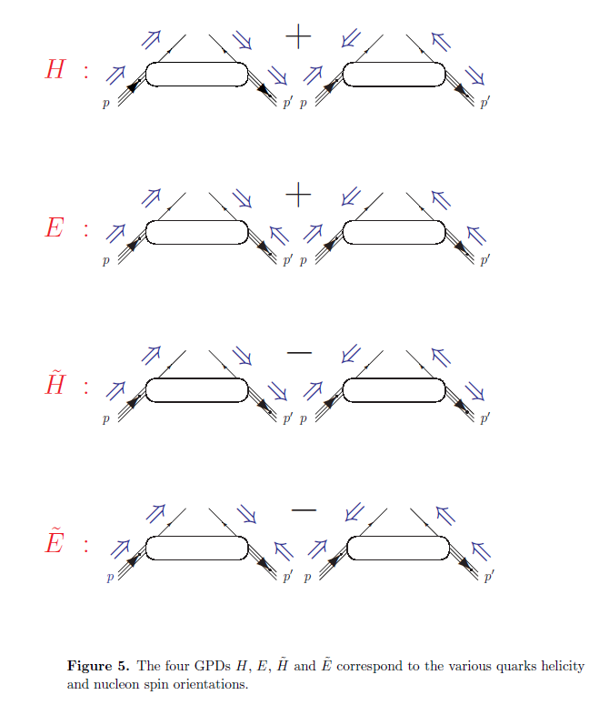

Slide 7
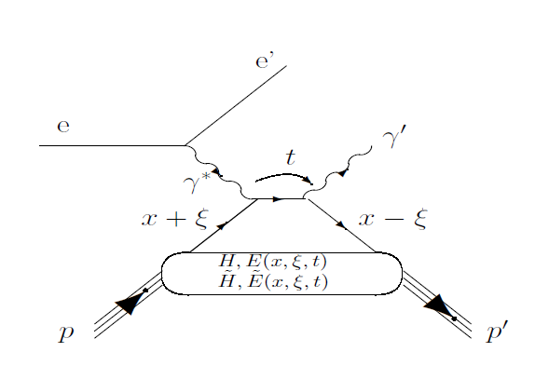
In the light-cone frame:
x+ξ : relative longitudinal momentum of initial quark
x-ξ : relative longitudinal momentum of final quark
t=Δ² : total squared momentum transfer to the nucleon
(transverse component: )

Slide 8
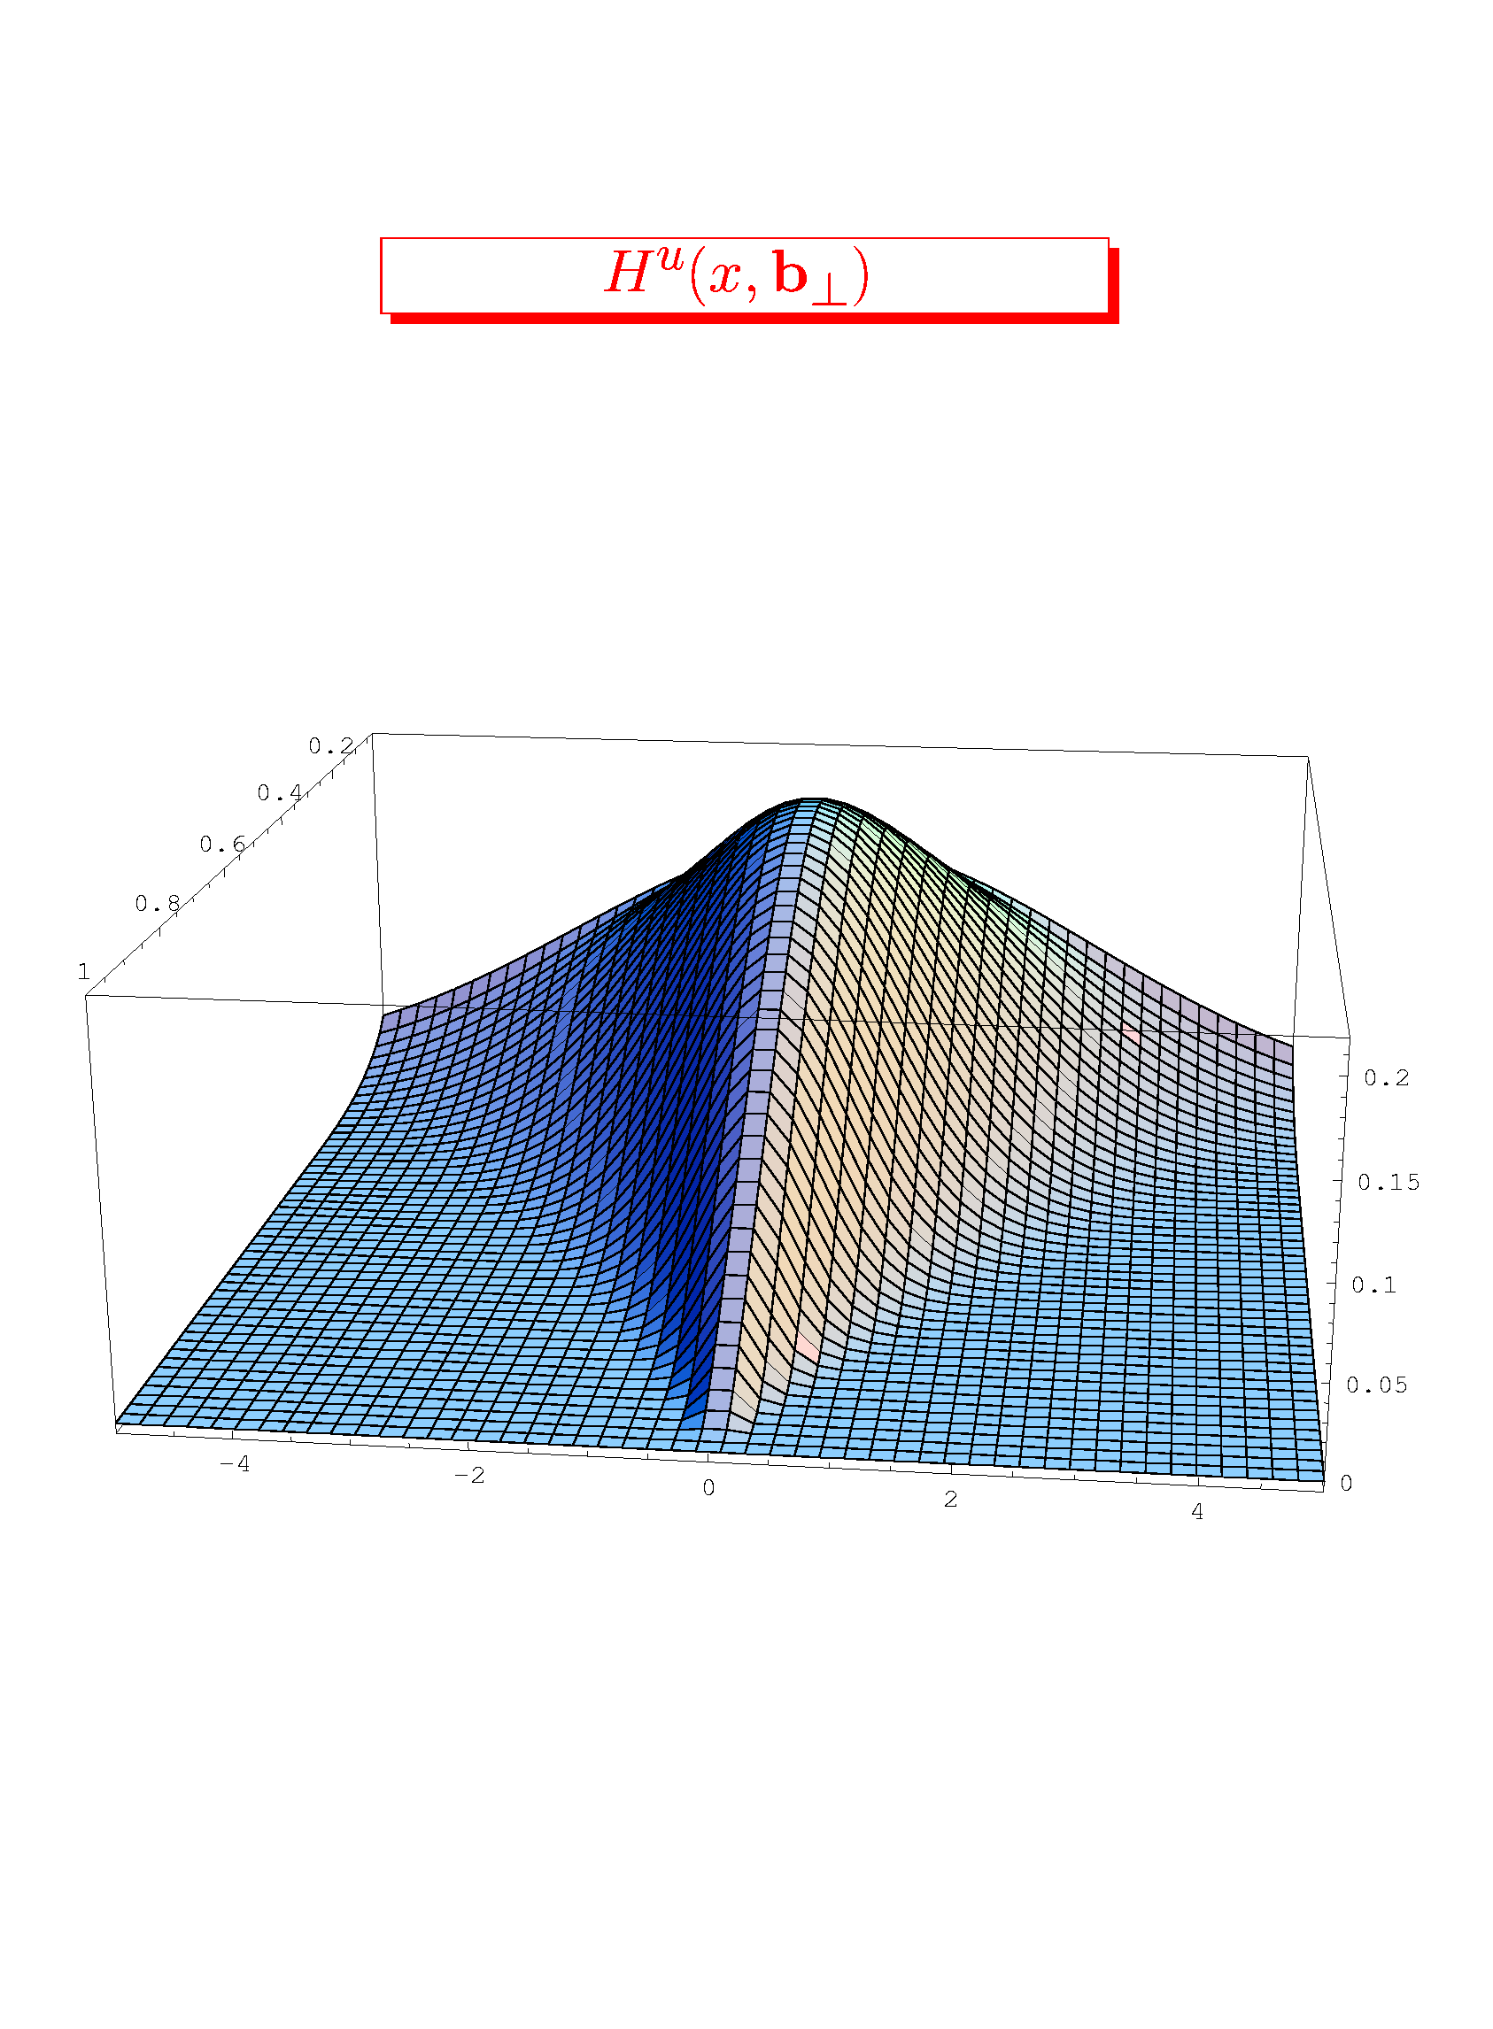
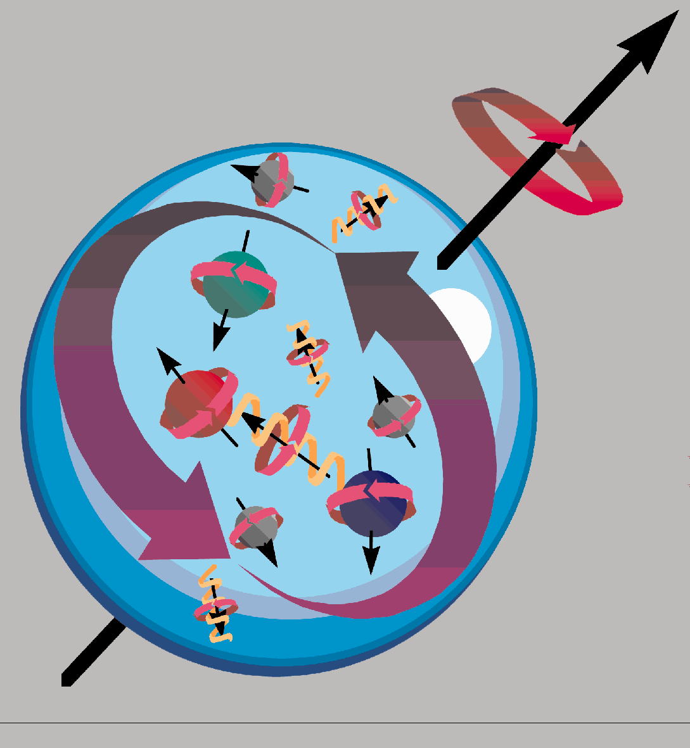
GPDs or the tomography of the nucleon
H^{u}(x,b )
y
z
x
_{x}
_{(GeV}⁻¹₎
_{b}
Ji’s sum rule
2J_{q} = ∫ x(H+E)(x,ξ,0)dx

Slide 9
γ
DVCS
Bethe-Heitler
e’
φ
e
leptonic plane
N’
hadronic
plane
GPDs
ξ= x_{B}/(2-x_{B}) k=-t/4M²
Polarized beam, unpolarized target (BSA) :
~
~
Δσ_{LU} ~ sinφ Im{F₁H + ξ(F₁+F₂)H -kF₂E}dφ
Im{H_{p}, H_{p}, E_{p}}
Unpolarized beam, longitudinal target (lTSA) :
~
~
~
Im{H_{p}, H_{p}}
Δσ_{UL} ~ sinφIm{F₁H+ξ(F₁+F₂)(H + x_{B}/2E) –ξkF₂ E+…}dφ
Polarized beam, longitudinal target (BlTSA) :
~
~
Re{H_{p}, H_{p}}
Δσ_{LL} ~ (A+Bcosφ)Re{F₁H+ξ(F₁+F₂)(H + x_{B}/2E)…}dφ
Unpolarized beam, transverse target (tTSA) :
Δσ_{UT} ~ cosφIm{k(F₂H – F₁E) + ….. }dφ
Im{H_{p}, E_{p}}
Notes:
nDVCS complements pDVCS for the different sensitivity to GPDs of the various observables

Slide 10
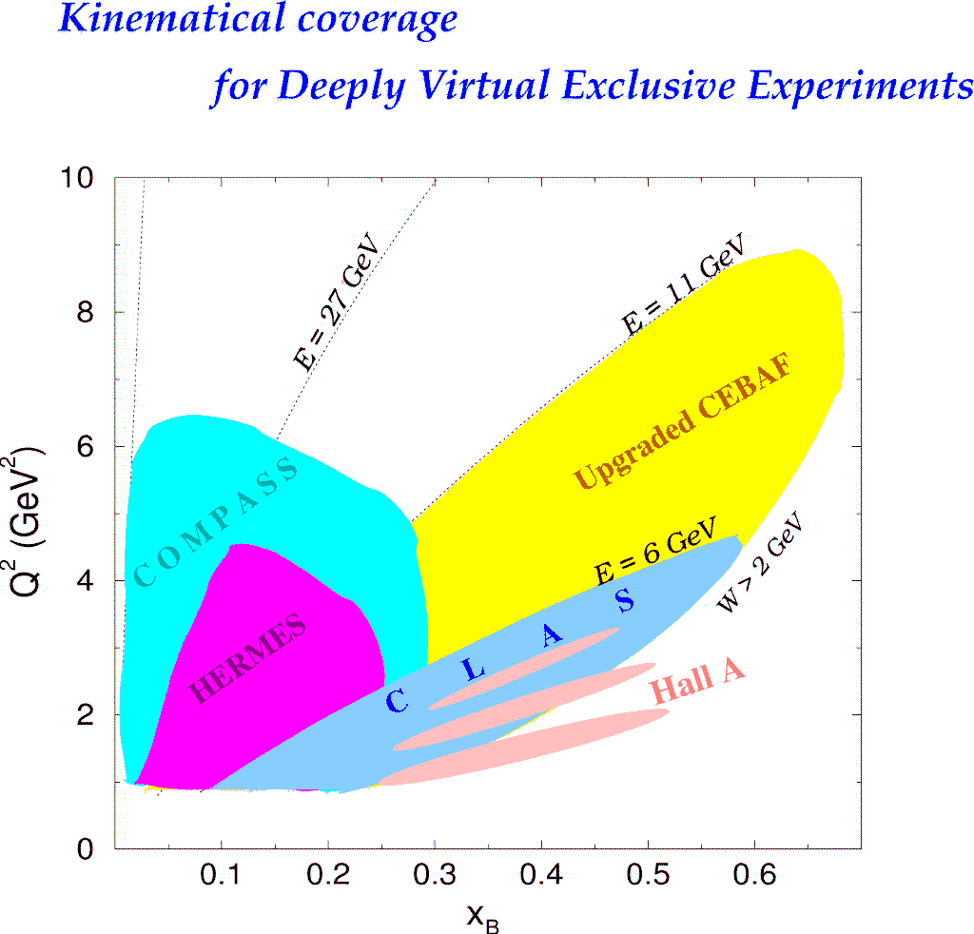

Slide 11
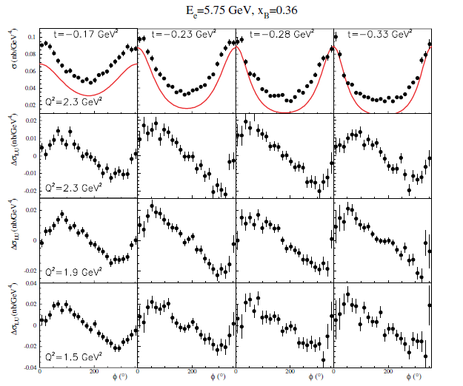
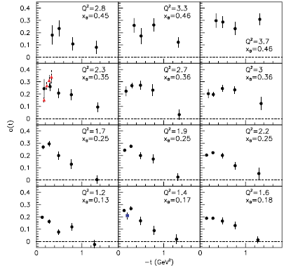
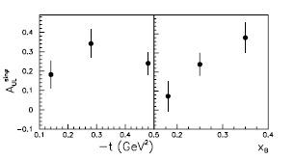
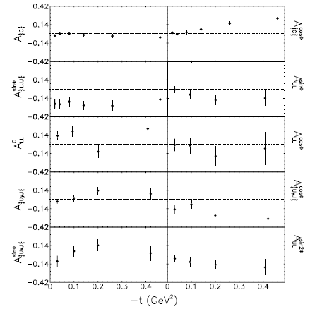
JLab
Hall A
DVCS
B-pol. X-section
DVCS
unpol. X-section
JLab
CLAS
DVCS
BSA
DVCS
lTSA
HERMES
DVCS
BSA,lTSA,tTSA,BCA
Notes:
Etat des lieux pour les donnees DVCS (AVANT les nouvelles donnees 2015 de CLAS; voir slide 16 pour ces nouvelles donnees)

Slide 12
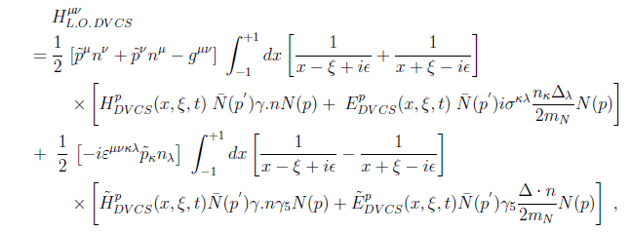
From data to GPDs (CFFs):
Deconvolution/
Fitting algorithms:

Slide 13
M.G., H. Moutarde,
M. Vanderhaeghen
Rept.Prog.Phys. 76 (2013) 066202

Slide 14
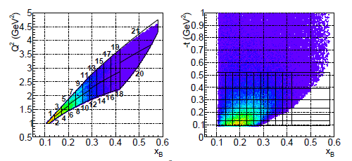
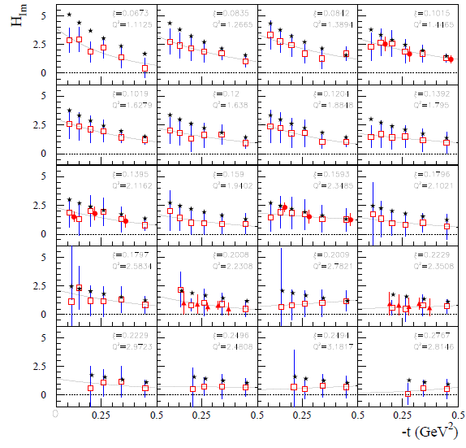
New recent data from JLab:
CLAS coll.
PRL 115 (2015), 212003
Hall A coll.
PRC92 (2015), 055202
CLAS coll.
PRL 114 (2015), 032001
CLAS coll.
PRD91 (2015), 052014
R. Dupré, M.G., M. Vanderhaeghen
arXiv:1606.07821 [hep-ph]

Slide 15
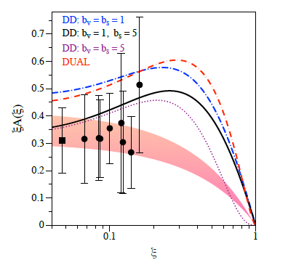
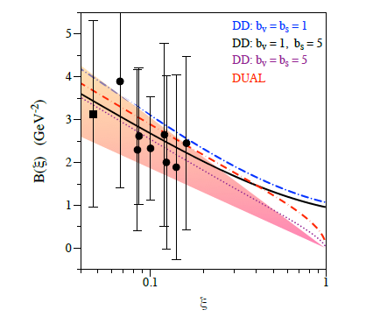

Slide 16
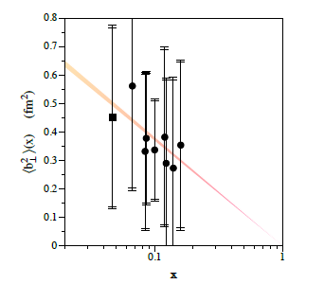
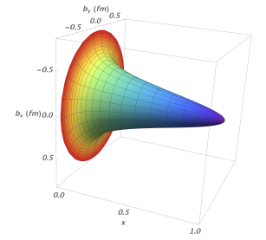
If
Up to (model-dependent) « deskewing effects » (a few percent) :
« Integrated » radius from elastic form factor F1:

Slide 17
The axial charge (H_{im}) appears to be more « concentrated » than the electromagnetic charge (H_{im})
~
Confirmed by new CLAS A_UL and A_LL data: Phys.Rev. D91 (2015) 5, 052014
Notes:
Resultats pour HtildeIm

Slide 18
GPDs contain a wealth of information on nucleon structure
and dynamics: space-momentum quark correlation, orbital
momentum, pion cloud, pressure forces within the nucleon,…
Large flow of new observables being released and
new data expected soon (JLab6,JLab12,COMPASS)
(Other DVCS-related processes planned for JLab 12 GeV
(TCS, DDVCS)
First new insights on nucleon structure already emerging
from current data with new fitting algorithms
Theory developments: higher twists, target mass corrections,
NLO corrections, …

