Slide 1
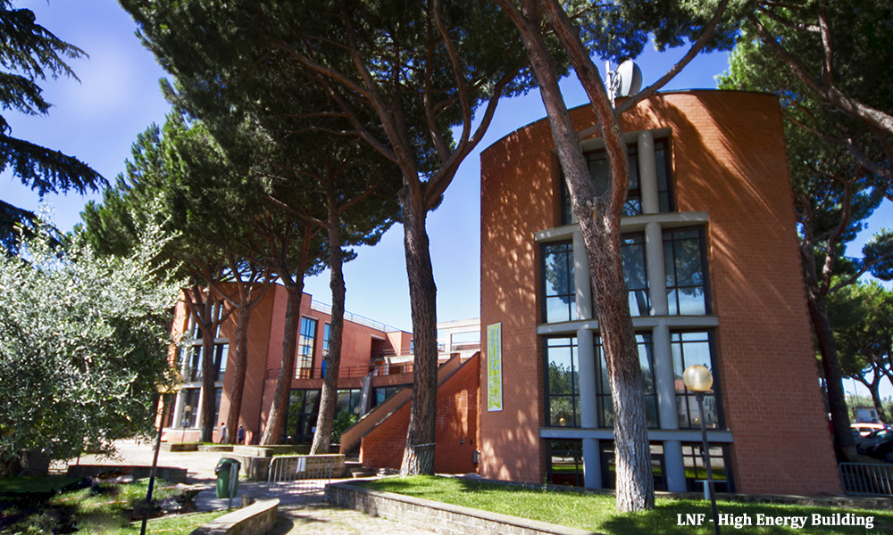
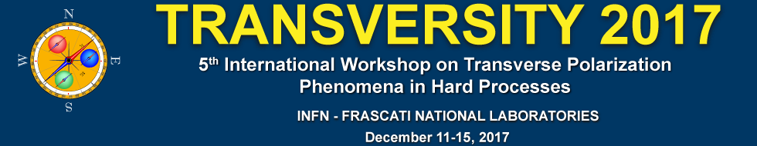
TMDs and spin asymmetries in SIDIS
Harut Avakian (JLab)
December 11, 2017

Slide 2
Outline
Introduction
SSA and azimuthal distributions
Accessing flavor and spin dependence
Complementarity of SIDIS experiments
Experimental factors affecting extraction of SFs
The experiment
Efficiency and acceptance
Vector meson contributions
Radiative Corrections
Testing procedure using MC
Optimizing the data output for 3D PDF studies
Extraction and Validation Framework (EVA) for 3D PDFs
example for DIS
Summary

Slide 3
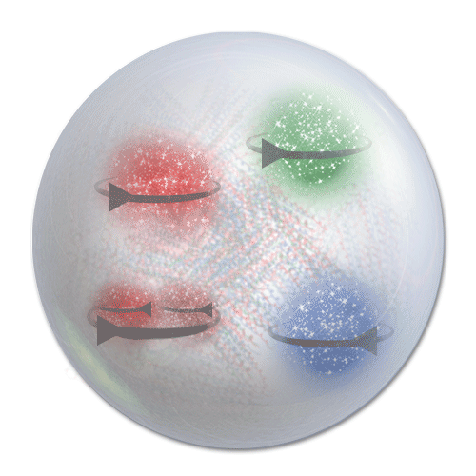
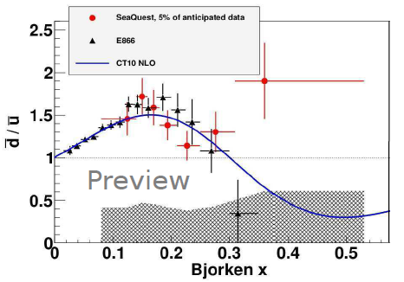
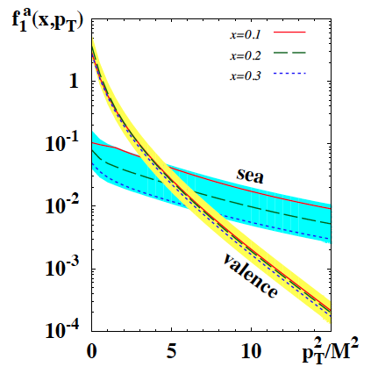
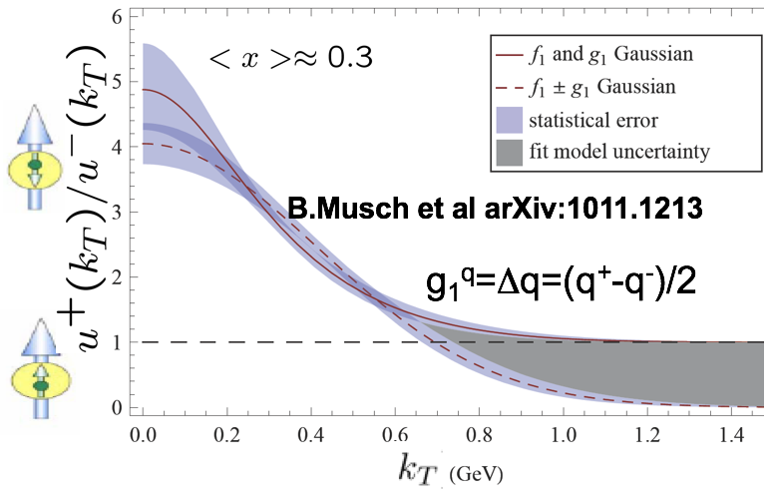
Features of partonic 3D non-perturbative distributions
Large flavor asymmetry of sea indicates non-perturbative sea plays a major
Predictions from dynamical models and lattice suggest that orbital structure of partonic distributions depend on flavor and spin.
P.Schweitzer et al. arXiv:1210.1267
Spin and momentum of struck quarks may be correlated with remnant
Correlations of spins of q-q-bars with valence quark spin and transverse momentum should lead to observable effects
0 0.5 1.0

Slide 4
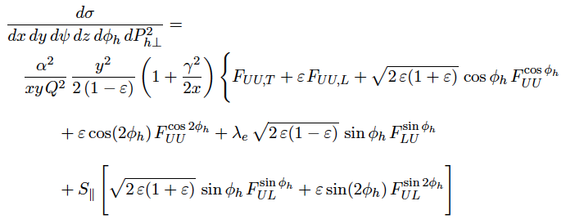
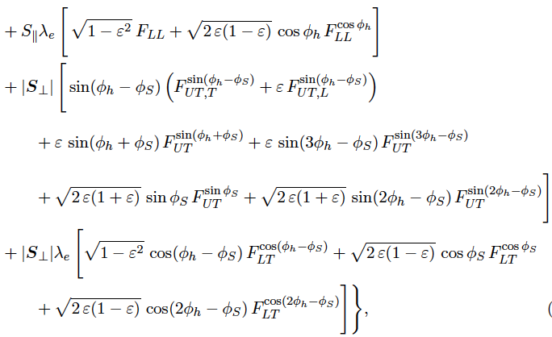
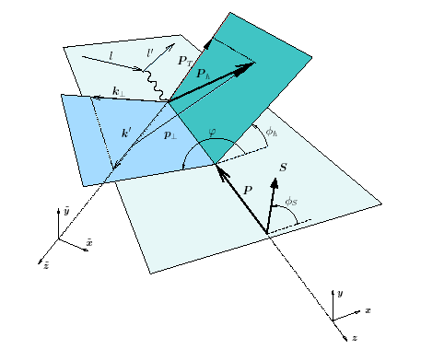

SIDIS x-section
p┴
P_{hT} = p┴ +z k┴
or
or any representation of structure functions!!!
Notes:
F_{UU,T}=x\sum_q e_q^2 \int d^2\bold{p_\perp}d^2\bold{k_{\perp}}\delta^{(2)}(zk_{\perp}+p_{\perp}-P_{hT})f^q(x,k_{\perp})D^{q\rightarrow h}(z,p_{\perp})

Slide 5
Experiment-Theory interaction
Theorist predicts effects and observables sensitive to them
Experimentalists submit a proposal and make measurement (~3-4 years)
Observables in form of a table bin# <average kin> | observable | <err>stat | <err>syst
Experiment measures “unexpected” effects
Theorist come up with possible interpretation
Description of data is necessary, but not sufficient!
What will be the most efficient format for the data (and metadata)?
Data required for certain analysis may require event by even info
How to store and preserve the data (for unbinned analysis)
Alternative to store full events (all tracks)
  Should provide easy access for theory)

Slide 6
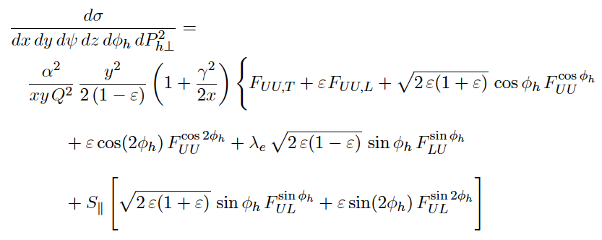
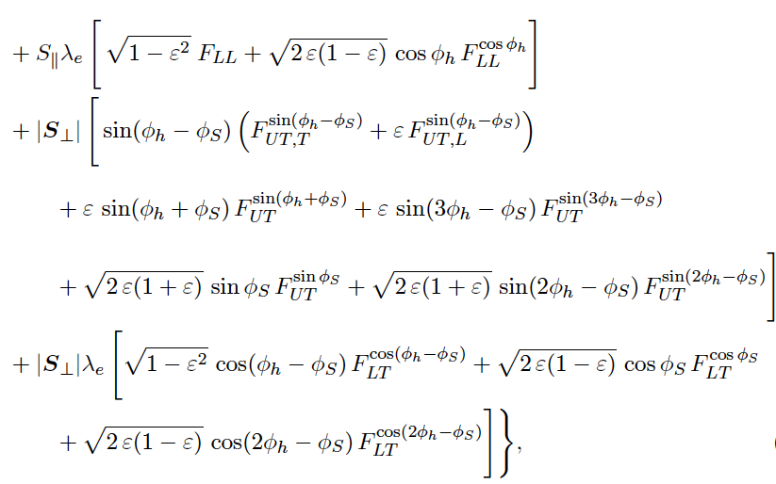
Nucleon structure & TMDs at leading twist
Extraction of leading twist TMDs limited to formalism accounting for only leading twists will require some mechanisms for controlling the systematics (measure and simulate background effects).
what
6

Slide 7
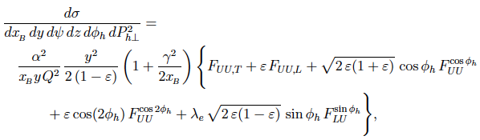
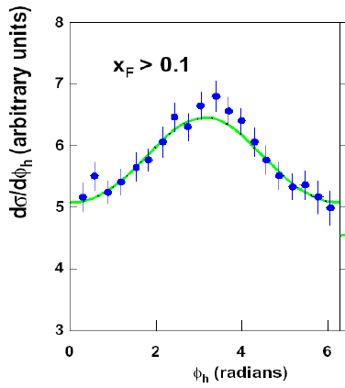
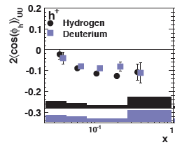
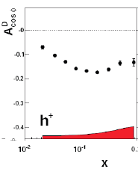
Higher twists in azimuthal distributions in SIDIS
HT
EMC (1987)
Large cosφ modulations observed by EMC were reproduced in electroproduction of hadrons in SIDIS with unpolarized targets at COMPASS and HERMES

Slide 8

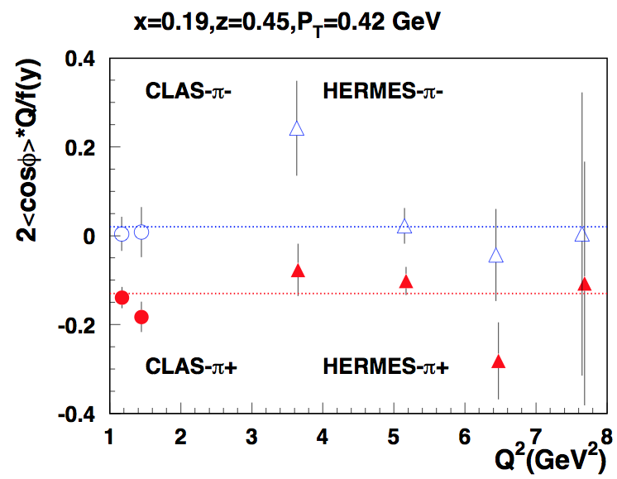
Comparing with HERMES
CLAS data consistent with HERMES (27.5 GeV)

Slide 9
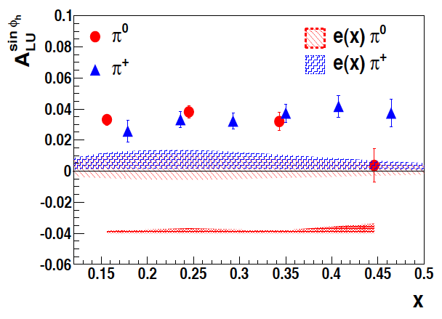
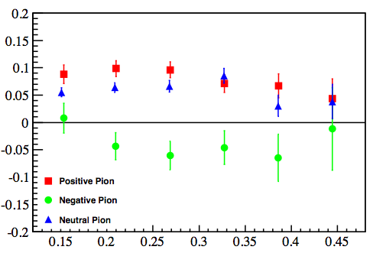
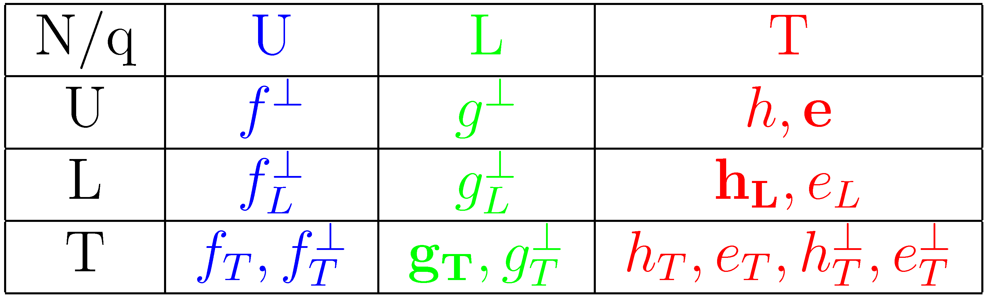
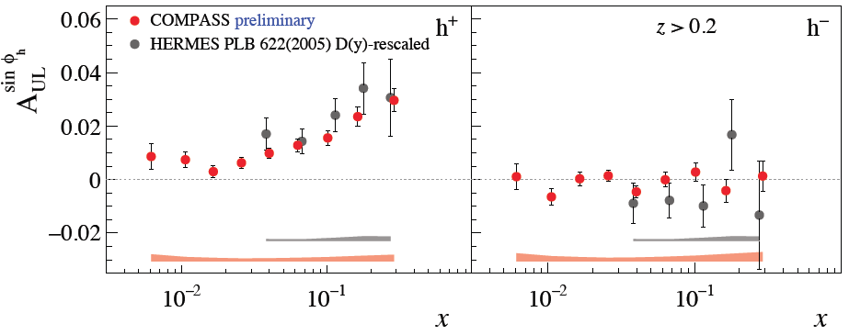
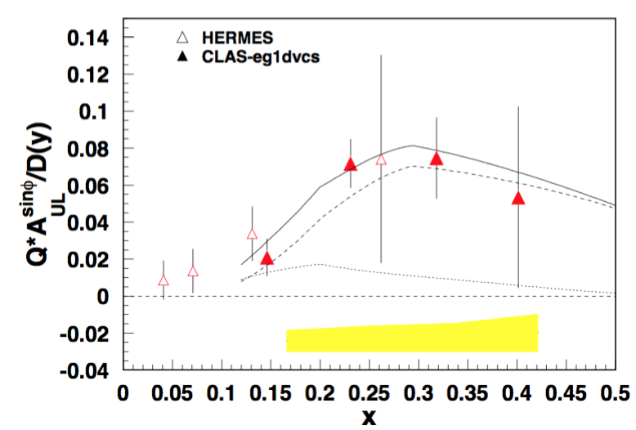
Quark-gluon correlations: flavor dependence
Higher Twist PDFs
roughly equal π⁺π⁰ SSA
π⁻ SSA much smaller, consistent with 0 or<0
CLAS/HERMES
arXiv:1709.10054
collins contribution
Significant longitudinal beam and target SSA measured at HERMES, JLab and COMPASS may be related to higher twist distribution functions
sinφ modulations for π⁺π⁰ consistent with dominance of Sivers mechanism
Subleading asymmetries comparable with leading ones (1/Q terms should be accounted)
Notes:
Lorenz invariant amplitudes

Slide 10
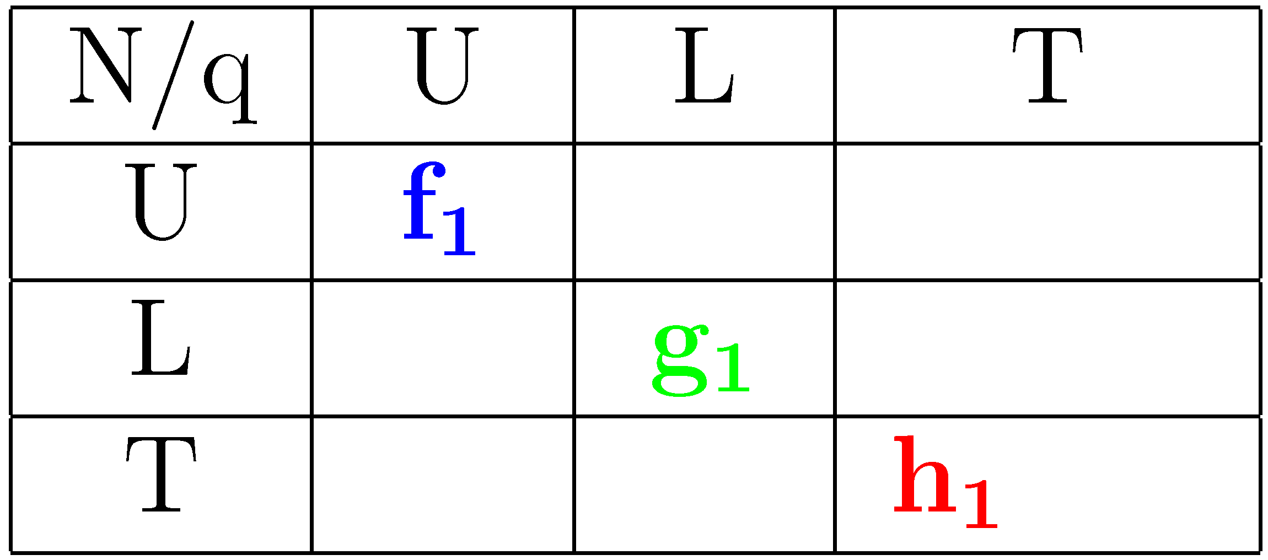
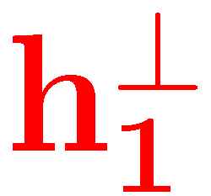


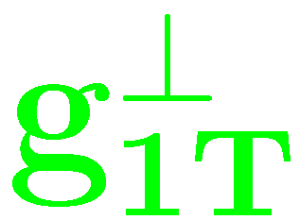

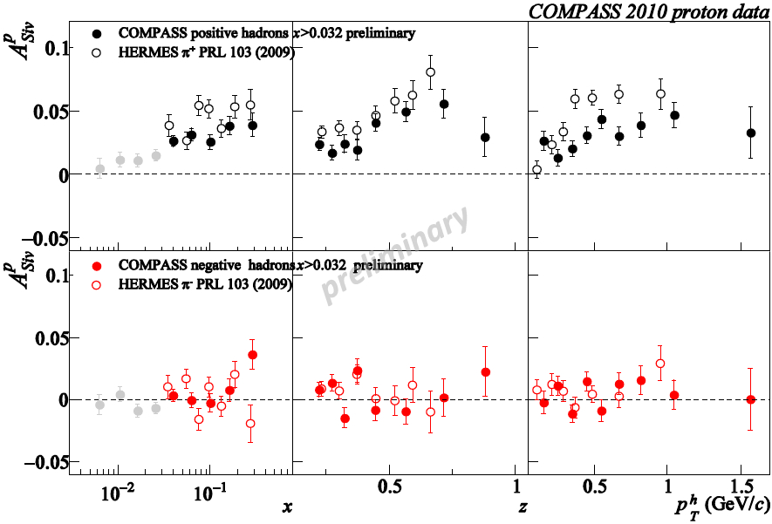
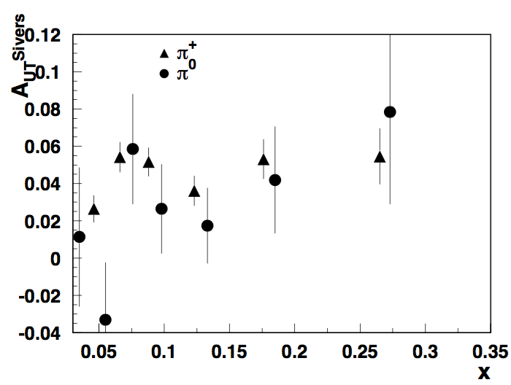
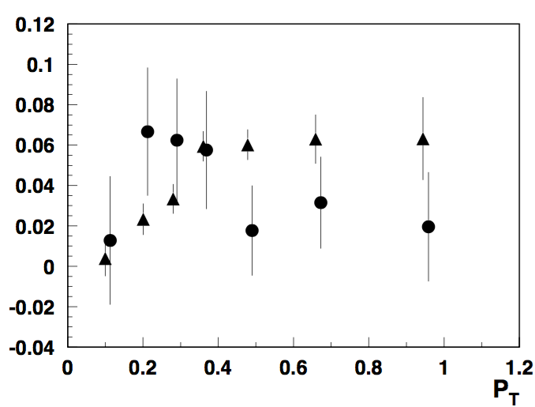
Sivers asymmetry: pions
π+/0, also K+ → Significant Sivers SSA increasing with x
K- and π- consistent with 0 ( contributions from different flavors cancel?).
Independent, high precision measurement in a wide Q² range is crucial
10
Notes:
A_{UT}^{Siv}=A_{UT}^{\sin(\phi-\phi_S)}\propto \frac{f_{1T}^{\perp u}(x,k_T)\otimes_W D_1^{u\rightarrow h}(z,p_T)}{f_1^{u}(x,k_T)\otimes D_1^{u\rightarrow h}(z,p_T)}

Slide 11
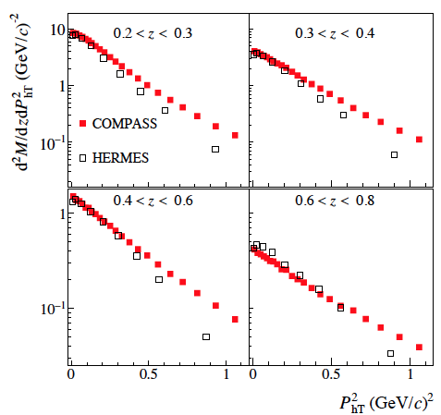
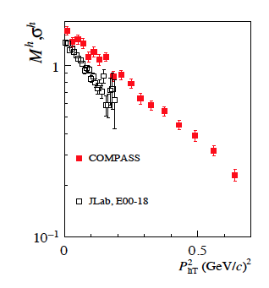
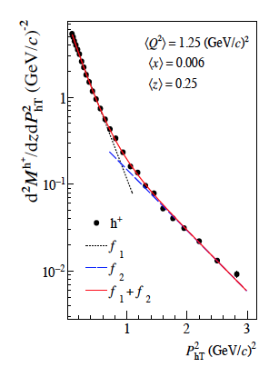
Multiplicities
COMPASS:1709.07374
Lower the beam energy, less phase space for high P_{T}
What is the origin of the tail?

Slide 12
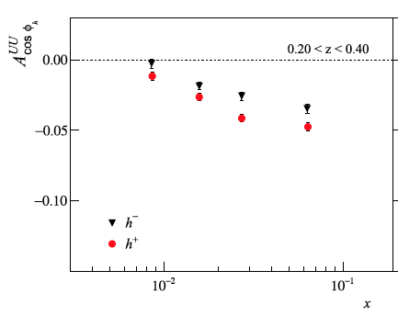
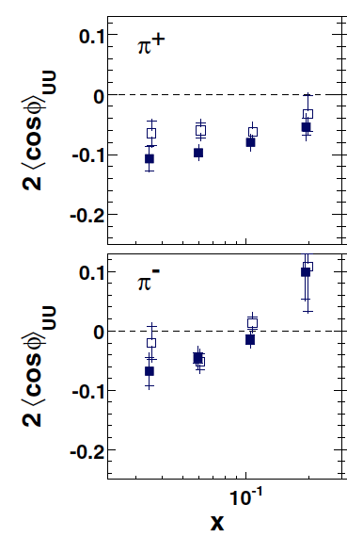
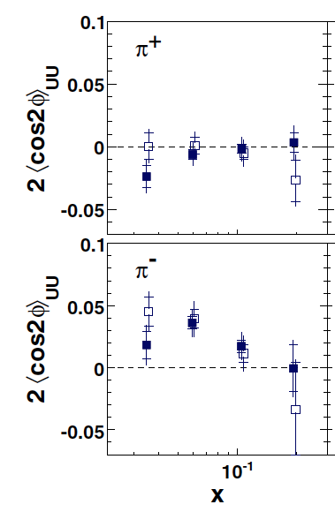
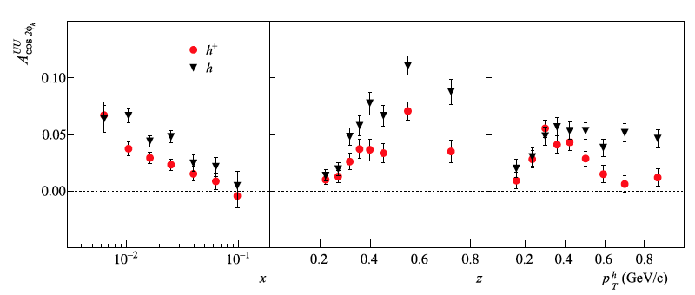
Azimuthal moments and BM effect
Can we understand cos2φ and get precision measurement of multiplicities without sorting out cosφ ?
Radiative corrections may be significant for ep

Slide 13
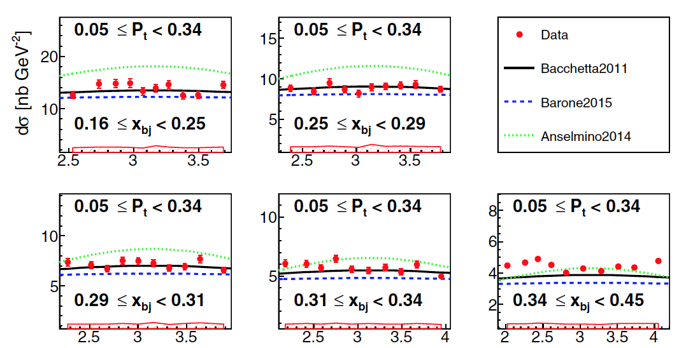
High precision measurements of SIDIS Cross Section
Hall-A, E06-010 (He3)
pi+ results Φ_{h} (rad)
Precision measurements in a limited φ-range can be combined with CLAS data

Slide 14
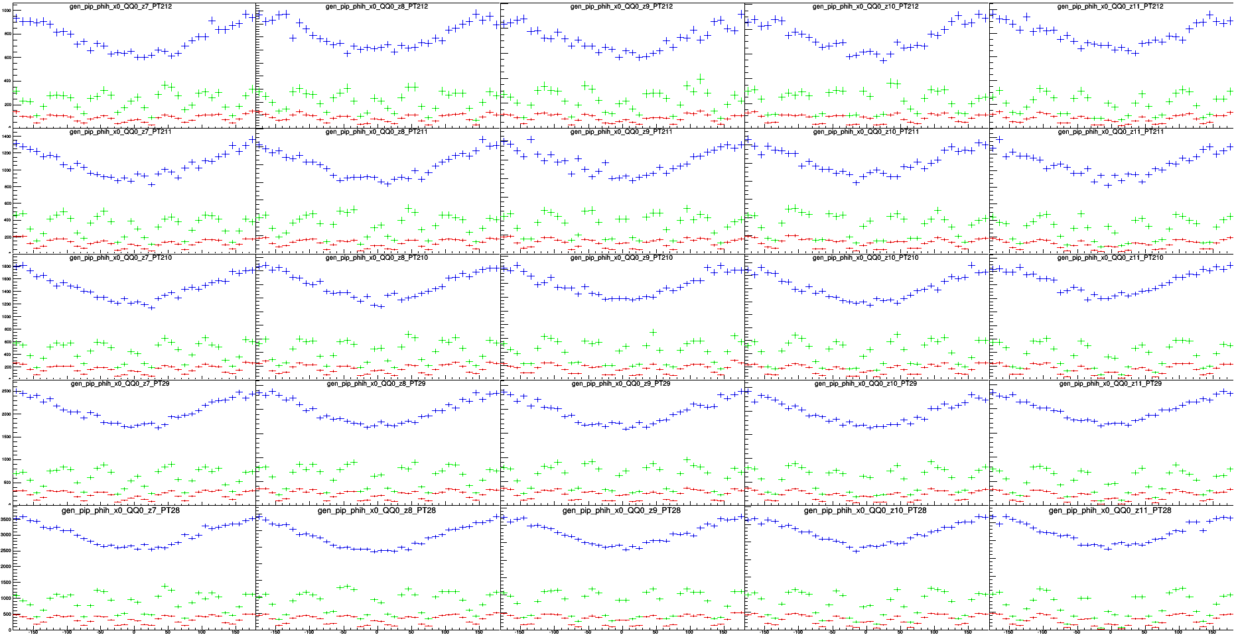
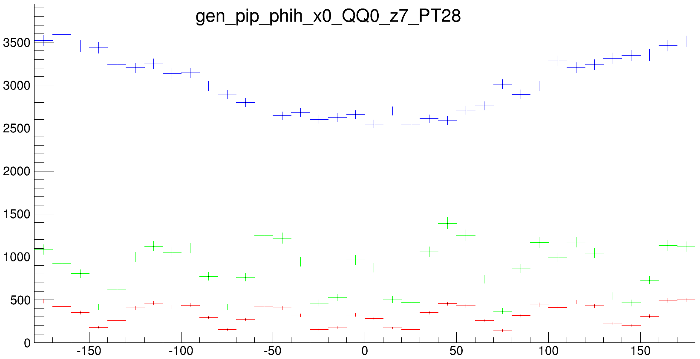
Monte Carlo φ generated, reconstructed, and acceptance for π+ (lowest x-Q² bin)
P_{T} (GeV²)
2
CLAS at 6 GeV
(acceptance scale goes 0 – 0.5)
0.55
zoom
0.50
acceptance =
reconstructed
generated
0.45
corrected data =
data
acceptance
0.40
0.35
0.40
0.45
0.50
0.55
z

Slide 15

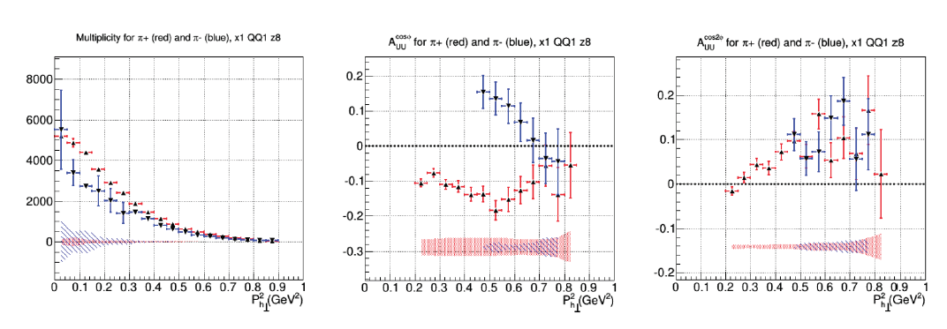
Measuring SIDIS cross section: CLAS 5.5 GeV
Fit with
π+ and π-
Cross section in several bins drops faster than gauss
Simmetric behavior in cosφ indicates large BM contribution

Slide 16
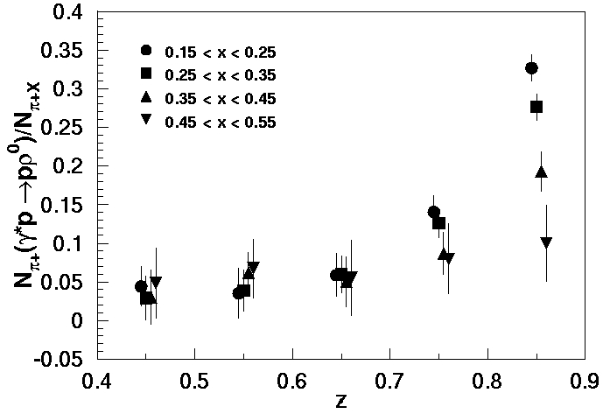
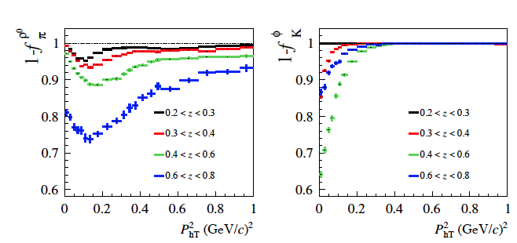
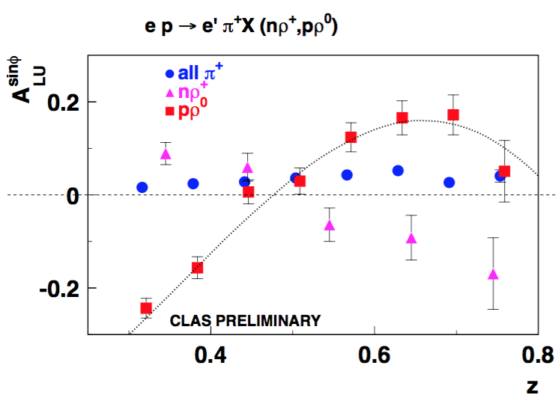
Vector meson contributions vs dihadrons
Should we worry about pions/kaons coming from vector meson decays?
What about ρ+ and ρ-
What do we know about relevant observables for pions specifically coming from vector meson decays
What about SIDIS rhos (can we measure?)
What is radiative correction due to rho?
Vector meson as resonance in dihadron production?
COMPASS:1709.07374
π+π⁰
π+π−

Slide 17
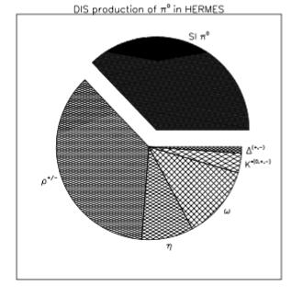
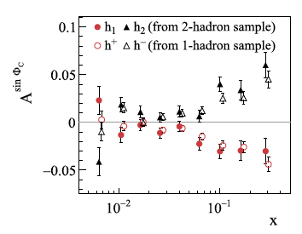
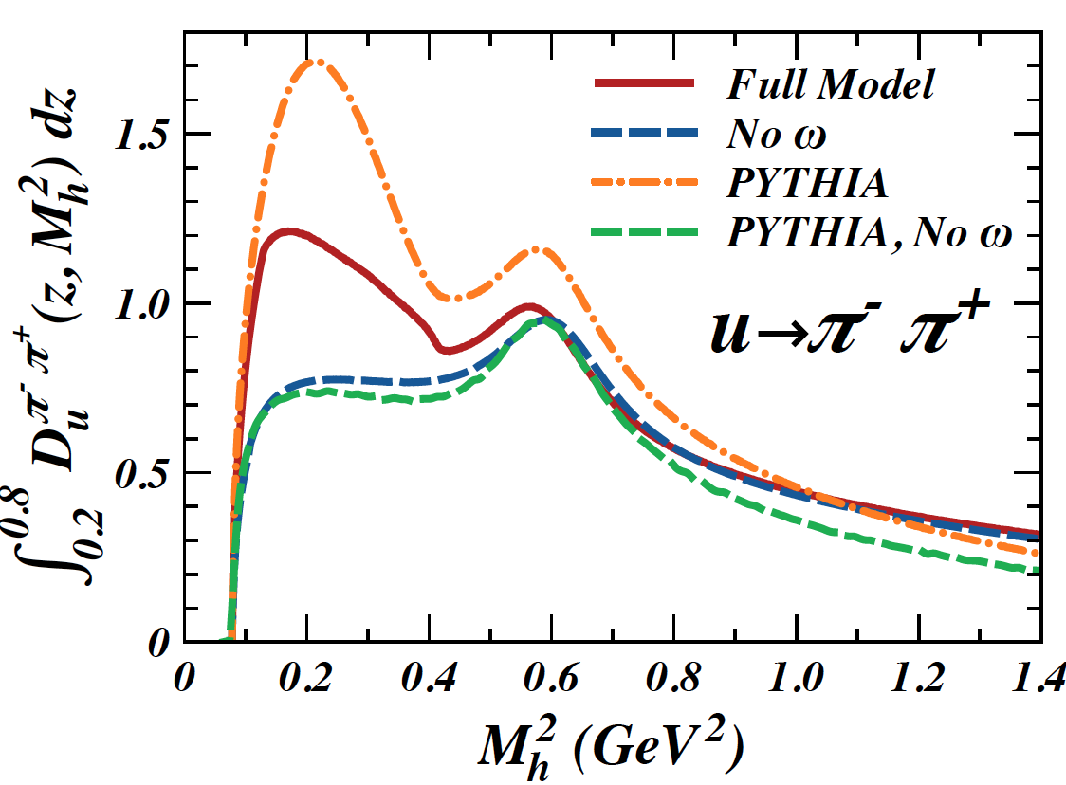
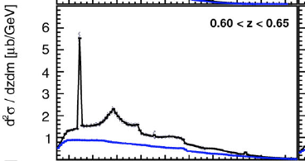

Dihadron production
What is the origin of dihadrons?
What is a single hadron?
COMPASS: arXiv:1507.07593
R. Seidl et al. arXiv: 1706.08348
Matevosyan et al, arXiv:1312.4556

Slide 18
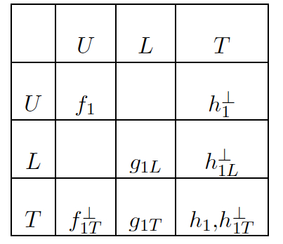
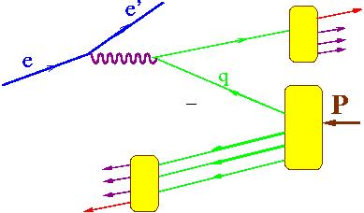
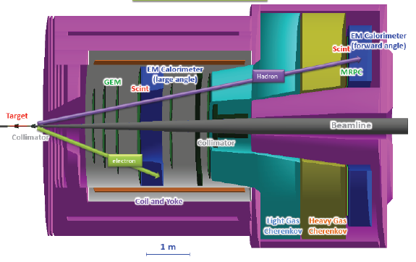
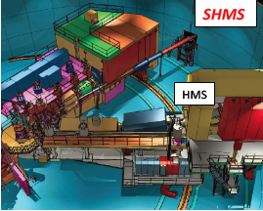
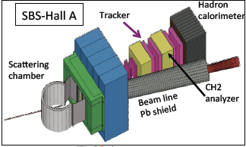





SIDIS at JLab12
π
Project Scope: completed
Complementary measurements with different targets
CLAS12
SOLID
E12-09-018
Combination of high resolution measurements from spectrometers combined with large acceptance data from CLAS12 and SOLID would allow to pin down all TMDs in the valence region
Notes:
Hall C requires three superconducting quadrupole magnets (Q1, Q2, and Q3), an HB dipole and a superconducting dipole magnet for the Super High Momentum Spectrometer (SHMS) to be installed within its Continuous Electron Beam Accelerator Facility (CEBAF).

Slide 19




C12-11-111
Aybat, Prokudin & Rogers
COMPASS
Large acceptance of CLAS12 allows studies of P_{T} and
Q²-dependence of SSAs in a wide kinematic range
Comparison of JLab12 data with HERMES, COMPASS (and EIC) will pin down the non-trivial Q² evolution of Sivers asymmetry.
HERMES
JLab12

Slide 20







Accessing transversity in dihadron production at JLab
Measurements with polarized protons
Measurements with polarized neutrons
CLAS12
SoLID
Bacchetta, Radici

Slide 21


TMDs: Access Quark Orbital Angular Momentum
TMDs : Correlations of transverse motion with quark spin and orbital motion
Without OAM, off-diagonal TMDs=0,
no direct model-independent relation to the OAM in spin sum rule yet
In a large class of models, such as light-cone quark models
Pretzelosity: ΔL=2
SoLID with trans polarized n/p → quantitative knowledge of OAM
SoLID Projections: Pretzelosity
J.-P. Chen

Slide 22


Transversity from SoLID
Collins Asymmetries ~ Transversity (x) Collins Function
SoLID with trans polarized n & p → Precision extraction of u/d quark transversity
Collaborating with theory group (N. Sato, A. Prokudin, …) on impact study
Collins Asymmetries
Significant improvement, but need to quantify the systematics from modeling (underlying assumptions)
Z. Ye et al., PLB (2017)
P_{T} vs. x for one (Q², z) bin
Total > 1400 data points

Slide 23





From data to phenomenology: EBC
bin# | x | Q² | y | W | M_{X} | φ | z | P_{T} | λ | Λ | N(counts) | RC
1 ... N
For precision studies of TMDs we need x-sections/muliplicities in smallest possible bins in x,y,z,P_{T},φ for all hadrons and all relevant polarization states
Elementary Bins vs macroscopic bins
Pros: Cons:
can go to wider bins, 1)Requires huge
smaller bin centering corrections MC sample
3) smaller acceptance/radiative correcions.
4) can perform also Bessel weighting
5)Can re-calculate for any other kinematical variables (η,P_{T}/z,…)
…………………….
EBC: bin sizes limited by resolutions
P²_{T}(GeV²)
Q²(GeV²)
z
x

Slide 24


Examples of data from SIDIS experiments
HERMES
COMPASS
http://hepdata.cedar.ac.uk/view/ins1278730
Experiment measures φ-dependence and performs fits to extract different moments
Need wide bins in kinematical variables to provide moments!

Slide 25




Extracting the average transverse momenta
Extraction very sensitive to input (replicas)
Most sensitive to parameters is the large P_{T} region
Multiplicity alone may not be enough to separate <k_{T}> from average <p_{T}>

Slide 26












Radiative SIDIS
Akushevich&Ilyichev in progress
additional photon can be described by three additional variables:
+…..
The phase space of the real photon:

Slide 27


Additional complications: Experiment can’t measure just 1 SF
I. Akushevich et al
Due to radiative corrections, φ-dependence of x-section will get multiplicative R_{M} and additive R_{A} corrections, which could be calculated from the full Born (σ₀) cross section for the process of interest
Due to radiative corrections, φ-dependence of x-section will get more contributions
Some moments will modify
New moments may appear, which were suppressed before in the x-section
Simplest rad. correction
Correction to normalization
Correction to SSA
Correction to DSA
Simultaneous extraction of all moments is important also because of correlations!
Notes:
\sigma=\sigma_{UU}+\sigma_{UU}^{\cos\phi}cos\phi +S_T\sigma_{UT}^{\sin\phi_S}\sin\phi_S+....
F_{XY}^{h}(x,z,P_T) \rightarrow F_{XY}^{B,h}(x,z,P_T)\times R(x,z,P_T,\phi_h) +F_{XY}^{R,h}(\dots)
So far the analysis of the asymmetry or the ratio of the differences and the sums of yield for two spin orientation was perform assuming no cross contributions from different structure functions to specific
observable. The yield indeed is more complicated and as you can see the azimuthal structure for transverse target in addition to Collins and Sivers, has several other contributions.
In case there are no radiative corrections or acceptance effects all moments are orthogonal and separation of moments could be done using standard procedures (ex. weighting with corresponding moments or fitting with corresponding functions).
However, radiative effects change the original simplicity, introducing addition azimuthal dependence. One important consequence here is not as much the correction to extracted structure fiunction from itself, but the
contrubutions to observables from other structure functions which may be much bigger. An example of the contribution of sin\phi_S term to Collins and sivers asymmetries will be discussed later on.

Slide 28
3D PDF Extraction and VAlidation (EVA) framework
SIDIS,DY,e+/e-)
experiments
Hard Scattering MC (GEANT, FASTMC,…)
EVA meetings at JLab to finalize goals and coordinate efforts
event selection
e’hX, e’hhX,..
Grid operations
QCD fundamentals
Library for Structure Function (SF) calculations
3D PDF and FF (models,
parametrizations)
Radiative
x-section
x-section calculations
SF calculations
Data Counts
(x-sections, multiplicities,….)
Defined set of assumptions
Defined set of assumptions
Extract 3D PDFs
extract
x-section
Extract SFs
Validation of extracted SFs or 3D PDFs (for a given set of assumptions)
Development of a reliable techniques for the extraction of 3D PDFs and fragmentation functions from the multidimensional experimental observables with controlled systematics requires close collaboration of experiment, theory and computing

Slide 29






EVA framework
Model input
simple Gaussian
no evolution
with evolution
small statistics
realistic MC
high statistics, better resolution
EVA Framework should allow
test the extraction procedures
Estimate systematic uncertainties from modeling
Evaluate the relevance of experimental uncertainties
…......

Slide 30
Estimating systematics
Steps for Extraction and Validation procedure
make sure we can recover the underlying 3D PDFs (TMD/GPD…) PDF from generated for a given beam energy sample
make sure we can recover the underlying 3D PDFs (TMD/GPD…) from reconstructed for a given detector configuration sample
add radiative effects
add other SFs to see the effect of Cahn on extraction of the F_UU,T and check the extraction of cos and cos2 moments
3) add/eliminate evolution effects with HT effects and see if we can indeed separate them
4) add F_UU,L part and see the effect of disregarding it in the extraction.
....... big list of systematic checks....

Slide 31

Studies of 1D PDFs
F. Aaron et al., JHEP 1001 (2010)
P. Jimenez-Delgado et al (2014), 1403.3355.
Strong model and parametrization dependence observed already for 1D PDFs
Positivity requirement may change significantly the PDF (need self consistent fits of polarized and unpolarized target data!!!)

Slide 32





From SIDIS to DIS
3D SIDIS
1D SIDIS
DIS

Slide 33
Reproduce SIDIS output with MC
SIDIS MC in 7D (10D)
p┴
Theory
step-1
Provide a set of SF_{l}
For a given model/theory based on underlying non-perturbative input calculate SF_{l}
step-2 (for a given E_{beam},λ,Λ)
step-3 (detected for a given Detector configuration)
Output counts for a given energy and detector setup
Notes:
$\frac{d\sigma_{\lambda\Lambda}^{eN \rightarrow e^\prime h X}}{dxdQ^2 dz dP_{hT}^2 d\phi_h d\phi_l d\phi_s}$

Slide 34



Comparing different DIS models
filled symbols F₂/F₂ ^{CJ15}
open symbols F₂/F₂ ^{CJ15},^{LT}
reasonable agreement between F2 from empiric SLAC fit (Bosted) with CJ15 Jlab fit in most of the relevant kinematics
x

Slide 35

Standard input for SFs
(JavaScript Object Notation for a single hadron production eN->e‘X)
Table can be generated from any existing program for calculation of SFs for any given set of parameters, final state particles, target nucleon, polarization states in tiny bins.

Slide 36



Radiative DIS
Akushevich et al. http://www.jlab.org/RC/radgen/
For EVA tests a DIS generator developed which works with x-sections, SFs, grids, has radiative effects.
DIS cut (E’>2 GeV)
Radiative
DIS

Slide 37


Recovering generated input from reconstructed set
Step-II
40Mil generated events (200x200 bins)
line N. Sato
Acceptance can be defined using the weighted generator set
Both MCs after reconstruction recover the generated input in most of the kinematics.)

Slide 38


Extraction of DIS x-section and acceptance
Radiative corrections may be significant
acceptance
<x> <y> <Q²>
DIS output can be generated using input F₁,F₂ or F₂,F_{L} or directly x-sections
Tables can be used by theorists for extraction of underlying SFs

Slide 39
Suggested standard input for SFs:SIDIS Example
#!{
#! "model": "VGD_Fuu_01",
#! “description”: “Cahn contribution to cos”,
#! "reference": “M. Boglione, S. Melis & A. Prokudin Phys. Rev. D 84, 034033 2011",
#! "web-source": "http://aaa.html",
#! "formula": "$sf1=-2*d/b*a*a*(1-a)^p0*c^p1*(1-c)^p2*c*p3/p4*exp(-d*d/(p4+c*c*p3)/p4$",
#! "moment": “$A_{uu}\\cos\\phi$",
#! “lepton-polarization”: “0”,
#! “nucleon-polarization”: “0”,
#! "particle": "pi+",
#! "variables": ["AuuCos2","AuuCos2-Err"],
#! "axis": [
#! { "name": "a", "bins": 40, "min": 0.025, "max": 0.995, "scale":"arb" ,"description":"Bjorken x"}
#! { "name": "b", "bins": 40, "min": 20.00, "max": 4.70, "scale":"arb”, ”description":"Q^2"},
#! { "name": "c", "bins": 40, "min": 0.025, "max": 0.995, "scale":"lin", "description":”z,hadron frac. energy"},
#! { "name": "d", "bins": 40, "min": 0.00, "max": 2.00, ”scale":"lin", "description":”P_{T}, transverse momentum"}
#! ],
#! "parameters": [
#! {"name":"p0", "value": 1.0},
#! {"name":"p1", "value": 0.2},
#! {"name":"p2", "value": 0.1},
#! {"name":"p3", "value": 0.33, "description":”average k_T2”},
#! {"name":"p4", "value": 0.16, "description":”average pt_T2”}
#! ]
#! }
(JavaScript Object Notation for a single hadron production eN->e’hX)
2 more
variables
Multiple files for all relevant combinations of involved parameters
0 0 0 0 -0.01285 0.00200
0 0 0 1 -0.03736 0.00200
0 0 0 2 -0.05850 0.00200
0 0 0 3 -0.07459 0.00200
0 0 0 4 -0.08467 0.00200
.............
Table can be generated from any existing program for calculation of SFs for any given set of parameters, final state particles, target nucleon, polarization states.

Slide 40


A set of Structure Functions needed for x-section
Framework should handle any SF input

Slide 41
Standard output for data
{
"model": "Nobuo_Fuu_01"
"description": "F_uu,T"
"reference": "N. Sato et al"
"multiplicity":"Counts"
"Beam Energy": 10.600
"lepton-polarization": "0"
"nucleon-polarization": "0"
"particle": "pi+"
"variables":["Counts","acc","xav","qav","zav","ptav","yav","phav","pt/zav","eta"
"axis":[
{"name":"a","bins": 10,"min": 0.05, "max": 0.55, "scale":"lin","description":"x_bj"}
{"name":"b","bins": 7, "min": 1.00, "max": 8.0, "scale":"lin","description":"Q^2"}
{"name":"c","bins": 7, "min": 0.20, "max": 0.9, "scale":"lin","description":"z"}
{"name":"d","bins": 15,"min": 0.00, "max": 1.5, "scale":"lin","description":"PT"}
{"name":"e","bins": 36,"min": 0.0,"max": 360.0,"scale":"lin","description":"PHI"}
],
"parameters":[
]
}
1 1 1 4 0.999900E+02 0.0141 0.0994 1.0424 0.2636 0.0708 0.5271 0.5492 0.2686 -0.5311
1 1 1 1 5 0.110602E+03 0.0191 0.0937 1.0067 0.2710 0.0818 0.5404 0.8707 0.3000 -0.5052
…....
1 1 1 1 35 0.655700E+02 0.0090 0.0969 1.1218 0.2447 0.0310 0.5820 5.9564 0.1266 -0.5818
1 1 1 1 36 0.619600E+01 0.0012 0.0913 1.0703 0.2268 0.0029 0.5896 6.1982 0.0136 -0.5068
1 1 1 2 4 0.604000E+03 0.0311 0.0985 1.0670 0.2055 0.1918 0.5446 0.6019 0.9336 0.1294
1 1 1 2 7 0.911300E+03 0.0385 0.0927 1.2218 0.2506 0.1408 0.6631 1.1898 0.5642 -0.3208
Note: counts in φ are provided
Table may contain generated (for given beam energy) or reconstructed (for given detector configuration) event counts
Some bins miss due to phase space limitations and detector acceptance

Slide 42

N.Sato & UConn

Slide 43
SUMMARY
Studies of azimuthal distributions of hadrons in SIDIS revealed complexity of the 3D nucleon structure, requiring new tools for multidimensional analysis
For application of Extraction and VAlidation (EVA) framework (even for DIS)
we need a collaboration of theorists, experimentalists and software experts to define the path to a flexible TMD extraction system with validation capabilities.
To proceed we need, well defined criteria, unified data presentation, and tools:
Define the data input (x-sections/multiplicities “Elementary Bin Counts” in φ-bins)
Use MC to test extraction procedures
Test the sensitivity to different assumptions in procedures for extraction of SFs and underlying 3D PDFs (“global fits”)
Apply different extraction procedures to define sensitivity to statistical and systematic uncertainties

Slide 44
Support slides…

Slide 45


Additional complications: Experiment has limited acceptance
Limited kinematical coverage (acceptance) in particular at acceptance edges, large Q² and P_{T}
SIDIS@5.5 GeV
A_{LL}
DVCS@5.7GeV
Ignoring other variables (φ-in particular) doesn’t mean integrating over them
Experiment measures φ − counts involving also HT contributions !!!

Slide 46




CLAS at 5.5 GeV
(top row), (middle row), and (bottom row) vs P_{T} for π+ and π-
Q²
2
x
(high Q² bin of 0.2 < x < 0.3)

Slide 47

Тяжело в учении
--легко в бою
the more you sweat in times of peace the less you bleed in war
Monte Carlo simulation is crucial for understanding of systematics of all steps and assumptions used in extraction of complex 3D nucleon structure

Slide 48



Target fragmentation in SIDIS
P₁
Leading Twist
M. Anselmino, V. Barone and A. Kotzinian, Physics Letters B 713 (2012)
P₂
The beam–spin asymmetry appears, at leading twist and low transverse momenta, in the deep inelastic inclusive lepto-production of two hadrons, one in the target fragmentation region and one in the current fragmentation region.
Understanding of Target Fragmentation Region (TFR) is important for interpretation of the Current FR
Need a consistent theoretical description for TFR
Measure/model fracture functions
Notes:
{\cal{F}}_{LU}^{\sin(\phi_1-\phi_2)}=\frac{\mid\vec{P}_{1\perp}\vec{P}_{2\perp}\mid}{m_Nm_2} {\cal{C}}[w_5M_L^{\perp,h}D_1]

Slide 49




Sivers asymmetry: kaons vs pions
combined 2007 – 2010 results
π+
π-
K+
K-
preliminary
K+ at large x has larger Sivers SSA which may come from orbital effects in hadronization (higher twist effects)
K- and π- consistent with 0 indicating contributions from different flavors cancel.
Independent, high precision measurement in a wide Q² range is crucial
49
Notes:
A_{UT}^{Siv}=A_{UT}^{\sin(\phi-\phi_S)}\propto \frac{f_{1T}^{\perp u}(x,k_T)\otimes_W D_1^{u\rightarrow h}(z,p_T)}{f_1^{u}(x,k_T)\otimes D_1^{u\rightarrow h}(z,p_T)}

Slide 50

Additional complications: Experiment has limited energy
In F_{XY}^{h}(x,y,z,P_{T},φ) variables independent, while in real life even for 100% acceptance they are limited
P_{T}
Z

Slide 51

Radiative DIS
Akushevich et al. http://www.jlab.org/RC/radgen/
/group/gpd/sidis/inclusive-dis-rad/generate-dis
--rad 1 (table input, generated on flight)
DIS cut (E’>2 GeV)
with radiation
without radiation
Radiative correction become very significant for low energy scattered electron

Slide 52
Analysis of azimuthal moments in SIDIS/HEP
Data (contains N events with 4 vectors of reconstructed particles, N~1B)
MC +RC (contains M events with 4 vectors of generated and reconstructed particles, M~10-100N)
Define x-sections/normalized counts
Compare generated with reconstructed
Acceptance in “small” bins (counts in λ,Λ,x,y,[z,P_{T}][t], φ) defining reconstruction efficiency and material on path of leptons
Counts in “small” bins in
λ,Λ,x,y, [z,P_{T}][t],φ,RC corrected for detector acceptance and efficiency
Counts in a given bin corrected by rec.efficiency and radiative effects
Size of the bins dictated by the statistics allowing fits for extraction of azimuthal moments

Slide 53






Quark-gluon correlations
Force on the active quark right after scattering (Burkardt)
CLAS/HERMES
JLab-Hall-A
arXiv:1311.1866
Significant longitudinal target SSA measured at JLab and HERMES may be related to HT and color forces
Large transverse spin asymmetries observed in inclusive pion production (Hall-A, HERMES)
Models and lattice agree on a large e/f1 -> large beam SSA
Notes:
Lorenz invariant amplitudes

Slide 54
Questions to address
SIDIS and Hard Exclusive processes requiring multidimensional analysis, are a major challenge for experiment, theory, software extraction framework, claiming control of systematic uncertainties
At which step the experimental extraction should stop and theory extraction start?
How a detailed MC could help to understand better different contributions in the x-section of single or double pion production?
How the TMD/GPD libraries could be integrated into extraction process
How we deal with “real” data with finite beam energies and limited phase space?
Do we need “validation” of extracted TMDs and what that will include?

Slide 55





A_{UT} studies at JLab
SOLID
CLAS12
E12-11-108
C12-11-111
Precision 4-d mapping of Collins target SSA using SoLID and CLAS12

Slide 56
Event generators for SIDIS studies
Main classes of event generators:
a)Full event generators where sets of outgoing particles are produced in the interactions between two incoming particles and a complete event is generated
Applications: attempt to reproduce the raw data
understand background conditions
estimating rates of certain types of events
planning and optimizing detector performances,…
b) Specific event generators (single hadron, di-hadron,…) , where only the final state particles of interest are generated
Applications: providing fast tests of analysis procedures with relatively simple integration of different input models.
developing analysis frameworks.
1) Providing events with cross section
2) Phase space with realistic x-sections provided as weight factors
+unfolding measured data for acceptance and detector resolution effects

Slide 57


Comparing generated ouput with input
using x-section generator in x/y
reconstructed (from generated) output
generated input (filled symbols)
compare 3 bins in Q²
average values agree
Reconstructing SFs from generated input 1st check of the procedure

Slide 58



Additional complications: Experiment covers ranges described by different SFs
Boglione et al, Phys.Lett. B766 (2017) 245-253
Kinematics covers regions with different fractions from target and current fragmentation
JLab12
Understanding of the scale of ignored contributions (M/Q²,P_{T}/Q², Target/Current correlations,…) will define the limits on precision for other involved contributions (ex. evolution).
more CFR more TFR
CM
Breit
Multidimensional bins (x,y,z,P_{T},φ) are crucial for separation of different contributions

Slide 59

N.Sato & UConn

Slide 60

N.Sato & UConn

Slide 61



QED radiative corrections in SSA
Due to radiative corrections, φ-dependence of x-section will get more contributions
HERMES
using a simple approximation
we can get correction factors to moments (ex. for RC for )
we can get new moments
In reality contributions will me more complicated
Due to radiative corrections, φ-dependence of x-section will get more contributions
Some moments will modify
New moments may appear, which were suppressed before in the x-section
Notes:
\sigma=\sigma_{UU}+\sigma_{UU}^{\cos\phi}cos\phi +S_T\sigma_{UT}^{\sin\phi_S}\sin\phi_S+....
F_{XY}^{h}(x,z,P_T) \rightarrow F_{XY}^{B,h}(x,z,P_T)\times R(x,z,P_T,\phi_h) +F_{XY}^{R,h}(\dots)
So far the analysis of the asymmetry or the ratio of the differences and the sums of yield for two spin orientation was perform assuming no cross contributions from different structure functions to specific
observable. The yield indeed is more complicated and as you can see the azimuthal structure for transverse target in addition to Collins and Sivers, has several other contributions.
In case there are no radiative corrections or acceptance effects all moments are orthogonal and separation of moments could be done using standard procedures (ex. weighting with corresponding moments or fitting with corresponding functions).
However, radiative effects change the original simplicity, introducing addition azimuthal dependence. One important consequence here is not as much the correction to extracted structure fiunction from itself, but the
contrubutions to observables from other structure functions which may be much bigger. An example of the contribution of sin\phi_S term to Collins and sivers asymmetries will be discussed later on.

Slide 62



Radiative Corrections
- Radiative effects, such as the emission of a photon by the incoming or outgoing electron, can change all five SIDIS kinematic variables.
- Furthermore, exclusive events can enter into the SIDIS sample because of radiative effects (“exclusive tail”).
- HAPRAD 2.0 is used to do radiative corrections.
- For a given (obtained from a model), HAPRAD calculates . The correction factor is then:
- 3 different models were used to study model dependence.

Slide 63

Radiative Corrections
A^{cos h} _{UU} vs PTh
the high Q2 of 0:1 < x < 0:2
A^{cos2h} _{UU} vs PTh
Model for azimuthal moments after few iterations, roughly consistent with the input.

Slide 64


Bin Centering Corrections
v - 5-dimensional “volume" of the micro
bin at the center of the normal bin
V - the “volume” of the normal bin, - cross-section averaged over the “normal bin”
- cross-section at the micro-bin at the center of the normal bin
Bin centering corrections are approximated using a model based on the
results of the measurement. Using the model, the cross-section is calculated
In “micro-bins" (bins much smaller than the “normal bins” used for the final analysis.

Slide 65



Radiative DIS
Dedicated DIS generator with radgen (gemc input)
Eγ
θγ
Significant fraction of DIS radiative photons may be reconstructed
reconstructed photons

Slide 66

Systematics
electron cuts
pion cuts
φ*
Systematics from different factors considered uncorrelated
rad.corr

Slide 67

Additional complications(IV): Large higher twist structure functions
target mass corrections and HT SFs with strong dependence on flavor
CLAS PRELIMINARY 5.5 GeV
CLAS PRELIMINARY
presence of large corrections due to limited Q² make the estimate of systematics due to ignoring them important

Slide 68
Suggested standard input for SFs:Example (data)
#! {
#! "model": "Data",
#! “description”: “”,
#! "reference": "Exploring the Structure of the Proton via Semi-Inclusive Pion Production, Nathan Harrison",
#! "web-source": "https://www.jlab.org/Hall-B/general/thesis/Harrison_thesis.pdf",
#! "moment": “$A_{uu}\\cos\ 2\phi$",
#! “lepton-polarization”: “0”,
#! “nucleon-polarization”: “0”,
#! "particle": "pi+",
#! "variables": ["AuuCos2","AuuCos2-Err"],
#! "axis": [
#! { "name": "a", "bins": 5, "min": 0.01, "max": 0.60, "scale":"arb" ,"description":"Bjorken x"}
#! { "name": "b", "bins": 2, "min": 1.00, "max": 4.70, "scale":"arb”, ”description":"Q^2"},
#! { "name": "c", "bins": 18, "min": 0.00, "max": 0.90, "scale":"lin", "description":"hadron frac. energy"},
#! { "name": "d", "bins": 20, "min": 0.00, "max": 1.00, ”scale":"lin", "description":"transverse momentum"}
#! ]
#! }
0 0 1 0 -0.0162215 0.00242759
0 0 2 0 0.0264976 0.00306648
0 0 2 1 -0.000968785 0.00326021
0 0 2 2 -0.0183257 0.00427527
0 0 2 3 -0.00224623 0.00469542
0 0 3 0 0.04539 0.00433408
0 0 3 1 -0.00307352 0.00409825
0 0 3 2 -0.0403614 0.00503846
0 0 3 3 -0.034225 0.0061943
0 0 3 4 0.00820626 0.00610658
0 0 3 5 0.0013598 0.00762099
(JavaScript Object Notation for a single hadron production eN->e’hX)

Slide 69

Suggested standard input for SFs:SIDIS
(JavaScript Object Notation for a single hadron production eN->e’hX)
Advantages:
Table can be generated from any existing program for calculation of SFs for any given set of parameters, final state particles, target nucleon, polarization states.
Corresponding API will allow rebining, summing of tables with different ranges, web browsing, graphical presentation, integrations and other operations (will need API)

Slide 70

φ_{h} distributions – acceptance and radiative corrected with fit results (lowest x-Q² bin)
P_{T} (GeV²)
2
0.45
0.40
0.35
0.30
0.25
0.30
0.35
0.40
0.45
z

Slide 71




CLAS: e1f data set
- Two 0.4 GeV linear accelerators.
- Nine recirculation arcs for five loops around the track.
- Continuous, polarized electron beam up to 6 GeV delivered simultaneously to 3 experimental halls.
- High luminosity of 0.5 x 10³⁴ (cm² s)⁻¹
- E1-f run: 5.498 GeV electron beam with ~75% polarization (averaged over for this analysis); unpolarized liquid hydrogen target; about 2 billion events; broad and comparable kinematic range for two channels:
- Electromagnetic Calorimeter (EC) and Čerenkov Counter (CC) used in electron identification.
- Drift Chamber (DC) (3 regions) and time of flight Scintillators (SC) record position and timing information for each charged track.
- Torus magnet creates toroidal magnetic field which causes charged tracks to curve while preserving the φ_{lab} angle.

Slide 72
Standard output: CLAS e1f at 5.5 GeV
D. Riser
(JavaScript Object Notation used
for serializing and transmitting structured data)
#! {
#! "data-set": ["E1-F"],
#! "reference": "Exploring the Structure of the Proton via Semi-Inclusive Pion Production, Nathan Harrison",
#! "web-source": "https://www.jlab.org/Hall-B/general/thesis/Harrison_thesis.pdf",
#! "particle": "pi+",
#! “lepton-polarization”: “0”,
#! “nucleon-polarization”: “0”,
#! “target”: “hydrogen”,
#! “beam-energy”: “5.498 GeV”,
#! "variables": ["counts-corrected","stat-err","rad-corr"],
#! "axis": [
#! { "name": "a", "bins": 5, "min": 0.10, "max": 0.60, "scale":"arb", "description":"Bjorken x"},
#! { "name": "b", "bins": 1, "min": 1.00, "max": 4.70, "scale":"arb", "description":"Q^2"},
#! { "name": "c", "bins": 18, "min": 0.00, "max": 0.90, "scale":"lin", "description":"hadron frac. energy"},
#! { "name": "d", "bins": 20, "min": 0.00, "max": 1.00, "scale":"lin", "description":"transverse momentum"},
#! { "name": "e", "bins": 36, "min": -180.00, "max": 180.00, "scale":"lin", "description":"azimuthal angle"},
#! ]
#! }
0 0 15 2 0 0.153135 1.16888 0.772973 0.125044 -175 0.74663 3173.48 205.893 1.00537
0 0 15 2 1 0.153135 1.16888 0.772973 0.125044 -165 0.74663 3464.36 226.181 1.00307
0 0 15 2 2 0.153135 1.16888 0.772973 0.125044 -155 0.74663 3473.09 241.549 0.999228
0 0 15 2 3 0.153135 1.16888 0.772973 0.125044 -145 0.74663 3015.84 253.718 0.994561
0 0 15 2 4 0.153135 1.16888 0.772973 0.125044 -135 0.74663 4327.02 463.082 0.988254
Full 5-dimentional table (7 with helicities) allowing rebining, proper integrations over other variables, web browsing, graphical presentation,…
While keeping “human readable” the data will be machine readable (will need API)
Reducing the size of the bins (limited by resolution and MC statistics for acceptance extraction

Slide 73



Kinematic distributions
eπX evnts compared with eπX events from PYTHIA tuned to data (dashed)
Simple event generator should be “reasonable”

Slide 74







Dihadron production
C. Braun

Slide 75




Additional complications: limited phase space
M. Boglione, S. Melis & A. Prokudin Phys. Rev. D 84, 034033 2011
EVA tests: Cahn vs BM
generated
reconstracted
dashed line: full integration
solid: within kinematical limits
BM contribution seem to be less sensitive to phase space limitations
Need cross check.

Slide 76


Slide 77



Missing mass of pions in ep->e’πX
Δ⁺⁺
π-
π⁰
n
π+
Δ⁰
Large Delta(1232) contribution makes π- different (M_{x}>1.5 GeV applied)

Slide 78


Born, radiated, and exclusive tail cross-sections from HAPRAD (lowest x-Q² bin)
P_{T} (GeV²)
2
0.55
zoom
0.50
0.45
0.40
0.35
0.40
0.45
0.50
0.55
z

Slide 79


Clas12 resolutions
Angular and momentum resolutions define the EBC size

Slide 80

φ_{h} distributions - raw data (lowest x-Q² bin)
P_{T} (GeV²)
2
0.45
0.40
0.35
0.30
0.25
0.30
0.35
0.40
0.45
z

Slide 81



systematics
clas12 proposals

Slide 82





Boer-Mulders effect: kaons vs pions
L. Pappalardo
Effect much bigger for Kaons than for pions
Sign of K- is the same as for K+ (sign H₁┴ ^{fav} / H₁┴ ^{unfav} for π and K inconsistent)
Independent, high precision measurement at large x is crucial

Slide 83


Systematics

Slide 84




B2B hadron production in SIDIS: First measurements
M. Anselmino, V. Barone and A. Kotzinian, Physics Letters B 713 (2012)
CLAS PRELIMINARY
Significant asymmetries observed by CLAS at 6 GeV
Notes:
{\cal{F}}_{LU}^{\sin(\phi_1-\phi_2)}=\frac{\mid\vec{P}_{1\perp}\vec{P}_{2\perp}\mid}{m_Nm_2} {\cal{C}}[w_5M_L^{\perp,h}D_1]

Slide 85


A_{LU} comparing CLAS data sets e16 and e1f
e1f: weaker field, lower Q² and x
e16: higher field, higher average Q²
Asymmetries may change the sign in the exclusive limit
Asymmetries are large in the large x-region

Slide 86

Extracting the average transverse momenta
difference?

Slide 87


Suggested standard input for SFs:Example
(JavaScript Object Notation for a single hadron production eN->e’hX)
“reference: “M. Boglione, S. Melis & A. Prokudin Phys. Rev. D 84, 034033 2011”
“formula”
begin{align}
F_{UU} &= \sum_{q} \, e_q^2 \,\xbj \, f_1^{q}(\xbj)\,D_{h/q}(z_h)
\frac{e^{-\pth^2/\wpth}}{\pi\wpth}}, \\
\end{align} “
p1 p2

Slide 88

I.Akushevich

Slide 89

Extracting the moments
Moments mix in experimental azimuthal distributions
Simplest correction
Correction to normalization
Acceptance:
Correction to DSA
Moments/asymmetries:
Correction to SSA
Virtual photon angle:
Fake DSA cos
Simultaneous extraction of all moments is important also because of correlations!
Notes:
(1+\alpha\cos\phi)(1+A\cos\phi)\rightarrow 1+A\alpha/2
\frac{1+\beta\lambda\Lambda}{1+A\cos\phi)}\rightarrow 1-A\beta\lambda\Lambda\cos\phi
(1+\beta\lambda\Lambda+\gamma\lambda\Lambda\cos\phi)(1+A\cos\phi) \\\rightarrow 1+(\beta+\gamma A/2)\lambda\Lambda

Slide 90




MC (level-I) for CLAS12
SIDIS MC in 7D (x,y,z,φ,φ_{S},p_{T},λ,π)
p┴
P_{hT} = p┴ +z k_{T}
CLAS12 acceptance & resolutions
Events in CLAS12
Can achieve a reasonable agreement of kinematic distributions with realistic LUND simulation

Slide 91
MC(level-II) for CLAS12
SIDIS MC in 7D->9D
p┴
P_{hT} = p┴ +z k┴
Not trivial to realize in a self consistent way,
what we learn starting MC at quark level?

Slide 92
Partonic Transverse Motion at 11 GeV
input
input
Kinematical limits on transverse momentum size provided by the parton model transfer directly to the experimental observables
Average values of the transverse momentums are not constant!

Slide 93

Analysis of azimuthal moments in SIDIS/HEP
Data (contains N events with 4 vectors of reconstructed particles, N~1B)
MC +RC (contains M events with 4 vectors of generated and reconstructed particles, M~10-100N)
Define x-sections/normalized counts
Compare generated with reconstructed
Counts in “small” bins in
λ,Λ,x,y, [z,P_{T}][t],φ,RC corrected for detector acceptance and efficiency
Acceptance in “small” bins (counts in λ,Λ,x,y,[z,P_{T}][t], φ) defining reconstruction efficiency and material on path of leptons
data
MC gen, rec, acc
corrected data
Experimental input to phenomenology: x-sections, moments

Slide 94







SIDIS with Bessel weighting
p┴
P_{hT} = p┴ +z k_{T}
the formalism in b_{T}-space avoids convolutions
provides a model independent way to study kinematical dependences of TMD

Slide 95




BGMP: extraction of k_{T}-dependent PDFs
Need: project x-section onto Fourier mods in b_{T}-space to avoid convolution
Boer, Gamberg, Musch &Prokudin arXiv:1107.5294
eg1
acceptance
the formalism in b_{T}-space avoids convolutions
easier to perform a model independent analysis of TMDs
Widths extracted from eg1dvcs π⁰s consistent with eg1
Notes:
\int_0^{2\pi}d\phi_h\sin(\phi_h-\phi_S)\int_0^{\inf}d\bold{|P_{h\perp}|}\bold{|P_{h\perp}|}\frac{2J_1(\bold{|P_{h\perp}||b_T|})}{zM_h\bold{|b_T|}}\big[\frac{d\sigma}{dxdydzd\phi_h\bold{|P_{h\perp}|}d\bold{|P_{h\perp}|}}\big]
\sum_a e_a^2\tilde{f}_{1T}^{\perp (1)q}(x,z^2b_T^2)\tilde{D}_1^{q\rightarrow \pi}(z,b_T^2)
Finally about plans for extraction of actual TMDs out of measured azimuthal distribututions and asymmetries.
Here are bit more details on he the procedure with Bessel weighting proposed by Boer and col., which Patrizia introduced in previous talk.
We basically sum over all events the Bessel function of the product of P_T and given b_T in a given bin of x,Q^2, and z.
The additional factors in the weight are the kinematic factor from x-section and the reconstruction efficiency for a given event.
As predicted thisparticular sum should give us the product of fourier transforms of f1 and D1. The comparison on the left shows that we I
Indeed recover the generated distribution. The procedure requires a full range in P_T and the sensitivity to the maximum P_T
Is shown on the right plot. Points are for 3 P_T maxim cuts. There are still systematic effects in the extraction, but this particular study indicates that P_Tmax of ~1.5 will be enough.
The
To summarize precision measurement of azimuthal moments (cos2φ, cos2φ, sinφ) in semi-inclusive pion production in DIS with CLAS12 will allow to

Slide 96
Bessel method: sensitivity to cuts
P_{T} cuts affects the value of extraction and the shape of b_{T} dependence!
The correlation is direct consequence of the energy and momentum conservation when we account for intrinsic motion of the quarks
The correlation is not sensitive to the details of the models used for the extraction.

Slide 97



Accounting for nuclear effects
[hep-ph/0801.0434].
Under the “maximal two gluon approximation", the TMD quark distribution in a nucleus for leading twist
for higher twist
for simple Gaussian
The broadening width Δ_{2F} or the total average squared transverse momentum broadening,
is given by the quark transport parameter depending on the spatial nucleon number density
inside the nucleus and the gluon distribution function in a nucleon

Slide 98

Correlations between moments
Unpolarized cosφ (sets correspond to 0 and 0.1) , affects polarized sin2φ,cosφ moments

Slide 99


SIDIS with Bessel weighting
the data analysis can be performed in the b_{T}-space.
Notes:
f_1(x,k_T)=\frac{N}{\pi <k_T^2>}e^{-\frac{k_T^2}{<k_T^2>}}
\tilde{f}_1(b_T)=\frac{1}{2}<k_T^2>Ne^{-<k_T^2>b_T^2/4}

Slide 100



Lattice calculations and b_{T}-space
(PDFs in terms of Lorenz invariant amplitudes
Musch et al, arXiv:1011.1213)
c₂
σ₂

Slide 101




Quarks Intrinsic Motion in MC
New event generator based on M. Anselmino Phys. Rev. D, 71, 7, 2005 is developed (non zero hadrons mass approximation).
As an input user can give his preferable distribution and fragmentation functions.
Quark light-cone momentum fraction
Notes:
\frac{d \sigma}{ dx dy dz d p^2_{\perp} d k^2_{\perp} d \phi_l d \phi_h d \phi_k} = K(x,y) \times \left[ f_{1}(x,k_{\perp})D_1(z,p_{\perp}) + ... \right]

Slide 102



Kinematic correlations at finite Q²
From energy/momentum conservation
arXiv: 1106.6177
TMD-MC
x and k_{T} are not independent at low Q² even in factorized Gaussian approach!

Slide 103
Output of MC in terms of physics
Well known function for each event and its dependence
from shows clear peak and smaller sigma at low , where TMD
Factorization holds.

Slide 104

BGMP: extraction of k_{T}-dependent PDFs
Need: project x-section onto Fourier mods in b_{T}-space to avoid convolution
Boer, Gamberg, Musch &Prokudin arXiv:1107.5294
acceptance
the formalism in b_{T}-space avoids convolutions
→ easier to perform a model independent analysis of TMDs
P_{T} cuts affect not only on the value
of extraction also the shape of b_{T} dependence!
Notes:
\int_0^{2\pi}d\phi_h\sin(\phi_h-\phi_S)\int_0^{\inf}d\bold{|P_{h\perp}|}\bold{|P_{h\perp}|}\frac{2J_1(\bold{|P_{h\perp}||b_T|})}{zM_h\bold{|b_T|}}\big[\frac{d\sigma}{dxdydzd\phi_h\bold{|P_{h\perp}|}d\bold{|P_{h\perp}|}}\big]
\sum_a e_a^2\tilde{f}_{1T}^{\perp (1)q}(x,z^2b_T^2)\tilde{D}_1^{q\rightarrow \pi}(z,b_T^2)
Finally about plans for extraction of actual TMDs out of measured azimuthal distribututions and asymmetries.
Here are bit more details on he the procedure with Bessel weighting proposed by Boer and col., which Patrizia introduced in previous talk.
We basically sum over all events the Bessel function of the product of P_T and given b_T in a given bin of x,Q^2, and z.
The additional factors in the weight are the kinematic factor from x-section and the reconstruction efficiency for a given event.
As predicted thisparticular sum should give us the product of fourier transforms of f1 and D1. The comparison on the left shows that we I
Indeed recover the generated distribution. The procedure requires a full range in P_T and the sensitivity to the maximum P_T
Is shown on the right plot. Points are for 3 P_T maxim cuts. There are still systematic effects in the extraction, but this particular study indicates that P_Tmax of ~1.5 will be enough.
The
To summarize precision measurement of azimuthal moments (cos2φ, cos2φ, sinφ) in semi-inclusive pion production in DIS with CLAS12 will allow to

Slide 105

BGMP: extraction of k_{T}-dependent PDFs
Need: project x-section onto Fourier mods in b_{T}-space to avoid convolution
Boer, Gamberg, Musch &Prokudin arXiv:1107.5294
x=0.33
z=0.65
acceptance
generated
BGMP provides a model independent way to extract k_{T}-dependences of helicity distributions
requires wide range in hadron P_{T}
Notes:
\int_0^{2\pi}d\phi_h\sin\phi_h\int_0^{\inf}d\bold{|P_{h\perp}|}\bold{|P_{h\perp}|}\frac{2J_1(\bold{|P_{h\perp}||b_T|})}{zM_h\bold{|b_T|}}\big[\frac{d\sigma}{dxdydzd\phi_h\bold{|P_{h\perp}|}d\bold{|P_{h\perp}|}}\big]
\sum_a e_a^2\tilde{e}^{(1)a}(x,z^2b_T^2)\tilde{H}_1^{\perp(1)a}(z,b_T^2)+\dots
Finally about plans for extraction of actual TMDs out of measured azimuthal distribututions and asymmetries.
Here are bit more details on he the procedure with Bessel weighting proposed by Boer and col., which Patrizia introduced in previous talk.
We basically sum over all events the Bessel function of the product of P_T and given b_T in a given bin of x,Q^2, and z.
The additional factors in the weight are the kinematic factor from x-section and the reconstruction efficiency for a given event.
As predicted thisparticular sum should give us the product of fourier transforms of f1 and D1. The comparison on the left shows that we I
Indeed recover the generated distribution. The procedure requires a full range in P_T and the sensitivity to the maximum P_T
Is shown on the right plot. Points are for 3 P_T maxim cuts. There are still systematic effects in the extraction, but this particular study indicates that P_Tmax of ~1.5 will be enough.
The
To summarize precision measurement of azimuthal moments (cos2φ, cos2φ, sinφ) in semi-inclusive pion production in DIS with CLAS12 will allow to

Slide 106

BGMP: extraction of k_{T}-dependent TMDs
BGMP provides a model independent way to extract k_{T}-dependences of TMD
requires wide range in hadron P_{T}
Notes:
\int_0^{2\pi}d\phi_h\sin\phi_h\int_0^{\inf}d\bold{|P_{h\perp}|}\bold{|P_{h\perp}|}\frac{2J_1(\bold{|P_{h\perp}||b_T|})}{zM_h\bold{|b_T|}}\big[\frac{d\sigma}{dxdydzd\phi_h\bold{|P_{h\perp}|}d\bold{|P_{h\perp}|}}\big]
\sum_a e_a^2\tilde{e}^{(1)a}(x,z^2b_T^2)\tilde{H}_1^{\perp(1)a}(z,b_T^2)+\dots
Finally about plans for extraction of actual TMDs out of measured azimuthal distribututions and asymmetries.
Here are bit more details on he the procedure with Bessel weighting proposed by Boer and col., which Patrizia introduced in previous talk.
We basically sum over all events the Bessel function of the product of P_T and given b_T in a given bin of x,Q^2, and z.
The additional factors in the weight are the kinematic factor from x-section and the reconstruction efficiency for a given event.
As predicted thisparticular sum should give us the product of fourier transforms of f1 and D1. The comparison on the left shows that we I
Indeed recover the generated distribution. The procedure requires a full range in P_T and the sensitivity to the maximum P_T
Is shown on the right plot. Points are for 3 P_T maxim cuts. There are still systematic effects in the extraction, but this particular study indicates that P_Tmax of ~1.5 will be enough.
The
To summarize precision measurement of azimuthal moments (cos2φ, cos2φ, sinφ) in semi-inclusive pion production in DIS with CLAS12 will allow to

Slide 107
Why SoLID
JLab 6 GeV: precision measurements
high luminosity (10³⁹) but small acceptance (HRS/HMS: < 10 msr)
or large acceptance but low luminosity (CLAS6: 10³⁴)
JLab 12 GeV upgrade opens up a window of opportunities (DIS, SIDIS, Deep Exclusive Processes) to study valence quark (3-d) structure of the nucleon and other high impact physics (PVDIS, J/ψ, …)
High precision in multi-dimension or rare processes requires very high statistics → large acceptance and high luminosity
CLAS12: luminosity upgrade (one order of magnitude) to 10³⁵
To fully exploit the potential of 12 GeV, taking advantage of the latest technical (detectors, DAQ, simulations, …) development
→ SoLID: large acceptance detector can handle 10³⁷ luminosity (no baffles)
10³⁹ with baffles

Slide 108
Mapping Sivers Asymmetries with SoLID
Sivers Asymmetries ~ Sivers Function (x, k_{T}, Q²) (x) Fragmentation Function (z, p_{T},Q²)
Gauge Link/ QCD Final State Interaction
Transverse Imaging
QCD evolutions
SoLID: precision multi-d mapping
Collaborating with theory group:
impact study with new approach
Sivers Asymmetries
P_{T} vs. x for one (Q², z) bin
Total > 1400 data points
Liu, Sato,… on-going

Slide 109
TMDs: Access Quark Orbital Angular Momentum
TMDs : Correlations of transverse motion with quark spin and orbital motion
Without OAM, off-diagonal TMDs=0,
no direct model-independent relation to the OAM in spin sum rule yet
Sivers Function: QCD lensing effects
In a large class of models, such as light-cone quark models
Pretzelosity: ΔL=2 (L=0 and L=2 interference , L=1 and -1 interference)
Worm-Gear: ΔL=1 (L=0 and L=1 interference)
SoLID with trans polarized n/p → quantitative knowledge of OAM
SoLID Projections
Pretzelosity

Slide 110




Worm-gear Functions
g_{1T} ⁽¹⁾
g_{1T} =
h_{1L}⊥ =
S-P int.
Dominated by real part of interference
between L=0 (S) and L=1 (P) states
No GPD correspondence
Exploratory lattice QCD calculation:
Ph. Hägler et al, EPL 88, 61001 (2009)
TOT
P-D int.
Light-Cone CQM by B. Pasquini
B.P., Cazzaniga, Boffi, PRD78, 2008
Neutron Projections,

