Slide 1

Comments on
Excited Nucleons
Imaging
Volker D. Burkert
Jefferson Laboratory

Slide 2
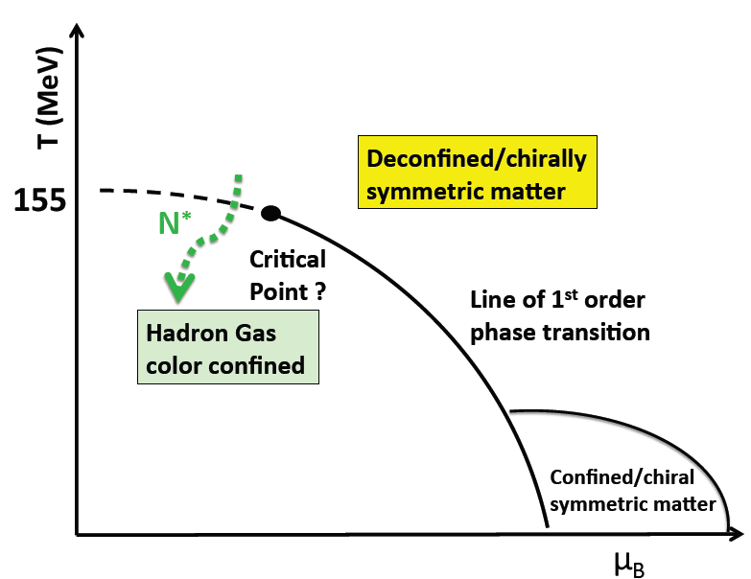
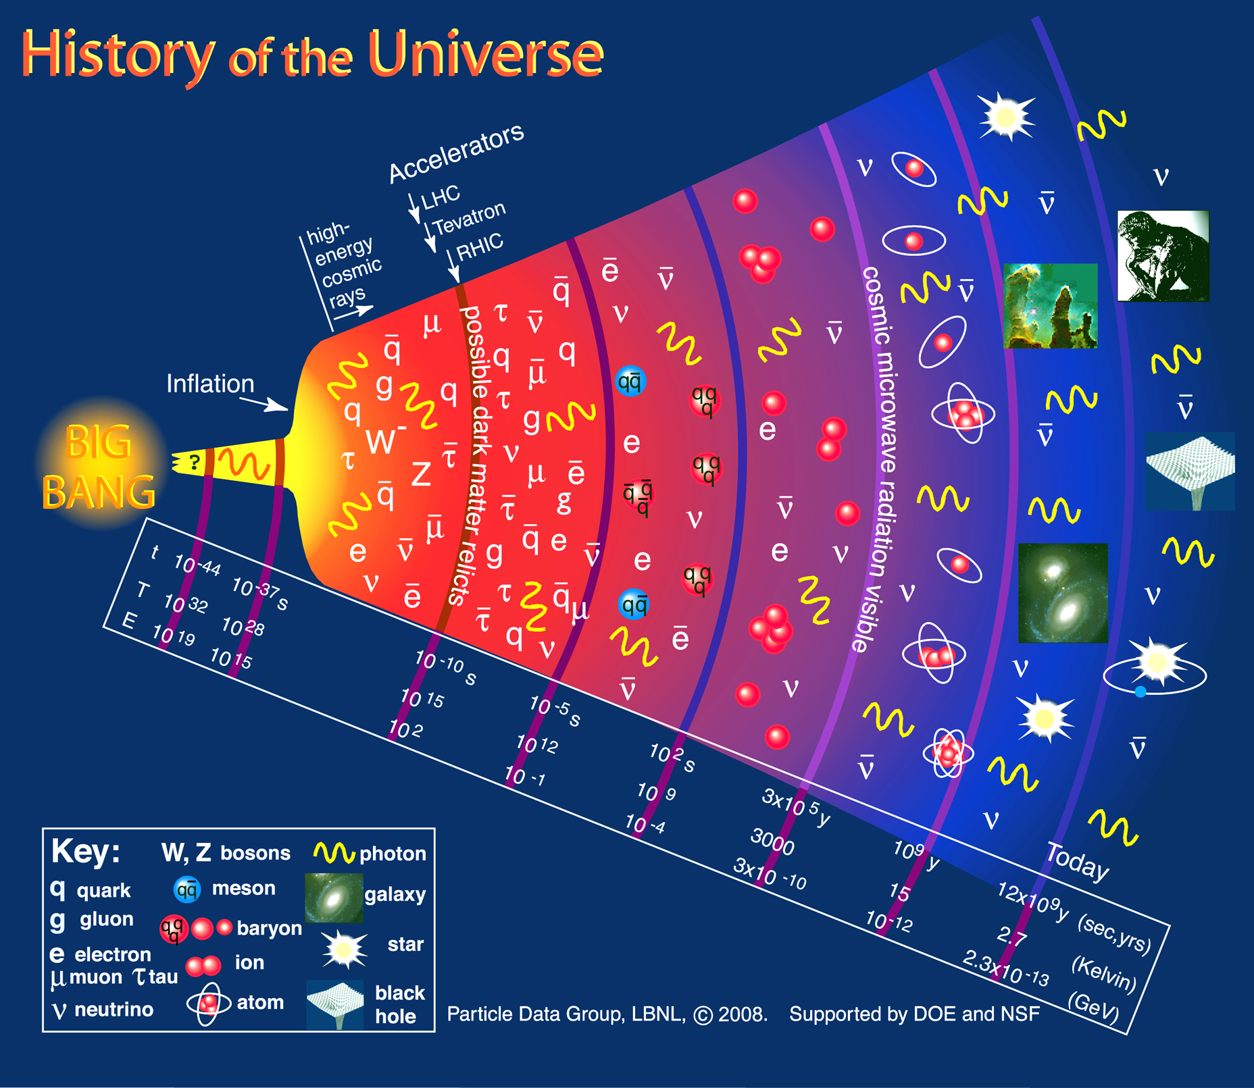
Confinement and Strong QCD
CEBAF
Dramatic events occur in the transition from the QGP phase to hadron phase
Chiral symmetry is dynamically broken
Quarks acquire masses dynamically
Color confinement occurs
Transition is driven by baryon excitations
N*
With CEBAF@12GeV and CLAS12 we can explore these events

Slide 3
Structure of excited baryons
  effective degrees of freedom
  transition charge densities
  running quark mass
  => nature of states
N(1680)5/2⁺
[56,2⁺]₂
2
L_{3q}
[70,1⁻]₁
N(1675)5/2⁻
N(1520)3/2⁻
N(1535)1/2⁻
e’
π, η, ππ, K
e
γ_{v}
1
N*,△*
Q
N
N, Y
[56,0⁺]₀
A_{1/2}, A_{3/2}, S_{1/2}
E₁₊, M₁₊, S₁₊
Δ(1232)3/2⁺
N(940)1/2⁺
N(1440)1/2⁺
N(1710)1/2⁺
[70,0⁺]₀
0
0
1
N [ħω]
2
I.G. Aznauryan et al., Analysis of p(e,e’Nπ) (DR, UIM); V.I. Mokeev et al., Analysis of p(e,e’pπ⁺π⁻) (JM)
Notes:
The N* spectrum teaches us about the underlying symmetries, to access the internal structure we need to probe the nucleon with virtual photons that measure the resonance strength versus the time-distance scale. What one measures are the helicity amplitudes A1/2, A3/2, and S1/2 or equivalent electromagnetic multipoles. I will focus on 3 states highlighted here.

Slide 4
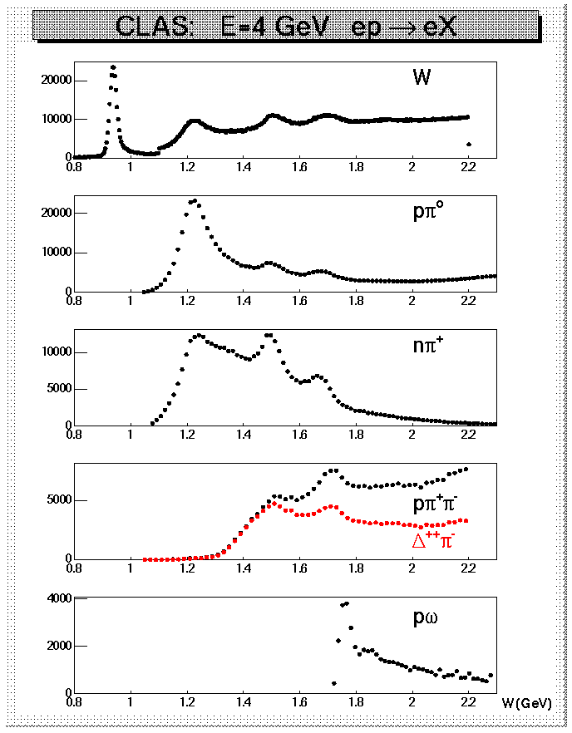
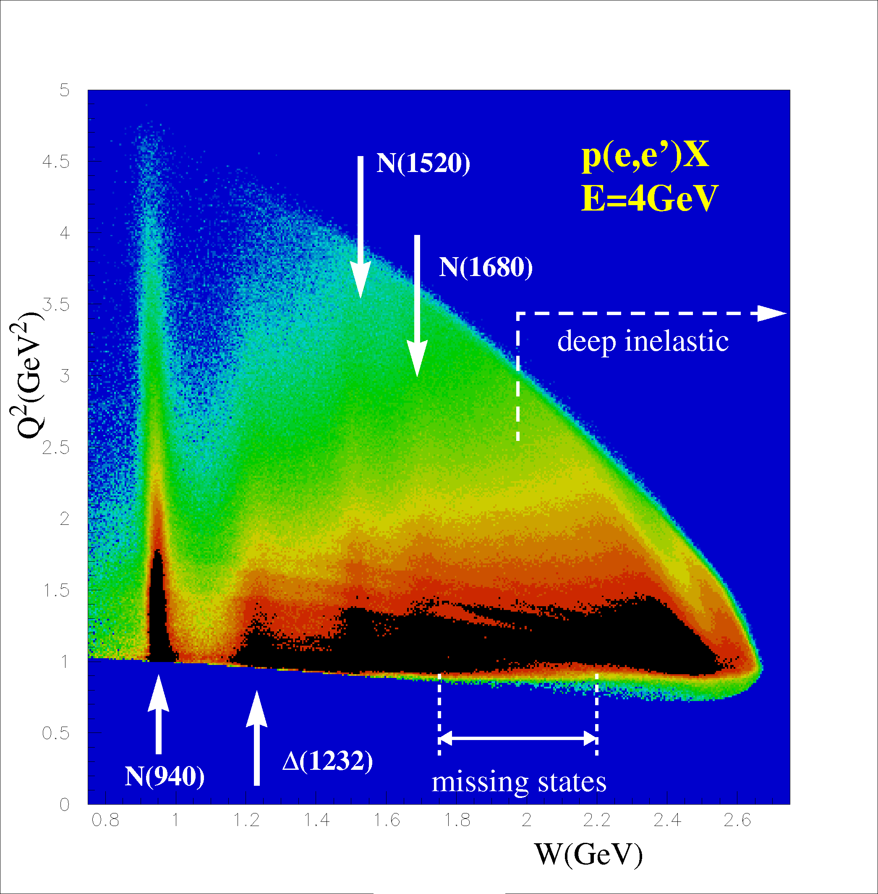
Electron Scattering ep→e’X
Q²=-(e-e’)²; W² = M_{X}²=(e-e’+p)²
e’
Resonances cannot be uniquely separated
in inclusive scattering → exclusive processes
4
Notes:
While the first resonance contains only the Delta resonance, the
higher mass bumps contain a multiple of known states.
In order to disentangle these states inclusive measurements are
obviously not sufficient, we need to measure exclusive hadronic final states.
(next slide)
Detection of a final state proton allows use of the missing mass technique to isolate ....

Slide 5
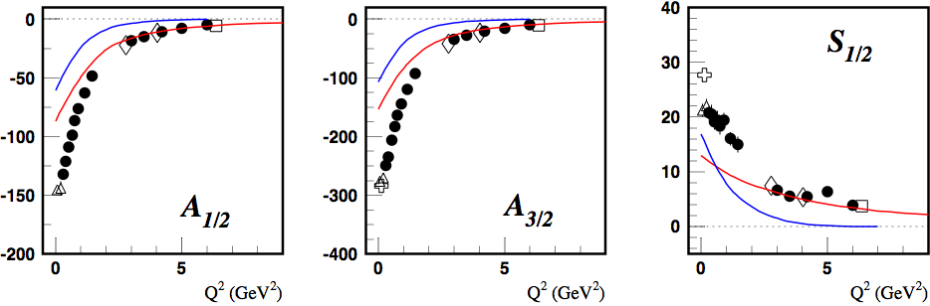
NΔ(1232)3/2⁺ helicity amplitudes
LF RQM [m_{q}(p)]
p(e,e’)π⁰
MB - inferred
MB contributions consistently present at Q² ≤ 3 GeV² for all amplitudes.

Slide 6

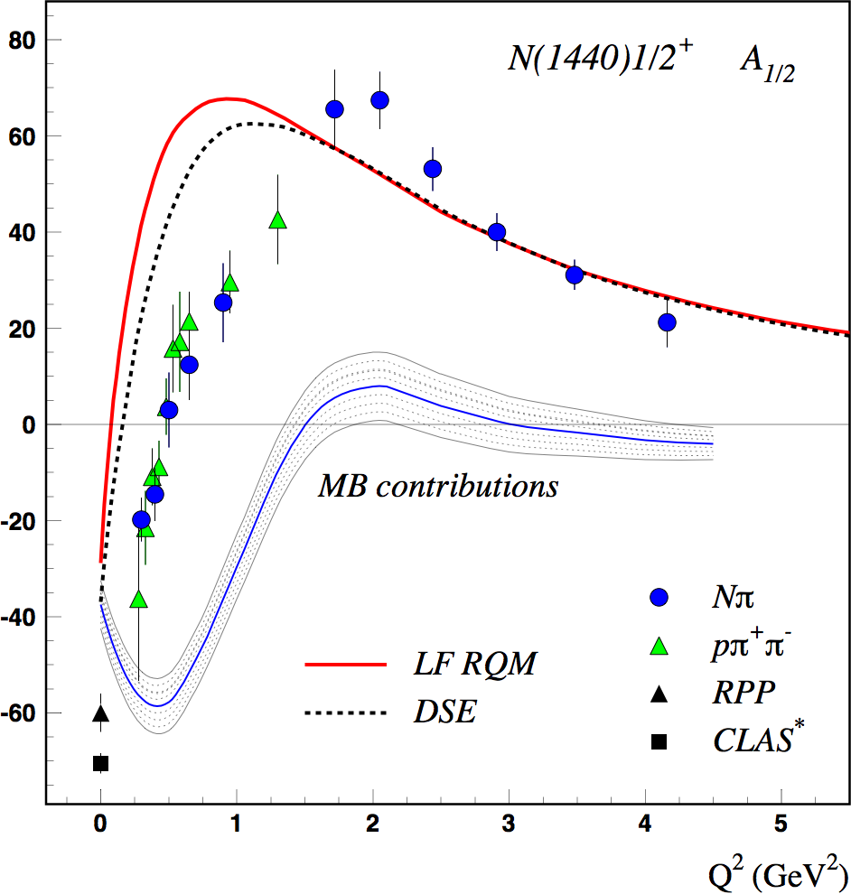
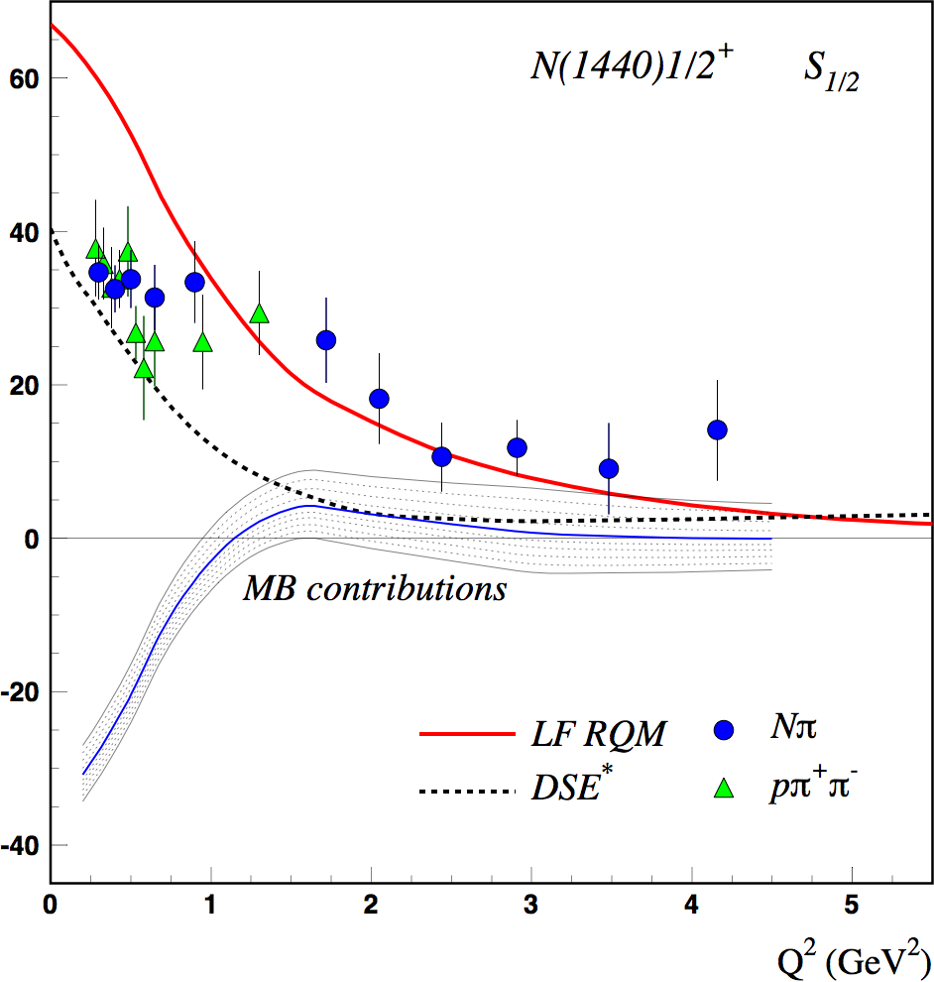
Roper resonance N(1440)1/2⁺
DSE: J. Segovia et al., arXiv:1504.04386
LF RQM: I. Aznauryan, V.B. (2016)
Non-quark contributions are significant at Q² < 2.0-2.5 GeV².
The 1st radial excitation of the 3-quark core seen when the probe penetrates the MB cloud.

Slide 7
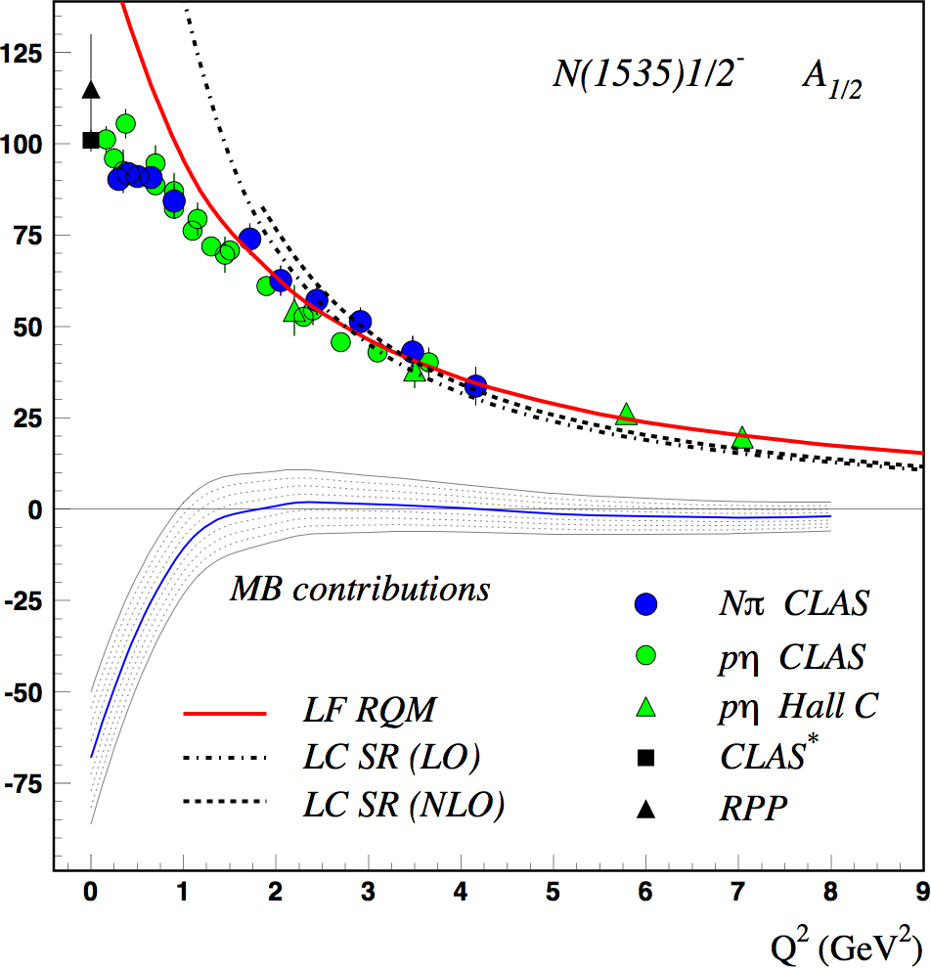
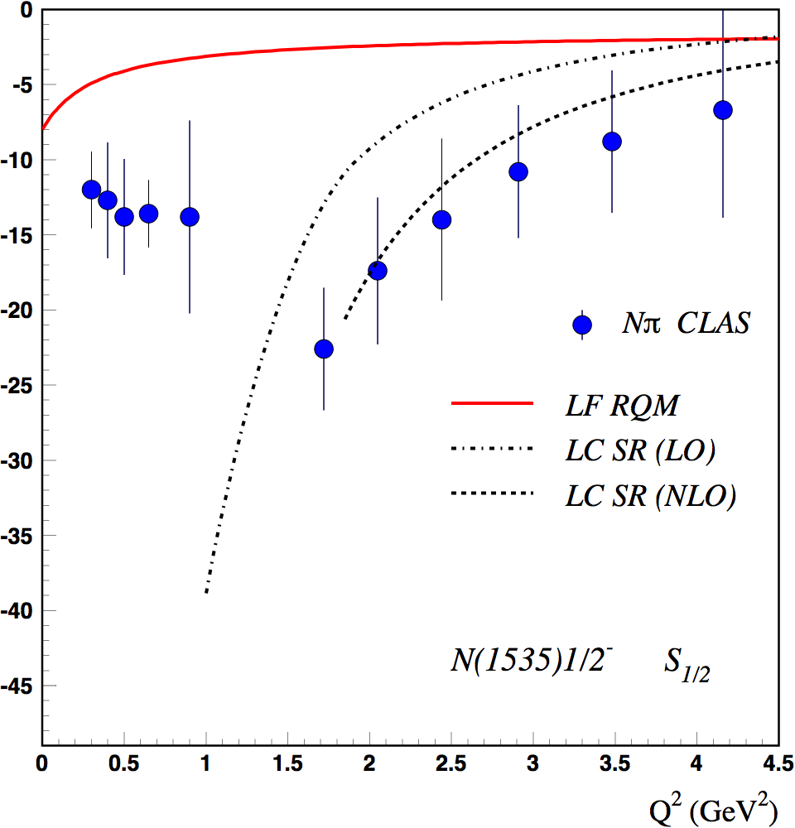
N(1535)1/2⁻ helicity amplitudes
LC SR: I.V. Anikin, V.M. Braun, N. Offen, arXiv 1505.05759
Non-quark contributions significant at Q² < 1.5 GeV².

Slide 8
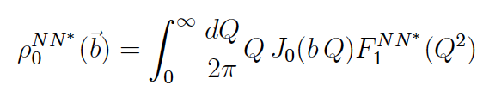
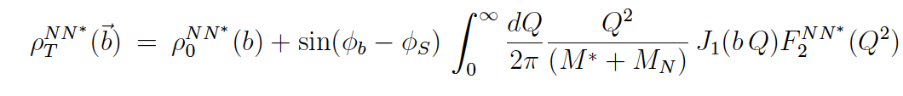
Transverse charge transition densities of N*/Δ*
Nucleon charge densities in the transverse plane in IMF
NN* charge transition densities in transverse plane in IMF
Nucleon: G.A. Miller, PRL 99, 112001 (2007)
Δ(1232): C.E. Carlson, M. Vanderhaeghen, PRL 100 (2008)
N*(1440)..: L. Tiator, M. Vanderhaeghen, PL B 672 (2009) 344
For J=1/2 states:
Exp: 0 <Q² < 4.5-7 GeV²

Slide 9
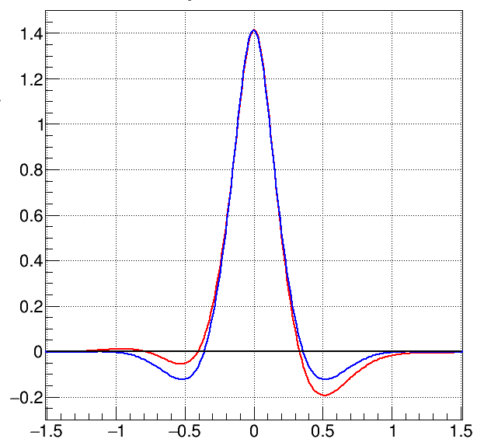
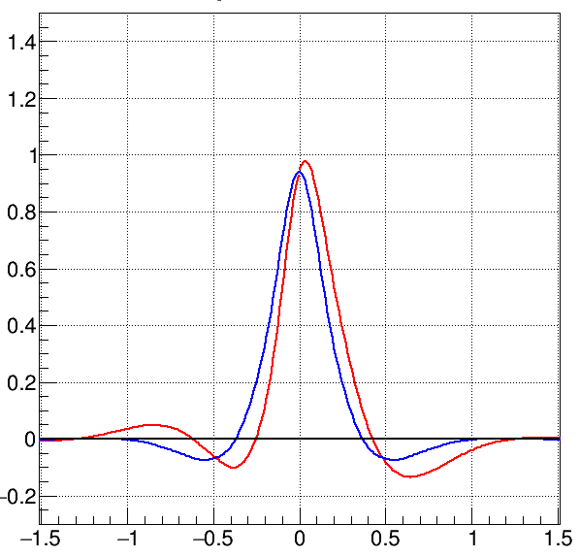
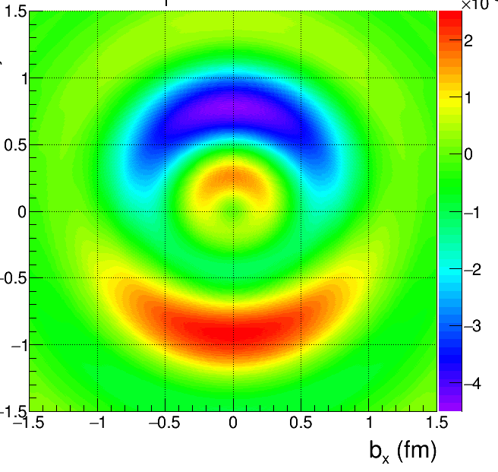
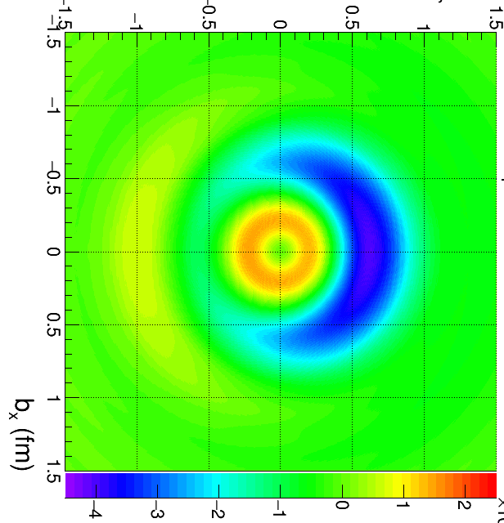
Light Front γpN* transition charge densities
Fourier transform in Q² of transition form factors
result in the IMF in transition
charge densities from the proton to the two states.
N(1535)1/2⁻
ρ₀
ρ_{T}
P
N(1440)1/2⁺
b²ρ_{T}
b_{y} (fm)
Electric Dipole
b_{y} (fm)
The N(1440) exhibits a softer core and wider clouds than N(1535)
b²ρ_{T}
ρ₀
ρ_{T}
P
FT involves integral in Q²->∞
=> need data at higher Q²
charge densities
courtesy
F.X. Girod
Electric Dipole
Notes:
The Q² dependence of the helicity amplitudes can be Fourier transformed to obtain the transition charge densities on the light cone. It is interesting to compare the distributions for two states with same spin but opposite parity. Also the Roper has a much more involved meson-baryon cloud component. One may thus expect a spatially more extended charge distribution.

Slide 10
From 2D to 3D imaging of NN* transitions
Charge transition densities are 2D projections in (b_{x}, b_{y}) space.
In order to get complete 3(2+1)D image of NN* transition in transverse impact parameter space and longitudinal momentum space we need a second scale beyond Q².
Go from s-channel excitation of N* (where Q² = t) to t-channel excitation with Q² and t independently variable and Q² >> t.
Experimentally this is achieved in N*DVCS. Probes quark contributions directly, avoids coupling to meson cloud for Q² > 2-3 GeV², while t/Q² << 1.

Slide 11
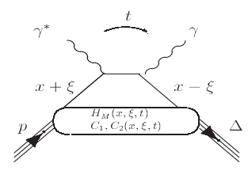
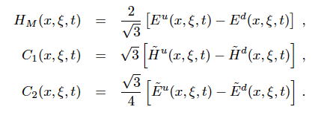
ΔDVCS
ΔVCS
Understand the physics of NΔ transition at the partonic level.
e’
e
γ*
At leading twist in QCD: 3 vector N-Δ GPDs and 4 axial-vector N-Δ GPDs.
Expectation is that 3 GPDs dominate at small t.
N
π

Slide 12
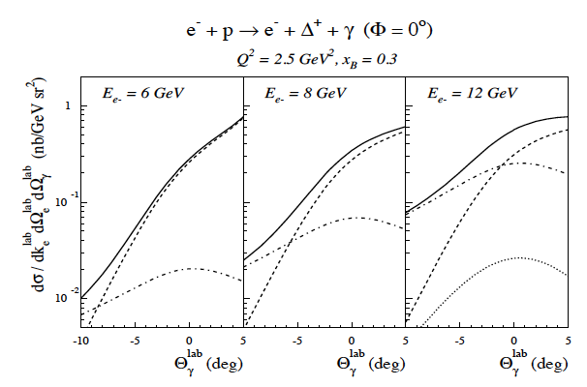
ΔDVCS & BH cross section
K. Goeke,
M.V. Polyakov,
M. Vanderhaeghen,
Prog. Part. Nucl. Phys. 47, 401 (2001).
Example: Access NΔ GPDs in ΔVCS
DVCS
DVCS
DVCS
BH
BH
C1
BH

Slide 13
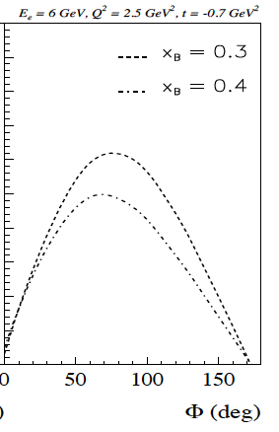

Beam Spin Asymmetry in ΔDVCS
Similar to elastic DVCS+BH
ΔVCS + BH have a beam spin asymmetry.
In large N_{c} limit beam spin asymmetry can be computed using magnetic transition form factor G_{M}^{Δ} of NΔ as input.
Beam Spin Asymmetry

Slide 14
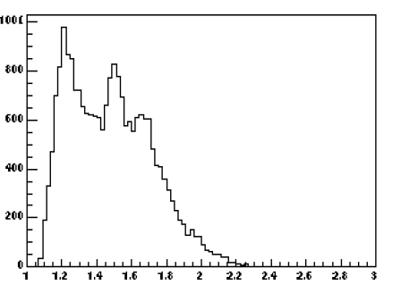
Experimental Aspects
ep --> enπ⁺(γ)
E_{e}=4.2GeV, Q² ~ 1GeV²
Δ(1232)
M. Guidal, et al. Nucl. Phys. A, 721, C327, 2003.
N*(1520)
W > 2 GeV
CLAS12 can access,
Q²< 10 GeV², x_{B}<0.8
N*(1680)
N-N*(J=1/2, T=1/2) GPDs should have simpler structure than N-Δ (J=3/2, T=3/2) GPDs.
M(nπ⁺)

Slide 15
Light Front γpN* transition charge densities
Fourier transform in Q² of transition form factors
result in the IMF in transition
charge densities from the proton to the two states.
N(1535)1/2⁻
ρ₀
ρ_{T}
P
N(1440)1/2⁺
b²ρ_{T}
The N(1440) exhibits a softer core and wider clouds than N(1535)
b_{y} (fm)
Electric Dipole
b_{y} (fm)
b²ρ_{T}
ρ₀
ρ_{T}
FT involves integral in Q²->∞
=> need data at higher Q²
P
charge densities
With N*DVCS we get similar (b_{x},b_{y}) slices but at fixed x_{B}.
courtesy
F.X. Girod
Electric Dipole
Notes:
The Q² dependence of the helicity amplitudes can be Fourier transformed to obtain the transition charge densities on the light cone. It is interesting to compare the distributions for two states with same spin but opposite parity. Also the Roper has a much more involved meson-baryon cloud component. One may thus expect a spatially more extended charge distribution.

Slide 16
Incorporate NN* GPDs in general framework?
Need to develop transition GPD formalism for NN* transitions in N*DVCS.
Channels of interest for experiments p(e,e’γpπ⁰), p(e,e’γpη), p(e,e’γnπ⁺), n(e,e’γpπ⁻) for low mass states, and p(e,e’γ pπ⁺π⁻) for high mass states.
Experiment schedule – data taking 2017/2018

Slide 18
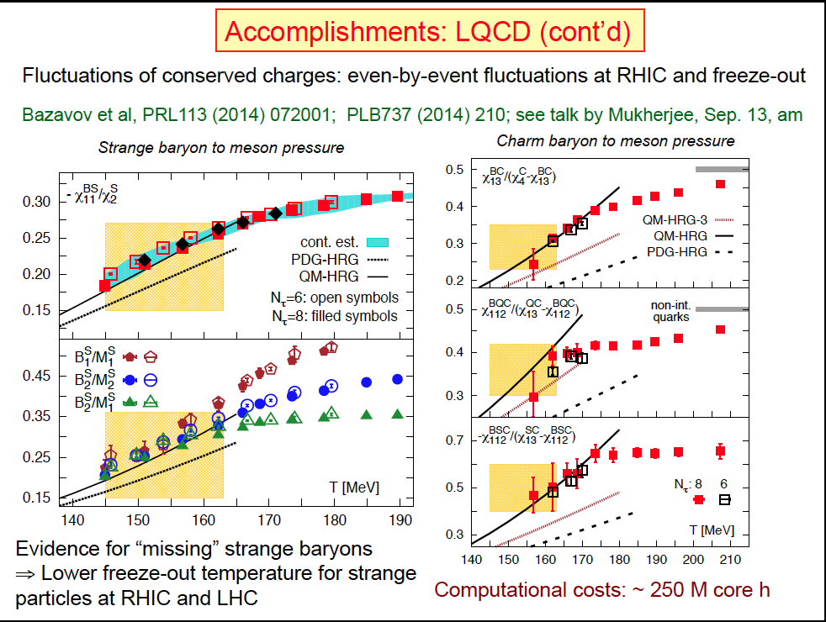
Missing baryons resonances and HIC
non-inter. quarks
T [MeV]
T [MeV]
Evidence for “missing” strange and charmed baryons
Discrepancy observed also for light quark baryons but calculations are not published.
Supplemental motivation for an excited baryon program of all quark flavors.
Notes:
The answer is NO if only baryons that are included in the Particle Data Book are used in the calculations. If all states from the quark model are used, i.e. SU(6)xO(3) or LQCD the data are reproduced well. This is not just for strange baryons but also for charmed baryons and u-d flavored baryons.
Relativistic Heavy Ion collisions provide additional evidence for missing baryons of all flavors, and support an experimental program to search for them.
Before I talk about nucleon resonances I like to begin with a reminder that much of what we know the structure of the hydrogen atom ….

Slide 19
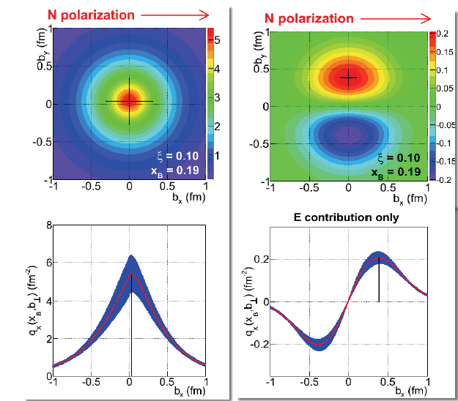
3D Imaging of Proton Quark Structure
From x, t dependence of DVCS cross section and all polarization observables we can determine Compton Form Factors H(x_{B} ,t), E(x_{B} ,t).
H + E contribution
A Fourier transform in t
in LC kinematics determines the quark distribution in impact parameter( b_{x} , b_{y}) space at fixed x_{B}.

