Slide 1
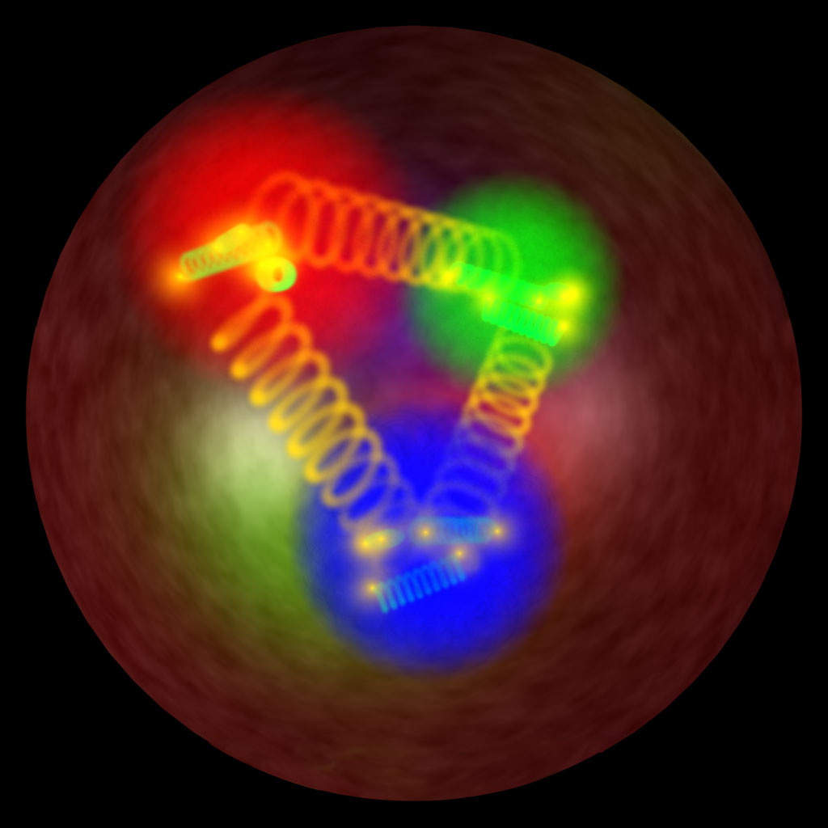
Nucleon and Resonance Structure
with Hard Exclusive Processes
31/05/2017
Fitting CFFs/GPDs
And the x-dependence
of the charge radius of the proton
Michel Guidal (IPN Orsay)
(in collaboration with R. Dupré, S. Niccolai & M. Vanderhaeghen)

Slide 2
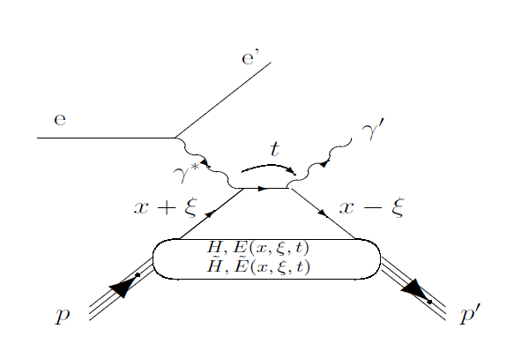
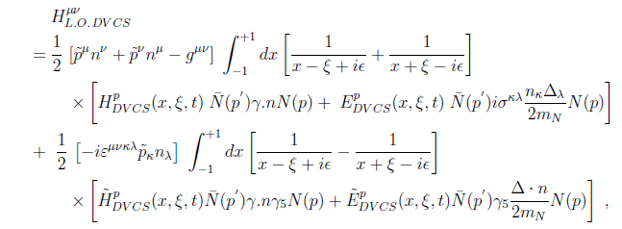
H^{q}(x,ξ,t) but only ξ and t experimentally accessible

Slide 3




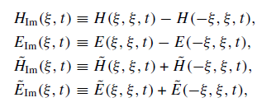

In general, 8 GPD quantities accessible
(sub-)Compton Form Factors
with

Slide 4


γ
DVCS
Bethe-Heitler
e’
φ
e
leptonic plane
N’
hadronic
plane
GPDs
ξ= x_{B}/(2-x_{B}) k=-t/4M²
Polarized beam, unpolarized target (BSA) :
~
~
Δσ_{LU} ~ sinφ Im{F₁H + ξ(F₁+F₂)H -kF₂E}dφ
Im{H_{p}, H_{p}, E_{p}}
Unpolarized beam, longitudinal target (lTSA) :
~
~
~
Im{H_{p}, H_{p}}
Δσ_{UL} ~ sinφIm{F₁H+ξ(F₁+F₂)(H + x_{B}/2E) –ξkF₂ E+…}dφ
Polarized beam, longitudinal target (BlTSA) :
~
~
Re{H_{p}, H_{p}}
Δσ_{LL} ~ (A+Bcosφ)Re{F₁H+ξ(F₁+F₂)(H + x_{B}/2E)…}dφ
Unpolarized beam, transverse target (tTSA) :
Δσ_{UT} ~ cosφIm{k(F₂H – F₁E) + ….. }dφ
Im{H_{p}, E_{p}}
Notes:
nDVCS complements pDVCS for the different sensitivity to GPDs of the various observables

Slide 5
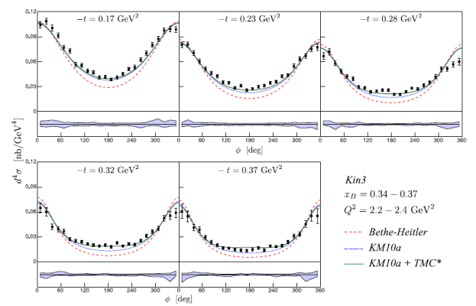
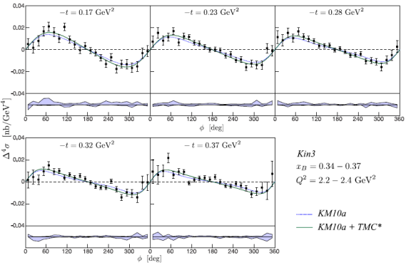
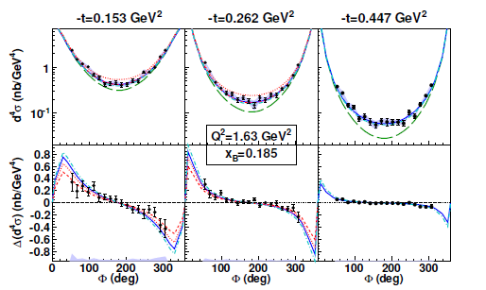
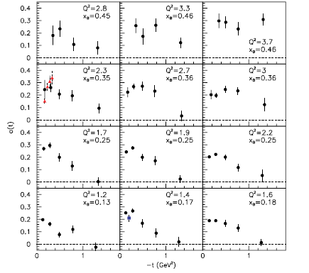
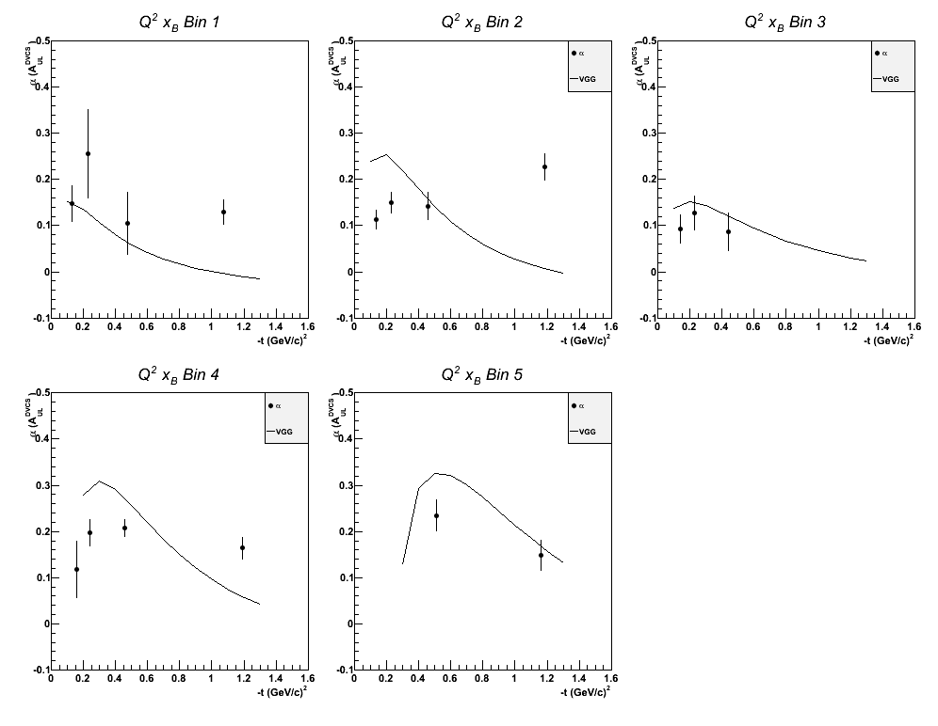
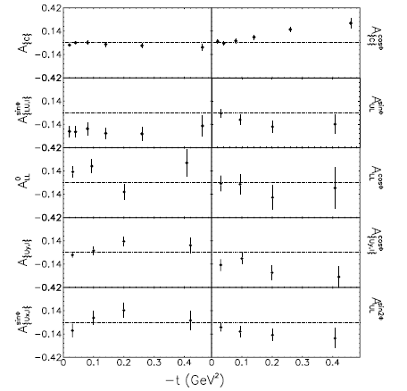
JLab
Hall A
DVCS
unpol. X-section
DVCS
B-pol. X-section
JLab
CLAS
DVCS
BSA
DVCS
lTSA
DVCS unpol. and
B-pol. X-sections
HERMES
DVCS
BSA,lTSA,tTSA,BCA

Slide 6
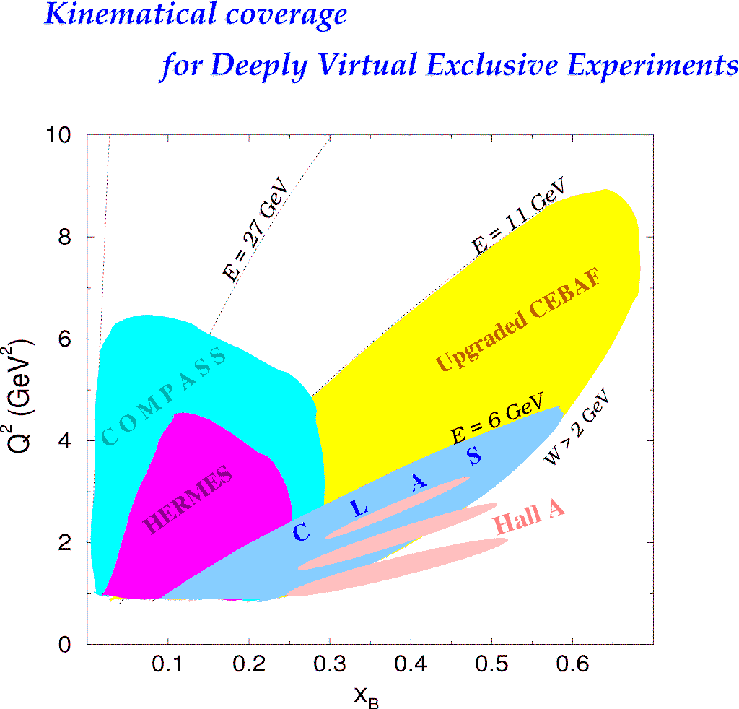

Slide 7
Given the well-established LT-LO DVCS+BH amplitude
DVCS
Bethe-Heitler
GPDs
Can one recover the 8 CFFs from the DVCS observables?
Obs= Amp(DVCS+BH) CFFs
Two (quasi-) model-independent approaches
to extract, at fixed x_{B}, t and Q² (« local » fitting),
the CFFs from the DVCS observables

Slide 8
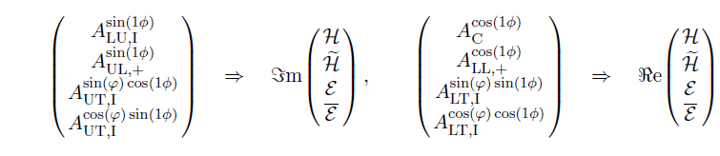
1/ Mapping and linearization
If enough observables measured, one has a system
of 8 equations with 8 unknowns
Given reasonable approximations (leading-twist dominance,
neglect of some 1/Q² terms,...), the system can be linear
(practical for the error propagation)
~
Δσ_{LU} ~ sinφ Im{F₁H + ξ(F₁+F₂)H -kF₂E}dφ
~
~
Δσ_{UL} ~ sinφIm{F₁H+ξ(F₁+F₂)(H + x_{B}/2E) –ξkF₂ E+…}dφ
K. Kumericki, D. Mueller, M. Murray Phys.Part.Nucl. 45 (2014) 4, 723

Slide 9


2/ «Brute force » fitting
χ² minimization (with MINUIT + MINOS) of the
available DVCS observables at a given x_{B}, t and Q² point
by varying the CFFs within a limited hyper-space (e.g. 5xVGG)
The problem can be (largely) underconstrained:
JLab Hall A: pol. and unpol. X-sections
JLab CLAS: BSA + TSA
2 constraints and 8 parameters !
However, as some observables are largely dominated by
a single or a few CFFs, there is a convergence (i.e. a well-defined
minimum χ²) for these latter CFFs.
The contribution of the non-converging CFF enters in
the error bar of the converging ones. For instance (naive):
If -10<x<10:

Slide 10
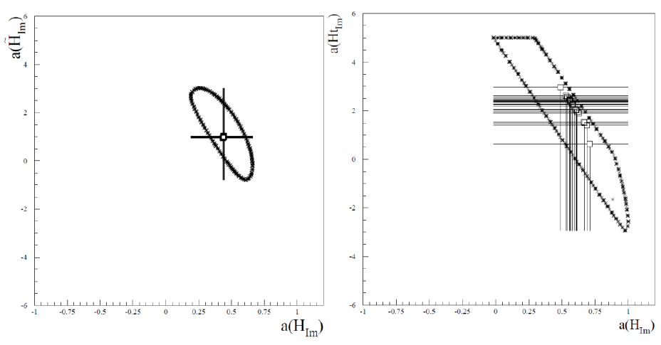
~
Examples of correlation between H_{Im} and H_{Im}
Fitting only 2 observables Δσ_{LU} & σ
Polarized beam, unpolarized target (BSA) :
~
Δσ_{LU} ~ sinφ Im{F₁H + ξ(F₁+F₂)H -kF₂E}dφ

Slide 11
2/ «Brute force » fitting
χ² minimization (with MINUIT + MINOS) of the
available DVCS observables at a given x_{B}, t and Q² point
by varying the CFFs within a limited hyper-space (e.g. 5xVGG)
The problem can be (largely) underconstrained:
JLab Hall A: pol. and unpol. X-sections
JLab CLAS: BSA + TSA
2 constraints and 8 parameters !
However, as some observables are largely dominated by
a single or a few CFFs, there is a convergence (i.e. a well-defined
minimum χ²) for these latter CFFs.
The contribution of the non-converging CFF enters in
the error bar of the converging ones.
M.G. EPJA 37 (2008) 319
M.G. PLB 689 (2010) 156
M.G. PLB 693 (2010) 17
M.G. & H. Moutarde EPJA 42 (2009) 71
M.G. & M. Boer J.Phys.G 42 (2015) 034023

Slide 12
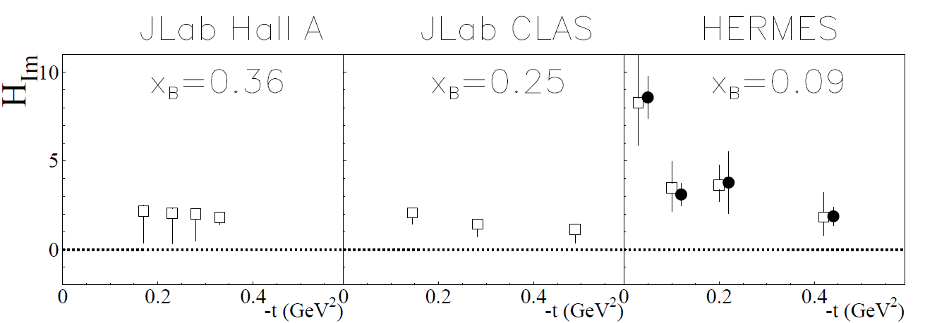
unpol.sec.eff.
+
beam pol.sec.eff.
χ² minimization
Notes:
Avec « ma » methode, extraction obtenue pour Him en fittant les sec.eff. (pol. et non-pol.) du Hall A

Slide 13
unpol.sec.eff.
+
beam pol.sec.eff.
beam spin asym.
+
long. pol. tar. asym
χ² minimization
Notes:
Avec « ma » methode, extraction obtenue pour Him en fittant les BSA et les TSA (Shifeng) de CLAS

Slide 14
unpol.sec.eff.
+
beam pol.sec.eff.
beam spin asym.
+
long. pol. tar. asym
beam charge asym.
+
beam spin asym
+
…
χ² minimization
linearization
Notes:
Avec la methode de KM et la mienne, extraction obtenue pour Him en fittant les asymetries d’HERMES.

Slide 15
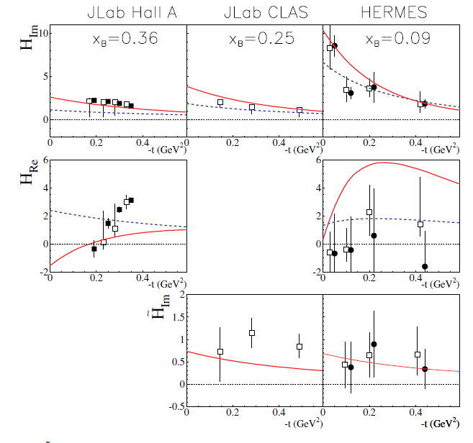
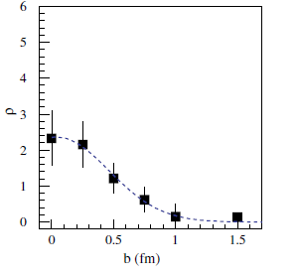
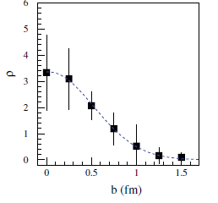
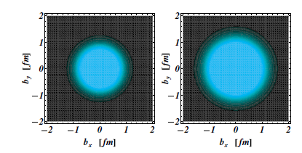
M.G., H. Moutarde,
M. Vanderhaeghen
Rept.Prog.Phys. 76 (2013) 066202

Slide 16
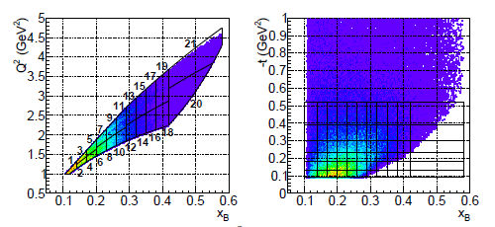
New recent data from JLab:
CLAS coll.
PRL 115 (2015), 212003
(unpol. and beam-pol.
x-sections)
Hall A coll.
PRC92 (2015), 055202
CLAS coll.
PRL 114 (2015), 032001
CLAS coll.
PRD91 (2015), 052014
(unpol. and beam-pol.
x-sections)
(lTSA)
(lTSA)

Slide 17
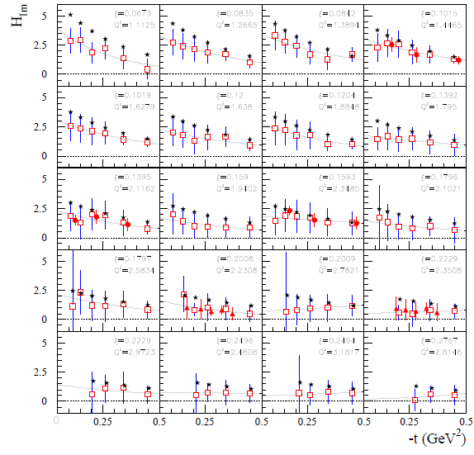

R. Dupré, M.G.,
M. Vanderhaeghen
arXiv:1606.07821
[hep-ph]

Slide 18
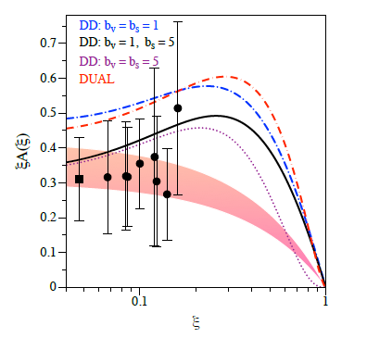
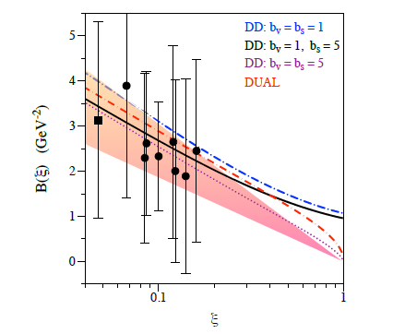





Slide 19







(M. Burkhardt)
If
However, this formula involves:
While we extract:
Need to estimate:
(assuming
)

Slide 20
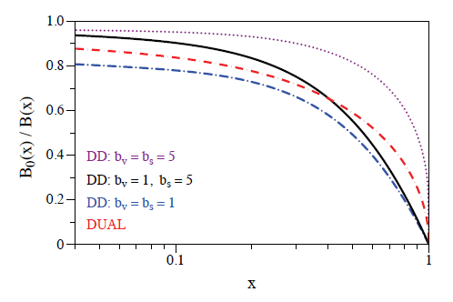

for

Slide 21
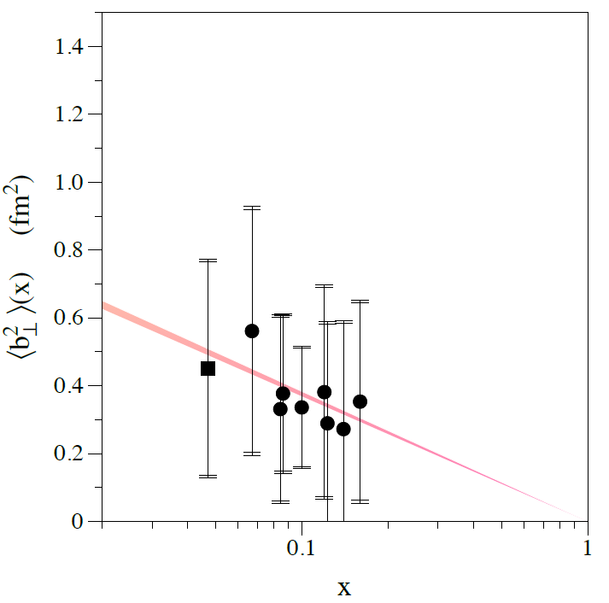

HERMES
JLab
« Integrated » radius from elastic form factor F1:

Slide 22
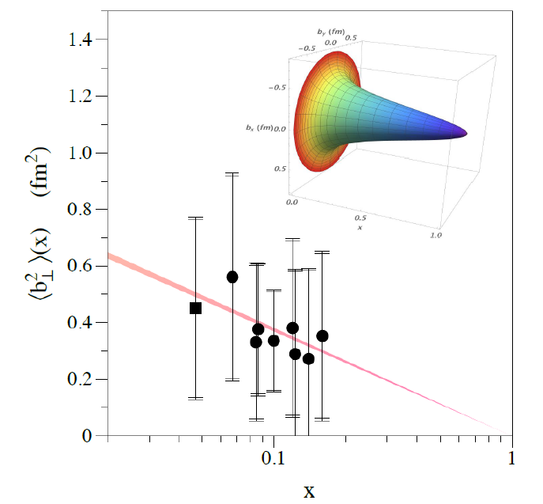
HERMES
JLab
« Integrated » radius from elastic form factor F1:

Slide 23
Dispersion relations

Slide 24
GPDs contain a wealth of information on nucleon structure
and dynamics: space-momentum quark correlation, orbital
momentum, pion cloud, pressure forces within the nucleon,…
Large flow of new observables being released and
new data expected soon (JLab6,JLab12,COMPASS)
(Other DVCS-related processes planned for JLab 12 GeV
(TCS, DDVCS)
First new insights on nucleon structure (x-dependence of the
charge radius, D-term)already emerging from current data
with new fitting algorithms
Theory developments: higher twists, target mass corrections,
NLO corrections, …

Slide 25
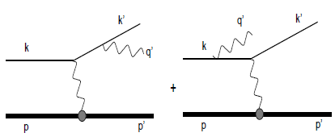

The Bethe-Heitler process

Slide 26
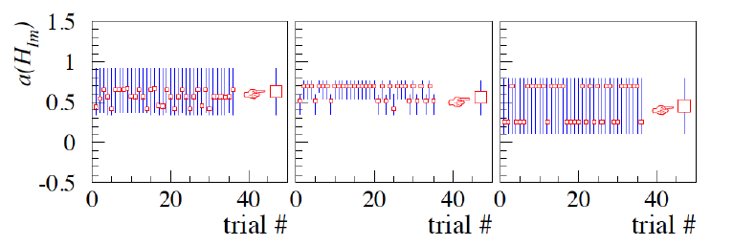
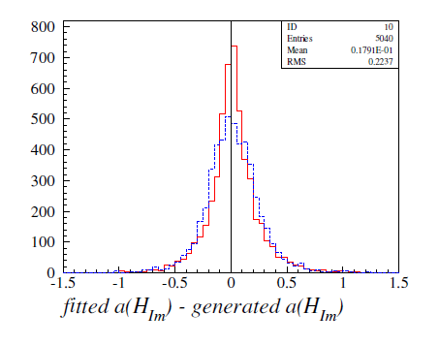

Slide 27
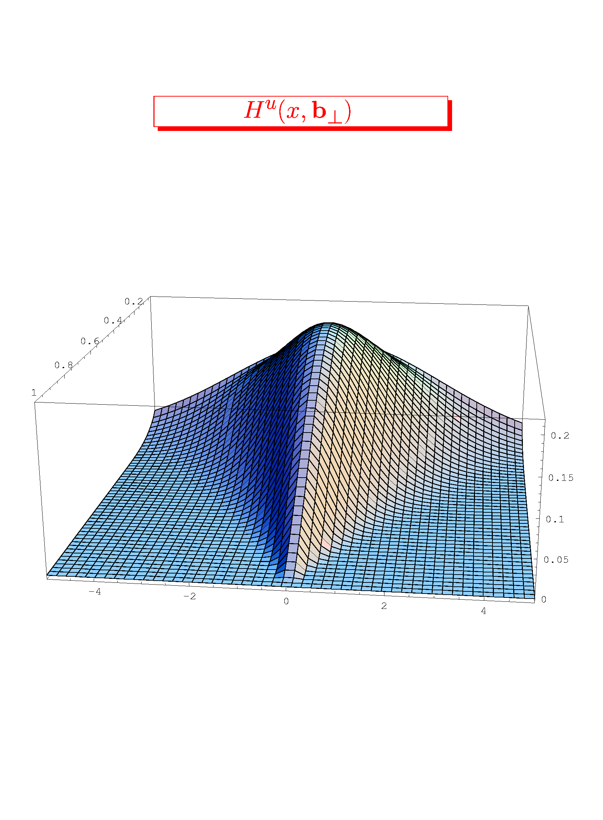
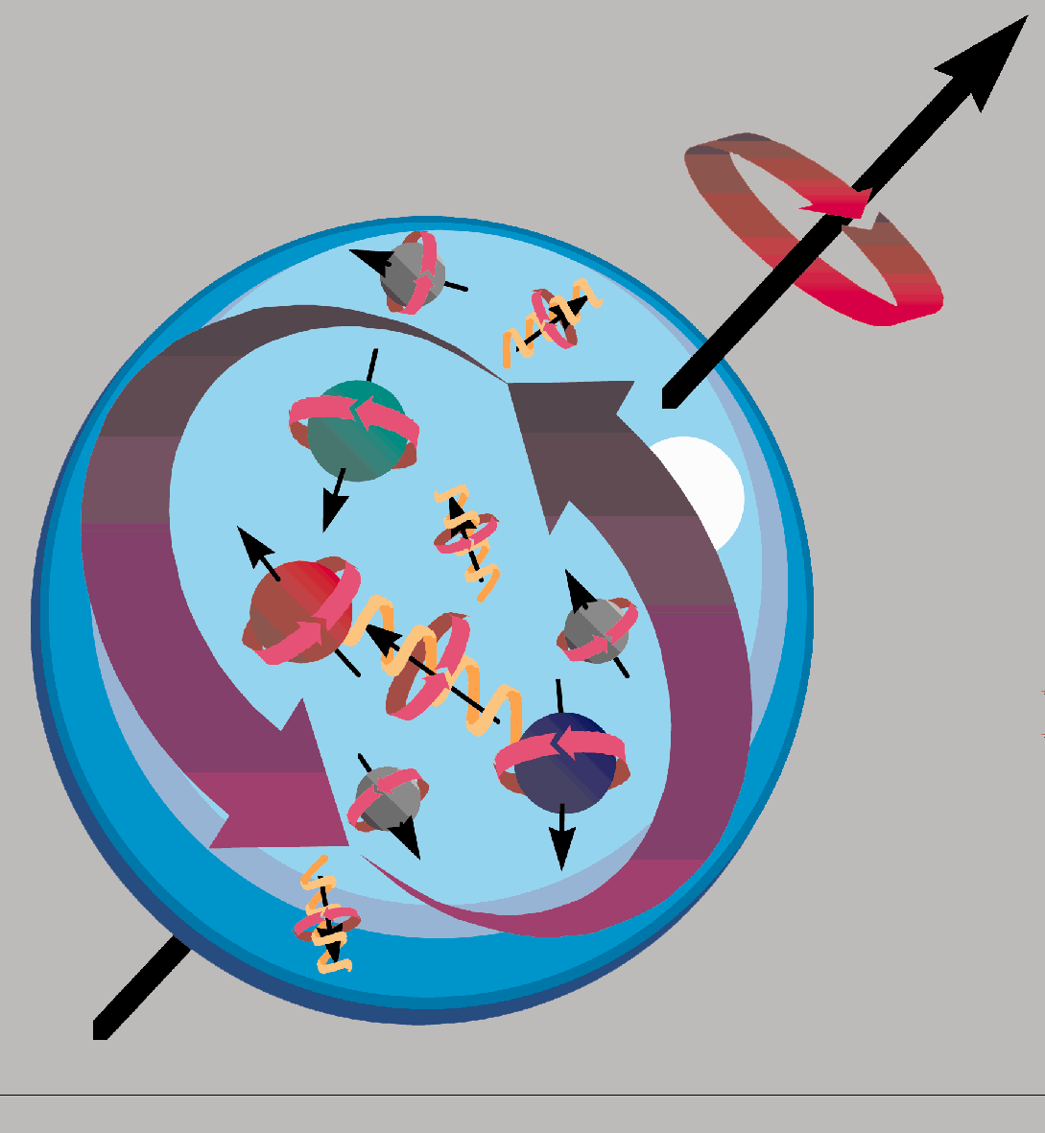
GPDs or the tomography of the nucleon
H^{u}(x,b )
y
z
x
_{x}
_{(GeV}⁻¹₎
_{b}
Ji’s sum rule
2J_{q} = ∫ x(H+E)(x,ξ,0)dx

Slide 28
The axial charge (H_{im}) appears to be more « concentrated » than the electromagnetic charge (H_{im})
~
Confirmed by new CLAS A_UL and A_LL data: Phys.Rev. D91 (2015) 5, 052014
Notes:
Resultats pour HtildeIm

Slide 29

(M. Burkhardt)
If
However, this formula involves:
While we extract:
Need to estimate:
(assuming
)

Slide 30
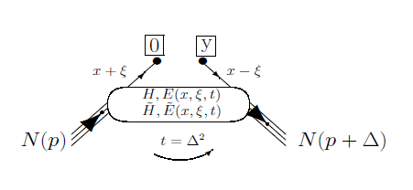
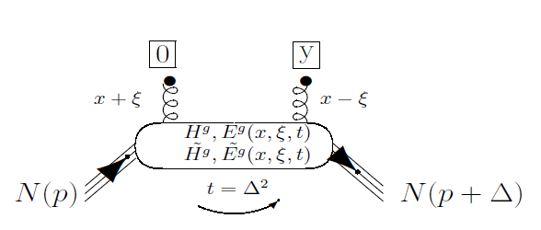

Slide 31
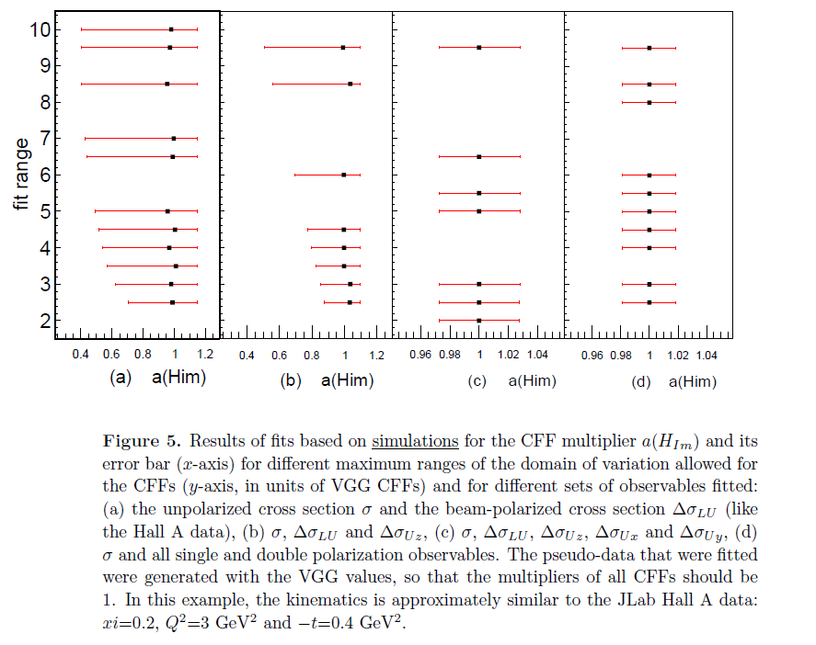
M. Boer, MG J.Phys. G42 (2015) 3, 034023

Slide 32
M. Boer, MG J.Phys. G42 (2015) 3, 034023

Slide 33
M. Boer, MG J.Phys. G42 (2015) 3, 034023

Slide 34
M. Boer, MG J.Phys. G42 (2015) 3, 034023

