Slide 1
Deeply Exclusive Meson Production with CLAS/CLAS12 at Jefferson Lab
Kyungseon Joo
University of Connecticut
The Nature of Hadron mass and Quark-Gluon Confinement from JLab Experiments in the 12-GeV Era
July 1-4, 2018

Slide 2
Physics Motivation (3-D structure of nucleon by assessing GPDs)
Differential cross section measurements for exclusive π⁰ and η productions.
Beam spin asymmetries for exclusive π⁺, π⁰, and π⁻ in forward and backward angles.
Beam spin asymmetries for coherent π⁰ production on ⁴He (spin-0 target)
JLAB 12 GeV outlook
Summary

Slide 3
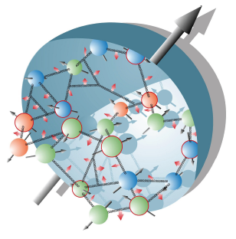
The Incomplete Nucleon: Spin Puzzle
Proton has spin-1/2
Proton is a composite system consisting of spin-1/2 quarks and spin-1 gluons
This implies that the sum of angular momentum of quarks and gluons together must amount to 1/2. Can be due to:
Quark spin Quark orbital angular momentum
Gluon spin Gluon orbital angular momentum
Classical: ~ r x p
Needs a cross-product or something three-dimensional!

Slide 4
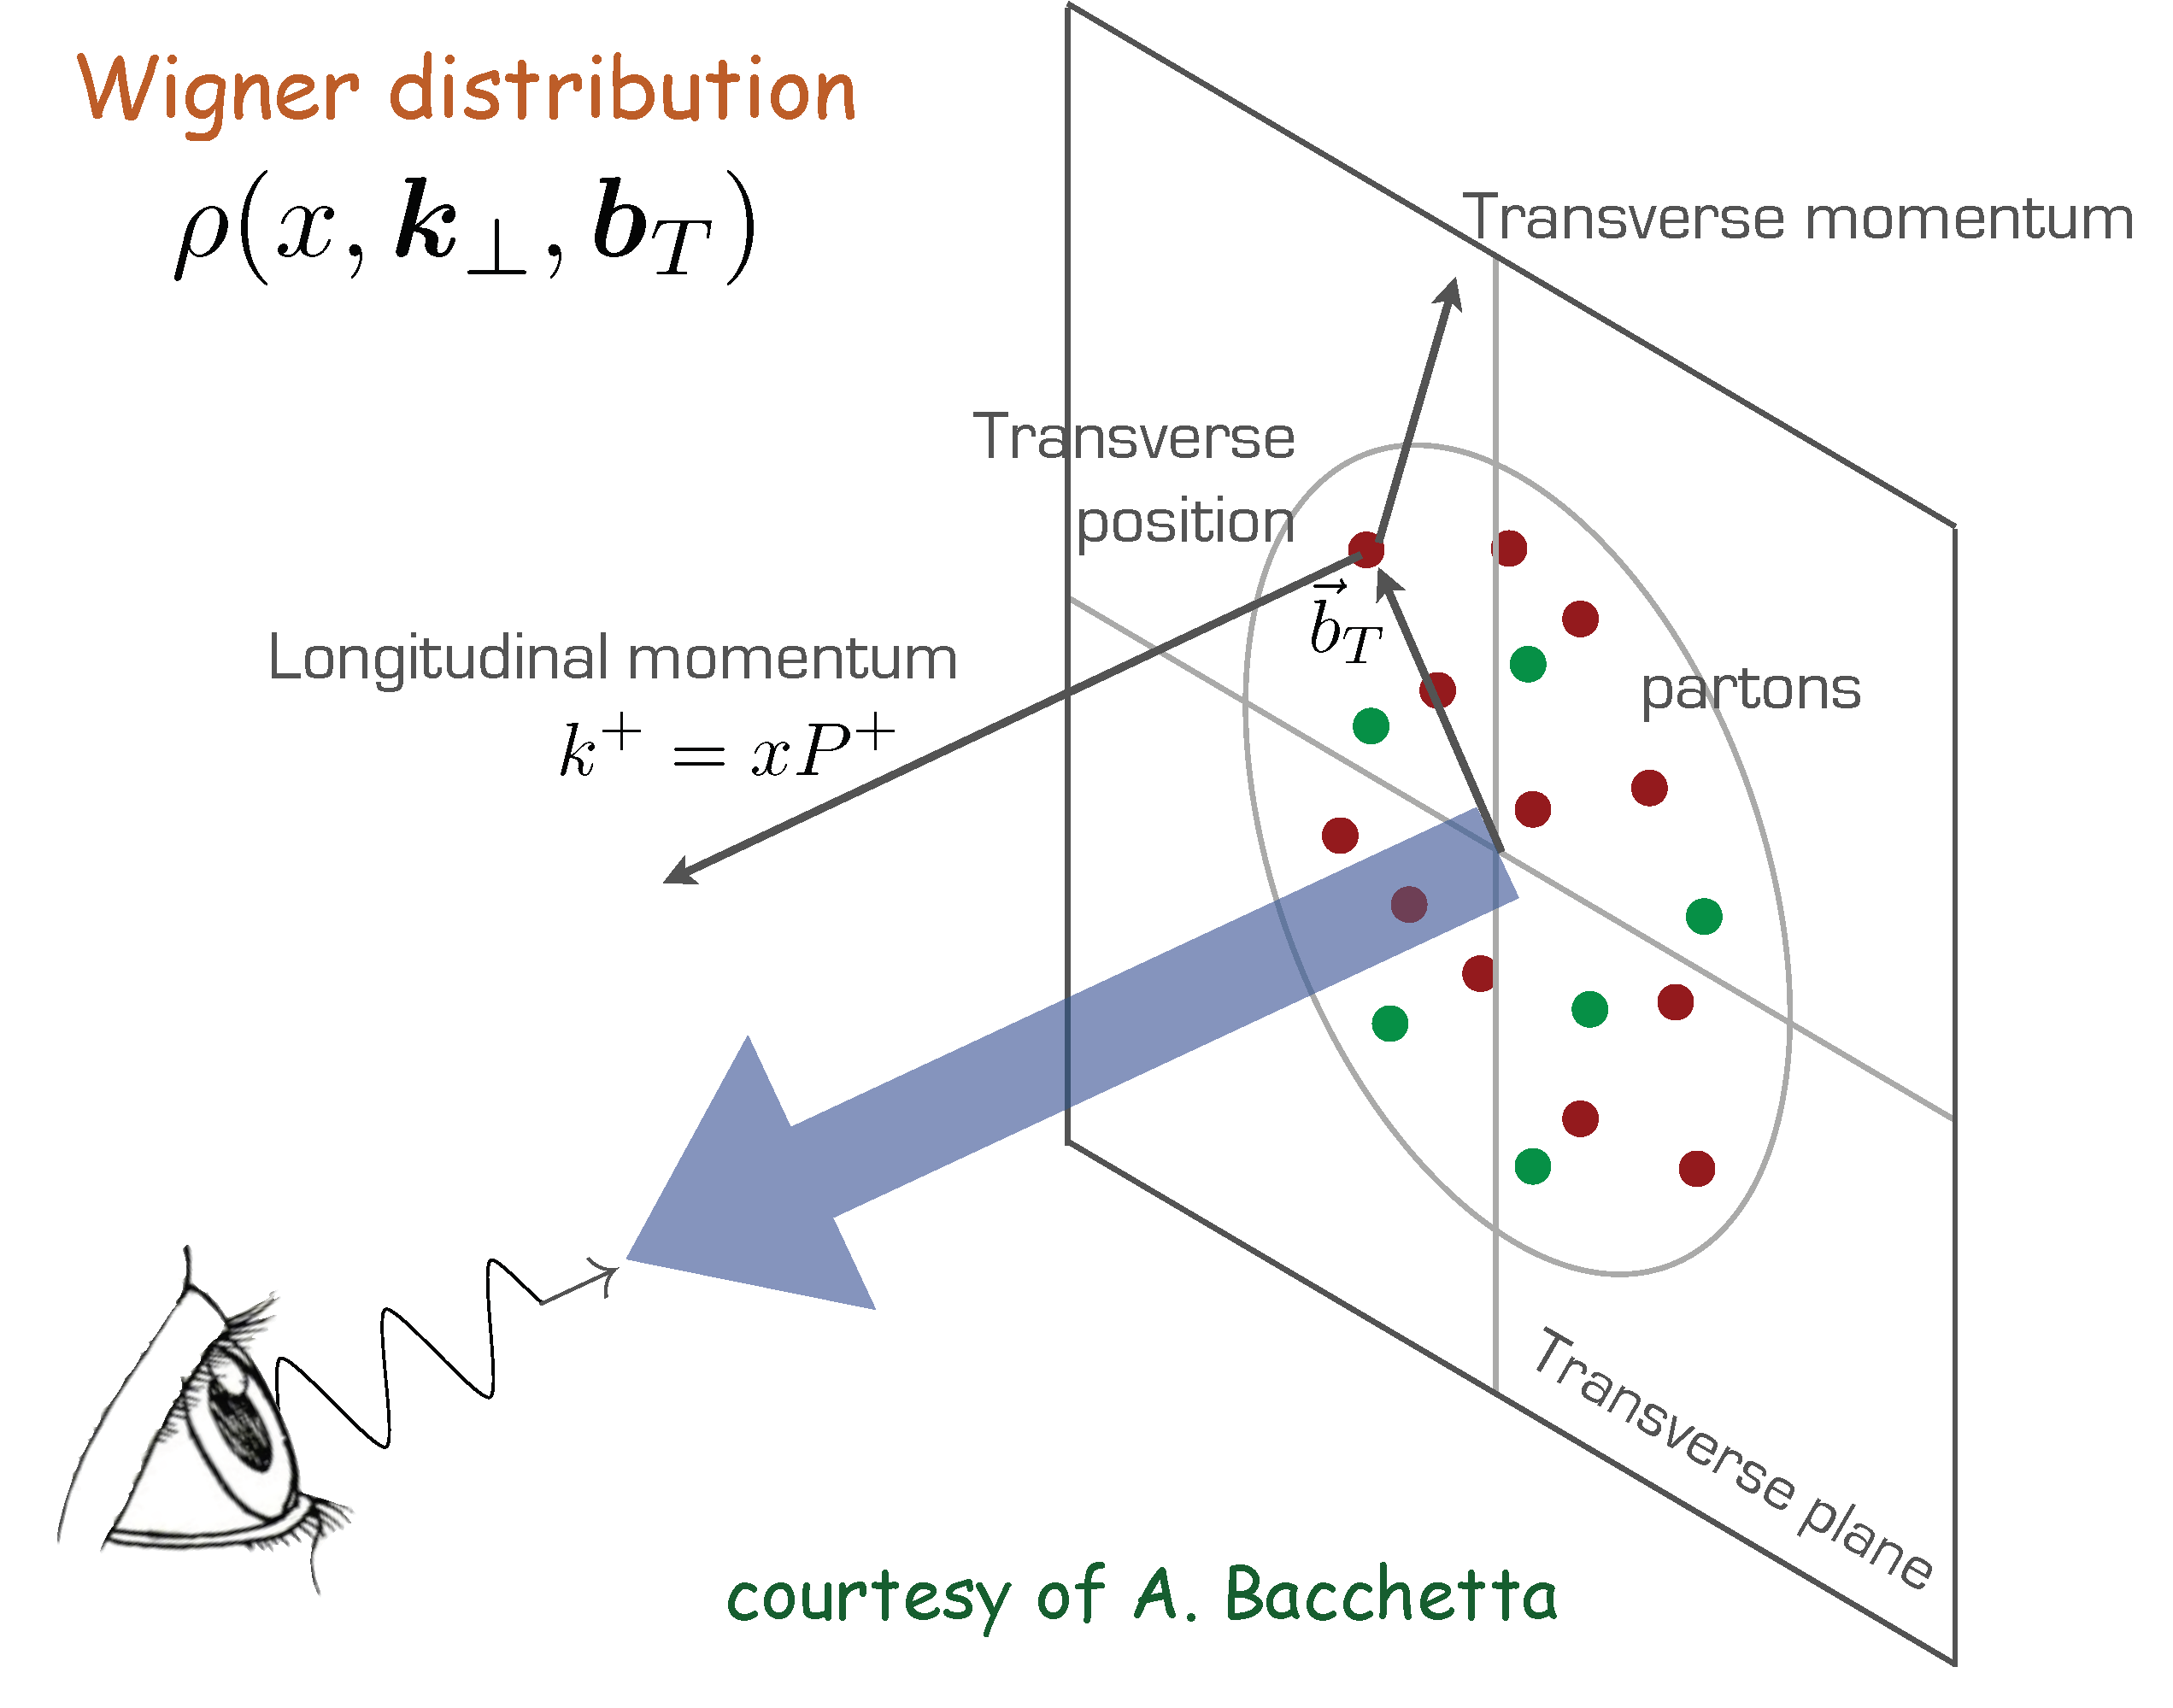
3-D Nucleon Structure Studies
(Quantum phase-space quark distribution in the nucleon)

Slide 5

3-Dimensional Imaging Quarks and Gluons
Wigner functions W(x,b_{T},k_{T})
offer unprecedented insight into confinement and chiral symmetry breaking.
W(x,b_{T},k_{T})
∫d²b_{T}
∫ d²k_{T}
Momentum
space
Coordinate
space
f(x,k_{T})
f(x,b_{T})
Spin-dependent 2D coordinate space (transverse) + 1D (longitudinal momentum)
images from exclusive scattering
→ GPDs
Spin-dependent 3D momentum space
images from semi-inclusive scattering
→ TMDs
Position and momentum → Orbital motion of quarks and gluons
Requires
  High luminosity, Polarized beams and targets
  Sophisticated detector systems
Major new capability with JLab @ 12 GeV

Slide 6
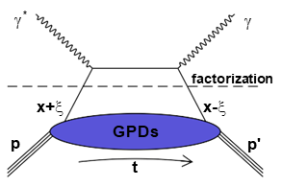
Generalized Parton Distributions

Slide 7
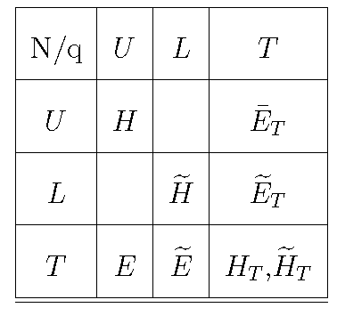
Generalized Parton Distributions (GPDs)
quark pol.
nucleon pol.
Integrate over transverse momentum space
Generalized Parton Distributions (GPD) H, H, E, E
~
~
3-D nucleon imaging in transverse coordinate and longitudinal momentum space

Slide 8
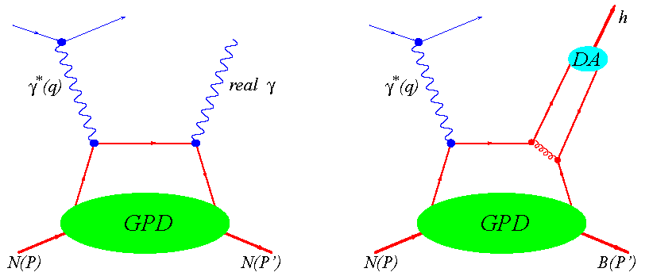
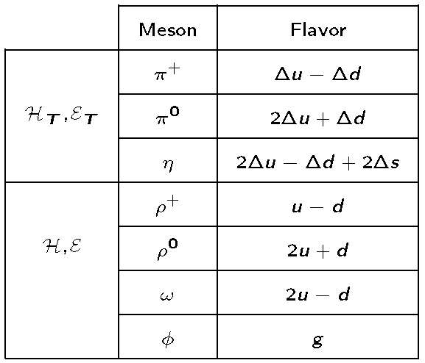
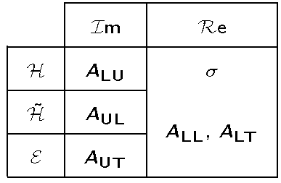
How to disentangle GPDs
Deeply Virtual Compton Scattering (DVCS)
Deeply Virtual Meson Production (DVMP)

Slide 9
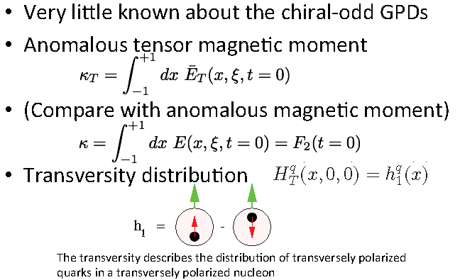
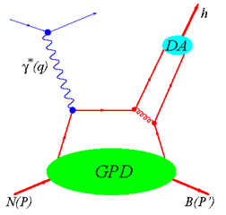

Chiral Odd (Transversity) GPDs
Deeply Virtual Pseudo-scaler Meson Production (DVMP)
π⁰, η
Chiral odd GPDs

Slide 10

12 GeV CEBAF Upgrade
12 GeV CEBAF
The Physics and Experiments
D
A
B
C

Slide 11
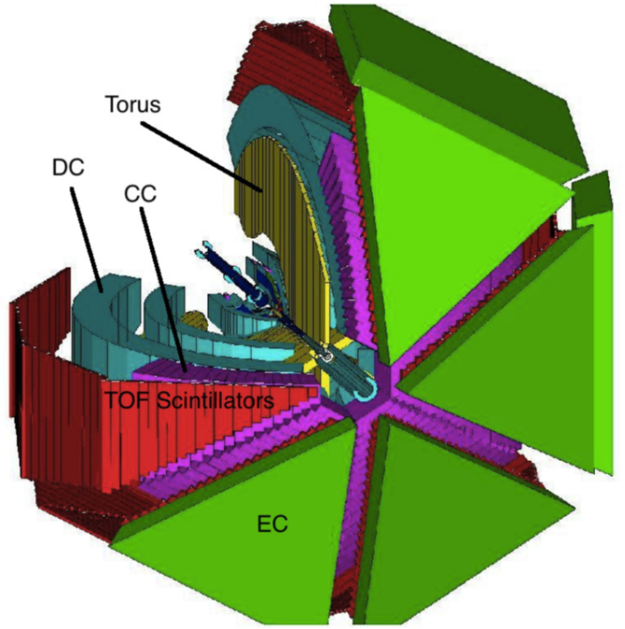

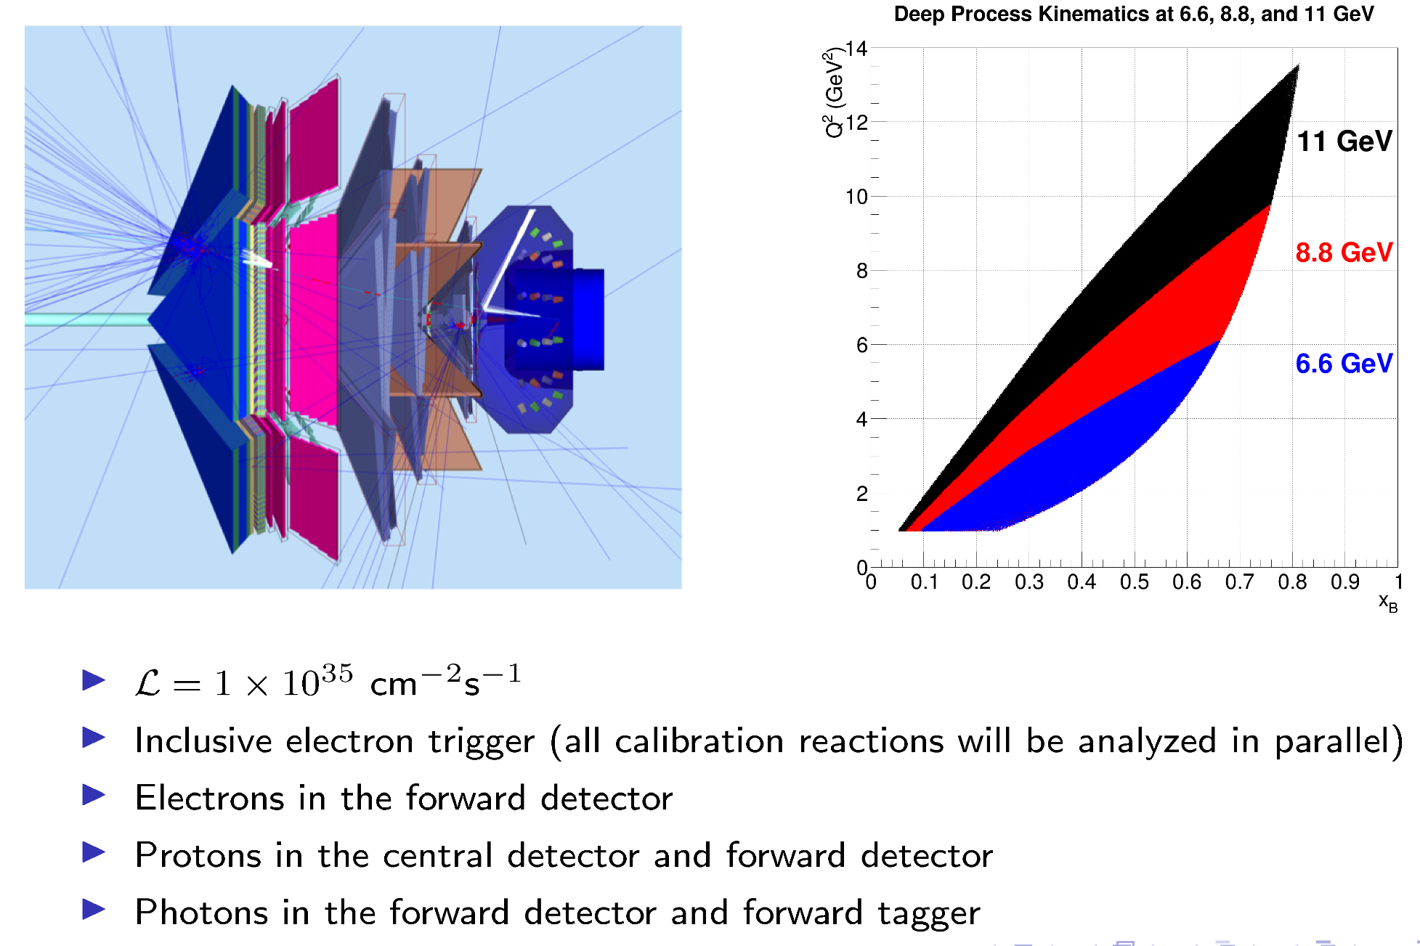
CLAS/CLAS12 in Hall B at Jefferson Lab

Slide 12
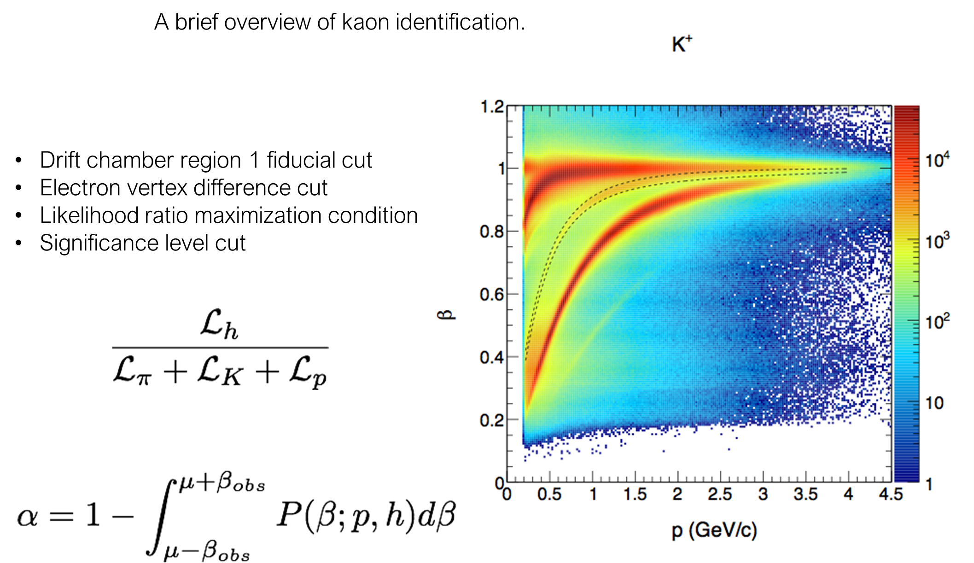
Particle Identification
π⁺, K⁺, proton

Slide 13

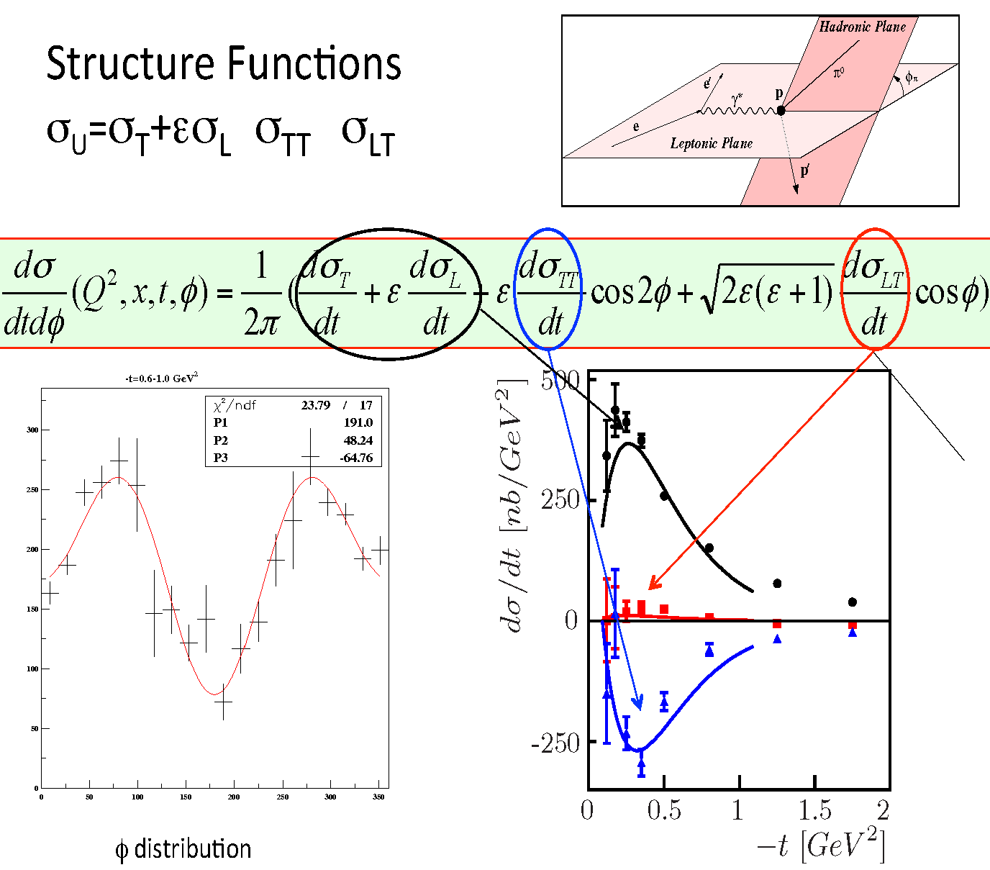
Differential Cross Sections

Slide 14
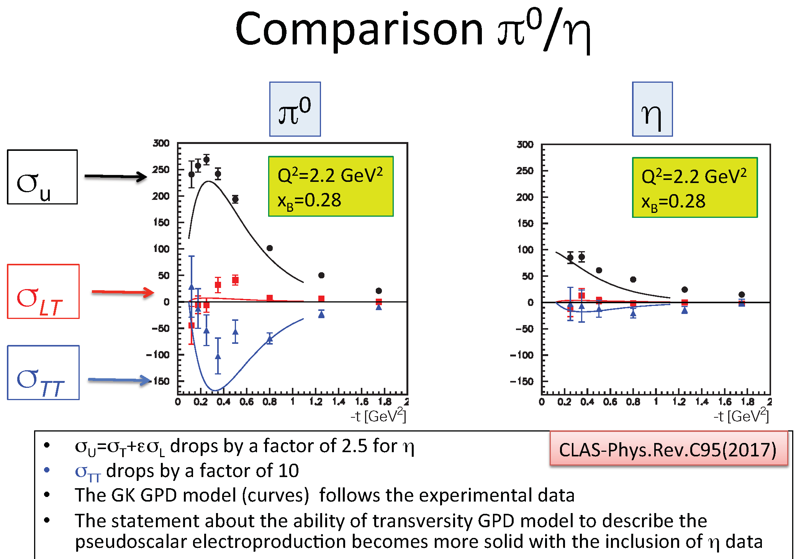

Slide 15
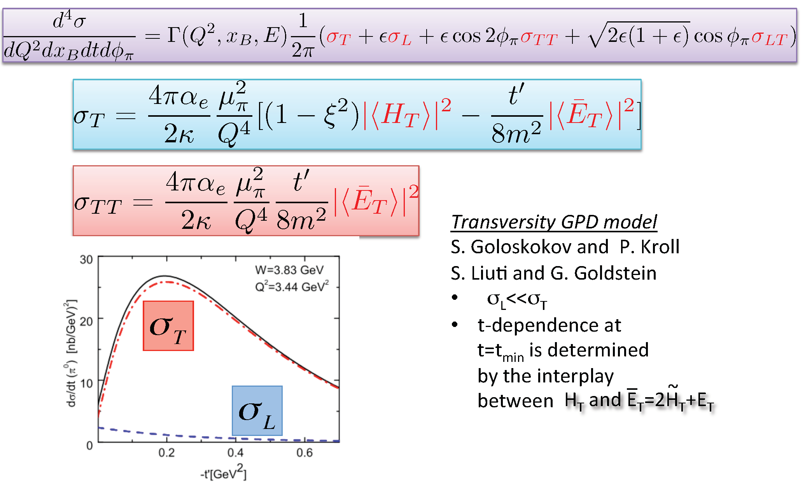
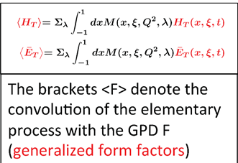
Structure Functions and Transversity GPDs

Slide 16
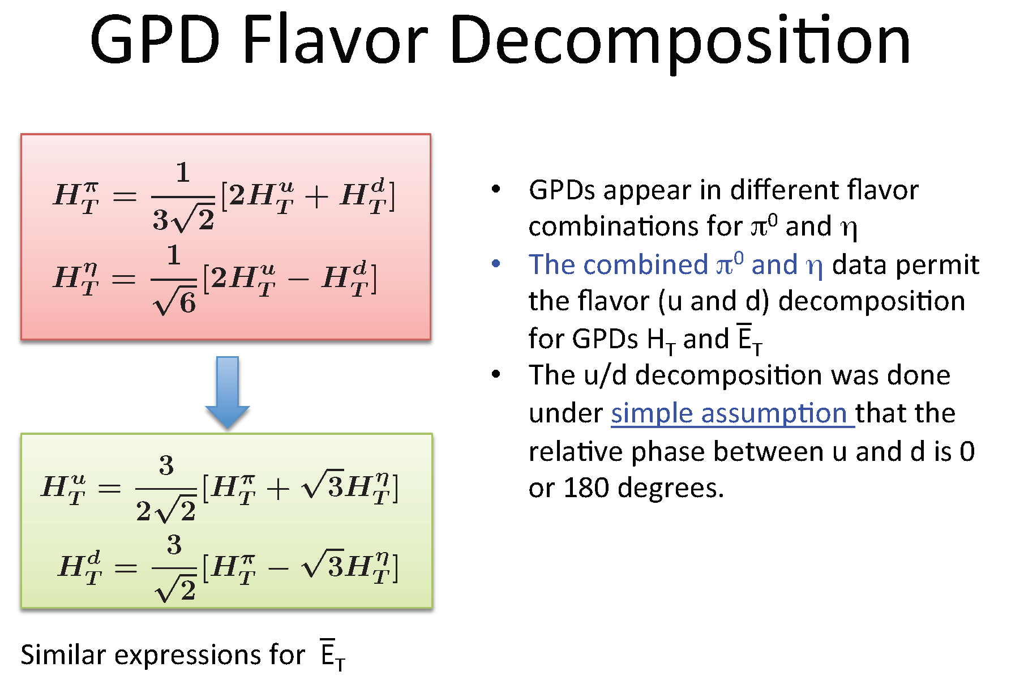

Slide 17
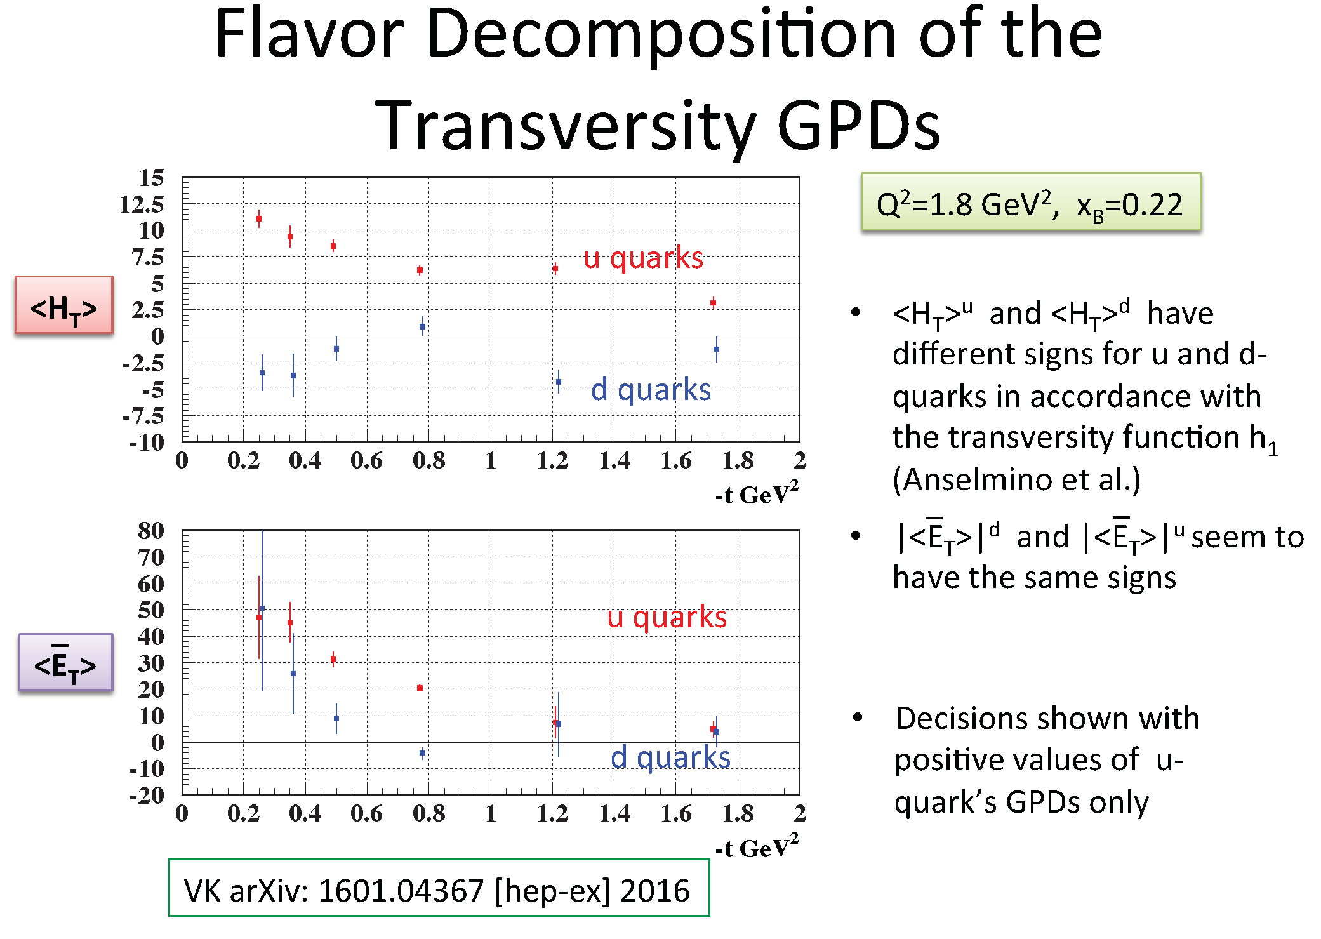
V. Kubarovsky (Jlab)

Slide 18
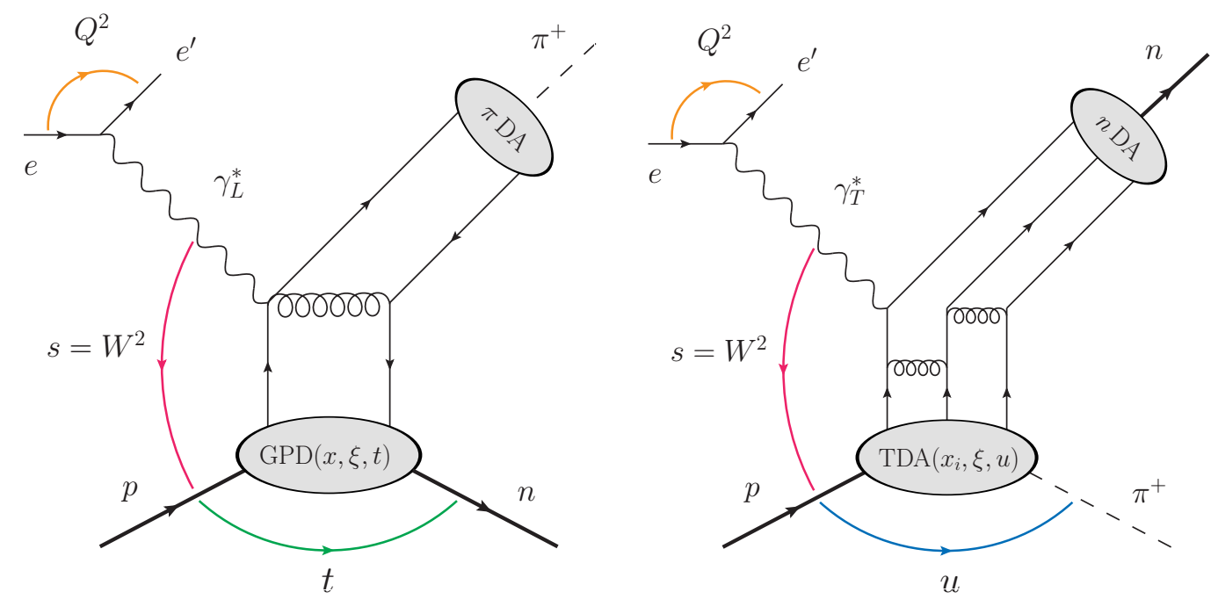
Nucleon-to-pion transition distribution amplitudes (TDAs)
meson in nearly forward region
small t channel contribution
larger u channel contribution
GPDs + π DA
meson in neraly backward region
small u channel contribution
larger t channel contribution
p to π TDAs + n DA
Park’s talk

Slide 19
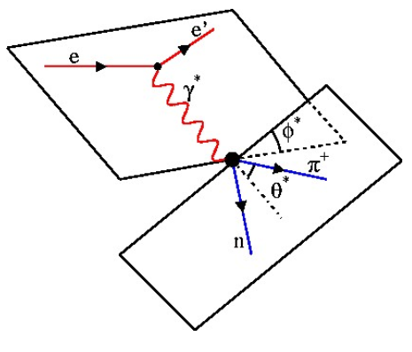
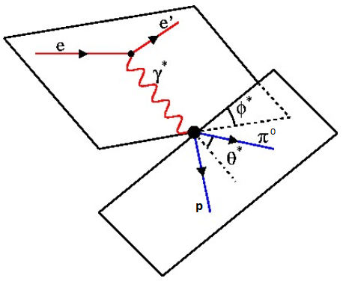
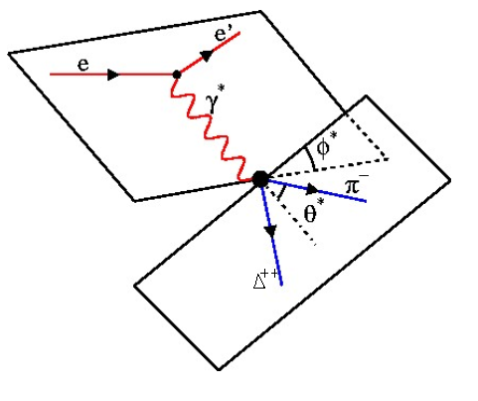
Hard exclusive pion electroproduction
beam helicity

Slide 20
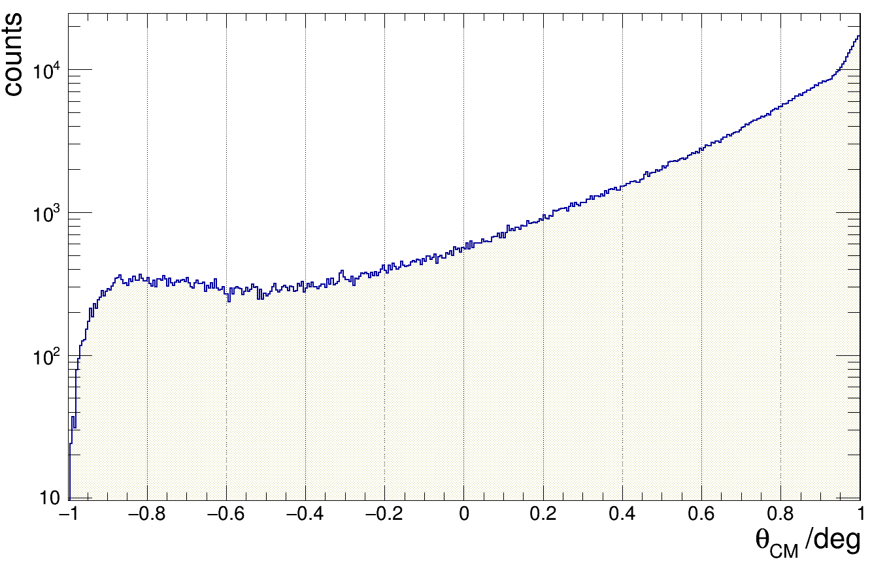

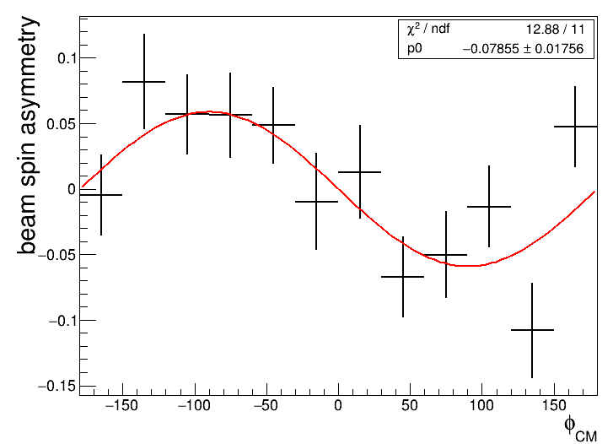
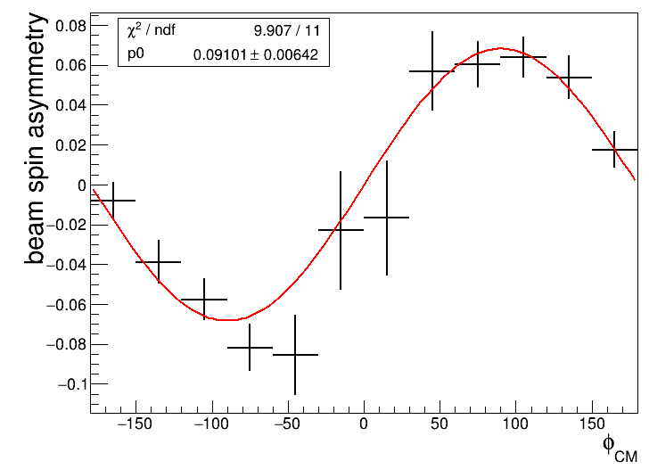
BSA for e p → e n π⁺
negative
positive
Notes:
20
Effective interaction due to high Z elements

Slide 21
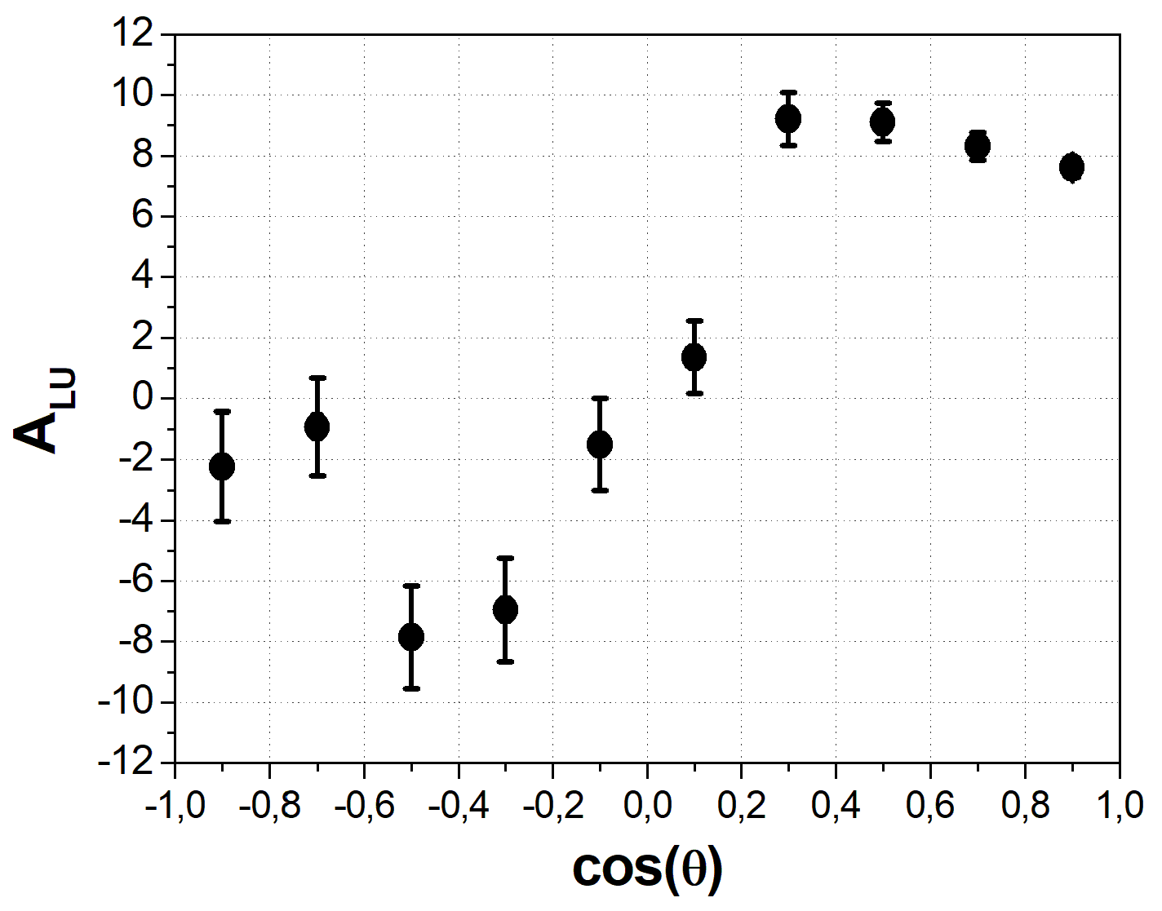
A_{LU} for e p → e n π⁺
Amplitude: 9-10 %
Notes:
21
Effective interaction due to high Z elements

Slide 22
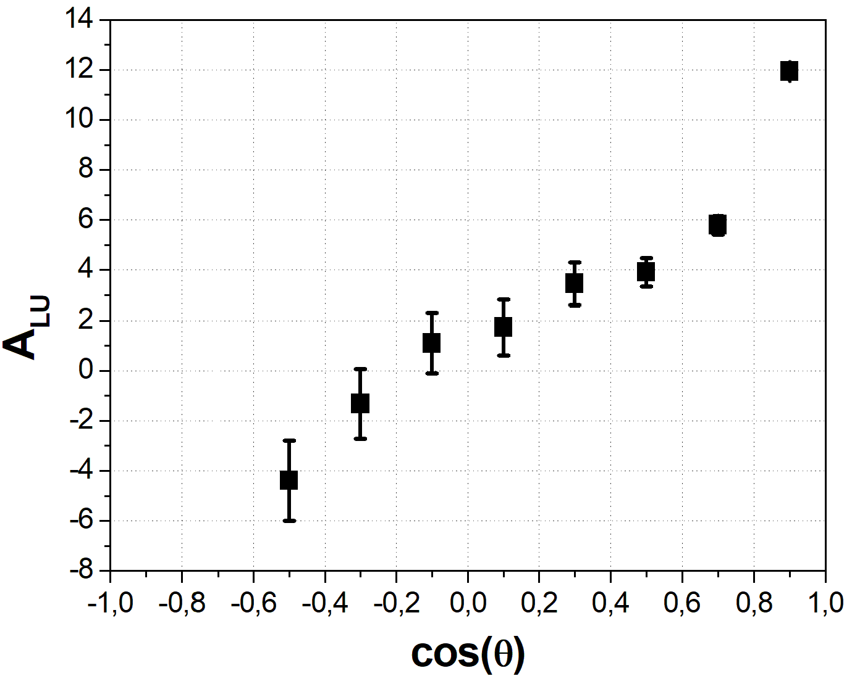
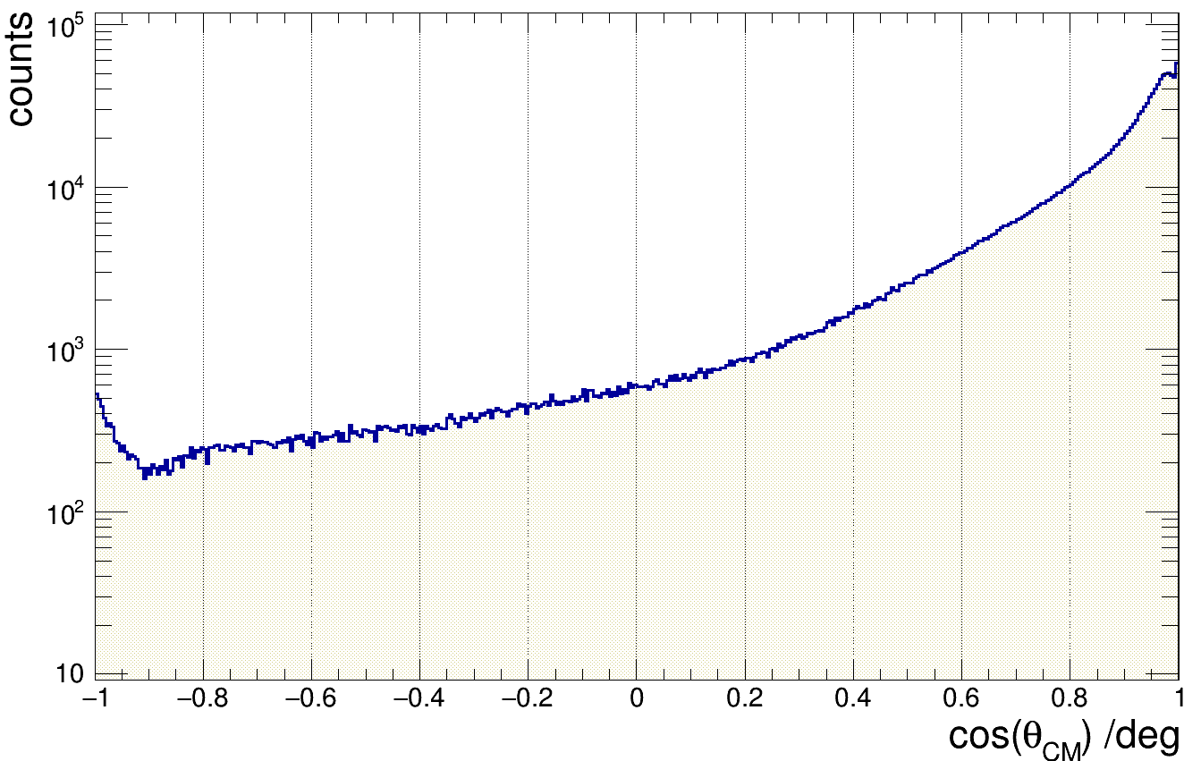
A_{LU} for e p → e p π⁰
A_{LU} increases in forward directions
Notes:
22
Effective interaction due to high Z elements

Slide 23
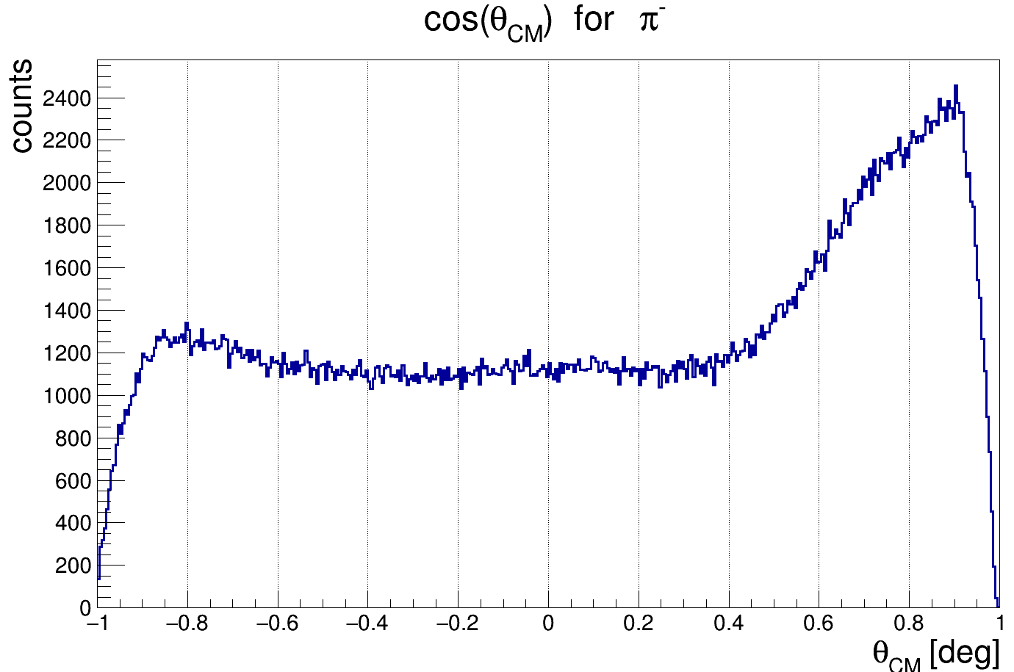
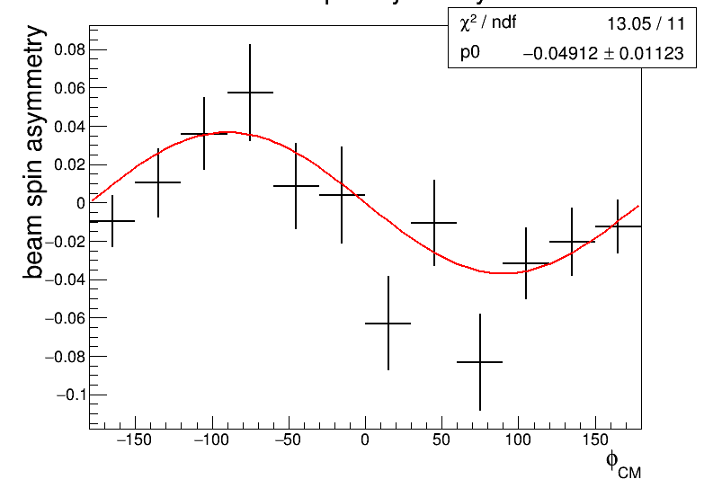
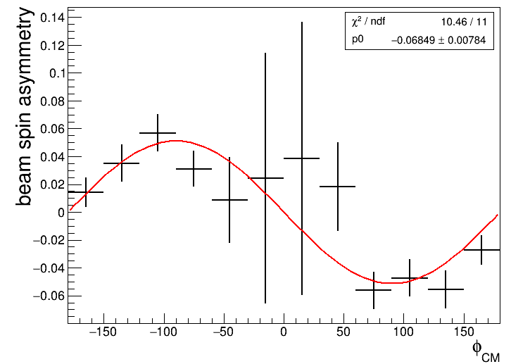
BSA for e p → e Δ⁺⁺ π⁻
Notes:
23
Effective interaction due to high Z elements

Slide 24
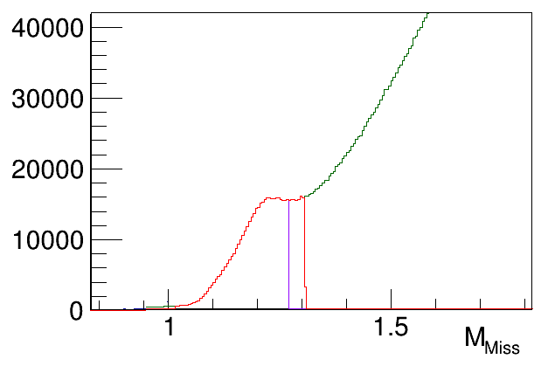
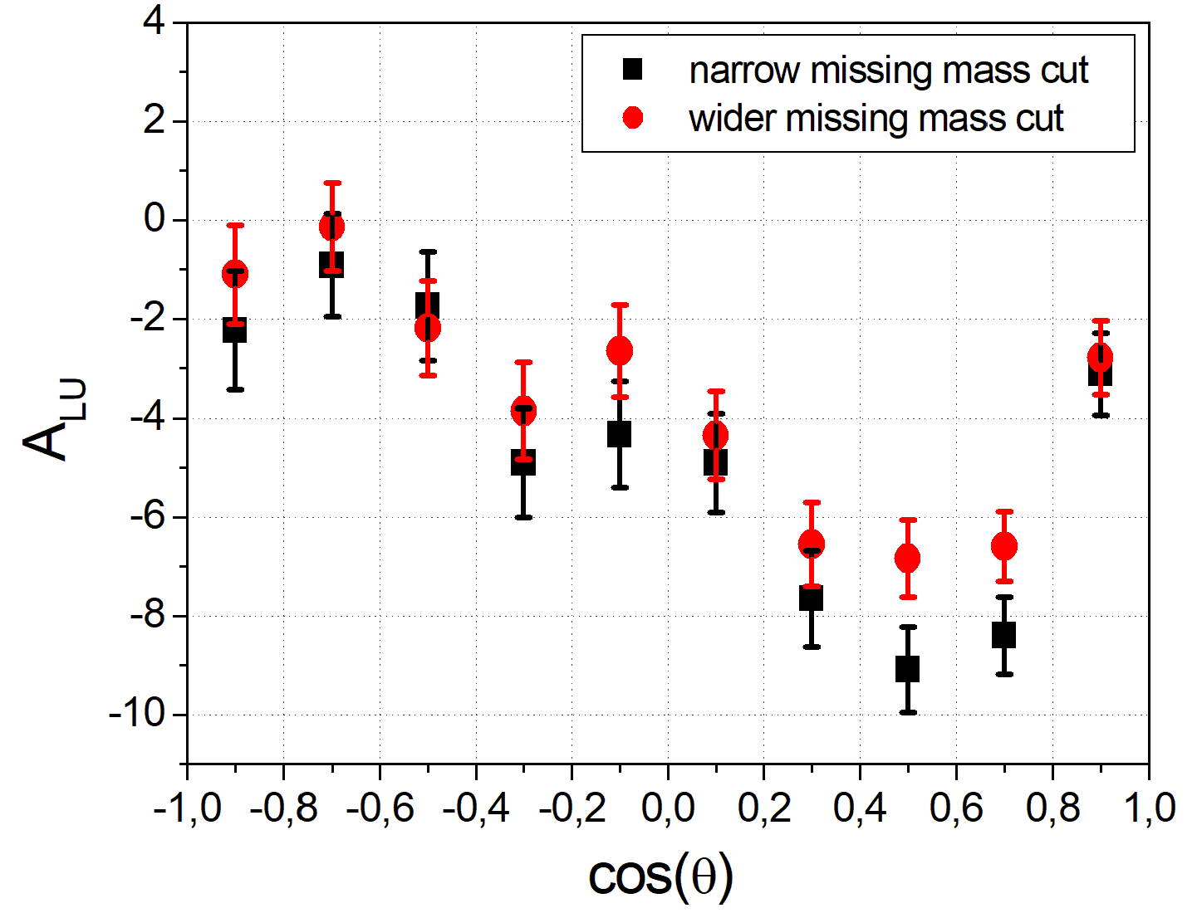
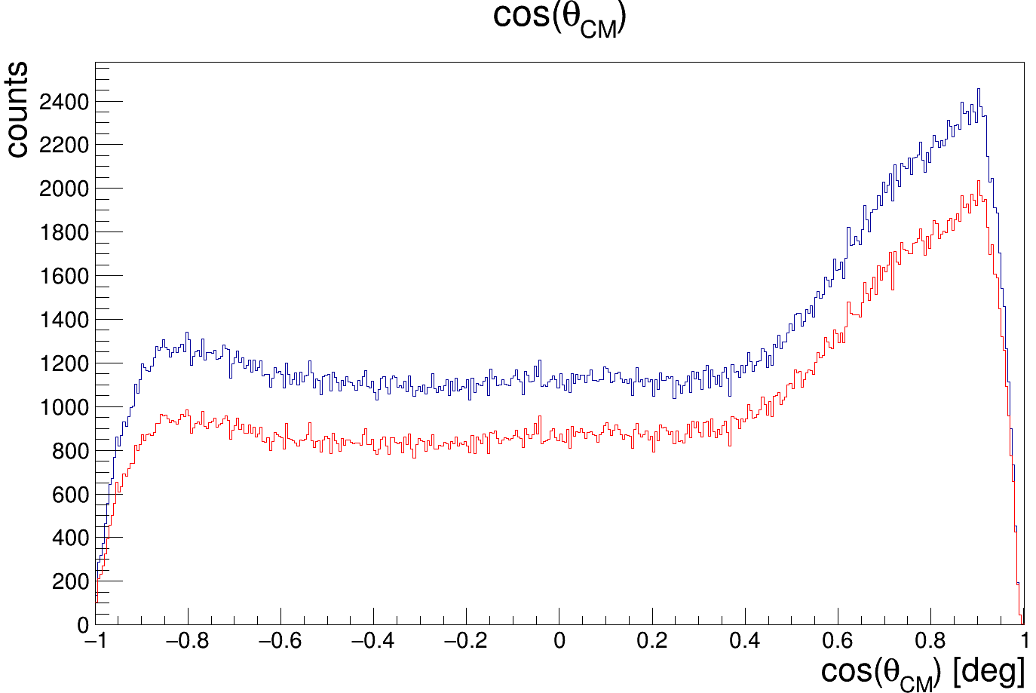
BSA for e p → e Δ⁺⁺ π⁻
Δ⁺⁺
wide cut
narrow cut
Amplitude: 4-5 %
Offset: - 4-5 %
wide cut
Negative offset
Significant background
Turning point at ~ 90°
narrow cut
24
Notes:
24
Effective interaction due to high Z elements

Slide 25
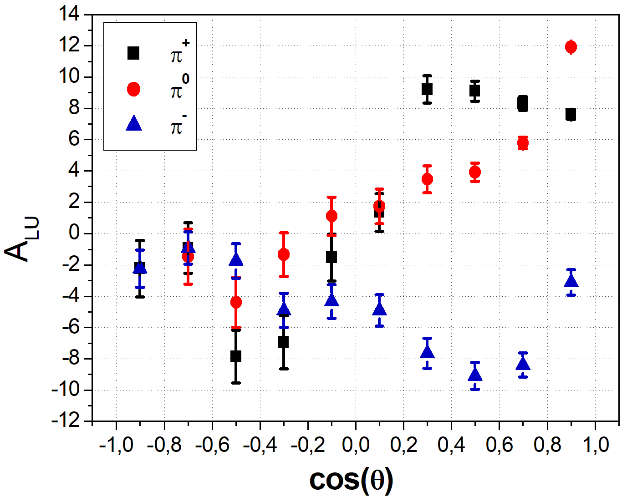
Comparison of A_{LU} for the three pions
A_{LU} of π⁺ and π⁰ are positive in
forward directions and
negative in backward
directions
→ sign changes at 90°
A_{LU} of π⁻ shows an
opposite bahviour if
the offset is considered
→ turning point at 90°
The nucleon to pion TDAs are believed to be the most direct observables to test the pion-cloud contribution to the nucleon structure.
Notes:
25
Effective interaction due to high Z elements

Slide 26
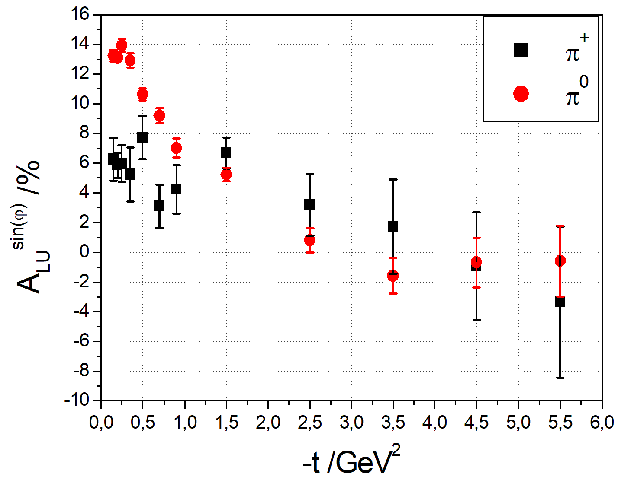
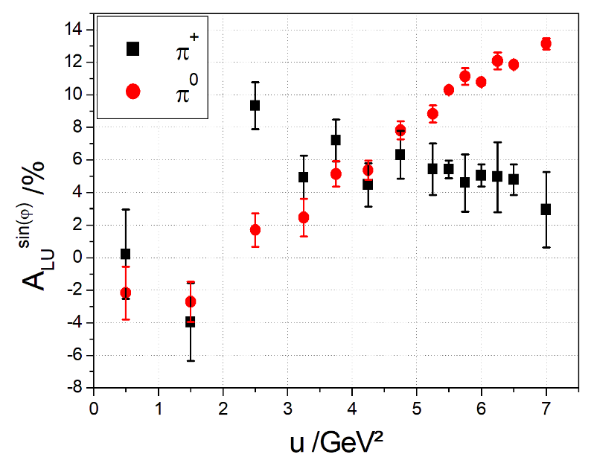
Dependence of A_{LU} on t and u
A_{LU} of π⁺ is positive in
forward directions and
negative in backward
directions
sign changes at 90°
A_{LU} of π⁰ is small in the
central region, but
increases in very forward
directions
→ sign changes ~ 90°

Slide 27
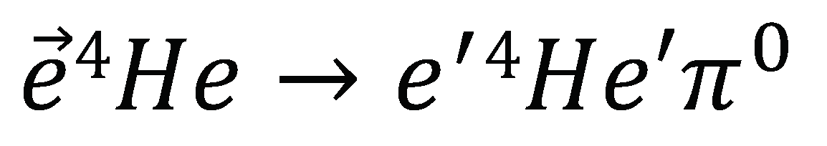

π⁰ Exclusive reactions on ⁴He (spin-0)
Coherent π⁰ Production:
Benchmark studies for spin-0 target
By symmetry argument BSA should be zero (Ji’s talk)
Incoherent π⁰ Production:
- Study the partonic structure of the bound nucleon
by compared to free nucleon and different nuclei

Slide 28
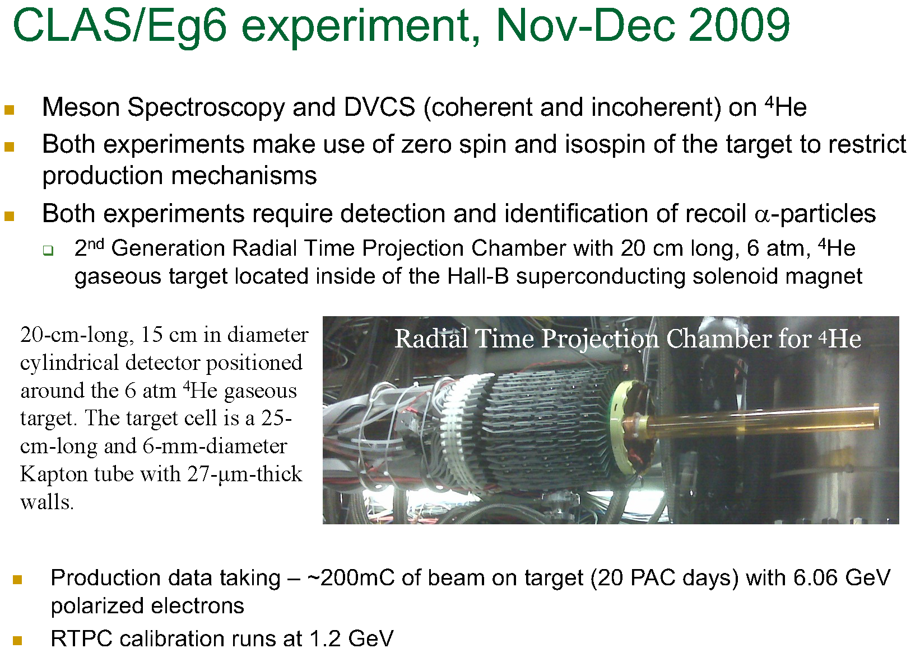

Slide 29
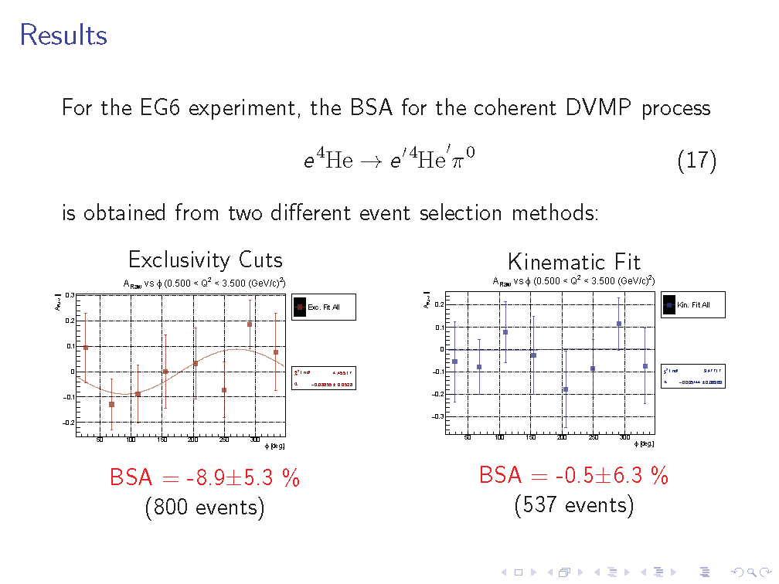
Coherent π⁰ production on ⁴He
F. Cao (Uconn)

Slide 30
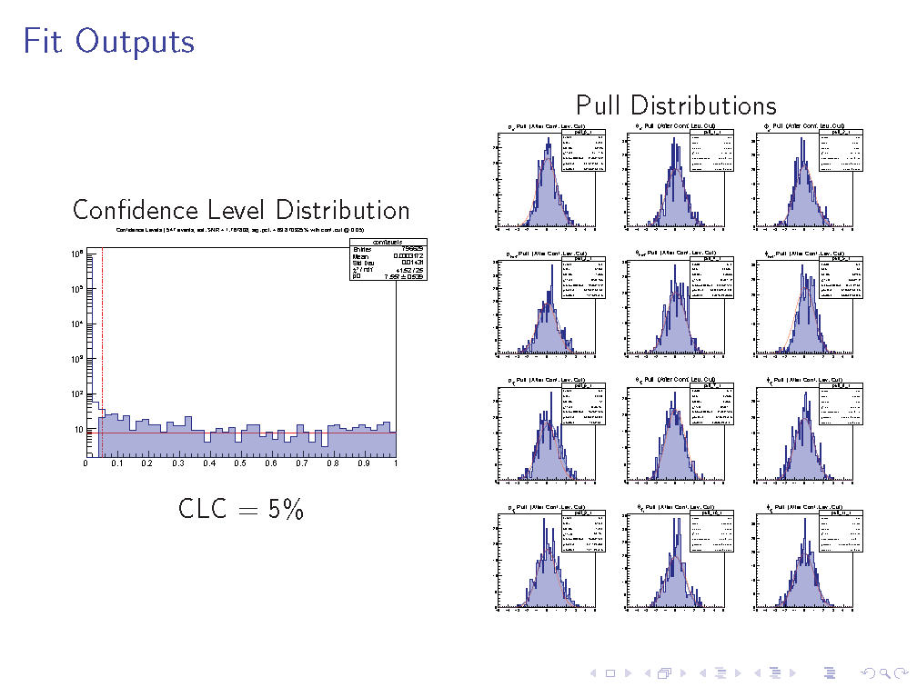
Kinematic Fit
F. Cao (Uconn)

Slide 31
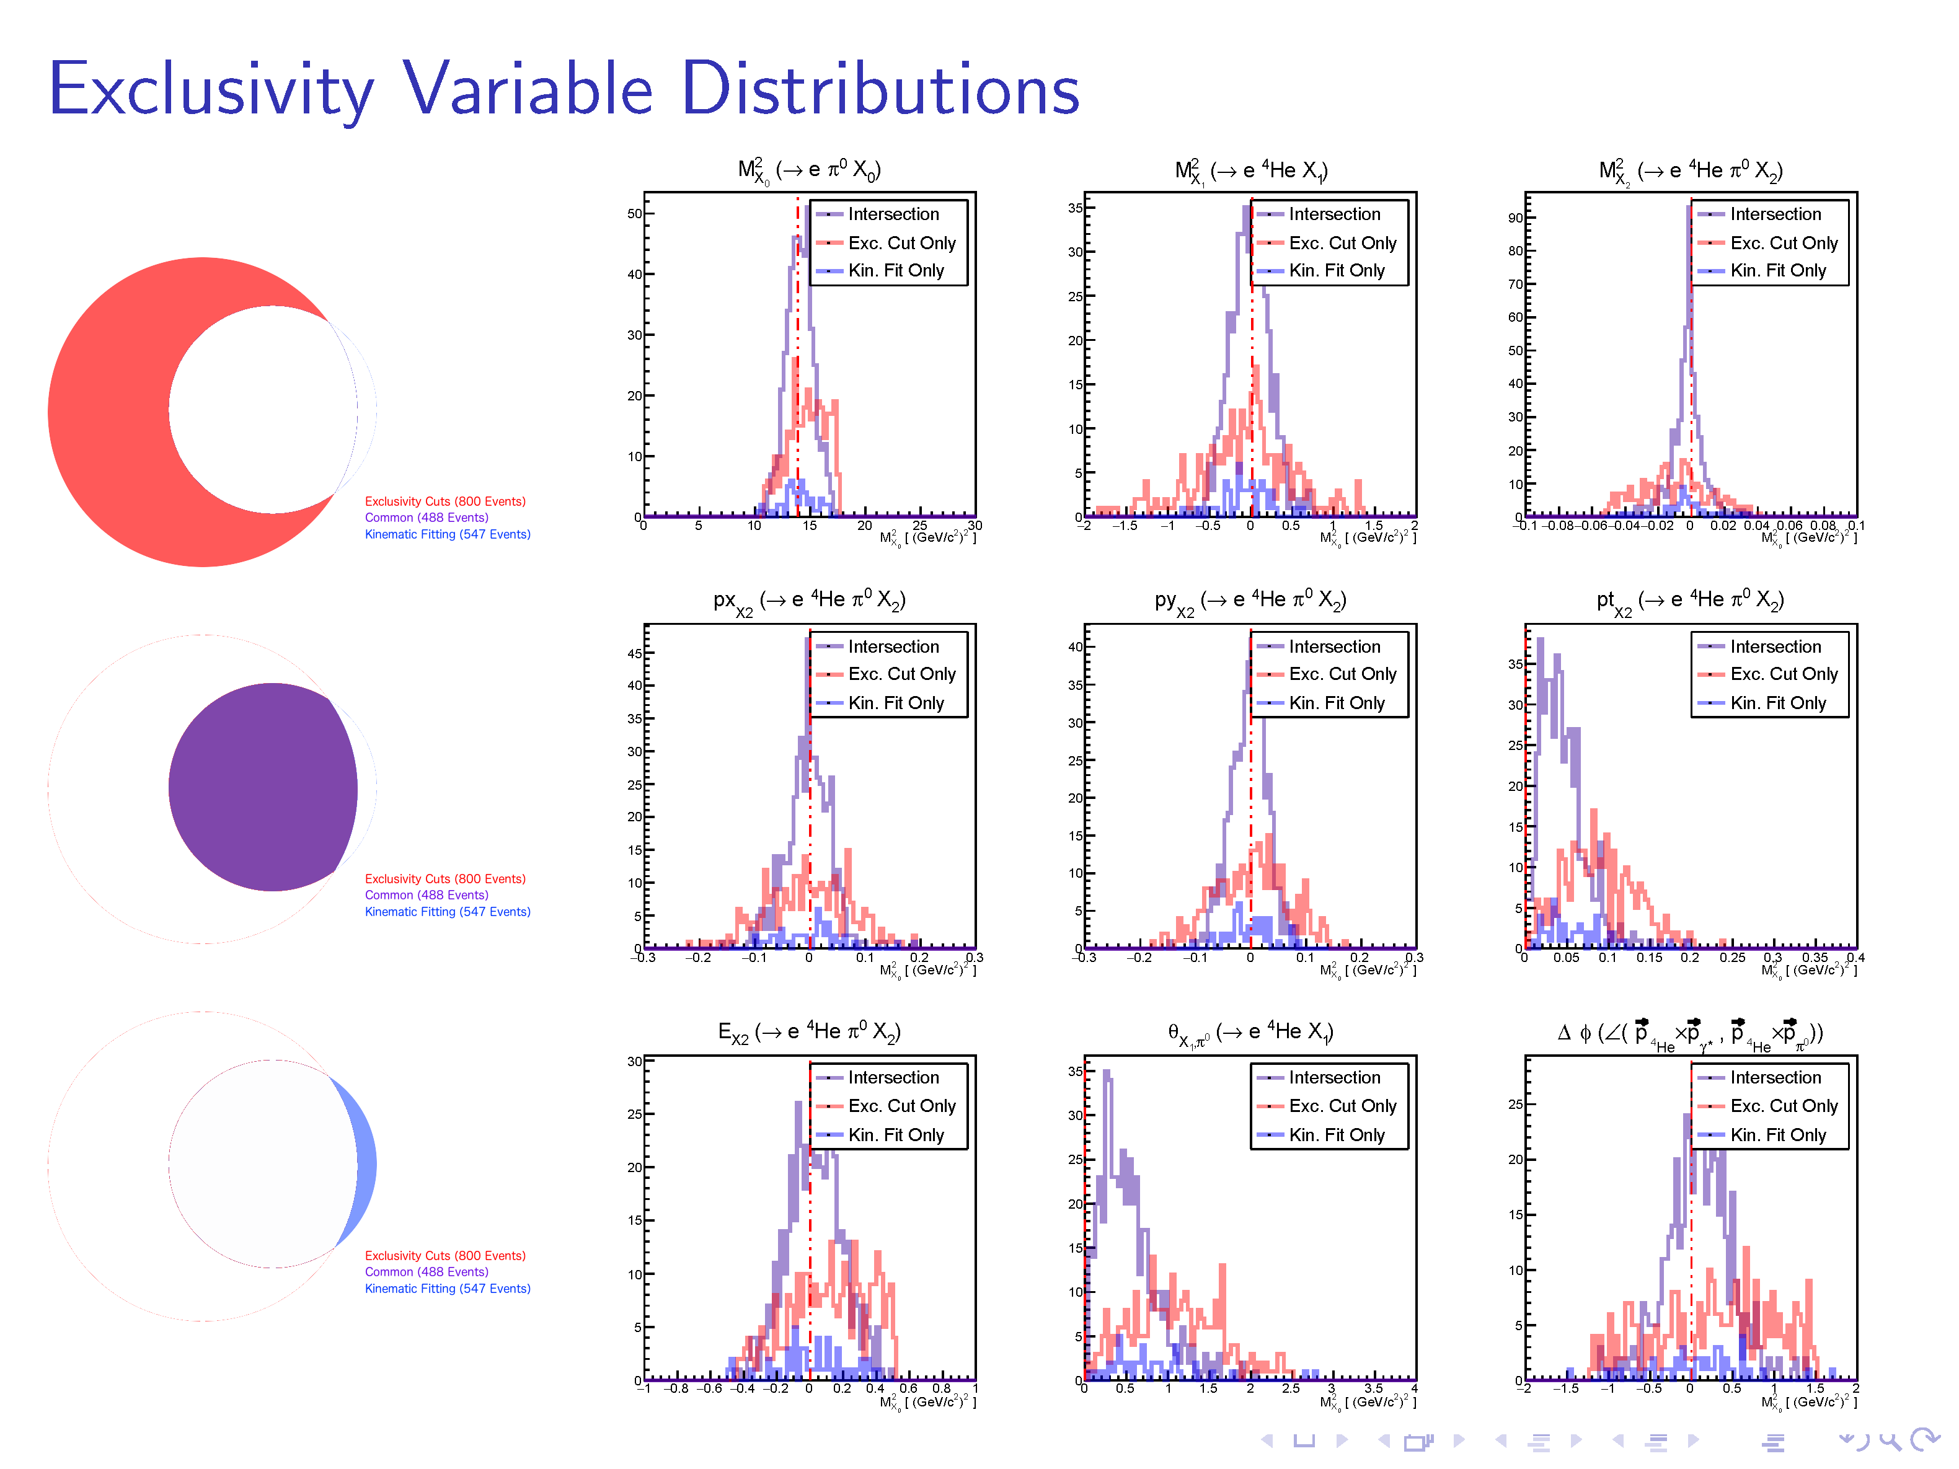
Exclusivity Cut vs. Kinematic Fit

Slide 32
Coherent π⁰ production on ⁴He
F. Cao (Uconn)

Slide 33







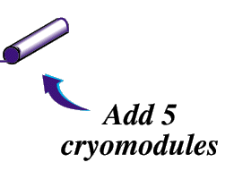
JLab Upgrade to 12 GeV
Add new hall
CHL-2
Enhance equipment in existing halls

Slide 34
CLAS12 in Hall B at Jefferson Lab
http://www.jlab.org/Hall-B/clas12-web/

Slide 35
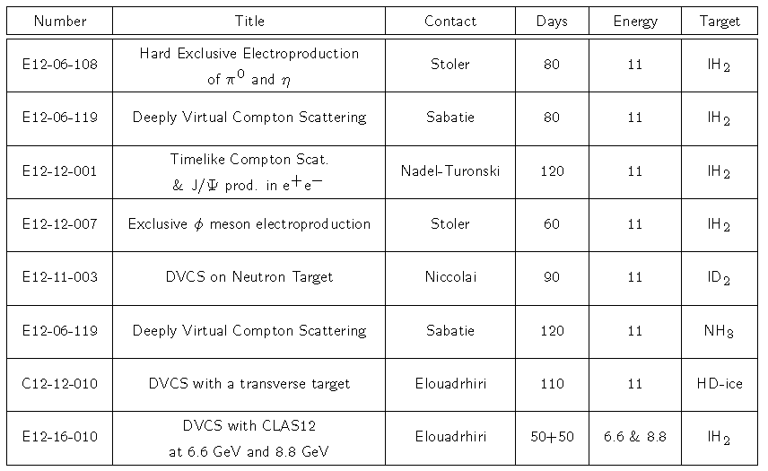
CLAS12 GPD Program
Gluon GPDs

Slide 36
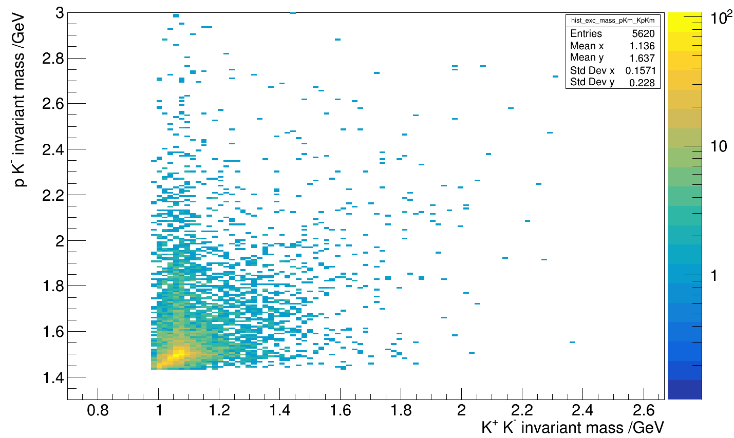
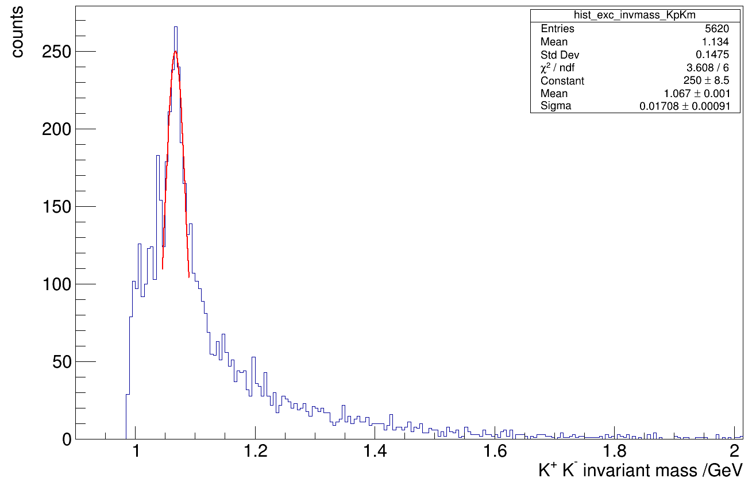
Select the inclusive channel with all 4 final state particle detected
Results without exclusivity cuts:
K⁺ K⁻ invariant mass
no exclusivity cuts

Slide 37
Summary
3-D nucleon structure program at Jefferson Lab 12 GeV: a unique combination of large acceptance, high-luminosity high-polarization experiments leads to comprehensive study of the partonic transverse degrees of freedom in the quark valence region of the nucleon
Electron Ion Collider (EIC) moving forward:
  Strong science case, much will be built on JLab 12 GeV program

