Slide 1


The prospect for studying nπ⁺π⁰ electroproduction off protons with CLAS12
G. Fedotov, K. Hicks, Iu. Skorodumina
APS April meeting 2018
Columbus, OH
Notes:
1
My talk will be about the electroexcitation of nucleon resonances. This conferences is all about nucleons and baryons.
Nathan Isgur has been a strong supporter of a nucleon research program at this laboratory. He formulated the importance of studies of the nucleon in 3 remarks he made at the N*2000 conferences in this auditorium:

Slide 2
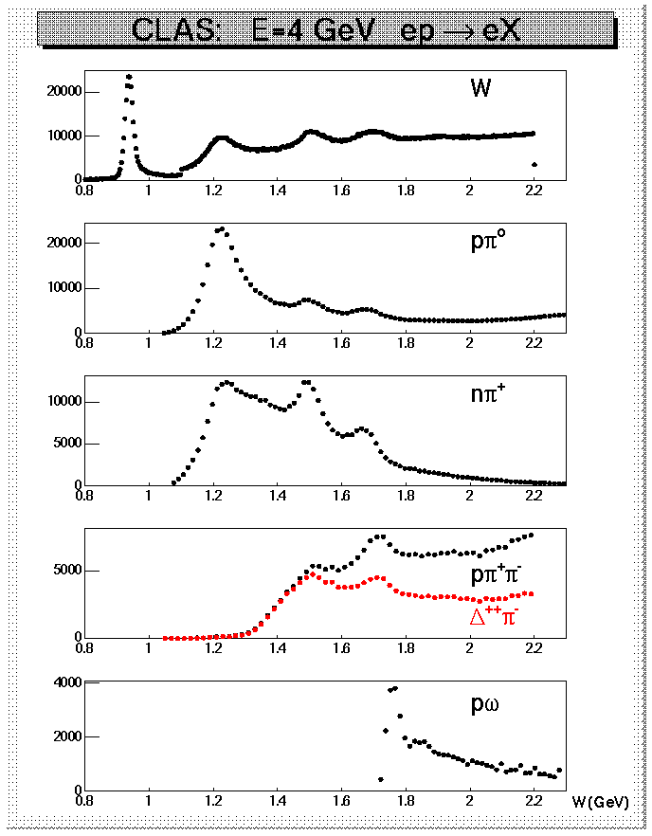
Double pion electroproduction
Hadronic decays of prominent N*s at W < 1.8 GeV.
CLAS data on yields of meson electroproduction at Q² < 4 GeV²
State | Bran. Fract. to Nπ. | Bran. Fract. to Nη | Bran.Fract. Nππ
Δ(1232)P₃₃ | 0.995
N(1440)P₁₁ | 0.55-0.75 |  | 0.3-0.4
N(1520)D₁₃ | 0.55-0.65 |  | 0.4-0.5
N(1535)S₁₁ | 0.48±0.03 | 0.46±0.02
Δ(1620)S₃₁ | 0.20-0.30 |  | 0.70-0.80
N(1650)S₁₁ | 0.60-0.95 | 0.03-0.11 | 0.1-0.2
N(1685)F₁₅ | 0.65-0.70 |  | 0.30-0.40
Δ(1700)D₃₃ | 0.1-0.2 |  | 0.8-0.9
N(1720)P₁₃ | 0.1-0.2 |  | > 0.7

Slide 3
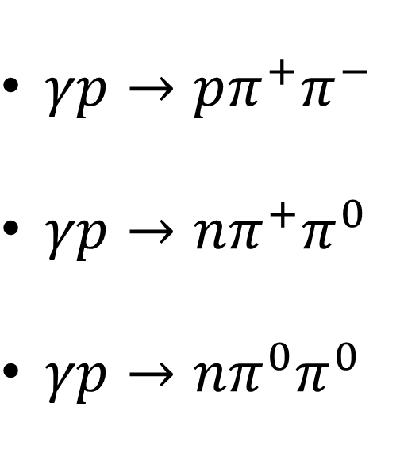
Exclusive channels with double pion emission
$γp→pπ^{+}π^{−}$
$γp→nπ^{+}π^{0}$
$γp→nπ^{0}π^{0}$

Slide 4
Exclusive channels with double pion emission
A lot of data on the cross sections of the reaction with the $pπ^{+}π^{−}$ final state exist:
Electroproduction
1) CLAS data at E_{beam} = 2. 5 GeV and E_{beam} = 4 GeV, W:[1.4, 1.9] GeV, Q²:[0.5, 2.1] GeV²
M. Ripani et al. [CLAS Collaboration], Phys. Rev. Lett. 91, 022002 (2003)
2) CLAS data at E_{beam} = 1.5 GeV, W:[1.3, 1.6] GeV, Q²:[0.2, 0.6] GeV²
G. V. Fedotov et al. [CLAS Collaboration], Phys. Rev. C 79, 015204 (2009)
3) CLAS data at E_{beam} = 5.8 GeV, W:[1.4, 2.0] GeV, Q²:[2, 5] GeV²
E. L. Isupov et al. (CLAS), Phys. Rev. C96, 025209 (2017)
4) CLAS data at E_{beam} = 2 GeV, W:[1.3, 1.8] GeV, Q²:[0.1, 1.0] GeV²
G. V. Fedotov et al. [CLAS Collaboration], to be published in Phys. Rev. C
Photoproduction
CLAS g11a experiment E. Golovach et.al. to be published in PRL
SAPHIR Eur. Phys. J. A 23, 317 (2005)
ABBHM Phys. Rev. 175, 1669 (1968)

Slide 5
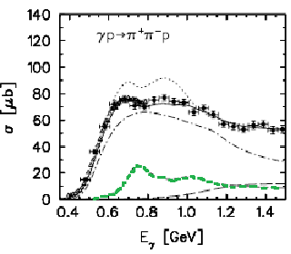
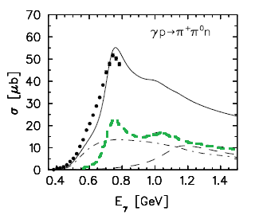
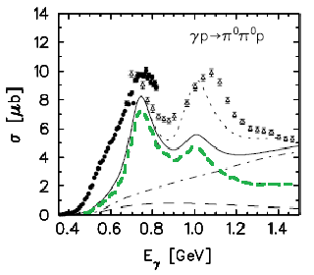
Exclusive channels with double pion emission
The channels w$ith$the ${nπ}^{+}π^{0}$ and $pπ^{0}π^{0}$ final states are so far unexplored.
A. Fix, H. Arenhoevel Eur.Phys.J. A25 (2005) 115-135.

Slide 6
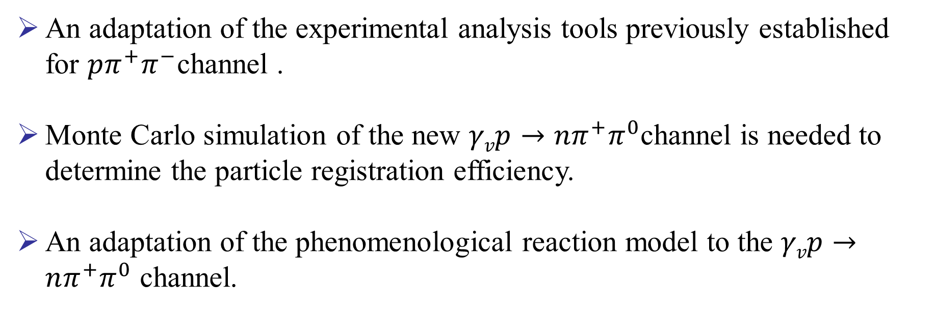
Things need to be done
An adaptation of the experimental analysis tools previously established for $pπ^{+}π^{−}$channel .
Monte Carlo simulation of the new $γvp→nπ^{+}π^{0}$channel is needed to determine the particle registration efficiency.
An adaptation of the phenomenological reaction model to the $γvp→nπ^{+}π^{0}$ channel.

Slide 7
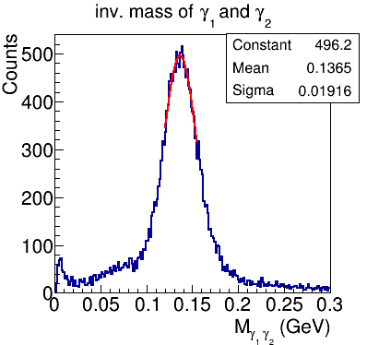
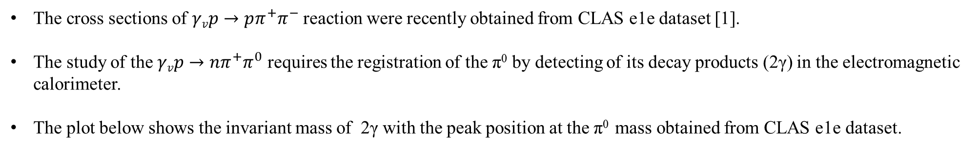
nπ⁺π⁰ production from CLAS e1e dataset
The cross sections of $γvp→pπ^{+}π^{−}$ reaction were recently obtained from CLAS e1e dataset [1].
The study of the $γvp→nπ^{+}π^{0}$ requires the registration of the π⁰ by detecting of its decay products (2γ) in the electromagnetic calorimeter.
The plot below shows the invariant mass of 2γ with the peak position at the π⁰ mass obtained from CLAS e1e dataset.
[1] G. V. Fedotov et al. [CLAS Collaboration], to be published in Phys. Rev. C.

Slide 8
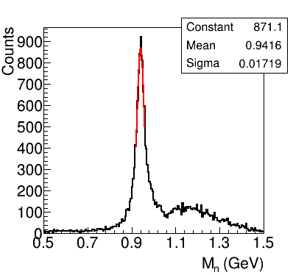

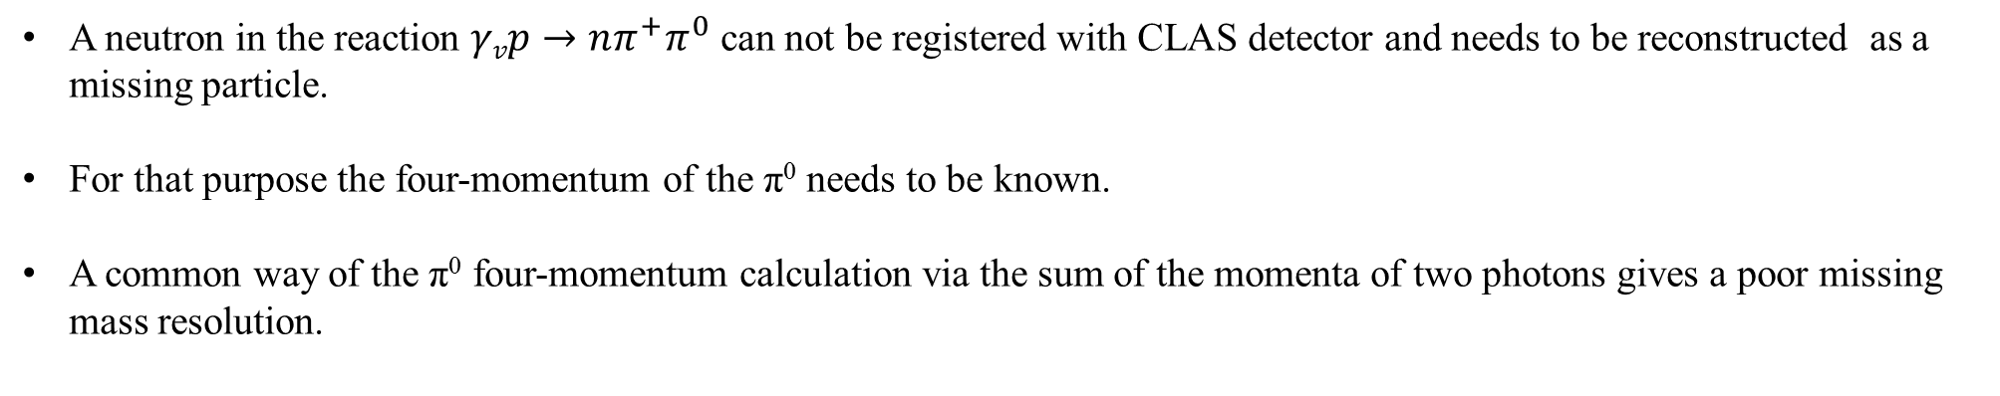
nπ⁺π⁰ production from e1e dataset
A neutron in the reaction $γvp→nπ^{+}π^{0}$ can not be registered with CLAS detector and needs to be reconstructed as a missing particle.
For that purpose the four-momentum of the π⁰ needs to be known.
A common way of the π⁰ four-momentum calculation via the sum of the momenta of two photons gives a poor missing mass resolution.
The π⁰ energy was calculated using two photons opening angle ϕ_{γ1γ2} as suggested in [2].
neutron
peak
background
On this way a missing mass plot with a peak at the neutron mass position was produced.
[2] Nucl.Instrum.Meth. A269 (1988) 568-579.

Slide 9
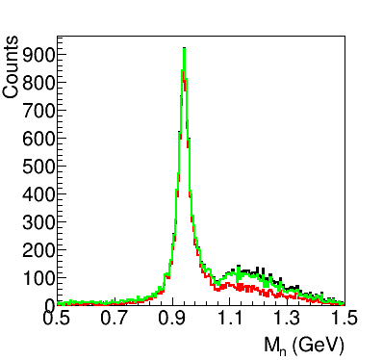
Background reduction
In order to reduce the background under the peak an additional cuts were introduced.
The black curve – no additional cuts.
The green curve – the absence of the π⁺ in the final state is claimed.
The red curve – the absence of the proton and the π⁺ in the final state is claimed.
neutron
peak
background

Slide 10
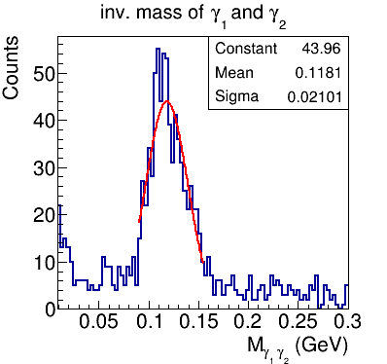
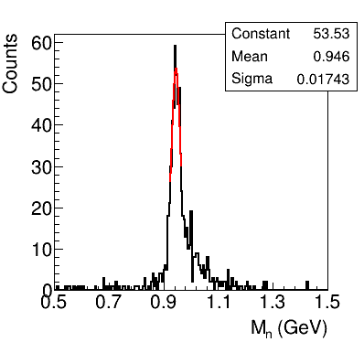
Monte Carlo simulation
The TWOPEG event generator [3] that is used in the analysis of the $γvp→pπ^{+}π^{−}$ channel was modified in order to make it suitable for the $γvp→nπ^{+}π^{0}$ channel.
π⁰ peak
neutron
peak
[3] Iu. Skorodumina, G. V. Fedotov, et al., CLAS12-NOTE-2017-001, arXiv:1703.08081.

Slide 11
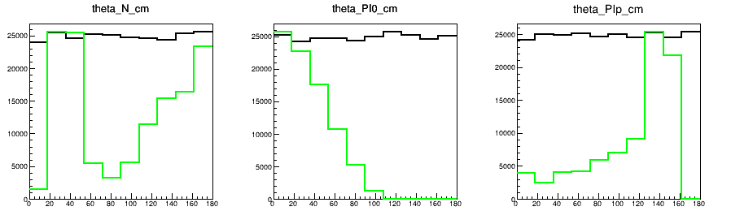



Angular distributions
Counts
Counts
Counts
$θ$_{n} (deg)
$θπ0$ (deg)
$θ$_{π+} (deg)
The black curves – Monte Carlo generated, while the green curves – Monte Carlo reconstructed.
The polar angular distribution of the π⁰ in the CMS shows that CLAS angular coverage is not enough for the extraction of γ_{v}p→nπ⁺π⁰ cross section. This problem is solved in CLAS12.
New CLAS12 data are needed!

Slide 12
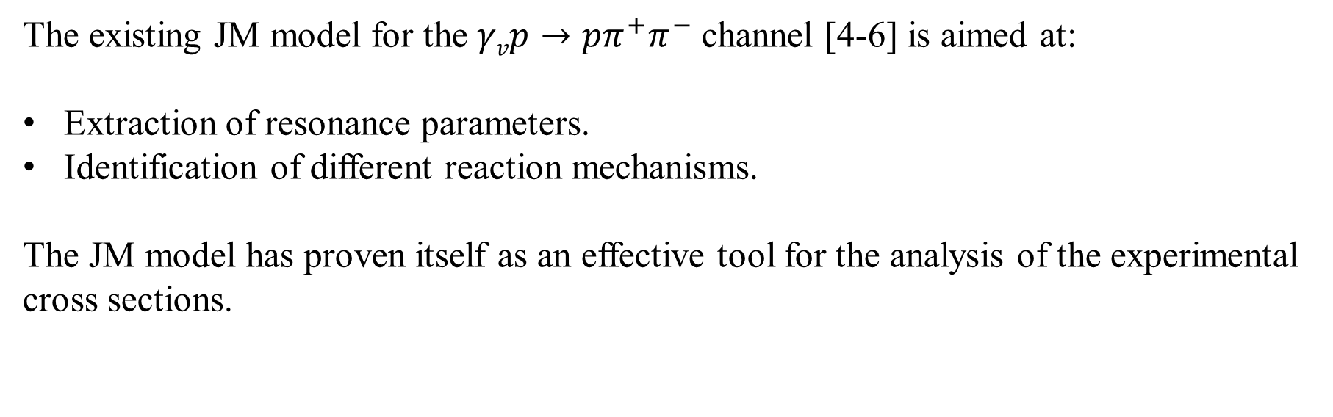
The existing reaction model
The existing JM model for the $γvp→pπ^{+}π^{−}$ channel [4-6] is aimed at:
Extraction of resonance parameters.
Identification of different reaction mechanisms.
The JM model has proven itself as an effective tool for the analysis of the experimental cross sections.
[4] V. I. Mokeev et al., Phys. Rev. C93, 025206 (2016) ), arXiv:1509.05460.
[5] V. I. Mokeev et al. (CLAS), Phys. Rev. C86, 035203 (2012), arXiv:1205.3948.
[6] V. I. Mokeev et al., EPJ Web Conf. 113, 01013 (2016), arXiv:1508.04088.

Slide 13
Reaction mechanisms
γ_{v}p→p(n)π⁺(π⁺)π⁻(π⁰)
=
Resonant part
+
Non-resonant part
N
π⁺(π⁺)
Δ
ρ⁰(ρ⁺)
π
π⁻(π⁰)
γ_{v}p→N*,Δ*
+
γ_{v}p→N*,Δ*
+
…
π
p(n)

Slide 14
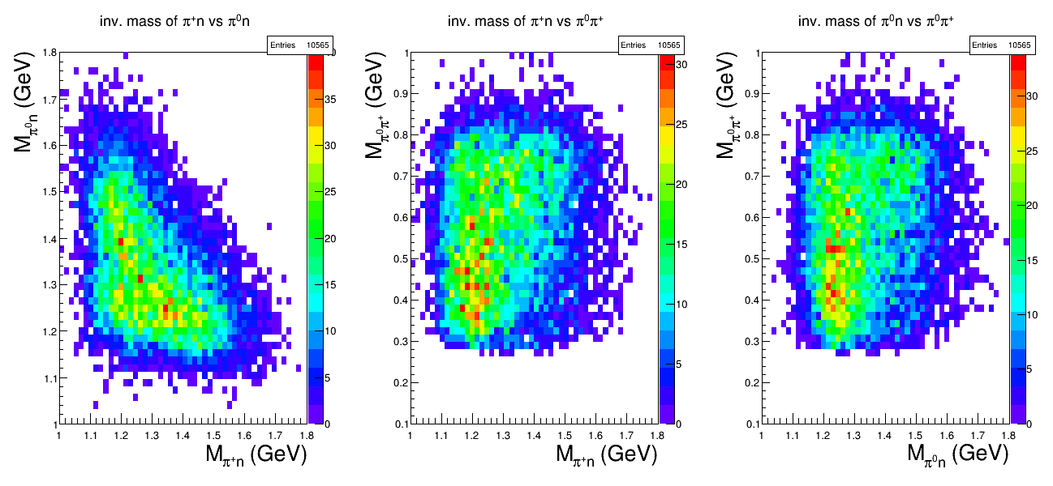






Invariant mass distributions for the nπ⁺π⁰ channel
$$ρ^{+}$$
$$ρ^{+}$$
$$∆^{0}$$
$$∆^{+}$$
$$∆^{+}$$
$$∆^{0}$$
All the plots are populated with ${nπ}^{+}π^{0}$ yield obtained from CLAS e1e dataset.

Slide 15
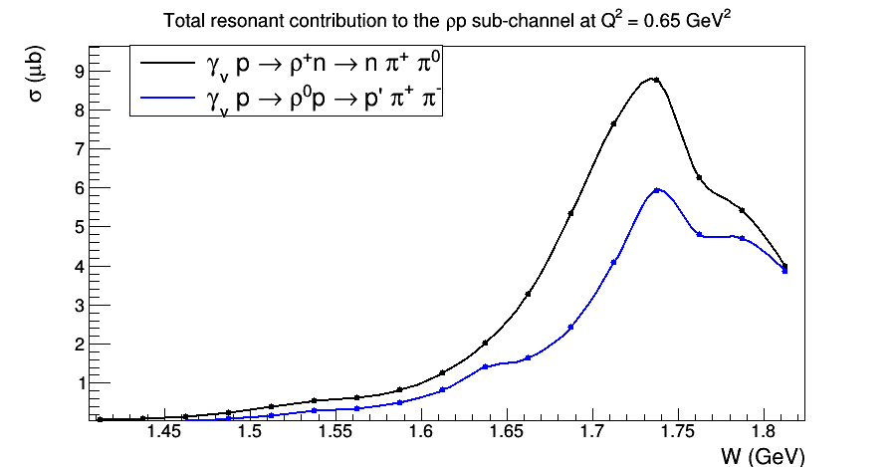
Adaptation of the reaction model for nπ⁺π⁰ channel
Preliminary
The curves are obtained from the new code that is based on the JM model and currently under development.

Slide 16
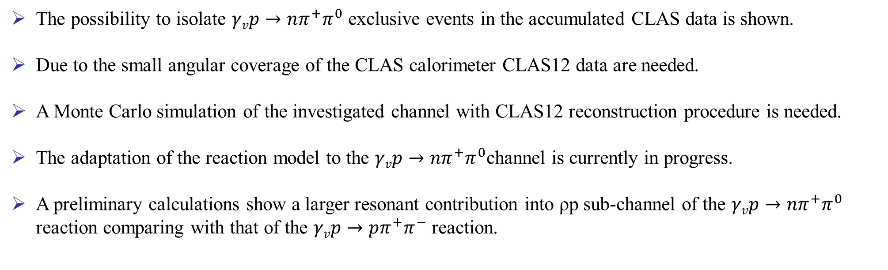
Conclusion and outlook
The possibility to isolate $γvp→nπ^{+}π^{0}$ exclusive events in the accumulated CLAS data is shown.
Due to the small angular coverage of the CLAS calorimeter CLAS12 data are needed.
A Monte Carlo simulation of the investigated channel with CLAS12 reconstruction procedure is needed.
The adaptation of the reaction model to the $γvp→nπ^{+}π^{0}$channel is currently in progress.
A preliminary calculations show a larger resonant contribution into ρp sub-channel of the $γvp→nπ^{+}π^{0}$ reaction comparing with that of the $γvp→pπ^{+}π^{−}$ reaction.

Slide 17
JM Model
Resonant amplitudes
Non-resonant amplitudes
π, η, ππ,..
π, η, ππ,..
γ_{v}
*
N*,△
+
N
N’
A_{3/2}, A_{1/2}, S_{1/2}
G_{M}, G_{E}, G_{C}
N’
N
An example of extracted electrocouplings for Roper resonance
A_{1/2}
S_{1/2}

Slide 18
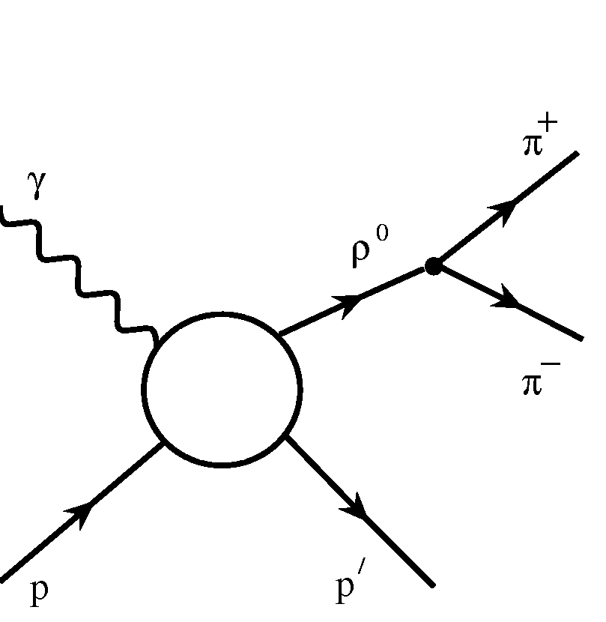
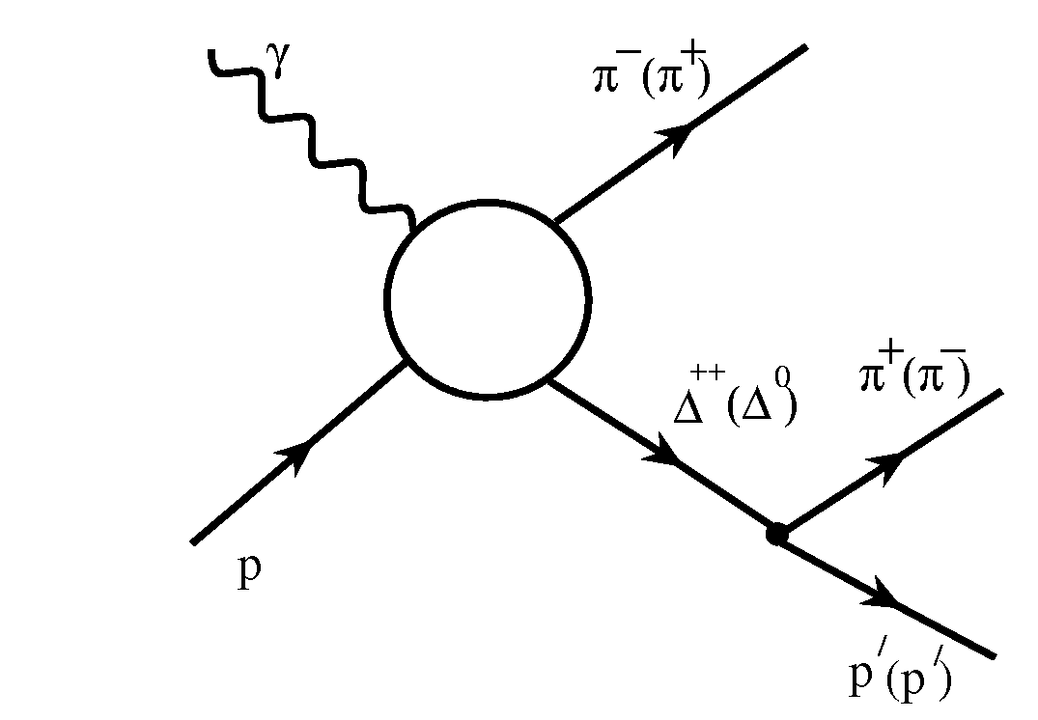
JM Model

Slide 19
Extraction of γ_{v}NN* Electrocouplings from the Data
e’
π, η, ππ,..
π, η, ππ,..
Data
γ_{v}
e
*
N*,△
+
Observables (cross sections, asymmetries, etc.)
N
N’
N
N’
A_{1/2}(Q²), A_{3/2}(Q²), S_{1/2}(Q²)
Reaction models,
partial wave analysis
  Separation of resonant/non-resonant contributions within the framework of reaction models; Breit Wigner ansatz for parameterization of resonant amplitudes; fit to the data.
  Consistent results on γ_{v}NN* electrocouplings from different meson electroproduction channels and different analysis approaches demonstrate reliable extraction of N* parameters.
Electrocouplings
A_{1/2}, A_{3/2}, S_{1/2}
QCD
Hadron models
Notes:
Reaction model works in the following way. Resonant and non resonant contributions should be separated. Resonant amplitudes can be parameterized by Breit Wigner ansatz. Then by fit to the data the electrocouplings can be extracted.
19

Slide 20
Higher-Lying Resonance Electrocouplings
Δ(1700)3/2⁻
A_{1/2}
Δ(1620)1/2⁻
S_{1/2}
N(1720)3/2⁺
A_{3/2}
Independent fits in different W-intervals
green: 1.46<W<1.56 GeV
magenta: 1.56<W<1.66 GeV
red: 1.61<W<1.71 GeV
blue: 1.66<W<1.76 GeV
black: 1.71<W<1.81 GeV
result in self-consistent electrocouplings and hence offer sound evidence for their reliable extraction.
The electrocouplings of the Δ(1620)1/2⁻, N(1650)1/2⁻, N(1680)5/2⁺, Δ(1700)3/2⁻ , and N(1720)3/2⁺ resonances were obtained at 0.5 GeV²<Q²<1.5 GeV², but just in three wide Q² bins.
Improved information on their Q² evolution expected from the new e1e data collected in six times smaller Q² bins will provide further insight to the structure of orbital nucleon excitations with L=1.
V. Mokeev et al., Phys. Rev. C 93, 025206
20

Slide 21
Branching Fractions in the 2nd and 3rd Resonance Regions
PDG values
State | η_{Nπ} | η_{Nη} | η_{Nππ}
P₁₁(1440) | 0.55-0.75 |  | 0.3-0.4
D₁₃(1520) | 0.55-0.65 | 0.0023 | 0.2-0.3
S₁₁(1535) | 0.35-0.55 | 0.42 | 0.1-1.0
S₃₁(1620) | 0.2-0.3 |  | 0.7-0.8
S₁₁(1650) | 0.5-0.9 | 0.05-0.15 | 0.1-0.2
F₁₅(1680) | 0.65-0.7 |  | 0.3-0.4
D₁₃(1700) | 0.12 |  | 0.85-0.95
D₃₃(1700) | 0.1-0.2 |  | 0.8-0.9
P₁₁(1710) | 0.05-0.2 | 0.1-0.3 | 0.4-0.9
P₁₃(1720) | 0.11 | 0.04 | >0.7
Analysis of the e1e data measured with CLAS in Hall-B at JLab will be presented in this talk.

Slide 22
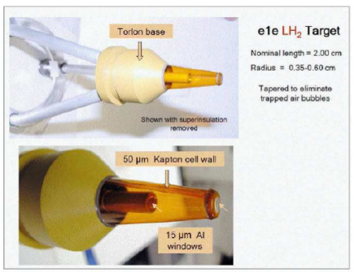
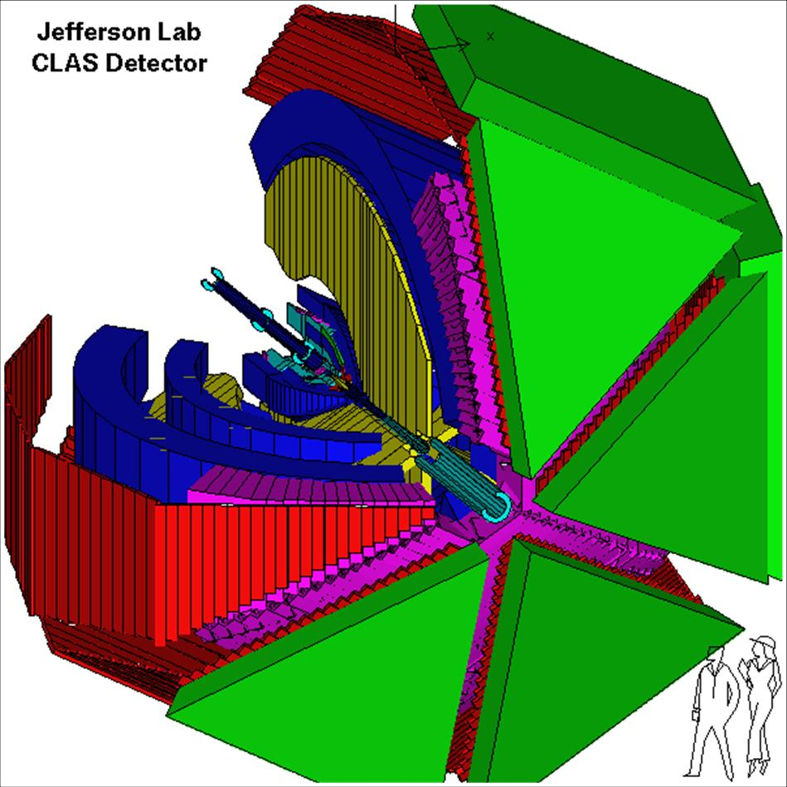
E1E target

Slide 23
New N’(1720)3/2⁺ State and its Properties
N* hadronic decays from JM15 that incorporates N’(1720)3/2⁺
A successful description of π⁺π⁻p photo- and electro-production cross sections at Q²=0, 0.65, 0.95, and 1.30 GeV² has been achieved by implementing a new N’(1720)3/2⁺ state with Q²-independent hadronic
decay widths of all resonances that contribute at W~1.7 GeV, that allows us to claim the existence of
a new N’(1720)3/2⁺ state.
Resonance | BF(πΔ), % | BF(ρp), %
N’(1720)3/2⁺ electroproduction photoproduction | 47-64 46-62 | 3-10 4-13
N(1720)3/2⁺ electroproduction photoproduction | 39-55 38-53 | 23-49 31-46
Δ(1700)3/2⁻ electroproduction photoproduction | 77-95 78-93 | 3-5 3-6
Mass: 1.715-1.735 GeV
Width: 120±6 MeV
Mass: 1.743-1.753 GeV
Width: 112±8 MeV
N’(1720)3/2⁺
N(1720)3/2⁺
23

Slide 24
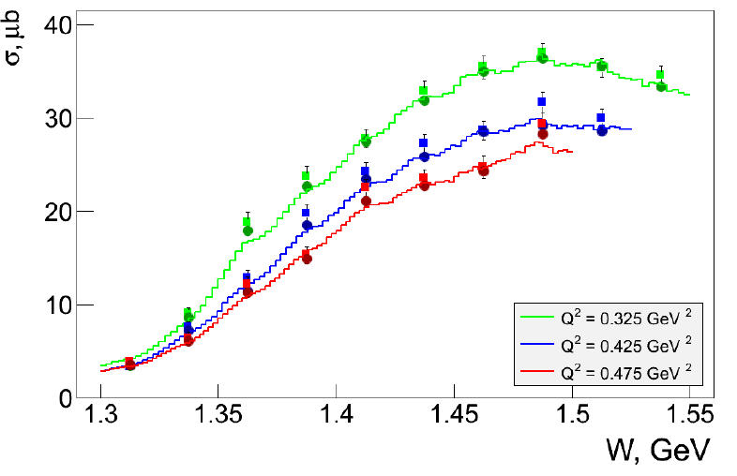
New EG in Comparison with Experimental Data
Squares – data (G. V. Fedotov et al., Phys. Rev. C 79, 015204 (2009))
Circles – model
Curves – event generator

Slide 25
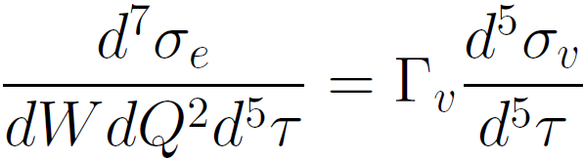
Kinematic Variables
in single photon exchange approximation
From
JM model
(fit to the data)
From
experiment
Final hadrons are described by 5 independent variables
All three sets of hadronic variables are used to extract cross sections. The difference between total cross sections obtained by integration over various sets of hadronic variables is interpreted as systematic uncertainty.

Slide 26
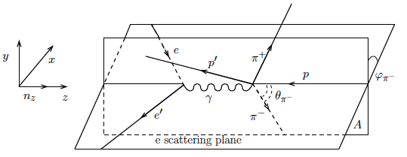
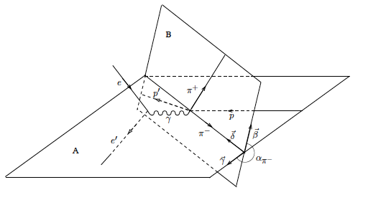
Definition of Final Hadron Angles

Slide 27

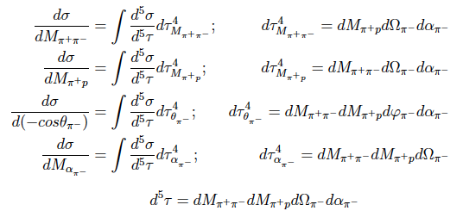
Cross Section Determination
ΔN_{full} and ΔN_{empty} are the numbers of events inside a seven-dimensional bin for runs with hydrogen - and empty target, respectively. F is the efficiency determined by the Monte Carlo simulation. R is the radiative correction factor. Q_{full} and Q_{empty} are the integrated Faraday cup charges for runs with hydrogen - and empty target, respectively, and q_{e} is the elementary charge. ρ is the density of liquid hydrogen at T = 20 K. l is the length of the target (l = 2 cm). M_{H} is the molar density of the natural mixture of hydrogen and N_{A} is Avogadro's number. ΔW and ΔQ² are kinematical bins determined by the electron scattering kinematics. Δτ is the hadronic five-dimensional kinematic phase-space element.
Due to statistical limitations only single-fold differential cross sections were analyzed:

