Slide 1
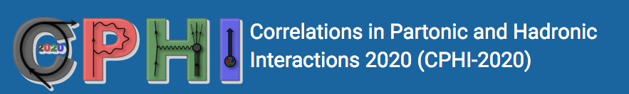
Studies of Spin-Orbit Correlations
H. Avakian (JLab)
Understanding azimuthal distributions of hadrons
Introducing studies of SSA
Kotzinian-Mulders Asymmetries
Target fragmentation and Fracture Functions
Correlations of target and current fragmentation
Summary

Slide 2
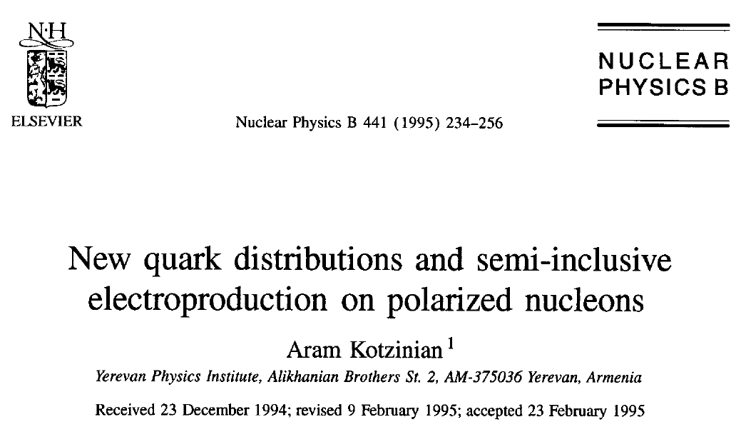


Slide 3
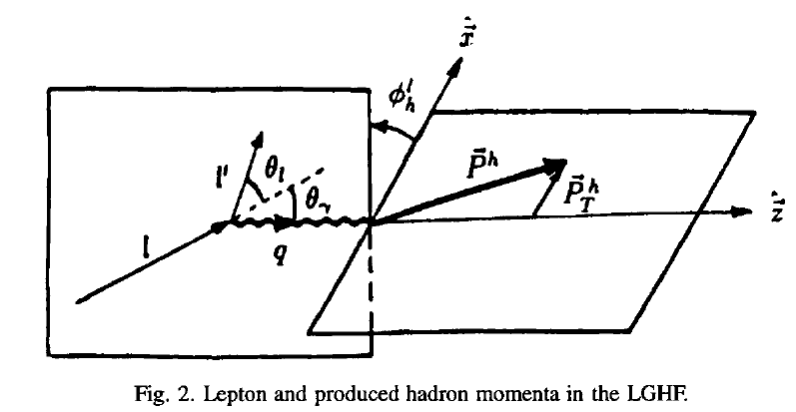
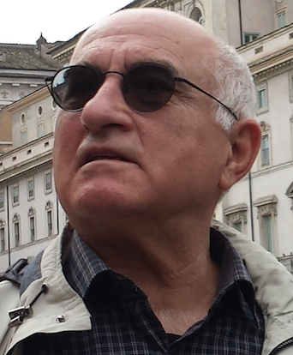
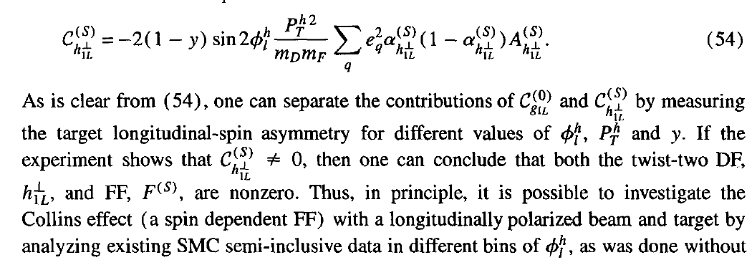
SIDIS described in the LGHF
laboratory gamma-lepton frame (later known as Trento convention)

Slide 4
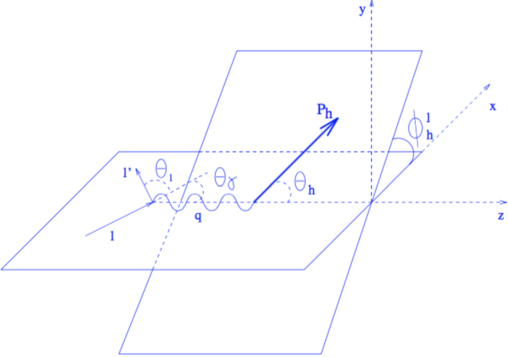
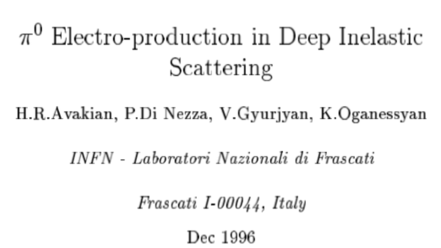
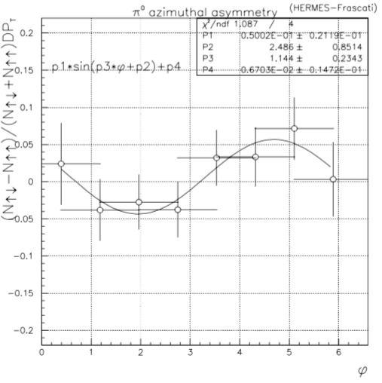

Single-Spin Asymmetries in electroproduction
HERMES note 96.059

Slide 5

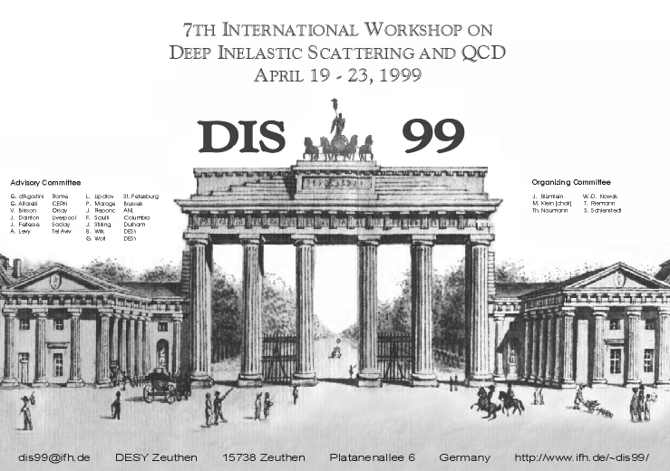
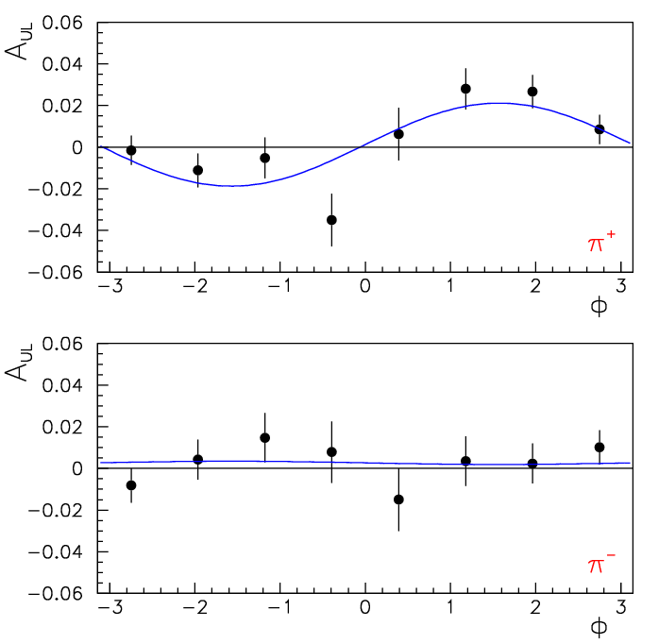


HERMES effect
Transverse with respect to γ*
γ*
Collins
A_{UT} ~
e
First measurement of significant SSA in electroproduction
Notes:
First SSA in electroproduction was observed by HERMES observed a sinusoidal target asymmetry
Shown here. Is amazing how big was the impact of this result first presented on the DIS99 conference in Berlin.
The first impression was that the asymmetry is related to the Collins effect and the transverse component came from
The small angle between the virtual photon and the proton spin.
HERMES experiment changed its run plan and started transverse target experimentts.

Slide 6
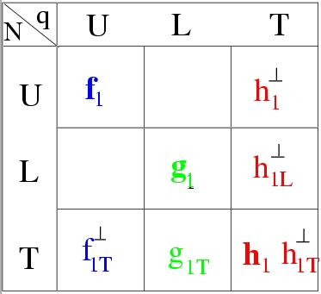
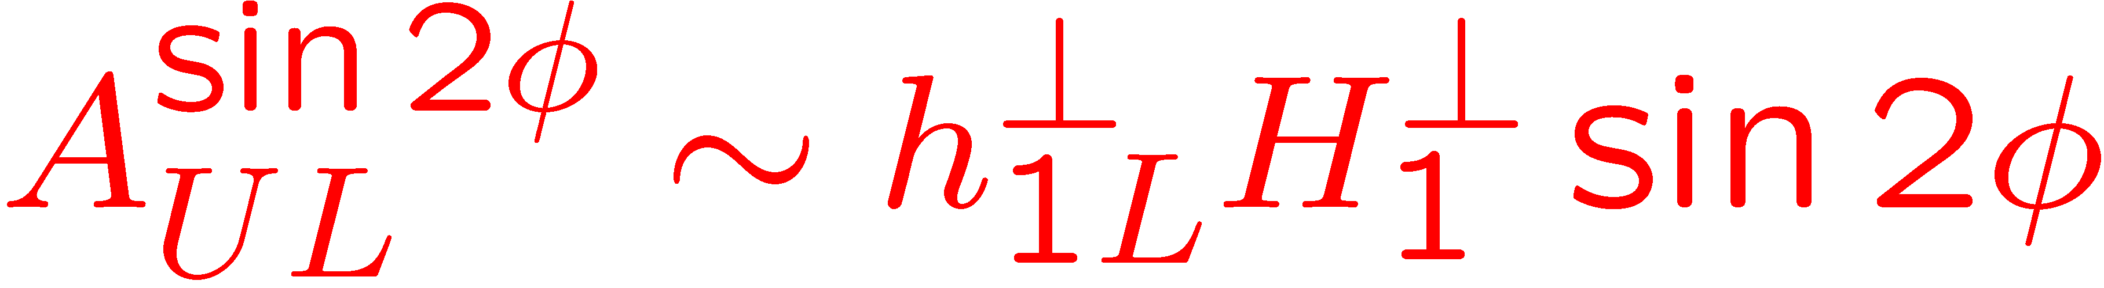

Collins fragmentation: Longitudinally polarized target
Kotzinian-Mulders Asymmetry (1996)
┴
(s_{T}k_{T})(pS_{L})↔ h_{1L}
y
φ_{S}=φ_{h}
P_{T}
φ_{h}
sin(φ_{h}+φ_{S}) = sin(2φ_{h})
curves, χQSM from Efremov et al
Study transversely polarized quarks in the longitudinally polarized proton
Provides independent information on the Collins function.
Notes:
As no transverse target was available at that time, and HERMES was running with a longitudinally polarized target
Kotzinian came up with an idea to measure the Collins fragmentation for transversely polarized quarks in the longitudinally polarized proton.
The corresponding contribution appears as a sin2\phi moment in the cross section.
HERMES measurement gave 0. The theory calculations came later which were consistent with that measurement indicating that asymmetry is large
Only in the valence region at large x. We will get back later to this observable.

Slide 7
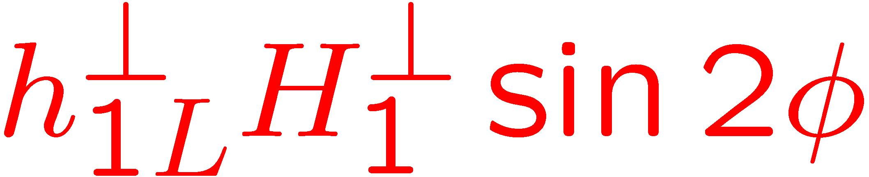
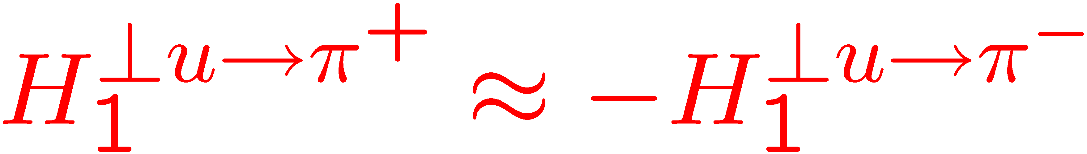
Collins fragmentation: Longitudinally polarized target
Transversely polarized quarks in the long. polarized nucleon
Kotzinian-Mulders Asymmetry
σ_{UL} ~
KM
curves, χQSM from Efremov et al
KM sin2φ moment, sensitive to spin-orbit correlations: the only leading twist azimuthal moment for longitudinally polarized target
More info will be available from SIDIS (COMPASS,EIC) and DY (RHIC,GSI)
Notes:
Back to original attempt to measure the Collins effect with longitudinally polarized target.

Slide 8



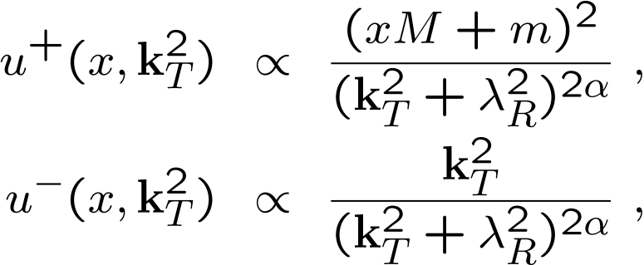
Quark distributions at large k_{T}: models
q
JMR model
M_{R}, R=s,a
Dq
Effect of the orbital motion on the q- may be most significant
Δu/u
Higher probability to find a quark anti-aligned with proton spin at large k_{T}
(dipole formfactor), J.Ellis, D-S.Hwang, A.Kotzinian
8

Slide 9
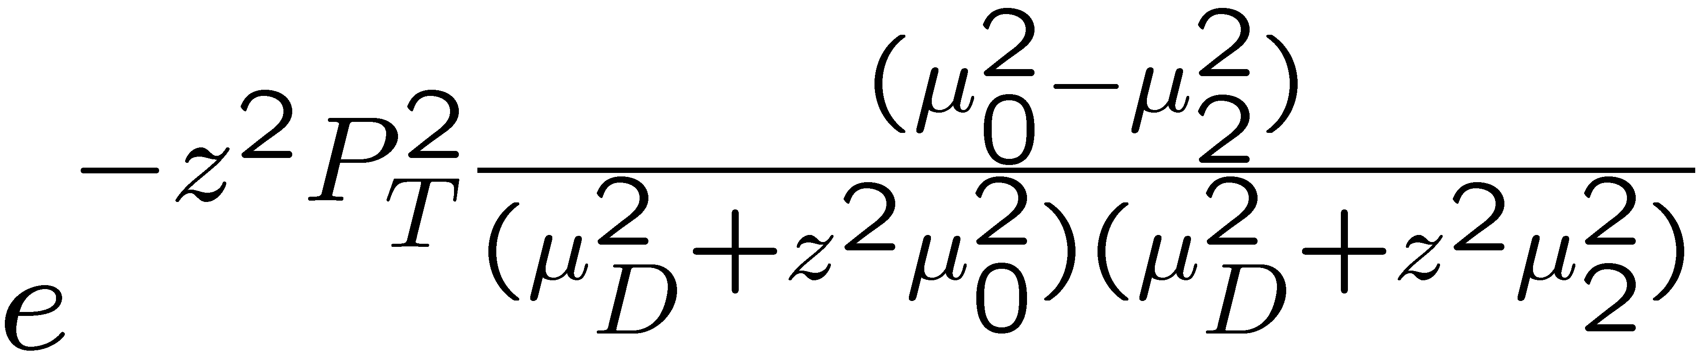
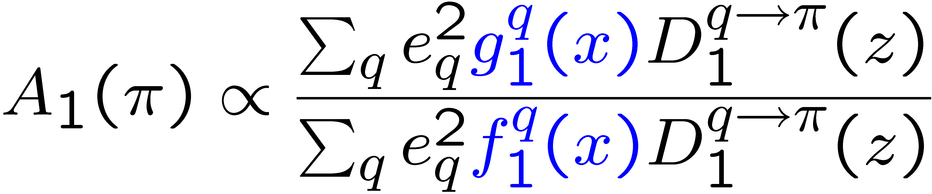
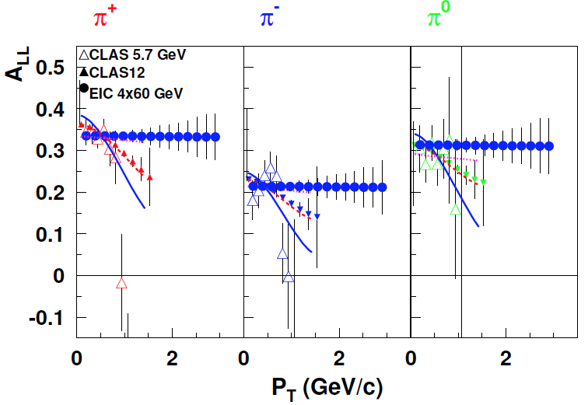
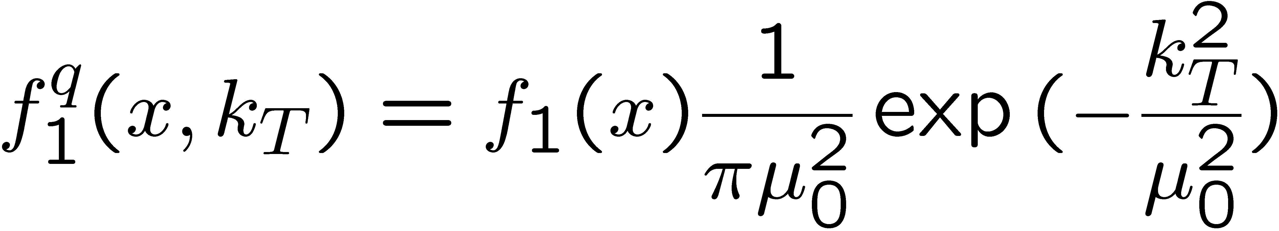
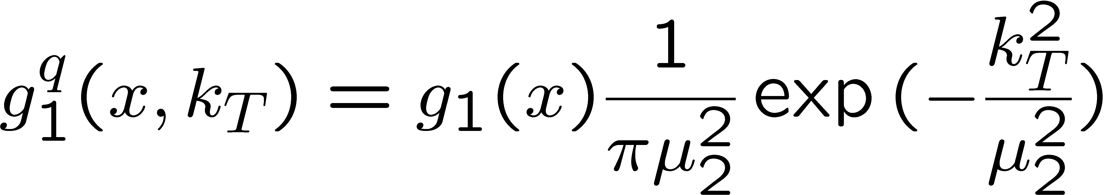
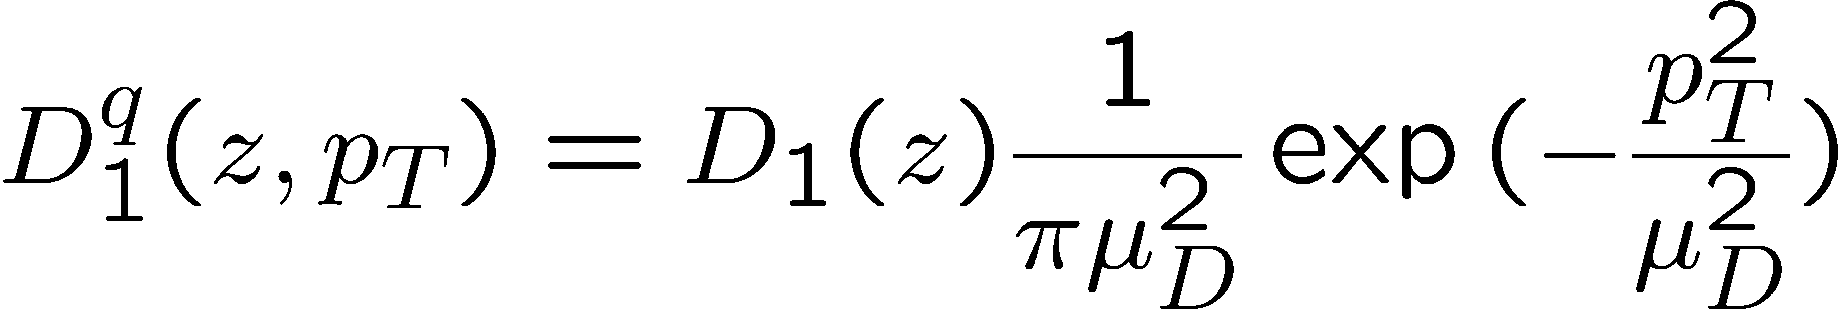
A₁ P_{T}-dependence in SIDIS
M.Anselmino et al hep-ph/0608048
μ₀²=0.25GeV²
μ_{D}²=0.2GeV²
π+ A_{LL} can be explained in terms of broader k_{T} distributions for f₁ compared to g₁
π- A_{LL} may require non-Gaussian P_{T}-dependence for different helicities and flavors
Notes:
The measurements of double spin asymmetries at CLAS indicate that there is a significant dependence
On the hadron transverse momentum, not expected in a simple 1 dimensional picture.
|
A simple model to account the possible helicity dependence of transverse momentum distributions was
Proposed by anselmino and collaborators, based on Gaussian widths for distribution and fragmentation functions.
|
Difference in widhts of f_1 and g_1
|
leads to an additional term in double spin asymmetry
Proportional to that difference.
|
While pi+ behavior is consistent with data, the pi- may require more realistic k_T-dependence which may be different for different helicities and flavors.

Slide 10

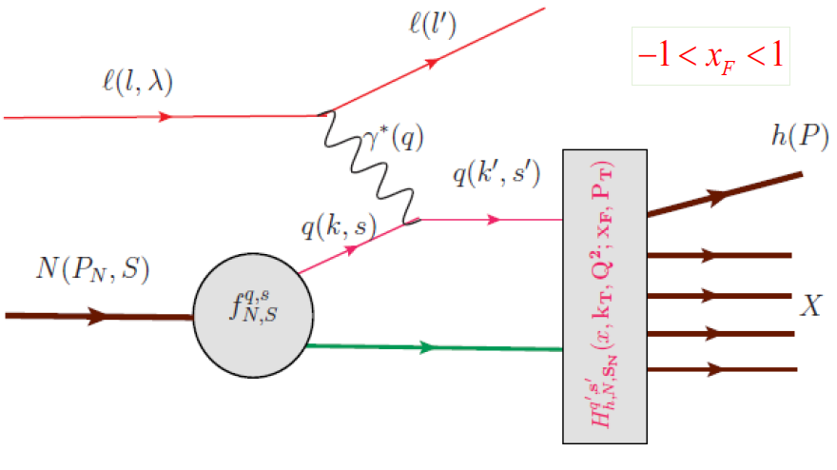
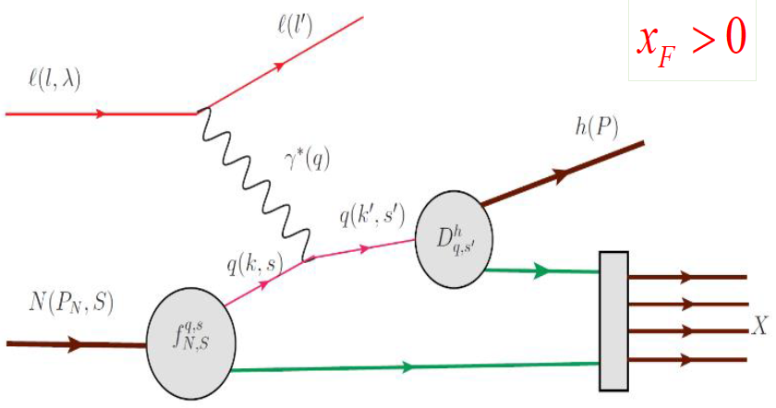
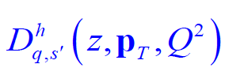

Hadronization and factorization
Hadronization Function
→ conditional probability to produce hadron 𝒉
Quark Fragmentation Functions (universal and independent)
Where this works?

Slide 11
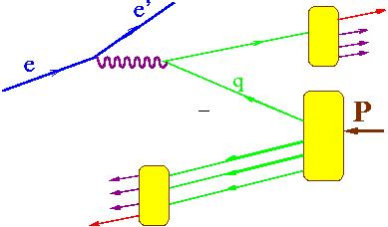
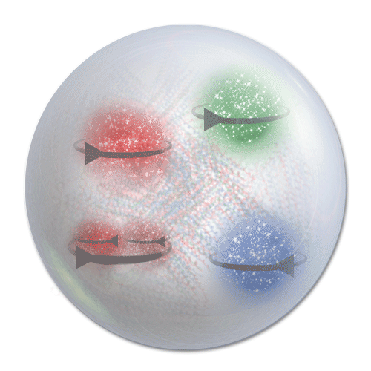
Hadron production in hard scattering
x_{F}>0 (current fragmentation)
X. Artru & Z. Belghobsi
h
L
FSI
x_{F}<0 (target fragmentation)
2-hadron correlations in CFR studied in EMC(1986) and COMPASS, Jlab, EIC
Karliner, Kharzeev , Ellis & Kotzinian
Strikman,Weiss & Schweitzer
Anselmino, Barone, Kotzinian
x_{F} - momentum in the CM frame
L
Correlations of the spin of the target or/and the momentum and the spin of quarks, combined with final state interactions define the azimuthal distributions of produced particles

Slide 12
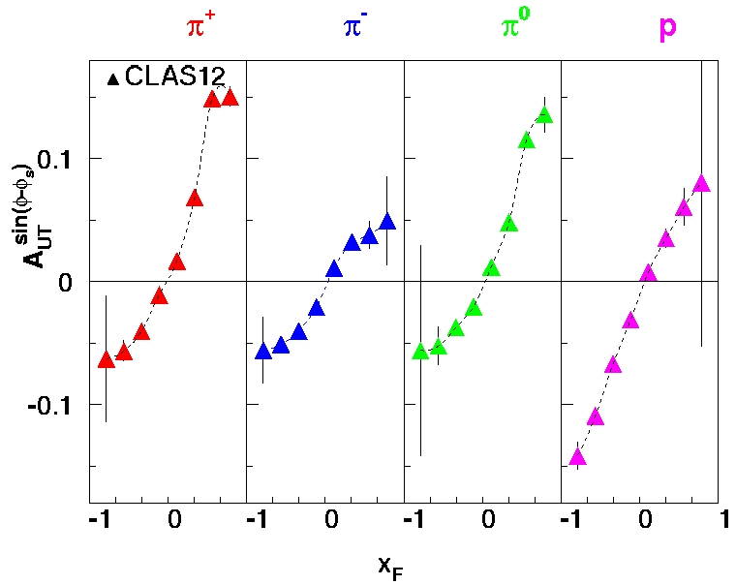
Sivers effect in the target fragmentation
A.Kotzinian
High statistics of CLAS12 will allow studies of kinematic dependences of the Sivers effect in target fragmentation region
Notes:
Significant effect predicted in the target fragmentation region, in particular for baryons (target remnant also asymmetric)
The same data set was used to produce projections for the target fragmentation.

Slide 13
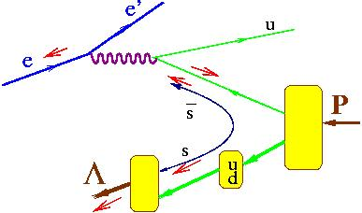
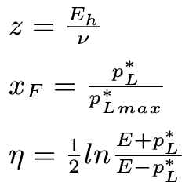
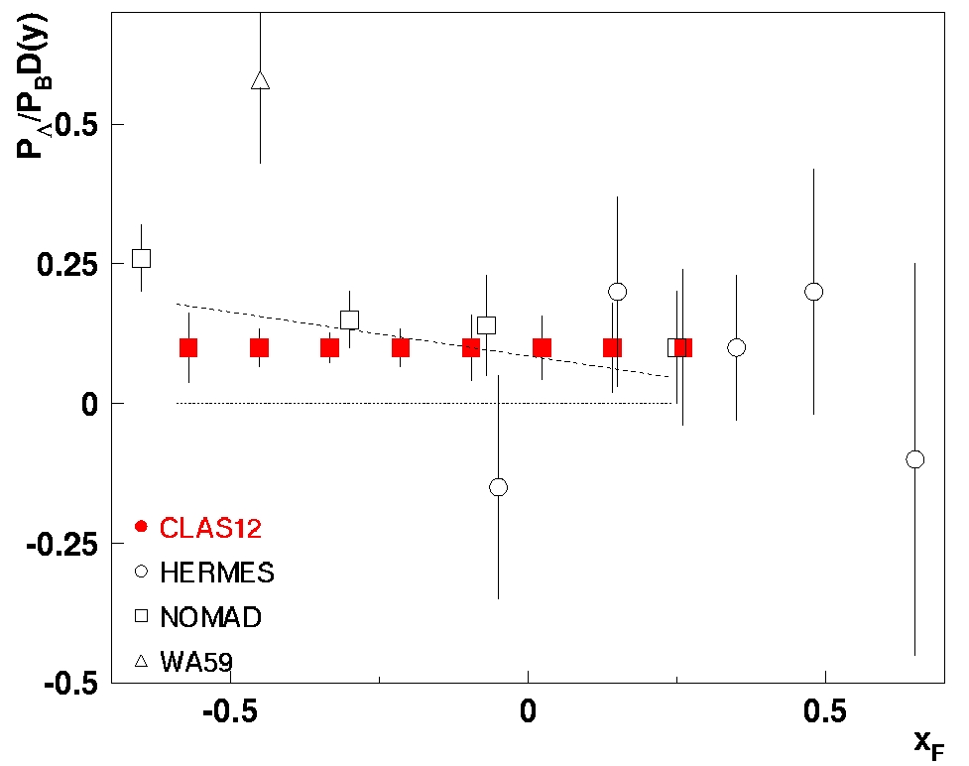
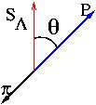
Λ polarization in the target fragmentation
e
e’
1
Λ
2
p
x_{F} - momentum in the CM frame
Λ – unique tool for polarization study due to self-analyzing parity violating decay
Wide kinematic coverage of CLAS12 allows studies of hadronization in the target fragmentation region

Slide 14
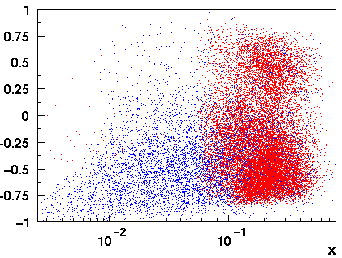
Λ production in the target fragmentation
Λ polarization in TFR provides information on contribution of strange sea to proton spin
(ud)-diquark is a spin and isospin singlet s-quark carries whole spin of Λ
x_{F} - momentum in the CM frame
x_{F}(Λ)
Study polarized diquark fracture functions sensitive to the correlations between struck quark transverse momentum and the diquark spin.
EIC
CLAS12
Wide kinematical coverage of EIC would allow studies of hadronization in the target fragmentation region (fracture functions)

Slide 15

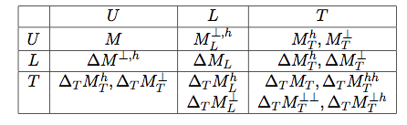
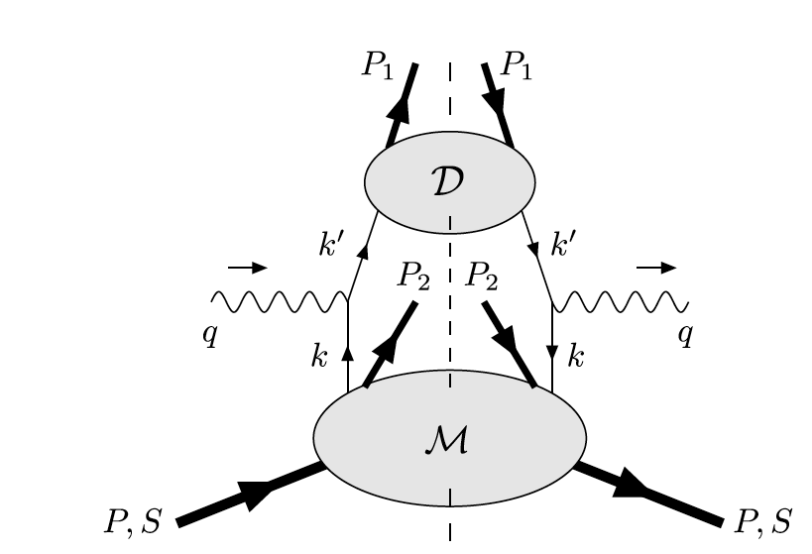

Target fragmentation in SIDIS
P₁
M. Anselmino, V. Barone and A. Kotzinian, Physics Letters B 713 (2012)
Leading Twist
P₂
The beam–spin asymmetry appears, at leading twist and low transverse momenta, in the deep inelastic inclusive lepto-production of two hadrons, one in the target fragmentation region and one in the current fragmentation region.
Understanding of Target Fragmentation Region (TFR) is important for interpretation of the Current FR
Need a consistent theoretical description for TFR
Measure/model fracture functions
Notes:
{\cal{F}}_{LU}^{\sin(\phi_1-\phi_2)}=\frac{\mid\vec{P}_{1\perp}\vec{P}_{2\perp}\mid}{m_Nm_2} {\cal{C}}[w_5M_L^{\perp,h}D_1]

Slide 16
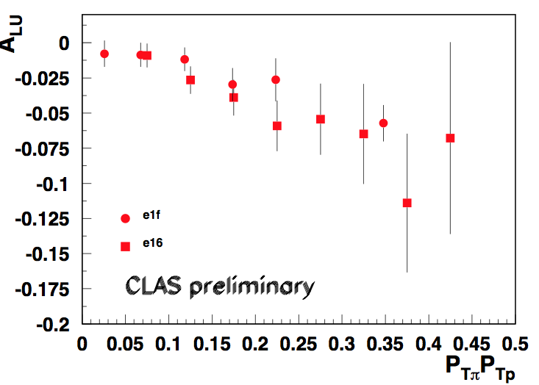
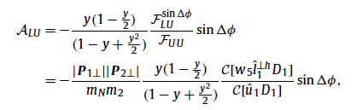
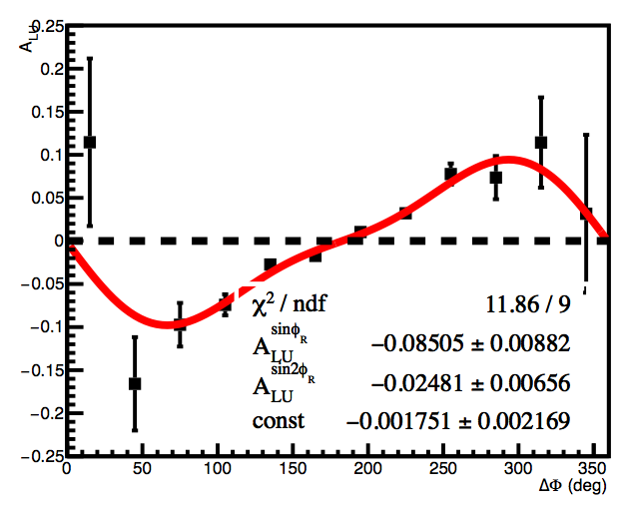
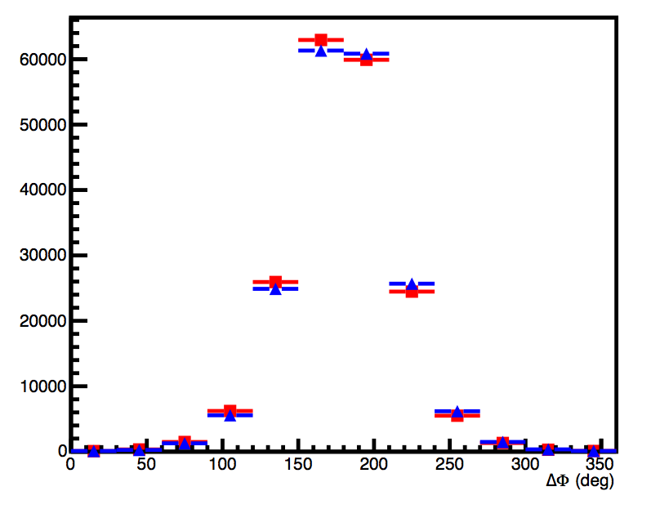
B2B hadron production in SIDIS: First measurements
M. Anselmino, V. Barone and A. Kotzinian, Physics Letters B 713 (2012)
CLAS PRELIMINARY
Significant asymmetries observed by CLAS at 6 GeV
Notes:
{\cal{F}}_{LU}^{\sin(\phi_1-\phi_2)}=\frac{\mid\vec{P}_{1\perp}\vec{P}_{2\perp}\mid}{m_Nm_2} {\cal{C}}[w_5M_L^{\perp,h}D_1]

Slide 17
SUMMARY
Correlations play a crucial role in non perturbative dynamics
Close communication of theorists and experimentalists was critical in extraction and interpretation of all kind of spin-azimuthal asymmetries
Target fragmentation can be an important (so far undervalued) domain for understanding of the partonic interactions and correlations
A proper visualization of the nucleon structure will require understanding of target fragmentation

Slide 18
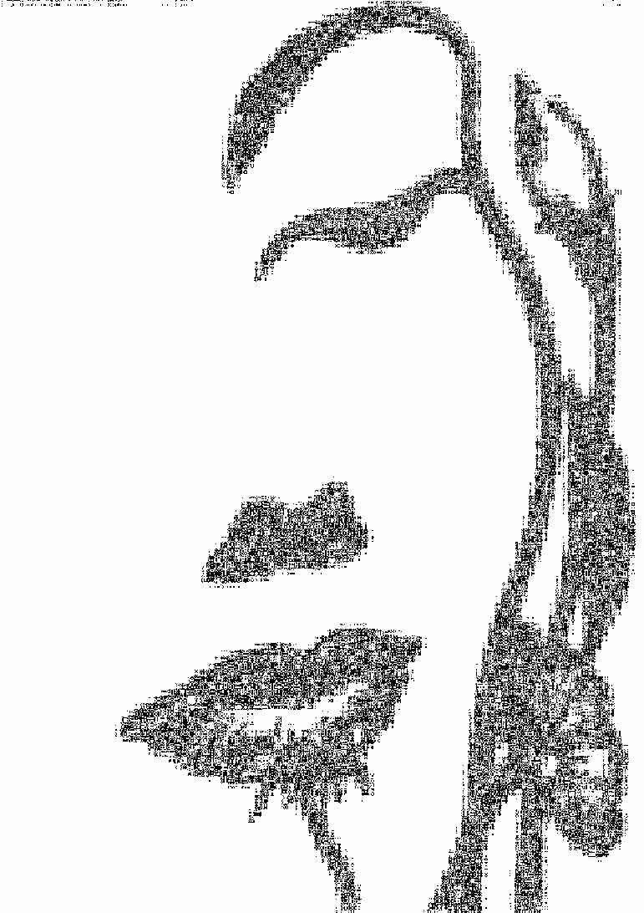
x_{F}
1
CFR
0
-1

Slide 19
x_{F}
1
Larger phase space
higher W, z, x
different asymmetries
0
-1

Slide 20

x_{F}
1
Better resolution,
higher statistics
0
-1

Slide 21
x_{F}
1
0
TFR with good
resolution etc
-1

Slide 22

Full picture can be
surprising and beautiful
x_{F}
1
0
-1

Slide 23
Support slides

Slide 24
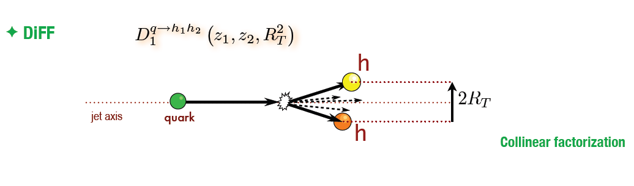
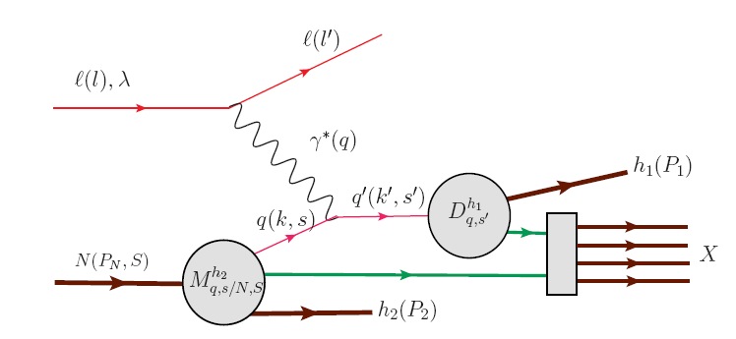

Hadronization in current and target regions
h₁
h₂
Anselmino/Barone/Kotzinian
arXiv:1107.2292 (2011)
Fracture Function:
conditional probabilities to find a quark with certain polarization and longitudinal momentum fraction xB and transverse momentum k_{T} inside a nucleon fragmenting into a hadron carrying a fraction z of the nucleon longitudinal momentum and a transverse momentum P_{T}
h₁
h₂

Slide 25
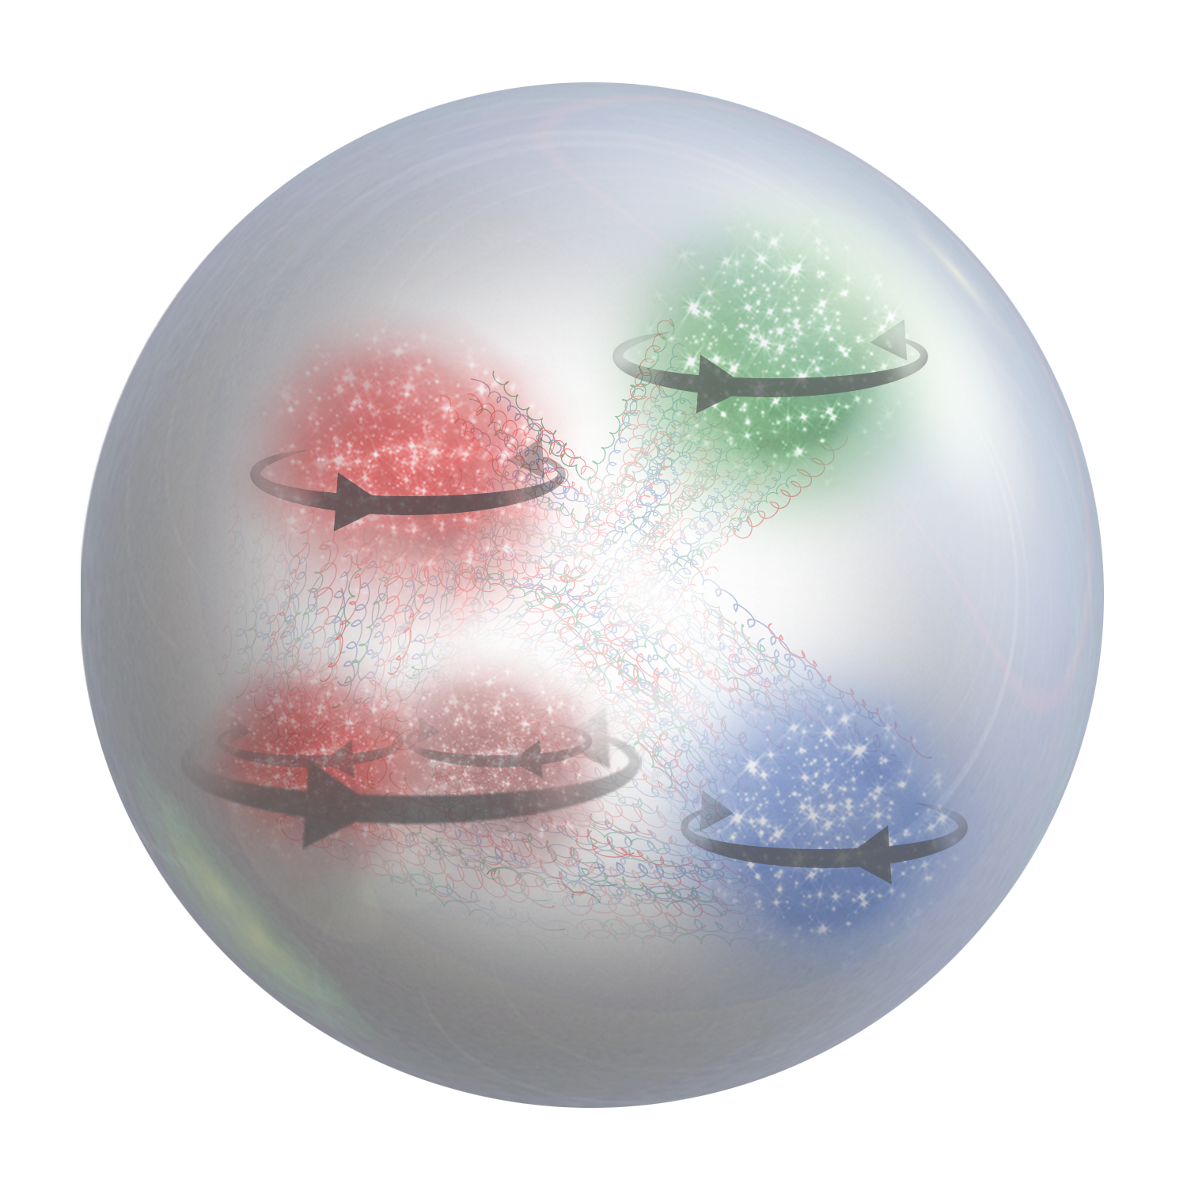


SSAs: Black Swans of Nucleon Structure
L
rarity: it is an outlier, as it lies outside the realm of regular expectations, because nothing in the past can convincingly point to its possibility.
it carries an extreme impact.
retrospective (not prospective) predictability: in spite of its outlier status, human nature makes us concoct explanations for its occurrence after the fact, making it explainable and predictable.
One single observation can invalidate a general statement derived from millennia of confirmatory sightings of millions of white swans. All you need is one single (ugly) black bird.

Slide 26
Three stages for new phenomena
Any unexplained phenomenon passes through three stages before the reality of it is accepted.
During the first stage it is considered laughable.
During the second stage, it is adamantly opposed.
Finally, during the third stage, it is accepted as self-evident.
Arthur Schopenhauer

