Slide 1
Exploring fundamental properties of ³He through the Polarized ³He(e,e’d) and ³He(e,e’p) Processes
Presented by Douglas Higinbotham in collaboration with
Or Hen, Miha Mihovilovič, Dien Nguyen, and Simon Širca

Slide 2
Magnetic Moments
Proton = 2.793 𝝻_{N} where 𝝻_{N} = eℏ/2m_{p}
Neutron = -1.913 𝝻_{N}
³He = -2.128 𝝻_{N}
Examples of 3He Magnetic Moment Calculations:
Shell Model = -1.913 𝝻_{N}
Quark Model = -2.005 𝝻_{N}
QCD Model = -2.291 𝝻_{N}
n
≃
n
p
p
Calculations from https://doi.org/10.1016/j.rinp.2017.07.065

Slide 3
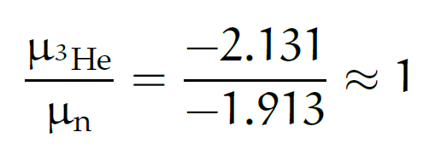
³He ground-state wave-function
S
1.) Spatially symmetric state S (90%):
Spin is dominated by spin of neutron, thus can be used as an effective polarized neutron target:
2.) State D (8%):
Generated by tensor component of NN force.
3.) Mixed symmetry state S’ (2%):
Arises from differences between T=0 and T=1 forces and hence reflects (spin-isospin)-space correlations.
n
p
p
D
(L=0)
n
p
p
S’
(L=2)
n
p
p
(L=0)

Slide 4
³He Used As Effective Neutron Target
For Example: Measurements of DIS neutron spin asymmetry A₁^{n}
X. Zheng et al., Phys .Rev. Lett. 92 (2004) 012004 and Phys. Rev. C70 (2004) 065207.
And next speaker in this session.
Main source of the systematic error is uncertainty of the proton and neutron polarization.
For 12 GeV data, a better understanding of ³He needed.
Also impacts form factor and structure function experiments that use polarized ³He.
Statistical errors,
predicted for 12GeV
E-12-06-112
Notes:
.

Slide 5
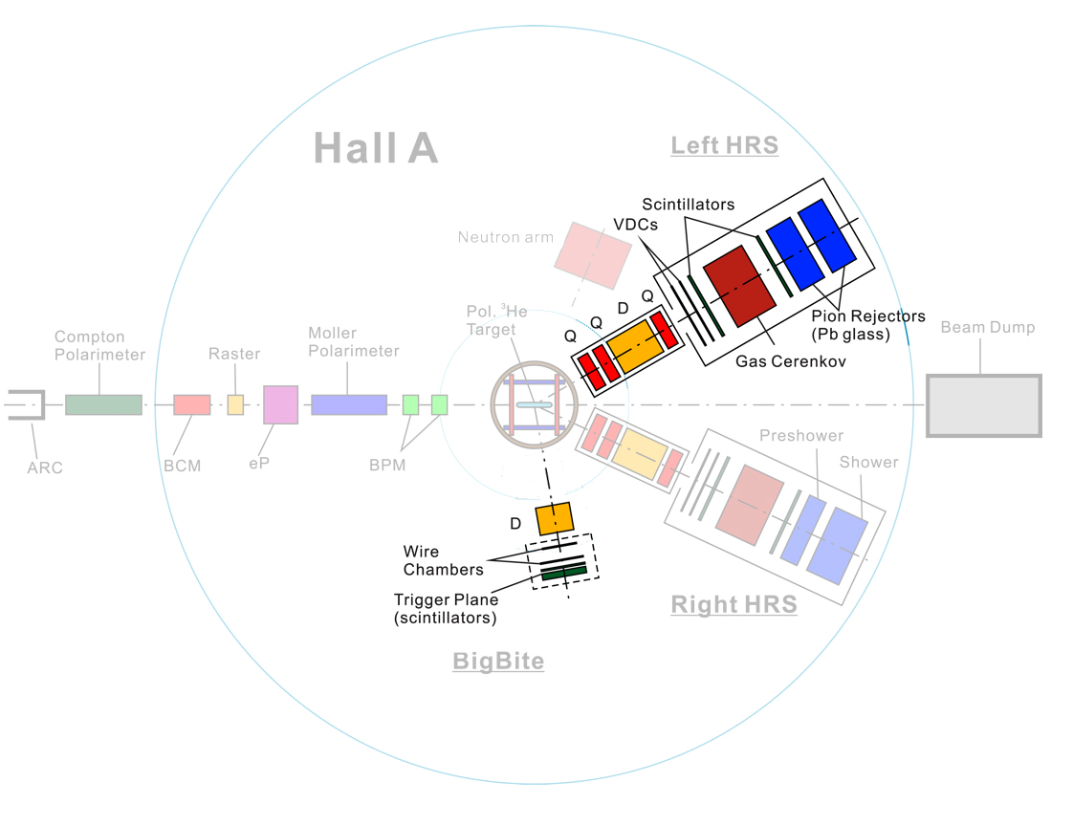
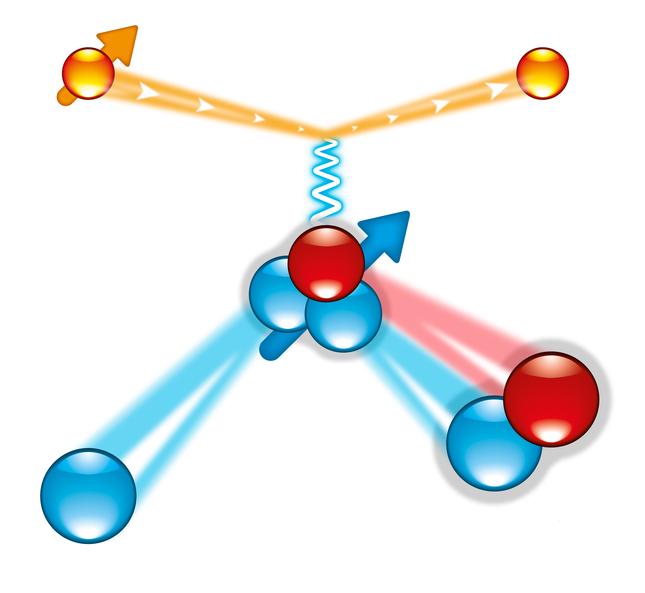
Experiment E05-102 @ Hall-A
Detec
Detected
Electron
(Left HRS)
Pol.³He Target
Incident polarized
electron
θ_{L}
θ_{q}
Beam Helicity
γ*
p
n
Taget orientations:
p
A_{x}
Trans.+
Kinematic Settings:
E_{beam} = 2.425 GeV
θ_{L} = 12.5, 14.5 deg
θ _{BB} = -75.0, -82.0 deg
Q² = 0.25 and 0.35 (GeV/c)²
A_{z}
Long.+
p
p
n
Detected Deuterons
and Protons
(BigBite Spectrometer)
Trans.-

Slide 6
Results for ³He(e,e’d)p
M. Mihovilvic et al., Phys. Rev. Lett. 113 (2014) 232505
Measured asymmetries are of order of 1%.
Theories reasonably well describe behavior of the data. Hannover (Bonn), Bochum (AV18), Pisa (AV18 + Urbana IX)
Calculations underestimate the measured asymmetries.
Hard to determine what is causing the discrepancy: FSI, SRC, 3NF and/or ?? but clearly state-of-the-art calculations don’t agree with the data.

Slide 7
Results for ³He(e,e’p)X
M. Mihovilovic et al., Phys. Lett. B 788 (2019) 117.
Theories from Krakow-Bochum (AV18) and Hanover-Lisbon (Bonn).
Calculations averaged over the acceptance and weighted with cross section ratios.
Theory qualitatively describes behavior of the data.
The calculated amplitudes are too small; zero crossing at wrong positions.
This disconcerting as low P_{m} (e,e’n) is where we extract G^{E}_{n} so there theory issues get put into the form factor!

Slide 8
Next Generation Experiment
Right now we know there are problems with the the state-of the-art models, but it isn’t clear what is wrong.
Letter of Intent was submitted to the last JLab PAC to study this reaction in Hall B with CLAS12.
With the large acceptance of the CLAS detector, it will provide extensive kinematics coverage allowing us to disentangle reaction mechanisms from initial-state effects to understand what ingredient(s) need to be improved.
This is important for all experiments that wish to use polarized 3He as an effective neutron target.

Slide 9
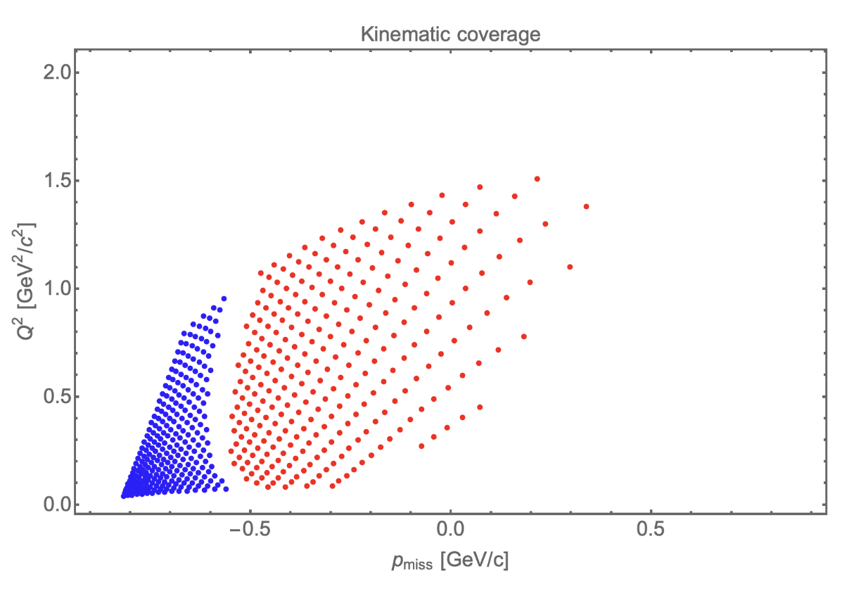
CLAS ³He(e,e’d) Kinematic Coverage
Blue (red) points show accessible kinematics when forward(central) ToF detector is employed to detect deuterons.

Slide 10
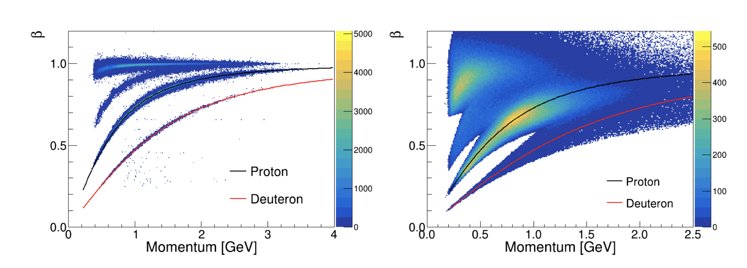
CLAS Particle Identification
Simulated with a 4.4 GeV incident beam.

Slide 11
Summary
Polarized ³He is often used as an effective neutron target for high precision measurements of quantities such as A1n or GEN.
Results from Hall A clearly show a deficiency in our current understanding of this system.
Given the complexity of the state-of-the-art three body calculations, it is very challenging to disentangle what piece or pieces of the calculations require improvement.
The new pol. ³He target and large acceptance of CLAS12 is ideal for solving this puzzle.

Slide 12
BACKUP

Slide 13
Electron Scattering Kinematics
p
scattering plane
e'
θ_{pq}
reaction plane
e
(ω,q)
p_{A–1}
φ_{x}
“out-of-plane” angle
Four-momentum transfer: Q² ≡ – q_{μ}q ^{μ} = q² –ω ²
Missing momentum: p_{m} = q – p = p_{A–1}
Missing energy: ω = e – e’
Bjorken x: x_{B} = Q²/2mω

Slide 14
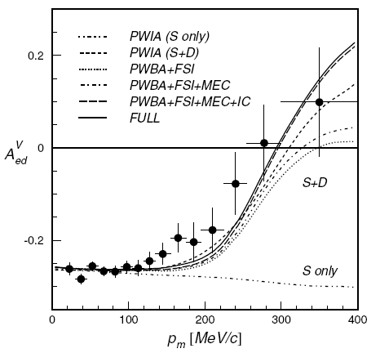
Results for ²H(e,e’p) from NIKHEF
I. Passchier et al., Phys. Rev. Lett. 88 (2002) 102302.
S
D
p
n
p
n
(L=0)
(L=2)
“The experiment reveals in a most direct manner the effects of the D state in the deuteron ground-state wave.”
BLAST: A. DeGrush et al., Phys. Rev. Lett. 119 (2017) 18250.
CLAS: M. Mayer et al., Phys. Rev. C95 (2017) 024005
This shows why “neutron” DIS experiments like BONUS tag low P_{m} protons.

Slide 15
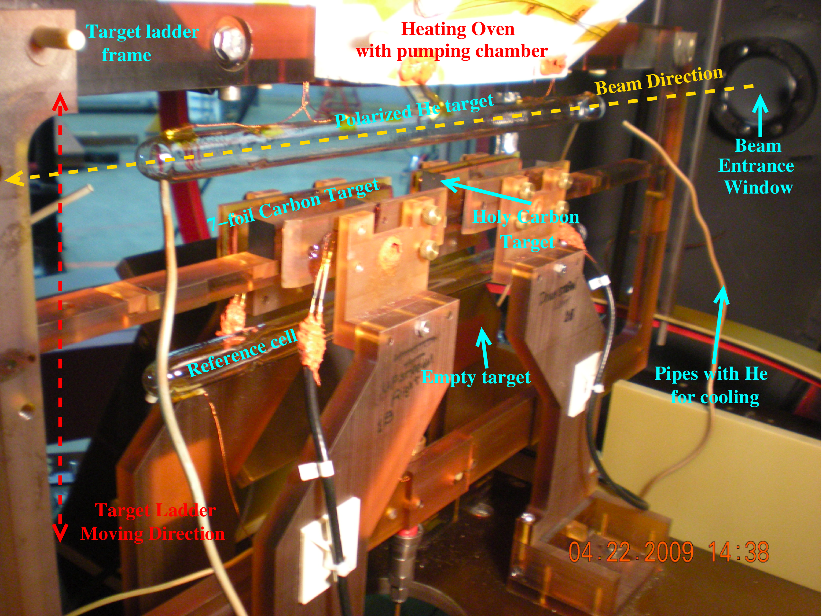
Polarized Helium-3 Target

Slide 16
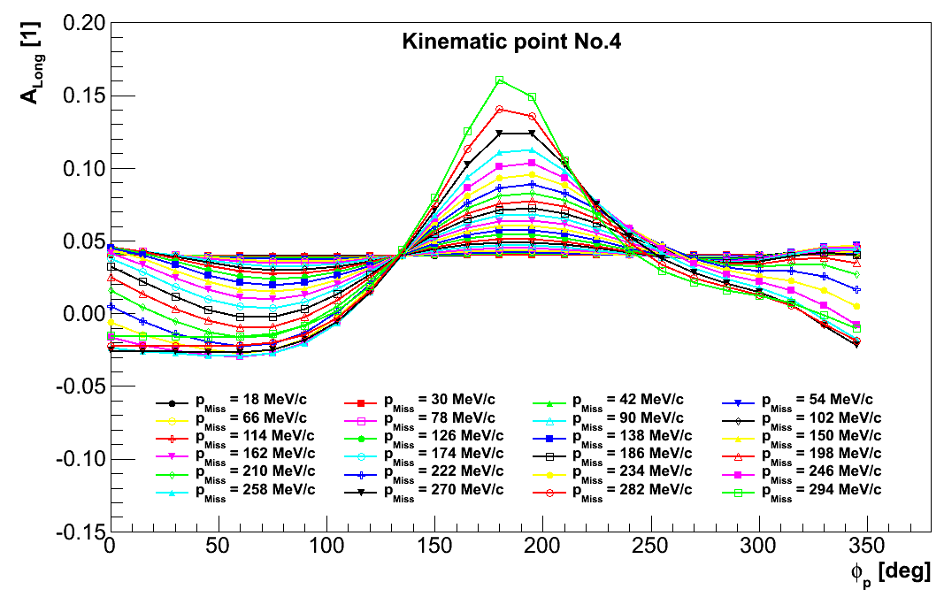
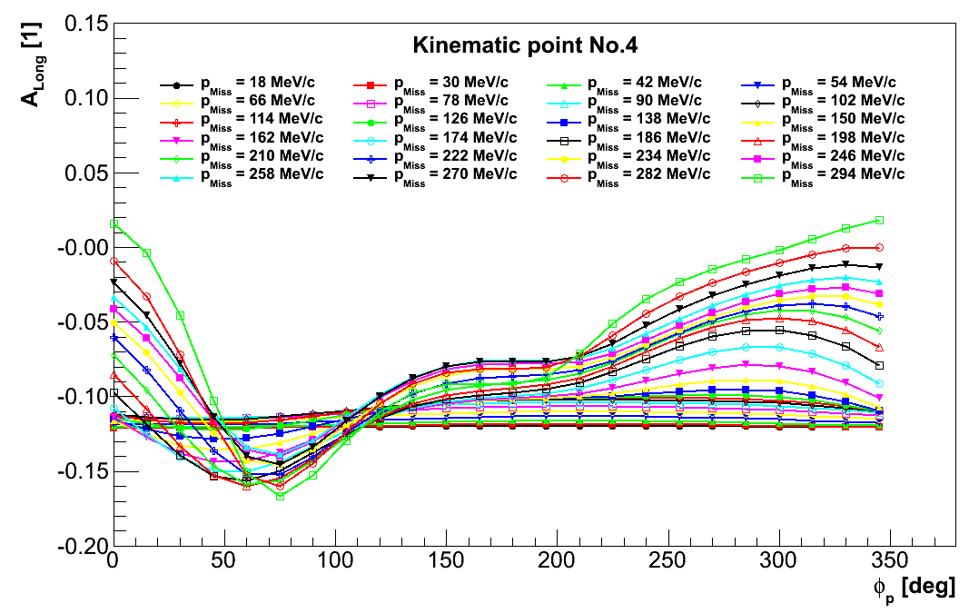
Averaging of theories over acceptance
Shown is the Faddeev calculation results from Krakow/Bochum group
Theoretical calculations must be average over the large acceptance
Separate calc. for 2BBU and 3BBU
Two-Body Breakup
3BBU asymmetries much larger
Three-Body Breakup

Slide 17
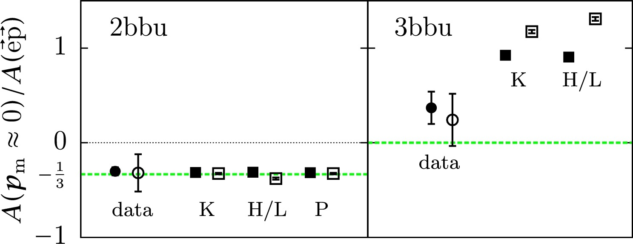
2BBU and 3BBU separated in theory
M. Mihovilovic et al., Phys. Lett. B 788 (2019) 117.
A_{2BBU} and A_{3BBU} with opposite signs.
Cross-section and A_{2BBU} well established.
Theory and experiment agrees with ³He(e,e’p)d 2bbu channel
Disagreement due to A_{3BBU}
P_{m} [MeV/c]

