Slide 1
Towards the First Strange Hexaquark with CLAS12
Geraint Clash
University of York, UK

Slide 2
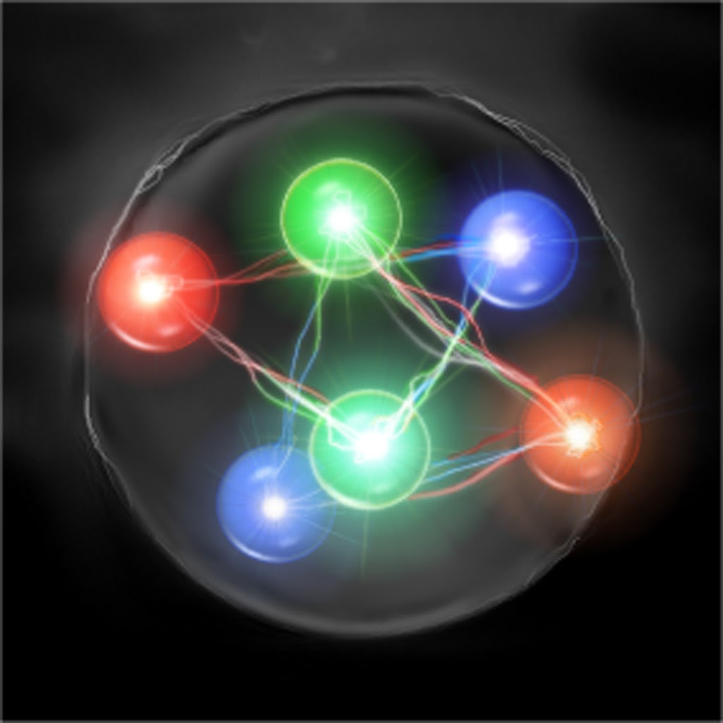
Contents
Motivation
JLab and CLAS12
Analysis and Results
Outlook
2

Slide 3
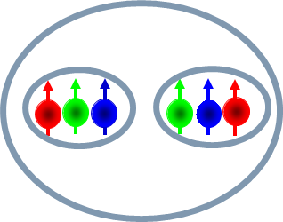
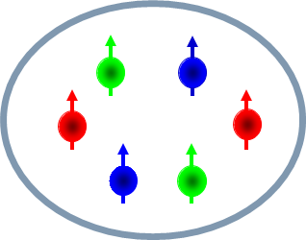
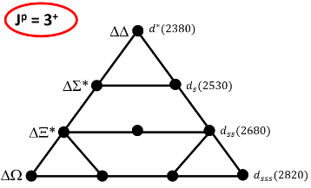
Motivation
What are Hexaquarks?
Mesons, Baryons and then exotic states (tetra, penta and hexa)
d* Antidecuplet
Hexaquark or Molecule?
Why are they important?
QCD many body effects
High density
Neutron stars
Early universe
Dr. Mikhail Bashkanov
Me
Matthew Nicol
3
Notes:
Why are they important?
Fantastic object to study many body effects

Slide 4
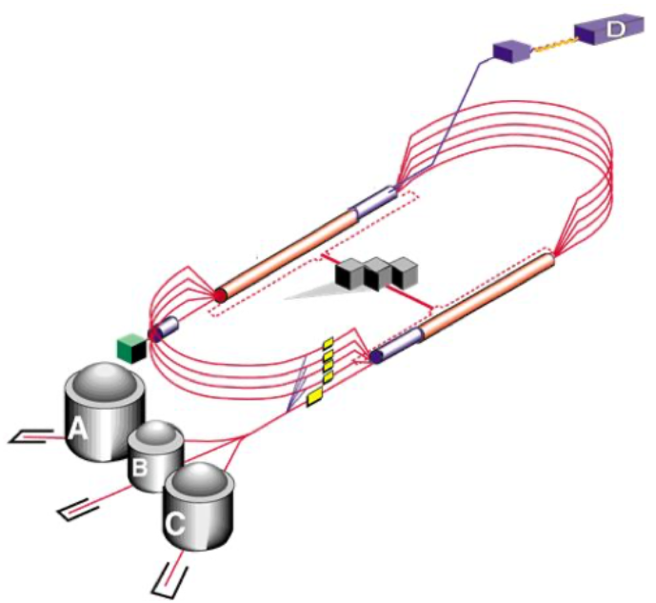
Jlab Overview
CEBAF
Beam splits
Hall B
4
Notes:
Electron beam produced by CEBAF

Slide 5
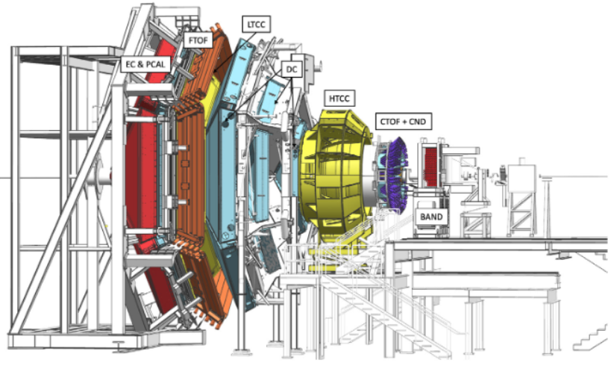
CLAS12 Overview
Forward Tagger
Forward Detector
Central Detector
5

Slide 6
CLAS12 Overview
RGB
Liquid deuterium target
Between 10.2 and 10.6 GeV
100k events per second produced
3k events per second stored
~200GB per hour
~3 months measurement period
6
Notes:
More specifically there are different at run groups at clas12

Slide 7
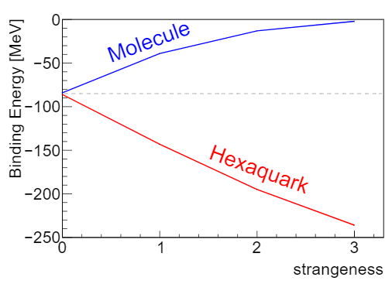
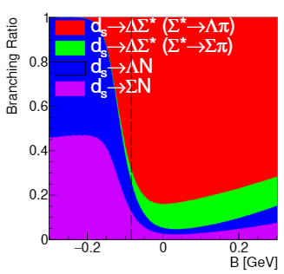
Analysis
$$d_{sss}$$
$$d^{∗}$$
$$d_{s}$$
$$d_{ss}$$
Theoretical study carried out
Widths and branching ratios
7
Notes:
We will keep the branching ratios in mind for how ive looked for the d_s

Slide 8
Analysis
$$e$$
$$e′$$
$$γ$$
$$n$$
$$K^{+}$$
$$π^{−}$$
$$K$$
$$Δ^{−}$$
$$p$$
$$d_{s}$$
$$Λ$$
$$d$$
$$π^{−}$$
$$Σ^{∗+}$$
$$π^{+}$$
$$e$$
$$e′$$
How we are looking for it?
Kaon for strangeness
Several Topologies
Up to 7 charge track final states
$$γ$$
$$K^{+}$$
$$K$$
$$n$$
$$d_{s}$$
$$p$$
$$d$$
$$Λ$$
$$π^{−}$$
8

Slide 9
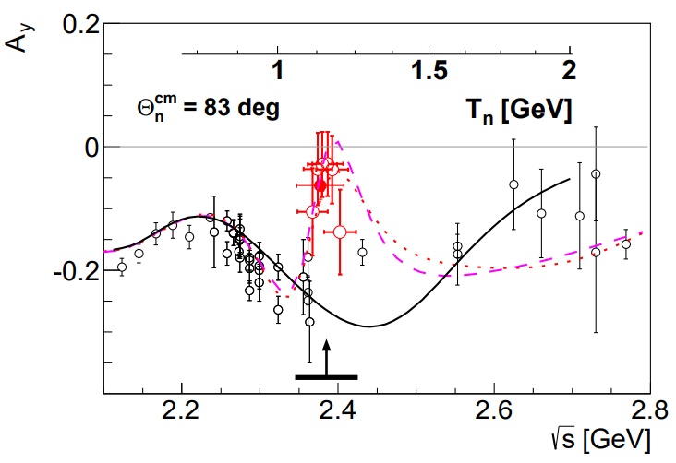
Analysis
More on why this channel
Polarization
Lambda self polarizing
Lambda 100% polarized
$$d^{∗}$$
9
Notes:
Polarization known from theory argument with spins and experiment with d* to pn

Slide 10
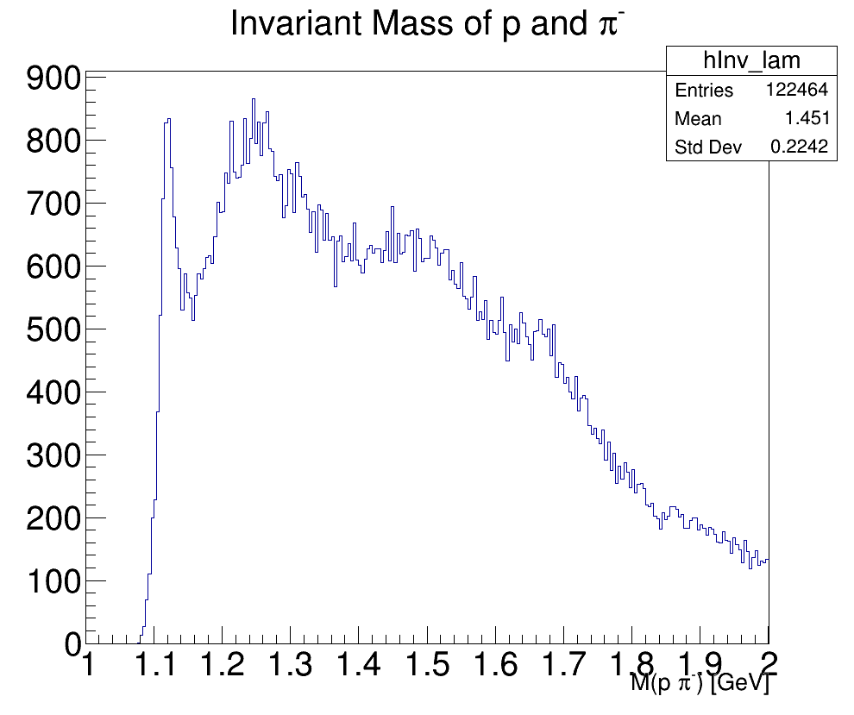
Results
$$Λ$$
$$e$$
$$e′$$
$$γ$$
$$K^{+}$$
$$K$$
$$n$$
Counts
$$d_{s}$$
$$p$$
$$d$$
$$Λ$$
$$π^{−}$$
10

Slide 11
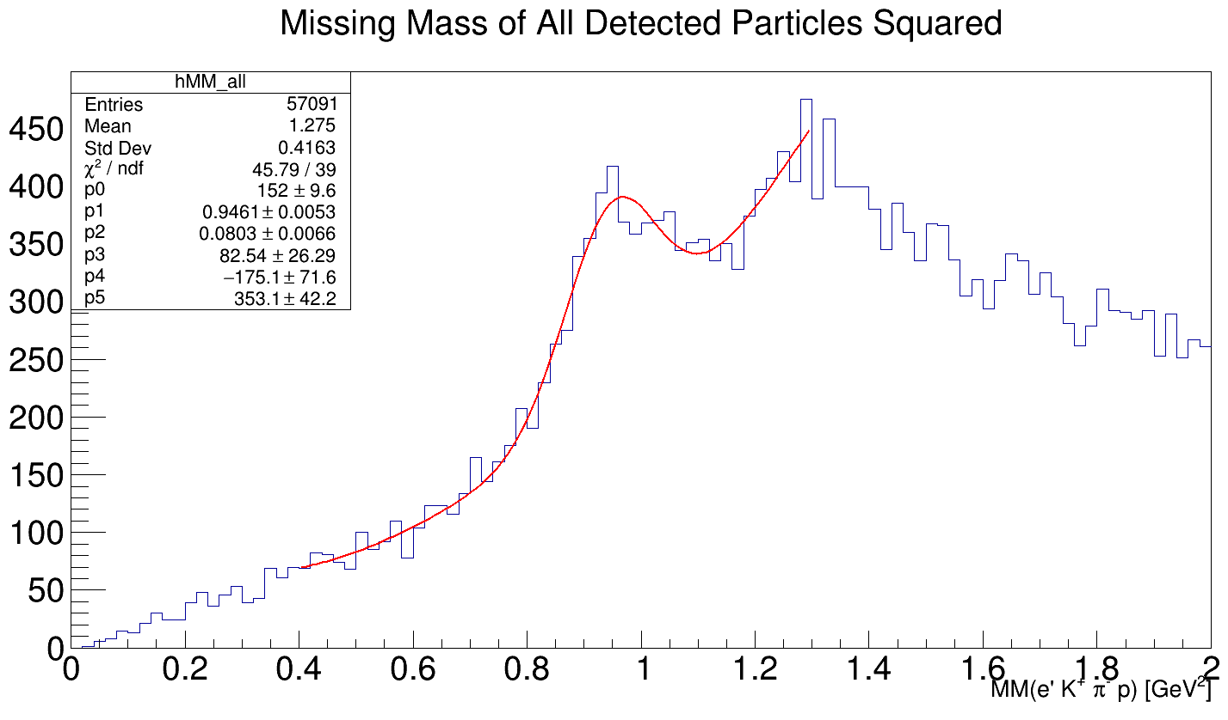
Results
$$e$$
$$e′$$
$$γ$$
$$K^{+}$$
$$K$$
$$d_{s}$$
$$n$$
$$p$$
$$d$$
$$Λ$$
$$π^{−}$$
$$n$$
Counts
Side band 1
Signal
Side band 2
11
Notes:
Fit with Gaussian and 2nd order poly
Side band subtraction preformed

Slide 12
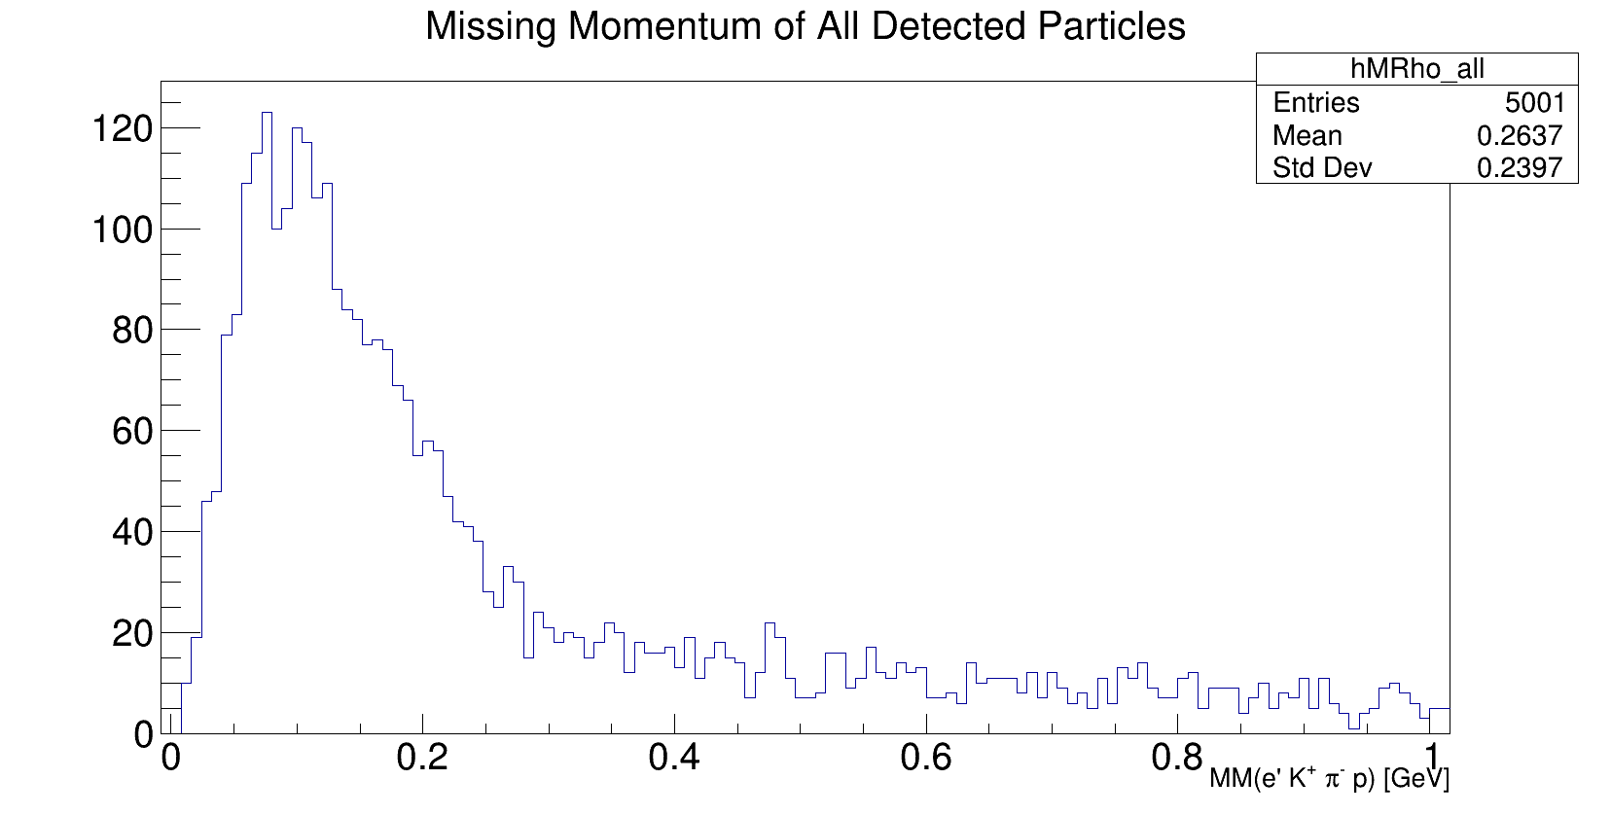
Results
$$e$$
$$e′$$
$$γ$$
$$K^{+}$$
$$K$$
$$p$$
$$p$$
$$Λ$$
$$π^{−}$$
$$n$$
$$e$$
$$e′$$
$$γ$$
$$K^{+}$$
$$K$$
$$n$$
Counts
$$d_{s}$$
$$p$$
$$d$$
$$Λ$$
$$π^{−}$$
P(n) [GeV/c]
12

Slide 13
Outlook
Other channels
$d_{s}→dK^{−}$
$d_{s}→pΛ$
$d_{s}→ΔΣ^{∗}$
Differential cross-sections and $Λ$polarizations
Efficiency and acceptance
MC simulations
13

Slide 14
Thank you Any questions?

