Slide 1

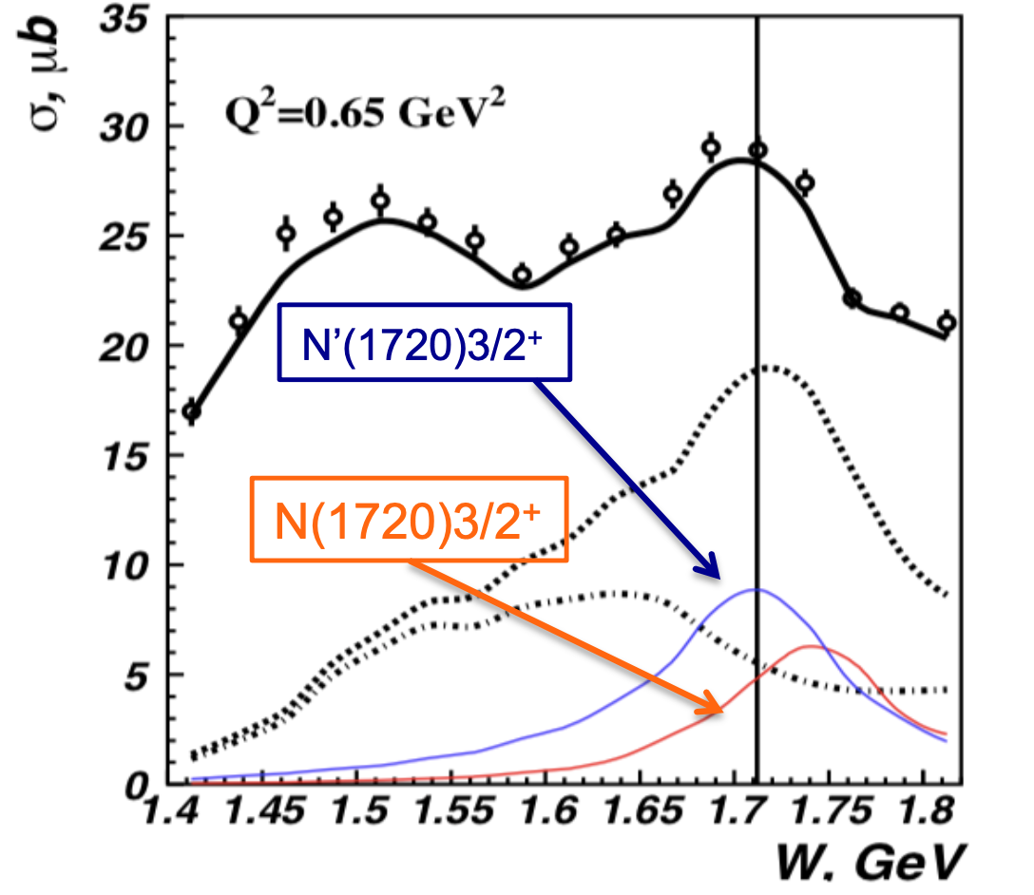
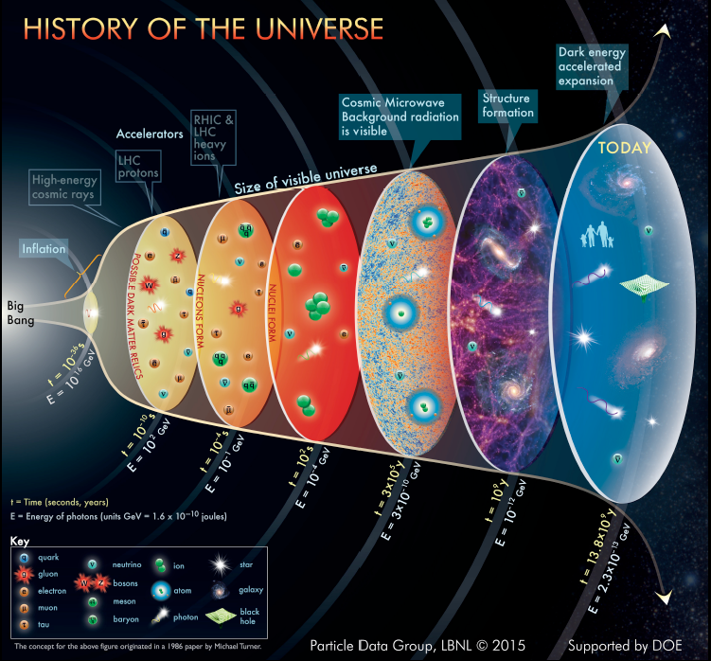



New Baryon State N’(1720)3/2⁺ from the CLAS π⁺π⁻p Photo- and Electroproduction Data
Talk outline:
V.I. Mokeev
Jefferson Laboratory
Hadron spectra and emergence of the strong QCD regime
New resonances from photoproduction
New N’(1720)3/2⁺ state from analysis of π⁺π⁻p photo-/electroproduction data
Insight into ``missing” resonance
structure
16th International Workshop on Meson Physics online via ZOOM
17th - 20th May 2021

Slide 2
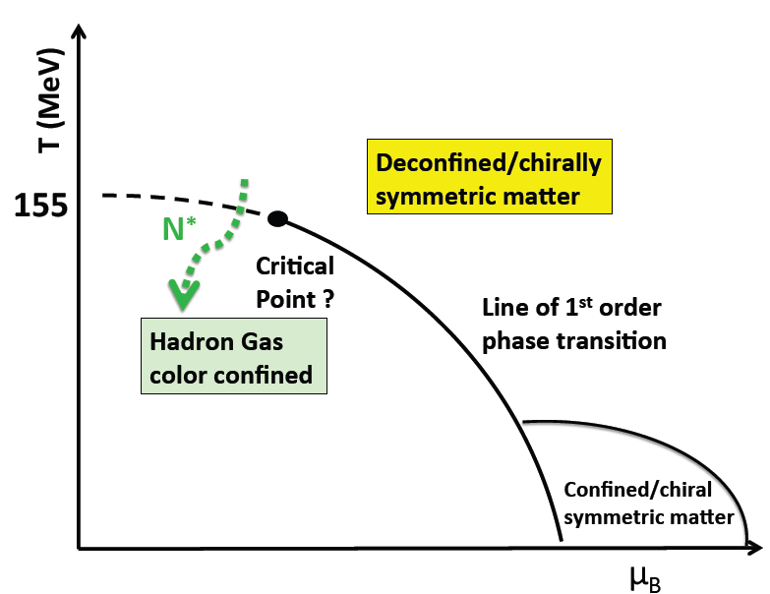
Nucleon Resonances in the Emergence of Hadronic Matter
Dramatic events occurred in the micro-second old universe during the transition from the deconfined quark and gluon phase to the hadron phase.
N*
hot QCD
Quark-gluon confinement emerges
Chiral symmetry of QCD is broken
Quarks and gluons acquire mass
Baryon resonances form
strong QCD
??
This transition was shaped by the full meson and baryon spectra

Slide 3
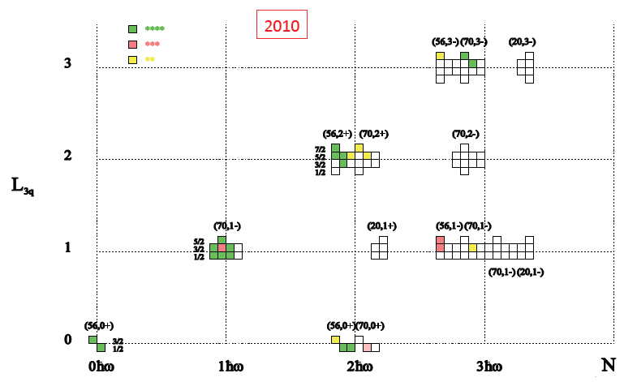
SU(6)xO(3) spin-flavor symmetry and ``missing” resonances
SU(6)xO(3) Spin-Flavor Symmetry and ``Missing” Resonances
PDG2010 status
Continuum QCD: Chen Chen et al.,
Phys. Rev. D100 (2019) 054009;
Si-xue Qin et al., Few Body Syst. 60
(2019) 26.
Lattice QCD: R. Edwards et al.,
Phys. Rev. D84 (2011) 074508.
SU(6)×O(3)
“missing” states
Studies of the N*-spectrum were driven by a guess for the ``missing” baryon states expected from underlying SU(6) xO(3) symmetry and supported by continuum lattice QCD results on the N*-spectrum.
Notes:
This shows the 2010 status of baryon states that have been associated with quark model states shown in this SU(6)xO(3) symmetry scheme. The color code indicating the confidence level in their existence. Clearly there are many open boxes where states are predicted but have not observed.

Slide 4
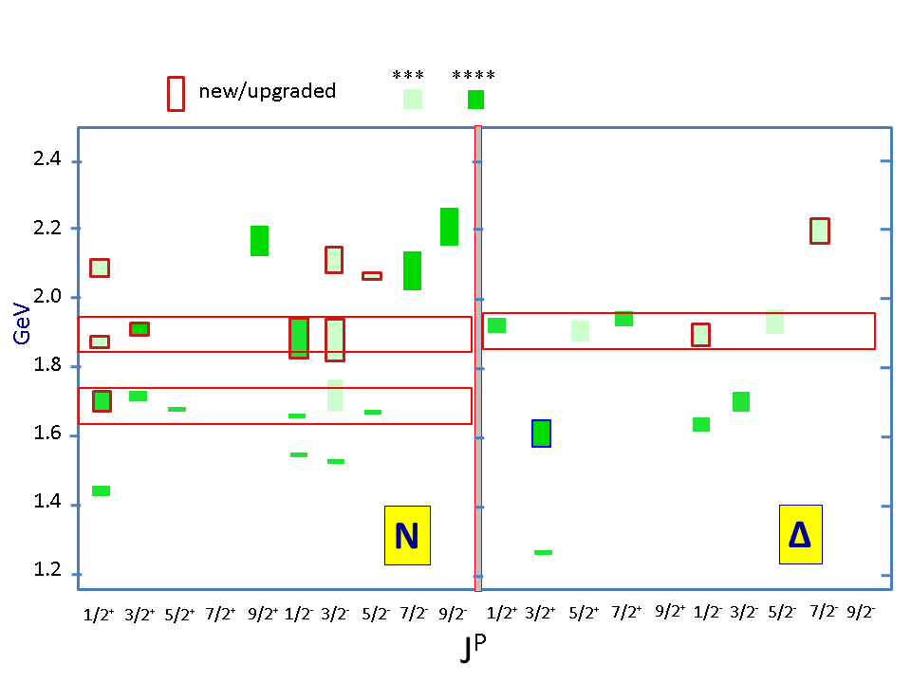
Advances in Exploration of the N* Spectrum in Photoproduction
Several new nucleon resonances were established in a global multi-channel analysis of exclusive photoproduction data
Nucleon resonances listed in Particle Data Group (PDG) tables
N*/Δ* Spectrum 2020
State N(mass)J^{P} | PDG pre 2012 | PDG 2020*
N(1710)1/2⁺ | *** | ****
N(1880)1/2⁺ |  | ***
N(1895)1/2⁻ |  | ****
N(1900)3/2⁺ | ** | ****
N(1875)3/2⁻ |  | ***
N(2100)1/2⁺ | * | ***
N(2120)3/2⁻ |  | ***
N(2000)5/2⁺ | * | **
N(2060)5/2⁻ |  | ***
Δ(1600)3/2⁺ | *** | ****
Δ(1900)1/2⁻ | ** | ***
Δ(2200)7/2⁻ | * | ***
Description of the exclusive electroproduction data off the proton with the same masses and hadronic decay widths as in photoproduction will validate the existence of new baryon states.
Combined studies of the CLAS π⁺π⁻p photo-/electroproduction off proton data allow us to observe
a new N’(1720)3/2⁺ baryon state in addition to those listed above.

Slide 5
Interpretation of the Structure at W~1.7 GeV in π⁺π⁻p Electroproduction
M. Ripani et al., CLAS Collaboration
Phys. Rev. Lett. 91, 022002 (2003)
conventional states only, consistent with PDG 02
implementing N’(1720)3/2⁺ candidate or only conventional states with different N(1720)3/2⁺ Nππ decays than in PDG 02
Two equally successful ways for the data description:
No new states, different than in PDG 02’ N(1720)3/2⁺ Nππ hadronic decay widths:
 | Γ_{tot,} MeV | BF(πΔ) % | BF(ρp) %
N(1720)3/2⁺ decays fit to the CLAS Nππ data | 126±14 | 64-100 | <5
N(1720)3/2⁺ PDG 02’ | 150-300 | <20 | 70-85
σ, μbn
new N’(1720)3/2⁺ and regular N(1720)3/2⁺:
 | Γ_{tot,} MeV | BF(πΔ) % | BF(ρp) %
N’(1720)3/2⁺ New | 119±6 | 47-64 | 3-10.
N(1720)3/2⁺ Conventional | 112±8 | 39-55 | 23-49
W, GeV

Slide 6
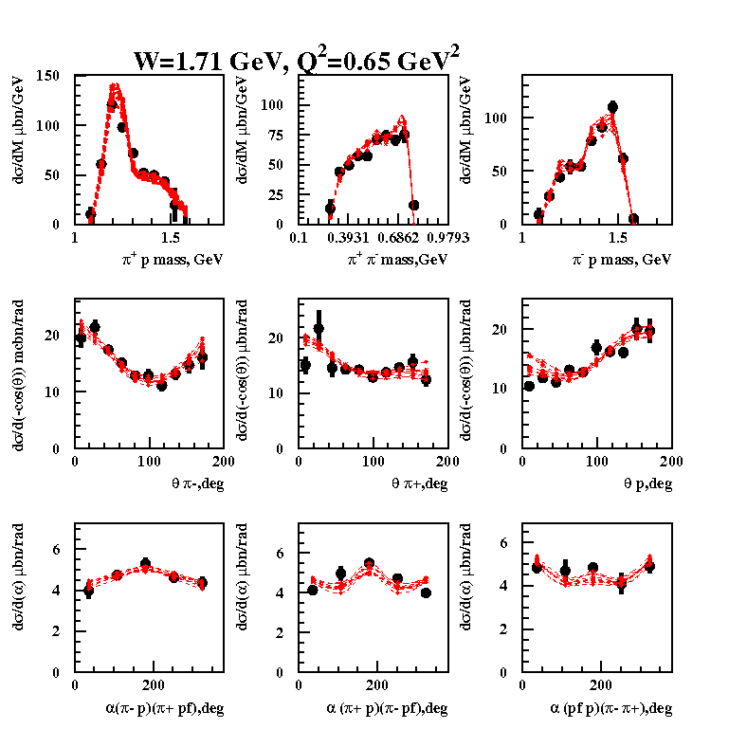
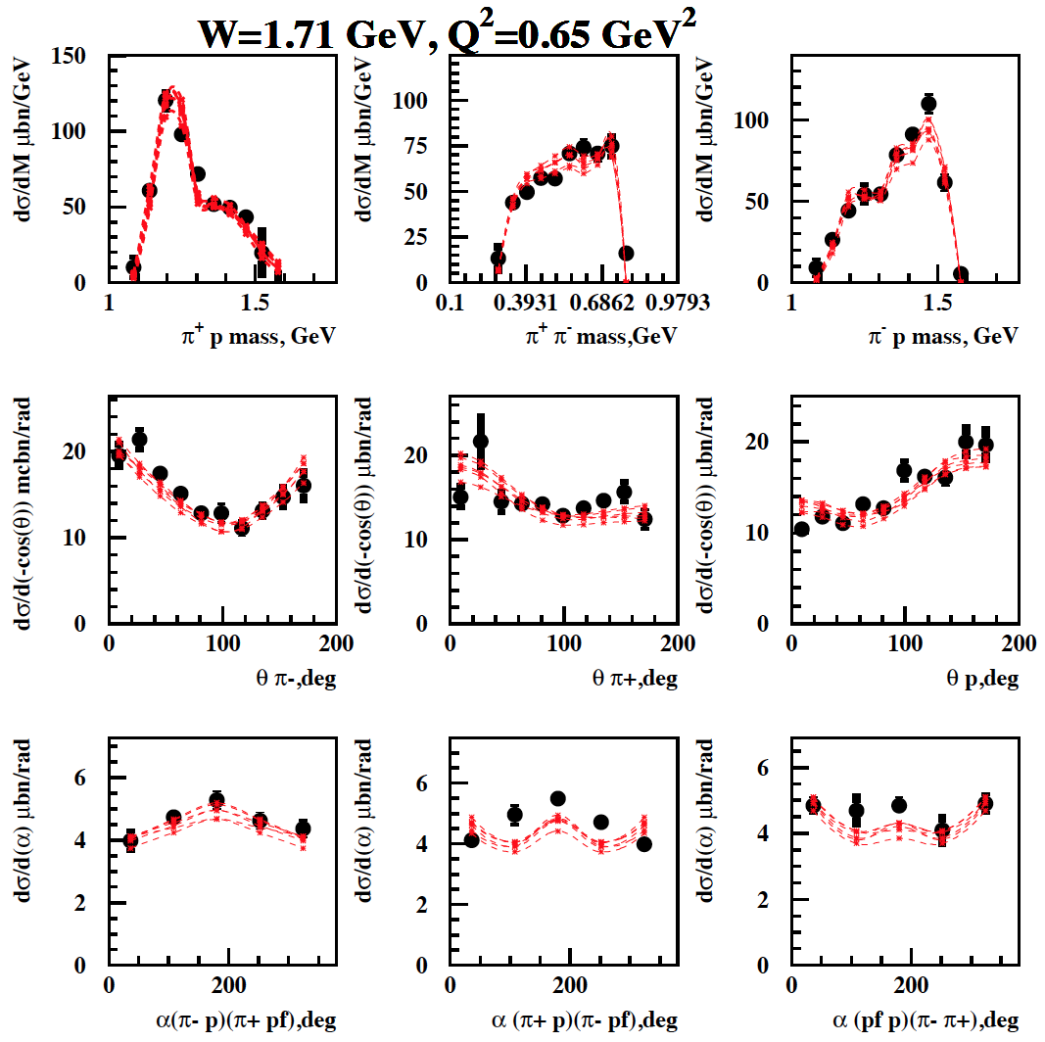
Analysis of the ep→ e’π⁺π⁻p CLAS data at W~1.7 GeV in the JM model
Conventional N*-states with πΔ, ρp couplings fit to the data
N’(1720)3/2⁺ candidate state is included in the fit
2.85<χ²/d.p.<3.03 (1.66 GeV<W<1.76 GeV)
2.56<χ²/d.p.<2.80 (1.66 GeV<W<1.76 GeV)
Fit of θ_{π−}, θ_{π+}, θ_{p} angular distributions requires essential contribution(s) from the resonance(s) of J^{π}=3/2⁺.
Single state of J^{π}=3/2⁺ should have major πΔ (>60%) and minor ρp (<5%) decays in order to reproduce
pronounced Δ−peaks in π⁺p and to avoid ρ-peak formation in the π⁺π⁻ mass distributions.

Slide 7
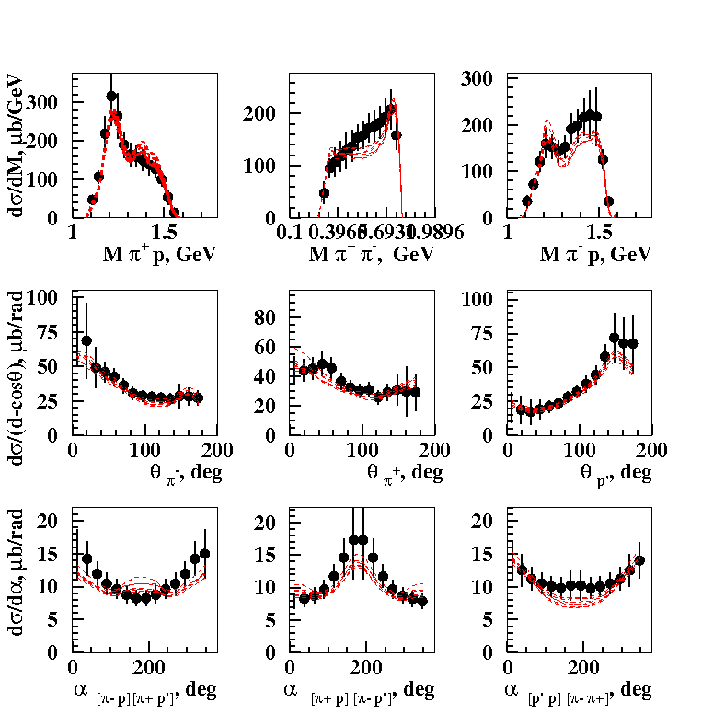
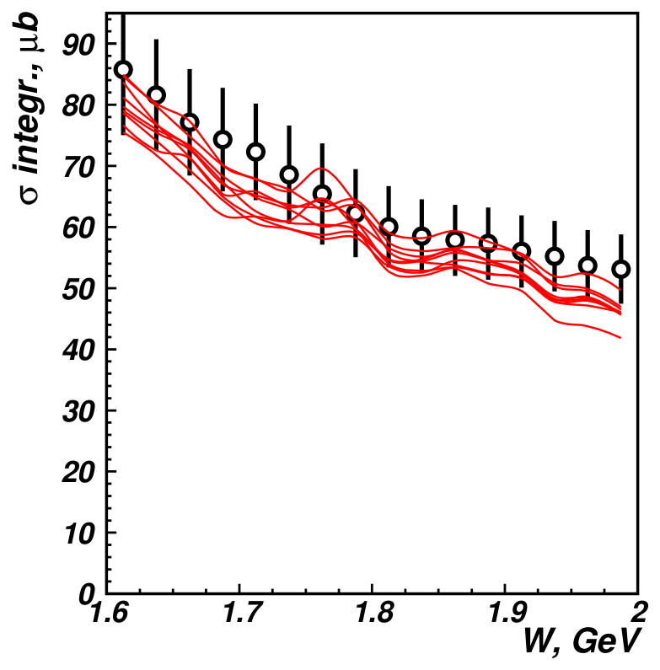
Description of the CLAS π⁺π⁻p Photoproduction off Protons Data with/without the New State N’(1720)3/2⁺
E.N. Golovach et al., CLAS Collaboration, Phys. Lett. B 788, 371 (2019).
One-fold differential cross sections
Fully integrated cross sections
W=1.71 GeV
Almost the same quality of the photoproduction data description was achieved with and without the new N’(1720)3/2⁺ state:
N(1720)3/2⁺ and N’(1720)3/2⁺ 1.19 < χ²/d.p. < 1.28
N(1720)3/2⁺ only 1.08 < χ²/d.p. < 1.26
Would it be possible to describe photo- and electroproduction data with Q²-independent resonance masses
and total and partial hadron decay widths?

Slide 8
Evidence for the Existence of the New State N’(1720)3/2⁺ from Combined π⁺π⁻p Analyses in both Photo- and Electroproduction
V.I. Mokeev et al., Phys. Lett. B 805, 135457 (2020)
N(1720)3/2⁺ hadronic decays from the CLAS data fit with
conventional resonances only
N* hadronic decays from the data fit that
incorporates the new N’(1720)3/2⁺ state
 | BF(πΔ), % | BF(ρp), %
electroproduction | 64-100 | <5
photoproduction | 14-60 | 19-69
Resonance | BF(πΔ), % | BF(ρp), %
N’(1720)3/2⁺ electroproduction photoproduction | 47-64 46-62 | 3-10 4-13
N(1720)3/2⁺ electroproduction photoproduction | 39-55 38-53 | 23-49 31-46
Δ(1700)3/2⁻ electroproduction photoproduction | 77-95 78-93 | 3-5 3-6
The contradictory BF values for N(1720)3/2⁺ decays to the πΔ and ρp final states deduced from photo- and electroproduction data make it impossible to describe the data with conventional states only.
The successful description of the π⁺π⁻p photo-
and electroproduction data achieved by
implementing new N’(1720)3/2⁺ state with
Q²-independent hadronic decay widths of
all resonances contributing at W~1.7 GeV
provides strong evidence for the existence of
the new N’(1720)3/2⁺ state.

Slide 9
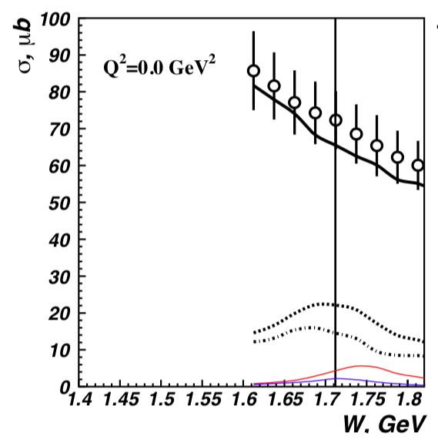
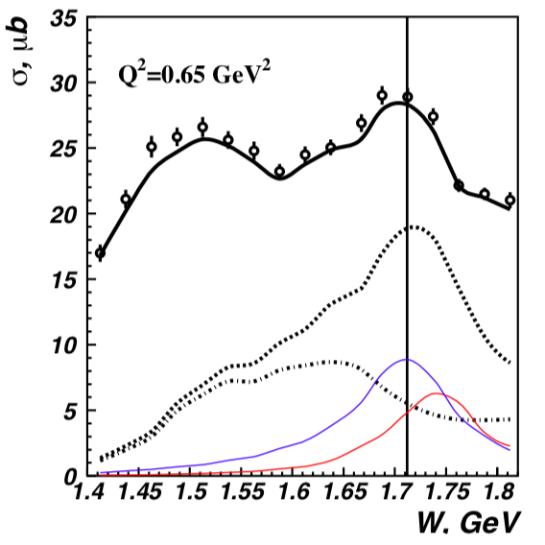
Newly Discovered N’(1720) 3/2⁺
π⁺π⁻p photoproduction
π⁺π⁻p electroproduction
V.I. Mokeev et al., Phys. Lett. B 805, 135457 (2020)
N(1720)3/2⁺
Resonant part
N’(1720)3/2⁺
N’(1720)3/2⁺
Resonant part w/o
N’(1720)3/2⁺,
& N(1720)3/2⁺
N(1720)3/2⁺
Evidence of a new N’(1720) 3/2⁺ resonance in the photo- and electroproduction of the π⁺π⁻p channel

Slide 10
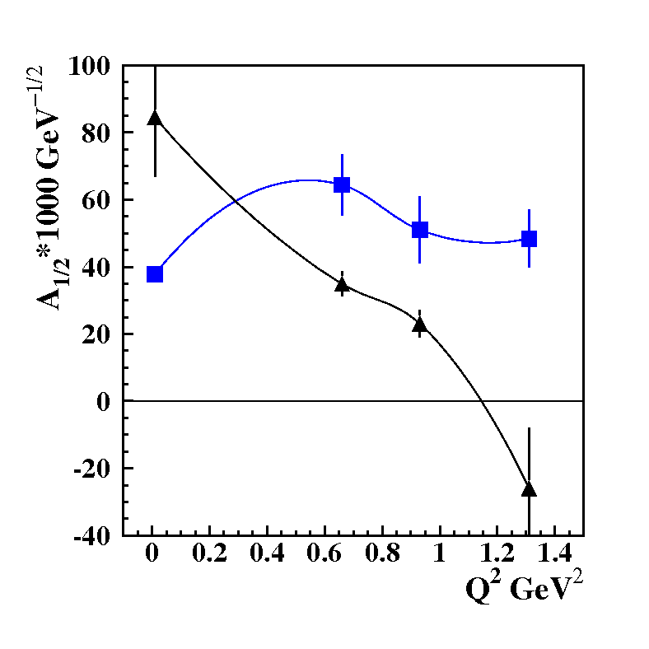
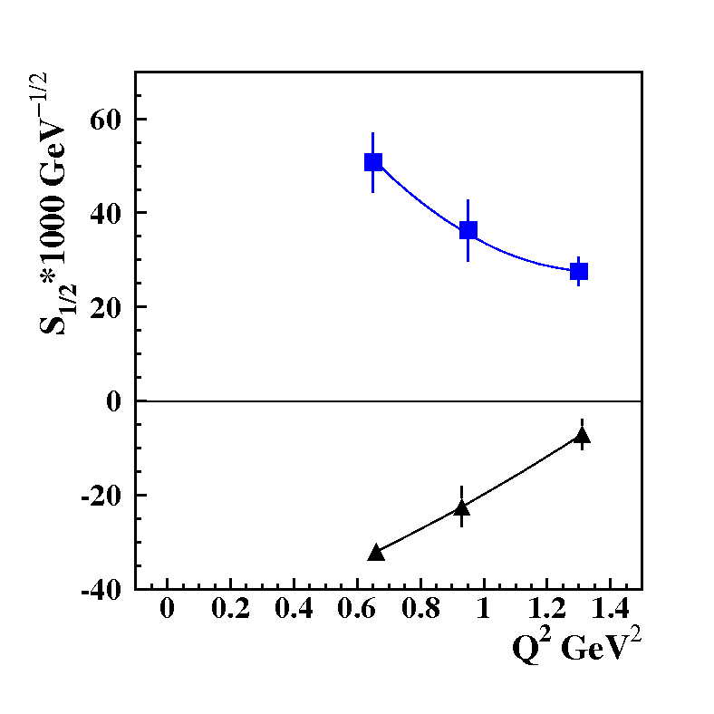
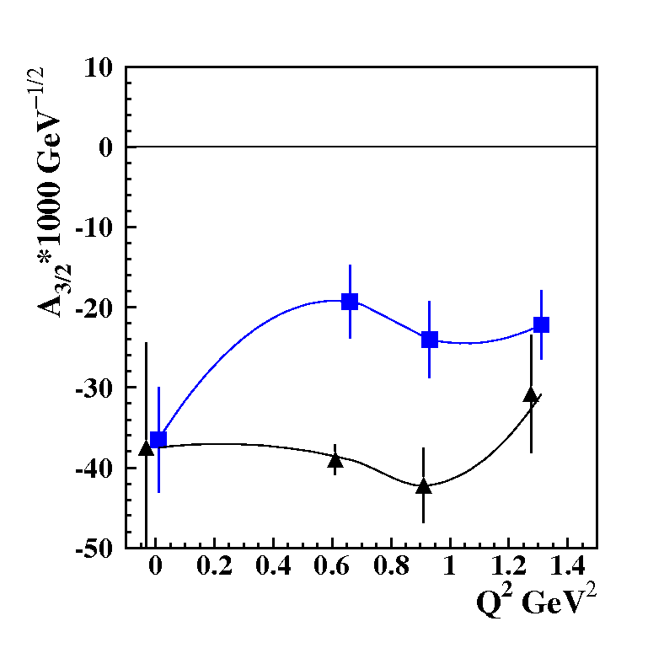
The Parameters of the New N’(1720)3/2⁺ State from the CLAS Data Fit
The photo-/electrocouplings of the N’(1720)3/2⁺ and conventional N(1720)3/2⁺ states
N’(1720)3/2⁺
Resonance | Mass, GeV | Total width, MeV
N’(1720)3/2⁺ | 1.715-1.735 | 120±6
N(1720)3/2⁺ | 1.743-1.753 | 112±8
N(1720)3/2⁺
N’(1720)3/2⁺ is the only new resonance for which data on electroexcitation amplitudes have become
available.
Gaining insight into the ``missing” resonance structure will shed light on their peculiar structural
features that have made them so elusive, as well as on the emergence of new resonances from QCD.

Slide 11
SU(6)-Assignment for N’(1720)3/2⁺ and N(1720)3/2⁺
New resonances discovered from exclusive meson photoproduction data revealed the following
pattern of the high lying resonance spectrum under approximate SU(6)XO(3) symmetry
[70,2⁺] multiplet
S_{q}=3/2
N(1880)1/2⁺ N(1900)3/2⁺ N(2000)5/2⁺ N(2000)7/2⁺
M_{aver} (S_{q}=3/2)=1.96 GeV. ΔM(S_{q}=3/2) =0.075 GeV
S_{q}=1/2
N’(1720)3/2⁺ N(1860)5/2⁺
ΔM(S_{q}=3/2-S_{q}=1/2)[70,2⁺]=ΔM(S_{q}=3/2-S_{q}=1/2)[70,1⁻]=0.16 GeV
M_{aver} (S_{q}=1/2)= M_{aver} (S_{q}=3/2)- ΔM(S_{q}=3/2-S_{q}=1/2)[70,2⁺]=1.96-0.16=1.80 GeV
M(N’(1720)3/2⁺⁾= M_{aver} (S_{q}=1/2)- ΔM(S_{q}=3/2)=1.80-0.075=1.73 GeV consistent with the mass of N’(1720)3/2⁺ inferred from the π⁺π⁻p photo-/electroproduction data.
N’(1720)3/2^{+ :} three constituent quarks of the total spin S_{q}=1/2 and of orbital momentum L=2 in
[70,2⁺] multiplet, double orbital excitation
N(1720)3/2^{+ :} three constituent quarks of the total spin S_{q}=1/2 and of orbital momentum L=2 in
[56,2⁺] multiplet
Quark model evaluation of γ_{v}pN* electrocouplings under the aforementioned assignments for
N(1720)3/2⁺ and N’(1720)3/2⁺ states will shed light on peculiar features in N’(1720)3/2+ structure

Slide 12
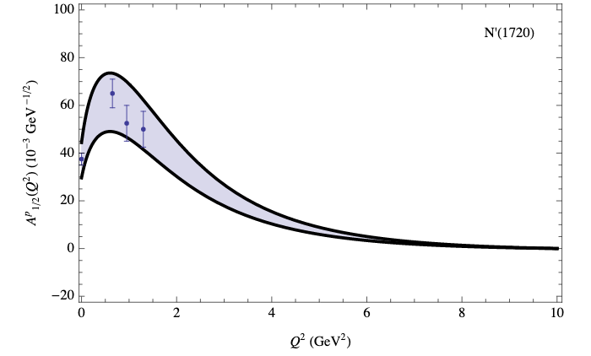
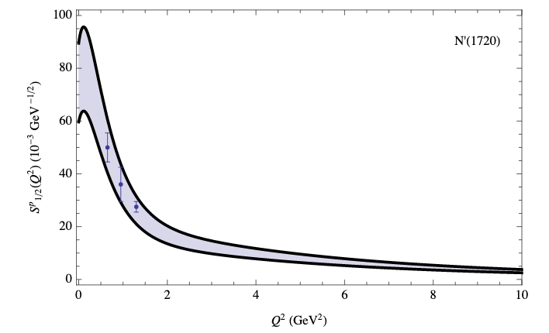
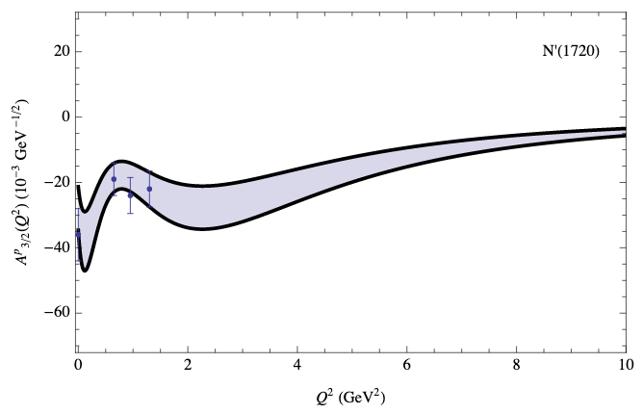
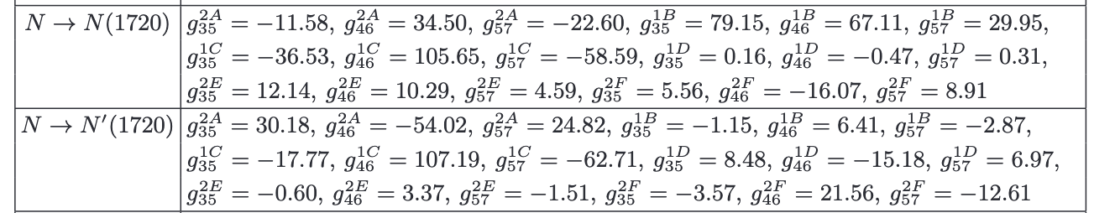
Insight into the Structure of the New N’(1720)3/2⁺
Soft wall Ads/CFT, V.E. Lyubovitskij and I. Schmidt, e-Print:2009.07115 [hep--ph]
CLAS12
CLAS12
CLAS12
Leading/sub-leading
contributions into
N’(1720)3/2⁺ and
N(1720)3/2⁺ are coming
from the same/different
AdS fields
Checking [70,2⁺] and [56,2⁺] assignments for N’(1720)3/2⁺ and N(1720)3/2⁺, respectively (R.Bijker et al., Phys. Rev. D94, 074040 (2016), G.Ramalho, Few Body Syst. 59, 92 (2018)) from the results on γ_{v}pN* electrocouplings. If confirmed, discovery of N’(1720)3/2+ represents the first observation of the resonance with two non-zero orbital momenta l_{λ} and lρ in three quark system .
Alternative assignment of N’(1720)3/2⁺ as a member of 27-SU(3) baryon multiplet of chiral soliton model (G.-S. Yang and H.-C. Kim, PTEP, 093D01 (2019))

Slide 13
Conclusions and Outlook
New resonance N’(1720)3/2⁺ has been observed in combined studies of π⁺π⁻p photo- and electroproduction data measured with CLAS in addition to several new, so-called ``missing” nucleon resonances, from exclusive meson photo- and hadroproduction data
N’(1720)3/2⁺ new state is the only ``missing” resonance for which the results on Q²-evolution of γ_{v}pN* electrocouplings have become available. In the future, the information on the N’(1720)3/2⁺ electrocouplings from the CLAS data will be extended towards Q²<5.0 GeV²
Combined studies of exclusive meson photo- and electroprtoduction will conclude the efforts on exploration of the N* spectrum with the CLAS12 detector including the hybrid-baryon search. The expected results are of particular importance in order to establish approximate strong QCD symmetries relevant of the N* spectrum generation, as well as to pin-down the exotic components in the N* structure.
Analyses of the results on the new resonance electrocouplings in collaborative efforts with hadron structure theory will shed light on particular features of the ``missing” resonance structure which have made them so elusive for detection.

Slide 14
Back Up

Slide 15
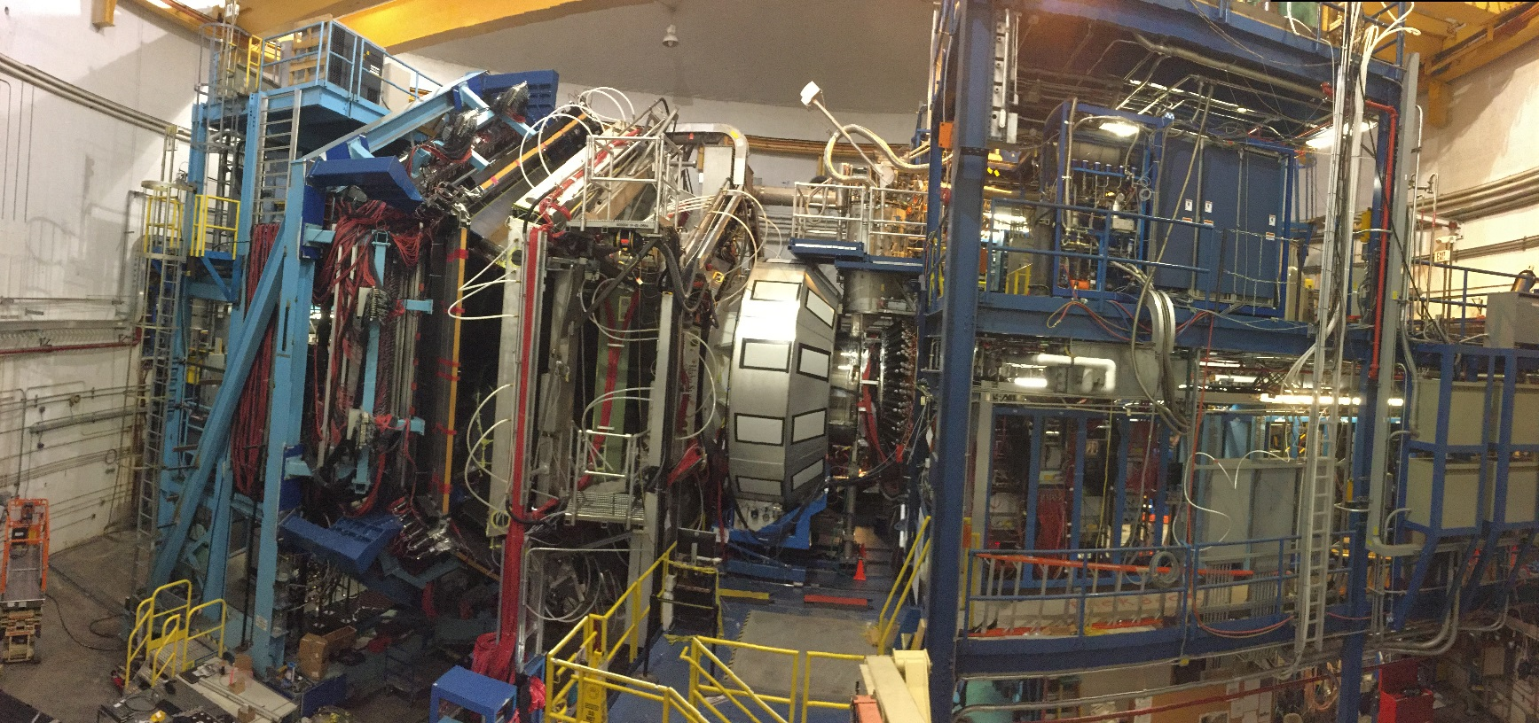
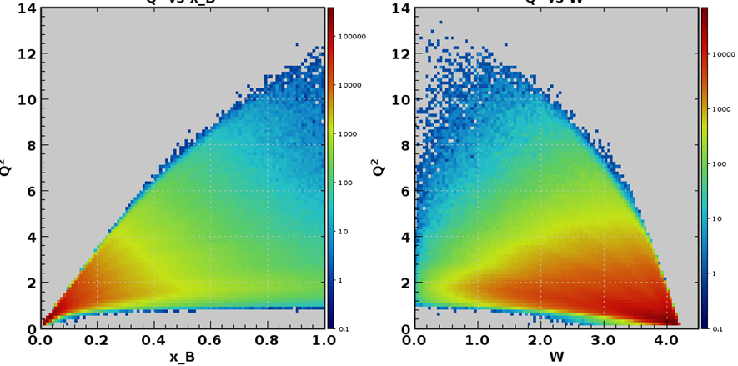

12 GeV Era with the CLAS12 Detector
CLAS12 in Hall B
N*
N*
DIS
DIS
Physics run started successfully
in February 2018
Q² , GeV²
x _{B}
W, GeV

Slide 16
N* studies at 0.05 GeV² < Q² < 7.0 GeV² with CLAS12
Hybrid Baryons E12-16-010 | Search for hybrid baryons (qqqg) focusing on 0.05 GeV² < Q² < 2.0 GeV² in mass range from 1.8 to 3 GeV in KΛ, Nππ, Nπ (A. D’Angelo, et al.)
KY Electroproduction E12-16-010A | Study N* structure for states that couple to KY through measurements of cross sections and polarization observables that will yield Q² evolution of electrocoupling amplitudes at Q²<7.0 GeV² (D. Carman, et al.)
Approved by PAC44
Run Group conditions:
E_{b} = 6.6 GeV, 50 days
E_{b} = 8.8 GeV, 50 days
Polarized electrons, unpolarized LH₂ target
L = 1x10³⁵ cm⁻²s⁻¹

Slide 17
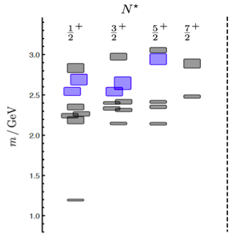
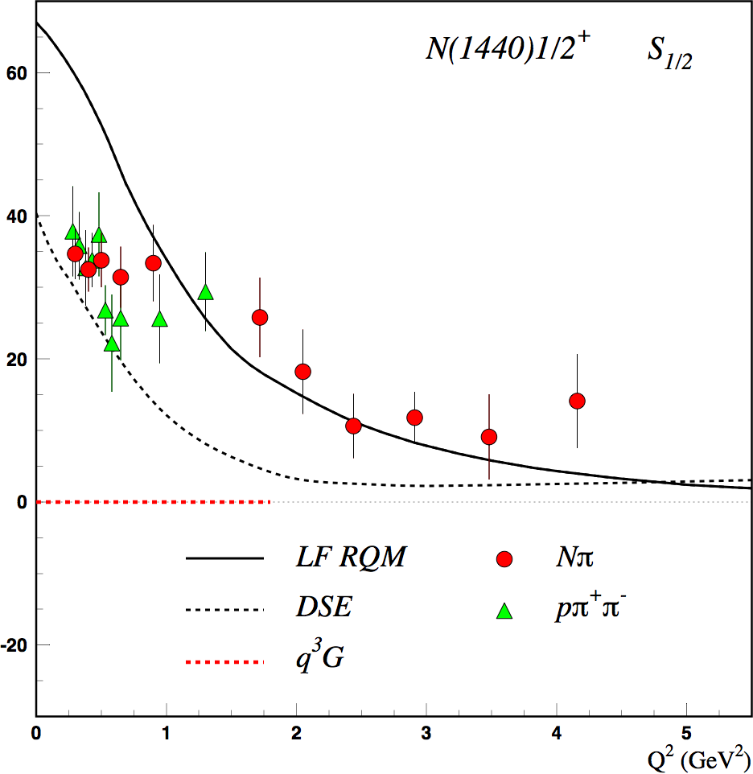
Hunting for Glue in Excited Baryons with CLAS12
Can glue be a structural component to generate hybrid q³g baryon states?
Search for hybrid baryons with CLAS12 in exclusive KY and π⁺π⁻p electroproduction
Predictions of the N* spectrum from QCD show both regular q³ and hybrid q³g states
LQCD and/or QM predictions on Q² evolution of the hybrid-baryon electroexcitation amplitudes are critical in order to establish the nature of a baryon state
N(1440)1/2⁺ S_{1/2}
GeV^{-1/2} *1000
Black curves if state is a q³ N*
CLAS
q³
1.3GeV
Scalar Electroexcitation Amplitude
regular states
N
LF RQM
DSE
QM
hybrid states
JLab LQCD group results
Red curve if state is a q³g hybrid
Q² (GeV²)

Slide 18
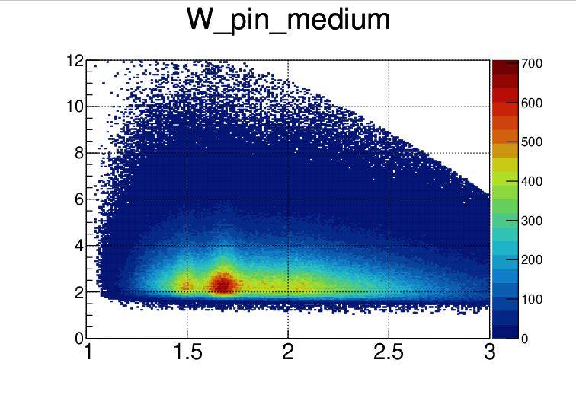
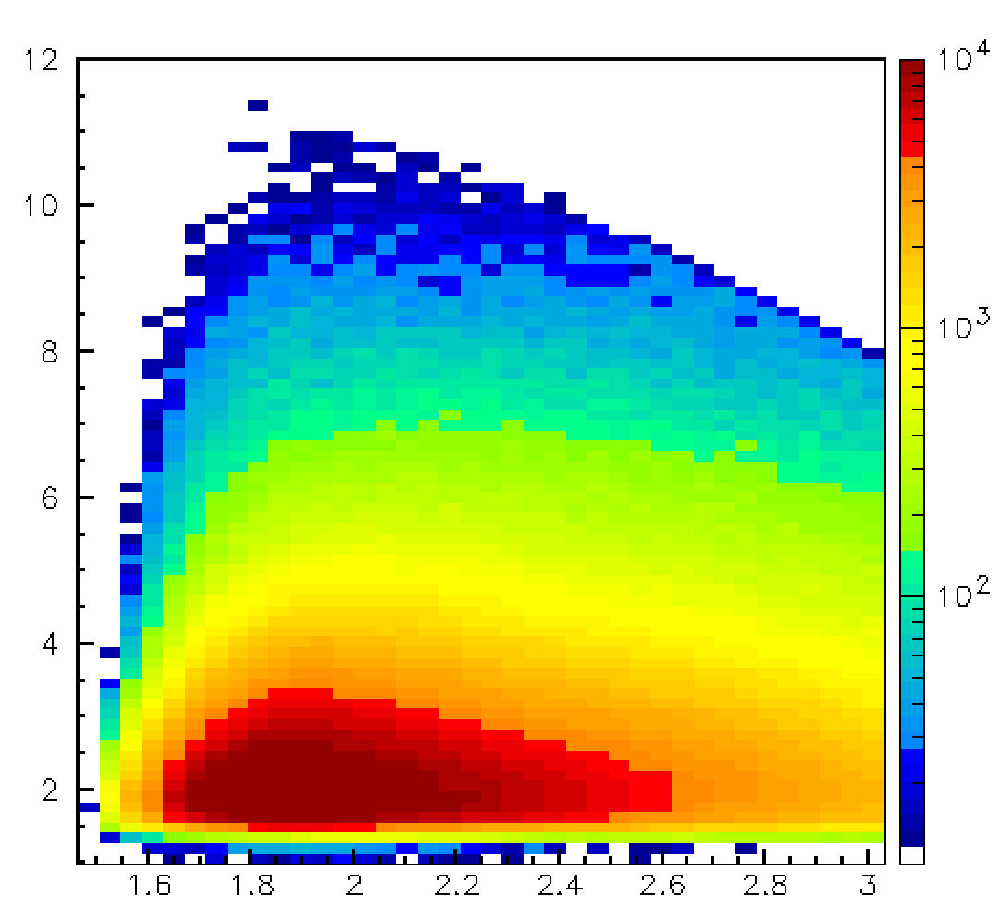
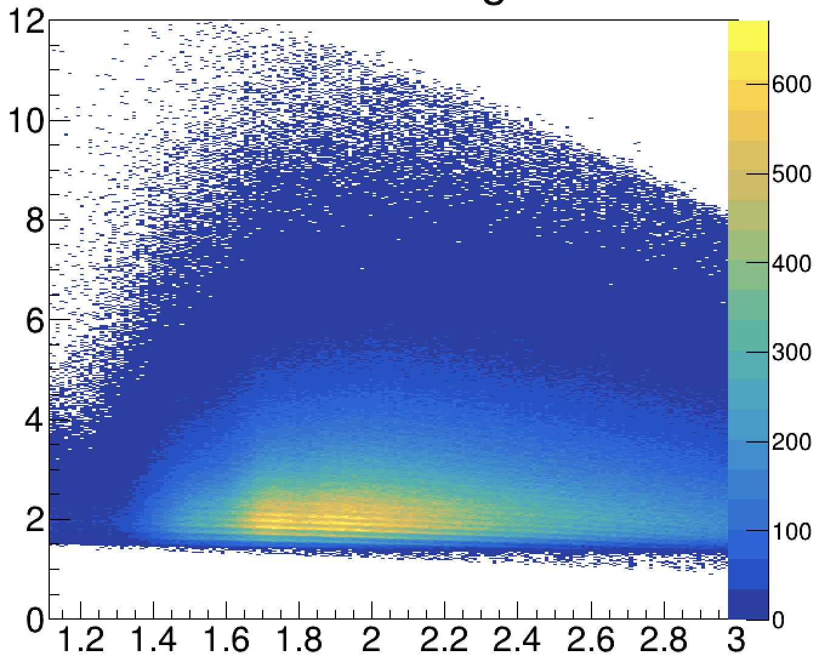
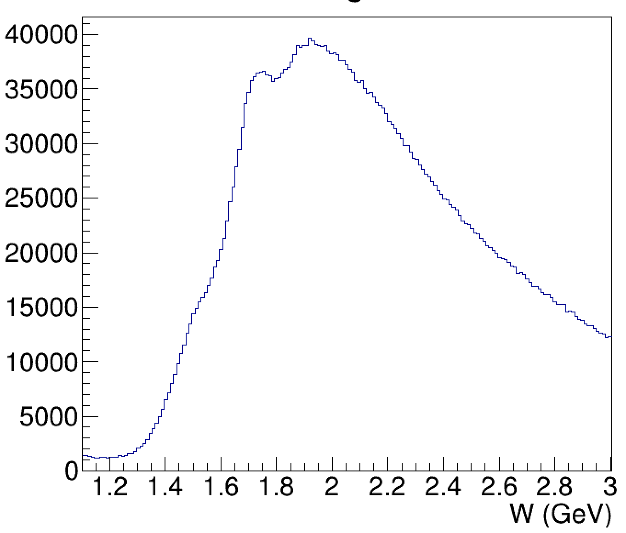
N* Electroexcitation to High Q² with CLAS12
Expected outcome: The first results on the γ_{v}pN* electrocouplings of most N* states from data in the range W < 3.0 GeV and Q² > 5.0 GeV² for exclusive reaction channels: πN, ππN, KY, K*Y, KY*
kinematic coverage for RG-A data @ 10.6 GeV
π⁺n
K⁺Y
π⁺π⁻p
π⁺π⁻p
Q² (GeV²)
Q² (GeV²)
Q² (GeV²)
resonances?
3rd
resonance
regions
2nd
W (GeV)
W (GeV)
W (GeV)
W (GeV)
Expected events per Q²/W bin for full RG-A dataset
π⁺n |  |  | K⁺Λ & K⁺Σ⁰ |  |  |  |  | π⁺π⁻p
Q² [GeV²] | W [GeV] 1.5-1.55 | W [GeV] 1.7-1.75 | Q² [GeV²] | W_{Λ} [GeV] 1.7-1.75 | W_{Σ} [GeV] 1.7-1.75 | W_{Λ} [GeV] 1.9-1.95 | W_{Σ} [GeV] 1.9-1.95 | Q² [GeV²] | W [GeV] 1.7-1.75 | W [GeV] 1.9-1.95
 |  |  | 1.4-2.2 | 63417 | 6012 | 66564 | 33170
 |  |  | 2.2-3.0 | 72144 | 5364 | 77443 | 28720
5.2-5.8 | 15272 | 4175 | 3.0-4.0 | 52358 | 3945 | 51991 | 18936 | 5.2-5.8 | 2813 | 2808
5.8-6.5 | 10737 | 2637 | 4.0-5.0 | 24833 | 3103 | 26690 | 5925 | 5.8-6.5 | 1822 | 1969
6.5-7.2 | 7367 | 1684 | 5.0-6.0 | 11203 | 1598 | 11160 | 2642 | 6.5-7.2 | 1159 | 1294
7.2-8.1 | 4567 | 1290 | 6.0-7.0 | 5566 | 648 | 6300 | 943 | 7.2-8.1 | 661 | 924
8.1-9.1 | 2742 | 540 | 7.0-8.0 | 2606 | 338 | 3276 | 633 | 8.1-9.1 | 364 | 414
9.1-10.5 | 1453 | 194 | 8.0-9.0 | 1440 | 244 | 936 | 86 | 9.1-10.5 | 118 | 179
Collected data will extend the Q² range of the γ_{v}pN* electrocouplings to 8-10 GeV² for each of these channels

