Slide 1



N->Δ Transition GPDs with CLAS12
APCTP Workshop on Nuclear Physics 2022: Hadron Physics Opportunities with Jlab Energy and Luminosity Upgrade
Kyungseon Joo
University of Connecticut
For the CLAS Collaboration
July 23, 2022

Slide 2
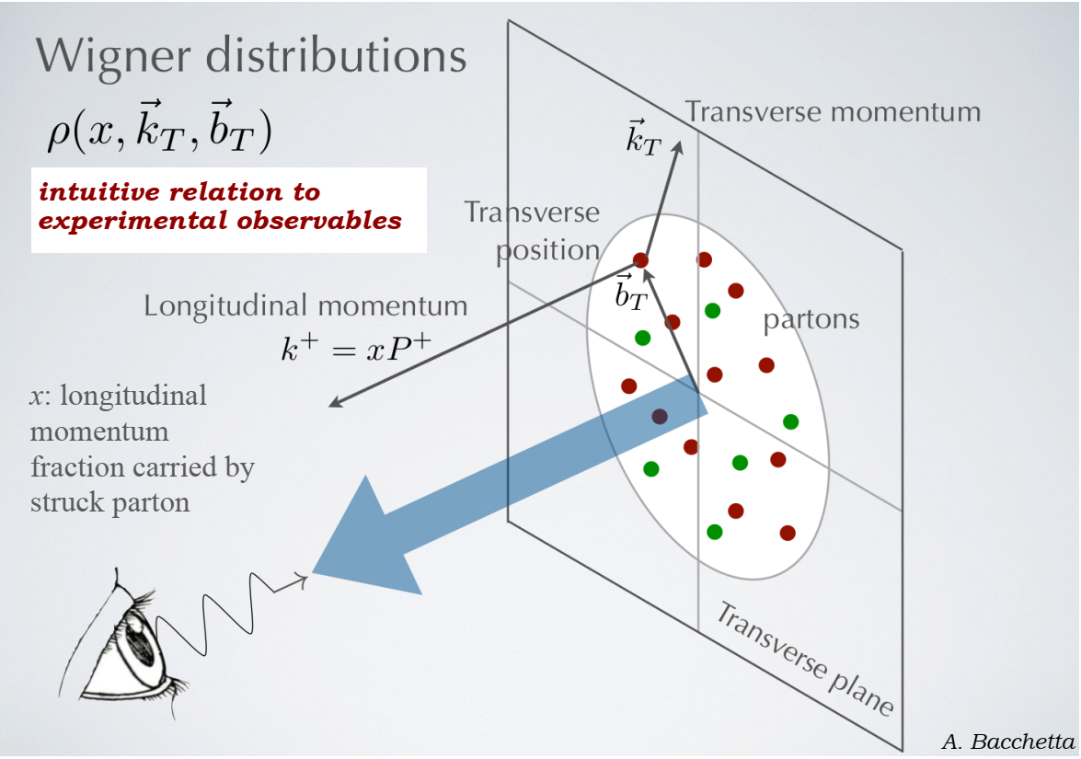
3-Dimensional Imaging of Quarks and Gluons

Slide 3
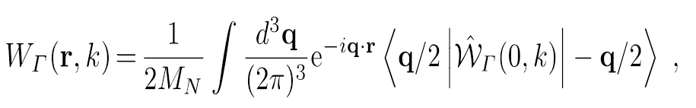
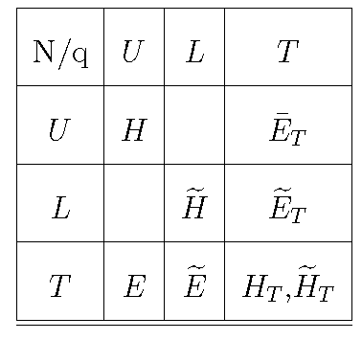

14
Generalized Parton Distributions (GPDs)
Integrate over transverse momentum space
quark pol.
Generalized Parton Distributions (GPD)
3-D nucleon images in the transverse coordinate and longitudinal momentum space
Stefan Diehl, JLU + UConn
APS April Meeting 2022, New York
04/10/2022

Slide 4
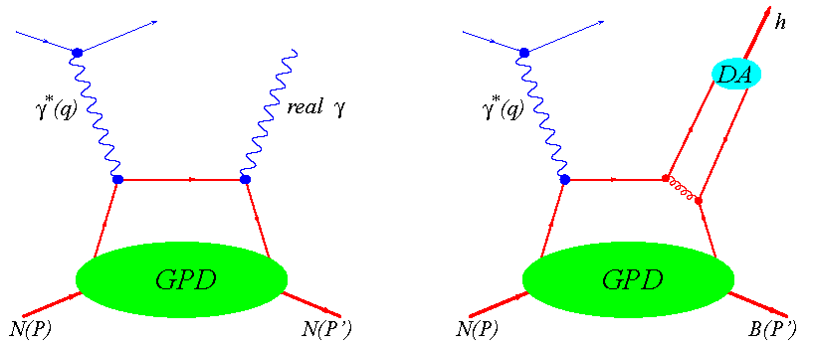


Study GPDs: Deeply Virtual Exclusive Processes
Deeply Virtual Compton Scattering (DVCS)
Deeply Virtual Meson Production (DVMP)
π⁰, η
L
+ Enables Flavour decomposition of GPDs
+ Access to transversity degrees of freedom
described by chiral-odd GPDs
- Distribution Amplitude (DA) is involved
as additional soft non pert. quantity
+ Clean process
- Only sensitive to chiral even GPDs

Slide 5
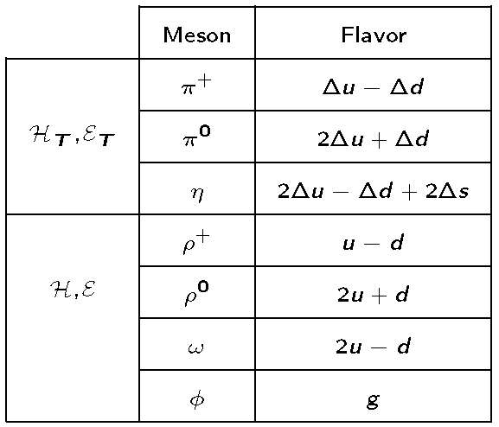
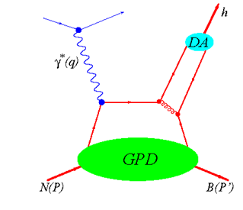
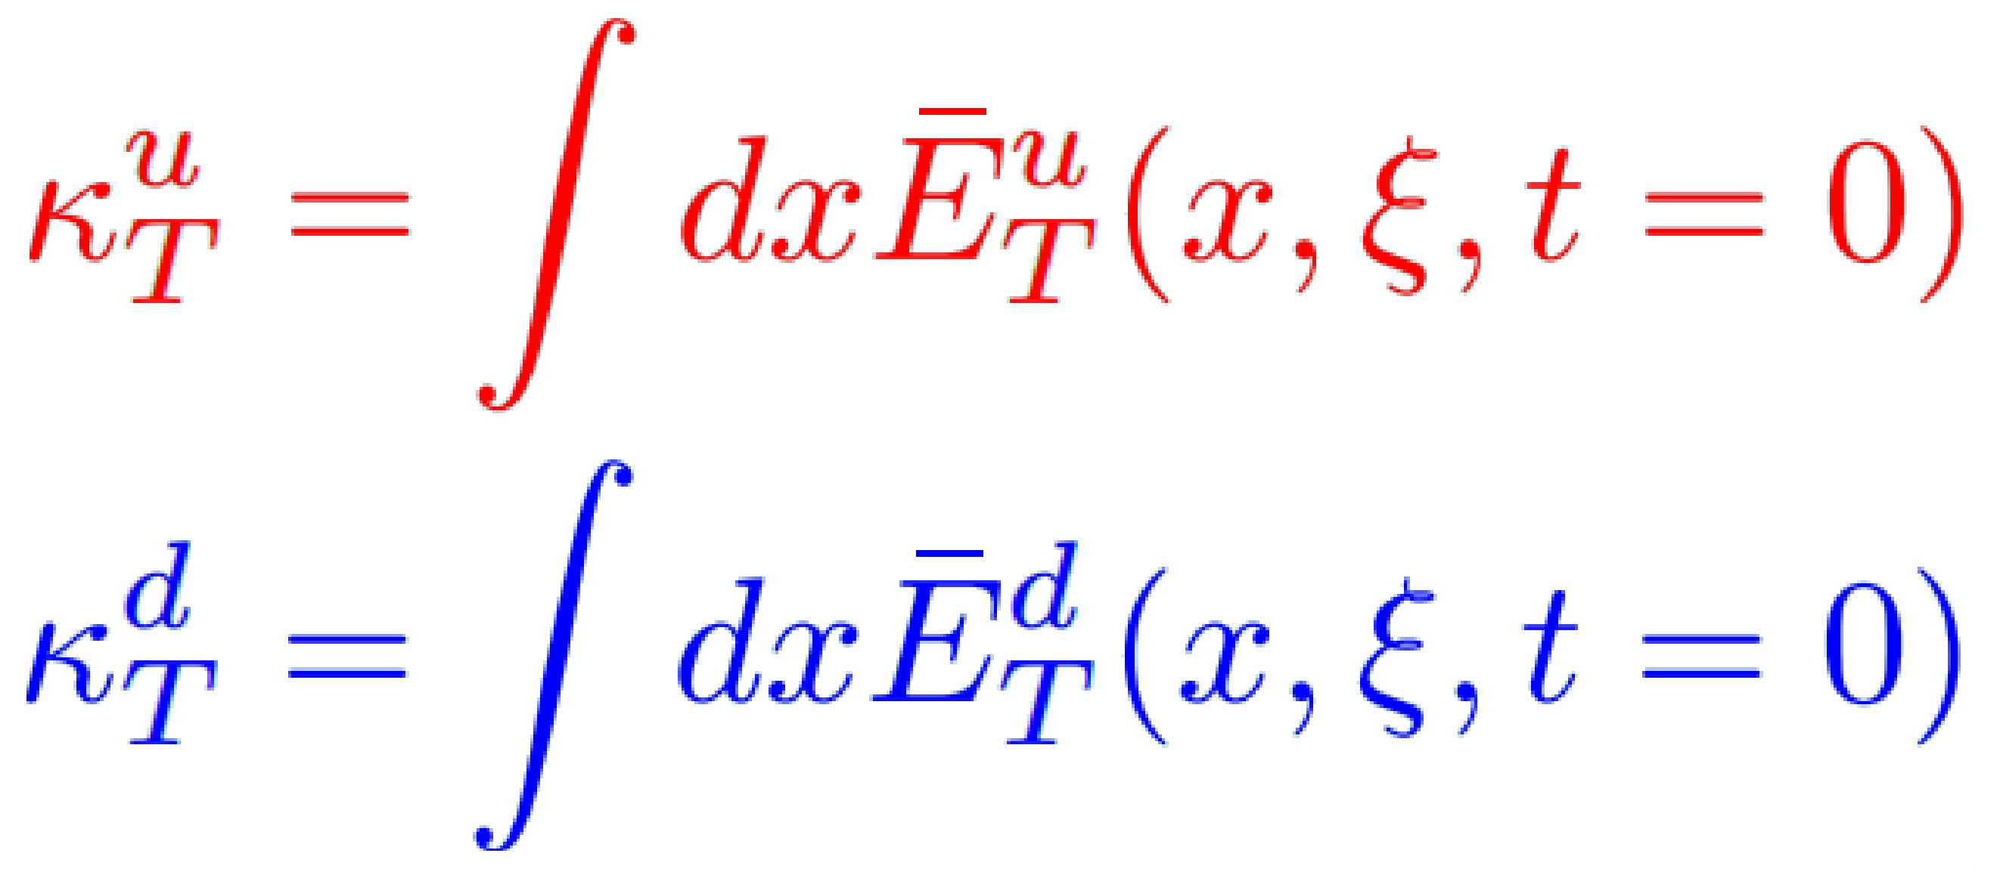
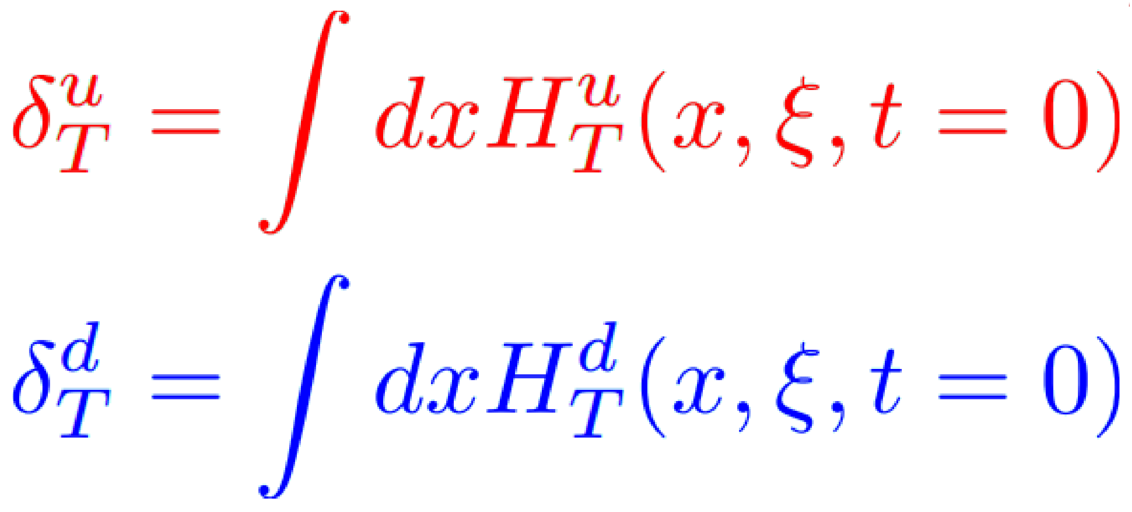
Deeply Virtual Meson Production in the GPD regime
E_{T} is related to the proton's
anomalous tensor magnetic moment
H_{T} is related to the proton's tensor charge
Absolute magnitude of transversly polarized
valence quarks inside a transv. polarized nucleon

Slide 6
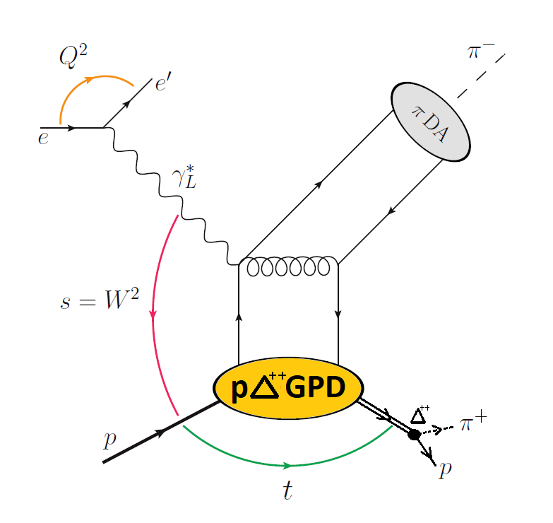
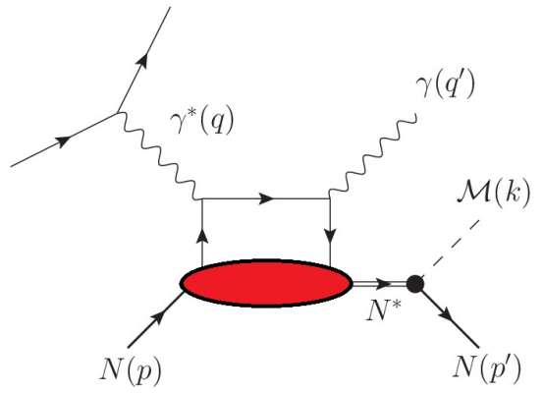
Studies of Transition GPDs
non-diag. DVCS
non-diag. DVMP
8 helicity non-flip trans. GPDs (twist 2)
3 are dominating in the large N_{C} limit
Connection to proton-proton GPDs
via symmetry considerations
Description of leading twist effects /
longitudinal photons → σ_{L}
→ First theoretical works available
8 helicity flip trans. GPDs
Needed for twist-3 sector (non-diag DVMP)
Theory in progress (no publ. so far)

Slide 7
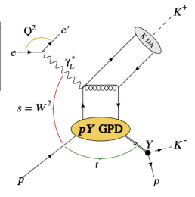
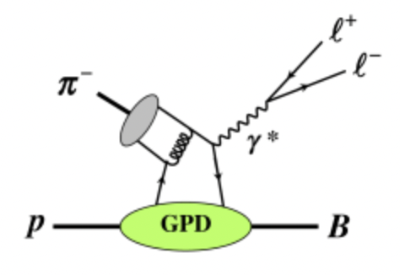
Studies of Transition GPDs
Jefferson Lab
J-PARC
Exclusive Drell-Yan Process
Exclusive KY Production
If B = Y, p->Y Transition GPDs
p->Y Transition GPDs
J-PARC Letter of Intent

Slide 8
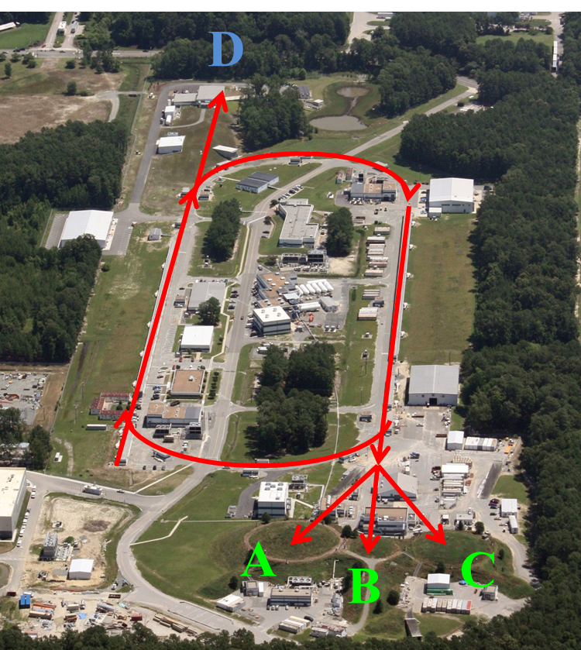
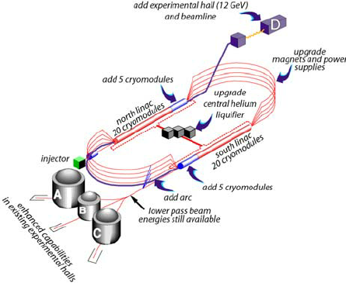
Thomas Jefferson National Accelerator Facility (Jefferson Lab)
CEBAF Upgrade completed in
September 2017
→ electron beam
→ E_{max} = 12 GeV
→ I_{max} = 90 μA
→ Pol_{max} ~ 90%
Physics Operation
4 halls running simultaneously since January 2018

Slide 9
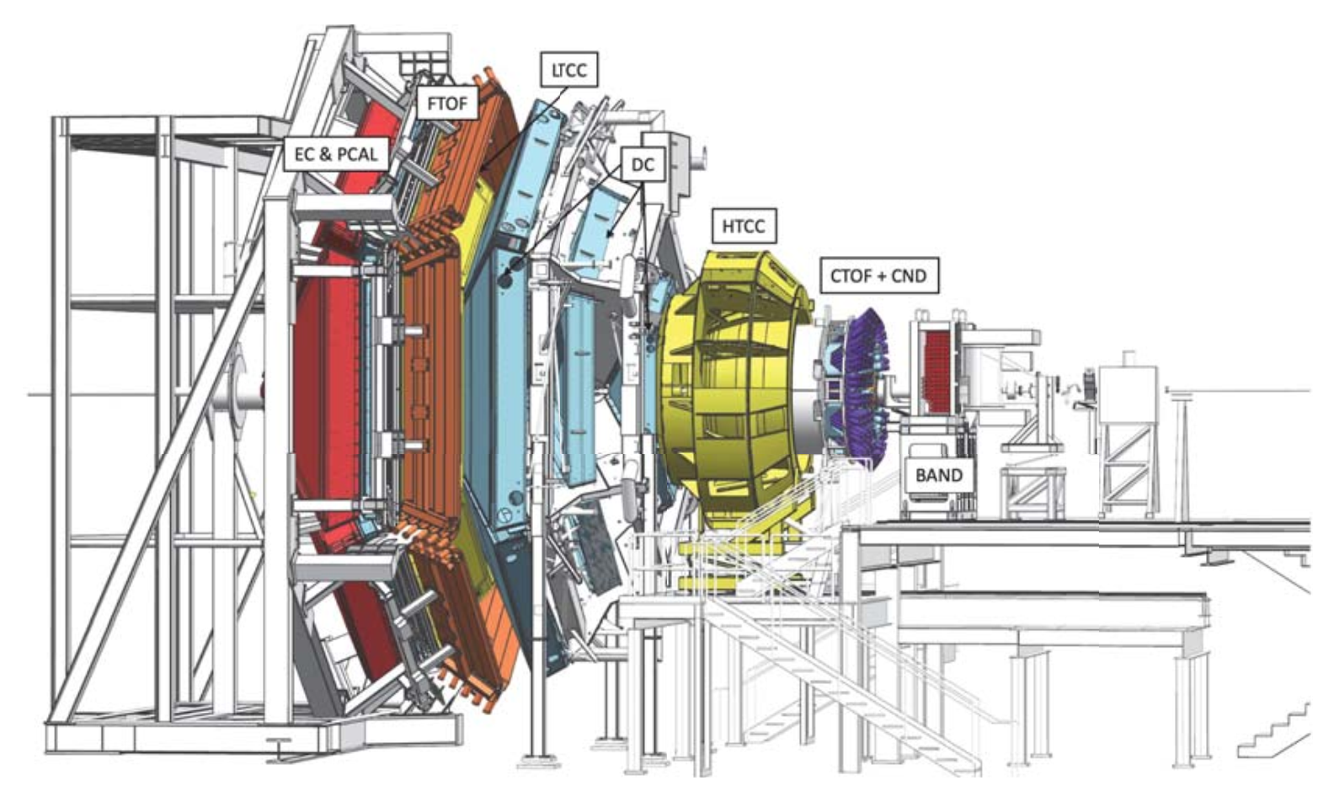
CLAS12 Experimental Setup in Hall B at JLAB
V. Burkert et al., Nucl. Instrum. Meth.A 959 (2020) 163419
Data recorded with CLAS12 during fall 2018 and spring 2019
10.6 / 10.2 GeV e⁻ beam
~87 % average polarization
liquid H₂ target
Analysed data ~ 35 % of the approved RG-A beam time

Slide 10
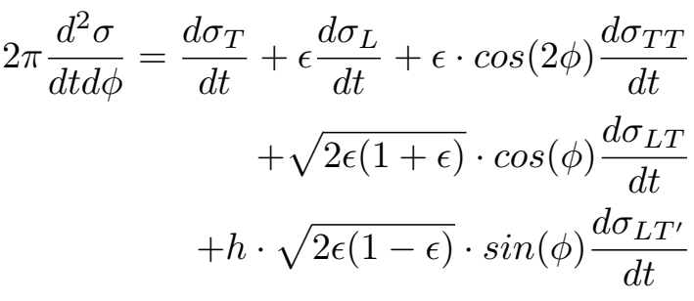
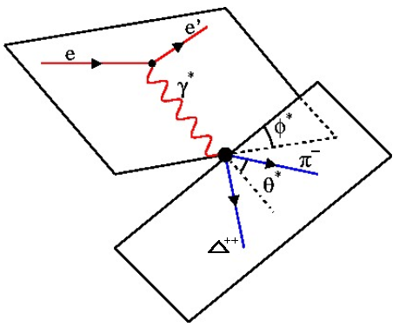
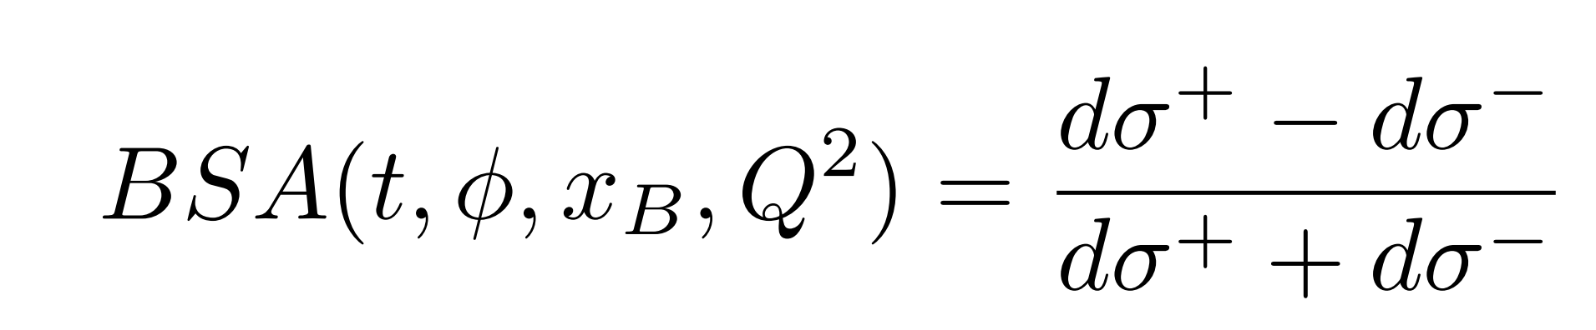
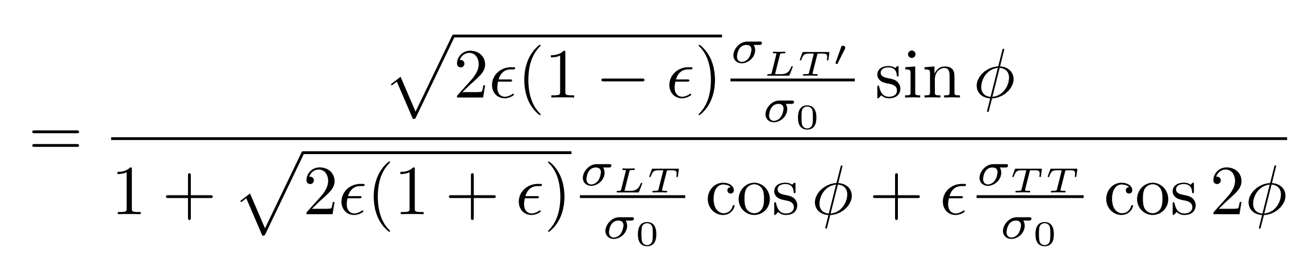
Hard Exclusive Meson Electroproduction and Beam Spin Asymmetries (BSA)
Cross section (longitudinally pol. beam and unpol. target):
Beam Spin Asymmetry:
Notes:
Effective interaction due to high Z elements

Slide 11

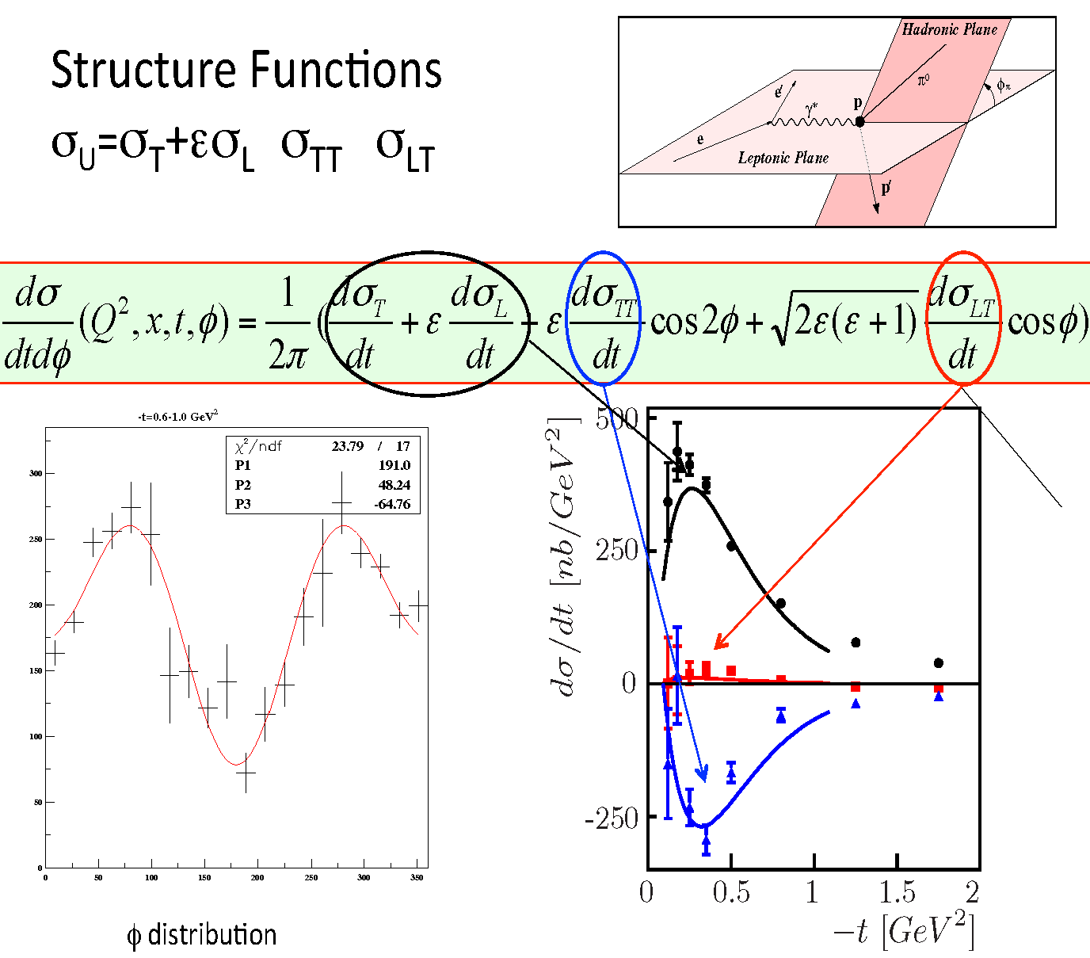
Differential Cross Sections for
Notes:
Effective interaction due to high Z elements

Slide 12
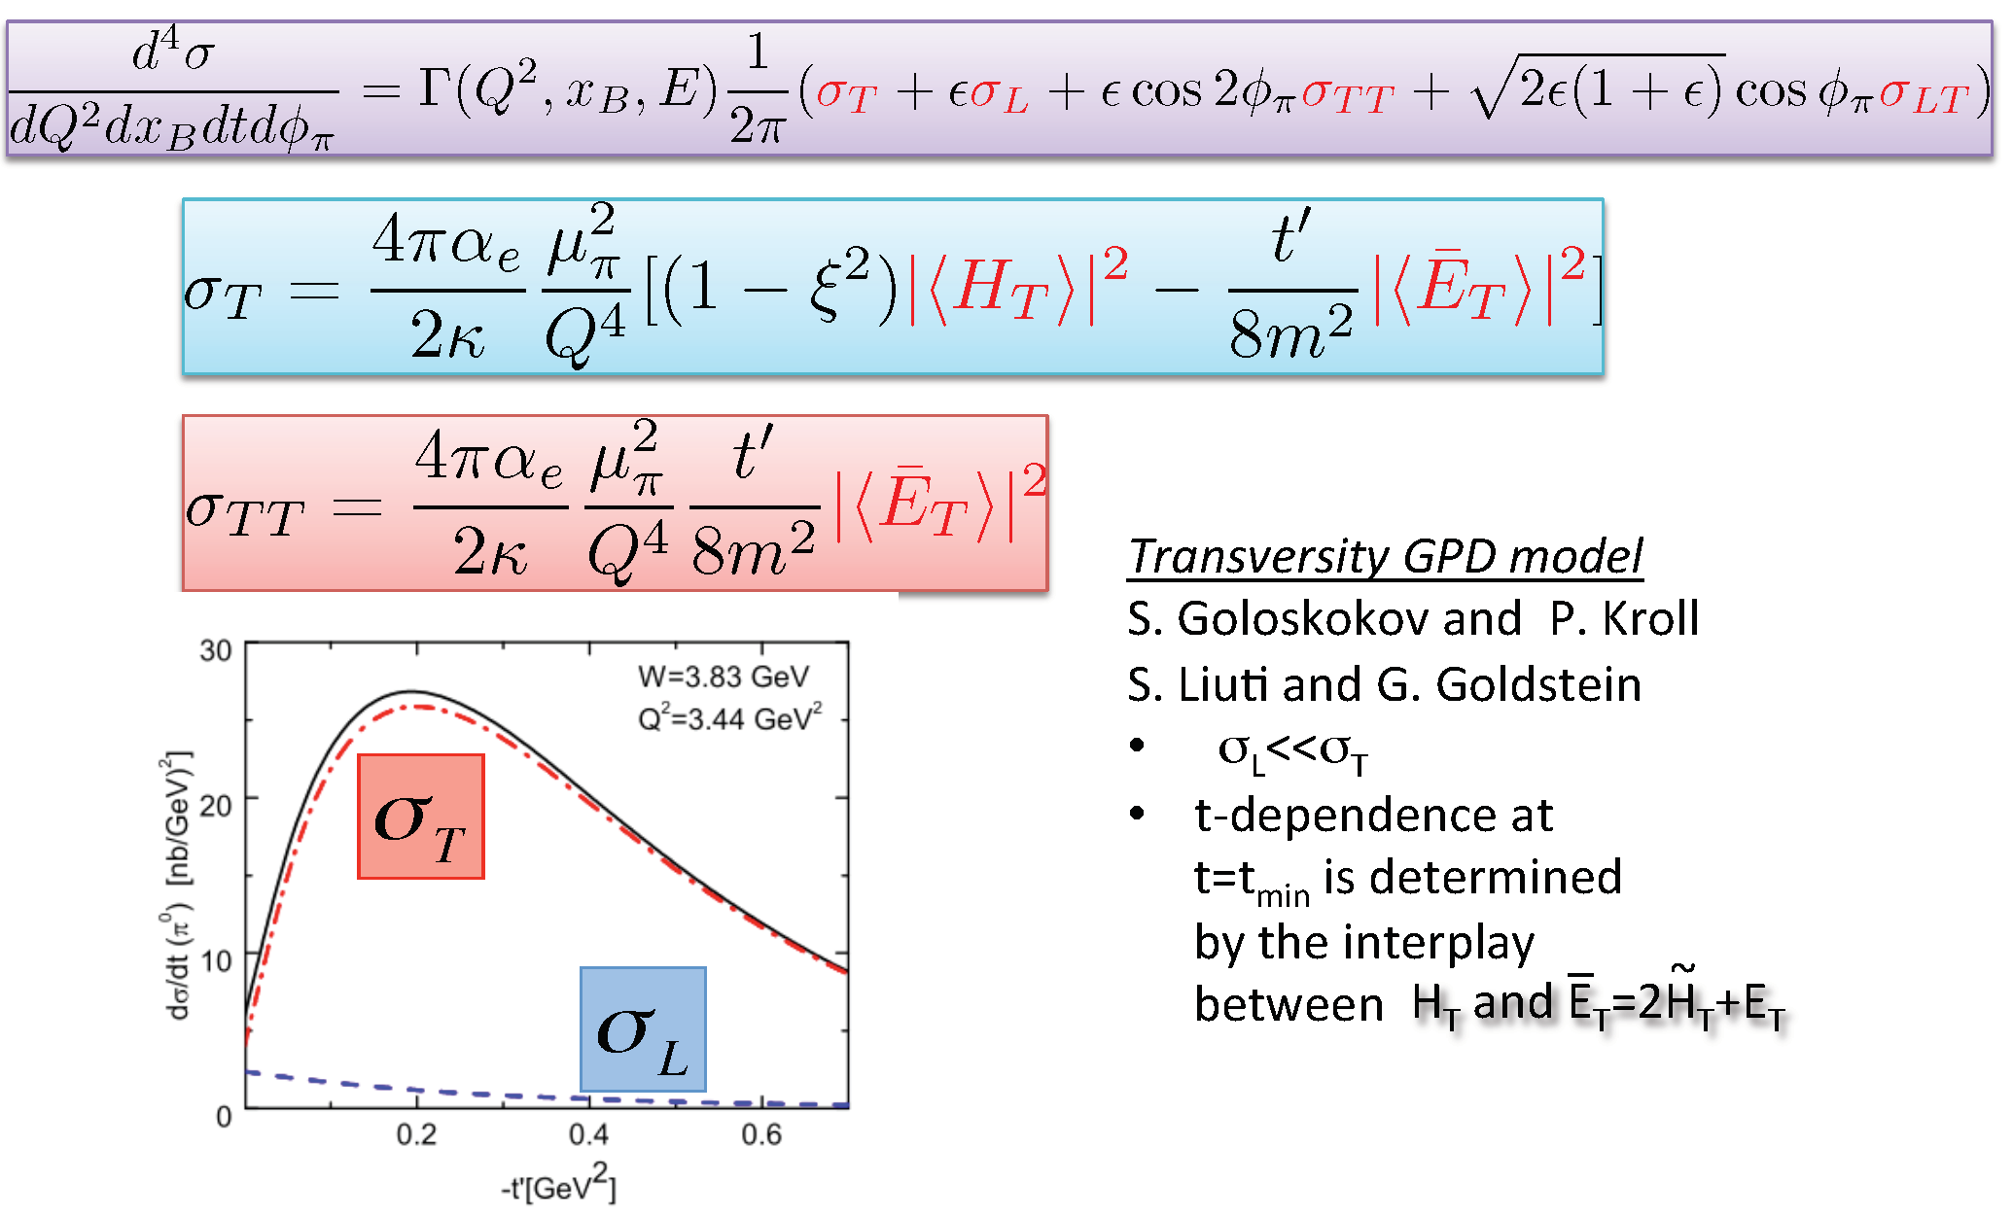
Structure Functions and Transversity GPDs
Notes:
Effective interaction due to high Z elements

Slide 13
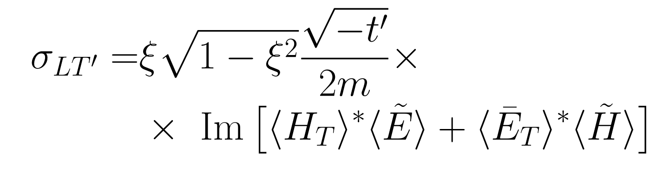
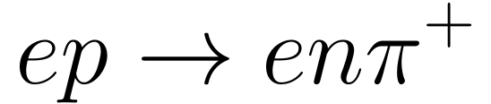
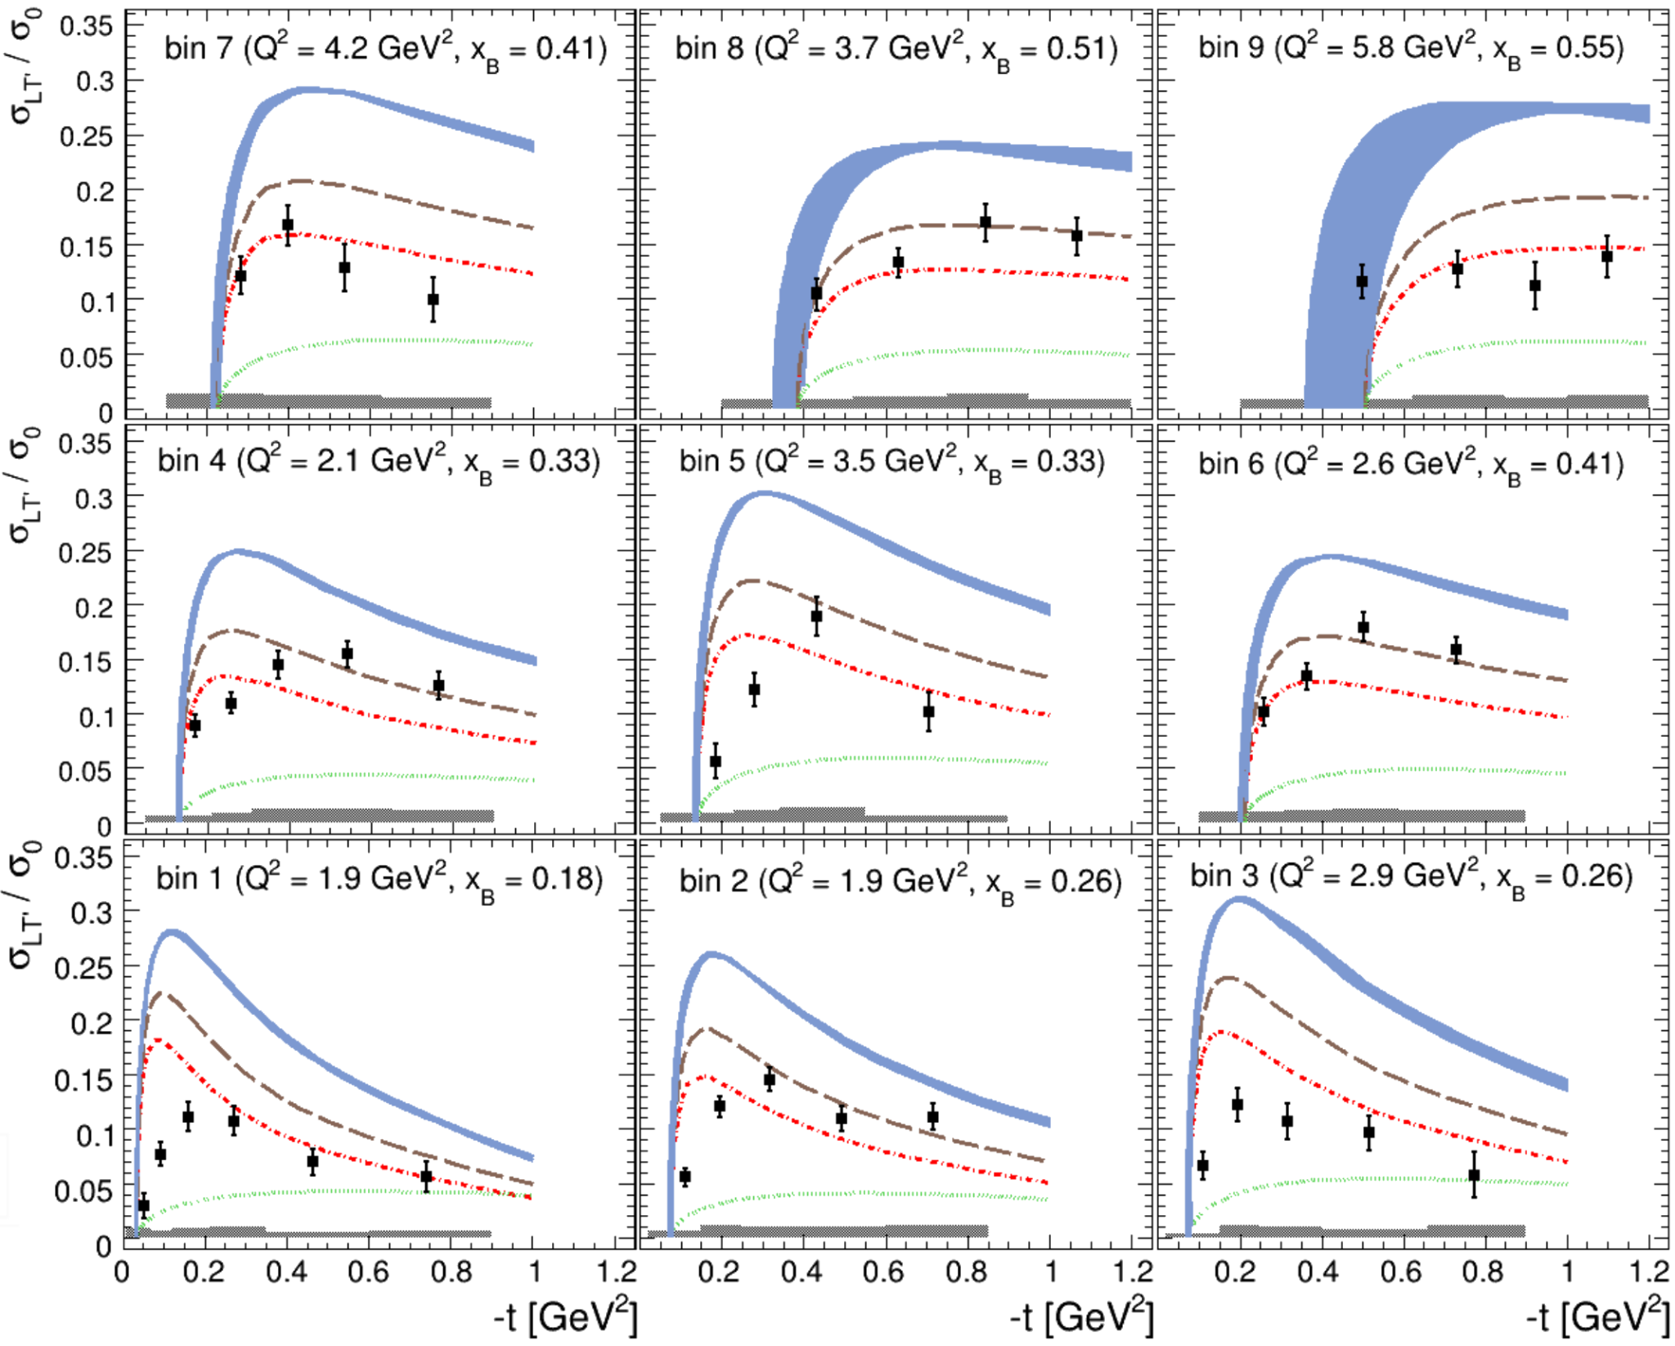
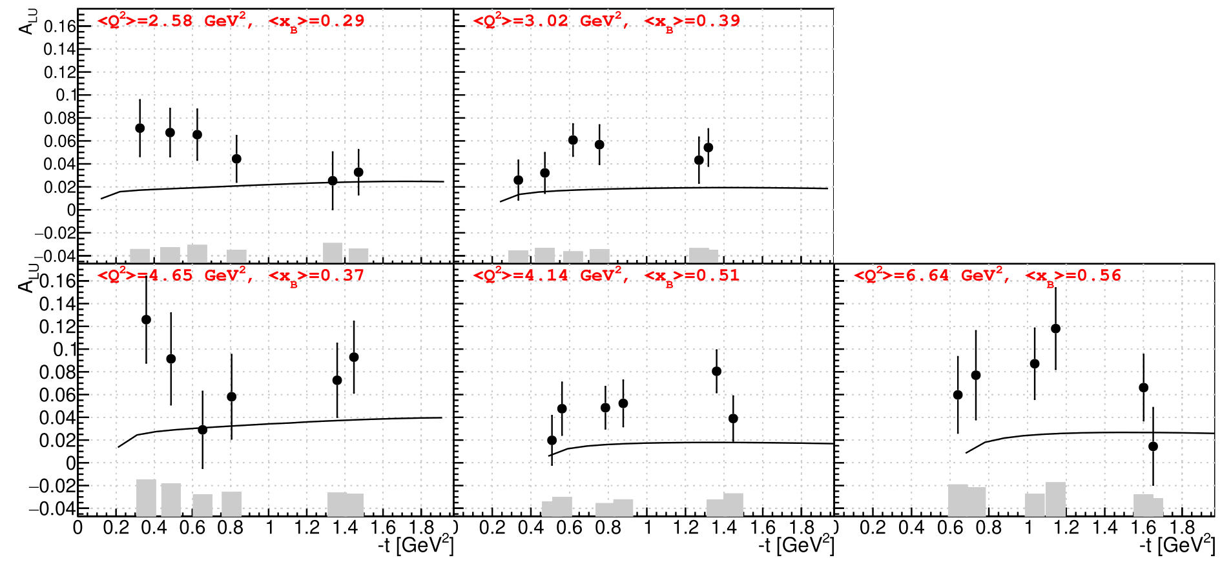
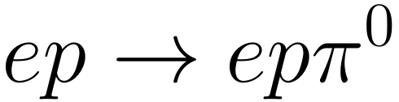
Pseudoscalar meson electroproduction with CLAS12
S. Diehl et al (UCONN)
A. Kim et al (UCONN)
PRELIMINARY
PRELIMINARY
active work on cross-section extraction by R. Johnston (MIT)
GK model
Additionally active work on 𝜂 beam spin asymmetry and cross-section extraction

Slide 14
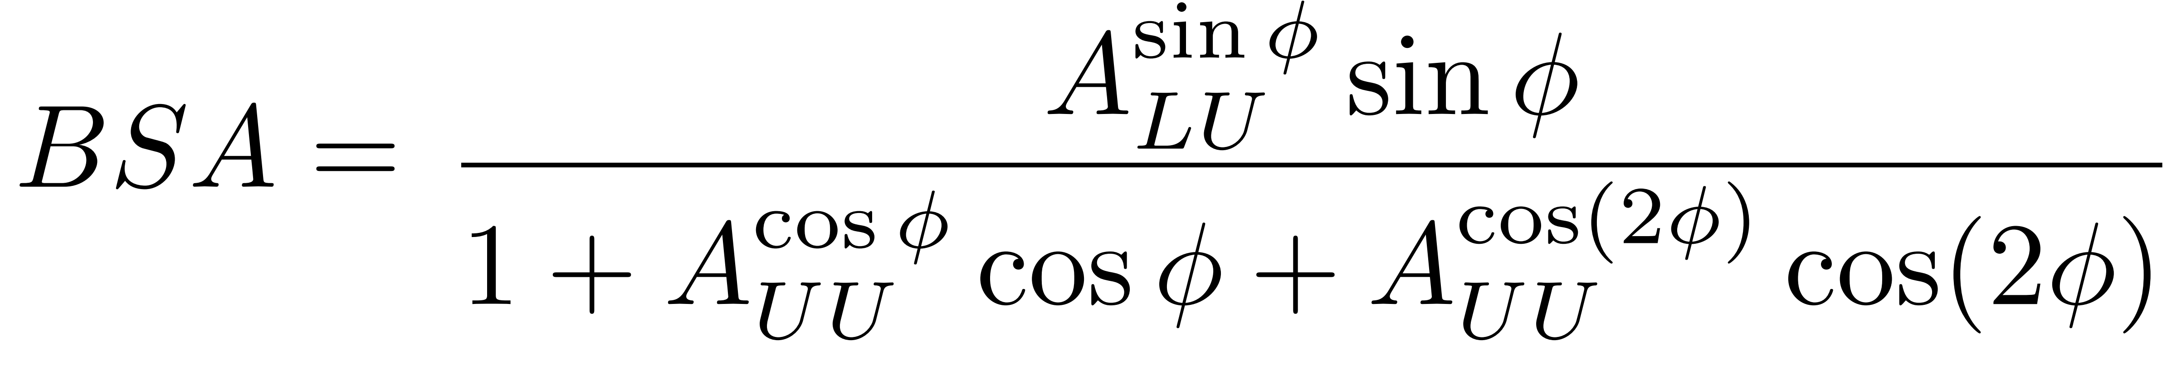
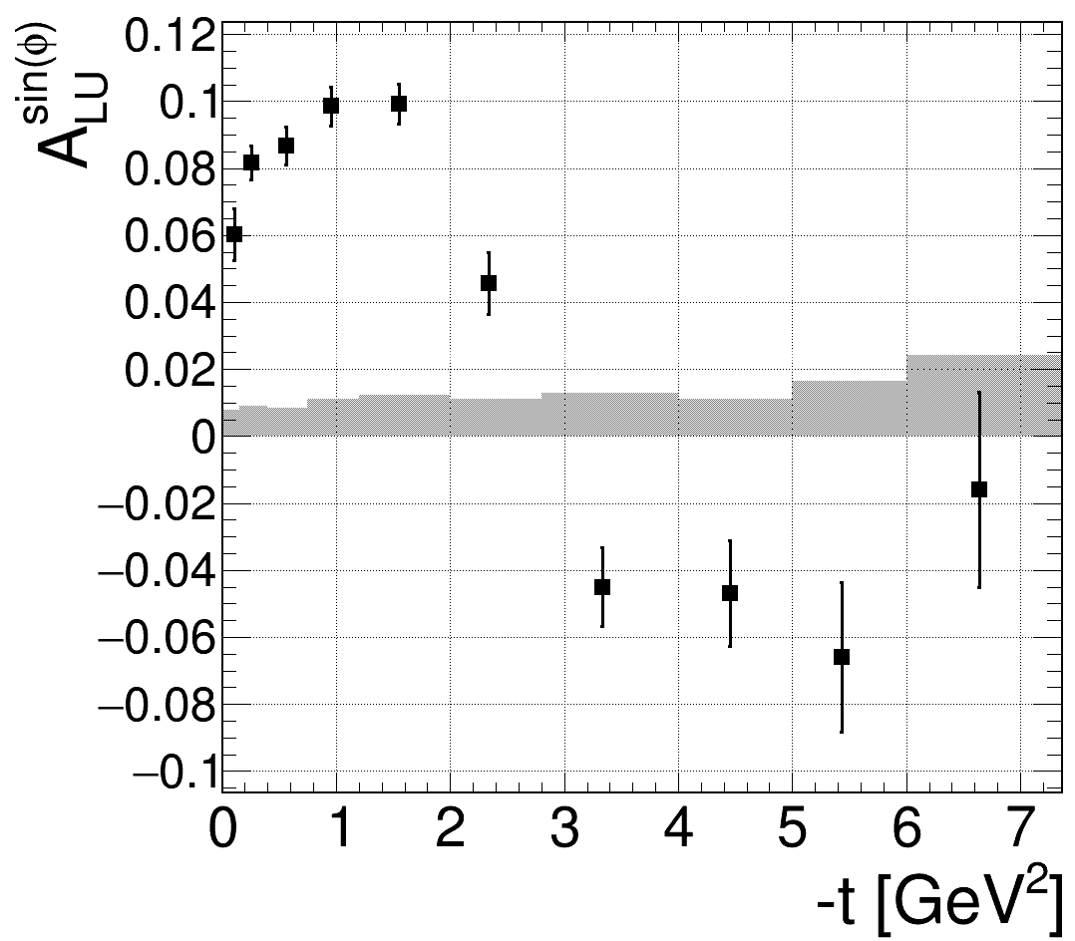
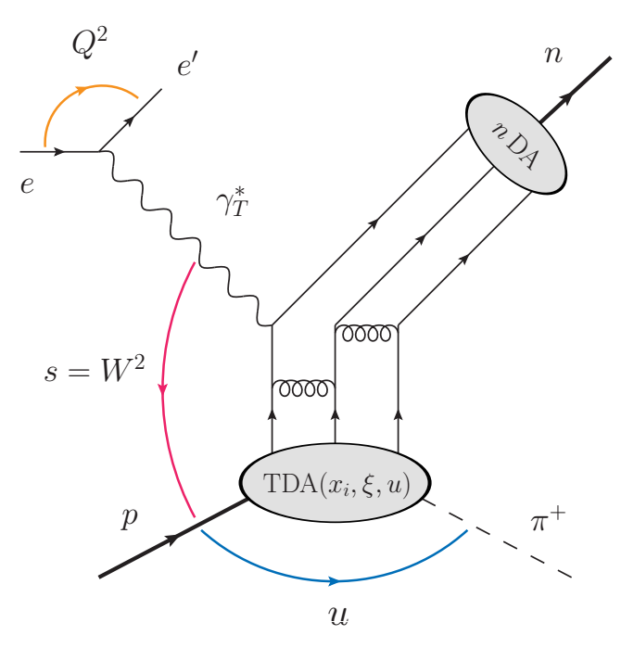
Beam spin asymmetry for
S. Diehl et al. (CLAS collaboration),
Phys. Rev. Lett. 125, 182001 (2020)

Slide 15
Factorization expected for:
-t / Q² << 1 and Q² > M_{Δ}²
x_{B} fixed
Provides access to p-Δ transition GPDs
3D structure of the Δ resonance and
of the excitation process
π± is expected to be especially sensitive
to the tensor charge of the resonance

Slide 16
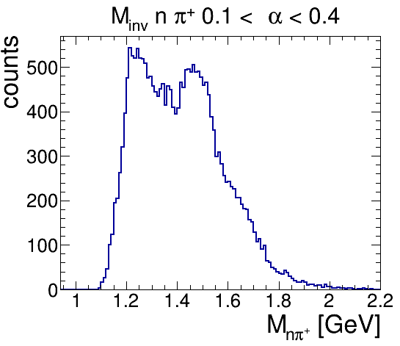
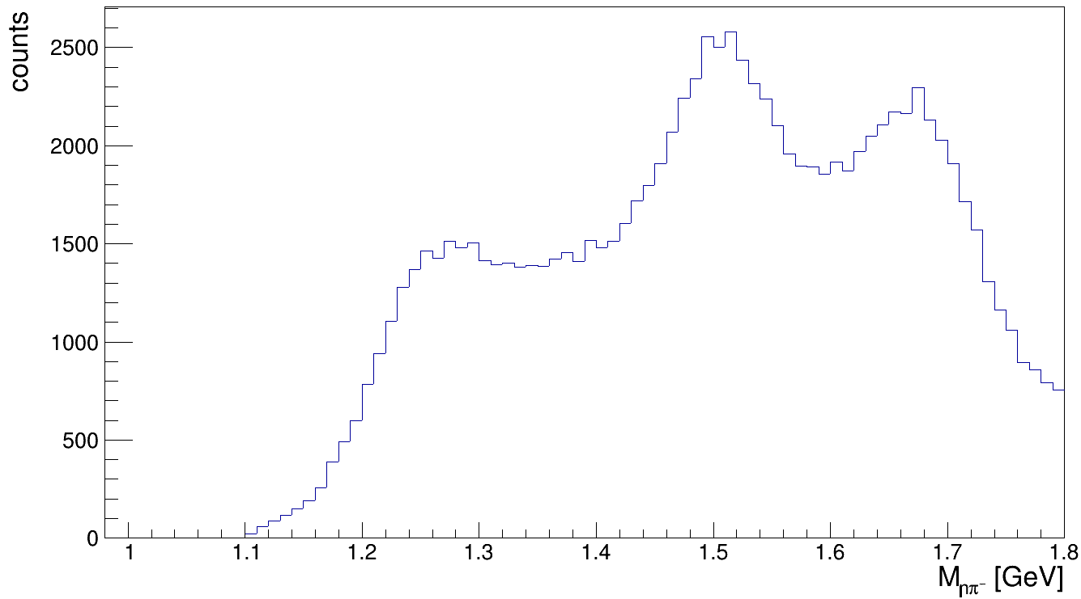

Why is π⁻Δ⁺⁺ special?
non-diagonal DVCS
other non-diagonal DVMP channels
2nd res
Δ
2nd res
3rd res
preliminary
Δ
3rd res
preliminary
I_{z} = +3/2
The pπ⁺ final state can only be populated by Δ-resonances
- Large gap between Δ(1232) and higher resonances

Slide 17
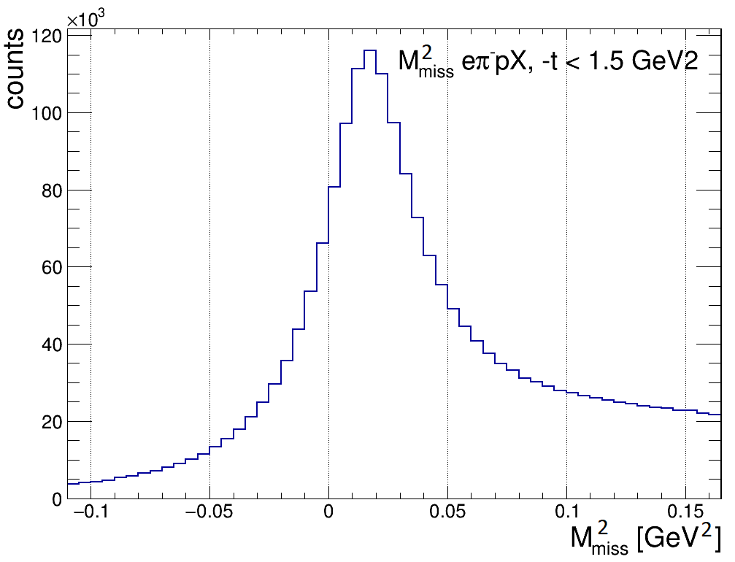
Event Selection and Kinematic Cuts
- 2 σ cut around the missing π⁺
Kinematic cuts:
Q² > 1.5 GeV² W > 2 GeV
y < 0.75
-t < 1.5 GeV² (only the forward region)

Slide 18
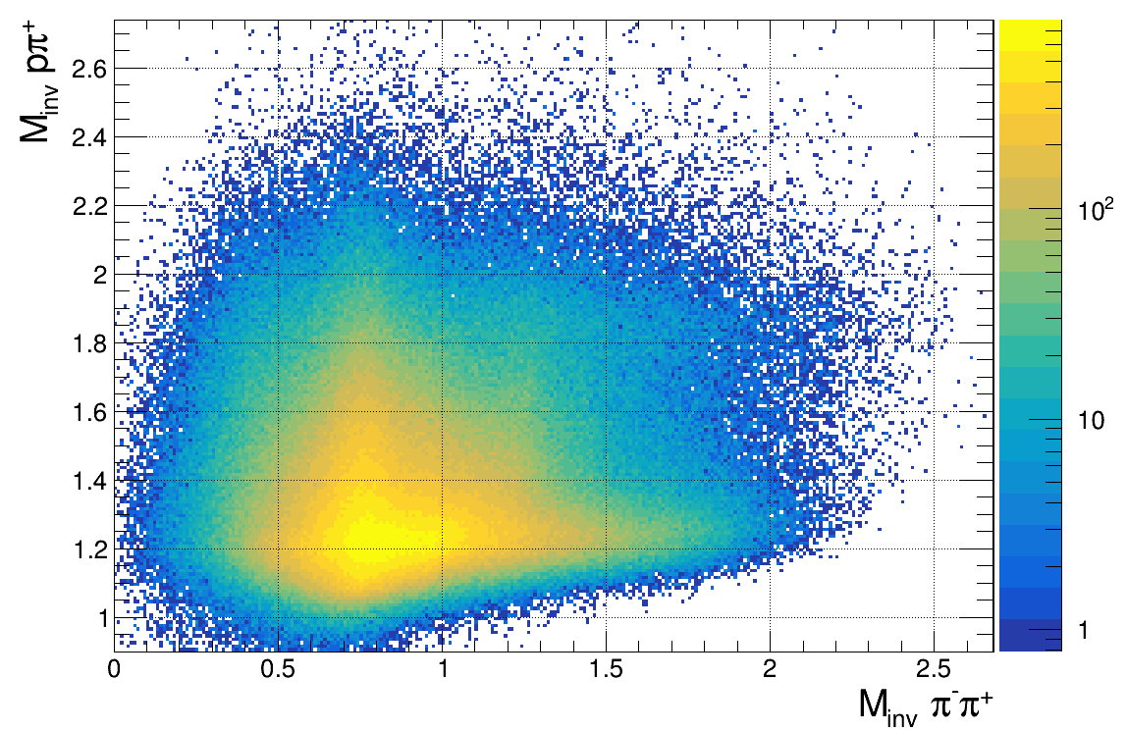
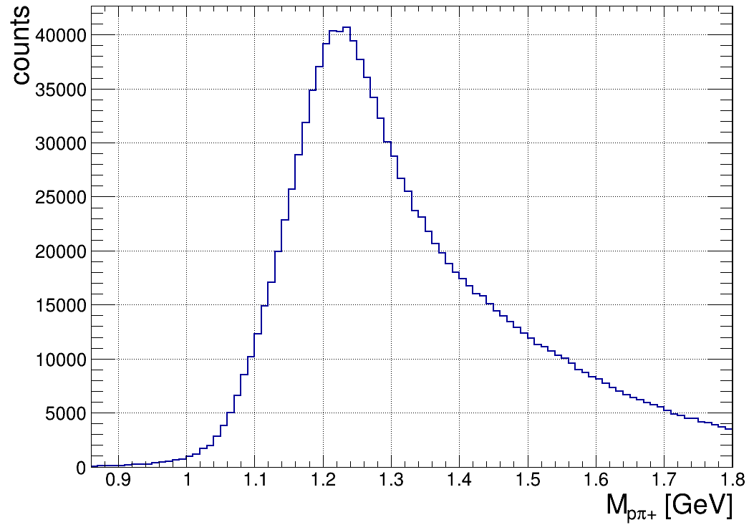
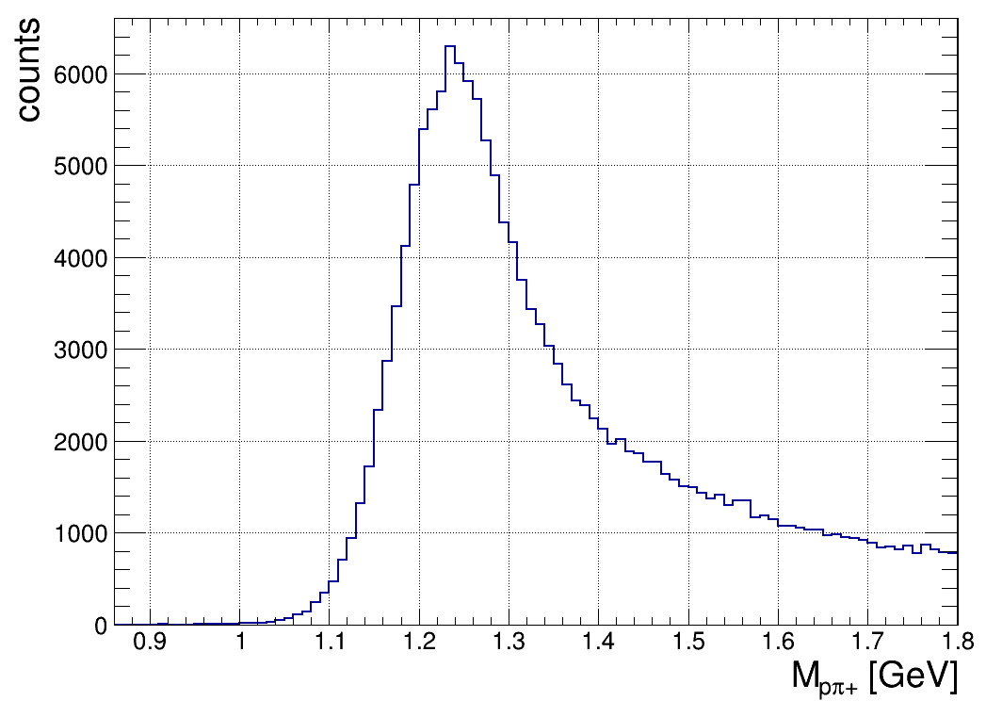
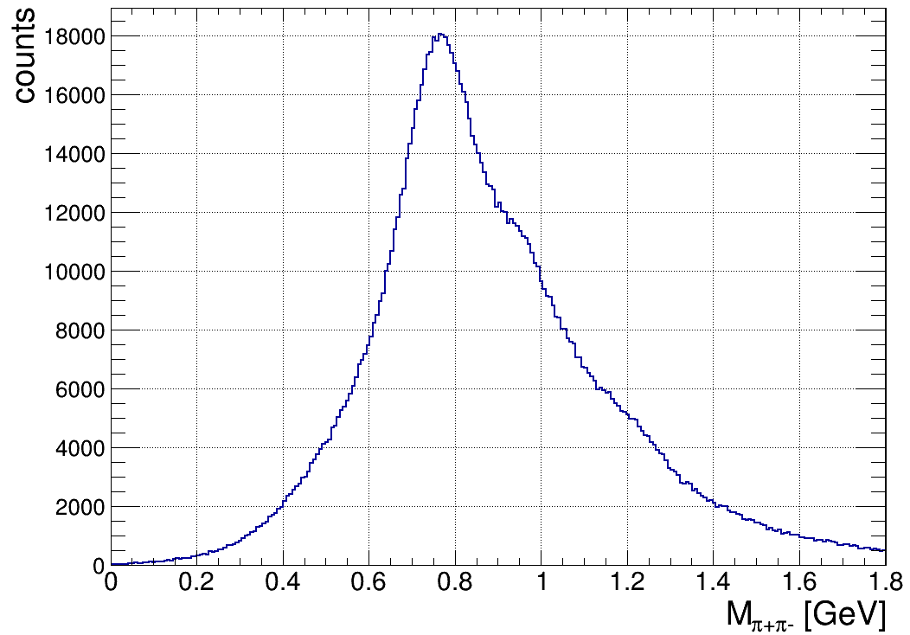
Event Selection and Background Rejection
Δ
full M(π⁺π⁻)
ρ
back-
ground
Δ
ρ
Δ
M(π⁺π⁻) > 1.1 GeV
M(pπ⁺) < 1.3 GeV
ρ contamination
< 0.8 %

Slide 19
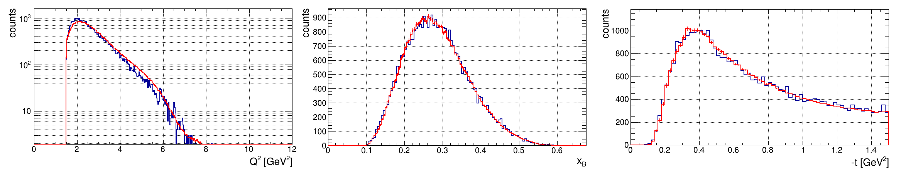
Monte Carlo Simulations
2 MC samples have been used:
a) Semi-inclusive DIS MC
→ Does not contain the π⁻Δ⁺⁺ production in „forward“ kinematics
→ Contains nonres. background as well as ρ production and other potential BG channels
➔ Used to estimate background shape and contaminations
b) Exclusive π⁻Δ⁺⁺ MC
→ Phase space simulation with a weigth added to match experimental data
→ Δ peak with PDG mass and FWHM
Both MCs are processed through the full simulation and reconstruction chain
data
excl. MC
Q²
x_{B}
-t

Slide 20
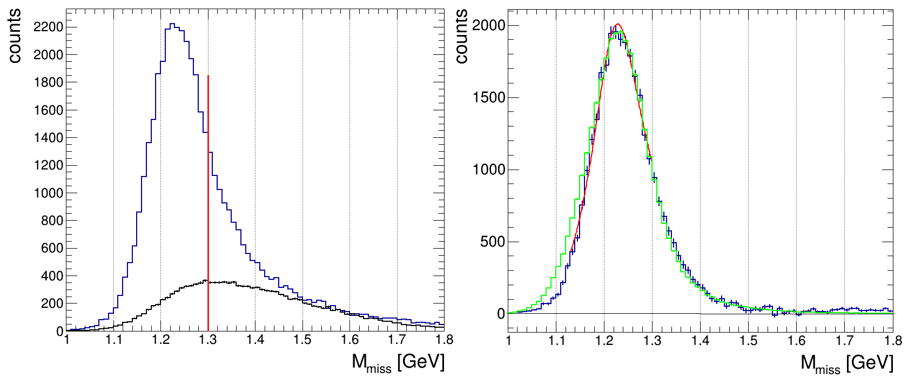
Event Selection and Background Estimate
experimental data
data after SIDIS MC subtraction
SIDIS MC (same cuts)
fit of a Sill function (BW with thr. effects)
exclusive MC (for comparison)

Slide 21
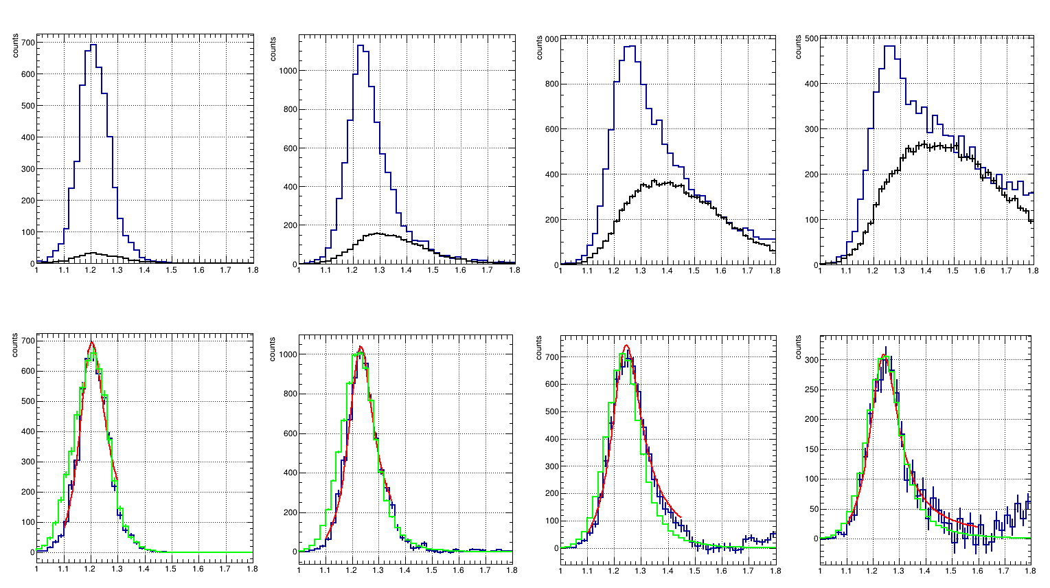
Event Selection and Background Estimate
0.1 GeV² - 0.3 GeV²
0.42 GeV² - 0.58 GeV²
0.8 GeV² - 1.07 GeV²
1.3 GeV² - 1.5 GeV²
S/B ~ 20
S/B ~ 6
S/B ~ 2.5
S/B ~ 1.5
M_{miss} [GeV]
M_{miss} [GeV]
M_{miss} [GeV]
M_{miss} [GeV]
M_{miss} [GeV]
M_{miss} [GeV]
M_{miss} [GeV]
M_{miss} [GeV]
experimental data
data after SIDIS MC subtraction
fit of a Sill function (BW with thr. effects)
SIDIS MC (same cuts)
exclusive MC (for comparison)

Slide 22
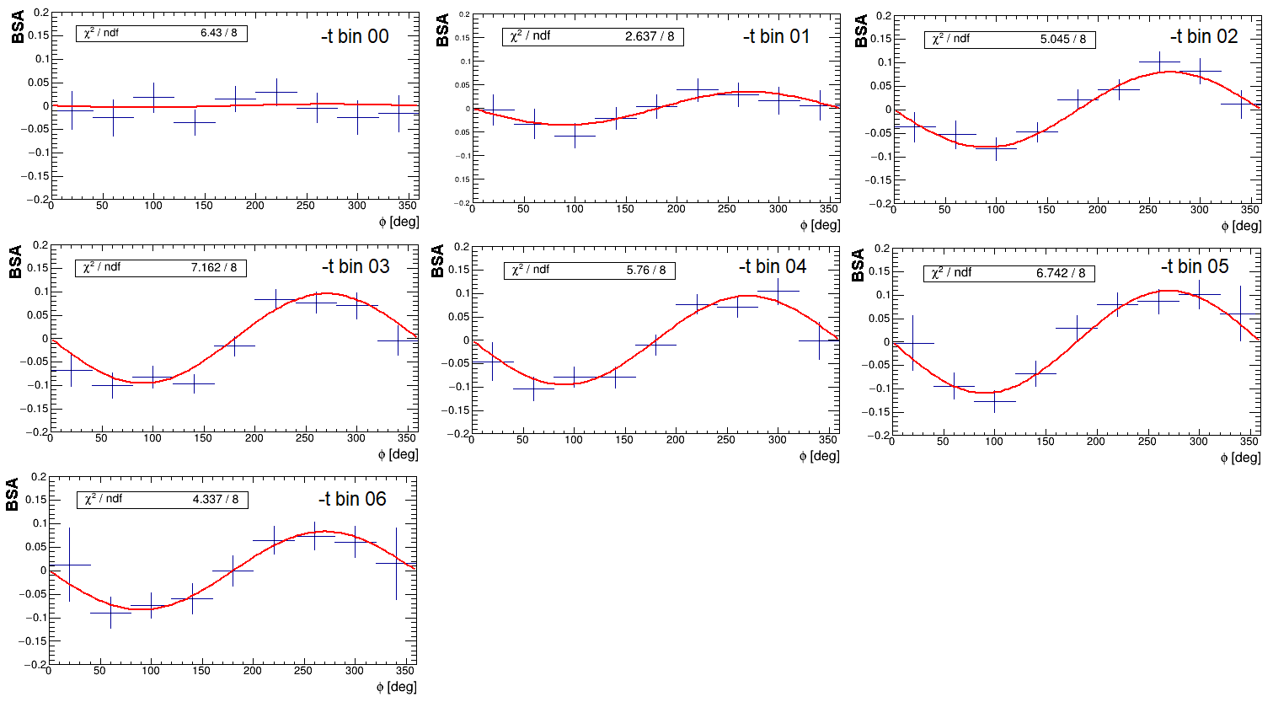
Resulting Beam Spin Asymmtries (Q²-x_{B} integrated)
0.1 GeV² - 0.3 GeV²
0.3 GeV² - 0.42 GeV²
0.42 GeV² - 0.58 GeV²
preliminary
0.58 GeV² - 0.8 GeV²
0.8 GeV² - 1.07 GeV²
1.07 GeV² - 1.3 GeV²
1.3 GeV² - 1.5 GeV²

Slide 23
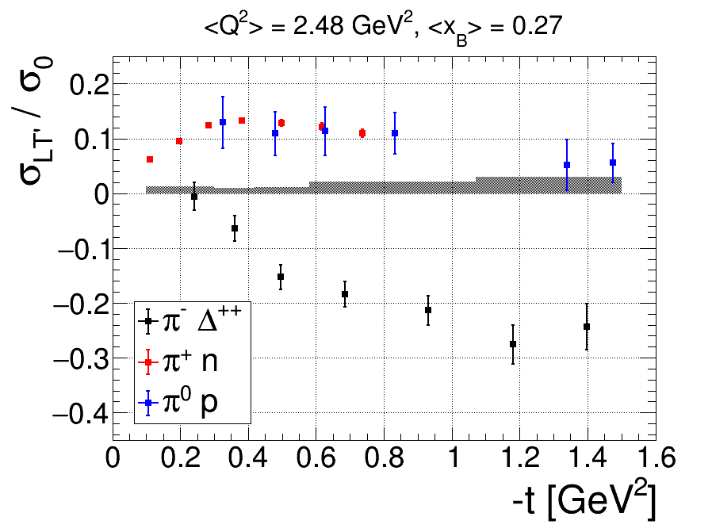
Q² - x_{B} Integrated Result
preliminary
Different sources of systematic uncertainty have been studied:
beam polarisation, background subtraction, fiducial volume, extraction method,
acceptance, bin migration, radiative effects

Slide 24
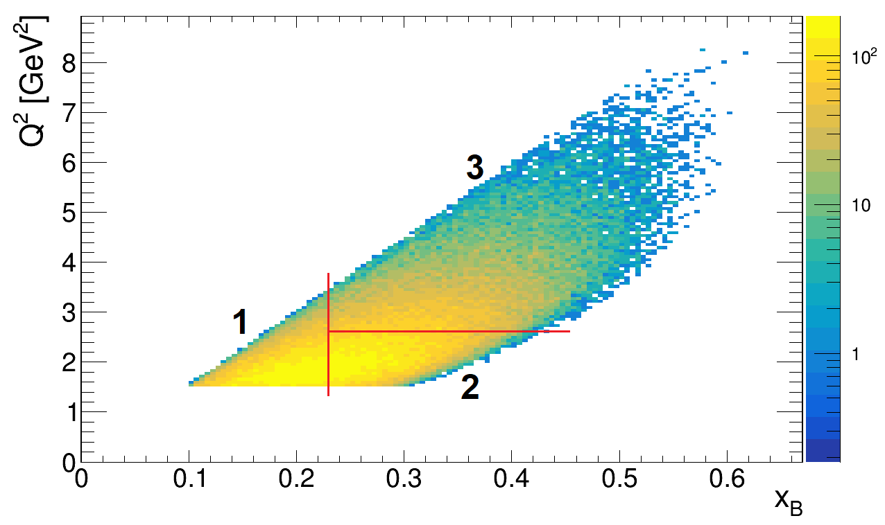
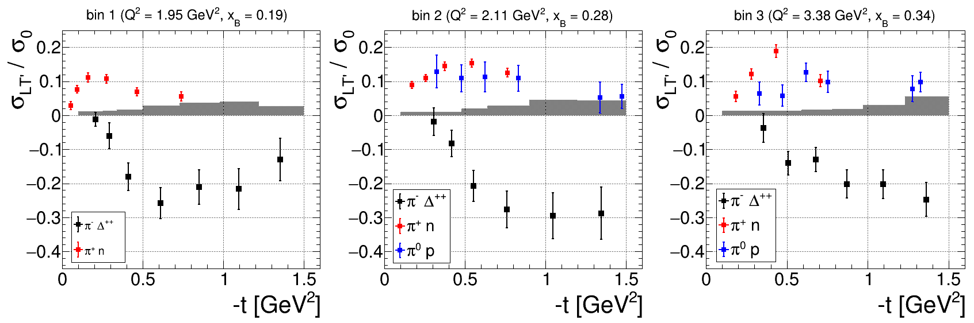
Multidimensional Results
preliminary
preliminary
preliminary
preliminary

Slide 25
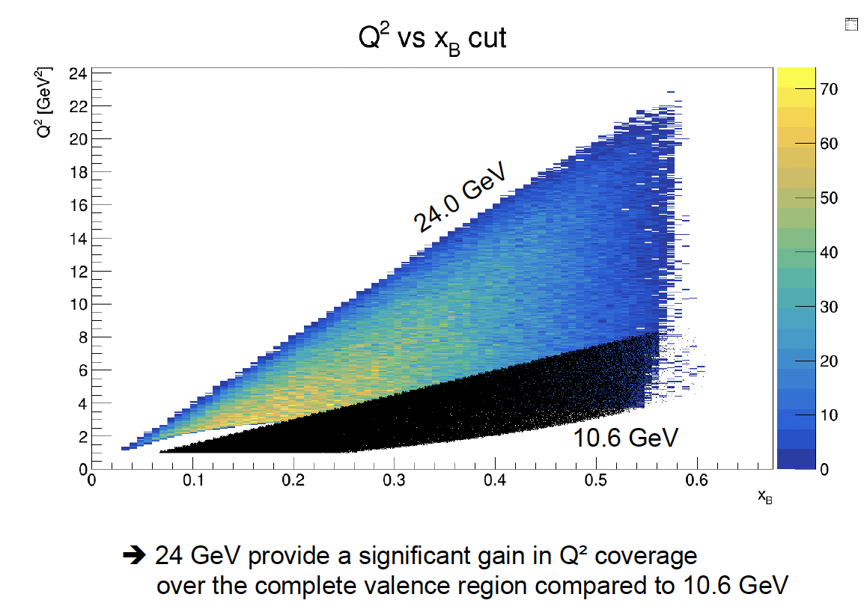
Jlab Energy Upgrade

Slide 26
Conclusion and Outlook
CLAS12 has a comprehensive program in measuring hard exclusive meson productions to access nucleon and transition GPDs.
Hard exclusive π⁻Δ⁺⁺ production can be well measured with CLAS12 to study transition GPDs.
The extracted BSA is a potential first "clean“ observable sensitive
to p-Δ transition GPDs
More comprehensive theoretical framework for the exclusive meson productions would be needed.

Slide 27
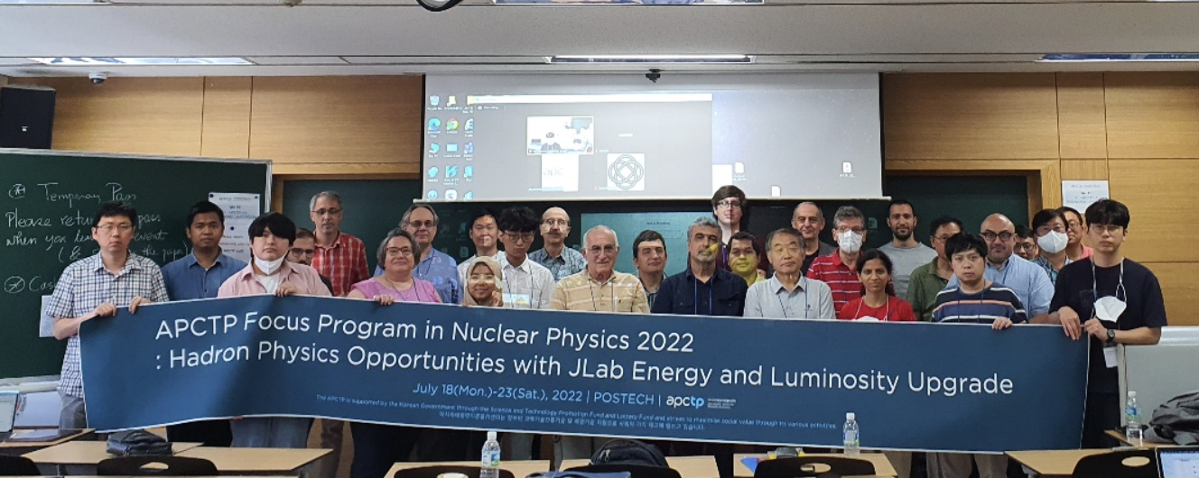
APCTP Workshop on Nuclear Physics 2022: Hadron Physics Opportunities with Jlab Energy and Luminosity Upgrade

Slide 28
JLab Energy Upgrade with 20+ GeV
The workshop aimed to develop compelling physics arguments for energy upgrade utilizing largely existing or already planned hall equipment.
3D imaging is recognized of key objectives of the 12 GeV program and driving force behind the construction of the future Electron Ion Collider (EIC).
Identify flagship measurements that can be done only with 20+ GeV
Identify flagship measurements with 20+ GeV that can extend and improve 11 GeV measurements, helping the physics interpretation through multi-dimensional bins in extended kinematics.
Identify measurements with 20+ GeV that can set the bridge between JLab 12 and EIC.

Slide 29
Thank Prof. Yongseok Oh and APCTP for their support making the workshop successful.

