Slide 1

First Measurement of Timelike Compton Scattering
PhysRevLett.127.262501
P. Chatagnon (INFN), S. Nicolai(IJCLab), St. St. (JLAB) at al.,
(CLAS collaboration)
Notes:
I will present first ever measurement of the time-like Compton scattering process. Credits to Pierre Chatagnon, who did the analysis as his PhD work
This talk is on April 10, Sunday in the room Majestic at 4:33 pm

Slide 2
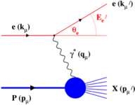
3-D Structure of the Nucleon: TMDs and GPDs
Electron scattering has been a tool of choice for many decades for studies of the structure of the nucleon in elastic and deep inelastic scattering regimes.
DIS Parton Distribution Functions
Elastic Form Factors
Lacks information on the spatial location of the constituents
Lacks information on the underlying dynamics of the system
Transverse Momentum Distributions & Generalized Parton Distributions
3-D imaging of the nucleon, map out correlated transverse spatial and longitudinal momentum distributions of partons and the quark angular momentum distribution
Notes:
For many decades electron scattering has been used for nucleon structure studies. But only past 20 year after emerging of TMD and GPD formalism mapping out correlated transvers and longitudinal momentum distributions of partons and their angular momentum distributions became possible.

Slide 3

Generalized Parton Distributions (GPDs)
GPDs are physical quantities which describe the quark and gluon structure of the nucleon
GPDs → PDFs (in the limit $t→0$)
Four leading-twist chiral-even GPDs:
GPDs → FFs (first moments of GPDs)
What GPDs offer
Link to the energy-momentum tensor
Nucleon tomography
Burkardt, Int.J.Mod.Phys.A, 2002
Decomposition of the nucleon spin
the D-term characterizes the distribution of forces inside the nucleon
Polyakov, Physics Letters B, 2003
Ji, Phys. Rev. Lett, 1997
Notes:
GPDs have already been introduced, so just to reiterate - these are physics quantities that describe soft part of he scattering amplitude in the deeply virtual exclusive process. At leading twist we have four chiral-even GPDs. Some certain kinematic limits they reduce to familiar 1D FF and PDFs. But of course they offer more than that. GPDs link to the energy-momentum tensor where D-term characterizes the distribution of forces inside the nucleon. Fourier transforms of GPDs describe the distribution of partons in the transverse plane, and the 2nd moments of sum of GPDs H and E has been identified by X.Ji with the angular momentum (orbital plus spin) carried by the quarks

Slide 4
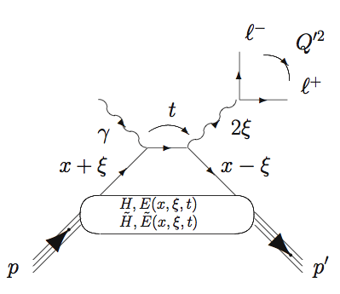
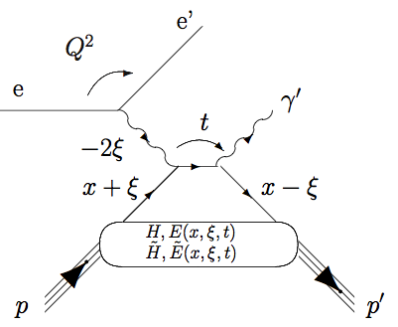
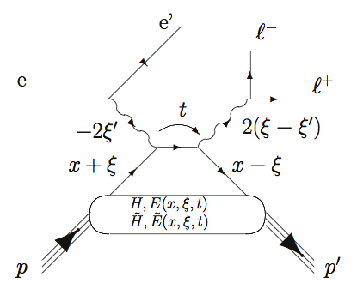






Compton Scattering and GPDs
DVCS
Deeply Virtual Compton Scattering, “golden” channel to study GPDs
Hard scale is defined by space-like photon
TCS
Hard scale is defined by time-like photons
$$γ^{∗}$$
$$γ^{∗}$$
$$ep→e^{′}p^{′}γ$$
Access to the Re & Im parts of the Compton amplitude
DDVCS
$$γ^{∗}$$
$$γ^{′∗}$$
Both space-like and time-like photons can set the hard scale
Notes:
How we can study GPDs experimentally? The Compton process, in particular Deeply virtual Compton scattering, or production of a real photon in deep inelastic scattering regime has been identified as the cleanest channel for that. In DVCS the hard scale that factorize the process into hard and soft parts is set by the virtuality of the incoming space like photon. In DVCS spin asymmetries allow access to the imaginary pat of the Compton amplitude allows access that contain GPDs at specific kinematic point. Measurement of the lepton charge asymmetry allows extraction of the real part of the scattering amplitude which in turn contains integral of GPDs along the internal fraction of momentum carried by a parton.
Besides DVCS, there are two other Compton processes that can provide significantly more and complimentary information. The TCS, photoproduction of a time-like virtual photon, the hard scale for the factorization is set by outgoing time-like photon. This is a unique reaction when both the Re and Im parts of the Compton amplitude are accessible in the same measurements. Another important reaction for study of GPDs is double deeply virtual scattering. Here both incoming and outgoing photons can set the hard scale. Most importantly this is a reaction when GPDs can be extracted away from the diagonal ridge and allow mapping of the whole GPD surface in x and \xi space. DDVCS will be access at JLANB in future high luminosity experiments.
Today I will present the first ever experimental measurement of the second Compton process, TCS

Slide 5
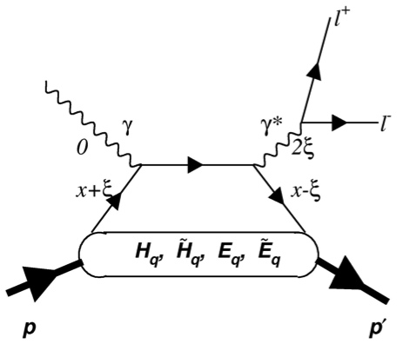
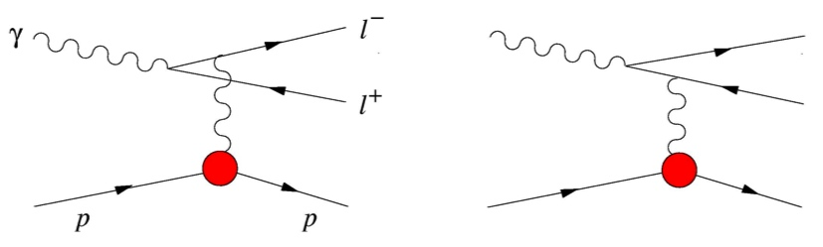
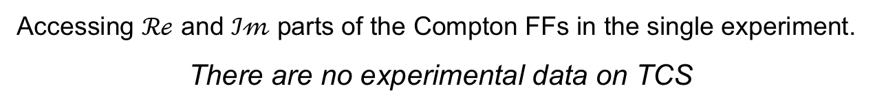
Lepton pair photo-production – BH+TCS
TCS
Bethe-Heitler (BH)
+
Pairs are produced in C-odd mode in TCS and in C-even in BH
azimuthal angular dependence projects out the interference terms
Incoming photon polarization
Scattering amplitude
CFF
Accessing $ℛℯ$ and $ℐ𝓂$ parts of the Compton FFs in the single experiment.
There are no experimental data on TCS
Notes:
TCS is a time-reversal process of DVCS. as in DVCS, final state of TCS is indistinguishable from the elementary BH scattering and in the experiment we measure both processes. At our energy range, BH dominates the cross section.
The key point is that the amplitudes for the Compton and Bethe-Heitler processes
transform with opposite signs under reversal of the lepton charge. As a consequence the
interference term between TCS and BH is odd under exchange of the ℓ+ and ℓ− momenta,
whereas the individual contributions of the two processes are even. Any observable that
changes sign under k ↔ k′ will hence project out the interference term, eliminating in particular
the large BH contribution

Slide 6
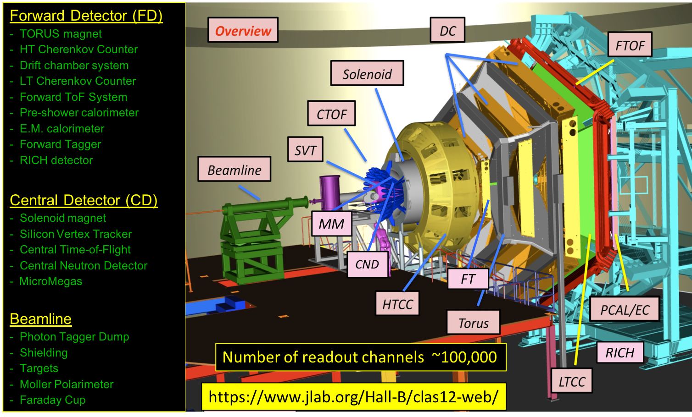
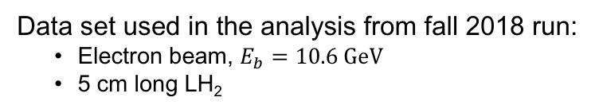

CLAS12 in Hall-B at JLAB
Data set used in the analysis from fall 2018 run:
Electron beam, $E_{b}=10.6 GeV$
5 cm long LH₂
Accumulated charge $\sim 60 mC (80 {fb}^{−1})$

Slide 7
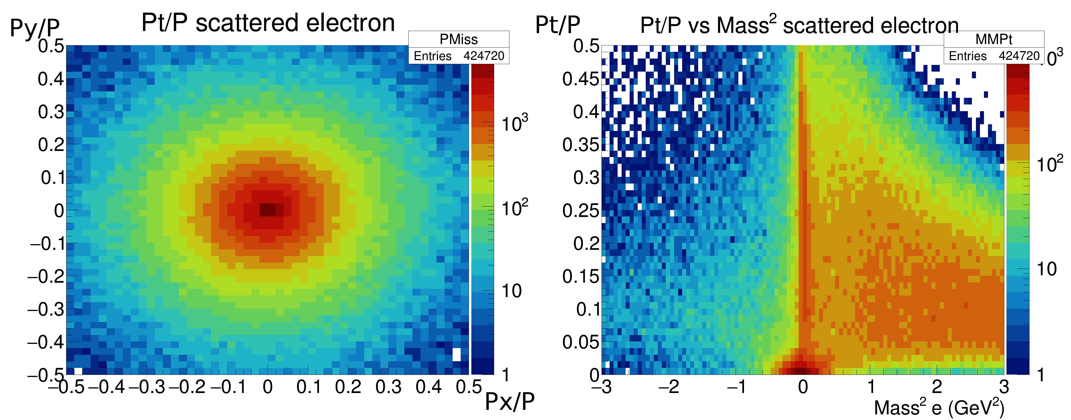







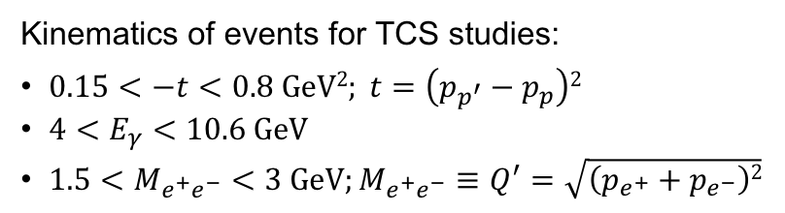


Quasi-real photoproduction of lepton pairs
$$ep→e^{+}e^{−}p^{′}(X)$$
Missing momentum analysis
$$p_{X}=p_{e}+p_{p}−p_{e^{+}}−p_{e^{−}}−p_{p^{′}}$$
Quasi-real photons, $Q^{2}<0.1 GeV2$
$$\left|M_{X}^{2}\right|<0.4 GeV2; \frac{P_{tX}}{P_{X}}<0.05; X≡e^{′}$$
Bremsstrahlung photons
$$ω (782)$$
$φ$(1020)
$$ρ (770)$$
Kinematics of events for TCS studies:
$0.15<−t<0.8 GeV2; t=\left(p_{p^{′}}−p_{p}\right)2$
$4<E_{γ}<10.6 GeV$
$1.5<M_{e^{+}e^{−}}<3 GeV;M_{e^{+}e^{−}}≡Q^{′}=\sqrt{\left(p_{e^{+}}+p_{e^{−}}\right)2}$
J/$ψ (3097)$
$$M_{e^{+}e^{−}}, GeV$$
Notes:
Photoproduction of lepton pairs is studies by detecting e+e- and a recoil proton from scattering of a 10.6 GeV electrons off a LH2 target. in Missing momentum analysis, events that have a missing particle with M~0 and the transverse momentum ~0 are selected. This selection isolates two types of reactions, electron scattering wit Q2~0 and the photoproduction from brem. photons in the target. In these reactions lepton pairs are production of decays of vector mesons or a time-like photon+BH process. For GPD studies we select invariant mass region above know vector meson resonances, >1.5 GeV and below 3 GeV.

Slide 8


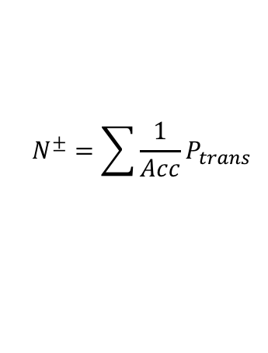



Beam polarization asymmetry $(A_{⨀U})$
Accessing imaginary part of the Compton amplitude
$$N^{±}=\sum{\frac{1}{Acc}P_{trans}}$$
P_{trans} – transferred polarization to the photon,
P_{b} – electron beam polarization $(≈85\%)$
$$<Q^{′}>=1.8 GeV$$
$$<s>=14.6 GeV2$$
$$<θ>=92o$$
The asymmetry is well reproduced by VGG and GK models – hints for universality of GPDs
Theoretical predictions by M.Vanderhaeghen, JGU Mainz (VGG model) and P.Sznajder, NCBJ Warsaw (GK model)
Fit – $f\sim \sin{φ}$
Notes:
As discussed before, the beam polarization asymmetry projects out imaginary part of the Compton amplitude with sin\phi modulation. On the left four graph, asymmetry is plotted vs \phi angle for four different transferred momentum bins showing sin\phi modulation. Red lines are fits to the experimental asymmetry shown in blue. On the right, amplitude of sin\phi modulation is plotted versus transferred momentum squared. One do not expect any asymmetry for BH process (calculation shown in red). Asymmetry of order of ~0.25 is clear sign of the TCS process. Moreover, the measured asymmetry is reproduced by GPD models that are tuned on DVCS – clear hint for universality of GPD framework.

Slide 9
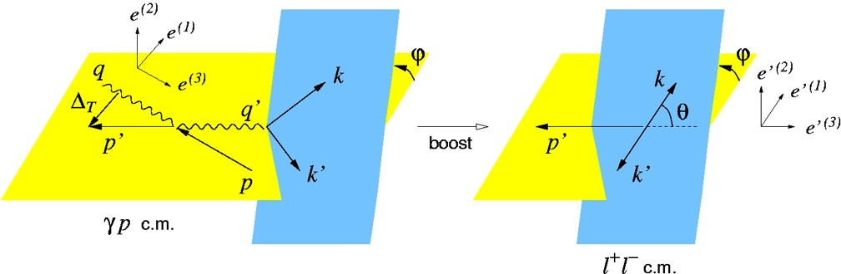
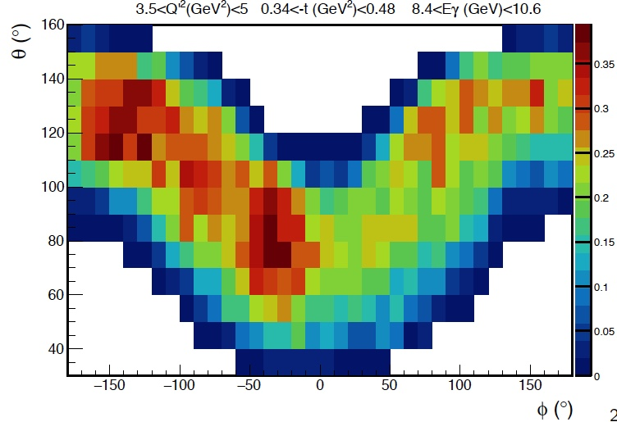


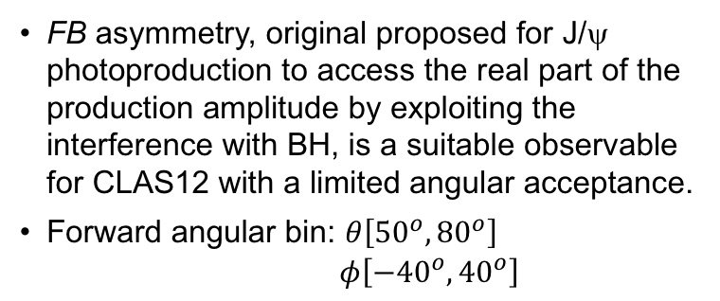
Forward-backward asymmetry $(A_{FB})$
Accessing real part of the Compton amplitude – the information one can extract from the DVCS process, when comparing cross sections for both electron and positron beams.
$$FB⇛(θ,φ)↔(π−θ,π+φ)$$
Backward
FB asymmetry, original proposed for J/ψ photoproduction to access the real part of the production amplitude by exploiting the interference with BH, is a suitable observable for CLAS12 with a limited angular acceptance.
Forward angular bin: $θ\left[{50}^{o},{80}^{o}\right]$
$$φ\left[{−40}^{o},{40}^{o}\right]$$
Forward
Notes:
To access the real part of the Compton amplitude, that can be access only in lepton change asymmetry in DVCS, we study so called forward-backward asymmetry. Definition is simple, it is basically replaces e+ and e- in final state. The BH amplitude is even under this transformation TCS and therefore the interference term not. The FB asymmetry projects out the real part of the amplitude with cos\phi modulation. The FB was developed for the J/psi photoproduction to access the real part of the production amplitude but is quite suitable for TCS with CLAS12 that has limited angular acceptance in forward region.

Slide 10
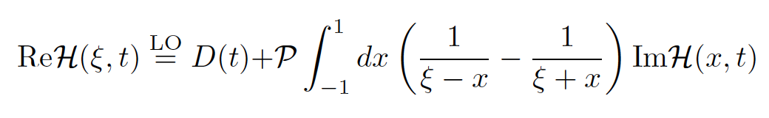

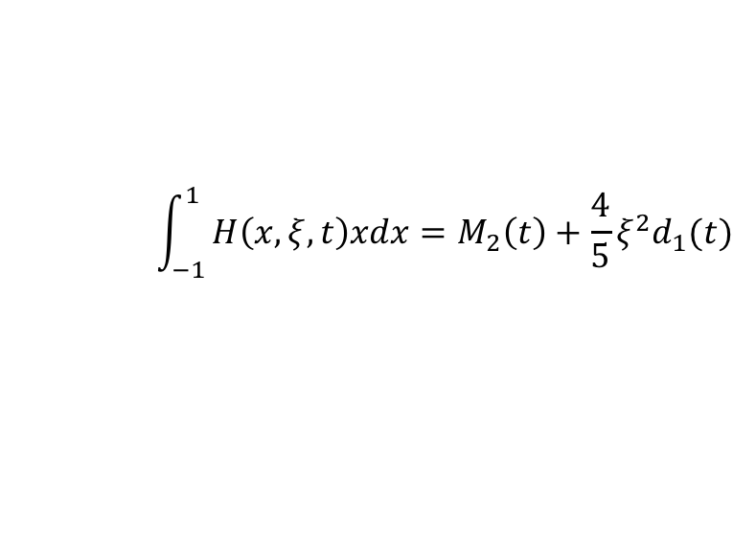
$A_{FB}$ results
$$<Q^{′}>=1.8 GeV <s>=14.6 GeV2$$
$$<Q^{′}≥2.25 GeV <s>=16.1 GeV2$$
Measured asymmetry is better described by the VGG model with the D-term.
The D-term appears, in the leading order approximation, as a subtraction term in the dispersion relation –
The first coefficient in the Gegenbauer expansion of the D-term is the FF d₁(t) that encodes share force and the pressure on partons inside the nucleon
$$\int_{−1}^{1}{H\left(x,ξ,t\right)xdx=M_{2}\left(t\right)+\frac{4}{5}ξ^{2}d_{1}(t)}$$
Notes:
Here are results for FB asymmetry, the left and right graphs are for t-dependence of asymmetry for the full analyzed invariant mass range and for higher masses, respectively. The data points are best described with GPD model (VGG) that has the D-term included. To remind that the D-term contains FF d(t) that encodes share force and the pressure on partons inside the nucleon.

Slide 11
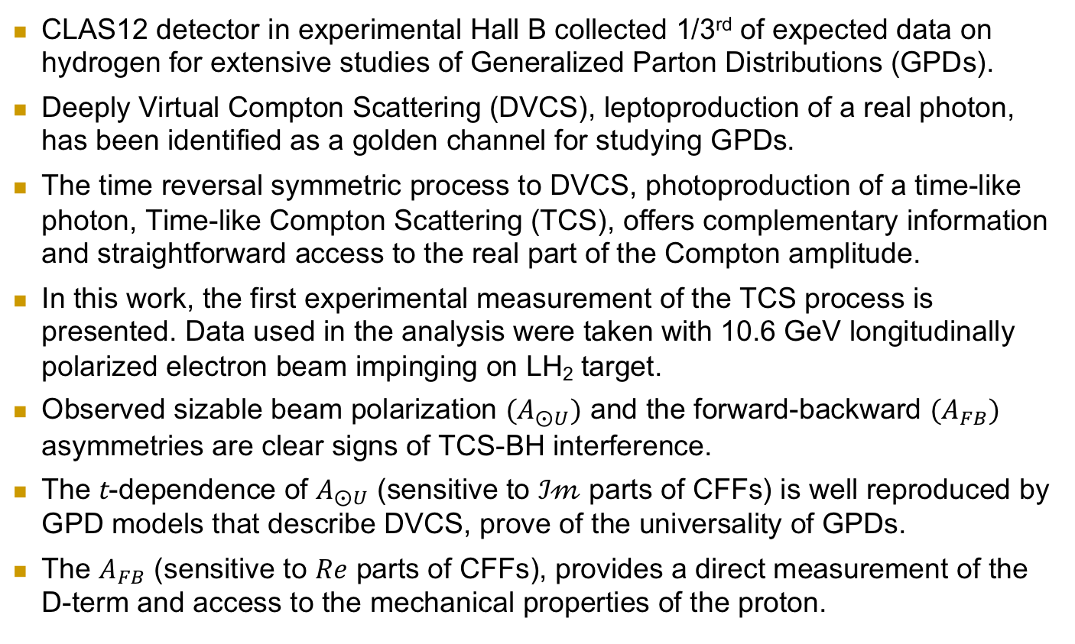
Summary
CLAS12 detector in experimental Hall B collected 1/3rd of expected data on hydrogen for extensive studies of Generalized Parton Distributions (GPDs).
Deeply Virtual Compton Scattering (DVCS), leptoproduction of a real photon, has been identified as a golden channel for studying GPDs.
The time reversal symmetric process to DVCS, photoproduction of a time-like photon, Time-like Compton Scattering (TCS), offers complementary information and straightforward access to the real part of the Compton amplitude.
In this work, the first experimental measurement of the TCS process is presented. Data used in the analysis were taken with 10.6 GeV longitudinally polarized electron beam impinging on LH₂ target.
Observed sizable beam polarization $(A_{⨀U})$ and the forward-backward $(A_{FB})$ asymmetries are clear signs of TCS-BH interference.
The t-dependence of $A_{⨀U}$ (sensitive to $ℐ𝓂$ parts of CFFs) is well reproduced by GPD models that describe DVCS, prove of the universality of GPDs.
The $A_{FB}$ (sensitive to $Re$ parts of CFFs), provides a direct measurement of the D-term and access to the mechanical properties of the proton.
Notes:
Get us closer to understand the mechanical properties of the nucleon.

