Slide 1
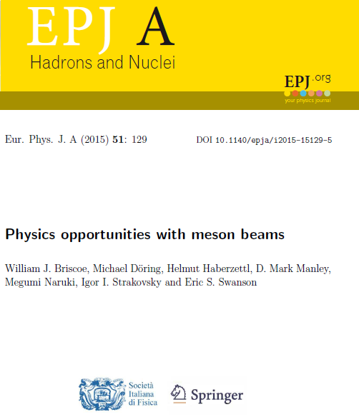
Physics Opportunities for Meson Beams
W.J. Briscoe and Igor Strakovsky
Department of Physics
The George Washington University
Virginia Science and Technology Campus
Ashburn, VA 20147
2015 White Paper
135 endorsers from 77 labs worldwide

Slide 2
The Need for Meson Factories
In recent years, electron facilities have measured meson photo- and electro-production data of excellent quality and quantity.
Much of the outdated meson-beam data for corresponding hadronic final states are of poor quality, if they exist at all, and provide inadequate input to interpret, analyze, and exploit the full potential of the EM data.
To exploit the high-precision EM data, high-statistics data from measurements with meson beams, with good angle and energy coverage, are needed to advance knowledge in baryon and meson spectroscopy and related areas of hadron physics.
Here we summarize unresolved issues in hadron physics and outlines the opportunities and advances only possible with such a facility.

Slide 3
What is a Meson Factory?
“Meson factories are medium-energy accelerators (300-1000 MeV), capable of producing proton beams of much greater intensity than other types of existing machines.” – The Ramsey Panel: Hans A. Bethe, chairman, Herman Feshbach, Harry Gove, W. W. Havens, Jr., Robert Christy, Gerald Phillips and Robert R. Wilson. Physics Today 17, 68 (1964).
“Accelerators that will produce 500—1000 MeV nucleons and mesons in beams thousands of times more intense than existing machines will be able to do experiments never before possible, increase precision of others and reveal processes now unknown”. Louis Rosen Physics Today 19, 21 (1966)
→ LAMPF (USA), TRIUMF (Canada), SIN (Switzerland)

Slide 4
What Would a Modern Meson Facility Be?
The CM energy range up to 2.5 GeV offer physics opportunities with pion and kaon beams to study baryon and meson spectroscopy issues complementary to EM programs at facilities e.g., JLab, MAMI, ELSA, SPring-8, and BEPC.
We highlight some opportunities and describes how new high energy and intensity meson factories can contribute to fuller understanding of recent high-quality EM data.
This is not a competing effort, but an experimental program that
  provides the hadronic complement of ongoing EM programs.
  Provides common ground for better, more reliable, phenomenological and theoretical analyses. [1,2]
  Refs available online with supplemental materials

Slide 5
Hyperon Spectrum is Important
This program well-aligned with a goal found in the 2015 Long Range Plan for Nuclear Science: “...a better understanding of the role of strange quarks became an important priority.” [3]
Knowledge of the low-lying spectra of mesons and hyperons is very poor in comparison with that of the nucleon.
Determination of pole positions and decays are needed.
Determination of hyperon spectra combined with measurements of spectra of charmonia and B particles at LHCb at CERN allows for clearer understanding of soft QCD matter and the approach to heavy quark symmetry. [4]
Recent studies that compare LQCD calculations of thermodynamic,
statistical Hadron Resonance Gas models, and ratios between measured yields of different hadron species in heavy ion collisions provide indirect evidence for presence of ”missing” resonances in these contexts.
Contribution order:
• Hyperons
• Non-strange Baryons
• Mesons
• Light Nuclei

Slide 6
Spectroscopy of Baryon and Hyperon Resonances
Pion Beams are Needed
Most current knowledge about the bound states of three light quarks comes from PWAs of πN → πN scattering.
Measurements of πN elastic scattering are required to determine absolute πN branching ratios.
Without that information it is impossible to determine the absolute branching ratios for other decay channels.
Summary of resonance properties is provided in Review of Particle Physics.[5]
Comparison of experimental results and models → “missing resonances”.[6]

Slide 7
Spectroscopy of Baryon and Hyperon Resonances
Pion and Kaon Beams
Most existing Meson Factories data on πN ηN, KΛ, KΣ are 20 - 40 years old. [7]
In many cases, systematic uncertainties were not reported or underestimated.
Analyses agree on 4-star resonances visible in elastic πN scattering; poor pion-induced data led different analyses to claim different resonance content.
No conclusive agreement on resonances that couple weakly to the πN channel. [8]
First determinations of pole position for Λ(1520) obtained only recently. [9]
Intense kaon beams provide opportunities to locate missing resonances and establish properties of decay channels for higher excited states.

Slide 8
Spectroscopy of Baryon and Hyperon Resonances
Pion and Kaon Beams
Goals of EM facilities benefit by hadron-beam data of a quality like EM data.
A vigorous program in hadronic physics requires facilities with pion/kaon beams.
A facility in which a “complete program” of πN→ πN, π⁻p → K⁰Λ, π⁻p → K⁰Σ⁰, π⁻p → K⁺Σ⁻, and π⁺p → K⁺Σ⁺ can be measured would be very useful.
Full solid angle coverage is required to study inelastic reactions such as π⁻p → ηn, π⁺p → π⁰π⁺p, strangeness production and other reactions.
Such a facility should be able to do baryon spectroscopy measurements up to W of about 2.5 GeV; this requires pion beams of about 2.85 GeV/c.
The 2 GeV/c pion beam at J-PARC allows baryon spectroscopy measurements up to W ≈ 2150 MeV.

Slide 9
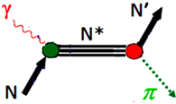
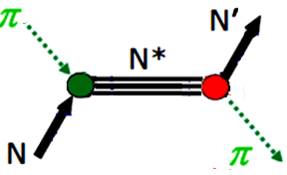
Status of Studies with Pion Beams
Measurements of final states involving a single pseudoscalar meson and a spin-1/2 baryon are important.
Reactions involving πN channels include:
γp → π⁰p, π⁻p → π⁰n,
γp → π⁺n, π⁻p → π⁻p,
γn → π⁻p, π⁺p → π⁺p,
γn → π⁰n.
Data bases for these reactions larger than for other reactions.

Slide 10
Why More Studies with Pion Beams are Needed
Figures 1, 2, and 3 summarize available data below center-of-mass energy W = 2.5 GeV for π⁺p → π⁺p, π⁻p → π⁻p, and π⁻p → π⁰n, respectively.
πN elastic scattering data[11] allowed establishment of the 4-star resonances[12].
πN→ πN data are old, have high systematic uncertainties and are incomplete.
Few data A and R for π⁻p → π⁻p and π⁺p → π⁺p and for few energies and angles.
No A and R data for π⁻p → π⁰n and very few P data; these observables needed to construct unbiased partial-wave amplitudes.
Dramatic improvement in statistics made possible in modern experimental physics (EPECUR) is demonstrated (for medium energies) in Fig. 4.

Slide 11
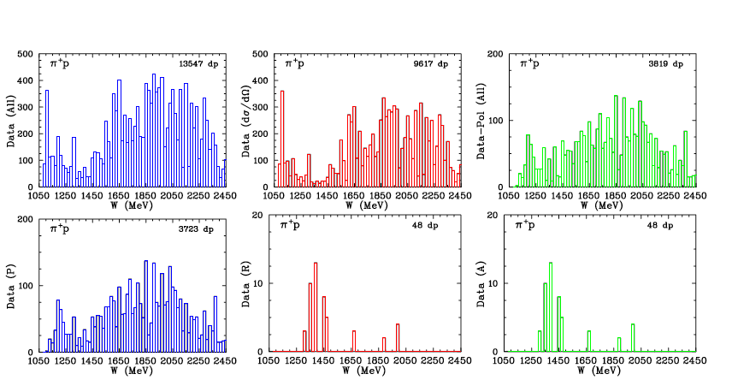
Fig 1 Data available for π⁺p → π⁺p as a function of W. [10] Row 1: (blue) total data for all observables, (red) differential cross-section (dσ/dΩ) data, (green) polarization data available. Row 2: (blue) P observables data, (red) R spin data, (green) A spin observable data.
Studies with Meson Beams

Slide 12
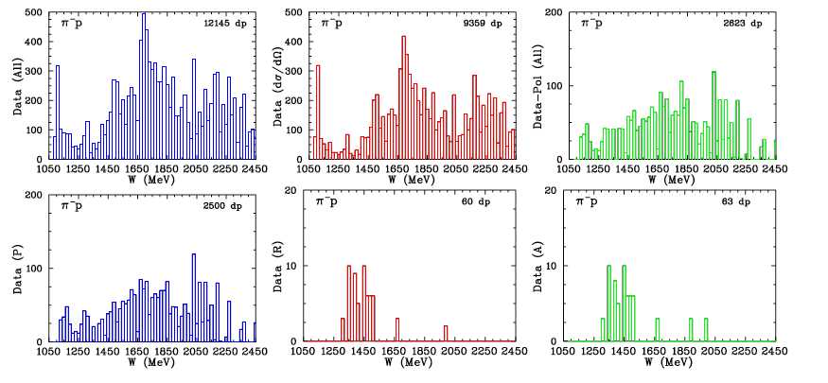
Fig 2 Data available for π⁻p → π⁻p as a function of W. [10] Row 1: (blue) total amount of data available for all observables, the second plot (red) differential cross-section (dσ/dΩ) data, (green) polarization data. Row 2: (blue) P observables data, (red) R spin data available, (green) A spin data.
Studies with Meson Beams

Slide 13
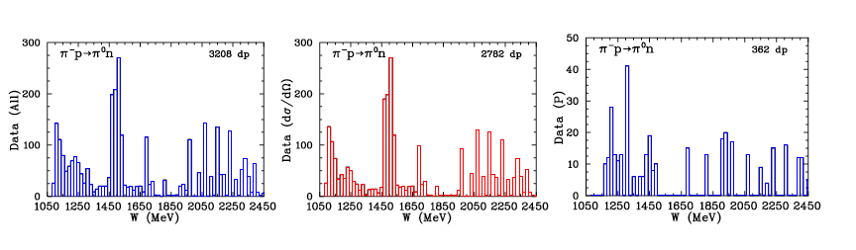
Fig 3 Data available for π⁻p → π⁰n as a function of W [10]. (blue) shows total amount of data available for all observables, (red) shows differential cross-section (dσ/dΩ) data, (blue) shows the amount of polarization data.
Studies with Meson Beams

Slide 14
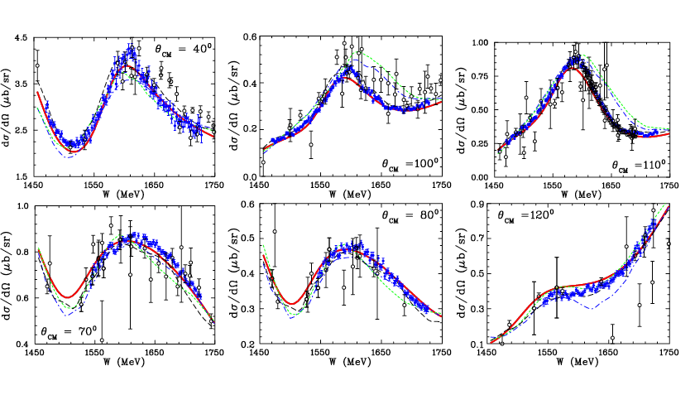
Fig 4 Differential cross section C.M. for π−p (top) and π+p (bottom) elastic scattering. EPECUR data (blue) [13] previous measurements [14] black. Data from earlier experiments within bins of ∆θ_{CM} = ±1⁰. GWU fit, WI08 [11] red solid curve, older KH80 [15], KA84 [16], and CMB [17] fits blue dash-dotted, green short dashed, and black dashed curves, respectively.
Improved Measurements from EPECUR

Slide 15
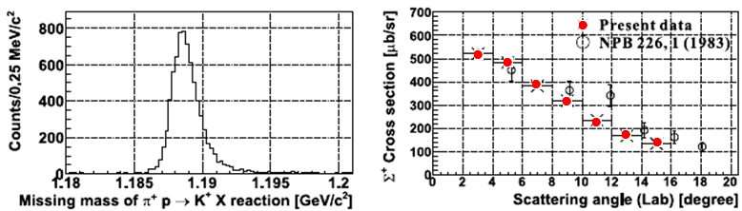
Fig. 6 Differential cross section of the reaction π⁺p → K⁺Σ⁺ at p_{lab} =1.37 GeV/c from a recent J-PARC experiment [25], compared older data. [26]
Newer Measurements from J-PARC
Fig. 6 shows measurements of the pure isospin I = 3/2 K+Σ+ final state by the E19 Collaboration at J-PARC, compared older data.
Note the improvement in uncertainties and angular range!
Similar measurements will greatly improve PWAs of KΣ final state and help to extract S-wave contributions needed in approaches based on unitarized chiral perturbation theory/

Slide 16
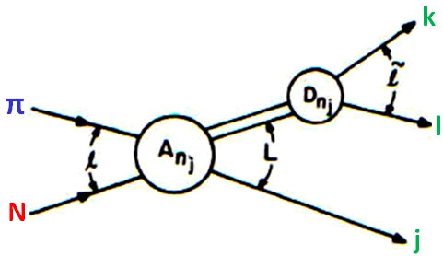
Other Studies with Pion Beams
Other measurable reactions include ππN final states:
  γp → π⁰π⁰p, π⁻p → π⁰π⁰n,
  γp → π⁰π⁺n, π⁻p → π⁰π⁻p,
  γp → π⁺π⁻p, π⁻p → π⁺π⁻n,
  γn → π⁰π⁰n, π⁺p → π⁰π⁺p,
  γn → π⁰π⁻p, π⁺p → π⁺π⁺n,
  γn → π⁺π⁻n.
Analysis/interpretation more complicated – involve 3-body final states.
πN → ππN reactions have lowest energy threshold of the inelastic hadronic channels and some of the largest cross sections.
For most established N ∗ and ∆∗ resonances, dominant inelastic decays go to ππN final states.
Much of the πN → ππN come from bubble-chamber data analyzed in isobar-model PWA at W = 1320 to 1930 MeV [30].
Need high-quality, high-statistics data for πN → ππN data that can be analyzed together with complementary data for γN → ππN channels. (E45 J-PARC)

Slide 17
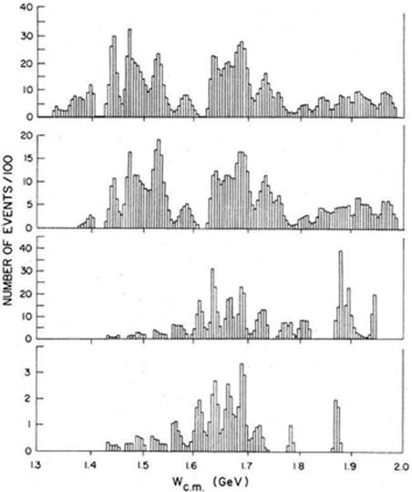



πp→ππN Measurements
Preparation for J-PARC/E45
π⁻p→π⁺π⁻n
• 241,214 Bubble Chamber events for πp→ππN
have been analyzed in Isobar-model PWA at
W = 1320 to 1930 MeV.
• Post-Bubble Chamber measurements:
• 349,611 events for π⁻p→π⁰π⁰n from
CB@BNL at W = 1213 to 1527 MeV.
• 20,000 events for π⁺⁻p→π⁺⁻π⁻⁺n from
CHAOS@TRIUMF at W = 1257 to 1302 MeV.
• 40,000 events for π⁻p→π⁻π⁺n from
ITEP at W = 2060 MeV.
Manley, Arndt et al, Phys Rev D 30, 904 (1984)
π⁻p→π⁰π⁻p
π⁺p→π⁰π⁺p
CB@BNL
Prakhov et al, Phys Rev C 69, 045202 (2004)
π⁺p→π⁺π⁺n
Kermani et al, Phys Rev C 58, 3431 (1998)
→
CHAOS
Alekseev et al, Phys At Nucl 61, 174 (1998)
ITEP

Slide 18
The K-Long Experiment at Jefferson Lab
The K-Long project is approved to setup a secondary K_{L} beam line in Hall D at Jefferson Lab with a flux three order of magnitude higher than SLAC.
Scattering experiments on both proton and neutron targets.
First hadronic facility at Jefferson Lab.
We will measure differential cross sections and (self) polarization of hyperons with GlueX detector to enable precise PWA to determine all resonances up to W=2500 MeV.
We will perform strange meson spectroscopy to locate pole positions in I = 1/2 and 3/2 channels.

Slide 19
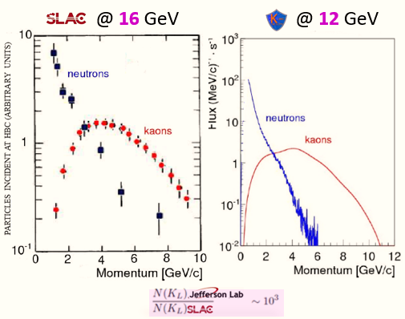
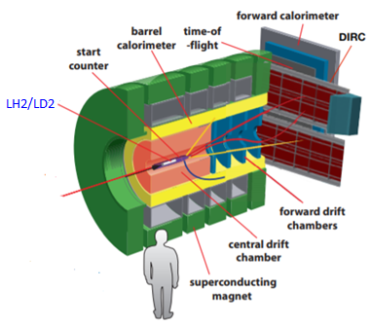
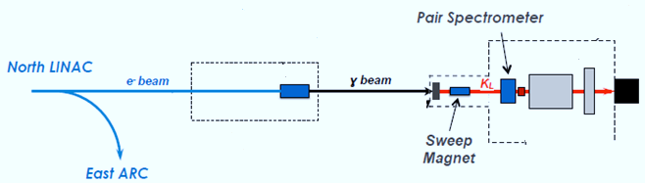
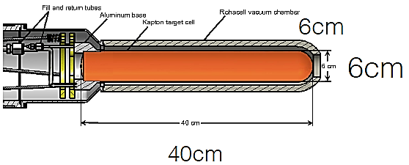

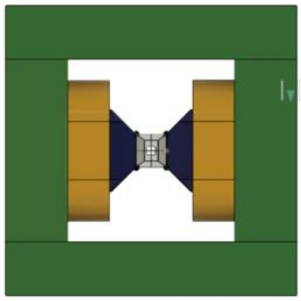
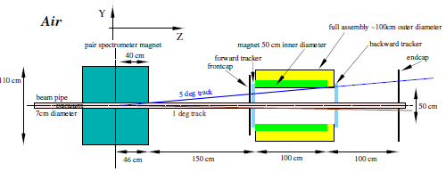
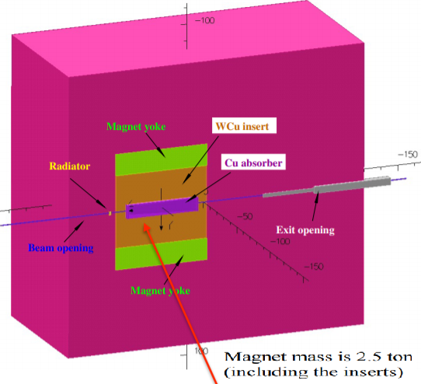
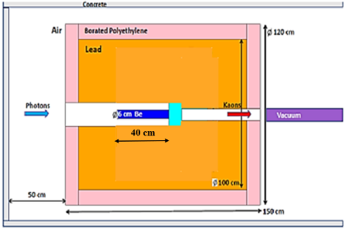

.
Kaon Beamline @ Hall D
• Electrons (3.1 x 10¹³ e/sec) hit Cu-radiator in CPS located in tagger alcove.
• Photons (4.7 x 10¹² γ/sec @ E > 1.5 GeV) hit Be-target located in collimator alcove.
• K_{L}s (1 x 10⁴ K_{L}/sec) hitt LH₂/LD₂ target within GlueX main frame.
GlueX
Spectrometer
K_{L}-beam
12 GeV 5 μA
Bunch spacing 64 ns → 128 ns
not used
CPS
KPT
KFM
No need
to tag
photons
n/γ Beam Dump
LH₂/LD₂-target
.
Compact Photon Source
Kaon Production Target
Kaon Flux Monitor
γ-beam
Be
W
K_{L}-beam
e-beam
γ-beam
IS et al. [arXiv:2002.04442 [physics.ins-det]
D. Day et al. Nucl Instrum Meth A 957, 163429 (2020)
Readiness Review is schedule for 1/2 2023.

Slide 20
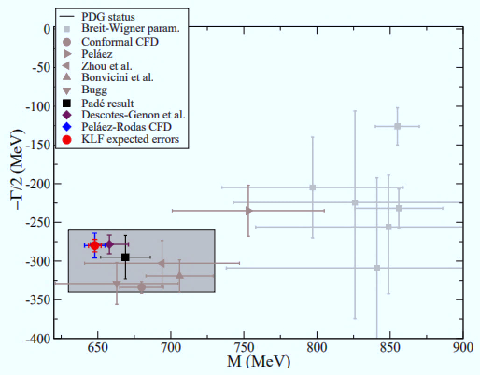
.
Summary of K_{L}p Spectroscopy
K_{L} will have significant impact on our knowledge of Kp scattering amplitudes.
Improve conflicting determinations of heavy K* parameters.
Help to settle tension between phenomen-ological determination of scattering lengths from data vs ChPT & LQCD.
For K*(700), it will reduce:
  uncertainties in mass by factor of two and
  uncertainties in width by factor of five. .
Help to clarify debated of its existence, and therefore, long standing problem of existence of the scalar meson nonet.
K*(700)
.
• Roy-Steiner dispersion approach
M – iΓ/2 = (648 ± 4) – i(280 ± 8) MeV
100 days
J.R. Pelaez et al Phys Rev D 93, 074025 (2016)

Slide 21
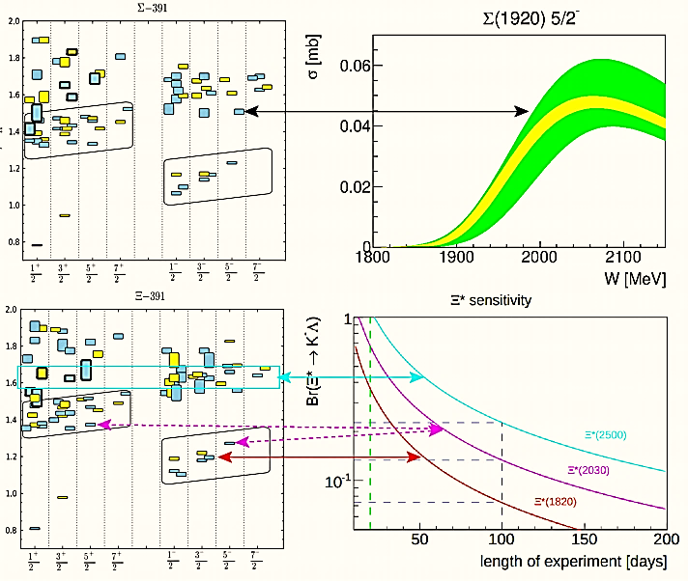

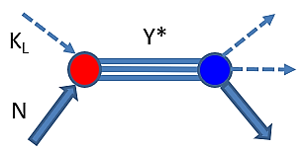
.
Summary of Hyperon Spectroscopy with K_{L} Beam
K_{L} sensitivity with 100 days of running will allow the discovery of many hyperons with good precision.
Why should it be done with K_{L} beam ?
This is only realizable way to observe
s-channel resonances having all
momenta of K_{L} at once (“tagged’’ kaons) .
Why should it be done at Jefferson Lab?
Because there are no other existing facilities where this
can be done.
Why should we care about dozens of missing states ?
Because is is a goal of the LRP!
100 days
20 days
Σ
.
R. G. Edwards et al, Phys Rev D 87, 054506 (2013)
…The new capabilities of the 12-GeV era facilitate a detailed study of baryons containing two and three strange quarks. Knowledge of the spectrum of these states will further enhance our understanding of the manifestation of QCD in the three-quark arena.
2015 LRP for Nuclear Science.

Slide 22
Summary – What is Needed Today
The goals of current EM facilities would benefit greatly from having hadron-beam data of a quality like that of electromagnetic data.
It is commonly recognized that a vigorous program in hadronic physics requires a modern facility with pion and kaon beams.
A Meson Factory in which πN elastic scattering and the reactions e.g. π⁻p → K⁰Λ, π⁻p → K⁰Σ⁰, π⁻p → K⁺Σ⁻, and π⁺p → K⁺Σ⁺ can be measured with high precision would be very useful.
Full solid angle coverage is required to study inelastic reactions such as π⁻p → ηn, π⁺p → π⁰π⁺p, or strangeness production (among many other reactions).
Such a facility ideally should allow baryon spectroscopy measurements up to W of about 2.5 GeV, which would require pion beams with momenta up to about 2.85 GeV/c.
The 2 GeV/c pion beam at J-PARC allows baryon spectroscopy measurements to W ≈ 2150 MeV.
Kaon beams would allow performance of the full range of experiments as described above.

Slide 23
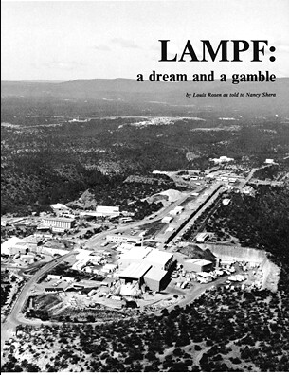
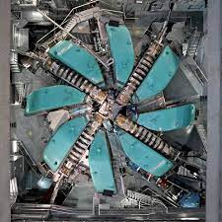
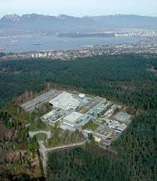
Thanks for Listening

Slide 24
Supplimental Material
Available online
Stuff for longer talk
Stuff for the proceedings
References

Slide 25
Hadron Induced Reactions
Our White Paper [2] outlined some of the physics programs that could be advanced with a hadron-beam facility.
Studies of baryon spectroscopy, particularly the search for “missing resonances” with hadronic beam data that would be analyzed together with photo- and electroproduction data using modern coupled-channel analysis methods.
A hadron beam facility would also advance hyperon spectroscopy and the study of strangeness in nuclear and hadronic physics.
Examples given below.

Slide 26
Spectroscopy of Baryon and Hyperon Resonances
The Missing Resonance Problem
Simply, models predict more states than are observed experimentally.
Missing resonances do not appear at all in the quark-diquark model.
The conjectured reason is that their weak coupling to the πN channel, which supplies the bulk of information about baryonic resonance states.
We can test this hypothesis by looking in reactions that do not involve πN in initial or final state – major reason behind construction of Hall B and CLAS at JLab.

Slide 27
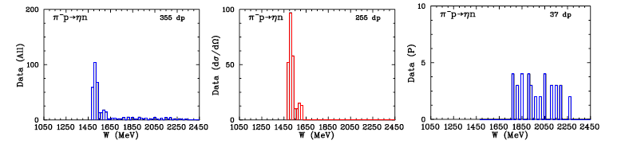
Fig 5 Data for π−p → ηn as a function of W [10]. (blue) total data available for all observables, (red) differential cross-section (dσ/dΩ) data, (blue) polarization data.
Studies with Meson Beams

Slide 28
Studies with Meson Beams
Dramatic improvement in statistics made possible in modern experimental physics (EPECUR) is demonstrated (for medium energies) in Fig. 4.
A similar improvement of data for low energies is needed.

Slide 29
Studies with Meson Beams
Reactions including ηN and KΛ channels notable – have pure isospin-1/2 contributions:
γp → ηp, π⁻p → ηn,
γn → ηn,
γp → K⁺Λ, π⁻p → K⁰Λ,
γn → K⁰Λ.
Figure 5 summarizes the available data below W = 2.5 GeV for π⁻p → ηn.
Photoproduction reactions significant – opportunity to search for “missing resonances” in reactions that do not involve the πN channel.
Combined photo- and pion-induced reactions help separate EM and hadronic vertices.
It is only by combining information from analyses of both πN elastic scattering and γN → πN that make it possible to determine the A_{1/2} and A_{3/2} helicity couplings for N∗

Slide 30
Studies with Meson Beams
γp → ηp reaction is a key to EM goal of a “complete measurement”.
Coupled-channel analyses will need precise data for π⁻p → ηn.
Most π⁻p → ηn data were published in the 1970s, is unreliable above W = 1620 MeV.
Measurements of π⁻p → ηn taken in 1990’s by the Crystal Ball Collaboration [18] – extend to peak of S₁₁ resonance at 1535 MeV.
Fig. 5 shows very few polarization data exist for π⁻p → ηn. Ref. [19] points out the imbalance of γ- vs. π-induced η data.

Slide 31
Studies with Meson Beams
Reason to study π⁻p → K⁰Λ given by resonances from KΛ photo- production claimed by Bonn-Gatchina group [20, 21] and others [22].
These states have large branching ratio into KΛ, pion-induced K⁰Λ production provides an independent reaction to confirm these states.
Current data are not of sufficient quality to do so.
These new states have only weak branching fractions into the πN channel, as they are less visible in elastic πN scattering.
Expect a signal of moderate strength for π⁻p → K⁰Λ.

Slide 32
Studies with Meson Beams
Striking example of why improved data for pion-induced kaon production are necessary is given by the N(1710)1/2⁺.
Properties/existence debated – intimately intertwined with the reaction π⁻p → K⁰Λ; similar arguments apply to the N(1900)3/2⁺. [23]
The latter resonance was also found in kaon photoproduction [22], which makes its study in the reaction π⁻p → K⁰Λ especially promising.
Precise data for π⁻p → K⁰Λ (combined with K⁻p → K⁰Ξ⁰) enable study of SU(3) flavor symmetry and its breaking.
SU(3) flavor symmetry relations could be confirmed to surprising accuracy by comparing the reactions π⁻p → ηn and K⁻p → ηΛ. [24]
Simultaneous study of π⁻p → K⁰Λ and K⁻p → K⁰Ξ⁰ would allow for another test of SU(3) flavor symmetry.

Slide 33
Studies with Meson Beams
Related reactions involve the KΣ channel:
γp → K⁺Σ⁰, π⁻p → K⁰Σ⁰,
γp → K⁰Σ⁺, π⁻p → K⁺Σ⁻,
γn → K⁺Σ⁻, π⁺p → K⁺Σ⁺,
γn → K⁰Σ⁰.
Except for π⁺p → K⁺Σ⁺, these involve mixture of isospin 1/2 and 3/2.
There are number of high-quality measurements involving KΣ photoproduction, status of pion-induced reactions is rather dismal.
Fewer data for π⁻p → KΣ, η′N, ωN, and φN than π⁻p → ηn.

Slide 34
Studies with Meson Beams
To demonstrate recent experimental progress, Fig. 6 shows new measurements of the pure isospin I = 3/2 K+Σ+ final state by the E19 Collaboration at J-PARC, compared to the best available older data.
Note the error bars that are up to one order of magnitude more precise than in the previously available data. Also, angular coverage is significantly improved.
Measurements like this, over a more comprehensive energy range, will greatly improve PWAs of the KΣ final state and, in return, help to extract the S-wave contribution needed, e.g., in approaches based on unitarized chiral perturbation theory (UChPT)

Slide 35
Studies with Meson Beams
Drop in γN → K⁰Σ⁺ σ, with change in dσ/dΩ at ELSA[27] should be visible in πN → KΣ[28]; better measurements of πN needed to shed light on this.
π⁻p → K⁺Σ⁻ where no meson t-channel exchanges possible sensitive to u-channel exchanges; models[29] cannot describe σ near W = 2 GeV - new resonances.
Self-analyzing property of hyperons allows measuring P with improved accuracy in future J-PARC experiments.
Measurements of dσ/dΩ & P will be possible at J-PARC; we encourage this activity.
πN → K⁰Λ, K⁰Σ⁰, K⁺Σ⁻, and K⁺Σ⁺ yields complementary/exclusive information compared to γN.
Larger angular range, smaller systematic uncertainties, finer energy bins needed to confirm recently discovered resonances, to discover new resonances inaccessible in photoproduction, and to test theoretical multichannel concepts.

Slide 36
Studies with Meson Beams
Few data for π⁻p → ωn lead to ambiguous PWA solutions in PWAs[31] and are worthless in constraining PWAs of ω photoproduction.
ωN threshold region attractive to searching for new resonances – reaction threshold is located at the higher-energy edge of the third resonance region – the RPP[5] shows 7 N∗ states with mass 1650 – 1720 MeV.
This energy range may contain unknown N∗ resonances that couple more strongly to ωN than to other meson-baryon channels.
Signs for resonances with low star rating have recently been found in η′N production. [32, 33]
In φ photoproduction, broad, pronounced structure for E_{γ} = 1.8 – 2.3 GeV was found [34] that could come from a resonant state; it should be visible in pion-induced φ production, for which little data exist. [35]
More precise data from pion beams would help clarify all three situations.

Slide 37
Studies with Meson Beams
Neutral hyperons Λ∗ and Σ∗ have been systematically studied in the following formation processes:
  K⁻p → K⁻p, K⁻p → π⁺Σ⁻,
  K⁻p → K^{0n,} K⁻p → π⁰Σ⁰,
  K⁻p → π⁰Λ, K⁻p → π⁻Σ⁺.
Recent analyses of K⁻p → π⁰Λ yield fits that agree for differential cross section and polarization but differ for spin rotation parameter β. [36,37]
Data for β are limited to measurements at only seven energies. [38]
β more sensitive to contributions from high PWs than d𝜎/d𝜴 or polarization.
Need new measurements with polarized target.

Slide 38
Studies with Meson Beams
In addition, Σ^{∗−} can be produced in K⁻n reactions with a deuteron target:
K⁻n → π⁻Λ, K⁻n → π⁰Σ⁻, K⁻n → π⁻Σ⁰.
PWA powerful for disentangling overlapping states, especially above 1.6 GeV/c² for Λ∗ (Σ∗) resonances.
N.B. Λ(1405)1/2⁻ and Σ(1385)3/2⁺ lie below the KN threshold; properties of these states obtained only through production processes such as
K⁻p → π⁻Σ^{∗+} → π⁻π⁺Λ∗.
t-channel process provides “virtual” K⁰ beam – allows production of Σ^{∗+}.
Λ(1405)1/2⁻ and Σ(1385)3/2⁺ identified in decay of Σπ and Λπ/Σπ.

Slide 39
Studies with Meson Beams
Spin and parity of Λ(1405) measured in γp → K⁺Λ(1405) - confirmed to be 1/2⁻ as expected[39]; nature of Λ(1405)^{1/2−} still an issue.
Lineshape of Λ(1405) depends on reaction channel [40 - 42]; comparing p- and K-induced reactions with photoproduction important.
Lineshape of Λ(1405) differs in π⁺Σ⁻ and π⁻Σ⁺ decays – result of isospin interference between different πΣ channels.
The π±Σ∓ spectra measured in π⁻p → K⁰Λ(1405) [43] and K⁻p → π⁺π⁻Λ(1405) [44] and neutral π⁰Σ⁰ measured in K⁻p → π⁰π⁰Σ⁰ [45].
Observed peak position near 1405 MeV in charged πΣ spectra; peak in the neutral channel is near 1420 MeV. All three πΣ channels studied recently in a single experiment using the γp → K⁺Σπ reaction [46].
Efforts in the lineshape study ongoing at JLab and J-PARC.

Slide 40
Studies with Meson Beams
Cascades can be studied with high-momentum kaon beams and multiparticle spectrometers.
Our knowledge of multi-strange baryons obtained from data measured with bubble chambers, lack of appropriate beams and detectors limited our knowledge.
Only cascade ground states of spin-1/2 and spin-3/2 are well identified.
Production of excited states possible kaon beams:
  K⁻p → K⁺Ξ^{∗−}, K⁻p → K^{∗+}Ξ^{∗−}, K⁻p → K^{∗0}Ξ^{∗0}.
Model-independent guidance for analyzing processes and theory found in Refs. [47, 48]
Other production processes with single or multi pions e.g.:
  K⁻p → K⁺π⁺π⁻Ξ^{∗−}, K⁻p → K⁺π⁻Ξ^{∗0}.
Analysis of decay vertex efficient for suppressing background processes; masses, widths, and decay modes to be studied at J-PARC.
These measurements will be complementary to planned measurements at CLAS12 to study Ξ∗ states via several reactions such as γp → K⁺K⁺(Ξ^{∗−}) and γp → K⁺K⁺π⁻(Ξ^{∗0}). [49]

Slide 41
Studies with Meson Beams
High-momentum kaon beams are crucial for producing Ω baryons in the inclusive reaction K⁻p → Ω^{∗−}X by measuring decay particles.
The Ω⁻ production mechanism should be quite specific since it is the first baryon with constituents of which none could come from the target proton.
These measurements will be complementary to planned measurements at CLAS12 to measure Ω photo- production on the proton target. [49]
Specific plans are to make the first precise measurement of the Ω⁻ differential cross section in γp → Ω⁻K⁺K⁺K⁰ and to search for Ω∗ resonances.

Slide 42
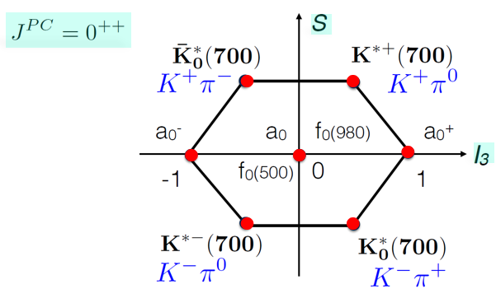
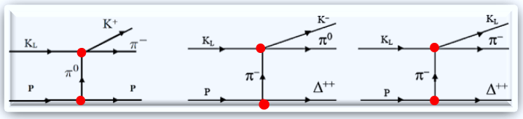
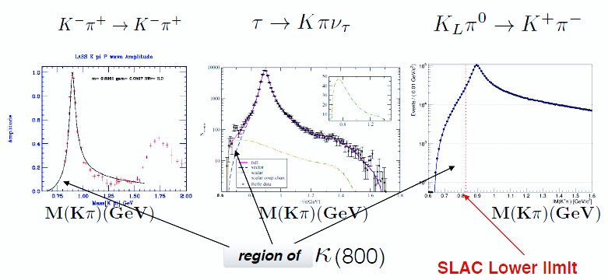



Proposed Measurements for Kπ Scattering
Higher masses
Terra Incognita

Slide 43
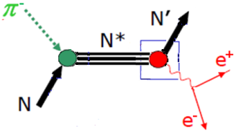
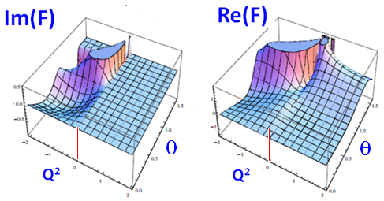
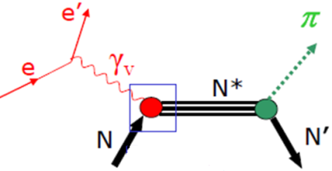
Homework for HADES
Form-Factor Measurements
• Inverse Pion Electroproducion is the only process which allows the determination of EM
nucleon and pion form factors in the intervals:
0 < k² < 4 M² 0 < k² < 4 m_{π}²
which are kinematically unattainable from e⁺e⁻ initial states.
Im=0
Time-like
MEIC
CLAS
Space-like
• π⁻p→e⁺e⁻n measurements will significantly complement the current electroproduction.
• γ*N→πN study for the evolution of baryon properties with increasing momentum transfer
by investigation of the case for the time-like virtual photon.
Forum for MAX-IV Ring, Lund, Nov 2011

Slide 44


E12-12-19-001
Worldwide Interest in Physics
110 experimentalists &
42 theorists
from 68 labs
across 19 countries
worldwide

Slide 45
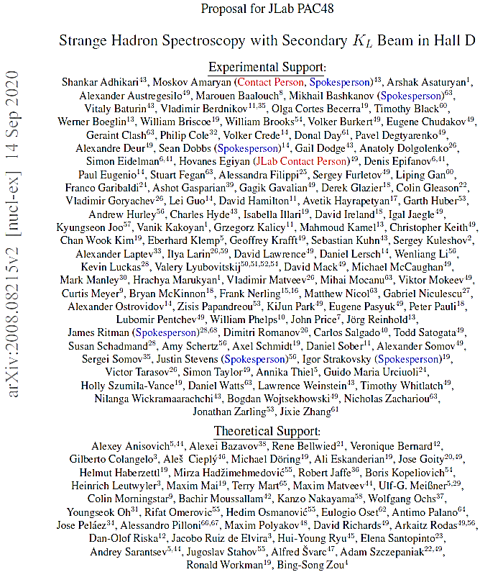







E12-12-19-001
https://wiki.jlab.org/klproject/index.php/Main_Page

Slide 46
References
Physics Opportunities with Meson Beams for EIC, William J. Briscoe (GWU), Michael Doring (GWU), Helmut Haberzettl (GWU), D. Mark Manley, (KSU), Megumi Naruki (Kyoto University), Greg Smith (JLab), Igor Strakovsky (GWU), Eric S. Swanson (University of Pittsburg—https://doi.org/10.48550/arXiv.2108.07591
Physics Opportunities with Meson Beams, William J. Briscoe (GW), Michael Döring (GW), Helmut Haberzettl (GW), D. Mark Manley (KSU), Megumi Naruki (Kyoto Univ.), Igor I. Strakovsky (GW), Eric S. Swanson (Univ. of Pittsburgh)—https://doi.org/10.48550/arXiv.1503.07763
A. Aprahamian et al., Reaching for the horizon: The 2015 long range plan for nuclear science, http://science.energy.gov/np/nsac/
N. Isgur and M.B. Wise, Phys. Rev. Lett. 66, 1130 (1991).
P.A. Zyla et al. [Particle Data Group], PTEP 2020, 083C01 (2020).
R Koniuk and N. Isgur, Phys. Rev. Lett. 44, 845 (1980).
R.A. Khalek et al. “Science requirements and detector concepts for the Electron-Ion Collider: EIC Yellow Report,” [arXiv:2103.05419 [physics.ins-det]].
R A. Arndt, W.J. Briscoe, I.I. Strakovsky, and R.L. Workman, Phys. Rev. C 74, 045205 (2006).
9. Y. Qiang, Y.I. Azimov, I.I. Strakovsky, W.J. Briscoe, H. Gao, D.W. Higinbotham, and V.V. Nelyubin, Phys. Lett. B 694, 123
(2011).
W.J. Briscoe, D. Schott, I.I. Strakovsky, and R. L. Workman, Institute of Nuclear Studies of the George Washington
University Database; http://gwdac.phys.gwu.edu/.

Slide 47
References
11. R.A. Arndt, W.J. Briscoe, I.I. Strakovsky, and R.L. Workman, Phys. Rev. C 74, 045205 (2006).
12. K.A. Olive et al. [Particle Data Group], Chin. Phys. C 38, 090001 (2014).
13. I.G. Alekseev et al. [EPECUR Collaboration], Phys. Rev. C 91, 025205 (2015).
14. R.A. Arndt, I.I. Strakovsky, R.L. Workman, and M.M. Pavan, Phys. Rev. C 52, 2120 (1995).
15 G. Höhler, Pion-Nucleon Scattering, Landoldt-Börnstein, Vol. I/9b2, edited by H. Schopper (Springer-Verlag, Berlin, 1983).
16. R. Koch, Z. Phys. C 29, 597 (1985).
17. R.E. Cutkosky, C.P. Forsyth, R.E. Hendrick, and R.L. Kelly, Phys. Rev. D 20, 2839 (1979).
18. S. Prakhov et al. [Crystal Ball Collaboration], Phys. Rev. C 72, 015203 (2005).
19. B. Krusche and C. Wilkin, Prog. Part. Nucl. Phys. 80, 43 (2014).
A. V. Anisovich et al., Eur. Phys. J. A 48, 15 (2012).
A. V. Anisovich et al., Eur. Phys. J. A 48, 88 (2012).
T. Mart and M. J. Kholili, Phys. Rev. C 86, 022201 (2012).
V. D. Burkert et al., arXiv:1412.0241 [nucl-ex]

Slide 48
References
24. A. Starostin et al. [Crystal Ball Collaboration], Phys. Rev. C 64, 055205 (2001).
25. K. Shirotori et al., Phys. Rev. Lett. 109, 132002 (2012).
26. D.J. Candlin et al., Nucl. Phys. B 226, 1 (1983).
27. R. Ewald et al., Phys. Lett. B 713, 180 (2012).
28. A. Ramos and E. Oset, Phys. Lett. B 727, 287 (2013).
29. D. Rönchen et al.. Eur. Phys. J. A 49, 44 (2013).
D.M. Manley, R.A. Arndt, Y. Goradia, and V.L. Teplitz, Phys. Rev. D 30, 904 (1984).
H. Karami et al., Nucl. Phys. B 134, 503 (1979).
F. Huang, H. Haberzettl, and K. Nakayama, Phys. Rev. C 87, 054004 (2013).
F. Huang, H. Haberzettl, and K. Nakayama, Int. J. Mod. Phys. Conf. Ser. 26, 1460113 (2014).
K.P. Adhikari et al. [CLAS Collaboration], Phys. Rev. C 89, 055206 (2014).
M. Döring, E. Oset, and B.S. Zou, Phys. Rev. C 78, 025207 (2008).
A.V. Anisovich et al., Eur. Phys. J. A 48, 88 (2012).

Slide 49
References
H. Zhang, J. Tulpan, M. Shrestha, and D.M. Manley, Phys. Rev. C 88, 035204 (2013).
K.W. Bell et al., Nucl. Phys. B 222, 389 (1983). [128]
K. Moriya et al. [CLAS Collaboration], Phys. Rev. Lett. 112, 082004 (2014).
B. Borasoy, R. Nißler, and W. Weise, Eur. Phys. J. A 25, 79 (2005).
N. Kaiser, P. B. Siegel, and W. Weise, Nucl. Phys. A 594, 325 (1995).
D. Jido, J. A. Oller, E. Oset, A. Ramos, and U.G. Meißner, Nucl. Phys. A 725, 181 (2003).
37. D.W. Thomas, A. Engler, H.E. Fisk, and R.W. Kraemer, Nucl. Phys. B 56, 15 (1973).
38. R.J. Hemingway, Nucl. Phys. B 253, 742 (1985).
39. S. Prakhov et al. [Crystal Ball Collaboration], Phys. Rev. C 70, 034605 (2004).
40. K. Moriya et al. [CLAS Collaboration], Phys. Rev. C 87, 035206 (2013).
41. B.C. Jackson, Y. Oh, H. Haberzettl, and K. Nakayama, Phys. Rev. C 89, 025206 (2014).
42. B.C. Jackson, Y. Oh, H. Haberzettl, and K. Nakayama, arXiv:1503.00845 [nucl-th].
43. Photoproduction of the Very Strangest Baryons on a Proton Target in CLAS12, Spokespersons: M. Dugger, J. Goetz, L.
Guo, E. Pasyuk, I.I. Strakovsky, D.P. Watts, and V. Ziegler [The Very Strange Collaboration], JLab Proposal E12–11–
005a, Newport News, VA, USA, 2012; http://www.jlab.org/exp prog/proposals/12/PR12-12-008.pdf.

