Slide 1

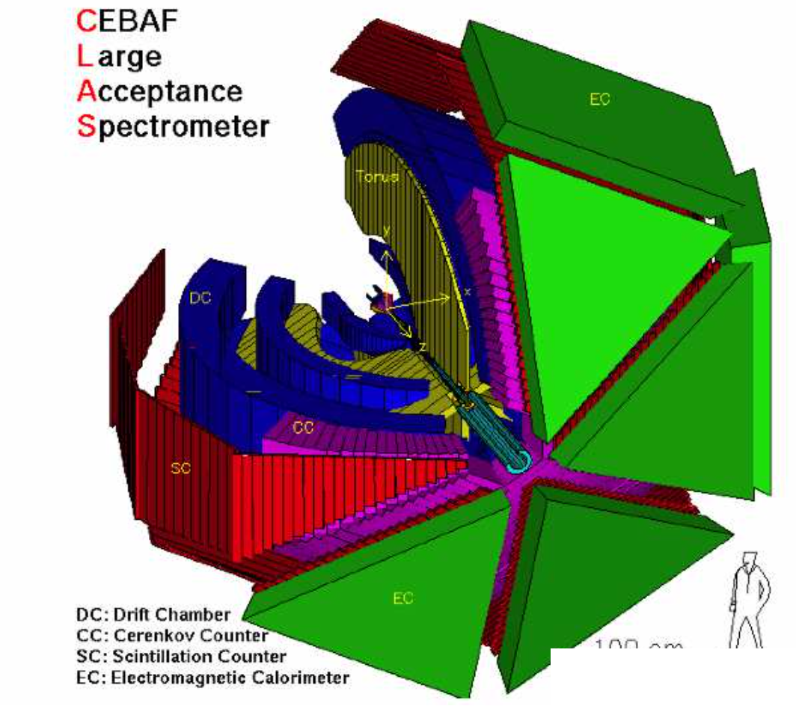
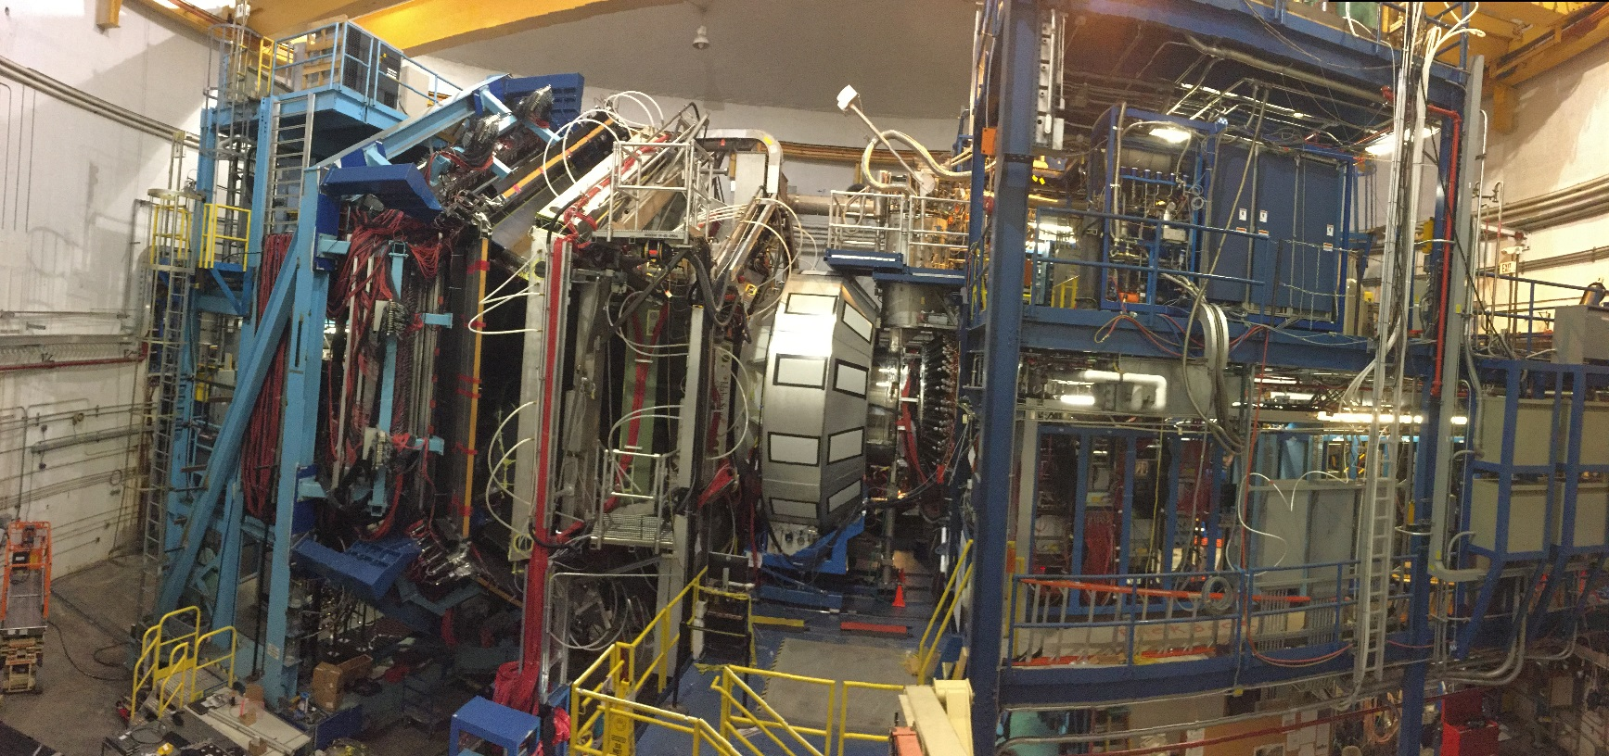
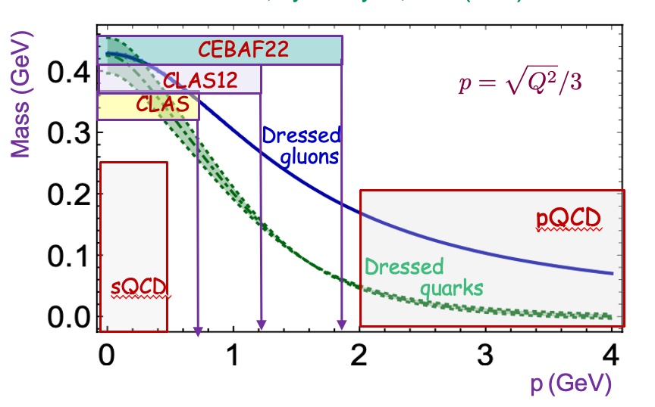



Resonance Electrocouplings and Emergent Hadron Mass
emergence of hadron mass (EHM) paradigm within continuum
Schwinger method (CSM)
complementarity in insight into EHM from the meson and baryon structure exploration
shedding light on EHM from the results on γ_{v}pN* electrocouplings
unique opportunity to understand EHM from the N* studies in
experiments of 22 GeV era at JLab
V.I. Mokeev, Jefferson Lab
(CLAS Collaboration)
Science at the Luminosity Frontier: Jefferson Lab at 22 GeV Workshop
1

Slide 2
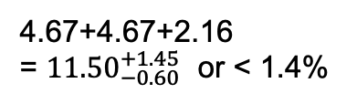
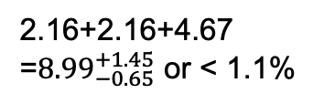
Why Emergence of the Ground/Excited Nucleon Mass Remains Open Problem?
Composition of the Nucleon Mass:
proton
neutron
M_{p}, MeV (PDG22)
M_{n}, MeV (PDG22)
938.2720813
±0.0000058
939.5654133
±0.0000058
Sum of bare quark
masses, MeV
Sum of bare quark
masses, MeV
2.16+2.16+4.67
=${8.99}_{−0.65}^{+1.45}$ or < 1.1%
4.67+4.67+2.16
= ${11.50}_{−0.60}^{+1.45}$ or < 1.4%
Higgs mechanism generates the masses of bare quarks with <2 % contribution into measured nucleon mass
Dominant part of nucleon mass is generated in processes other than the Higgs mechanism.
CSM paradigm on EHM supported by the experiments on hadron structure studies demonstrates the dominant part of hadron mass is created by strong interaction in the strongly-coupled regime when QCD running coupling α_{s}/π→1
2

Slide 3
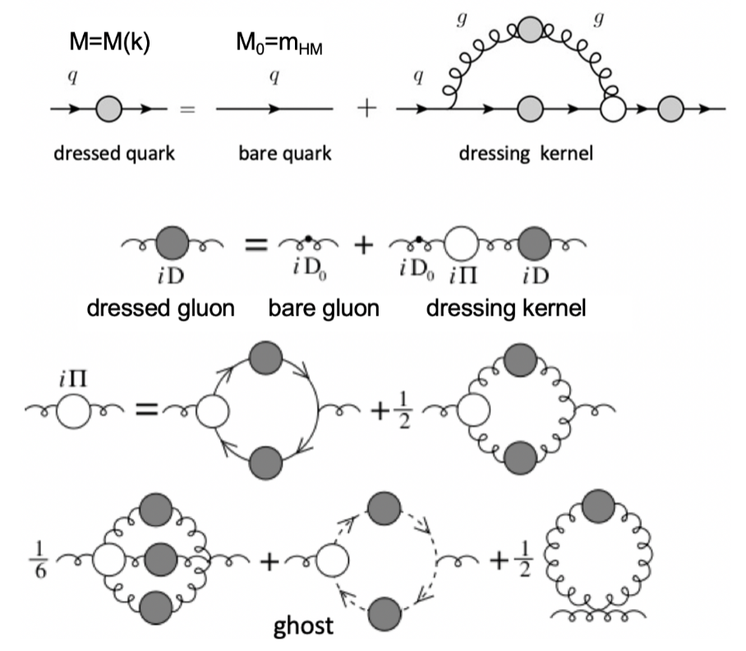
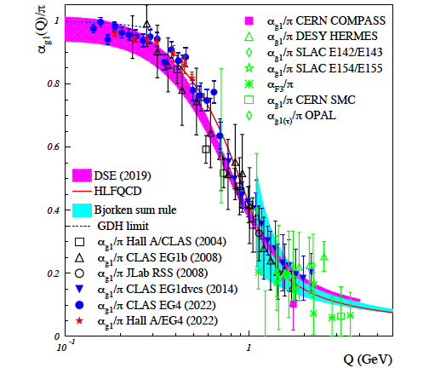
Basics for Insight into EHM: Continuum and Lattice QCD Synergy
Emergence of Dressed Quarks and Gluons
D. Binosi et al., Phys. Rev. D 95, 031501 (2017)
QCD Running Coupling α(k)
Zh-F. Cui et al., Chin. Phys. C44, 083102 (2020)
A. Deur et al., Particles 5, 171 (2022)
α_{s}(k)/π
k (GeV)
In the regime of the QCD running coupling comparable with unity, dressed quarks and gluons with distance (momentum) dependent masses emerge from QCD, as follows from the equations of the motion for the QCD fields depicted above

Slide 4
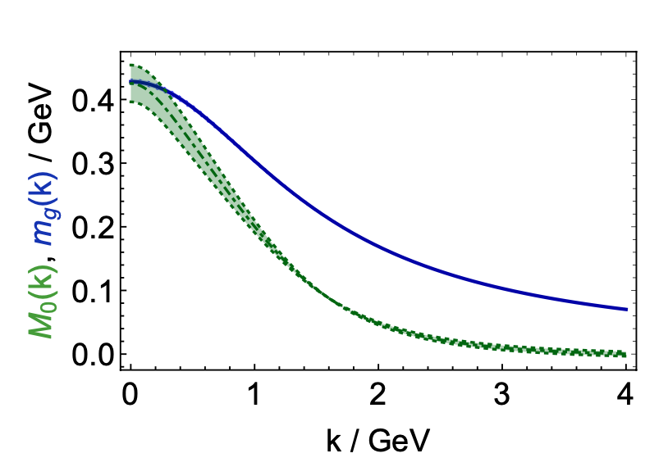
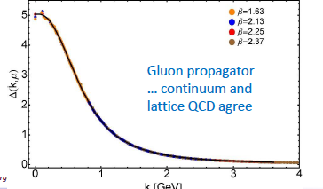
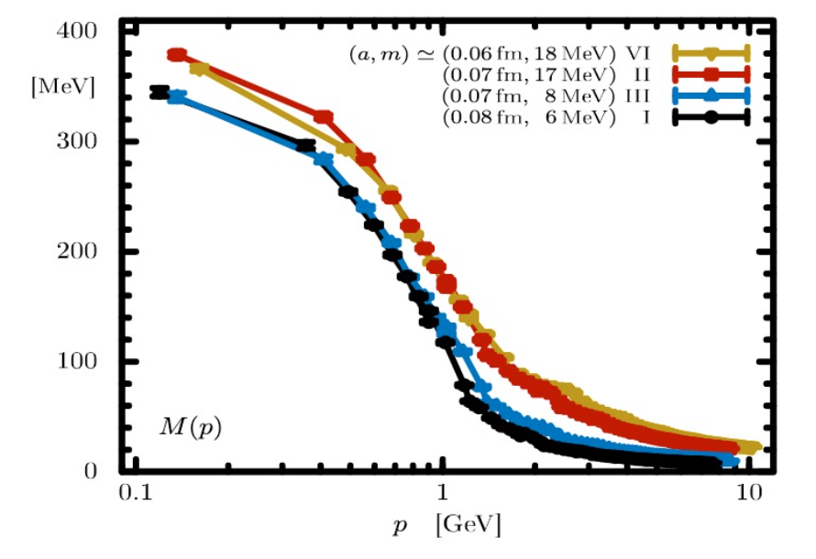
Basics for Insight into EHM: Continuum and Lattice QCD Synergy
Dressed quark/gluon masses converge at the complete QCD mass scale of 0.43(1) GeV – value.
Express the fundamental feature: emergence of the quark and gluon masses even in the case of massless quarks in chiral limit and massless QCD gluons.
Running dressed quark/gluon masses and effective charge (slide#3) as are three pillars of EHM
Continuum QCD results are confirmed by LQCD
Insight into dressed quark mass function from data on hadron structure represents a challenge for experimental hadron physics
Dressed Quark/Gluon Masses (continuum QCD)
C.D. Roberts, Symmetry 12, 1468 (2020), AAPS Bull 31, 6 (2021)
Dressed
gluons
Dressed
quarks
Inferred from QCD Lagrangian with only the Λ_{QCD} parameter
Dressed Quark Mass (lattice QCD)
O. Olivera et al., Phys. Rev. D 99, 094506 (2019)
k [GeV]
M(k)
k (GeV)

Slide 5
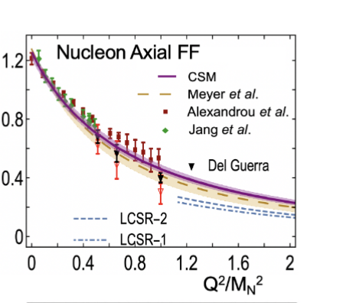
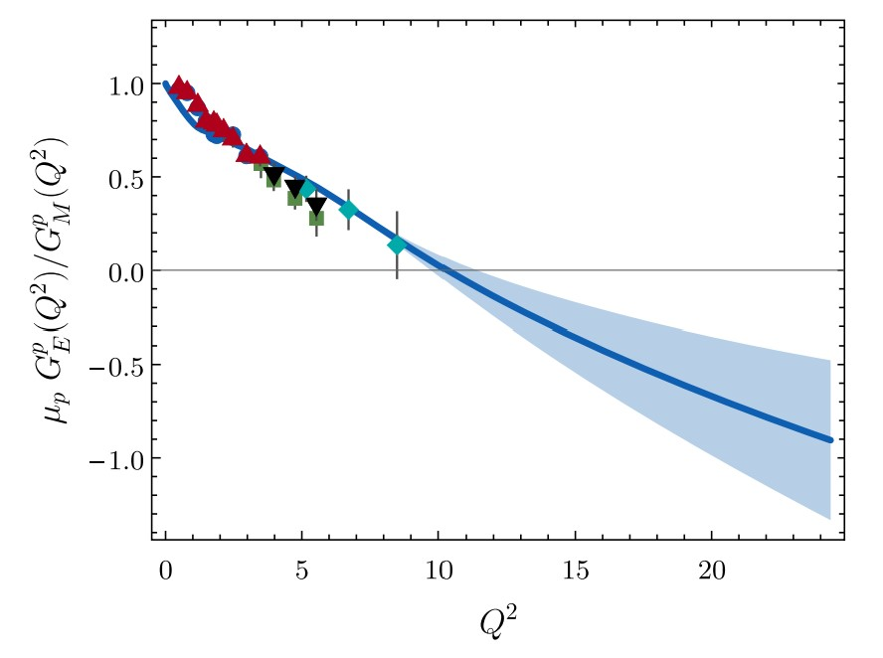
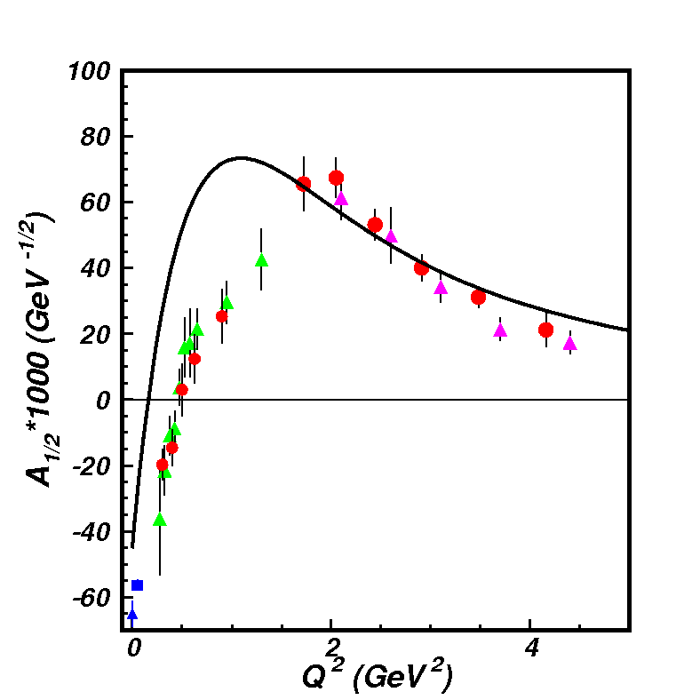
EHM from Global Hadron Structure Analysis
Will be extended by the future data from JLab in the 12 GeV era
Nucleon Elastic FF
γ_{v}pN* Electrocouplings
Nucleon axial form factor G_{A}
N(1440)1/2⁺
μ_{p}G_{E}/G_{M} (Q²)
in DSEQCD
New data from studies of D-Y at AMBER and Sullivan processes at JLab
Dressed Quark/Gluon
Running Masses
Pion Elastic FF
Pion PDF
Dressed
gluons
Dressed
quarks
insight into the dressed quark/gluon running masses from all of the experimental results above within continuum QCD approach

Slide 6
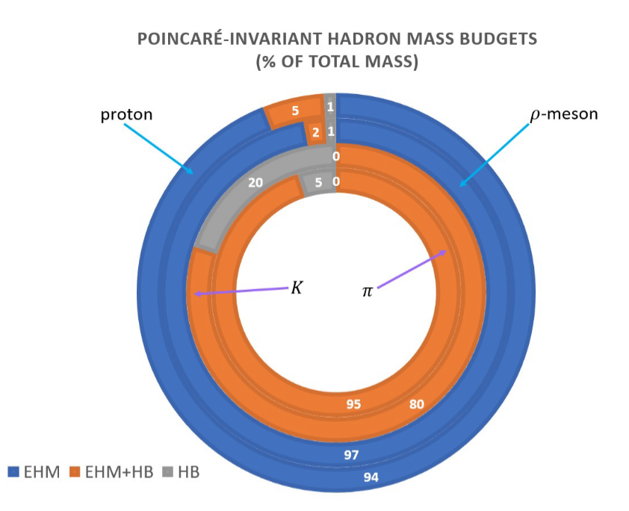
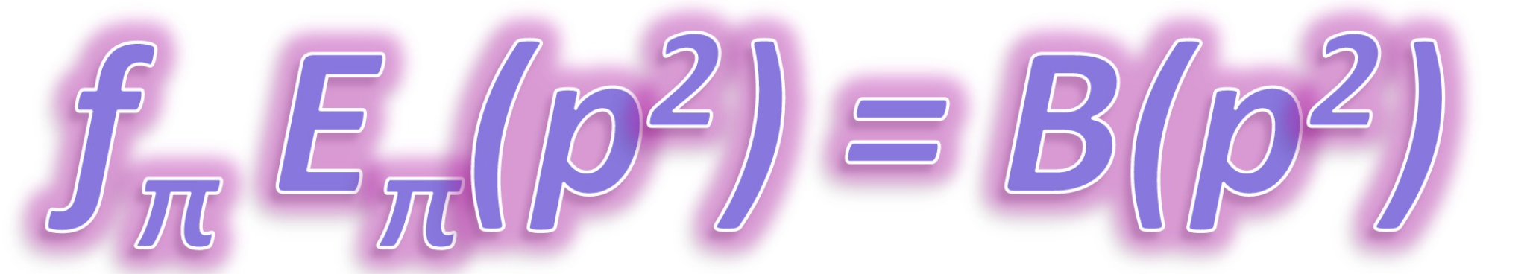
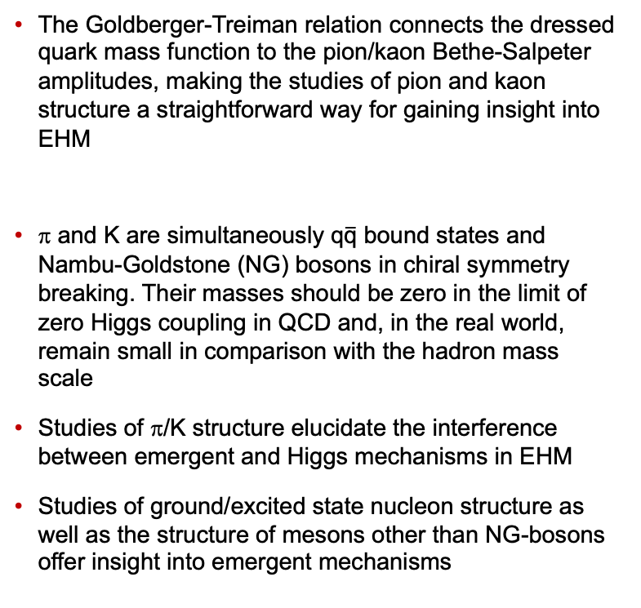
Complementarities in Insight into EHM from the Studies of the Meson
and Baryon Structure
The Goldberger-Treiman relation connects the dressed quark mass function to the pion/kaon Bethe-Salpeter amplitudes, making the studies of pion and kaon structure a straightforward way for gaining insight into EHM
π and K are simultaneously q$\overline{\text{q}}$ bound states and Nambu-Goldstone (NG) bosons in chiral symmetry breaking. Their masses should be zero in the limit of zero Higgs coupling in QCD and, in the real world, remain small in comparison with the hadron mass scale
Studies of π/K structure elucidate the interference between emergent and Higgs mechanisms in EHM
Studies of ground/excited state nucleon structure as well as the structure of mesons other than NG-bosons offer insight into emergent mechanisms
The successful description of the π/K elastic FF and PDF, nucleon elastic/axial FFs, the γ_{v}pN* electrocouplings of prominent nucleon resonances of different structure and elastic FFs for mesons other than NG-bosons achieved with the same dressed quark mass function is of particular importance for the validation of insight into EHM.

Slide 7
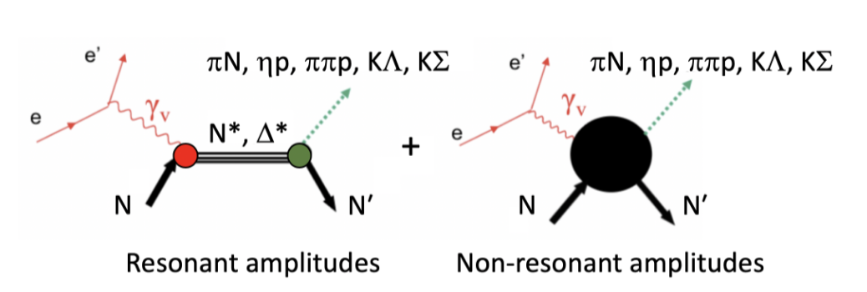
N* Photo-/Electroexcitation Amplitudes (γ_{r,v}pN* Photo-/Electrocouplings)
and their Extraction from Exclusive Photo-/Electroproduction Data
Real A_{1/2}(Q²), A_{3/2}(Q²), S_{1/2}(Q²)
I.G. Aznauryan and V.D. Burkert, Prog. Part. Nucl. Phys. 67, 1 (2012)
Definition of N* photo/electrocouplings
employed in CLAS data analyses:
  Consistent results on γ_{r,v}pN* photo-/electrocouplings from different meson photo-/electro-production channels allow us to establish systematical uncertainties for their extraction related to use of reaction models

Slide 8
Nucleon Resonance Electrocouplings from Data On Exclusive Meson Electroproduction of 6.0 GeV Era at JLab
Exclusive meson electroproduction channels | Excited proton states | Q²-ranges for extracted γ_{v}pN* electrocouplings, GeV²
π⁰p, π⁺n | Δ(1232)3/2⁺ N(1440)1/2⁺,N(1520)3/2⁻, N(1535)1/2⁻ | 0.16-6.0 0.30-4.16
π⁺n | N(1675)5/2⁻, N(1680)5/2⁺ N(1710)1/2⁺ | 1.6-4.5
ηp | N(1535)1/2⁻ | 0.2-2.9
π⁺π⁻p | N(1440)1/2⁺, N(1520)3/2⁻ Δ(1620)1/2⁻, N(1650)1/2⁻, N(1680)5/2⁺, Δ(1700)3/2⁻, N(1720)3/2⁺, N’(1720)3/2⁺ | 0.25-1.50 2.0-5.0 (preliminary) 0.5-1.5
The γ_{v}pN* electrocouplings have become available from analysis of CLAS data for most excited states of the nucleon in the mass range <1.8 GeV and in a broad range of Q²<5.0 GeV² .
The experiments in Halls A/C extended the results on γ_{v}pN* electrocouplings of Δ(1232)3/2⁺ and N(1535)1/2⁻ for Q² < 7.5 GeV²
The recent results can be found in: A.N. Hiller Blin et al, PRC100, 035201 (2019).

Slide 9
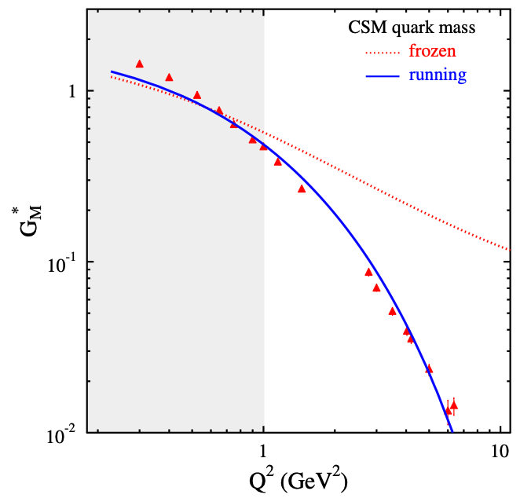
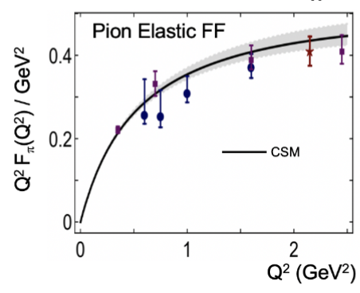
CSM Predictions for Resonance Electroexcitations vs. Available Experimental Results
CLAS/Hall A/C results vs. CSM expectations
A successful description of the pion and nucleon elastic FFs, and the electrocouplings of the Δ(1232)3/2⁺ and N(1440)1/2⁺ resonances has been achieved with the same dressed quark/gluon mass functions
N→Δ(1232)3/2⁺ magnetic FF
N(1440)1/2⁺
Substantial contributions from M-B cloud
J. Segovia et al., FBS 55, 1185 (2014)
J. Segovia et al., PRL 115, 171801 (2015)
Dressed quarks with dynamically generated masses represent active degrees of freedom in the structure of the pion, nucleon, and the Δ(1232)3/2⁺, N(1440)1/2⁺ resonances
Strong evidence for insight into momentum dependence of dressed quark mass
Pion Elastic FF
C.D. Roberts et al., Prog. Part. Nucl Phys. 120, 103883 (2021)
Nucleon Elastic FF
M. Barabanov et al., Prog. Part. Nucl. Phys. 103835 (2021)
Q² F_{π} / GeV²
μ_{p}G_{E}^{p}(Q²)/G_{M}^{p}(Q²)
Data points: Jlab Fπ
Collaboration
Hall A/C data
Q² (GeV²)
Q² (GeV²)
One of the most important achievements in hadron physics of the last decade
in synergistic efforts between experimentalists, phenomenologists, and theorists.
10
Notes:
- The picture of a quark inside of a hadron is a dynamical picture - what we effectively see depends on the quark momentum - review the picture and the importance of scale
- Model calculations of form factors and electrocouplings are sensitive to the evolution of the dressed quark mass function.
- Review the model calculations
- The data from CLAS12 will cover for the first time the range of Q2 where the dominant part of the hadron mass is generated addressing the key open problems of what is the nature of confinement and how is more than 98% of the visible mass in the Universe generated?

Slide 10
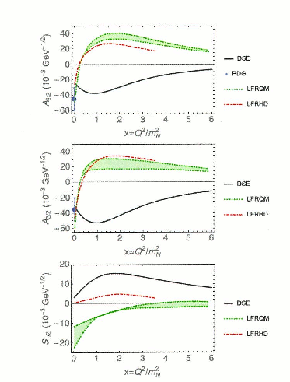
Δ(1600)3/2⁺ Electrocouplings: CSM Prediction vs. Data Determination
Extraction of Δ(1600)3/2⁺ electrocouplings from the CLAS π⁺π⁻p electroproduction data at 2.0 GeV²<Q²<5.0 GeV² within the JM reaction model, January-March, 2022
Closest to the data
9 one-fold differential
cross sections evalu-
ated within the JM
model
Resonant contributions
Into selected in the data
fit 9 one-fold differential
cross sections
Comparable spread for the selected in the data fit 9
one-fold differential cross sections and the respective resonant
contributions suggests credible and unambiguous separation
between the resonant/non-resonant contributions
γ_{v}pN* electrocouplings were determined from the fit of the
resonant contributions within the unitarized BW ansatz
Parameter-free CSM predictions for Δ(1600)3/2⁺ electrocouplings
Ya Lu et al., Phys. Rev. D 100, 034001 (2019)
Notes:
Continnum QCD approaches provided parameter free prediction on D(1600)3/2+ electrocopuplings. The CLAS p+p-p electroproduction data at 2.0 < Q < 5.0 GeV2 (current and next slides) are comsistent with the contribution of D(1600)3/2+ resonance with electrocouplings predicted within continuum QCD approach. The extraction of these electrocouplings from the data without any model bias is in progress. If expectations from continuum QCD on electrocouplings of this state will be confirmed, the access to dressed quark mass function from the data on resonance electrocouplings will be fully validated.

Slide 11
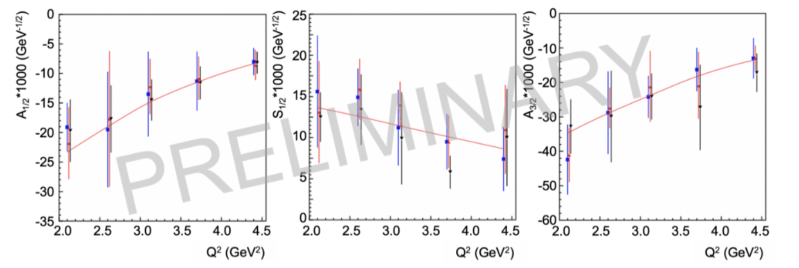
Δ(1600)3/2⁺ Electrocouplings : CSM Prediction vs. Data Determination
CSM predictions, Ya Lu et al., Phys. Rev. D 100, 034001 (2019)
Electrocouplings from independent analyses of π+π⁻p differential cross sections within three W-intervals, 1.46<W<1.56 GeV, 1.51<W<1.61 GeV, and 1.56<W<1.66 GeV for 2.0<Q²<5.0 GeV²
CLAS results on Δ(1600)3/2⁺ electrocouplings confirmed the CSM prediction, solidifying evidence for gaining insight into dressed quark mass function and, consequently, into EHM from the studies of γ_{v}pN* electrocouplings
11

Slide 12
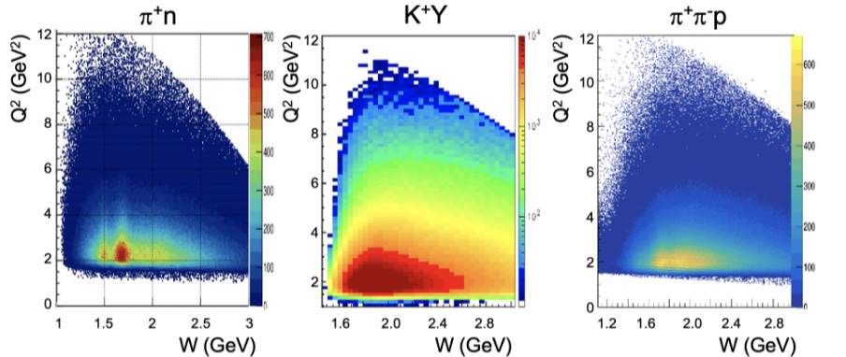
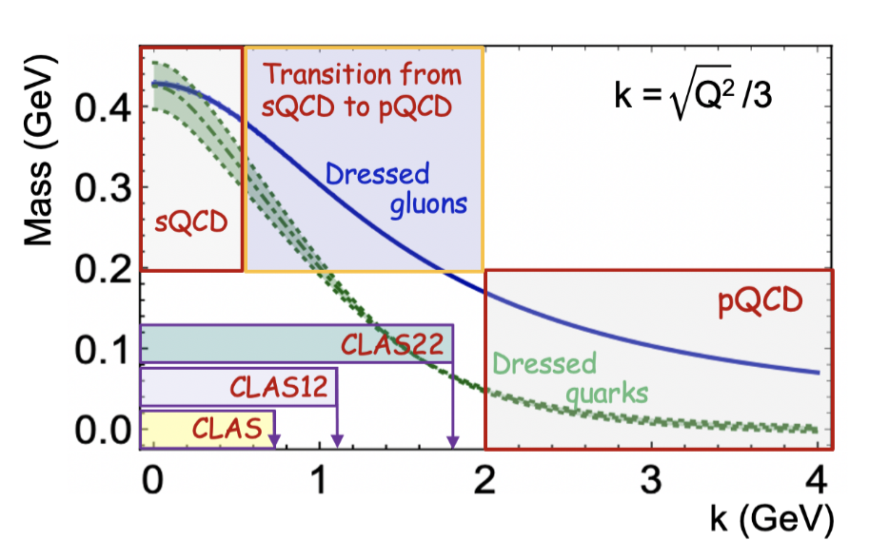
Emergence of Hadron Mass from the Measurements with CLAS12 and after CEBAF 22 GeV Energy Upgrade
Meson electroproduction yields measured with the CLAS12
CLAS12: Extension the results on γ_{ϖ}pN* electrocouplings of most N* states in the range W < 2.5 GeV and Q² up to 8.0-10.0 GeV² from exclusive channels: πN, ππN, KY, K*Y, KY* allows to map-out range of quark momenta where ~ 50 % of dressed quark mass is generated
In order to resolve the challenging problem on EHM, the dressed quark mass function M_{q}(k) should be mapped out within the entire range of quark momenta to ~2 GeV, where the transition from strongly-coupled to perturbative QCD takes place and where dressed quarks/gluons emerge as α_{s}/π→1.
12

Slide 13
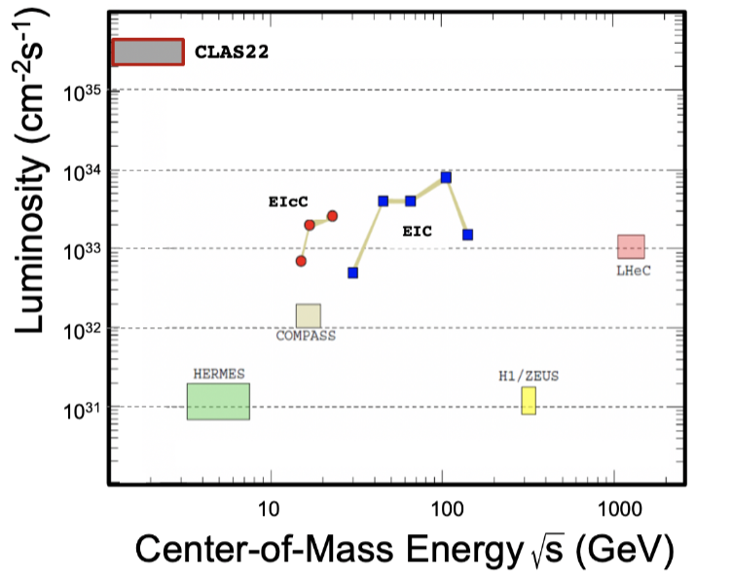
Unique Opportunities for Insight into EHM through Studies of the N* Structure After CEBAF 22 GeV Energy Upgrade with CLAS22
Simulations of πN, KY, and π⁺π⁻p electroproduction with CEBAF@22 GeV show:
γ_{v}pN* electrocouplings can be determined up to Q² ~ 30 GeV² for 𝓛 ~ 2 - 5 ⨉ 10³⁵ cm⁻²s⁻¹
Both EIC and EIcC would need much higher luminosity to carry out such a program
The luminosity “frontier” is a unique advantage of JLab
Beam energy 22 GeV
Large acceptance
High luminosity
Studies of exclusive reactions
Extending the results on the γ_{v}pN* electrocouplings into the Q² range from 10 - 30 GeV² after the increase of the CEBAF energy and pushing the CLAS12 detector capabilities to measure exclusive electroproduction to the highest possible luminosity, will offer the only foreseen opportunity to explore how the dominant part of hadron mass and N* structure emerge from QCD and will make CEBAF@22 GeV unique and the ultimate QCD-facility at the luminosity frontier.
13

Slide 14

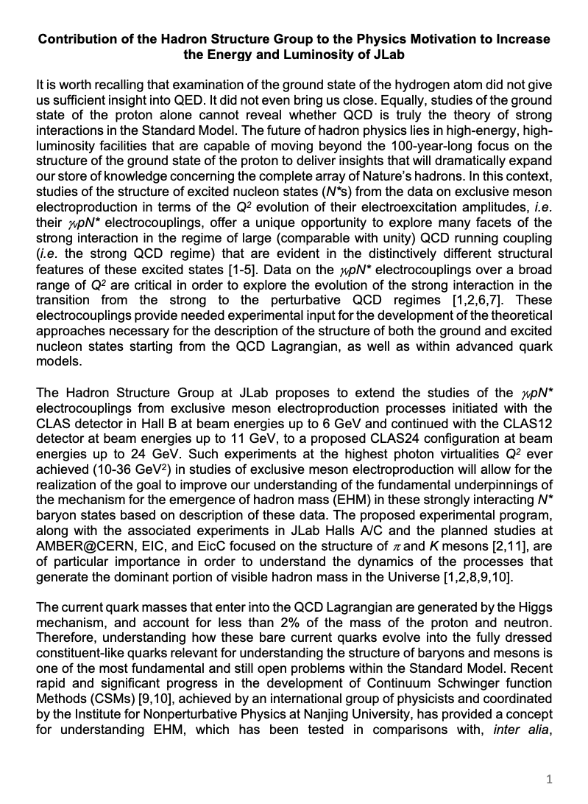
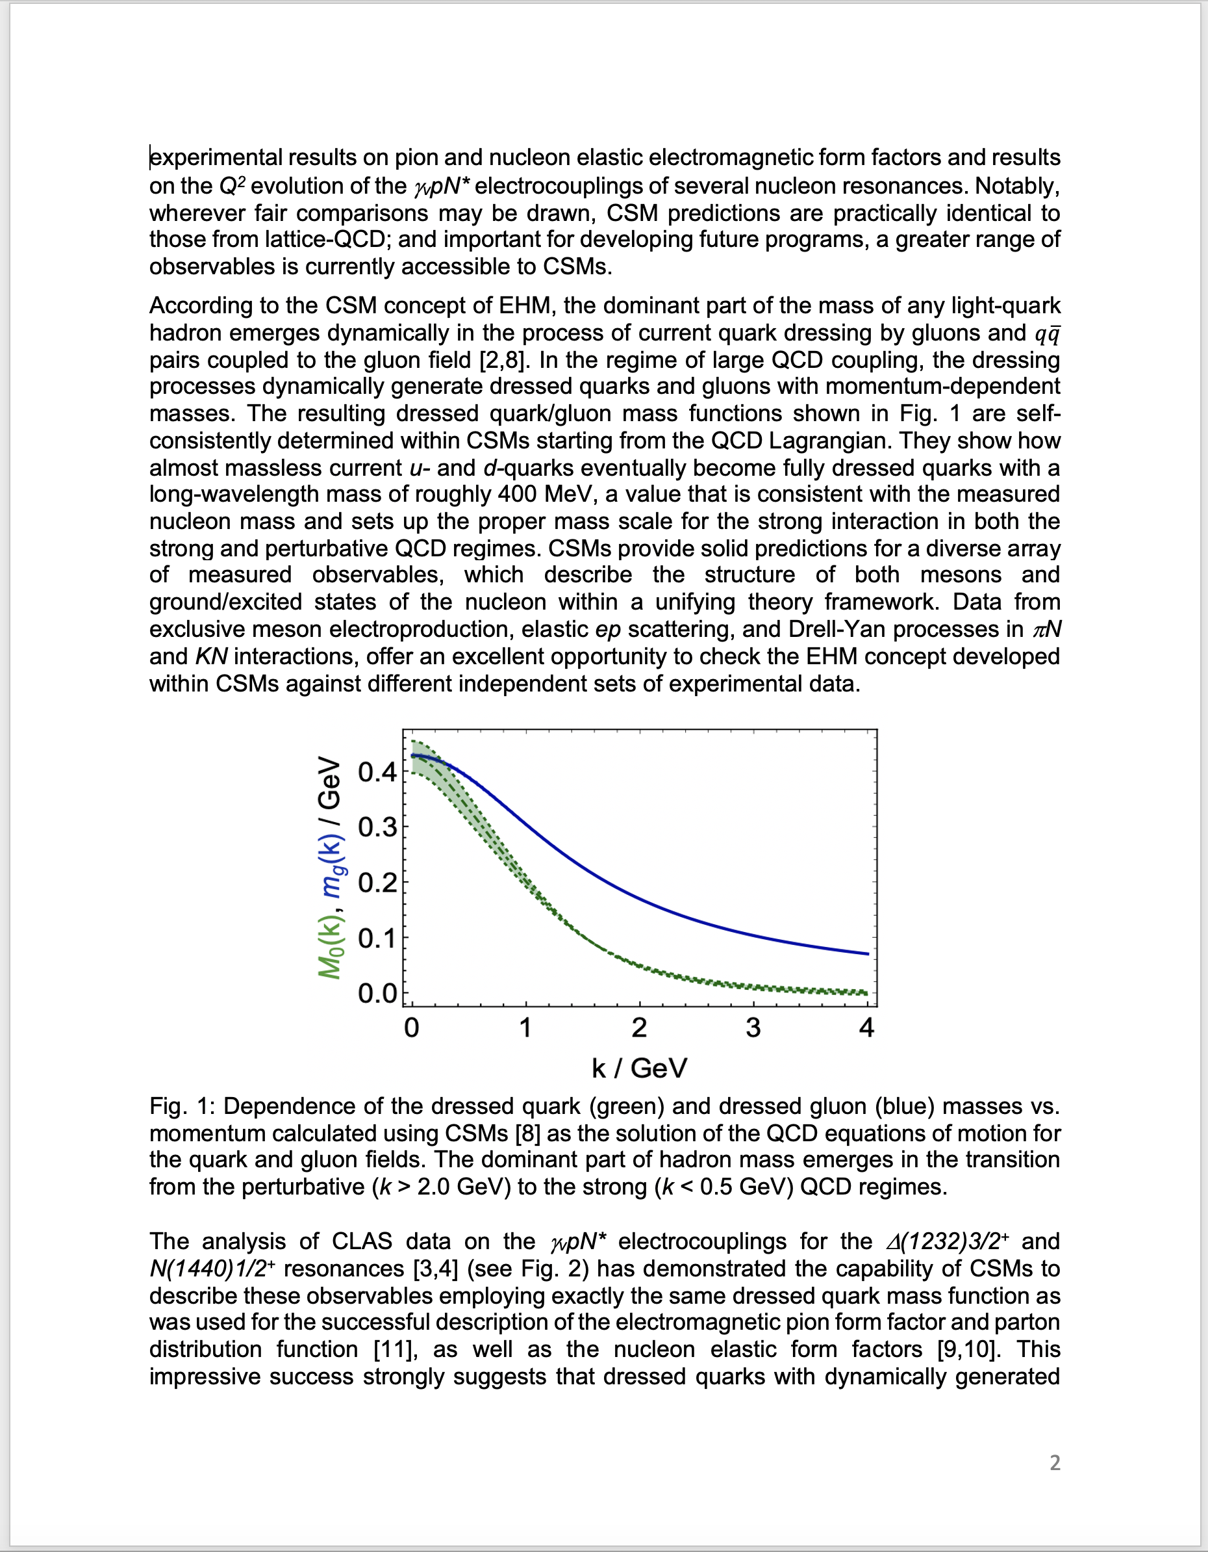
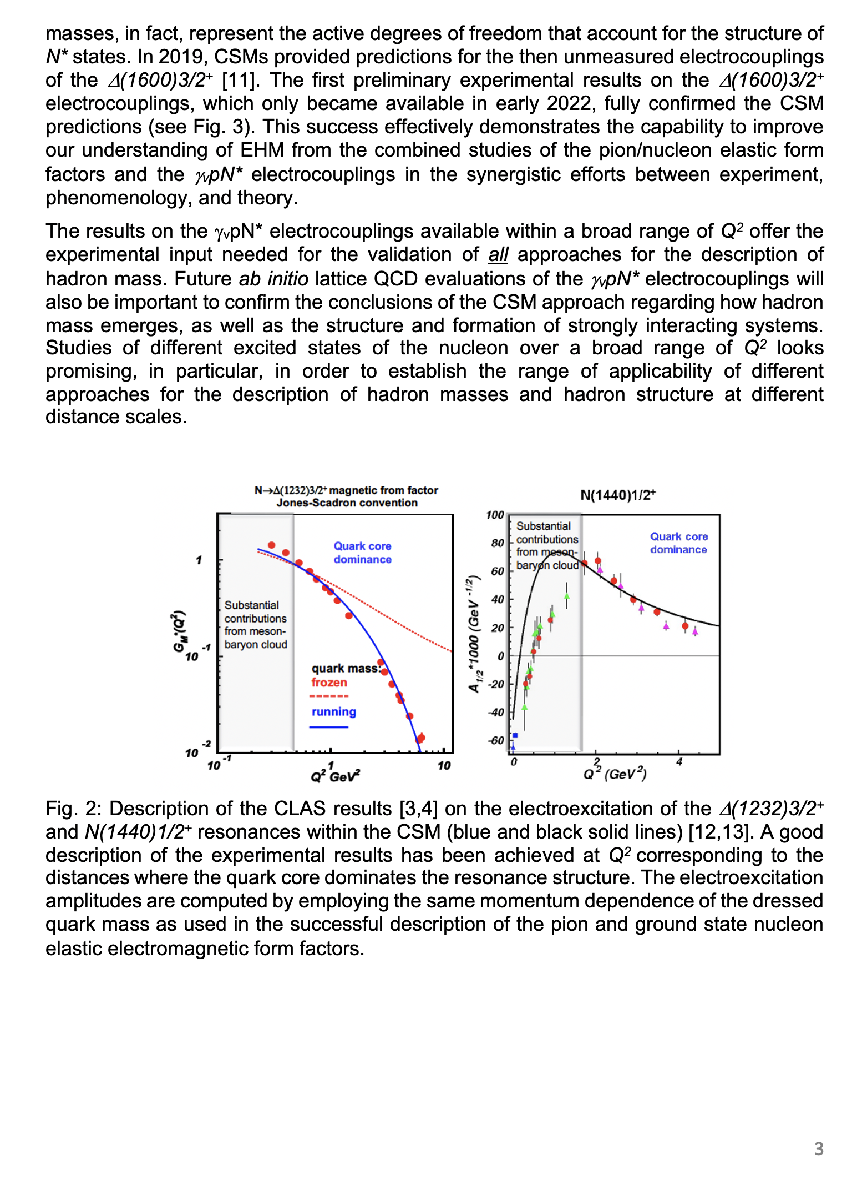
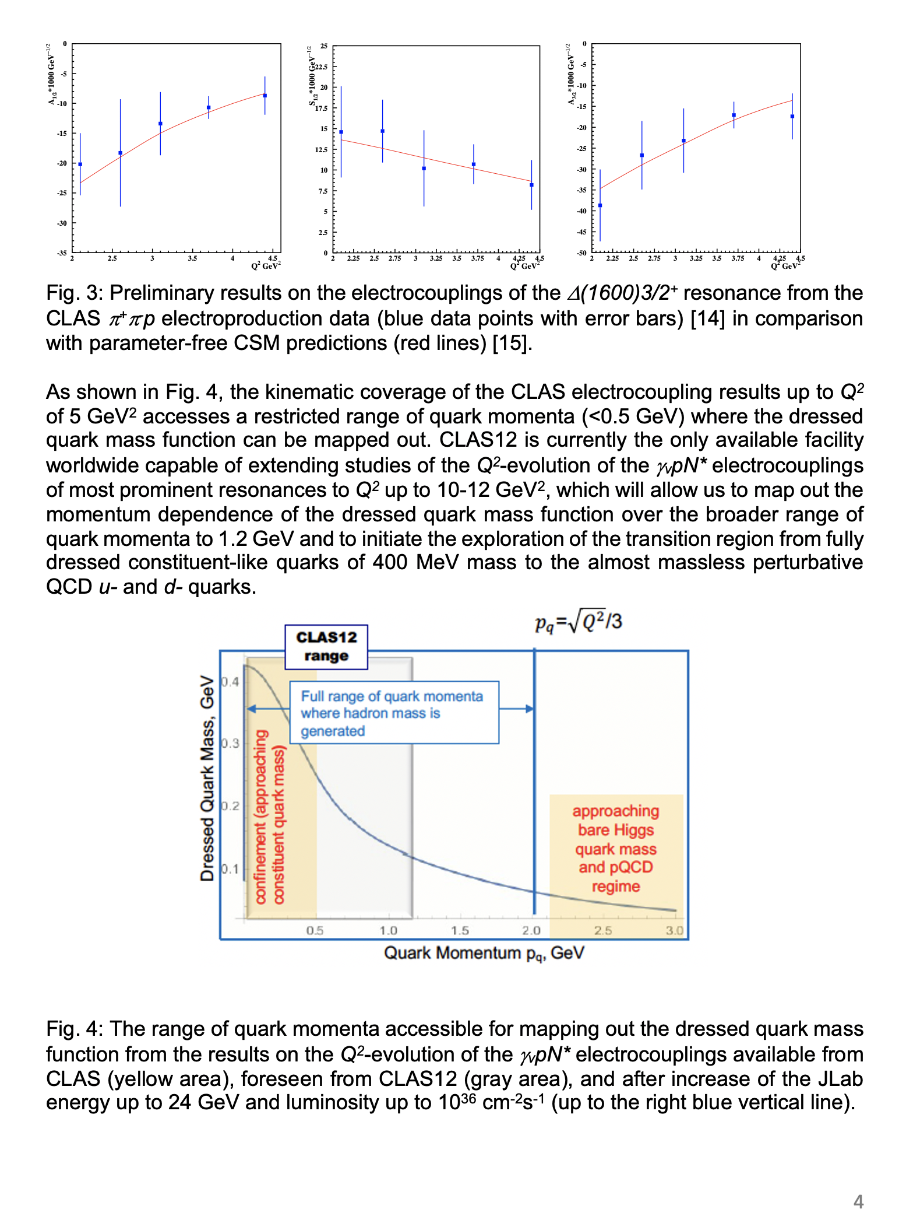
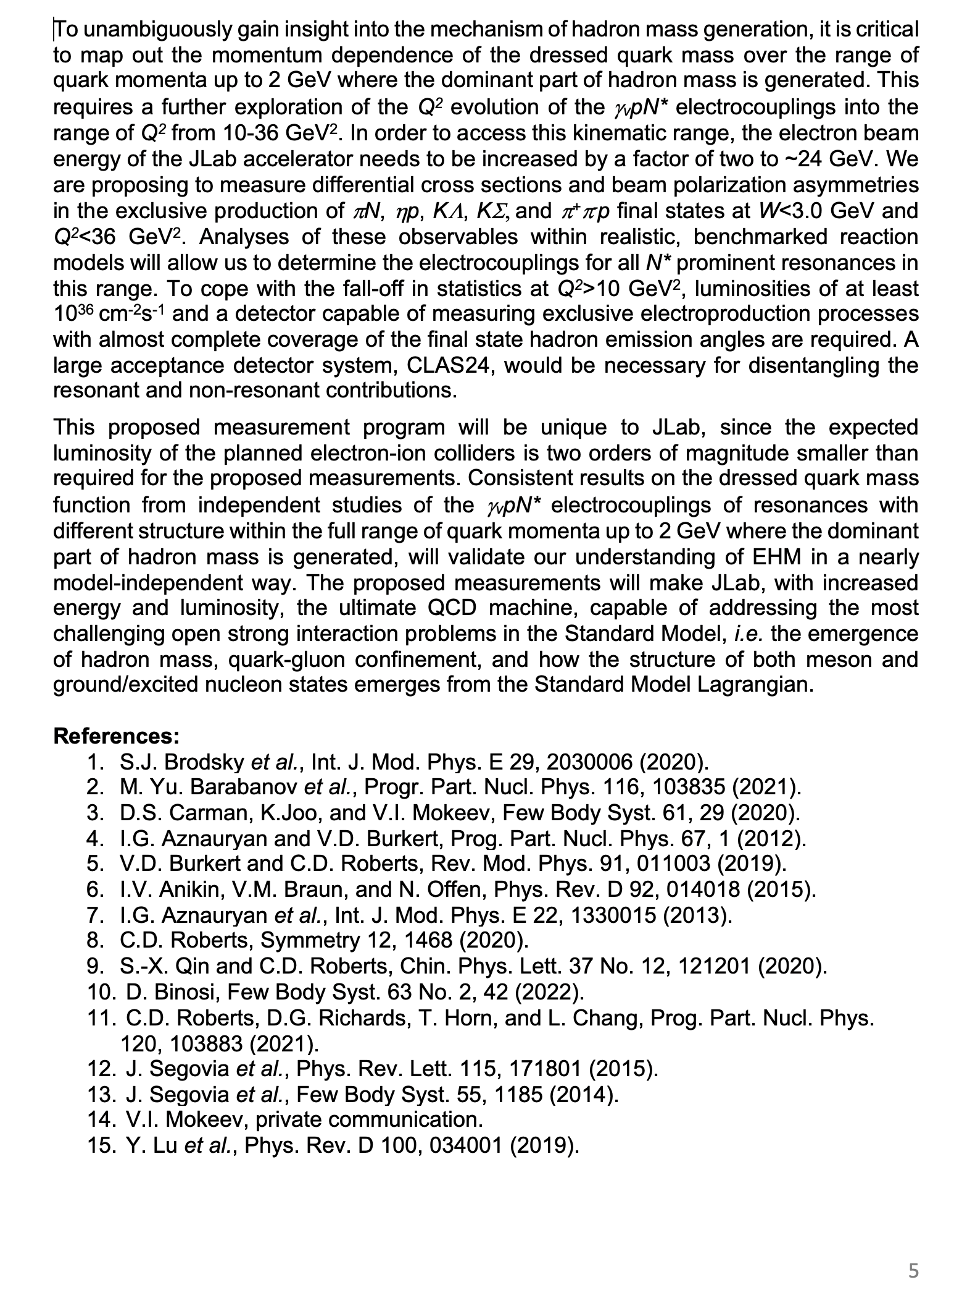
Hadron Structure Studies with CLAS22
Hadron Structure Group in Hall B developing physics case to support CLAS22 upgrade
List of Participating Institutions:
Jefferson Lab (Hall B and Theory Division)
University of Connecticut
Genova University and INFN of Genova
Lamar University
Ohio University
Skobeltsyn Nuclear Physics Institute and Physics Department at Lomonosov Moscow State University
University of South Carolina
INFN Sez di Roma Tor Vergata and Universita di Roma Tor Vergata
Nanjing University Institute for Nonperturbative Physics and affiliated institutes
Tubingen University
Tomsk State University and Tomsk Polytechnic University
James Madison University
George Washington University
https://userweb.jlab.org/~carman/clas24
14

Slide 15
Conclusions and Outlook
Baryons are the most fundamental three-body systems in Nature. If we don’t understand how QCD builds each of the baryons in the complete spectrum, then we don't understand Nature.
High-quality meson electroproduction data of 6.0 GeV era at JLab have allowed for the determination of the electrocouplings of most nucleon resonances in the mass range up to 1.8 GeV for Q²<7.5 GeV². They improved vastly our understanding of the momentum dependence of the dressed quark mass function, which is one of the three pillars of EHM. The remaining two pillars running gluon mass and QCD effective charge are constrained by the results on N* electroexcitation.
A good description of the Δ(1232)3/2⁺, N(1440)1/2⁺, and Δ(1600)3/2⁺ electroexcitation amplitudes at Q²<5.0 GeV² achieved within CSM with the same dressed quark mass function determined by QCD dynamics and used in the successful description of the elastic nucleon and pion electromagnetic form factors, offers sound evidence for insight into the momentum dependence of the dressed quark mass at quark momenta < 0.7 GeV.
CLAS12 is the only facility in the world capable of obtaining the electrocouplings of all prominent N* states in the still unexplored Q² range from 5 - 10 GeV² from measurements of Nπ, π⁺π⁻p, and KY electroproduction, allowing to probe the dressed quark mass at quark momenta < 1.1 GeV, a domain whereupon up to ≈ 1 / 2 of hadron mass is generated.
Extension of the results on the γ_{v}pN* electrocouplings into the Q² range from 10 - 30 GeV² after the increase of the CEBAF energy and pushing the CLAS12 detector capabilities to measure exclusive electroproduction to the highest possible luminosity, will offer the only foreseen opportunity to explore how the dominant part of hadron mass and N* structure emerge from QCD and will make CEBAF@22 GeV unique and the ultimate QCD-facility at the luminosity frontier.
15
18

Slide 16
Back up

Slide 17
N* Structure in Experiments of 6.0 GeV Era at JLab
The experimental program on the studies of N* structure in exclusive meson photo-/electroproduction with CLAS/CLAS12 as well as with spectrometers in Halls A/C seeks to determine:
  γ_{v}pN* electrocouplings at photon virtualities Q² up to 10 GeV² for most excited proton states through analyzing the major meson electroproduction channels
  Explore hadron mass emergence (EHM) by mapping out the dynamical quark mass in the transition from almost massless pQCD quarks to fully dressed constituent quarks
An important part of the efforts on the exploration of strong QCD (sQCD) from the experimental data with electromagnetic probes:
S.J. Brodsky et al., Int. J. Mod. Phys. E29, 203006 (2020)
C.D. Roberts, Symmetry 12, 1468 (2020)
M. Barabanov et al., Prog. Part. Nucl. Phys. 103835 (2021)
A unique source of information on many facets of sQCD in generating excited nucleon states with different structural features:
V.I. Mokeev and D.S Carman, Few Body Syst. 63, 59 (2022)
D.S. Carman, K. Joo, and V.I. Mokeev, Few Body Syst. 61, 29 (2020)
V.D. Burkert and C.D. Roberts, Rev. Mod. Phys. 91, 011003 (2019)

Slide 18
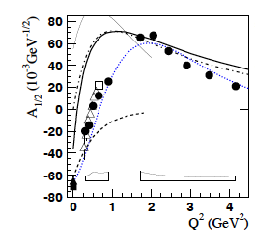
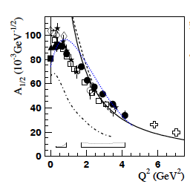
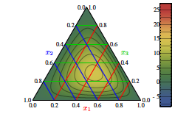
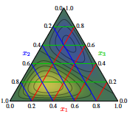
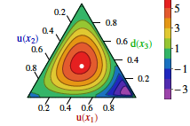
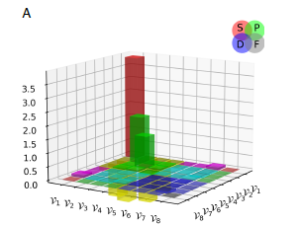
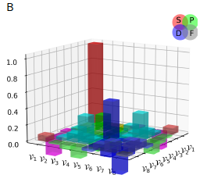
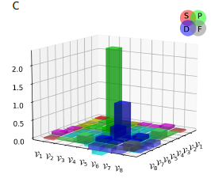
Facets of Strong QCD from Combined Studies of the Ground/Excited Nucleon State Structure
N(1535)1/2⁻
V.D.Burkert and I.G. Aznauryan, Prog. Part
Nucl. Phys. 67, 1 (2012)
The results on electroexcitation of different resonances
allow us to rigorously test the quark model ingredients
for the description of the ground/excited hadron structure
N(1440)1/2⁺
V.M. Braun et al., Phys. Rev. D 89, 094511 (2014)
C. Mezrag et al., Phys. Rev. Lett. B 783, 263 (2018)
Parton distribution amplitudes (PDA) in:
N(938)1/2⁺
N(1535)1/2⁻
N(1440)1/2⁺
Pronounced differences
predicted for N/N* PDAs
can be explored in N* electroexcitation, offering insight into the sQCD mechanisms that underlie these differences
Rest frame quark-correlated-di-quark angular momentum content in:
L. Liu et al., e-print: 2203-12083 [hep-ph]
Studies of N* electroexcitation
will contribute to understanding
of the nature of spin of the
ground and excited states of the
nucleon
Δ(1232)3/2⁺
Δ(1600)3/2⁺
Δ(1700)3/2⁻
Exploration of N* electroexcitations is an important part of efforts aimed to considerably extend knowledge on sQCD

Slide 19
Summary of Published CLAS Data on Exclusive Meson Electroproduction off Protons in N* Excitation Region
Hadronic final state | Covered W-range, GeV | Covered Q²-range, GeV² | Measured observables
π⁺n | 1.1-1.38 1.1-1.55 1.1-1.70 1.6-2.00 | 0.16-0.36 0.3-0.6 1.7-4.5 1.8-4.5 | dσ/dΩ dσ/dΩ dσ/dΩ, A_{b} dσ/dΩ
π⁰p | 1.1-1.38 1.1-1.68 1.1-1.39 1.1-1.80 | 0.16-0.36 0.4-1.8 3.0-6.0 0.4-1.0 | dσ/dΩ dσ/dΩ, A_{b},A_{t},A_{bt} dσ/dΩ dσ/dΩ
ηp | 1.5-2.3 | 0.2-3.1 | dσ/dΩ
K⁺Λ | thresh-2.6 | 1.40-3.90 0.70-5.40 | dσ/dΩ P⁰, P′
K⁺Σ⁰ | thresh-2.6 | 1.40-3.90 0.70-5.4 | dσ/dΩ P′
π⁺π⁻p | 1.3-1.6 1.4-2.1 1.4-2.0 | 0.2-0.6 0.5-1.5 2.0-5.0 | Nine 1-fold differential cross sections
dσ/dΩ−CM angular
distributions
A_{b},A_{t},A_{bt}-longitudinal
beam, target, and
beam-target asym-
metries
P⁰, P′ –recoil and
transferred polarization
of strange baryon
Around 150,000
data points!
Almost full coverage
of the final state hadron phase space
The measured observables from CLAS are stored in the
CLAS Physics Data Base http://clas.sinp.msu.ru/cgi-bin/jlab/db.cgi
Notes:
Исследования процессов электровозбуждения N* во всех эксклюзивных каналах электророждения мезонов в резонансной области стало возможным в экспериментах на детекторе CLAS , где была получена доминирующая чеать результатов по реакциям эксклюзивного электророждения мезонов на нуклонах.

Slide 20
Approaches for Extraction of γ_{v}NN* Electrocouplings from the CLAS Exclusive Meson Electroproduction Data
Analyses of different meson electroproduction channels independently:
π⁺n and π⁰p channels:
Unitary Isobar Model (UIM) and Fixed-t Dispersion Relations (DR)
I.G. Aznauryan, Phys. Rev. C67, 015209 (2003)
I.G. Aznauryan et al. (CLAS), Phys. Rev. C80, 055203 (2009)
I.G. Aznauryan et al. (CLAS), Phys. Rev. C91, 045203 (2015)
ηp channel:
Extension of UIM and DR
I.G. Aznauryan, Phys. Rev. C68, 065204 (2003)
Data fit at W<1.6 GeV, assuming N(1535)1/2⁻ dominance
H. Denizli et al. (CLAS), Phys. Rev. C76, 015204 (2007)
π⁺π⁻p channel:
Data driven JLab-MSU meson-baryon model (JM)
V.I. Mokeev, V.D. Burkert et al., Phys. Rev. C80, 045212 (2009)
V.I. Mokeev et al. (CLAS), Phys. Rev. C86, 035203 (2012)
V.I. Mokeev, V.D. Burkert et al., Phys. Rev. C93, 054016 (2016)
Global coupled-channel analysis of γ_{r,v}N , πN, ηN, ππN, KΛ, KΣ exclusive channels:
H. Kamano, Few Body Syst. 59, 24 (2018). Argonne-Osaka
H. Kamano, JPS Conf. Proc. 13, 010012 (2017). Argonne-Osaka
M. Mai et al., Phys. Rev. C103, 065204 (2021) Julich-Bonn-Washington
M. Mai et al., Phys. Rev. C106, 015201 (2022) Julich-Bonn-Washington
Notes:
Для извлечания амплитуд электровозбуждения N* из сечений и поляризационных асимметрий реакций эксклюзивного электророждения мезонов на
протонах были развиты как подходы для извлечения параметров N* из независимого анализа различных эксклюзивных каналов, так и из совместного анализа данных всех каналов в рамках многоканальных моделей реакций

Slide 21
Electrocouplings of N(1440)1/2⁺ and N(1520)3/2⁻ Resonances from πN and π⁺π⁻p Electroproduction off Proton Data
N(1440)1/2⁺
pπ⁺π⁻ CLAS
preliminary 2022
A_{1/2}
A_{1/2}
N(1520)3/2⁻
Consistent results on the N(1440)1/2⁺ and N(1520)3/2⁻ electrocouplings from independent studies of the two major πN and π⁺π⁻p electroproduction channels with different non-resonant contributions allow us to evaluate the systematic uncertainties of these quantities in a nearly model-independent way.

