Slide 1
Electrons For Neutrinos $(e4ν)$ Mapping Neutrino-Nuclei Interactions Using Electrons
Rhidian Williams
April 6th , 2023
Rhidian Williams
April 6th, 2023 1/18

Slide 2
Deep Underground Neutrino Experiment (DUNE)
$$ν$$
$$ν$$
Rhidian Williams
April 6th, 2023 2/18

Slide 3
Sanford Underground Research Facility (SURF)
What is the initial beam energy?
$$P_{να→νβ}\left(Etrue,L\right)≈\sin^{2}\left(2θ\right)\sin^{2}\left(\frac{Δm^{2}L}{Etrue}\right)$$
A-1
$$ν$$
P₁
Ar
∏⁰
Rhidian Williams
April 6th, 2023 3/18

Slide 4
Motivation
$$N\left(E_{rec}, L\right)=\sum_{i}{∫Φ\left(E, L\right)×σ_{i}\left(E\right)f_{σ_{i}}\left(E, E_{rec}\right)dE}$$
Measured
$ν$ flux
Interaction Model
Measure counts
Use interaction model
Deconvolute $ν$ flux
Rhidian Williams
April 6th, 2023 4/18

Slide 5
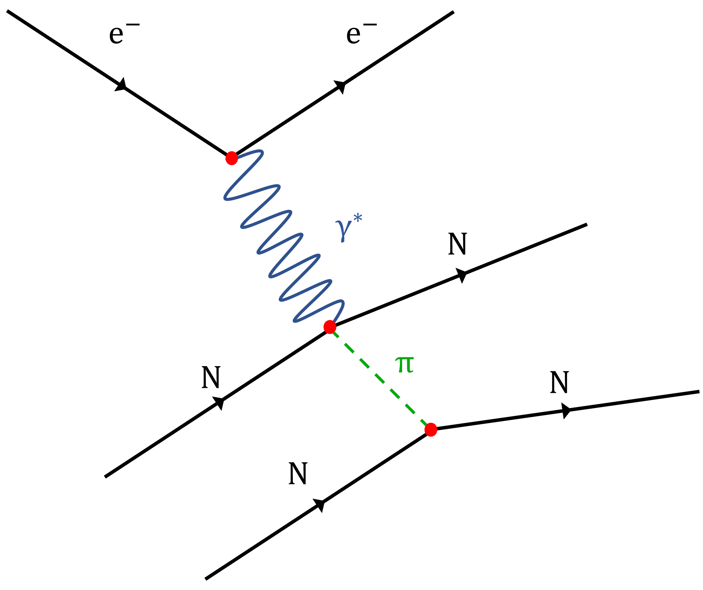
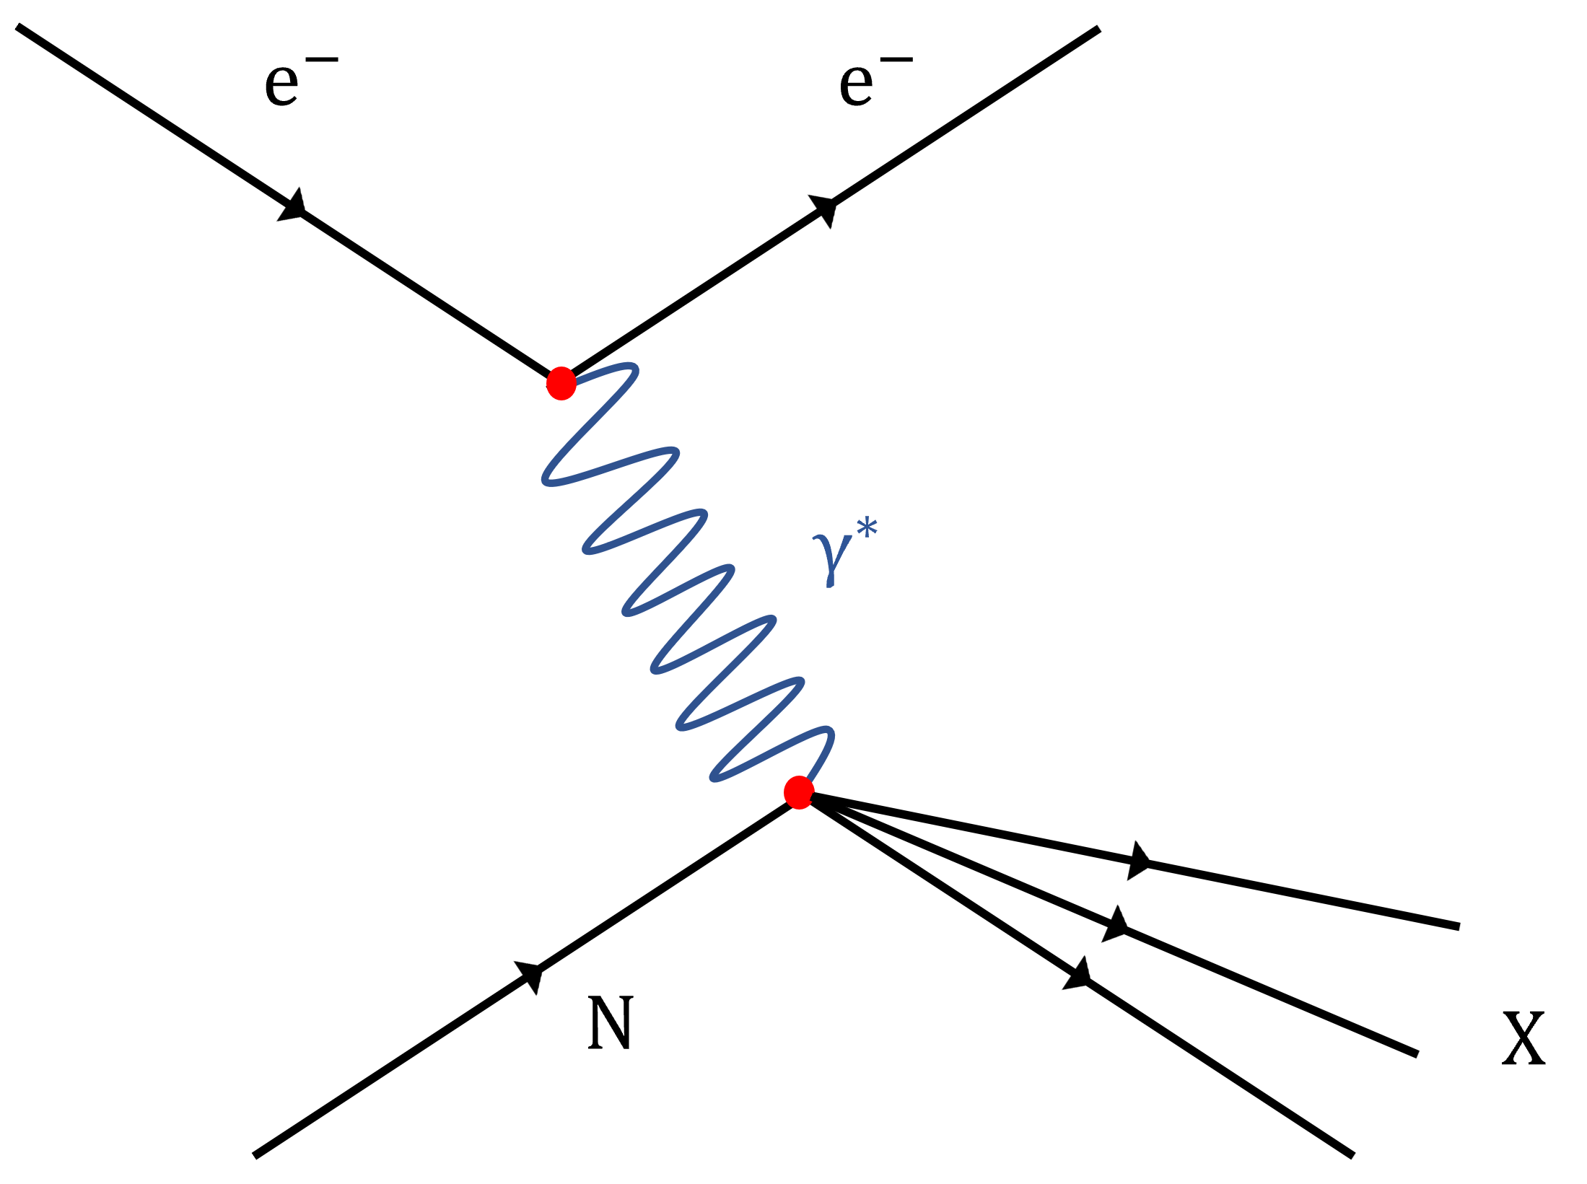
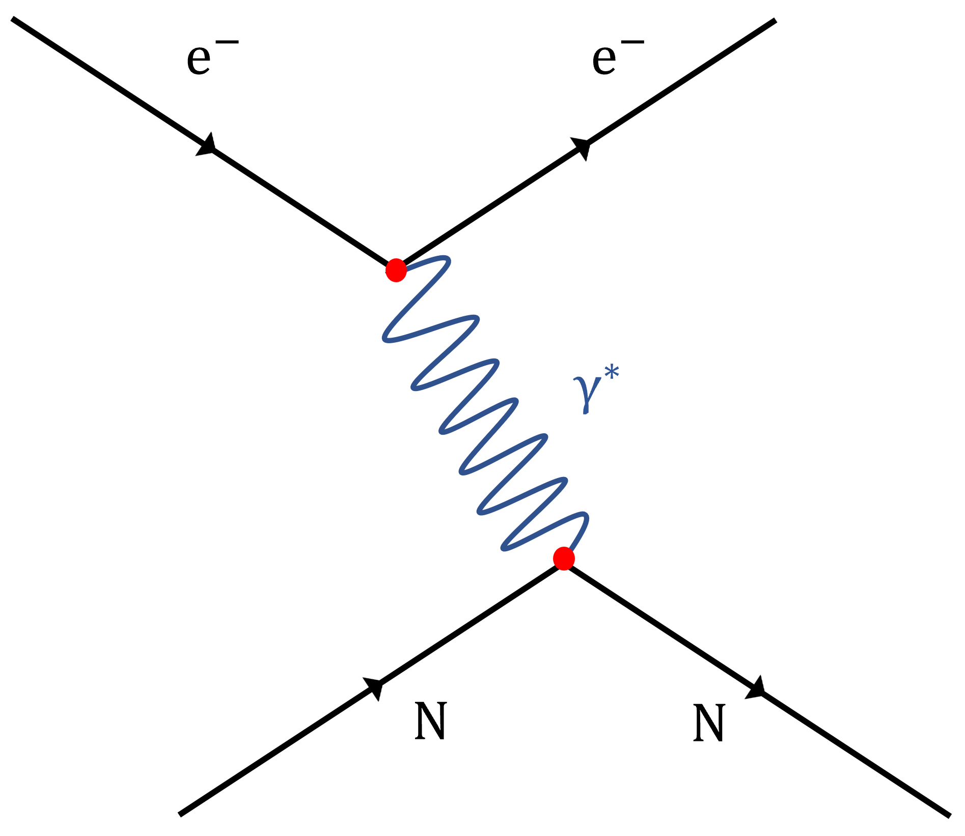
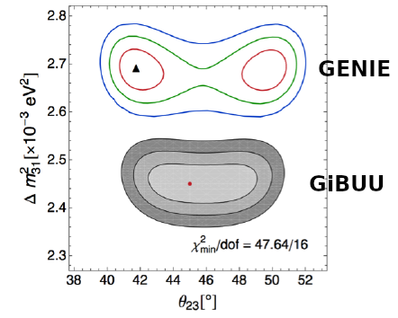
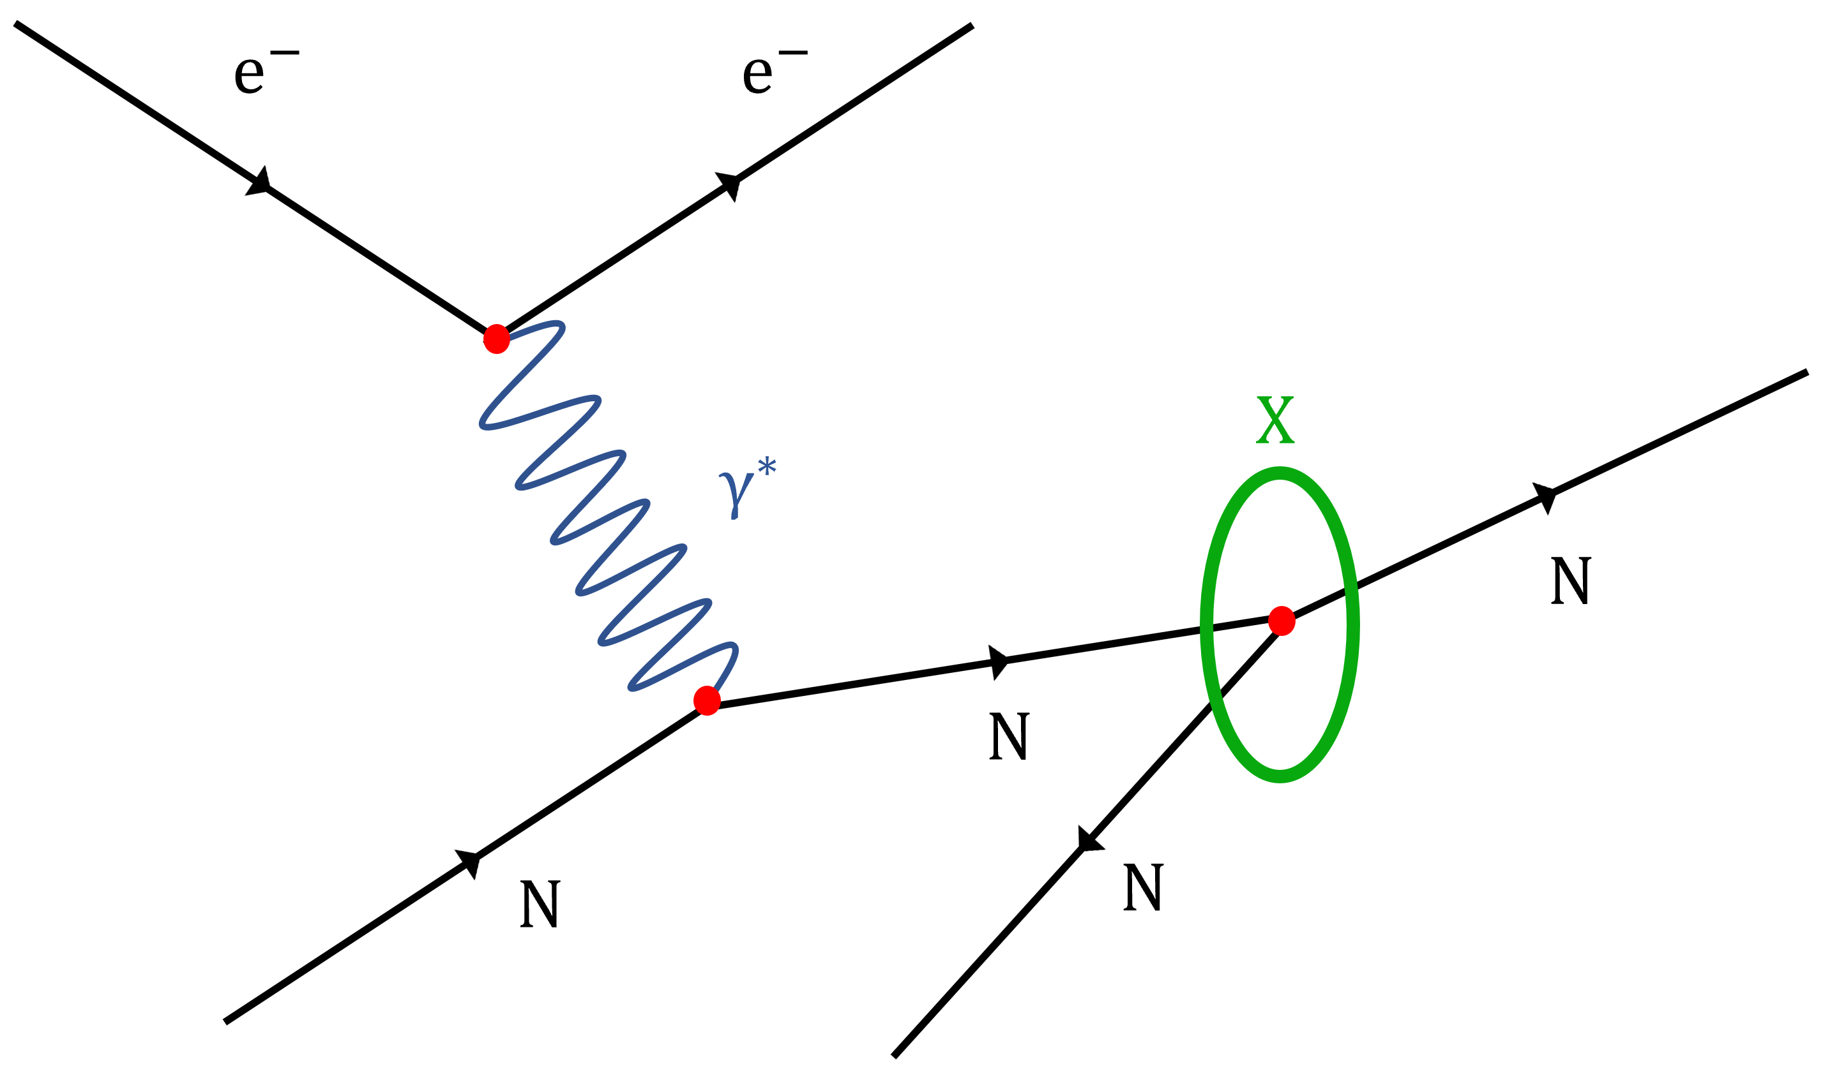
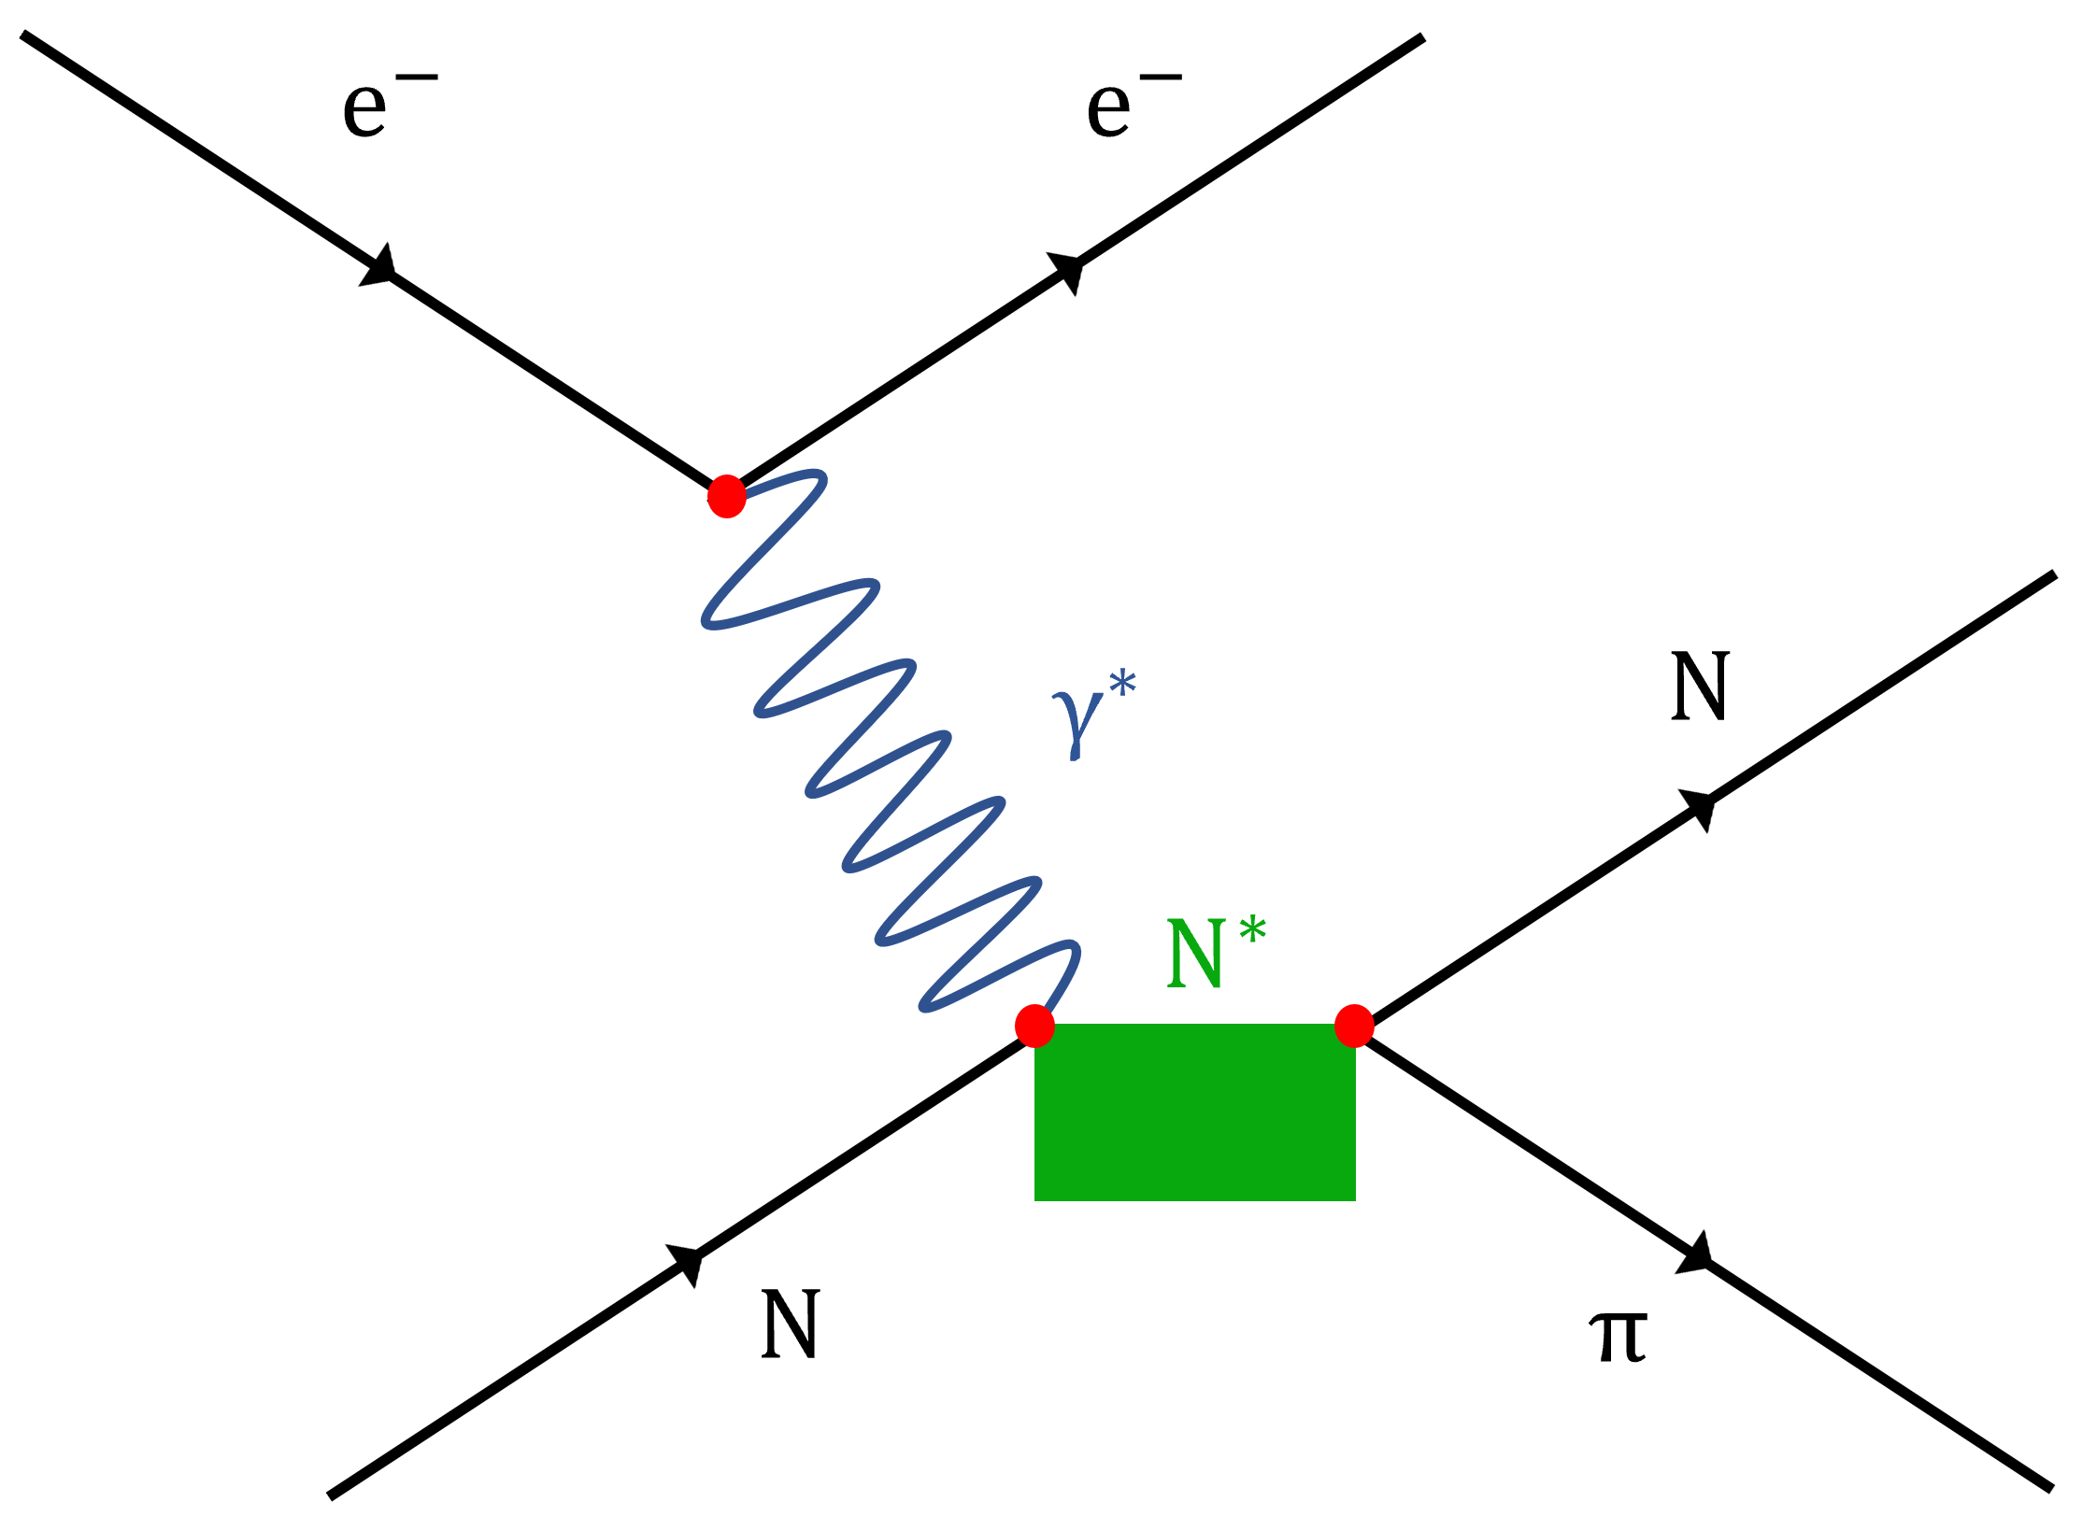
What Is The Challenge?
$$N\left(E_{rec}, L\right)=\sum_{i}{∫Φ\left(E, L\right)×σ_{i}\left(E\right)f_{σ_{i}}\left(E, E_{rec}\right)dE}$$
Measured
$ν$ flux
Interaction Model
Resonance Production
Resonance Production
Quasielastic Scattering
Quasielastic Scattering
Meson exchange currents
Meson exchange currents
No good complete theories
Nuclear Interactions are Complex!
Deep inelastic scattering
Deep inelastic scattering
Rescattering and absorption
Rescattering and absorption
Rhidian Williams
April 6th, 2023 5/18

Slide 6
Why Electrons?
Similar interactions with nuclei
Single boson exchange
Weak current
- Electromagnetic current
Similar nuclear physics
Lots of data!!!
WE KNOW THE BEAM ENERGY!!!
Monoenergetic
High intensity
$$P\left(p\right)≈\frac{1}{p^{2}−m_{w}^{2}}$$
$$Q^{2}$$
$$P\left(p\right)≈\frac{1}{p^{2}}$$
Rhidian Williams
April 6th, 2023 6/18

Slide 7
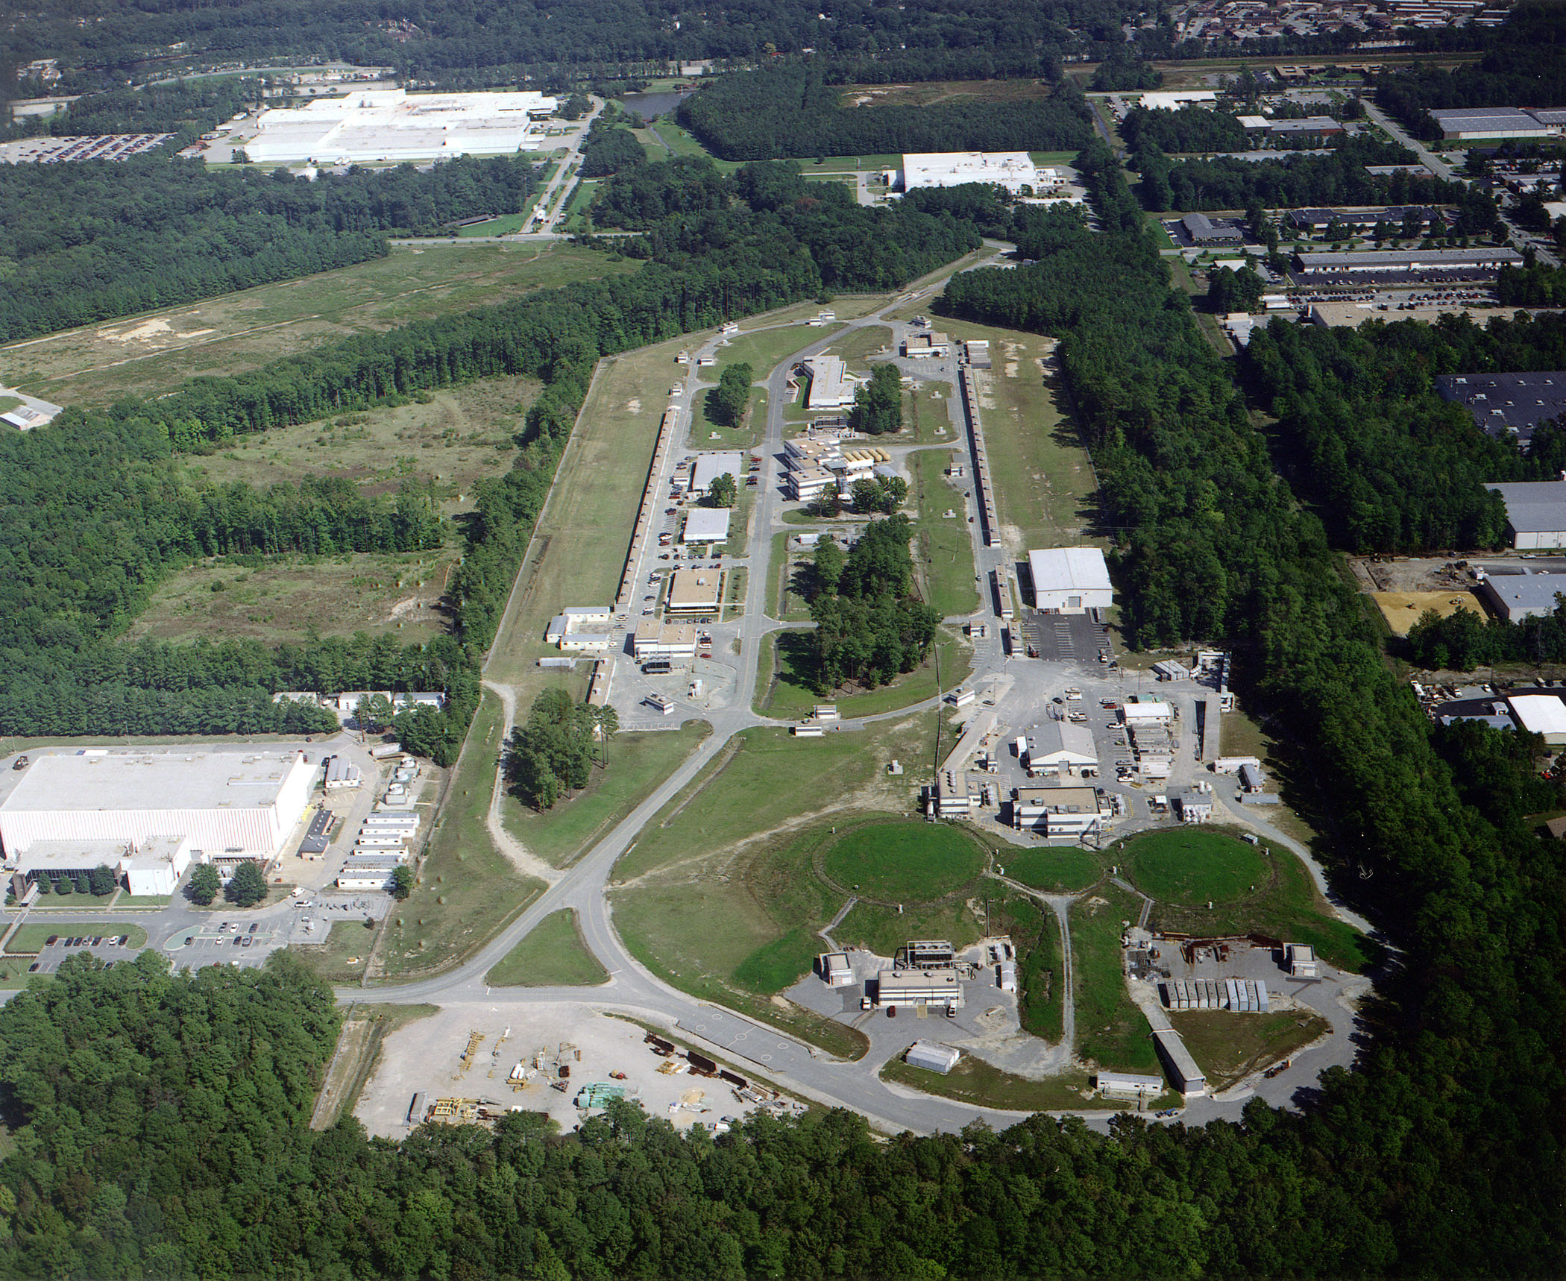
Thomas Jefferson National Laboratory
e⁻
A
B
C
Rhidian Williams
April 6th, 2023 7/18

Slide 8
What’s Been Done So Far?
Previous Result – Quasi-Elastic
Small contribution to nuclear processes
Need to model more reactions
$$\frac{dσ}{dE_{Cal}} \left(μbGeV^{−1}\right)$$
A
$$e^{−}$$
P₁
A-1
$$E_{cal} (GeV)$$
$$σ_{i}\left(E\right)f_{σ_{i}}\left(E, E_{rec}\right)$$
Ref: Khachatryan, M., Papadopoulou, A., Ashkenazi, A. et al. Electron-beam energy reconstruction for neutrino oscillation measurements. Nature 599, 565–570 (2021). https://doi.org/10.1038/s41586-021-04046-5
Rhidian Williams
April 6th, 2023 8/18

Slide 9
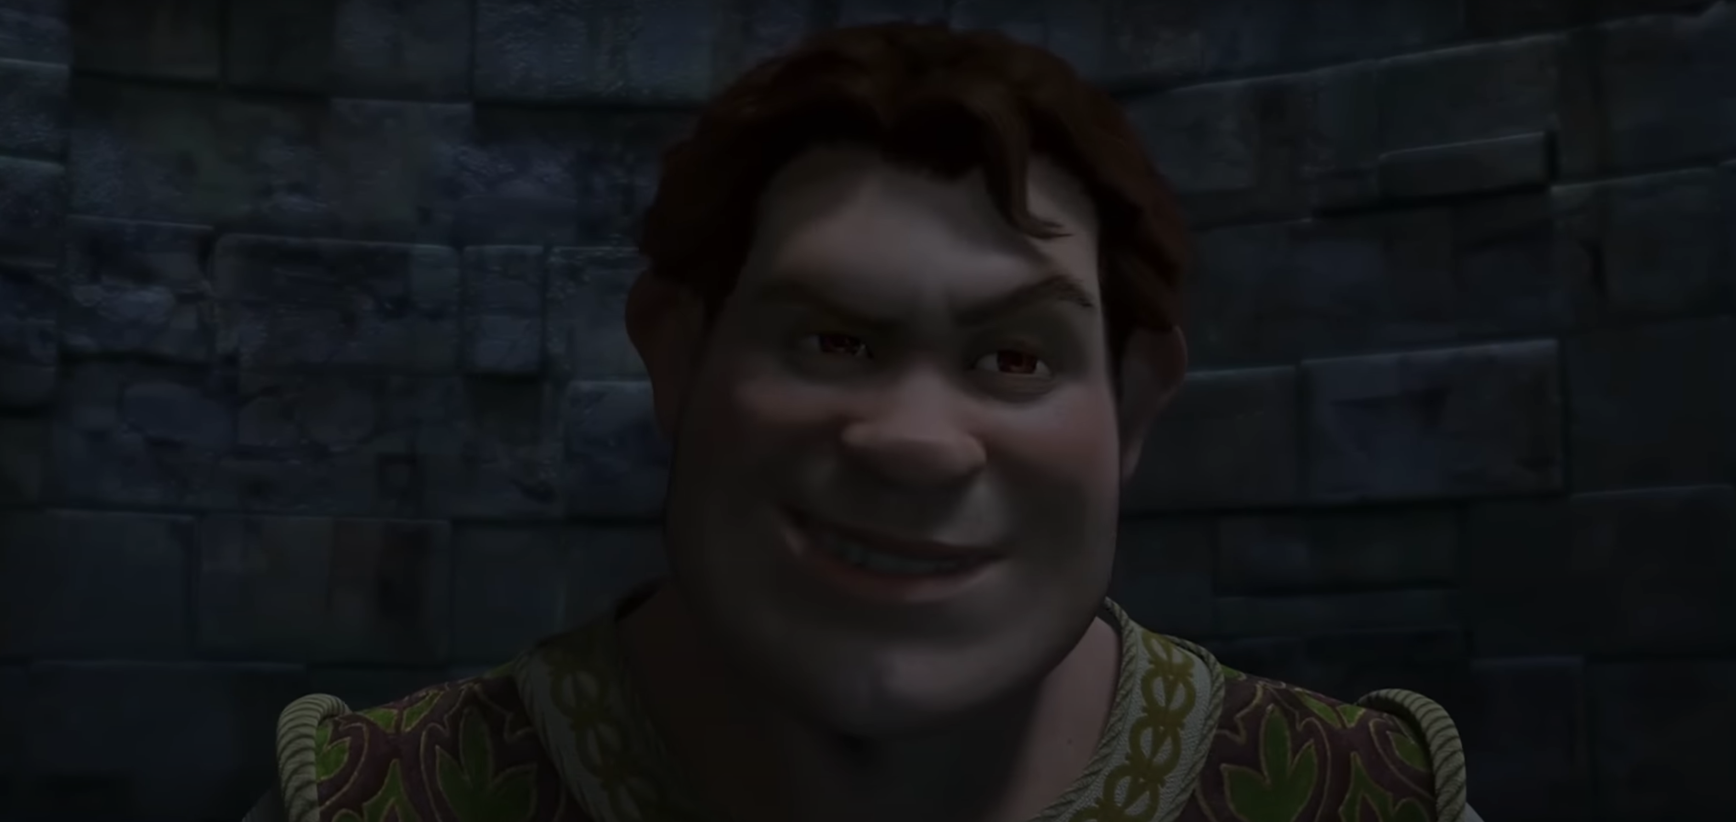
$e4ν$ Goals
Use eA data to constrain models – eA and νA reactions
Different interactions compare different model aspects
Improving models reduces neutrino oscillation parameter uncertainty
We’re gonna need cross sections. Lots and lots of cross sections!
Rhidian Williams
April 6th, 2023 9/18

Slide 10
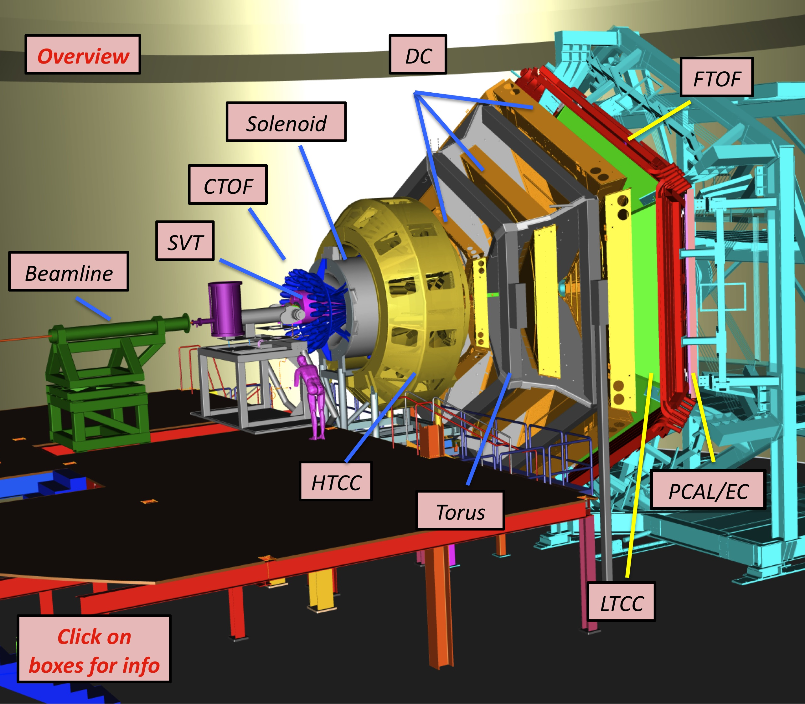
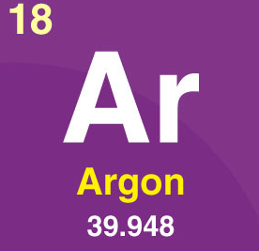
My $e4ν$ Project
Electron beam energy reconstruction from complicated final states
Many targets – including LAr $→$ DUNE
2, 4 and 6 GeV beam $→$ match DUNE kinematics
P₁
A
P₂
∏⁺
e⁻
∏⁻
A-2
Rhidian Williams
April 6th, 2023 10/18

Slide 11
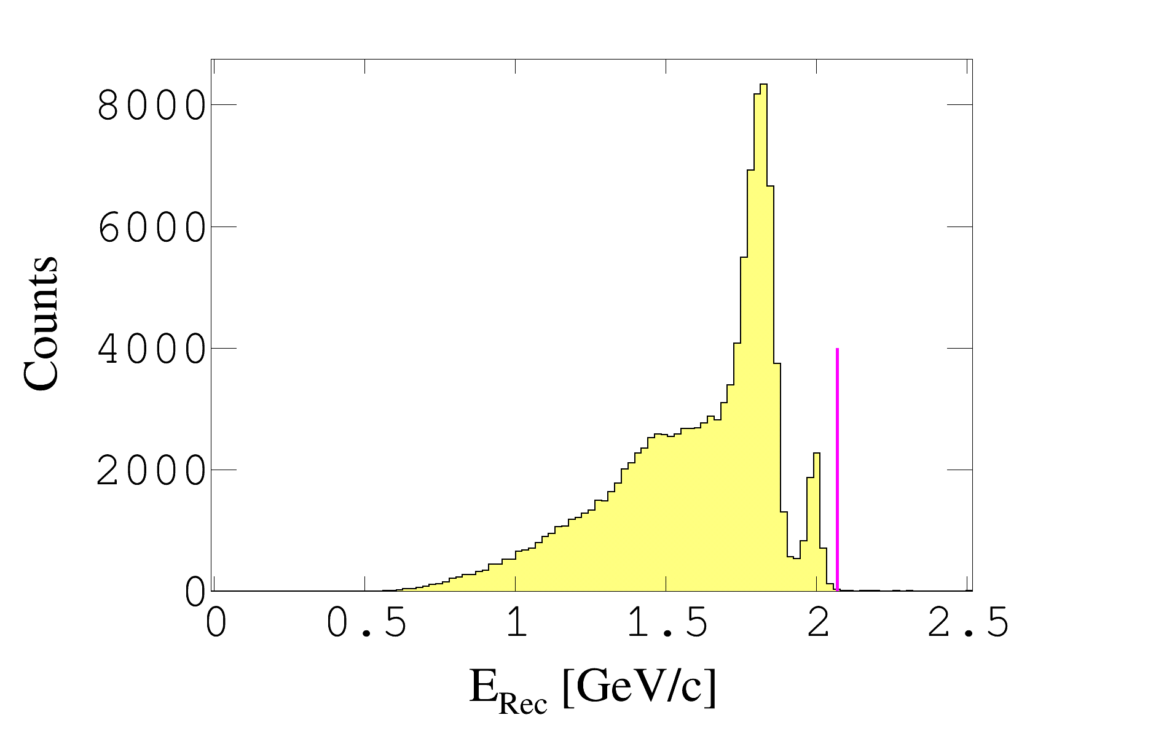
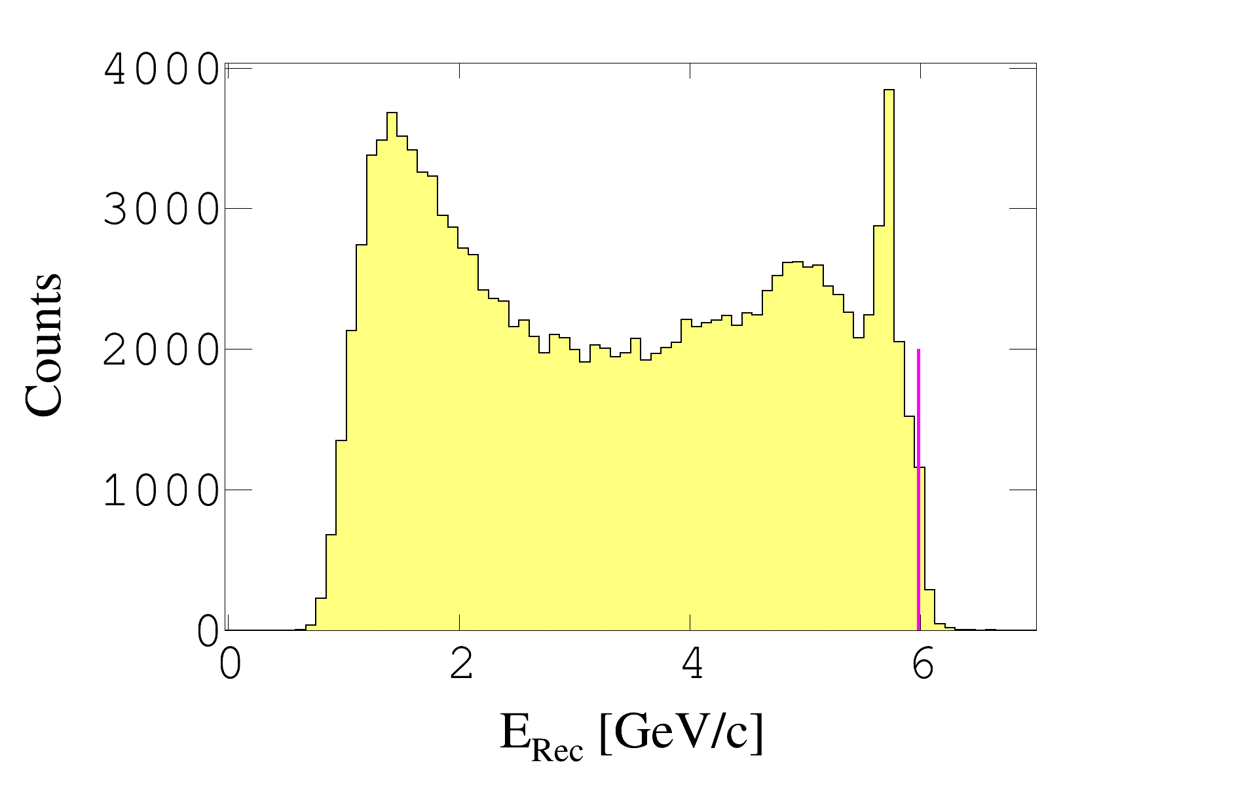
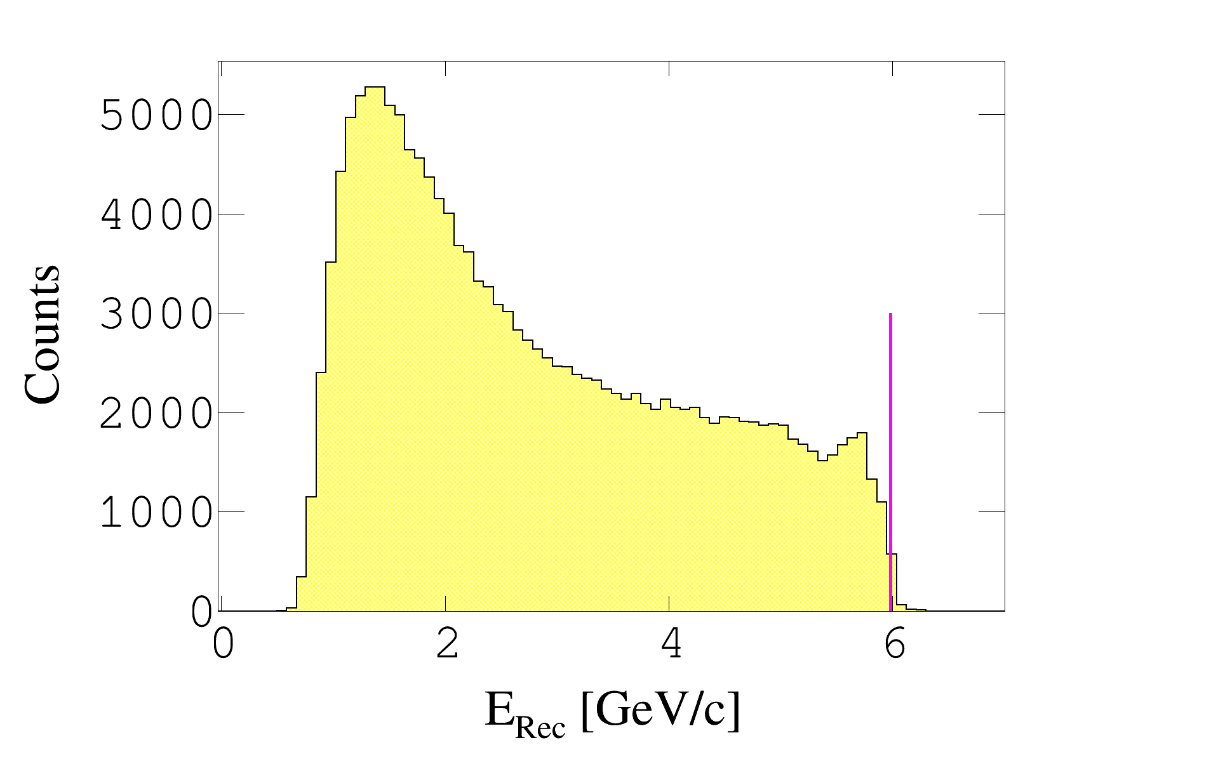
$E_{Rec}$ For $A\left(e,e^{′}p\right)X$ Interactions
$D$ @ 6 GeV
$D$ @ 2.1 GeV
$LAr$ @ 6 GeV
Rhidian Williams
April 6th, 2023 11/18

Slide 12
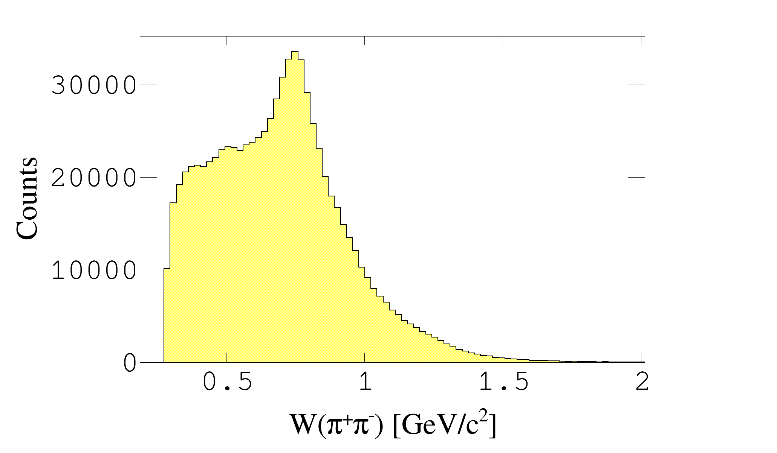
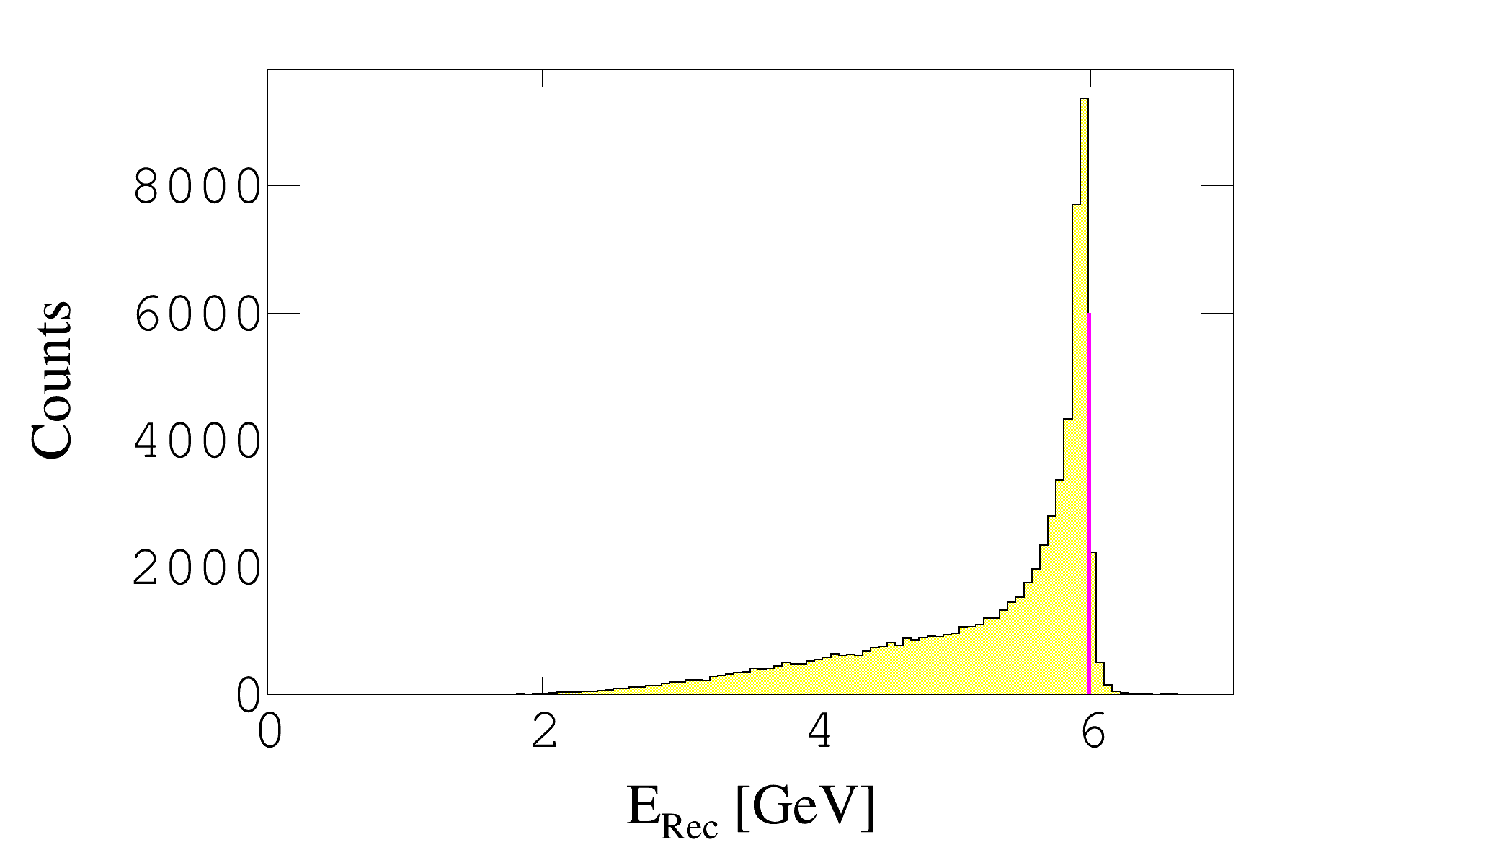
$He\left(e,e^{′}pρ\right)X$ @ E = 6.0 GeV
ρ
P₁
A
$$e^{−}$$
$$ρ$$
$$π^{+}$$
A-1
$$π^{−}$$
Rhidian Williams
April 6th, 2023 12/18

Slide 13
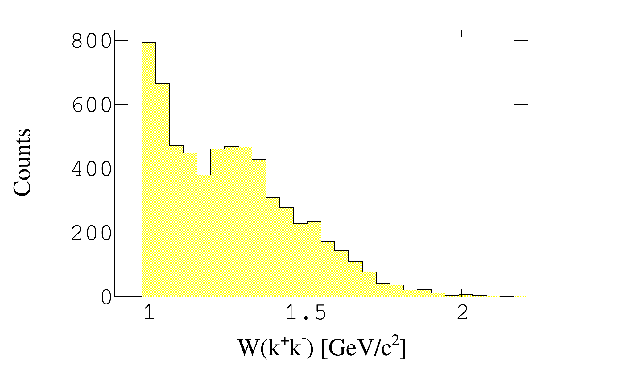
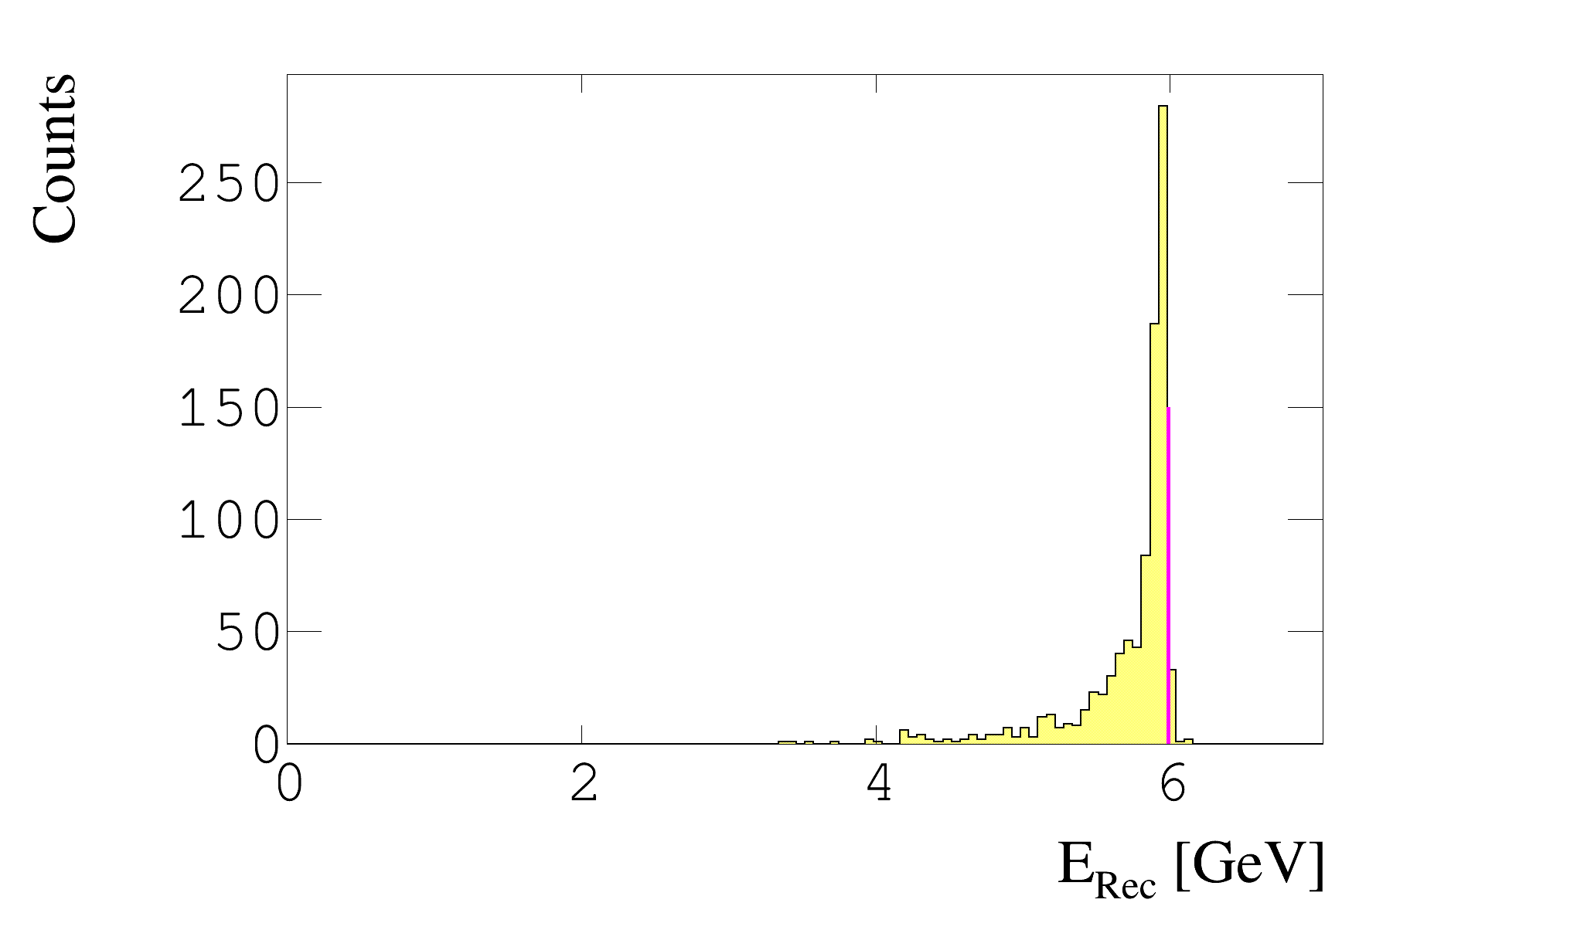
$He\left(e,e^{′}pφ\right)X$ @ E = 6.0 GeV
φ
P₁
A
$$e^{−}$$
$$φ$$
K⁺
A-1
K⁻
Rhidian Williams
April 6th, 2023 13/18

Slide 14
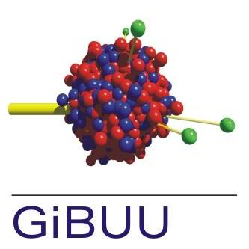
Just Breath!
Now for theory model comparisons
Theory data passed through virtual CLAS12 detector
Rhidian Williams
April 6th, 2023 14/18

Slide 15
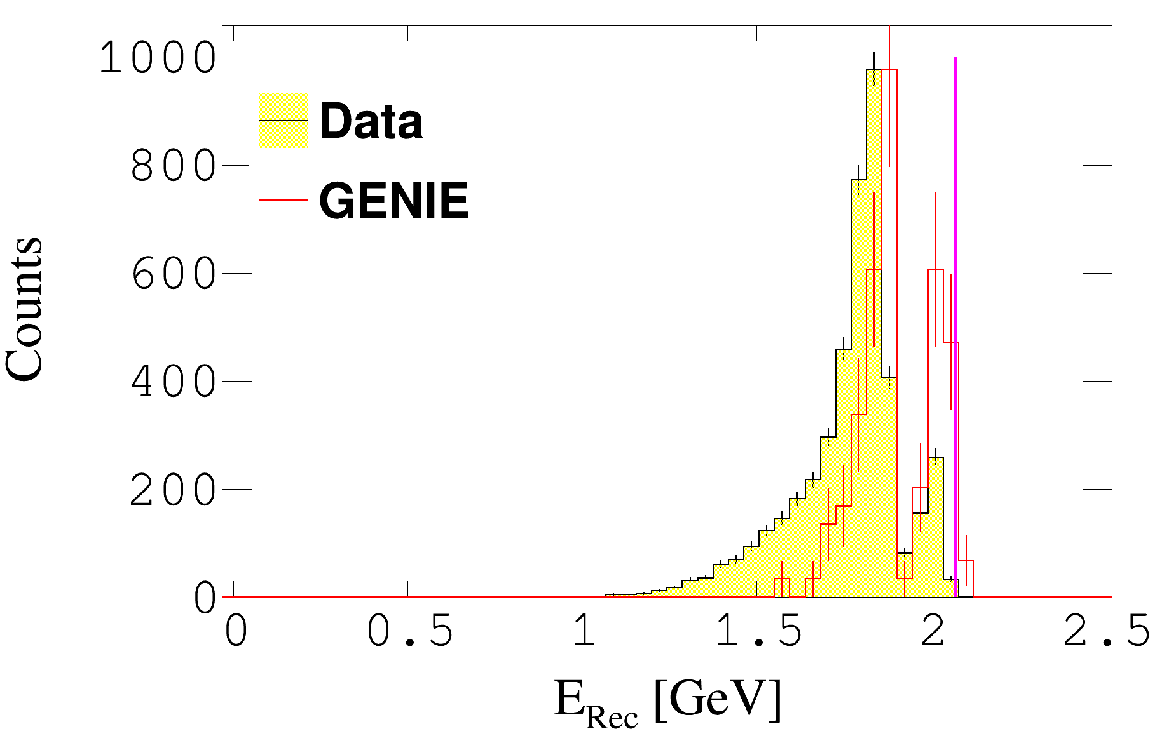
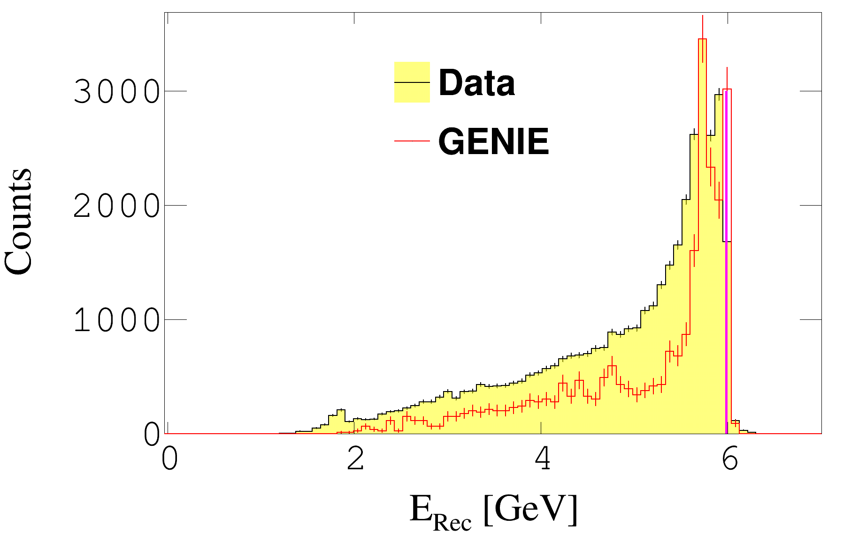
Energy Dependence For $D\left(e,e^{′}pπ^{−}\right)X$
2 GeV – Clean reconstruction
Low number of missing particles
6 GeV – More missing particles
Model does not capture physics
Rhidian Williams
April 6th, 2023 15/18

Slide 16
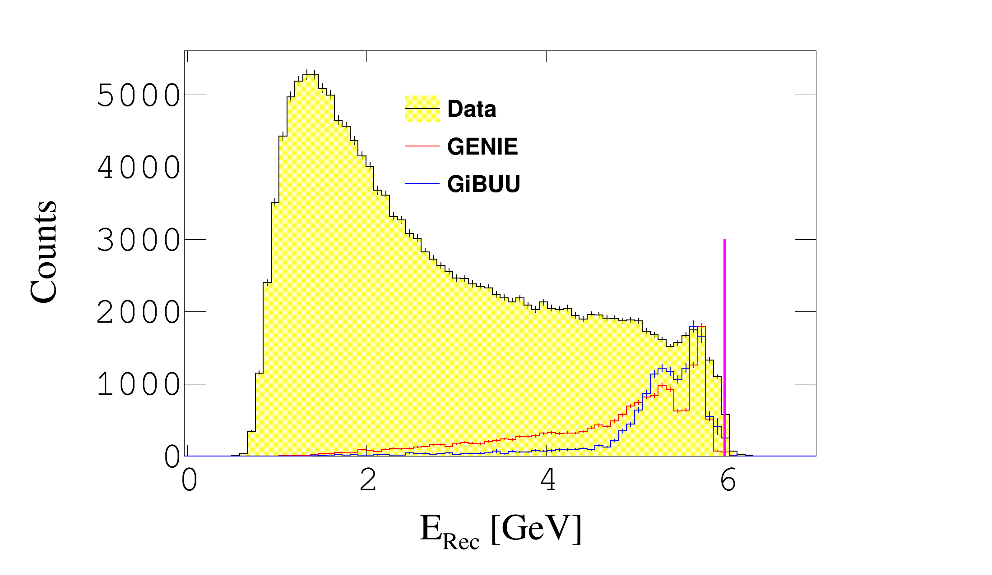
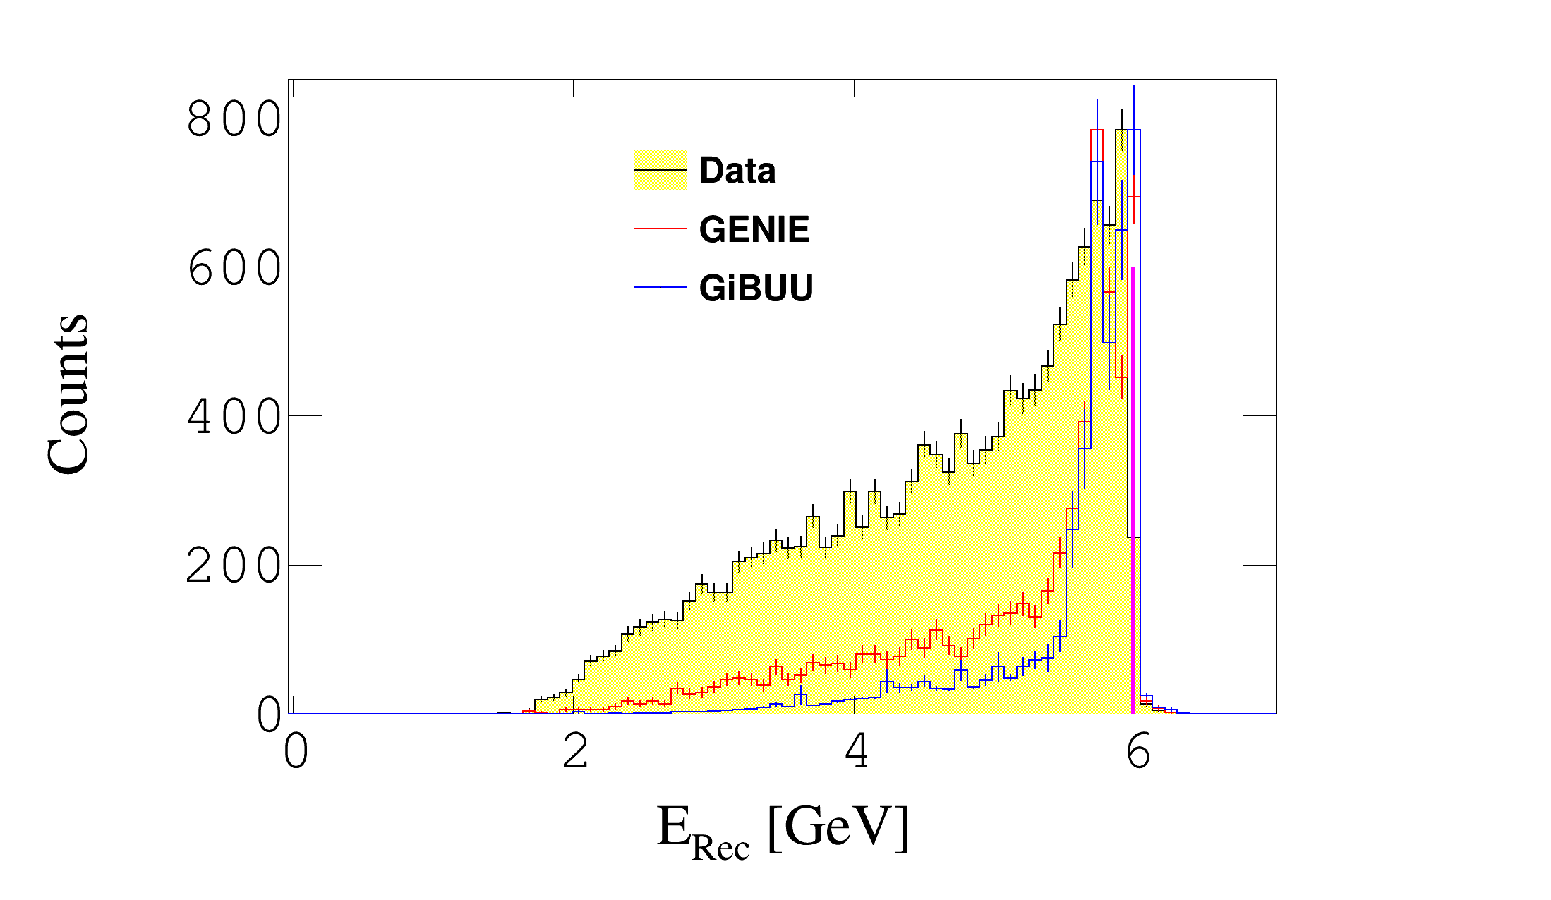
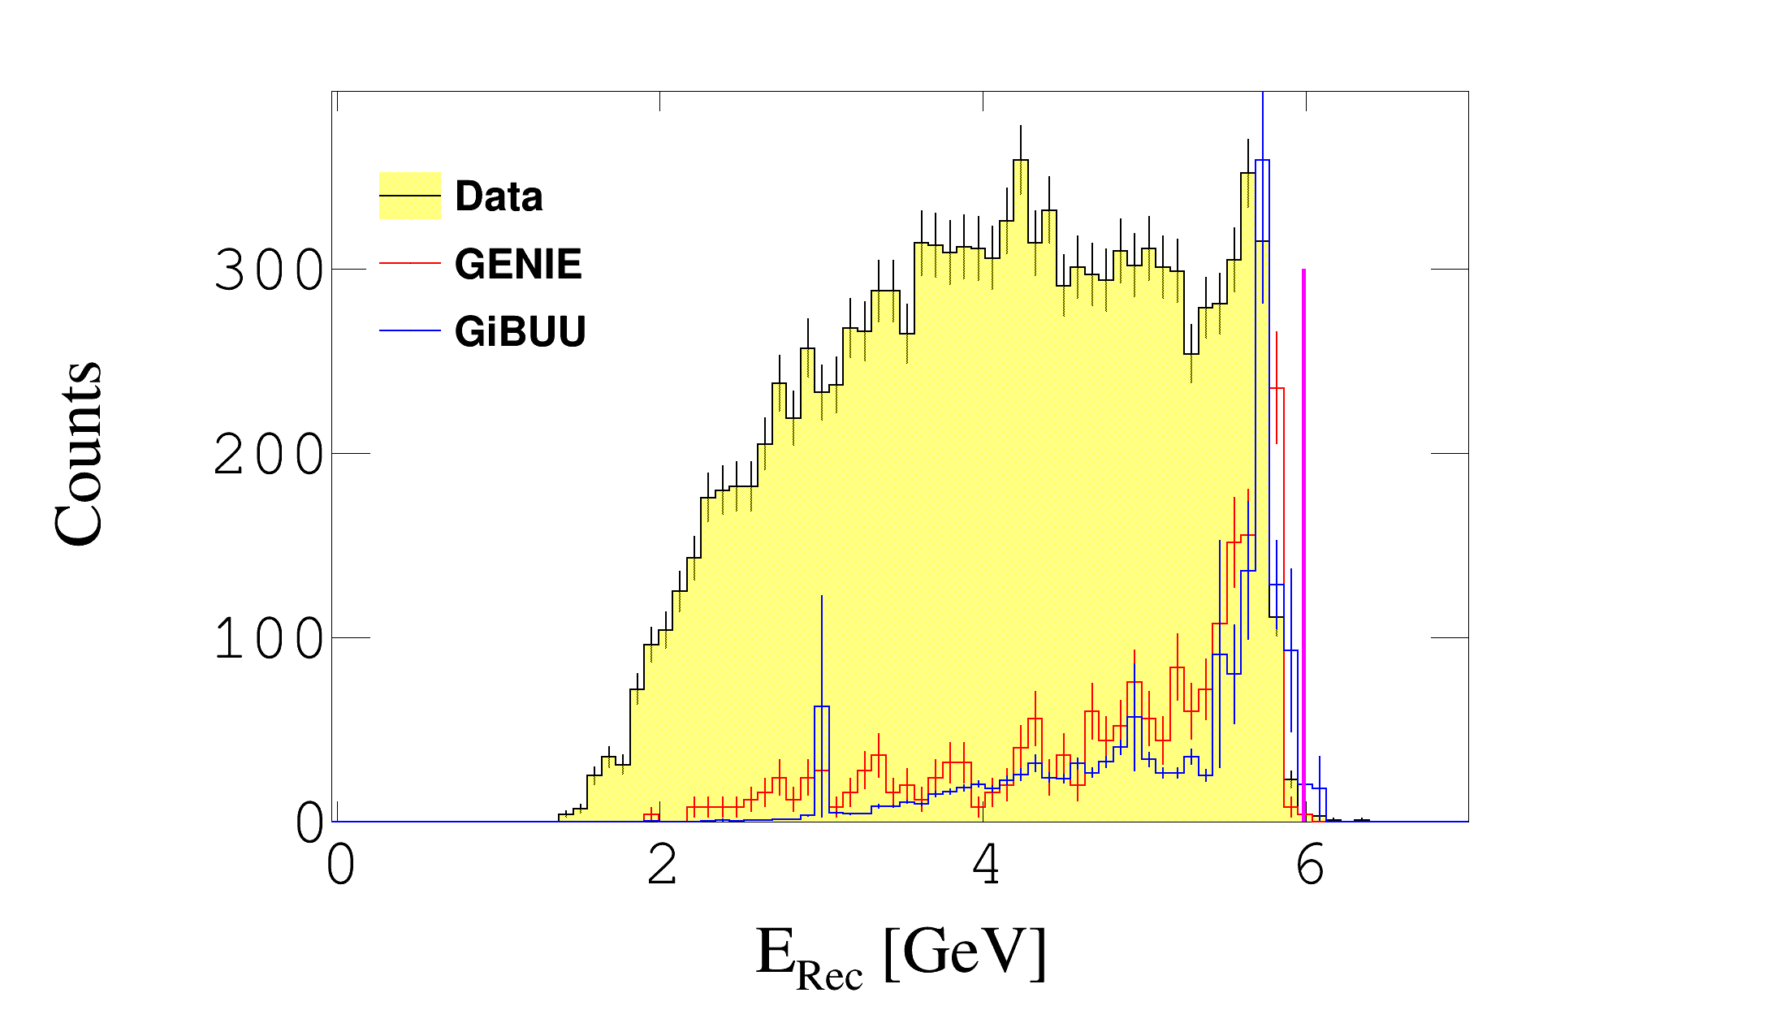
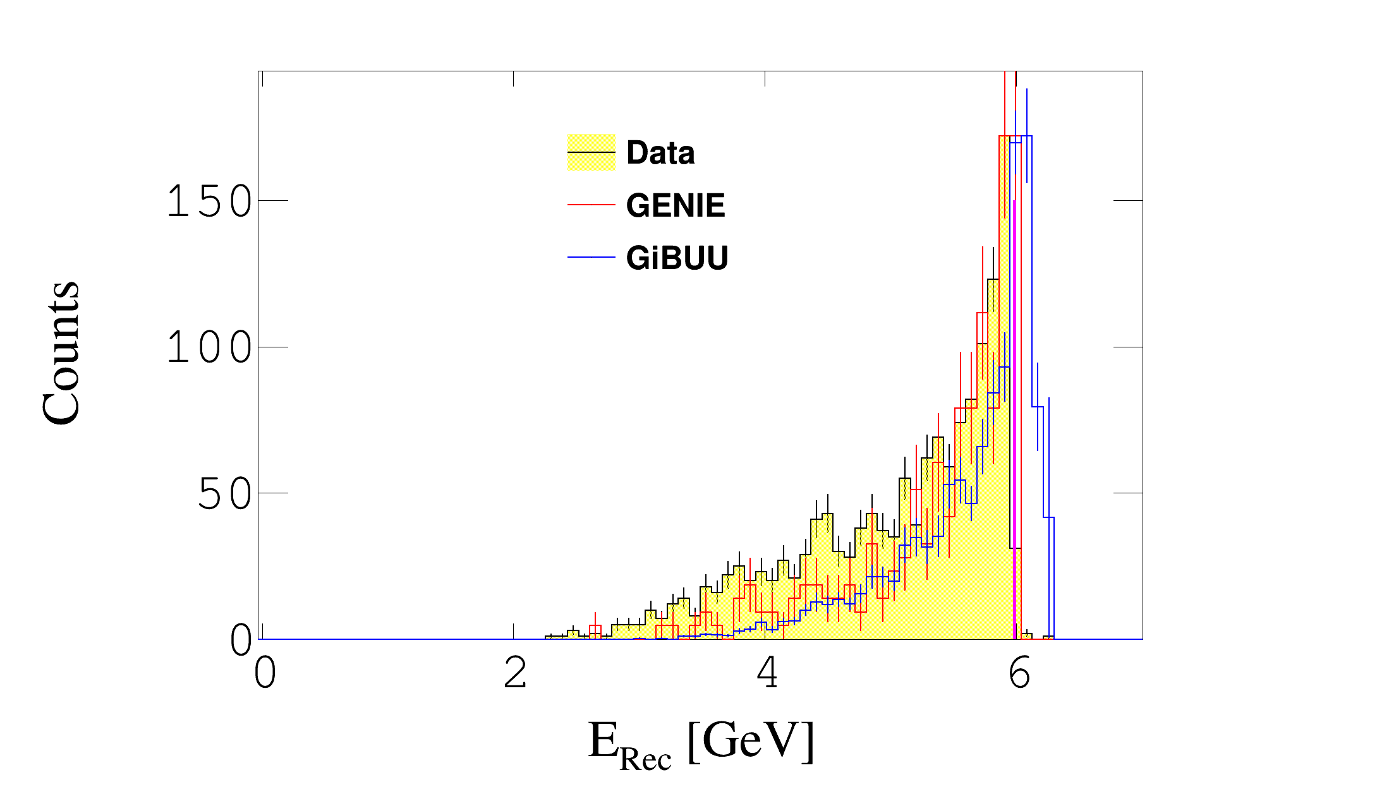
Reaction Dependence For LAr @ 6 GeV
$LAr\left(e,e^{′}pπ^{−}\right)X$
$LAr\left(e,e^{′}p\right)X$
$LAr\left(e,e^{′}p{π^{+}π}^{−}\right)X$
$LAr\left(e,e^{′}pπ^{+}\right)X$
Rhidian Williams
April 6th, 2023 16/18

Slide 17
Work To Do
More models for more targets
Reanalyse calibrated data
Correct for undetected particles
More reactions channels
Rhidian Williams
April 6th, 2023 17/18

Slide 18
Conclusion
GENIE and GiBUU fail to capture many aspects of data
First study of models for exclusive reactions at DUNE energies
Exciting results describing complicated exclusive channels
Rhidian Williams
April 6th, 2023 18/18

