Slide 1
Search for the First Strange Hexaquark
Geraint Clash
University of York, UK

Slide 2
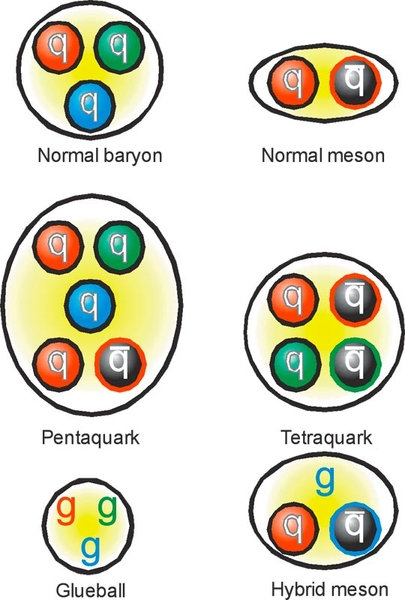
Hadrons an Introduction
Hadrons formed from u,d,c,s,b
Baryons and mesons
Exotic states

Slide 3
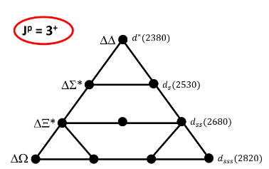
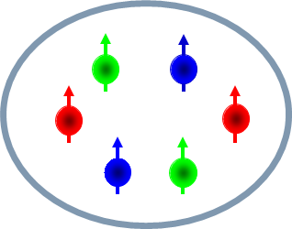
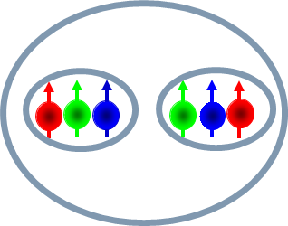
What are Hexaquarks
Mihai Mocanu
Talk: Previous session
Me
Dr. Matthew Nicol
Talk: 4:45 PM
P. Adlarson et al., Phys.Rev.Lett. 106 (2011) 242302
P. Adlarson et al., Phys.Rev.Lett. 112 (2014) 20, 202301

Slide 4
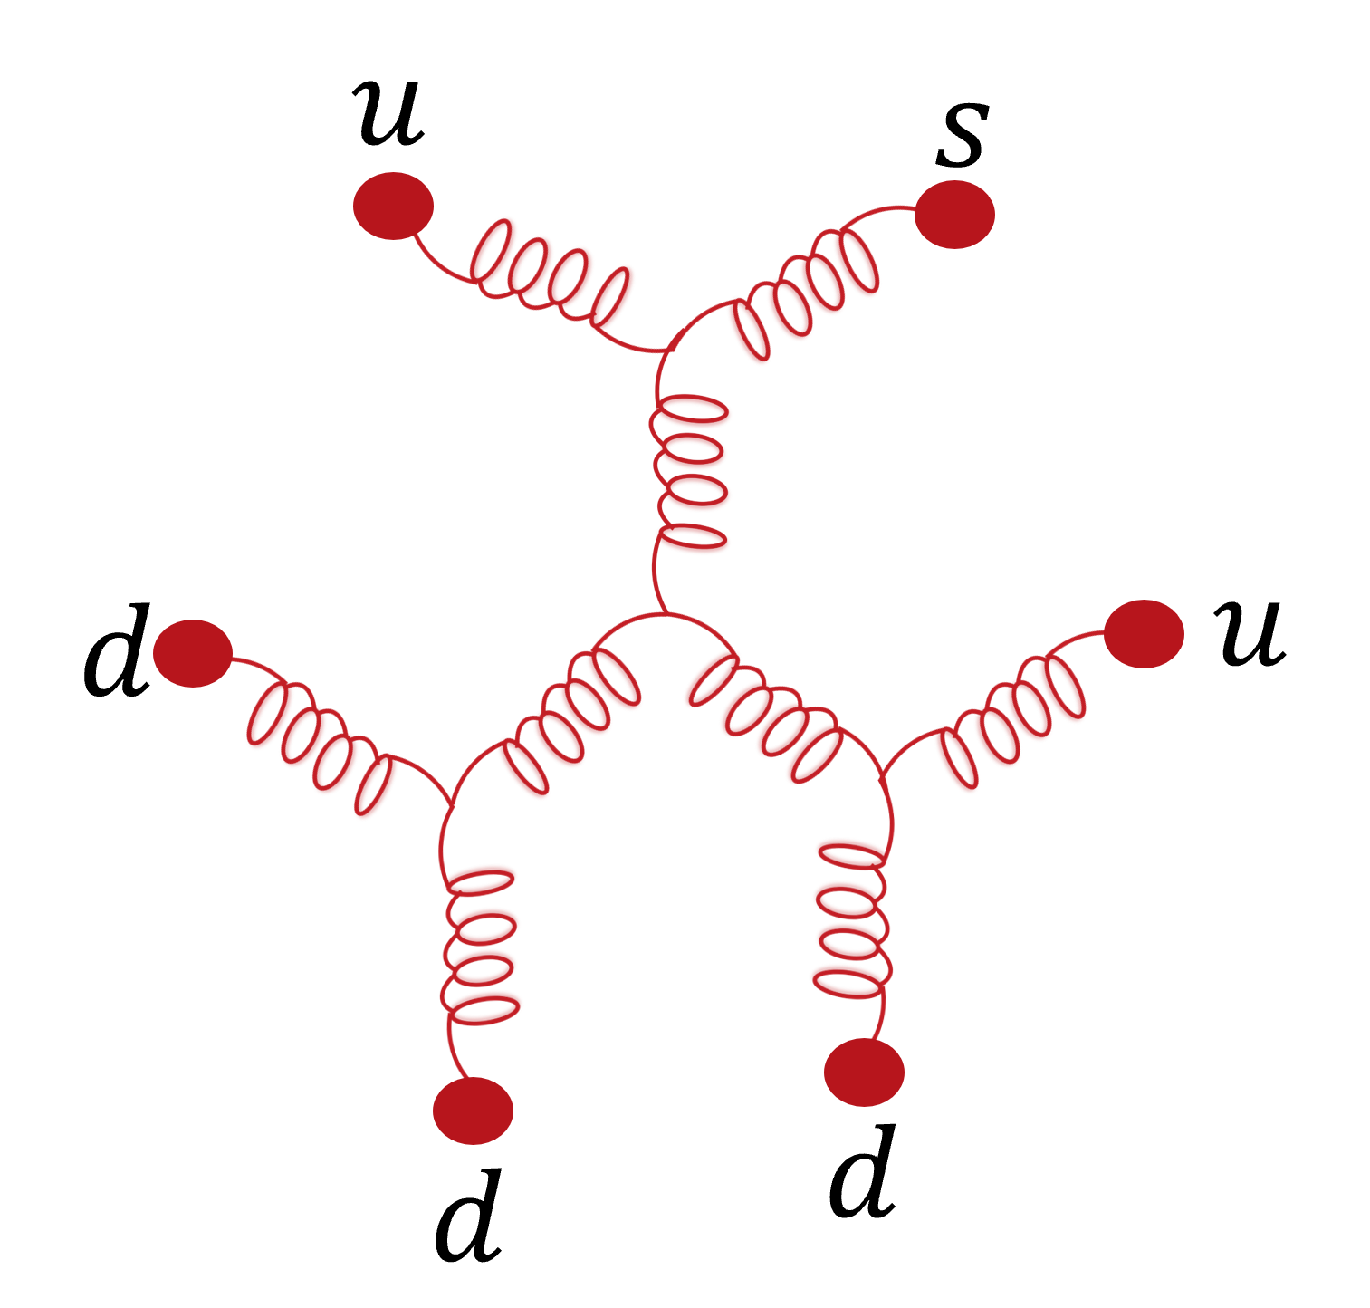
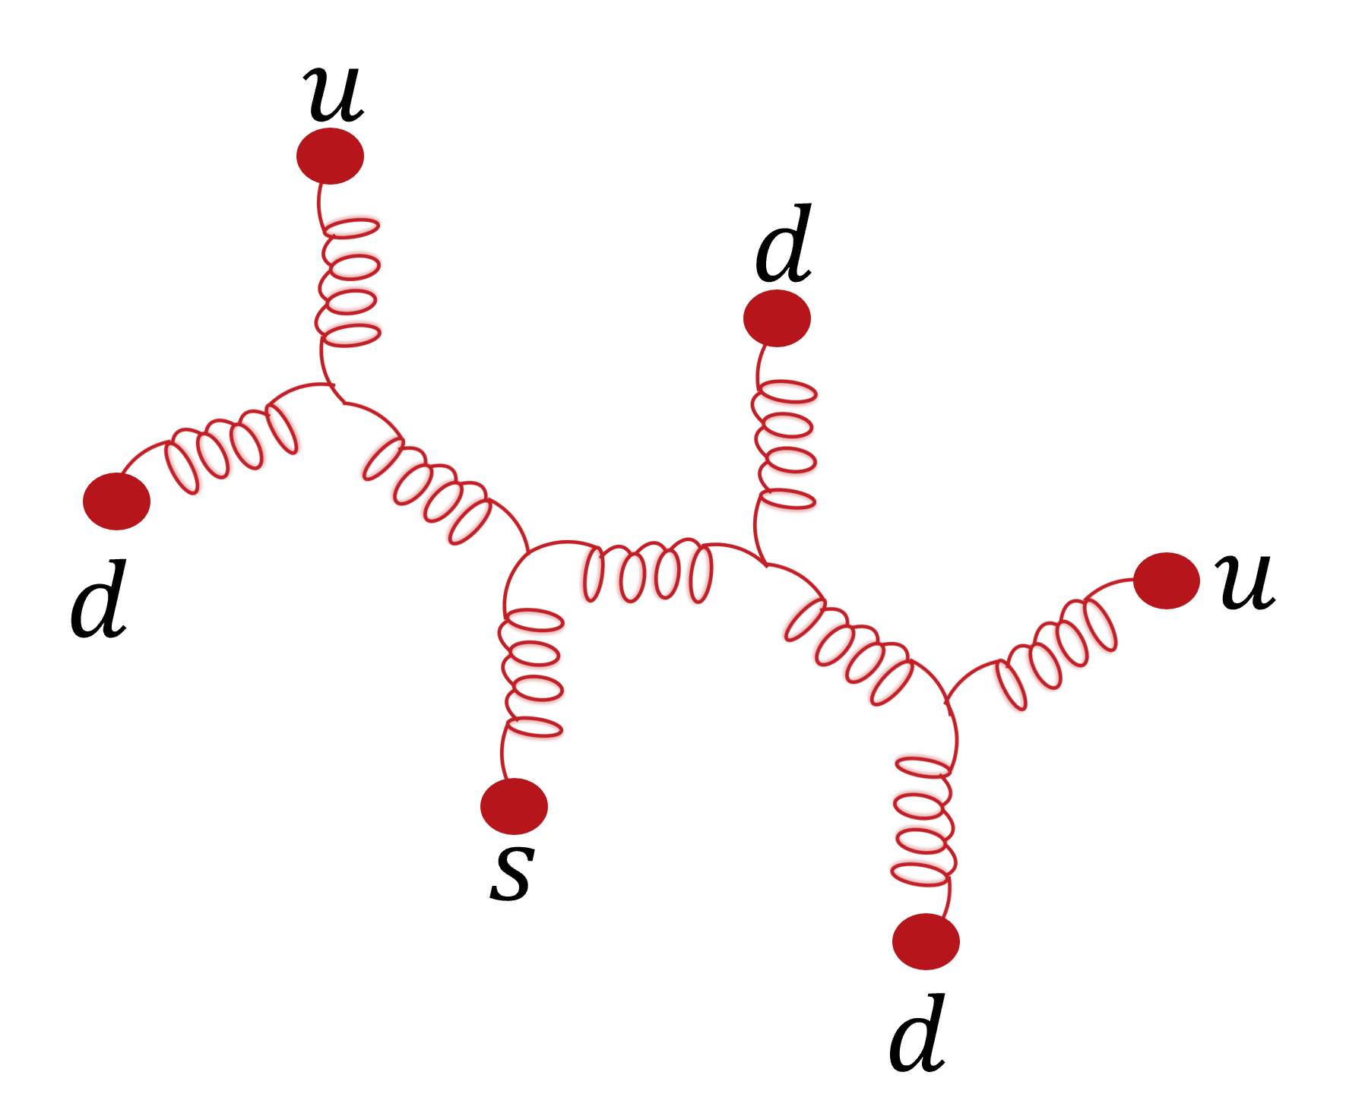
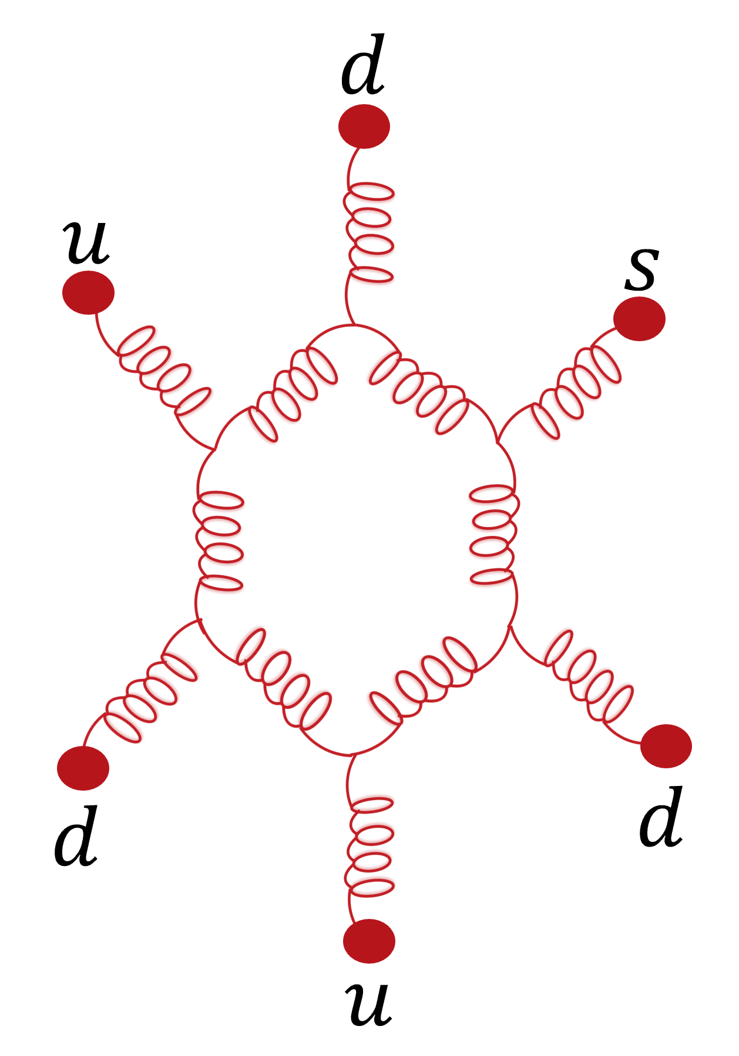
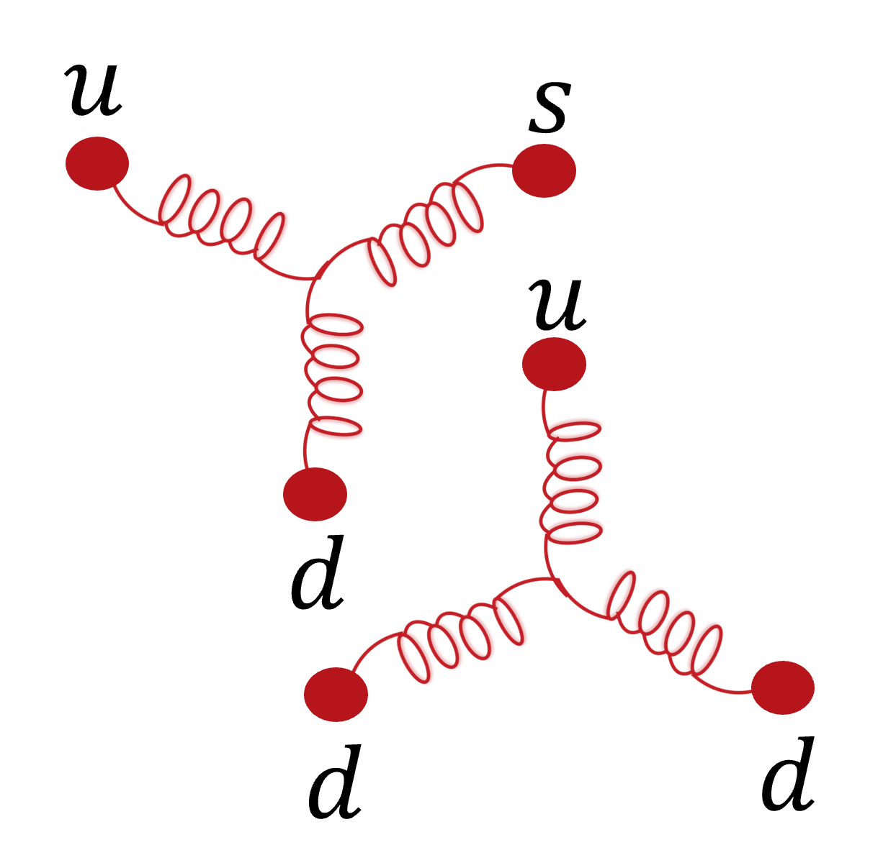
Why Hexaquarks
QCD many body effects
Fan Wang, arXiv:1711.01445v1

Slide 5
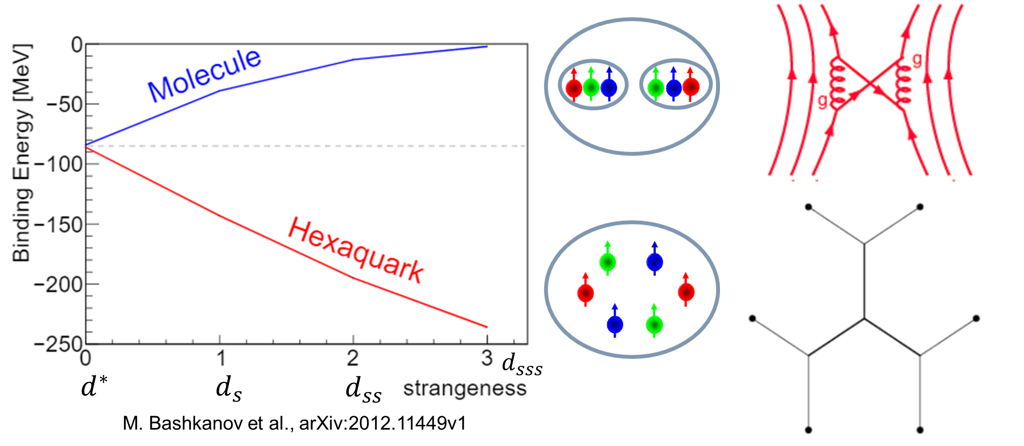
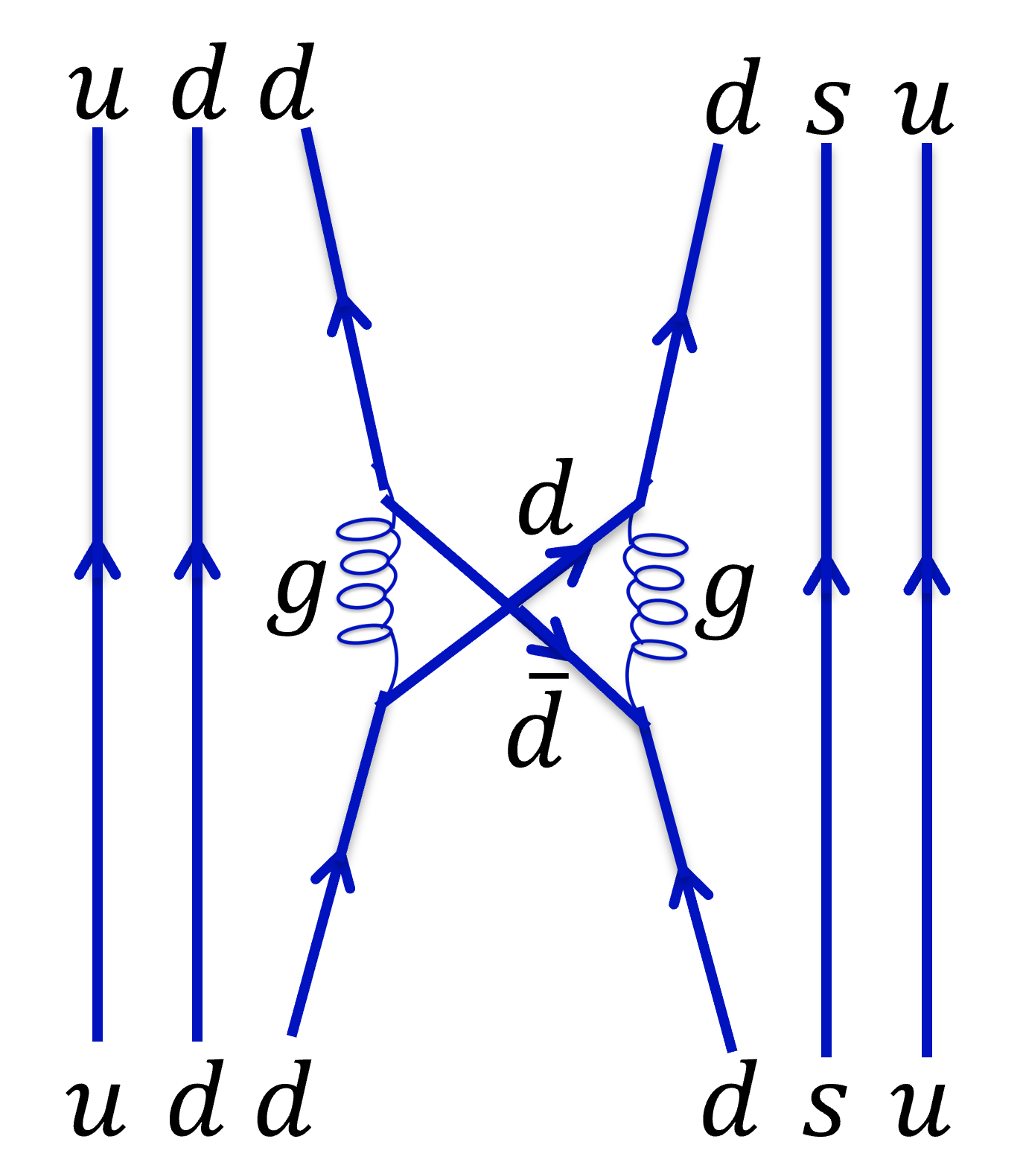
The Question of Structure
Molecule
Pion exchange
Pion wont couple to strange quark
Genuine hexaquark
Colour magnetic force scales with quark mass

Slide 6
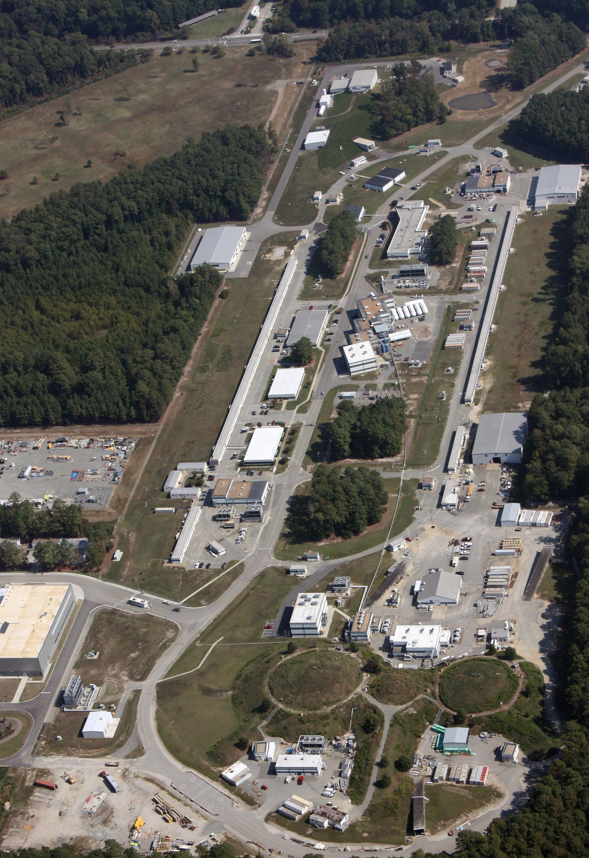
The Experiment
CEBAF gives electron beam
2 anti-parallel linacs
At energy (10.2 – 10.6 GeV) beam enters halls
Hall b is where CLAS12 lives

Slide 7
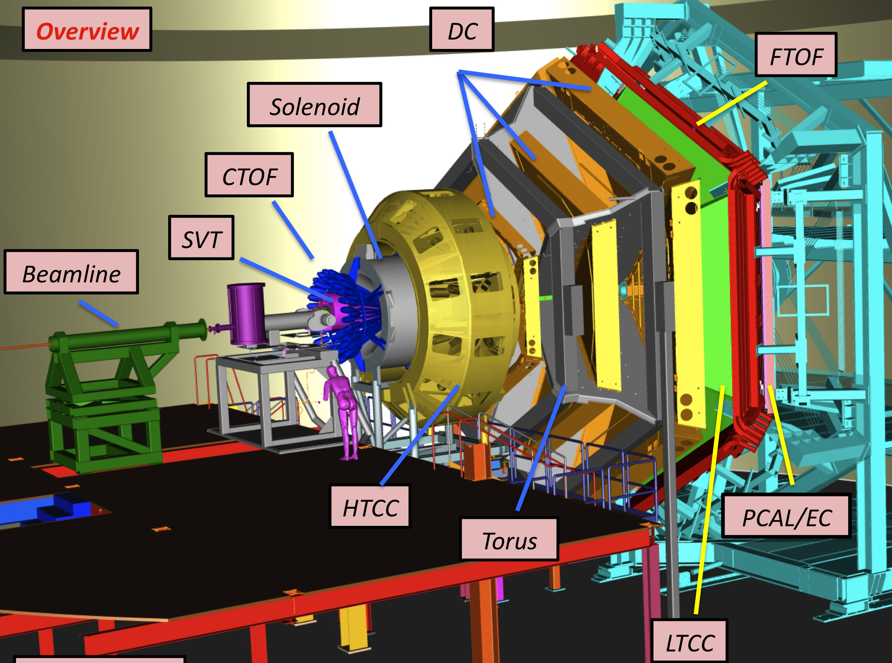
The Experiment

Slide 8
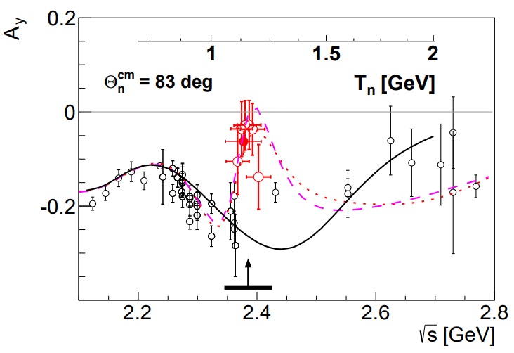
The Method
$$d^{∗}$$
$$\vec{n}$$
$$d_{s}$$
$$\vec{n}$$
$$\vec{p}$$
$$\vec{Λ}$$
$$P_{y}$$
Sensitive to polarization
Lambda self analysing
Lambda 100% polarized
P. Adlarson et al., Phys. Rev. Lett. 112, 202301 (2014).

Slide 9
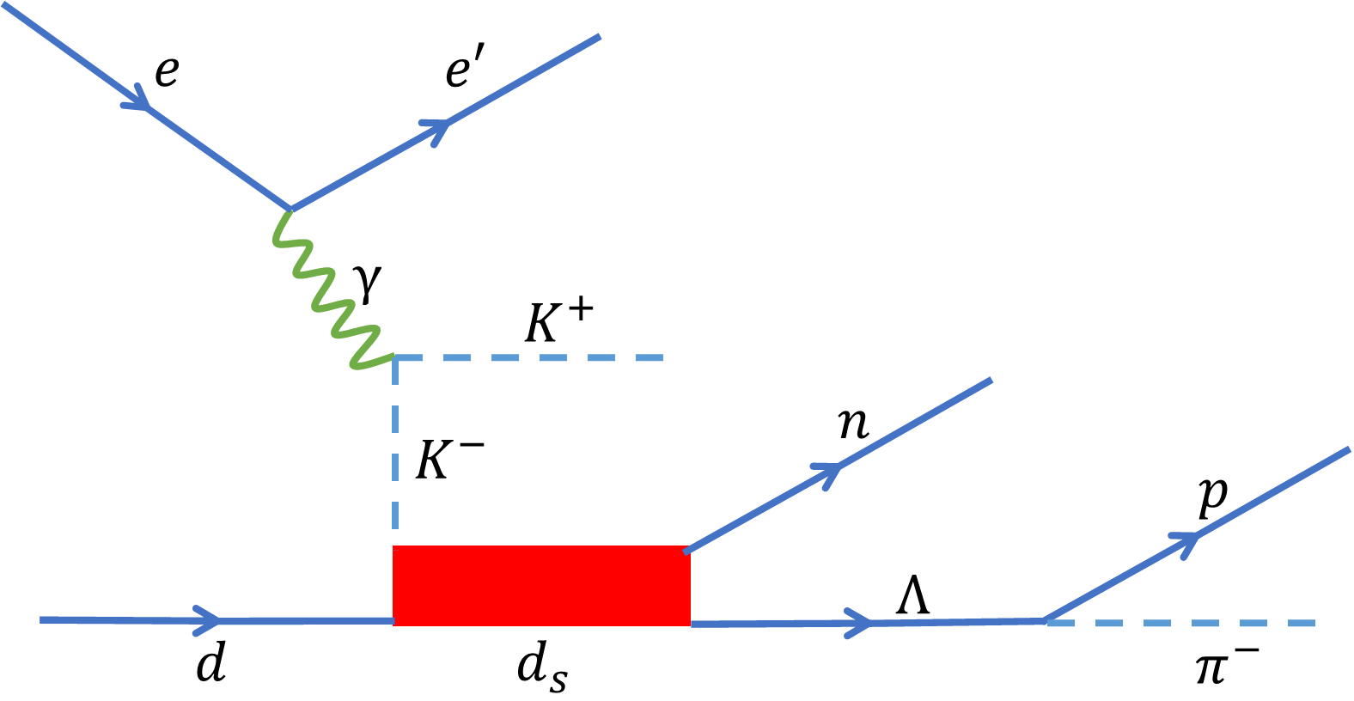
Specific Channel
$$ed→e^{′}{K^{+}d}_{s}→e^{′}K^{+}\vec{Λ}n$$
$$→pπ^{−}$$
*
$$→$$

Slide 10
Specific Channel
$$ed→e^{′}{K^{+}d}_{s}→e^{′}K^{+}\vec{Λ}n$$
$$→pπ^{−}$$
*
$$→$$

Slide 11
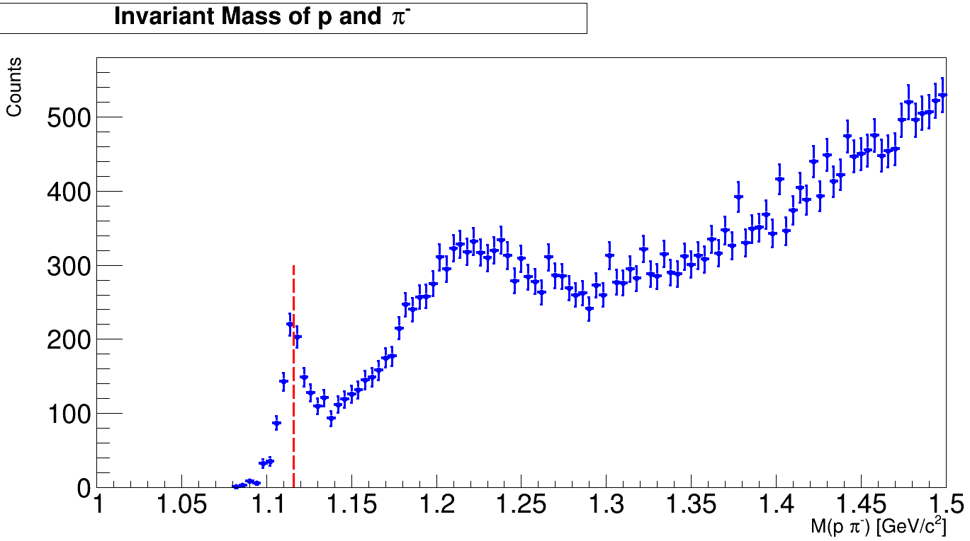
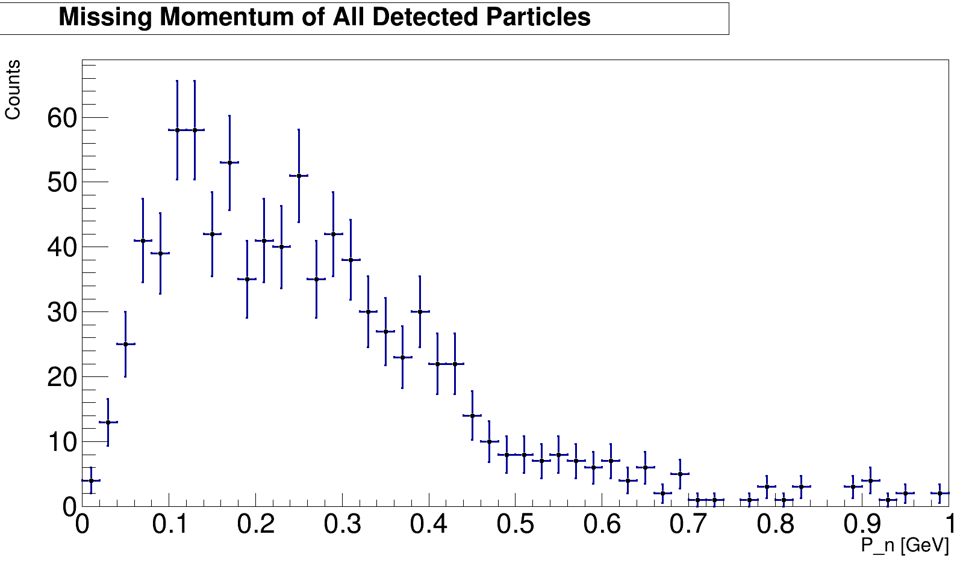
Event Selection
$$\vec{Λ}→pπ^{−}$$
$${ed→e}^{′}K^{+}nΛ$$
$$P_{n}[GeV]$$

Slide 12
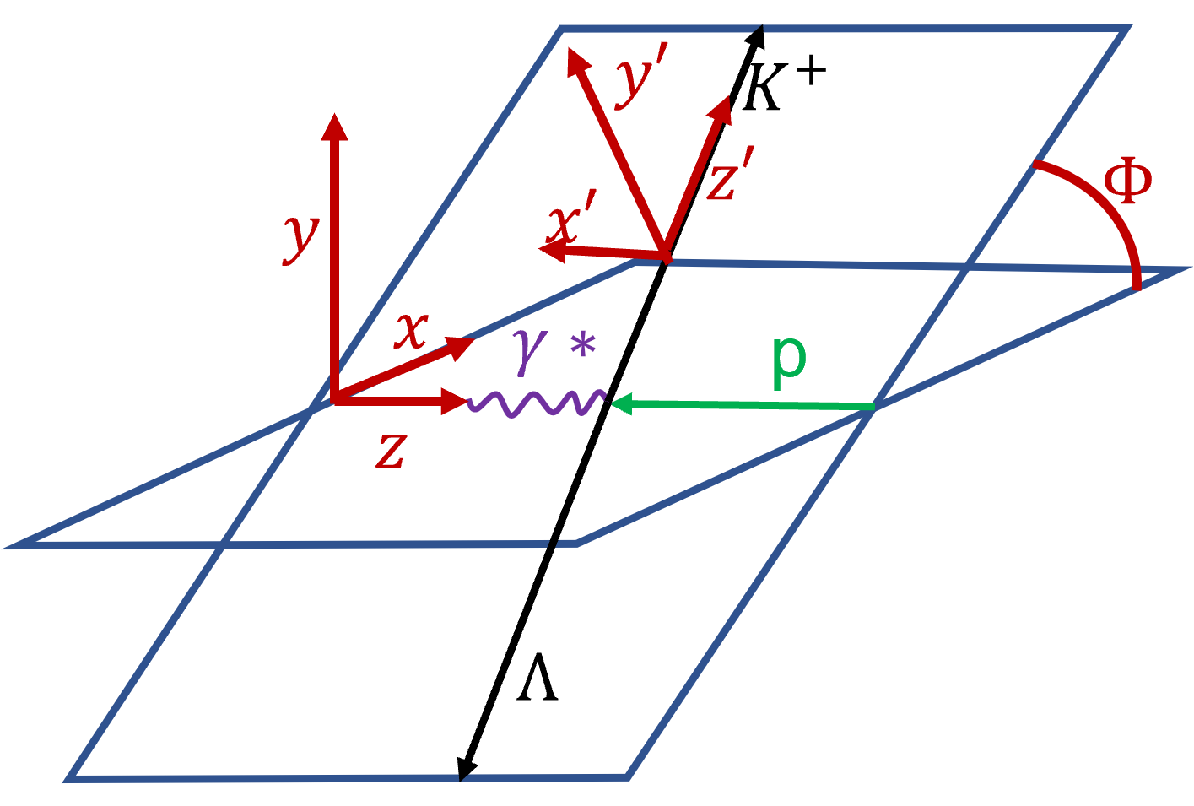
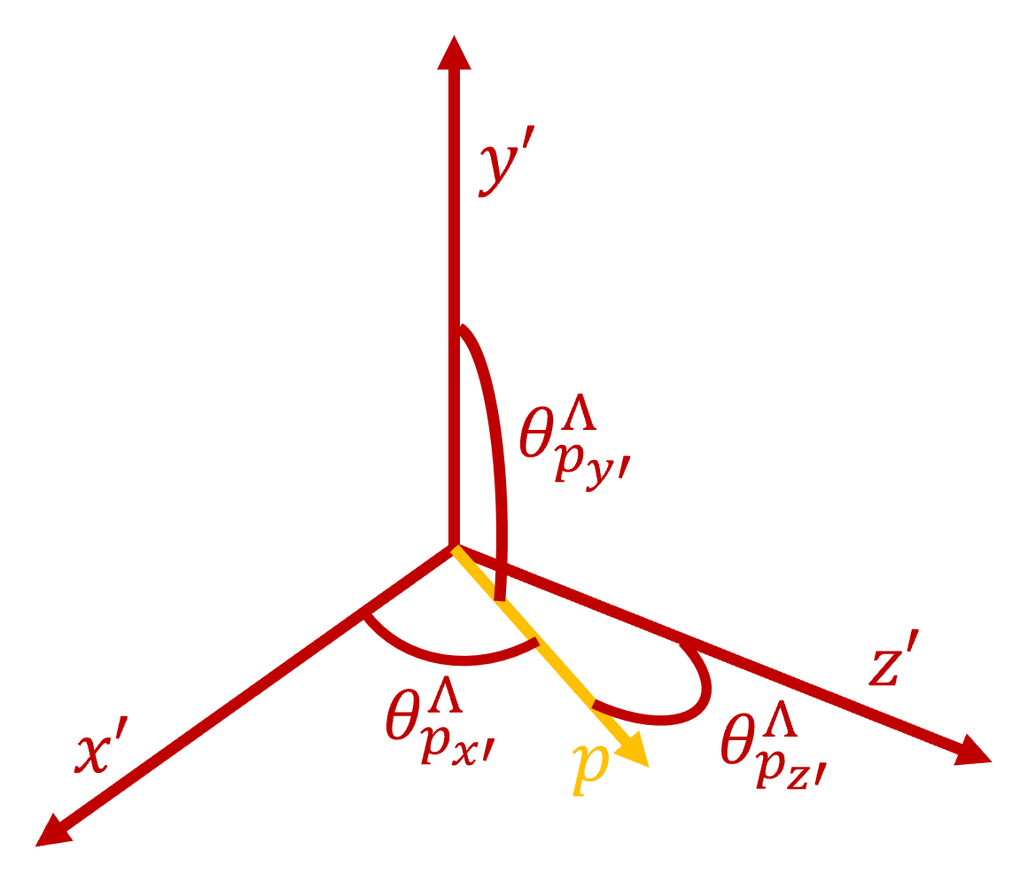
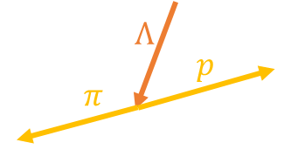
Polarization a Closer Look
$${ep→e}^{′}K^{+}Λ$$
Boost to $Λ$ rest frame

Slide 13
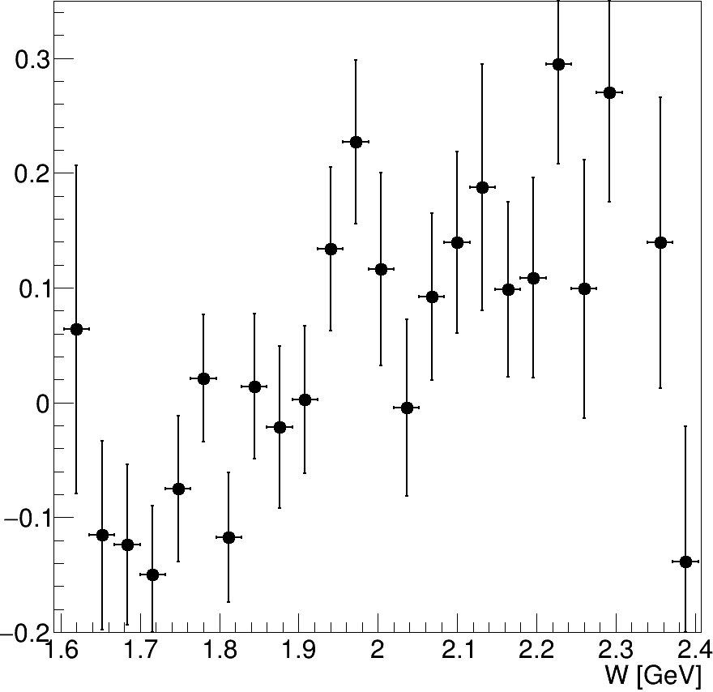
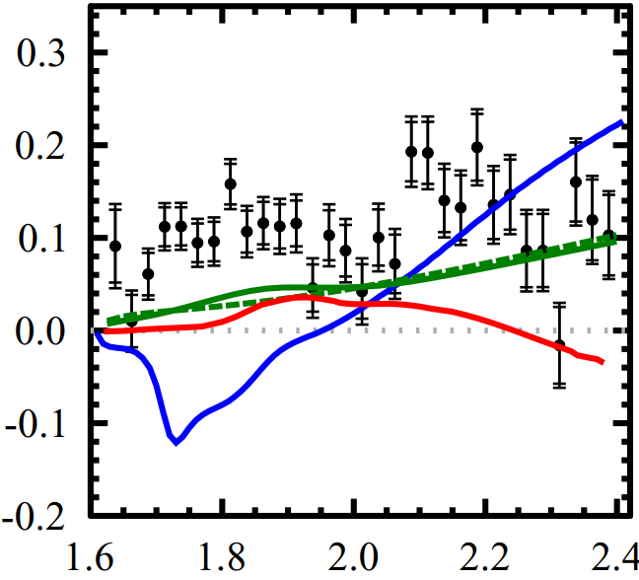
Benchmark Reaction
$${ep→e}^{′}K^{+}Λ$$
$$P_{z′}$$
$$P_{z′}$$
W [GeV]
D. S. Carman et al. Phys. Rev. C 105, 065201 (2022)

Slide 14
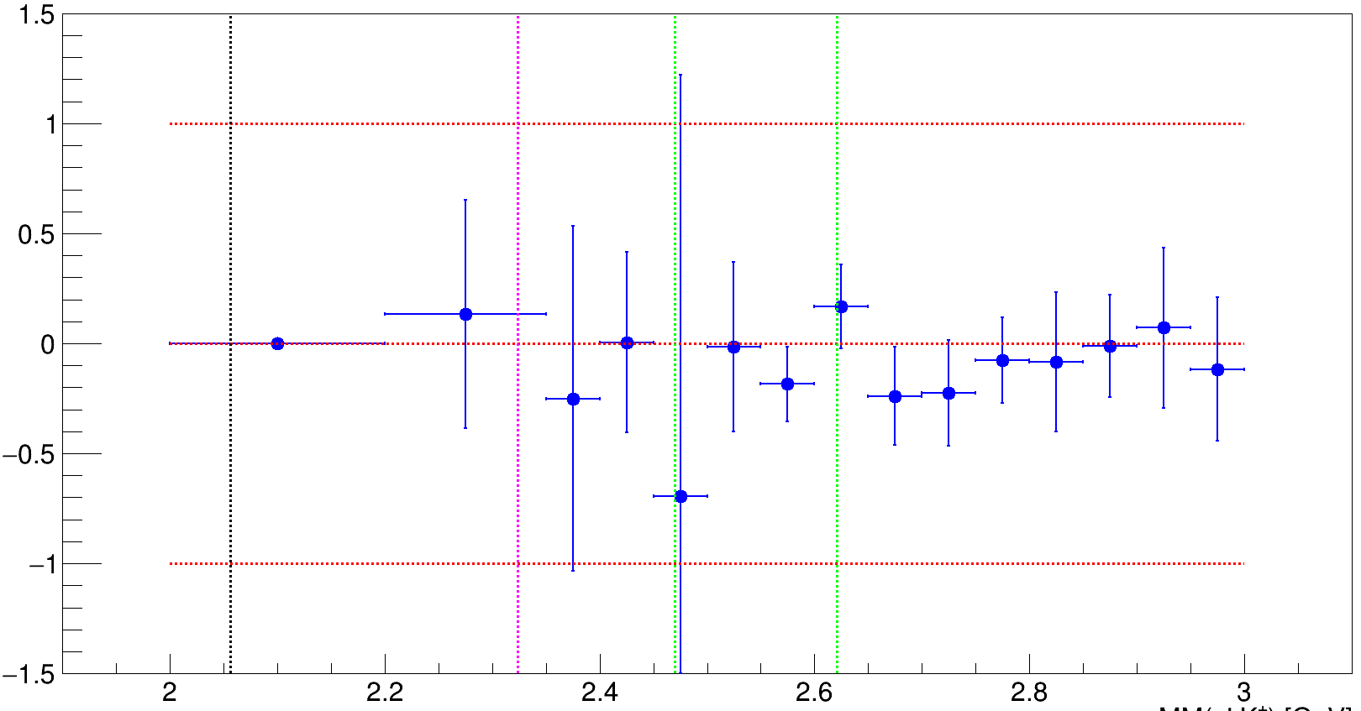
Preliminary Results
$$ed→e^{′}K^{+}X→e^{′}K^{+}nΛ$$
$$P_{y′}$$
$$Λn$$
$$Σ^{∗}n$$
$d_{s}$ region
Mass of X [GeV]

Slide 15
Summary
Benchmark reaction - done
First ever results ${ed→e}^{′}K^{+}nΛ$
Polarization observables $→$ high sensitivity for exotics (mass, width)
More data to come
Stay tuned

Slide 16
Thank you Any Questions?

Slide 17
Polarization
$$d_{s}$$
$$\vec{n}$$
$$Λ\left(\frac{1^{+}}{2}\right)→p \left(\frac{1^{+}}{2}\right)π^{−}(0^{−})$$
$$\vec{Λ}$$
$$π^{−}$$
$$p$$
${P=\left(−1\right)}^{L}∴L=1$ for parity conservation
Weak decay allows parity violation

Slide 18
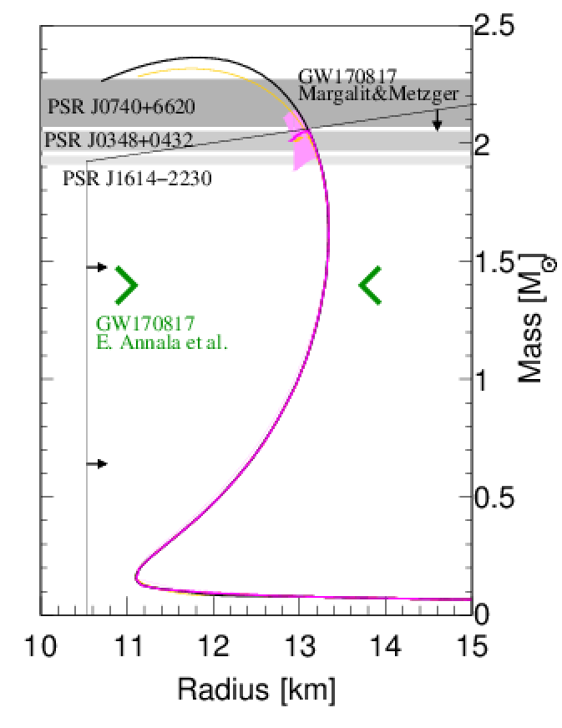
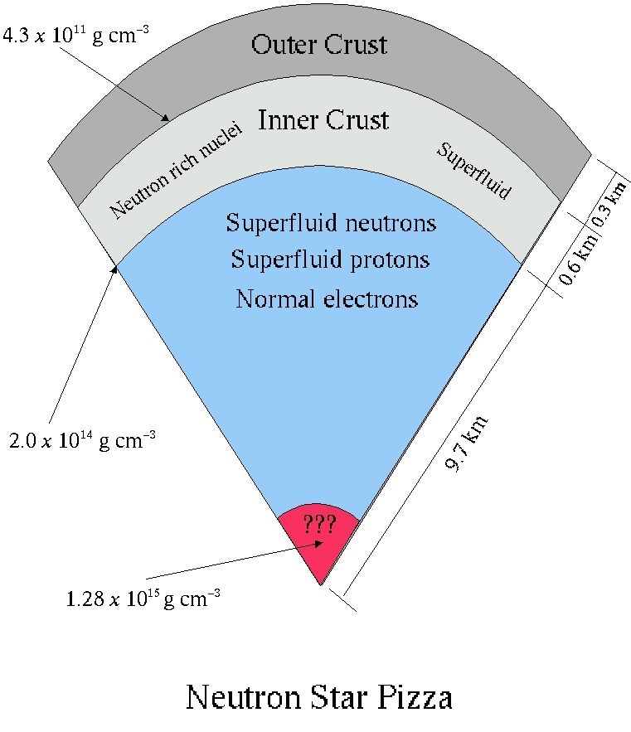
Background and Motivation
Neutron Stars
Nuclear Matter
Hexaquark Matter
$$d^{∗}(2380)$$
I.Vidaña et al., Phys.Lett.B 781 (2018) 112-116

