Slide 1
Parity-Violating Asymmetry in Electroproduction of the $Δ$: Inelastic Electron and Pion Results from the G⁰ Experiment at Backward Angle
Carissa Capuano
College of William and Mary
for the
G⁰ Collaboration
Hall C Users Meeting
January 14, 2012

Slide 2
G⁰ Inelastics: Overview
Purpose:
Measurement of axial transition form factor, $G_{NΔ}^{A}(Q^{2})$
0.2 (GeV/c)² < Q² < 0.5 (GeV/c)²
What does $G_{NΔ}^{A}(Q^{2})$ tell us?
$G_{}^{A}\left(Q^{2}\right)$ → Axial elastic form factor for N
How is the spin distributed?
$G_{NΔ}^{A}(Q^{2})$ → Axial transition form factor for N →Δ
How is the spin redistributed during transition?
What do we measure?
Parity violating asymmetry A_{inel}
Allows a direct measure of the axial (intrinsic spin) response during N →Δ
Accessing $G_{NΔ}^{A}(Q^{2})$ :
Previous Measurements: Charged current process (W± exchange)
Both quark flavor change and spin flip
G⁰ N-Δ Measurement: Neutral current process (Z⁰ exchange )
Quark spin flip only
First measurement in neutral current sector

Slide 3
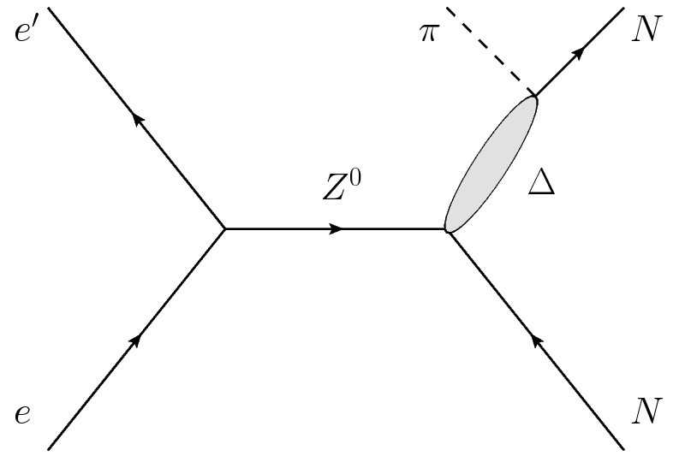
Inelastic Asymmetry Formalism
$$A_{inel}=−\frac{G_{F}Q^{2}}{4πα\sqrt{2}}\left[Δ_{(1)}^{π}+Δ_{(2)}^{π}+Δ_{(3)}^{π}\right]$$
M.J. Musolf et al. Phys. Rept. 239 (1994)
PV Vector Hadron Vertex
Resonant: $Δ_{(1)}^{π}$= 2(1-2sin² θ_{W}) ≈ 1
Non-Resonant: $Δ_{(2)}^{π}$
PV Axial Vector Hadron Vertex
Resonant: $Δ_{(3)}^{π}$= 2(1-4sin²θ_{W}) F(Q²,s)
Non-resonant: Neglected
V A
A V
Axial Form Factors
EM Form Factors
$$F\left(Q^{2},s\right)=\frac{E+E^{′}}{M}H^{EM}(Q^{2},θ)G_{NΔ}^{A}(Q^{2})$$

Slide 4
Axial Electroweak Radiative Effects
Rewrite $Δ_{(3)}^{π}$ to include EW radiative effects:
$∆_{(3)}^{π}=2(1−4\sin^{2}{θ_{W}^{0})\left(1−R_{A}^{∆}\right)F(Q^{2},s)}$
One-quark: Interactions between gauge boson and constituent quarks
Corrections to SM couplings - well known
Can be calculated using info from PDG
Calculated to be ~60%
For vector terms: ~1-1.5%
Applied to theoretical inelastic asymmetry
Multi-quark: Interactions between quarks in the nucleon
May be significant for axial term, but high theoretical uncertainty
Negligible for vector hadron terms
Especially interesting at low Q²
$$R_{A}^{Δ}=R_{A}^{1q}+R_{A}^{multi}$$
See Zhu et al. PRD 65 (2001) 033001

Slide 5
Seigert Term, $d_{Δ}^{−}$ and Pion Asymmetry
Zhu et al. PRD 65 (2001) 033001
At the Q² → 0 limit, asymmetry may not vanish
$$A\left(Q^{2}=0\right)≡A_{γ}^{−}=−\frac{2d_{Δ}^{−}}{C_{3}^{V}}\frac{M_{N}}{Λ_{χ}}$$
A large non-zero asymmetry could explain large asymmetries in hyperon decay
Size of $A_{γ}^{−}$ will depend on the size of $d_{Δ}$
Low energy coupling constant characterizing the PV $γNΔ$ vertex
Given in terms of $g_{π}$ = 5 x 10⁻⁸
Zhu et al. theorized a “reasonable range” of $±$(1-100)$g_{π}$
Corresponds to $\left|A_{γ}\right|=\left(0.052−5.2\right) ppm$
Can be studied using G⁰ pion data from LD₂ at 362 MeV
Measurement performed at Q² = 0.003 (GeV/c)²
$A_{π}$ is a linear combo of photo- ($A_{γ})$ and electroproduced ($A_{inel})$ pions
Will also be studied by Qweak using inelastic ep data
Measurement of A_{inel} at $0.02<Q^{2}<0.03$(GeV/c)²

Slide 6
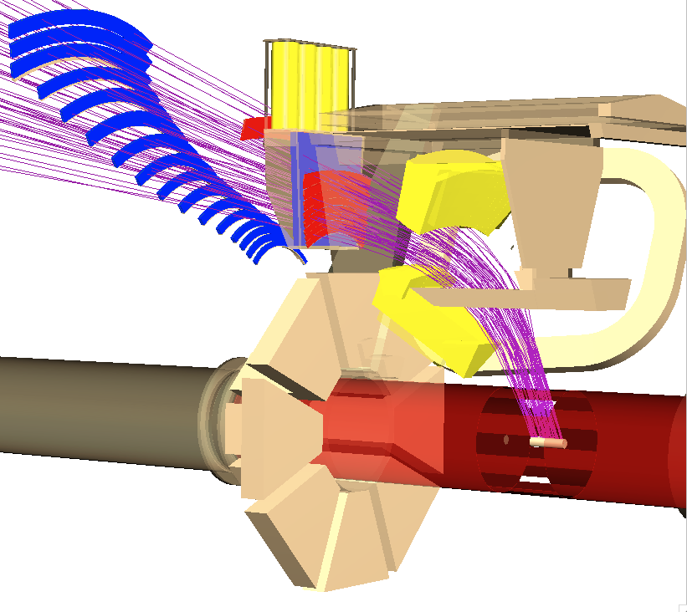
G⁰ Experimental Setup
Polarized Beam:
Longitudinally polarized beam
P_{b} = 85%
Unpolarized Cryotarget:
LH₂ or LD₂
Detector System:
Scintillators:
Two sets allow for kinematic separation of elastic and inelastic regions
Cryostat Exit Detectors (CED)
Focal Plane Detectors (FPD)
Cherenkov Detectors (CER):
Allow us to distinguish between pions and electrons
Measured events: Coincidences
CED + FPD + CER fire
→ electron
CED + FPD fire (CER doesn’t fire)
→ pion
CED + Cherenkov
FPD
e⁻ beam
target
Cutaway view of a single octant
Eight detector arrays like the one above are arranged symmetrically around the target

Slide 7
Data Analysis: Summary
Correct for beam and instrumentation
Dead time and randoms
Helicity correlated beam properties
Beam polarization
Transverse polarization
Correct for Backgrounds
Inelastic: Significant background fraction; dominated by elastic radiative tail
Pions: Small background, big effect on asymmetry; dominated by electron contamination
Correct for EM radiation & acceptance averaging
Inelastic hydrogen only!
Once all corrections are applied, can extract physics results from the measured asymmetries

Slide 8
Final Corrected Asymmetries
Inelastic Data: W = 1.18 GeV, Q² = 0.34 (GeV/c)²
A^{D}_{inel} = -43.6 ± (14.6)_{stat} ± (6.2)_{sys} ppm
A^{H}_{inel} = -33.4 ± (5.3)_{stat} ± (5.1)_{sys} ppm
**Form factor determination will be for H result only
Pion Data: W = 1.22 GeV, Q² = 0.0032 (GeV/c)²
A_{π} = -0.55 ± (1.03)_{stat} + (0.37)_{sys} ppm

Slide 9
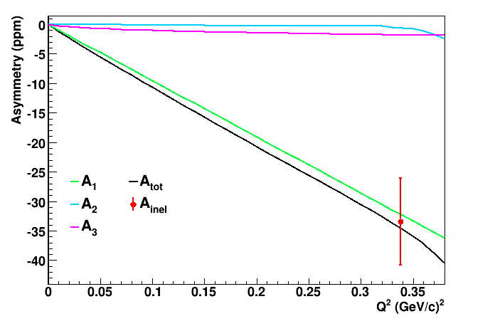
Comparison: Measured A_{inel} vs. Theory
Inelastic hydrogen result: Compare to theoretical total asymmetry and individual components.

Slide 10
Extracting the Axial Form Factor, $G_{NΔ}^{A}$
First need to isolate $A_{3}$
Assuming A₁ and A₂ are known, $A_{3}=A_{inel}−A_{1}−A_{2}$
From $A_{3}$, extract $G_{NΔ}^{A}$
$$A_{inel}=A_{1}+A_{2}+A_{3}=−\frac{G_{F}Q^{2}}{4πα\sqrt{2}}\left[Δ_{(1)}^{π}+Δ_{(2)}^{π}+Δ_{(3)}^{π}\right]$$
$A_{3}=−0.69±{\left(5.3\right)}_{stat}+{\left(5.1\right)}_{sys}+{\left(0.7\right)}_{th}$ ppm
(Theory: $A_{3}=−1.8$ ppm)
$$G_{NΔ}^{A}=−\frac{M}{E+E^{′}}\frac{\left.2πα\sqrt{2}\right.}{G_{F}Q^{2}}\frac{A_{3}}{2H^{EM}\left(Q^{2},θ\right)\left[1−4\sin^{2}{θ_{W}}\right]}$$
$$G_{NΔ}^{A}=−0.05±{\left(0.35\right)}_{stat}+{\left(0.34\right)}_{sys}+{\left(0.06\right)}_{th}$$
(Theory: $G_{NΔ}^{A}=−0.2$)

Slide 11
Extracting the coupling constant, $d_{Δ}^{−}$
First need to find photoproduction asymmetry, $A_{γ}^{−}$
$$A_{π}=f_{brems}\left\langle D(y)\right\rangle A_{γ}^{−}+f_{virt}\left\langle A_{e}^{−}\left(Q^{2}\right)\right\rangle$$
Use input from theory and simulation to isolate $A_{γ}^{−}$
$f_{virt}=0.45±{\left(0.05\right)}_{sys}→f_{brems}\sim 0.55$
$\left\langle D(y)\right\rangle =0.95±{\left(0.05\right)}_{sys}$
$\left\langle A_{e}^{−}\left(Q^{2}\right)\right\rangle$ estimate as $\sim { Δ}_{(1)}^{π}$
$$A_{γ}^{−}=−0.36±{\left(1.06\right)}_{stat}±{\left(0.37\right)}_{sys}±{\left(0.03\right)}_{th} ppm$$
From $A_{γ}^{−}$, extract $d_{Δ}^{−}$
$$d_{Δ}^{−}=−\frac{C_{3}^{V}Λ_{χ}}{2M_{N}}A_{γ}^{−}$$
$$d_{Δ}^{−}=\left[8.4±{\left(23.9\right)}_{stat}±{\left(8.3\right)}_{sys}±{\left(0.7\right)}_{th}\right]g_{π}$$
(Theory: ${|d}_{Δ}^{−}|=(1−100)g_{π}$)

Slide 12
Final Summary
Measurement: PV asymmetry in electroproduction of the $Δ$
E = 687 MeV, D target – Determine A_{inel}
E = 687 MeV, H target – Determine A_{inel} and form factor $G_{NΔ}^{A}$
E = 362 MeV, D target – Determine $A_{γ}^{−}$ and $d_{Δ}^{−}$
Results:
Inelastic Data:
First measurement using neutral current process
Form factor $G_{NΔ}^{A}$found to be consistent with theory, but large error
Pion Data:
Resulted in ±25$g_{π}$ bound on $d_{Δ}^{−}$ → |A(Q²=0)| < 2 ppm
Publications:
Pion Result:
arXiv:1112.1720v1 [nucl-ex] (submitted to PRL)
Inelastic Result:
Coming soon…

Slide 13
Backup Slides
☺

Slide 14
Computing the Axial Component
$$F\left(Q^{2},s\right)=\frac{E+E^{′}}{M}H^{EM}(Q^{2},θ)G_{NΔ}^{A}(Q^{2})$$
Depend on the Adler form factors, $C_{i}^{Z}(Q^{2})$
Unknown
Requires neutral weak axial and vector form factors
CVC Hypothesis: Replace vector with EM form factors
EM FF’s well known
Isospin Rotation: Replace axial with CC axial form factors
CC FF’s determined from neutrino data
Basic Form: Adler Parameterization
Vector: $C_{i}^{γ}\left(Q^{2}\right)=C_{i}^{γ}\left(0\right){\left[1+\frac{Q^{2}}{M_{V}^{2}}\right]}^{−2}, i =3, 4$
Axial: $C_{i}^{A}\left(Q^{2}\right)=C_{i}^{A}\left(0\right)\left[1−\left(\frac{1.2Q^{2}}{2+Q^{2}}\right)\right]{\left[1+\frac{Q^{2}}{M_{A}^{2}}\right]}^{−2}, i =4,5$
Extra Q²
Dependence
$$ξ^{A}\left(Q^{2}\right)$$
Dipole Form

Slide 15
Axial Electroweak Radiative Corrections
Zhu et al. PRD 65 (2001) 033001
Rewite $Δ_{(3)}^{π}$ to include effects:
$∆_{(3)}^{π}=2(1−4\sin^{2}{θ_{W}^{0})\left(1−R_{A}^{∆}\right)F(Q^{2},s)}$
tree-level
$$R_{A}^{Δ}=R_{A}^{ewk}+R_{A}^{Siegert}+R_{A}^{anapole}+R_{A}^{d−wave}+ …$$
1-quark
PV πNΔ
vertex
PV γNΔ vertex
60% effect
Negligible
Pion Measurement:
Siegert term dominates, size depends on coupling constant
$$R^{Siegert}=\frac{A_{3}^{Siegert}}{A_{3}}\sim d_{Δ}$$
Inelastic measurement: Anapole may contribute ~0.3ppm but high theoretical uncertainty
→Multiquark corrections neglected

Slide 16
Axial Multi-quark EW Radiative Effects
Pion:
Q² = 0.003 GeV²
Inelastic:
Q² = 0.34 GeV²
A₃
Note: Figure taken from Zhu et al., not at exact G⁰ kinematics
r_{i} = A_{i} /A_{tot}
Siegert
($d_{Δ}=25g_{π}$)
anapole
d-wave
Zhu et al. PRD 65 (2001) 033001

Slide 17
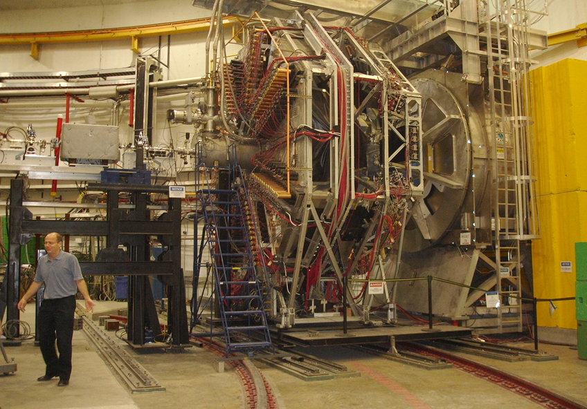
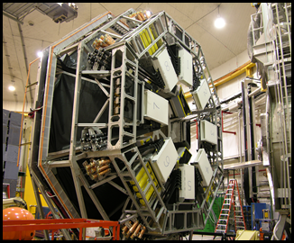
The G⁰ Experiment in Hall C
Superconducting
Magnet
(SMS)
Target Service Module
G0 Beam Monitoring
“Front” View:
Detectors:
Ferris Wheel (FPDs)
Detectors:
Mini-Ferris wheel
(CEDs+Cherenkov)

Slide 18
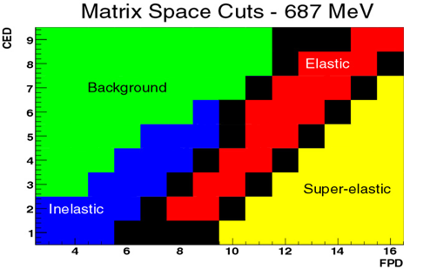
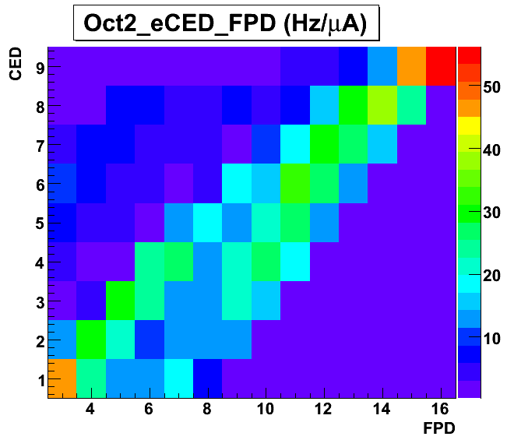
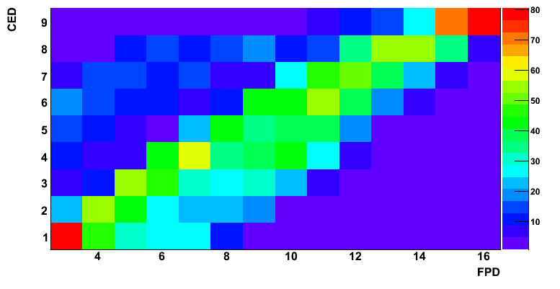
Detector Acceptance and Yields
** Similar matrices exist for pion data
H 687 Electron Yield (Octant 2)
D 687 Electron Yield (Octant2)
CED
CED
CED
elastics
elastics
inelastics
inelastics
FPD
FPD

Slide 19
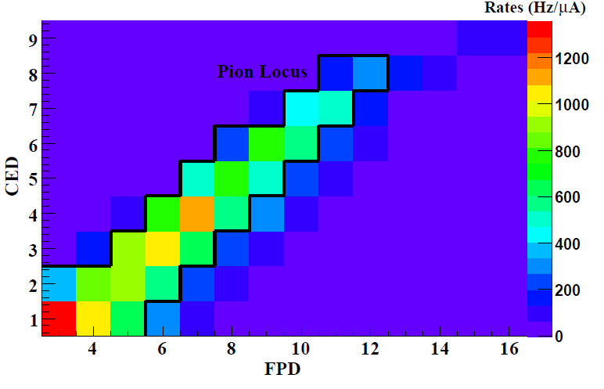
Detector Acceptance and Yields
D 362 Pion Yield (Octant Average)

Slide 20
Data Summary
Two Targets: Needed for elastic measurement
Elastic asymmetry contains 3 form factors
Forward H + Backward H + D allows full separation
Two Energies: Allows for elastic result at two Q² points
Only high energy run periods useful for inelastic measurement
Only low energy D run period used for pion measurement
Date | Target | E_{beam} (MeV) | I_{beam}(μA) | Charge(C) | # Runs
Apr ’06 | H | 685.6 | 60 | 16.3 | 100
Sep-Oct ’06 | H | 684.9 | 60 | 97.1 | 548
Nov-Dec ’06 | D | 689.6 | 20 | 32.8 | 532
Mar ’07 | D | 689.4 | 17 | 17.3 | 332
Jul-Aug ’06 | H | 361.9 | 60 | 78.0 | 475
Jan-Feb ‘07 | D | 363.1 | 35 | 67.4 | 649

Slide 21
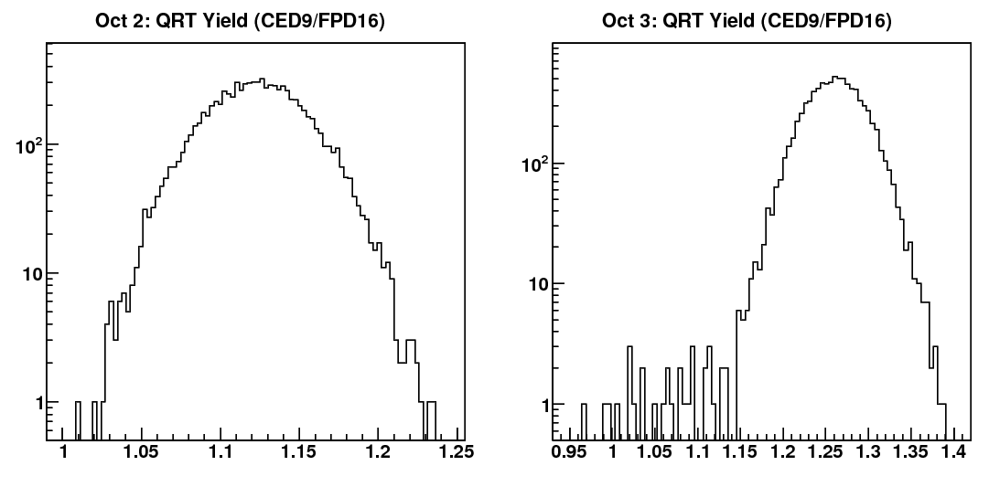
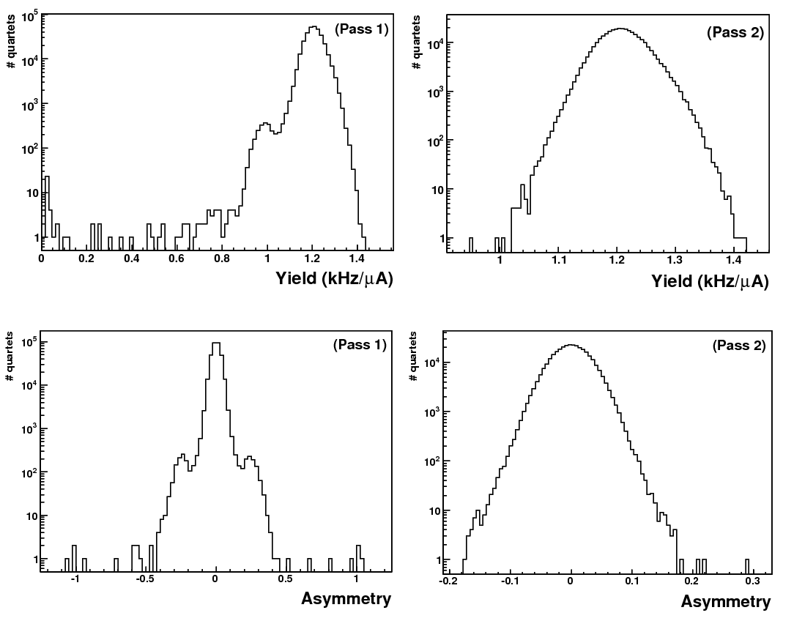
Scaler Counting Correction
Symptom: Tails on the yield
D 362 data most affected
Rate dependent
→ Impact on inelastic cells minimal
Problem: Bad MPS counts in NA octants
NA coincidence boards did not have a minimum output width
Scaler boards didn’t properly handle consecutive short pulses
→ Two effects combined lead to dropped bits
Solution: Program a minimum output width of 10ns
Problem diagnosed and corrected during experimental run
Correction: Remove QRTs with bad MPSs
Events outside ±5σ window removed from averaging
Impact: Tails removed w/o negatively impacting unaffected data
Bad MPS Uncorrelated across cells
Correction results in 1% of events cut in D 362 run period
0.1% in all others
FR
NA
Yield
raw
Yield
corrected
Asymmetry

Slide 22
Rate Corrections: Inelastic Data
Dead Time:
Real events missed while electronics processed previous events → adds events
Accounts for components of the CED and FPD electronics
Does not include Cerenkov DT
Contamination:
Misidentified particles → adds & subtracts events
Cerenkov dead time – e in π matrix
Cerenkov randoms – π in e matrix
Randoms:
Random CED·FPD coincidences → subtracts events
Only applied to the pion matrix
Overall impact of rate corrections on asymmetry → net effect
Uncertainty:
False asymmetry from residual DT → negligible
False asymmetry from CED·FPD·CER randoms
→ Bound inelastic locus uncertainty using information from elastic analysis
dA = $\left\{ \begin{aligned}\sim 10\% , H \\ \sim 90\% , D\end{aligned}\right.$
Error ~10%
of correction
Notes:
H = -2.17 +/- 0.16, D = -12.6 +/- 1.2

Slide 23
Helicity Correlated Beam Properties
Correct for false asymmetry due to changes in…
Beam position in x or y direction
Beam angle in x or y direction
Beam Current
Beam Energy
Size of correction determined by beam quality
Specifications given to ensure sufficient precision
$$P_{i}$$ | Spec | Actual
$$∆x (nm)$$ | 40 | -19 $±$ 3
$$∆y (nm)$$ | 40 | -17 $±$ 2
$$∆θ_{x} (rad)$$ | 4 | -0.8 $±$ 0.2
$$∆θ_{y} (rad)$$ | 4 | 0.0 $±$ 0.1
$$∆E (eV)$$ | 34 | 2.5 $±$ 0.5
$$A_{Q} (ppm)$$ | 2 | 0.09 $±$ 0.08
$$A_{false}=\sum{\frac{1}{2Y}\frac{∂Y}{∂P_{i}}∆P_{i}}$$
$$⟹$$
|A_{false}|< 0.3 ppm

Slide 24
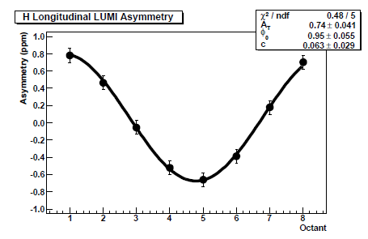
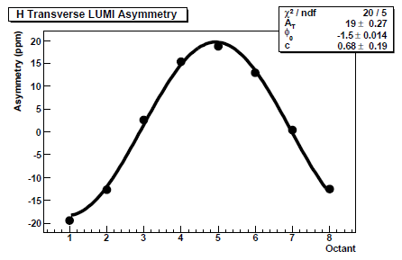
Transverse Asymmetry Correction: Inelastic Data
Correct for false asymmetry arising from transverse beam:
Impact depends on…
Magnitude of transverse asymmetry, $A_{T}$
Determined through direct measurement
Physical misalignment in detector system, $M_{det}$
Sinusoidal octant dependence
→ Should cancel in a symmetrical detector system
Degree of transverse polarization, $\frac{P_{T}}{P}$
Determined from LUMI data
Computed upper bound, found to be small (< 0.05 ppm)
Consistent with elastic locus results
→ No correction applied, treated as uncertainty
$$A_{T}^{corr}= A_{T}M_{det}\frac{P_{T}}{P}$$
Difficult to quantify
Longitudinal
Transverse
-1 → 1
-20 → 20

Slide 25
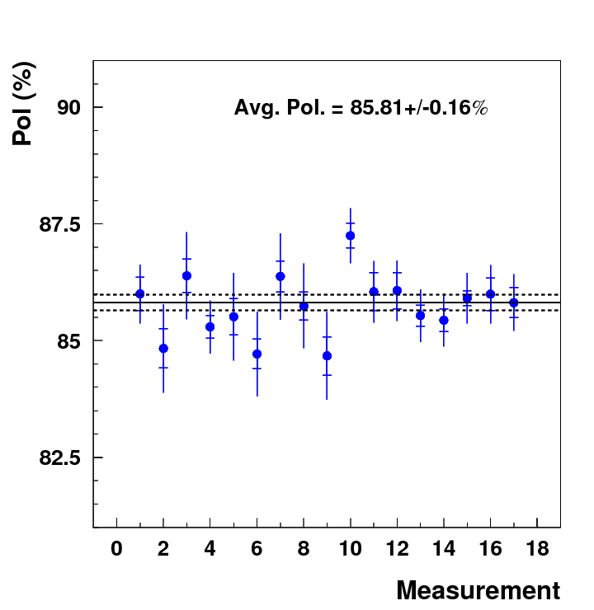
Beam Polarization
Polarimeter: Measure an asymmetry using Møller scattering
$$A_{moll}=\frac{σ^{↑↑}−σ^{↑↓}}{σ^{↑↑}+σ^{↑↓}}=P_{t}P_{b}A_{zz}(θ)$$
Polarized iron target
θ = 90°
Measurements performed periodically throughout the experimental run
P_{b} stable throughout
$$⟹P_{687}=[85.1±(0.07)_{stat}±\left(1.38)_{sys}\right]\%$$

Slide 26
Background Correction: Inelastic Data
Contributing processes:
Electrons from inelastic e-p(d) scattering
Electrons from elastic e-p(d) scattering
Electrons from π⁰ decay
Electrons scattered from Al target windows
Contamination from π⁻ (D target only)
Fitting: Scale Yield vs. FPD for each CED
Before fitting, subtract π⁻ contamination and target window yield
Scale the remaining contributions independently to fit the data
Fit Requirements:
Fit across all octants - forces all to have the same scale factor
Require scale factors to vary smoothly across CEDs
GEANT Simulation
“Empty target” data **
Pion data analysis
** Gas target data scaled to remove the gas contribution and to account for the kinematic differences in the liquid and gas target

Slide 27
Background Correction: Application
Correcting the Asymmetry:
Extract A_{inel} from A_{meas} by subtracting off backgrounds
High backgrounds: $f_{bg}$~50% for H, ~65% for D
Background Asymmetries:
Elastic Electrons
Use A_{el} measured by G⁰
Dominated by radiative tail → Use simulation to determine a scale factor
Target windows
Dominated by inelastic events
A^{inel}_{al} is unknown, but can use measured D asymmetry
Pion related: Misidentified π⁻ and electrons from π⁰ decay
A_{π} measured by G⁰
$$A_{inel}=\frac{A_{meas}−\sum{f_{i}^{bg}A_{i}^{bg}}}{1−\sum{f_{i}^{bg}}}$$
Impact on Asymmetry:
26% change for H, 40% change for D
Impact on Uncertainty:
Significant increase - more than doubled

Slide 28
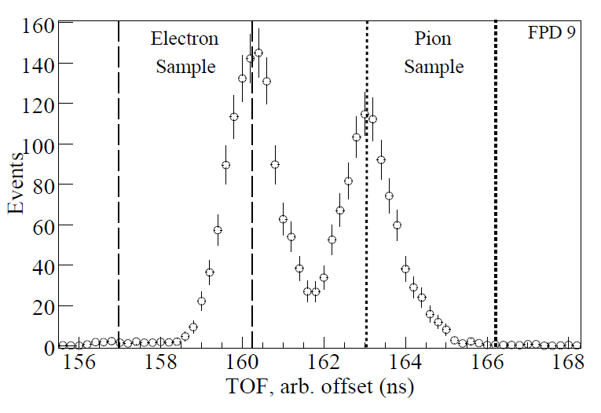
Background Correction: Pion Data
Method: Use time of flight spectra from 31MHz pulsed beam
Primary source: Misidentified electrons
Particle ID: Use ToF cuts to define true e and $π$ rates, compare to data to get efficiency
Backgrounds:
2.6% electrons scattered from target liquid
2% Al target windows can be ignored
→D target!
Apply Correction: Same procedure as inelastics

Slide 29
D 687 Inelastics: Summary of Corrections & Error
All values in ppm
Correction | A_inel | σ_tot | σ_stat | σ_sys | σ_cor | dA_corr
Raw | -14.11 | 2.62 | 2.62 | 0.00 | --- | ---
Scalar Counting Prob. | -14.06 | 2.62 | 2.62 | 0.00 | 0.00 | +0.05
Rate Corrections | -26.66 | 5.99 | 5.87 | 1.20 | 1.20 | -12.6
Linear Regression | -26.41 | 6.01 | 5.88 | 1.23 | 0.25 | +0.25
Beam Polarization | -31.07 | 7.04 | 6.92 | 1.30 | 0.43 | -4.66
Transverse | -31.07 | 7.04 | 6.92 | 1.30 | 0.02 | ---
Backgrounds | -43.57 | 15.91 | 14.64 | 6.23 | 5.52 | -12.5
A^{D}_{inel} = -43.57 ± 15.9 ppm
Notes:
36% error

Slide 30
H 687 Inelastics: Summary of Corrections & Error
All values in ppm
Correction | A_inel | σ_tot | σ_stat | σ_sys | σ_cor | dA_corr
Raw | -20.23 | 2.00 | 2.00 | 0.00 | --- | ---
Scalar Counting Prob | -20.00 | 1.99 | 1.99 | 0.00 | 0.00 | +0.23
Rate Corrections | -22.17 | 2.26 | 2.25 | 0.16 | 0.16 | -2.17
Linear Regression | -22.33 | 2.25 | 2.24 | 0.23 | 0.16 | -0.16
Beam Polarization | -26.27 | 2.64 | 2.64 | 0.43 | 0.36 | -3.91
Transverse | -26.27 | 2.64 | 2.64 | 0.43 | 0.03 | ---
Backgrounds | -33.60 | 7.36 | 5.30 | 5.10 | 4.93 | -7.33
EM Radiation | -33.99 | 7.36 | 5.30 | 5.10 | 0.20 | -0.39
Acceptance Avg. | -33.44 | 7.36 | 5.30 | 5.13 | 0.55 | +0.55
A^{H}_{inel} = -33.44 ± 7.4 ppm
Notes:
21% error

Slide 31
D 362 Pions: Summary of Corrections & Error
All values in ppm
Correction | A_pi | σ_stat | σ_cor
Raw | -0.17 |  | ---
Scalar Counting Prob. | -0.17 | 0.75 | 0.00
Rate Corrections | -0.54 | 0.78 | 0.26
Linear Regression | -0.52 | 0.78 | 0.21
Backgrounds | -0.22 | 0.88 | 0.12
Transverse | -0.45 | 0.89 | 0.08
Polarization | -0.55 | 1.03 | 0.01
A_{π} = -0.55 ± 1.1 ppm

