Slide 1
E02-017: Lifetime of Heavy Hypernuclei
Introduction and Status
Xiyu Qiu
Lanzhou University
Hall C meeting
Jan 13, 2012

Slide 2
Outline
Physics motivation
Experimental setup
Data analysis status
Position & Timing Reconstruction
Future

Slide 3
Physics motivation
Study hadronic weak interactions by the unique (non-mesonic) decay in the nuclear medium after formation of Λ hypernuclei
  Non-mesonic decay (ΛN→NN) is believed to be dominant for heavy hypernuclei
  Large release energy from decay causes binary fission which is utilized by this experiment
Provide crucial information on the short range nature of the hyperon-baryon interaction
  A dependence to heavy mass region is needed

Slide 4
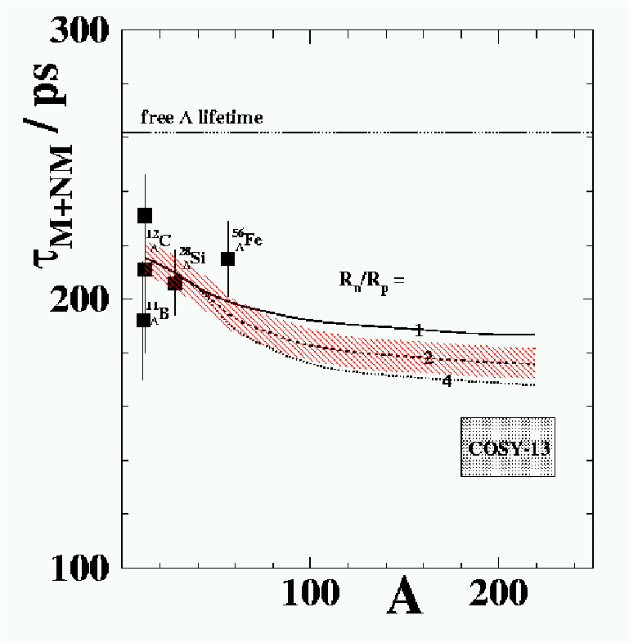
Physics motivation – cont.
Limited data in light to medium mass region indicates a constant lifetime
about 200-220ps.
COSY-13 result was from indirect measurements and is the only one in heavy
mass region. It contradicts to our general believe and could not be explained
by the current theories
Our goals:
1) An independent but direct lifetime measurement in heavy mass region
(Challenge or confirm the COSY result)
2) Possible A dependence from multiple target materials: Fe, Cu, Ag, Au, and Bi

Slide 5
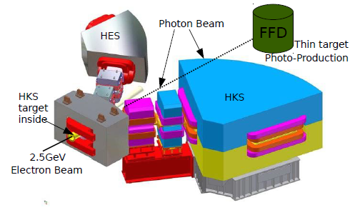
Experimental Setup
The main detector of this exp.

Slide 6
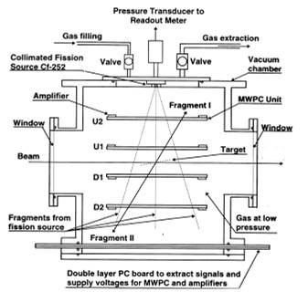
FFD structure

Slide 7
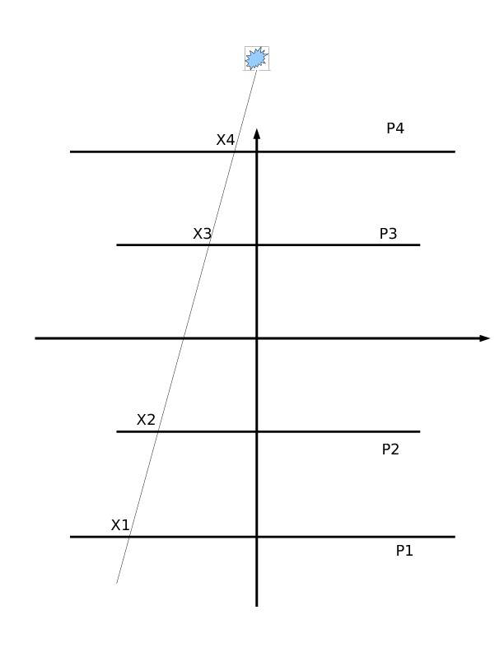
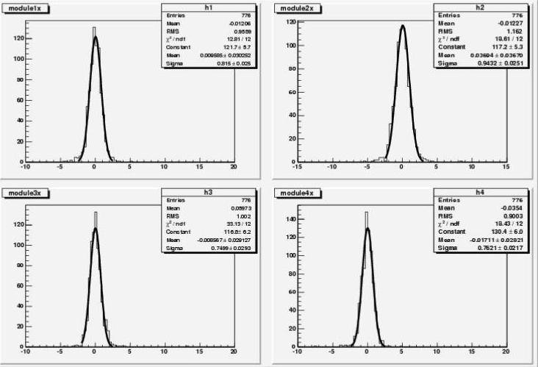
Analysis: Source (Cf-252) Data Calibration
Position determination: X_{i} =(X_{il}-X_{ir})/2.0, i = 1, 2, 3, 4.
Source fragment trajectory
Single plane residual <0.9mm

Slide 8
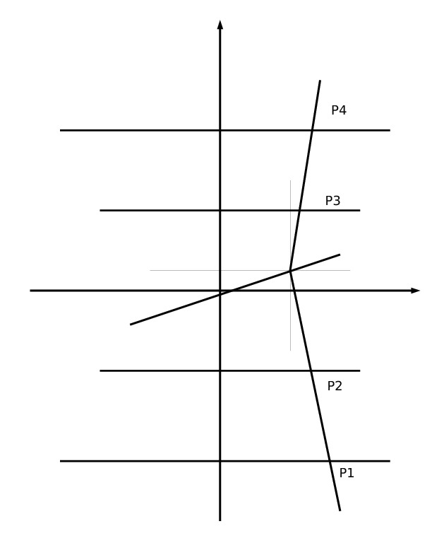
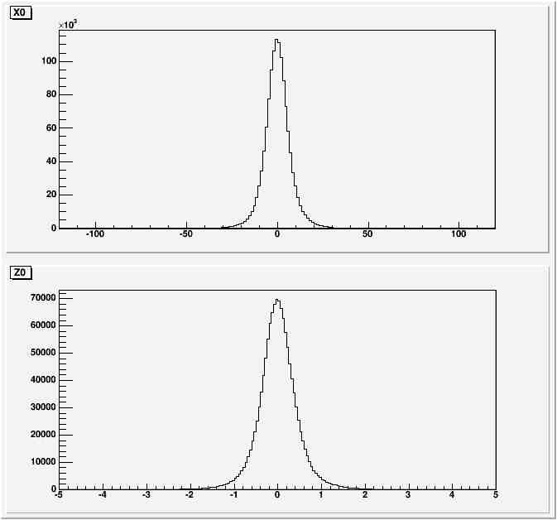
Analysis: Data with Beam
Position determination: X_{i} =(X_{il}-X_{ir})/2.0, i = 1, 2, 3, 4.
X0
Z0
target fragment trajectory
Events distribution on the target

Slide 9
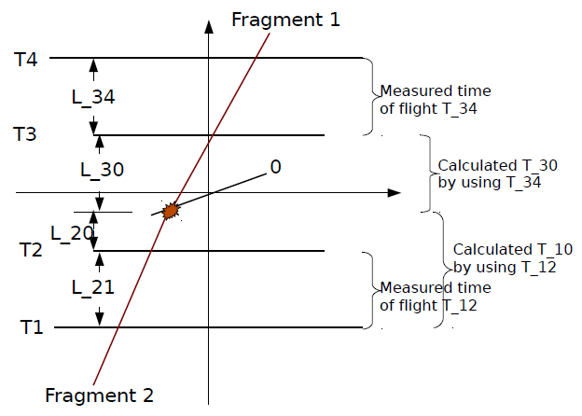
Analysis: Beam Data Timing
For example:
(without needed corrections)
Definitions:
Measured time of flights: T_12 = T1-T2, T_43 = T4-T3;
Calculated time of flights: using the fixed Z distances between planes and
measured TOFs;
T_10, T_20, T_30, T_40 (“0” refers to fission point on target)

Slide 10
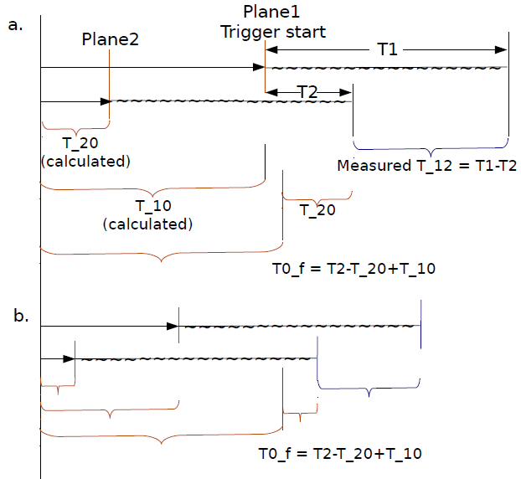
Analysis: Beam Data Timing(I)
Fission time zero: T0_f
Algorithm:

Slide 11
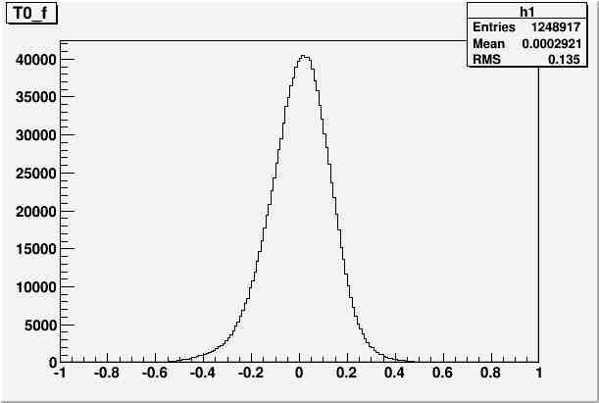
Analysis: Beam Data Timing(II)
Fission time zero
------Energy loss correction
------additional energy loss correction
using the correlation between fragment I and II
------ Trigger time walk correction

Slide 12
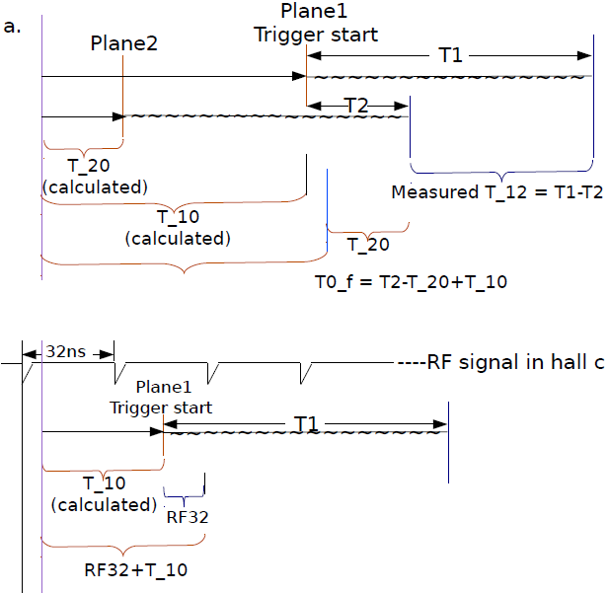
Analysis: Beam Data Timing(III)
Production time zero:T0_p
Algorithm:

Slide 13
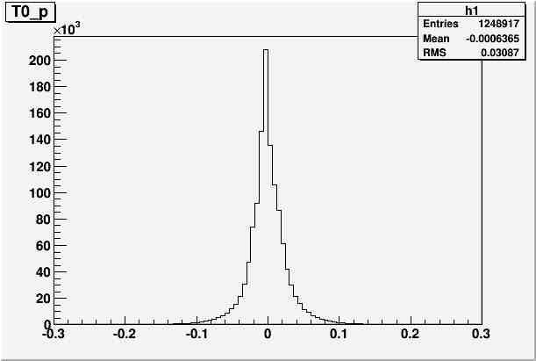
Analysis: Beam Data Timing(IV)
Production time zero:
Which is the ideal formula, must includes Energy loss correction in the calculation.

Slide 14
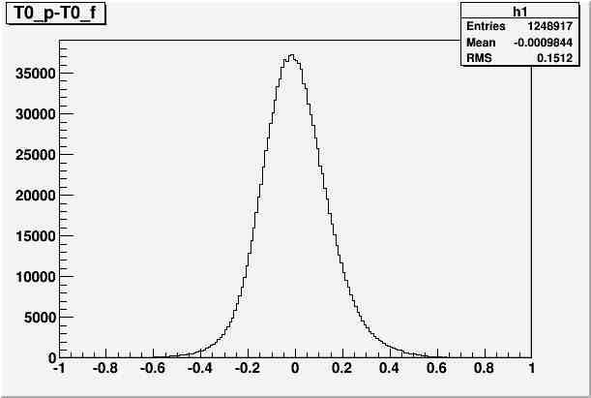
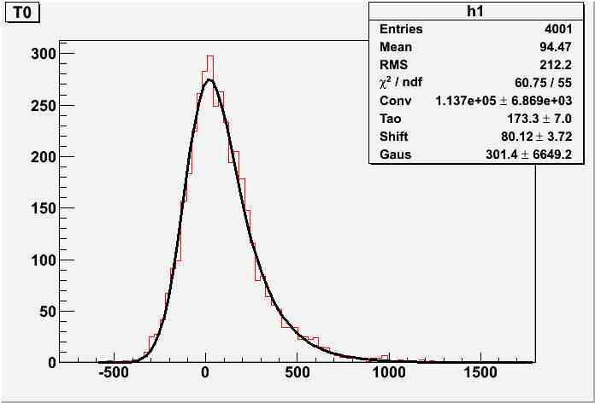
Analysis: Time Spectrum
Beam data:
T = T0__{p} - T0__{f}
Simulation:
Prompt:Delay = 1:1
Expected Prompt/Delay: ~ 400:1

Slide 15
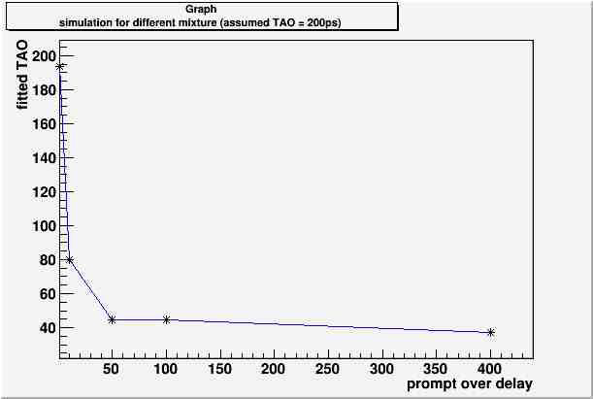
What’s learned from simulation
The ratio between the prompt and delay in the mixture has important impact on extracting the lifetime of hypernuclei.
New Extracting Method:
Fit the main Prompt events;
Substract the Prompt events from Time Spectrum;
Fit the left-over spectrum.

Slide 16
Summary
After long time struggling, the Fission time
zero, Production time zero and the Time
Spectrum have been extracted.
To Do
Work on the investigation for other new Lifetime Extracting Method, then evaluate the system error.

Slide 17
Thanks for your attention!

