Slide 1
Hall C Super High Momentum Spectrometer(SHMS) Status January 2011 Hall C Users meeting
Paul Brindza
January 14, 2011

Slide 2
SHMS status
Superconducting(SC) Magnet Status
SC Magnet JLAB Components status
Support Structure/Shield House status
Hall C infrastructure status
Installation Planning
Conclusions

Slide 3
SHMS 11GeV/c

Slide 4
SHMS SC Magnet Status
 | contractor | Award | Cost K$ | status
Horizontal Bend | MSU/NSCL | June 2010 | 967 | PDR Aug 2010 Coil winding done
Q1 Quad | Scientific Magnetics | June 2009 | 1065 | IDR June 2010 Cold mass ordered Coil winding
Q2Q3 Quads | Sigma Phi | Oct 20, 2010 | 2960 | Contract Start
Dipole | Sigma Phi | Dec 3, 2010 | 2100 | PDR held Dec 2010
total |  |  | 7092 K$

Slide 5
Q1 SC Magnet JLAB Cold Iron Design ( clone of HMS Q1)
11 GeV/c performance
7.9 T/M Gradient
40 cm warm bore
1.86 M EFL
14.75 (T/M)M Int. Grad.
398 KJ Stored Energy
25 % design margin
SC is SSC outer

Slide 6
SHMS Q1 Magnet Recent Activities at SMI
Q1 magnet in Final Design at SMI
Design Milestones completed
D1,D2,D3,D5,D6,D7,D8,D9,D10,D12,D13
Fabrication Milestones Completed F1,F2
SMI re-established in new Location
Conductor insulated
Cold mass components ordered
Winding tooling and coil form assembly underway
Coil winding spring 2011

Slide 7
Final Q1 Winding Tooling at SMI
Cast Coil end forms
Winding tooling & turntable

Slide 8
HB SC Magnet Cutaway shown with HMS Q1
Superferric “C” magnet
2.6 Tesla
35cm x 36cm bore
0.75 M EFL
1.93 TM
19 % design margin
220 KJ stored Energy
SC is SSC outer

Slide 9
HB Magnet Recent Activities
HB Contract Awarded to MSU.NSCL June 2010
Preliminary Design Review held Aug 2010
PDR Report Received Sept 2010
Contract MS achieved D1,D2,F1,F4,F6,F7
Design, analysis and engineering underway
Coil winding complete
Preparations for cold coil testing underway

Slide 10
Coil #2 winding at MSU completed Nov 2010

Slide 11
Q2/Q3 SC Cosine(2Θ)Magnets Cryostable design
Q2 11.8 T/M SC Quad
60 cm. warm bore
1.64 M EFL
10 % TEST margin
7.6 MJ stored Energy
Q3 identical to Q2 but runs at 7.9 T/M
Uses same conductor as dipole(Cu + SSC outer)

Slide 12
SHMS Q2Q3 Quad Recent Activities
Q2Q3 Rebid Offers received June 2010
Tech Evaluation completed Sept 2010
Best and Final Offers Dec 2010
No Technical exceptions or issues
Delivery in 36 months
Awarded to Sigma Phi in Dec 2010

Slide 13
SHMS SC Dipole
3.86 Tesla Cosine(Θ)dipole
60 cm warm bore
2.85 M EFL
11.2 TM Integral B.dL
10 % TEST margin
13.7 MJ stored Energy
4800 A/cm^2
11 GeV/c

Slide 14
SHMS Dipole Recent Activities
Dipole rebid offers received May 2010
Tech Evaluation completed Aug 2010
Best & Final Offers received Sept 2010
Awarded to Sigma Phi Oct 2010
Delivery in 31 months
Preliminary Design Review held Dec 2010
Relocated CCR

Slide 15
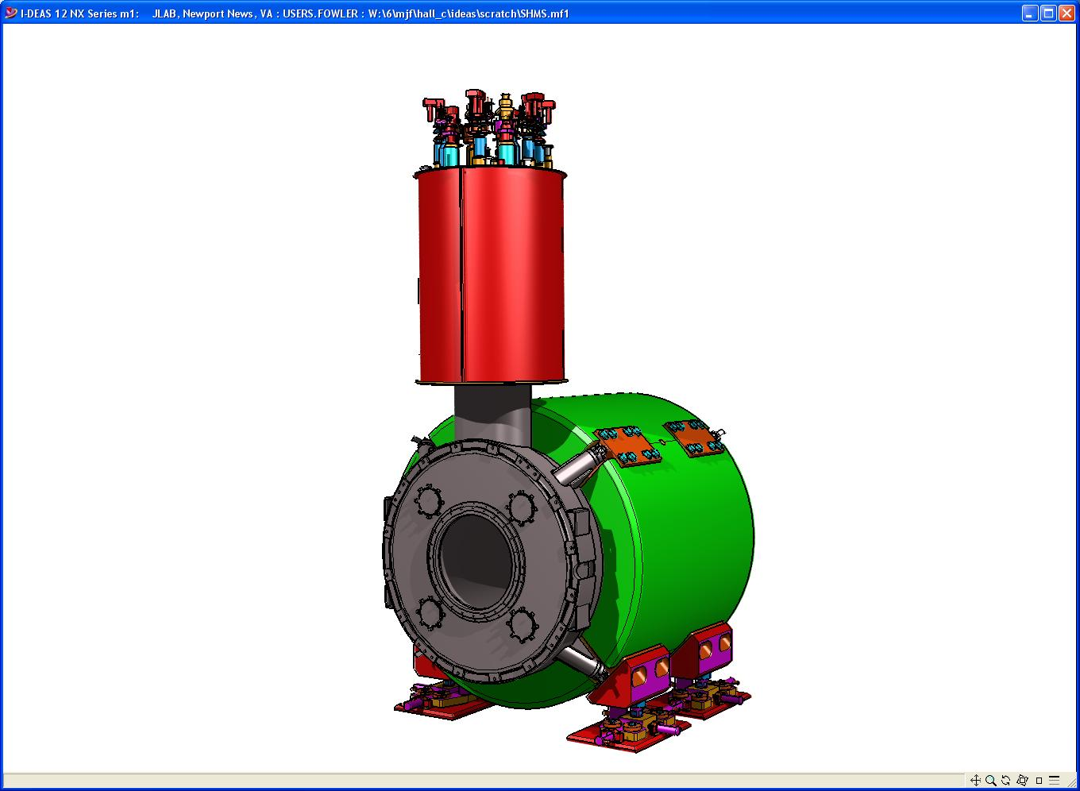
SHMS SC Magnet System Plan
Magnet Control System JLAB
PLC rack complete
HB rack complete
Q1Q2Q3Dip Racks complete
Cryogenic Control Reservoir
Awarded Meyer Tool
1st CCR delivered
DC Power System
Awarded Danfysik
Fixed Price Procurements
Q1 awarded SMI
HB awarded MSU
Dipole & Q2Q3 awarded Sigma Phi
Fab Magnets
Q1 underway
HB underway
Q2Q3 & Dipole Underway
On Site Integration & Assembly
Ship to JLAB
Acceptance Testing
Conductor Processing
HB & Q1 complete
Q23D extrusion(FMM)Done
Wave soldering(AESS) Underway
Magnet Support & Alignment
Bid Jan 2011
Warm Iron Yoke
Bid Jan 2011
Testing at BNL Complete
SC Cable (SSC surplus)

Slide 16
JLAB Supplied Magnet components
Item | Contractor | Award | Cost K$ | Status | Delivery
Conductor substrate | Freeport McMoran | Feb 2010 | 240 | Complete | Nov/Dec 2010
Conductor wave soldering | AESS | Aug 2010 | 260 | Solder trials complete | Feb 2011
Current Leads | Amer. Magnetics | Nov 2009 | 80 | Complete | Delivered
Cryo Control reservoir | Meyer Tool | Dec 2009 | 1050 | CCR 2 & 3 Fab Done Jan 11 Tested Feb 11 | #1 June 10 2&3 Feb. 11 4,5&6 Aug 11
DC Power system | Danfysik | Aug 2010 | 865 | Awarded 9/24/10 | 12 Mo for 2 18 Mo for 3
PLC based Magnet controls | JLAB | Jan 2010 | 360 FY10 150 FY 11 500 FY 12 | PLC rack 95 % HB rack 90 % Q1Q2Q3D 90% | Jan 2011 Jan 2011 Dec 2010
Yoke steel | TBD | Apr. 11 | 1266 CB | Bid Jan 2011 | 18 Mo
Total |  |  | 4771 K$

Slide 17
Magnet Components
Cryo-Reservoir Article 1
Installed and tested
on Hall D Solenoid
Burnout Resistant Current Leads

Slide 18
Cryo Reservoirs for HB and Q1

Slide 19
SHMS Dipole and Q2Q3 Superconductor fabrication
Copper channel at FMM
Wave soldering at AESS

Slide 20
Magnet Components (Aug 2010)
HB Magnet Control Rack(2010)
SHMS PLC Control Rack(2010)

Slide 21
SHMS Control Racks Q1,Q2,Q3,Dipole Jan 2011

Slide 22
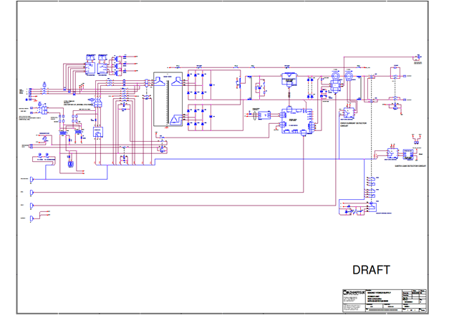
Magnet Components DC power system
5000 A Danfysik schematic
Typical Danfysik System 8000
DC system cabinet

Slide 23
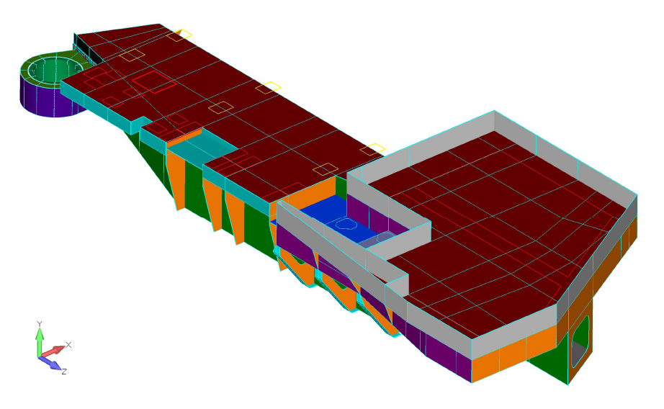
Isometric View SHMS Structure with load locations
FSW
Utility Platform Leg (6 places)
Q1 (4 pl.)
Horizontal Bender (3 Pl.)
Q2 (4 pl.)
Q3 (4 pl.)
Dipole (4 pl.)
Shield Hut

Slide 24
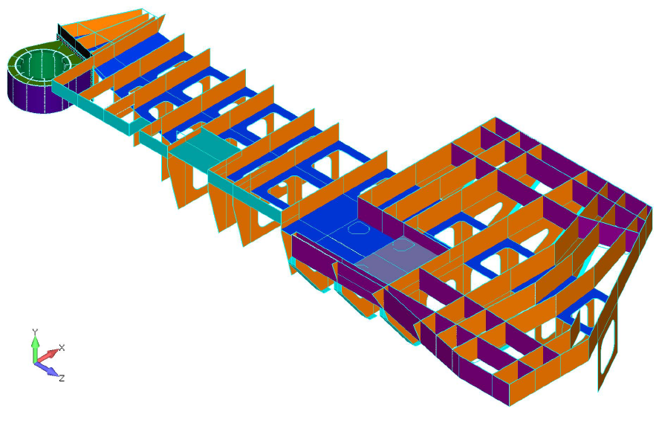
SHMS Structure Isometric Skeleton View
Following items hidden to show internal structure:
Top, side and bottom Plates
Shield hut upper web
Load patches

Slide 25
Support Structure/Shield House Status
 | contractor | award | Cost(k$) | status | delivery
Main Bearing | FAG Kugelfischer | Apr2010 | 84 K$ | Fabrication | Feb 2011 expected
B4C concrete | JLAB Branscome | Mar 2010 | 5 K$ | Complete Patent Disc. | Tests and specs done
B4C Panels | JLAB | NA | NA | Complete Patent Disc. | Tests done
Lite weight concrete | JLAB Branscome | Sep 2010 | 5 K$ | Complete Patent Disc. | Tests and Specs Done
Steel structure optimization | AMSEC | May 2010 | 110 K$ | Complete | Oct 2010
Bogeys&wheels | TBD | Apr 2011 | ~300 K$ | Out for bid | Aug 2012
Rail & Rail Base | TBD | Apr 2011 | ~ 50 K$ | Out for Bid | July 2011
Pivot section | TBD | May 2011 | ~100K$ | Out for Bid | Dec 2011
Quad Section | Drafting/JLAB | June 2011 | ~100K$ | Bid Feb 2011 | Jan 2012

Slide 26
Double Bogey 3D Model Awaiting Funds/ Bid Oct 1, 2011
Dbl Bogey Model
DBL bogey drawing

Slide 27
Bearing housing/pivot section Out to bid Jan 2011/award April 2011

Slide 28
SHMS Infrastructure
 | Design | Bid Documents | Status | Bid date | Award date
Magnet stands | complete | Done | Bid With Yoke | Jan 2011 | Apr 2011
Dipole Field Clamp | Complete | Underway | Bid with Yoke | Jan 2011 | Apr 2011
Scattering Chamber Mods | complete | complete | window metal seals Impossible mods not needed | NA | NA
SC shms windows | TBD | TBD | O-ring seals in house Fab | NA | NA
SHMS Vacuum | complete | TBD | Waiting Magnet Vendor design | Jan 2012 | Mar 2012
Cryo system | complete | Done | Transfer line U-Tubes | Feb 2011 | May 2011
Beam line | complete | TBD | Waiting Q2 Yoke | Jan 2013 | July 2013

Slide 29
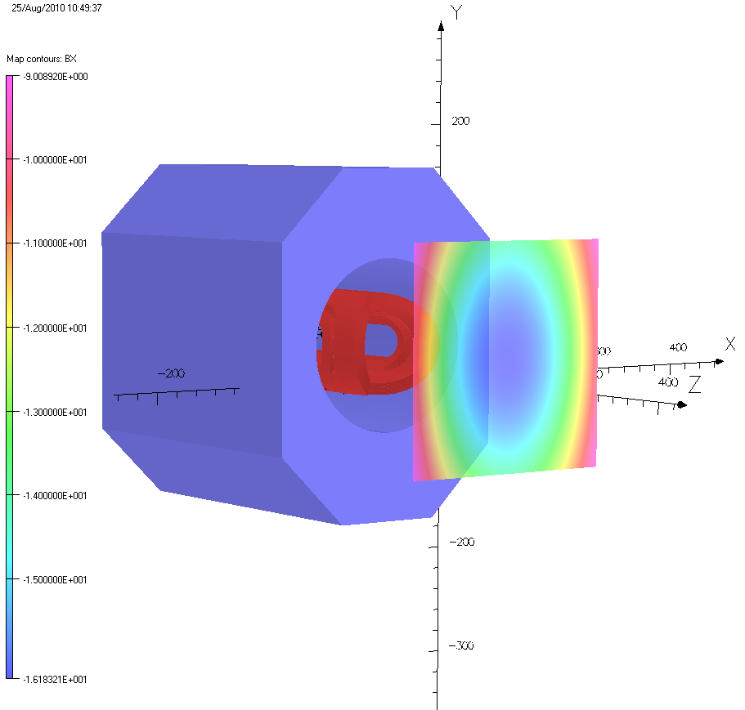
Field at Cerenkov , no clamp, Bx (-9 to -16 gauss)

Slide 30
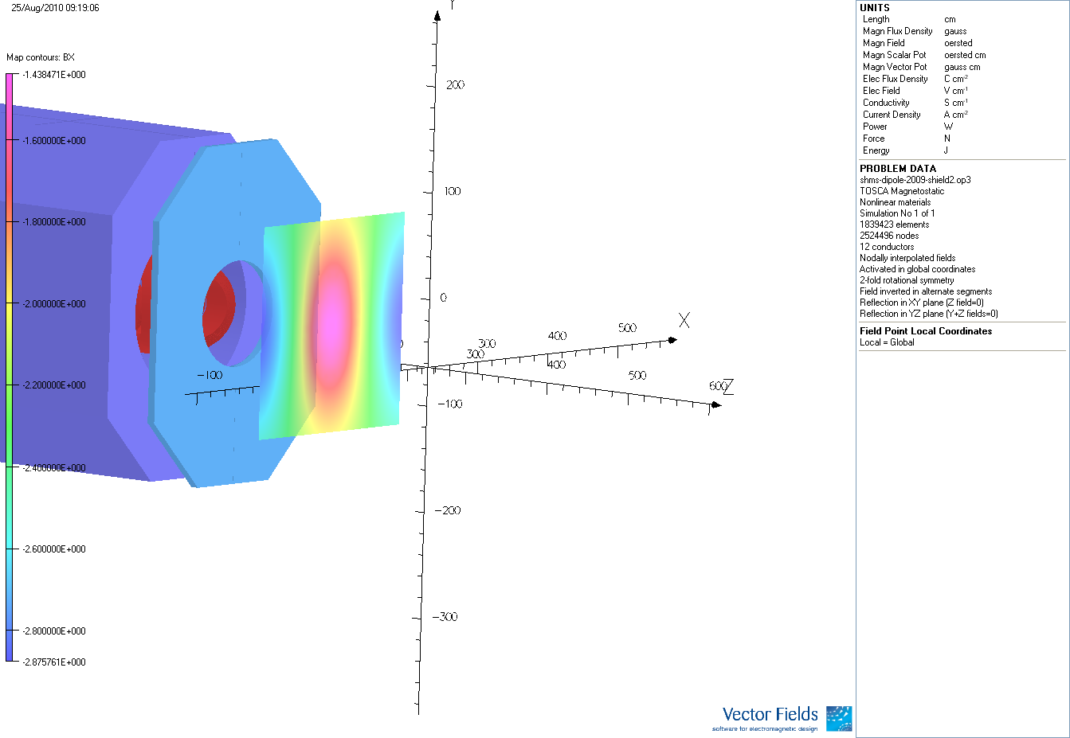
Field at Cerenkov PMT with Clamp Bx(-1.4 to 2.8 gauss)

Slide 31
Transfer Line and U-Tubes

Slide 32
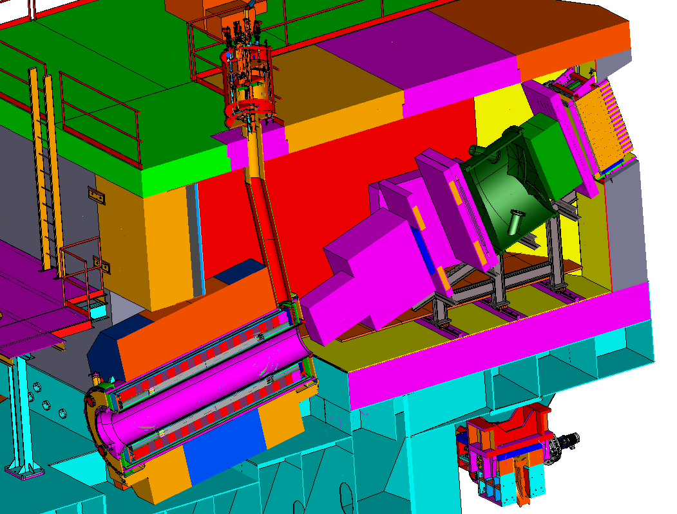
Section View
Small plug block around Cryocan
When installing removable roof blocks Can not hit or move

Slide 33
SHMS Shielding
Use B4C loaded concrete on high rate sides
where thick Boron (5-7 inches) required
Use B4C loaded “counter top material” where “thin” B4C is required ~ ½ inch
Use light weight concrete for Shield House with recycled plastic(20% by volume) added to enhance Neutron thermalazation & save weight
All three shielding systems are the subject of patent disclosures

Slide 34
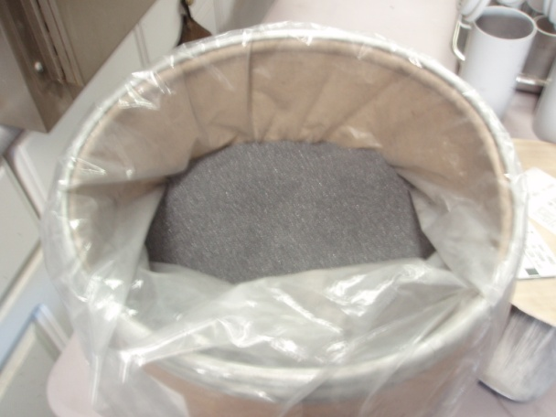
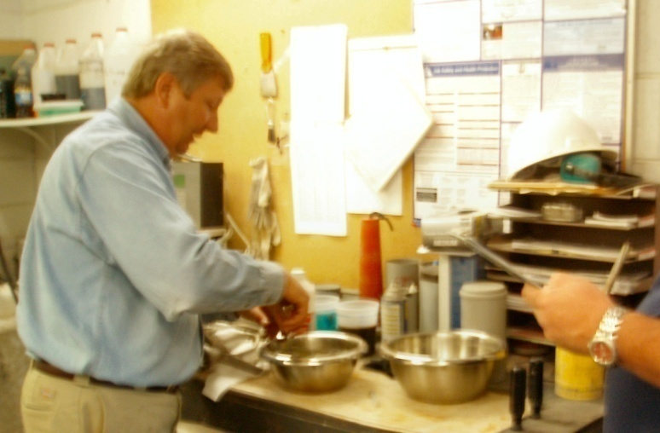
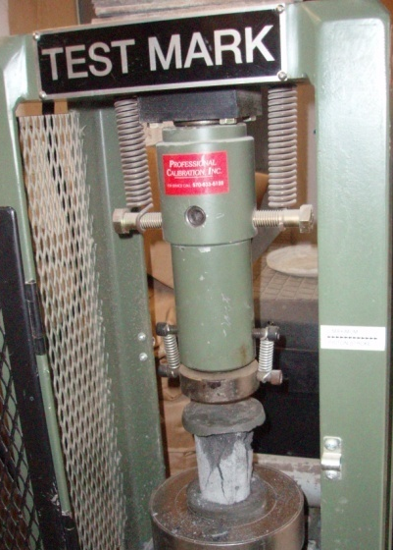
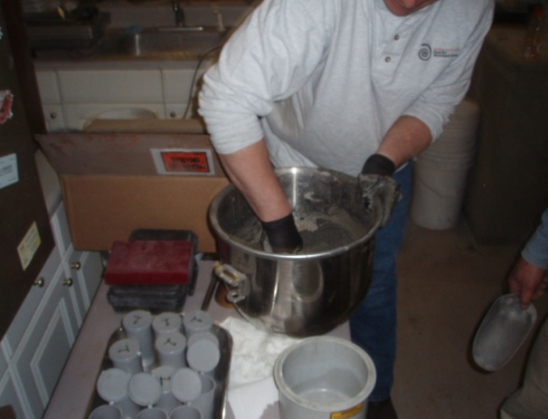
Boron Carbide Concrete Mix Results (mix can be pumped from a truck)
(Or 1.24 g/cc)
(Or 1.30 g/cc)
Boron Carbide Powder
(Or 1.36 g/cc)
(Or 1.42 g/cc)
Note compared to
Boron Carbide Dry Powder Packing
Max dry pack density 1.44 g/cc
JLAB Max dry pack density 1.31 g/cc
Measuring / Recording
Different Samples /Mixes
Mixing / Checking
(also used a power mixer)
Measuring / Breaking

Slide 35
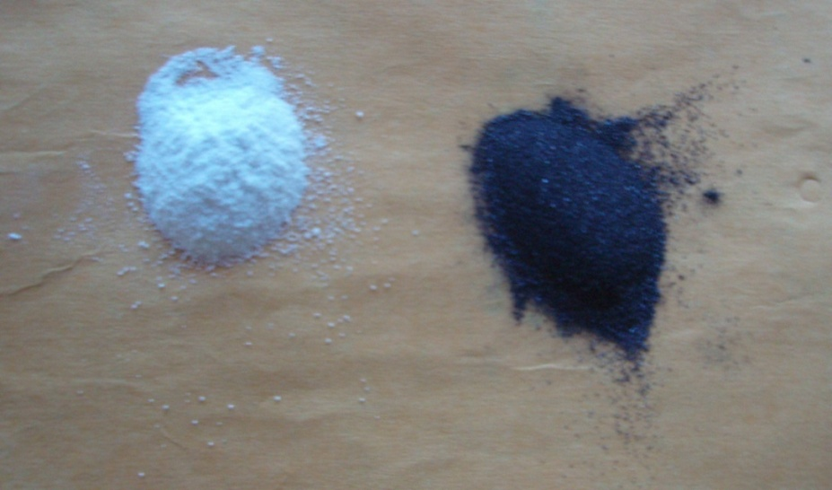
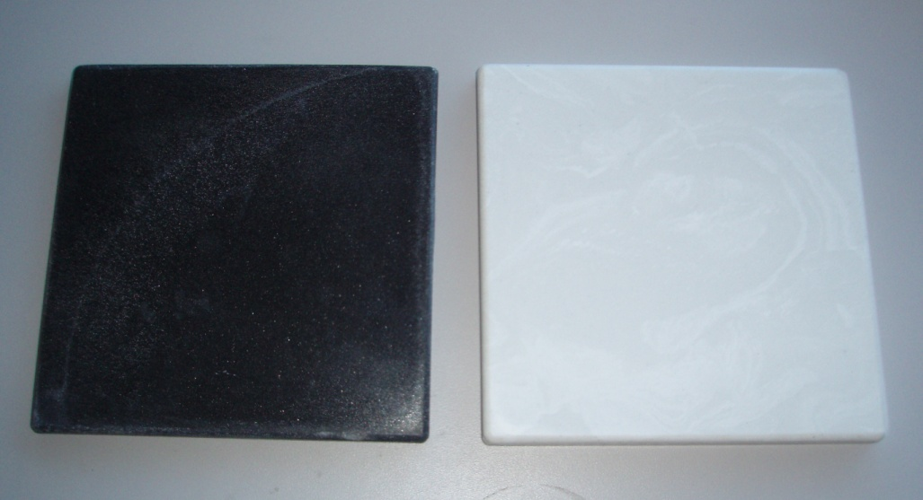
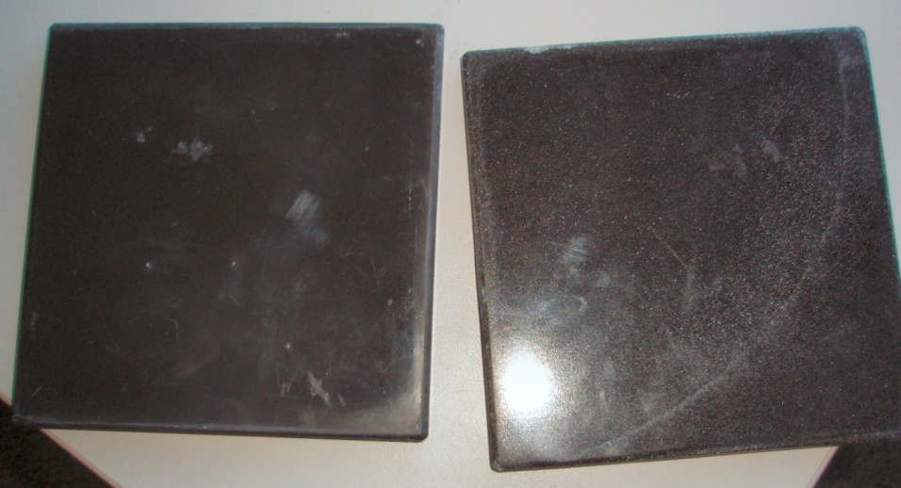
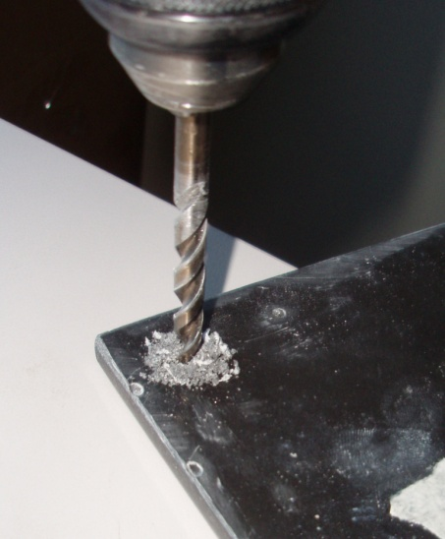
B4C Shielding Panels Bert Metzger and Marble Impressions
Calcium Carbonate
B4C
Cultured Marble counter tops are made with
POLYLITE (the glue) NOROX (The Hardener)
And 60% Calcium Carbonate (the marble filler material)
Replaced the Calcium Carbonate with 60% B4C
(particle size is about the same)
Panels can be made at any counter top maker
B4C Sample
Cultured marble
B4C Samples
Three B4C Samples were made by weight 6" x 6" x 3/8" 1_Fine B4C (60% B4C 40% Resin)
2_Course B4C (60% B4C 40% Resin)
3_Course and Fine B4C (50/50 mix) (60% B4C 40% Resin)

Slide 36
Light weight concrete testing 4400 psi at 56 days

Slide 37
Installation planning
Qweak experiment occupies much of Hall C
Legacy equipment remains in Hall
(SOS, HKS, parts of G0,….)
Space must be cleared for SHMS assembly
Cryogenic system must be restarted
HMS must be re-cooled for early testing of SHMS components & commissioned for 11 GeV Physics

Slide 38
Photo of Hall C with Qweak

Slide 39
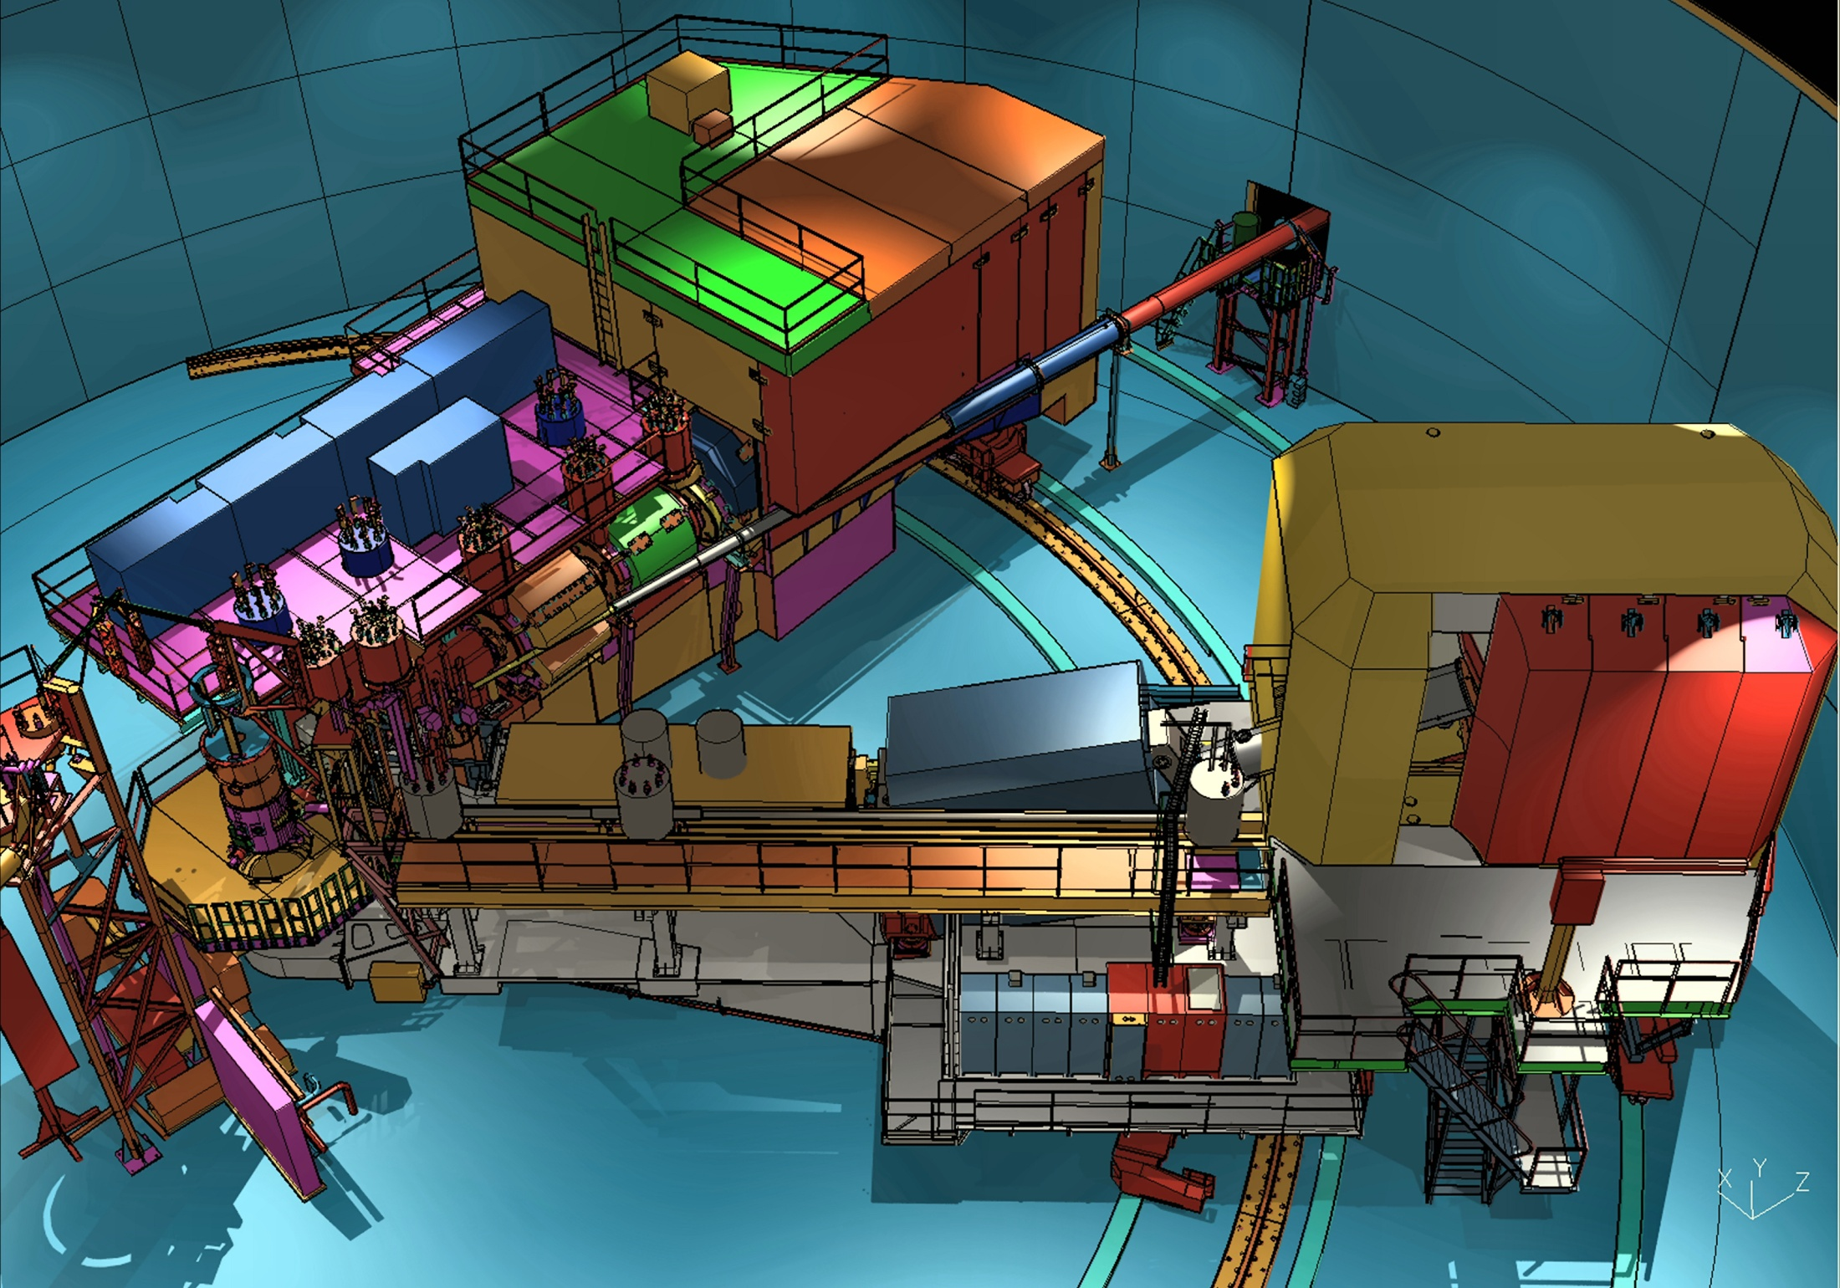
SHMS Spectrometer
11 GeV/c ca 2014
HMS Spectrometer 7.3 GeV/c ca 1994

Slide 40
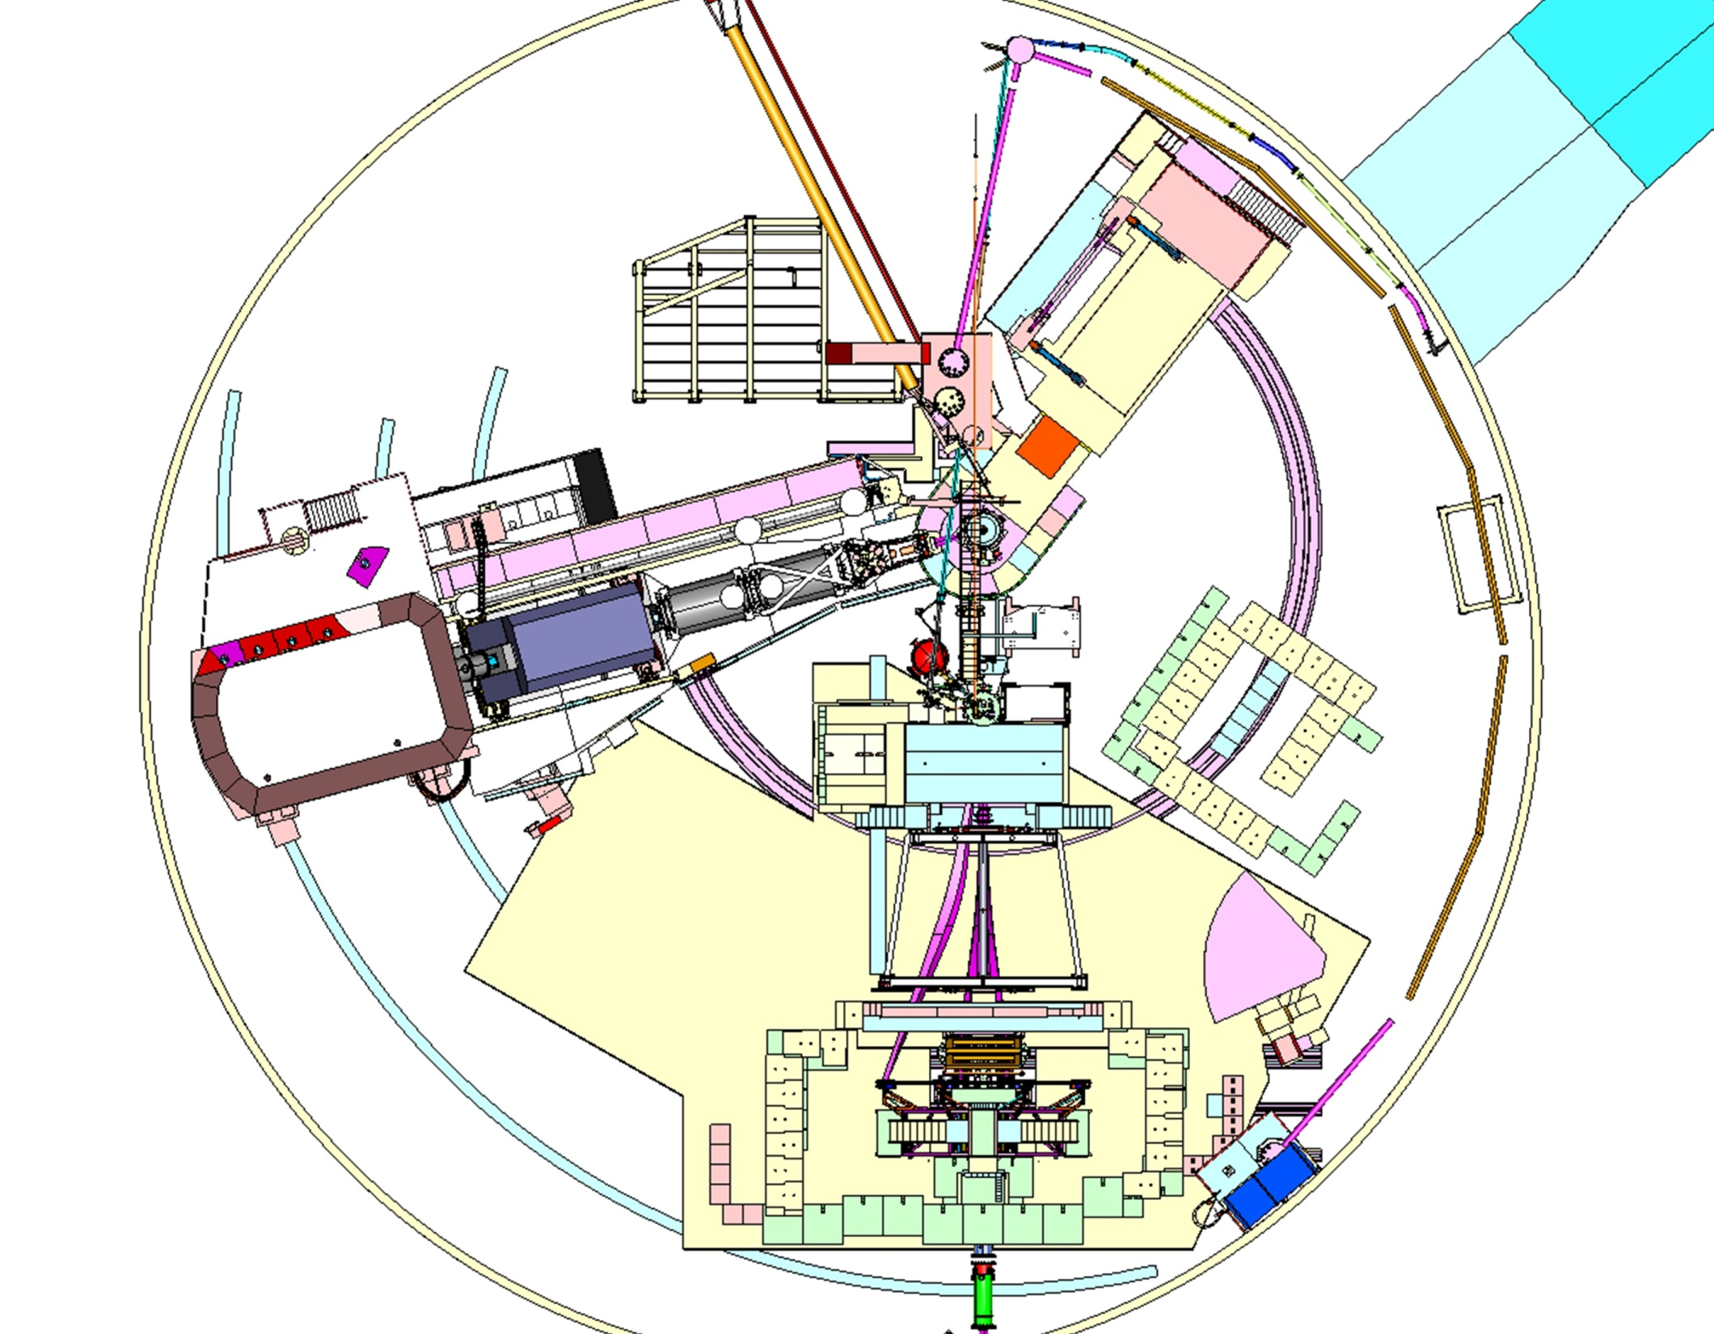
Hall C at end of Qweak Experiment May 2012
DC Supplies
Target equipment
HMS Spectrometer
Remove SOS Spectrometer
Remove Qweak Experiment
Remove HKS Spectrometer
Remove G0 Cryo

Slide 41
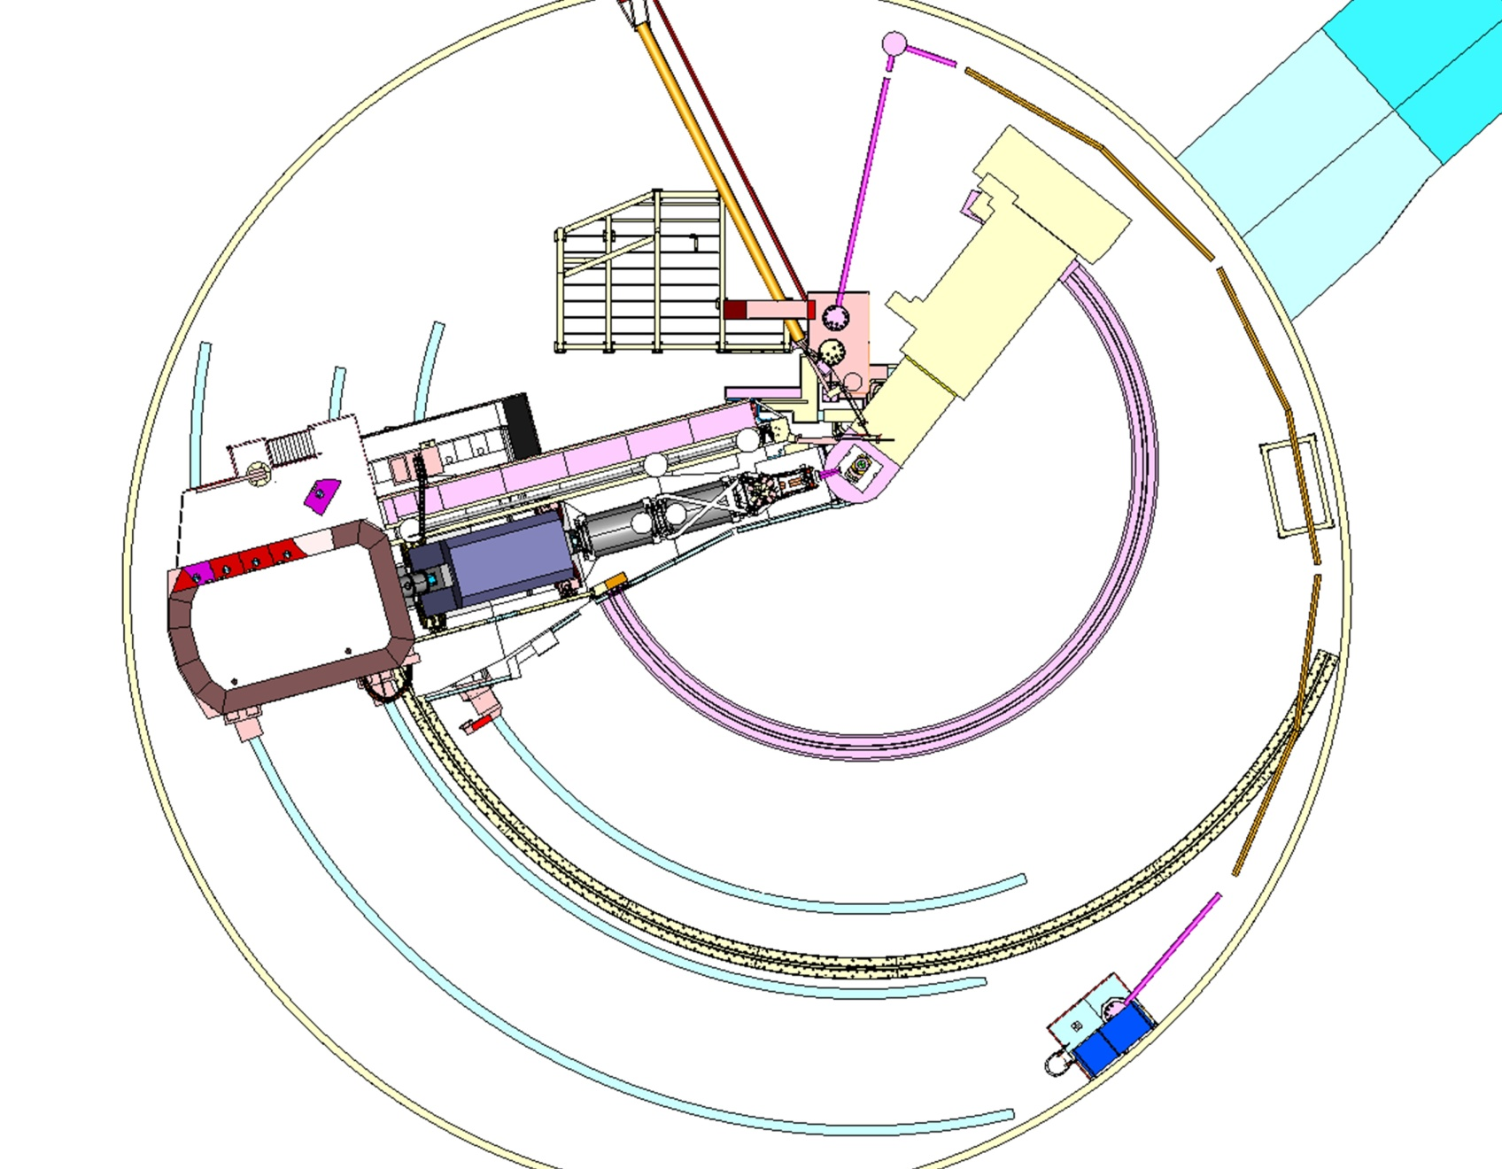
SHMS Installation Planned Start Aug 2012
First SHMS Activity is SHMS Rail Installation 15-Aug-2012

Slide 42
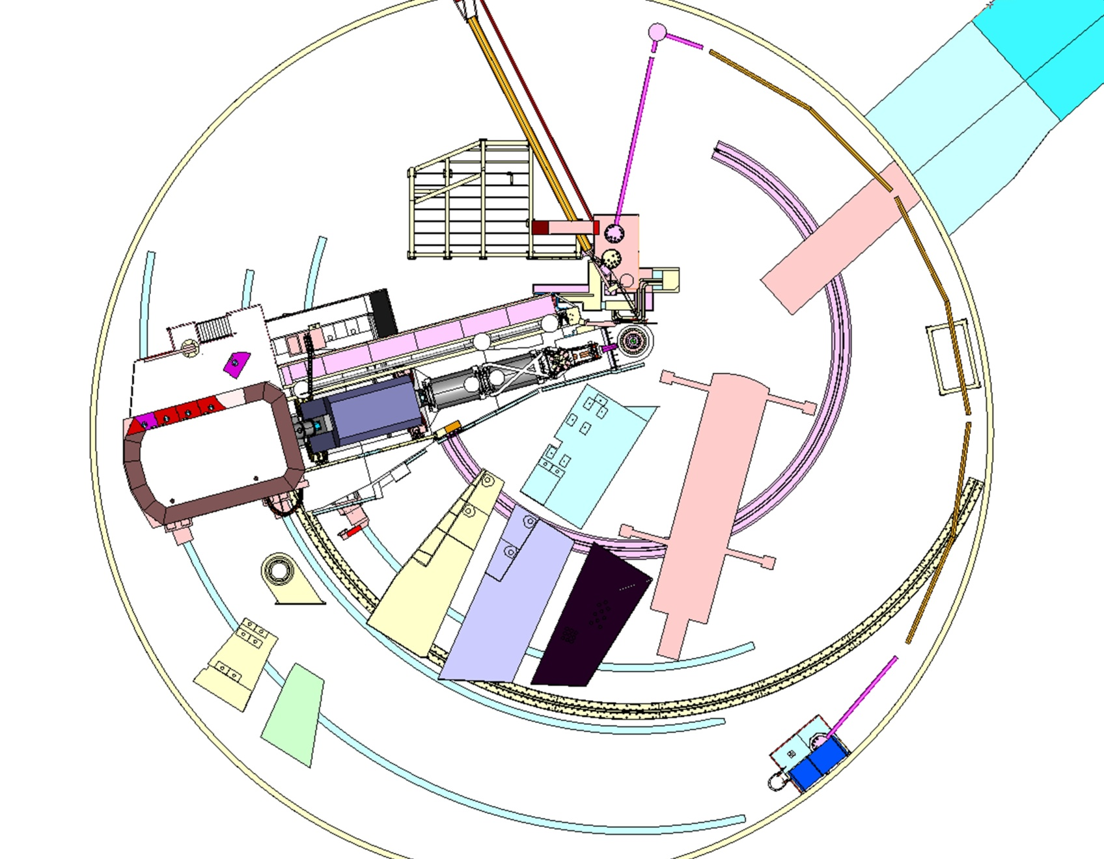
SHMS Structure Delivery Start of SHMS Assembly
Transport SHMS Structure parts into Hall Sept 2012
18 wheeler
150 Ton road crane
SHMS Steel Structure components

Slide 43
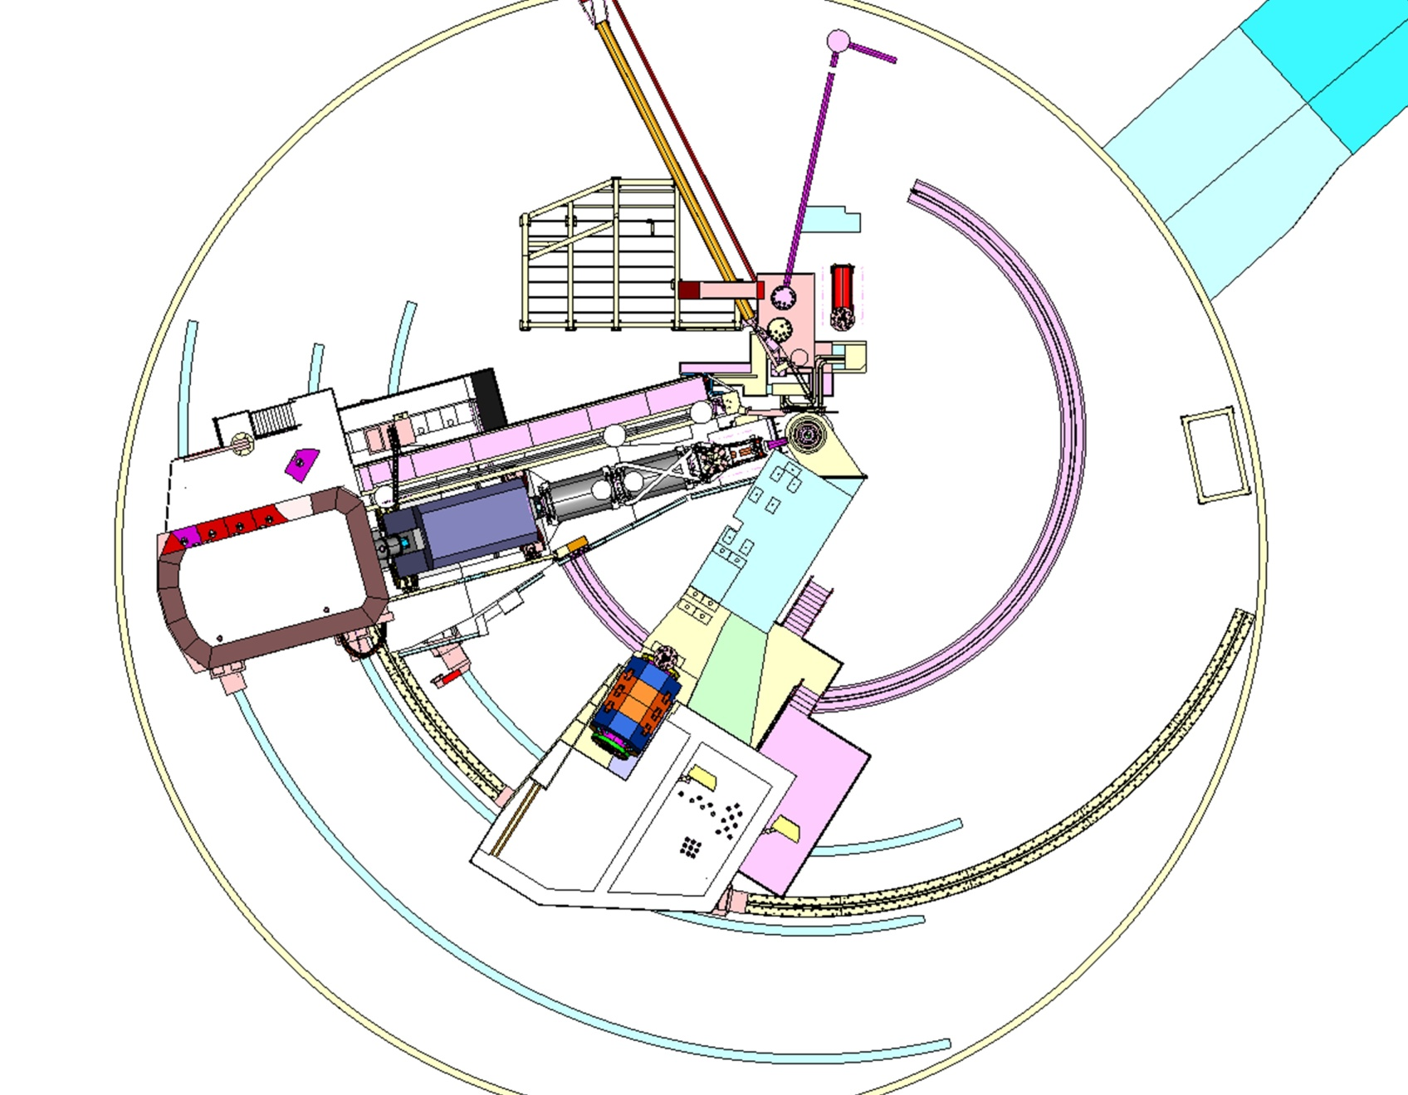
Dipole Installation June 2013 Detector Installation starts after Dipole test Aug 2013
Install Dipole June 13-July 13, 2013
SHMS Dipole components are designed to be less than 20 tons!
Magnet Parts lay down area
Warm yoke and Cryostat

Slide 44
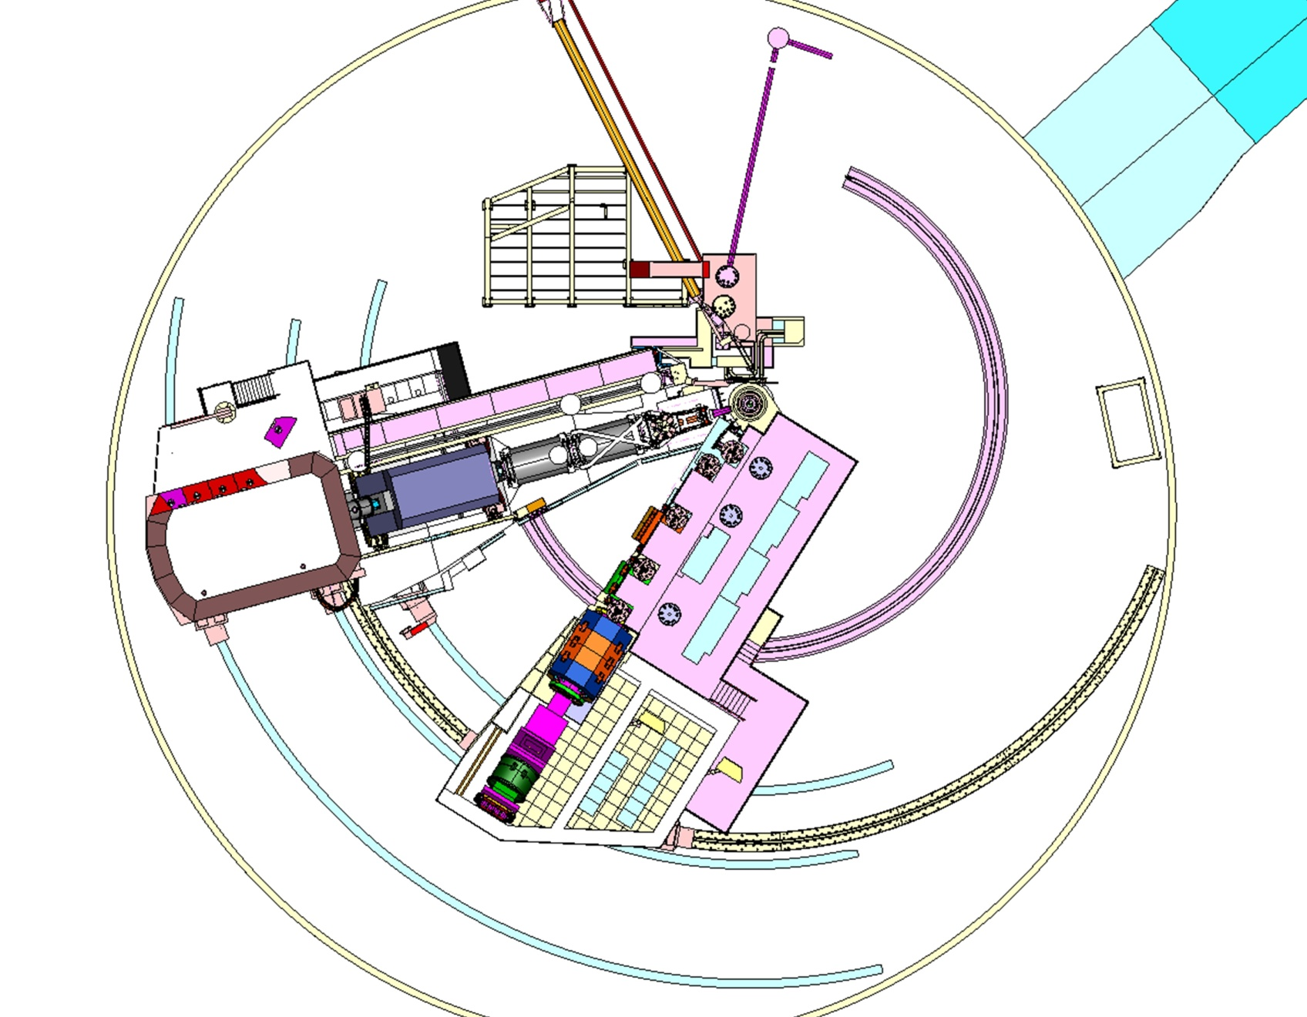
SHMS at end of Installation Summer 2014

Slide 45
Conclusions
SHMS Super Conducting Magnets all awarded to excellent contractors at good prices
SHMS Magnet components by JLAB all awarded except yoke steel-Out to bid Jan/Award Apr 2011
SHMS Support Structure Excellent Progress
rail&bases-bogeys&wheels-pivot section all out to bid
Hall C Infrastructure- SHMS cryo system bidding started
Advanced SHMS Installation planning underway
SOS Removal is critical path for SHMS Assembly

