Slide 1





Qweak’s Tracking System
John P Leckey IV
January 14th 2011

Slide 2
Outline
Tracking system components
Measurements performed
Future work

Slide 3
Qweak Tracking System Components
Region II Horizontal Drift Chambers
Virginia Tech
Region III Vertical Drift Chambers
William & Mary
Trigger Scintillator
George Washington U.
Focal Plane Scanner
U. Winnipeg
Tracking Software
all + Ohio U.

Slide 4
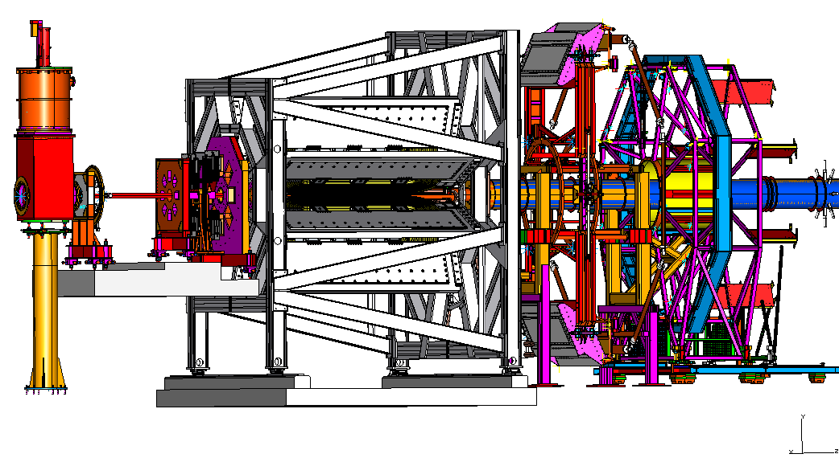
APPARATUS
Tracking Mode: 50 pA beam current, two opposing octants instrumented, rotator system for each region to cover all octants
Move to “parked” position for asymmetry measurement
Focal plane scanner to monitor profile in one octant at high current

Slide 5
Why Have Tracking System?
Need 0.5% on Q² for 2% on A_{z}
Error Budget: Beam polarimetry 1.0, Absolute Q² determination 0.5%, Backgrounds 0.5%, Helicity correlated beam properties 0.5%
Subtleties:
Moments of Q²
Map Light-weighted response of Cerenkov (vs. position/angle)
Sanity-check on collimators, toroidal field, event generator/Eloss
(Limited) diagnostics on backgrounds (tracking to target windows; elastic/inelastic)
Radiative tail shape

Slide 6
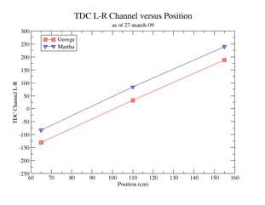
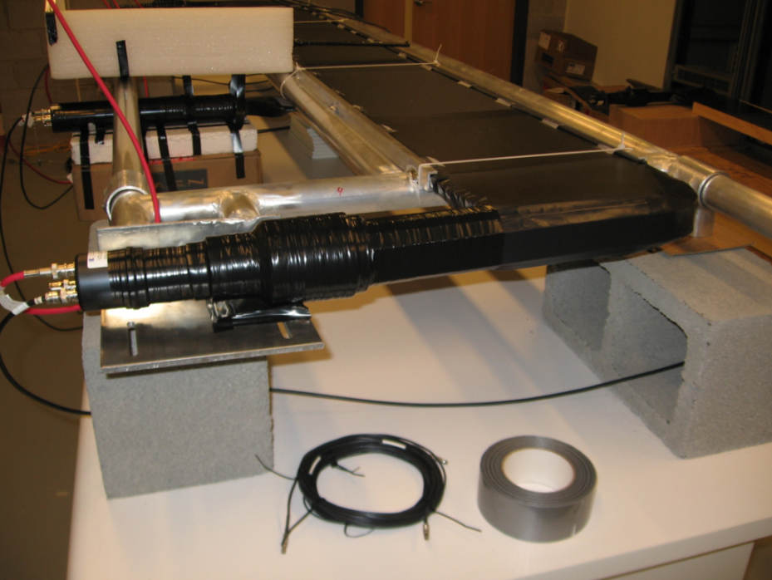
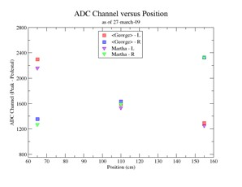
Trigger Scintillator - GWU
Assembled, tested at GWU
2.2 meters long BC 408 (Saint-Gobain)
One scintillator per tracking octant
Mounted on Region III rotator behind VDCs
Mean timer to create uniform time response

Slide 7
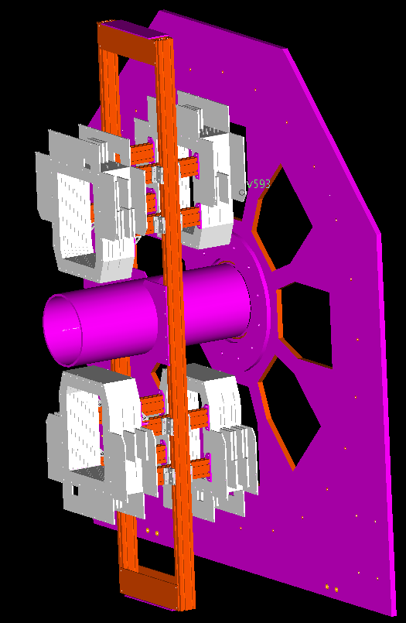
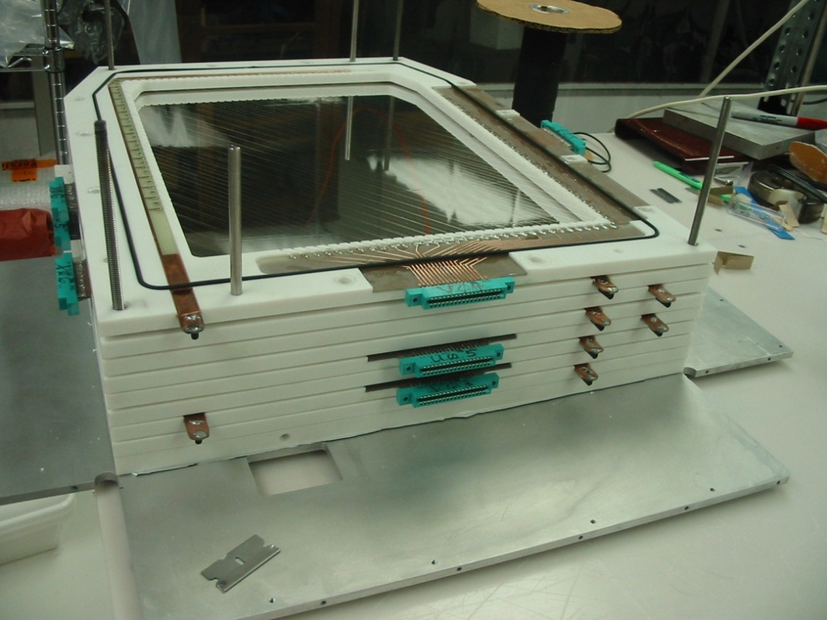
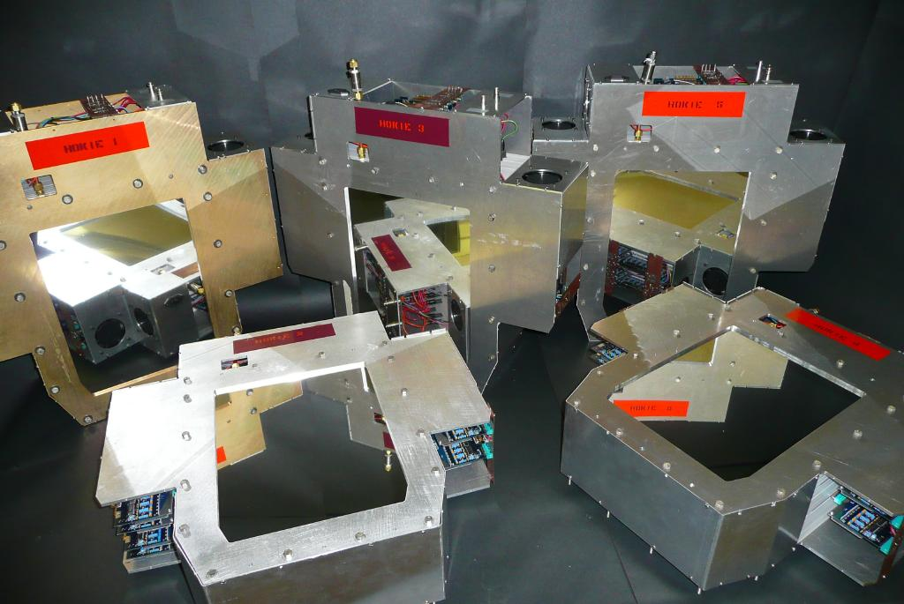
Region 2 HDCs – VT
Pairs of 6-layer Horizontal Drift Chambers per tracking octant
x, x‘ 39 sense wires each
u,u',v,v' (45°) 55 sense wires each
1192 electronic channels F1TDC readout

Slide 8
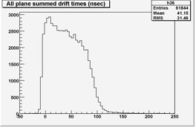
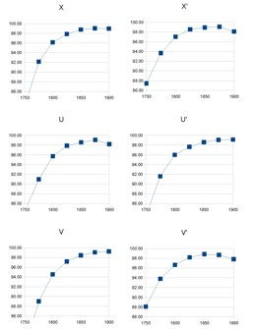
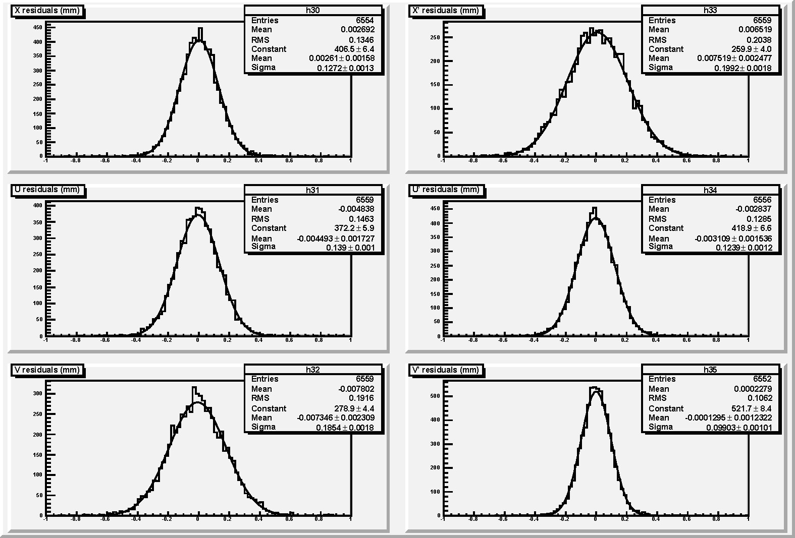
Region 2 HDCs – VT
> 99 % single plane efficiency
200 µm single plane resolution
X: 127 μm
U: 199 μm
U: 139 μm
U: 124 μm
U: 185 μm
U: 99 μm

Slide 9
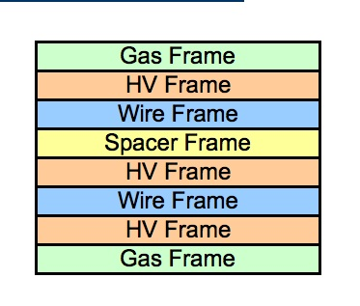
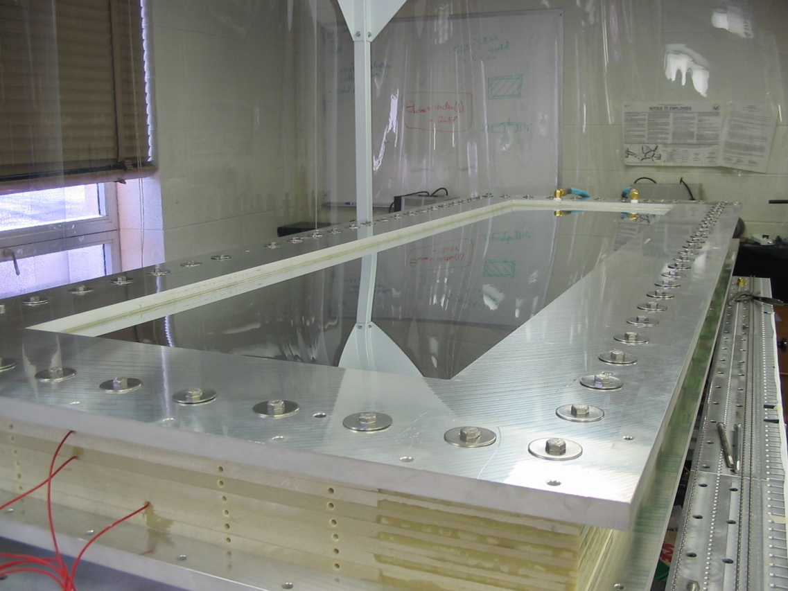
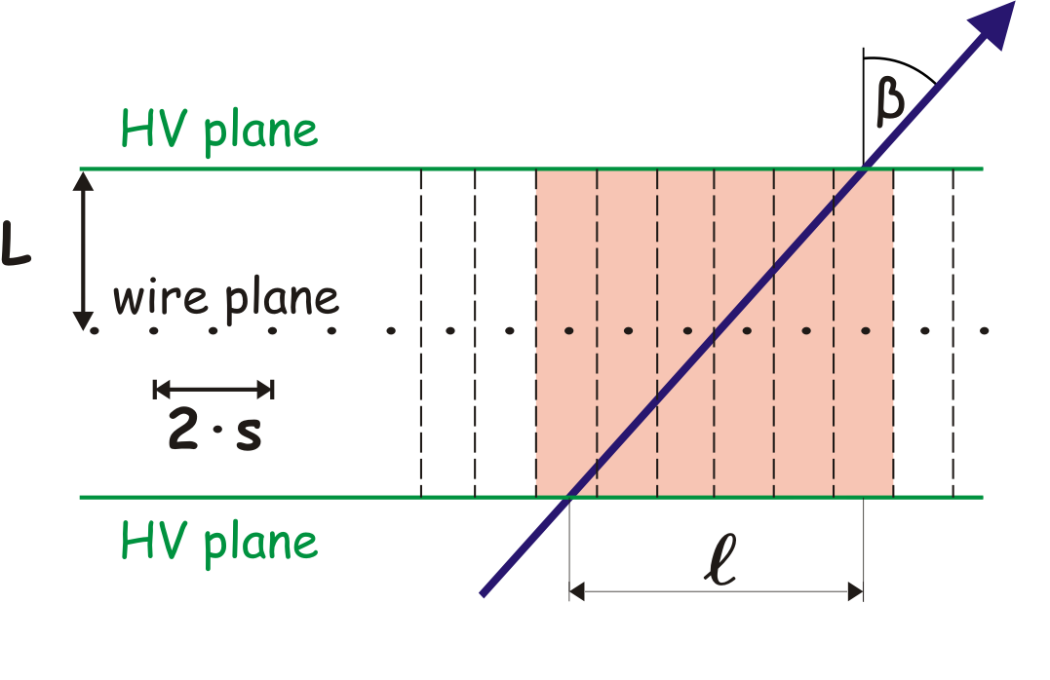
Region 3 VDCs – W&M
Pairs of 2-layer Vertical Drift Chambers per tracking octant
u, v (45°) 55 sense wires each
2240 electronic channels
Multiplexed F1TDC readout

Slide 10
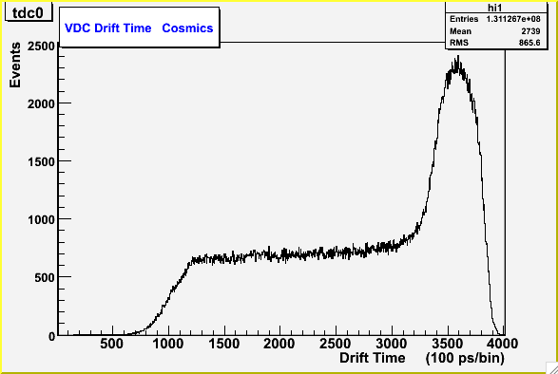
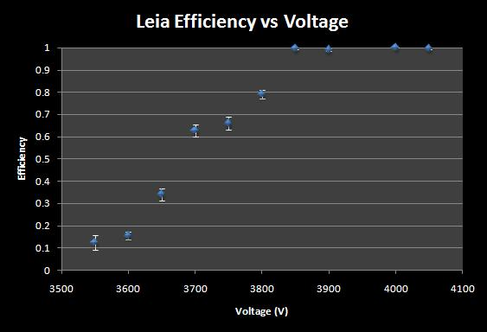
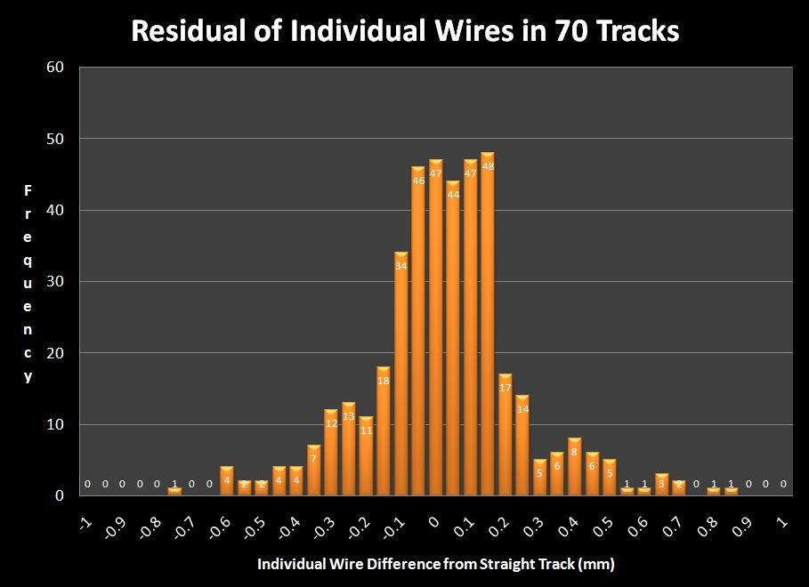
Region 3 VDCs – W&M
> 99.9 % single plane efficiency
98 % single wire efficiency
225 µm single plane resolution

Slide 11
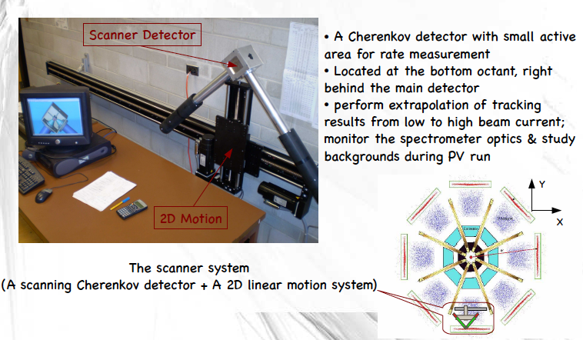
Focal Plane Scanner – U. Winnipeg
Cherenkov detector with small active area
Located in bottom octant in front or behind main detector
Link between pA tracking measurements and uA parity running
Monitor spectrometer optics and study backgrounds

Slide 12
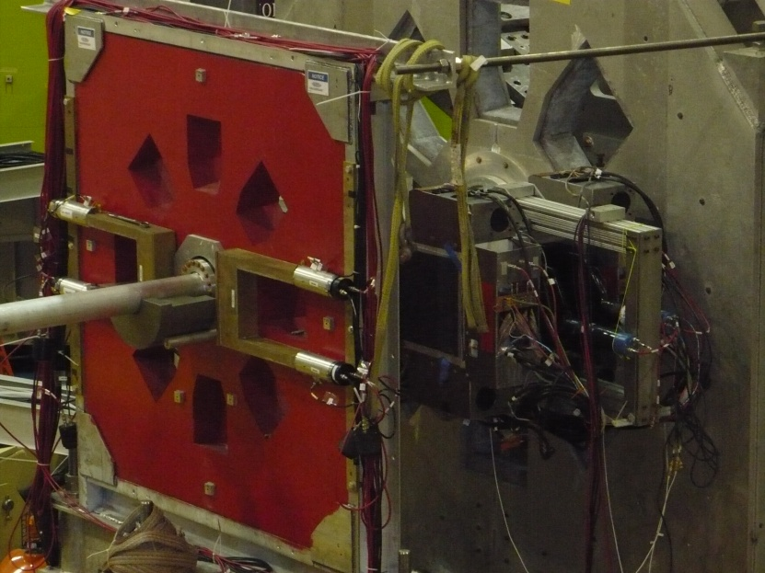
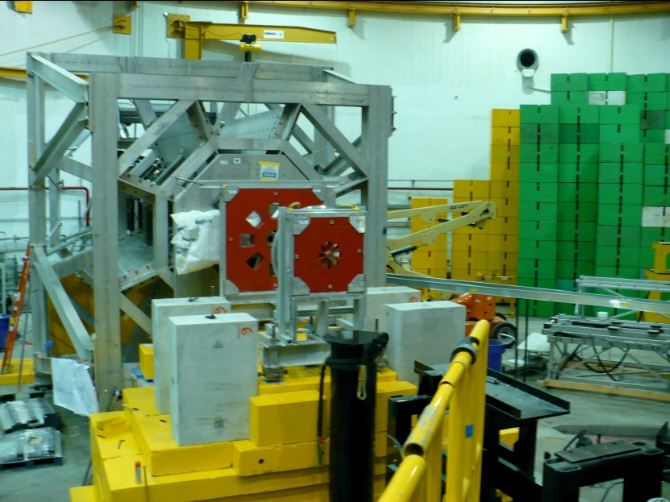
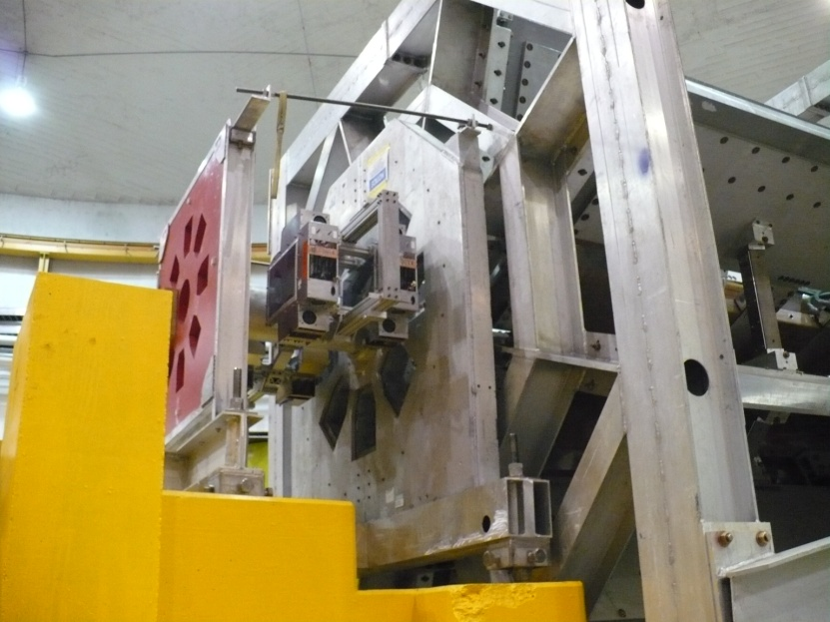
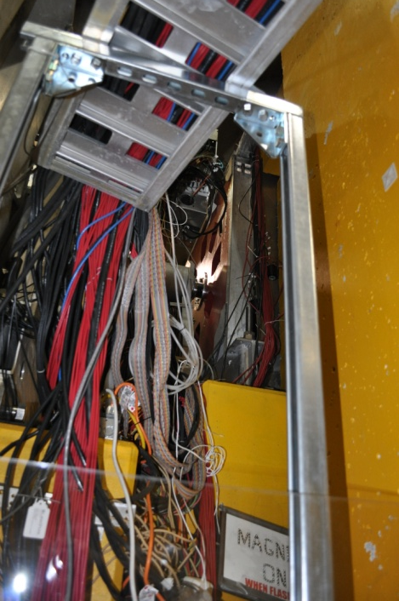
R2 HDCs in Hall

Slide 13
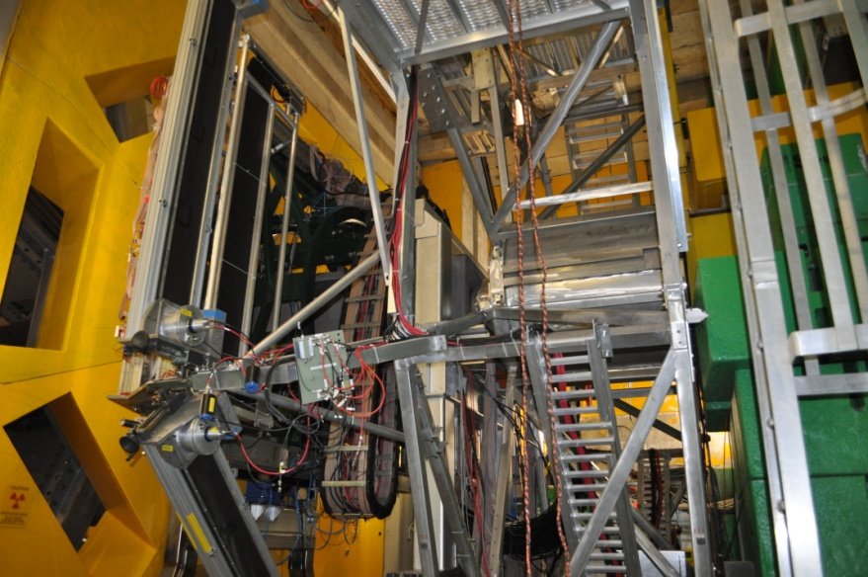
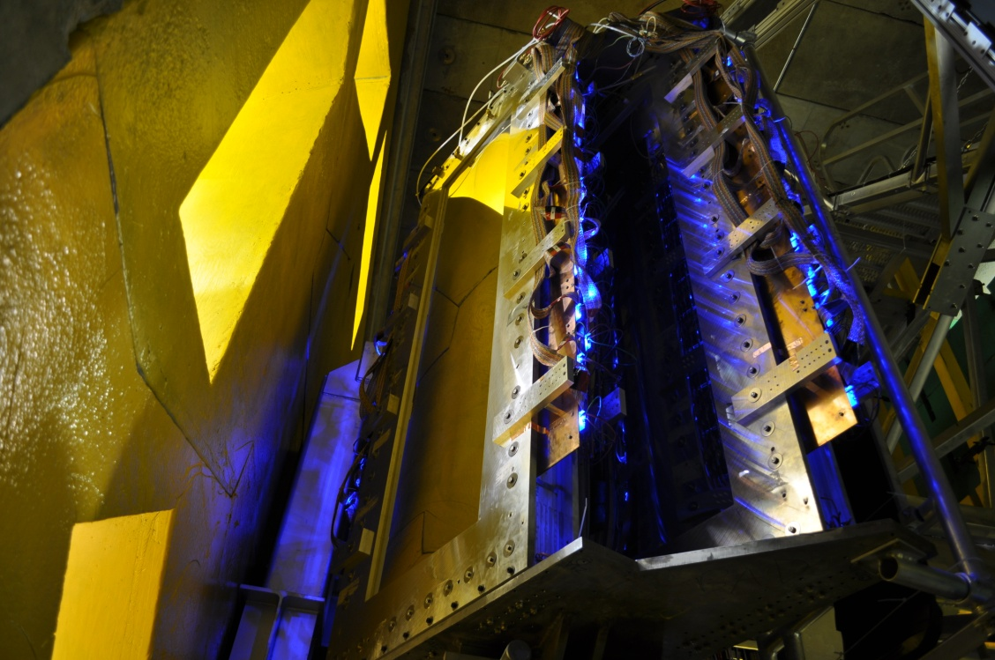
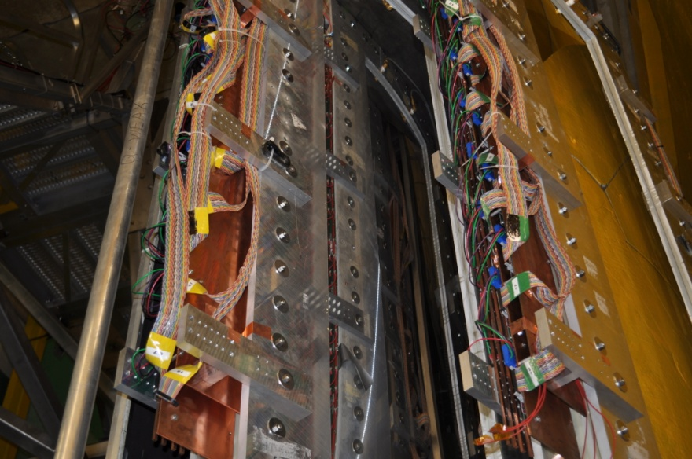
R3 VDCs in Hall

Slide 14
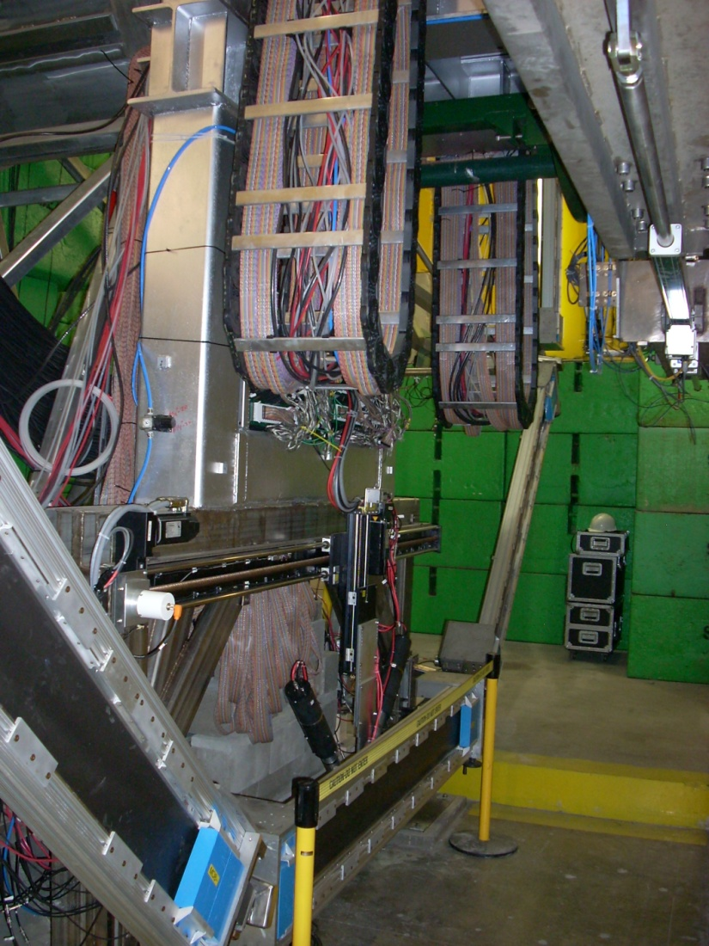
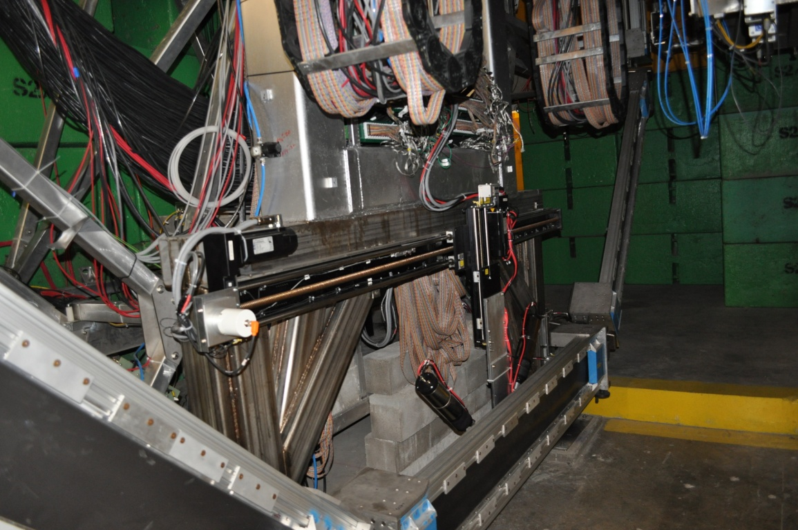
Scanner in Hall

Slide 15
Running Modes
Full tracking with R2 + R3 (50 pA)
  R3 rate = 100 Hz
  R2 rate = 50000 Hz
    Dominated by Mollers
    Removed by QTOR
R3/MD tracking R3 (25 nA)
  R3 rate = 75000 Hz
  R2 off

Slide 16
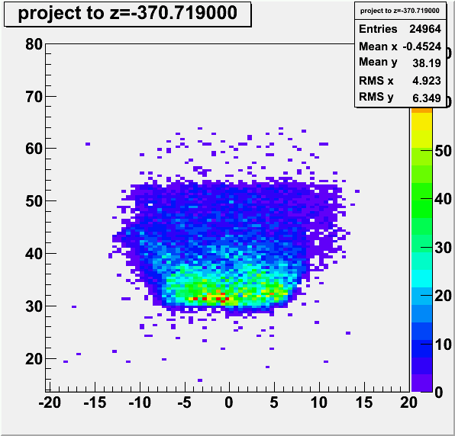
R2 Tracking
350 µm average residual
Scattering angle measured to be 8.3º (7º – 11º design)
Projection to front face of primary collimator
Size and shape agrees with survey to 0.5 cm

Slide 17
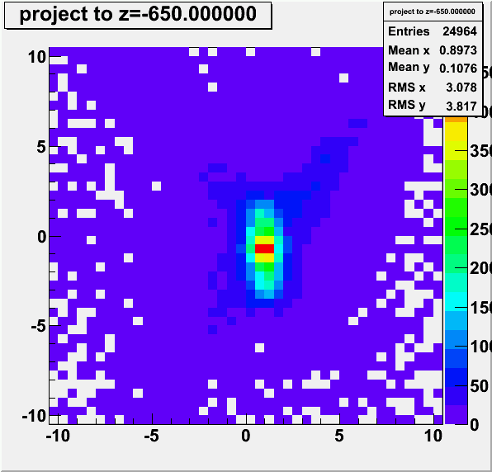
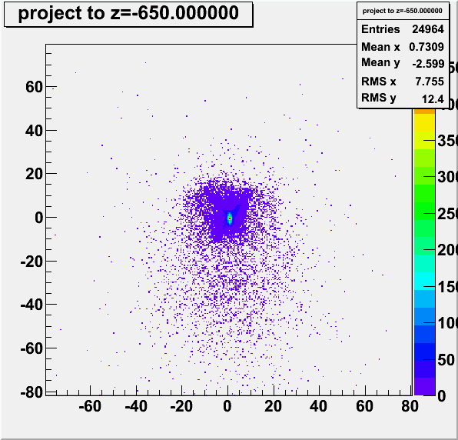
R2 Tracking
Projection onto thin foil Al target
Pattern converges to correct location in Z
Most tracks fall within 2x2 cm
  Should be 3x3 mm
  Work in progress

Slide 18
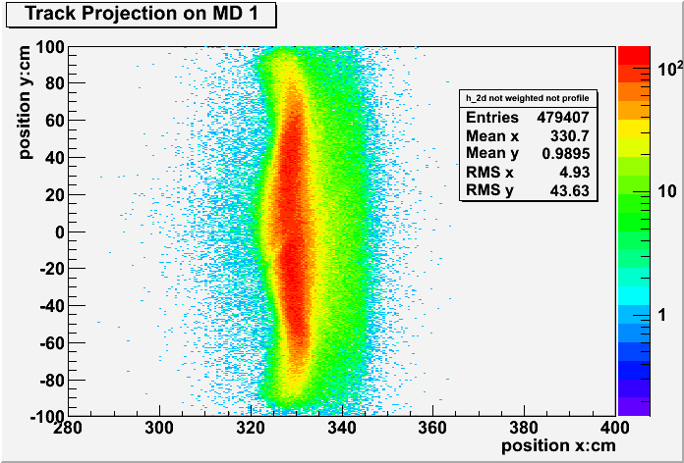
R3 Tracking
Average track residual 300 µm
Tracks projected to a Z of the MD
Not weighted
Designed “moustache” shape from toroidal spectrometer

Slide 19
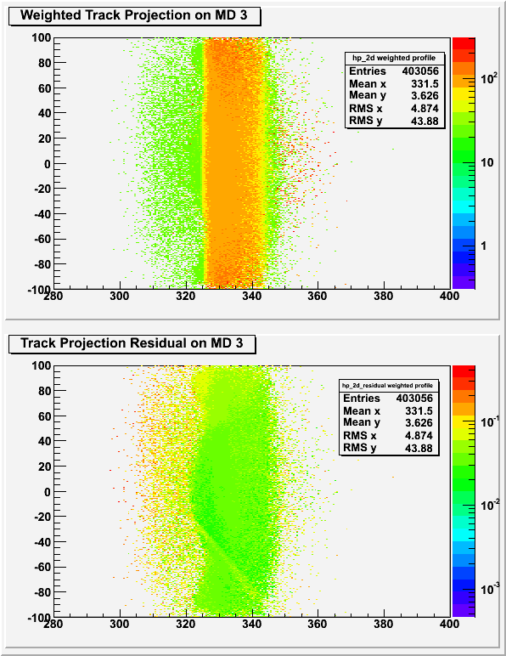
R3 Tracking onto MD with Weighting
Projection onto MD with weighting by MD photo tubes in top and by track residual on bottom
80 to 120 PEs per event on both tubes
Low residual for all tracks in center of bar
Worse residual for tracks away from bar

Slide 20
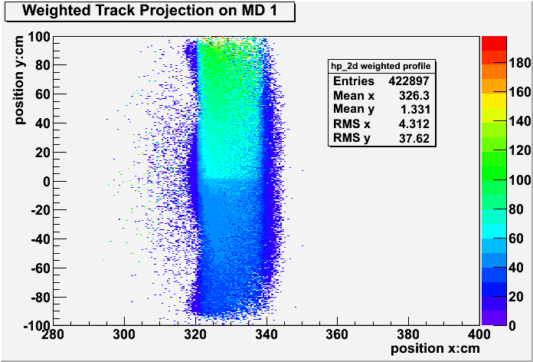
MD Glue Joint
Projection onto MD weighted by only 1 photo tube
MD is glued together in middle
Loss of 10-20 % across joint

Slide 21
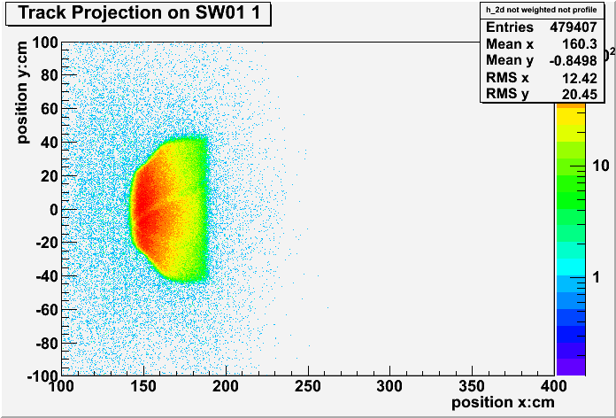
Beam Profile after QTOR

Slide 22
Conclusions
R3 + R2 local track reconstruction working OK
Able to see
  Target
  Collimator
  Main Detector
  Trigger Scintillator
Elastic profile is on Main Detector
Beam profile evolves as designed

Slide 23
Future Work
Refine tracking algorithms to reduce residuals and find more tracks
Connect tracks in R2 to R3 to measure E’
Study backgrounds in main detector
Analyze Q² data taken last weekend
Repeat measurement

Slide 24
Extras

Slide 25
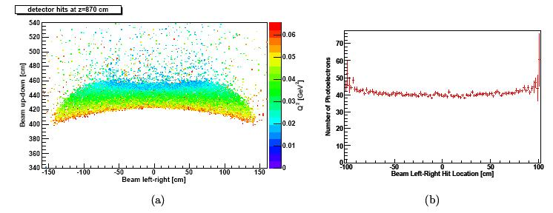
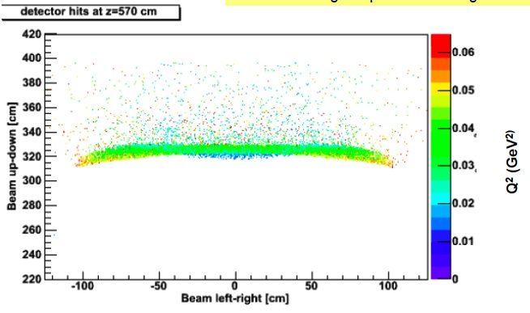
Light-Weighted Q² WBS 5
2.5% predicted shift in acceptance-averaged Q²

Slide 26
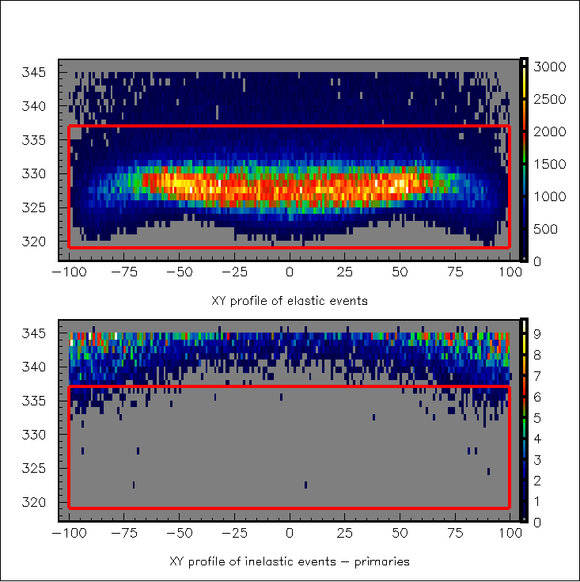
Inelastic Backgrounds WBS 5
Cerenkov bar

Slide 27
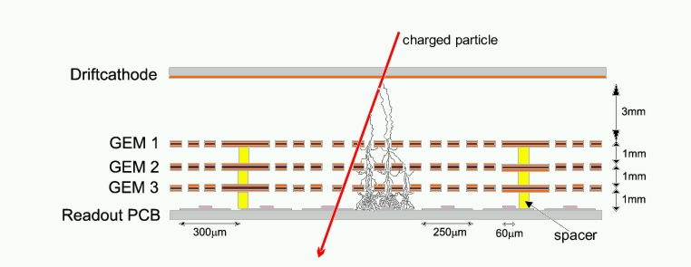

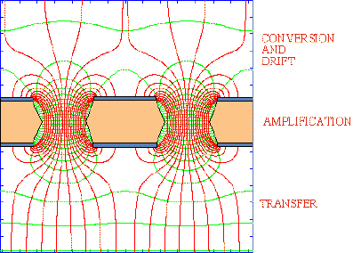
Region 1 GEMs – ISU/LATech
Two GEMs per tracking octant; ionization chamber; single spatial point
Gas Electron Multiplier

Slide 28
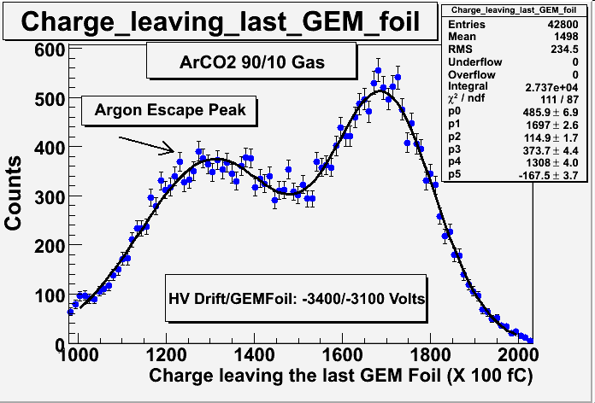
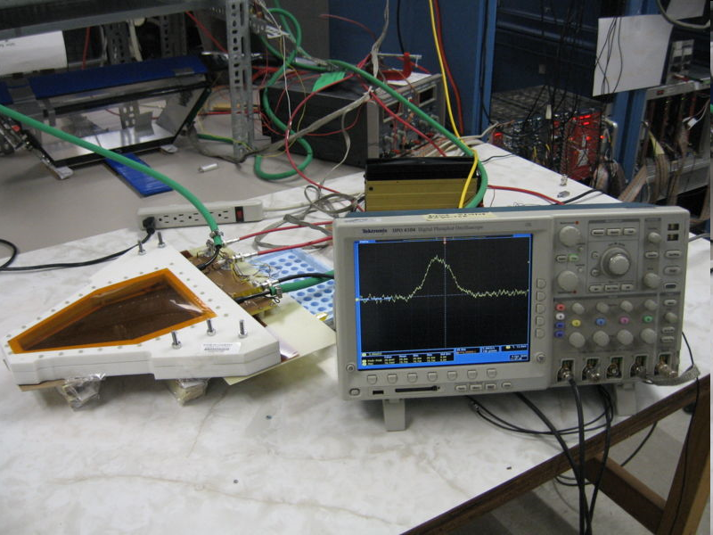
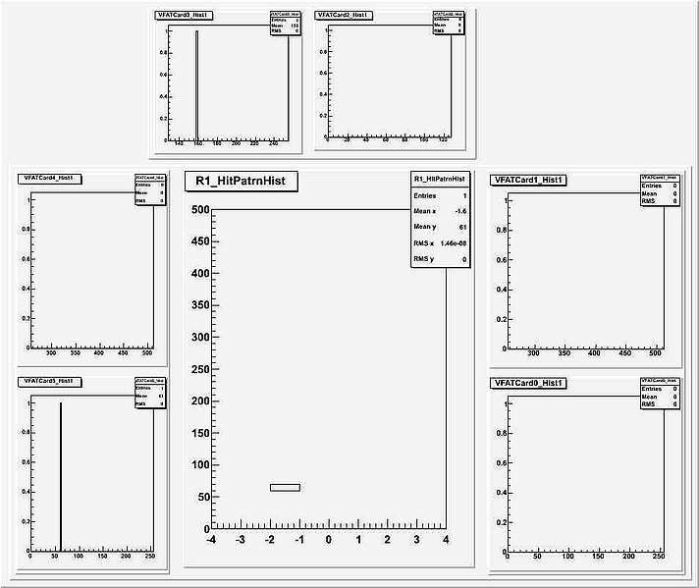
Region 1 GEMs – ISU/LATech
Two completed chambers (one at ISU, one at LaTech)
Expected resolution: 100 μm
Cosmic Ray: ADC spectrum
Cosmic Ray Event

