Slide 1
Proton Form Factor Ratio G_{E}/G_{M}
from
Double Spin Asymmetry
with
Polarized Beam and Target
Spin
Asymmetries of the
Nucleon
Experiment
Users Meeting
( E07-003)
Anusha Liyanage

Slide 2
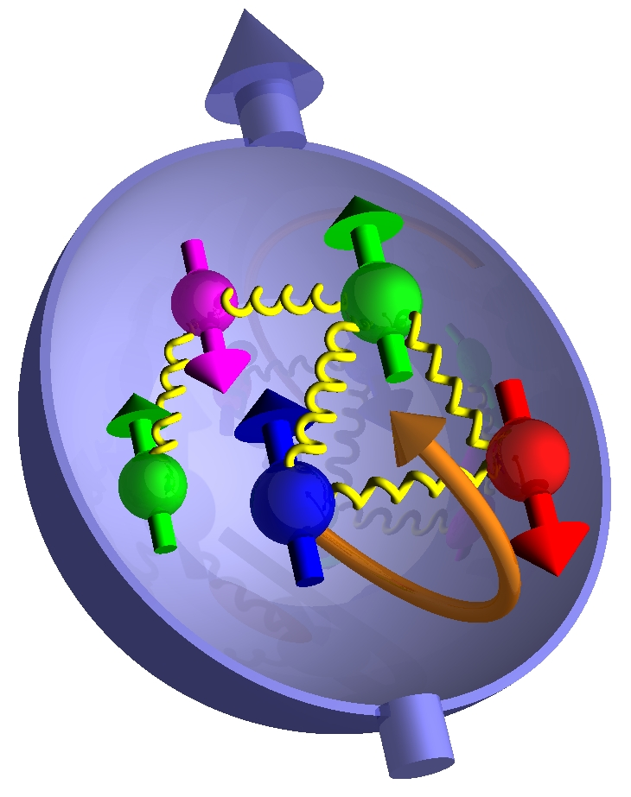
Outline
Physics Motivation
Experiment Setup
Elastic Kinematics
Data Analysis
• Electrons in HMS
• Protons in HMS
Future Work/Conclusion
Polarized Target

Slide 3
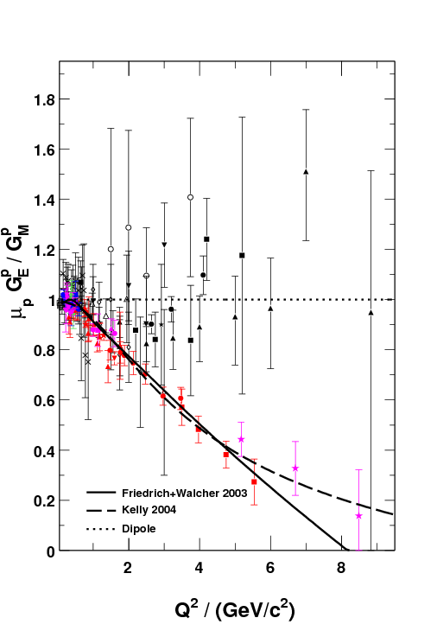
Physics Motivation
M. Jones et al., PRC74 (2006) 035201
Dramatic discrepancy between
Rosenbluth and recoil polarization
technique.
Multi-photon exchange considered
the best candidate for the
explanation
Double-Spin Asymmetry
is an Independent
Technique to verify
the discrepancy
RSS (Jlab)
Q² = 1.50 (GeV/c)²
A. Puckett , GeP-III
Dramatic discrepancy !
SANE
2.20
5.17
6.25
Q² / (GeV/c²)

Slide 4
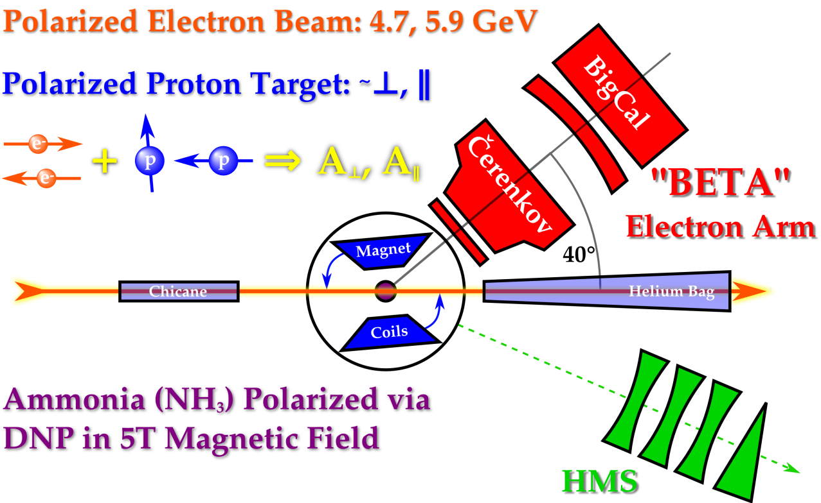
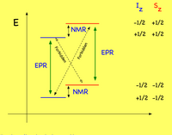
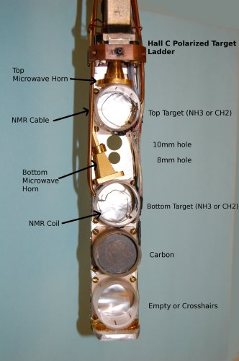
Exp. Setup/Polarized Target
• C ,CH₂ and NH₃
• Dynamic Nuclear Polarization (DNP)
polarized the protons in the NH₃
target up to 90%
• Used microwaves to excite spin flip
transitions
• Polarization measured using NMR coils
Θ_{B} = 80°
Θ_{B} = 180°
( 80 and 180 deg )
Used perpendicular Magnetic
field configuration
Average target polarization is
~ 70 %
Beam polarization is ~ 73 %
• Refrigerator - 1 K
• Magnetic Field - 5 T
• NMR system
• Microwaves - 55 GHz - 165 GHz

Slide 5
Run Dates | Beam Energy | Magnet Orientation | Run Hours/ Proposed PAC hours | Average Beam Polarization
Elastic Kinematics
Spectrometer mode | Coincidence | Coincidence | Single Arm
HMS Detects | Proton | Proton | Electron
E Beam GeV | 4.72 | 5.89 | 5.89
P GeV/C | 3.58 | 4.17 | 4.40
Θ_{HMS} (Deg) | 22.30 | 22.00 | 15.40
Q² (GeV/C)² | 5.17 | 6.26 | 2.20
Total Hours (h) | ~40 (~44 runs) | ~155 (~135 runs) | ~12 (~15 runs)
e-p Events | ~113 | ~824 | -

Slide 6
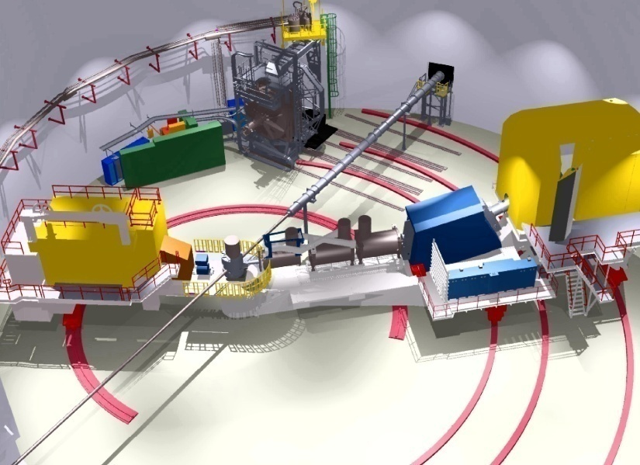
Data Analysis
PART I : Electrons in HMS
By knowing the
incoming beam energy, E and
the scattered electron angle,
Θ
e⁻
E
e⁻ p e⁻ p

Slide 7
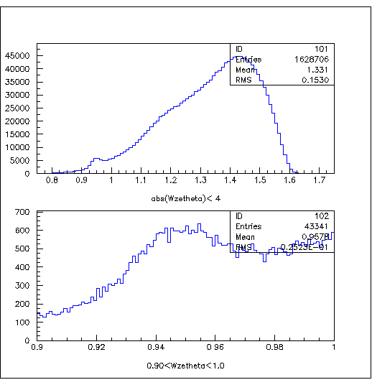
Extract the electrons
• Used only the Electron selection
cuts.
# of Cerenkov
photoelectrons > 2
shtrk/hse > 0.7
The Invariant mass
< 8
abs(W)<4
Here,
P – Measured Proton momentum at HMS
Pc – Central momentum of HMS
shtrk - Total measured shower energy of chosen track
hse - Calculated Proton energy by knowing the Proton
momentum ,
0.9<(W)<1

Slide 8
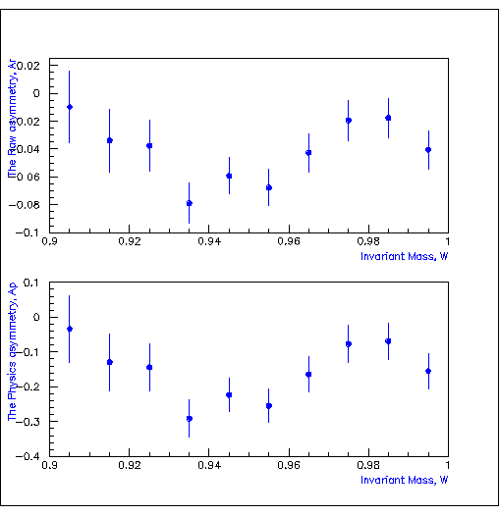
PART I : Continued…..
The raw asymmetry, A_{r}
N⁺ = Charge normalized Counts for the + helicity
N⁻ = Charge normalized Counts for the – helicity
∆A_{r} = Error on the raw asymmetry
The Raw Asymmetries
Further analysis requires a
study of the dilution factor and backgrounds
in order to determine the
physics asymmetry and G_{E}/G_{M}.
(at Q²=2.2 (GeV/C)² )
The Raw Asymmetry, A_{r}
Invariant Mass, W

Slide 9
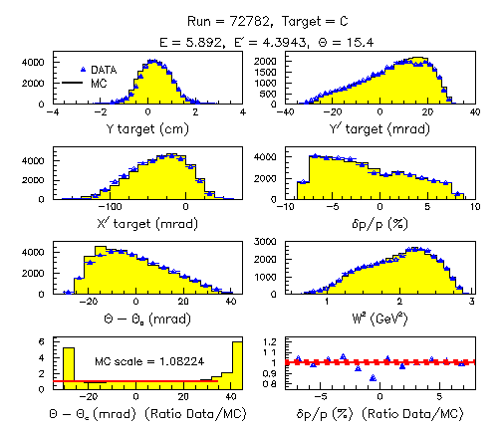
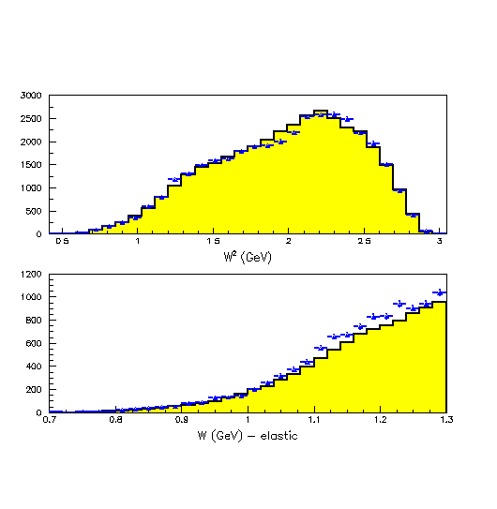
Study of a Dilution Factor
Comparing with MC for C target
Invariant Mass, W (GeV)

Slide 10
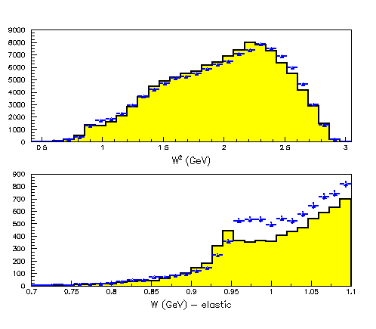
Comparing with MC for NH3 target
In order to consider NH3 target,
Used N, H and He separately
Invariant Mass, W (GeV)

Slide 11
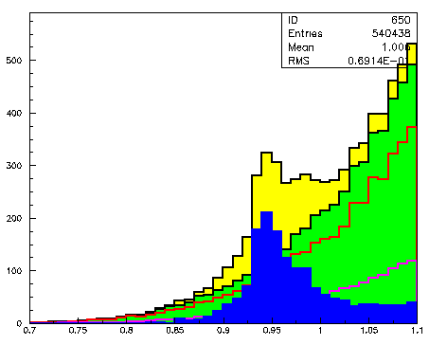
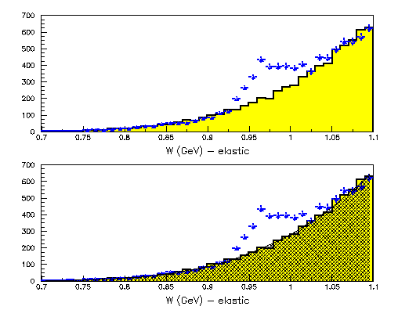
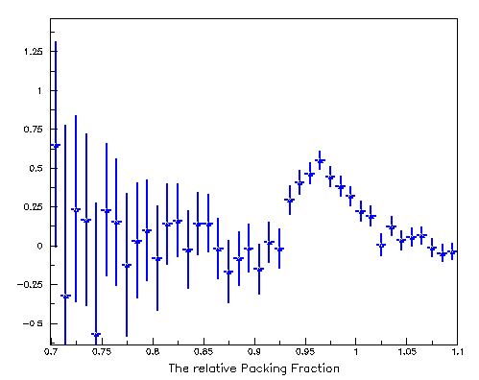
Determination of the Dilution Factor
Background contribution
MC is Normalized with the scale factor 1.30
calculated using the Data/MC ratio for 0.75 < W<0.875
Used the polynomial fit to the N + He in MC
H + N + He
N + He
N
He
H
Invariant Mass, W (GeV)
Invariant Mass, W (GeV)
MC for C reproduce the W spectra
well even in the law W region
So, needed scale factor of 1.3 for the
NH3 does not have to do with the MC.
It must be the Proton data is spread out
over the law W region.
Dilution Factor,
The Relative Dilution Factor, f %

Slide 12
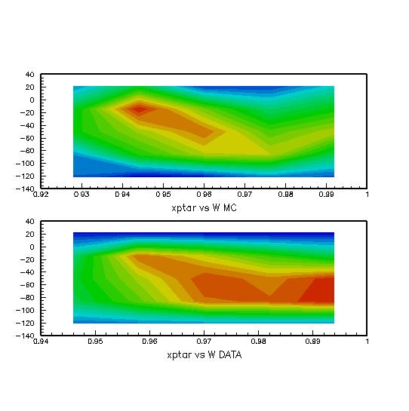
Corrections for the elastic peak shift
We see the correlation between the out-of-plane angle (xptar) with the invariant mass (W) on Data
Out-Of-Plane angle (mrad)
Invariant Mass, W (GeV)
Azimuthal angle correction -
Add an azimuthal angle dependence to
the target field map
MC
Apply the azimuthal angle correction to the target
magnetic field only for the forward direction of the
MC and make the same correlation as Data does
by adjusting the linear correction factor to the B field
Then, Use both forward and backward corrections
to make sure the elastic peak appear at the same
position before any corrections applied.
Use this correction factor to correct the B field
applied on data
Out-Of-Plane angle (mrad)
Invariant Mass, W (GeV)
Data
Invariant Mass, W (GeV)

Slide 13
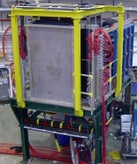
Extracting the elastic events
PART II: Protons in HMS
Definitions :
X/Yclust - Measured X/Y positions
on BigCal
X = horizontal /in-plane coordinate
Y = vertical / out – of – plane
coordinate
Yclust
Xclust
e’
Θ_{P}
P
e
By knowing
the energy of the polarized electron beam, E_{B}
and
the scattered proton angle, Θ_{P}
We can predict the
X/Y coordinates - X_HMS, Y_HMS and
( Target Magnetic Field Corrected)

Slide 14
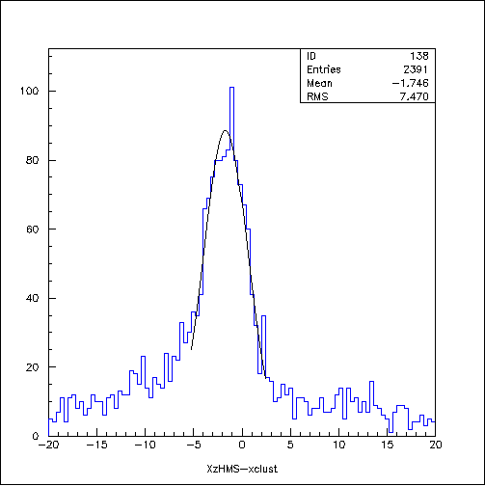
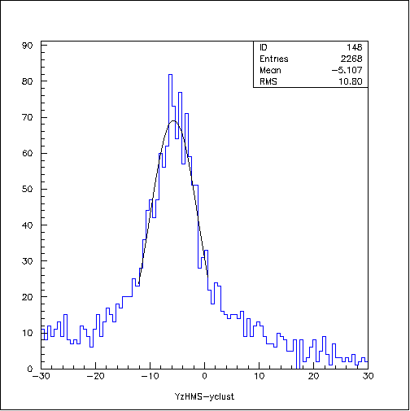
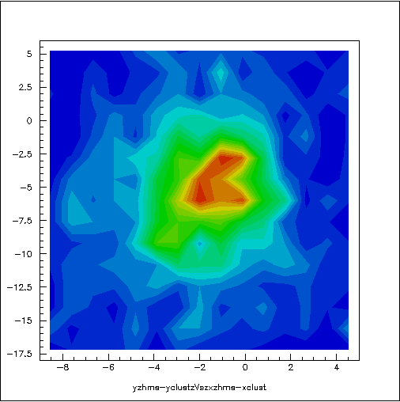
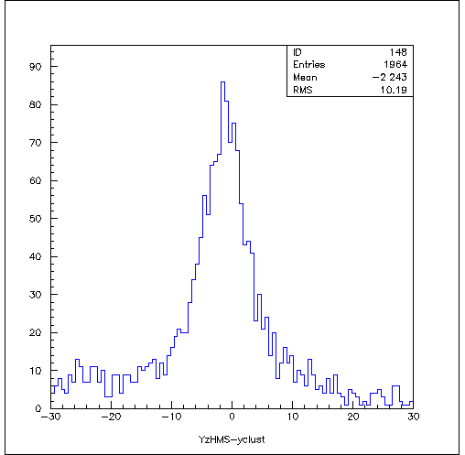
Extracting the Elastic
Events…
X position difference
Y position difference
abs(X_HMS-Xclust+1.6)<7
abs(Y_HMS-Yclust+5.7)<12
Y position diff. Vs X position diff.
X_HMS-Xclust (cm)
Y_HMS-Yclust (cm)
The Elliptic cut,
Y_HMS-Yclust (cm)
Y_HMS-Yclust (cm)
Suppresses background most effectively
Here, ∆X = X_HMS – xclust
∆Y = Y_HMS – yclust
X(Y)_{max} = The effective area cut
X_HMS-Xclust (cm)
X_HMS-Xclust (cm)
y position difference
abs(Y_HMS-yclust) < 10
Y_HMS-yclust (cm)

Slide 15
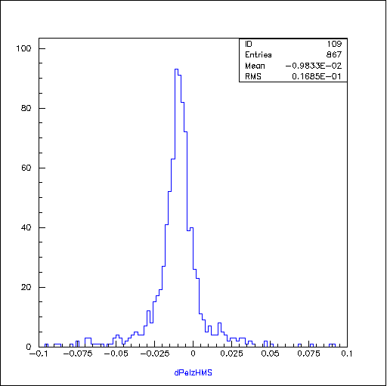
Momentum difference
The Momentum Difference , dPel_hms
P_{HMS} – Measured Proton momentum by
HMS
P_{cal} – Calculated Proton momentum by
knowing the beam energy, E and the
Proton scattered angle,
P_{cent} – HMS central momentum
abs(dpel_hms+0.01)<0.04
dpel_hms
The final elastic events are selected by using,
• The Elliptic cut and
• The ‘dpel_hms’ cut
Here , M is the Proton mass.

Slide 16
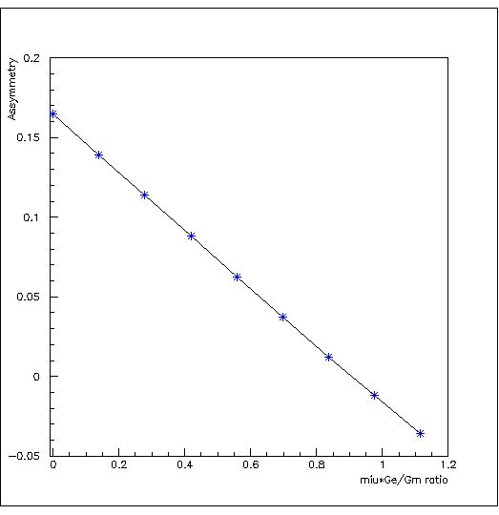
From The Experiment
The raw asymmetry, A_{r}
N⁺ = Charge normalized Counts for the + helicity
N⁻ = Charge normalized Counts for the – helicity
∆A_{r} = Error on the raw asymmetry
The elastic asymmetry, A_{p}
f = Dilution Factor
P_{B},P_{T} = Beam and Target polarization
∆A_{p} = Error on the elastic asymmetry
N_{c}= A correction term to eliminates the contribution from quasi-elastic ¹⁴N scattering under the elastic peak
The beam - target asymmetry, A_{p}
The calculated asymmetry vs μG_{E}/G_{M}
0.20
At Q²=6.26 (GeV/C)²
and
≈ 102° and = 0
Asymmetry
0.15
Here,
r = G_{E} /G_{M}
0.10
a, b, c = kinematic factors
, = pol. and azi. Angles between q and S
Pol. Tran. Tech
0.05
≈ 102° and = 0
From the HMS kinematics, r² << c
0.00
Rosenbluth Tech.
0.0
-0.05
0.4
0.0
0.2
0.6
0.8
1.0
1.2
μ G_{E}/G_{M} Ratio

Slide 17
Error Propagation From The Experiment…..
Positive Polarization
H + Counts | H- Counts | A_{raw} | Error A_{raw} | A_{phy} | Error A_{phy}
259 | 263 | -0.009 | 0.044 | -0.029 | 0.085
Negative Polarization
Tot H + | Tot H - | A_{raw} | Error A_{raw} | A_{phy} | Error A_{phy}
223 | 226 | -0.008 | 0.039 | -0.026 | 0.099
Weighted Averaged
A_{phy} | Error A_{phy}
-0.028 | 0.064
Used the
average Beam Polarization = 73 %
Average Target Polarization = 70 %
Using the experiment data at
Q²=6.26 (GeV/C)² ,
with total ep events ~970, ∆A_{p}=0.064
∆r = 0.127
μ ∆r = 2.79 x 0.127
μ ∆r = 0.35
Where , μ – Magnetic Moment of the
Proton

Slide 18
Future Work ..
Extract the physics asymmetry and the G_{E}/G_{M} ratio
Improve the MC/SIMC simulation and
estimate the background
Conclusion ..
Measurement of the beam-target asymmetry in elastic electron-proton scattering offers an independent technique of determining G_{E}/G_{M} ratio.
This is an ‘explorative’ measurement, as a by-product of the SANE experiment.
Plan to submit a proposal to PAC for *dedicated* experiment with higher statistics after the 12 GeV upgrade.

Slide 19
SANE Collaborators:
Argonne National Laboratory, Christopher Newport U., Florida International U., Hampton U., Thomas Jefferson National Accelerator Facility, Mississippi State U., North Carolina A&M, Norfolk S. U., Ohio U., Institute for High Energy Physics, U. of Regina, Rensselaer Polytechnic I., Rutgers U., Seoul National U., State University at New Orleans , Temple U., Tohoku U., U. of New Hampshire, U. of Virginia, College of William and Mary, Xavier University, Yerevan Physics Inst.
Spokespersons: S. Choi (Seoul), M. Jones (TJNAF), Z-E. Meziani (Temple),
O. A. Rondon (UVA)
Thank You

Slide 20
Backup Slide

Slide 21
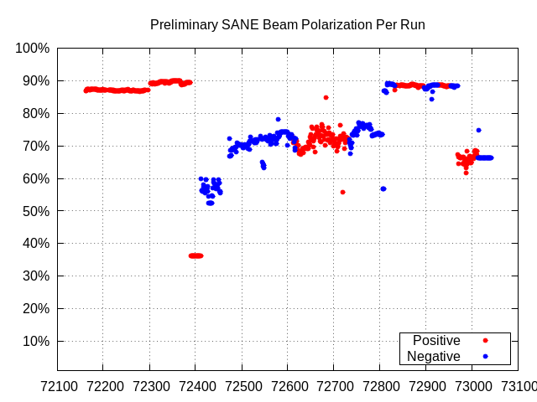
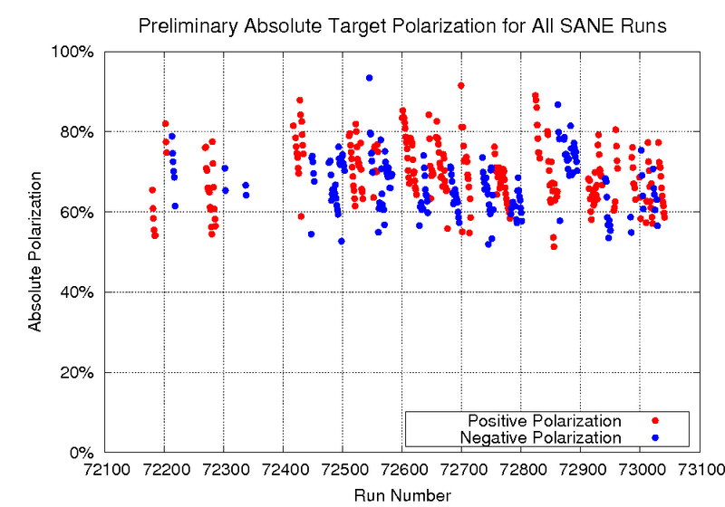
Beam/Target Polarizations and some Asymmetries
Used the
average Beam Polarization = 73 %
Average Target Polarization = 70 %

