Slide 1
SHMS Wire Chamber Update
RECAP from August Review:
Vendor price quote 5x larger than expected
Exploring possibility of manufacturing smaller PCBs and then
laminating several together to make a single plane
Discussions with Hall D Engineers (their circular chambers are
made in pieces).
Do NOT do it!!! (if possible!)
Vendor Search – industry maximum tooling for PCBs is 40 inches wide.
Only two vendors in the USA capable of making such large PCBs
Triangle Labs, Inc, Nevada
Universal Circuits Inc, Minnesota
Start to revise our design to accommodate a narrower PCB.
Peter Monaghan “Hall C January 2011 Users Meeting” 15th January 2011

Slide 2
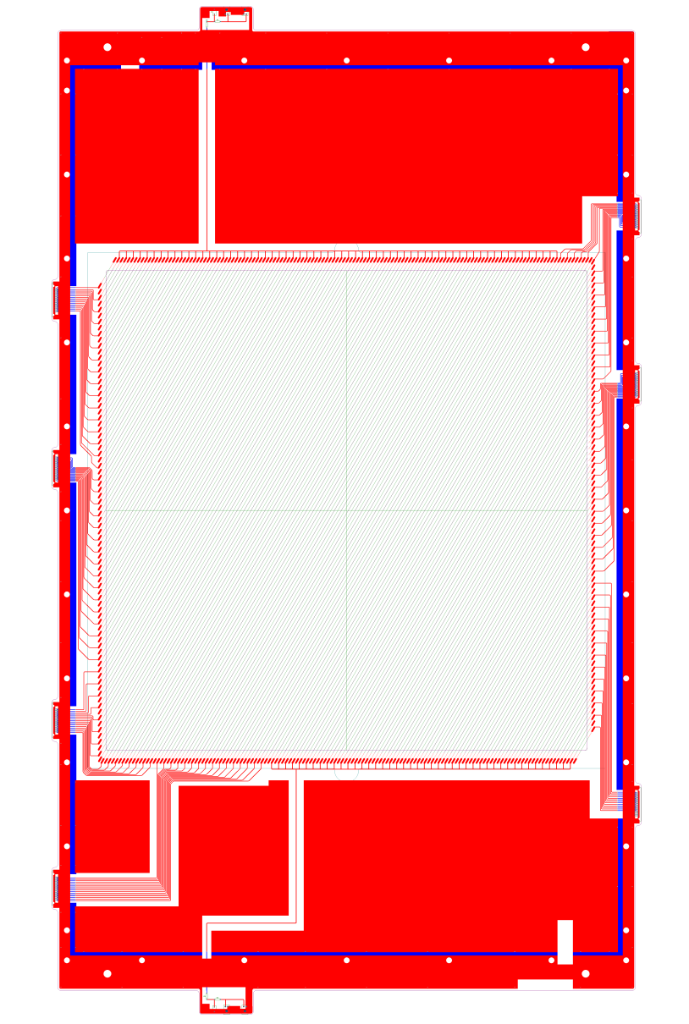
PCB Redesign – U Plane
Acceptance unchanged : 80cm X 80 cm
Overall width reduced to 38.6 "
Side bar width reduced to 3.15 "
Frame deflection due to wire tension changes from 0.002" to 0.011" (0.034 % of wire length)
Working on procedures for transfer of wire planes from stringing jigs to final assembly station
Peter Monaghan “Hall C January 2011 Users Meeting” 15th January 2011

Slide 3
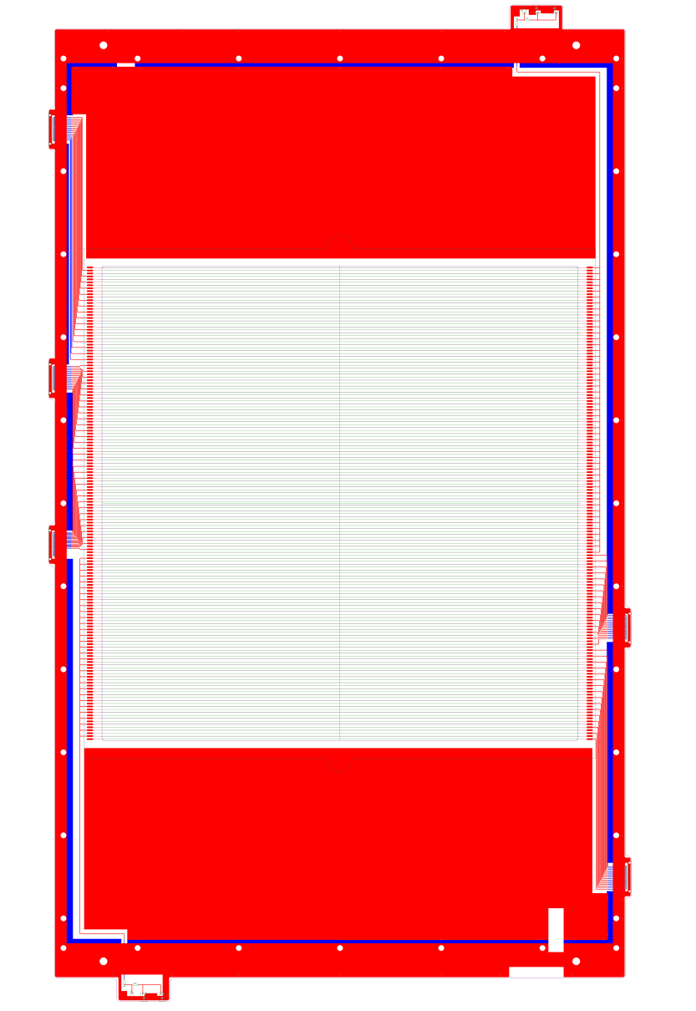
PCB Redesign – X Plane
Wire planes now have two HV inputs
Overall length unchanged (ex. HV in)
Wire cell spacing unchanged
Peter Monaghan “Hall C January 2011 Users Meeting” 15th January 2011

Slide 4
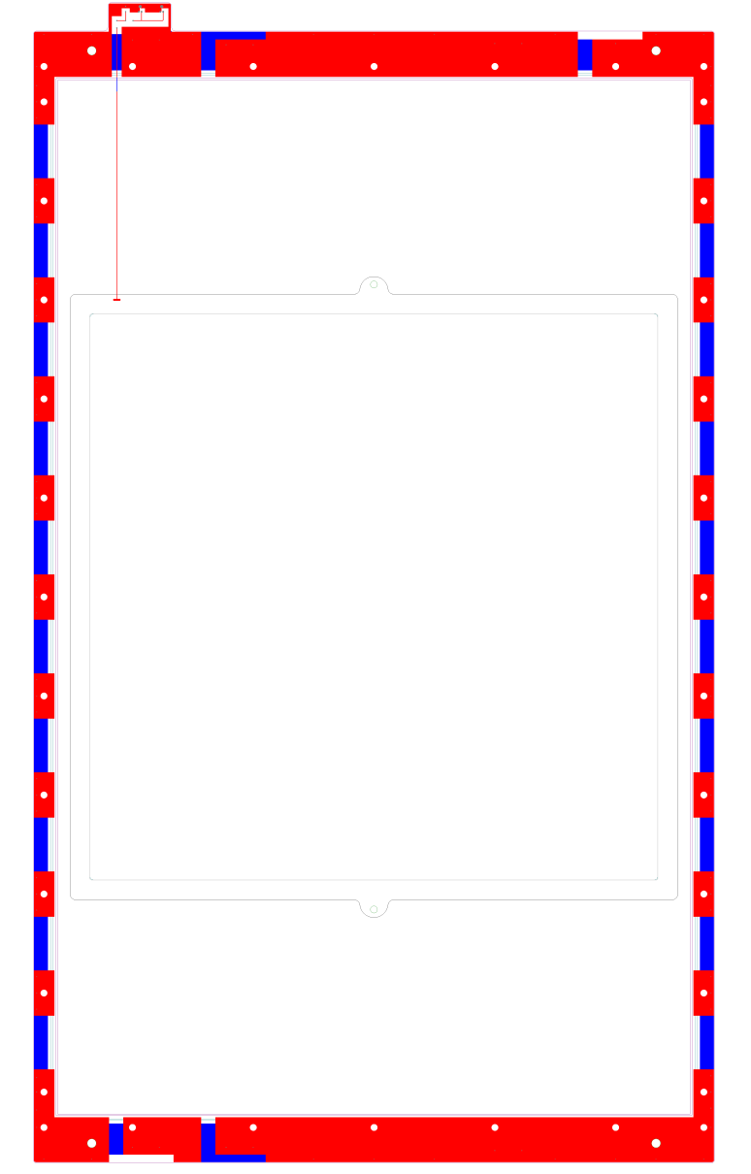
PCB Redesign – K (cathode) Plane
All designs check for consistency
Advice from Fast Electronics Group taken into consideration
Redesign means small changes to design and dimensions of front and rear plates
Changes mounting frame design
Peter Monaghan “Hall C January 2011 Users Meeting” 15th January 2011

Slide 5
Redesign and PCB Status
Redesign keeps acceptance unchanged but reduces overall width of pcb to less than 40 inches.
Final eCAD drawings completed for cathode (K), U and X wire planes.
Final fabrication drawings to be completed for vendor.
Complete set of drawings sent to vendor next week.
Triangle Labs Inc, Nevada, quoted $54 000 for the whole project.
includes spare boards – 2 X, 2 U and 4 K boards
Purchase order placed through Hampton University
received by vendor and material ordered.
Peter Monaghan “Hall C January 2011 Users Meeting” 15th January 2011

Slide 6
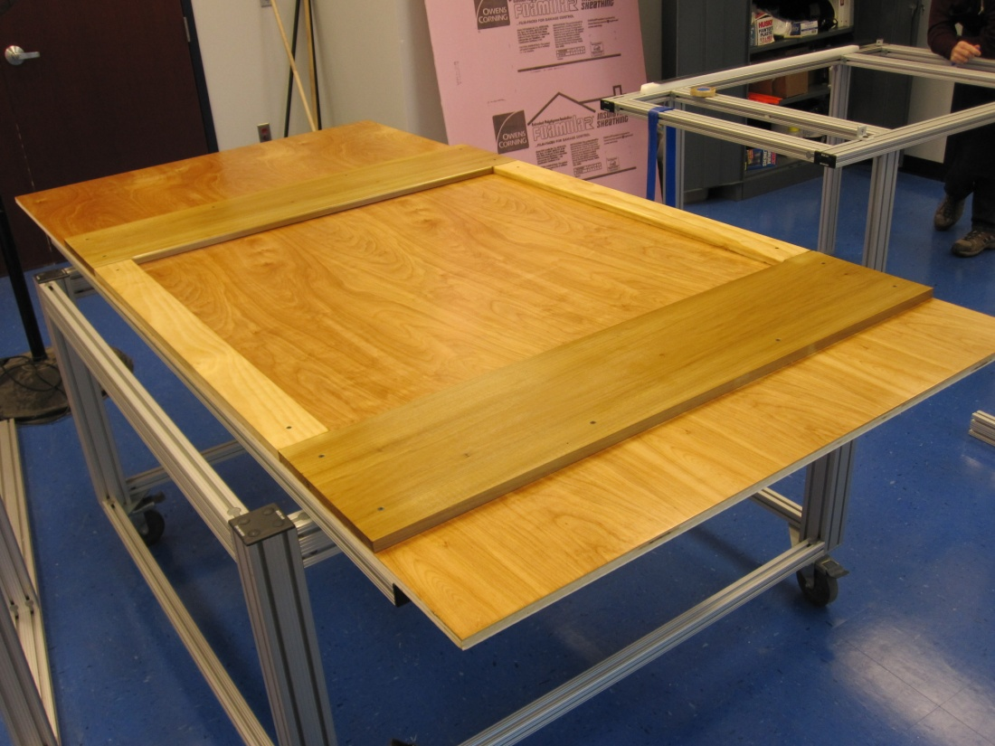
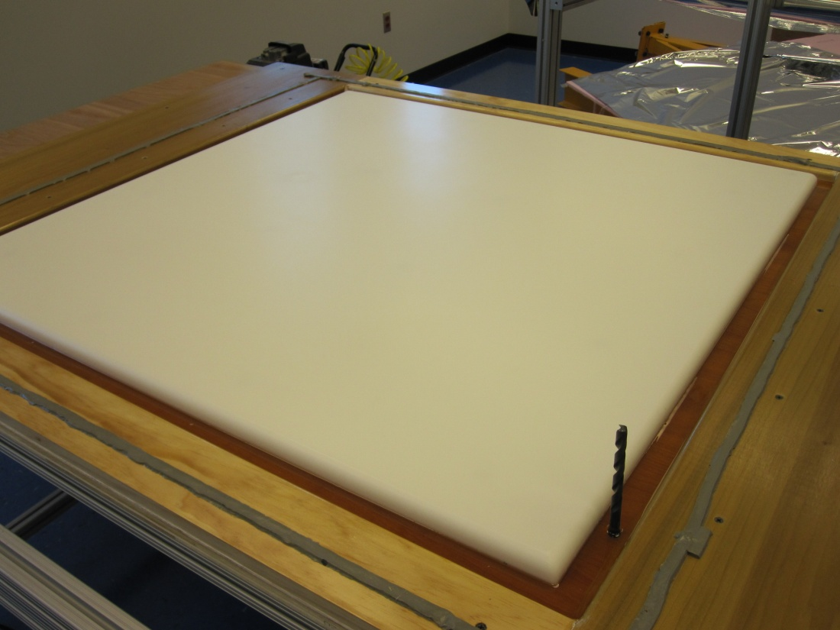
Foil Stretching Jig
Finished construction of the foil stretching jig.
Successful full scale test using mylar foil; see videos separately.
Sealed plywood base and wooden sides
Polished polyethylene block in centre
Peter Monaghan “Hall C January 2011 Users Meeting” 15th January 2011

Slide 7
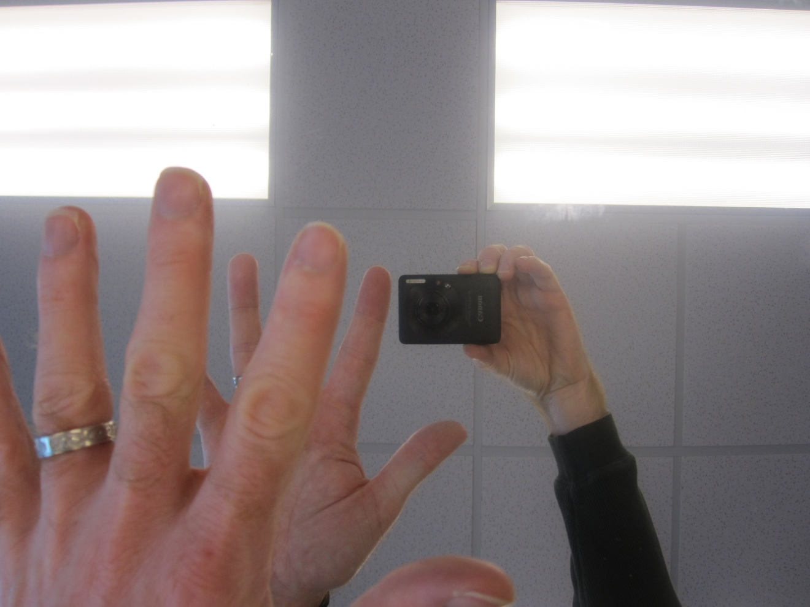
Foil Stretching Tests
Several stretching tests completed to check foil tension.
Peter Monaghan “Hall C January 2011 Users Meeting” 15th January 2011

Slide 8
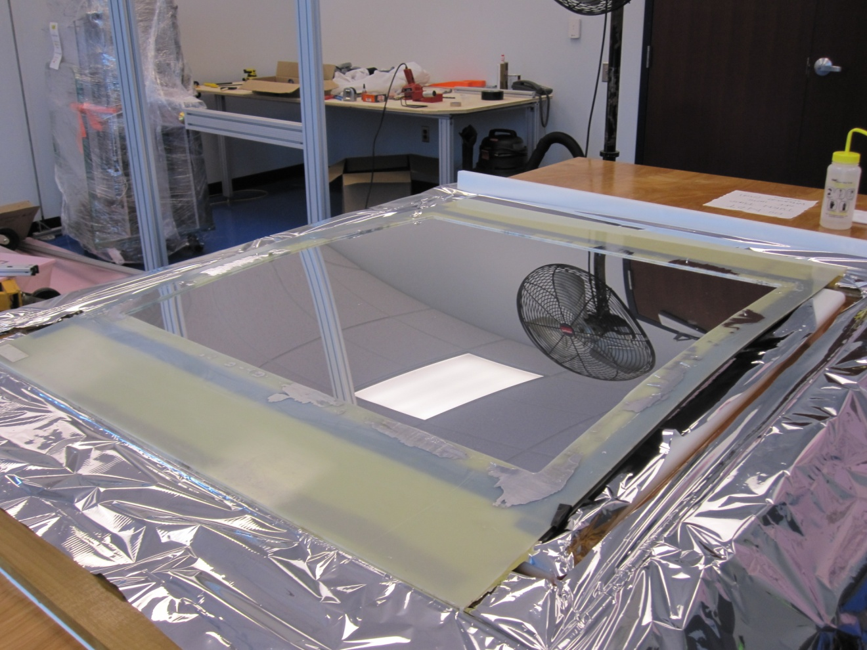
Foil – Frame Adhesion Test
Successfully test glued a stretched foil to G10 frame.
Peter Monaghan “Hall C January 2011 Users Meeting” 15th January 2011

Slide 9
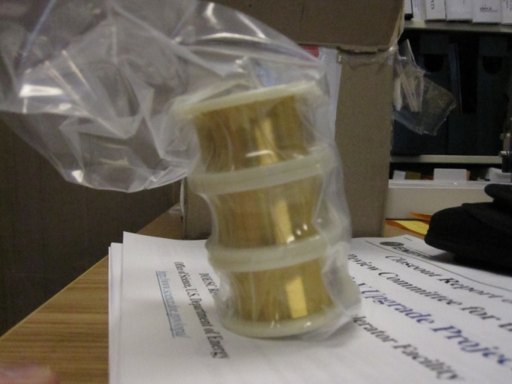
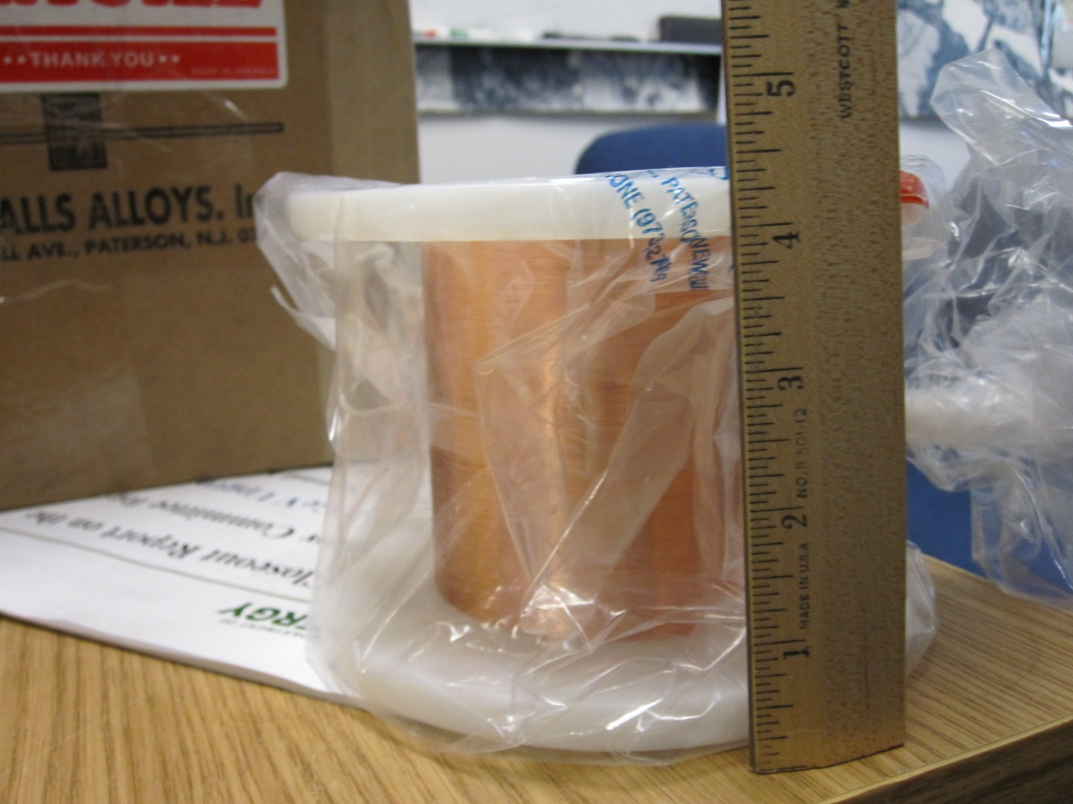
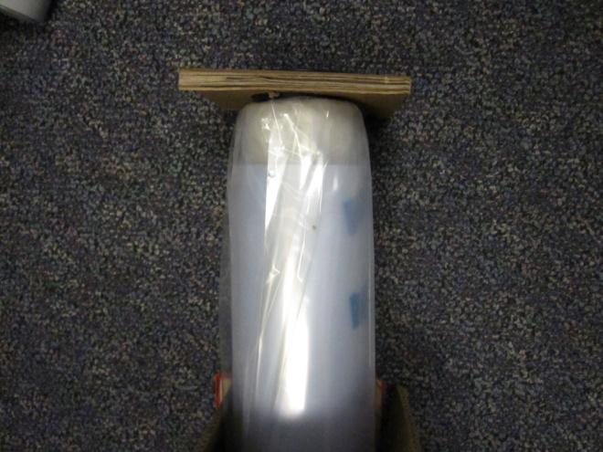
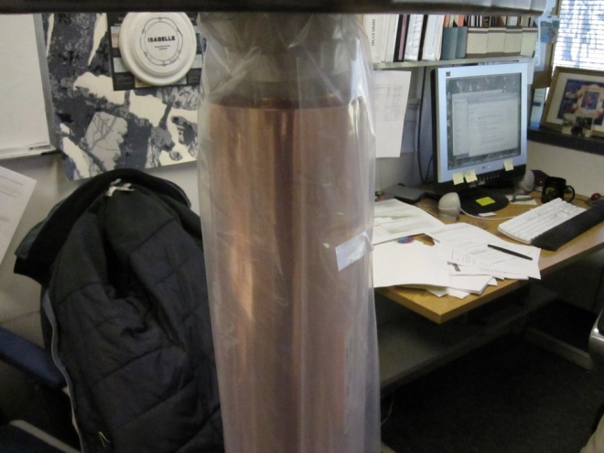
Materials Purchased
HV wire, signal wire, epoxy, cathode foil and gas window foil purchased.
Signal wire: 25 μm
gold plated tungsten
HV wire: 100 μm
copper-beryllium
Gas window is
aluminised mylar
1 mil thick
Cathode foil is
copper coated
kapton, 1 mil thick
Peter Monaghan “Hall C January 2011 Users Meeting” 15th January 2011

Slide 10
Summary
Redesigned PCBs to be able to manufacture each plane as a single piece; acceptance unchanged.
Received a reasonable price quote from vendor.
Purchase order for PCBs placed.
New eCAD drawings complete; fabrication drawings next.
Full suite of drawings to go to vendor next week.
Foil stretching jig constructed and tested successfully.
HV wire, signal wire, epoxy, cathode foil and gas window foil purchased and received; thanks to HCF and SAW.
Continuing to develop our techniques and procedures.
Peter Monaghan “Hall C January 2011 Users Meeting” 15th January 2011

