Slide 1
Rosen07 Two-Photon Exchange Status Update
James Johnson
Northwestern University & Argonne National Lab
For the Rosen07 Collaboration

Slide 2
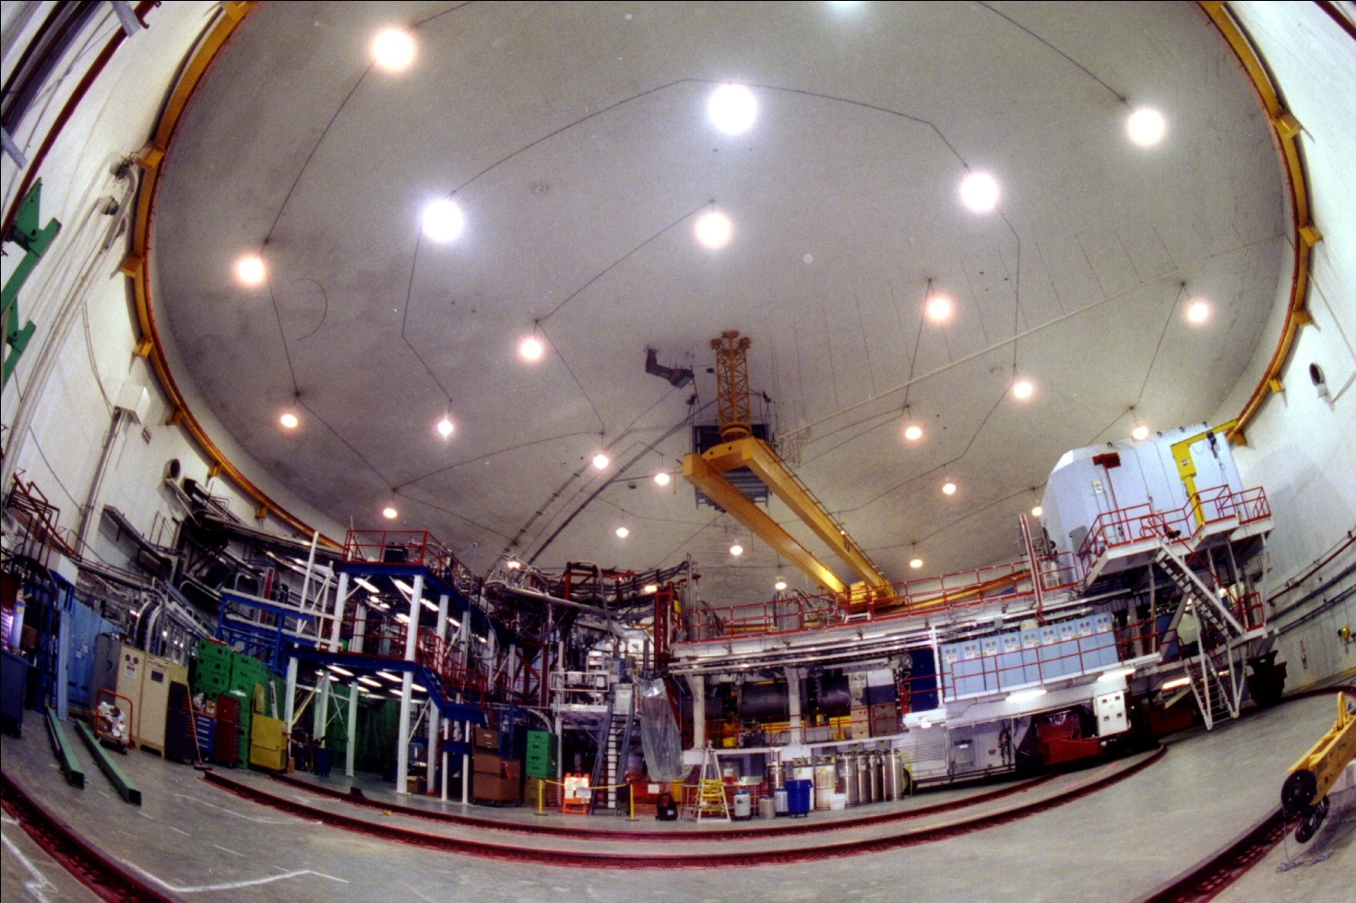
Rosenbluth 2007 JLab E05-017
HMS in Hall C at Jefferson Lab
4cm liquid hydrogen target for elastics
4cm aluminum dummy for endcap subtraction
May 8 – July 13, 2007
Notes:
Add picture of HMS

Slide 3
Rosenbluth 2007
Rosenbluth method
Plot reduced cross section vs. angular variable ε at fixed Q²
G_{E}, G_{M} from slope and intercept
Super Rosenbluth
Detect protons instead of electrons
Reduces error
I. A. Qattan et. al, Phys. Rev. Lett. 94:142301, 2005
Notes:
Epsilon – virtual photon longitudinal polarization

Slide 4
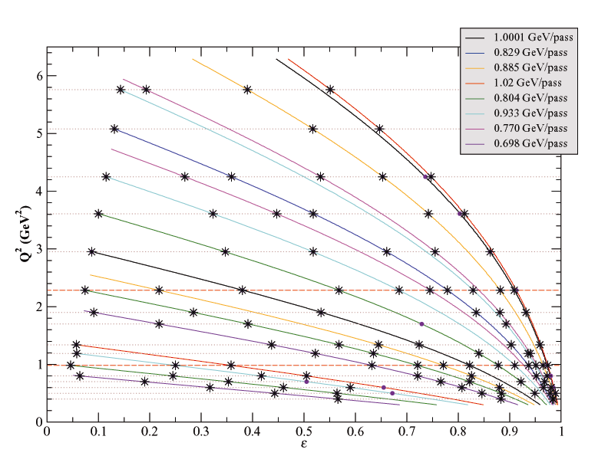
Rosenbluth 2007
102 Kinematics points
Q² 0.40-5.76 GeV²
13 points at Q²=0.983
10 points at Q²=2.284
Notes:
Kinematics taken
Each solid, colored line is a different beam energy, data is where the lines intersect our Q^2 values
In particular, very low- and very high-epsilon points, where there is little previous data
16 Q^2 values
17 Ebeam values, range
At each Q^2, several points for an L-T seperation

Slide 5
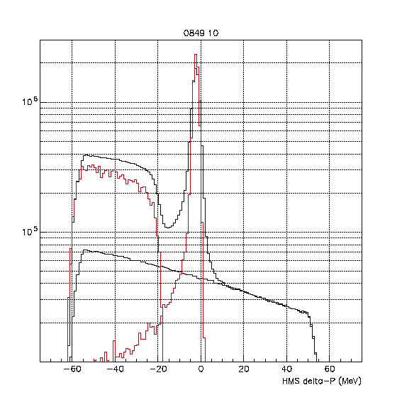
Elastic Spectrum
Hydrogen elastics
Compare to simulated elastics
Background
‘Dummy’ runs for endcap subtraction
Simulated π⁰ photoproduction
Notes:
Don’t have a simple gaussian peak, there’s a tail because of the radiative spectrum
Q^2 = 0.980 GeV^2, eps = 0.046

Slide 6
Analysis Steps
Sum data & dummy runs at selected kinematic
Simulate elastics, pion photoproduction, compton scattering
Scale all to charges and efficiencies
Fit dummy + simulations to the data
Extract ratio of simulation cross-section to actual cross-section
Notes:
Maybe example unpeeling here

Slide 7
Current Status
Calibrations – Completed
Drift Chamber Offset
Efficiencies
Tracking, Triggering, Deadtime – Well known
Target Length Correction
Proton Absorbtion
Particle Identification
Time-of-Flight cuts
Aerogel cut
Resolution Mismatch
Smearing, Non-Gaussian Tails
Finalize Δp cuts
Notes:
Picture?

Slide 8
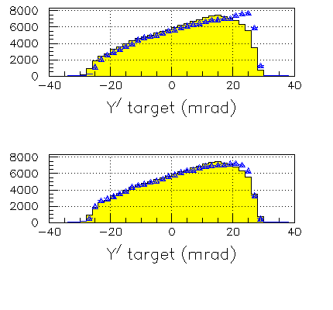
Drift Chamber Offsets
Shoulder in yptar distribution
Examined in thin-foil and sieve slit targets
Small resolution improvement
Now included in Replay
Notes:
Yptar – particle angle at target
Ibrahim Albayrak
Plot from first attempt

Slide 9
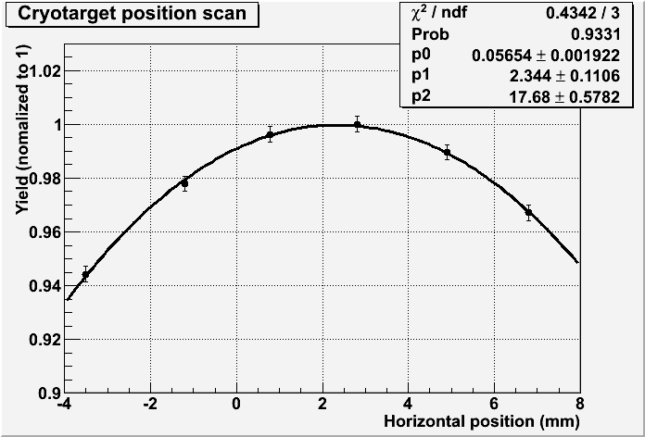
Target Length Correction
4cm cylindrical target
Off-center beam leads to a shortened target and lower yield
Beam is rastered 1mm to either side of the center
Survey runs done at different beam positions
Fit to the yields gives the beam offset
Beam positioned around +1mm during data collection
Shows a half-percent reduction in yield
Notes:
Target position shifts slightly during cooling, this was also surveyed but is unnecessary when we fit yield directly in terms of beam position
Graphic – fit of normalized yield to beam position
Fit performed by Vahe

Slide 10
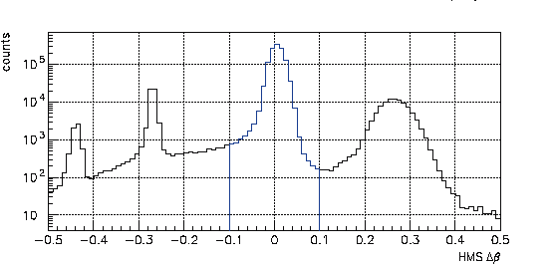
ToF Cut Efficiency
Time-of-Flight cuts used for particle identification
Refine cut positions
Different cuts above and below the proton peak
Determine efficiency
Largest remaining correction
Different issues on positive and negative sides
Notes:
Both most strongly momentum dependant
2.055 GeV 47 deg; 0.98 GeV^2

Slide 11
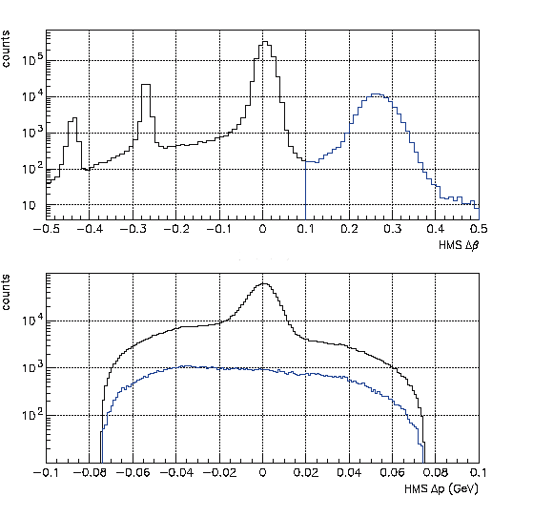
ToF High Side
Excluding pions, faster than protons
Elastic protons disappear quickly
Pion tail may extend underneath proton peak
Notes:
Graph, no elastic peak for high ToF
2.055 GeV 47 deg; 0.98 GeV^2

Slide 12
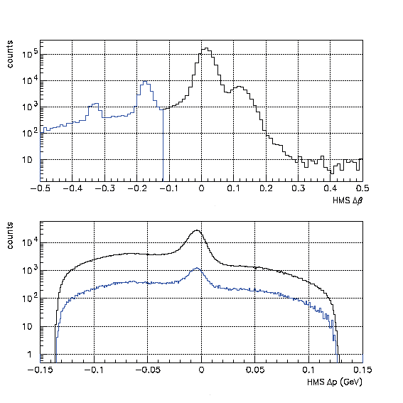
ToF Low Side
Excluding deuterons
Place cut just above deuteron cutoff
Elastic protons extend into this region as they lose energy or scatter
Need to know the shape of this tail
Notes:
Plot – Data w/ deuteron peak subtracted out 3.362 GeV 36 degrees 2.28 GeV^2
3.362 GeV, 36 deg; 2.28 GeV^2

Slide 13
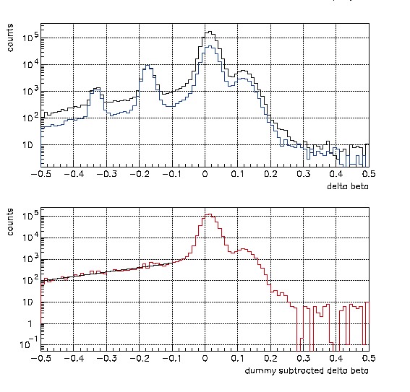
ToF Low Tail
All deuterons come from the endcaps
Can be removed with dummy subtraction
Shape of the tail
Determine efficiency
Notes:
Plot – Data w/ deuteron peak subtracted out 3.362 GeV 36 degrees 2.28 GeV^2
3.362 GeV, 36 deg; 2.28 GeV^2

Slide 14
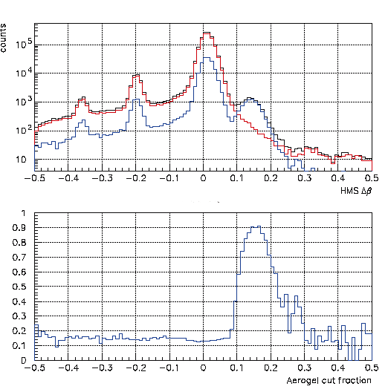
Aerogel Cut Efficiency
Aerogel cut excludes pions
What rate does it capture protons?
What rate does it fail to capture pions?
Not necessary at low momentum
Slight angular dependence
Notes:
Plot – uniform below pion cutoff, we like this
2.055 GeV, 30 deg; 1.90 GeV^2

Slide 15
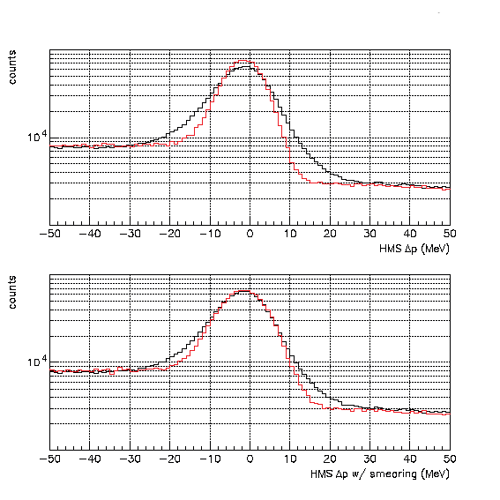
Resolution Mismatch
Data peak was broader than elastic simulation
Shape improved with angle smearing
0.9 milliradians
Non-gaussian tails are also present
Can affect integrated counts
Notes:
3.362 GeV 36 deg 2.28 GeV^2

Slide 16
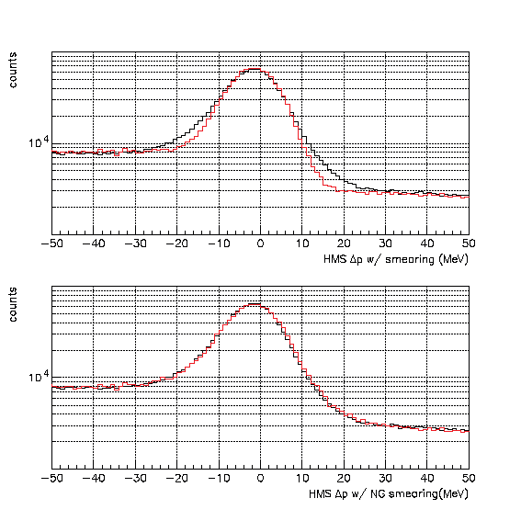
Non-Gaussian Tails
Possibly due to extra hits in wire chambers decreasing resolution
Applied to angle
Works better on broad Δp peaks than narrow
Suggests momentum smearing is also present
Notes:
Broad peaks occur at high angles

Slide 17
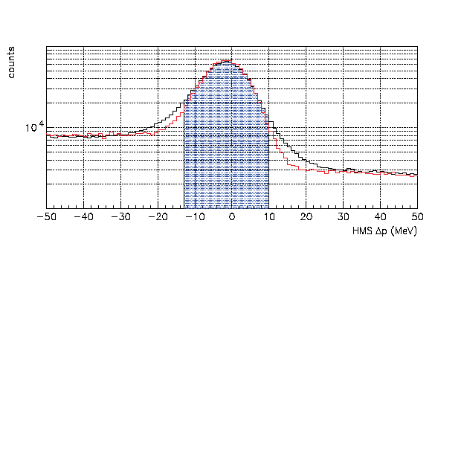
Momentum Cuts
Determine the integrated cut region
Preliminary cuts based on width of Δp peak
Explicit problem with resolution mismatch
Angular dependence
Refining cuts relies on fixing non-gaussian tails

Slide 18
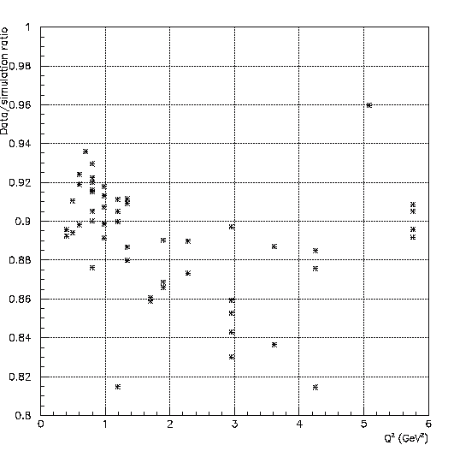
Missing Efficiencies
Data/simulation ratio should be ~1
Target length ~0.5%
Non-gaussian Tails, Cuts, ToF, Aerogel few percent each

Slide 19
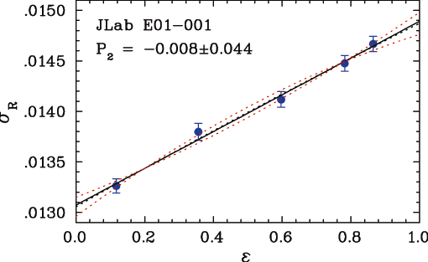
Finally
Closing in on final efficiencies
Find cross sections
Extract form factors
Perform linearity testing
Early summer

