Slide 1
Polarized Targets and Physics Program
Jian-ping Chen, Jefferson Lab
JLab high luminosity polarized targets workshop, June 18-19, 2010
Introduction
Progress in the last decade
12 GeV program and needs
How to meet the needs

Slide 2
Introduction to Spin and Polarized Targets
Spin, Nucleon Spin Structure
Polarized p, d and ³He Targets

Slide 3
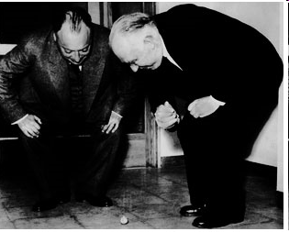
Introduction: Spin
Spin Milestones: (Nature)
  1896: Zeeman effect (1)
  1922: Stern-Gerlach experiment (2)
  1925: Spinning electron (Uhlenbeck/Goudsmit)(3)
  1928: Dirac equation (4)
  Quantum magnetism (5)
  1932: Isospin(6)
  1935: Proton anomalous magnetic moment
  1940: Spin–statistics connection(7)
  1946: Nuclear magnetic resonance (NMR)(8)
  1951: Einstein-Podolsky-Rosen argument in spin variables(11)
  1971: Supersymmetry(13)
  1973: Magnetic resonance imaging(15)
  1980s: “Proton spin crisis”
  1988: Giant magnetoresistance(18)
  1997: Semiconductor spintronics (23)
  2000s: “Nucleon transverse spin puzzle”?

Slide 4
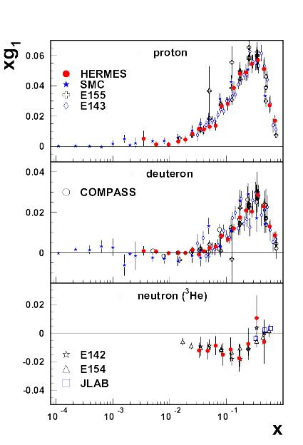
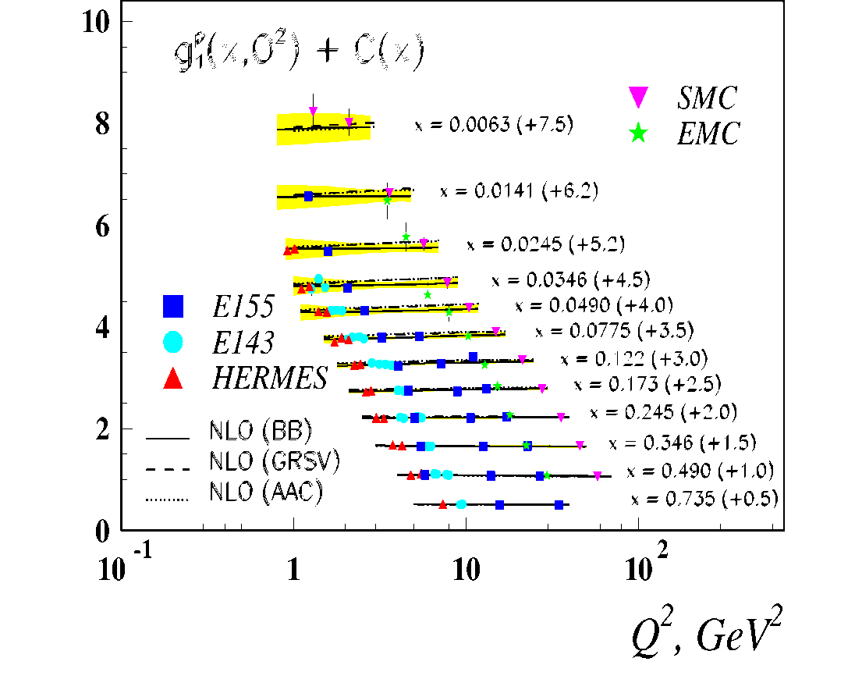
Polarized Structure functions

Slide 5
JLab Spin Experiments
Results:
  Spin in the valence (high-x) region
  Moments: Spin Sum Rules and Polarizabilities
  Higher twists: g₂/d₂
  Quark-Hadron duality
  Form factors
Recently completed:
  d₂^{p} (SANE) and d₂^{n}
  Transversity (n)
Planned
  g₂^{p} at low Q²
Future: 12 GeV
  Inclusive: A₁/d₂ , …
  Semi-Inclusive: Transversity/TMDs, Flavor-decomposition, …
  Exclusive: π/K production, form factors, DVCS…
Review: Sebastian, Chen, Leader, arXiv:0812.3535, PPNP 63 (2009) 1

Slide 6
Asymmetry Measurements for Spin Experiments
Double spin symmetries for polarized beam on polarized targets
Figure of Merit (FOM) depends on luminosity, beam and target polarization (squared), dilution factor (squared) and acceptance

Slide 7
Polarized Luminosity
Internal targets (storage ring)
10³¹
Polarized external (fixed) targets
Solid (p/d) 10³⁵
Gas (³He) 10³⁶

Slide 8
Polarization
Highly polarized electron beams (SLAC, Jlab,…)
P_{e} = > 80%
High density and highly polarized 3He-gas targets (JLab, SLAC, Mainz,…)
P_{3He} = 30–60 %
Highly polarized H- and D-gas target cells (HERMES, …)
P = 70-80 (30-60)%
Solid target materials with high radiation resistivity and high polarization (JLab/UVa, SLAC, Bochum, Bonn, Michigan,…)
P_{H(D)} = 70-90 (30-60)%
Solid targets, low beam intensity, large acceptance (Bonn, COMPASS, PSI,…)
P_{H(D)} = 70-90 (30-60)%

Slide 9
Dilution Factor
Dilution factor f = # of polarizable nucleons/ # of all nucleons
DNP solid targets f ~ 0.1 - 0.5
³He gas targets f ~ 0.3
HDIce (Brute Force) f ~ 0.66
internal gas targets f ~ 0.9
Dilution factor depends on reaction

Slide 10
Polarized Targets for Nucleon Spin Experiments
Polarized Proton Target: (solid)
Dynamic nuclear polarization (DNP)
SLAC/JLab polarized NH₃ (or ⁷LiH) for electron beam (up to 100 nA)
Frozen Spin target (Butanol, NH₃) for low intensity γ, μ beam (10⁷ 1/s)
Brute Force: High B field, low temperature
Polarized Ice HD for low intensity photon beam (electron beam?)
Polarized neutron: (no free neutron target, too short lifetime)
Polarized deuteron (solid)
ND₃, ⁶LiD, d-butanol, HD
Polarized ³He (gas)
Meta-stable state optical pumping + spin exchange
Alkali (Rb) optical pumping + spin exchange

Slide 11
Principle for Polarizing Targets
Polarization
Brute Force:
Zeeman split: energy level split in a magnetic field B
Boltzmann distribution: spin up (+ state):
spin down (- state):
Magnetic moment →
much easier to polarize electron (atom) than polarize proton (nuclei)
large B (~15T) , low T (~10mK) to have significant polarization for proton

Slide 12
Dynamic Nuclear Polarization (proton)

Slide 13
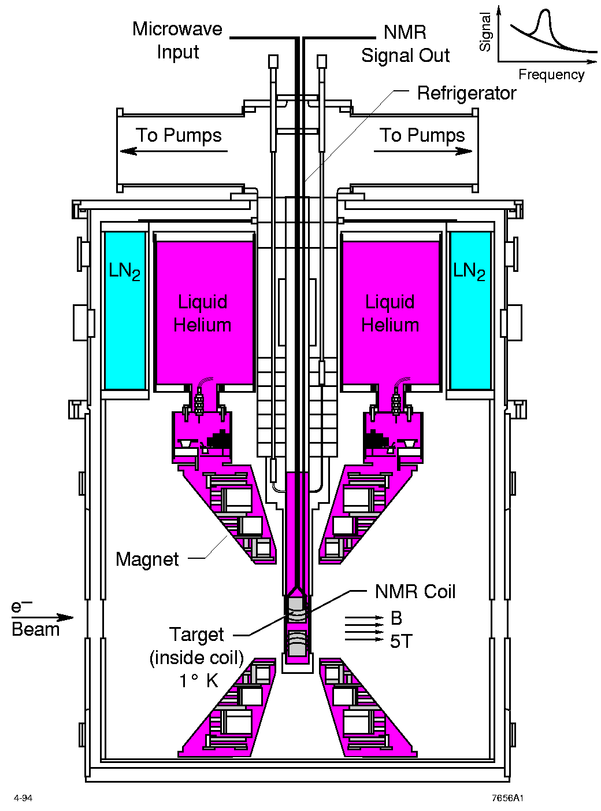
JLab Polarized proton/deuteron target
Polarized NH₃/ND₃ targets
Dynamical Nuclear Polarization
In-beam average polarization
70-90% for p
30-50% for d
Luminosity up to ~ 10³⁵ (Hall C)
~ 10³⁴ (Hall B)

Slide 14
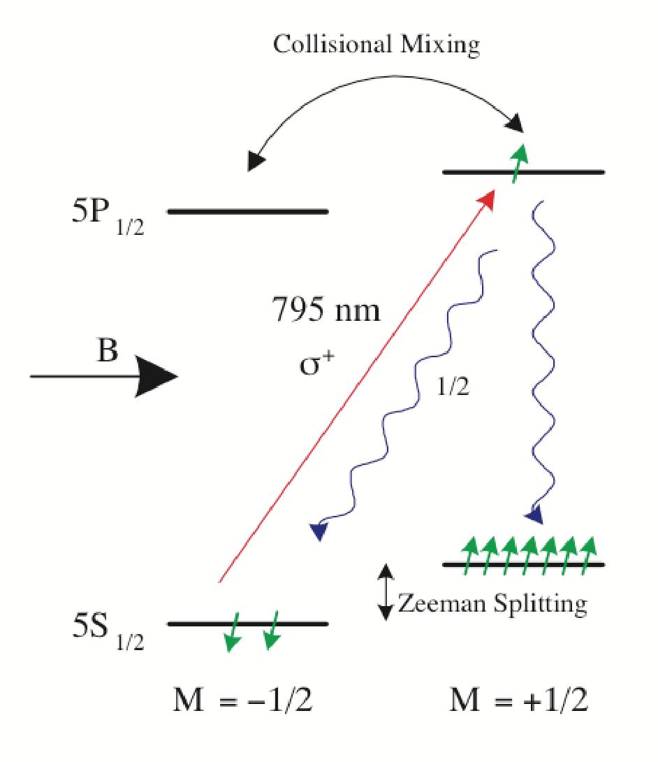
Spin exchange Optical Pumping for ³He
Rb
K
Rb
K
K
³He
K
³He

Slide 15
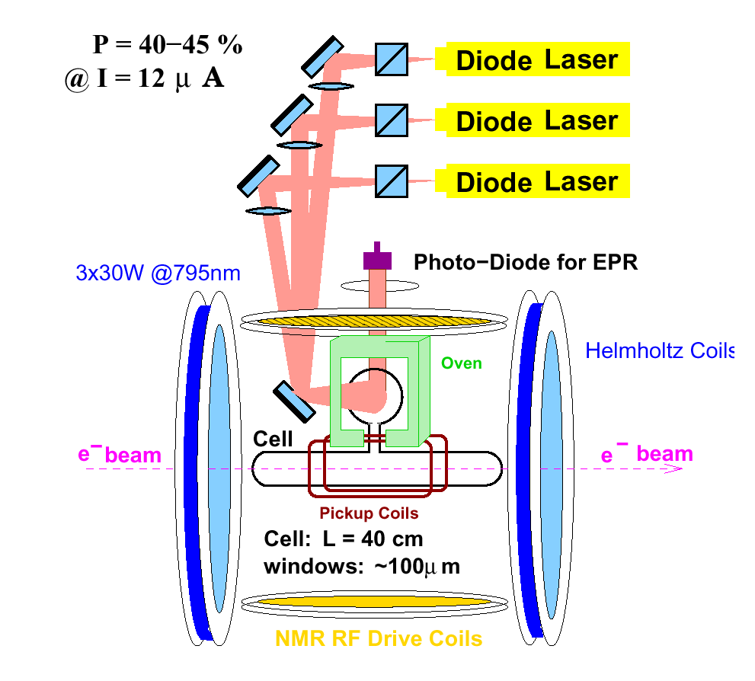
JLab polarized ³He target
longitudinal,
transverse and vertical
Luminosity=10³⁶ (1/s)
(highest in the world)
High in-beam polarization
~ 65%
Effective polarized
neutron target
13 completed experiments
6 approved with 12 GeV (A/C)
15 uA

Slide 16
Polarized 3He Target (JLab)
Spin-Exchange Optical Pumping

Slide 17
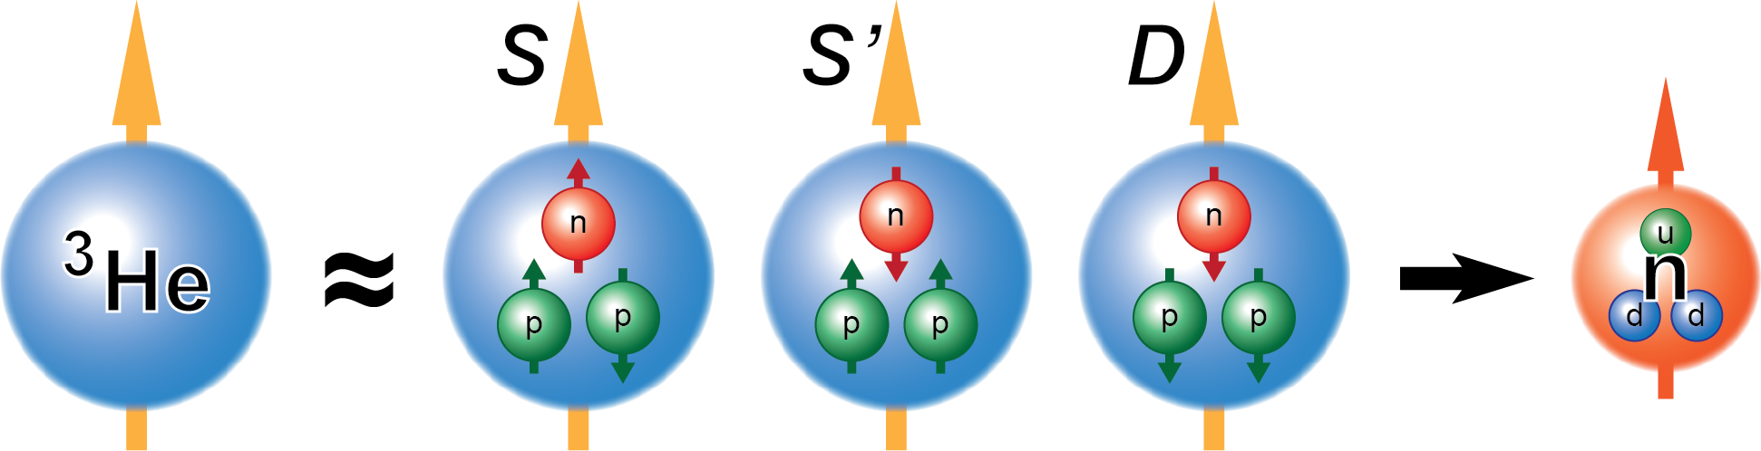
Why Polarized ³He Target ?
Both polarized proton and neutron targets are necessary in flavor separation of nucleon spin structure.
³He and Deuteron are two candidates for a neutron target.
Polarized 3He is a good effective polarized neutron target
An Effective Polarized Neutron Target!
~90% ~1.5% ~8%
Notes:
OK. now let’s see why we need a polarized 3He target.
First of all, the polarized targets bring us important information about nucleon spin structure, they can also help us precisely measure the nucleon form factors and of course many other physics
To understand the contributions of quarks of different flavor to the nucleon structure, it’s crucial to have data from both proton and neutron targets.
And for a polarized neutron target, polarized 3he and deuteron are two good options.
As we know for 3he nucleus, it has two protons and a signal neutron. The S state dominates the 3he wave function, which means that the two protons tend to form a pair with total spin equal to 0. Therefore most of the 3He spin is carried by the single neutron and that’s why we call polarized 3he a very good effective polarized neutron target!

Slide 18
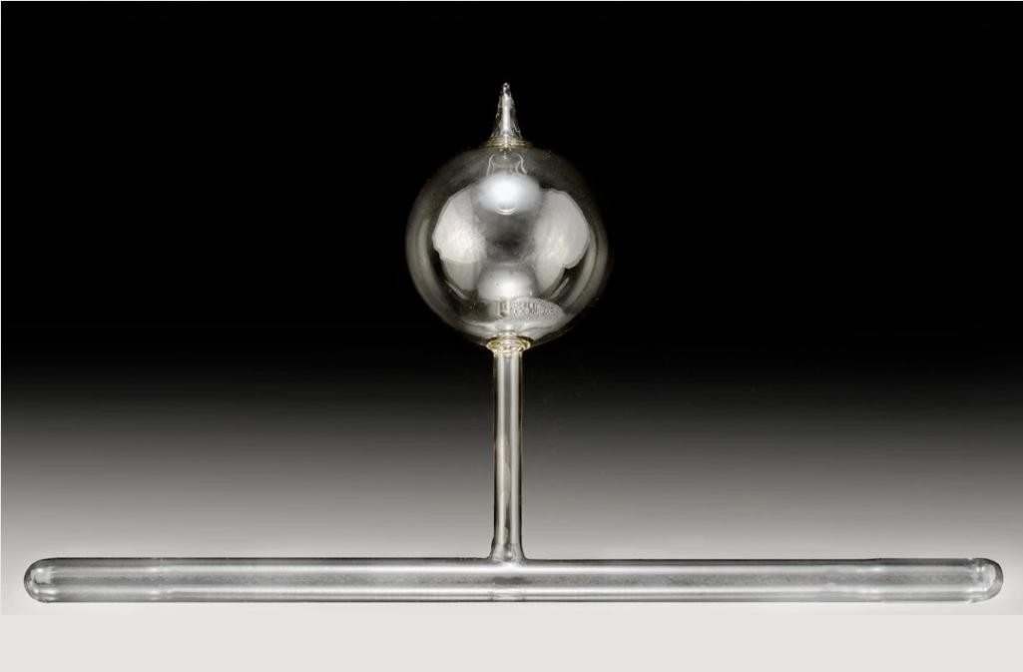
Polarized ³He Target in Jefferson Lab Hall A
Oven @ 230 ºC
Polarized Laser
795 nm
10 atm ³He
Some N₂, Rb, K
Φ = 3”
Pumping Chamber
25 G Holding Field
40 cm Target Chamber
10 atm ³He, Rb/K alkali mixture
Luminosity with 15 μA electron beam
  L(n) = 10³⁶ cm²/s
World Record
Notes:
Here is the picture of a 3He cell we use in Jefferson Lab. It has two parts. The Top part is the 3 inch spherical pumping chamber where the spin exchange optical pumping happens. The lower part is the 40 cm long target chamber where electron beam passes through.
The cell filled with 10 atm 3He, other than Rb and K, a little bit N2 is added as well to increase the optical pumping efficiency.
The pumping chamber is put in a oven and heated it up to 230 degrees to get enough amount of alkali vapor.
The whole target was put in a uniform 25 G magnetic field, and a circular polarized high power laser was shot to the pumping chamber.
The laser is 795 nm which is the wavelength of Rb D1 transition.
With this cell, we have so far taken up to 15 uA electron with a luminosity of 10 to the 36 nuclei per cm 2 per s. which is a world record!

Slide 19
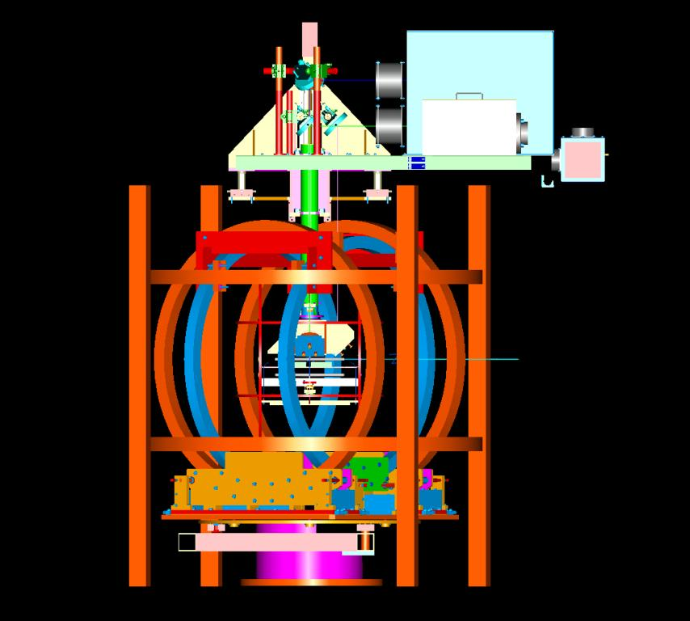
Polarized ³He Target Setup
Three sets of Helmholtz coils to provide polarization in 3-d

Slide 20
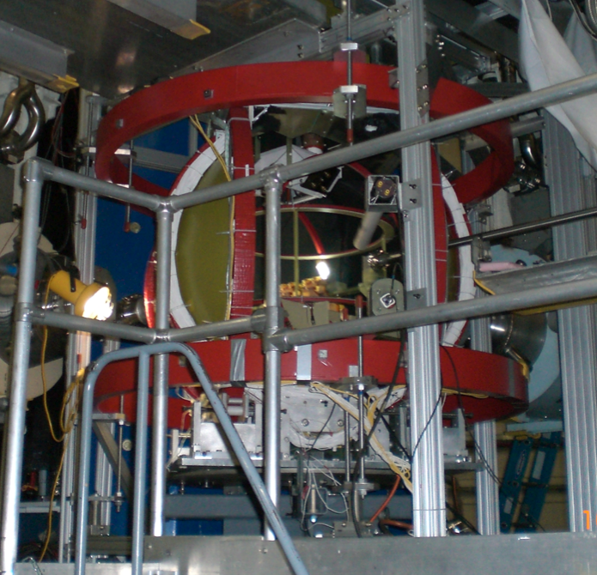
Polarized ³He Set-up in Hall A

Slide 21
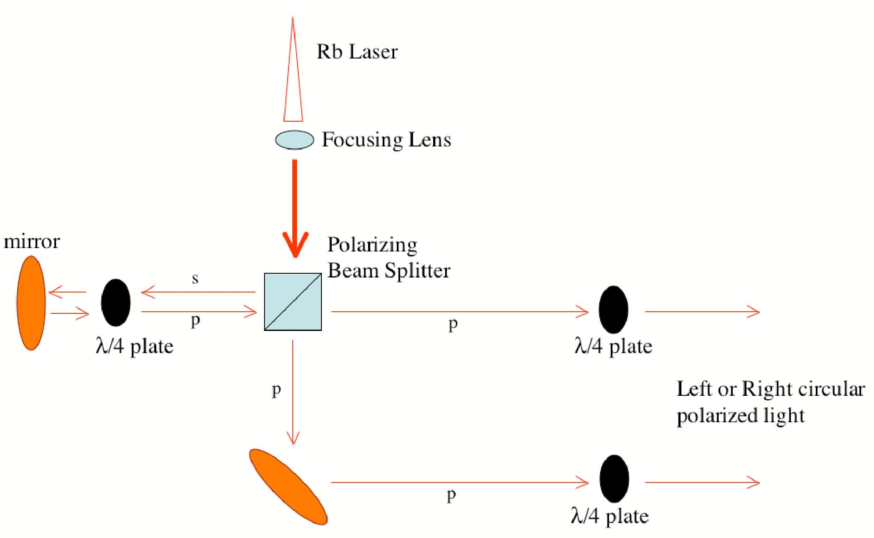
Laser Optics
Three-five 30 watts diode lasers per polarization direction
Local laser hut → long optical fiber to transport to the experimental hall
5-to-1 combiner
Recent improvement
narrow-width lasers

Slide 22
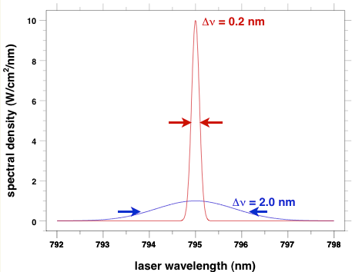
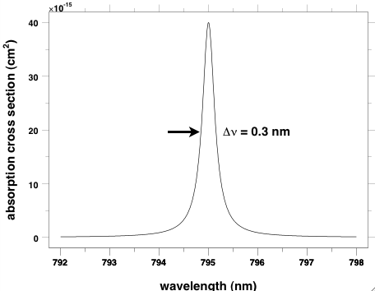
Narrow-width (Comet) Lasers
With new narrow-width (Comet) lasers, polarizations > 70%
Left: Blue is current lasers, Red is Comet laser
Right: Absorption spectrum of Rb

Slide 23
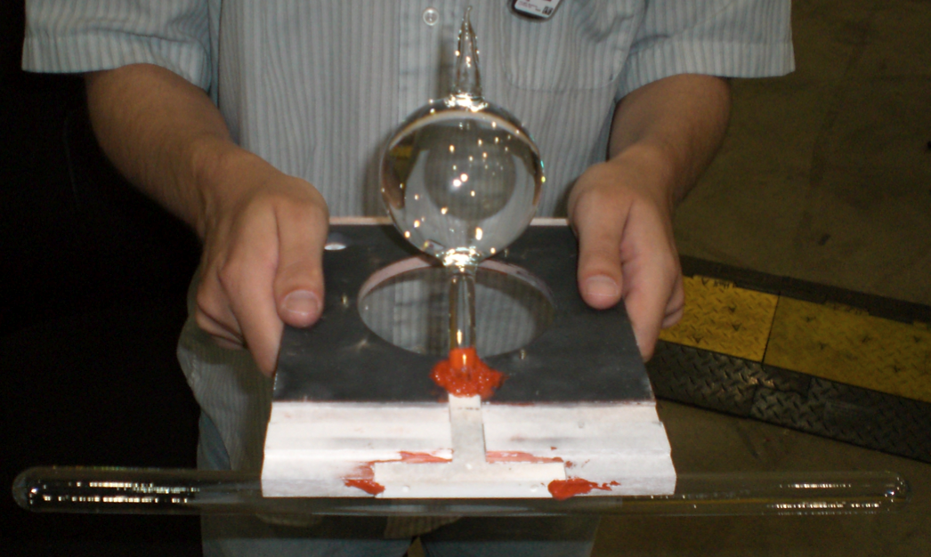
Target cell
Double-chamber
Pumping chamber for optical pumping
Target chamber (40 cm) for electron scattering
Future improvements

Slide 24
Polarimetry
Two methods: NMR and EPR, precision 2-3%
NMR (nuclear magnetic resonance)
  RF field
  AFP (adiabatic fast passage) sweep through resonance when
  target spin flips, induced signal through pickup coils
  both field sweep and RF sweep
  Needs calibration from a known (water calibration)
EPR (electron-paramagnetic resonance)
  Rb energy level splitting (D2 light) corresponding to main field +/- a small field due to 3He polarization
  Using AFP to flip ³He spin. Frequency difference of lights emitted proportional to ³He polarization
  No calibration needed
Cross checking with elastic asymmetry measurements

Slide 25


Helmholtz, RF and Pick-up coils
Pick-up
coils
Circular Polarized
Rb Laser
³He

Slide 26
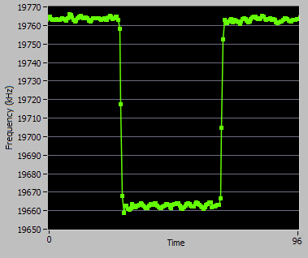
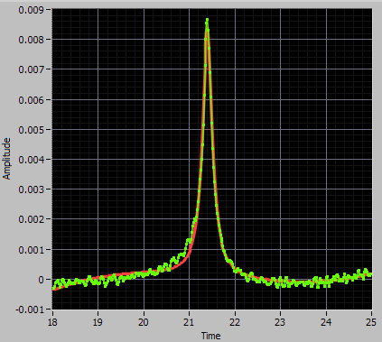
EPR and Water NMR
EPR
Water NMR

Slide 27
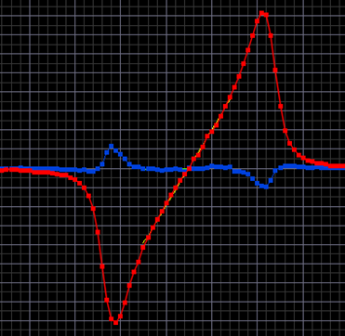
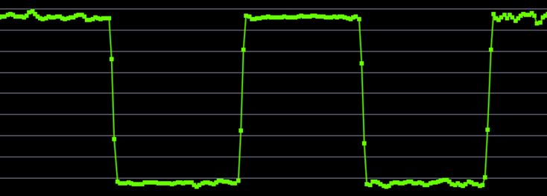
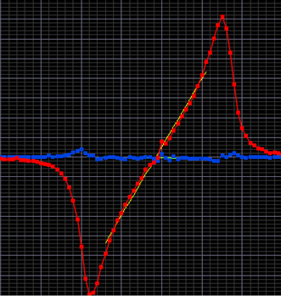
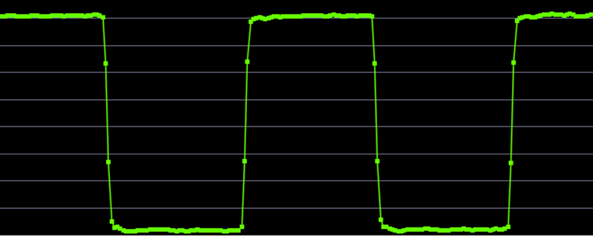
D1 EPR Signal
D1 signal: absorption of pumping laser
  Drops (more absorption) as alkali polarization drops.
  Many time stronger than D2 signal!
  Impossible to use for traditional FAP laser: too much background.
  Possible with COMET laser!
FM Sweep
EPR AFP
EPR Frequency
D1 Signal:
Absorption
D2 Signal:
Emission
RF Frequency

Slide 28
Fast Spin-Flip
Single target spin symmetry measurements requires fast spin flip to reduce spin-state-correlated systematic effects
Using AFP flip target spin every ~20 minutes
  Added bonus: free polarimetry with each flip!
Due to AFP loss, equilibrium polarization is ~5% (relative) lower
  depends on AFP loss, spin-up time and flip frequency
Can also be done with field rotation
  tested to flip every 1 minute with negligible loss

Slide 29
Progress with Polarized ³He
Initial polarized ³He, 40 years ago
ρ ~ 0.1 amg, P <1%
SLAC E142/E154 (1990s)
ρ ~ 10 amg, P~ 30%, L~ 10³⁵ cm⁻²s⁻¹
JLab (1998-2009)
ρ ~ 10 amg, P~65% in-beam, L ~ 10³⁶ cm⁻²s⁻¹
Future: improve luminosity to L ~ 10³⁷ cm⁻²s⁻¹

Slide 30
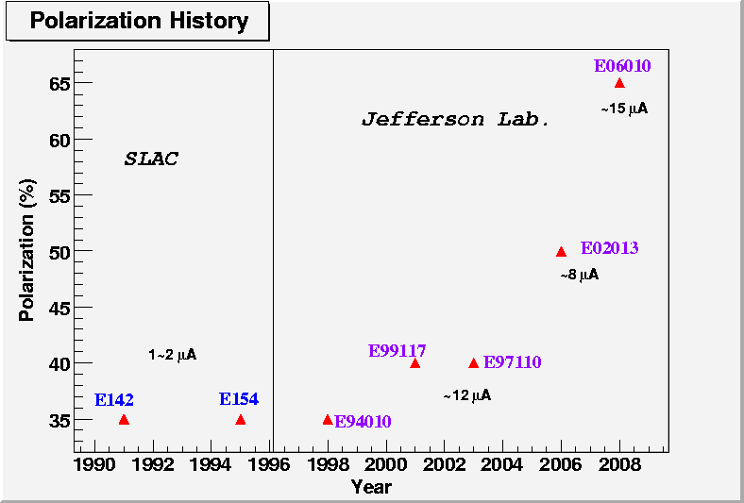
Polarized ³He Progress

Slide 31
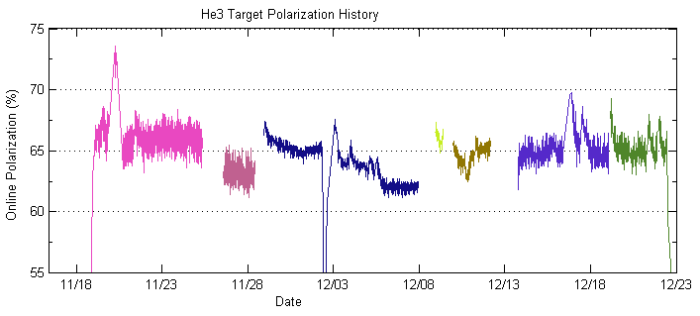
Target Performance During Transversity Experiment
Online preliminary EPR/NMR analysis shows a stable 65% polarization with 15 μA beam and 20 minute spin flip
Online Preliminary
Cell: Astral
Cell: Maureen

Slide 32
12 GeV Physics Program with Polarized ³He
Inclusive DIS:
A₁^{n}: Hall A with BB (approved)
Hall C with HMS+SHMS (conditionally approved)
d₂^{n} : Hall C with HMS+SHMS (approved)
Hall A with BB (deferred)
Proposed with 10³⁶ luminosity, can take advantage of higher L (10³⁷)
SIDIS:
Transversity with BB+Super BB: (conditionally approved), 10³⁷
Transversity with SOLID: (approved), 10³⁶
Spin-Flavor decomposition: BB+HRS (deferred) , 10³⁶
Exclusive:
G_{E}^{n} : Hall A with BB+SuperBB (approved), need 10³⁷
DVCS , need 10³⁷
Exclusive meson production

Slide 33
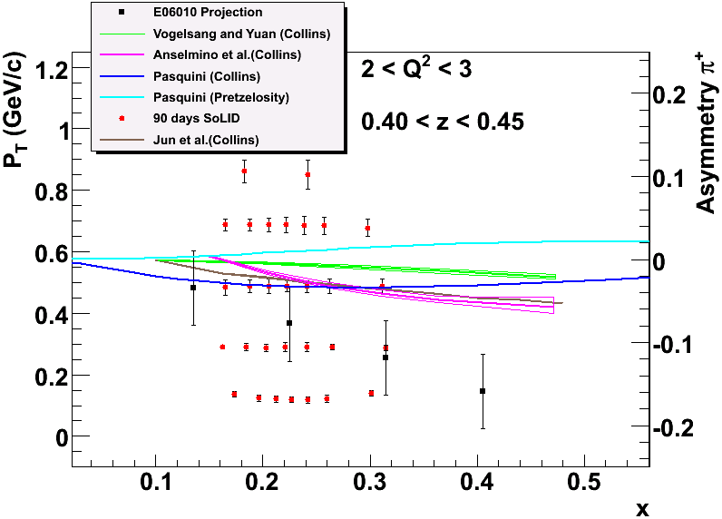
4-D Mapping of SSAs with 12 GeV SOLID
π+ and π-
One set of
z and Q² shown
Will cover
z (0.3-0.7)
Q² (1-8 GeV²)
Upgrade
PID for K+ and K-

Slide 34
How to Increase Luminosity for Polarized ³He
Increase beam current
Increase density (higher pressure or lower temperature)
Target chamber needs to take high current and high pressure
  Use metal or metal coating
  Keep gas flowing fast
Pumping chamber needs to take laser beam
  Still use glass
Separate pumping chamber from target chamber

Slide 35
Issues and R&D
How can we take high beam current?
  Depolarization effects
  Radiation effects
How to flow gas fast?
  What are the depolarization effects when flowing fast?
Will metal cell or metal coated cell work?
  Any issues related to metal cell or metal coated cell
  Will polarimeter(s) work? Pulsed NMR?
How to increase density?
  How high can we increase pressure?
  Will cooling work, what will be depolarization effects?
How to keep target chamber, pumping chamber and transfer tube in B field?
Other R&D projects associated with increasing luminosity?
Other issues: Laser power? ³He gas supply?

Slide 36
Polarized Solid (H/D) Targets
Nuclear Dynamic Polarization

Slide 37
Dynamic Polarized Solid Target
Production of a high polarization degree in a suitable material with a high content of polarizable nucleons and ‘free’ electrons (radicals) by means of
– high magnetic field (5 T)
– low temperature (1 K)
– microwave irradiation → (dynamic nuclear polarization (DNP))
– radiation hardness of the polarization
Polarization measurement
Nuclear magnetic resonance (NMR)

Slide 38
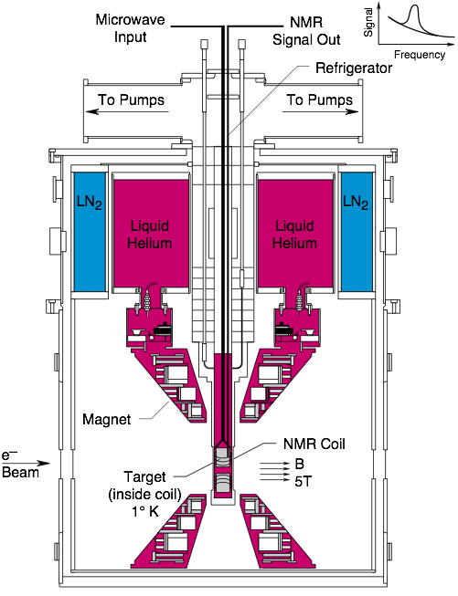
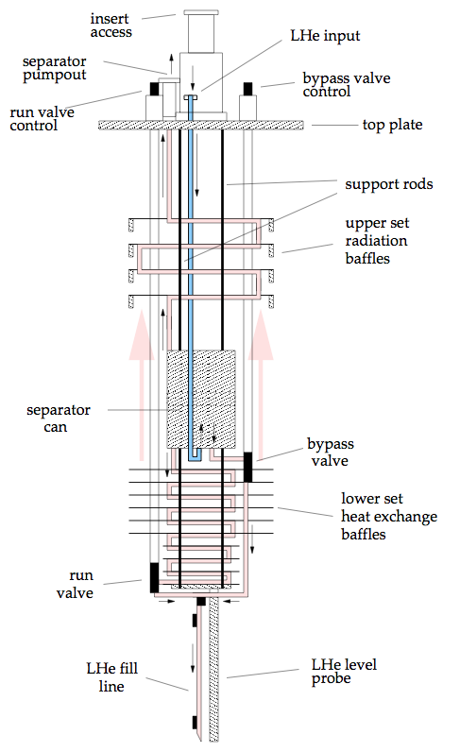
UVA/SLAC/JLAB Target

Slide 39
12 GeV High Luminosity Polarized p/d Experiments
No approved experiments in Hall A or Hall C yet
Active discussion and studies
Longitudinal polarization program:
  Deuteron Tensor Structure (Karl Slifer)
  Spin-flavor decomposition (Andrew Puckett)
Transverse polarization program:
  Transversity with SOLID?
  Need fast spin flip
  Other possibilities (Narbe Kalantarians)
Is it possible to increase luminosity significantly? How?
New user groups with younger generations?

Slide 40
Transverse Polarization for p/d
Physics program requires transverse polarization:
- g₂, transversity, …
JLab experiments with transversely polarized solid (p/d) targets:
- difficult in Hall B (CLAS)
- g₂p(d₂p) measurements in Hall C: SANE in 2009
- g₂p in Hall A: planned for 2011-2012
Future 12 GeV:
-CLAS12: HD target, low current (1 nA?)
- proton transversity with SOLID?
- other experiments?

Slide 41
Fast Spin Reversal for Polarized p/d Targets
Fast spin reversal
- field rotation takes too long (hours)
- AFP should be the way to go
short time
manageable loss
last study done 15 years ago, need more study

Slide 42
AFP for Polarized ⁷LiH
P, Hautle, et al., NIM A 356, 108 (1995)

Slide 43
AFP for Various Target Materials

Slide 44
Summary
Polarized targets critical for nucleon spin structure
Overview of polarized solid (p/d) and gaseous (³He) targets
Progress in polarized ³He targets
In-beam polarization: 30% → 65%
highest polarized luminosity: 10³⁶
3-d polarization direction, fast spin-flip
Future: 12 GeV program with polarized ³He
Improve luminosity by one order of magnitude
Issues and R&D needed in the next a few years
Polarized solid (p/d) targets
  DNP targets for high intensity beam, P~80 (40)%, luminosity up to 10³⁵
  Transverse polarization: Fast spin-flip, feasible with AFP, needs R&D
  Frozen Spin for low intensity beam, including HD (Hall B)
  New and younger user groups.

