Slide 1
SHMS Design Parameters and 12 GeV Experiments in Hall C Hall C Physics Investigations before the 12 GeV Upgrade Dave Gaskell August 7, 2009
1. Original SHMS design considerations
2. Present SHMS configuration
3. Hall C 12 GeV program and SHMS
4. SHMS improvements

Slide 2
Hall C Physics at 12 GeV
From Hall C pCDR, circa 2004:
Physics program envisioned for Hall C at 12 GeV builds on 6 GeV program
→ L-T separations
→ Meson electroproduction
→ Form factors
→ Inclusive reactions (esp. at x>1)
→ Color transparency
SHMS designed with these experiments in mind, but also flexible enough to handle physics/experiments we haven’t yet thought of.

Slide 3
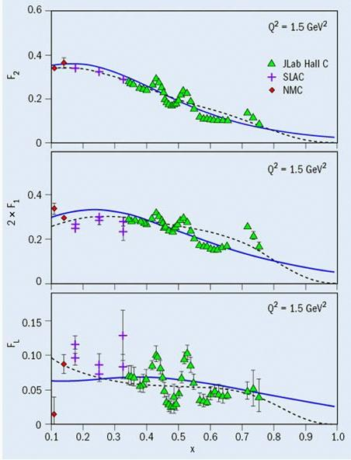
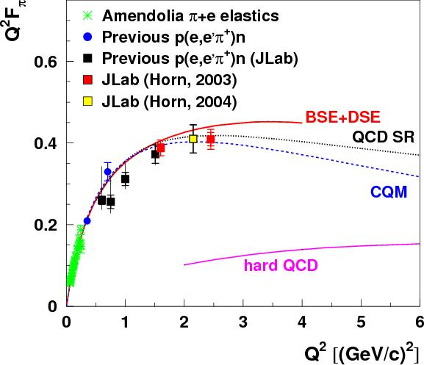
Hall C: A “Factory” for L-T Separations
Inclusive: H(e,e’)
Large program of L-T separations in Hall C at 6 GeV:
Inclusive H(e,e’), D(e,e’), A(e,e’)
Exclusive H(e,e’π⁺), D(e,e’π^{+/-}), A(e,e’π^{+/-}), H(e,e’K+), A(e,e’K+)
Exclusive: H(e,e’π⁺)n
F_{L} 2xF₁ F₂

Slide 4
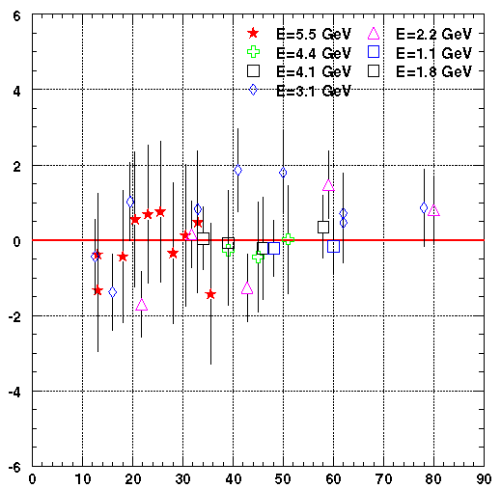
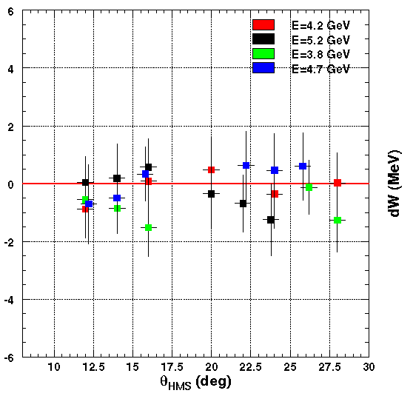
L-T separations
L-T separations require excellent knowledge of systematic uncertainties
acceptance, kinematics, efficiencies, etc.
SHMS parameters should be guided by excellent performance of HMS
1999
2003
July, 1999
July, 2003
ΔW_{elastic}
Position of elastic peak stable to <1 MeV over many years
ΔW (MeV)
ΔW (MeV)
Θ_{HMS} (degree)
Θ_{HMS} (degree)
HMS pointing stable and reproducible

Slide 5
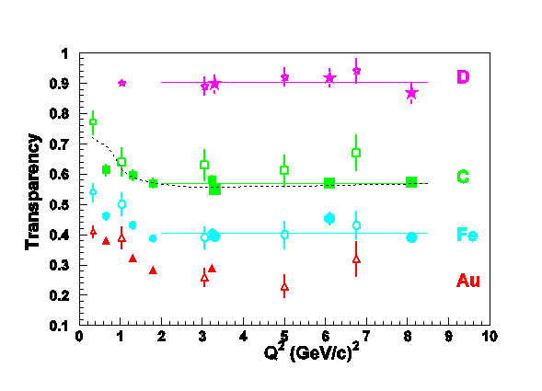
Color Transparency
Studies of color transparency in (e,e’p) required large momentum reach
(> 5 GeV/c) and high luminosity capability

Slide 6
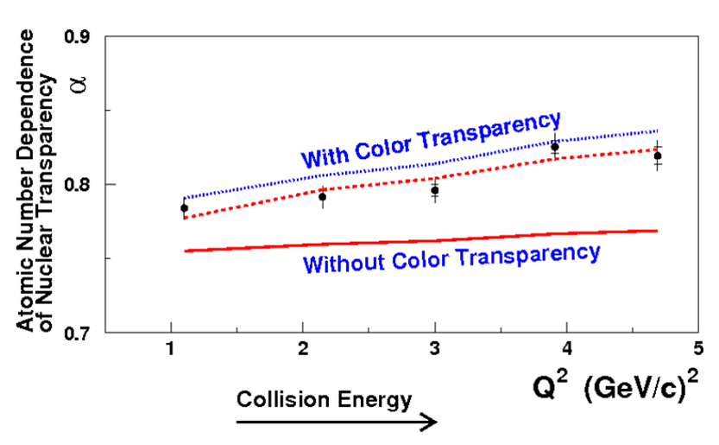
Color Transparency
Studies of color transparency in (e,e’p) required large momentum reach (> 5 GeV/c) and high luminosity capability
Can also be studied using (e,e’π)
→ requires good hadron ID to high momentum

Slide 7
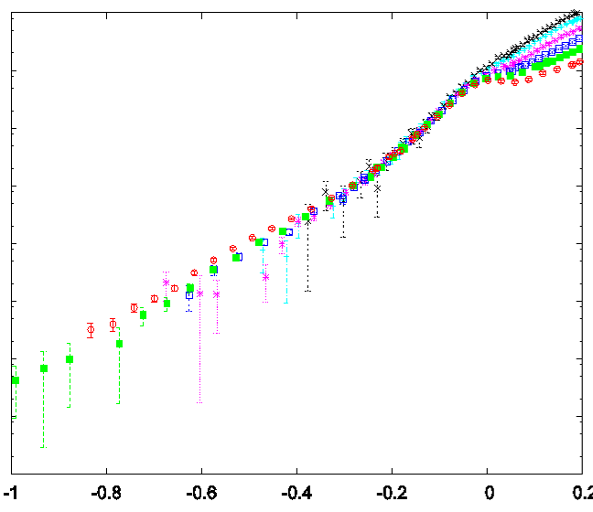
x>1
³He
Inclusive (single arm) electron scattering at x>1
F(y)
y
Requires spectrometer with momentum acceptance up to ~ available beam energy
Excellent pion suppression, at large x signal quite small

Slide 8
SHMS Design Requirements
Excellent particle ID for hadrons and electrons at high energies
proton/kaon/pion separation at positive polarity
electron/pion ID/separation at negative polarity
Allow rapid, reproducible configuration changes (momentum and angle) for L-T separations
Acceptance understood at level comparable to HMS
→ Flat momentum, target acceptances
Adequate kinematic coverage for both single arm and coincidence physics of interest → small angles, high momentum
Flexible detector stack for installation of special use detectors (FPP for G_{Ep})

Slide 9
Original SHMS Design
Parameter | Specification
Central mom. range | 2.5-11 GeV/c
Angle range | 5.5-25 degrees
Horizontal acceptance | +/- 18 mrad
Vertical acceptance | +/- 50 mrad
δ acceptance | -15% to +25%
Solid angle | 2 msr (SSA) 4 msr (LSA)
e/h Discrimination | 1000:1 (98% eff.)
π/K Discrimination | 100:1 (95% eff.)

Slide 10
Original SHMS Design
SHMS had 2 “tunes”
Small solid angle (SSA)
Quads pushed back to achieve smallest central angle (5.5 degrees): solid angle 2 msr
Large solid angle (LSA)
Quads pushed forward to increase solid angle to 4 msr
Minimum angle = 10 degrees
Quads would be mounted on a rigid “slider” to switch between the two modes

Slide 11
Original SHMS Design
Original magnet layout used QQ(QD) design
Q1/Q2 like HMS Q1
QD = combined function magnet to save space
→QD magnet somewhat exotic, but posed only modest risk

Slide 12
SHMS Design Updates
In 2005, work was already underway to see if the combined function (QD) magnet, could be replaced with a more conventional Q-D configuration
Results looked promising: resolution, acceptance still adequate
At the same time, there was a very first look at using a pre-bender (septum, splitter, …) before the 1st quad
Advantages: single tune, larger solid angle, spectrometer further from beamline
January 2006, a meeting was held to examine the JLab physics reach in the event that only the SHMS or MAD (Hall A) could be built
→ One of the outcomes of that meeting was the suggestion that the bender option be pursued in order to increase the solid angle acceptance of SHMS

Slide 13
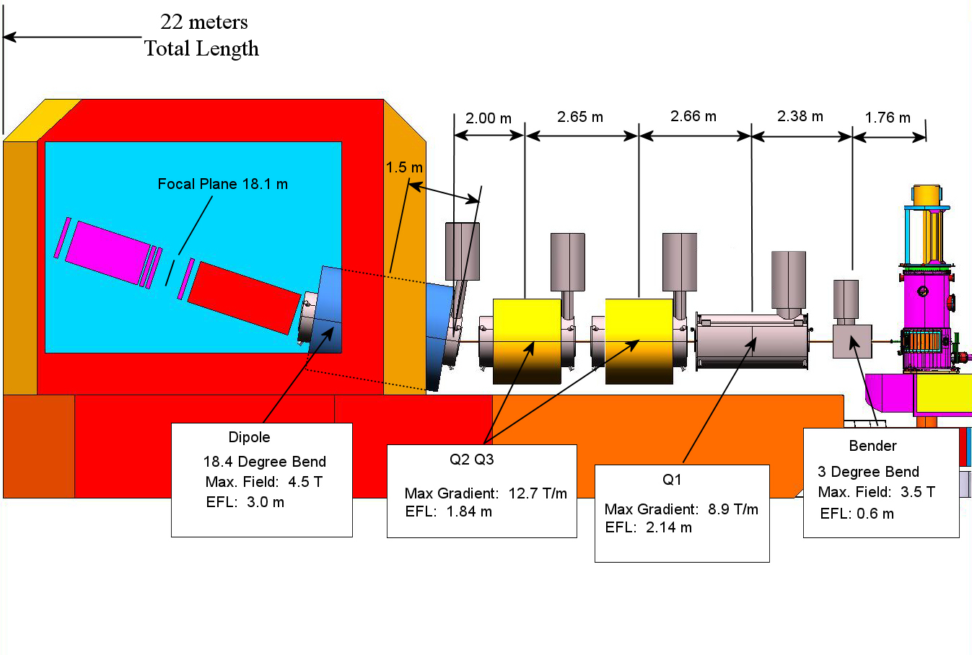
SHMS Design: 2009

Slide 14
SHMS Design: 2009
Parameter | 2004 Specification | 2009 Specification
Central mom. range | 2.5-11 GeV/c | 2.0-11 GeV/c
Angle range | 5.5 to 25 degrees | 5.5 to 40 degrees
Horizontal acceptance | +/- 18 mrad | +/-24 mrad
Vertical acceptance | +/- 50 mrad | +/- 55 mrad
δ acceptance | -15% to +25% | -10% to +22%
Solid angle | 2 msr (SSA) 4 msr (LSA) | 5.0 msr
e/h Discrimination | 1000:1 (98% eff.) | 1000:1 (98% eff.)
π/K Discrimination | 100:1 (95% eff.) | 100:1 (95% eff.)

Slide 15
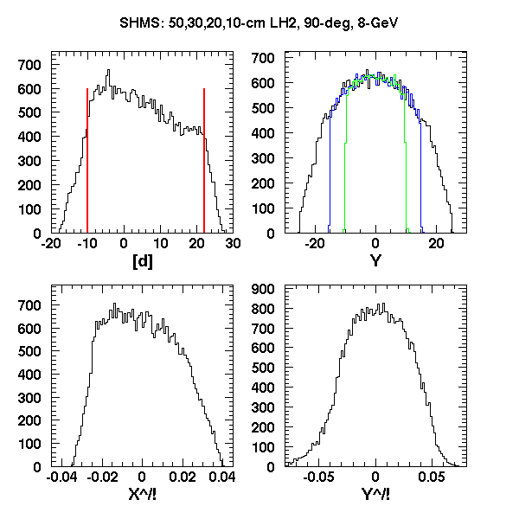
SHMS Acceptance
SHMS - pCDR
SHMS - 2009

Slide 16
Detector Stack
Horizontal drift chambers
Atmospheric Cerenkov for low signal:noise situations (x>1)
Heavy gas Cerenkov for π/K separation
Aerogel for π/K,K/p separation → de-scoped
Scintillator/quartz hodoscope for triggering
TRD for electron detection → de-scoped
Lead glass calorimeter

Slide 17
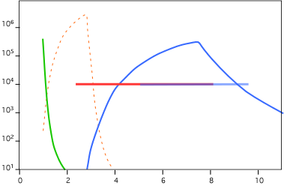
Particle ID Capabilities
At positive polarity, π:(K,p) separation from:
Heavy gas cerenkov for
p>3.4 Gev/c
Aerogel detector (de-scoped) for
lower momenta
HG Cerenkov
TOF
Aerogel
Cerenkov
(not in project but space reserved)
Discrimination Power
Experiment Needs
Momentum (GeV/c)
At negative polarity, e:π separation from combination of Noble gas Cerenkov (50:1) and Pb:Glass calorimeter (>200:1)

Slide 18
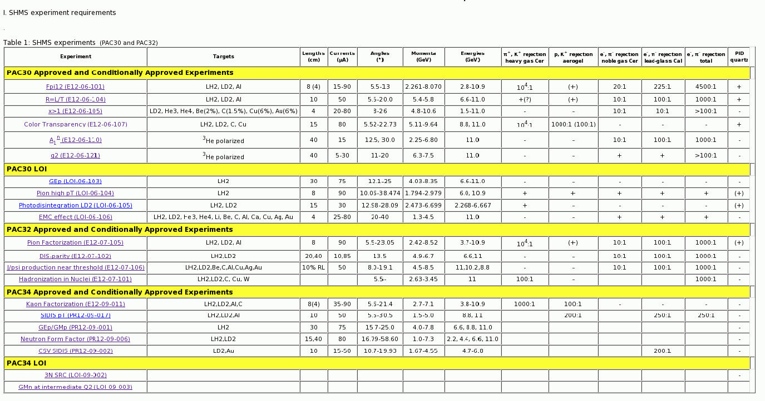
Approved Hall C Experiments
http://www.jlab.org/~hornt/HALLC_12GEV/shms_experiments_pid.html
List of LOIs, Approved, and Conditionally Approved experiments in Hall C
(compiled by Tanja Horn)
→ includes range of momenta and angles and PID requirements

Slide 19
SHMS requirements overview
Approved (or conditionally) experiments so far
Kinematics
Momentum range: 1.5 GeV/c (SIDIS P_{T}) to 10.6 GeV/c (x>1)
Angular range: 5.5 degrees (several) to 30 degrees (A₁^{n}, SIDIS P_{T})
Particle ID
Negative polarity
→ e/π discrimination: >10² (g₂ from ³He) to 5 10³ (x>1, F_{π}-3)
Positive polarity
→ π/K discrimination from 10² (Hadronization) to 10⁴ (F_{π}-3,Pion Factorization, …)
→ K/p separation from 10² (Kaon Factorization) to 10³ (Color Transparency)

Slide 20
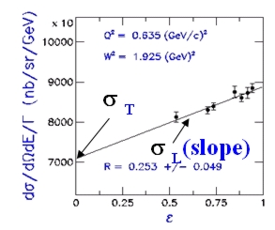
Rosenbluth Separation Experiments
4 L-T separation experiments approved so far
E12-06-101: Measurement of the Charged Pion Form Factor to High Q² (Huber, Gaskell)
E12-06-104: Measurement of the Ratio R = σ_{L}/σ_{T} in Semi-Inclusive DIS (Bosted, Ent, Mkrtchyan)
E12-07-105: Scaling Study of the L-T Separated Pion Electroproduction Cross-Section at 11 GeV (Horn, Huber)
4. E12-09-011:Studies of the L-T Separated Kaon Electroproduction Cross Section from 5-11 GeV (Horn, Huber, Markowitz)

Slide 21
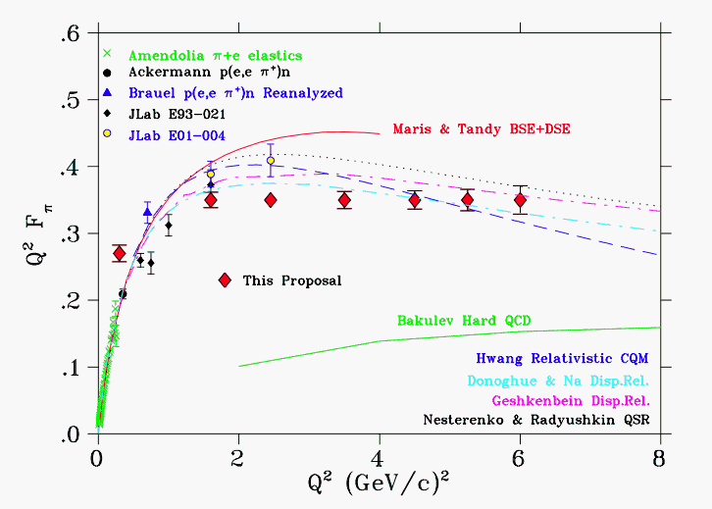
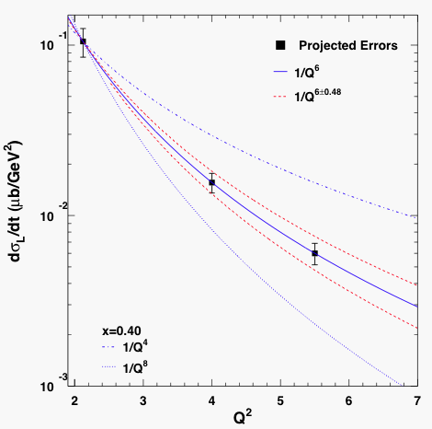
Rosenbluth Separations
F_{π} – measure σ_{L} to extract pion charged form factor, look for beginning of transition to asymptotic regime?
Scaling studies in pion/kaon electroproduction → will examine Q² dependence of σ_{L} (size of σ_{L}/σ_{T})
→ critical test of factorization, highly relevant to 12 GeV GPD program

Slide 22
σ_{L} Uncertainties

Slide 23
SHMS and L-T Separations
Control of systematic errors crucial
SHMS designed with this in mind:
Rigid carriage, attached to pivot → kinematics, pointing reproducible
QQQD optics solid angle defining w/collimator → good resolution, flat acceptance
“Clean” trigger to understand tracking efficiencies

Slide 24
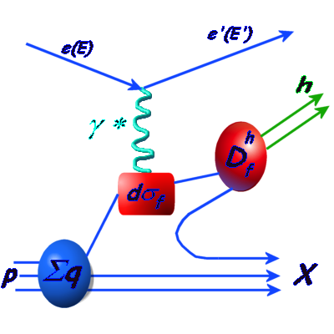
Semi-inclusive Measurements
E12-06-104: Measurement of the Ratio R = σ_{L}/σ_{T} in Semi-Inclusive DIS (Bosted, Ent, Mkrtchyan)
E12-07-101: Hadronization in Nuclei by Deep Inelastic Electron Scattering (Norum, Wang, Chen, Lu)
3. PR12-09-017: Transverse Momentum Dependence of Semi-inclusive Pion Production (Bosted, Ent, Mkrtchyan)
4. PR12-09-102: Precise Measurement of π⁻/π⁺ Ratios in Semi–inclusive Deep Inelastic Scattering: Charge Symmetry Violating Quark Distributions (Hafidi, Dutta, Gaskell)
R=σ_{L}/σ_{T} in semi-inclusive DIS will test assumptions regarding equivalence of R in semi-inclusive and inclusive DIS → precision goal is relatively modest, but R is small, so systematic error control still important
→ Has important implications for extraction of polarized, unpolarized PDFs

Slide 25
Semi-inclusive Measurements
2 experiments will make precise measurements of charged pion ratios (Y_{π+}/Y_{π-})
Place constraints on charge symmetry violating quark distributions
Measure P_{T} dependence of yield ratio to gain access to intrinsic k_{T} of quarks
Want to measure yield ratio at 1% level – only possible with magnetic spectrometers → identical acceptance for both polarities
(μ₊)² ~ width of D⁺(z,p_{t}), (μ₋)² ~ width of D⁻(z,p_{t}),
(μ_{u})² ~ width of u(x,k_{t}), (μ_{d})² ~ width of d(x,k_{t})

Slide 26
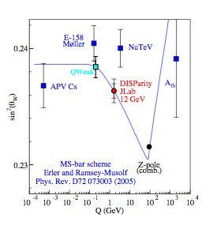
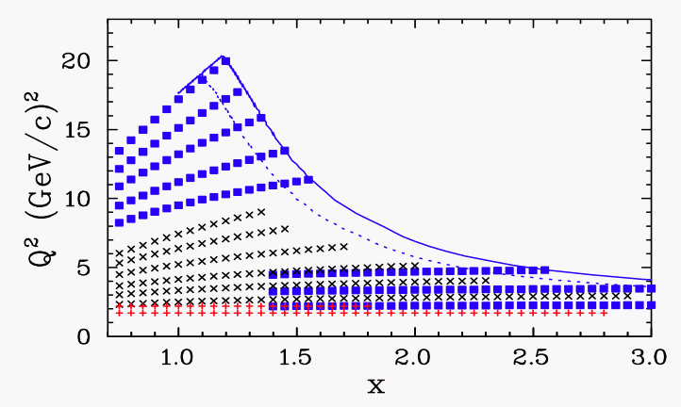
Inclusive Measurements
E12-06-105: Inclusive Scattering from Nuclei at x > 1 in the quasielastic and deeply inelastic regimes (Arrington, Day)
E12-06-110: Measurement of Neutron Spin Asymmetry A₁^{n} in the Valence Quark Region using an 11 GeV Beam and a Polarized ³He Target in Hall C (Chen, Zheng, Meziani, Cates)
3. E12-06-121: A Path to “Color Polarizabilities” in the Neutron: A Precision Measurement of the Neutron g₂ and d₂ at High Q² in Hall C (Korsch, Meziani, Sawatzky, Averett)
4. E12-07-102: Precision Measurement of the Parity-Violating Asymmetry in Deep Inelastic Scattering oﬀ Deuterium using Baseline 12 GeV Equipment in Hall C (Reimer, Paschke, Zheng)
x>1 kinematics
HMS
SHMS

Slide 27
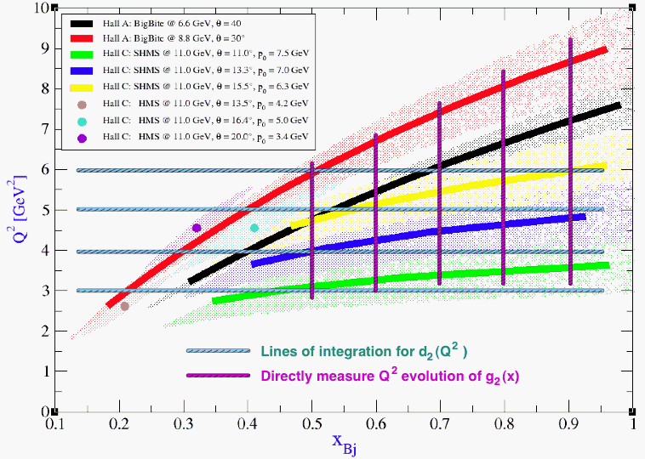
SHMS and polarized ³He
Polarized ³He targets must be long (40 cm) to overcome relatively low density
→ large Y_{target} acceptance of SHMS (30 cm at 90 degrees) a bonus for these kinds of measurements
SHMS Y_{target}
E12-06-121: Measurements of g₂ and d₂
HMS/SHMS provides flat Q² coverage for x=0.4 to 1 → well suited for extracting d₂(Q²)

Slide 28
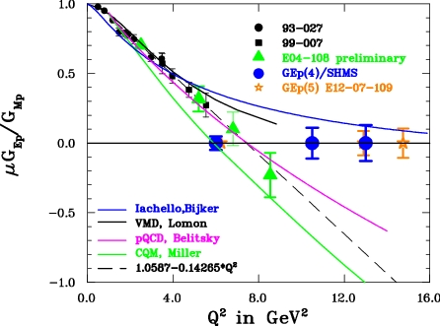
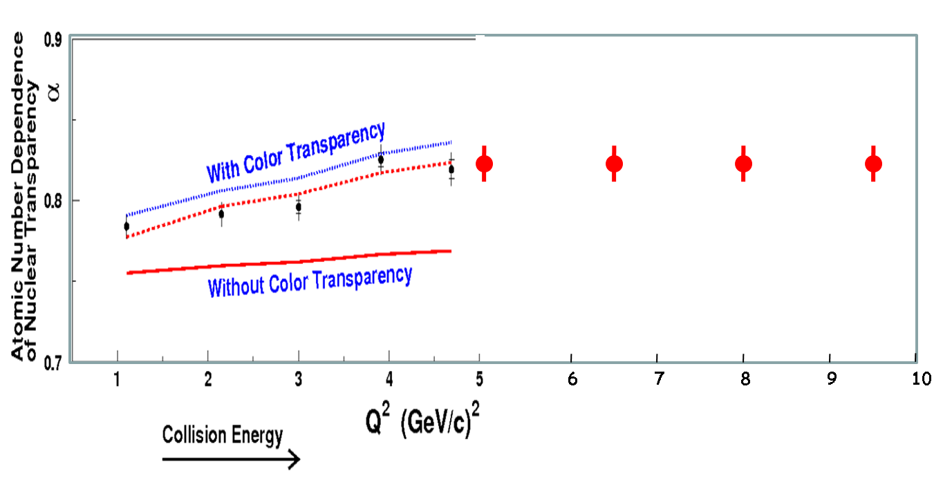
Form Factors, nuclei
E12-09-001: G_{Ep}/G_{Mp} with an 11 GeV electron beam (Brash, Jones, Punjabi, Perdrisat)
E12-09-006:The Neutron Electric Form Factor at Q2 up to 7 (GeV/c)² from the Reaction ²H(\vec{e}, e′\vec{n})¹H via Recoil Polarimetry (Anderson, Arrington, Kowalski, Madey, Plaster, Semenov)
3. E12-07-106:The A-Dependence of J/ψ Photoproduction Near Threshold (Bosted, Chudakov, Dunne)
4. E12-06-107: The Search for Color Transparency at 12 GeV (Ent, Dutta)
A(e,e’π⁺)

Slide 29
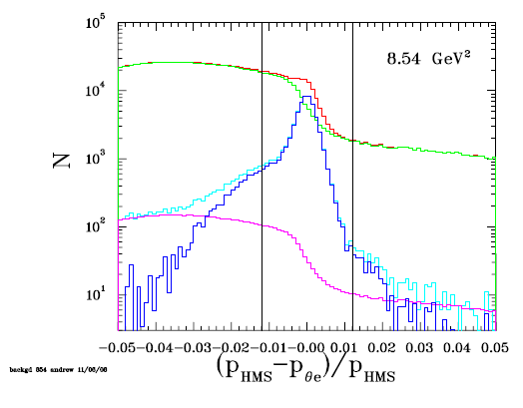
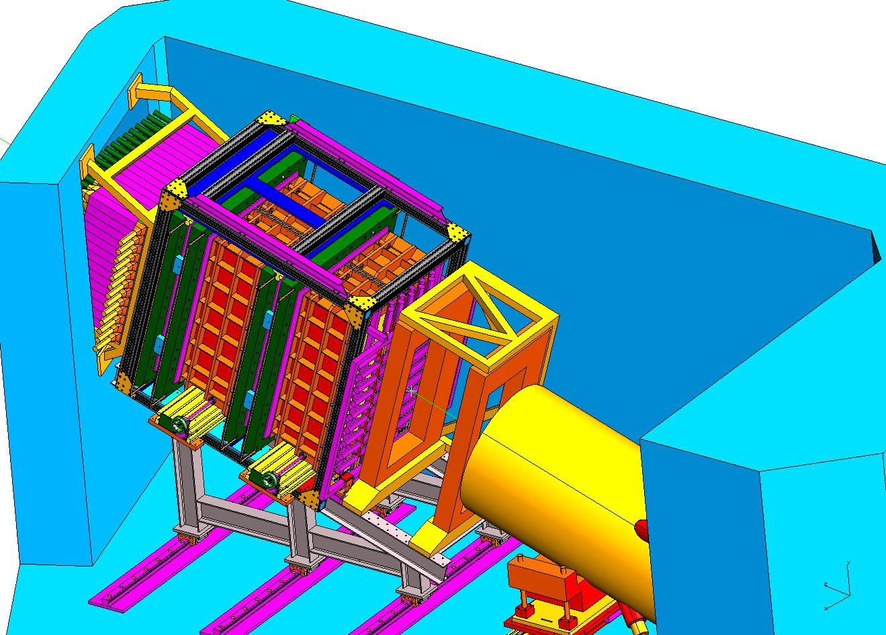
SHMS for GEp - Resolution and FPP
As Q² increases – backgrounds grow and resolution becomes increasingly important
Detector stack design able to accommodate FPP - an important consideration in earliest design decisions

Slide 30
Tracking in the SHMS (and HMS)
Precision cross section experiments (both 6 and 12 GeV) require accurate knowledge of tracking efficiency
At MHz rates, efficiency drops below 95%
Difficult to verify that tracking efficiency calculated accurately
Even more difficult for hadrons: hodoscope cuts used to define “good” events susceptible to “junk” hits
T. Horn, PhD thesis
Solutions(?):
→ Tracking detectors with slower rate drop-off (GEMs)
→ Segmented “hadron” detector to help determine clean sample of triggers

Slide 31
Kaons in the SHMS
SHMS aerogel was de-scoped from 12 GeV project
At least 2 experiments require an aerogel detector to accomplish their main physics goals
E12-06-107 (Color Transparency) → kaons must be rejected from proton sample
E12-09-011 (Kaon Factorization) → protons must be rejected from kaon sample
Other semi-inclusive experiments would benefit from kaon detection → primary emphasis usually on pions, but kaons come for “free”
Alternate kaon detection scheme using dE/dx in drift chambers suggested by H. Mkrtchyan (see G. Huber talk, Jan. 2009), but this requires new electronics
A couple requests for funding to build aerogel detectors → coordinated for maximum efficiency?

Slide 32
Negative Pion Detection
When detecting negative pions in SHMS, electron singles rates can be quite high
Electron signal in Cerenkov (not correlated with track or trigger) can “block” pions
For 100 to 150 ns Cerenkov window, 7.5% probability for electron to block pion
Previously, no option but to apply this as an estimated correction with little cross check
SHMS fly’s-eye calorimeter will help correlate electron hit with track
Segmented hadron detector would also be useful in this case

Slide 33
Conclusions
SHMS design parameters well chosen for Hall C 12 GeV program
Design based on flexibility and excellent performance of HMS
Improvements after pre-CDR version have been fairly dramatic → twice the central angle range, larger solid angle at ALL central angles
Approved program so far has pretty much “saturated” the SHMS’ capabilities, utilizing full momentum and angle range*, PID capabilities
Potential (or needed) improvements
Kaon detection scheme (in progress, but coordinated?)
Segmented hadron detection for high rate tracking, Cerenkov-blocking correction checks

Slide 34
Acknowledgements
Slides and figures “borrowed” from
Howard Fenker
Tanja Horn
Rolf Ent
Hall C Engineers and designers
Everyone who wrote 12 GeV proposals

