Slide 1
High Precision Hypernuclear Spectroscopy at JLab
Lulin Yuan / Hampton University
For HKS-HES collaboration
Hall C Summer meeting, August 7, 2009
Notes:
Talk about Jeff. Lab HKS. exp., a high precision hyper. Spec. exp for hyper. From l.p. to mid-heavy systems.
I will first give a overview the mot., show the exp. Setup and talk about the calibration of the spectrometer system, which is a crucial step in data anal. In order to obtain high energy resolution. I will show the current pre. Spec.

Slide 2
Physics Goals
JLab HKS experiment: High precision hypernuclear spectroscopy by electroproduction in a wide mass range
  Electroproduction: ^{A}Z + e → ^{A}_{Λ}(Z-1) + e’+ K⁺
~400 keV energy resolution achievable by utilizing high precision electron beam
Hypernuclear Spectroscopy: Probe hyperon-nucleon(YN) effective interaction inside medium
Resolve fine level structures in hypernuclear spectra beyond p-shell. Precise binding energy determination in a wide mass range
Possibly resolve spin-doublet splittings
Parameters to determine EOS of dense hadronic matter from study of heavy hypernuclear system– interior of neutron star
Produce and study of exotic (highly neutron rich) hypernuclei - ⁷_{Λ}He
Notes:
HKS aims to obtain …(EM)
targets we are using including Li7, and C12. And Si. By Electroproduction is complementary to hadronic rec.. It can produce high-spin…states of B12L from C12. We produce neutron He7L. We use Si28 above p-shell in the sd shell region to obtain first high resolution beyond p-shell.

Slide 3
Hypernuclear Experiments: Overview
Three approved experiments in Hall C:
HNSS: Completed in 2000. ¹²_{Λ}B
HKS (E01-011): Completed in 2005. ¹²_{Λ}B, ²⁸_{Λ}Al, ⁷_{Λ}He
HES (E05-115): Scheduled Aug. to Oct., 2009. ⁴⁰_{Λ}K, ⁵²_{Λ}V, etc
Goals of experimental design:
Increase hypernuclear yield: detect e’ at very forward angle with a on-target splitter magnet
Good energy resolution
HKS Spectrometer System
To beam dump
Virtual photon flux factor Γ
HKS
Enge
Flux Factor (/e/MeV/sr)/
K
Bremsstralung flux
e’
Splitter
Target
e
Beam
Scattering Angle (mr)

Slide 4
HNSS: First hypernuclear Experiment at JLab
Splitter
SOS Spectrometer(QDD)
Electron Beam
K⁺
1.2GeV/c
_
Q
1.864 GeV
D
D
Local Beam Dump
e’
Target
Enge
e’:0.3GeV/c
Split-Pole
( SSD + Hodoscope )
Beam Dump
0
1m
K arm: existing Hall C SOS
E arm: Enge split-pole magnet. e’ angle acceptance: 0-3 degree
e’ momentum reconstructed from the 1-D X position along momentum spreading plane on Enge focal plane by a Silicon Strip Detector (SSD) array

Slide 5
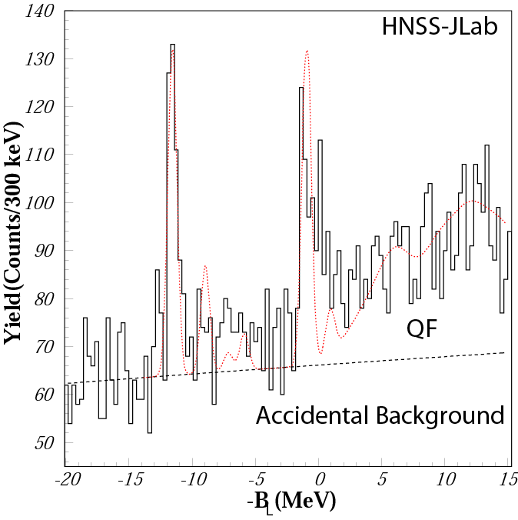
¹²C(e,e’K⁺)¹²_{Λ}B From HNSS (E89-009)
Resolution: 720 keV FWHM
Dominant contribution to the resolution: SOS momentum resolution ~600 keV
Needed improvements:
Spectrometer resolution
Reduce background from Bremsstrhlung electrons which limited beam current
¹¹B(gs)×Λ(0s)
¹¹B(gs)×Λ(0p)

Slide 6
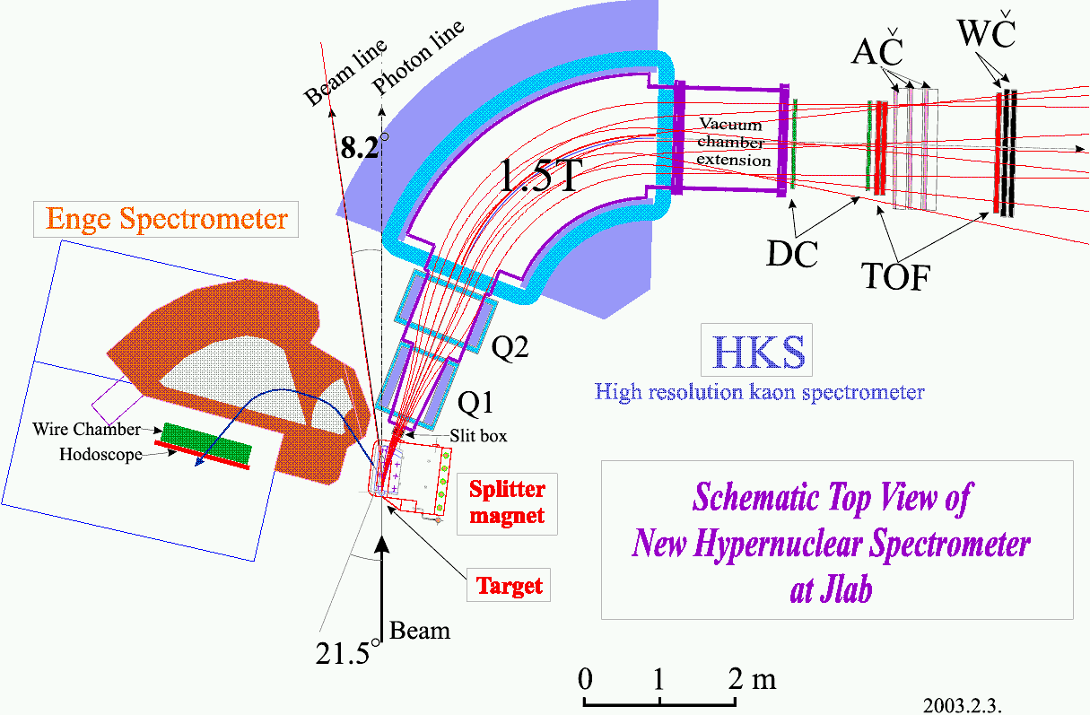
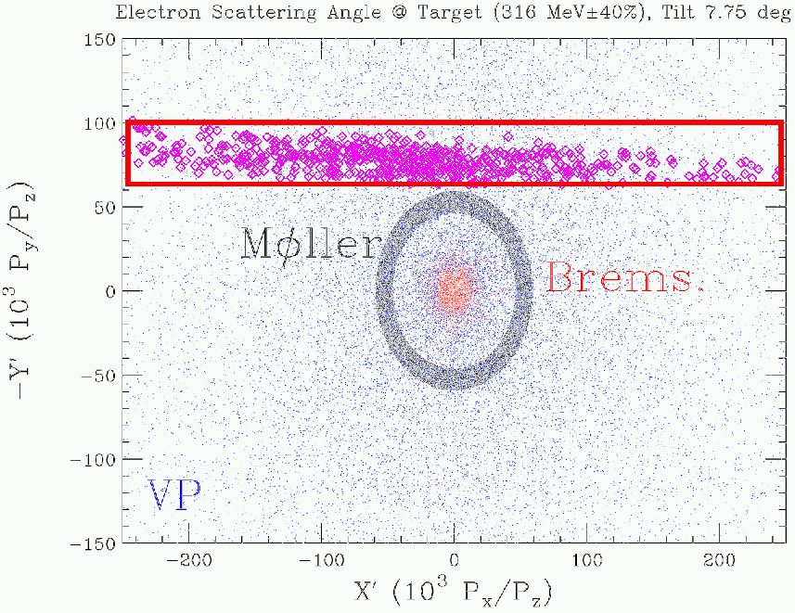
The HKS Experiment
  K arm: Replace SOS by a large acceptance, high resolution HKS
  Vertically tilt electron spectrometer to block bremsstrhlung electrons
  Expected yield: 25 Times of HNSS for gs of ¹²_{Λ}B
Notes:
The goal of the exp. Design is to increasing hyp yield and reduce
accidental background. Because the vpf and hyp cro peaked
at 0 degree, a splitter dipole magnet is placed on target bebore both arm spectrometers to
separate (e’: 4.3, K: 6.9)(EM) from very….The Enge
is vertially tilt to avoid
the high rate e’, at 0 degree.

Slide 7
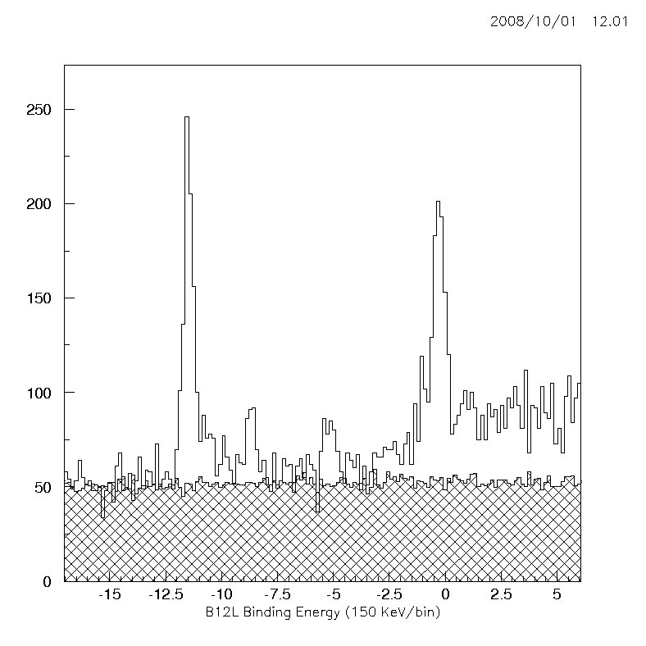
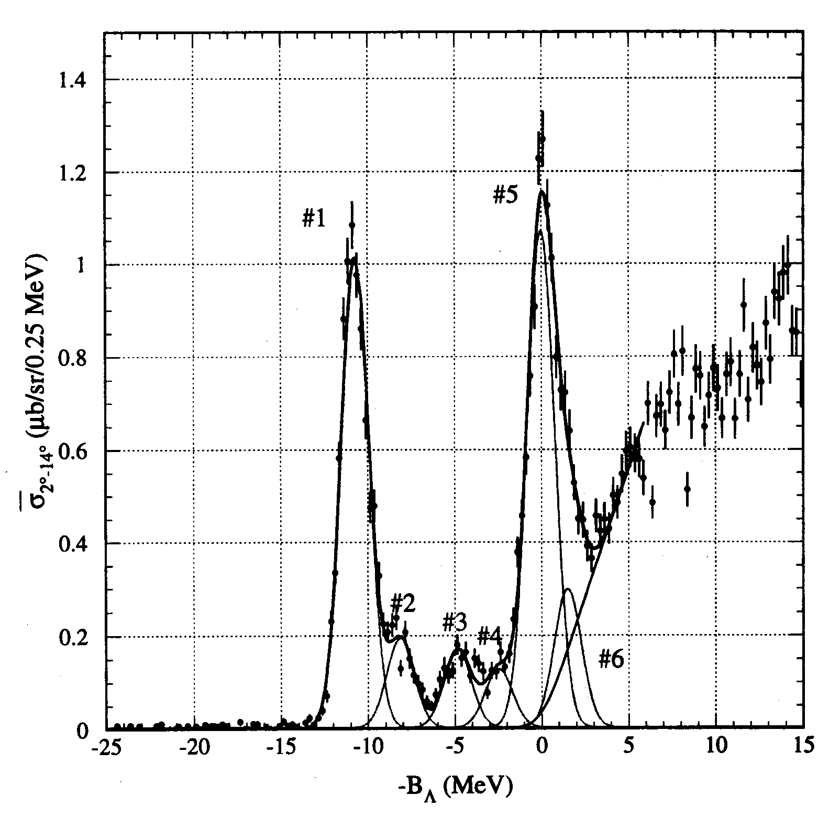
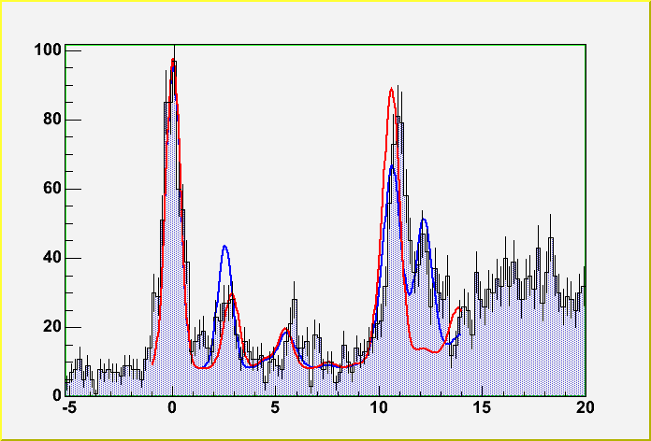
¹²_{Λ}B used for kinematics and optics calibration
KEK E369 (2001)
s_{Λ} (2-/1-)
JLAB – HKS
¹²_{Λ}C
Γ~1.5 MeV
Preliminary
p_{Λ}(3⁺/2⁺)
C.E. #1 (1-)
Count s / 0.15 MeV
C.E. #2(2-/1-)
JLab E94-107 (2004)
¹²_{Λ}B
Γ~670keV
Accidentals
B_{Λ} (MeV)
Counts /0.2 MeV
¹²_{Λ}B Ground state resolution: 465 keV FWHM
Excitation Energy(MeV)
Notes:
This is the B12L spec. from C12 with binding energy scale. We can see clearly the two dominant peaks: the gs s-shell peak at 11.88 MeV and the p-shell structure at about –0.9 MeV. Which appears have multi-peak. There are 2 smaller core excited states appears. The resolution of gs is ~400 keV FWHM. The spectrum is in general consistent with previous result.

Slide 8
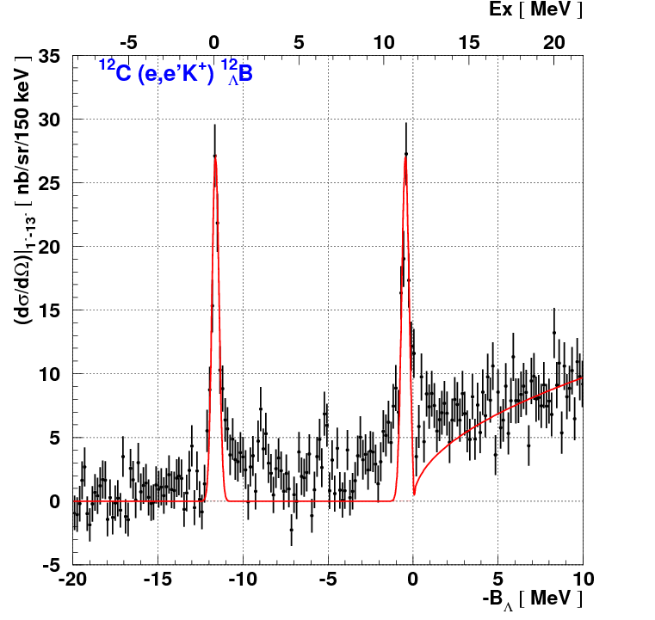
¹²C(e,e’K⁺)¹²_{Λ}B
Result
ID | Ex [MeV] | Cross section [nb/sr]
#1 | 0 | 89±7 (stat.) ±19 (sys.)
#2 | 11.2±0.1 (stat.) ±0.1 (sys.) | 98±7 (stat.) ± 22 (sys.)
#2
#1
Theory by Sotona et. al.
(1.3 < Eγ < 1.6 GeV, 1 < θ_{K} < 13 deg.)
J^{π} | Ex [MeV] | Cross section [nb/sr]
 |  | SLA | C4 | KMAID
1⁻ 2⁻ | 0 0.14 | 19.7 65.7 | 22.8 82.0 | 20.7 43.0
2⁺ 3⁺ | 10.99 11.06 | 48.3 75.3 | 56.9 107.3 | 38.0 68.5
Data taking : ~90 hours w/ 30 μA

Slide 9
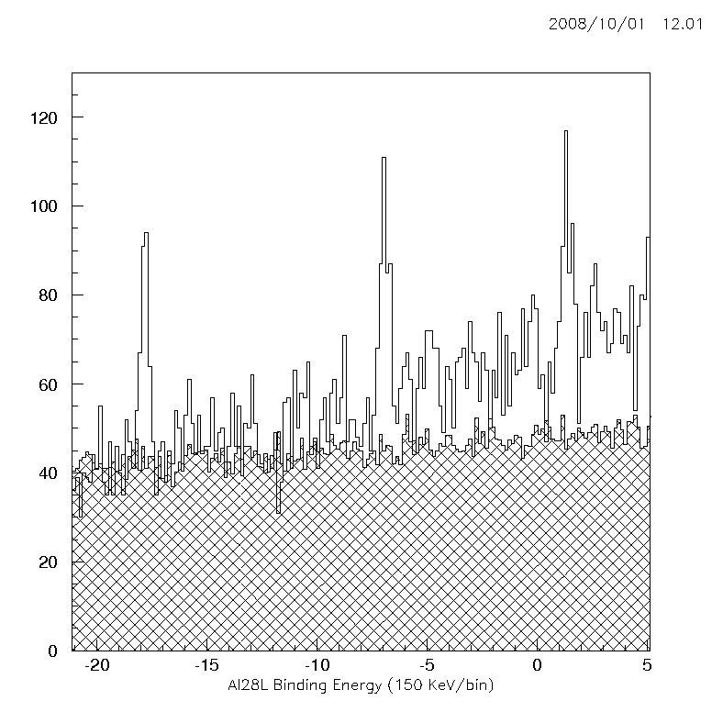
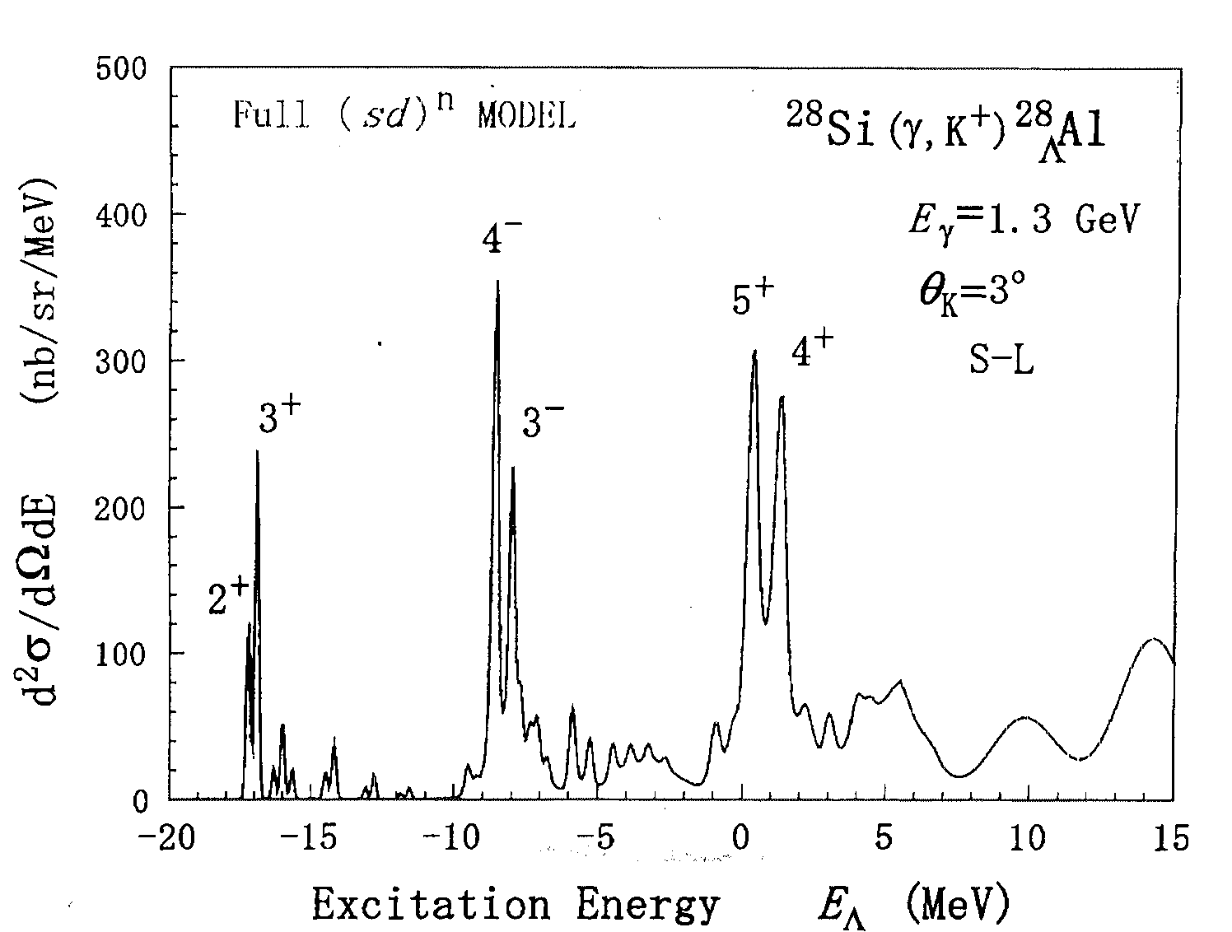
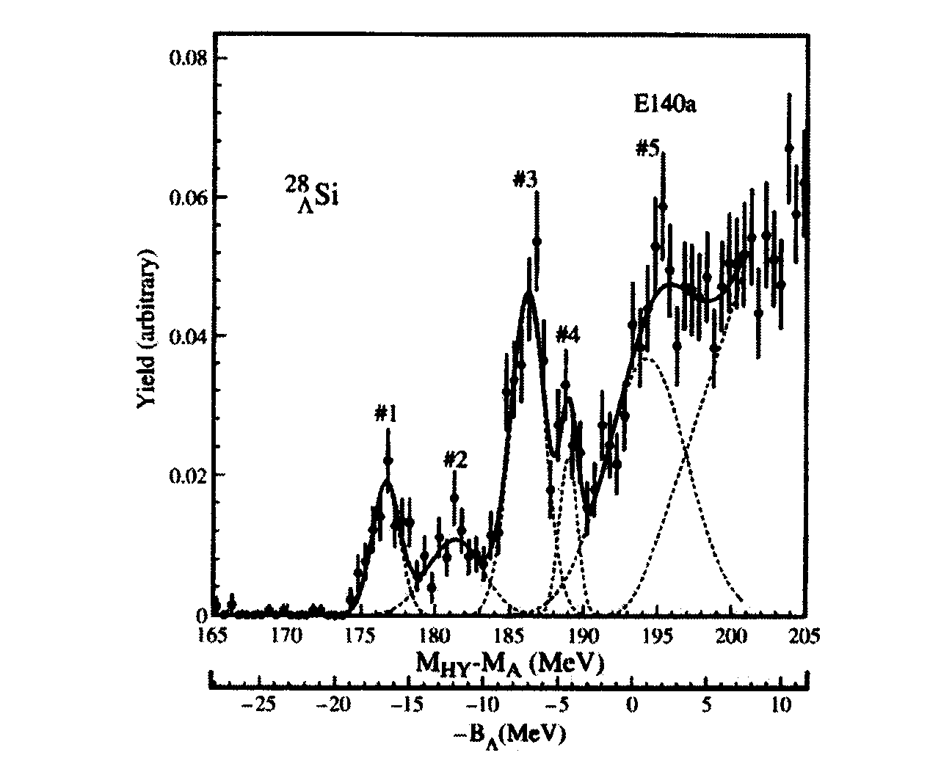
²⁸Si(e,e’K⁺)²⁸_{Λ}Al – First Spectroscopy of ²⁸_{Λ}Al
JLAB – HKS
Preliminary
g.s. resolution ~420 keV
p_{Λ}
d_{Λ} ?
S_{Λ}
C.E. ?
Counts / 0.15 MeV
Accidentals
* Motoba 2003
B_{Λ}- Binding Energy (MeV)
KEK E140a (1995)
²⁸_{Λ}Si
Notes:
Here is the Al28l spectrum from Si28l. This is the first measuement of Al28l spectrum, a hypernuclei above p-shell. The theoretical calculation shown on the left show the 3 groups of major states formed by the L at s,p,d shell coupled to nuclear core with the 5/2 proton hole. The spin-flip states the 3+, 4- and 5+ have larger amplitute than the natural parity.
In the exp spec, There 3 dominant peaks corresponding to the s-shell and p-shell are clearly seen. The g.s. has a resolution of 420 keV. There is also significant strength between major shell structure, indication of core ex st.
The spec of its mir. Hyp si28L from KEK just show broad distribution corresponding to the major there is also indication of significant core excited strength.
There is some strength between major shell, but the statistical significance is low because of the background.
The position and strength of the states will provide important information about the core nuclear wave function.

Slide 10
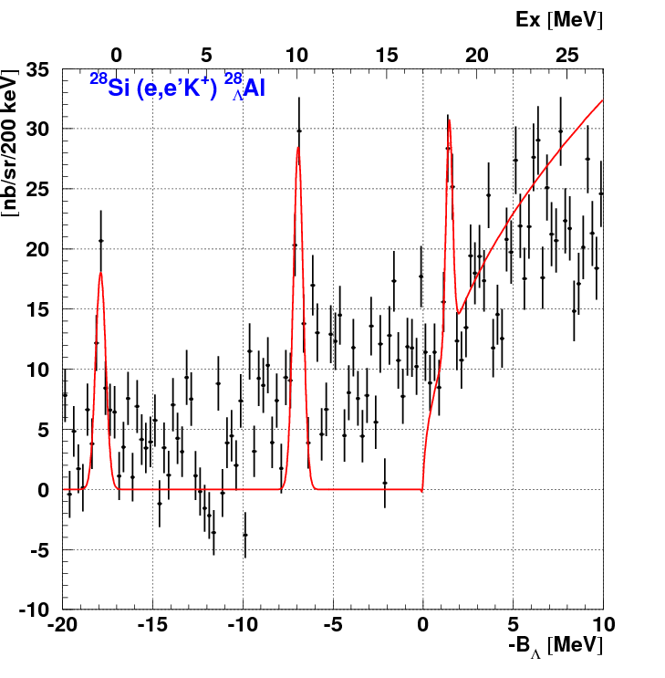
²⁸Si(e,e’K⁺)²⁸_{Λ}Al
Result
ID | Ex [MeV] | Cross section [nb/sr]
#1 | 0 | 51±10 (stat.) ±12 (sys.)
#2 | 11.0±0.1 (stat.) ±0.1 (sys.) | 78±13 (stat.) ± 18 (sys.)
#3 | 19.3±0.1 (stat.) ±0.1 (sys.) | 33±7 (stat.) ± 8 (sys.)
#3
#2
#1
Theory by Sotona et. al.
(1.3 < Eγ < 1.6 GeV, 1 < θ_{K} < 13 deg.)
J^{π} | Ex [MeV] | Cross section [nb/sr]
 |  | SLA | C4 | KMAID
2⁺,3⁺ | 0 | 92.1 | 112.7 | 71.76
4⁻ 3⁻ | 9.42 9.67 | 134.9 91.3 | 167.7 109.1 | 117.5 58.5
4⁺ 5⁺ | 17.6 17.9 | 148.4 139.1 | 184.7 167.1 | 135.1 89.9
Data taking : ~140 hours w/ 30 μA
* By Matsumura

Slide 11
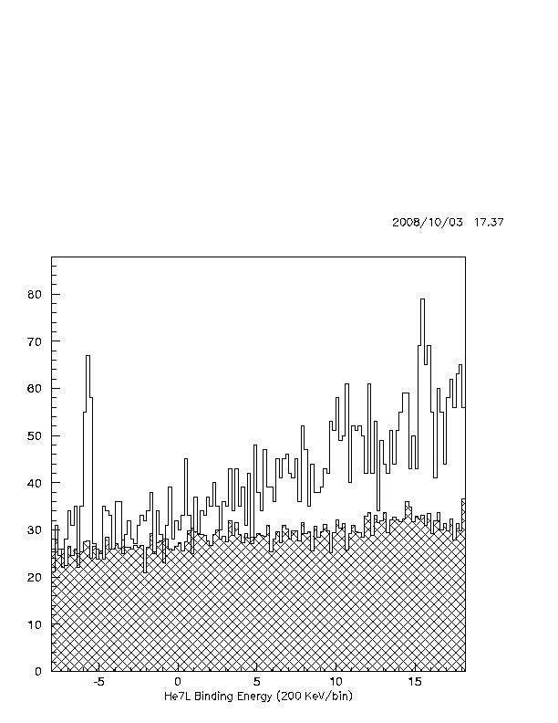
⁷Li(e,e’K⁺)⁷_{Λ}He – First Observation of ½⁺ G.S. of ⁷_{Λ}He
g.s. resolution ~465 keV
B_{Λ} g.s. = -5.7 MeV
Preliminary
S_{Λ} (1/2⁺)
“Gluelike role” of hyperon in ⁷_{Λ}He
Counts / 0.2 MeV
n
⁶He
n
Λ
⁷_{Λ}He
α+n+n
α+Λ+n+n
α
0+
Accidentals
-0.69
<r_{α-n}>=4.6
½+
-6.12
<r_{core-n}>=3.55 fm
B_{Λ}- Binding Energy (MeV)
* Hiyama 1997
Notes:
Here is the spec. of He7L, this is the first time the gs bound by 6 MeV is clearly identified. He7 is formed by add a Lambda to one alpha and 2 neutron .The cluster model cal. Shows the L will bring down the binding e from 0.69 MeV from a+n+n threhold to 6.12 Mev, and reduce the size of He6 to ~75%.

Slide 12
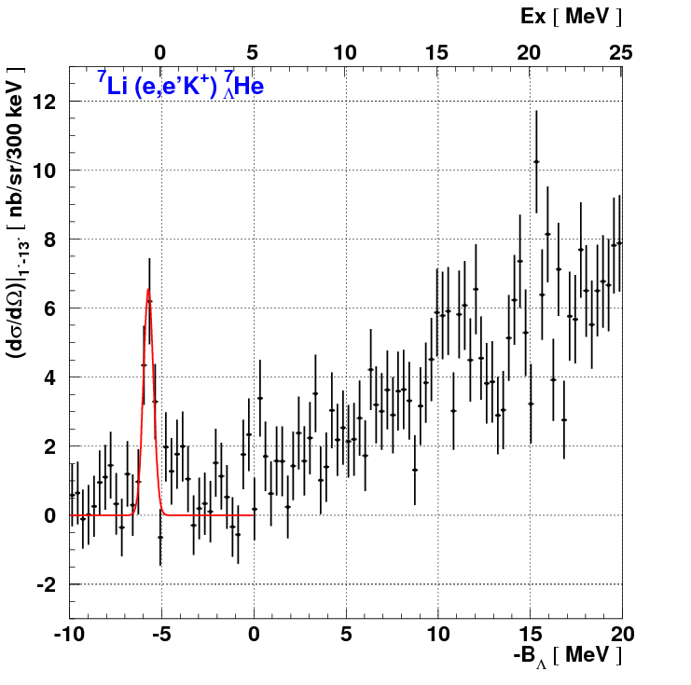
⁷Li(e,e’K⁺)⁷_{Λ}He
Result
ID | -B_{Λ} [MeV] | Cross section [nb/sr]
#1 | -5.7±0.2 (stat.) ±0.1 (sys.) | 15±3 (stat.) ±3 (sys.)
#1
Theory by Sotona et. al. (Cross section)
by Hiyama et. al. ( -B_{Λ} )
(1.3 < Eγ < 1.6 GeV, 1 < θ_{K} < 13 deg.)
J^{π} | -B_{Λ} [MeV] | Cross section [nb/sr]
 |  | SLA | C4 | KMAID
1/2⁺ | -5.56 | 13.2 | 16.2 | 9.7
Data taking : ~30 hours w/ 30 μA

Slide 13
HKS Physics Outputs
Best resolution hypernuclear reaction spectroscopy of ¹²_{Λ}B, ⁷_{Λ}He and ²⁸_{Λ}Al (420-470keV FWHM)
Precise binding energy measurements for hypernuclear states from lower p shell to s-d shell: systematic error: 130 keV, statistical error: ~30 keV
¹²_{Λ}B: spectrum consistent with E89-009 and Hall A in general
⁷_{Λ}He:first measurement of its gs binding energy provide important information about Λ-S coupling effect in nuclear medium
²⁸_{Λ}Al : information about YN interaction above p-shell and nuclear structure

Slide 14
3D view of the HKS-HES magnet system
e’
To beam dump
HES
7.5 deg tilted
HKS
Target
K⁺
2.5 GeV
Electron beam
Replace Enge spectrometer with a high-resolution large acceptance electron spectrometer – HES
Beam momentum: from 1.8 to 2.344GeV

Slide 15
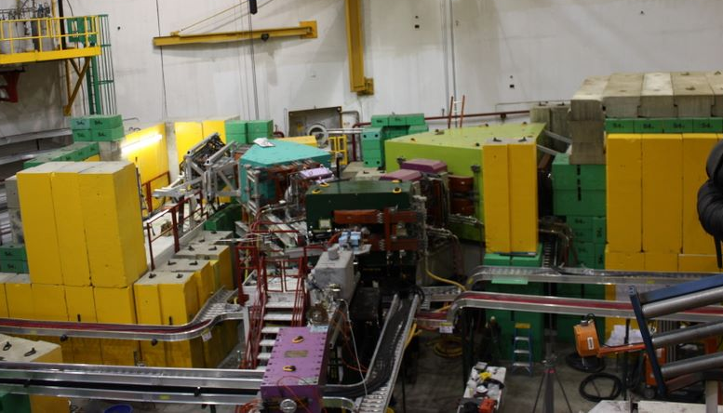

Slide 16
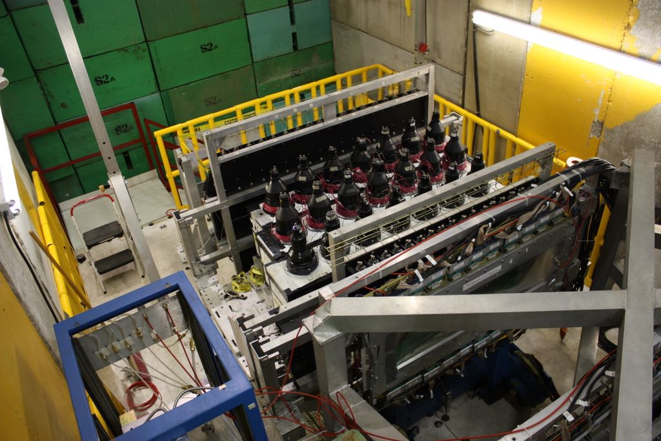

Slide 17
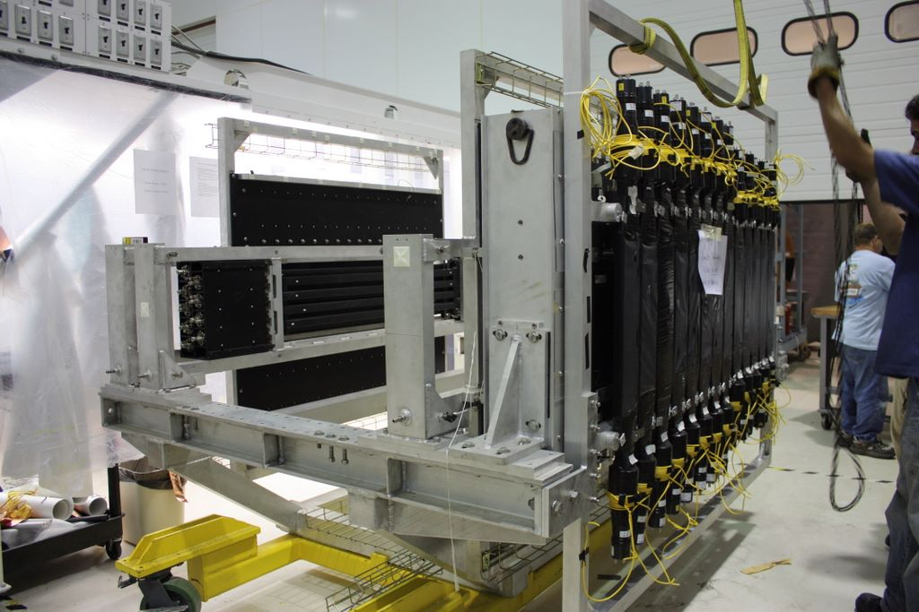

Slide 18
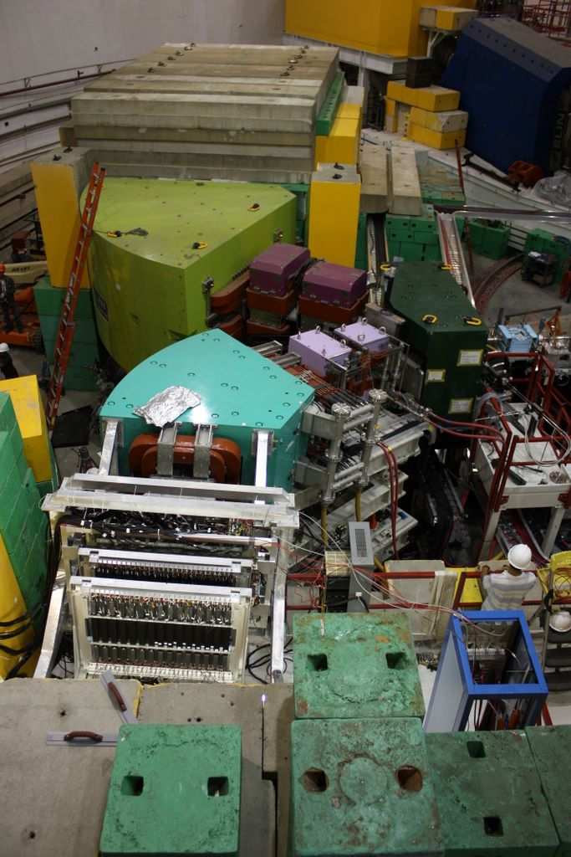

Slide 19
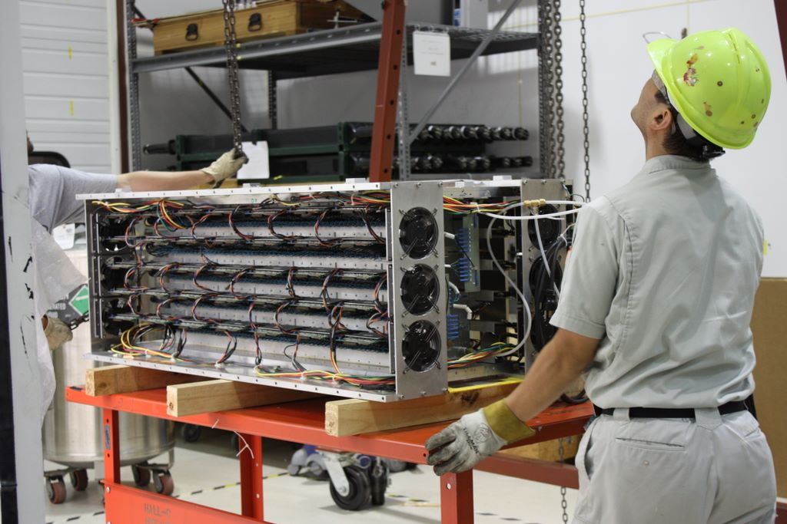

Slide 20
Spectrometer System Calibration
Issue with calibration: on-target splitter field couple e’ and K+ arms with fixed beam dump line – only one fixed kinematics setting available
Solution:
Using known masses of  Λ, Σ⁰ from CH₂ target and identified hypernuclear bound states for spectrometer calibration
Directly minimize a criterion function by an Nonlinear Least Square method to optimize reconstruction matrix M of momentum
For HES:
Water cell target in place of CH₂
 3 different beam energy provide 3
independent data sets for momentum
calibration
Kinematics Coverage
Electron Momentum (MeV/c)
Λ
¹²_{Λ}Al
¹²_{Λ}B (gs)
Σ⁰
Kaon Momentum (MeV/c)
Notes:
In order to obtain the ~400 kev energy resolution, the two spec should reach a momentum reoslution of ~level. The optical calibration of the spectrometer system is a crucial step in data analysis to achieve this goal. Which is to deterimine the rec m for momentum and angel of scattering particles. The calibration procedure has to be different from the standard method for other two-arm experiment because the use of splitter. The splitter field (EM)… 1 settings to detect hyp…
So the single arm elastic scattering and delta scan data is not available.
Thus we use the known mass of L, S which produced from the h nucl. In Ch2 and …. All these masses can be dete. By the Spe. Under the same kinematics. The reason to use bound states in addion
To hyperons is because the uncertainty of the scattering angle of the recoiling particle in much heavy in hypernuclei case, this makes the intrinsic width of hyperons much wider than hypernuclei.
So we will still see high acci… in the calibration data.

Slide 21
Angular Calibration By A 2-step Procedure
HKS Spectrometer System
To beam dump
HKS
Enge
Sieve Slit
Splitter
Target
Beam
F_{S2T}: Sieve Slit to Target Function
  Splitter is a dipole magnet only, no focusing – target angles can be determined uniquely from particle positions and momenum at SS plane
  Initial matrix fitted from simulation
F_{F2S}: Focal plane to Sieve Slit Function
  Obtained by Sieve Slit calibration data

Slide 22
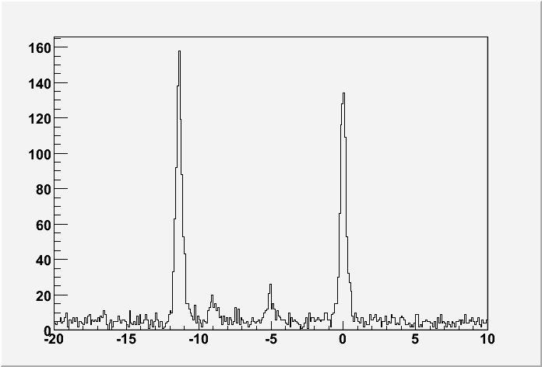
What We Expect From HES (E05-115)
Hypernclei: ⁴⁰_{Λ}K, ⁵²_{Λ}V, etc. Energy Resolution: ~400 keV (FWHM)
Yield: 5 Times of HKS: 45 /hr Vs. 9/hr for ¹²_{Λ}B gs
¹²_{Λ}B spectrum
Simulated Spectrum( ⁵²_{Λ}V )
d
f
counts/ 100keV
24h x 30μA
p
Simulation
s
-B_{Λ} (MeV)]
KEK E369:π⁺ +⁵¹V→K⁺+⁵¹_{Λ}V

Slide 23
Optimization of the Experimental Technique
Do all things right this time:
All spectrometers: Splitter, HES, HKS specially built for hypernuclear experiments. Optics optimized and field mapped – good initial knowledge of spectrometer optics
Reliable spectrometer calibration plan
Prebended beam line design
Better background control (Tilted HES, better shielding)
Detector improvements
Best opportunity than ever to explore fully the rich physics from precise hypernuclear spectrocopy

Slide 24
Other Hypernuclear experiments At JLab
E94-107: completed in Hall A
hypernuclear spectroscopy of ¹²_{Λ}B, ¹⁶_{Λ}N and ⁹_{Λ}Li obtained with resolution of 500-700 keV (FWHM)
E02-017: measure the lifetime of heavy hypernuclei produced by real photons
Will run parasitically with E05-115
E08-012: Precise binding energy measurement of light hypernuclei by weak pionic decay
Conditionally approved by PAC

Slide 25
Summary
The hypernuclear experiments carried out at Jefferson Lab aims to obtain high precision hypernuclear spectroscopy in a wide mass range by electroproduction
New large acceptance, high resolution spectrometers and experimental techniques such as on-target splitter, tilted electron spectrometer, has been developed for JLab hypernuclear experiments.
The preliminary spectrum from E01-011 has a resolution of 420 - 470 keV (FWHM) for ¹²_{Λ}B, ²⁸_{Λ}Al and ⁷_{Λ}He ; The best resolution obtained from direct reaction spectroscopy. Their binding energy has been determined with a precision of ~100 keV (σ).
The experiment E05-115 which is currently taking place in JLab Hall C will increase hypernuclear yield by a factor of 5 and extend hypernuclear spectroscopy to heavier mass region

Slide 26
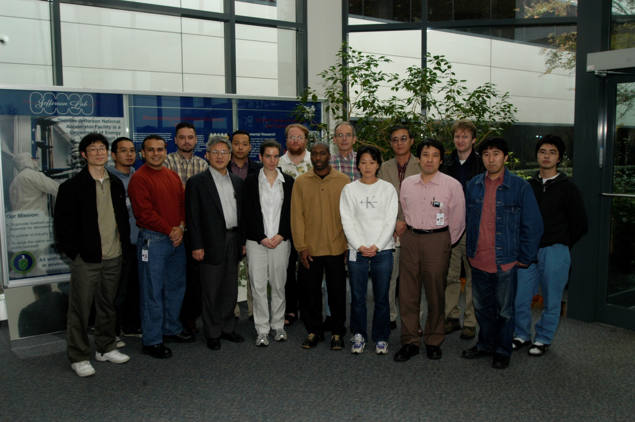

Slide 27
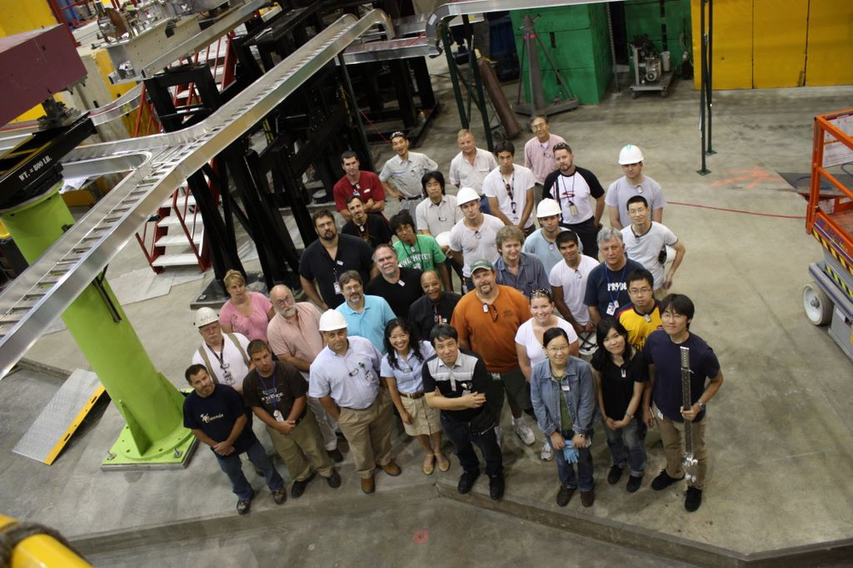

Slide 28
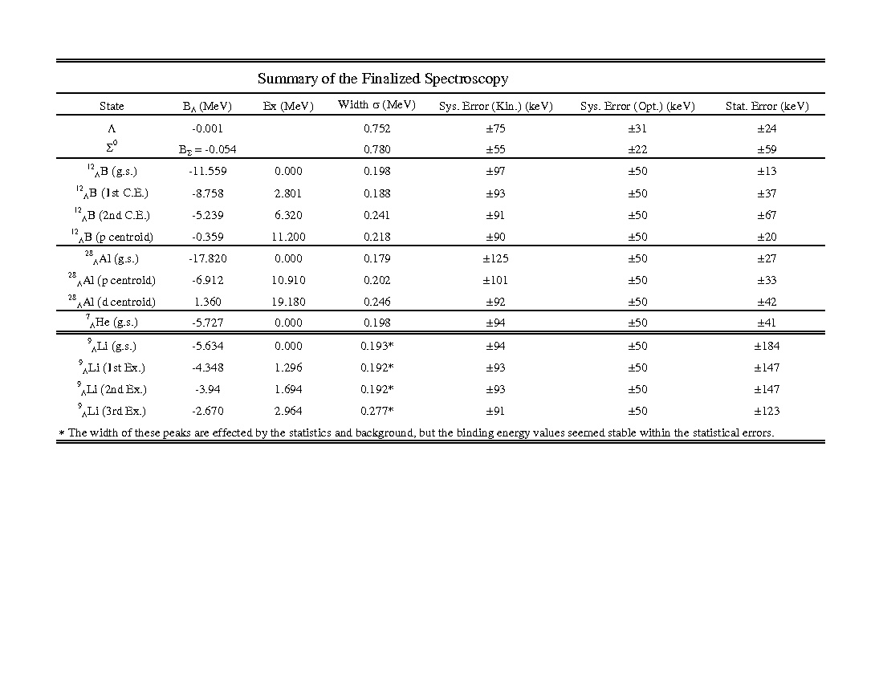
Summary Of The Spectra

Slide 29
HKS Spectra: Energy Resolution And Binding Energy Precision
Current HKS Hypernuclear Spectra Compared With Previous Measurements
In Terms of Energy Resolution And Binding Energy Precision
Energy Resolution (MeV)
KEK (π,K)
JLab E89-009(HNSS)
JLab E94-107
JLab HKS
B_{Λ} Precision (MeV)
JLab E94-107
KEK (π,K)
JLab HKS
Hypernuclear Mass Number A
Notes:
How the of current HKS spectra compare with previous world’s data in terms of ER and BEP ? Plot on this slide show the and , HA is the mass coverage upper panel is the Energy resol in FWHM. Lower panel is the BE precision one sigma value.
Data from KEK by pk reaction cover a wide mass range. The resolutioin is at ~ 1.5 to 2 MeV level. Jlab HNSS and E94107 get the resolution to below 1 MeV and now the current HKS spec. further improve the res. To 400 keV level from ligh system to above ps. In case of BE precision, Both Jlab E and KEK exp is at the level of 500 keV, while the HKS spec has a precision of ~120 keV, as a result of our kinematics calibration.

Slide 30
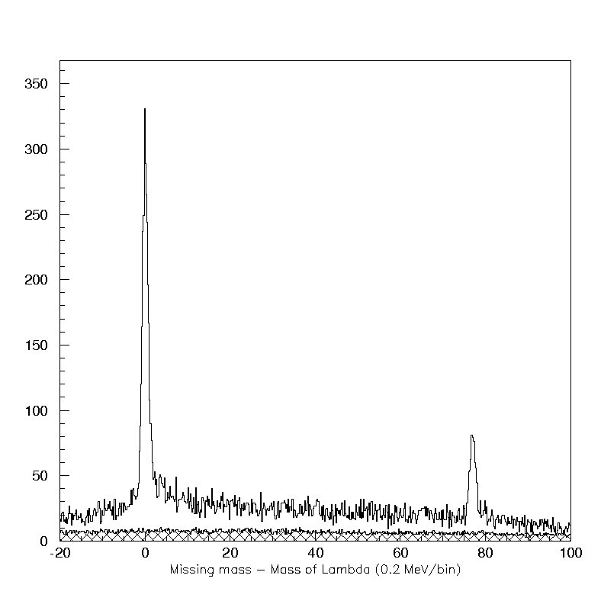
p(e,e’K⁺)Λ&Σ⁰ used for kinematics and optics calibration
Λ
HKS-JLAB
CH2 target
Γ = 752 keV
δM_{Λ} = -1 keV
δM_{Σ} = -54 keV
Preliminary
Counts (0.2MeV/bin)
Σ⁰
Events from C
Accidentals
Notes:
Here I show the L and S spectrom from Ch2. Horizontal axis is the mass difference from L mass. It shows clearly the LS peak. The bg is come from both the accidental and C12. The centroid of hyperon peaks are with 20 kev from their pDG value now.

Slide 31
  L. Tang (Spokesperson), O.K. Baker, M. Christy, P. Gueye, C. Keppel, Y. Li,
  L. Cole, Z. Ye, C. Chen, L. Yuan (Hampton U)
  O. Hashimoto (Spokesperson), S.N. Nakamura (Spokesperson), Y. Fujii, M. Kaneta, M. Sumihama, H. Tamura,K. Maeda, H. Kanda, Y. Okayasu, K. Tsukada, A. Matsumura, K.~Nonaka, D. Kawama, N. Maruyama, Y. Miyagi (Tohoku U)
  S. Kato (Yamagata U)
  T. Takahashi, Y. Sato, H. Noumi (KEK)
  T. Motoba (Osaka EC)
  J. Reinhold (Spokesperson), B. Baturin, P. Markowitz, B. Beckford, S. Gullon, C. Vega (FlU)
  Ed.V. Hungerford, K. Lan, N. Elhayari, N. Klantrains, Y. Li,S. Radeniya, V. Rodrigues (Houston)
  R. Carlini, R. Ent, H. Fenker, T. Horn, D. Mack, G. Smith, W. Vulcan, S.A. Wood, C. Yan (JLab)
  N. Simicevic, S. Wells (Louisiana Tech)
  L. Gan (North Carolina, Wilmington)
  A. Ahmidouch, S. Danagoulian, A. Gasparian (North Carolina A&T)
  M. Elaasar(New Orleans)
  R. Asaturyan, H. Mkrtchyan, A. Margaryan, S. Stepanyan, V. Tadevosyan (Yerevan)
  D. Androic, T. Petkovic, M. Planinic, M. Furic, T. Seva (Zagreb)
  T. Angelescu (Bucharest)
  V.P. Likhachev (Sao Paulo)

Slide 32
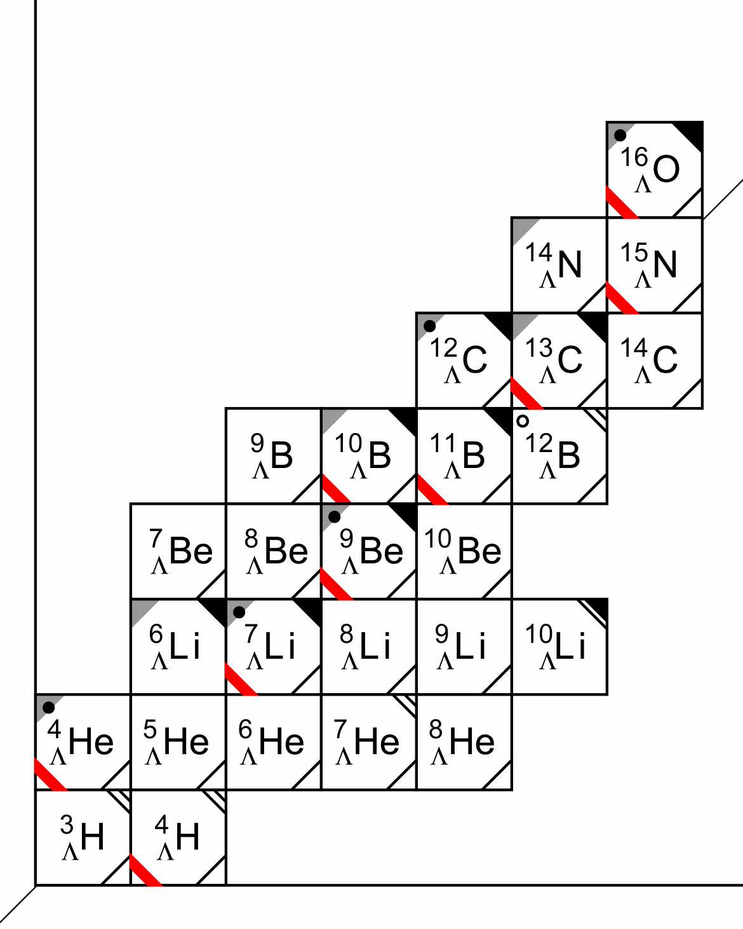
New Structure Induced by Strangeness
New dynamical features induced by Λ: extreme neutron rich systems. An example: ⁷_{Λ}He -- Λ added to a neutron halo state ⁶He
Role of hyperon in the core neutron star: need precise YN potential to determine onset of hyperon formation and maximum mass of neutron star
Need high resolution hypernuclear spectroscopy in a wide mass region
Oberserved Hypernuclei Below p-shell
Z
¹¹_{Λ}Be
n
Notes:
Due to the extra dof of strangeness in hypernuclei, New mbs will arise. For example, the formation of extreme neutron rich system. Shown in the hyp chart below, the He8l and Li10L is the ext. neu, rich An example is He7L. The hyp in red box will be studied by this experiment and future exp. At Jefferson Lab.
Precise YN potential is need to understand the internal structure of neutron star and predict the maximum mass. Hyperons play important role in neutron star interior. The formation of hyp will
Lower the bar. Chem. Potent. And lower the maximum mass. But The exact onset of hyperon formation, at which bar. Density and the fraction of hyperon, this related to the mass-radius relation for nutron star, better information from hypernuclei spectroscopy is needed.
TO resovle these important questions, high resolution hyp spec. in a wide mass region is crucial.

Slide 33
Experimental Road Map
HNSS: Completed in 2000
Spectrometer: Splitter + SOS (K) + Enge (e’)
First hypernuclear spectrum by (e,e’K) reaction: ¹²_{Λ}B (resolution~1 MeV)
HKS : Data taking summer 2005, analysis approaching final stage
Spectrometer: Splitter + HKS (K) + Enge (e’)
Targets: ¹²C, ²⁸Si, ⁷Li
HES : Approved and preparation under way
Spectrometer: New Splitter + HKS + HES
Targets: ⁴⁰Ca, ⁵²Cr, etc
Notes:
The first hypernuclear spec. exp by elec.pro was carried out at Jefferson Lab in 2000. It obtained ~ 1 MeV resolution for B12L.
The current experiment, HKS was finished in year 2005. And data analysis approaching the last stage. We also have a upgraded new experi. HES under prep.

Slide 34
Spectrometer System Calibration Strategy
Kinematics calibration: utilizing well known masses of Λ, Σ⁰ produced from CH2. essential to determine binding energy level to a precision <100 keV
Spectrometer optics calibration: directly minimize Chisquare w.r.t reconstruction matrix M by an Nonlinear Least Square method
Iteration
Iteration procedure for spectrometer calibration
Kinematics calibration
Better signal to background ratio
More accurate bound state mass
Optics calibration
Calculate new missing mass spectra based on new optics
Notes:
The calibration strategy. Ulizing the known masses, we can first define a chis as the sum of mass defe. Between the recon. Mass and the expec. Mass value, it is the PDB v for the hyperons, for the bound states. The expe. Mass is determined by fiting the centroid of the bound state peak in the missing mass spectrum. Because the rec. mass is function of the rec. matrices. The chiq is a nonlinear function rec mat. So by mini the chi2 w.r.t. rec m, we can find the new rec m. the wi is relative w of different states involved in the calibration.
Due to the nonlinearity and acci. Background, This is a iteration procedure. Based on the initial optics, calculate the missing mass, then select,… bound if they are clearly identifiable,
then minimie chi2 to get the new matrices. With the new optics, the S/A will be better and the bound states mass will be better determine, we perform another cycle of optimization.
Repeat until chi2 converge.
We also place emphasize on kinematics calibration, which is to determine precisely the central P and real beam energy. This is important to obtain correct binding energy.
The systematic error associated with the calibration procedure is being evaluated by applying the same procedure on simulated data right now.

