Slide 1
Commissioning Experiments for Hall C at 12 GeV
Ioana Niculescu
James Madison University
August 15, 2013

Slide 2
Commissioning Experiments
E12-06-107 The Search for Color Transparency at 12 GeV (CT)
E12-10-002 Precision measurements of the F₂ structure function at large x in the resonance region and beyond (F2)
E12-10-003 Deuteron Electro-Disintegration at Very High Missing Momentum (DED)
E12-10-008 Detailed studies of the nuclear dependence of F2 in light nuclei (EMC)

Slide 3
Commissioning Goals
A mix of short/partial experiments with moderate requirements that provide calibration/performance data for later experiments
Experiments that exercise full PID capabilities, high SHMS momentum, and unique Hall C capabilities (i.e. high luminosity, small systematic uncertainties, good PID at high rates)

Slide 4
Experimental Requirements
Beam energy:
11 GeV (most)
8.8 GeV (CT)
6.6 GeV (F2)
Beam current: 15 – 80 μA
Targets:
Liquid (H and D) 10 cm (4 cm? 15cm?)
Al (empty)
Solid (Be-9, B-10, B-11, thick C-12, thin C-12, multi-foil)

Slide 5
Experimental Requirements
SHMS settings
Used for electrons, positrons, and hadrons (CT)
Momentum: 1.55 to 9.64 GeV/c
Angle: 5.52 – 40 deg
HMS settings
Used for electrons, positrons
Momentum: 1.6 – 6.4 GeV/c
Angle: 20 – 63.5 deg

Slide 6
Beam Time Requirements
CT: 10 days (on 10 cm target)
F2: 9 days
DED: 2.6 days (62 hr)
EMC: 3 days
Total: 24.6 days (PAC days)

Slide 7
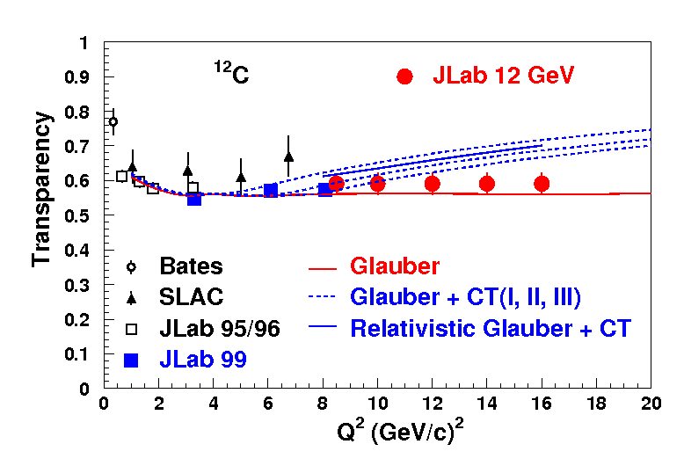
More Details - CT
A(e,e’p) cross-section on
¹H and ¹²C with 80 μA, of
8.8 & 11.0 GeV beam.
5 different Q² points
(8,10, 12, 14 & 16.4 GeV²)
Coincidence experiment : commission the SHMS and HMS
H(e,e'p) needed for commissioning spectrometer is part of the experiment
Smooth well known cross sections
Analysis framework (SIMC) already exists, online results can be used as diagnostics
Simultaneously commission the aerogel detector

Slide 8
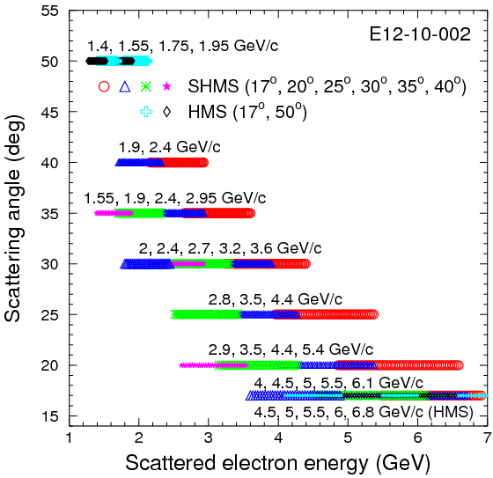
More Details – F2
Inclusive experiment
Extend proton and deuteron F2 structure function precision measurements to larger x and Q² by measuring H(e,e’) and D(e,e’) cross sections in the resonance region and beyond up to Q²~ 17 GeV² and x ~ 0.99
17 deg setting in both HMS and SHMS
good overlap between momentum settings for each fixed-angle setting
substantial overlap between momentum settings at 17 and 30 deg
lowest central momentum needed with SHMS: 1.55 GeV
Other measurements:
R measurement: 10 h
H₂ elastics: 5 h
target length acceptance: 12 h
configuration change: 45 h
detector checks: 24 h

Slide 9
More Details - DED
3 kinematic settings
Centered at p_{m} = 0.5, 0.65 and 0.8 GeV/c
Good overlap with existing data
Hydrogen normalizations not included

Slide 10
More Details - EMC
Maximize the physics impact for the run period while minimizing additional beamtime and configuration changes
Get results for new light nuclei of interest
Extract “smeared” F_{2n}/F_{2p} ratio
Expand examination of EMC-SRC correlation
Take Q² scan for scaling studies
Targets: ¹H, ²H, ⁹Be, ¹⁰B, ¹¹B, ¹²C and Al
C/D EMC ratios at 20, 25, 30 degrees (35, 40 if time) with SHMS to look at Q² dependence (deuterium parasitic with F2)
Data on ⁹Be, ¹⁰B, ¹¹B, ¹²C at 20 degrees with SHMS
Add extra EMC ratios for light nuclei with cluster structure
Extract “smeared” F2p, F2n (and ratios) from ¹²C-¹¹B, ¹⁰B-⁹Be and ¹¹B-¹⁰B
SRC target ratios at x>1 with HMS [parasitic with EMC]
Take EMC and SRC ratios together to examine EMC-SRC correlation
High Q² C/D ratios (35, 40 degrees)
2 PAC days, run with E12-10-002 (F₂ on ¹H,²H): overlap in data/kinematics

Slide 11
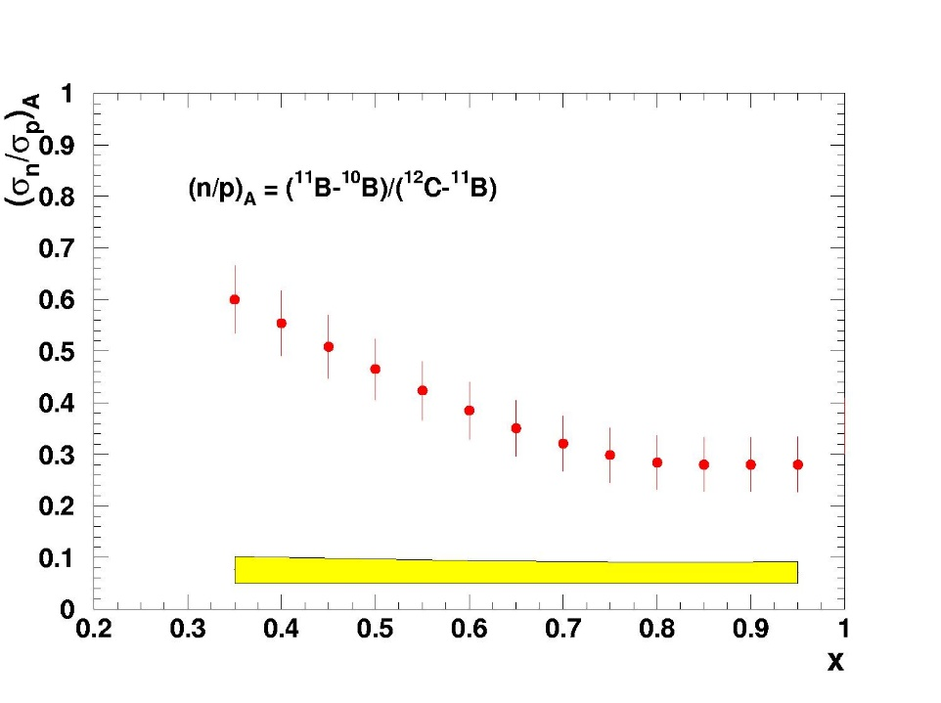
EMC: some of the results expected
EMC effect on light nuclei: ⁹Be, ¹⁰B, ¹¹B, ¹²C and ²⁷Al
Neutron or proton in-medium effects : ¹¹B-¹⁰B, ¹²C-¹¹B
Extraction of n/p in-medium
Notes:
11

Slide 12
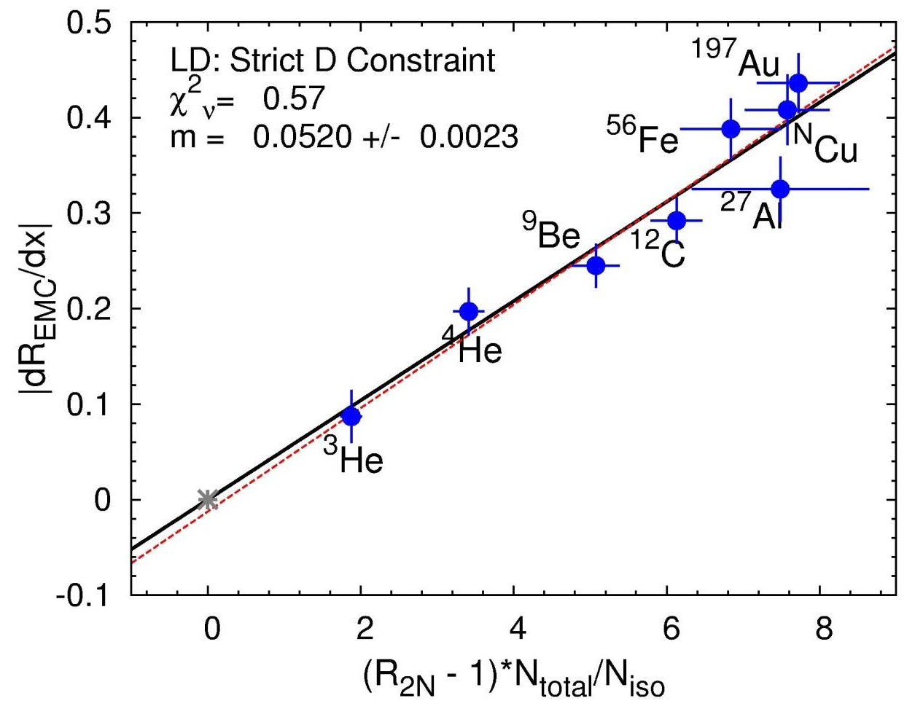
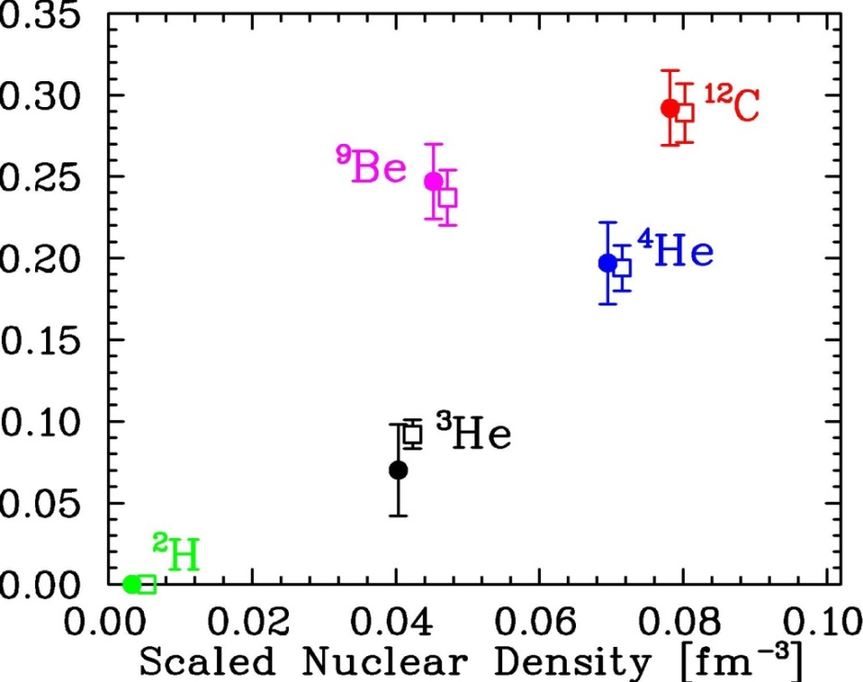
SRC ratios on light nuclei: ⁹Be, ¹⁰B, ¹¹B, ¹²C, ²⁷Al
Improved Al ratios and new light nuclei (^{10,11}B) with cluster structure to better study SRC-EMC correlation, test different explanations.
Notes:
12

