Slide 1
Confessions of an Applied Nuclear Physicist
Glen Warren
Pacific Northwest National laboratory
glen.warren@pnnl.gov
Hall C Meeting, JLab
Aug. 16, 2013
PNNL-SA-97564

Slide 2
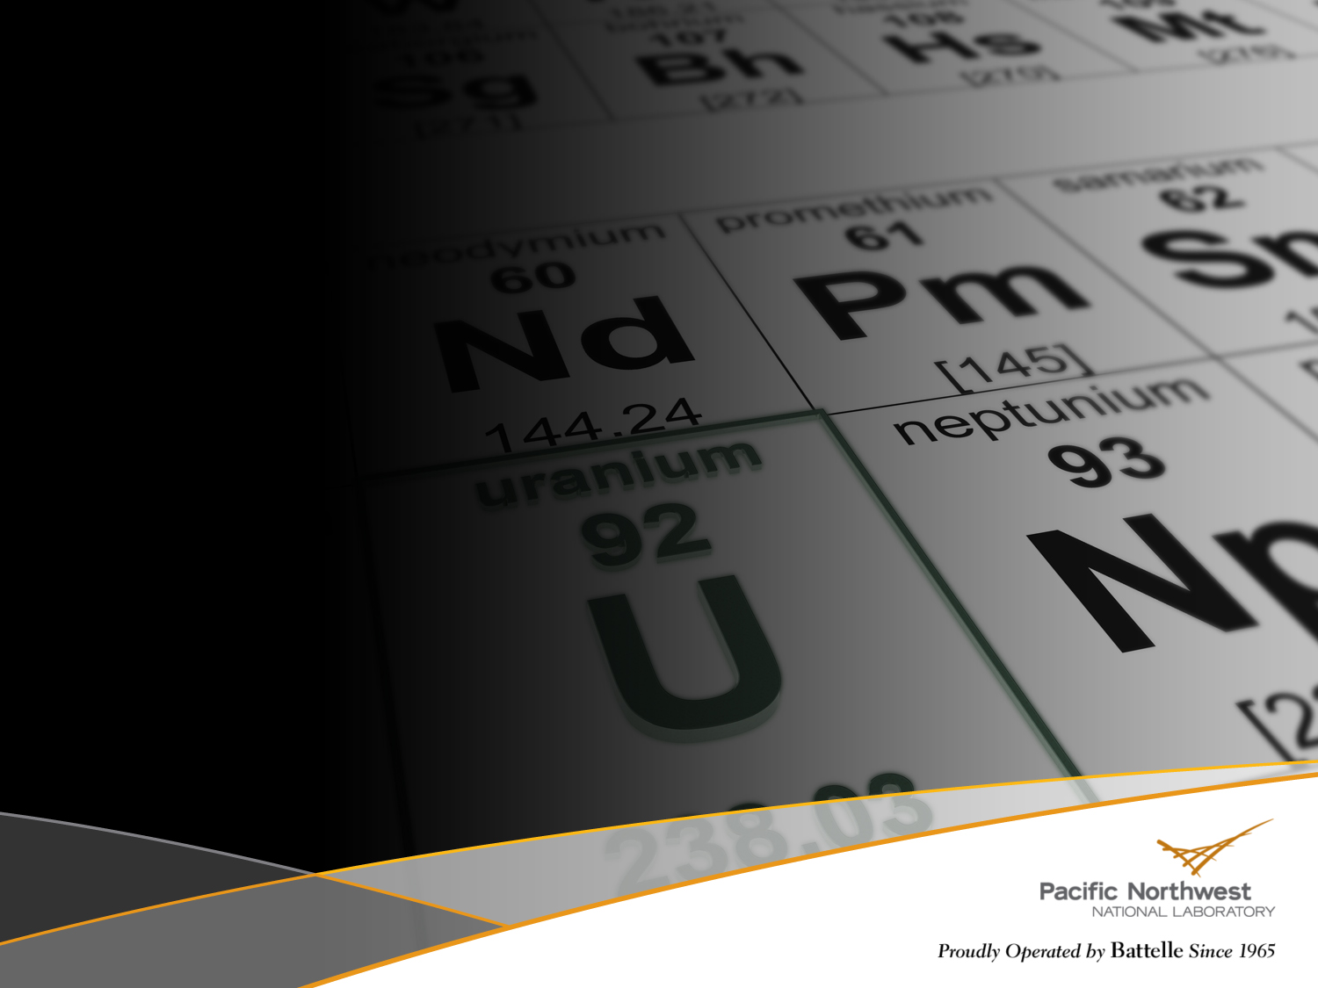




Outline
Introduction
PNNL and RDNS
Nuclear Physics
Lead Slowing Down Spectrometry
Material Verification for Arms Control

Slide 3
My Job
Apply nuclear physics to solve national security and non-proliferation needs
  Specialize in active interrogation: use of beams
  Look for ways to exploit nuclear physics to do better measurements
Kinds of Applications:
  Assay used nuclear fuel
  Confirm nuclear weapons dismantlement
  Environmental measurement samples
  Cargo inspection techniques
  General radiation detection:
    Detector design
    Algorithm development

Slide 4
My View of Differences
Energy Scale
  From GeV to keV
Applied Research
  Clients have questions they want answered
  Shorter time scales (requires greater flexibility)
Work environment
  Work with nuclear physics, particle physicists, chemists, nuclear engineers, chemists, mechanical engineers
  Strong emphasis on integrated team work
  No more night shifts!

Slide 5
Outline
Introduction
PNNL and RDNS
Nuclear Physics
Lead Slowing Down Spectrometry
Material Verification for Arms Control

Slide 6
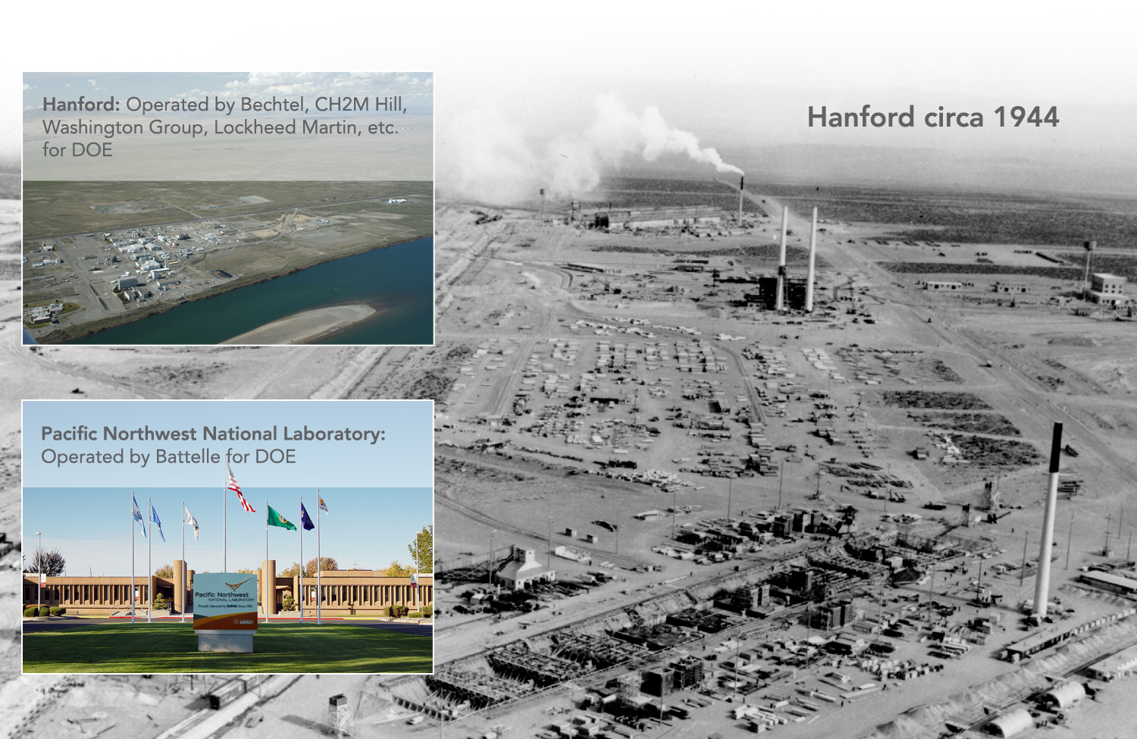
PNNL’s Past is Linked with Hanford
6
Notes:
Two separate DOE roles and histories
One is cleanup today
PNNL is the enduring one
(perhaps) only minimal environmental business at lab
Hanford heritage (health physics, nuclear materials and ops, environmental signatures, subsurface)

Slide 7
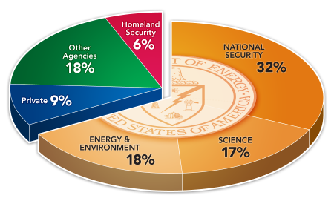
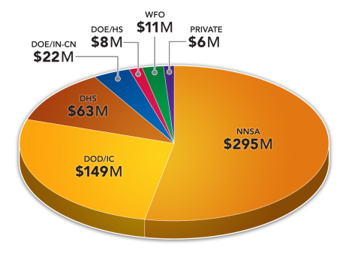
National Security and PNNL
FY12 PNNL
Business Volume: $1.03 Billion
Staff: 4,500
FY12 National Security
Business Volume: $554 Million
Direct Staff (Mission): 1,037
Direct Staff (Organization): 781
7
Notes:
PNNL and NSD funding. Key clients and BV

Slide 8
RDNS and DSG
DSG Capabilities
Software
Electronics
Testing
Detector design & fabrication
Shared Missions:
Basic Science
  High energy physics
  Nuclear physics
Treaty Enforcement
Nonproliferation
Interdiction
RDNS Capabilities
Ultra-low background rad detection
Materials development
Algorithms, modeling & simulation
Active Interrogation

Slide 9
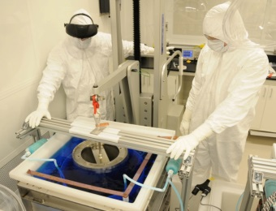
Nuclear & High-Energy Physics at PNNL
  Lepton Number Violation (Majorana) - 0νββ
Dark Matter (MJD, CoGeNT, C4, COUPP, CDMS)
Neutrino Mass (Project 8)
Heavy Quark Physics (Belle/Belle II)
Lepton Flavor Physics (µ2e)
http://www.pnnl.gov/physics/
9
Notes:
PNNL Dark Matter Capability: “Creating high-sensitivity, low-background detectors and deploying clean, low-background experiments deep underground for dark matter research.”
We achieve these outcomes through the following capabilities:
Upper-left, moving clockwise:
Science objective: Pie chart of the non-dark energy composition (call it the matter composition) of the universe demonstrating that the majority of matter in the universe is composed of dark matter. Dark matter is not part of the Standard Model of particle physics. The Standard Model of particle physics describes the rest of the pie chart including atoms, photons, and neutrinos. As a matter of research, scientists hope to directly detect dark matter with underground, highly sensitive detectors, here represented as a green arrow scattering off a detector composed of (blue) atoms. We can measure these dark matter scattering interactions through measurement of heat, light, or ionization, each shown schematically.
Low-background electronics front-ends: PNNL has developed electronics front-end boards that are low-mass and composed of low-background materials. Two versions of PNNL low-background front-end electronic packages are shown. These front-ends are placed near germanium detector crystals as the first stage of ionization read-out. The front-ends are designed to contribute very little U/Th chain background sources to the experiment as the front-end electronics are so close to the detectors are can’t be shielded. Having the front-ends near the detector itself provides improved (lower noise, stiffer) electronics read-out, highly desirable for high-resolution germanium detectors.
Community engagement: PNNL has a 25+ year history of dark matter research. PNNL activity engages the dark matter research community, one example is hosting of the Dark Matter Silver Jubilee Symposium celebrating 25 years since the first underground direct detection publication results.
Electric field modeling: Maxwell-3D electric field modeling is used to understand the stray capacitance in low-noise germanium detector cryostat designs. Such electric field modeling is employed to understand the ultimate electrical performance in the design phase.
Material assays: PNNL has world class capability to assay materials for ultra-trace levels of contaminates in bulk materials. Numerous methods are employed including an array of mass spectroscopy methods in dedicate clean laboratories and radiometric counting with germanium detector arrays in the PNNL shallow underground laboratory.
Detector design & Fabrication: PNNL has an engineering and designer cohort focused on “radiation detectors” of all kinds. The engineering and design expertise includes cryogenic design and considerations for employing low-background construction techniques. Furthermore, our engineers and designers see their work through the fabrication process, either done in specialized shops on the PNNL campus or contracting firms to perform specialized fabrication activities.
Ultra-pure electroformed copper: PNNL has developed ultra-pure electroformed copper to supply a detector fabrication material (copper) that has extremely low levels of U/Th chain contaminates, as quantified by the Materials assay capability. The electroformed copper is produced at PNNL in the shallow underground laboratory as well as a Sanford Underground research Facility (SURF) for the Majorana Demonstrator neutrinoless double beta decay experiment.
Material cleaning & handling: Methods for chemically cleaning the exteriors of materials for low-background detectors and experiments are also a PNNL development, in additional to the procedural methods of handling clean materials so under wanted contaminants (principally U/Th chain isotopes) are not introduced in the experimental detectors during the fabrication process.
Shallow underground cleanroom facility: This PNNL facility allows for the development and deployment of instruments shielded from cosmic ray neutrons and protons that are a direct background to measurements and can activate materials at a level to which some of the most sensitive instruments can measure.
Electron beam welding facility: The electron beam welding facility is a complement to ultra-pure electroformed copper production because it allows welding of electroformed copper parts without introduction of uncontrolled materials (e.g. solder rods). Having the electron beam facility at PNNL allows many “one-off” production activities that would not be bid on by commercial electron beam welding contractors.
Data analysis & Background modeling: The culmination of building a low-background detector and experiment is understanding the collected data, performing the data analysis to obtain a scientific result, and importantly placing that result in the context of a well-understood background model. The attention to low-background methods comes full circle at this point where results from an experiment can be fed back to the assay and materials production capabilities for further development.
Sensitivity reach: Using the background modeling capability, PNNL is able to build concrete scientific reach predictions based on up-front estimation of the under-lying background source terms. This modeling and sensitivity reach also provides for a natural development cycle down prior to the fabrication of any piece of detection equipment.
Experimental design & Deployment: PNNL uses the same engineers and designers for full experimental design, fabrication, and deployment at underground locations. This is the aspect of taking a low-background detector capability and turning it into a successful scientific research activity.

Slide 10
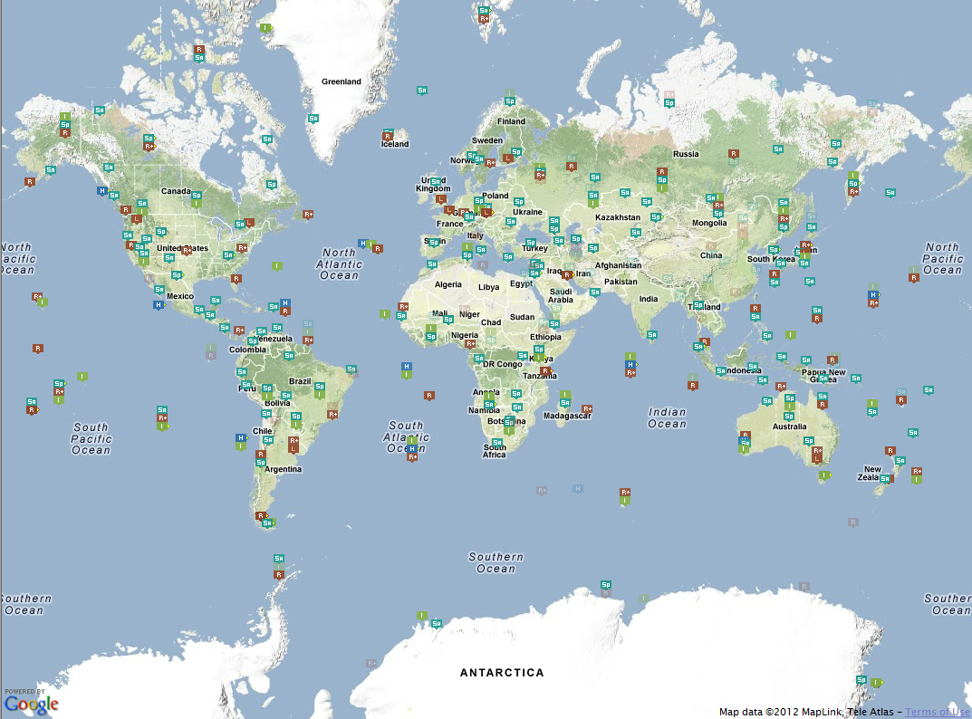
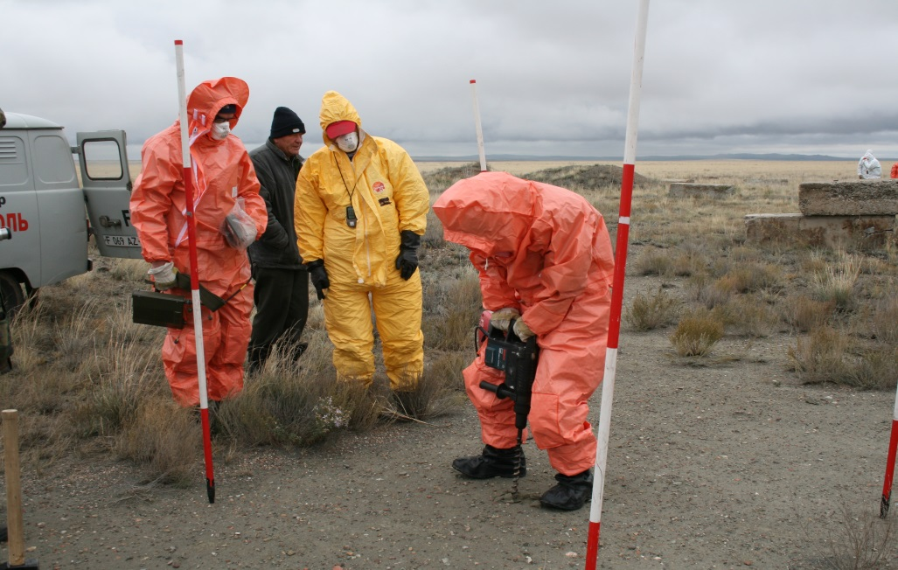
Treaty Enforcement at PNNL
CTBT’s three critical components:
  International Monitoring System (IMS)
    Seismic activity
    Airborne particulates
  International Data Center
    Process information from IMS
  On-site inspections
PNNL has become CTBTO’s go-to source for expertise in radiation detection technology and training

Slide 11
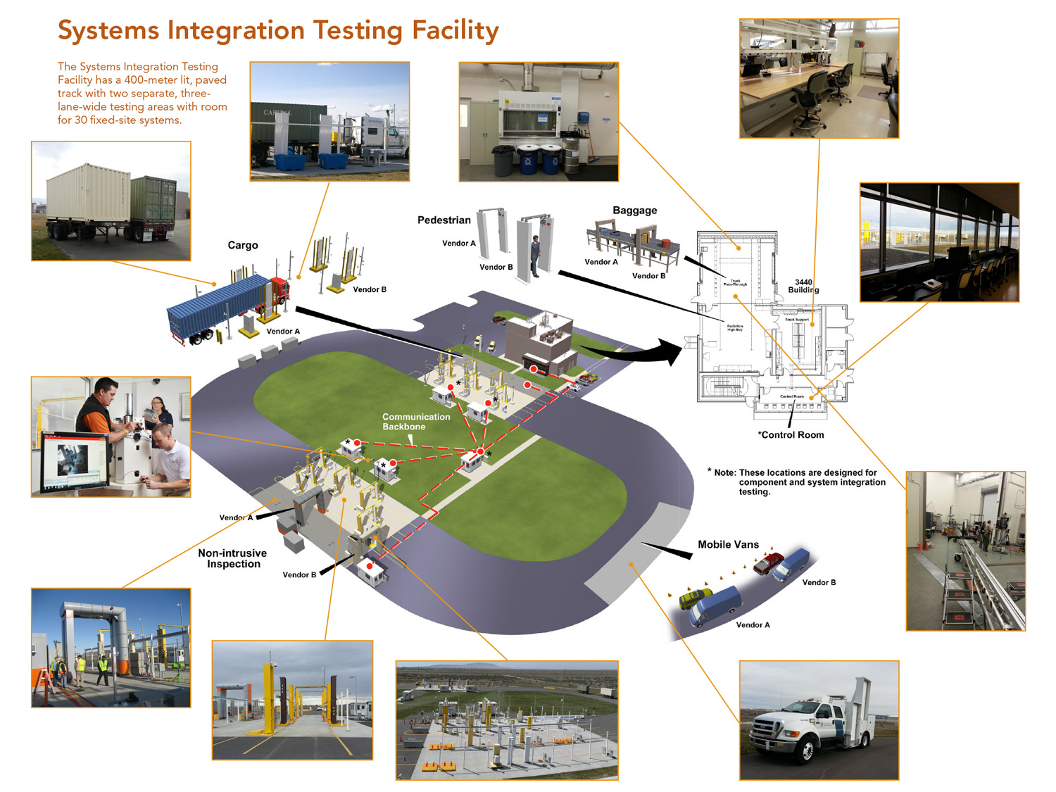
Interdiction Technologies at PNNL

Slide 12
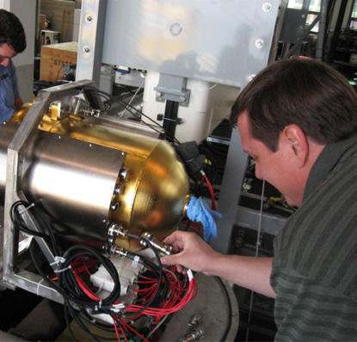
Multi-Sensor Airborne Radiation Survey (MARS)
Challenge: Rapidly detecting and identifying radiological materials
  Standoff distances
  Wide area
  Lightweight, rugged, mobile
Solution: Multi-sensor Airborne Radiation Survey (MARS)
  Rugged to temperature, humidity and transport conditions
  Energy resolution of 3 keV at 1333 keV
  Over 400% photopeak efficiency at
  1333 keV compared to 3″×3″ NaI(Tl) detector
  Synchronized GPS data for isotope mapping

Slide 13
Outline
Introduction
PNNL and RDNS
Nuclear Physics
Lead Slowing Down Spectrometry
Material Verification for Arms Control

Slide 14
Fission
Application
  Reactors: “clean” energy
  Nuclear weapons
Emissions
  Separation of nucleus into multiple pieces
  Emissions per fission
    2-3 Fission products
      Typically about 2/3 and 1/3 of original A
    200 MeV kinetic energy
    Average 2-3 neutrons
    Average 7-8 γ

Slide 15
Isotopes of Interest
U-235
  Goes BOOM (fissile)
  Naturally occurring, but at low concentrations
  Very little radiation emissions (186-keV γ, very few neutrons)
U-238
  Benign, unless in nuclear weapon (fissionable)
  Naturally occurring
  Strong γ emissions (1001-keV γ, very few neutrons)
Pu-239
  Goes Boom (fissile)
  Produced in reactors
  Strong γ emissions (375-keV γ)
Pu-240
  Produced in reactors
  Accompanies Pu-239
  Strong neutron emitter
  Ratio of Pu-240/Pu-239 determines quality of material

Slide 16
Outline
Introduction
PNNL and RDNS
Nuclear Physics
Lead Slowing Down Spectrometry
Material Verification for Arms Control

Slide 17
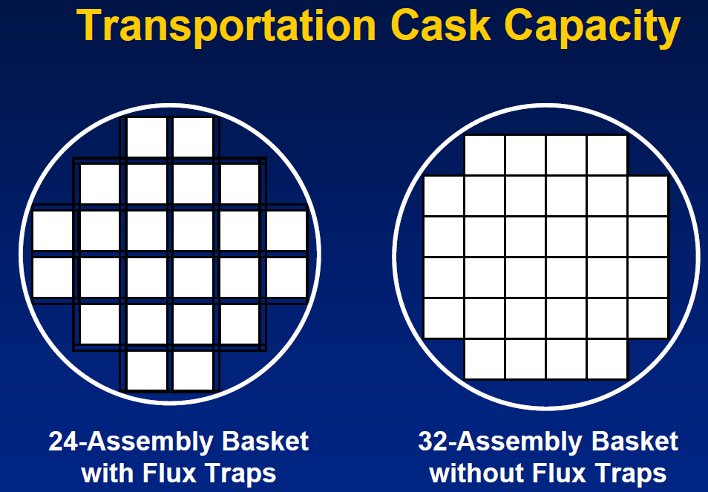
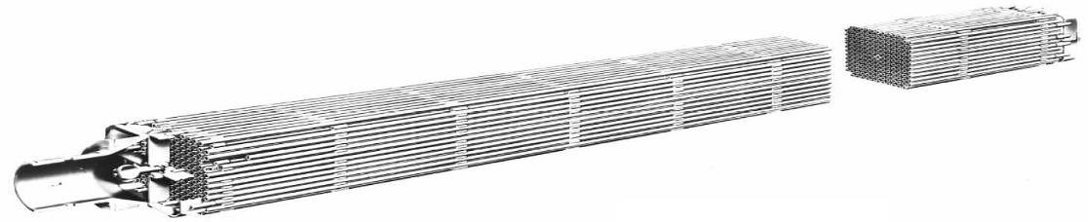
Motivation: Direct Measurement of Pu Isotopes in Used Fuel
Measurement of Pu is necessary for:
  Quantifying material input at reprocessing facility
  Independent verification of burnup to support criticality calculations for fuel storage
  Resolving used fuel shipper-receiver difference
  Maintaining continuity of knowledge
Traditional assay methods: Indirectly measure Pu and carry ~10% uncertainty
Lead Slowing Down Spectrometry (LSDS)
  NDA technique for direct measurement of Pu in used fuel assemblies
  Our Focus: Develop algorithm to extract fissile isotopic masses from simulated LSDS measurement data

Slide 18
Background: LSDS Principles
Using fission resonance structure to assay fuel
cross sections are off-set for clarity
0.1

Slide 19

LSDS for Fuel Assay
Fuel Assembly
Assay Signal = y(t)
Sensitive to fission neutrons
Isotope Responses = x(t)
Sensitive to interrogation neutrons
n
n
Threshold Fission Chambers
(²³⁸U, ²³²Th)
Isotopic Fission Chambers
(²³⁹Pu, ²⁴¹Pu, ²³⁵U)
n
2 m × 1 m of Pb
t = neutron slowing-down time
Constants t_{o} and k

Slide 20
Outline
Introduction
PNNL and RDNS
Nuclear Physics
Lead Slowing Down Spectrometry
Material Verification for Arms Control

Slide 21

Material Verification
Material verification in the arms control context
  process by which monitor verifies that an item is consistent with a declaration
  governed by an agreement
Example of items to be evaluated
  assembled weapons
  weapon components
  disassembled materials
  non-treaty limited items

Slide 22
Operating Environment
Host or inspected party
  owns the item to be inspected
  absolute protection of sensitive information
  safety
  as a result
    host controls equipment
    host either provides the equipment or touches it last
Monitor or inspecting party
  must confirm that item inspected has the declared properties

Slide 23
Constraints
From the host perspective
  About to reveal secrets about your national crown jewels … big risks
From the monitor perspective
  Expected to verify the measurement is working as intended when you do not control the equipment … hard, really hard
There are possible solutions to help address some of these problems
  joint design
  random selection
  incorporating certification and authentication throughout the design process
Measurement systems are driven more by these constraints than by physics

Slide 24
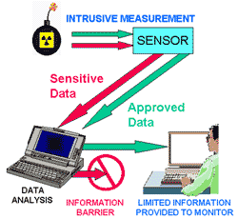
Information Barrier
Raw data from measurements on sensitive items often contain sensitive information
  e.g., complete HPGe spectrum would enable the evaluation of Pu isotopics, which is sensitive to the Russians
Information barrier limits information that goes into and out of the system
Limits
  possible operator input
  filter line voltage
  electromagnetic cage for shielding
  output information

Slide 25
Attributes
The evaluation of an attribute is a non-sensitive characteristics of a measured item that can be determined from potentially sensitive measurements
Example
  measure the gamma-ray spectrum from a sample
  extract the ratio ²⁴⁰Pu/²³⁹Pu from that spectrum
  whether that ratio exceeds a threshold is then the evaluation of the attribute
Examples of attributes
  presence of ²³⁹Pu
  mass of ²³⁹Pu above a threshold
  age of Pu
  U enrichment above a threshold

Slide 26
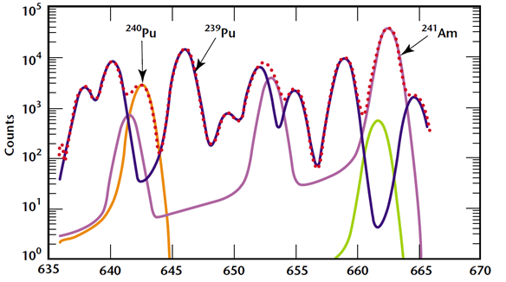
²³⁹Pu and ²⁴⁰Pu Ratio
Measure γ from ²³⁹Pu
  646 keV line from ²³⁹Pu
  642 keV line from ²⁴⁰Pu
Measured in previous AMS
Equipment
  HPGe detector
Assumptions
  adequate amount of ²⁴⁰Pu present to measure
  homogenous mixture of ²³⁹Pu and ²⁴⁰Pu
Gamma-ray spectrum for a Pu-bearing item (Taken from: Arms Control and Nonproliferation Technologies, 2001)

Slide 27
Summary
PNNL
  Mission-driven lab with diverse efforts
RDNS
  Basic and applied research
  Staff have diverse backgrounds
Applied Nuclear Physics
  Many nuclear physics-related problems to address

