Slide 1



Imaging Studies at Future Facilities
Rolf Ent – Jefferson Lab
Hall C Summer Workshop, August 20th 2011
(Thanks to Nicole d’Hose for COMPASS-II slides)
(Thanks to Horn, Nadel-Turonski, Prokudin, Weiss for plots)
-II
2015+
2013-16
2025+?

Slide 2



Beyond form factors and quark distributions –
Generalized Parton and Transverse Momentum Distributions
X. Ji, D. Mueller, A. Radyushkin (1994-1997)
Proton form factors, transverse charge & current densities
Structure functions,
quark longitudinal
momentum & helicity
distributions
Correlated quark momentum
and helicity distributions in
transverse space - GPDs
Extend longitudinal quark momentum & helicity distributions to transverse momentum distributions - TMDs
2000’s

Slide 3
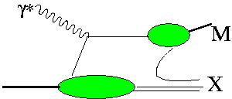
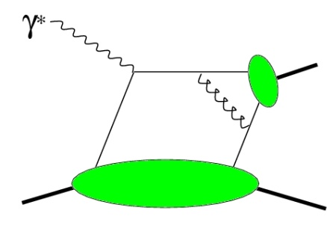
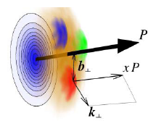
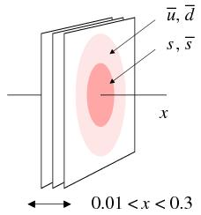
Towards a “3D” spin-flavor landscape
W^{u}(x,k,r)
(Wigner Function)
m
m
d³r
d²k_{T}
p
x
p
TMD
GPD
B
Transverse-Momentum Dependent Parton Distributions
TMD^{u}(x,k_{T})
f₁,g₁,f_{1T} ,g_{1T}
h₁, h_{1T} , h_{1L} , h₁
Link to Orbital Momentum
GPD^{u}(x,ξ,t)
H^{u}, E^{u}, H^{u}, E^{u} + 4“_{T}”s
Link to Orbital Momentum
Generalized Parton Distributions
~
~
Want P_{T} > Λ but not too large!
d²k_{T}
ξ = 0, t = 0
dx
f₁(x)
g₁, h₁
u(x)
Δu, δu
F₁^{u}(t)
F₂^{u},G_{A}^{u},G_{P}^{u}
Parton Distributions
Form Factors

Slide 4
COMPASS-II: a Facility to study QCD
COMMON
MUON and
PROTON
APPARATUS for
STRUCTURE and
SPECTROSCOPY
New Program (SPSC-P-340) until ~2016
recommended by SPSC and approved by Research Board
Primakoff with π, K beam ➔ Test of Chiral Perturb. Theory
DVCS & DVMP with μ beams ➔ Transv. Spatial Distrib. with GPDs
SIDIS (with GPD prog.) ➔ Strange PDF and Transv. Mom. Dep. PDFs
Drell-Yan with π beams ➔Transverse Momentum Dependent PDFs

Slide 5
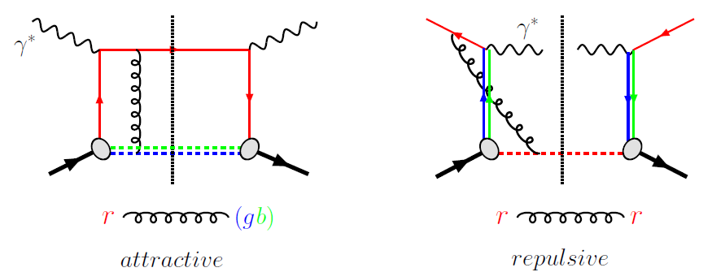
Experimental check of the change of sign of
TMDs confronting Drell-Yan and SIDIS results
The T-odd character of the Boer-Mulders and Sivers function
implies that these functions are process dependent
In order not to be forced to vanish by time-reversal invariance
the SSA requires an interaction phase generated by
a rescattering of the struck parton in the field of the hadron remnant
FSI
ISI
Need experimental verification
Test of consistency
of the approach
Boer-Mulders
Sivers
COMPASS + HERMES have already measured non zero Sivers SSA in SIDIS

Slide 6
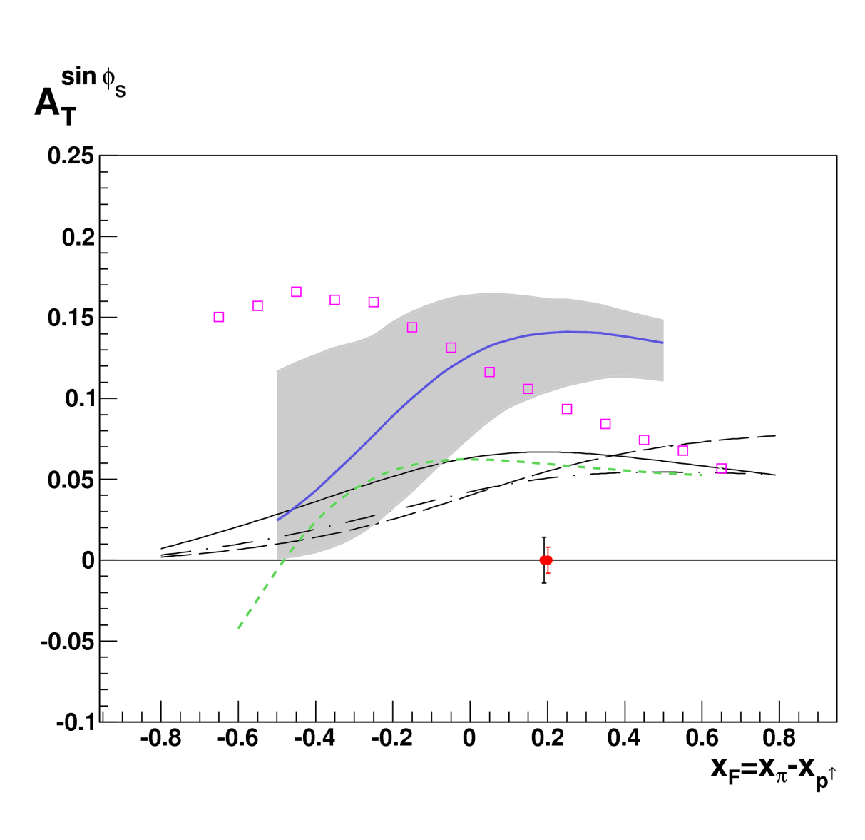
Predictions for Drell-Yan at COMPASS
Drell –Yan π⁻ p → μ⁺μ⁻X
with the COMPASS spectrometer equipped with an absorber
Sivers function in the safe dimuon
mass region 4 < M_{μ+μ-} < 9 GeV
2 years of data
190 GeV pion beam
6 .10⁸ π⁻/spill (of 9.6s)
1.1 m transv. pol. NH₃ target
Lumi=1.2 10³² cm⁻²s⁻¹
Blue line with grey band:
Anselmino et al., PRD79 (2009)
Black solid and dashed:
Efremov et al., PLB612 (2005)
Black dot-dashed:
Collins et al., PRD73 (2006)
Squares:
Bianconi et al., PRD73 (2006)
Green short-dashed:
Bacchetta et al., PRD78 (2008)
The change of sign can already be seen in 1 year

Slide 7
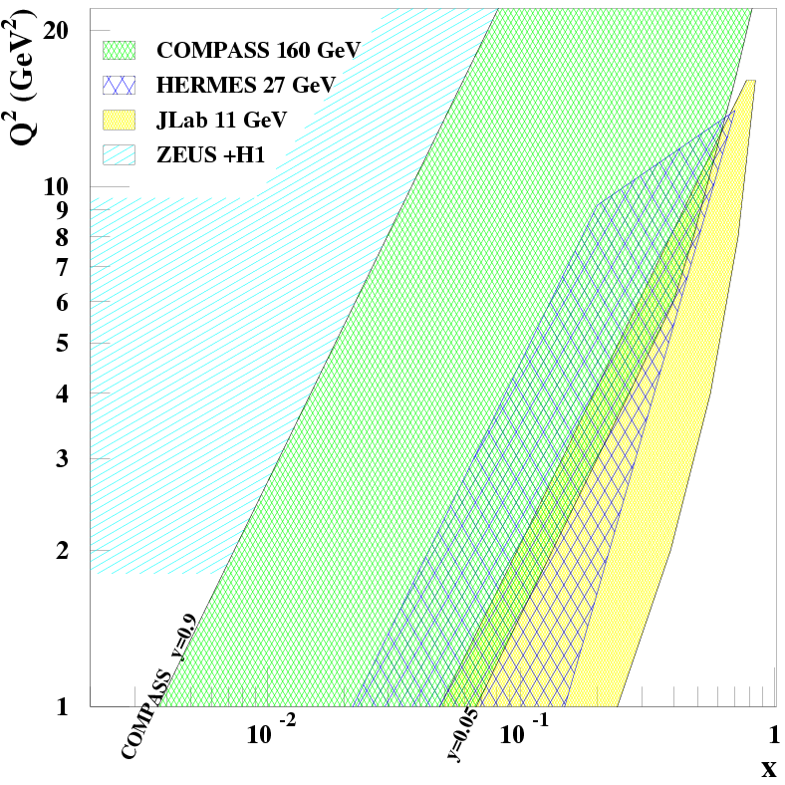
What makes COMPASS unique for GPDs?
CERN High energy muon beam
  100 - 190 GeV
  μ⁺ and μ⁻ available
  80% Polarisation
  with opposite polarization
Will explore
the intermediate x_{Bj} region
Uncovered region between
ZEUS+H1 and HERMES+Jlab
before new colliders may be
available
presently only 2 actors:
JLab and COMPASS
Transverse structure at
x~10⁻² essential input for
phenemenology of high-
energy pp collision (LHC)
B

Slide 8
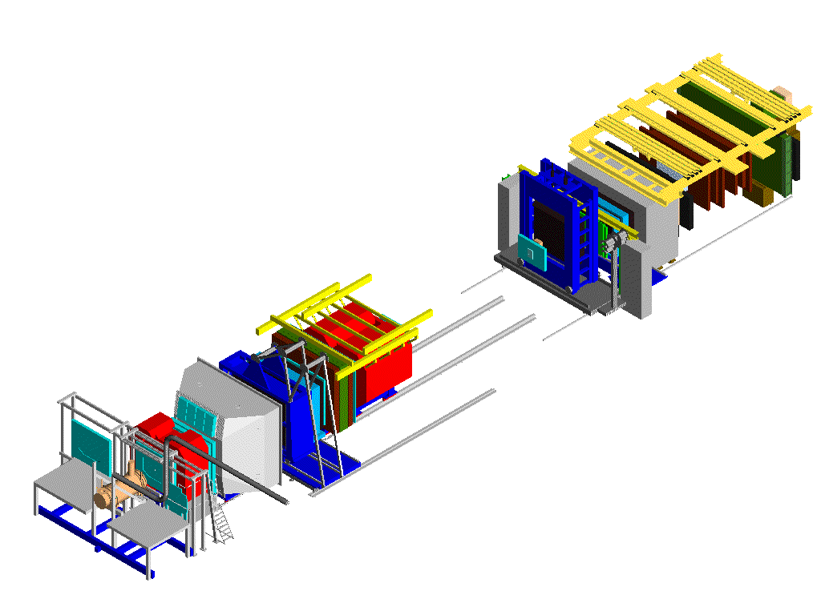
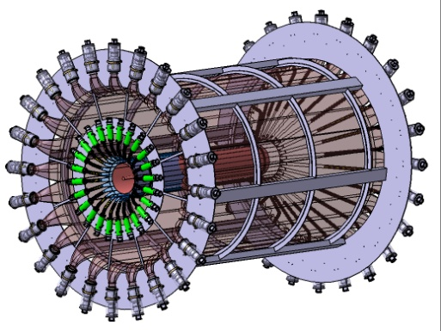
Experimental requirements for DVCS
μ p → μ’ p γ
μ’
Phase 1
~ 2.5 m Liquid Hydrogen Target
~ 4 m Recoil Proton Detector (RPD)
γ
SM2
ECAL2
SM1
ECAL1
ECALs upgraded
+ ECAL0 before SM1
μ
p’
Phase 2 (in future)
Polarized Transverse Target
Integrating RPD

Slide 9
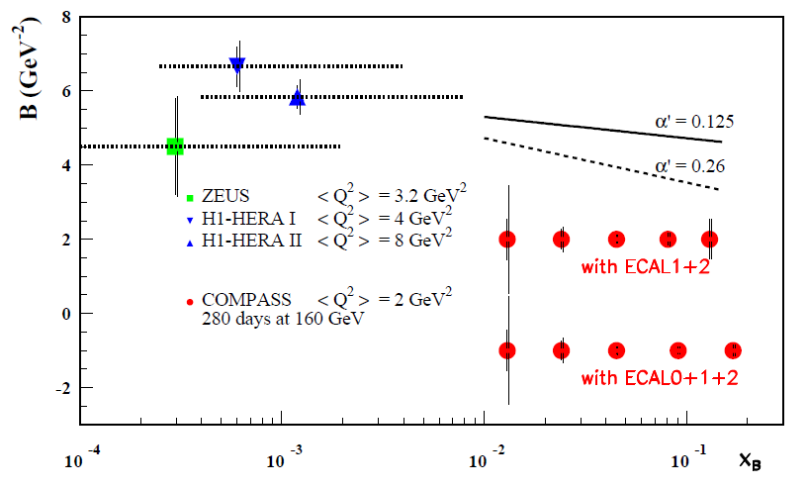
DVCS: Transverse imaging at COMPASS
dσ_{DVCS}/dt ~ exp(-B|t|)
14
Transverse size
of the nucleon
?
1.
0.5
0.65 ±0.02 fm
H1 PLB659(2008)
COMPASS
x_{B}
2 years, 160 GeV muon beam, 2.5m LH₂ target, ε_{global} = 10%
without any model we can extract B(x_{B})
B(x_{B}) = ½ < r⊥² (x_{B}) >
r⊥ is the transverse size of the nucleon

Slide 10
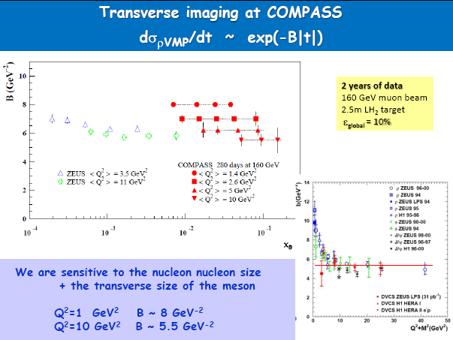

Slide 11
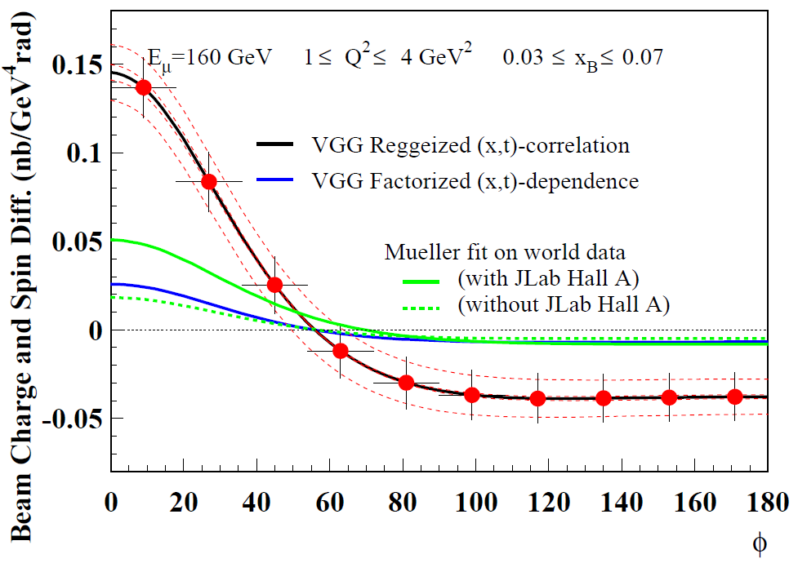
Beam Charge and Spin Difference (using D_{CS ,U})
Comparison to different models
μ’
γ*
γ
μ
θ
φ
p
α’=0.8
α’=0.05
2 years of data
160 GeV muon beam
2.5m LH₂ target
ε_{global} = 10%
Systematic error bands assuming a 3% charge-dependent effect
between μ+ and μ- (control with inclusive evts, BH…)

Slide 12
Summary for GPD @ COMPASS
GPDs investigated with Hard Exclusive Photon and Meson Production
  the t-slope of the DVCS cross section ……………… LH₂ target + RPD……phase 1
  → transverse distribution of partons
  the Beam Charge and Spin Sum and Difference and Asymm…………….phase 1
  → Re T^{DVCS} and Im T^{DVCS} for GPD H determination
  the Transverse Target Spin Asymm………polarised NH₃ target + RPD……phase 2
  → GPD E and angular momentum of partons (future addendum)

Slide 13
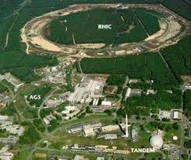
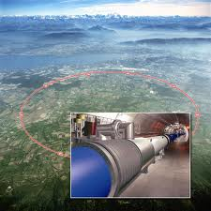

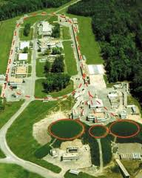
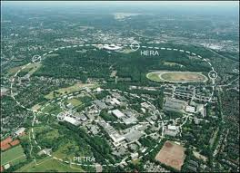

Electron Ion Colliders on the World Map
LHC ➔ LHeC
RHIC ➔ eRHIC
CEBAF ➔ MEIC
HERA
FAIR ➔ ENC

Slide 14
The Science of an MEIC
Nuclear Science Goal: How do we understand the visible matter in our universe in terms of the fundamental quarks and gluons of QCD?
Overarching EIC Goal: Explore and Understand QCD
Three Major Science Questions for an EIC (from NSAC LRP07):
What is the internal landscape of the nucleons?
What is the role of gluons and gluon self-interactions in nucleons and nuclei?
What governs the transition of quarks and gluons into pions and nucleons?
Or, Elevator-Talk EIC science goals:
Map the spin and spatial structure of quarks and gluons in nucleons
(show the nucleon structure picture of the day…)
Discover the collective effects of gluons in atomic nuclei
(without gluons there are no protons, no neutrons, no atomic nuclei)
Understand the emergence of hadronic matter from quarks and gluons
(how does M = E/c² work to create pions and nucleons?)
+ Hunting for the unseen forces of the universe?

Slide 15
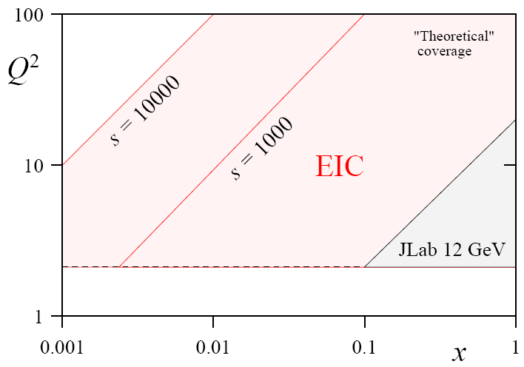
MEIC assumptions
s
x = Q²/ys
s
(x,Q²) phase space directly correlated with s (=4E_{e}E_{p}) :
@ Q² = 1 lowest x scales like s⁻¹
@ Q² = 10 lowest x scales as 10s⁻¹
C. Weiss
Detecting only the electron y_{max} / y_{min} ~ 10
Also detecting all hadrons y_{max} / y_{min} ~ 100
C. Weiss
(“Medium-Energy”) EIC@JLab option driven by:
access to sea quarks (x > 0.01 (0.001?) or so)
deep exclusive scattering at Q² > 10 (?)
any QCD machine needs range in Q²
→ s = few 100 - 1000 seems right ballpark
→ s = few 1000 allows access to gluons, shadowing
Requirements for deep exclusive and high-Q² semi-inclusive reactions also drives request for (lower &) more symmetric beam energies.
Requirements for very-forward angle detection folded in IR design

Slide 16
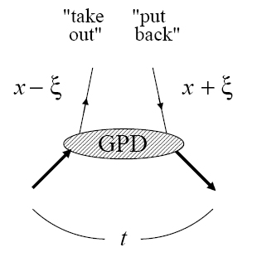
Transverse Quark & Gluon Imaging
Deep exclusive measurements in ep/eA with an EIC:
diffractive: transverse gluon imaging J/ψ, φ, ρº, γ (DVCS)
non-diffractive: quark spin/flavor structure π, K, ρ⁺, …
Are gluons uniformly distributed in nuclear matter or are there small clumps of glue?
Are gluons & various quark flavors similarly distributed?
(some hints to the contrary)
Describe correlation of longitudinal momentum and transverse position of quarks/gluons →
Transverse quark/gluon imaging of nucleon
(“tomography”)

Slide 17
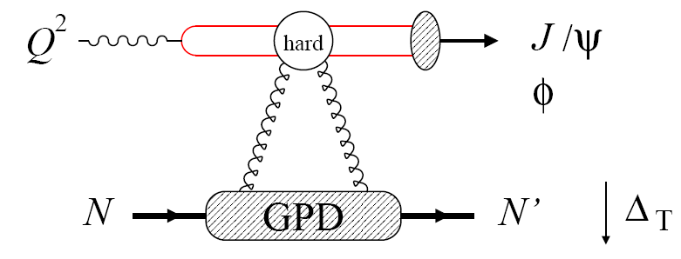
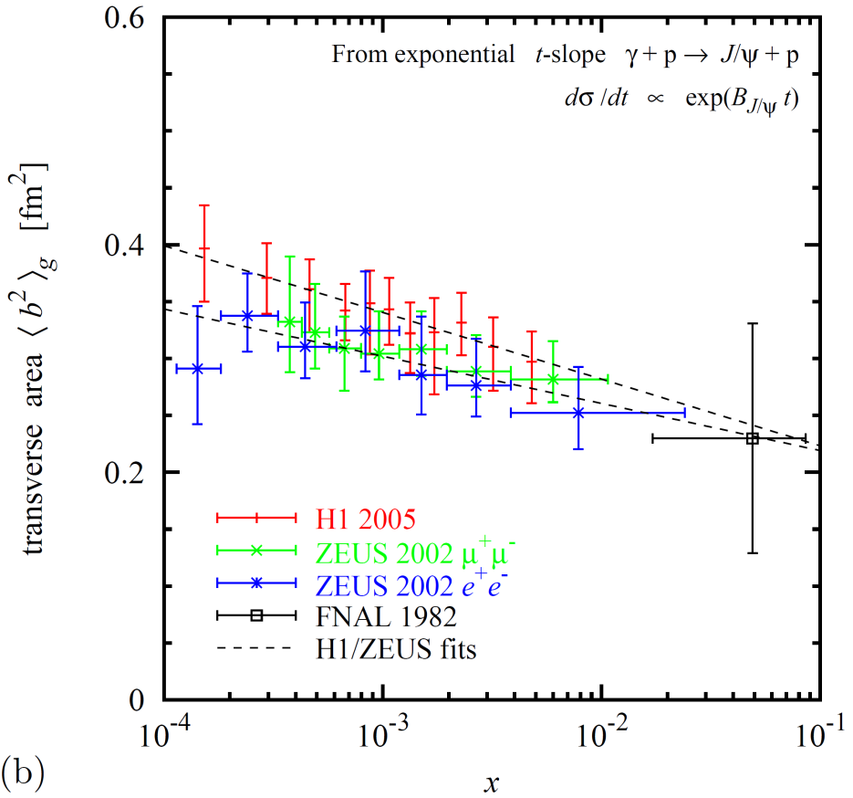
Gluon Imaging with J/Ψ (or φ)
Transverse spatial distributions from exclusive J/ψ, and φ at Q²>10 GeV²
  Transverse distribution directly from Δ_{T} dependence
  Reaction mechanism, QCD description studied at HERA [H1, ZEUS]
Physics interest
  Valence gluons, dynamical origin
  Chiral dynamics at b~1/M_{π}
  [Strikman, Weiss 03/09, Miller 07]
  Diffusion in QCD radiation
Existing data
  Transverse area x < 0.01 [HERA]
  Larger x poorly known [FNAL]
[Weiss INT10-3 report]

Slide 18
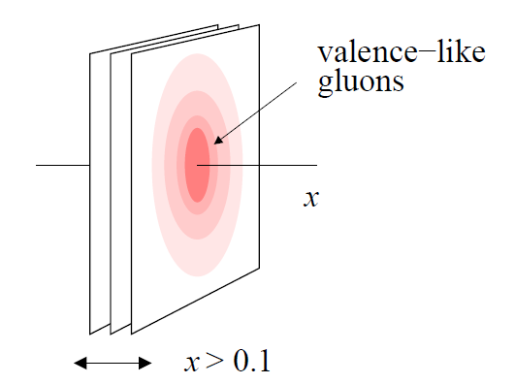

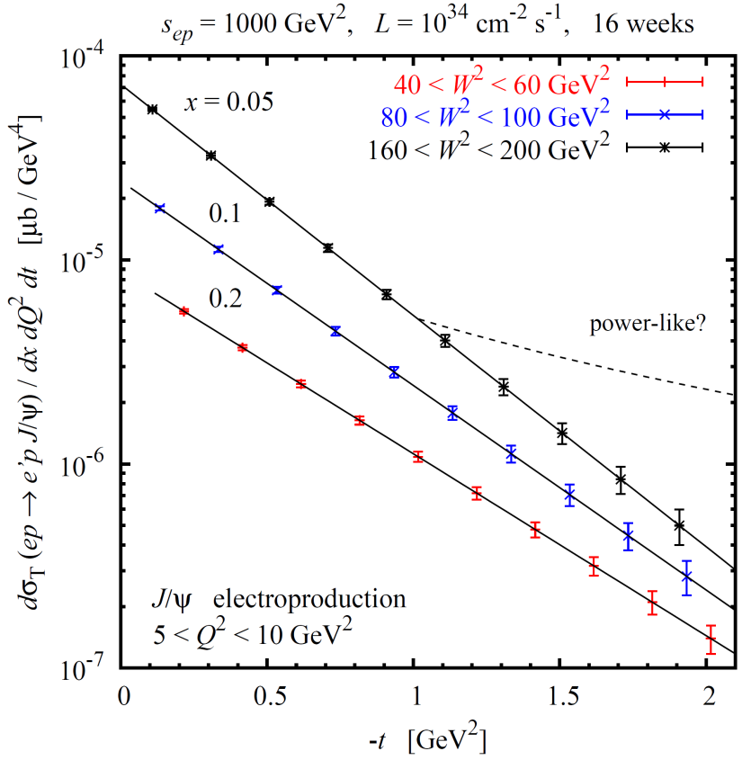
Gluon Imaging: Valence-like Gluons
EIC: Precise Gluon imaging through exclusive J/Ψ and φ (Q² > 10 GeV²)
valence-like gluons
~100 days, ε=1.0, L=10³⁴ s⁻¹cm⁻²
Transverse distribution derived directly from Δ_{T}-dependence
EIC: Map unknown region of non-perturbative gluons at x > 0.01
Needed for imaging
  Full t-distribution to allow Fourier transform, and distinguish e.g. between exponential (solid) and power-like (dashed) fall-off
  Q² > 10 GeV², various channels
1st gluonic images of nucleon @ large x
√s~30 GeV
[Weiss INT10-3 report]

Slide 19
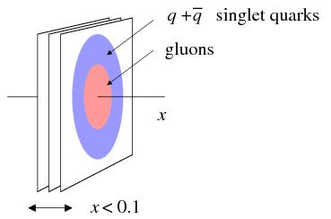
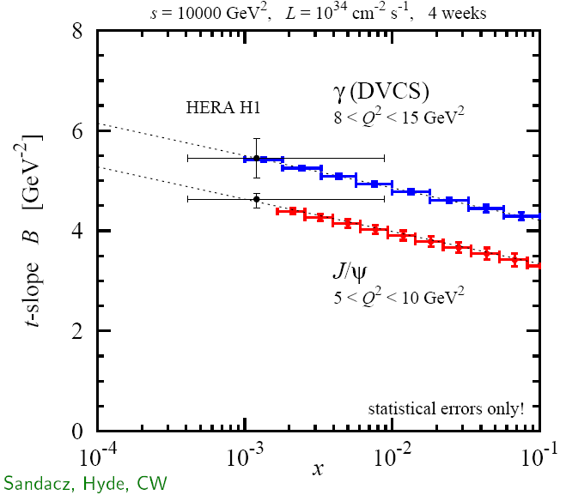
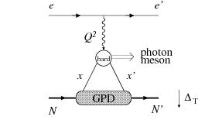
Gluon Imaging: Gluon vs Quark Size
Do singlet quarks and gluons have the same transverse distribution?
Hints from HERA:
Area (q + q) > Area (g)
Dynamical models predict difference:
pion cloud, constituent quark picture
-
EIC: Gluon size from J/Ψ electroproduction,
singlet quark size from deeply virtual
compton scattering
~30 days, ε=1.0, L =10³⁴ s⁻¹cm⁻²
Detailed differential images of nucleon’s partonic structure
√s=100 GeV
[Sandacz, Hyde, Weiss 08+]

Slide 20
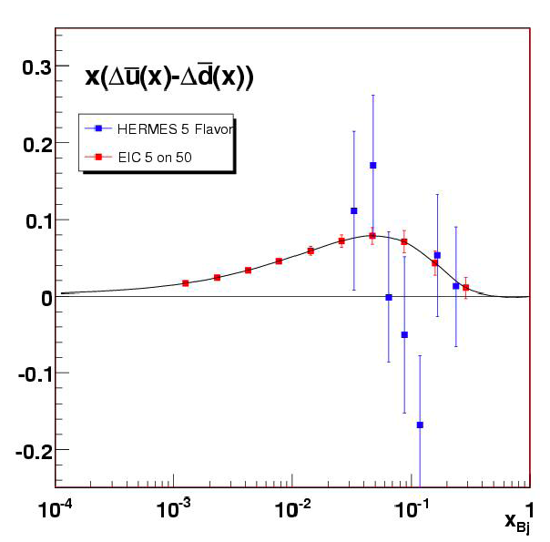
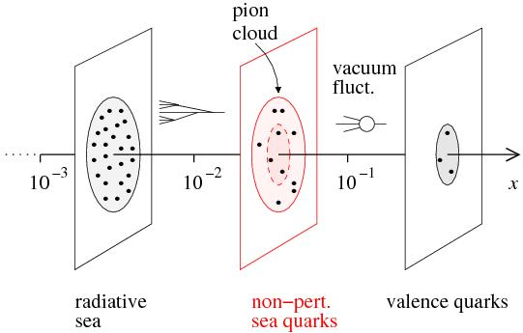
Sea Quark Polarization
Spin-Flavor Decomposition of the Light Quark Sea
}
100 days, L =10³³, s = 1000
Access requires s ~ 1000 (and good luminosity)
Kinney, Seele
u
u
u
Many models predict
Δu > 0, Δd < 0
>
u
d
| p = + + + …
u
u
u
u
d
d
d
d

Slide 21
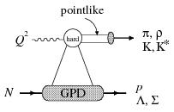
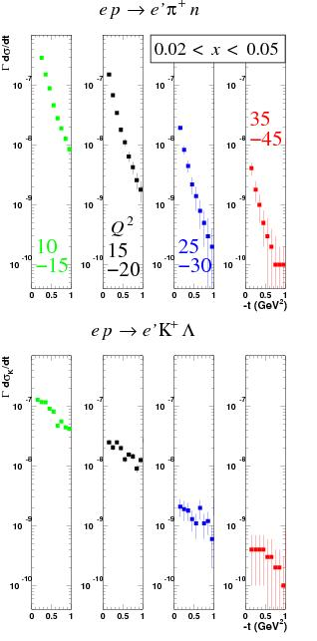
Sea Quark Imaging
Do strange and non-strange sea quarks have the same spatial distribution?
  πN or KΛ components in nucleon
  QCD vacuum fluctuations
  Nucleon/meson structure
~100 days, ε=1.0, L=10³⁴ s⁻¹cm⁻²
Accessible with exclusive π and K production!
Q² > 10(?) GeV² relevant for application of factorization
Statistics hungry
35
-45
Q²
15
-20
25
-30
10
-15
Imaging of strange sea quarks!
√s~30 GeV
[Horn et al. 08+, INT10-3 report]

Slide 22
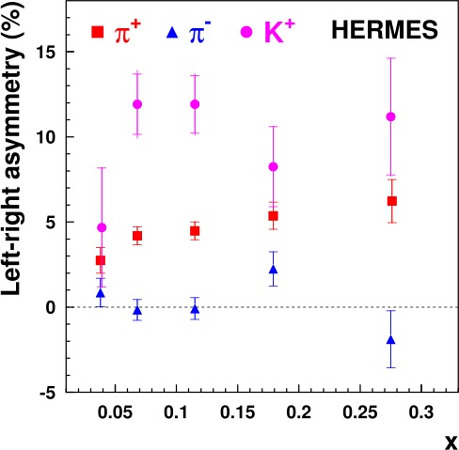
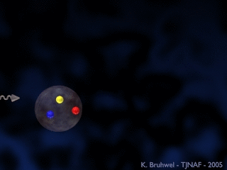
Image the Transverse Momentum of the Quarks
Swing to the left, swing to the right:
A surprise of transverse-spin experiments
The difference between the π⁺, π–, and K⁺ asymmetries reveals that quarks and anti-quarks of different flavor are orbiting in different ways within the proton.
dσ^{h} ~ Σe_{q}²q(x) dσ_{f} D_{f}^{h}(z)
Sivers distribution

Slide 23
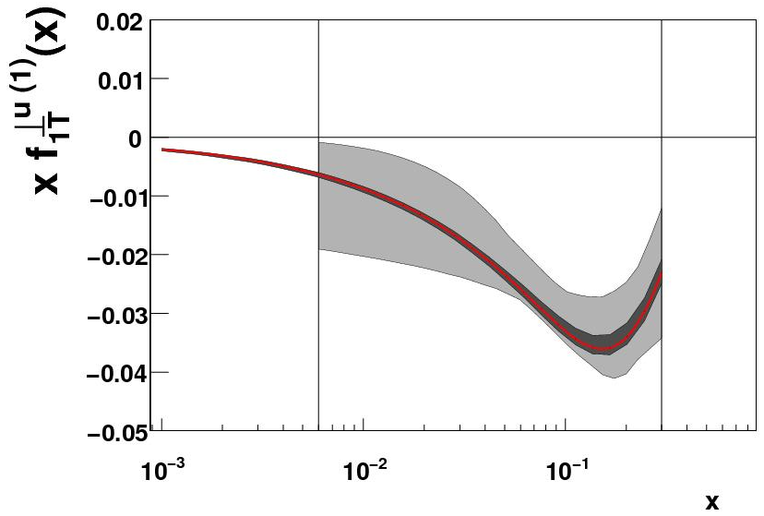
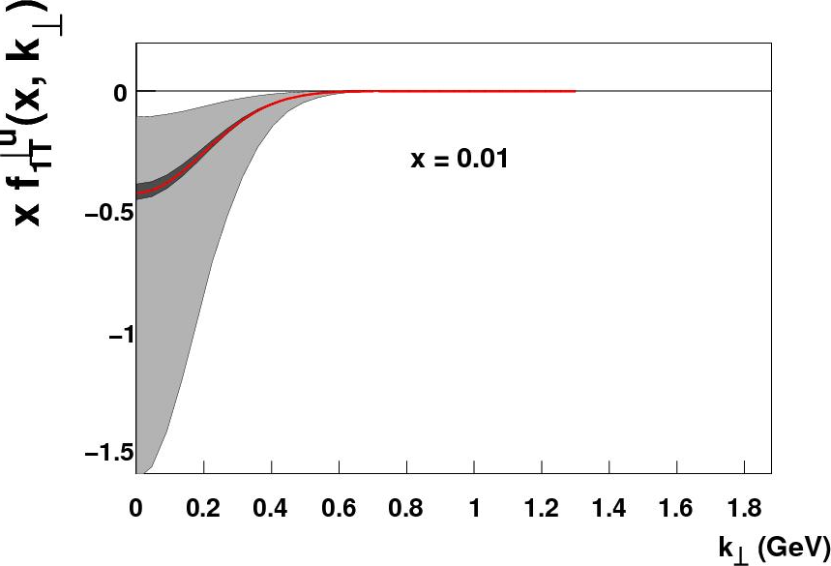
Image the Transverse Momentum of the Quarks
Prokudin, Qian, Huang
Only a small subset of the (x,Q²) landscape has been mapped here: terra incognita
Gray band: present “knowledge”
Red band: EIC (1σ)
(dark gray band: EIC (2σ))
Prokudin
Exact k_{T} distribution presently unknown!
“Knowledge” of k_{T} distribution at large k_{T} is artificial!
(but also perturbative calculable limit at large k_{T})
An EIC with good luminosity & high transverse polarization is the optimal tool to to study this!

Slide 24
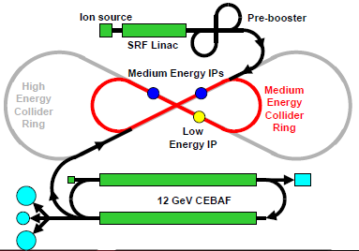
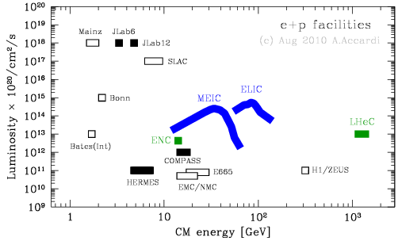
Present MEIC Design
The present JLab EIC design focuses on a medium CM energy range up to 65 GeV, however, retains an upgrade option to reach higher energy and luminosity
MEIC reaches 6x10³³ cm⁻²s⁻¹ luminosity for a full acceptance detector at a 60x5 GeV² design point, and double this luminosity for a 2nd large acceptance detector. Proton energies up to 100 GeV are o.k. (with luminosity scaling with γ).
The present MEIC design takes a conservative technical approach by limiting several key design parameters within state-of-the-art. It relies on regular electron cooling to obtain the ion beam properties.
CASA has established extensive collaborations with scientists worldwide on MEIC design and R&D. It also works closely with the physics community.

Slide 25
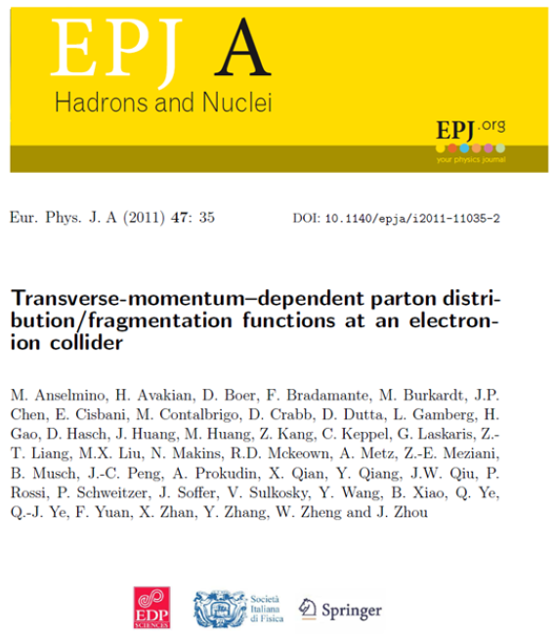
EIC Community Efforts
1 out of 5 User-Led Workshops Related to EIC Physics has been Published as Refereed Publication.
Plans remain to publish Imaging, Nuclear QCD, and detector/IR.
JLab Staff and Users Submitted Three Proposals in Response to a Call for Proposals within a Generic R&D Program Funded by BNL.
Work “completed” on the Yellow Book / White Paper following the 10-week INT Program. JLab staff and Users were editors of science sections & the accompanying detector section.
Good representation of JLab users in the Steering Committee to draft “executive summary style” EIC White Paper from INT.

Slide 26
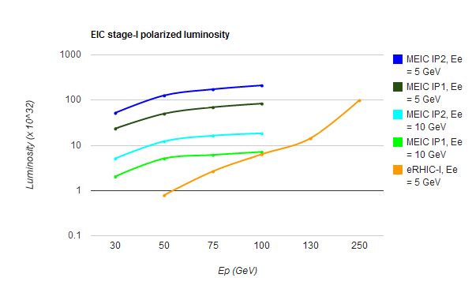
EIC Luminosity – Beware what you get
High luminosity where you want it!
t range of 0-2 does not correspond
to infinitesimally small angles
→ Remove Roman Pots where possible!
full acceptance of detector (do not
hit peak fields in focusing quads)
Ease of particle identification
Ease of polarized beam
Base EIC Requirements per Executive Summary INT Report:
    range in energies from s ~ 400 to s ~ 5000 & variable
    fully-polarized (>70%), longitudinal and transverse
    ion species up to A = 200 or so
    high luminosity: about 10³⁴ e-nucleons cm⁻² s⁻¹
    multiple interaction regions
    upgradable to higher energies

Slide 27
Summary for EIC
Close and frequent collaboration between accelerator and nuclear physicists regarding the machine, interaction region and detector requirements has taken place. The MEIC detector/IR design has concentrated on maximizing acceptance for deep exclusive processes and processes associated with very-forward going particles, over a wide range of proton energies (20-100 GeV).
Potential ring layouts for MEIC, including integrated interaction regions, have been made. Chromatic compensation for the baseline parameters has been achieved in the design. A remaining task is to quantify the dynamic aperture of the designs. Suitable electron and ion polarization schemes have been integrated into the design.
We have unique opportunities to make a (future textbook) breakthrough in nucleon structure and QCD dynamics, including:
  the possibility to truly explore and image the nucleon
  the possibility to study the role of gluons in structure and dynamics
BNL and JLab management, and the EIC community, closely collaborate, and some convergence has occurred on performance deliverables in terms of energy and luminosity, detector design, and the EIC realization timeline. Nonetheless, differences remain in design approach, interaction region integration, and benchmark processes.

