Slide 1
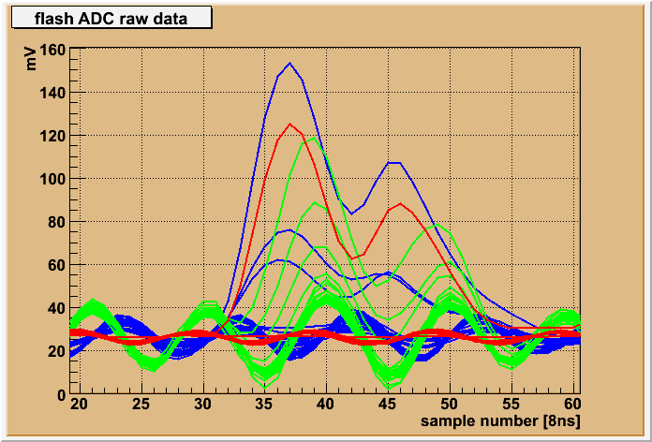
FDC pulse data format
Wires Upper strips Down strips

Slide 2
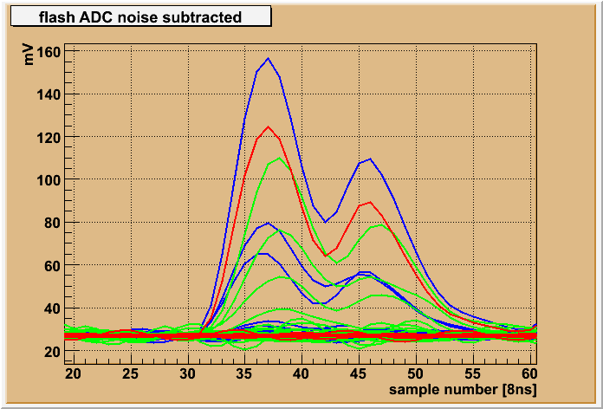
FDC pulse data format
Wires Upper strips Down strips

Slide 3
FDC pulse data format
fADC125 is needed for:
1) find the center of the avalanche using signals from at least 5 strips (+/- 2 from the central) in a presence of noise; most important are the side strips with amplitudes close to the noise
2) make sure the signals from all the strips and the wire (seeing the same avalanche) have the same shape and timing
Without real data (real noise) from the Hall we can’t optimize the strip resolution: need to have more quantities like: integral, peak amplitudes and their timings
~80% from the data comes from the FDC: need to use effectively all the bits
Common FDC/CDC data format:
- Leading edge time:11+1 bits (as needed for the CDC)
Integral: 12 bits (don't need better precision), OR peak amplitude (in another mode)
Peak time: 8 bits in samples (FDC needs 7 bits), OR integral range in samples (CDC may need this?)
Pedestal: 11 bits (maybe 8 bits are enough, but to be safe?)
- Overflows: 3 bits
First word (15 free bits): Integral/peak amplitude (12), Overflow (3)
Second word (31 free bits): Leading edge time (12), Peak time/Integral range (8), Pedestal (11)

