Slide 1
Vladimir Berdnikov
FDC`s cathode strips calibration
FDC/CDC meeting. October 16 2014.

Slide 2
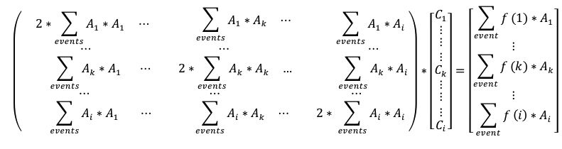
Slide 2. Calibration procedure.
-For each hit total charge on upper strips = down strips (first term in minimization sum)
-For each cathode hit, induced charge has certain distribution over the strips: Matheson function f(xstrip)
-For each hit and each cathode first fit the charge distribution then accumulate the matrix event by event
-Do next iteration using the estimated coefficients Ci

Slide 3
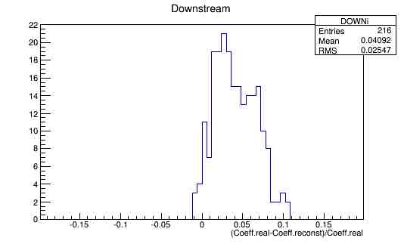
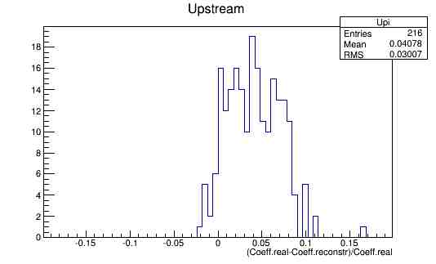
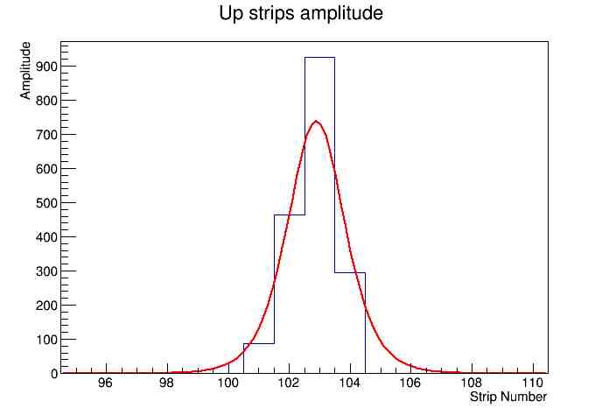
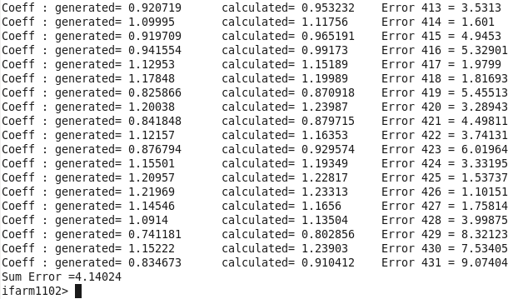
Slide 3. The result using simulated events.
-Results using simulated events:
Ci varying by 30% (few factor of 3 higher)
-Charge +/-50%
-Threshold at 15% of mean charge
-Random noise 50% of threshold
-Results: Ci estimated with ~3% error

Slide 4
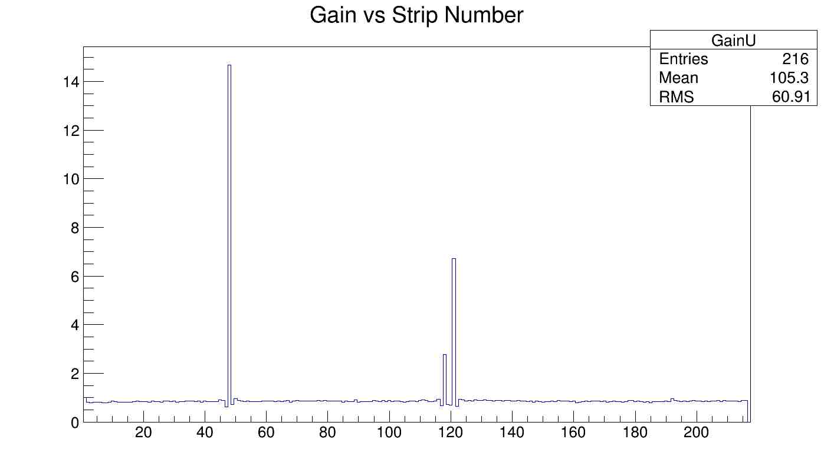
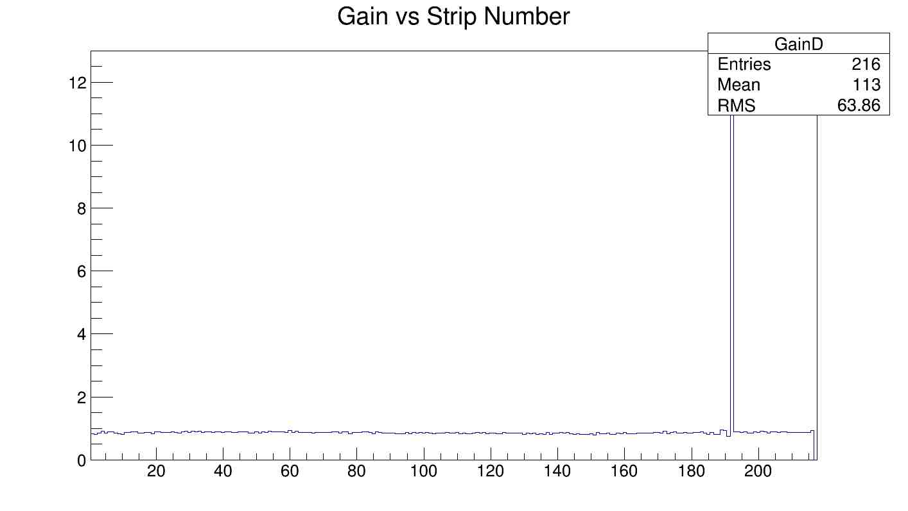
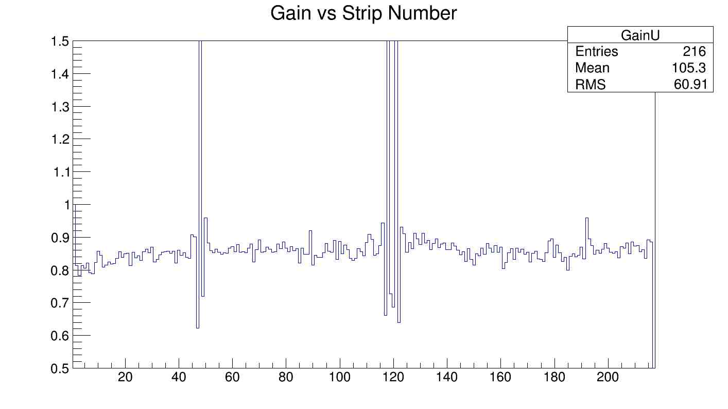
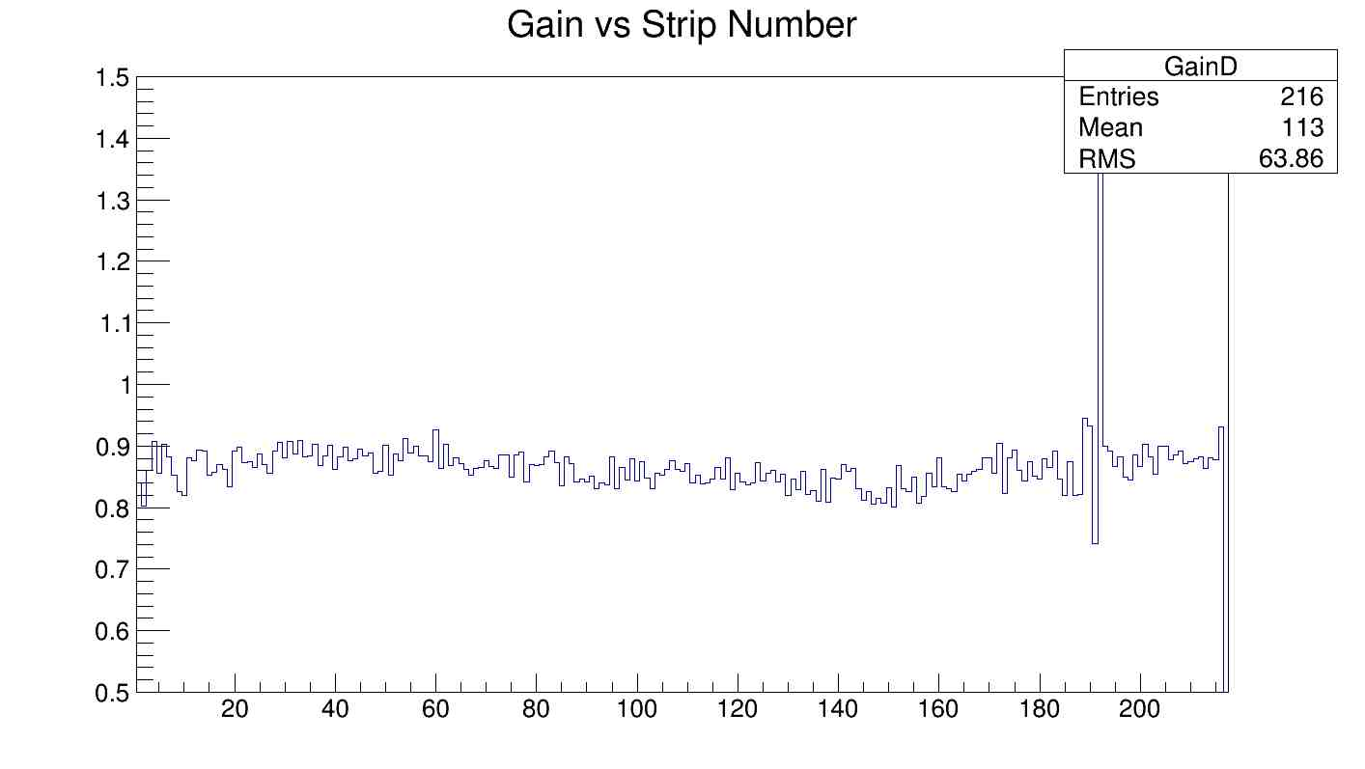
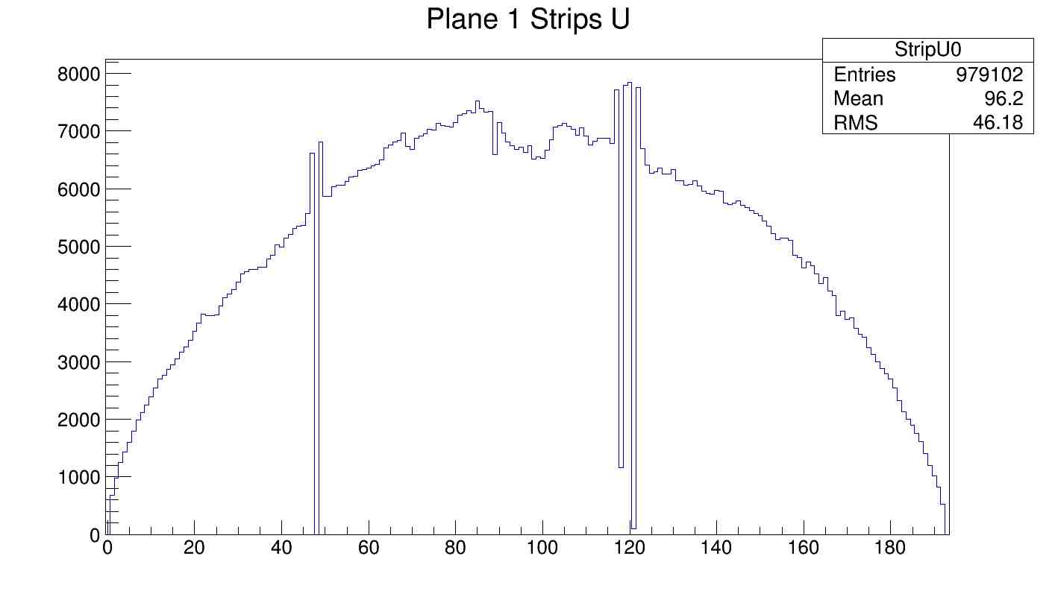
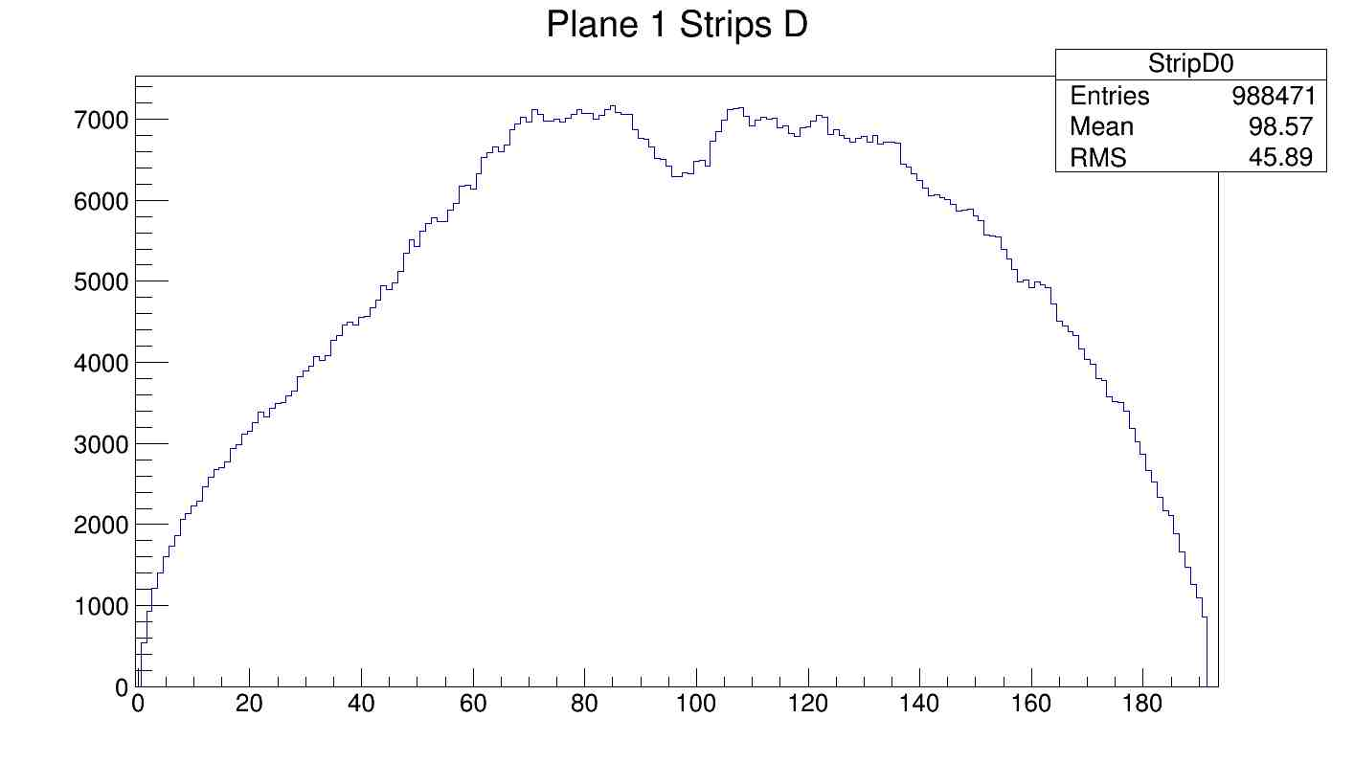
Slide 4. Result using package 3 EEL126 cosmic test data. Cell1.

Slide 5
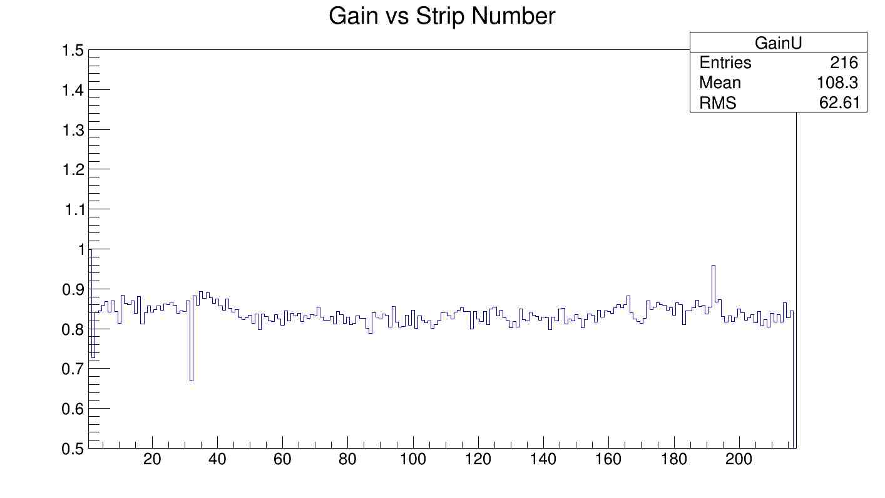
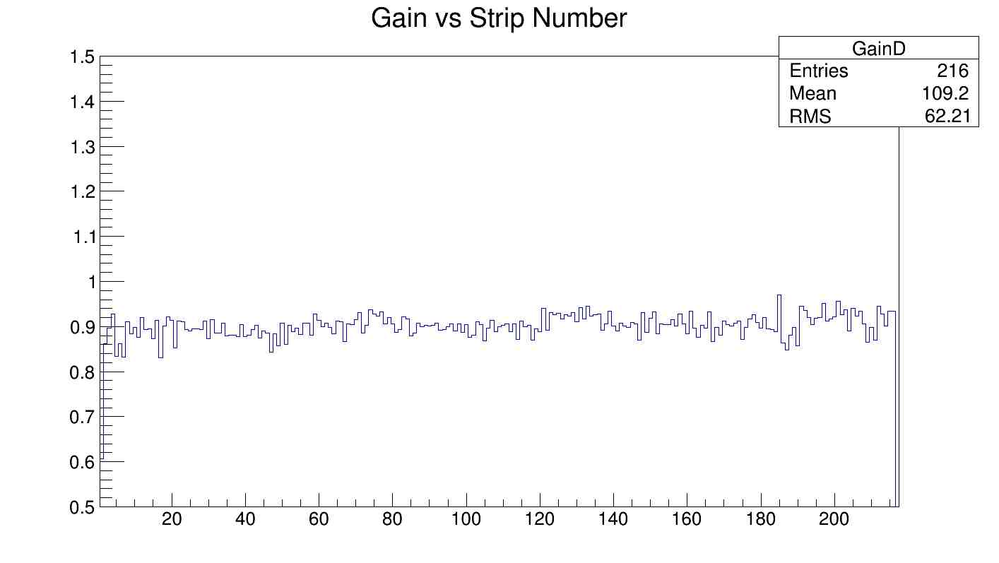
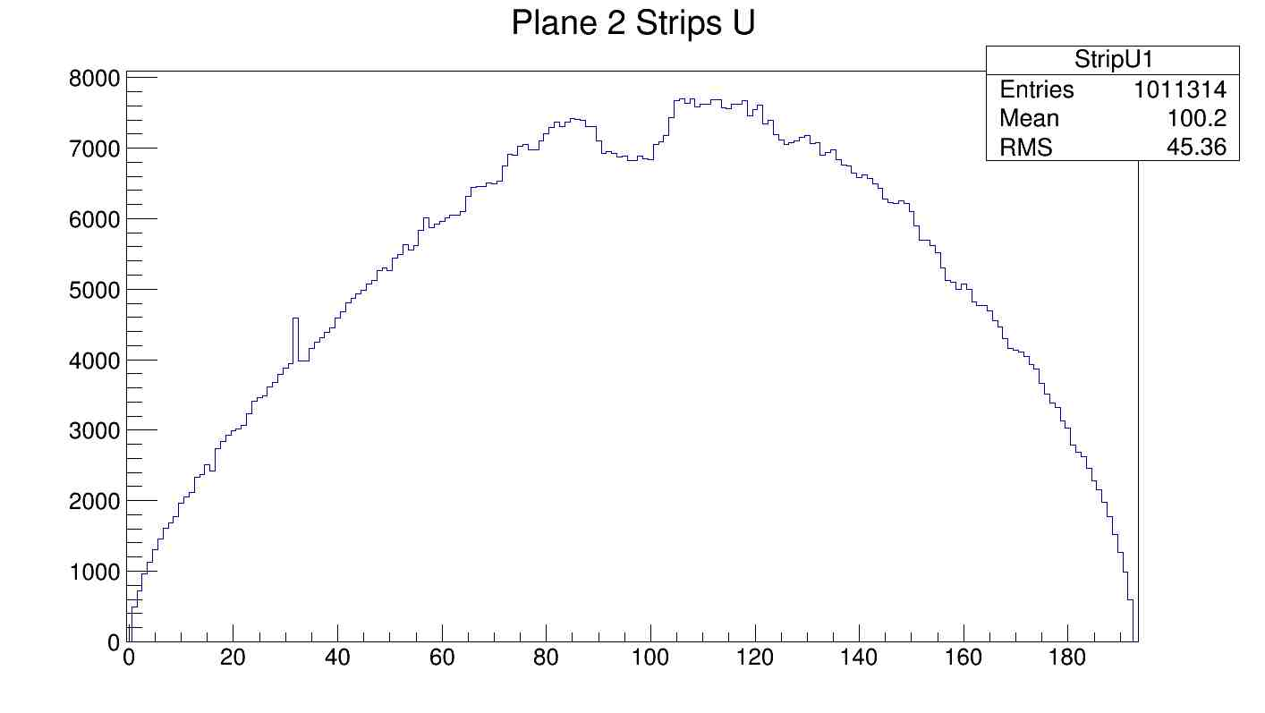
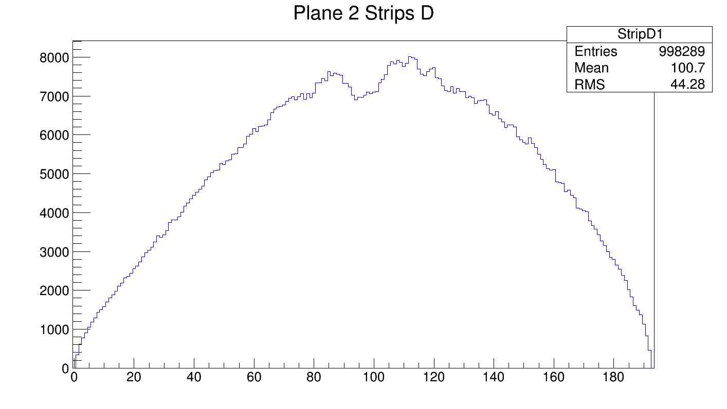
Slide 5. Result using package 3 EEL126 cosmic test data. Cell2.

Slide 6
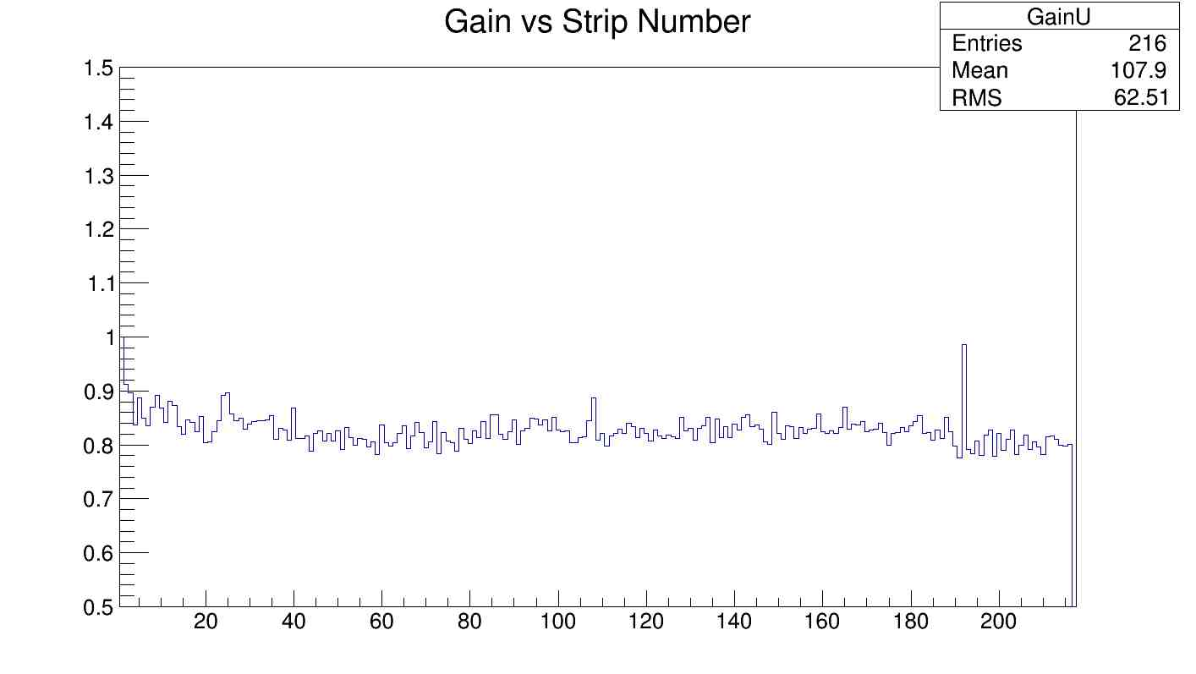
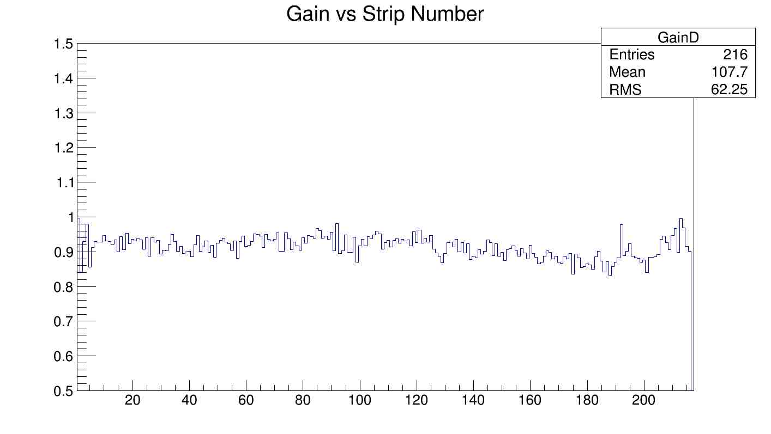
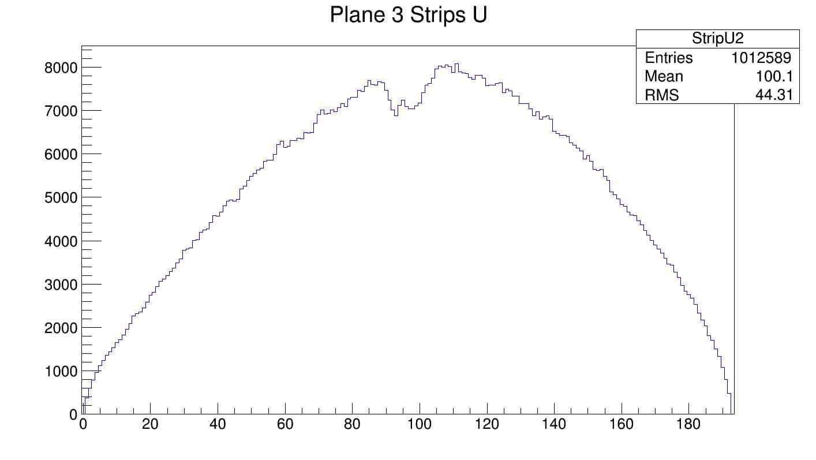
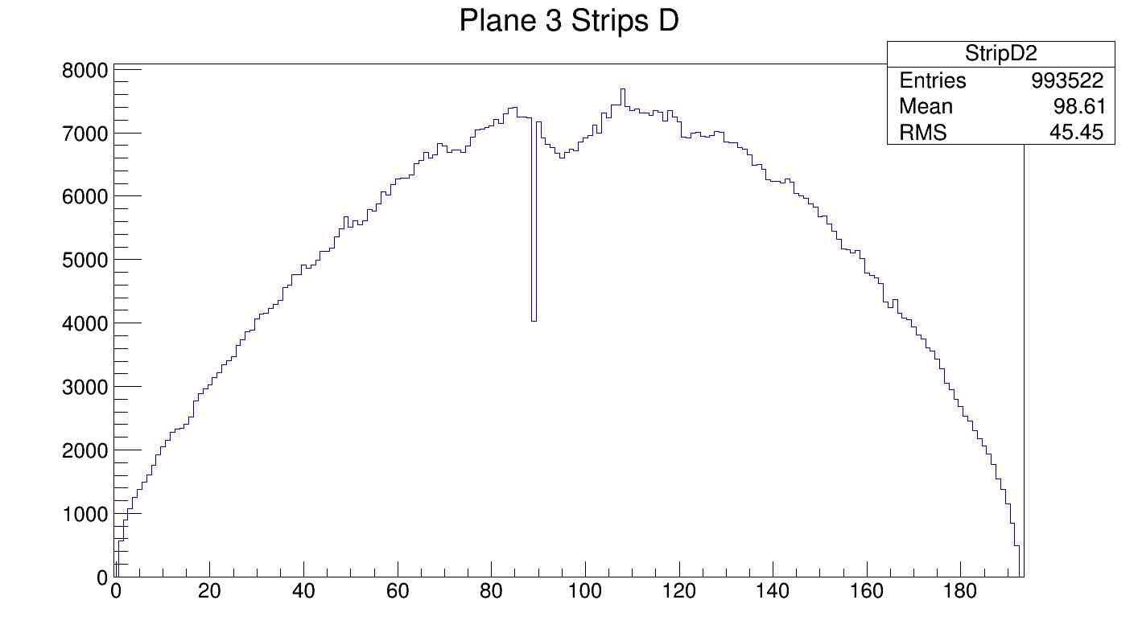
Slide 6. Result using package 3 EEL126 cosmic test data. Cell 3.

Slide 7
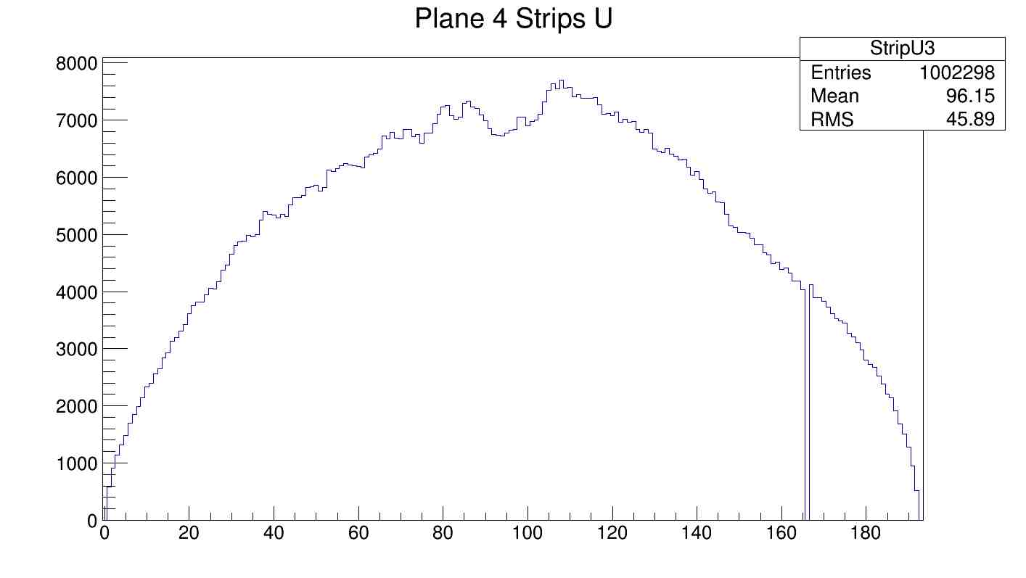
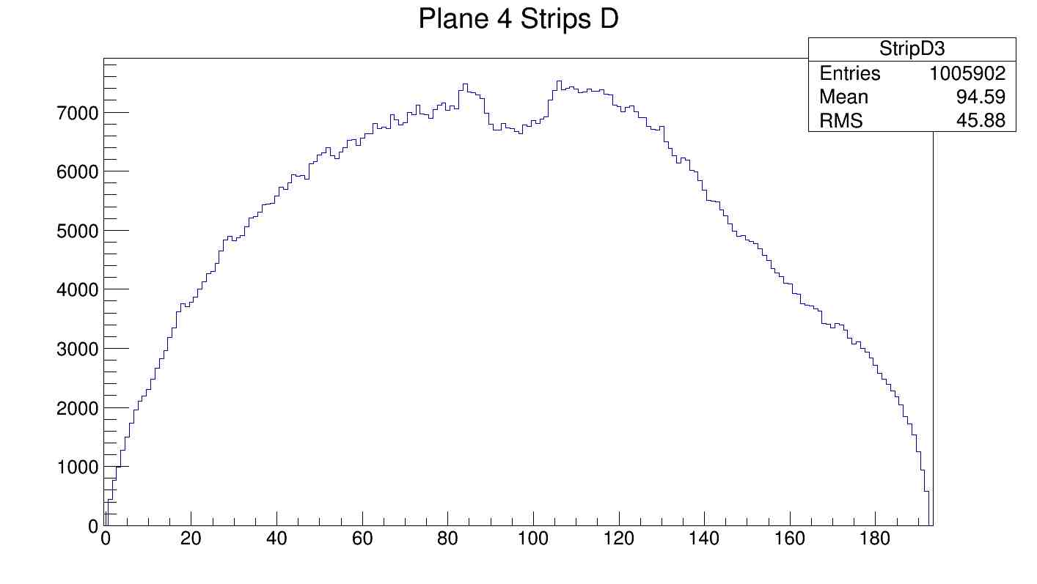
Slide 7. Result using package 3 EEL126 cosmic test data. Cell 4.
Matrix decomposition failed.
-2 neighbor upstream strips are “dead” this introduce issues to solve the equation
Possible solutions :
-->Double check the code. Find and fix bugs in the calculation code if such present.
-->Exclude bad area and calculate coefficients without bad strips.
-->Using more complex terms when creating calibration data file.

Slide 8
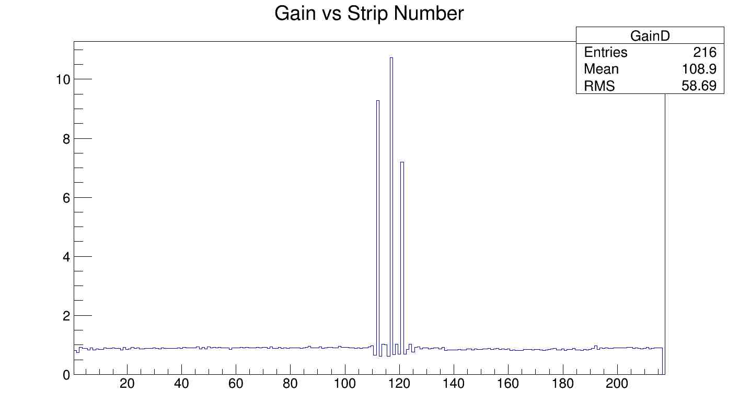

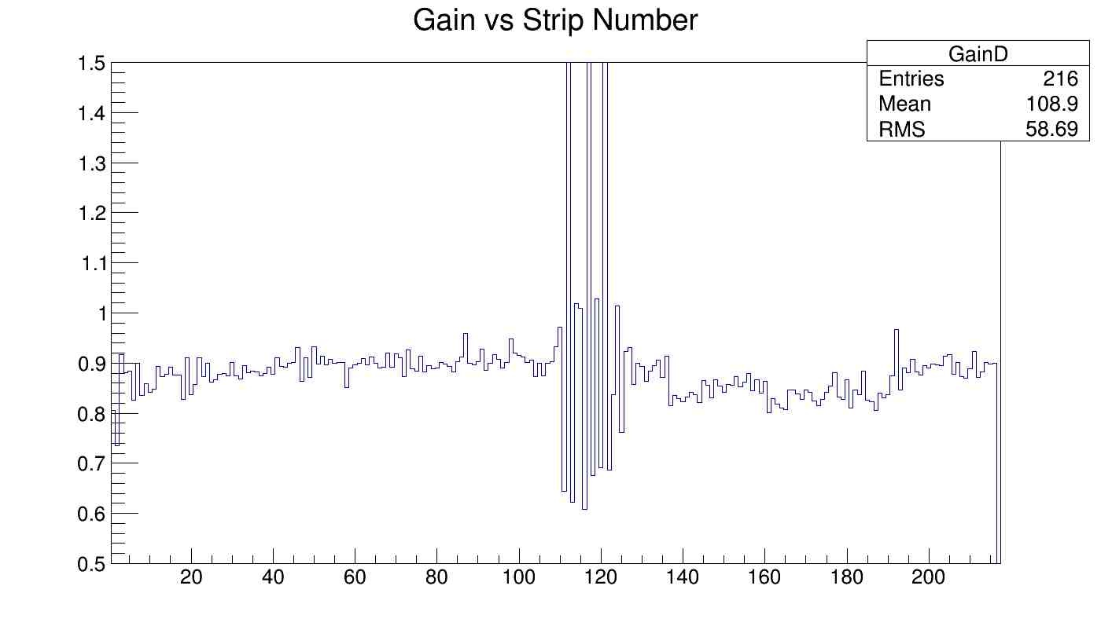
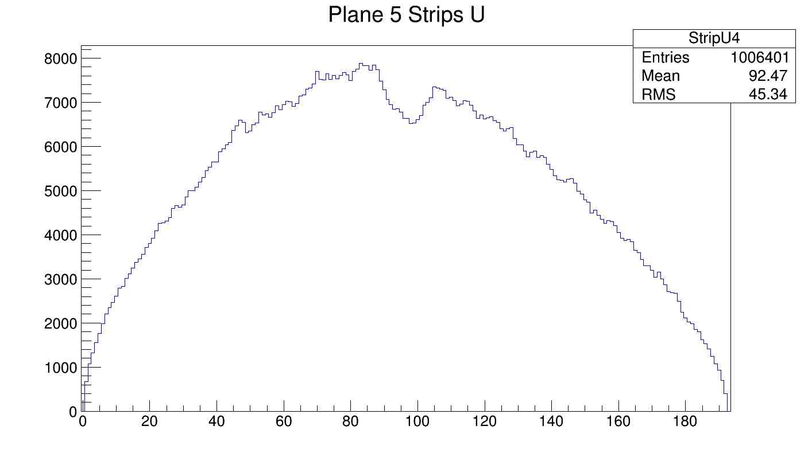
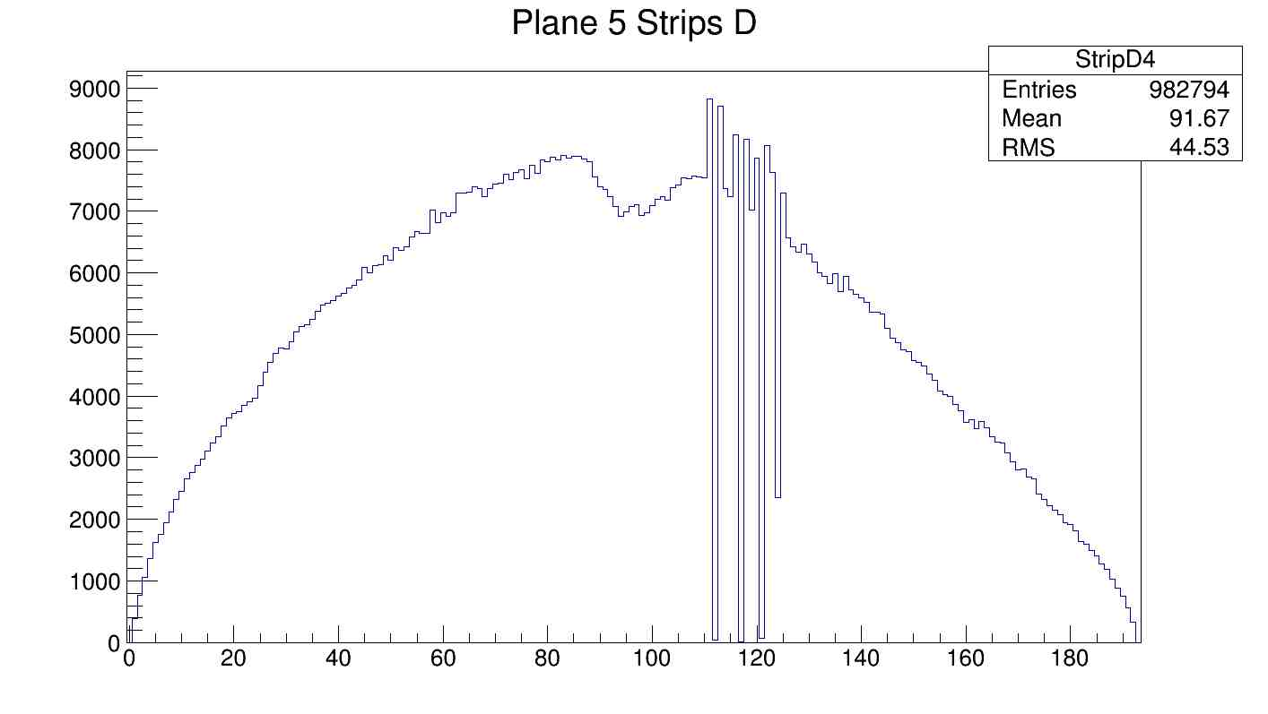
Slide 8. Result using package 3 EEL126 cosmic test data. Cell 5.

Slide 9
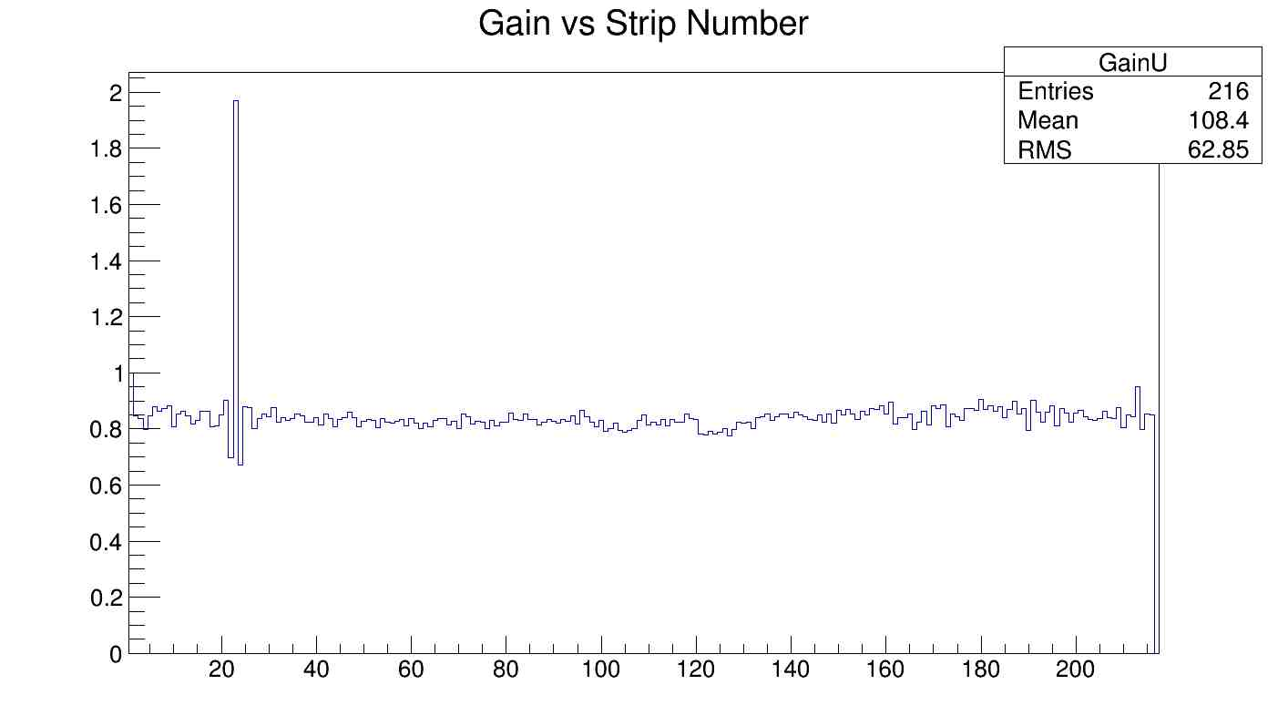
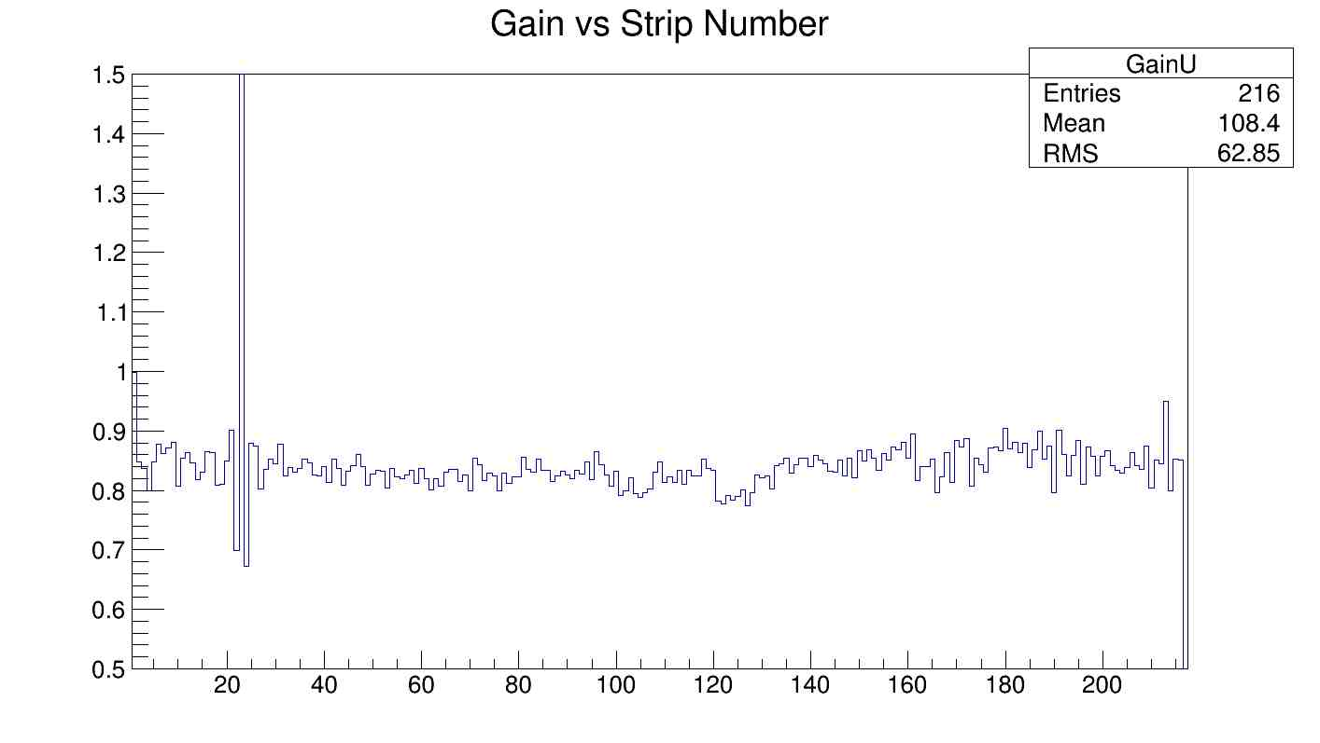
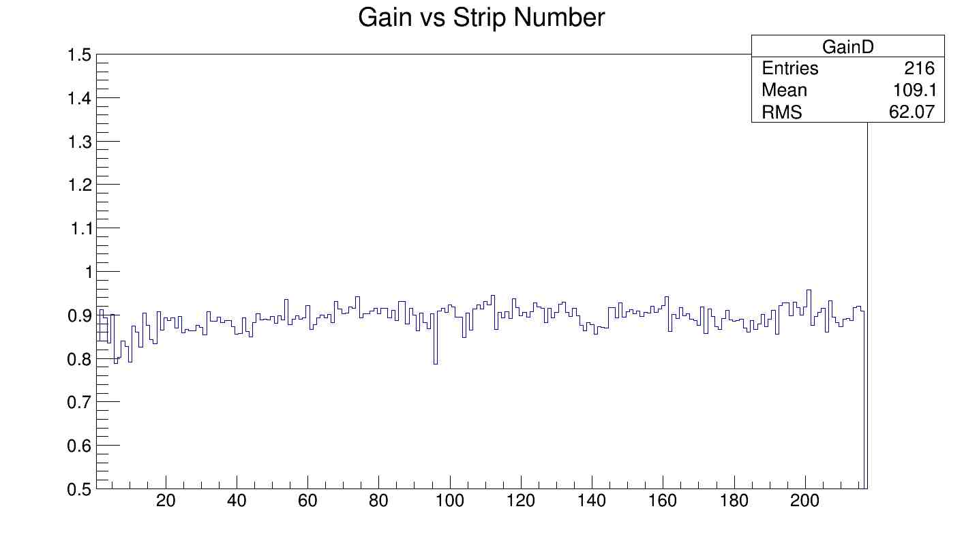
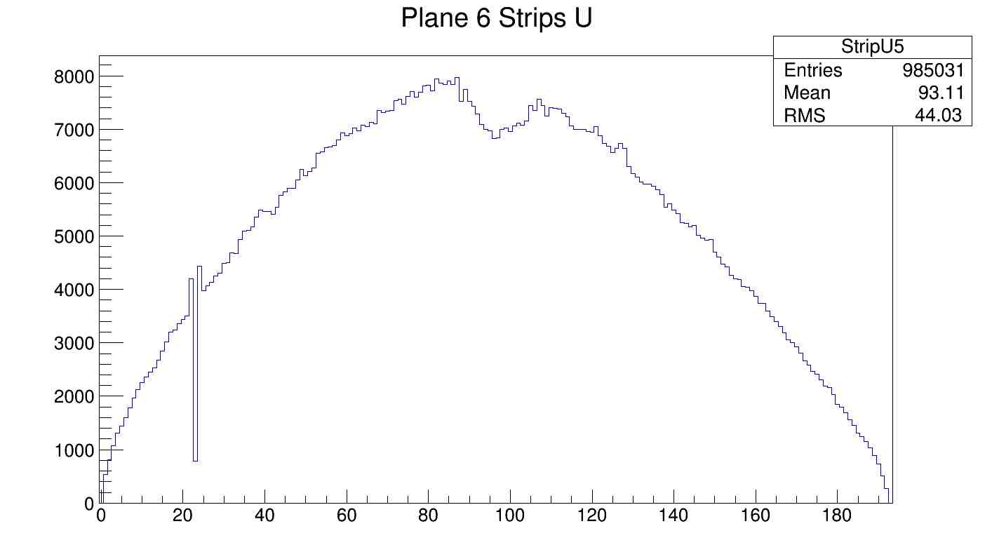
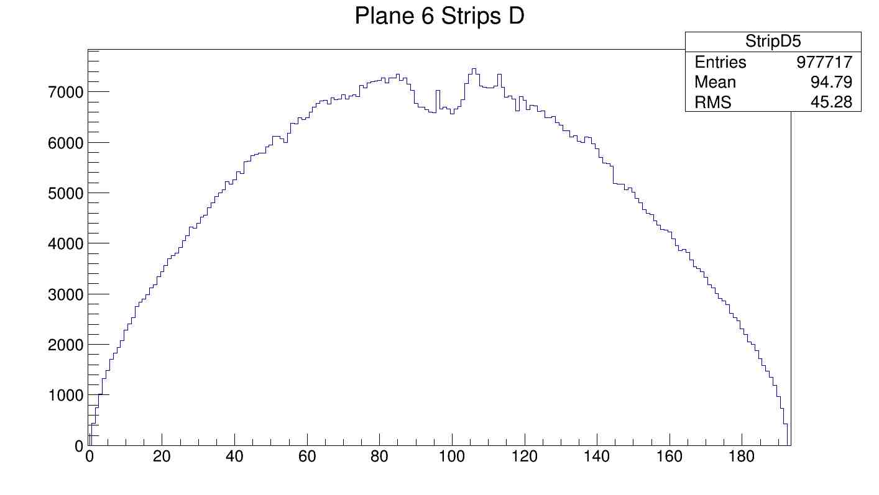
Slide 9. Result using package 3 EEL126 cosmic test data. Cell6.

Slide 10
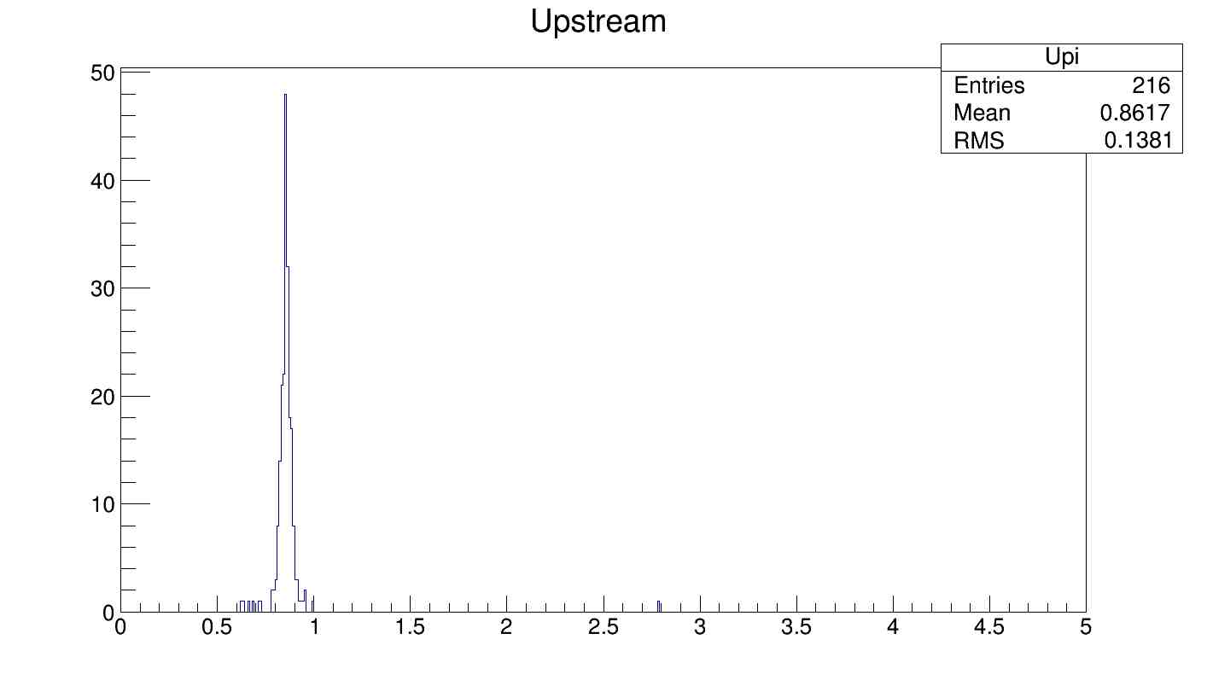
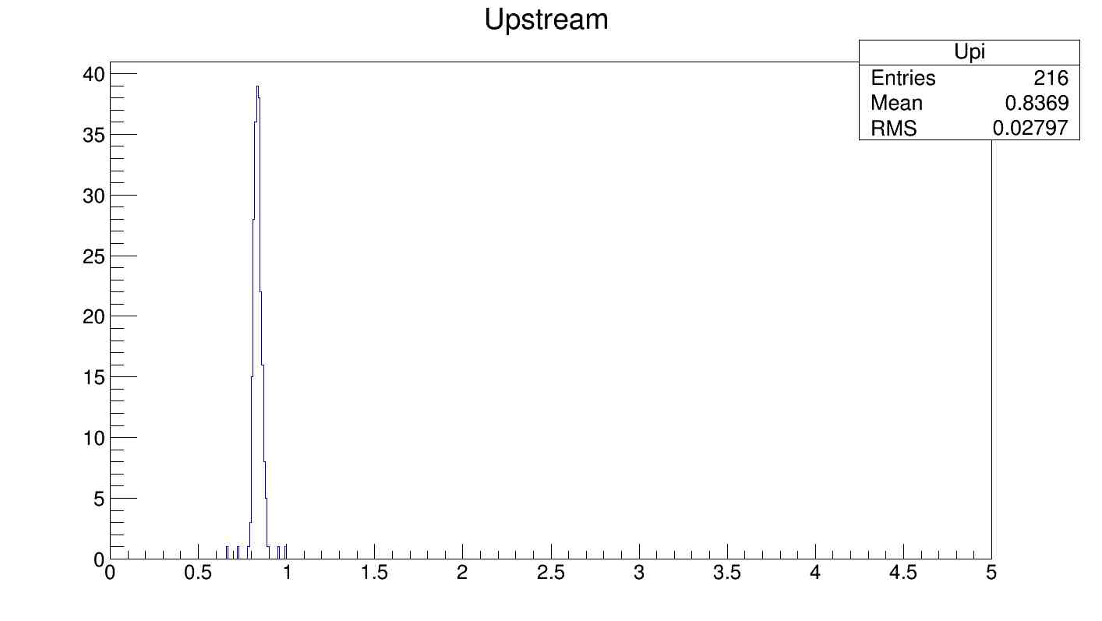
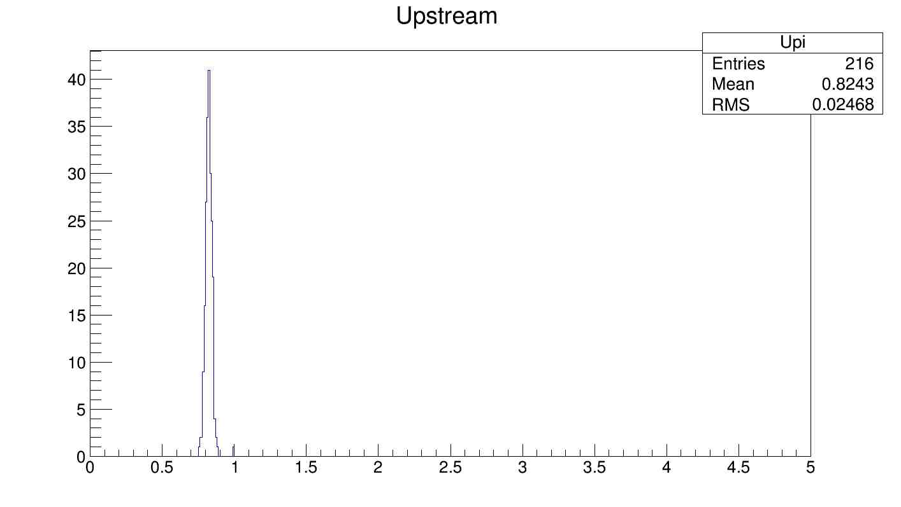
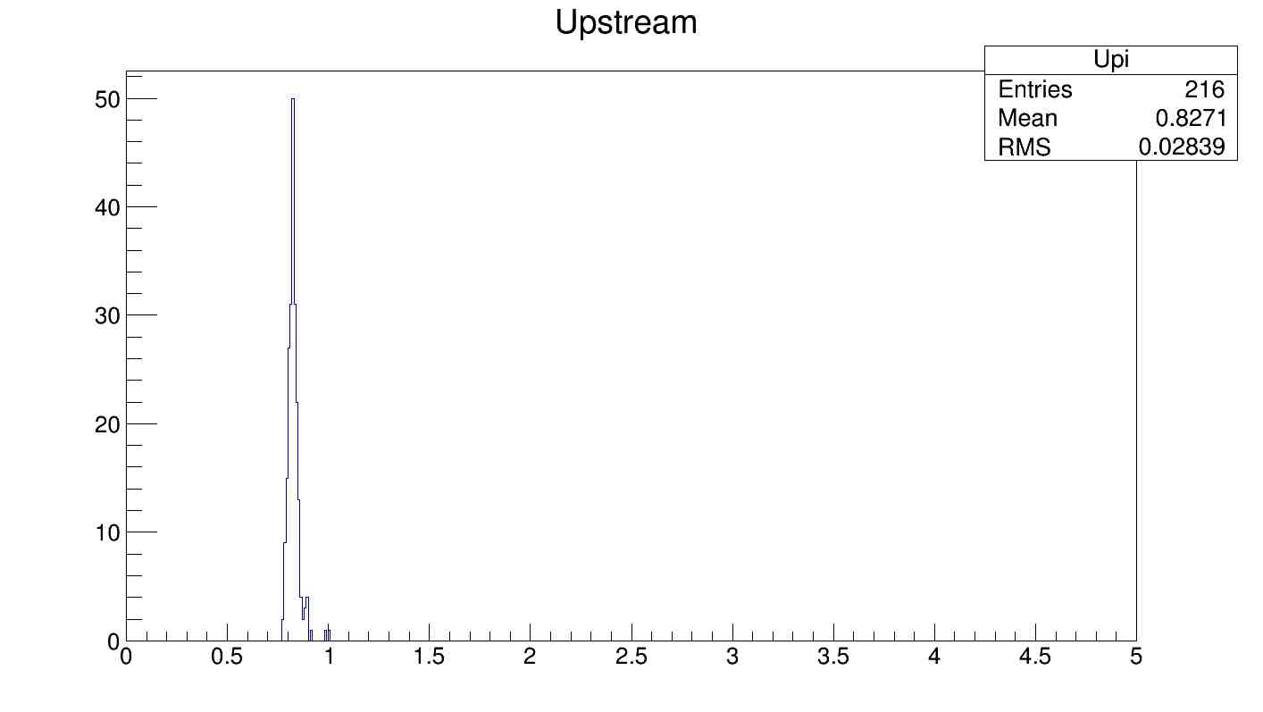
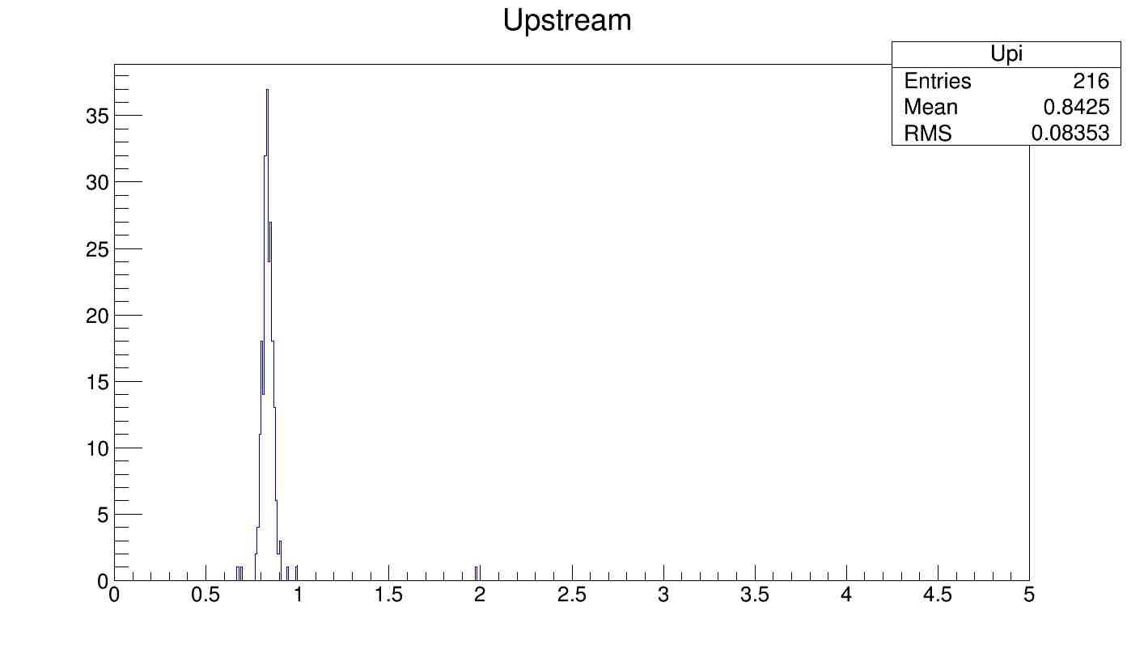
Slide 10. Result using package 3 EEL126 cosmic test data. Upstream coefficients distribution.
?

Slide 11
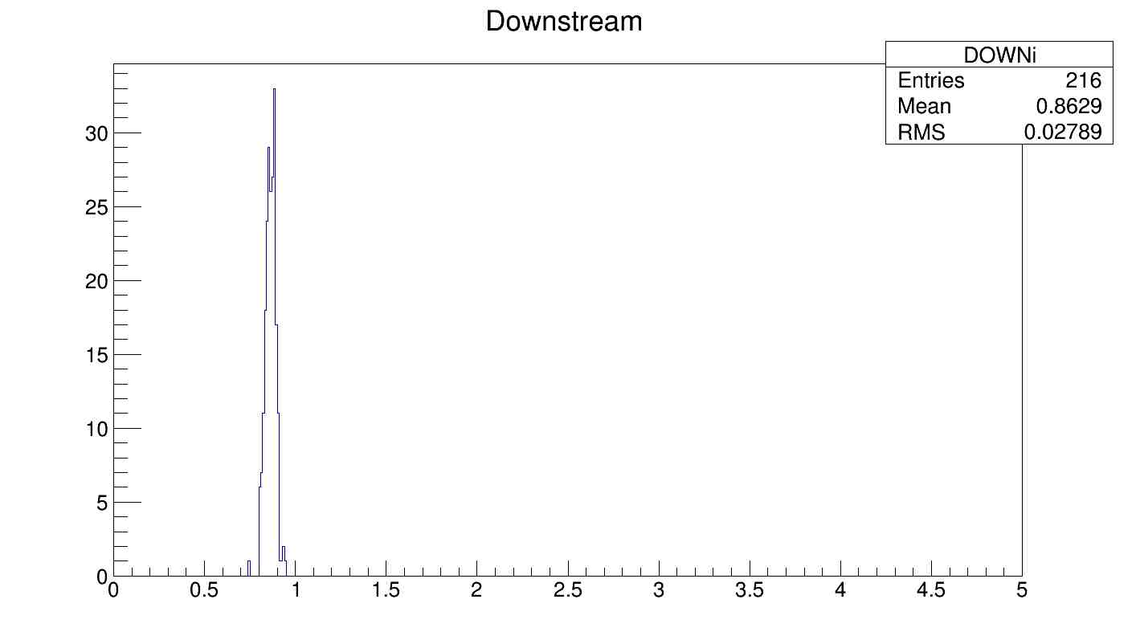
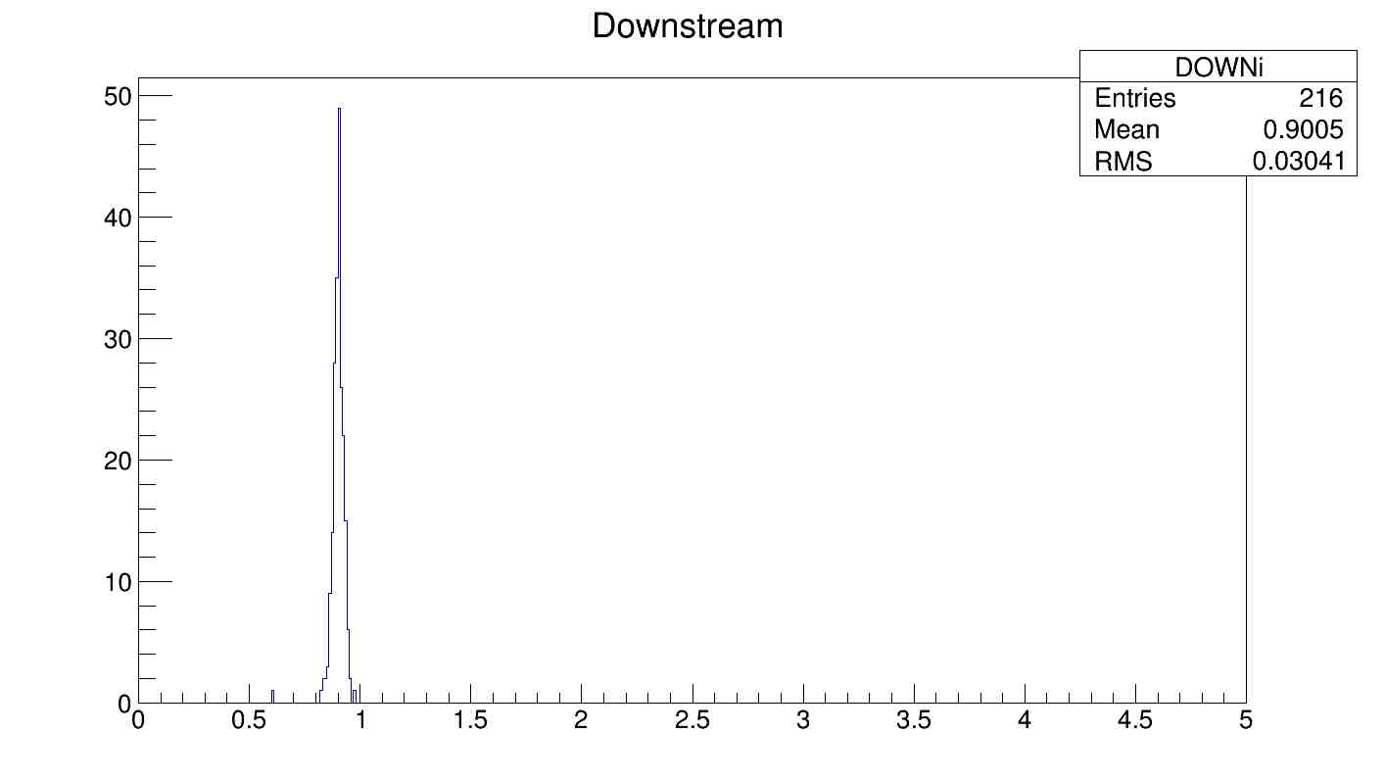
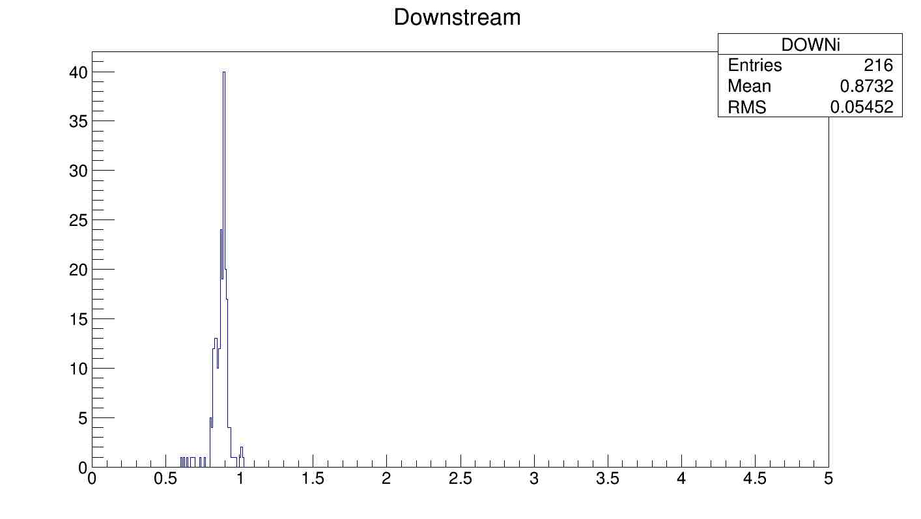
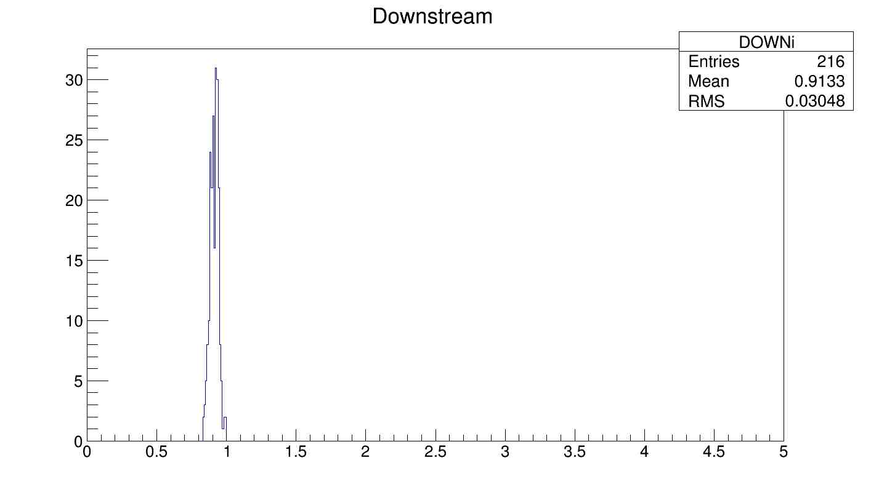
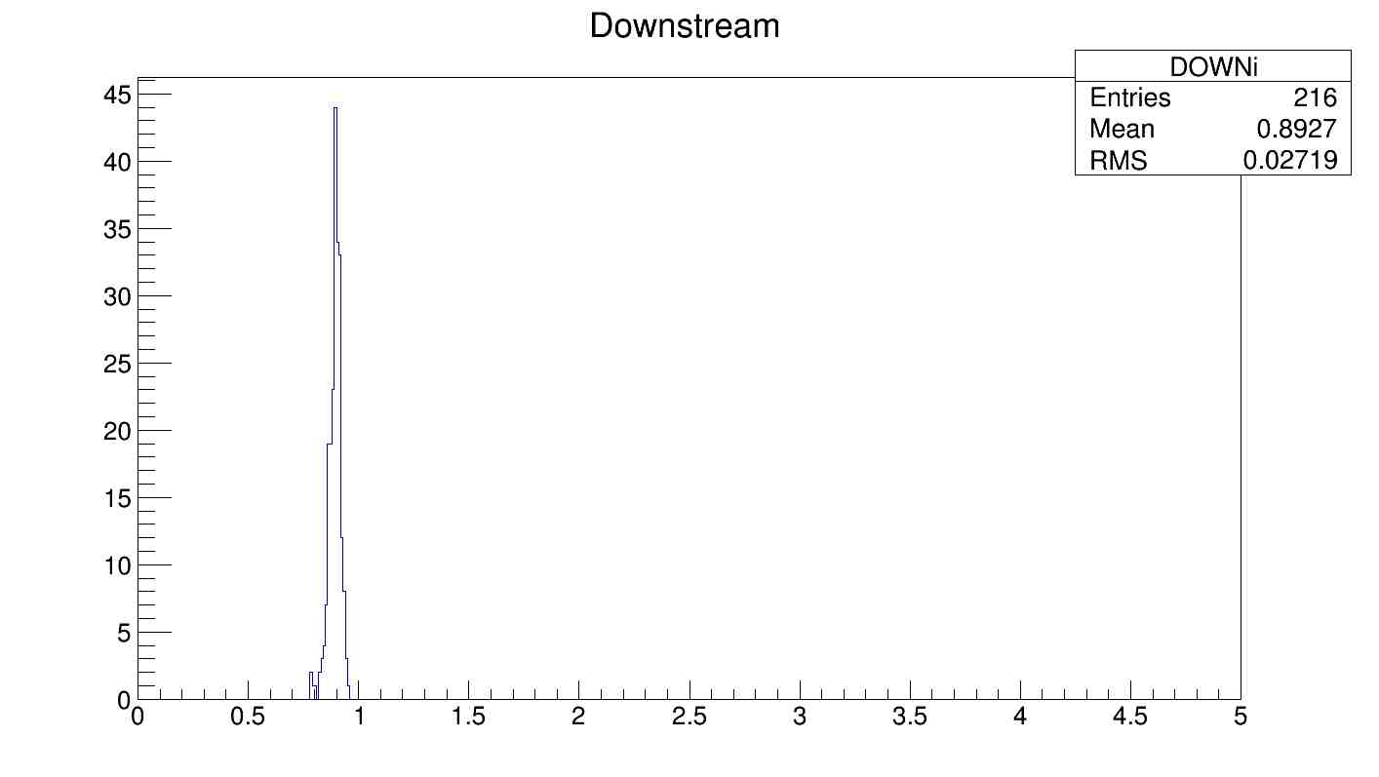
Slide 11. Result using package 3 EEL126 cosmic test data. Downstream coefficient distribution.
?

