Slide 1
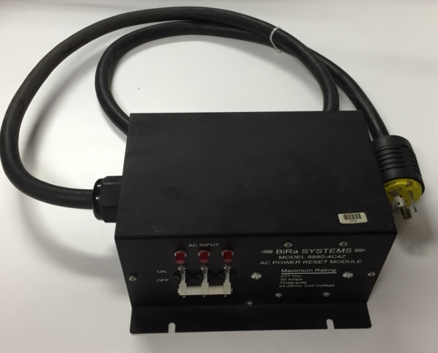
FDC Chiller Interlock

Slide 2
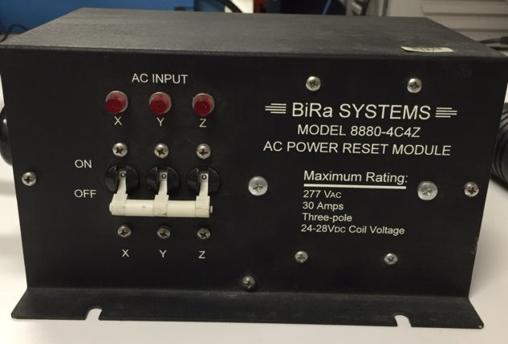

Slide 3
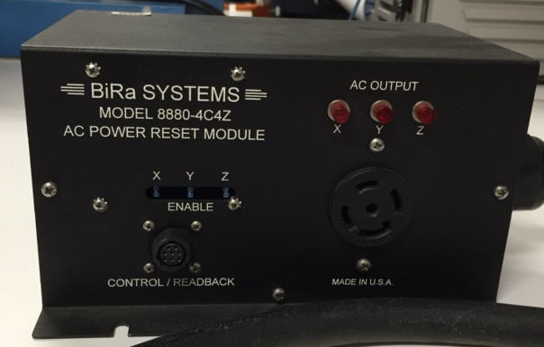

Slide 4
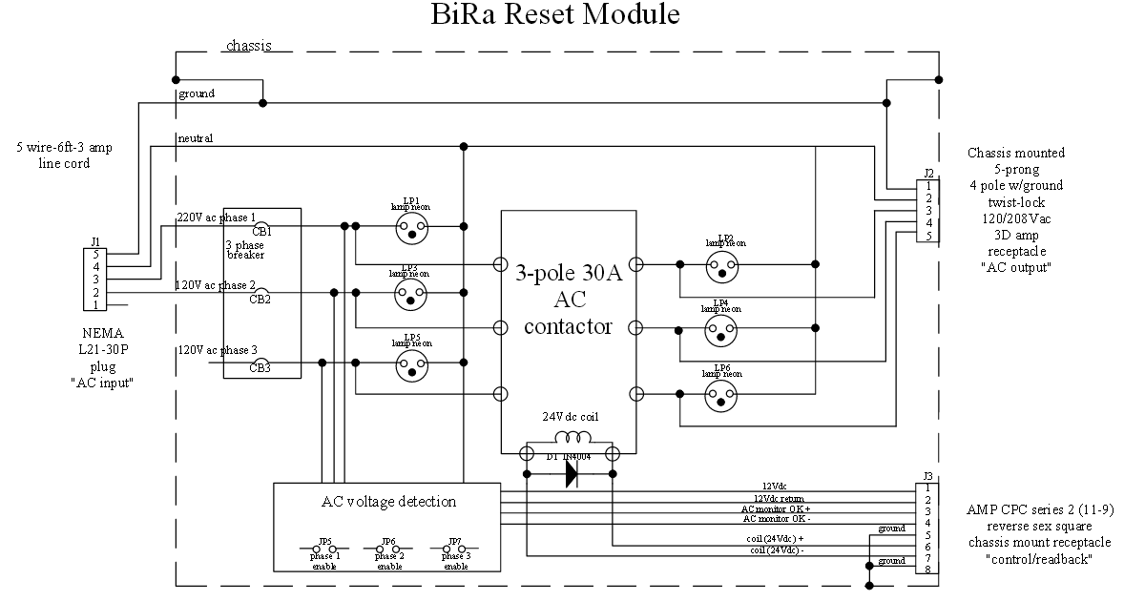

Slide 5
EPICS
Low Voltage
Inhibit Tag
FDC Chiller
208 AC monitor
24vdc Control (NO)
PLC Interlock
BiRa
System
208 AC 3 Phase
208 AC monitor
5v Inhibit
LV MPOD

