Slide 1
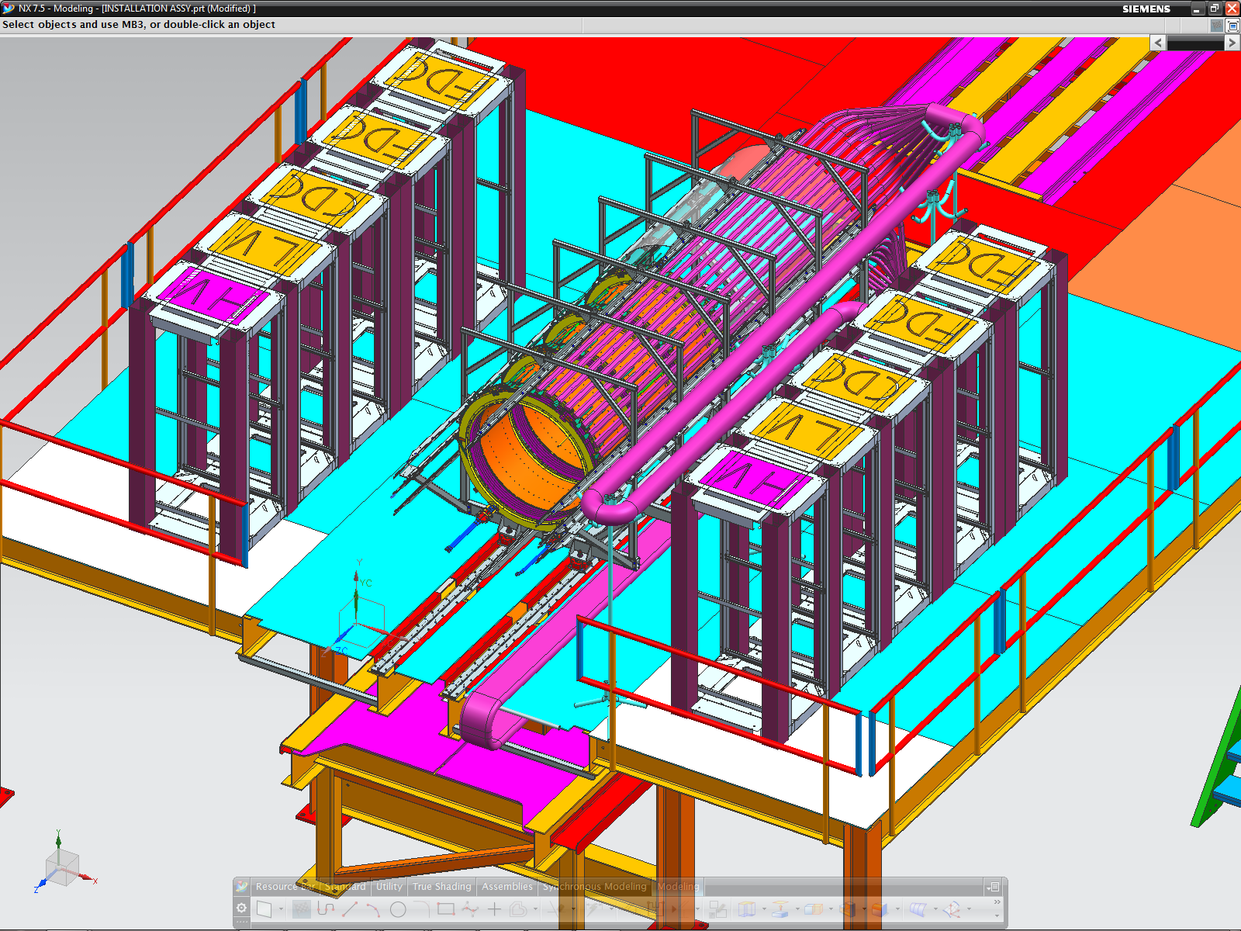
UPPER QUADRANT WIREWAY
LOWER QUADRANT WIREWAY
Notes:
WORKING POSITION

Slide 2
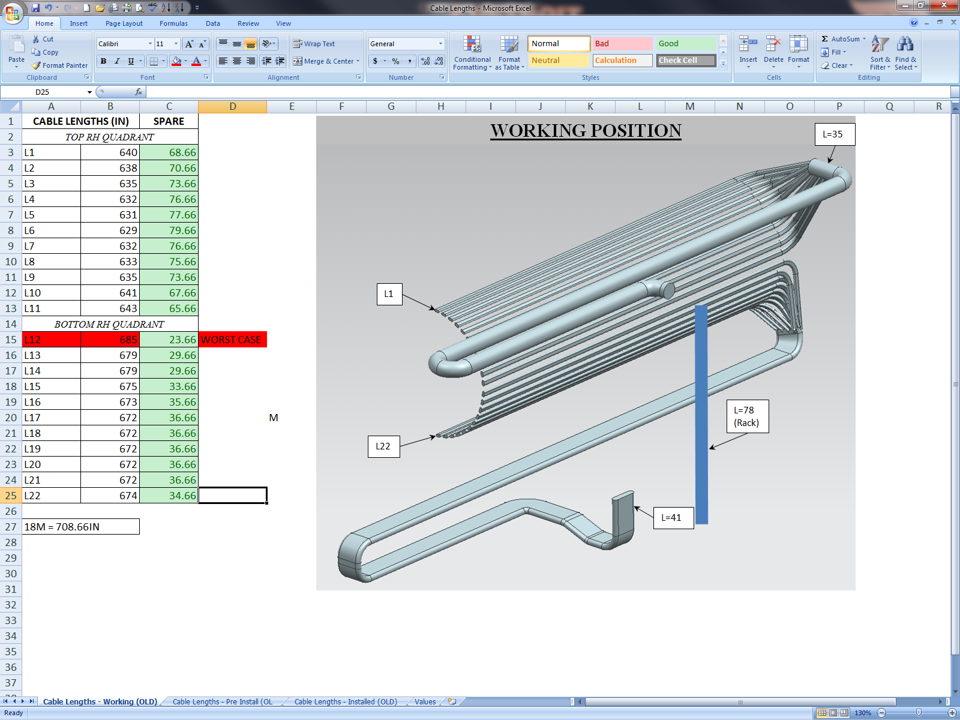
Notes:
WORKING POSITION – CABLE LENGTHS

Slide 3
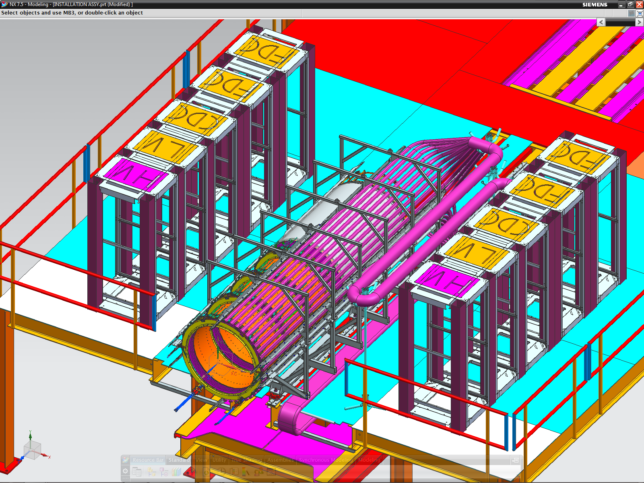
Notes:
PRIOR TO INSTALL

Slide 4
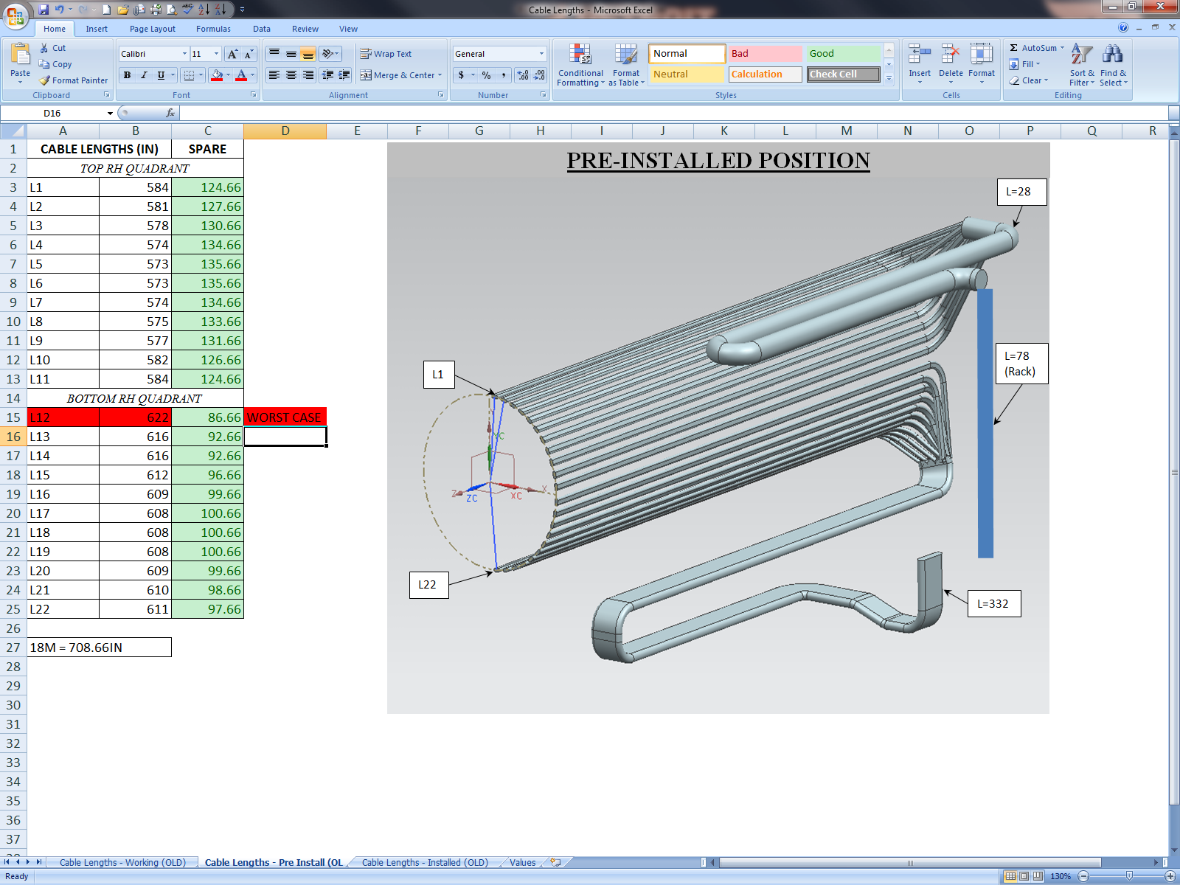
Notes:
PRIOR TO INSTALL – CABLE LENGTHS

Slide 5
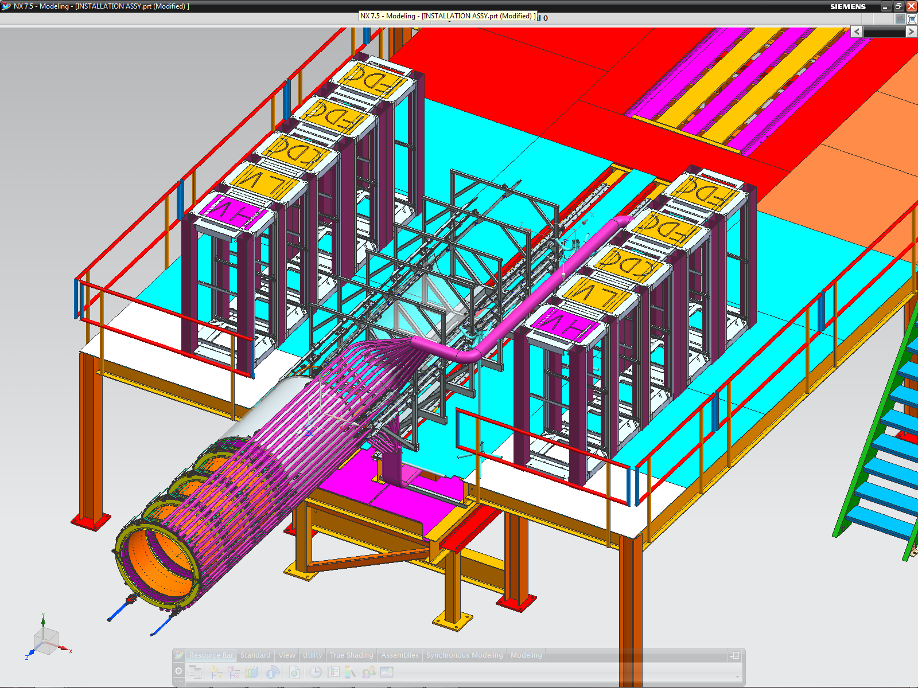
Notes:
INSTALLED

Slide 6
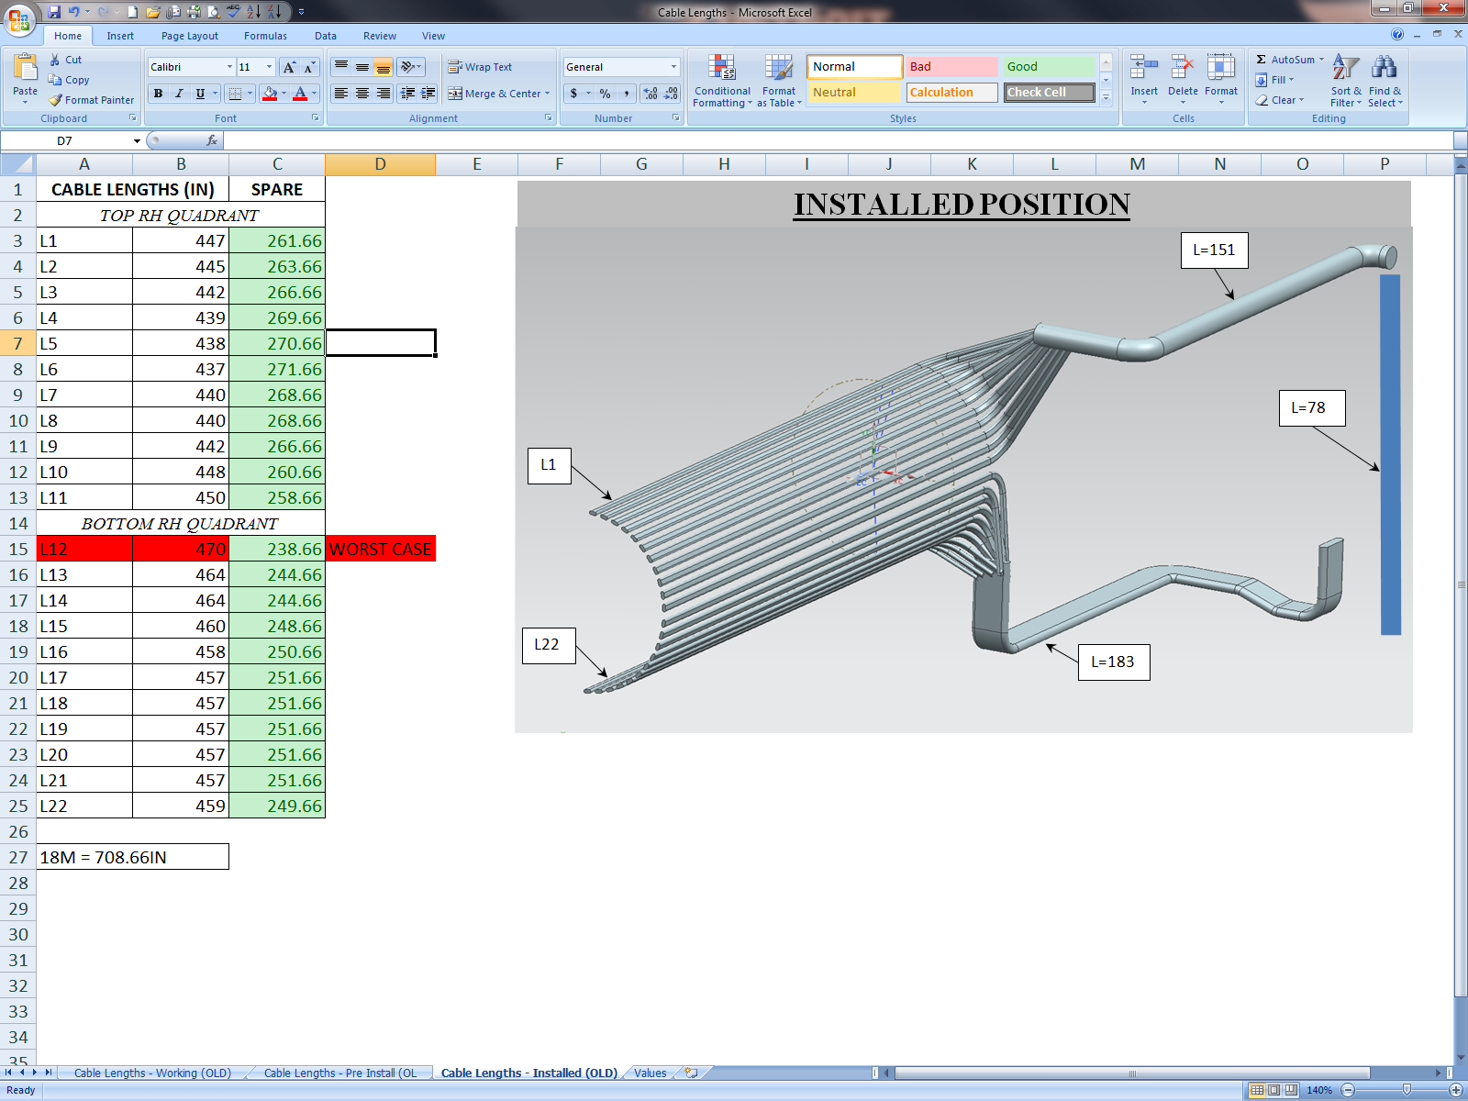
Notes:
INSTALLED CABLE LENGTHS

