Slide 1
Configurations of G10 in FDC panels
Where are we and where do we need to go?

Slide 2
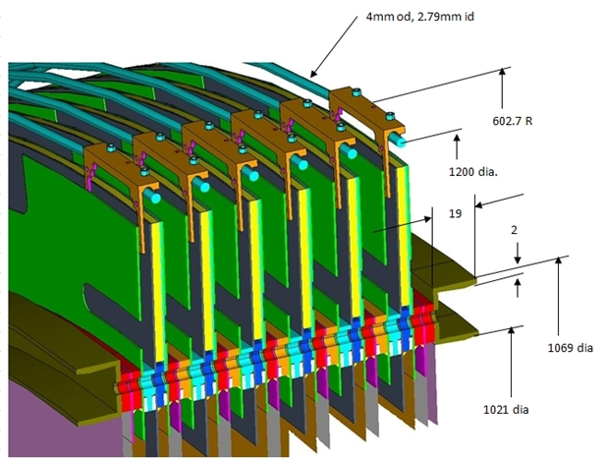
This geometry was given to Simon for simulation:

Slide 3
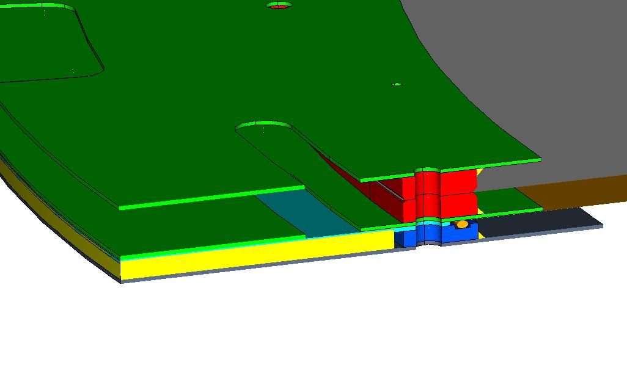
Currently being fabricated in 126
Glued cathode pair. Note no back skin.
Wireboard with blue G10 ring constructed of arcs

Slide 4
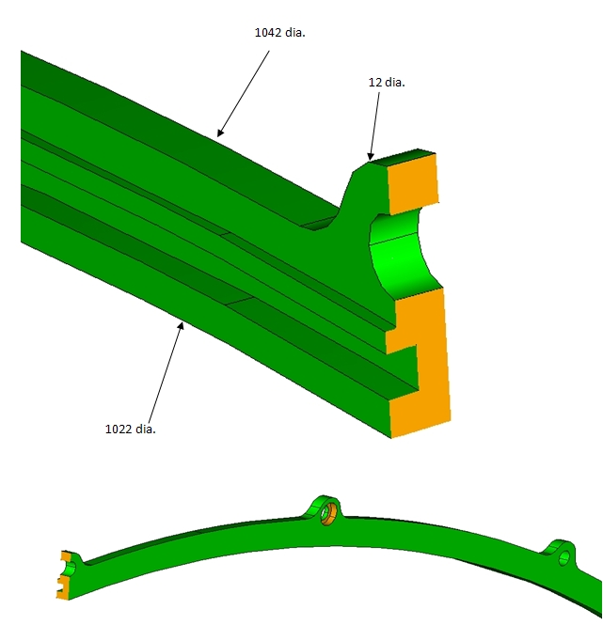
I can go to this (wireboard only) to reduce material:
10mm.

Slide 5
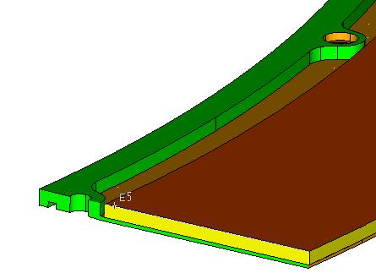
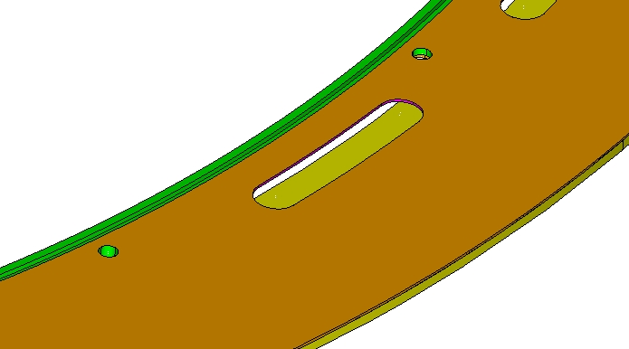
What I would like to produce is this- a solid G10 piece- machine shop will price, but this should reduce labor and potential for leaks:
8mm!

