Slide 1
FDC Cable Sorting

Slide 2
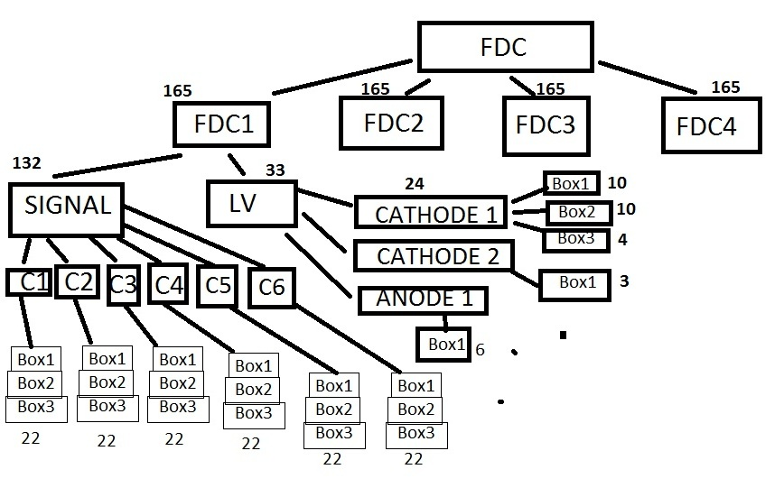
FDC Cable Flow Chart

Slide 3
FDC1-Cable Locations By Box

Slide 4
Signal Cables Stacked

Slide 5
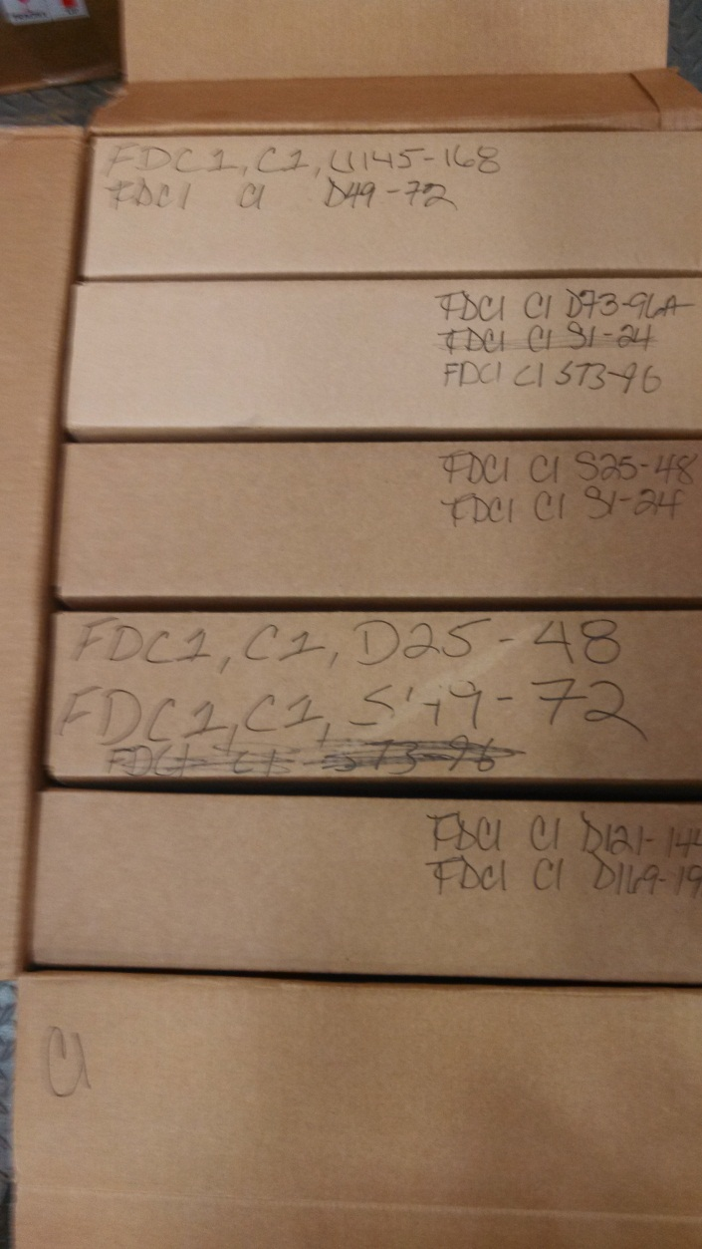
Signal Cable Box

Slide 6
LV Cables Stacked

